Slide 1
WP-10
XFEL Accelerator Module Test Facility- Status Report
Contributions: In-Kind (IFJ-PAN,WUT,Kriosystem),BINP,
DESY (ZM,FLA,D3,D5,M-groups)
…more than 40 colleagues at DESY directly involved in AMTF installations
Notes:
How to edit the title slide
Upper area: Title of your talk, max. 2 rows of the defined size (55 pt)
Lower area (subtitle): Conference/meeting/workshop, location, date,
your name and affiliation,
max. 4 rows of the defined size (32 pt)
Change the partner logos or add others in the last row.

Slide 2
Outline
AMTF layout
Preparations for AMTF operation: IFJ-PAN team
XMTS: magnet test stand
Vertical cavity tests
In AMTF (not WP10 !): cavity insert assembly
Cryomodule tests
More activities
Organizational issues / working safety
Summary

Slide 3
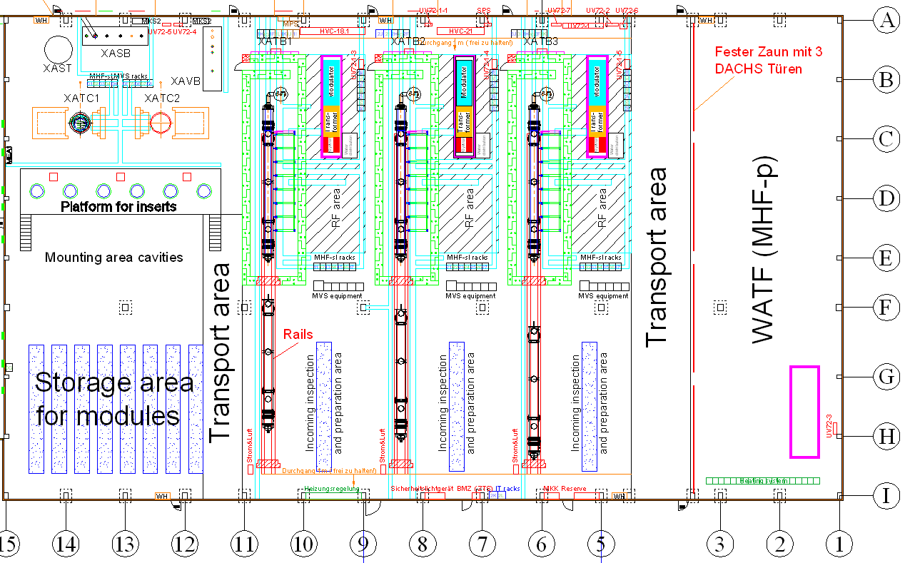
WP10 AMTF layout
Three test benches (XATB1, XATB2 and XATB3) for testing assembled modules and RF tests of assembled cavities
Two test cryostats (XATC1 and XATC2) for RF acceptance tests of the cavities
(One magnet test stand XMTS (located in the Magnet Test Hall Building 55) for testing magnets)
Notes:
Before you start editing the slides of your talk change to the Master Slide view:
Menu button “View”, Master, Slide Master:
Edit the following 2 items in the 1st slide:
1) 1st row in the violet header:
Delete the existent text and write the title of your talk into this text field
2) The 2 rows in the footer area: Delete the text and write the information
regarding your talk (same as on the Title Slide) into this text field.
If you want to use more partner logos position them left
beside the DESY logo in the footer area
Close Master View

Slide 4
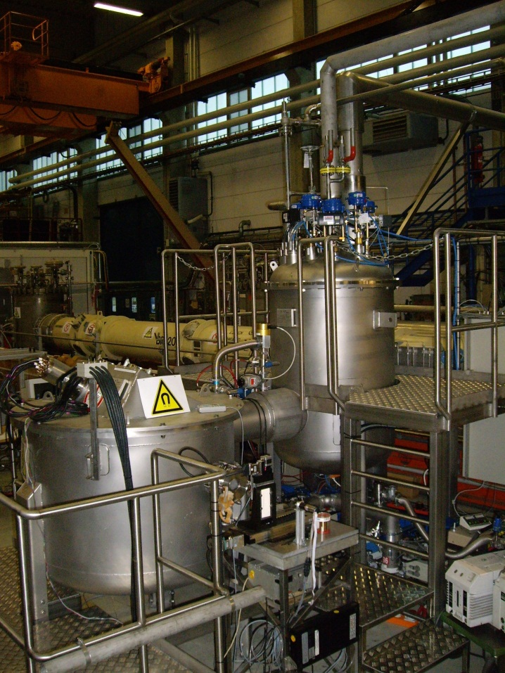
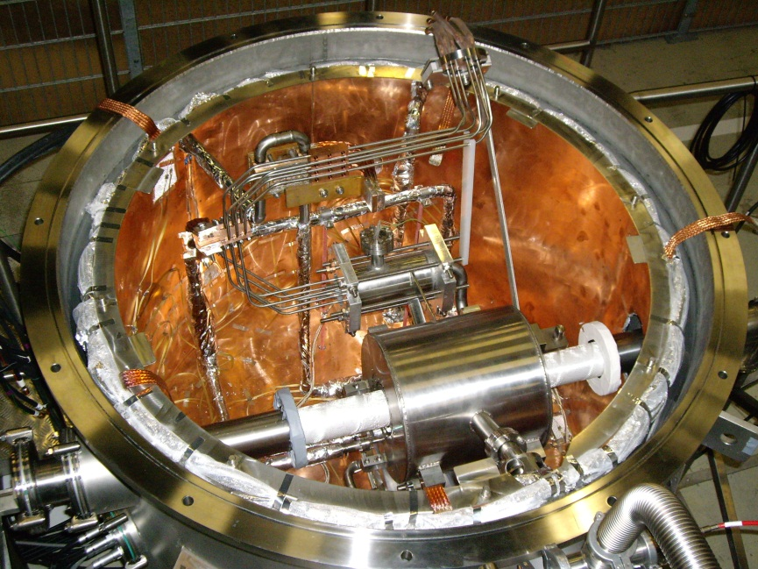
XMTS: Test stand for sc Quadrupoles
Formal part of AMTF installed and in operation since July 2008
DESY in-kind:
Cryostat & 2K Helium pump
For the development and series tests of superconducting magnet packages & current leads (in MTH-bldg 55)

Slide 5
Preparations for AMTF operation-IFJ-PAN Team
IFJ-PAN team should report !
Training: cavity measurements
Training: module tests at CMTB
Quadrupole measurements at XMTS
Detailed work flow analysis & working instructions
Working safety instructions
Software for cryogenics,RF etc. in preparation
Cavity insert preparation
Etc…………

Slide 6
AMTF – cryogenics in-kind-contributions
Blue = DESY MKS
Acting for XFEL company
(no in-kind !)
Red = WUT
Green= BINP

Slide 7
Vertical Tests of Cavities
First priority: provide test capacities for series production of XFEL cavities
What hardware do we need (minimum requirements) ?
one vertical dewar,transfer lines & piping -> critical path
transferline connection to AMTF (XATL1) ->delayed, but on track
subcooler box (XASB) -> just in time for connection to XATL1
concrete shielding -> installed (2 cryostats)
warm magnetic shielding -> installed (2 cryostats)
cold magnetic shielding -> fabricated (2x), annealing at LH
2K helium pumps -> ready for operation ( but !!!)
warm gas connection to refrigerator -> installed, ready for operation
cryostat inserts/frames -> prototype exists, series production proceeding
mounting platform for inserts -> delayed, 1st section ready end of May, complete in July
RF equipment for measurements -> commissioned in hall3, more than 1 month transfer
vacuum components & several parts -> on track
controls (interlock,vacuum,cryo,RF)-> on track

Slide 8
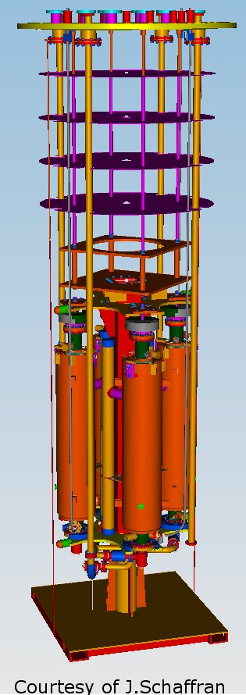
AMTF: 2 Vertical Cryostats
SPEC DESY
April 2009
Design & Construction
Poland/WUT in-kind
Delivery & installation
Cavity Frame Design:
DESY
6 inserts for AMTF

Slide 9
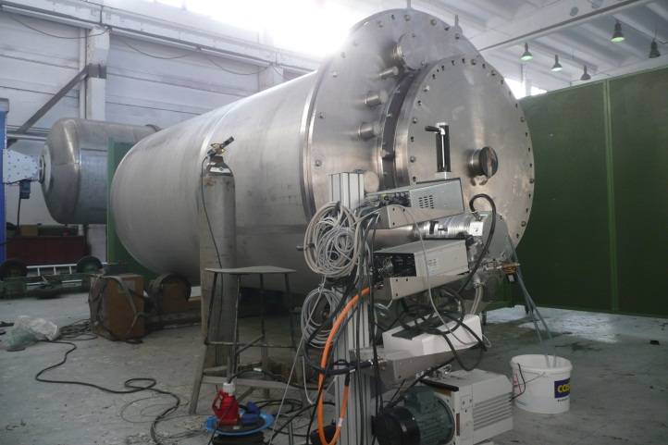
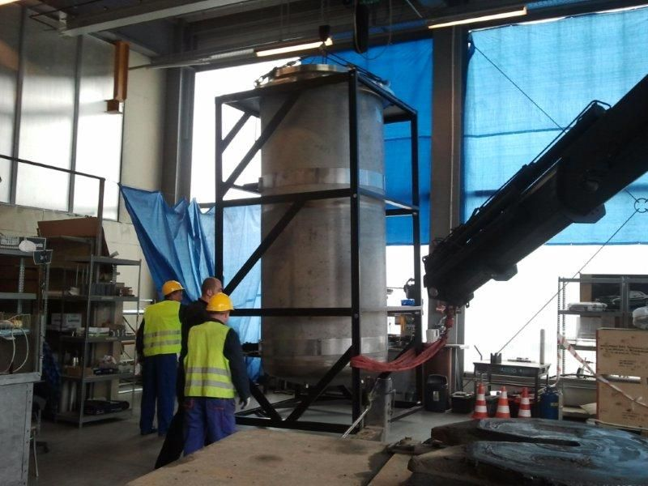
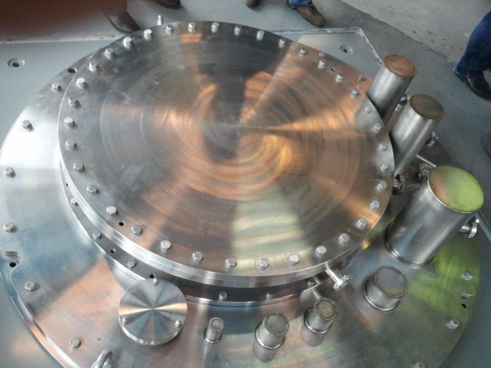
Vertical Cryostats - status
1st cryostat : pressure & leak test at KATES company
30.04.2012
TÜV acceptance of helium vessel (also second cryostat)
1st cryostat at Wroclav/Kriosystem 07.05.2012
With reference to latest WUT schedule dated 16.04.2012:
1st cryostat delivery to DESY 6.7.2012
Installation finished 3.8.2012
-> available for cavity tests not before 1.10.2012

Slide 10
Vertical Cryostats - remarks
delivery 2nd cryostat 1.9.2012
2nd installation ready 1.10.2012
available for cavity tests not before 12/2012 (full capacity)
Please note:
installation of 2nd in parallel to the cryo/RF commissioning of the 1st - ‚a technical and logistical challenge‘
pre-series (+first series?) cavities have to be measured in hall3 in parallel to the commissioning in AMTF (see above)
installation of cryostats includes delivery and assembly of complicated transfer lines and warm gas piping !
latest schedule (16.04.2012) will be still possible to achieve but is rather demanding….

Slide 11
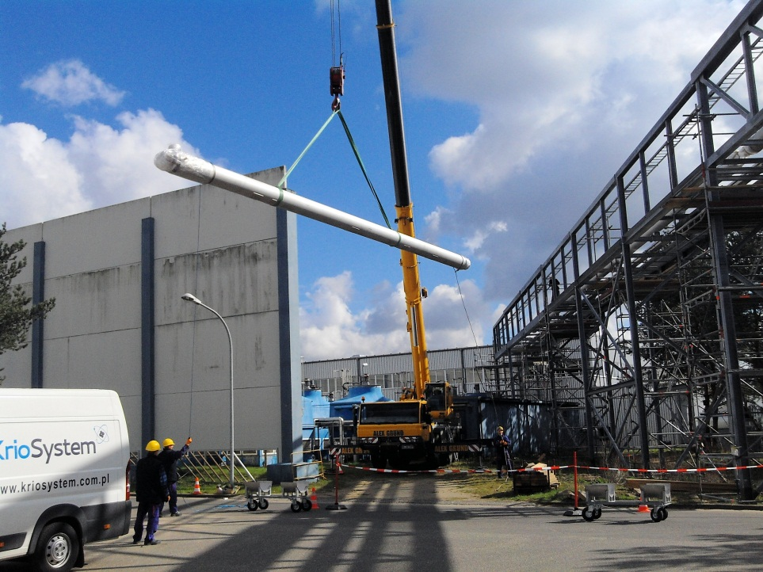
Transfer Line to Refrigerator – XATL1
delivery completed 2/2012
installation started 3/2012
all process tube connections welded till end of week 20
pressure test week 21
1st leak test (welds) week 21
closing interconnections (shield,MLI,sliding muffs) week 22
connection to subcooler box XASB week 23
vacuum insulation pumping week 24
first cool down/commissioning end of June
Courtesy: J.Dlugolecki

Slide 12
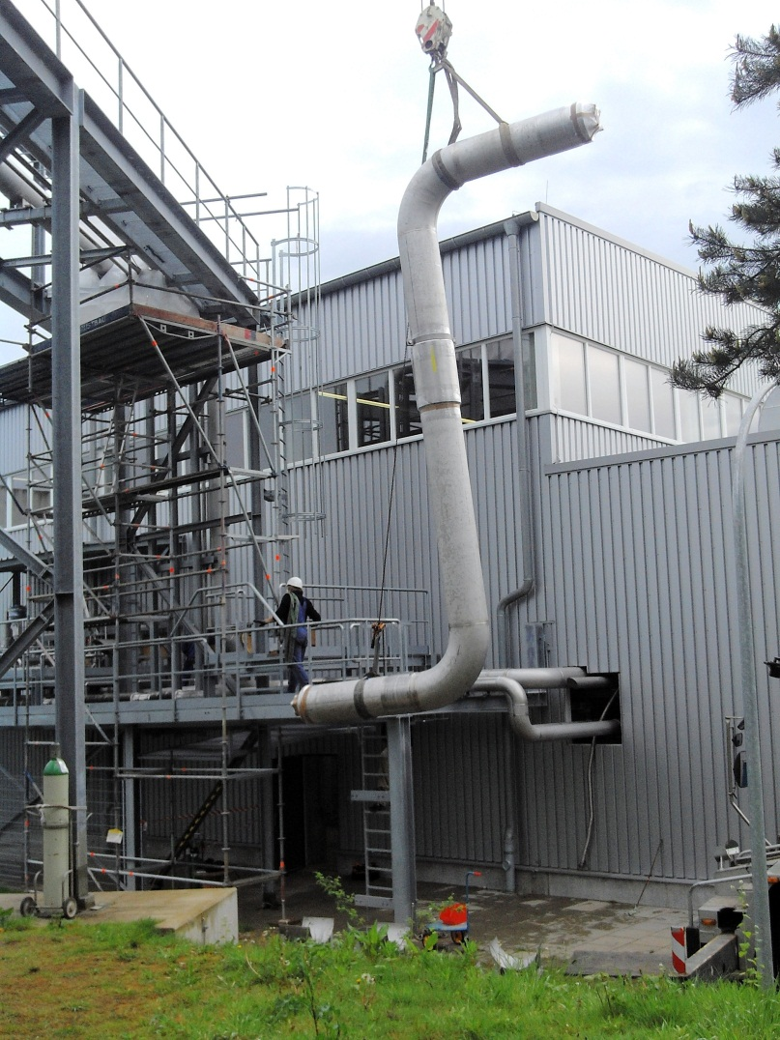
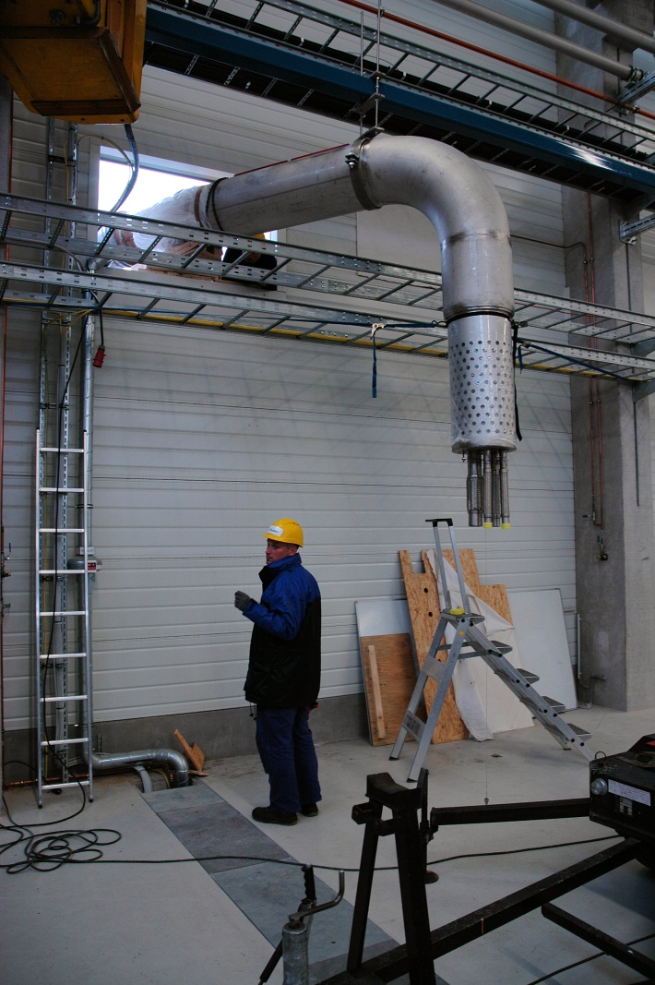
Transfer Line to Refrigerator – XATL1 (2)
Courtesy: J.Dlugolecki
Yesterday: breakthrough in AMTF !

Slide 13
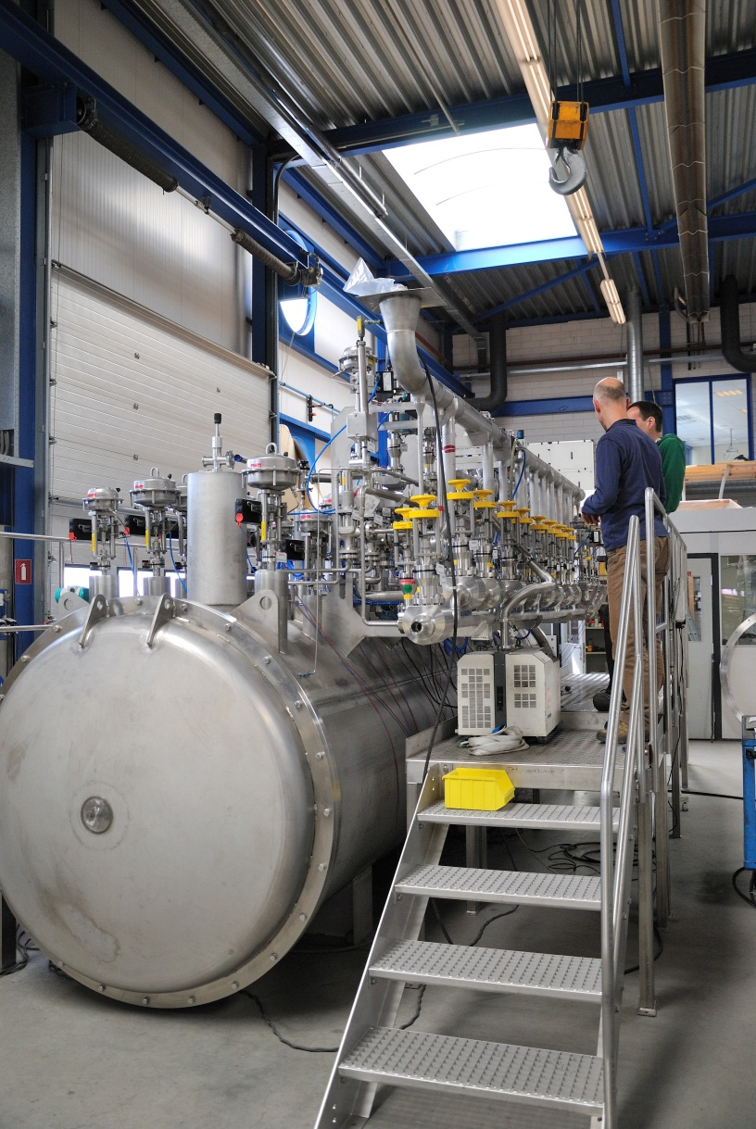
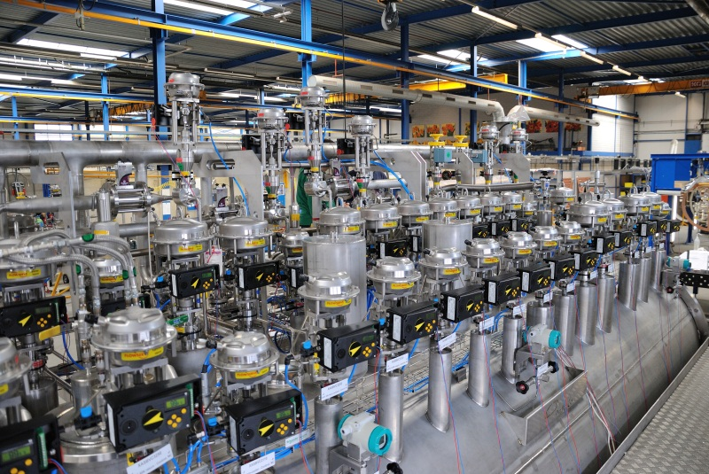
Subcooler Box XASB (XAVB,XAST) - Status
factory acceptance test completed 4.5.2012
delivery to AMTF 21.05.2012
installation completed week 22
valve box XAVB and helium storage dewar XAST: acceptance test mid of June
XAVB&XAST delivery and installation:July

Slide 14
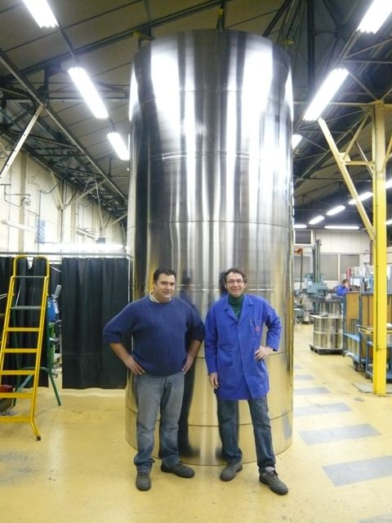
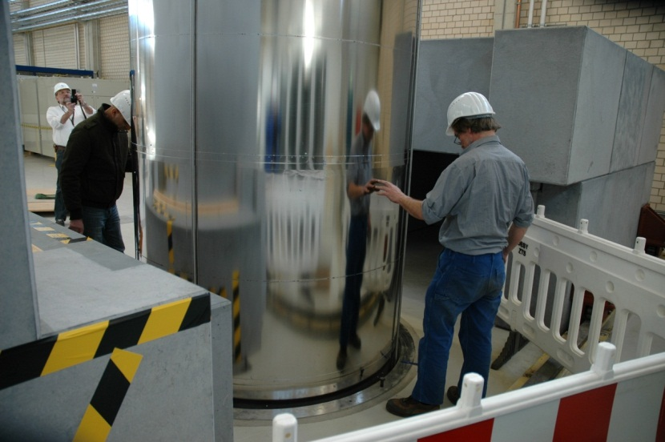
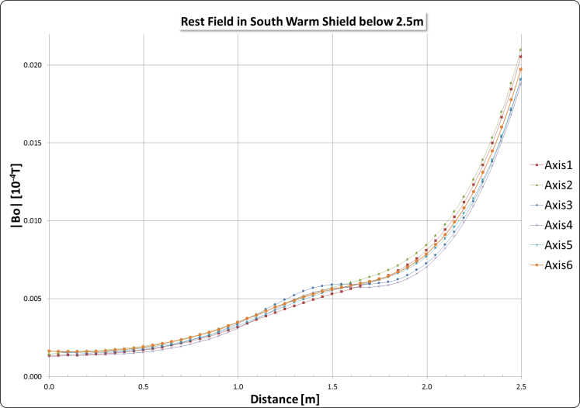
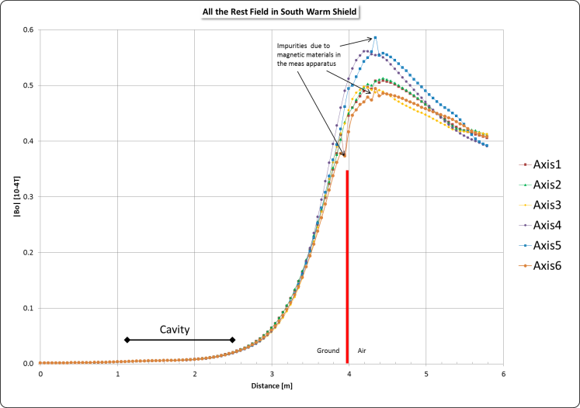
Warm Magnetic Shielding
delivery & assembly completed (for both cryostats)
field measurements completed
Courtesy:M.Stolper –MKS4-

Slide 15
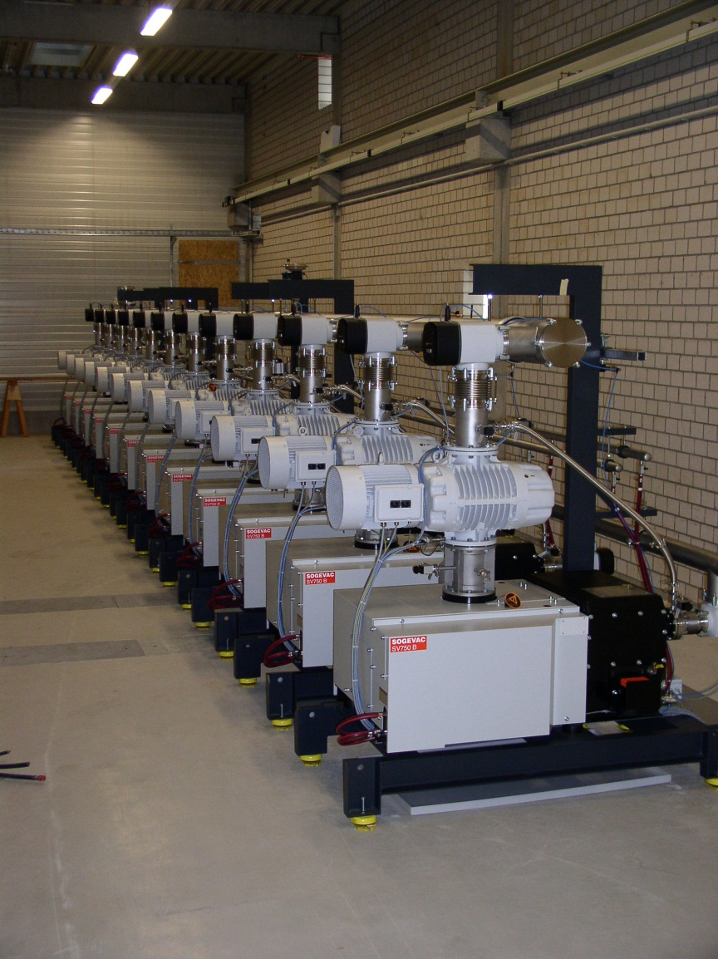
2K Helium Pumps (DESY in-kind)
2 sets of compressors for 2K operation at AMTF ( 2 x 20 g/s helium at 20 mbar)
– simple, robust, modular, redundant
Ready for operation since summer 2011
After 3000h long term run of one Sogevac
Pump: damage of shaft sealing, bearings,
and rotor – investigation in progress.
Because of the modular and redundant
design, operation for AMTF not at risk.

Slide 16
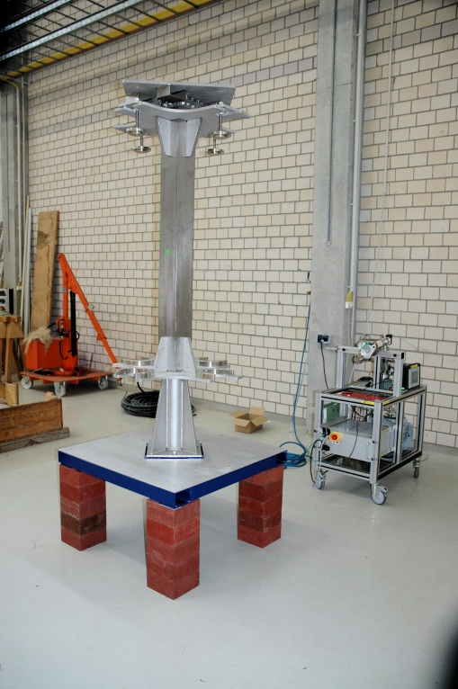
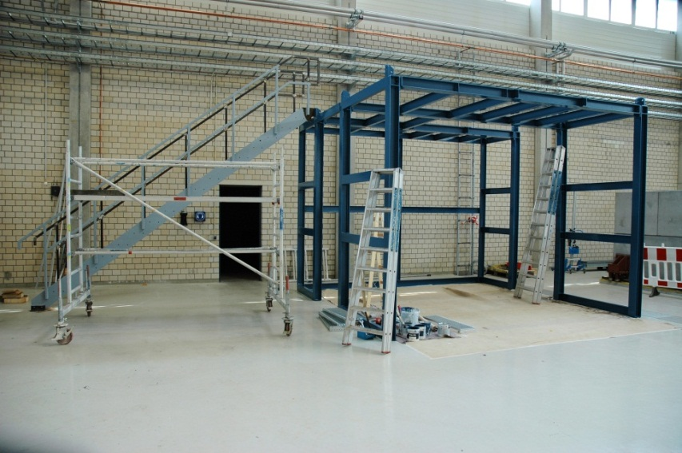
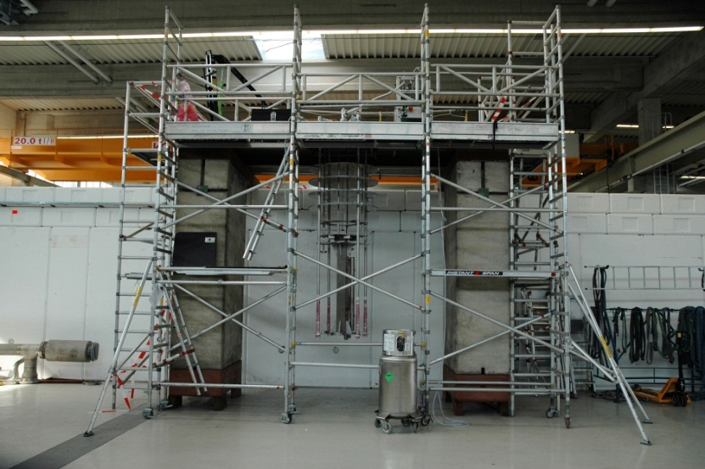
Inserts & Mounting Platform
first section (of 6) of mounting platform completed end of May
mounting platform completed end of July
prototype insert/frame: installations proceeding
Delivery and assembly of 5 remaining inserts in June

Slide 17
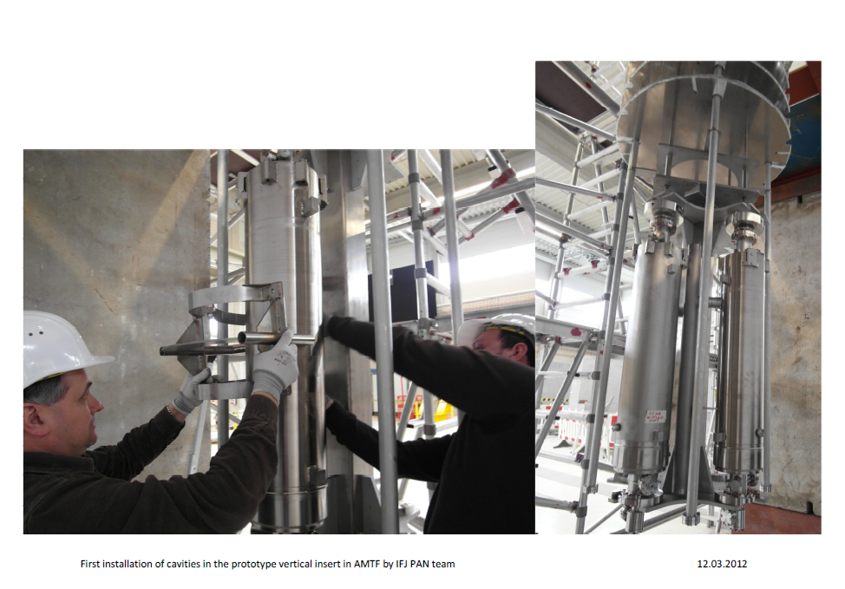
First installation of cavities in prototype insert
Courtesy of IFJ-PAN team

Slide 18
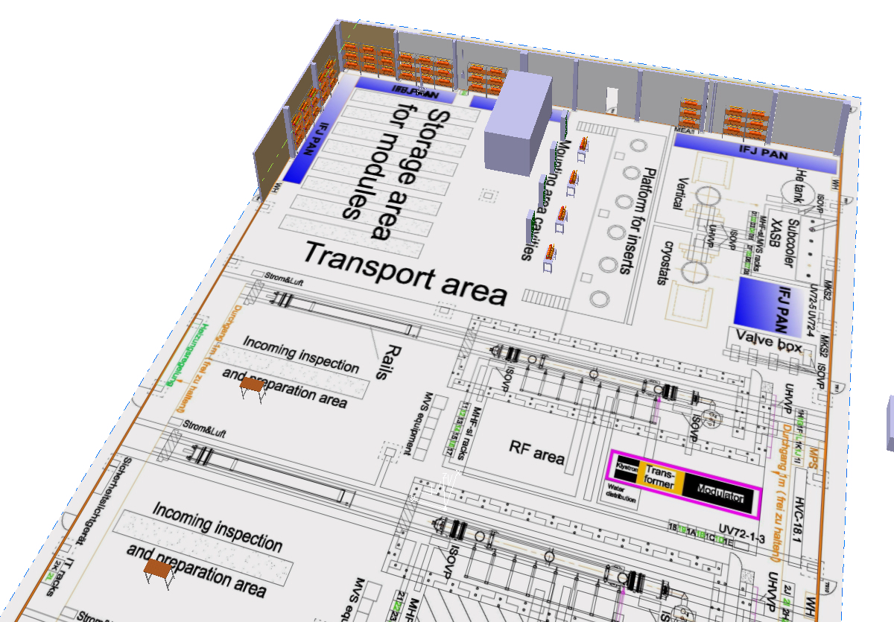
Cavity Storage & Insert Assembly (not WP10)
Cavities -storage area
Storage capacities for 32 cavities
Cavities -storage area
Cavities-monting area
Modules-preparation area
Courtesy: J.Kotula IFJ-PAN

Slide 19
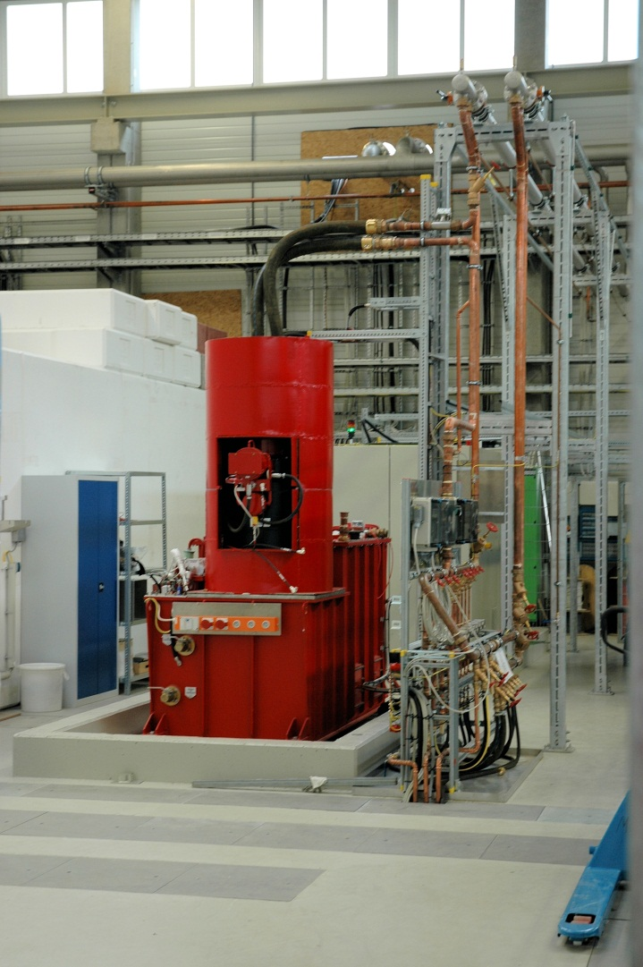
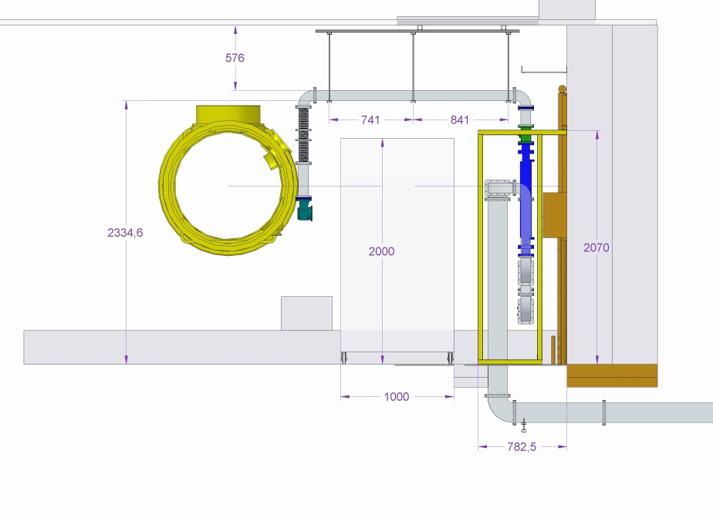
Module Test Benches: RF Equipment
1st test bench complete: modulator,klystron,puls-transformer
2nd&3rd: complete in June –
(all components available)
Conventional wave guides:
severe delay in delivery ! Delivery not
before September !
RF-cabling: new ideas for panels at cryomodules

Slide 20
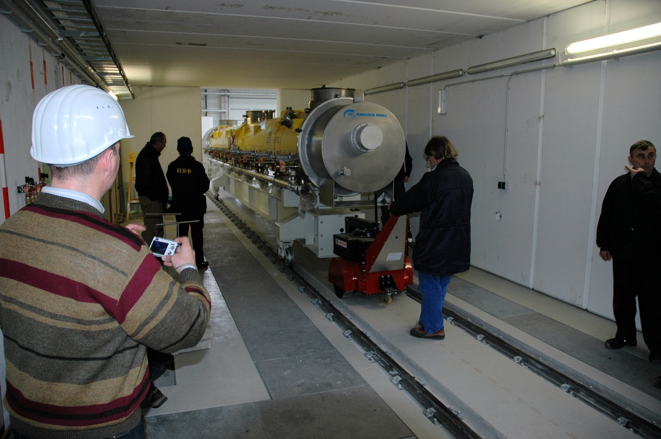
Module Test Benches: Supports (BINP)
3 movable supports delivered & installed
transport test with cryomodule prototype

Slide 21
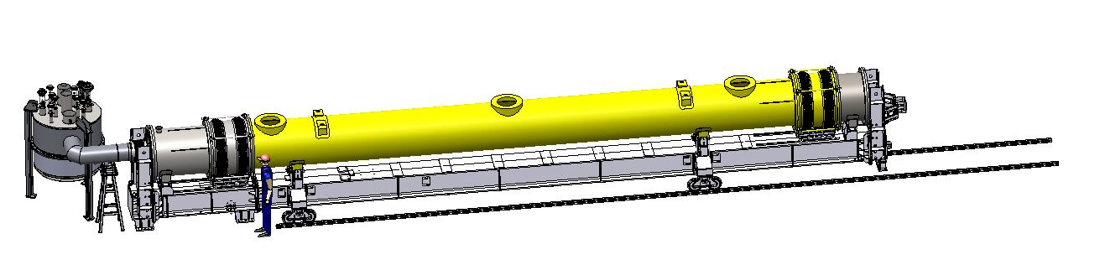
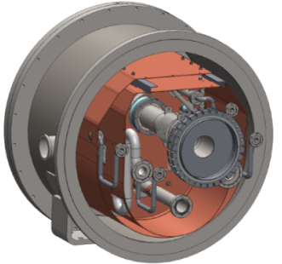
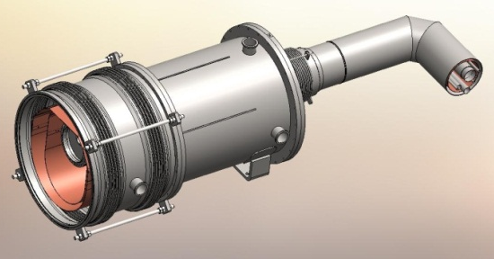
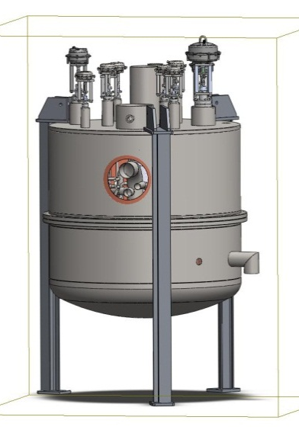
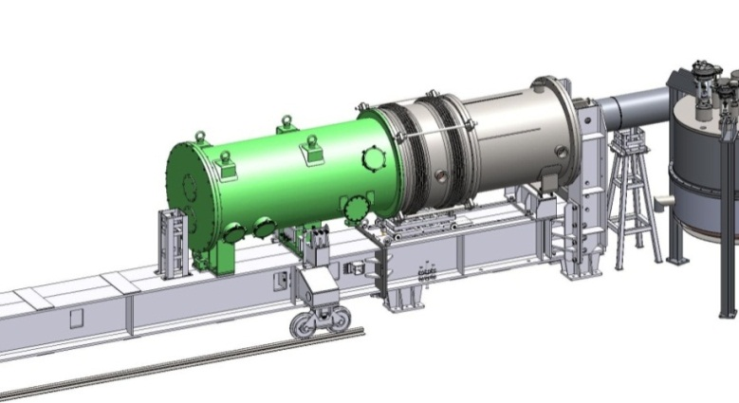
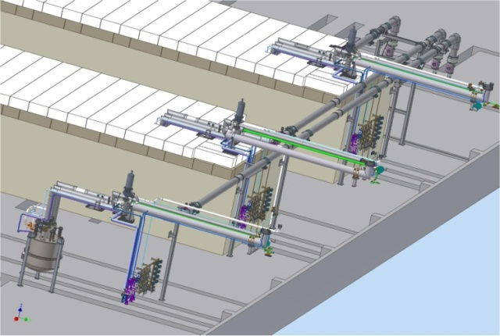
Module Test Benches : Cryogenic Components (BINP)
All the components of the cryogenic equipment are worked and in production.

Slide 22
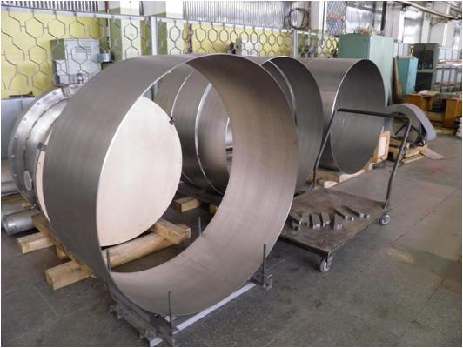
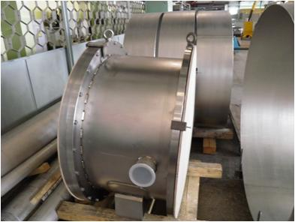
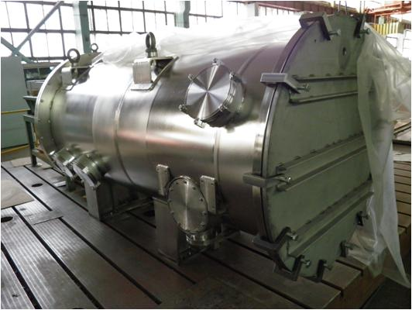
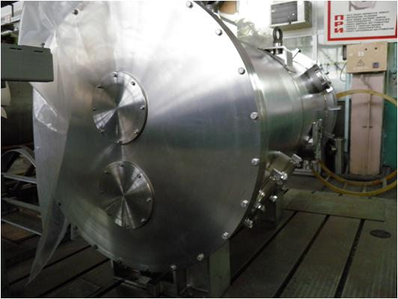
Production of XATB components at BINP (1)

Slide 23
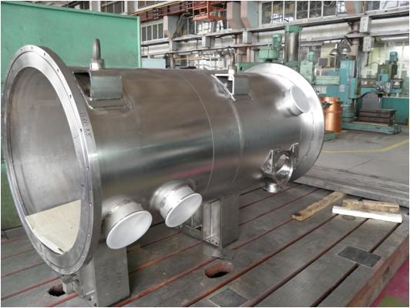
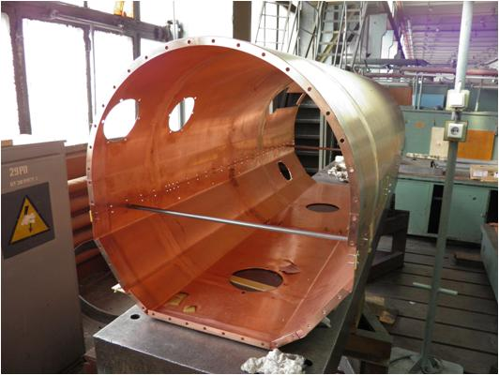
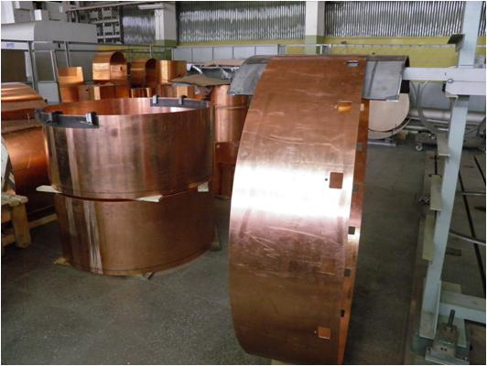
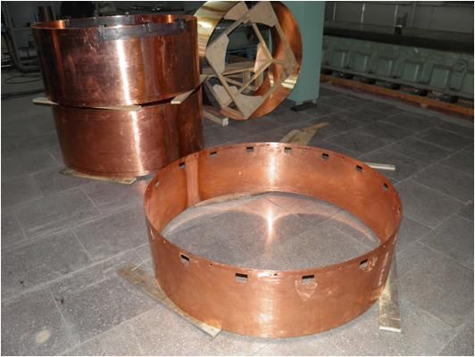
Production of XATB components at BINP (2)

Slide 24
WP10
BINP cryogenic equipment
 | 2012
Items | April | May | June | July | August | September | October | November | December
Final test 1st XATB in BINP
Cryostat-adapter 1st and 2nd
Feed cap
End cap
Feed box
Main transfer lines XATL3, XATL4 and XATL5
Shipping 1st XATB
Installation 1st XATB in AMTF
Final test 2nd and 3rd XATBs in BINP
Shipping 2nd and 3rd XATB
Installation 2nd and 3rd XATB in AMTF

Slide 25
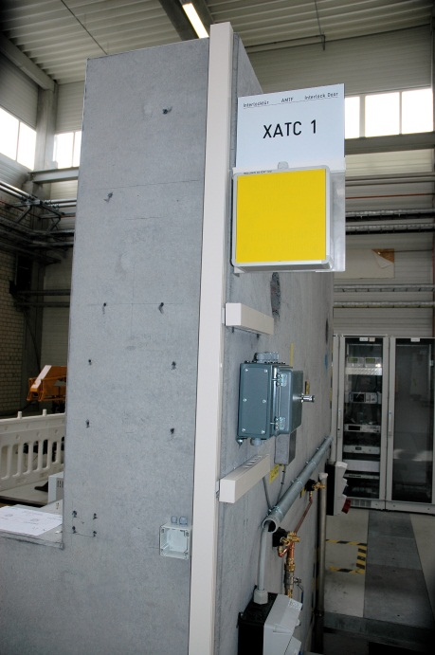
Personnel Interlock
Personnel interlock for vertical cryostats completed in April;
electronic components for all test stands will be built up in June

Slide 26
More Activities
There are several more activities, which were not mentioned but add considerable work load to all involved groups: LLRF,local clean rooms…etc-etc.
‚Installation‘ by in-kind partners or contractors always involves several parallel activities of DESY groups
(supervision, controls hard- & software…etc.)
‚Commissioning‘…the same

Slide 27
Organizational Issues/ Safety at Work
AMTF installation meeting is established since ½ year:
each 2nd Friday, 10:30 h, AMTF seminar room
next: May 25
please join this meeting, if you contribute to installation
organization of safety at work during operation needs to be established
mixed activities of installation & operation need special attention

Slide 28
Summary
AMTF ready for cavity tests at half capacity: October 2012
AMTF ready for cavity tests at full capacity: December 2012
AMTF ready for module tests at ⅓ capacity (1 test bench available): Dec 2012
AMTF ready for module tests at full capacity: February 2013
Thank you for your attention !

