Slide 1
CMS and LHC BCM1F status (May 2012)
Elena Castro

Slide 2
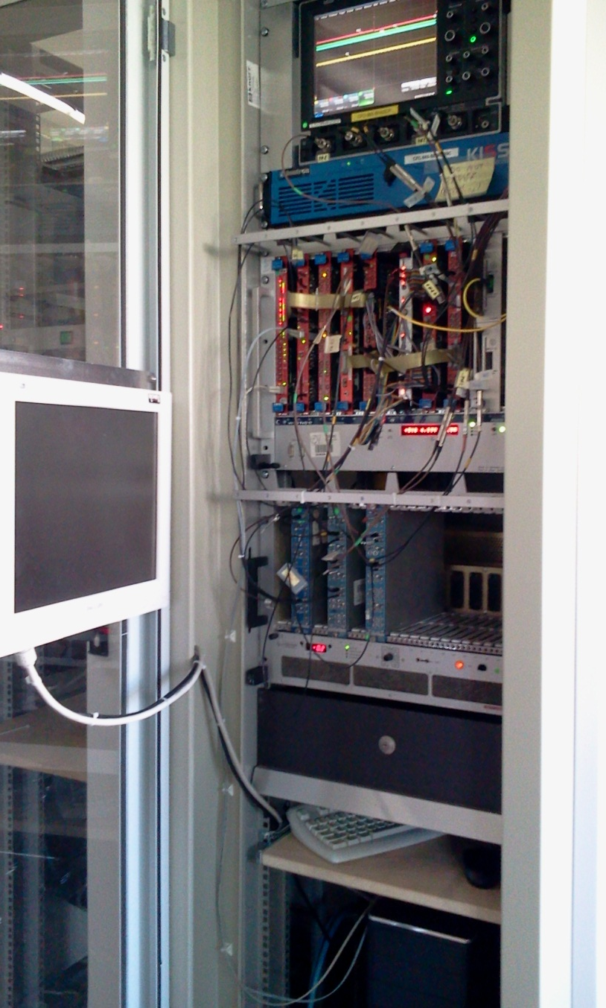
BCM1F4LHC
DAQ
Scalers ok
ADC baseline ok
TDC and ADC not running continuously
Data storage:
So far working fine for scalers, TDCs and ADC baseline. Automatic weekly move to CASTOR.
Warning!!! CERN will decommission the current user area (/castor/cern.ch/user/)
on the CASTOR disk/tape system this year (what to do???)
Data analysis:
To be done for the 4 diamonds: TDC bunch ID, ADC amplitude spectra.

Slide 3
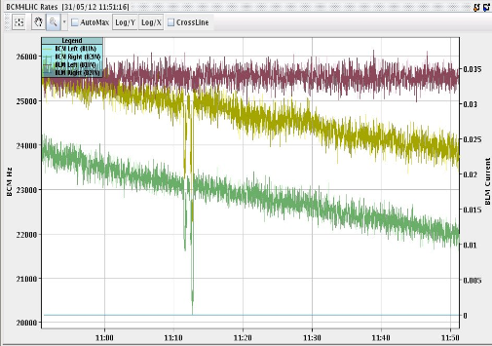
BCM1F4LHC displays
The 2 new P5 diamonds are displayed in CMS control room together with the closest BLMs.
BLM Left
BCM1F4LHC Left
BCM1F4LHC Right
BLM Right (not working??)
Alick will include the 2 new sensors in the existing Vistars display but for future development we should be involved (Maria, Sebastian+Elena remotely??)

Slide 4
Next issue: UFO studies
To clarify how the Griesmeyer diamonds (scope self trigger at high amplitude signals or scope external trigger with BLM?)
Include in the daq setup the UFO detection (in general a Post Mortem analysis)
Signals available in our setup in Prevessin:

Slide 5
Email from Ewald Effinger:
There is two possibilities to get the PM trigger via the Lemo connector on the BOBR card.
1. Reprogramming the FPGA on the BOBR card and set the event as default setting.
2. The card needs to receive a command from the VME bridge to set the event to be transferred to the LEMO connector
With version 1. the output will be always operational also after the VME rack was switch off and on again. The option is easy but the event can’t be changed easily.
With version 2. you have to communicated with the BOBR to set it correctly. You can select on which event you get a trigger.
Possible events (you need to select one):
Global PM:
Is triggered for all injection and all extraction in the LHC.
Time delay: 2-5 ms
You need to distinguish which data are important for you.
BLM_Capture:
Is triggered for all extraction and UFO-events in the LHC.
Time delay: 1-2 s
You need to distinguish which data are important for you.

Slide 6
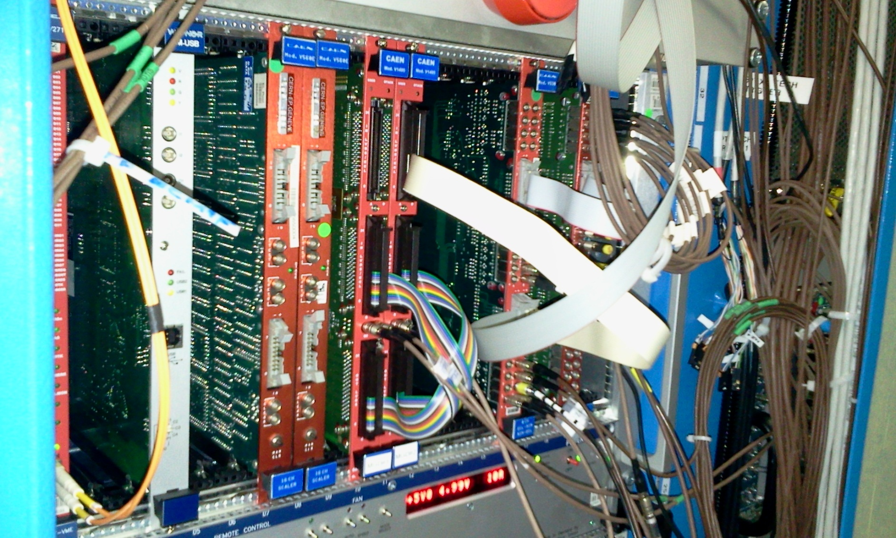
CMS BCM1F
Installation of MGD in S1
Sensor signals from
NIM->ECL converter
Wiener VM-USB
BPTX1
BPTX2

Slide 7
Software
Upgrade tool:
Available in ctrl3 for flashing the LUT firmware
Available in the laptop for flashing the MGD firmware.
Serivas tool:
Available in ctrl3 (cms account needed) using the CAEN optical link (use this option)
Available in the laptop using the Wiener VM USB

Slide 8
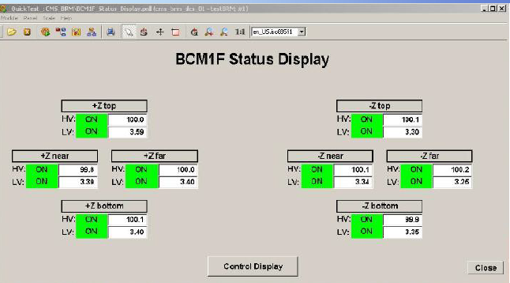
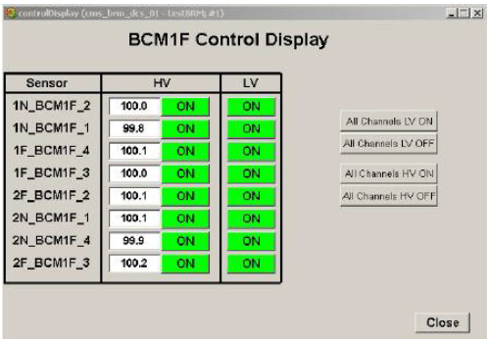
PVSS monitor available in CMS control room

