Slide 1
Uncertainty management in traffic modelling
B. Ciuffo¹, V. Punzo^{1,2,} M. Montanino²
¹European Commission - Joint Research Centre
²University of Napoli Federico II – Department of Transportation Engineering
MULTITUDE Project (COST Action TU0903) – Methods and tools for supporting the Use, caLibration and validaTion of Traffic simUlation moDEls

Slide 2
"What makes modelling and scientific inquiry in general so painful is uncertainty. Uncertainty is not an accident of the scientific method, but its substance”
(Saltelli et al., 2008)

Slide 3
Nature of uncertainty (1)
Ontological uncertainty (Aleatory): it is the physical variability present in the system or its environment.
  It is not strictly due to a lack of knowledge and cannot be reduced (also referred to as variability, stochastic uncertainty or irreducible uncertainty) but can be “considered”
  It is naturally defined in a probabilistic framework

Slide 4
Nature of uncertainty (2)
Epistemic uncertainty: it is a potential deficiency that is due to a lack of knowledge.
  It can arise from assumptions introduced in the derivation of the mathematical model or from incomplete knowledge of the inputs and can be reduced (it is also called reducible uncertainty or incertitude)
  It can lead to strong bias in the predictions

Slide 5
Possible uncertainty classification
Uncertainty Nature
  Mostly reducible
  Mostly irreducible
  Mixed natures
Uncertainty Source
  Model
  Observable inputs (-> direct estimation)
  Unobservable Inputs (-> indirect estimation)
    Hardly measurable
    Unphysical parameters
    Uncertain parameters

Slide 6
Traffic simulation models
In the last century, contributions from engineers, physicists, mathematicians, and behavioral psychologists have lead to a better understanding of driver behavior and vehicular traffic flow.
The focus is on applications ranging from novel driver-assistance systems, to intelligent approaches to optimizing traffic flow, to the precise detection of traffic jams, the short-term forecasting of traffic for dynamic navigation aids, to the assessment of the impact of new transportation infrastructures.

Slide 7
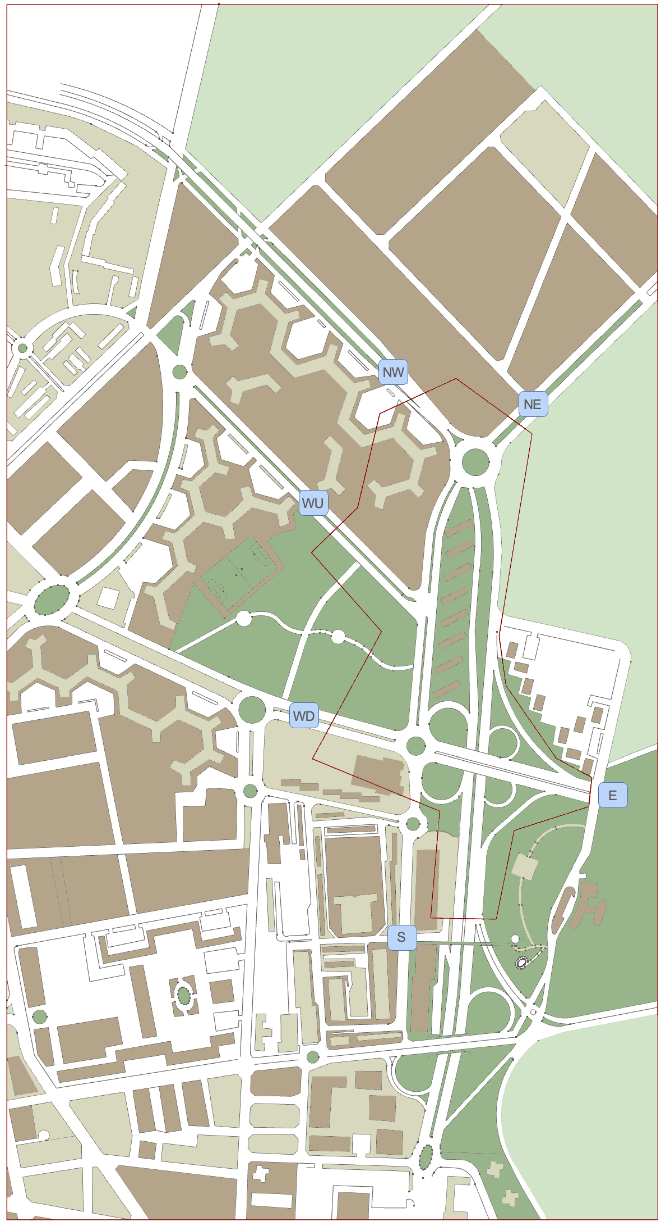
Traffic models – study area

Slide 8
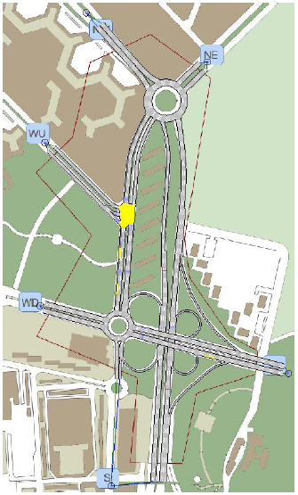
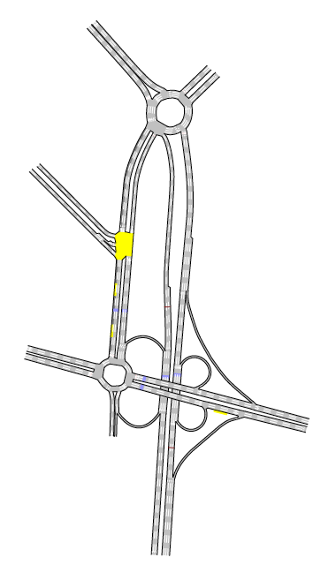
Traffic models – Transportation supply

Slide 9
Traffic models – Transportation demand
A
OD | A | B | C | D | E | F
A | f_{AA} | f_{AB} | f_{AC} | f_{AD} | f_{AE} | f_{AF} | O_{A}
B | f_{BA} | f_{BB} | f_{BC} | f_{BD} | f_{BE} | f_{BF} | O_{B}
C | f_{CA} | f_{CB} | f_{CC} | f_{CD} | f_{CE} | f_{CF} | O_{C}
D | f_{DA} | f_{DB} | f_{DC} | f_{DD} | f_{DE} | f_{DF} | O_{D}
E | f_{EA} | f_{EB} | f_{EC} | f_{ED} | f_{EE} | f_{EF} | O_{E}
F | f_{FA} | f_{FB} | f_{FC} | f_{FD} | f_{FE} | f_{FF} | O_{F}
 | D_{A} | D_{B} | D_{C} | D_{D} | D_{E} | D_{F}
B
F
E
C
D

Slide 10
Traffic models – Supply/demand interaction
A
OD | A | B | C | D | E | F
A | -- | f_{AB} | f_{AC} | f_{AD} | f_{AE} | f_{AF} | O_{A}
B | f_{BA} | -- | f_{BC} | f_{BD} | f_{BE} | f_{BF} | O_{B}
C | f_{CA} | f_{CB} | -- | f_{CD} | f_{CE} | f_{CF} | O_{C}
D | f_{DA} | f_{DB} | f_{DC} | -- | f_{DE} | f_{DF} | O_{D}
E | f_{EA} | f_{EB} | f_{EC} | f_{ED} | -- | f_{EF} | O_{E}
F | f_{FA} | f_{FB} | f_{FC} | f_{FD} | f_{FE} | -- | O_{F}
 | D_{A} | D_{B} | D_{C} | D_{D} | D_{E} | D_{F}
B
F
E
C
D
Notes:
Od matrix very effective but hides several uncertainties behind it

Slide 11
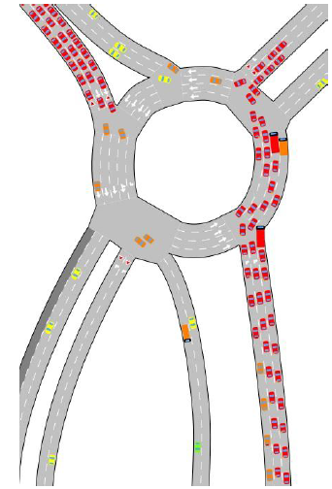
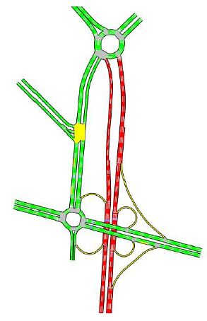
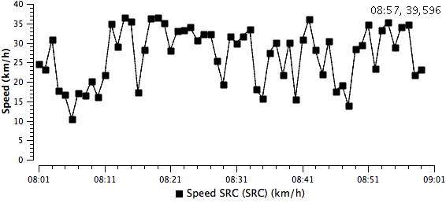
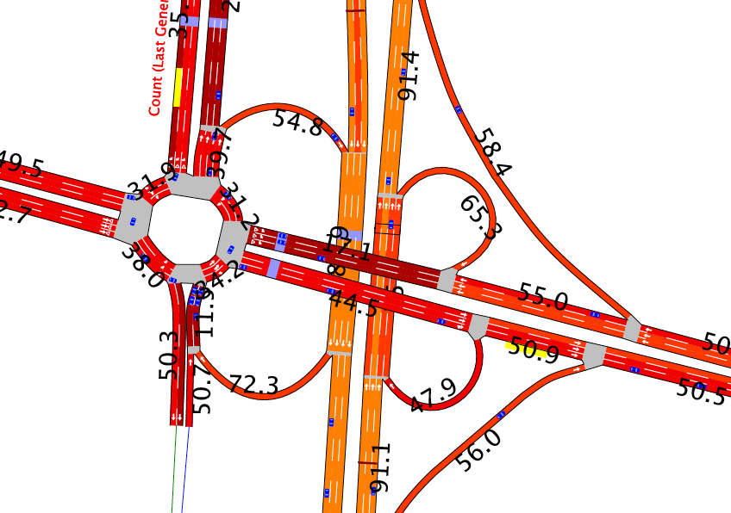
Traffic models - Results
A
B
F
E
C
D
Notes:
Od matrix very effective but hides several uncertainties behind it

Slide 12
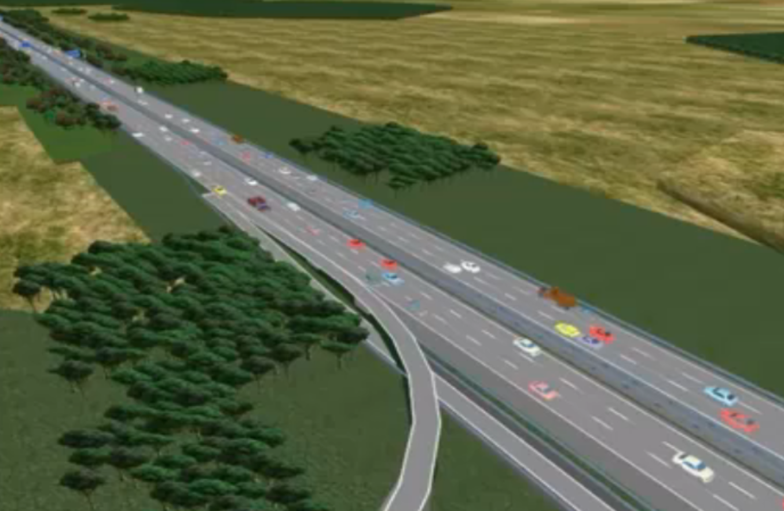
Possible sources of uncertainty
A
B
OD flows are only aggregate measures of traffic patterns
    No or limited capability to resemble space-time dynamics
    No or limited capability to identify drivers heterogeneity
F
E
C
D
Notes:
Od matrix very effective but hides several uncertainties behind it

Slide 13
Effect of input distributions – Empirical analysis from NGSIM database I80-1
Real trajectories
Space
Time

Slide 14
Vehicles’ calibrated parameters
Sampled from empirical joint pdf
Space
Space
Time
Time
Sampled from marginal empirical pdf
Sampled from marginal normal pdf
Space
Space
Time
Time

Slide 15
Travel time distributions

Slide 16
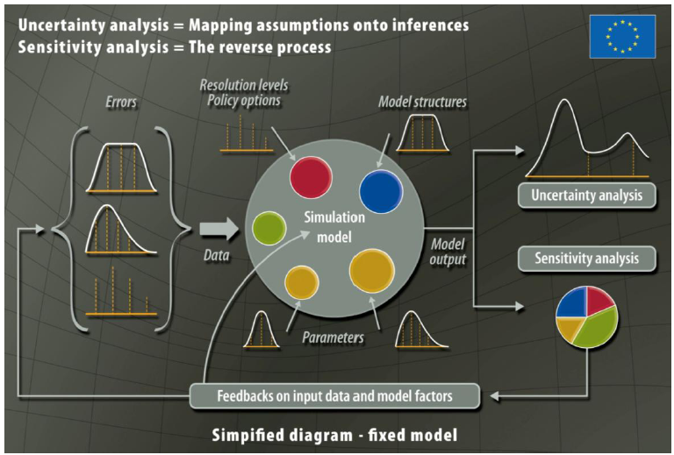
A framework of uncertainty management

Slide 17
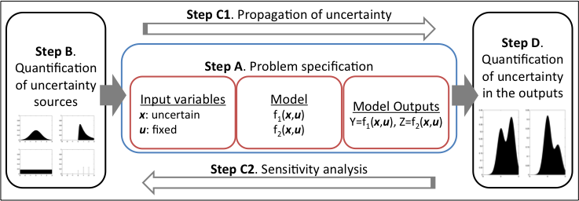
Uncertainty management
The process of identification/quantification/reduction of modeling uncertainties

Slide 18
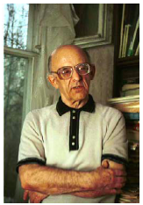
Propagation of modeling uncertainties
Monte Carlo framework using Sobol quasi-random sequences: “Quasi Monte Carlo” methods
If the sequence of random numbers keeps “low-discrepancy” whatever the number of dimensions, the size of the Monte Carlo experiment decreases
Discrepancy: a measure of deviation from uniformity
Prof. I.M.Sobol has devoted big part of his life in studying LDS properties

Slide 19
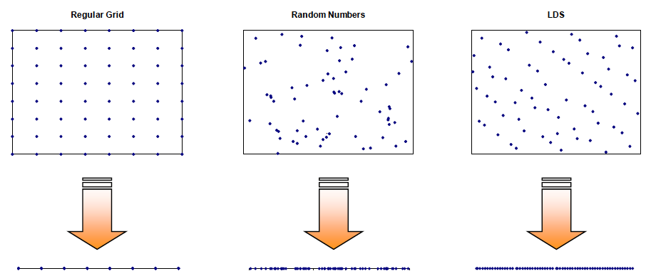
Some properties of Sobol sequences (1)

Slide 20
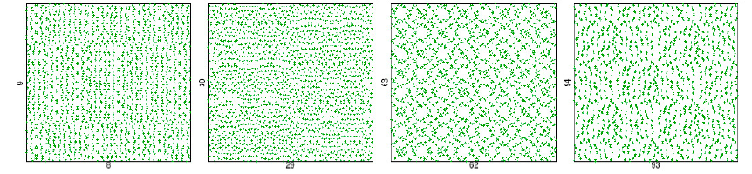



Some properties of Sobol sequences (2)
In integral calculation, error ε:
Sobol sequence (for N=2^{k})
Other LDS
Random numbers

Slide 21
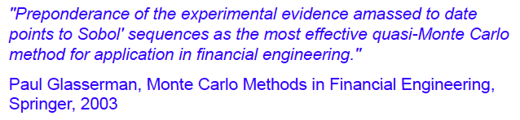
Some properties of Sobol sequences (3)
Summary of the main features:
Best uniformity of distribution as N goes to infinity
Good distribution for fairly small initial sets
Fast computational algorithm

Slide 22

Need for sensitivity analysis
Although efficient, the convergence rate of LDS depends (exponentially) on the problem dimensionality
Reducing the number of uncertain inputs is key for the uncertainty management of traffic models (for n>50 QMC not applicable)
Sensitivity analysis is the family of techniques designed for this purpose

Slide 23


Global sensitivity analysis
Family of theories and techniques aimed at defining how “the uncertainty in the model outputs can be apportioned to the different sources of uncertainties in the model inputs”
Important to:
uncover technical errors in the model
identify critical regions in the inputs domain
simplify models
Variance-based methods
    Output variance as a proxy of output uncertainty
    Variance decomposition formulas as sensitivity analysis tools

Slide 24
Variance-based methods
(Cukier, 1973; Sobol, 1990; Homma and Saltelli, 2000)

Slide 25
First order effect

Slide 26
Variance decomposition

Slide 27
Sobol sensitivity indices
An efficient (numerical) evaluation of Sobol indices requires the application of techniques based on QMC methods (Saltelli et al 2012)

Slide 28
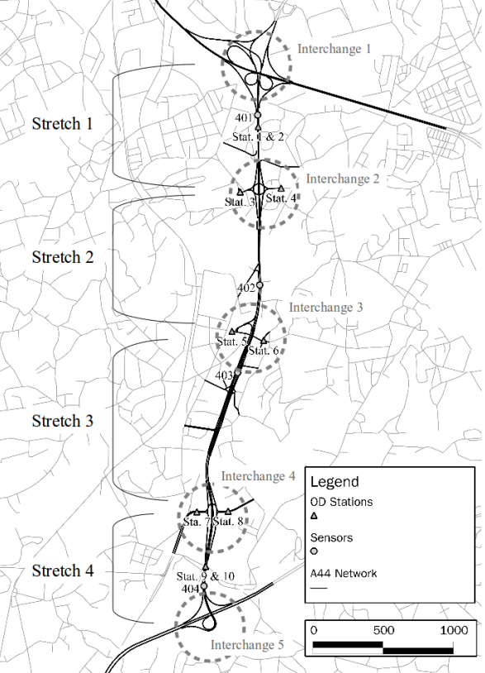
Application (work in progress)
MITSIM microscopic traffic simulation model
Freeway scenario (Portugal)
2 years of traffic demand and data available
Objective:
    Calibration and uncertainty management
Main obstacle:
    Number of model inputs (101)
    Computation time (5’ per simulation)

Slide 29
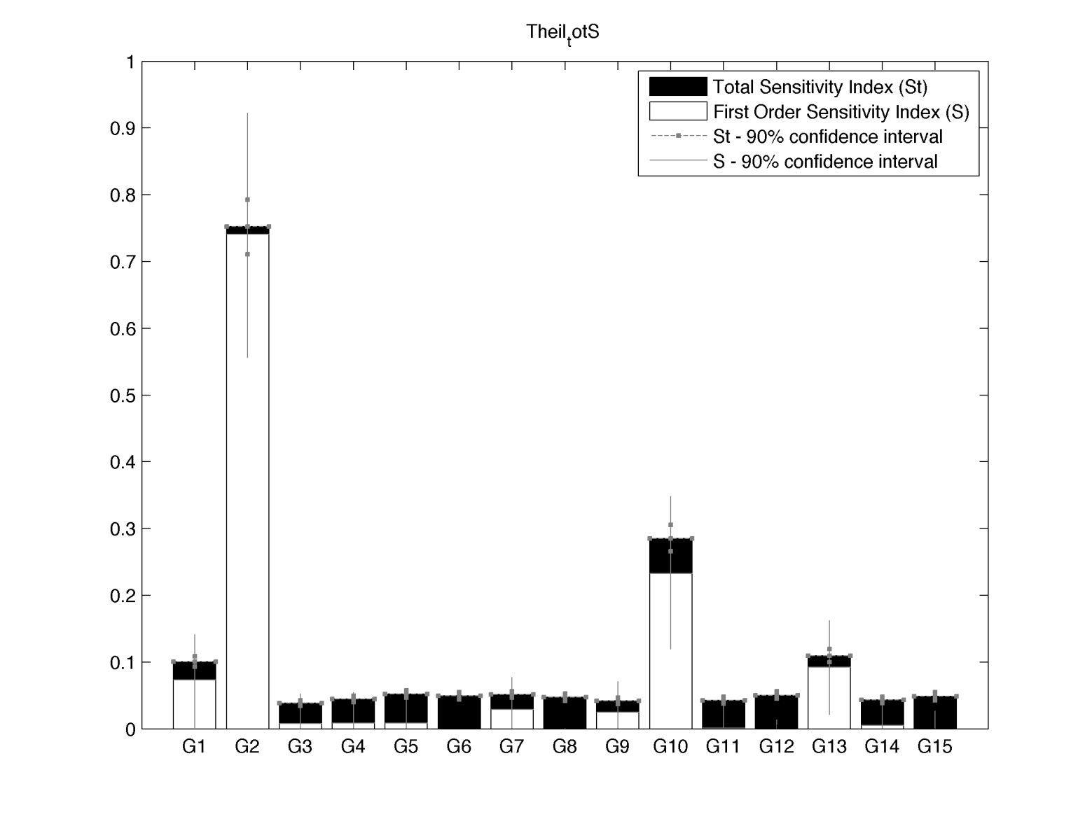
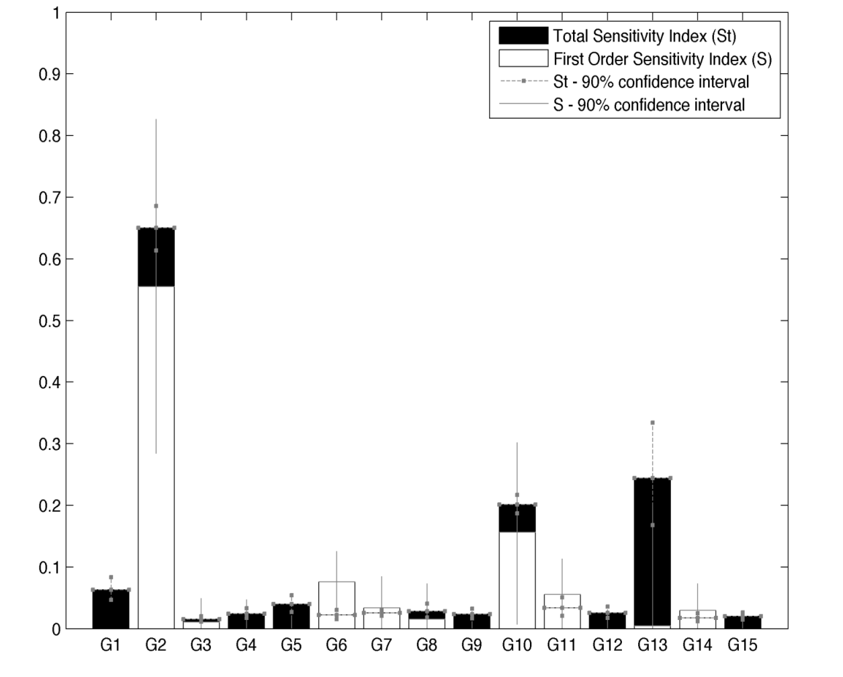
I phase: Group sensitivity analysis
Model inputs divided in 15 groups
Sensitivity analysis applied to groups
Results:
    4 groups (34 input factors) accounting for 90% of total variance for both speed and counts as model outputs
Speed
Counts

Slide 30
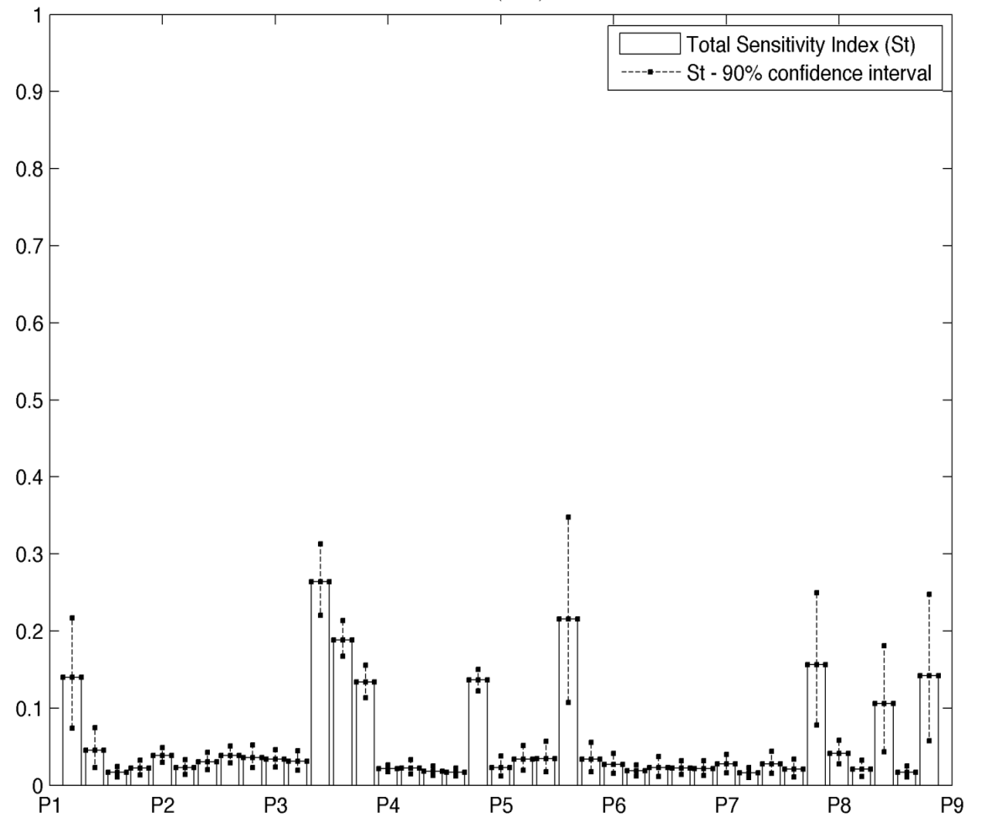
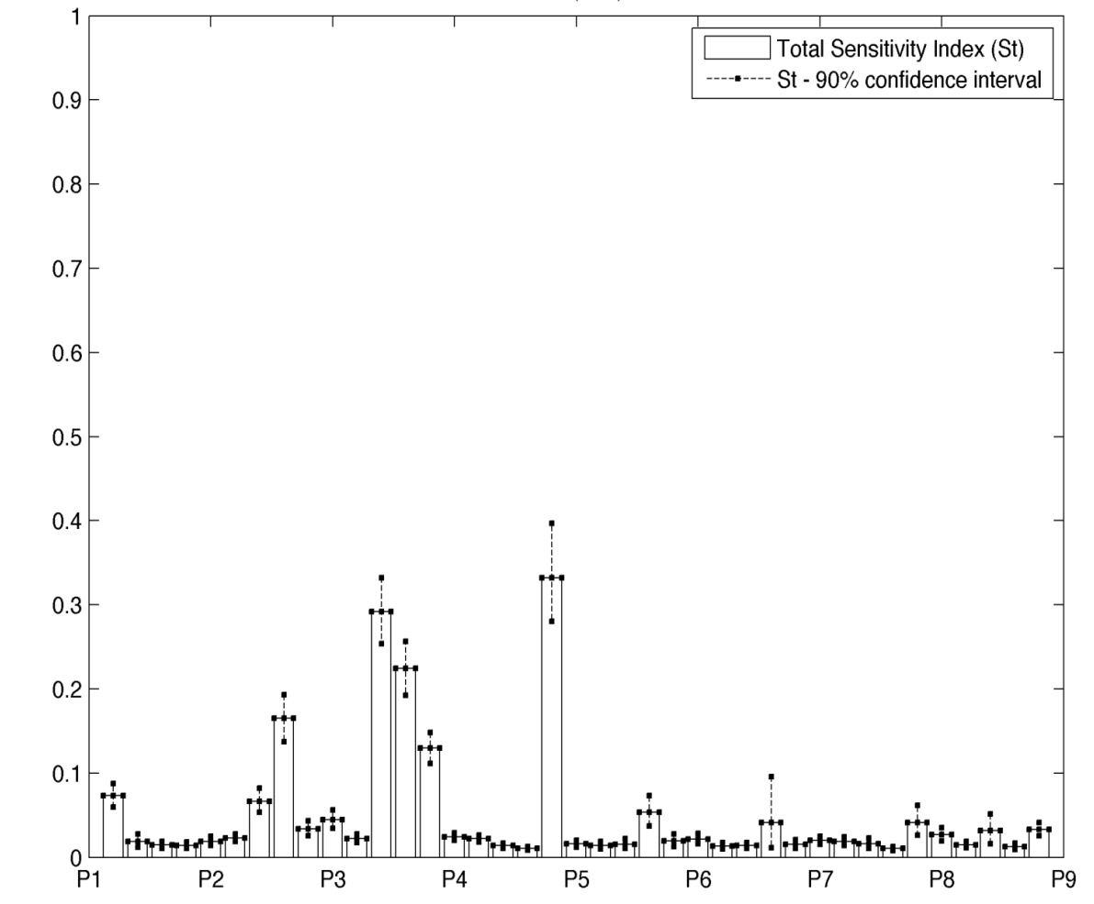
II phase: Total order analysis
Sensitivity analysis applied to the 34 remaining inputs
Given the still high dimensionality only total order effect calculated (faster in reaching convergence)
Results:
    10 parameters resulting conseiderably most sensitive than the others
Speed
Counts

Slide 31
III phase: Uncertainty analysis (in progress)
Uncertainty analysis entails a correct definition of the distribution of the inputs. For model parameters this may require their indirect estimation
Morning Peak
Afternoon Peak

Slide 32
Conclusions
traffic dynamics are the results of the combination of several mutually correlated stochastic elements
given the underlying complexity, traffic models require an uncertainty management
Monte Carlo methods are the most appropriate way to perform both sensitivity and uncertainty analysis
Sobol quasi random sequences can provide considerable benefits if used in Monte Carlo sampling

