Slide 1

Uncertainty quantification and going beyond the independent-particle approximation
What’s hot and new in a mature field
Monte Carlo for particle transport in particle/nuclear/astro/medical/etc. physics
Maria Grazia Pia
Paolo Saracco
INFN Genova, Italy

Slide 2
Implicit throughout this talk
Monte Carlo
Monte Carlo for particle transport
in matter

Slide 3
Monte Carlo in journals
1960-2009
Fraction of papers mentioning Monte Carlo or simulation
HEP
Medical physics
M.G. Pia, T. Basaglia, Z.W. Bell, P.V. Dressendorfer, The butterfly effect: Correlations between modeling in nuclear-particle physics and socioeconomic factors, Proc. IEEE NSS 2010

Slide 4
Nuclear Science & Technology
Instruments & Instrumentation
604059 publications
J. P. Biersack, L. L. Haggmark,
A Monte-Carlo computer-program for the transport of energetic ions in amorphous targets
NIM, vol. 174, no. 1-2, pp. 257-269, 1980
Times Cited: 3661
S. Agostinelli et al.,
GEANT4 - a simulation toolkit
NIM A, vol. 506, no. 3, pp. 250-303, 2003
Times Cited: 3640
L. R. Doolittle,
Algorithms for the rapid simulation of Rutherford backscattering spectra
NIM B, vol. 9, no. 3, pp. 344-351, 1985
Times Cited: 2095
Thomson-Reuters, ISI Web of Science
Updated 15 February 2013

Slide 5
Physics, Particles & Fields
256905 publications
A. H. Guth,
Inflationary universe - a possible solution to the horizon and flatness problems
Phys. Rev. D, vol. 23, no. 2, pp. 347-356,1981
Times Cited: 4,157
Particle Data Group
Review of particle physics
J. Phys. G, vol. 33, no. 1 Special Issue, 2006
Times Cited: 3,661
S. Agostinelli et al.,
GEANT4 - a simulation toolkit
NIM A, vol. 506, no. 3, pp. 250-303, 2003
Times Cited: 3640
Most cited CERN paper (excluding Rev. Part. Phys.)
Thomson-Reuters, ISI Web of Science
Updated 15 February 2013

Slide 6
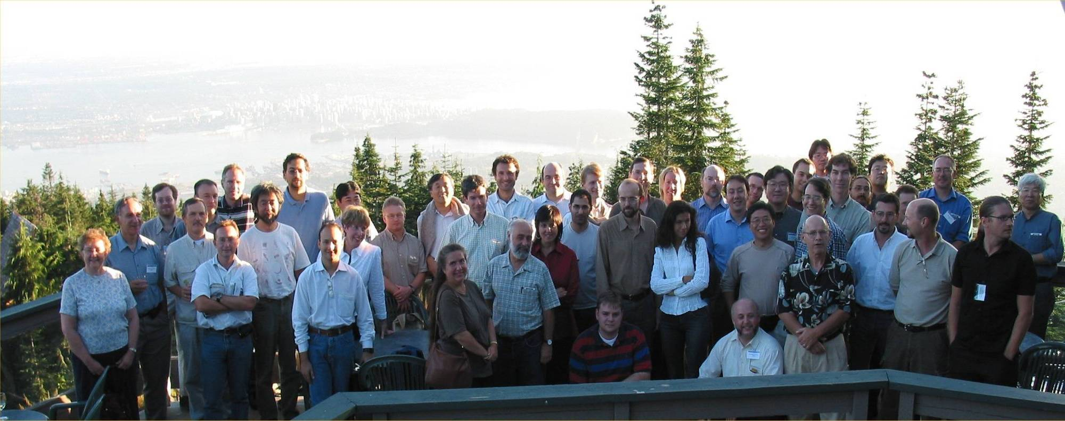
An international collaboration of ~ 100 physicists, engineers and computer scientists
Laboratories, national institutes and universities
1994-1998 RD44 (CERN): R&D phase
1st public release: 15 December 1998
1-2 new versions/year
Open source
Freely downloadable
No limitations on use

Slide 7
Who uses Geant4?
Some degree of subjectivity in the classification:
journal scope
manual inspection
Source of citations of Geant4 NIM 2003 paper
Update: end 2009
Roughly similar distribution in recent scientometric data

Slide 8
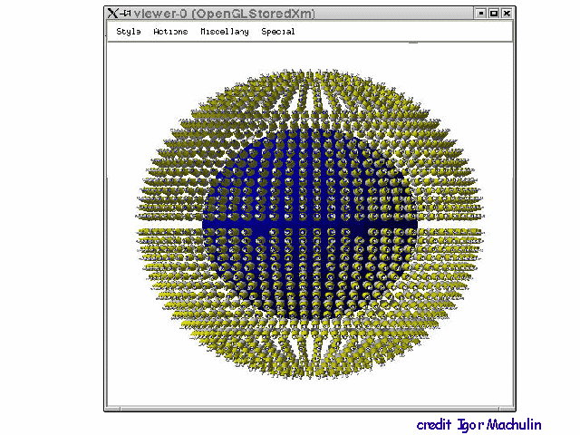
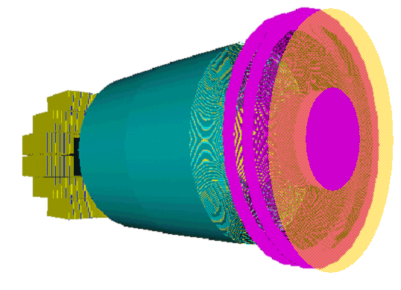
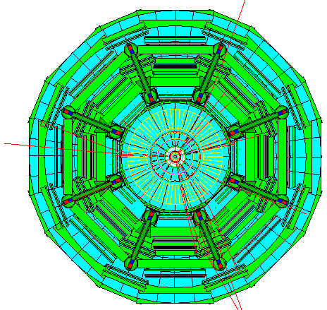
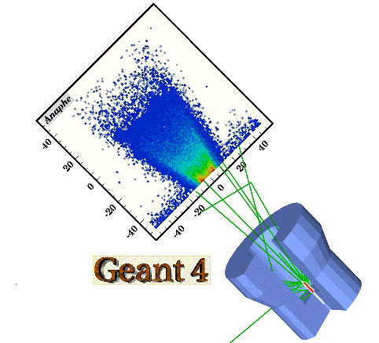
Simulation in
HEP/nuclear/astro experiments
Courtesy Borexino
Oncological radiotherapy
Space science
LHC
Gran Sasso lab
Courtesy R. Nartallo et al.,ESA
Courtesy of ATLAS
Fundamental in various domains and phases of an experiment
  design of the experimental set-up
  evaluation and definition of the potential physics output of the project
  evaluation of potential risks to the project
  development and optimisation of reconstruction and physics analysis software
  contribution to the calculation and validation of physics results
Simulation of the passage of particles through matter
  other kinds of simulation components, such as physics event generators, electronics response generation, etc.
  often the simulation of a complex experiment consists of several of these components interfaced to one another

Slide 9
Basic ingredients
Modeling the experiment: geometry + materials
Tracking particles through matter
Interaction of particles with matter: physics models
Modeling the detector response
Run and event control
Interface to primary event generators
Accessory utilities (random number generators, PDG particle data etc.)
Visualisation of the set-up, tracks and hits
User interface
Persistency

Slide 10
The zoo
Monte Carlo codes at the MC200 Conference, Lisbon, October 2000
DPM
EA-MC
FLUKA
GEM
HERMES
LAHET
MCBEND MCU
MF3D
NMTC
MONK MORSE
RTS&T-2000 SCALE
TRAX
VMC++
Many codes not publicly distributed
EGS4, EGS5, EGSnrc
GEANT 3, Geant4
MARS
MCNP, MCNPX, A3MCNP, MCNP-DSP, MCNP4B
MVP, MVP-BURN
Penelope
Peregrine
Tripoli-3, Tripoli-3 A, Tripoli-4
...and I probably forgot some more
2004-2008

Slide 11
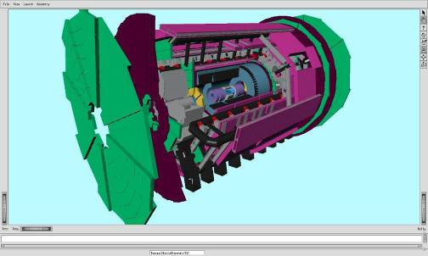
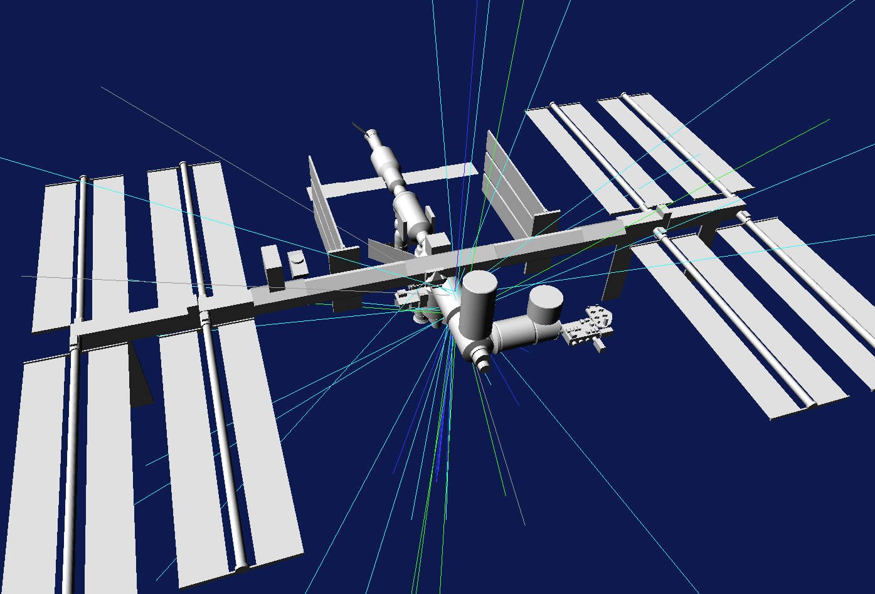
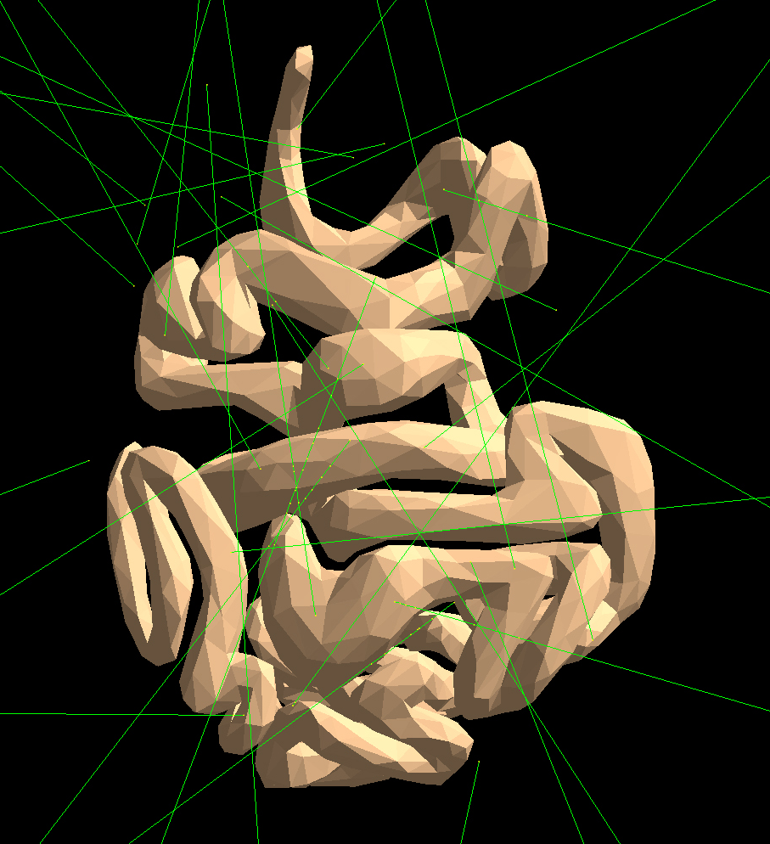
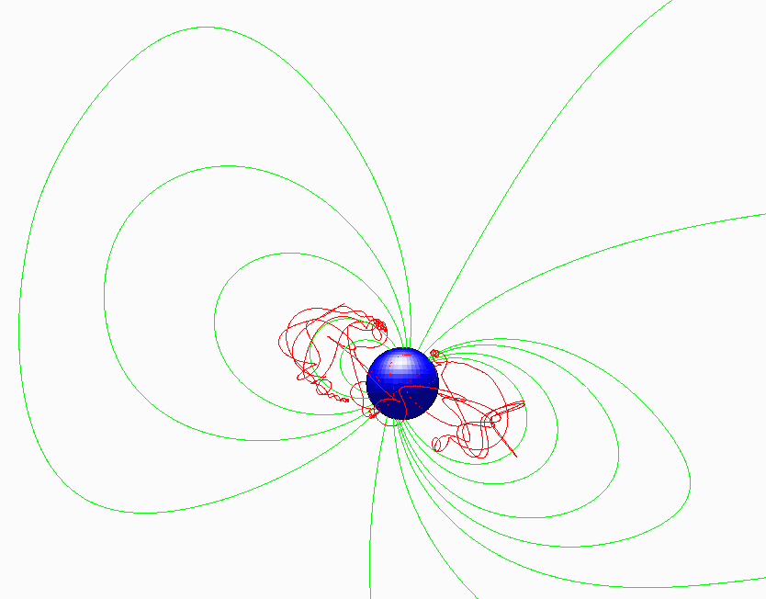
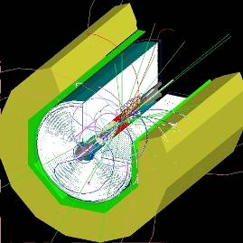
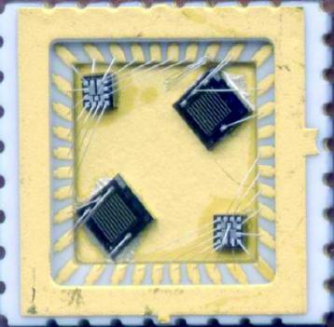
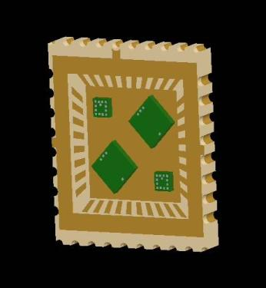
Geometry
Courtesy of ATLAS Collaboration
International Space Station
ATLAS
~5.2 M volume objects
~110 K volume types
Courtesy T. Ersmark, KTH Stockholm
Electric and magnetic fields
Courtesy HUREL, Hanyang Univ.
1 GeV proton in the Earth’s geomagnetic field
Intestine
1 GeV proton in the geomagnetic field of the earth
MOKKA Linear Collider Detector
RADMON, CERN
Courtesy L. Desorgher, Univ. Bern

Slide 12
Geant4 electromagnetic physics
electrons and positrons
photons (including optical photons)
muons
charged hadrons
ions
Multiple scattering
Bremsstrahlung
Ionisation
Annihilation
Photoelectric effect
Compton scattering
Rayleigh scattering
γ conversion
Synchrotron radiation
Transition radiation
Cherenkov
Refraction
Reflection
Absorption
Scintillation
Fluorescence
Auger electron emission
Multiple models for the same process:
Standard
Based on EADL-EEDL-EPDL data libraries
Penelope-like
+ some variants, e.g. polarised photons
…sometimes nominally different models are actually identical
also across different Monte Carlo codes…

Slide 13
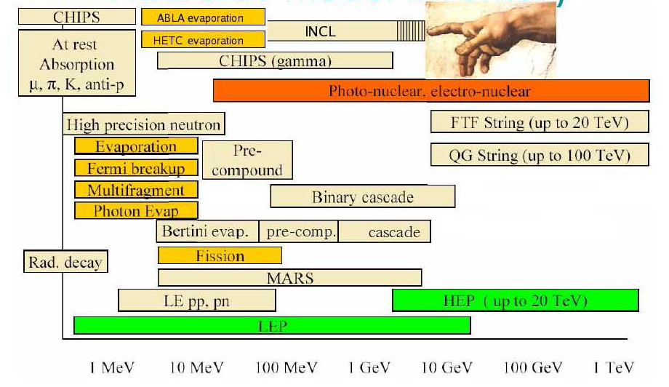
Geant4 hadronic inelastic model inventory
■ Data-driven ■ Parameterised ■ Theory-driven
Also included in LAHET used by MCNPX
FRITIOF
Weisskopf-Ewing
DostrovskyGEM
Griffin’s exciton
Cascade derived from Frankfurt QMD
Re-engineering of INUCL
Preequilibrium based on CEM (used by MCNPX and SHIELD)
GHEISHA-like
Many physics models are the same across different codes!

Slide 14
A mature Monte Carlo code
Successfully used in many, multi-disciplinary experimental applications
Cited by many relevant publications
  e.g. Higgs boson discovery
Ongoing improvements and refinements
  Similar evolution also in other Monte Carlo codes
Adaptation to evolving computing technologies
  e.g. multithreading
Anything new and hot in the field?

Slide 15
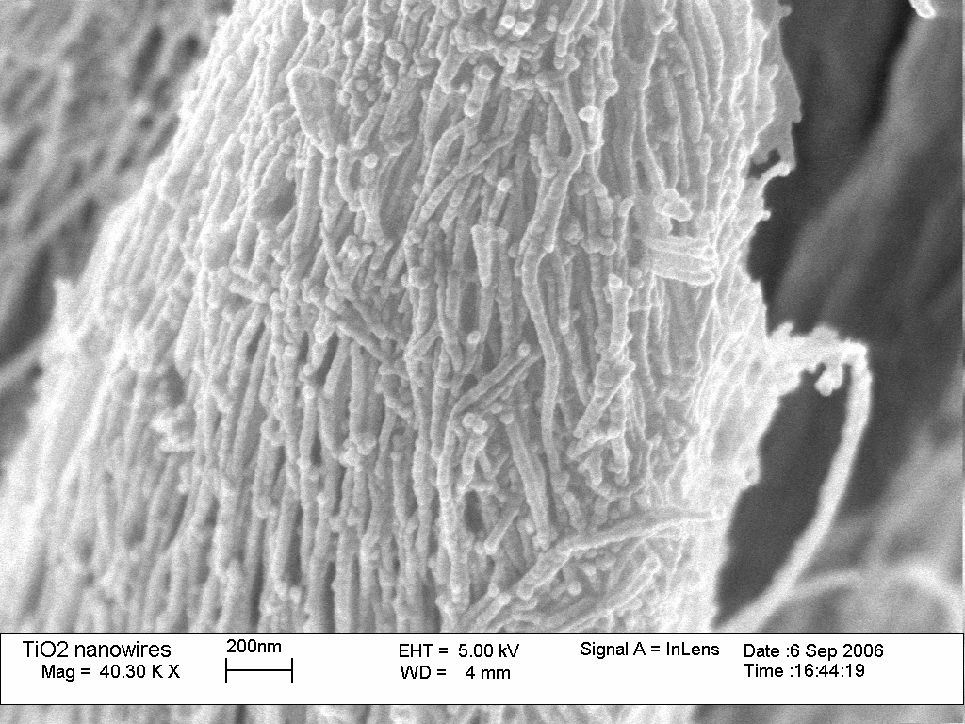
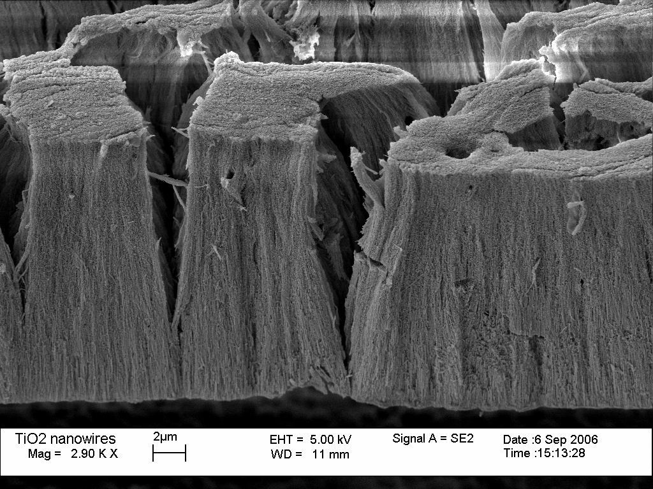
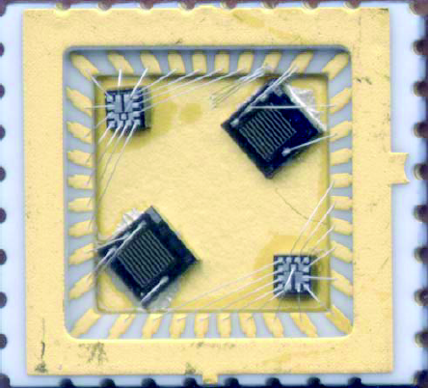
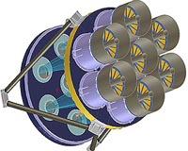
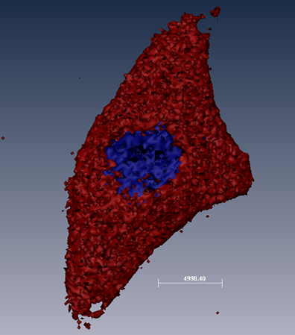
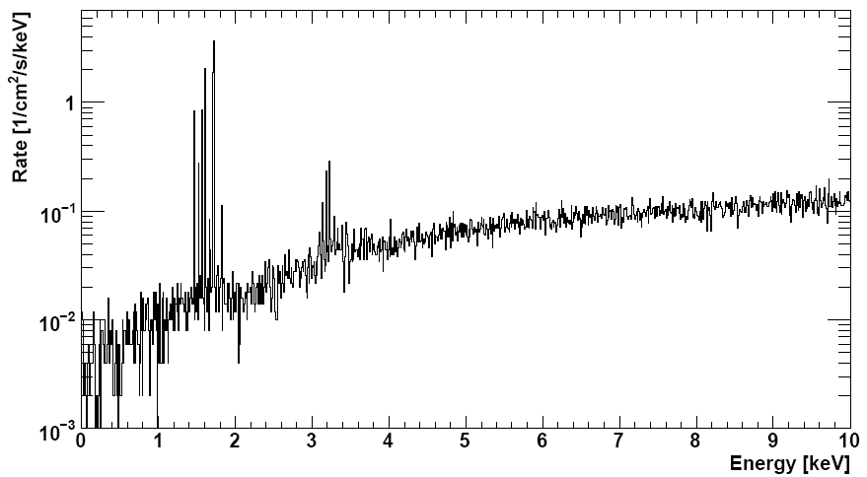
The world changes…
TiO₂ nanowires
Courtesy RADMON (M. Moll et al.) Team, CERN,
NSS 2006 Conf. Rec.
Courtesy A. Montanari et al., INFN Bologna
NSS 2006 Conf. Rec.
Courtesy eROSITA
Courtesy S. Incerti et al., CENBG, NSS 2007 Conf. Rec.
G. Weidenspointner et al., NSS 2008 Conf. Rec
S. Incerti et al., Monte Carlo dosimetry for targeted irradiation of individual cells using a microbeam facility, Radiat. Prot. Dosim., vol. 133, no. 1, pp. 2-11, 2009

Slide 16
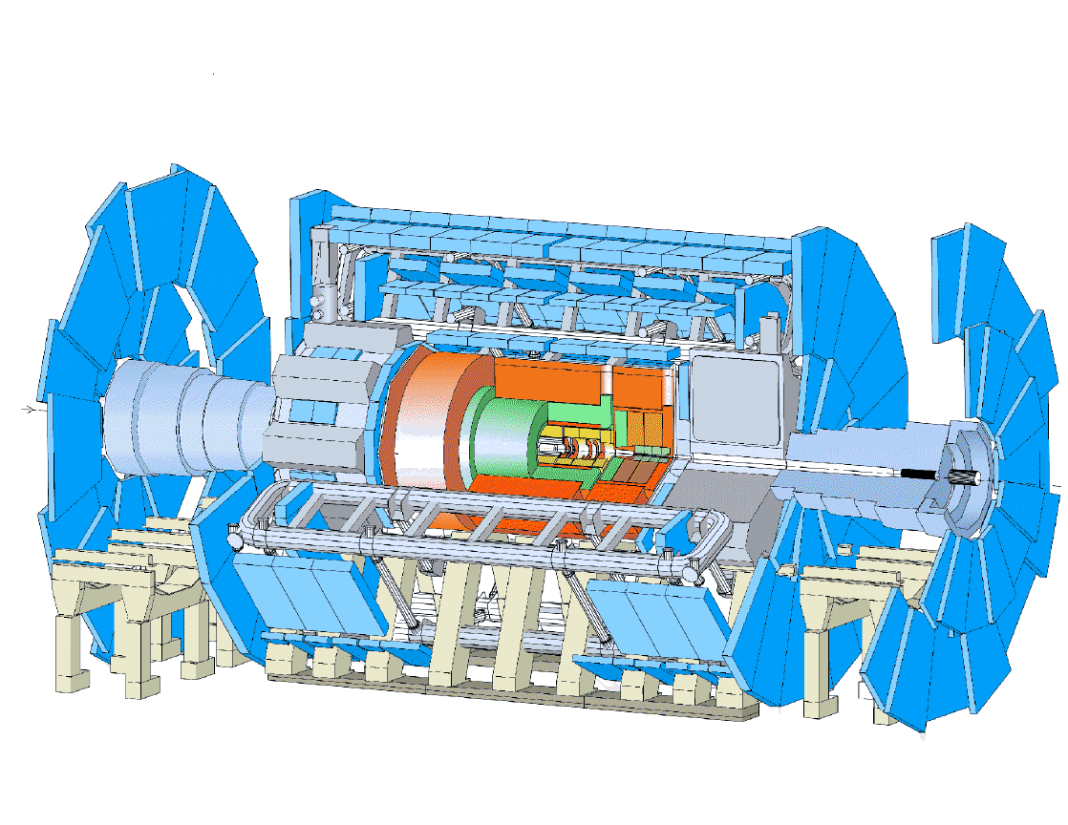

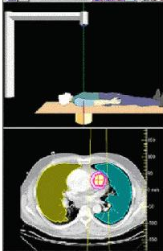
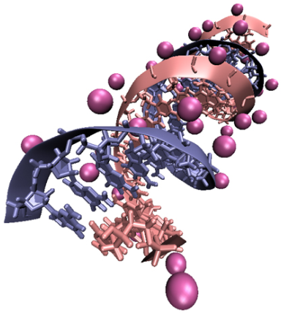
Two worlds…
Condensed-random-walk OR “discrete” régime
  Characterizing choice in a Monte Carlo system
RADMON
How does one estimate radiation effects on components exposed to LHC + detector environment?
ATLAS
And what about nanotechnology-based detectors for HEP?
And tracking in a gaseous detector?
And plasma facing material in a fusion reactor?
How does one relate dosimetry to radiation biology?

Slide 17
Transport very low energy particles (~eV scale)
Physics models
Experimental data
Simulation at small scale
Drop the condensed history scheme
Move beyond the independent particle approximation
Nano- and macro-scale in the same environment
Condensed and discrete schemes
Multi-scale simulation
…it is not just a matter of if-then-else
Source of inconsistency even in conventional scenarios (e.g. PIXE)

Slide 18
Independent particle approximation
Molecules?
Solids?
Particles interact with atoms
Each electron is considered to move independently in the average field of the Z - 1 other electrons plus the nucleus
Central-field approximation
the distribution of the Z - 1 other electrons is spherically symmetric around the nucleus
(Dirac) Hartree-Fock calculations are at the basis of the physics models used in Monte Carlo particle transport
When does it break?

Slide 19
Photon elastic scattering

Slide 20
Photoionization

Slide 21
PARTRAC, OREC, NOREC, LAPPA, MC4V, MC4L,TRION…
M. Zaider, D. J. Brenner, W. E. Wilson, “The application of track calculations to radiobiology: I. Monte Carlo simulation of proton tracks”, Radiat. Res., vol. 95, pp. 231-247, 1983.
H. G. Paretzke, “Radiation track structure theory”, in Kinetics of Non- homogeneous Processes, Ed. New York: Wiley, 1987, pp. 89-170.
W. E. Wilson and H. G. Paretzke, “Calculation of distribution of energy imparted and ionisations by fast protons in nanometer sites”, Radiat. Res., vol. 81, pp. 521-537, 1981.
A. Ito, “Electron track simulation for microdosimetry”, in Monte Carlo Transport of Electrons and Photons, Ed. Plenum, 1988, pp. 361-382.
S. Uehara, H. Nikjoo, and D. T. Goodhead, “Cross-sections for water vapor for the Monte Carlo electron track structure code from 10 eV to the MeV region”, Phys. Med. Biol., vol. 37, pp. 1841-1858, 1992.
A. V. Lappa, E. A. Bigildeev, D. S. Burmistrov, and O. N. Vasilyev, “Trion code for radiation action calculations and its application in microdosimetry and radiobiology”, Radiat. Environ. Biophys., vol. 32, pp. 1-19, 1993.
C. Champion, “Multiple ionization of water by heavy ions: a Monte Carlo approach”, Nucl. Instrum. Meth. B, vol. 205, pp. 671-676, 2003
W. E. Wilson and H. Nikjoo, “A Monte Carlo code for positive ion track simulation”, Radiat. Environ. Biophys., vol. 38, pp. 97-104, 1999.
S. Uehara, L. H. Toburen, and H. Nikjoo, “Development of a Monte Carlo track structure code for low-energy protons in water”, Int. J. Radiat. Biol., vol. 77, pp. 138-154, 2001.
D. Emfietzoglou, G. Papamichael, and M. Moscovitch, “An event-by-event computer simulation of interactions of energetic charged particles and all their secondary electrons in water”, J. Phys. D: Appl. Phys., vol. 33, pp. 932-944, 2000.
D. Emfietzoglou, G. Papamichael, K. Kostarelos, and M. Moscovitch, “A Monte Carlo track structure code for electrons ( 10 eV-10 keV) and protons ( 0.3-10 MeV) in water: partitioning of energy and collision events”, Phys. Med. Biol., vol. 45, pp. 3171-3194, 2000.
D. Emfietzoglou, G. Papamichael, and M. Moscovitch, “Charged particle interactions in water: Cross sections and simulations”, Radiat. Phys. Chem., vol. 61, pp. 597-598, 2001.
M. Terrissol and A. Beaudre, “Simulation of space and time evolution of radiolytic species induced by electrons in water”, Radiat. Prot. Dosim., vol. 31, pp. 171-175, 1990.
S. M. Pimblott, J. A. LaVerne, A. Mozumder, N. J. B Green, “Structure of electron tracks in water. 1. Distribution of energy deposition events”, J. Phys. Chem., vol. 94, pp. 488-495, 1990.
R. H. Ritchie et al., “Radiation Interactions and Energy Transport in the Condensed Phase”, in Physical and Chemical Mechanisms in Molecular Radiation Biology, Ed. Plenum Press, 1991, pp. 99-136.
M. Zaider, M. G. Vracko, A. Y. C. Fung, J. L. Fry, “Electron transport in condensed water”, Radiat. Prot. Dosim., vol. 52, pp. 139-146, 1994.
M.A. Hill, F. A. Smith, “Calculation of initial and primary yields in the radiolysis of water”, Int. J. Appl. Radiat. Isot., 43, pp. 265-280, 1994.
V. Cobut, Y. Frongillo, J. P. Patau, T. Goulet, M. J. Fraser, and J. P. Jay-Gerin, “Monte Carlo simulation of fast electron and proton tracks in liquid water I. Physical and physicochemical aspects”, Radiat. Phys. Chem., vol. 51, pp. 229-243, 1998.
V. A. Semenenko et al., “NOREC, a Monte Carlo code for simulating electron tracks in liquid water”, Radiat. Environ. Biophys., vol. 42, pp. 213-217, 2003.

Slide 22
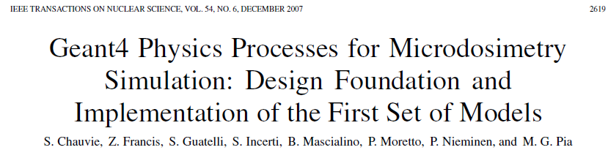
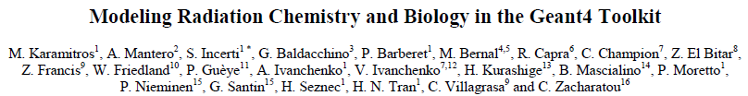
Very-low energy models
1st development cycle:
Physics of interactions in water down to the eV scale
Further developments
Physics mostly derived from other “track structure” codes

Slide 23
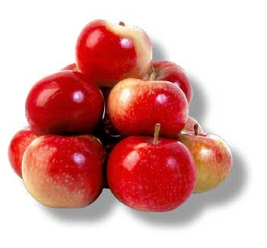
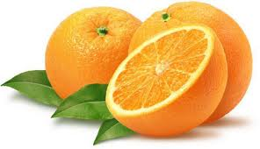
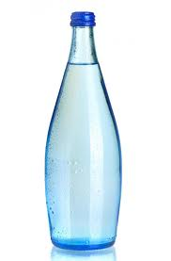
Incerti S, Ivanchenko A, Karamitros M, Mantero A, Moretto P, Tran HN, Mascialino B, Champion C, Ivanchenko VN, Bernal MA, Francis Z, Villagrasa C, Baldacchin G, Guèye P, Capra R, Nieminen P, Zacharatou C.
Comparison of GEANT4 very low energy cross section models with experimental data in water
Med. Phys., vol. 37, no. 9, pp. 4692-4708, 2010
Software
Good software
Validated software

Slide 24
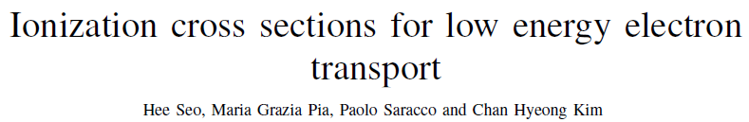
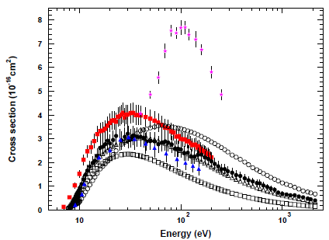
Best Student Award Monte Carlo 2010
IEEE Trans. Nucl. Sci., vol. 58, no. 6, pp. 3219–3245, 2011
Cross section models
Binary-Encounter-Bethe (BEB)
Deutsch-Märk (DM)
EEDL (current Geant4 Low Energy)
Validation
57 elements
181 experimental data sets
statistical data analysis
Experimental data:
R. R. Freund et al.
M. A. Bolorizadeh et al.
S. I. Pavlov et al.
J. M. Schroeer et al.
□ BEB
❒ DM
 EEDL
Cu
Percentage of elements for which a model is
compatible with experimental data at 95% CL

Slide 25
A fresh look at atomic parameters
Lotz+NIST
Lotz
 EADL
Atomic binding energies from various sources compared to experimental data
C, K shell
Proton ionisation cross section using different atomic data, compared to measurements
Benefits also in conventional simulations
With current Geant4
With improved physics data
Radioactive decay: Median relative intensity deviation per isotope for X-ray emission

Slide 26
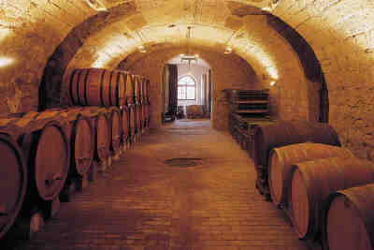
How good are Monte Carlo codes?
Hardly any systematic, quantitative validation of the physics models in Monte Carlo codes for particle transport is documented in the literature

Slide 27
Photoelectron angular distribution
Penelope Geant4
Error aged for ~30 years and propagated across different Monte Carlo codes
New, correct sampling algorithm reproduces the expected theoretical distribution
GEANT 3

Slide 28

Monte Carlo as a predictive instrument
If we know the uncertainties of the “ingredients” of our Monte Carlo code, can we calculate the uncertainties of the observables resulting from the simulation?
Quantify the uncertainties
of the “ingredients”
Validation of physics models and parameters
Epistemic uncertainties
Induced systematic effects
Propagation of uncertainties into observables
Uncertainty Quantification
Hot topic in deterministic simulation,
still in its infancy in Monte Carlo simulation

Slide 29
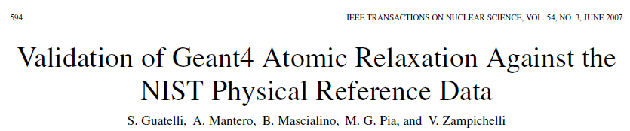
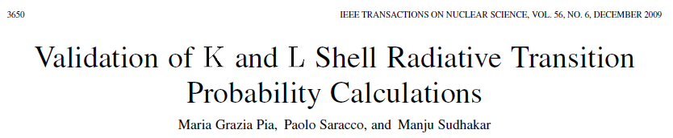
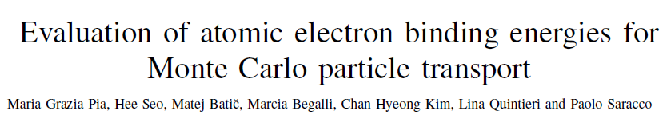
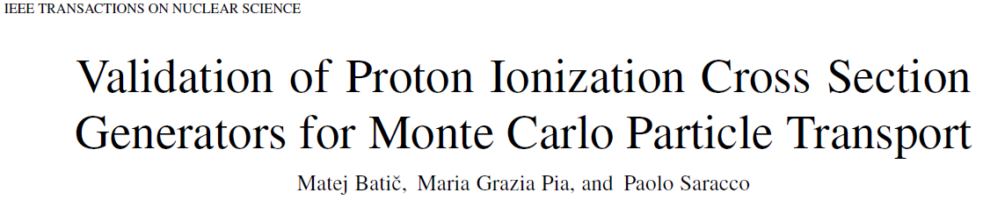
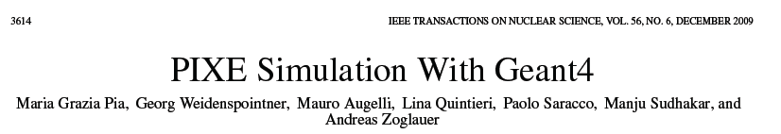
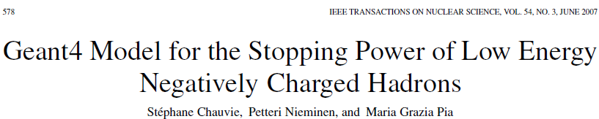
Validation of the “ingredients”
etc.
Physics Today,
vol. 58, no. 1, 2005
Douglass E. Post and Lawrence G. Votta

Slide 30
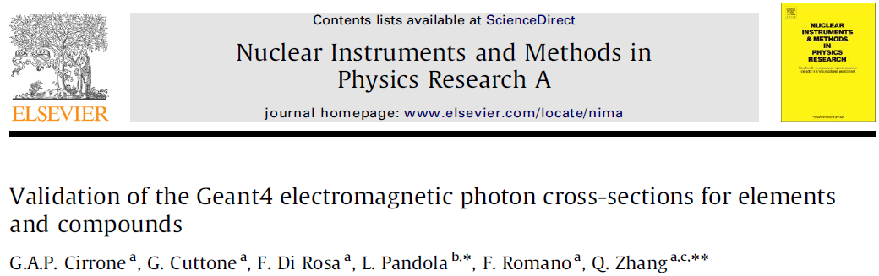
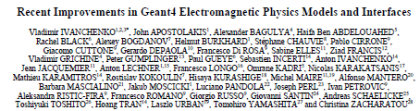
Comparison to theoretical data libraries
NOT validation!
“After the migration to common design a new validation of photon cross sections versus various databases was published ²⁶⁾ which demonstrated general good agreement with the data for both the Standard and Low-energy models.”

Slide 31

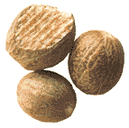
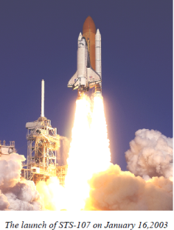
Validation is holistic
One must validate the entire calculation system
Including:
User
Computer system
Problem setup
Running
Results analysis
An inexperienced user can easily get wrong answers
out of a good code in a valid régime
Columbia Space Shuttle accident, 2003
Source:NASA

Slide 32
Epistemic uncertainties
Epistemic uncertainties originate from lack of knowledge
Relatively scarce attention so far in Monte Carlo simulation
Studies in deterministic simulation (especially for critical applications)
Possible sources in Monte Carlo simulation
incomplete understanding of fundamental (physics) processes, or practical inability to treat them thoroughly
non-existent or conflicting experimental data for a (physical) parameter or model
applying a (physics) model beyond the experimental conditions in which its validity has been demonstrated
Epistemic uncertainties affect the reliability of simulation results
Can we quantify them?

Slide 33
Which one is right?
Often an answer can be found only through a
statistical analysis over a large sample of simulated and experimental data
(and would be a result with a given CL, rather than black & white)
Empty symbols: simulation models
Filled symbols: experimental data

Slide 34
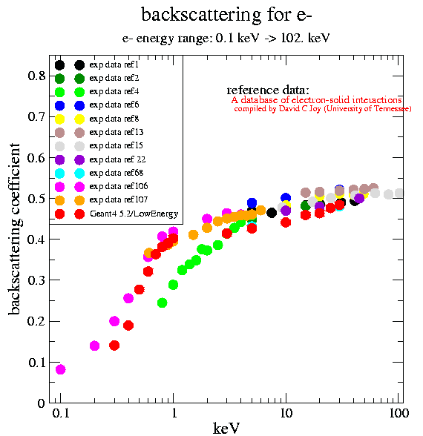
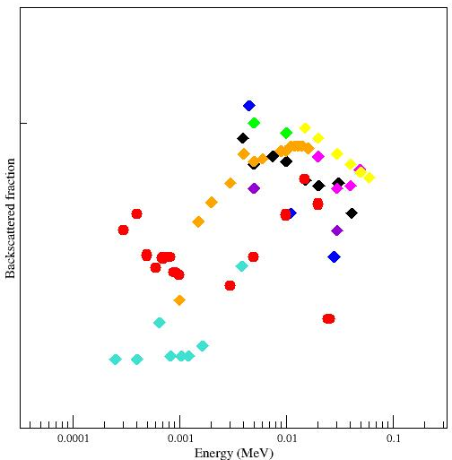
The main problem of validation: experimental data!
Fe
Au
Experimental data often exhibit large differences!

Slide 35
theoretical ground of Uncertainty Quantification
First steps to establish a
Toy Monte Carlo as a tool to study the problem
Simple geometry: a sphere
Macroscopic cross section (i.e. probability) for each process: scattering, absorption…
Tallies (e.g. particle flux) in various positions
How do uncertainties in the cross section affect the tally?

Slide 36
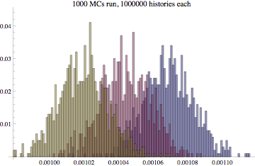
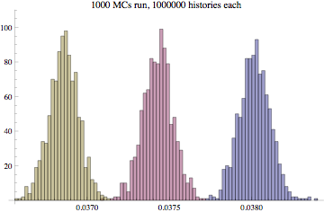
We vary the “ingredients”, e.g. the scattering cross section Σ_{S}
We observe the effect on the tally
<- σ_{<t>}->
<- σ_{<t>}->
<- σ_{<t>}->
Σ_{S}=1
Σ_{S}=1.1
Σ_{S}=1.2
Σ_{S}=1
Σ_{S}=1.1
Σ_{S}=1.2
Tally near the source:
higher statistics
Tally far from source:
lower statistics
The Central Limit Theorem ensures that we can reduce the widths by increasing the number of histories in each Monte Carlo run:

Slide 37
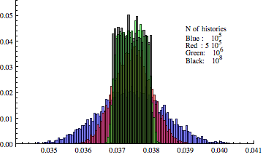
For instance, here Σ_{S} varies continuously with a flat distribution in a given interval 1.0 < Σ_{S} < 1.2
We observe the effect on the tally
If the number of histories N is “small”, the outcome may be confused with a gaussian distribution
As the number of histories in each MC increases, the outcome becomes closer and closer to a flat distribution (the same form we assumed for the variability of the ingredient)
MC simulation transfers the original form of the uncertainty into the final outcome, adding some statistical “noise”
This stems from the identity:
The statistical “noise” can be reduced in principle arbitrarily by increasing the number of histories

Slide 38
If we run many N-histories MCs varying the parameter(s) Σ_{S} in some interval with probability f(Σ_{S}), the final distribution of the tally will be
exact mean value of the tally
(invertible) function x₀(Σ_{S})
original value of the “ingredient”
This assumption relies on the interpretation of the
simulation as a surrogate for the solution of Boltzman transport equation
In the limit of infinite histories
If the range of variability of Σ_{S} is sufficiently small,
x(Σ_{S}) can be approximated by a linear relation
the final distribution of tallies has the same form of the original uncertainty
Σ_{min}≤ Σ_{S} ≤ Σ_{max}
x_{min}≤ x ≤ x_{max}

Slide 39
Ongoing activity
Further work in progress
two papers in preparation
many ingredients
many observables
Deal with
Define best practices
to quantify uncertainties of a simulation
Experimental application use cases
…along with Geant4 physics validation

Slide 40






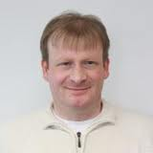
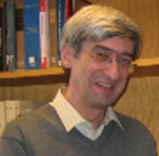
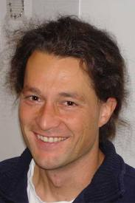

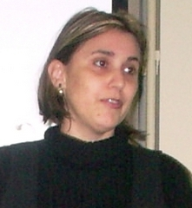
Acknowledments
Tullio Basaglia
Matej Batic
Marcia Begalli
Zane W. Bell
Paul V. Dressendorfer
Min Cheol Han
Steffen Hauf
Gabriela Hoff
Chan Hyeong Kim
Han Sung Kim
Markus Kuster
Paolo Saracco
Hee Seo
Georg Weidenspointner
Andreas Zoglauer

Slide 41
Thank you, Thomas!
post workshop…
Commonality across different disciplines
Uncertainty Quantification
Epistemic uncertainties
Beyond the IPA
Physics calculations
Cross-disciplinary cooperation?
Maria.Grazia.Pia@cern.ch
MariaGrazia.Pia@ge.infn.it

Slide 42
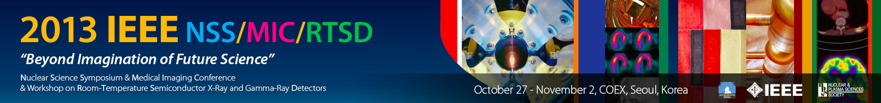

http://www.nss-mic.org/2013/
Seoul, 27 October – 2 November 2013
Abstracts: 13 May 2013
IEEE Nuclear Science Symposium
Contributions concerning Monte Carlo methods are welcome!
IEEE Transactions on Nuclear Science
Nuclear, particle physics, astrophysics, space science, medical physics, photon science etc.

