Slide 1
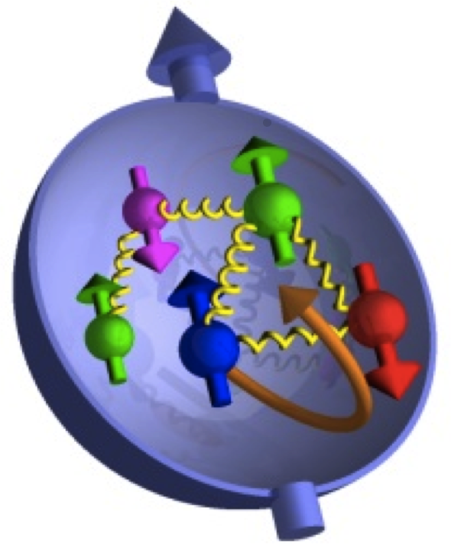
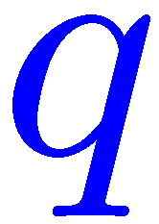
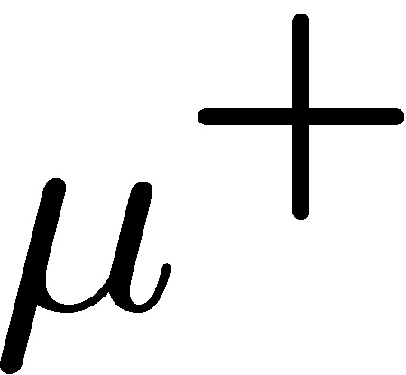

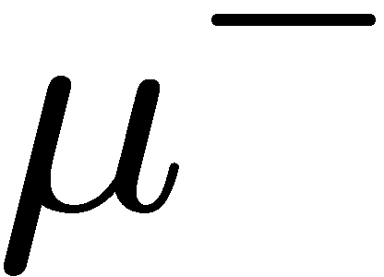
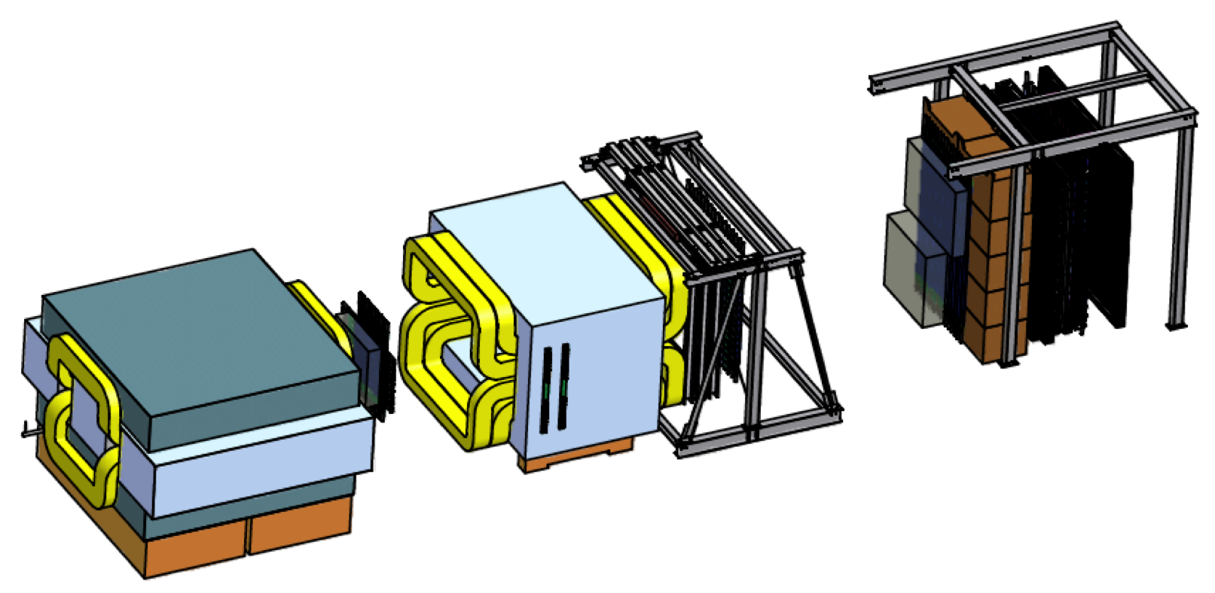
What can more Drell-Yan data tell us about QCD (or Drell-Yan Overview)?
Paul E. Reimer
Physics Division
Argonne National Laboratory
The Drell-Yan Process: The Big Picture
Unpolarized Measurements
  Longitudinal parton distributions
  Angular distributions
Polarized Measurements
HERMES
U. Elschenbroich
This work is supported in part by the U.S. Department of Energy, Office of Nuclear Physics, under Contract No. DE-AC02-06CH11357.

Slide 2
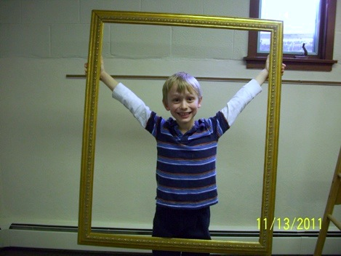
The Big Picture

Slide 3
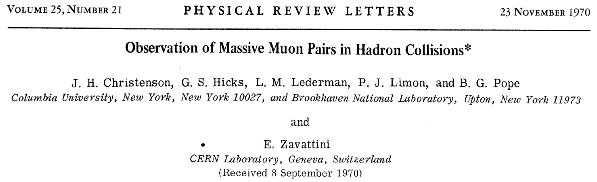
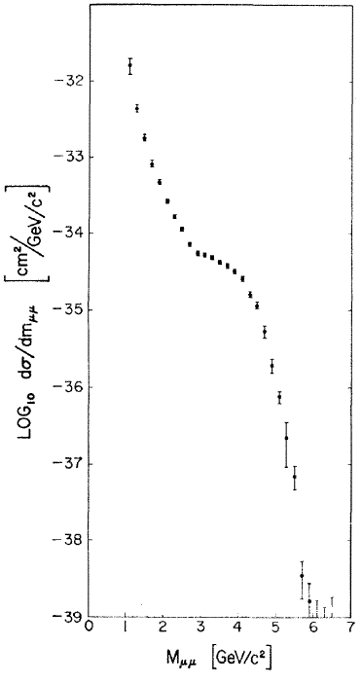
Early Muon Pair Data—soon to be called Drell-Yan
Muon Pairs in the mass range 1 < m_{μμ} < 6.7 GeV/c² have been observed in collisions of high-energy protons with uranium nuclei. At an incident energy of 29 GeV, the cross section varies smoothly as dσ/dm_{μμ} ≈ 10⁻³² / m_{μμ}⁵ cm² (GeV/c)⁻² and exhibits no resonant structure. The total cross section increases by a factor of 5 as the proton energy rises from 22 to 29.5 GeV.

Slide 4
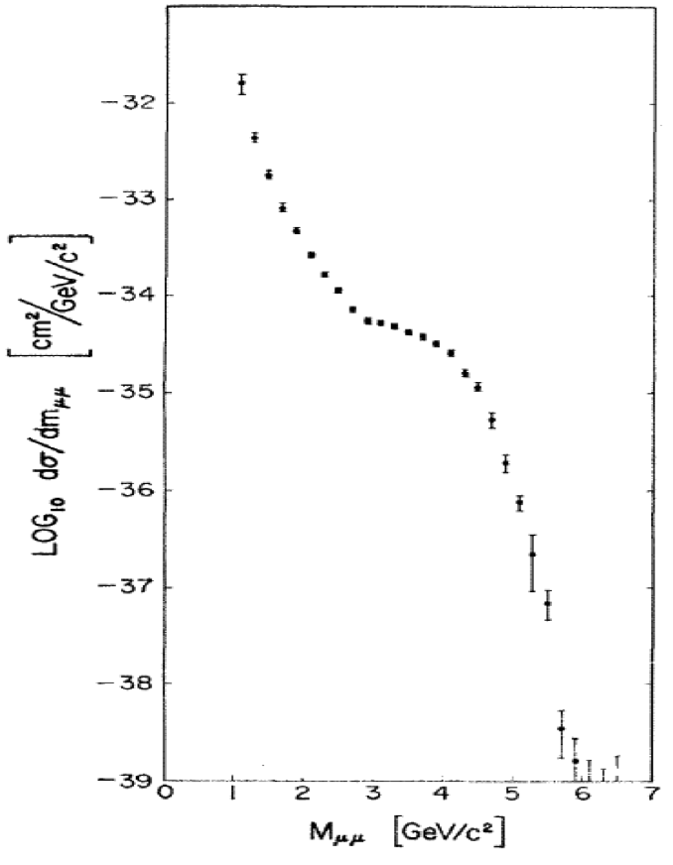
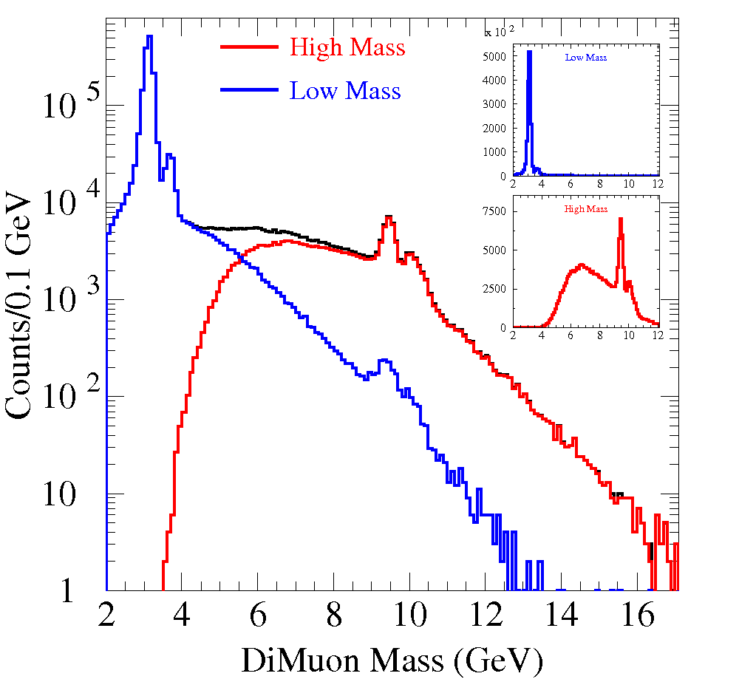
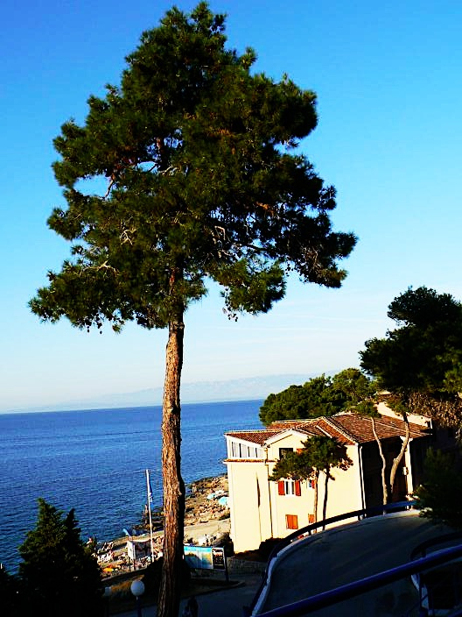
Early Muon Pair Data—soon to be called Drell-Yan
Don’t miss the tree when looking at the beautiful scenery

Slide 5
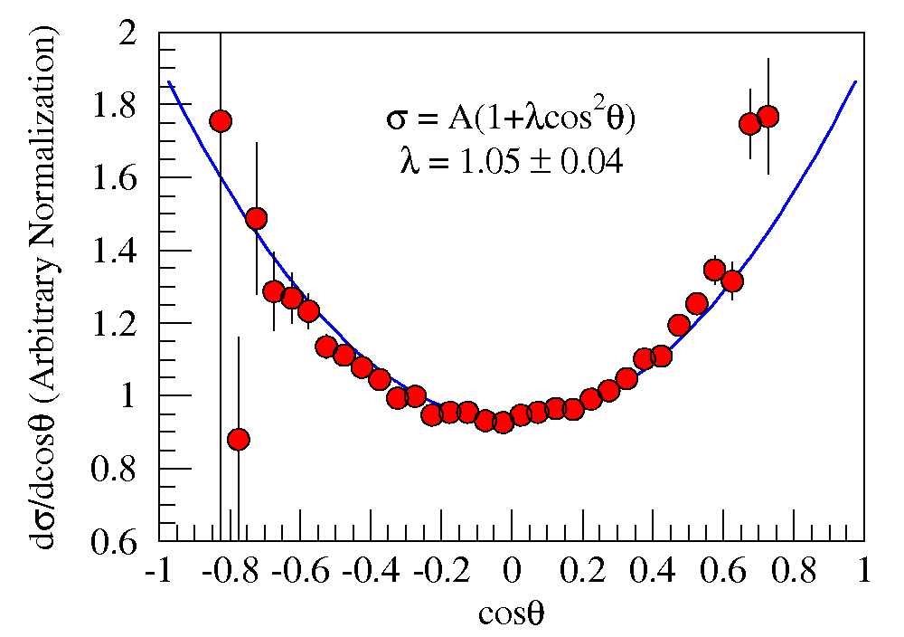
Drell and Yan’s explanation
Also predicted
λ(1+cos²θ)
angular distributions.
Fermilab E-866/NuSea
unpublished

Slide 6
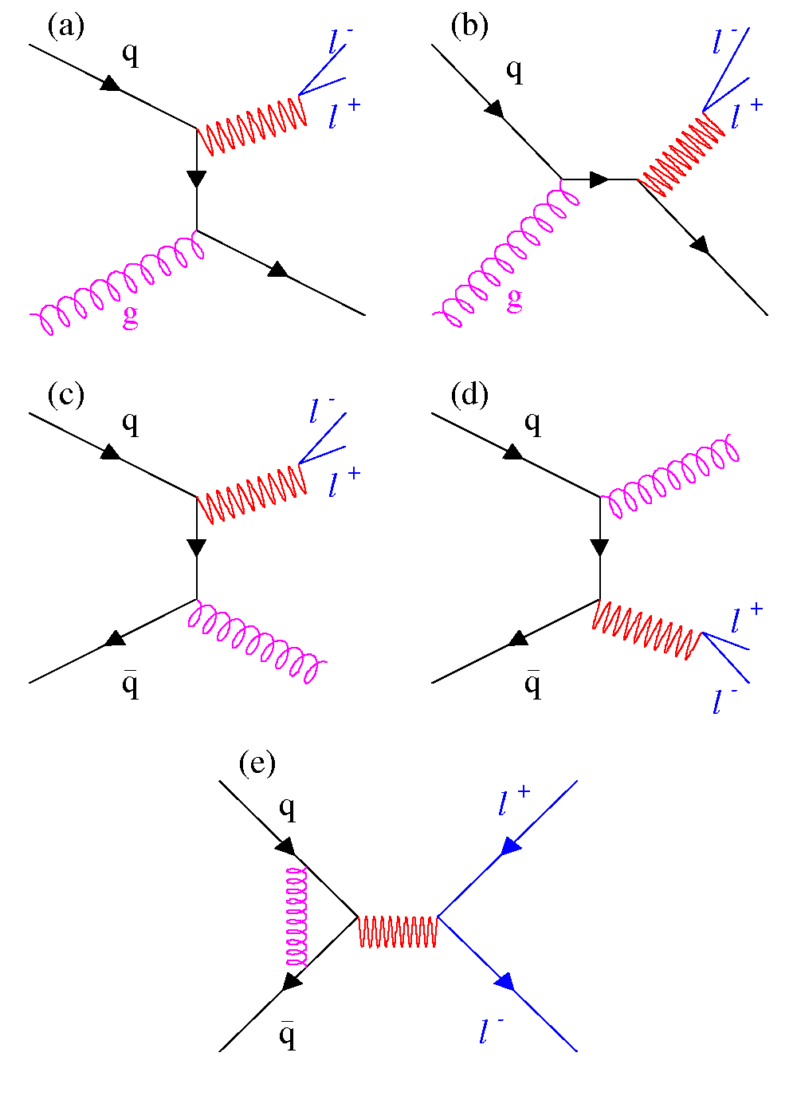
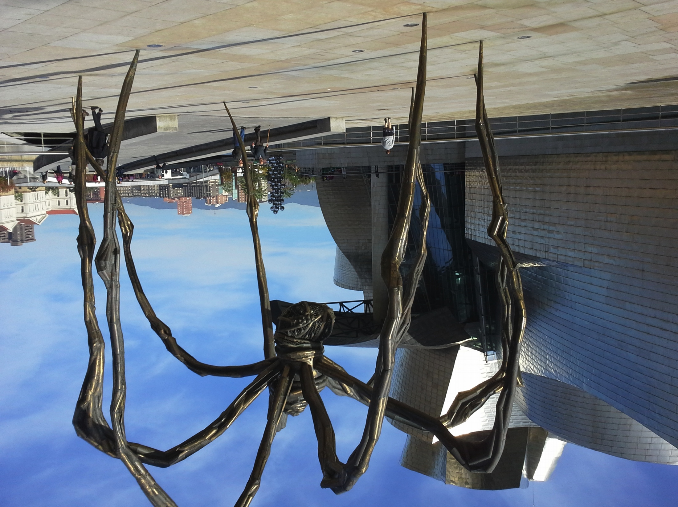
Drell-Yan Cross Section
Next-to-Leading Order
These diagrams are responsible for up to 50% of the measured cross section
Parton distributions are Universal!
Intrinsic transverse momentum of quarks (although a small effect, λ > 0.8)
Soft gluon resummation at all orders
Angular Distributions
Higher Twist??

Slide 7
Drell-Yan Cross Section
Next-to-Leading Order
These diagrams are responsible for up to 50% of the measured cross section
Parton distributions are Universal!
Intrinsic transverse momentum of quarks (although a small effect, λ > 0.8)
Soft gluon resummation at all orders
Angular Distributions
Higher Twist??

Slide 8
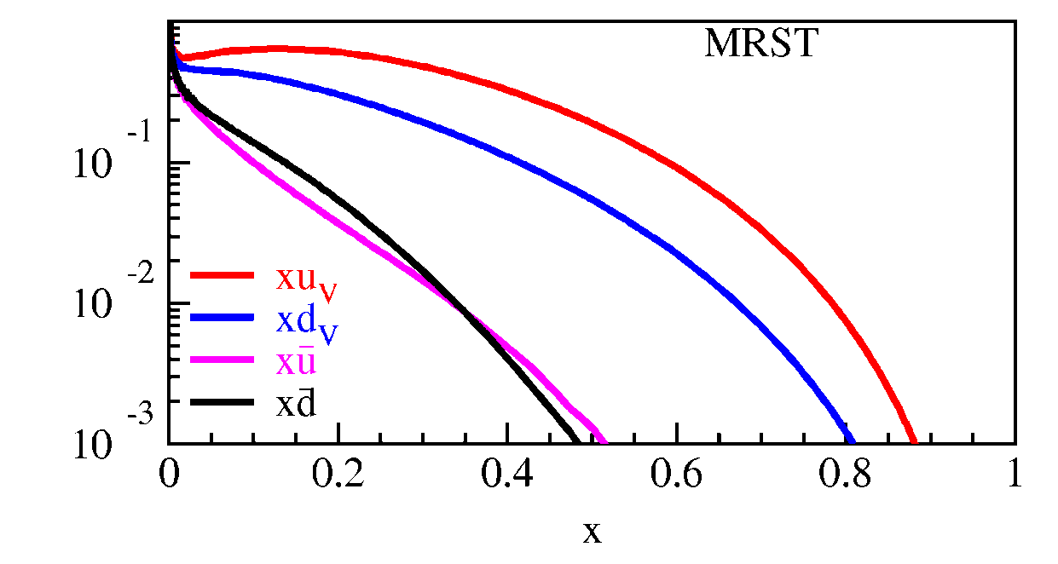
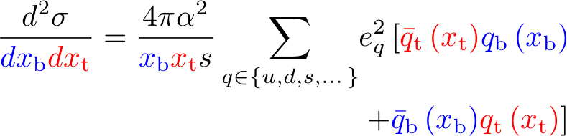
Drell-Yan Cross Section
Measured cross section is a convolution of beam and target parton distributions
Proton Beam
  Target antiquarks and beam
u-quark dominance
  (2/3)² vs. (1/3)²
x_{target}
x_{beam}

Slide 9
Drell-Yan Cross Section
Measured cross section is a convolution of beam and target parton distributions
Proton Beam
  Target antiquarks and beam
u-quark dominance
  (2/3)² vs. (1/3)²
x_{target}
x_{beam}
Acceptance limited

Slide 10
Drell-Yan Cross Section
Measured cross section is a convolution of beam and target parton distributions
Proton Beam
  Target antiquarks and beam
u-quark dominance
  (2/3)² vs. (1/3)²
x_{target}
x_{beam}
π⁻ beam
  Valence beam anti-u quark and u target quark
Acceptance limited

Slide 11
Drell-Yan Cross Section
Measured cross section is a convolution of beam and target parton distributions
Proton Beam
  Target antiquarks and beam
u-quark dominance
  (2/3)² vs. (1/3)²
x_{target}
x_{beam}
π⁻ beam
  Valence beam anti-u quark and u target quark
Acceptance limited
Beam | Target | Experiment
Hadron | Beam valence quarks target antiquarks | Fermilab E-906, RHIC (forward acpt.) J-PARC
Anti-Hadron | Beam val. antiquarks Target valence quarks | GSI-FAIR Fermilab Collider
Meson | Beam val. antiquarks Target valence quarks | COMPASS
Valence × Valence
Valence-sea ×¼
Sea-Sea

Slide 12

Unpolarized Drell-Yan—Boring?

Slide 13

Unpolarized Drell-Yan—No Exciting!!!!
Measurements of longitudinal structure of target and beam
Measurements of Boer-Mulders through angular distributions

Slide 14
Drell-Yan Cross Section
Measured cross section is a convolution of beam and target parton distributions
Proton Beam
  Target antiquarks and beam
u-quark dominance
  (2/3)² vs. (1/3)²
In leading order w/above assumptions
Suggested by Martin, Stirling and Roberts Phys.Lett. B308 (1993) 377
x_{target}
x_{beam}
Acceptance limited
Next-to-leading order terms have minimal effect on the ratio

Slide 15
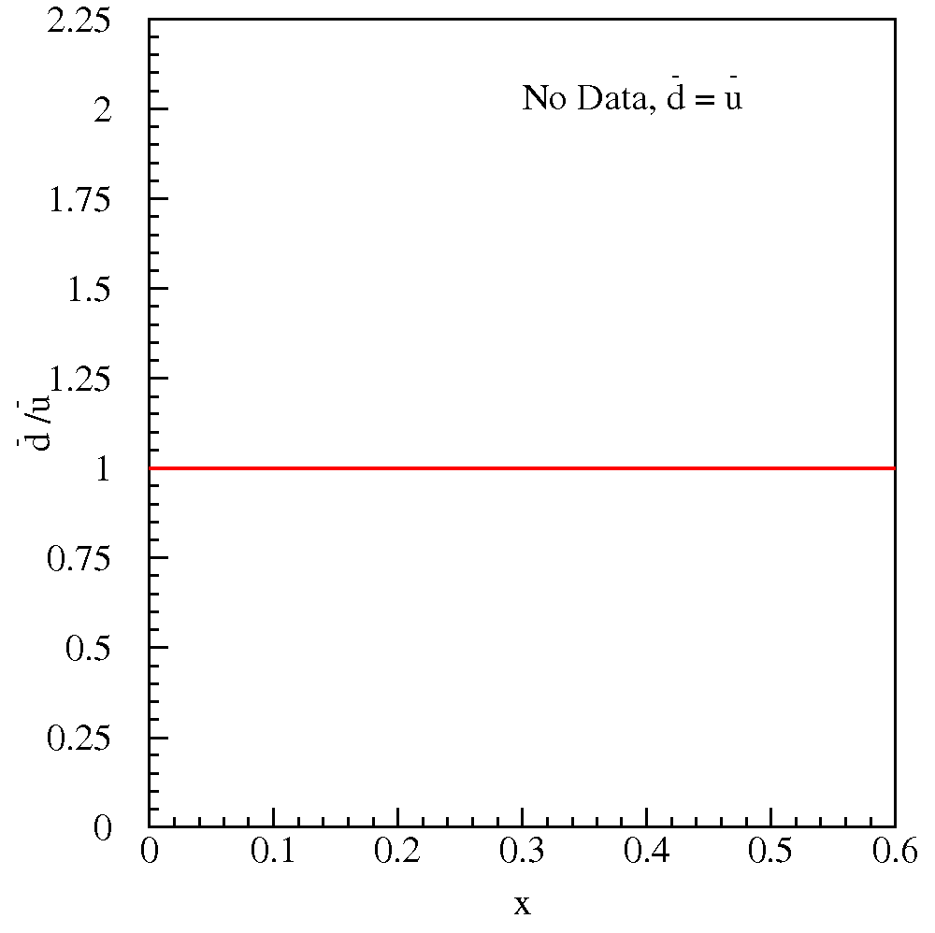
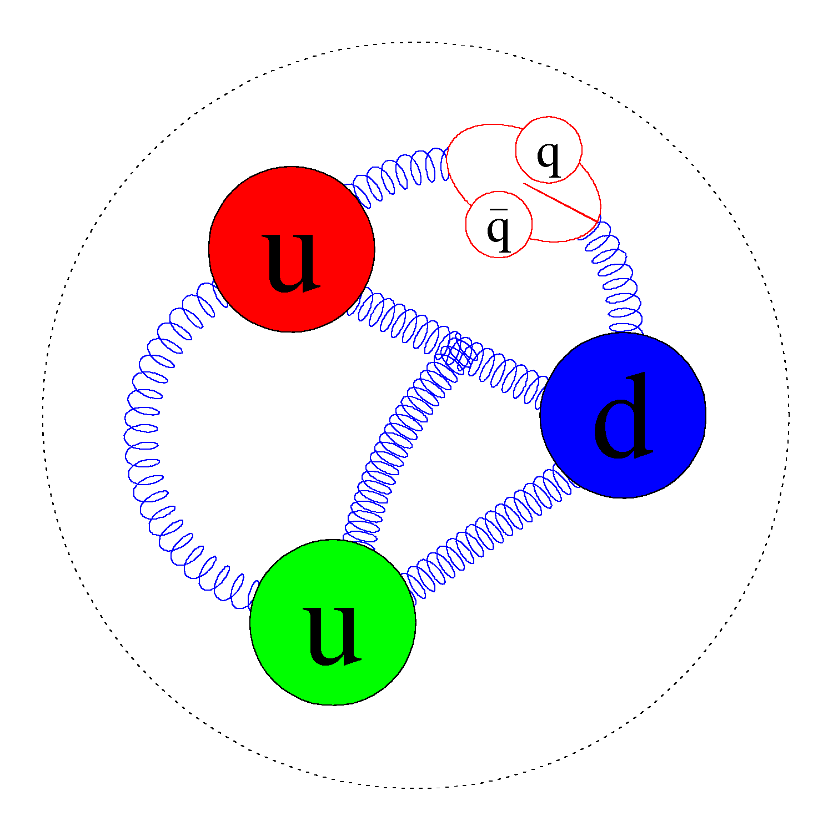
Light Antiquark Flavor Asymmetry: Brief History
Naïve Assumption:
Why shouldn’t it be
  the sea is generated by gluon splitting.
  Gluons couple to color, not flavor!

Slide 16
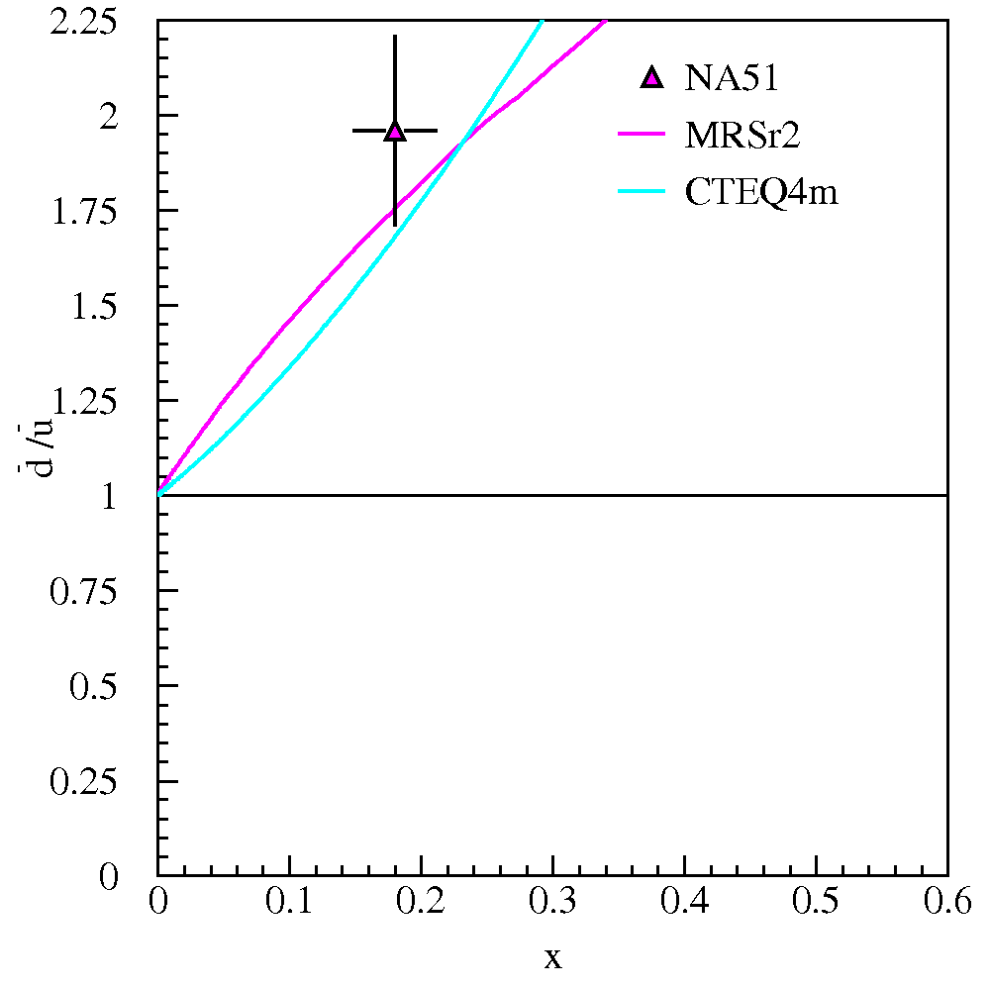
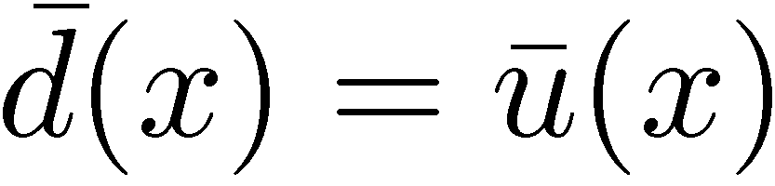
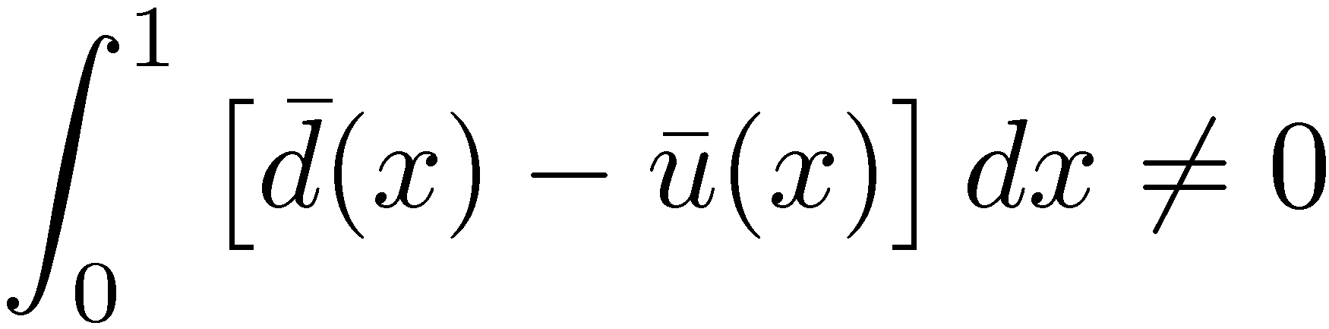
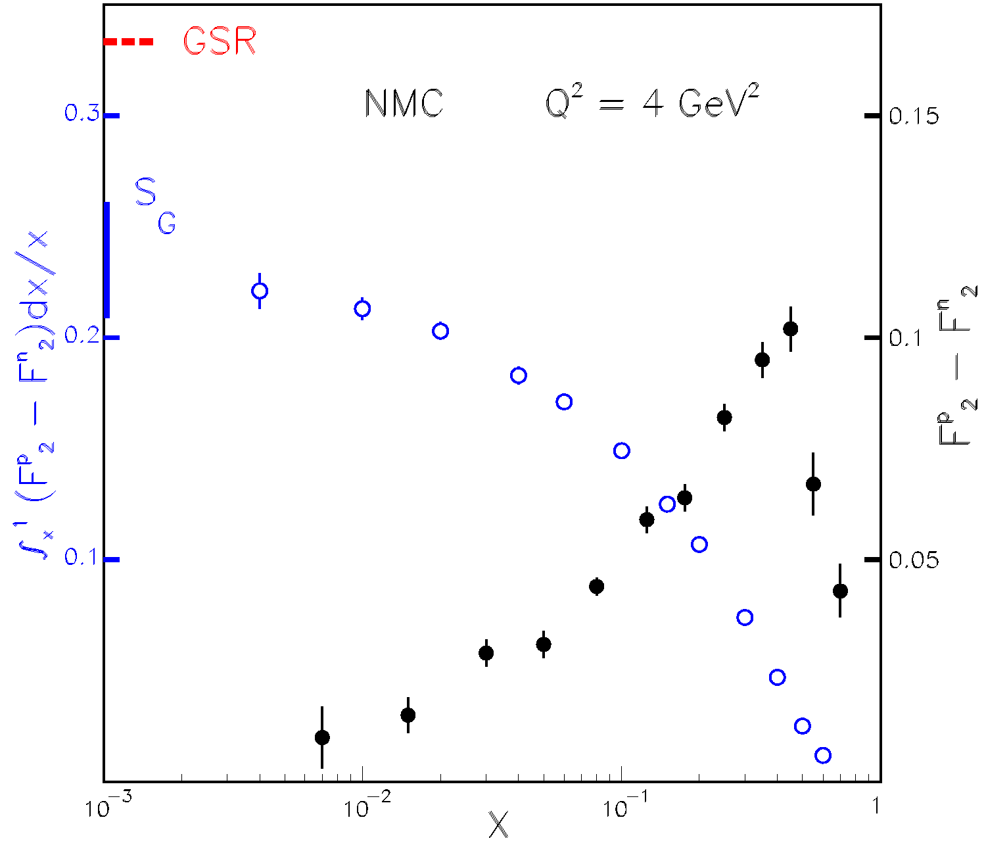
Light Antiquark Flavor Asymmetry: Brief History
Naïve Assumption:
CERN NMC (Gottfried Sum Rule)
NA 51 Drell-Yan confirms
d-bar(x) > u-bar(x)

Slide 17
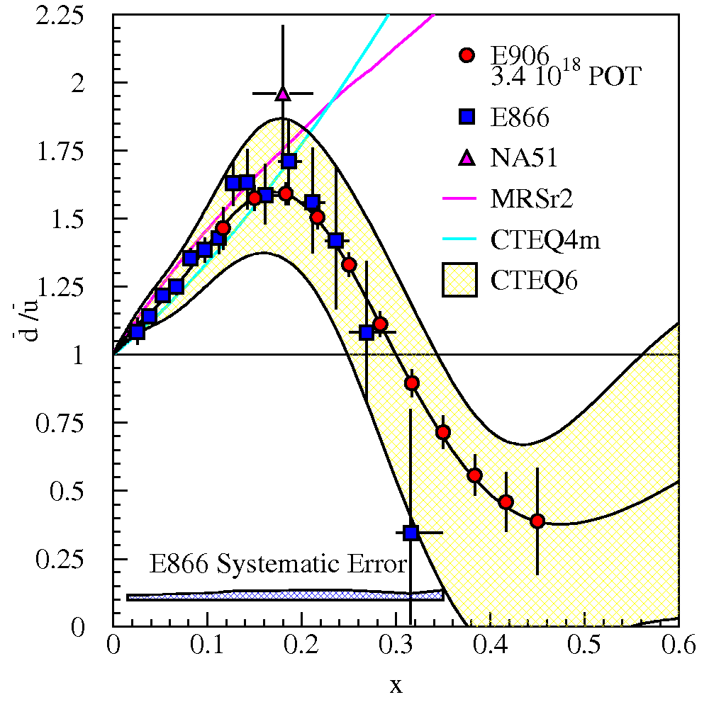


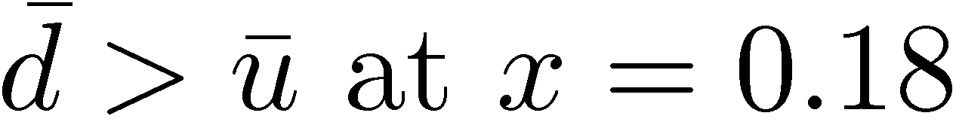
Light Antiquark Flavor Asymmetry: Brief History
Naïve Assumption:
NMC (Gottfried Sum Rule)
NA51 (Drell-Yan)
E866/NuSea (Drell-Yan)
Knowledge of sea dist. are data driven
  Sea quark distributions are difficult for Lattice QCD
Non perturbative QCD models can explain excess d-bar quarks, but not return to symmetry or deficit of d-bar quarks

Slide 18
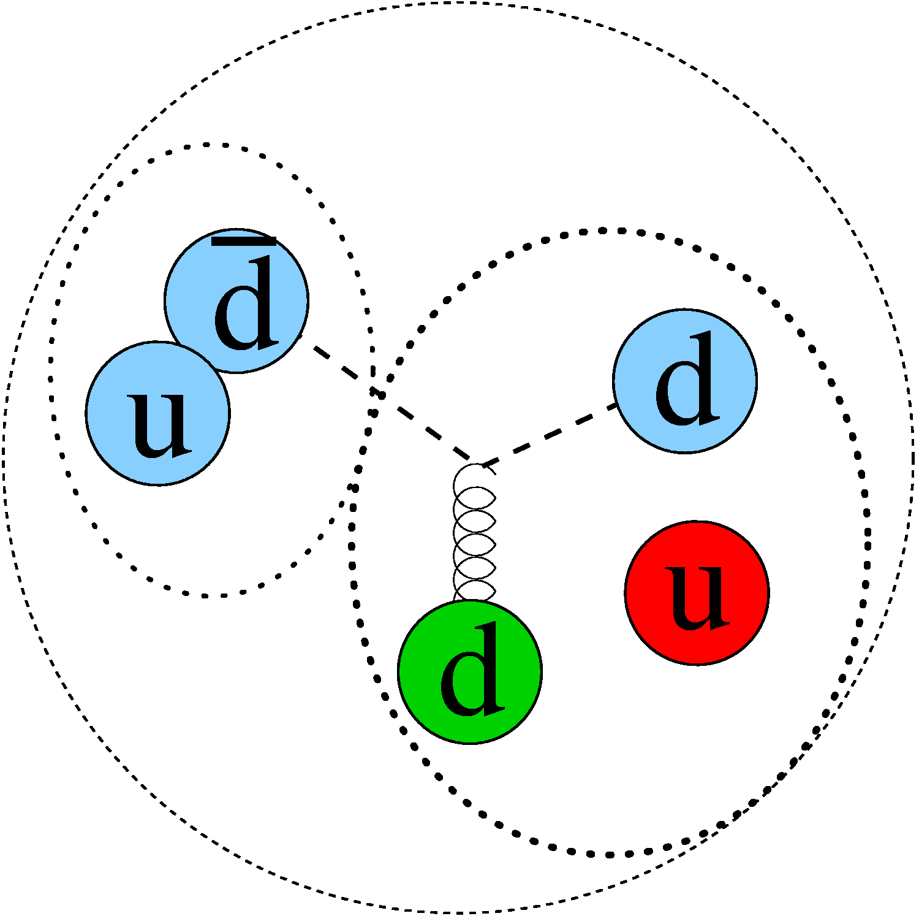
Light Antiquark Flavor Asymmetry: Brief History
Non perturbative QCD models can explain excess d-bar quarks, but not return to symmetry or deficit of d-bar quarks
+

Slide 19
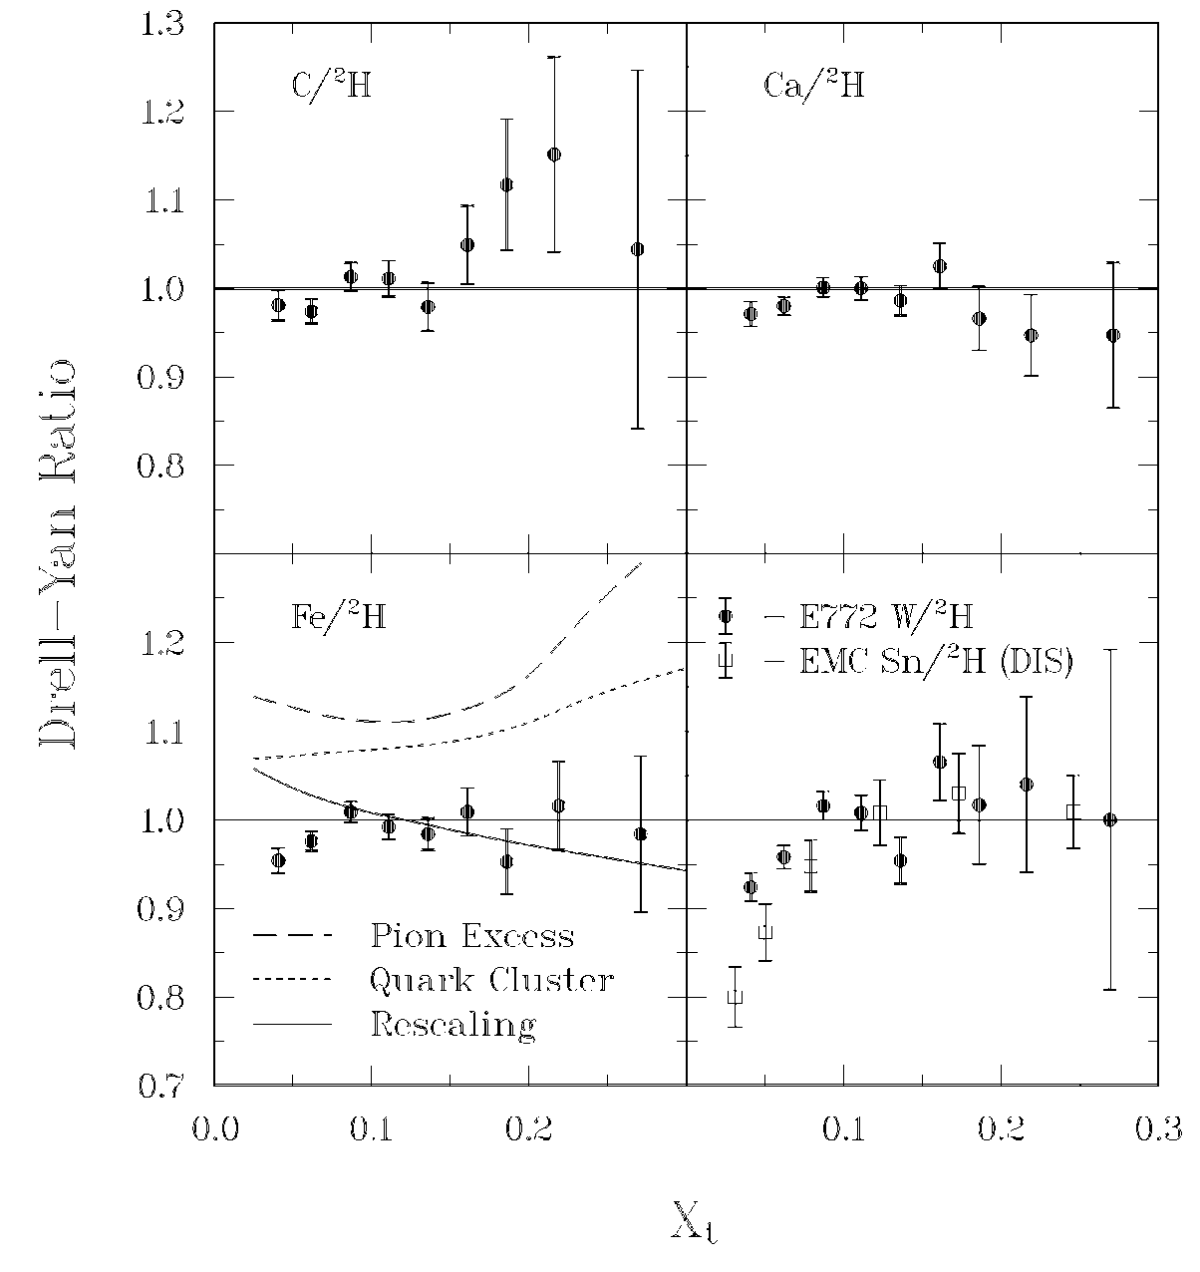
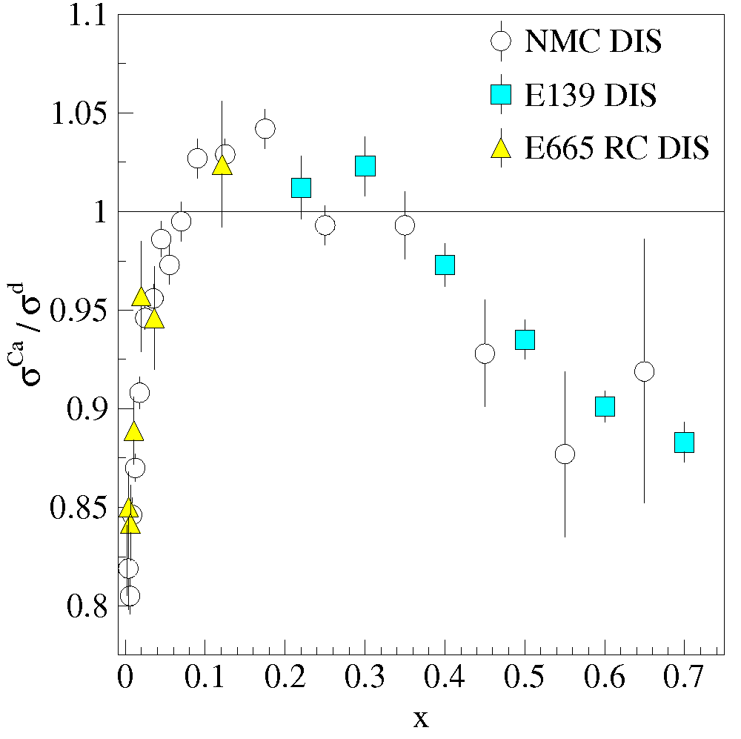
Structure of nucleonic matter:
How do sea quark distributions differ in a nucleus?
Comparison with
Deep Inelastic Scattering (DIS)
EMC: Parton distributions of bound and free nucleons are different.
Antishadowing not seen in Drell-Yan—Valence only effect
Alde et al (Fermilab E772) Phys. Rev. Lett. 64 2479 (1990)

Slide 20
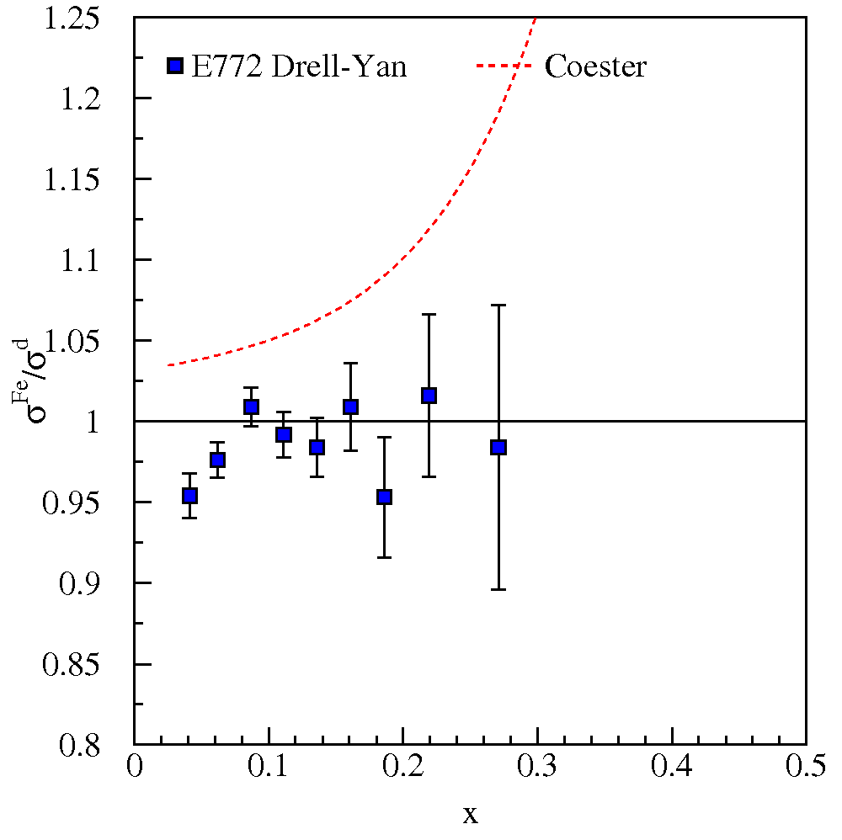
Structure of nucleonic matter: Where are the nuclear pions?
The binding of nucleons in a nucleus is expected to be governed by the exchange of virtual “Nuclear” mesons (pions).
No antiquark enhancement seen in Drell-Yan (Fermilab E772) data.
Notes:
George Bertsch in Science: Where are the nuclear pions? Answers in terms of Gluonic fields
Berger and Coester: Standard nuclear convolution:
F_2^A = \int dy f_N^A(y) F_2^N(x/y) + \int dy f_\pi^A(y) F_2^\pi(x/y)
where the F_2’s are the DIS structure functions of the nucleus, nucleon and pion and f_N/\pi^A are the nucleon/pion distribution functions. Other baryons are added as well and all is subject to conservation rules on baryon number and small f’s have total momentum conservation rules
Jung and Miller: Start with Berger and Coester, but uses different pionic distribution function in nucleus from Ericson and Thomas—points out that Berger and Coester should have used a light cone rather that instant-(time) form nuclear wave function.
Brown et al.: Brown, Rho rescaling—inside a nuclear environment masses of hadron composed of light quarks all decrease with density (at the same rate—see eqn 2.23). The rescaling is based on a partial restoration of Chiral Symmetry. This the also effects the coupling strengths. Based on this, one obtains a modified pion density distribution and follows the convolution model of Berger and Coester.
Dieperink and Korpa: First, range of curves is for various Migdal parameters. Looks at real and imaginary parts of particle-hole (nucleon-hole?) and \Delta-hole contributions. Also look at the self-energy of the pion propagator. The dressed pion propagator included nucleon and \Delta terms. These affect the pion distribution function (f_pi)

Slide 21
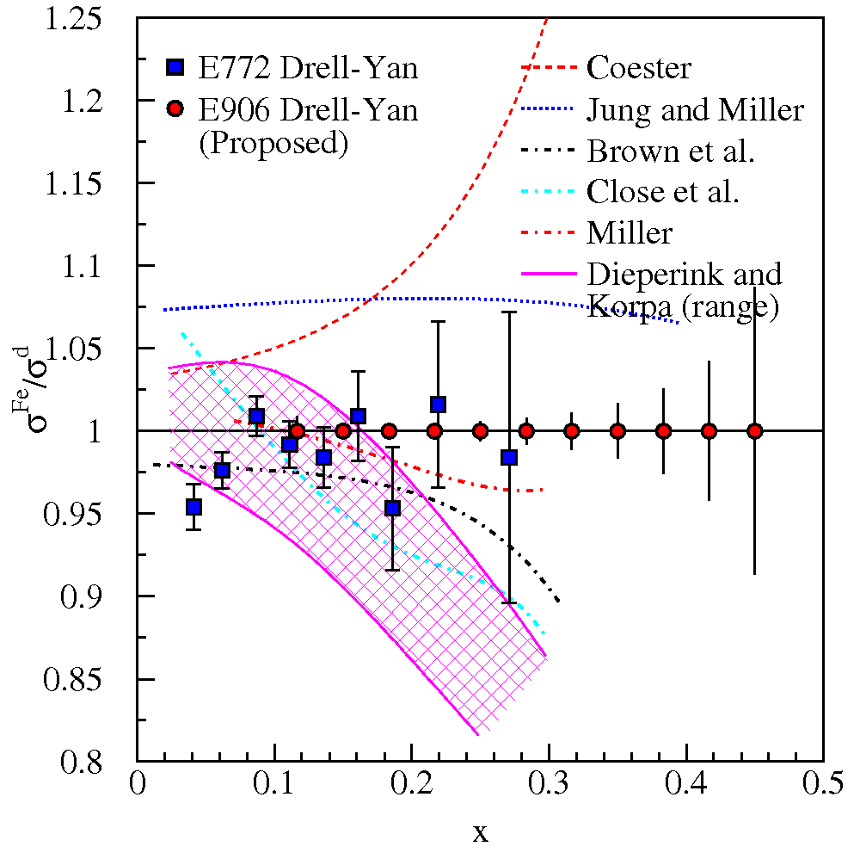
Structure of nucleonic matter: Where are the nuclear pions?
The binding of nucleons in a nucleus is expected to be governed by the exchange of virtual “Nuclear” mesons.
No antiquark enhancement seen in Drell-Yan (Fermilab E772) data.
Contemporary models predict large effects to antiquark distributions as x increases.
Models must explain both DIS-EMC effect and Drell-Yan
Notes:
George Bertsch in Science: Where are the nuclear pions? Answers in terms of Gluonic fields
Berger and Coester: Standard nuclear convolution:
F_2^A = \int dy f_N^A(y) F_2^N(x/y) + \int dy f_\pi^A(y) F_2^\pi(x/y)
where the F_2’s are the DIS structure functions of the nucleus, nucleon and pion and f_N/\pi^A are the nucleon/pion distribution functions. Other baryons are added as well and all is subject to conservation rules on baryon number and small f’s have total momentum conservation rules
Jung and Miller: Start with Berger and Coester, but uses different pionic distribution function in nucleus from Ericson and Thomas—points out that Berger and Coester should have used a light cone rather that instant-(time) form nuclear wave function.
Brown et al.: Brown, Rho rescaling—inside a nuclear environment masses of hadron composed of light quarks all decrease with density (at the same rate—see eqn 2.23). The rescaling is based on a partial restoration of Chiral Symmetry. This the also effects the coupling strengths. Based on this, one obtains a modified pion density distribution and follows the convolution model of Berger and Coester.
Dieperink and Korpa: First, range of curves is for various Migdal parameters. Looks at real and imaginary parts of particle-hole (nucleon-hole?) and \Delta-hole contributions. Also look at the self-energy of the pion propagator. The dressed pion propagator included nucleon and \Delta terms. These affect the pion distribution function (f_pi)

Slide 22
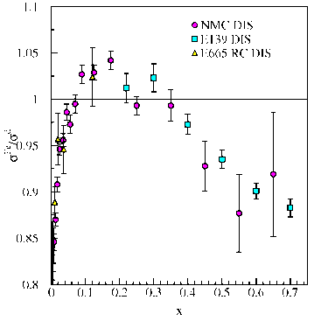
Pionic Parton Distributions: Why are should you be interested in the pion?
Explains quark asymmetry in nucleon sea.
Key role in nuclear binding and structure
Simple quark-antiquark system (valence).
  Should have an easy theoretical interpretation.
  What about mass—constituent quark mass ≈300 MeV each?
QCD’s Goldstone Boson
How do we treat 3 and 4 in a unified way?
Models predict different behavior as x→1
At some base Q₀
pQCD: xq(x)/ (1-x)^{β} β = 2
NJL: xq(x)/ (1-x)^{β} β = 1
DSE: xq(x)/ (1-x)^{β} β ~ 1.9
Evolution to experimental Q increases β.

Slide 23
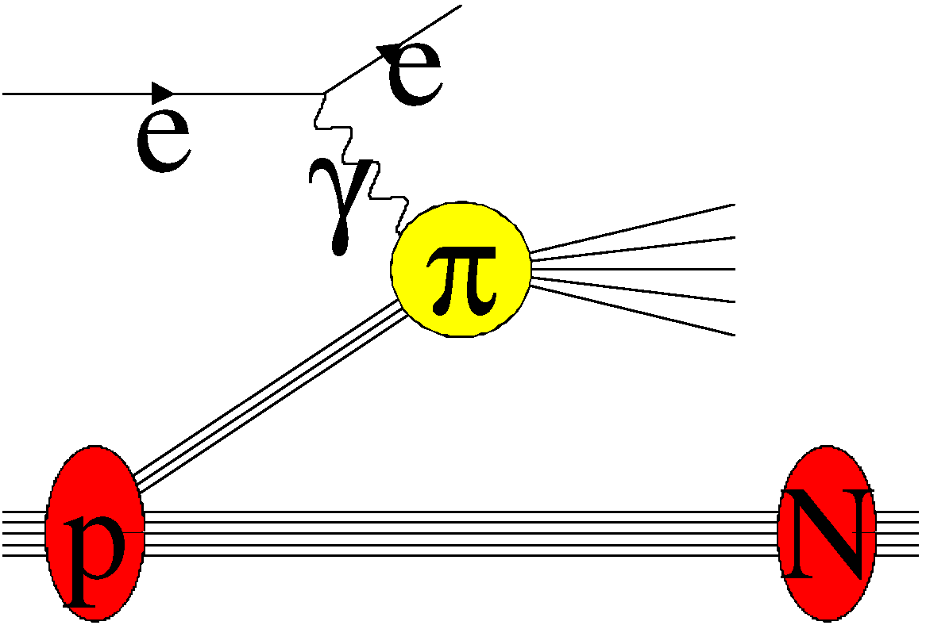
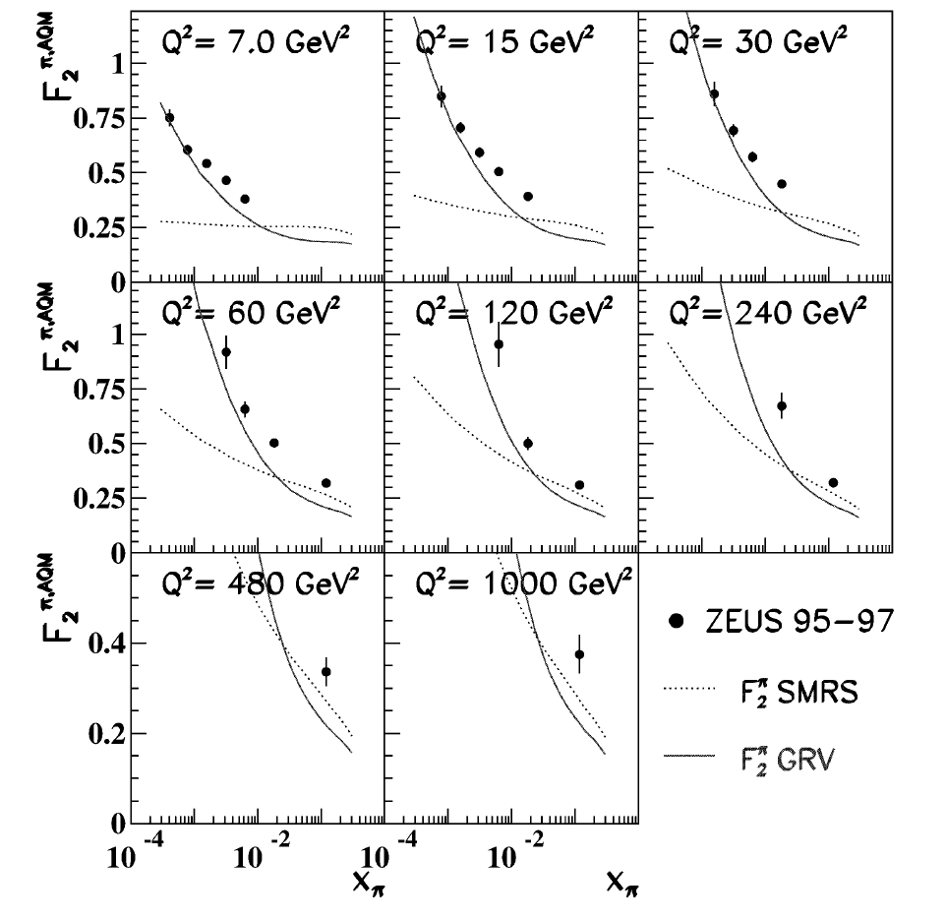
Pionic Parton Distributions: Why are should you be interested in the pion?
Explains quark asymmetry in nucleon sea.
Key role in nuclear binding and structure
Simple quark-antiquark system (valence).
  Should have an easy theoretical interpretation.
  What about mass—constituent quark mass ≈300 MeV each?
QCD’s Goldstone Boson
  “Pion targets are not abundant” Hecht
  DIS on virtual pions:
    ep→eNx HERA data [ZEUS, NPB637 3 (2002)]
    Possible JLab and EIC.
How do we treat 3 and 4 in a unified way?
Models predict different behavior as x→1
At some base Q₀
pQCD: xq(x)/ (1-x)^{β} β = 2
NJL: xq(x)/ (1-x)^{β} β = 1
DSE: xq(x)/ (1-x)^{β} β ~ 1.9
Evolution to experimental Q increases β.

Slide 24
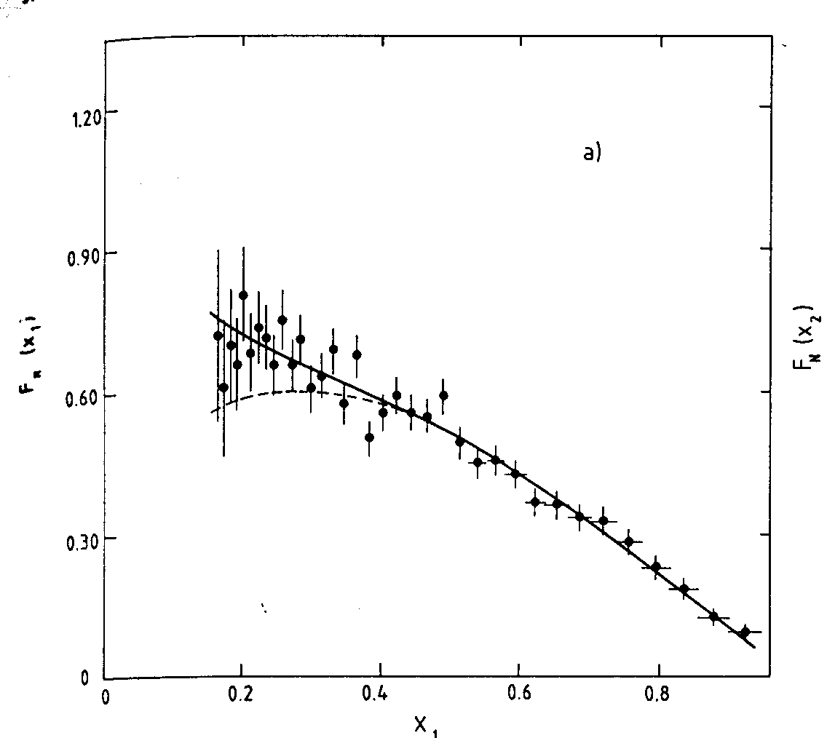
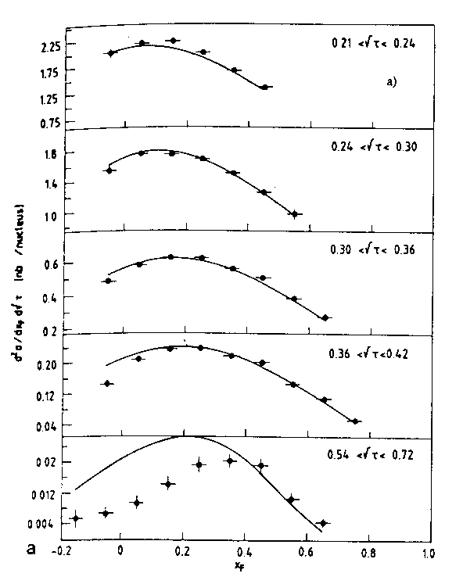
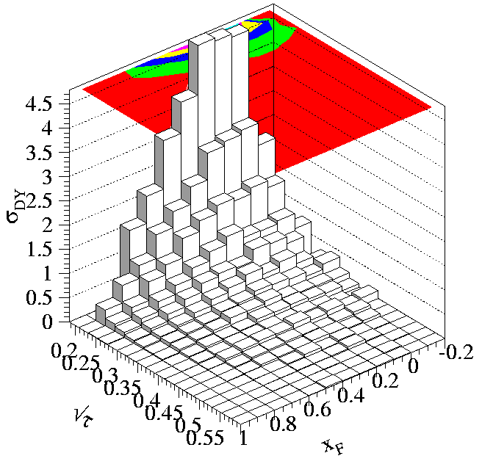
Pion Drell-Yan Data: CERN NA3 (π⁺) NA10 (π⁻)
CERN NA3 200 GeV π⁻ data (also have 150 and 180 GeV π⁻ and 200 GeV π⁺ data).
Fermilab E-615 π⁻ data
CERN NA10 194 GeV π⁻ data

Slide 25
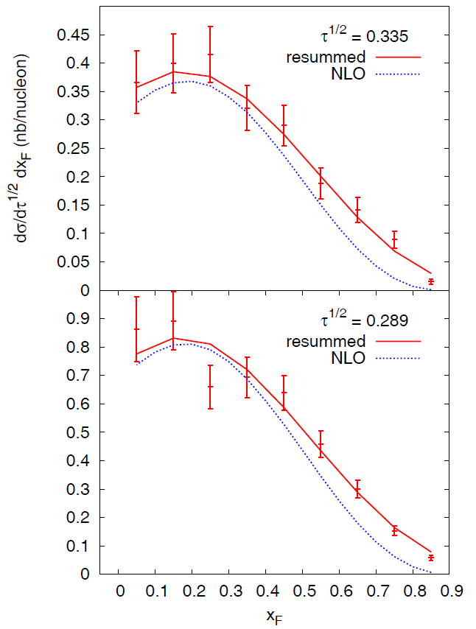
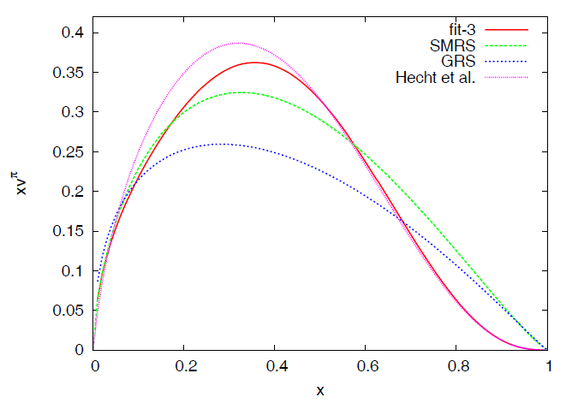
Soft Gluon Resummation
β = 2.03 ±0.06
QCD and Dyson-Schwinger survive!
pQCD: xq(x)/ (1-x)^{β} β = 2
DSE: xq(x)/ (1-x)^{β} β ~ 1.9
Caveat: Better data would really help establish this.

Slide 26
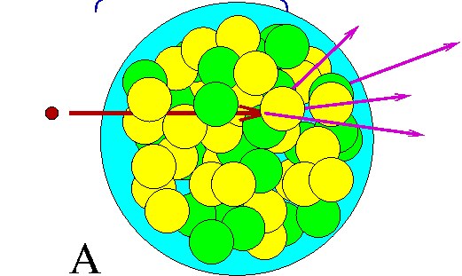
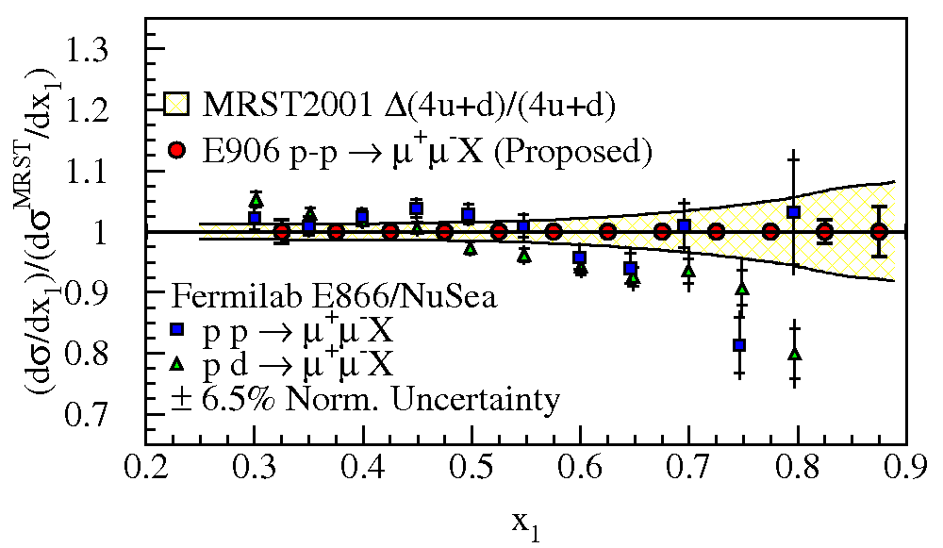
Longitudinal Structure: Other topics
Partonic energy loss
  quarks traveling through cold, strongly interacting mater
  Are antiquarks the same?
Large-x proton parton distributions
Longitudinal Structure: What
data would I like to see? (My personal view)
Proton deuterium Drell-Yan ratios –dbar/ubar
  Fermilab E-906/SeaQuest
Deuterium/A ratios—EMC and nuclear binding
  Fermilab E-906/SeaQuest
Unpolarized π-p Drell-Yan—nature of Goldstone Boson
  CERN Compass
  K-p Drell-Yan (another test of low energy QCD)
Double Polarized Drell-Yan—Δq(x) nice complement for SIDIS and W±
  CERN Compass, J-PARC, RHIC

Slide 27
Transverse Momentum Distributions: Introduction
Survive k_{T} integration
Sivers' Function
k_{T} - dependent, T-even
k_{T} - dependent,
NaiveT-odd
Boer-Mulders Function

Slide 28
Transverse Momentum Distributions: Introduction
Survive k_{T} integration
Sivers' Function
k_{T} - dependent, T-even
k_{T} - dependent,
NaiveT-odd
Boer-Mulders Function

Slide 29
Generalized Angular Distributions & Lam Tung relation
Chi-Sing Lam and Wu-Ki Tung—basic formula for lepton pair production angular distributions PRD 18 2447 (1978)
Structure function formalism
Derived in analogy to DIS
Independent of Drell-Yan and parton “models”
Showed same relations follow as a general consequence of the quark-parton model
Lam-Tung relation
Derived in analogy to Colin-Gross relation of DIS

Slide 30
Generalized Angular Distributions & Lam Tung relation
Chi-Sing Lam and Wu-Ki Tung—basic formula for lepton pair production angular distributions PRD 18 2447 (1978)
Structure function formalism
Derived in analogy to DIS
Independent of Drell-Yan and parton “models”
Showed same relations follow as a general consequence of the quark-parton model
Lam-Tung relation
Derived in analogy to Colin-Gross relation of DIS

Slide 31
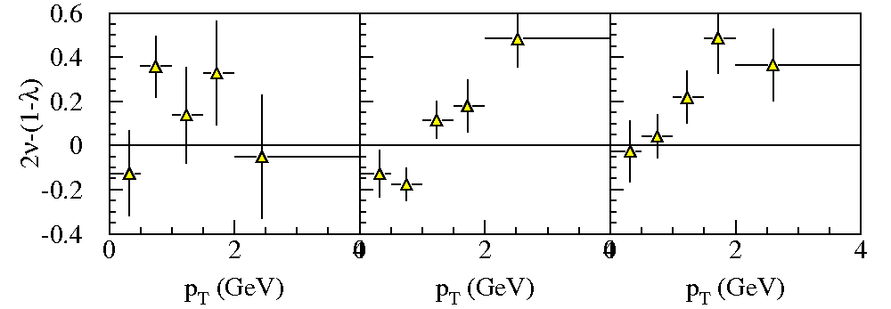
NA10 Lam-Tung Relation vs. p_{T}
140 GeV
194 GeV
286 GeV
Large statistical uncertainty
Violation of Lam-Tung relation as p_{T} increases in higher momentum data. Statistics poor in 140 GeV data.
Since most data is at low p_{T}, on average the Lam-Tung relationship holds
For all three energies λ ~1 and ν > 0
Note: Correlation between λ and ν uncertainties not considered.

Slide 32
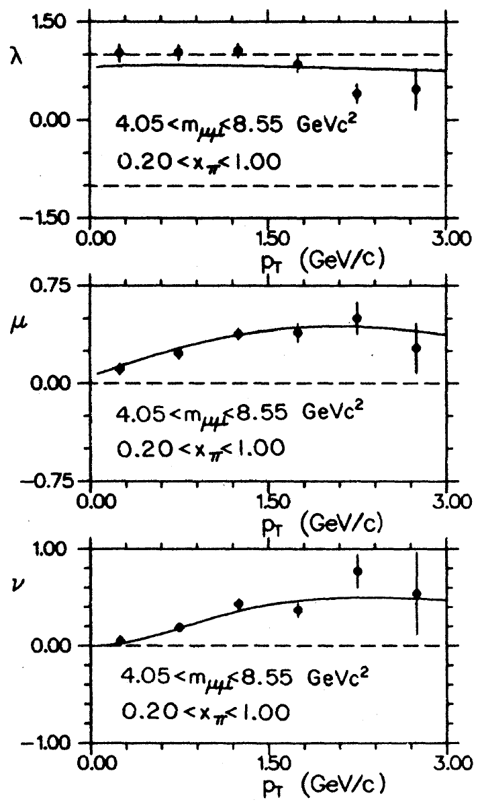
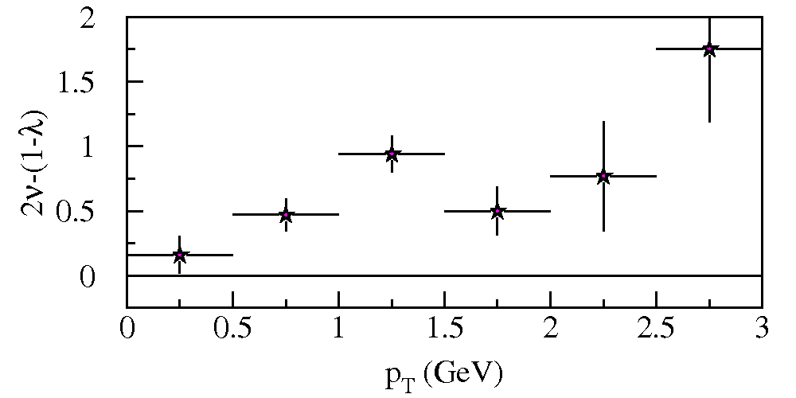
Pionic Data Fermilab E615
Significant non-zero ν coefficient
Shows other kinematic dependencies
Conway et al. PRD 39 92 (1989)
Clear violation of Lam-Tung Relation vs. p_{T}.
Violation larger than NA10

Slide 33
Why is Lam-Tung relation important? What does it have to do with Transverse Momentum?
Lam-Tug Relation is theoretically robust?
  Unaffected by O(α_{s}) (NLO) corrections
  NNLO [O(α_{s}²)] corrections also small Mirkes and Ohnemus, PRD 51 4891 (1995)
  Soft Gluon Resummation–Berger, Qiu and Rodrigues-Pedraza showed that the Lam-Tung relation is preserved under resummation. arXiv:0707.3150, and PRD 76 074006 (2007)
k_{T} dependent transverse momentum distribution (Boer Mulders h₁┴)
Factorization breaking QCD Vacuum
Alternatives:
  Nuclear effects
  Higher-Twist effects from quark-antiquark binding in pion
  Neither seen in data

Slide 34
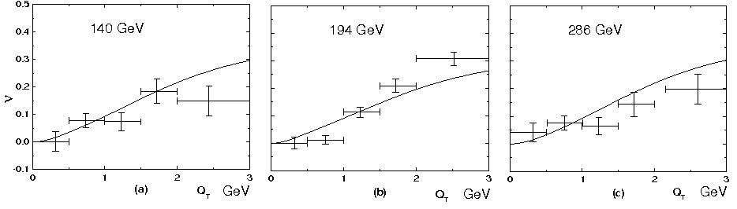
Boer-Mulders Structure Function
Relates transverse spin and transverse momentum (k_{T}) in an unpolarized nucleon.
Presence in both quark and antiquark in annihilation could form correlation contributing to cos(2φ) distribution
Reasonable fits to pionic data
194 GeV NA10
Boer PRD 60 014012 (1999)
Lu, Ma, PLB 615, 200 (2005)

Slide 35
Lam-Tung Relation—Alternative View: QCD effects
Factorization breaking Brandenburg, Nachtmann and Mirkes, ZPC 60, 679 (1993).
  QCD Vacuum may correlate the spins and momenta of incoming partons
  Effect could be instanton-induced Boer, Brandenburg, Nachtmann, Utermann, EPJC 40 55 (2005), Brandenburg, Ringwald, Utermann NPB 754, 107 (2006).
NA10 194 GeV data
  Fit NA10:
    κ = 0.17
    m_{T} = 1.5
Should be flavor blind and seen in both sea and valence distributions

Slide 36
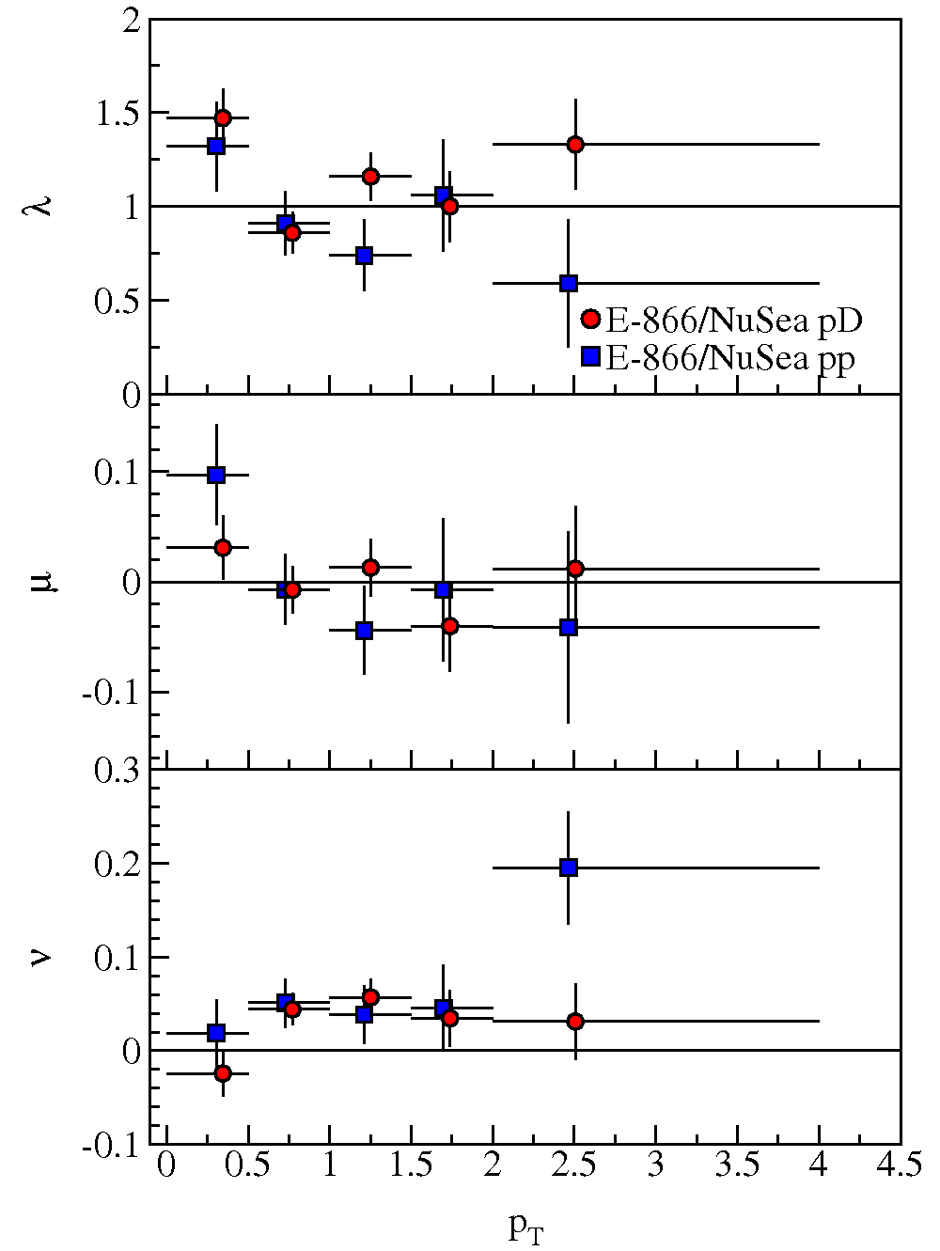
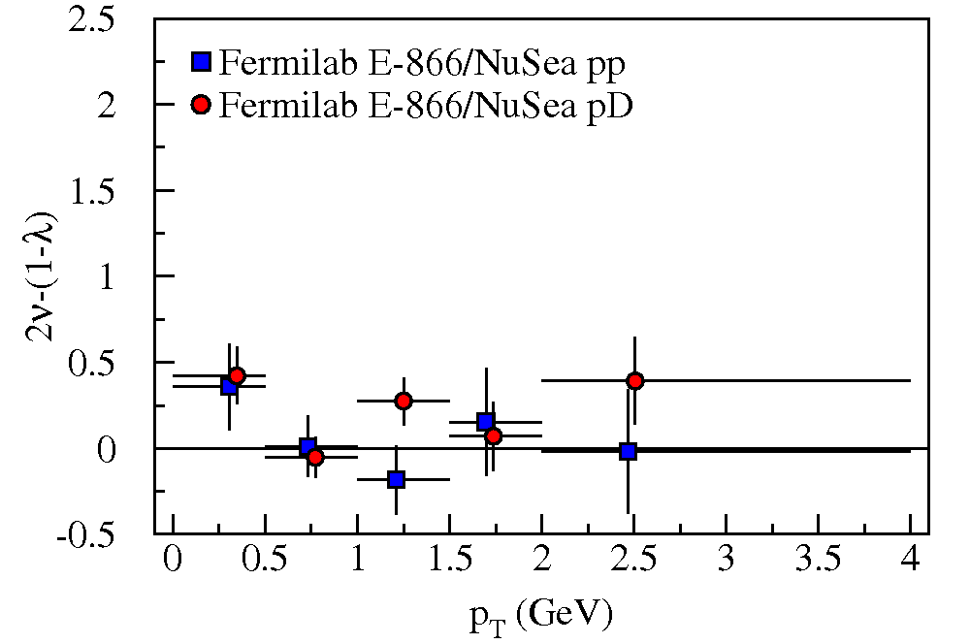
Protonic Drell-Yan
E-866/NuSea: Angular distrib.
λ consistent with 1
μ consistent with 0
ν consistent with 0 (or slightly positive)

Slide 37
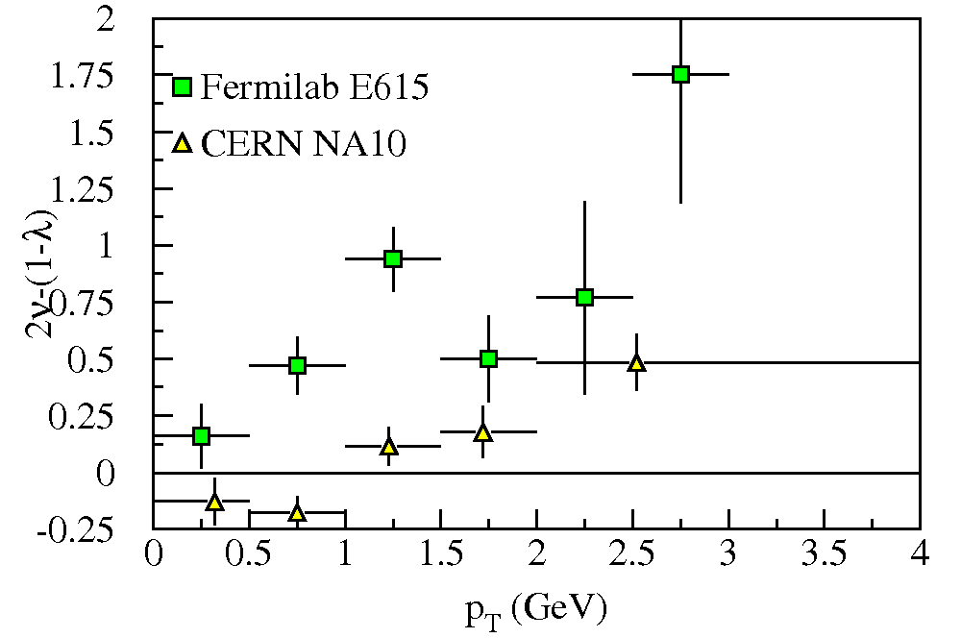
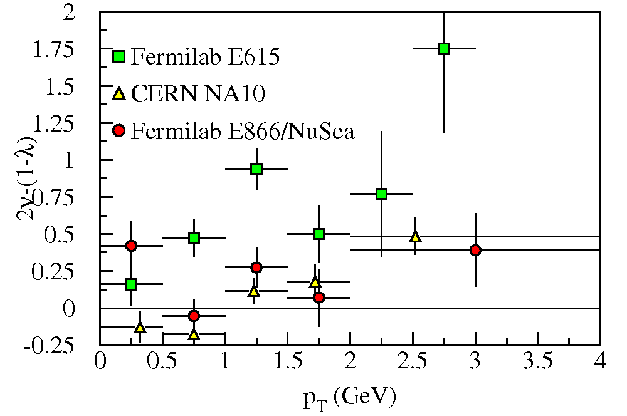
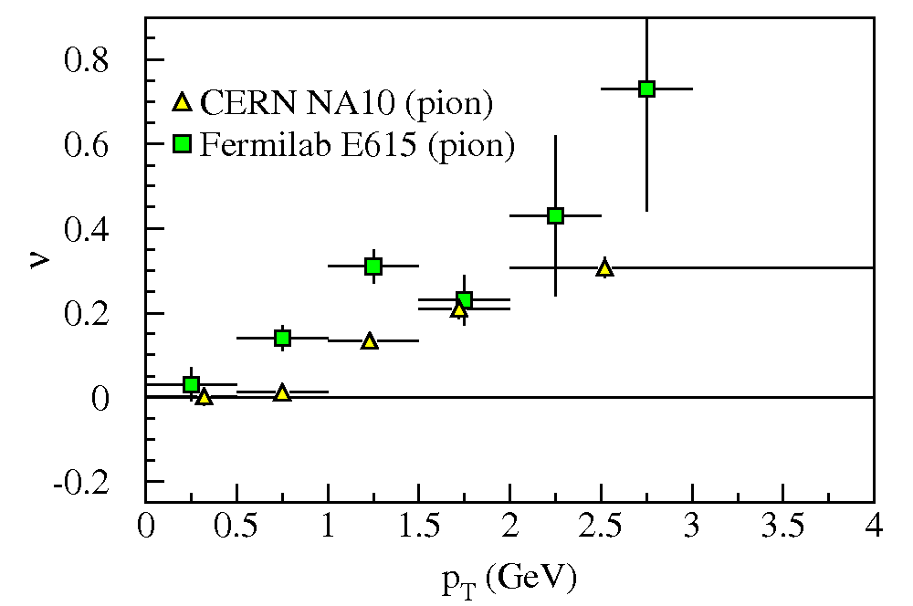
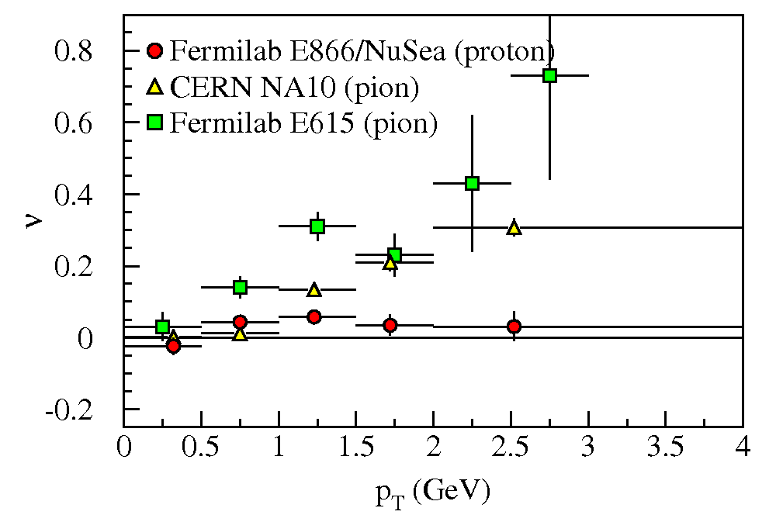
Lam-Tung Relation
π⁻ Drell-Yan
  Violates L-T relation
  Large ν (cos2φ) dependence
  Strong with p_{T}

Slide 38
Lam-Tung Relation
π⁻ Drell-Yan
  Violates L-T relation
  Large ν (cos2φ) dependence
  Strong with p_{T}
Proton Drell-Yan
  Consistent with L-T relation
  No ν (cos2φ) dependence
  No p_{T} dependence

Slide 39
Lam-Tung Relation
π⁻ Drell-Yan
  Violates L-T relation
  Large ν (cos2φ) dependence
  Strong with p_{T}
Proton Drell-Yan
  Consistent with L-T relation
  No ν (cos2φ) dependence
  No p_{T} dependence
With Boer-Mulders function h₁┴:
  ν π-W → µ⁺µ⁻X
    valence h₁┴(π) * valence h₁┴(p)
  ν pd → µ⁺µ⁻X
    valence h₁┴(p) * sea h₁┴(p)
Consistent story but need better statistics
  π-p → µ⁺µ⁻X—CERN Compass
  pd → µ⁺µ⁻X—Fermilab E906/SeaQuest
Remember QCD effects are important too!!

Slide 40
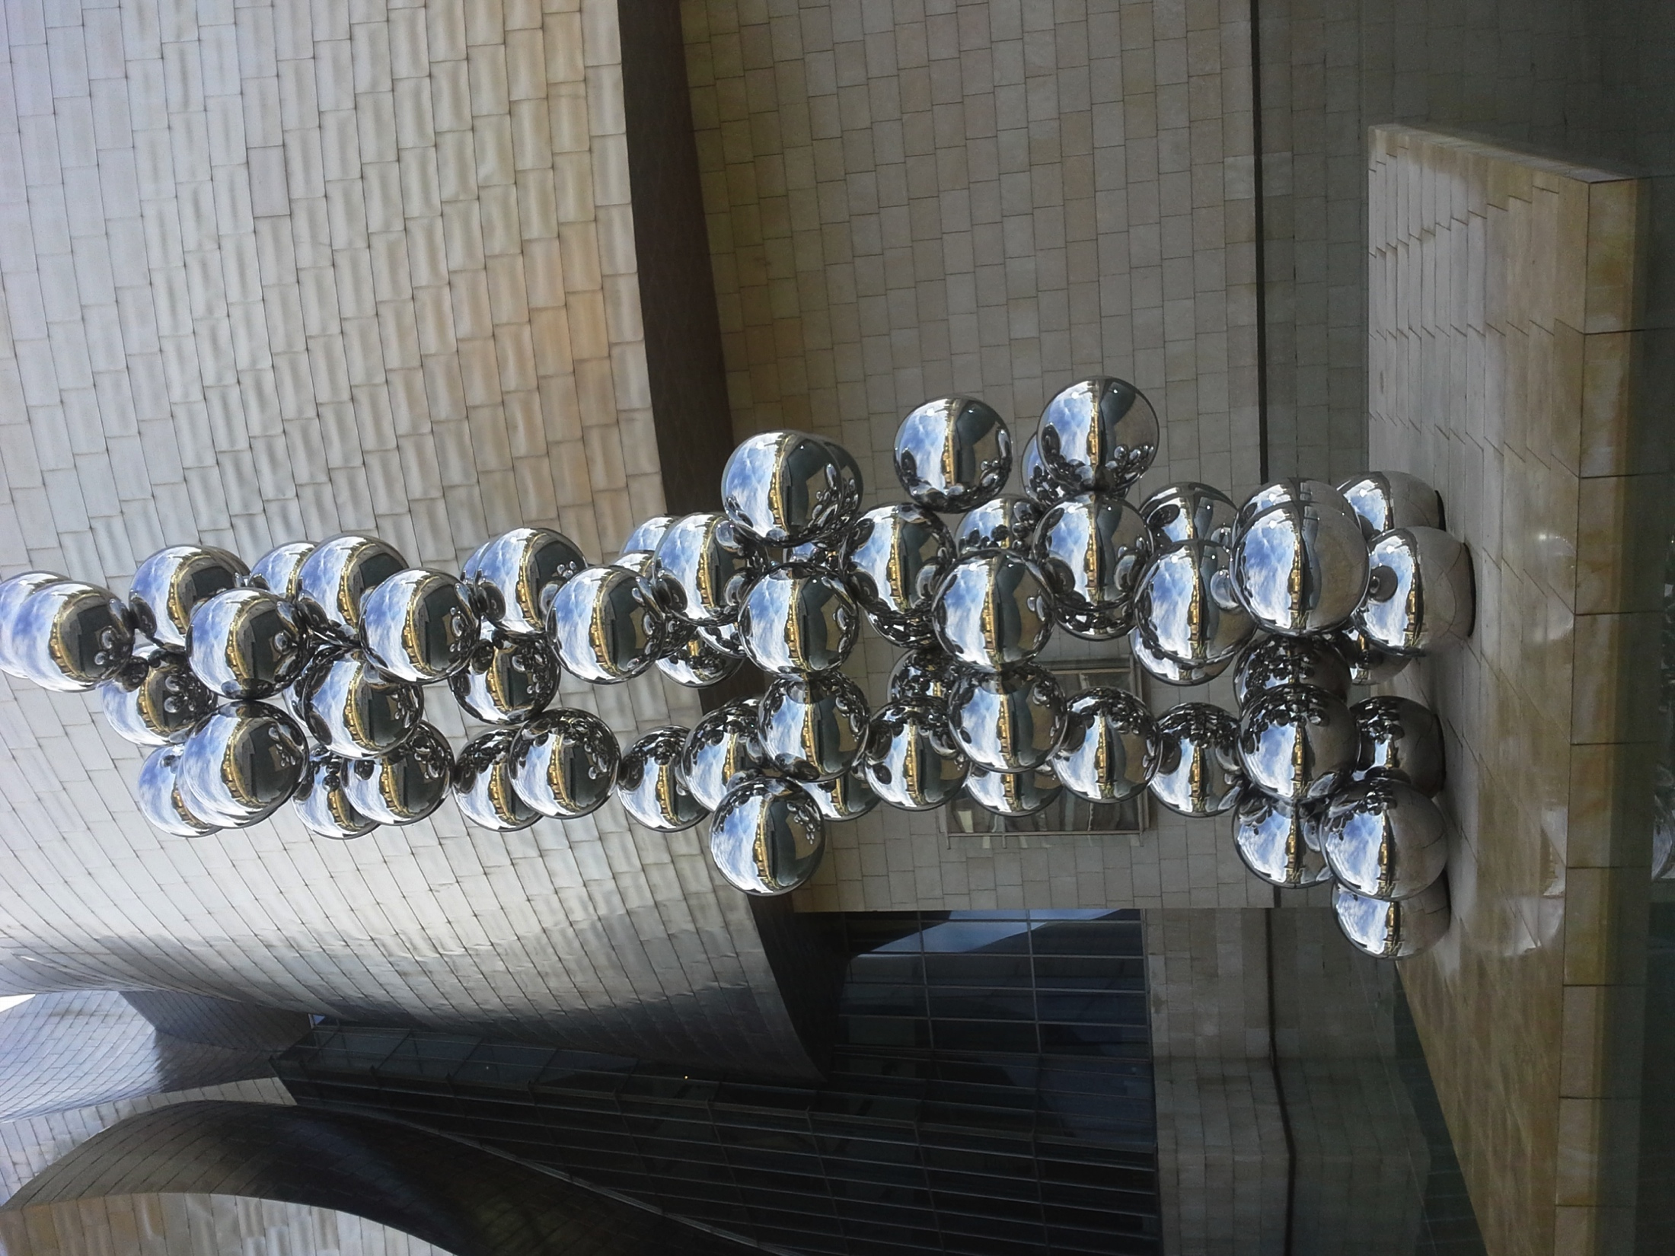
Spin Asymmetries in Drell-Yan reactions

Slide 41
Single Spin Leading Order Drell-Yan Cross Section
Formula: from Aram Kotzinian
Slide: content Oleg Denisov’s
Transversity 2011 talk
Boer-Mulders of beam hadron
Sivers' for target nucleon
Boer-Mulders of beam hadron and h₁⊥ and pretzelosity of target nucleon
Boer-Mulders of beam hadron and h₁ and transversity of target nucleon

Slide 42
Transverse Momentum Distributions:
The Sivers’ function
What is the Sivers’ function?
When will we have Drell-Yan data?
k_{T} - dependent, Naïve T-odd

Slide 43

Transverse Momentum Distributions:
The Sivers’ function
What is the Sivers’ function?
When will we have Drell-Yan data?
k_{T} - dependent, Naïve T-odd

Slide 44

SIDIS Sivers' measurements
HERMES
COMPASS
Global fit to sin(φ_{h} –φ_{S}) asymmetry in SIDIS from HERMES, and COMPASS
Comparable measurements needed for single spin asymmetries in Drell-Yan process
Caution:
  Must cover same kinematics with Drell-Yan and SIDIS (or have robust QCD evolution)
  Right now, nothing excludes a node

Slide 45


Future Polarized Drell-Yan Measurements
From W. Lorenzon
Actual luminosity at Fermilab limited to 2 10³⁵ cm⁻²s⁻¹ by proton needs of other experiments

Slide 46



A_{N}^{sin(φγ-φs)} prediction Anselmino et al
COMPASS
Fermilab
Anselmino, et al Phys. Rev. D79 (2009) 054010 and private communication (for Fermilab)
Uncertainties in predictions dominated by uncertainties in SIDIS data
Also predictions for GSI PAX, GSI PANDA, J-PARC, JINR NCIA, IHEP SPASCHARM
RHIC

Slide 47


COMPASS@CERN
See talk by S. Takekawa (next)
Very well understood apparatus
  A_{N} angular measurements already completed for SIDIS
  MC and test data match
Polarized target
Data in 2014
Expected: J/ψ 3600±600 and DY110±22
Measured: J/ψ 3170±70, and DY 84±10

Slide 48

COMPASS@CERN
See talk by Oleg Denisov
Very well understood apparatus
  A_{N} angular measurements already completed for SIDIS
  MC and test data match
Polarized target
Data in 2014
From ECT* Drell-Yan Workshop
May 2012
Expected: J/ψ 3600±600 and DY110±22
Measured: J/ψ 3170±70, and DY 84±10

Slide 49



Polarized Drell-Yan@Fermilab Main Injector
Polarized beam
  Major advantage—the beam is a blow torch—Luminosity
  Major disadvantage—the beam polarization is presently virtual—only a proposal
Spectrometer:
  By 2014, spectrometer will be well understood, including angular acceptance
Exploring polarized target
sea quark Sivers’
SPIN@Fermi Collaboration

Slide 50
Drell-Yan Data:
What data would I like to see? (My personal view)
Siver’s function relation to DIS tested
  CERN COMPASS, GSI PAX, J-PARC, RHIC
Unpolarized Angular Distributions—Boer-Mulders Structure Function, QCD
  Fermilab E-906/SeaQuest, J-PARC, RHIC (pp, pA)
  CERN COMPASS (πp)
Double polarized Drell-Yan—h₁(x)
  GSI-FAIR PAX antiproton-proton
  Fermilab polarized beam and target

Slide 51





Future Drell-Yan Experiments
Fixed Target Beam lines
Tevatron 800 GeV
Main Injector 120 GeV
Fermilab E-906/Drell-Yan
  Better statistical precision (unpolarized)
  Polarized extension under consideration
COMPASS
  Pion beam—valence distributions
GSI FAIR—PAX experiment
  Antiproton beam will sample valence distributions of targets
JINR Dubna-NICA
J-PARC
RHIC

Slide 52
Epilogue:
This is a “simulated” (that is, equivalent to Monte Carlo?) picture of what the effect might look like done with GIMP software.

Slide 53
NA10 angular distributions vs. p_{T}
Significant non-zero ν coefficient.

