Slide 1


Exclusive Reactions at HERMES
Hrachya Marukyan
ANL (Yerevan Physics Institute)
3rd Workshop on the QCD Structure of the Nucleon (QCD-N’12), Bilbao, Spain,
Oct. 22-26, 2012
Exclusive measurements and GPDs
HERMES experiment at HERA
DVCS measurement at HERMES: azimuthal asymmetries
Exclusive meson production: cross section, asymmetries, SDMEs
Summary

Slide 2
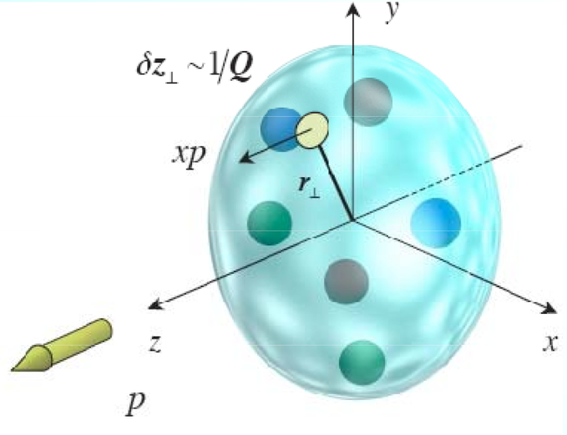
Generalized Parton Distributions
Generalized Parton Distributions (GPDs)
Generalization of Form Factors (moments of GPDs) and PDFs (forward limit)
Generalized description of nucleon structure in 2+1 dim
Number density of quarks with longitudinal momentum fraction x at radial position r⊥
Hrachya Marukyan, 22.10.2012, QCD–N’12, Bilbao, Spain

Slide 3
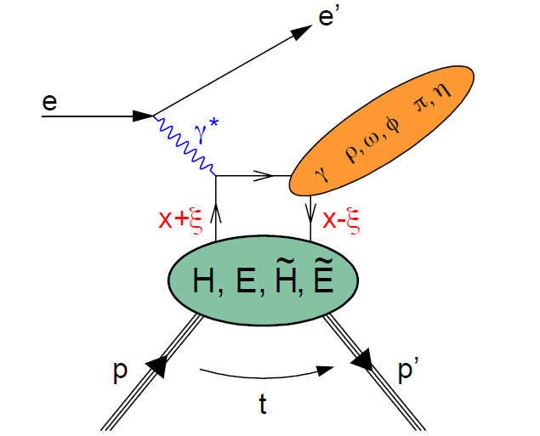
Exclusive measurements & GPDs
Ji sum rule ⟹ access OAM
Correlated information about longitudinal momentum xp
and transverse spatial position r⟘
H^{q} and E^{q} : quark Generalized Parton Distributions (GPDs)
Spin-½ target: 4 chiral-even leading-twist
quark GPDs
Η , Ε ,
Final state sensitive to different GPDs
DVCS ( γ )
Η , Ε ,
Vector mesons ( ρ, ω, φ )
Η , Ε ,
Pseudoscalar mesons ( π,η )
Hrachya Marukyan, 22.10.2012, QCD–N’12, Bilbao, Spain

Slide 4
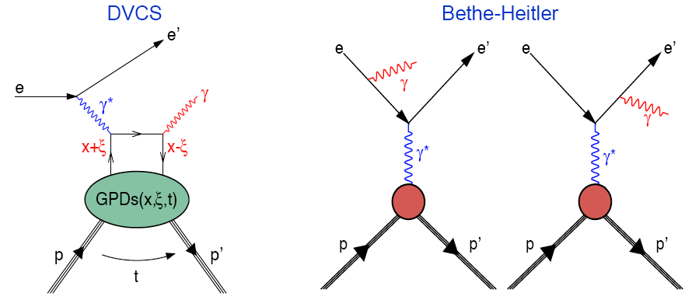
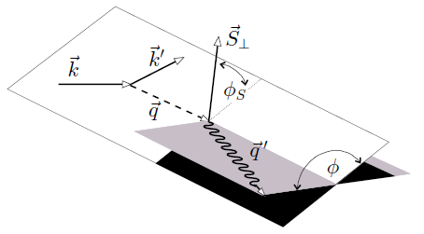
DVCS & GPDs
Theoretically cleanest way
to access GPDs
Interference between DVCS
and Bethe-Heitler amplitude
|τ_{DVCS}| ⪡ |τ_{BH}| at HERMES
A_{XY}
Access to GPD combinations through azimuthal asymmetries
HERMES: Complete set of asymmetries
beam
target
Both beam charges
Both beam helicities
Unpolarized H, D and nuclear targets
Longitudinally polarized H and D targets
Transversely polarized H target
Hrachya Marukyan, 22.10.2012, QCD–N’12, Bilbao, Spain

Slide 5
Accessing GPDs in DVCS
Beam-Charge Asymmetry
Beam-Spin Asymmetry
Longitudinal Target-Spin Asymmetry
Longitudinal Double-Spin Asymmetry
Transverse Target-Spin Asymmetry
Transverse Double-Spin Asymmetry
Compton Form Factors: convolutions of GPDs with hard scattering kernels
Hrachya Marukyan, 22.10.2012, QCD–N’12, Bilbao, Spain

Slide 6
The HERMES Spectrometer
Data taking:1996-2005
Gas Target: Beam:
• Long. polarized H(50 pb⁻¹), D(200 pb⁻¹) • Long. polarized e+ and e−
• Unpolarized H(400 pb⁻¹), D(300 pb⁻¹) • Energy 27.6 GeV
• Unpolarized He,N,Ne,Kr,Xe (all : 400 pb⁻¹) • Both helicities
• Transverse polarized H(170 pb⁻¹)
Data taking: 2006-2007, Recoil detector
Hrachya Marukyan, 22.10.2012, QCD–N’12, Bilbao, Spain

Slide 7
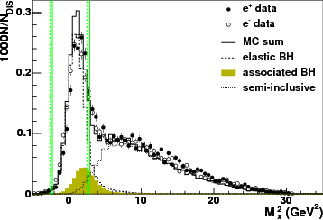
DVCS without recoil detector
Event with exactly one DIS – lepton and exactly one trackless cluster in the
calorimeter.
No recoil detection Exclusivity via missing mass: M_{X}²=(q + P - q')²
< Θ _{γ*γ} < 45 mrad
-t < 0.7 GeV², E _{γ} > 5 GeV
0.03 < x _{B} < 0.35 , 1 < Q² < 10 GeV²
W > 3 GeV, ν < 22 GeV
MC for background and cuts,
systematic uncertainty
e p → e' X γ
e p → e' p γ ; elastic BH
e p → e' Δ⁺ γ ; associated BH
e p → e' π⁰ X ; semi-inclusive
Correction; π⁰ background (≈ 3%)
Associated (≈ 12%) ; part of signal
Exclusive bin ( - (1.5)² < M_{X}² < (1.7)² GeV² )
Hrachya Marukyan, 22.10.2012, QCD–N’12, Bilbao, Spain

Slide 8
Exclusive measurements: DVCS asymmetries at HERMES
Beam-charge asymmetry
GPD H: PRL 87 (2001) 182001
PRD 75 (2007) 011103
JHEP 11 (2009) 083
JHEP 07 (2012) 032 JHEP 10 (2012) 042
D: Nucl. Phys. B 829 (2010)1
Beam-spin asymmetry
GPD
Transverse target-spin asymmetry
GPD H: JHEP 06 (2008) 066
Transverse double-spin asymmetry
GPD H: Phys. Lett. B 704 (2011) 15
Longitudinal target spin asymmetry
GPD H: JHEP 06 (2010) 019
D: Nucl. Phys. B 842 (2011) 265
Longitudinal double spin asymmetry
GPD
Hrachya Marukyan, 22.10.2012, QCD–N’12, Bilbao, Spain

Slide 9
Beam-Charge Asymmetry
KM09:global fit
Including data from HERA
HERMES and Jlab
K. Kumericki, D. Muller
Nucl. Phys. B 84 (2010) 1
GGL11:model calculation
G. Goldstain, S. Liuti,
J. Hernandez
Phys. Rev. D 84 034007 (2010)
JHEP 07 (2012) 032, arXiv:1203.6287
Fractions of associated
process from MC
Hrachya Marukyan, 22.10.2012, QCD–N’12, Bilbao, Spain

Slide 10
Beam-Spin Asymmetry
JHEP 07 (2012) 032, arXiv:1203.6287
Fractions of associated
process from MC
Hrachya Marukyan, 22.10.2012, QCD–N’12, Bilbao, Spain

Slide 11
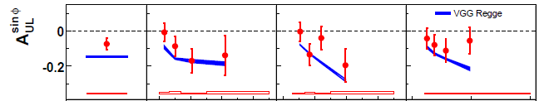
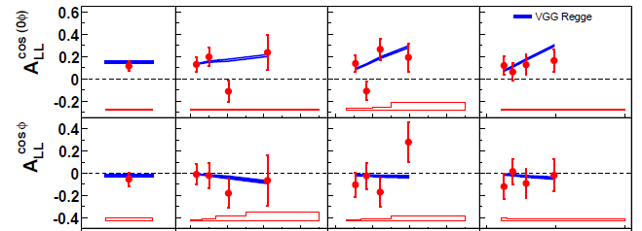
Longitudinal Single- and Duble-Spin Asymmetries
JHEP 06 (2010) 019, arXiv:1004.0177
VGG: model calculation
M. Vanderhaeghen, P. Guichon, M. Guidal
Phys. Rev. D60 (1999) 0940177
Prog. Nucl. Phys. 47 (2001) 401
Relatively large BH
contribution to these
asymmetries
Hrachya Marukyan, 22.10.2012, QCD–N’12, Bilbao, Spain

Slide 12
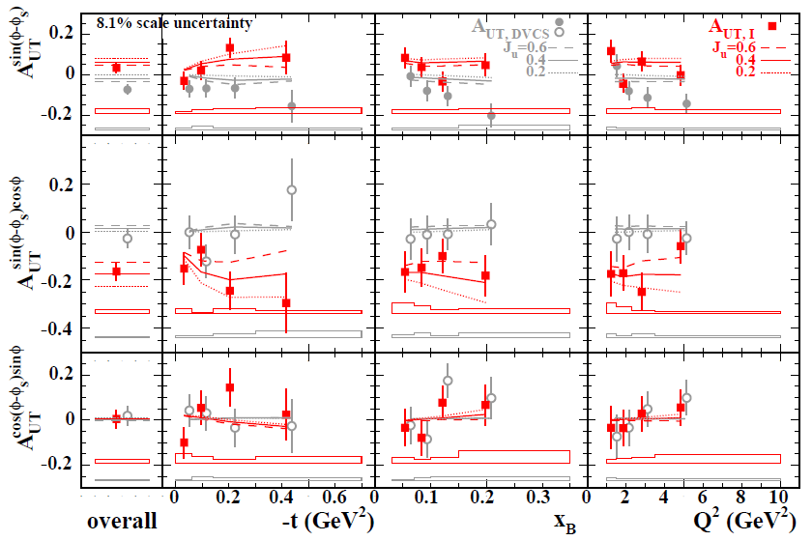
DVCS: Transverse Target-Spin Asymmetry A_{UT}
Sensitive to GPD E
JHEP 06 (2008) 066, arXiv:0802.2499
Sensitive to J_{u}
Not sensitive to J_{u}
Model: VGG with variation of J_{u}, while J_{d}=0
Hrachya Marukyan, 22.10.2012, QCD–N’12, Bilbao, Spain

Slide 13
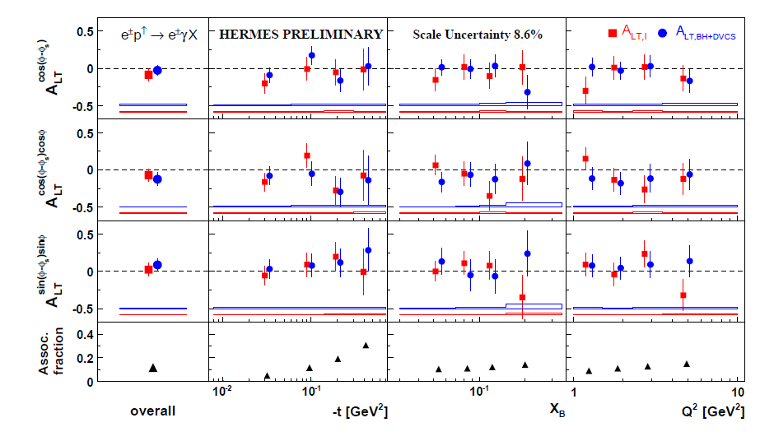
DVCS: Transverse Double-Spin Asymmetry A_{LT}
Phys Lett. B704 (2011) 15, arXiv:1106.2990
Sensitive to both GPDs
entering the Ji sum rule
Consistent with zero, cancellations between E and H
Sensitivity to J_{u} is suppressed by kinematic factors
Hrachya Marukyan, 22.10.2012, QCD–N’12, Bilbao, Spain

Slide 14
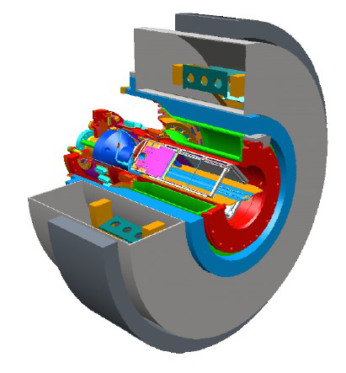
DVCS with Recoil Detector
e p → e' γ X
1 T SC Solenoid
Photon Detector
Scintillating fiber Tracker
Silicon-Strip Detector
Unpolarized H and D targets
Exclusivity via missing mass:
M_{X}²=(q + P - q')²
Recoil Detector to tag exclusivity
Hrachya Marukyan, 22.10.2012, QCD–N’12, Bilbao, Spain

Slide 15
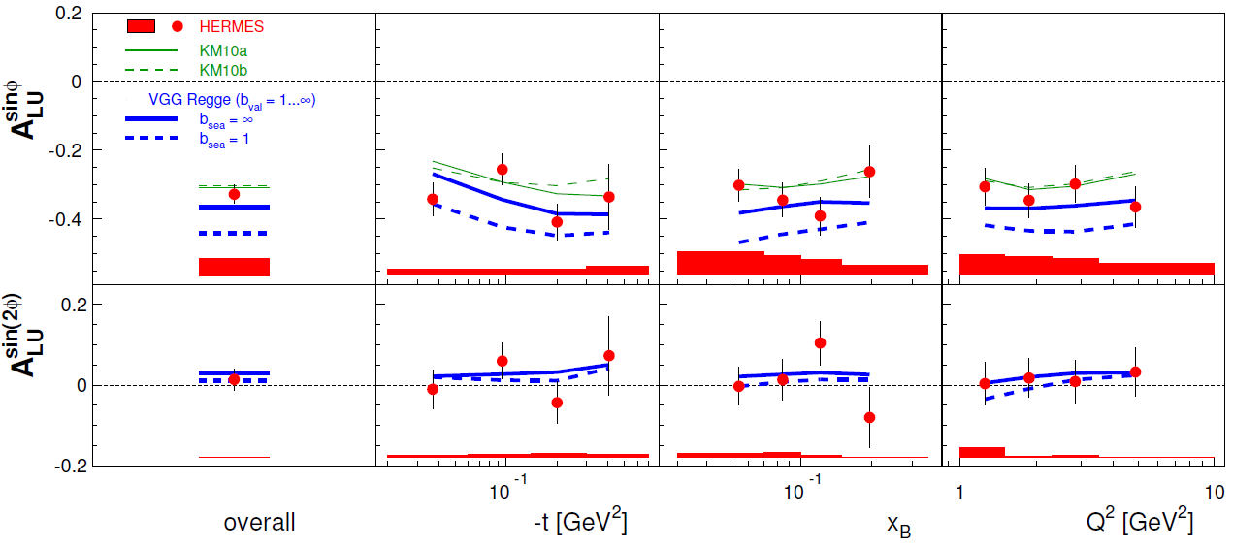
Pure elastic DVCS
JHEP 10 (2012) 042, arXiv:1206.5683
KM10:global fit
Including data from HERA
HERMES and Jlab
K. Kumericki, D. Muller
Nucl. Phys. B 84 (2010) 1
VGG: model calculation
M. Vanderhaeghen, P. Guichon, M. Guidal
Phys. Rev. D60 (1999) 0940177
Prog. Nucl. Phys. 47 (2001) 401
The leading amplitude for pure elastic process is larger than
for unresolved signal (elastic+associated) and well described
by recent fits to previously published data
Hrachya Marukyan, 22.10.2012, QCD–N’12, Bilbao, Spain

Slide 16
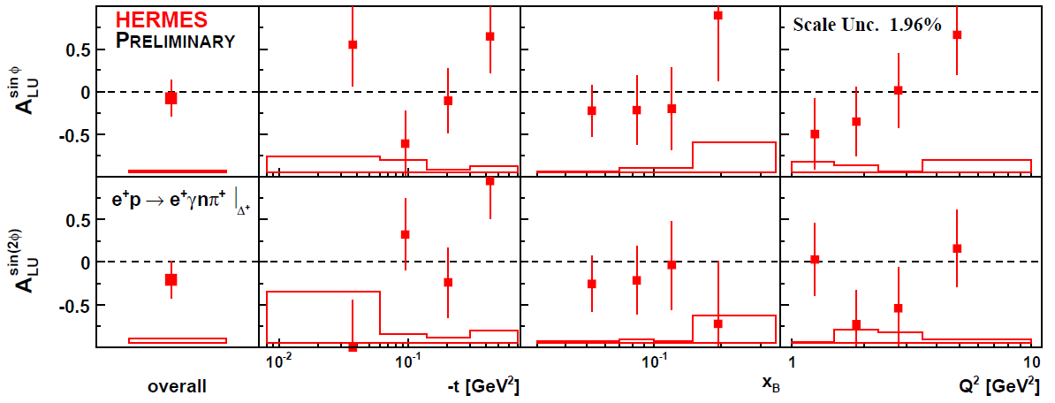
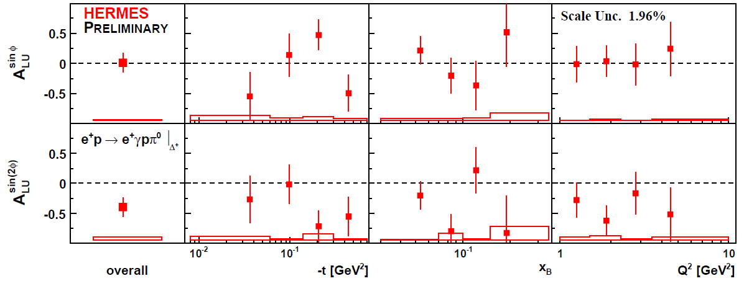
Beam-Spin Asymmetry in „associated“ DVCS : ep→e𝛾Δ⁺
Correction: π⁰ SIDIS background (5-25% for p𝜋⁰, and 8-44% for n𝜋⁺ channel)
Elastic (≈ 1%)
Hrachya Marukyan, 22.10.2012, QCD–N’12, Bilbao, Spain

Slide 17
Beam-Charge /Spin Asymmetries on heavier nuclei
Phys. Rev. C 81 (2010) 035202
Target | Spin | L (pb⁻¹)
¹H | 1/2 | 227
He | 0 | 32
N | 1 | 51
Ne | 0 | 86
Kr | 0 | 77
Xe | 0, 1/2, 3/2 | 47
Separation of coherent-enriched and incoherent-enriched data samples
by t- cutoffs : similar average kinematics
Coherent-enriched samples: ≈ 65 %
Incoherent enriched samples: ≈ 60 %
Hrachya Marukyan, 22.10.2012, QCD–N’12, Bilbao, Spain

Slide 18
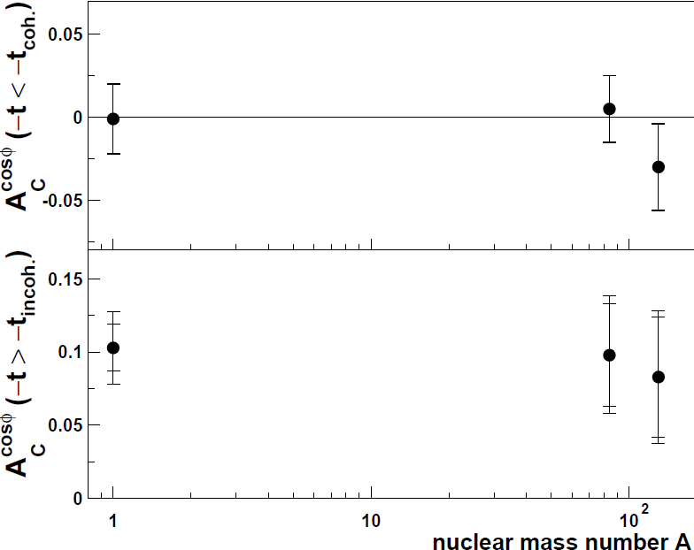
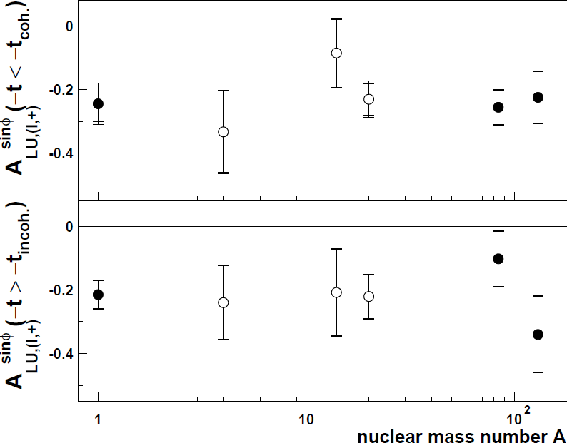
Nuclear-mass dependence of asymmetries
A_{C}^{cos φ} vs. A
A_{LU}^{sin φ} vs. A
A_{LU}^{A} / A_{LU}^{H}
Coherent-enriched: 0.91 ± 0.19
Incoherent-enriched: 0.93 ± 0.23
Hrachya Marukyan, 22.10.2012, QCD–N’12, Bilbao, Spain

Slide 19
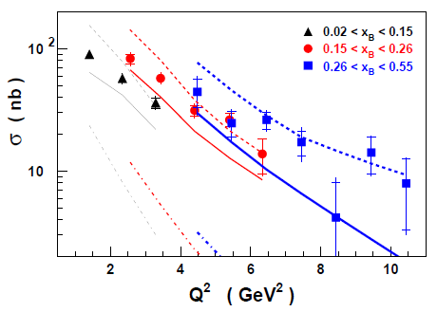
Cross section of exclusive 𝜋⁺ production
𝛾p→𝜋⁺n
Phys. Lett. B 659 (2008) 486, arXiv:0707.0222
Regge model: J. M. Laget
Phys Rev. D 70 (2004) 054023
- - d𝜎/dt’
…... d𝜎_{L}/dt’
GPD model: VGG
Phys. Rev. D 60 (1999) 094017
• - d𝜎_{L}/dt’ leading order
---- with power correction
GPD model:
Fair agreement at lower t’
Regge model:
Good description of the data
Hrachya Marukyan, 22.10.2012, QCD–N’12, Bilbao, Spain

Slide 20
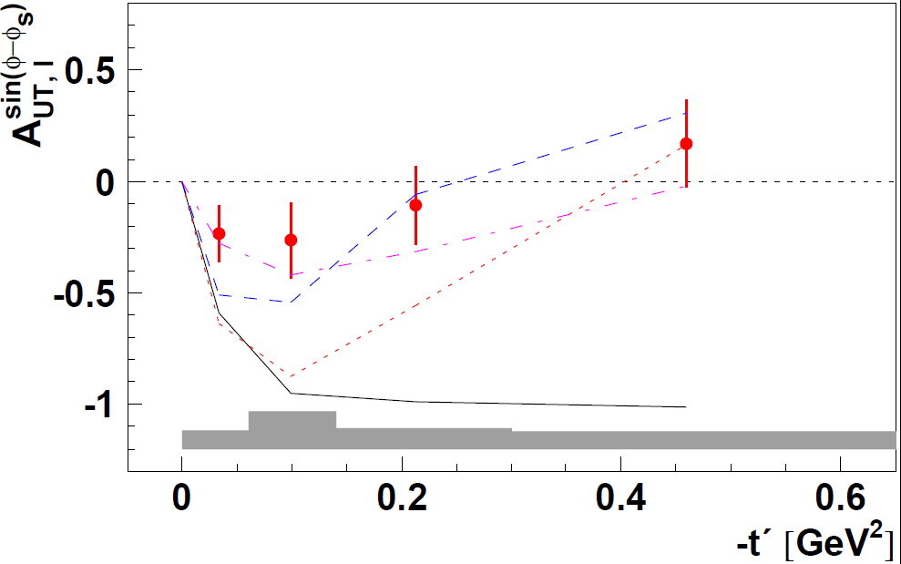
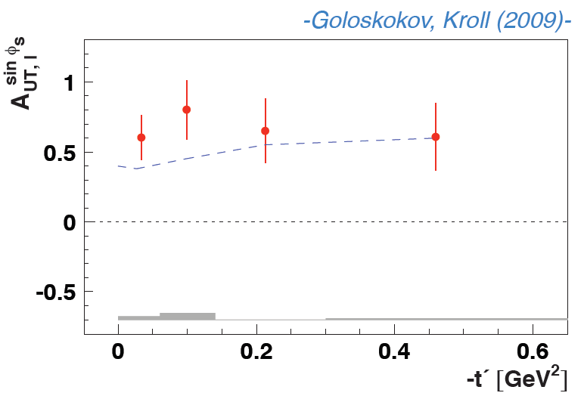
Target-Spin asymmetry in exclusive 𝜋⁺ production
Phys. Lett. B 682 (2010) 351, arXiv:0907.5369
Small value with possible change of the sign
Theoretical expectations:
Large negative value:
L. L. Frankfurt et al. (2000)
A. V. Belitsky, D. Muller (2001)
Difference could be due to the 𝛾⋆_{T} :
S. Goloskokov, P. Kroll (2009)
Ch. Bechler, D. Muller (2009)
Large positive value can be explained
by sizable interference between
the 𝛾⋆_{L} and 𝛾⋆_{T}
Hrachya Marukyan, 22.10.2012, QCD–N’12, Bilbao, Spain

Slide 21
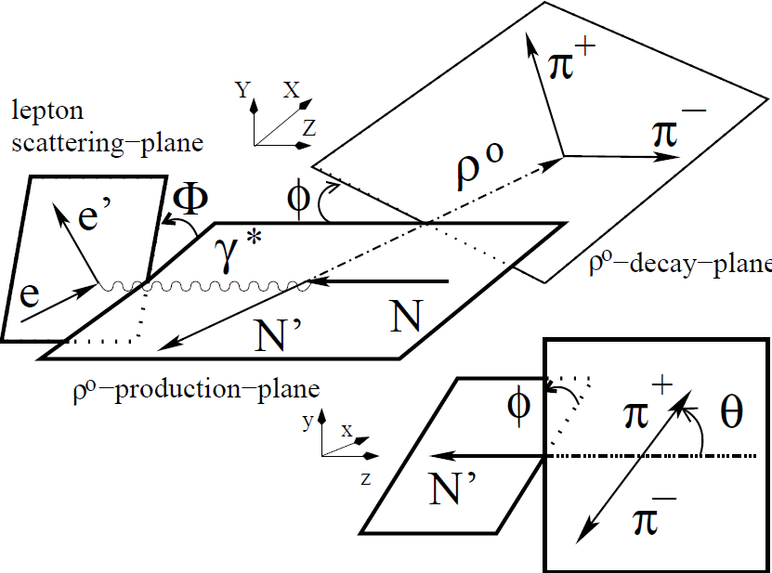
Exclusive vector meson production
Meson SDMEs
EPJC 62 (2009) 659
Photon SDMEs
Helicity amplitudes
Helicity amplitudes are the
fundamental quantities to be
compared with theory
They form a basis for the SDMEs
Natural Parity Exchange (NPE)
Unnatural Parity Exchange (UPE)
Hrachya Marukyan, 22.10.2012, QCD–N’12, Bilbao, Spain

Slide 22
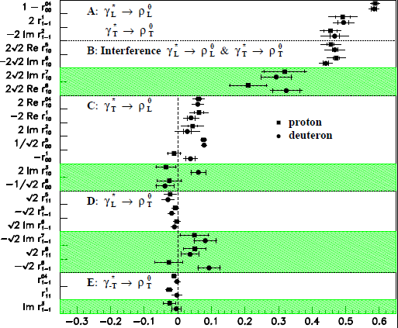
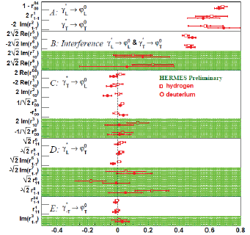
SDMEs on unpolarized targets: ρ⁰ & 𝜙 productions
Hierarchy predicted by theory:
confirmed by HERMES
𝛾∗_{L}→V_{L}
𝛾∗_{T}→V_{T}
𝛾∗_{T}→V_{L}
𝛾∗_{L}→V_{T}
EPJ C 62 (2009) 659, arXiv:0901.0701
𝛾∗_{L}→V_{L} & 𝛾∗_{T}→V_{T} :
10-20% difference between ρ⁰ & 𝜙
𝛾∗_{T}→V_{L} :
pronounced difference between ρ⁰ & 𝜙
Hrachya Marukyan, 22.10.2012, QCD–N’12, Bilbao, Spain

Slide 23
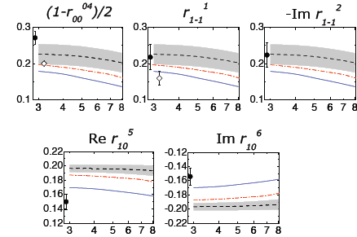
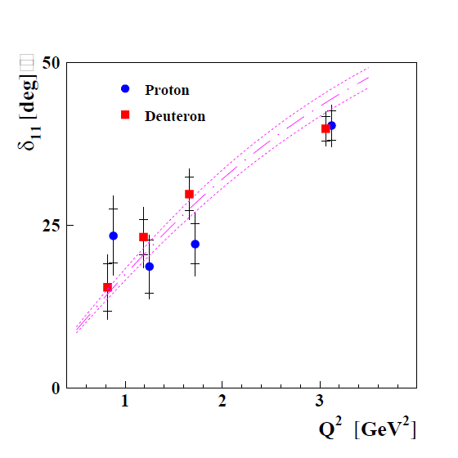
Comparison of ρ⁰ SDMEs to GPD model
𝛾∗_{L}→ ρ⁰ _{L} & 𝛾∗_{T}→ ρ⁰ _{T}
Interference
𝛾∗_{L}→ ρ⁰ _{L} & 𝛾∗_{T}→ ρ⁰ _{T}
GPD model: S. Goloskokov, P. Kroll (2007)
EPJ C 71 (2011) 1609, arXiv:1012.3676
Expected small
By GPD models
Model predicts phase difference
between T₁₁ and T₀₀ , 𝛿 ₁₁ = 3.1 deg.
𝛿 ₁₁ ⋍ 20 deg. observed by H1
W = 5 GeV, 10 GeV and 75 GeV
Model is in an agreement with data
Hrachya Marukyan, 22.10.2012, QCD–N’12, Bilbao, Spain

Slide 24
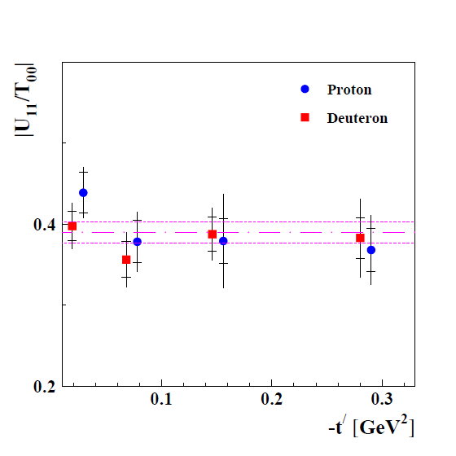
Observation of Unnatural Parity Exchange
At large W² and Q² the transition expected to be suppressed
The combinations of SDMEs are expected
to be zero in case of NPE:
Direct analysis of amplitude ratio
EPJ C 71 (2011) 1609, arXiv:1012.3676
EPJ C 62 (2009) 659, arXiv:0901.0701
Sizeable UPE
Significant UPE contribution for ρ⁰ ,
sensitivity to GPD
Hrachya Marukyan, 22.10.2012, QCD–N’12, Bilbao, Spain

Slide 25
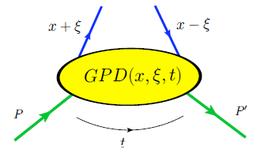
Summary
Hrachya Marukyan, 22.10.2012, QCD–N’12, Bilbao, Spain

Slide 26
Backup slides
Backup Slides
Hrachya Marukyan, 22.10.2012, QCD–N’12, Bilbao, Spain

Slide 27
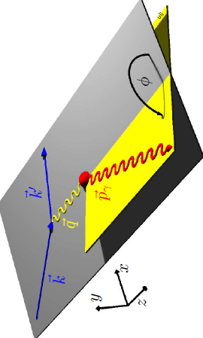
Azimuthal dependences in DVCS
Fourier coefficients are related to certain linear or bi-linear combinations of Compton Form factors (CFFs):
Hrachya Marukyan, 22.10.2012, QCD–N’12, Bilbao, Spain

Slide 28
Azimuthal asymmetries in DVCS off unpolarized targets
Charge-difference beam-helicity asymmetry:
A_{LU}
Charge-averaged beam-helicity asymmetry:
beam
target
Beam-Charge asymmetry:
Measurement with both beam helicity and both beam charges
separate contributions from DVCS and Interference term
This separation is impossible in measurements of single-charge
beam-helicity asymmetry A_{LU}(ϕ) = (σ→ - σ←)/(σ→ + σ←)
Hrachya Marukyan, 22.10.2012, QCD–N’12, Bilbao, Spain

Slide 29
Asymmetries on longitudinally polarized targets
Single-charge target-spin asymmetry (Hydrogen/Deuterium):
Single-charge double-spin asymmetry (Hydrogen/Deuterium):
Single-charge beam-helicity asymmetry (Deuterium):
Single-helicity (←) beam-charge asymmetry (Deuterium):
Hrachya Marukyan, 22.10.2012, QCD–N’12, Bilbao, Spain

Slide 30
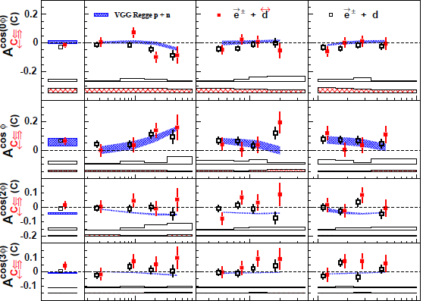
A_{C} (A_{C↔} ) on (un)polarized Deuterium
Nucl. Phys. B 842 (2011) 265
For coherent scattering
ℜ
e
(
−
)
H
1
H
1
3
5
ℑ
m
(
H
)
5
A_{LZZ} sin φ amplitude:
0.074 ± 0.196 ± 0.022
(-t < 0.06 GeV2, 40% coherent)
Hrachya Marukyan, 22.10.2012, QCD–N’12, Bilbao, Spain

Slide 31
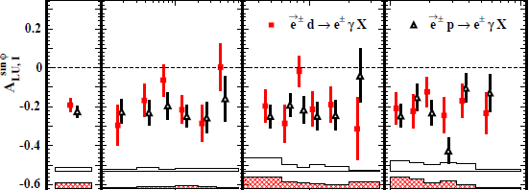
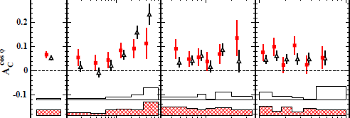
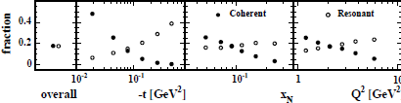
Deuterium (Hydrogen): Unpolarized target
JHEP 11 (2009) 083
Nucl. Phys. B 829 (2010) 1
m
ℑ
(
)
H
1
e
ℜ
(
)
H
1
-0.29 ± 0.18 (stat) ± 0.03 (syst)
0.11 ± 0.07 (stat) ± 0.03 (syst)
Hrachya Marukyan, 22.10.2012, QCD–N’12, Bilbao, Spain

Slide 32
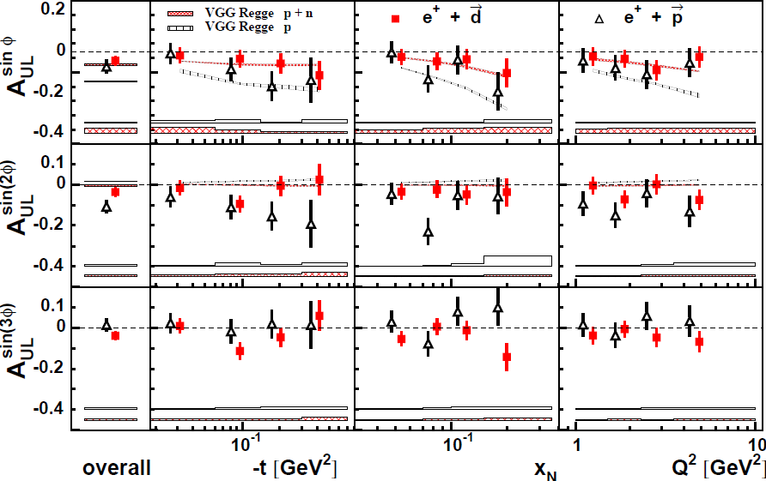
Deuterium (Hydrogen): Target-Spin Asymmetry
JHEP 11 (2009) 083
Nucl. Phys. B 842 (2011) 265
~
ℑ
(
)
m
H
1
VGG:
Phys. Rev. D60 (1999) 0940177
&
Prog. Nucl. Phys. 47 (2001) 401
Hrachya Marukyan, 22.10.2012, QCD–N’12, Bilbao, Spain

Slide 33
Deuterium (Hydrogen): Double-Spin Asymmetry
JHEP 11 (2009) 083
Nucl. Phys. B 842 (2011) 265
VGG:
Phys. Rev. D60 (1999) 0940177
&
Prog. Nucl. Phys. 47 (2001) 401
Hrachya Marukyan, 22.10.2012, QCD–N’12, Bilbao, Spain

Slide 34
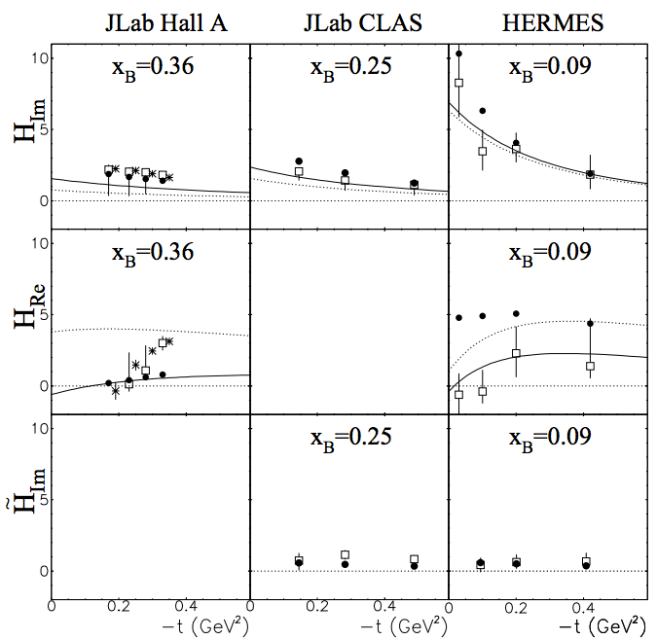
GPD extraction
M. Guidal ICHEP Proc. (2010) 148
CFFs are extracted from
experimental measurements
VGG model:
GPD H in this model is not
consistent with experimental
results.
M. Guidal, ICHEP Proc. (2010) 148
⋆ H. Moutarde, Phys. Rev. D 79 (2009)
Curves:
K. Kumericki, D. Muller
Nucl. Phys. B 841 (2010)
Hrachya Marukyan, 22.10.2012, QCD–N’12, Bilbao, Spain

Slide 35
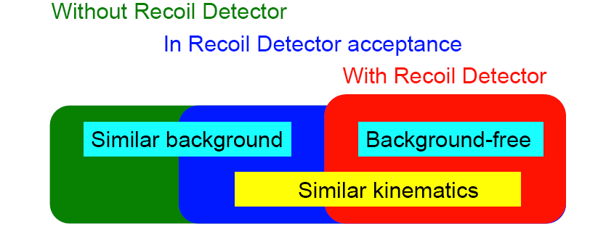
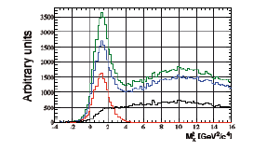

DVCS with Recoil Detector
- No requirement for Recoil
- Charged recoil track in acceptance
- Kinematic fit probability > 1 %
- Kinematic fit probability < 1 %
Kinematic event fitting technique: all 3 particles
In the final state detected should satisfy
4-constraints on energy-momentum conservation
Hrachya Marukyan, 22.10.2012, QCD–N’12, Bilbao, Spain

Slide 36
Pure elastic DVCS
Indication that leading amplitude for pure elastic process is
slightly larger than for unresolved signal (elastic+associated)
Hrachya Marukyan, 22.10.2012, QCD–N’12, Bilbao, Spain

Slide 37
Leading amplitudes of asymmetries on nuclei
Leading amplitude of
Beam-charge asymmetry
Leading amplitudes of
Beam-helicity asymmetry
Two beam charges available
Only one beam charge available:
single-charge asymmetry without
entanglement of squared DVCS
and Interference terms
Hrachya Marukyan, 22.10.2012, QCD–N’12, Bilbao, Spain

Slide 38
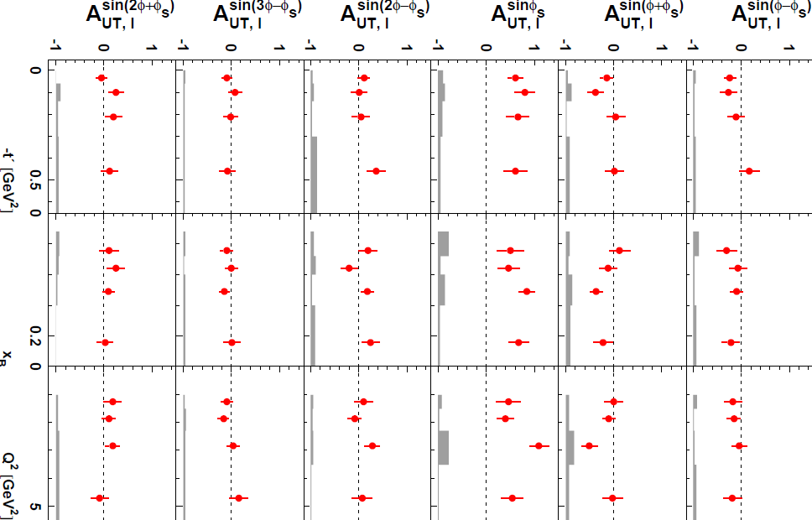
Target-Spin asymmetry in exclusive 𝜋⁺ production
Phys. Lett. B 682 (2010) 351,
arXiv:0907.5369
No L/T separation
Small value for the leading
asymmetry amplitude
A_{UT} ^{sin(𝜙-𝜙}S⁾
Unexpected large value for the
asymmetry amplitude A_{UT} ^{sin(𝜙}S⁾
All other asymmetry amplitudes
are consistent with zero
Evidence for interference of
contributions from longitudinal
and transverse photons
Hrachya Marukyan, 22.10.2012, QCD–N’12, Bilbao, Spain

Slide 39
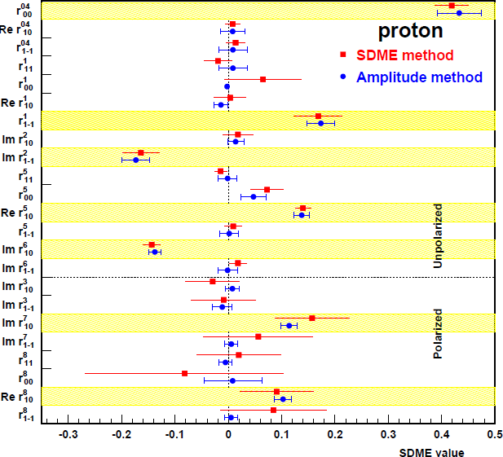
Exclusive ρ⁰-meson production
Meson SDMEs
EPJC 62 (2009) 659
Photon SDMEs
EPJ C 71 (2011) 1609, arXiv:1012.3676
Helicity amplitudes
Helicity amplitudes are the
fundamental quantities to be
compared with theory
They form a basis for the SDMEs
Natural Parity Exchange (NPE)
Unnatural Parity Exchange (UPE)
Hrachya Marukyan, 22.10.2012, QCD–N’12, Bilbao, Spain

