Slide 1
European Strategy
Update of the European Strategy in Particle Physics
Joachim Mnich
LHC Physics Discussions
October 15, 2012

Slide 2
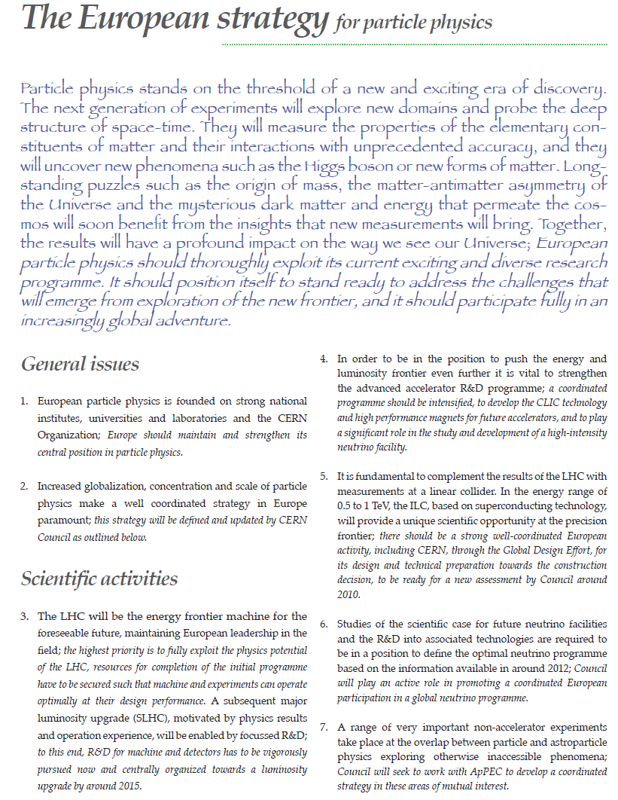


The European Strategy for Particle Physics 2006
Accelerator R&D
Studies for Linear Collider
Scientific case for υ factory
http://council-strategygroup.web.cern.ch/council-strategygroup/Strategy_Statement.pdf
LHC

Slide 3
Update ESPP 2012/2013
The 2006 strategy foresees a regular O(5 years) update of the Strategy
Initiated by CERN Council
  in its role as board for European Particle Physics (funding agencies)
  and not as administrative council of the Geneva laboratory
The Update of the European Strategy for Particle Physics shall in particular aim at:
  enhancing the visibility of existing European particle physics programmes;
  increasing collaboration among Europe's particle physics laboratories, institutes and universities;
  promoting a coordinated European participation in global projects and in regional projects outside Europe;
  encouraging knowledge transfer to other disciplines, industry, and society.
For details see
http://europeanstrategygroup.web.cern.ch/europeanstrategygroup/ESG/welcome.html

Slide 4
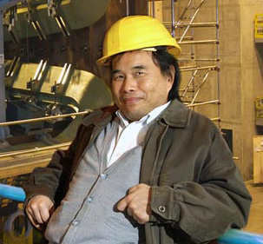
Organisation
European Strategy Group ESG
  composition (approx. 50 people):
  representatives from CERN member states (D: Siggi Bethke), directors large laboratories (DESY: JM), non-member states, invitees, …
  Chair (Scientific Secretary): Tatsuya Nakada
European Strategy Preparatory Group (ESPG)
  16 people, some overlap with ESG
  includes experts on various fields from different countries
  D: Peter Braun-Munzinger & Klaus Desch
Working groups on specific (political) topics
  Mandate and organisational structure CERN Council
  European participation in global projects, role of national laboratories and CERN
  (DESY: JM)
  Relation with external bodies,in particular EU related issues
  Knowledge and technology transfer, relations with industry
  Outreach and education

Slide 5
Timeline
2011/1st half 2012 start of the process, set up ESG, ESPG, working
groups etc.
Sep 2012 Open Symposium in Cracow input from the
community
Nov 2012 Plenary ECFA: last chance for input
7. Dec 2012 ESPG prepares briefing book
synthesis of Cracow
21. - 26. Jan 2013 ESG drafting session in Erice
March 2013 Finalizing Update of Strategy by CERN Council
May 2013 Formal adaption of Strategy by CERN Council
special meeting in Brussel with EU commission

Slide 6
DESY input to Cracow
Community was invited to provide written input to the Cracow symposium
DESY scientists involved in several documents
  LHC (ATLAS, CMS), ILC, Belle II, theory, WIMPs (ALPS)
  plus 1 document on DESY strategy
  prepared by leading scientists & group leaders
All documents can be found at
http://indico.cern.ch/conferenceCFA.py?confId=175067

Slide 7
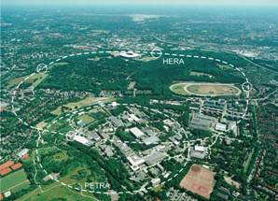
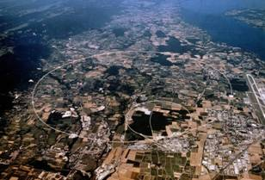
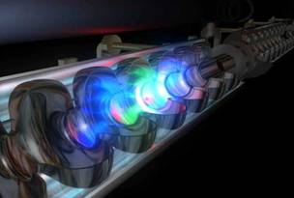
DESY Long-term Strategy in Particle Physics
HERA
LHC
ILC
Accelerators
Detectors
Physics
+ support through strong theory group
+ computing infrastructure
+ testbeam & other infrastructures
Use of DESY infrastructure for particle physics
  e.g. ALPS, OLYMPUS …
  explore potential use of DESY infrastructure for particle physics
Strengthen role of DESY as national laboratory for particle physics

Slide 8
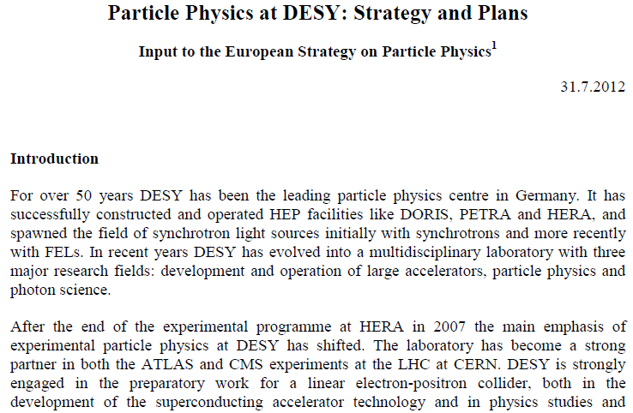
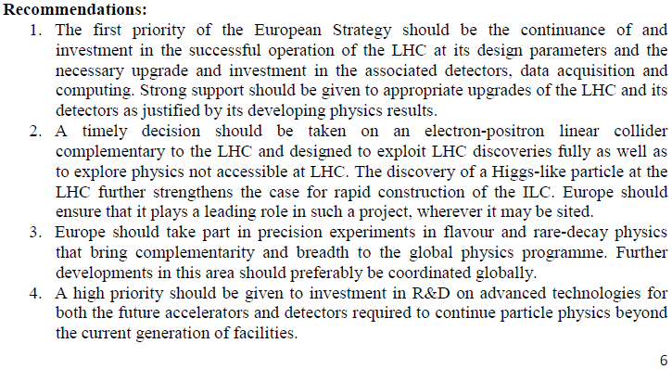
DESY Strategy
DESY submitted 6 page document
…

Slide 9
Cracow Symposium
My very personal biased view & recollection!!!
High Energy Frontier
  Discovery of a Higgs-like boson at the LHC
  How to proceed? LHC and/or Higgs factory?
Strong statement from Japanes particle physics community
  250 – 500 GeV electron-positron LC is top priority
  Positive signals from Japanes politicians to host such a machine (ILC)
  incl. significant financial contributions
  Circular 250 GeV machine?
JM: important points to be addressed
  What is the relative reach LHC (with 3/ab) versus ILC?
  Why do we need to make precision Higgs studies? (→ grand challenges in HEP)

Slide 10
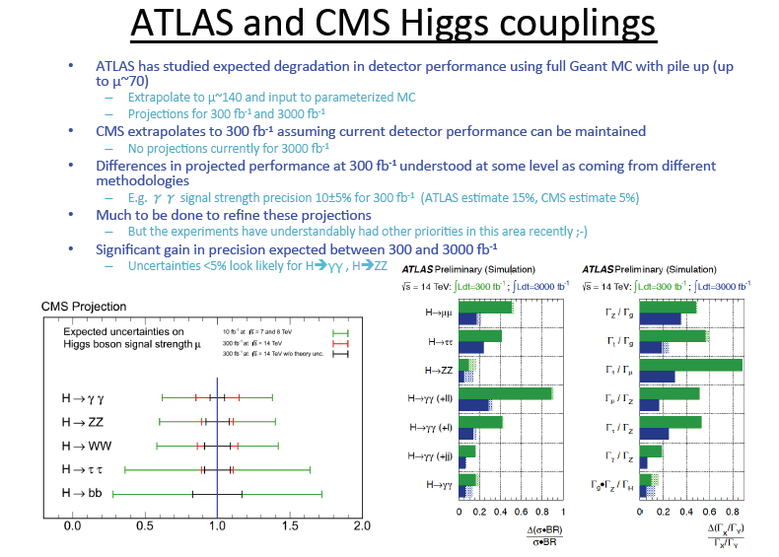
Higgs at LHC
Taken from Terry Wyatt‘s talk
More studies under way

Slide 11
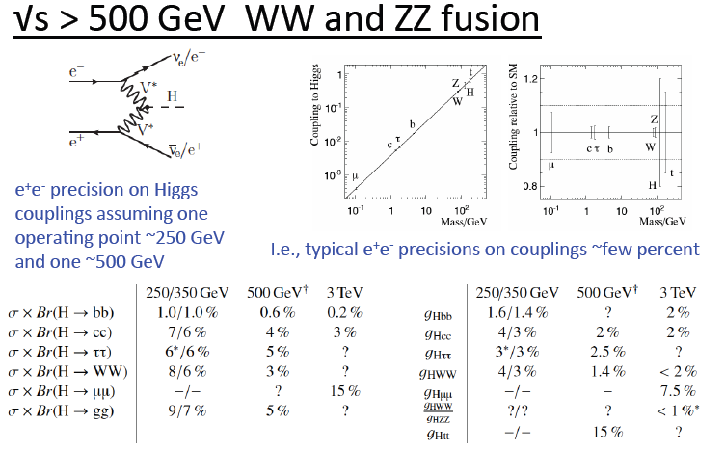
Higgs at ILC
See Terry Wyatt‘s talk
ILC TDR to be published end 2012

Slide 12
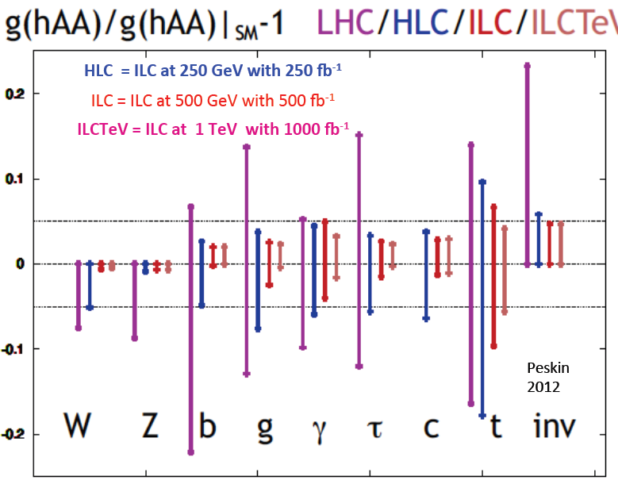
Higgs Couplings: LHC vs ILC
Probably not yet the final word

Slide 13
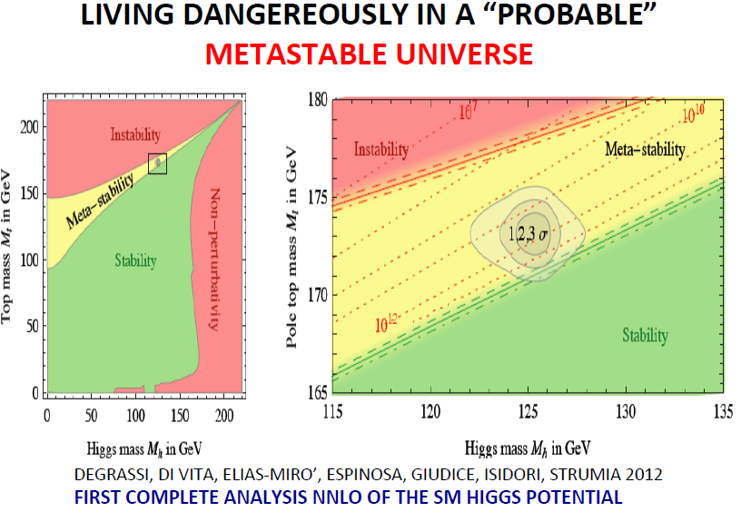
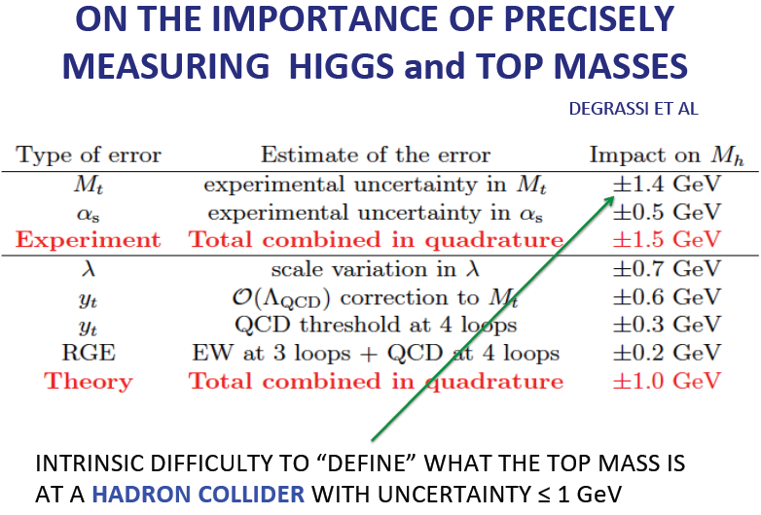
Importance of Top Mass
At an LC O(100 MeV) precision are possible from threshold scan

Slide 14
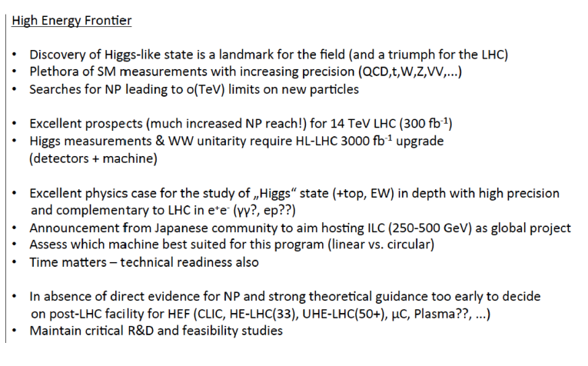
Summary Slide on High Energy Forntier

Slide 15
Cracow Symposium
Future neutrino programme
Next questions
  Mass hierachy (inverted or normal)
  CP violating phase
  Mass
  Dirac or Majorana? (→ υ-less double beta decay)
New results show that sin Θ₁₃ is large
  CP violating phase is experimentally accessible
  Reactor versus accelerator-based Long Baseline Neutrino Experiments
European LBNE Project CERN to Finland
Strong statement from US
  Invitation to participate in Fermilab programme
JM: global coordination and cooperation needed

Slide 16
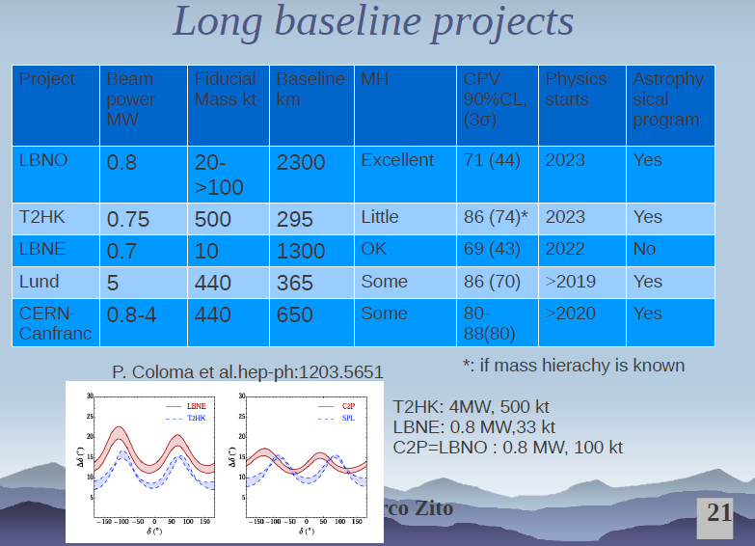
Taken from Marco Zito‘s talk

Slide 17
Summary & Key Issues
High-Luminosity LHC to be decided now
  Guarantees CERN future up to or even beyond 2030
European participation in Japanese ILC-project
  Yes or no?
  Define organisational issues in strategy update
  Is circular e⁺e⁻ Higgs-factory , e.g. LEP 3, an alternative?
High Energy Physics at CERN after LHC
  LEP §, gamma-gamma Higgs- factory
  LHeC
  High Energy proton machine:
  double LHC energy or 80 km tunnel for O(100 TeV)
  in both cases R&D on magnets needed
LBNE programme
  inside/outside Europe?

