Slide 1
Updated Higgs Results from CMS
Rainer Mankel, Alexei Raspereza
DESY
LHC Physics Discussions
DESY, 17-Dec-2012

Slide 2
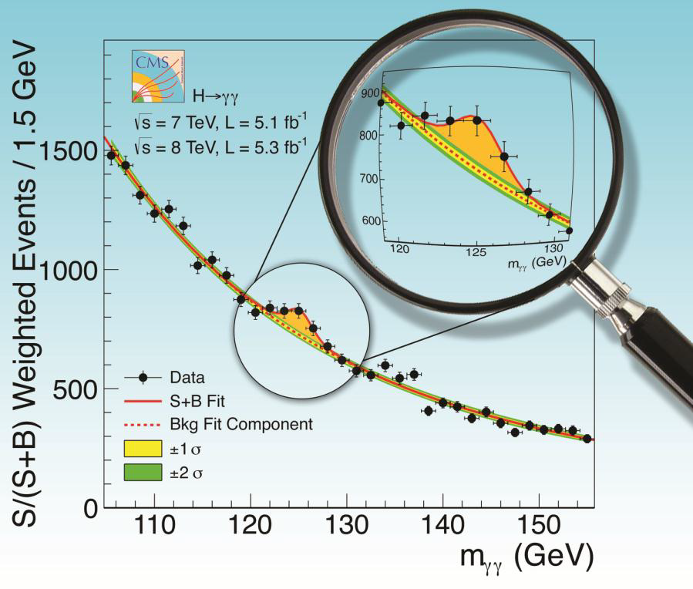
After the Discovery !
Main points of interest after the initial observation of a new boson has been made:
Confirmation of the 126 GeV signal with more statistics → ZZ*, [WW]
Do we see the decay to fermions ?
  ττ, bb
Measurement of the couplings & comparison with SM
Is the 126 GeV signal just one state in a more complex Higgs sector?
  e.g. MSSM (five Higgs states)
  ττ, bb
Focus on new results as they were prepared for HCP 2012!

Slide 3


Slide 4
Confirmation of the 126 GeV Signal

Slide 5
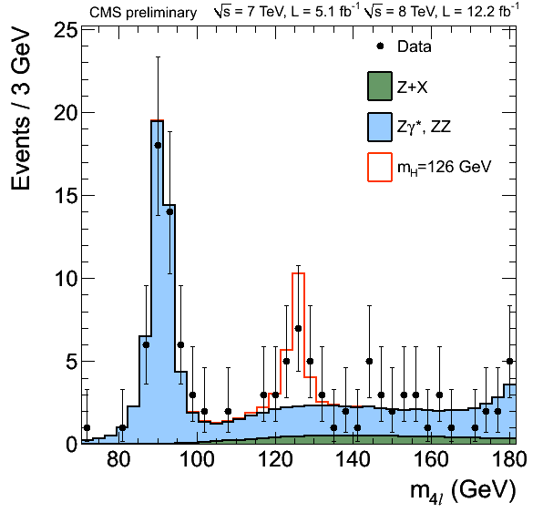
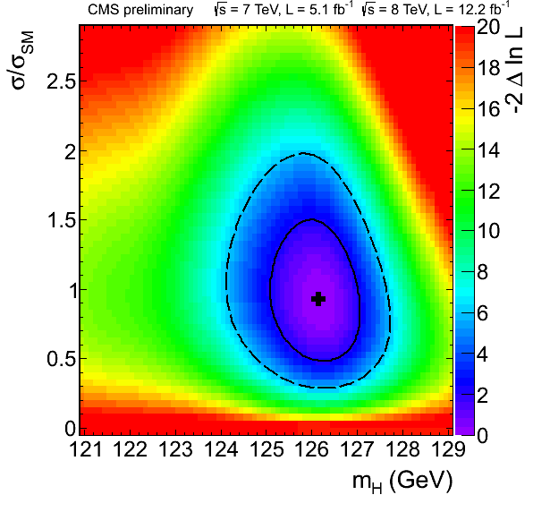
Update for H→ZZ*→ 4 l
Z
Clean signature: 4 isolated leptons
Excellent mass resolution
Backgrounds: ZZ*, Z+jets/ttbar/WZ
Matrix Element Likelihood Analysis (MELA)
  kinematic discriminant separating signal + background
  based on the 2 masses + 5 angles describing the decay
Fitted mass value of the excess:
M_{X} = 126.2 ± 0.6(stat) ± 0.2(sys) GeV
Observed local significance: 4.5 σ
Expected local significance: 5.1
For comparison the July result (ICHEP) was:
3.2 σ (observed), 3.8 σ (expected)
→ With 1.7x more data, the excess has
grown as expected!

Slide 6
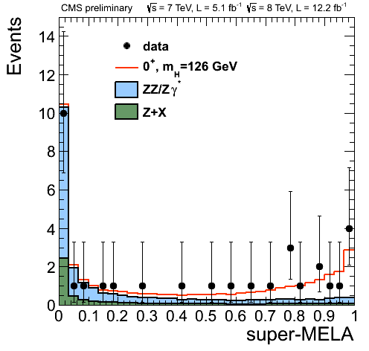
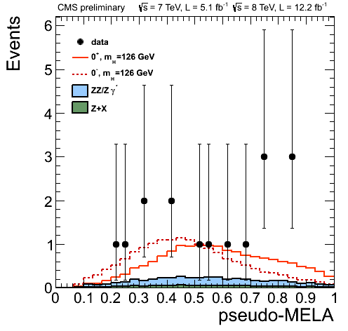
Determination of Parity
(0⁺ = SM, vs. 0⁻ Hypothesis)
Kinematic distributions of decay observables are sensitive to the parity
Construct extended MELA-based likelihoods for both scalar and pseudoscalar hypotheses, taking also the mass into account
super-MELA>0.5
SM
BG
Signal
0⁻
0⁺

Slide 7
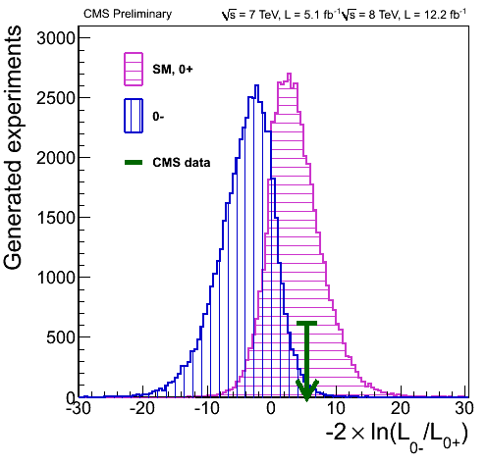
Scalar (0⁺ = SM) vs. Pseudoscalar (0⁻) Hypothesis
Expected separation of the two hypotheses: ~1.9 σ
Observation is consistent
  with 0⁺ at the level of 0.53 σ
  with 0⁻ at the level of 2.45 σ
SM
→ With our current data, the pseudoscalar hypothesis is clearly disfavored (CL~2.4%)

Slide 8
Search for Fermionic Higgs Decays

Slide 9
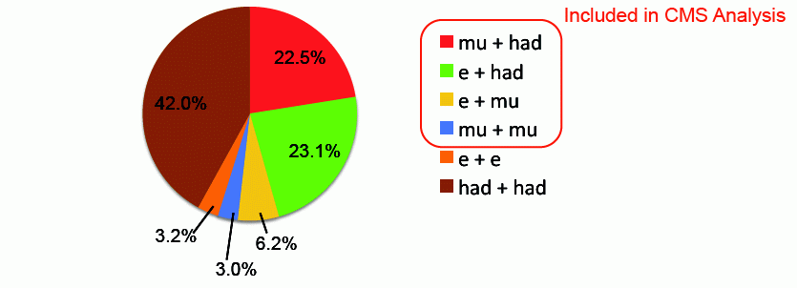


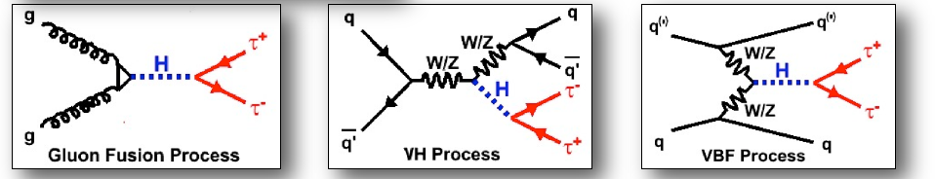
H → ττ
Large σ * BR at low Higgs masses
Sensitive to all production
mechanisms
Direct probe of Higgs
coupling to leptons
Full reconstruction of di-tau
invariant mass from
ττ decay kinematics /
matrix element and
missing E_{T}
→ almost full coverage of decay spectrum

Slide 10
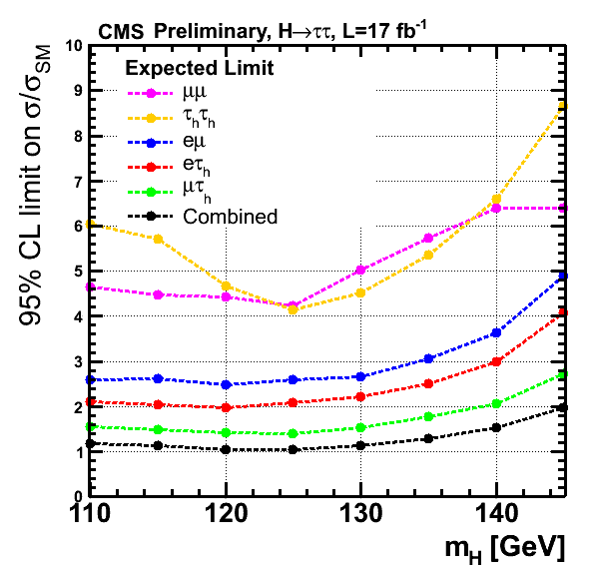
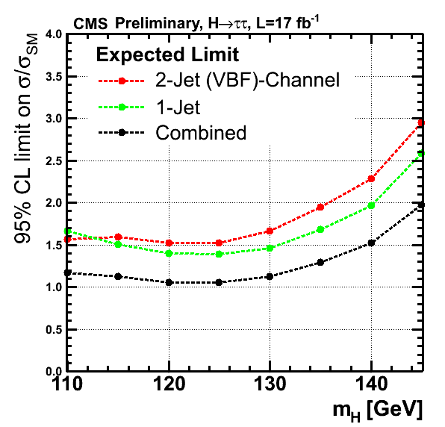
H → ττ Search Sensitivity
sensitivity / channel
sensitivity / category

Slide 11
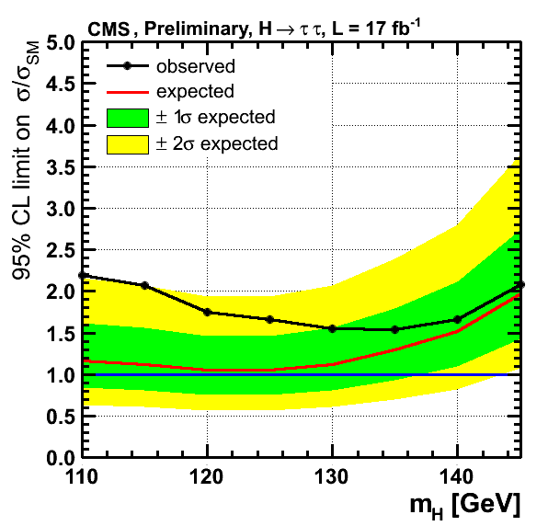
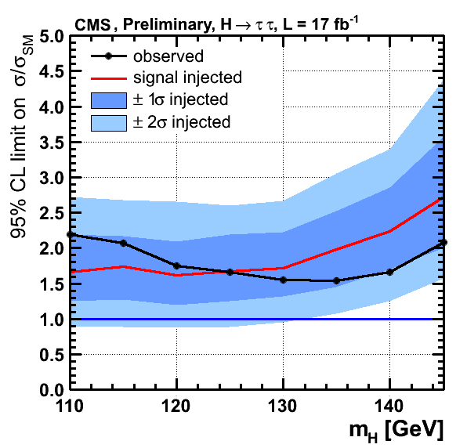
H → ττ Search Results
injected
signal
While analysis approaches exclusion sensitivity for SM model Higgs, an excess develops which is compatible with SM Higgs σ * BR
→ Compatible with the “gradual appearance” of a signal

Slide 12
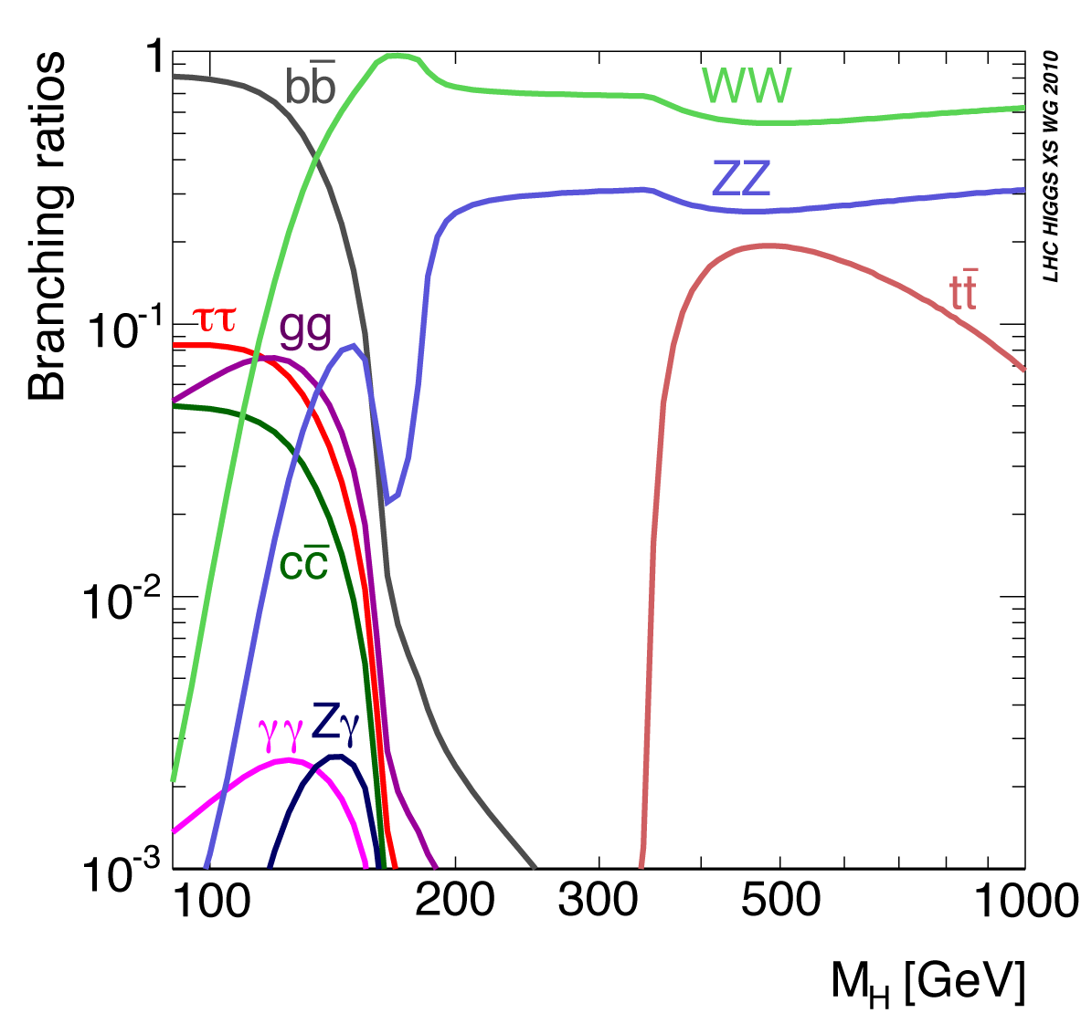
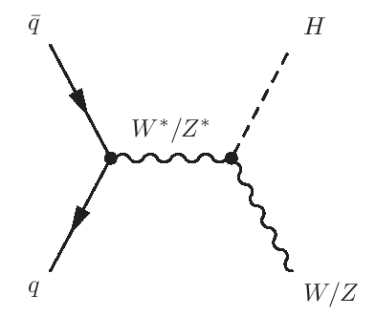
VH, H → bb
H → bb decay has the largest branching ratio for m_{H} ≤ 130 GeV
Inclusive search is impossible due to the overwhelming QCD background (S/B~10⁻⁹)
Study Higgs production in association with an additional vector boson (V = W or Z)
Five subchannels included:
  W→ eν, W → μν
  Z → ee, Z → μμ, Z → νν (invisible)
Strategy:
  boosted Higgs candidate recoiling against V
  ≥ 2 b-tagged jets
  b-jet energy regression
  BDT shape analysis

Slide 13
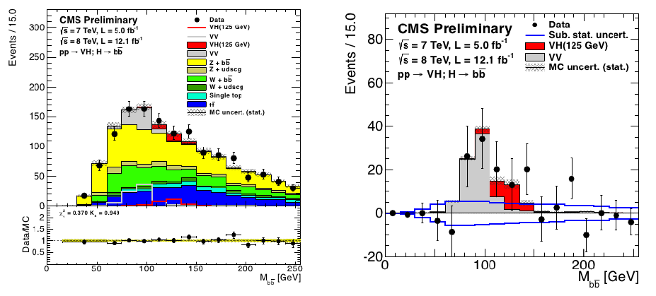
VH, H → bb (cont’d)
M(bb) after tight cuts on BDT discriminants:
VV production (an expected background) appears & is well described
  important “standard candle”
Additional excess attributed to VH production (not yet significant)

Slide 14
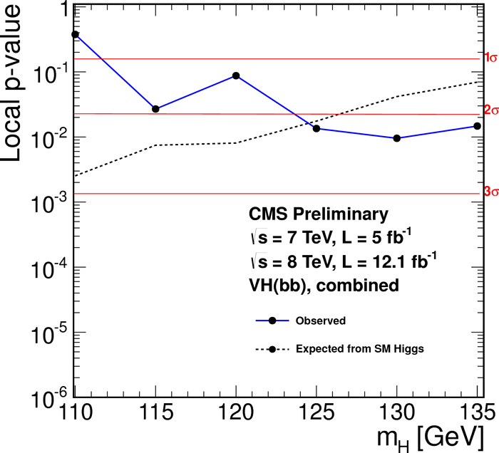
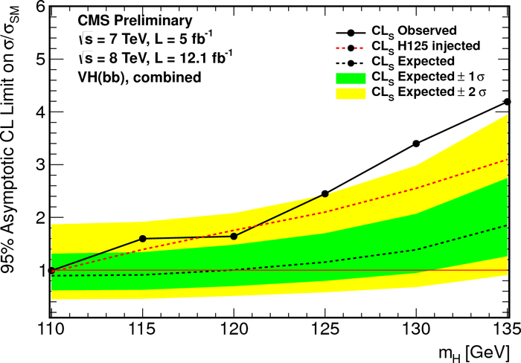
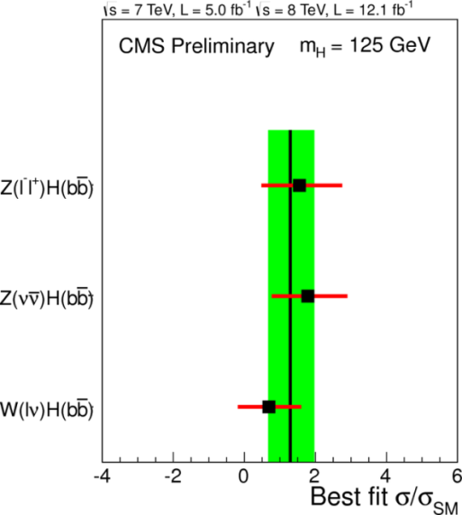
VH, H → bb Results
At m_{H}=125 GeV:
  observed excess = 2.2 σ
  expected excess = 2.1 σ (with injected SM Higgs signal)
→ Best-fit signal strength is positive, consistent across channels & compatible with SM cross section

Slide 15
SM Higgs Combination

Slide 16
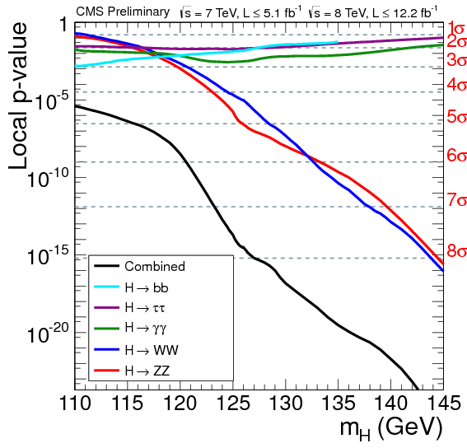
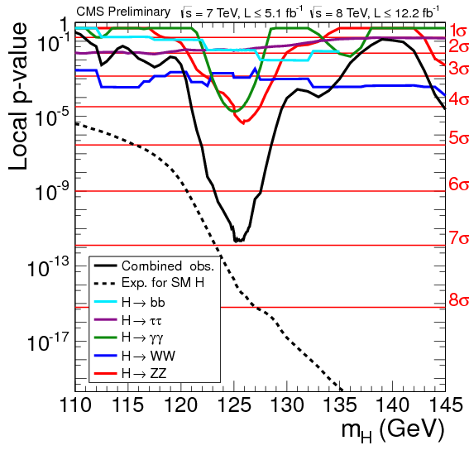
Combined Sensitivity & Observation
sensitivity / channel
observed significance
Combination of the five main channels (H→γγ at the level of ICHEP)
Good consistency between expectation & observation at m_{H} ~ 126 GeV

Slide 17
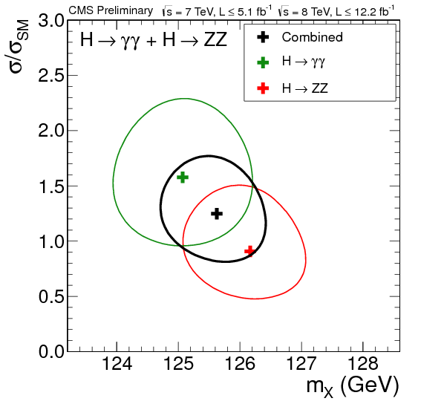
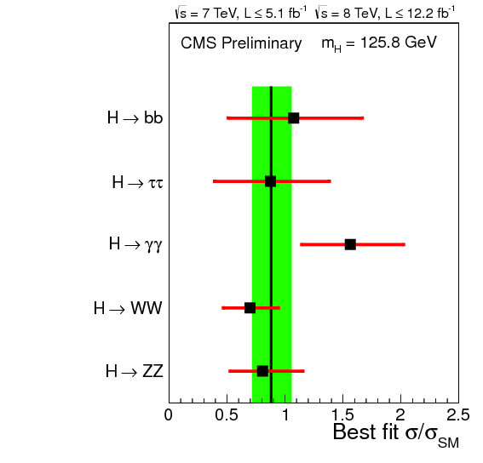
Mass & Signal Strength
ICHEP
H → γγ: ICHEP analysis
fitted mass
M_{X} = 125.8 ± 0.4(stat) ± 0.4(sys) GeV
Best fit of signal
strength in combination
σ/σ_{SM} = 0.88 ± 0.21

Slide 18
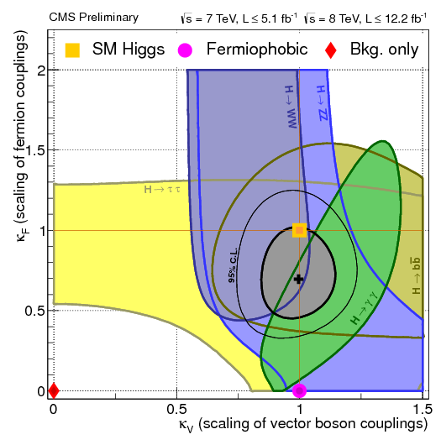
Higgs Couplings
K_{F}: uniform scaling factor applied to SM coupling of H to fermions (τ, b, t, …)
K_{V}: uniform scaling factor applied to SM coupling of H to vector bosons (γ, W, Z)
Combination of production and decay mechanism introduces correlations
Couplings are consistent with
standard model Higgs
  fermiophobic Higgs is excluded
→ Everything is consistent
with SM !

Slide 19
Searches for Neutral MSSM Higgs Bosons

Slide 20
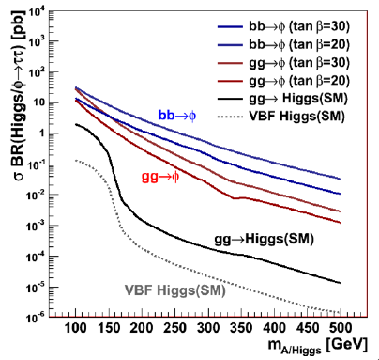
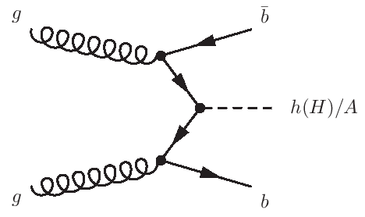
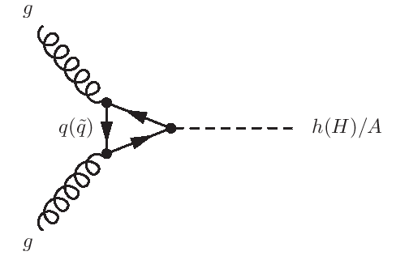
MSSM Higgs Bosons
MSSM features two complex Higgs doublets
Five Higgs particles
  three neutral (h, H, A) →
  denoted Φ
  two charged (H±)
  the observed 126 GeV state is often attributed to
  the lightest Higgs (h)
Two free parameters:
  m_{A}
  tan β (ratio of vacuum expectation values of the
  two Higgs doublets)
MSSM search in ττ channel
uses two event classes:
  B-jet category
  Non-B category

Slide 21
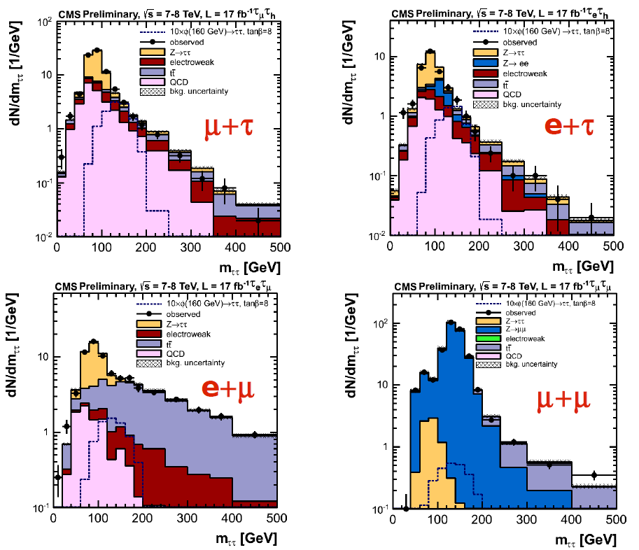
MSSM Φ → ττ:
Mass Distribution in B-Category
Background compositions differ significantly across the various decay channels
All distributions well described by background hypothesis

Slide 22
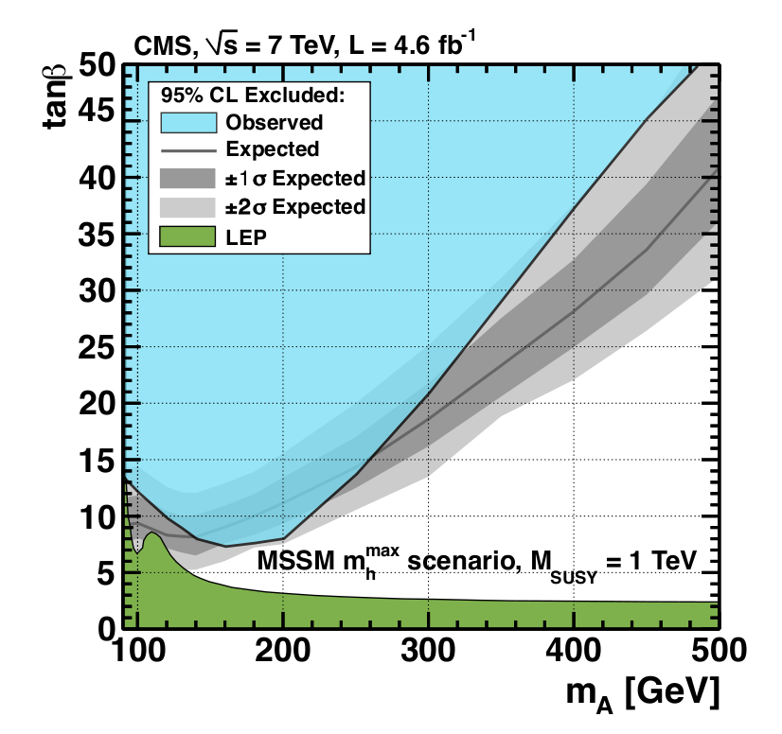
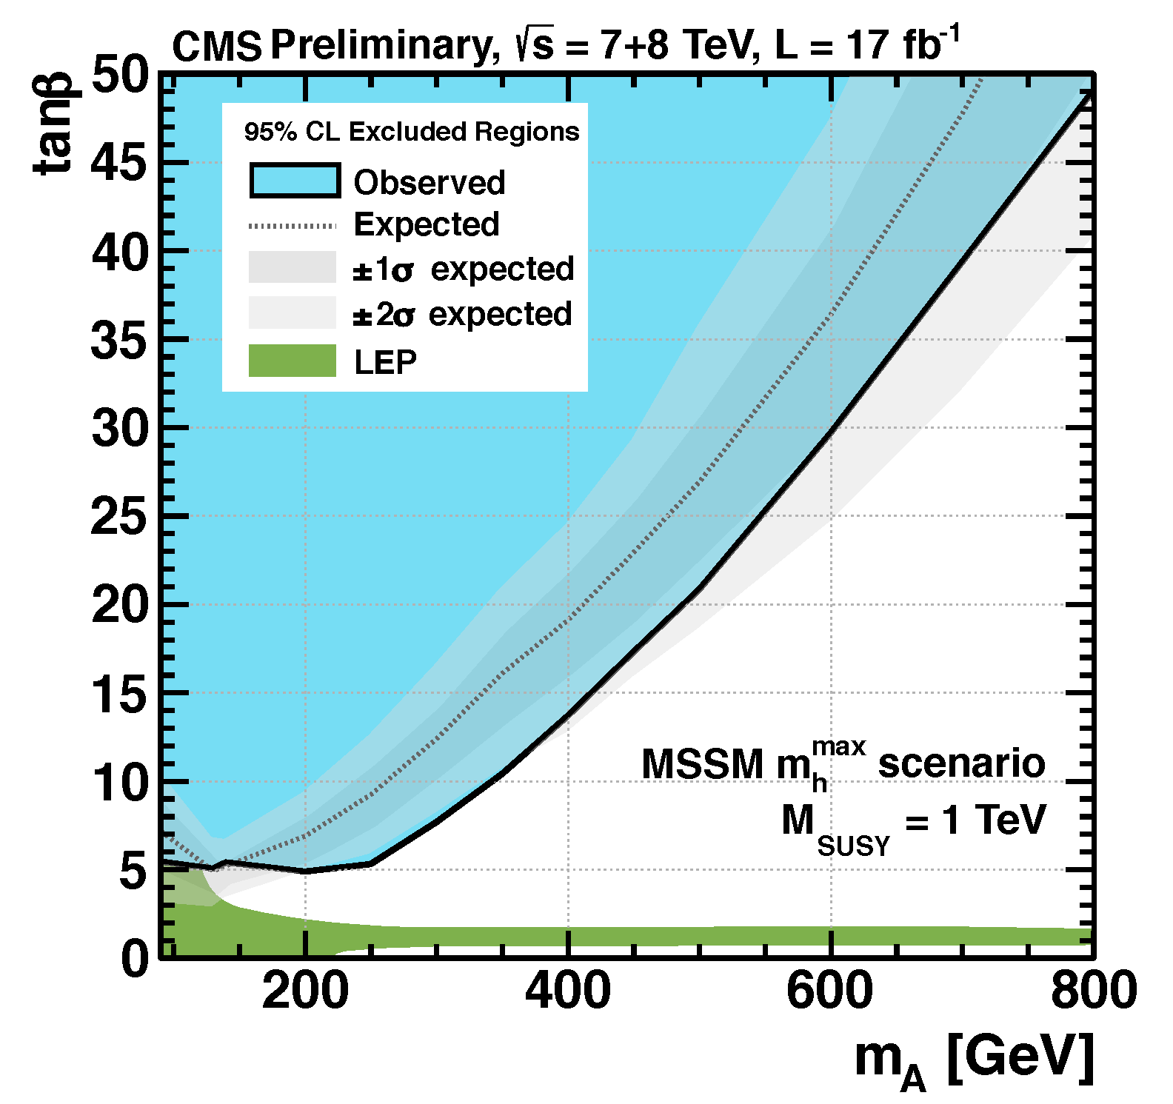
Results of MSSM Search (ττ)
Previous result (7 TeV):
New result:
Substantial improvement of tan β upper limits (tan β < 5 for m_{A}<250 GeV ! )
  touching the LEP constraint at low m_{A}
Extension of mass scale up to 800 GeV

Slide 23
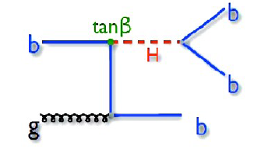
bΦ → 3b Search
Search for MSSM Higgs boson decaying to
b quarks, and produced with at least one
additional b quark
  enhancement if tan β > 1
Two analyses:
  all-hadronic (CMS-PAS-12-026)
  semileptonic (CMS-PAS-12-027)
  new: combination (CMS-PAS-12-033)
Only accessible with sophisticated triggering
  dedicated triggers: jets + b-tagging (+ muon)
Event selection: three leading b-tagged jets (+ non-isolated muon)
Data: 2.7 – 4.8 fb⁻¹ at 7 TeV
Main background: multi-jet QCD
  derived from data
Pushing the CMS trigger to its limits!

Slide 24
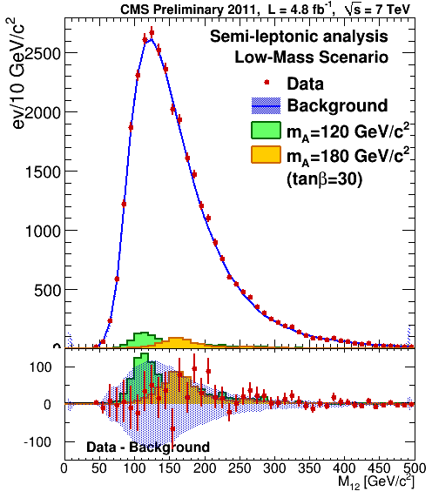
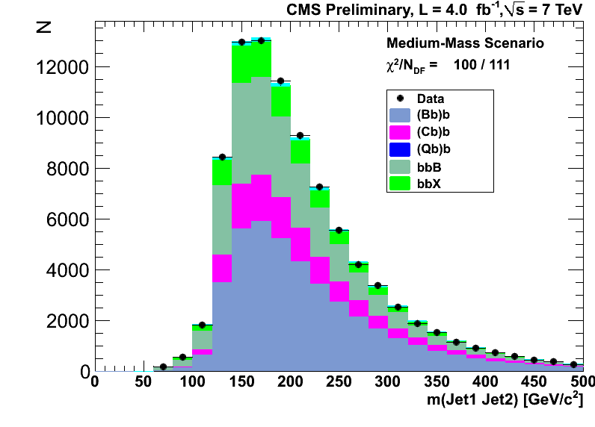
Results from MSSM Higgs Search (bΦ → 3b )
semi-leptonic
all-hadronic
No signal observed in either analysis
Nearly orthogonal selection
Analyses have been combined

Slide 25
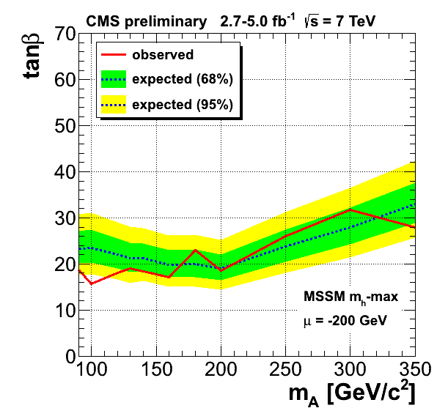
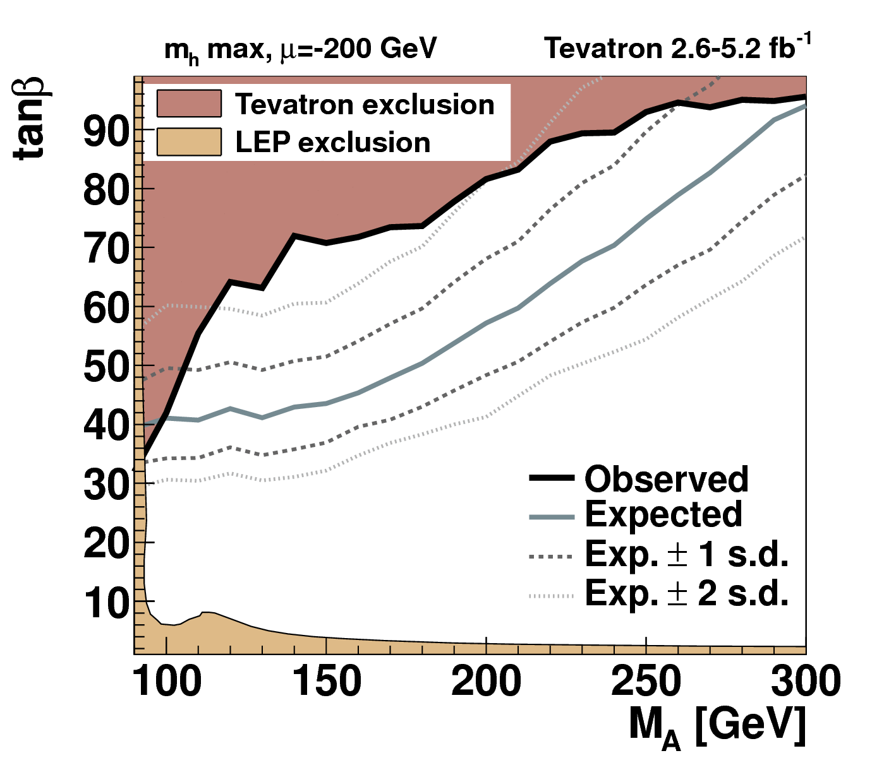
bΦ → 3b Search: Combination &
Comparison with Tevatron
Not confirming ~2σ-plus excesses seen by CDF + DZero
→ First time this is done at LHC! CMS has much better sensitivity
already with 2011 data (2012 under analysis)

Slide 26
Summary
Significance of Higgs candidate at 126 GeV is growing as expected
  Spin/parity: 0⁺ is preferred over 0⁻
Observation of decays into fermions may be around the corner
  SM-compliant excesses seen in H→ττ and H→ bb
Combination reaches a significance of 7 σ
  signal strengths in various channels compatible with SM
  coupling constants (F vs. V) consistent with SM
Growing sensitivity for MSSM Higgs sector
  very stringent exclusion limits from ττ at low m_{A}
  new combination results from bb channel (for the first time at LHC) supersede those from the Tevatron

Slide 27
CMS Higgs Results for HCP
Document | Analysis
PAS HIG-12-041 | H → ZZ → 4ℓ Search
PAS HIG-12-042 | H → WW → 2ℓ2ν Search
PAS HIG-12-043 | (SM) H → ττ Search
PAS HIG-12-044 | VH, H → bb Search
PAS HIG-12-045 | CMS Combined Search for Higgs
PAS HIG-12-046 | H → WW → ℓνjj
PAS HIG-12-050 | MSSM H → ττ
PAS HIG-12-051 | (SM) VH, H → ττ Search
PAS HIG-12-033 | bΦ → 3b ( combination )

Slide 28
CMS Higgs Results for HCP
Document | Analysis
PAS HIG-12-041 | H → ZZ → 4ℓ Search
PAS HIG-12-042 | H → WW → 2ℓ2ν Search
PAS HIG-12-043 | (SM) H → ττ Search
PAS HIG-12-044 | VH, H → bb Search
PAS HIG-12-045 | CMS Combined Search for Higgs
PAS HIG-12-046 | H → WW → ℓνjj
PAS HIG-12-050 | MSSM H → ττ
PAS HIG-12-051 | (SM) VH, H → ττ Search
PAS HIG-12-033 | bΦ → 3b ( combination )
Higgs @ CMS:
Very Successful Data Analysis
… and we @ DESY are part of it!

Slide 29
Backup

Slide 30
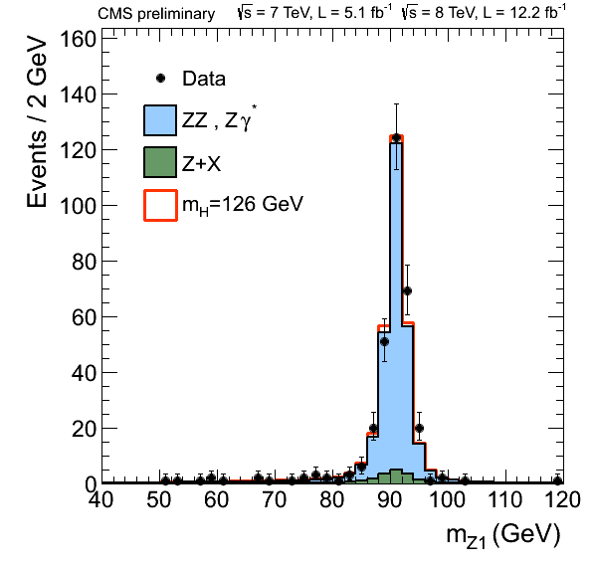
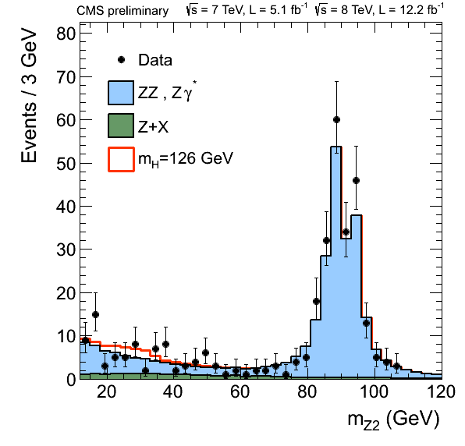
H→ZZ*→4ℓ Search Channel : Overview
Golden channel
  clean signature : 4 isolated leptons
  excellent momentum resolution of leptons
  Narrow mass peak m_{4l}
Backgrounds :
  irreducible : ZZ*
  reducible : Z+jets/ttbar/WZ
Channels studied : 4μ, 2μ2e, 4e
Lepton selection
minimal lepton p_{T} = 5 GeV (μ), 7 GeV (e)
at least one lepton with p_{T} > 20 GeV
at least two leptons with p_{T} > 10 GeV
Z1 candidate : pair with mass closest to m(Z)
Z2 candidate : built from remaining leptons with highest p_{T}
40 GeV < m(Z1) < 120 GeV 4 GeV < m(Z2) < 120 GeV

Slide 31
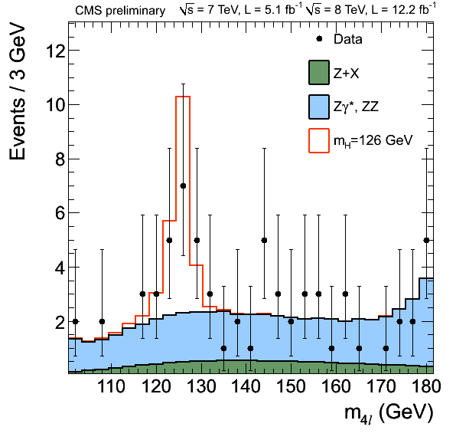
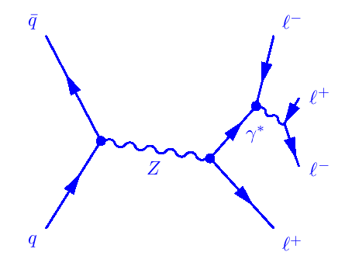
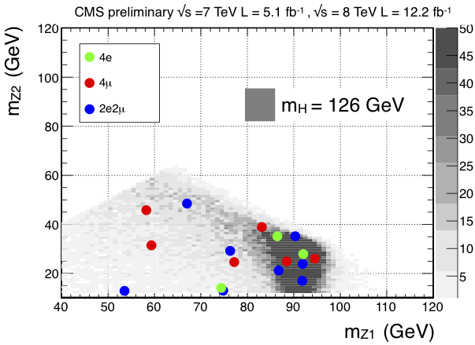
M_{4ℓ} after Dedicated Selection

Slide 32
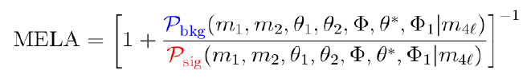
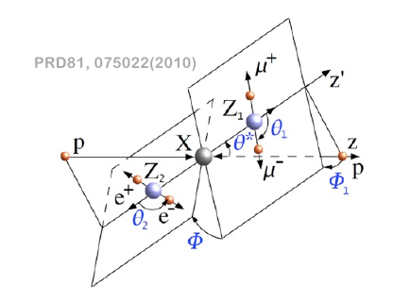
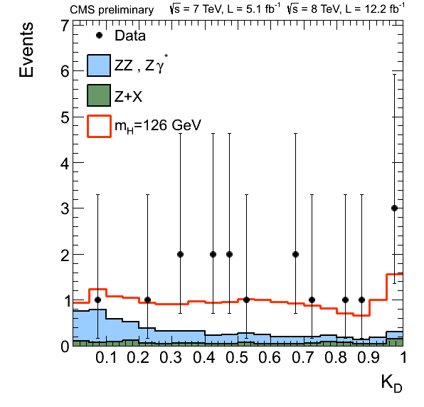
Matrix Element Likelihood Analysis
dynamics of decay described fully by 2 masses and 5 angles
Matrix Element Likelihood Analysis
discriminates J^{P} = 0⁺ state from background

Slide 33
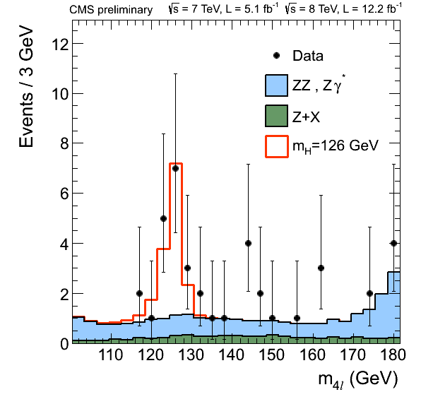
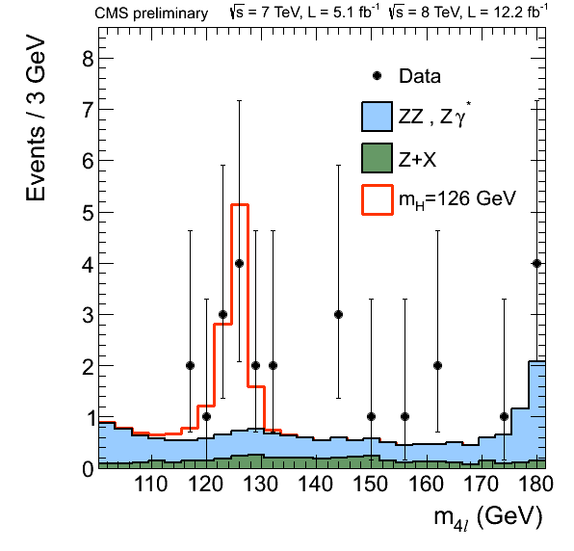
Statistical Analysis in H → ZZ* → 4ℓ Channel
K_{D} > 0.3
K_{D} > 0.5
statistical analysis performed with 2D distribution [K_{D} , m_{4l}]

Slide 34
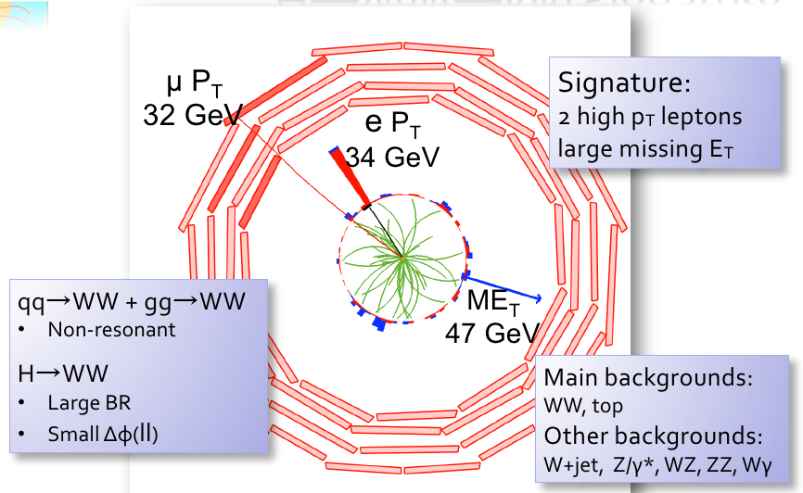
H → WW* → 2ℓ + 2ν

Slide 35
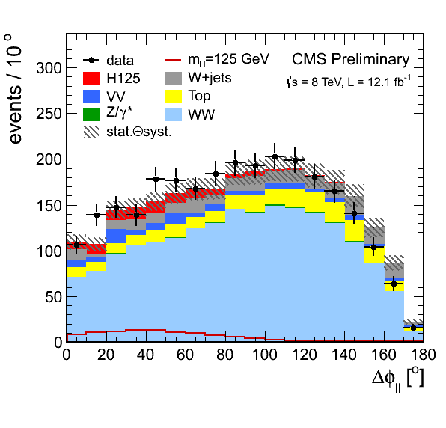
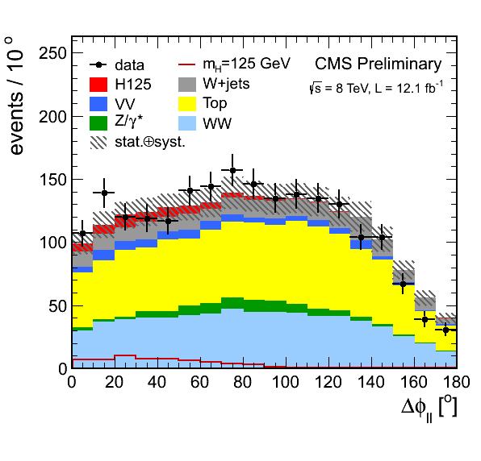
H → WW → 2ℓ + 2ν Channel
Signatures
→ 2 hight p_{T} isolated leptons (μμ, ee, eμ)
→ large missing E_{T}
→ small Δφ(ℓℓ) (SM Higgs scalarity)
Main backgrounds
WW, top, W+jets, Z+jets, WZ
Search strategy
cut based selection exploiting lepton kinematics;
event categorization based on jet multiplicity
  N_{jets} = 0
  N_{jets} ≥ 1
final 2D discriminant : [M_{ℓℓ} , M_{T} ]

Slide 36
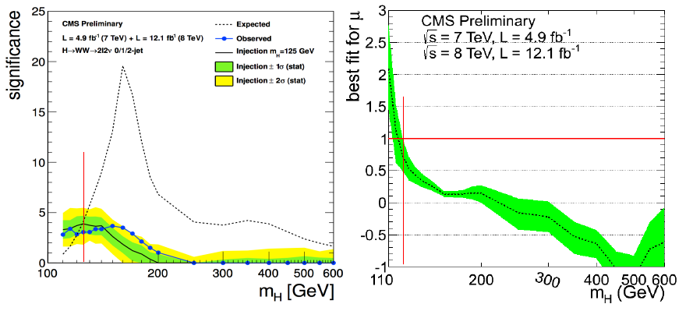
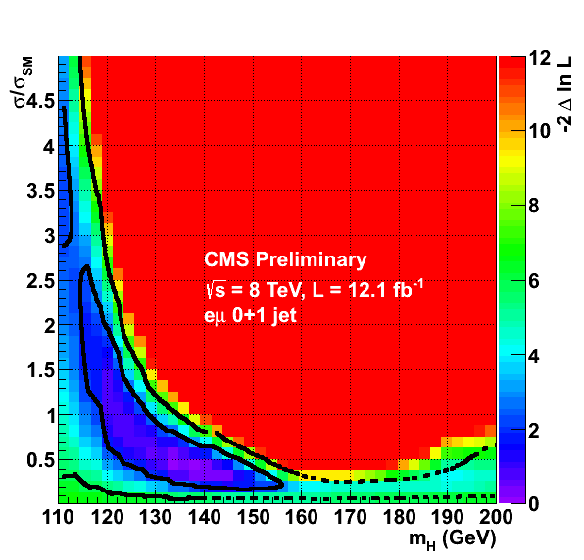
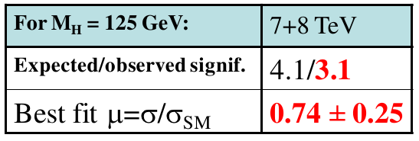
H → WW* → 2ℓ + 2v

Slide 37


H → ττ Search
new channel!
VBF : 2 jets
e+μ, ℓ+τ : M_{jj} > 500 GeV, Δη_{jj} > 3.5
τ+τ : M_{jj} > 250 GeV, Δη > 2.5
μ+μ : dedicated MVA
no jets in rapidity gap
full reconstruction of ditau mass from
ττ decay kinematics, E_{T} , ττ decay matrix element

Slide 38


bΦ → bbb Combination

Slide 39


Published Results (July 2012)
CMS and ATLAS experiments have observed a new boson consistent with expectations for the SM Higgs boson

Slide 40


Published Results (July 2012)
CMS
M_{X} = 125.3 ± 0.4(st.) ± 0.5(sys.) GeV
μ = 0.87 ± 0.23
ATLAS
M_{X} = 126.0 ± 0.4(st.) ± 0.4(sys.) GeV
μ = 1.4 ± 0.3

Slide 41


Standard Model Higgs Boson at LHC
Main search channels (m_{H} ≤ 150 GeV)
qqH / gg→H | H→γγ
qqH / gg→H | H→WW→2ℓ2ν
gg→H | H→ZZ→4ℓ
qq→VH | Z→ℓℓ,νν / W→ℓν / H→bb
ttH | H → bb
qqH / VH / gg→H | H→ττ

Slide 42

SM Higgs: Data Samples

