Slide 1
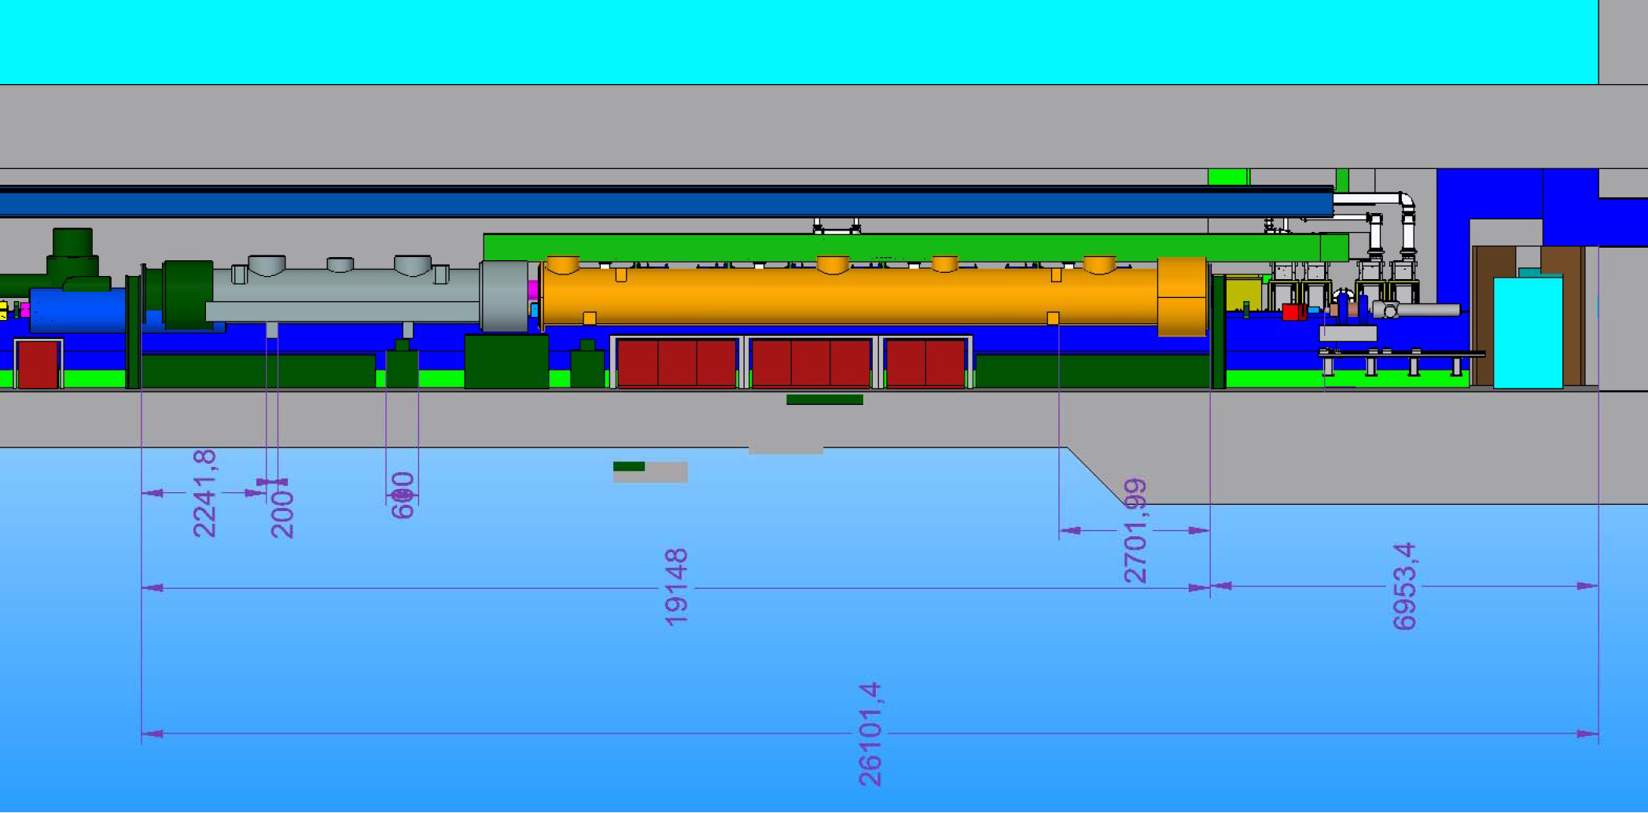
SUPPORTS FOR INJECTOR FEED CAP AND END CAP
The Budker Institute
of NuclearPhysics
Novosibirsk, RUSSIA
KonstantinovV.M., PivovarovS.G., PyataE.E.
12.04.2012

Slide 3
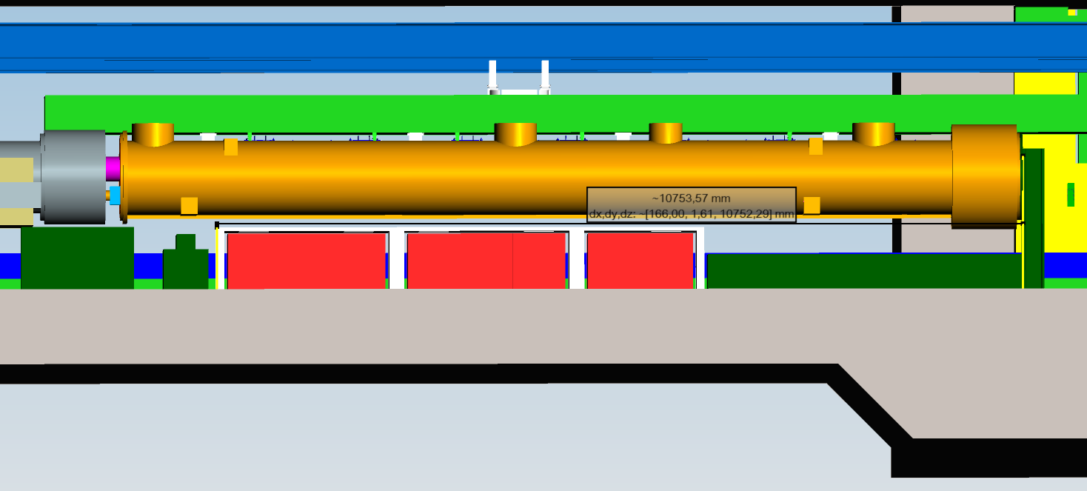
10,753 – 2,702 = 8,05 m available for electronics racks and shilding
= 0,6 + 1,0 + 0,6 = 2,2 m
= 0,6 + 1,0 = 1,6 m
2,2 m
2,2 m
1,6 m
1,6 m
= 7,6 m (10x16 HE)
2,8 m
2,8 m
2,2 m
= 7,8 m (11x16 HE)

Slide 4
Support colums added N.Meyners 2082012
U-shaped colum?
Colum use as rack shielding?
…if we use exactly the columns as shown in the master model, I measure a space of 7,79m between the columns, which would be enough for ten racks (the number we assumed possible). How much space would be gained by making the columns asymmetric, and would it be enough for one more rack (I assume that we can easily gain 1cm but probably we need a little more space to actually get the racks in)?
On slide 4 I am missing the 3.9GHz preamp, can it go into the same rack as the HOMs?
Markus Hüning

Slide 5
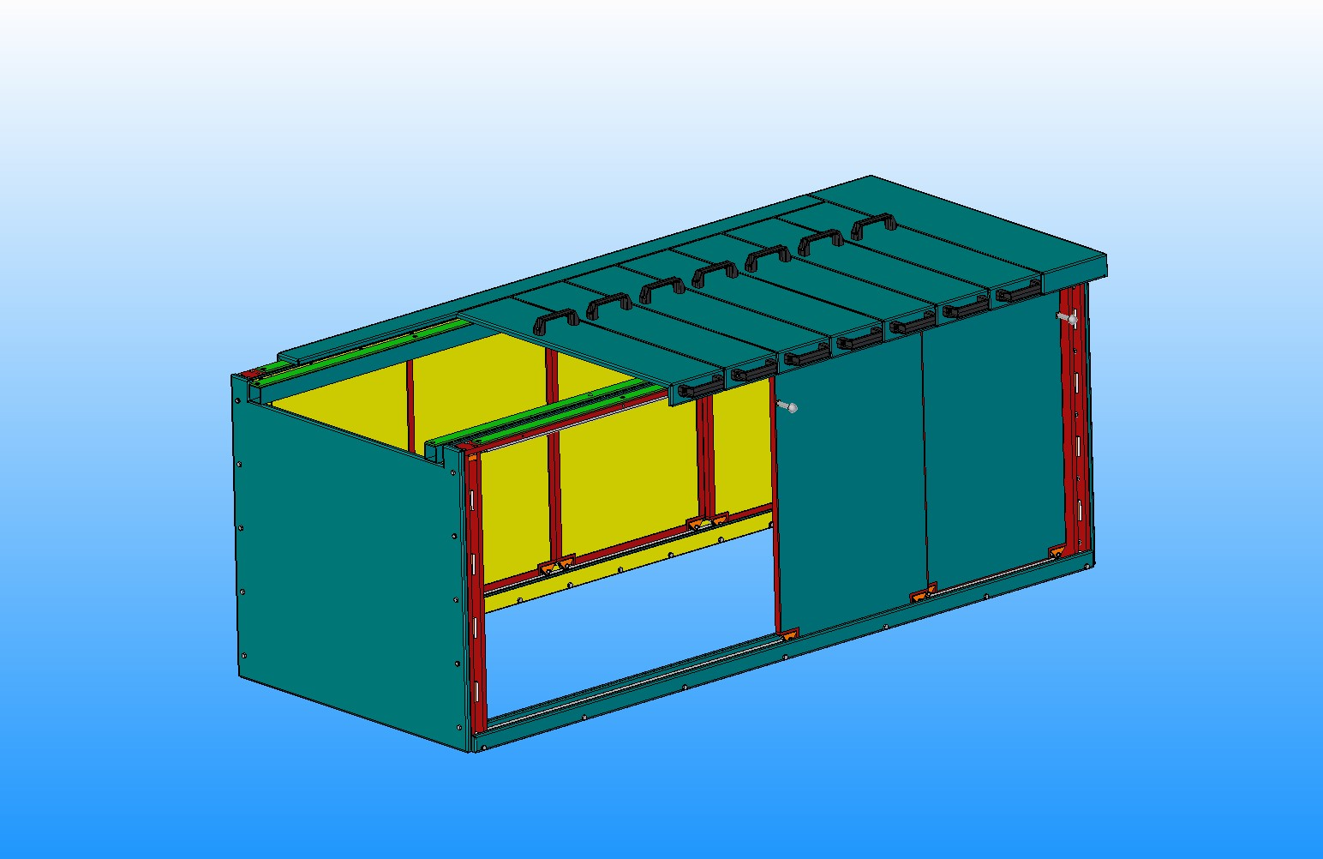
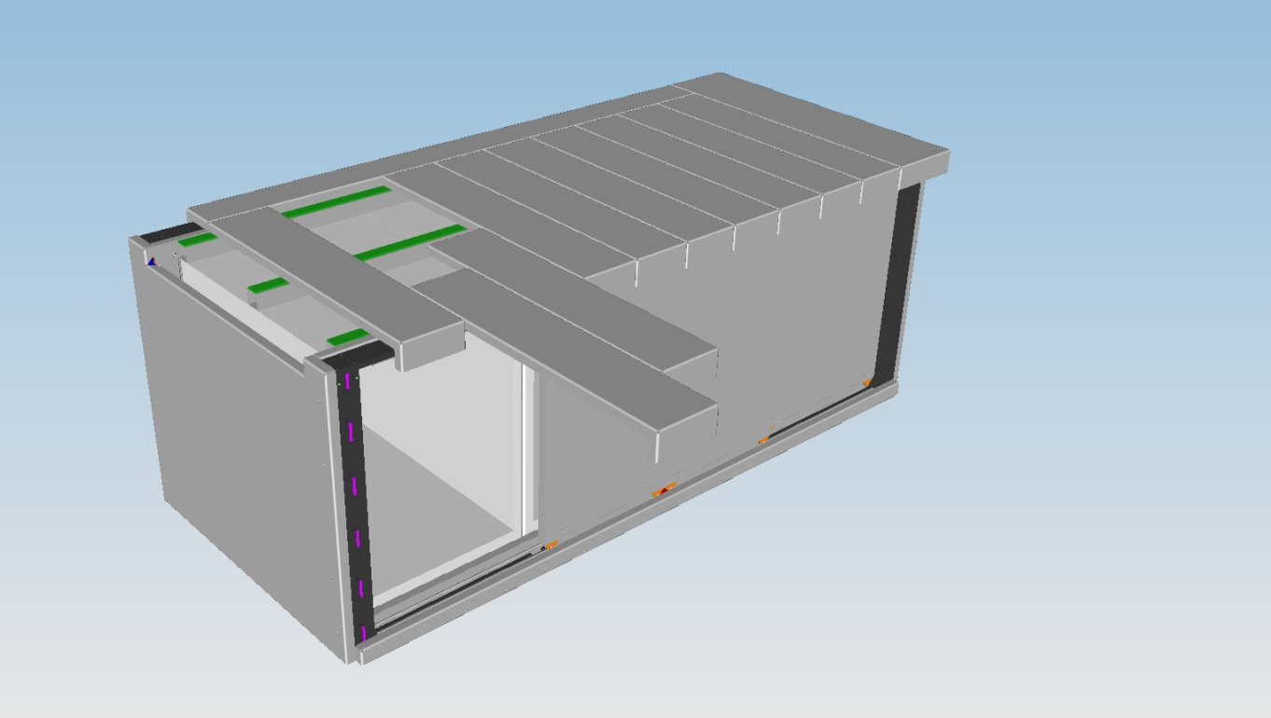
Radiation Shielding
It is possible to design one Rad. Shield. for set of cabinets (i.e. 3+3+2+2) without shielding plates between set of racks , but in my opinion,
it is not possible to have one single frame for sliding doors (front and rear) with length of more than 7 m. The frame should be divided in at least 2
parts.
The frame should have 100 mm clearance on both sides (left and right) of racks cabinet to allow sliding doors open fully.
The shielding plates on left and right sides of set of cabinets needs 2 times 25 mm = 50 mm
Wojciech Wierba
If the frame is divided into two part we have clearances
100 mm (left) + 200 mm (middle) + 100 mm (right) + 50 mm = 450 mm
For 2 sets of 3 racks with extended (6 kW, 20C)cooling plus 2 sets of standard (3 kW, 20C, ~40C air inside) we have:
2.6 + 2.6 + 1.6 + 1.6 + 0.45 (Rad. Shield) = 8.85 m.
For sure, it will not fit between two supporting columns.
Wojciech Wierba

Slide 6
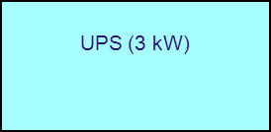
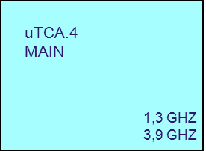
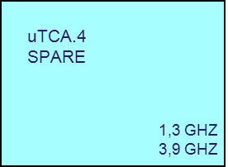
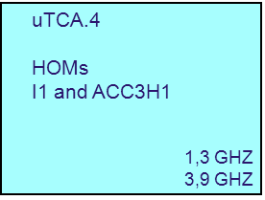
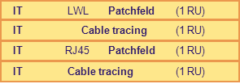
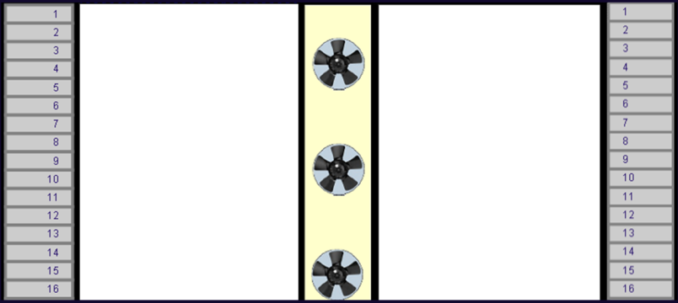
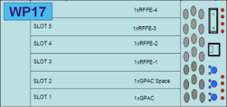
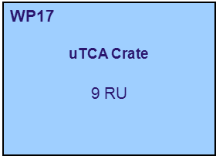
Preamplifier
3,9 GHz
Phasenschieber
1,3 GHz
Phasenschieber
3,9 GHz
Tuner
1,3 GHz and 3,9 GHz
Main Coupler
1,3 GHz

Slide 7
Opened questions
Space under 3,9 GHz Module
IT Hauptverteiler (11 HE) for Injector. Could it be placed in XSE 5UG? ---> UG04/25 XSIN
On slide 6 the 3.9GHz preamp is missing, can it go into the same rack as the HOMs?
Cooling capacity for 3-Rack- and 2-Racks-Cabinets
0,6 m
0,6 m
1,0 m
0,6 m
0,6 m
1,0 m
0,6 m
1,0 m
0,6 m
1,0 m
= 7,6 m (10x16 HE)
0,6 m
0,6 m
1,0 m
0,6 m
0,6 m
1,0 m
0,6 m
0,6 m
1,0 m
0,6 m
= 7,2 m (10x16 HE)
0,6 m
1,0 m
1,0 m
0,6 m
0,6 m
1,0 m
0,6 m
0,6 m
1,0 m
0,6 m
= 7,6 m (10x16 HE)

