Slide 1
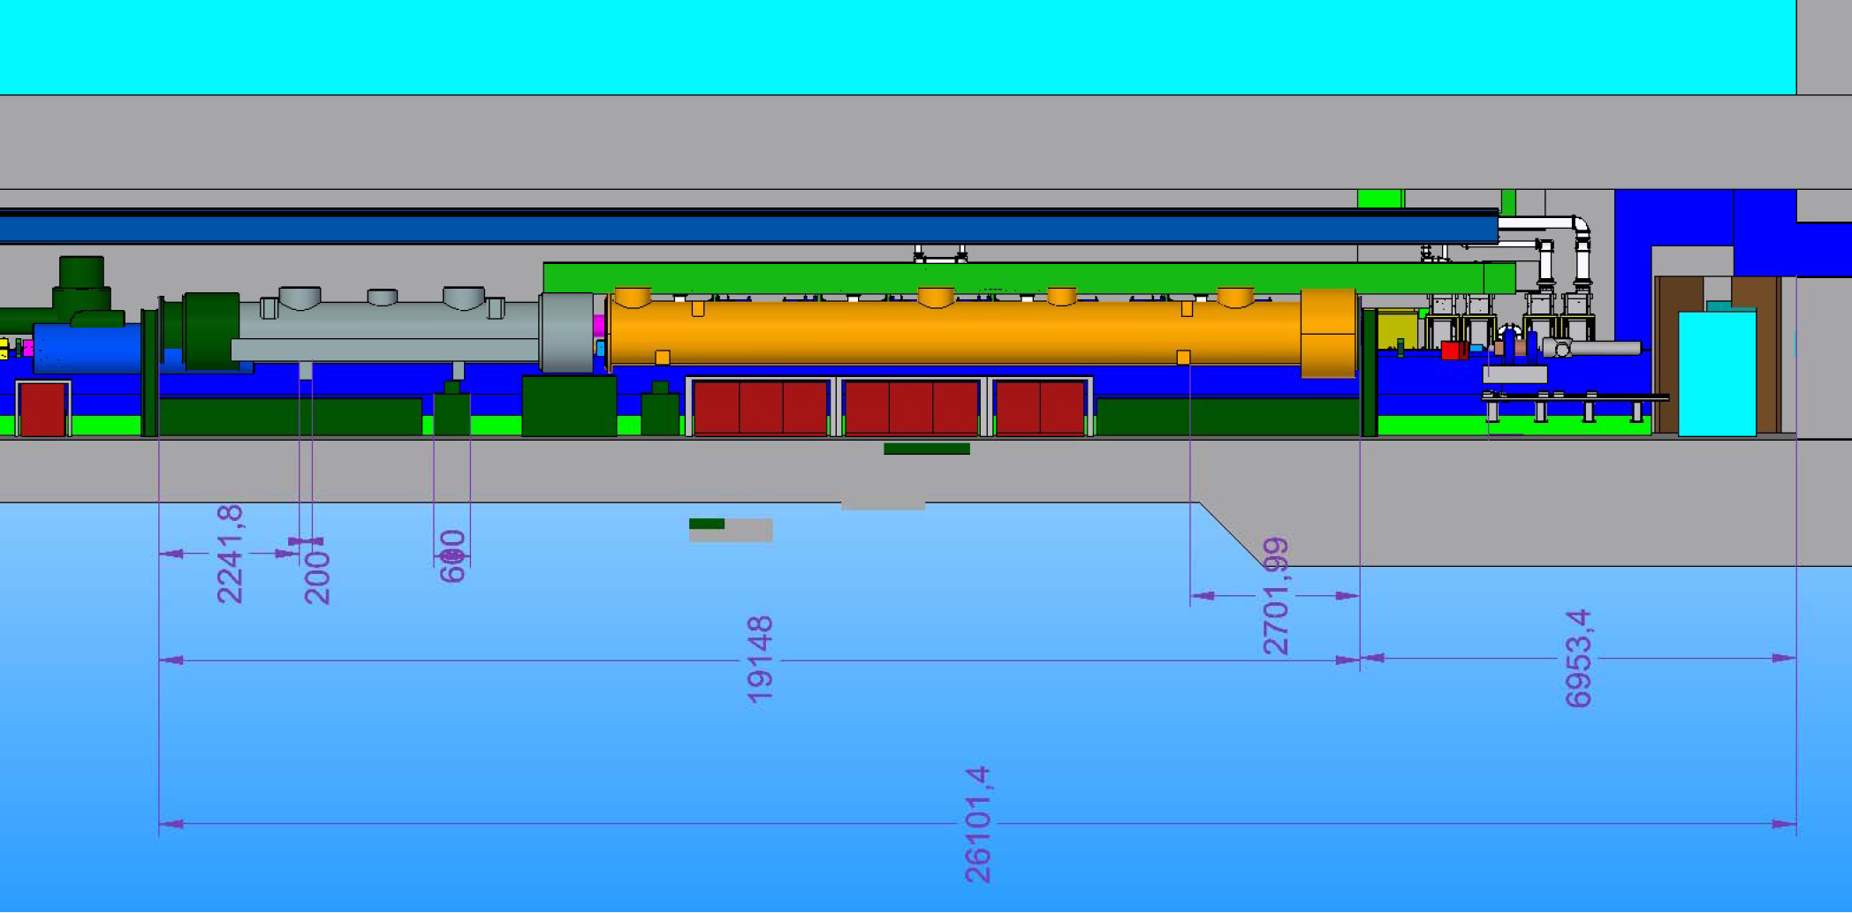
SUPPORTS FOR INJECTOR FEED CAP AND END CAP
The Budker Institute
of NuclearPhysics
Novosibirsk, RUSSIA
KonstantinovV.M., PivovarovS.G., PyataE.E.
12.04.2012

Slide 3
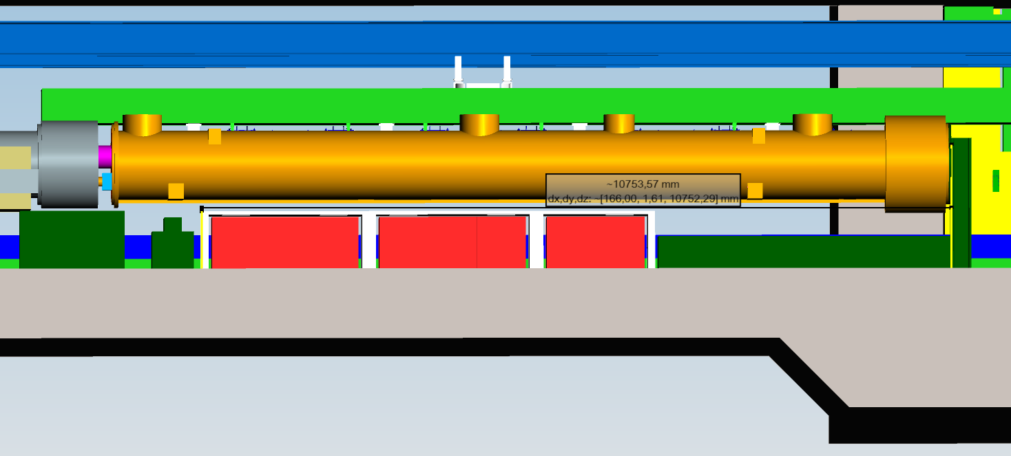
10,753 – 2,702 = 8,05 m available for electronics racks and shilding
= 0,6 + 1,0 + 0,6 = 2,2 m
= 0,6 + 1,0 = 1,6 m
2,2 m
2,2 m
1,6 m
1,6 m
= 7,6 m (10x16 HE)
2,8 m
2,8 m
2,2 m
= 7,8 m (11x16 HE)

Slide 4
Support colums added N.Meyners 2082012
U-shaped colum?
Colum use as rack shielding?

Slide 5
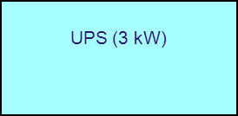
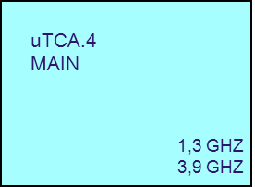
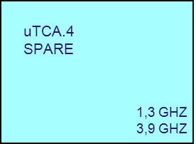
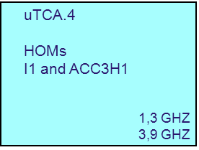
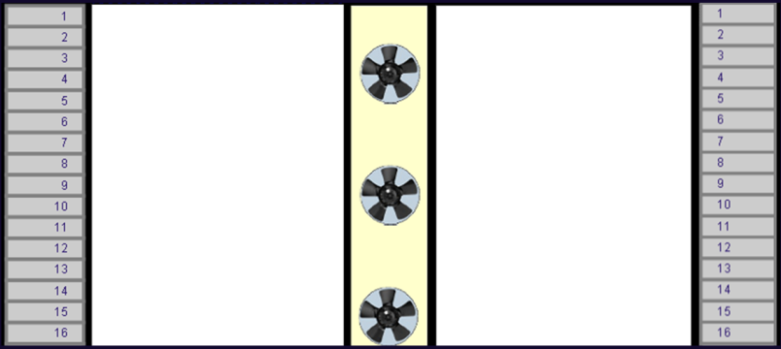
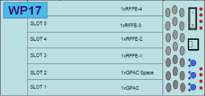
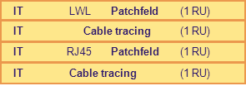
Phasenschieber
1,3 GHz
Phasenschieber
3,9 GHz
IT Control Net Switch 1 (1 RU)
IT Control Net Switch 2 (1 RU)
IT
RJ45 Patchfeld (2 RU)
Tuner
1,3 GHz and 3,9 GHz
IT
Cable tracing (2 RU)
IT
LWL Patchfeld (3 RU)
Main Coupler
1,3 GHz
IT
Cable tracing (2 RU)

Slide 6
Opened questions
Space under 3,9 GHz Module
IT Hauptverteiler (11 HE) for Injector. Could it be placed in XSE 5UG?

