Slide 1

MAMA at FLASH
Momentum and momentum spread analysis at FLASH:
The Accelerator and the magnetic spectrometer
Luca Somaschini
DESY, 6 - Sept - 2012

Slide 2
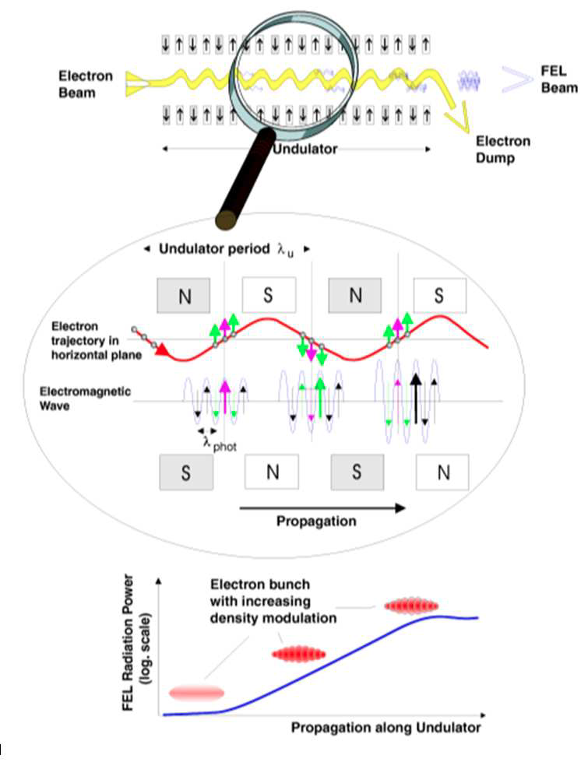
Motivation: SASE Beam Requirements
SASE: Self Amplified Spontaneous Emission
The beam undergoes a process called micro-bunching, due to the energy transfer from electrons to electromagnetic wave.
The power of the electromagnetic wave grows exponentially with z until saturation
: exponential characteristic growth length.

Slide 3
Motivation: SASE Beam Requirements
To decrease means to reduce the undulator length
It is necessary to obtain:
Small Transverse Emittance: Good overlap of electron-photon all over the undulator length
High Peak Current: High radiation power within a small length
Small Energy Spread: As many particles as possible within the lasing bandwidth and to allow good compression

Slide 4
FLASH Accelerator

Slide 5
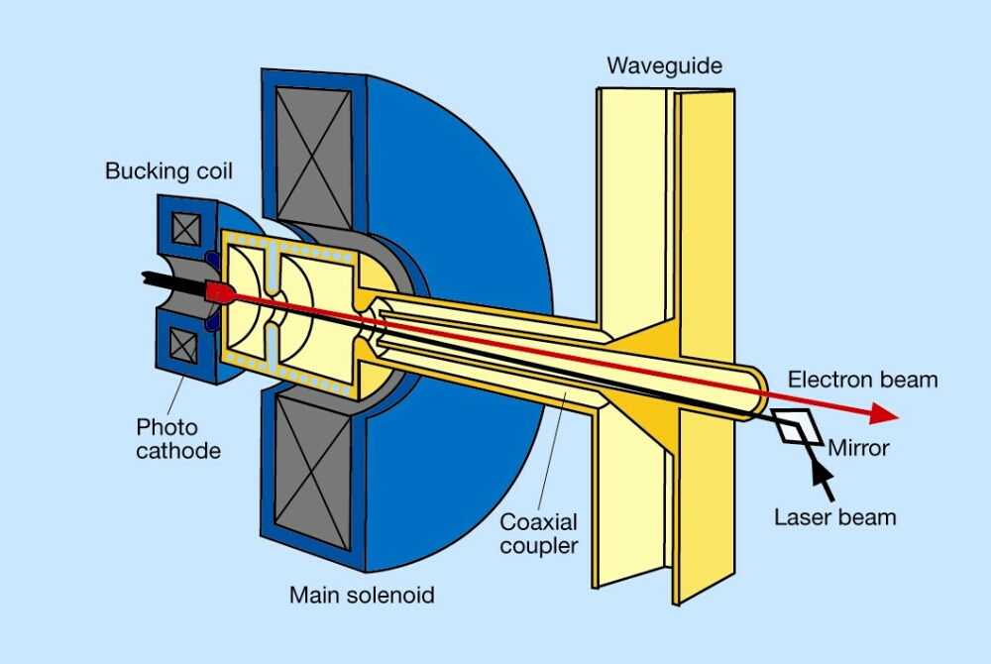
FLASH Complex
UV LASER PULSE
262 nm

Slide 6
FLASH Complex
Cs₂Te Cathode emits electrons

Slide 7
FLASH Complex
Electrons are accelerated by a 1.5-cell cavity to avoid space charge effect

Slide 8
FLASH Complex
Beam is squeezed by a Solenoid

Slide 9
FLASH Complex
To avoid space-charge effect it is not possible to obtain too short bunches.

Slide 10
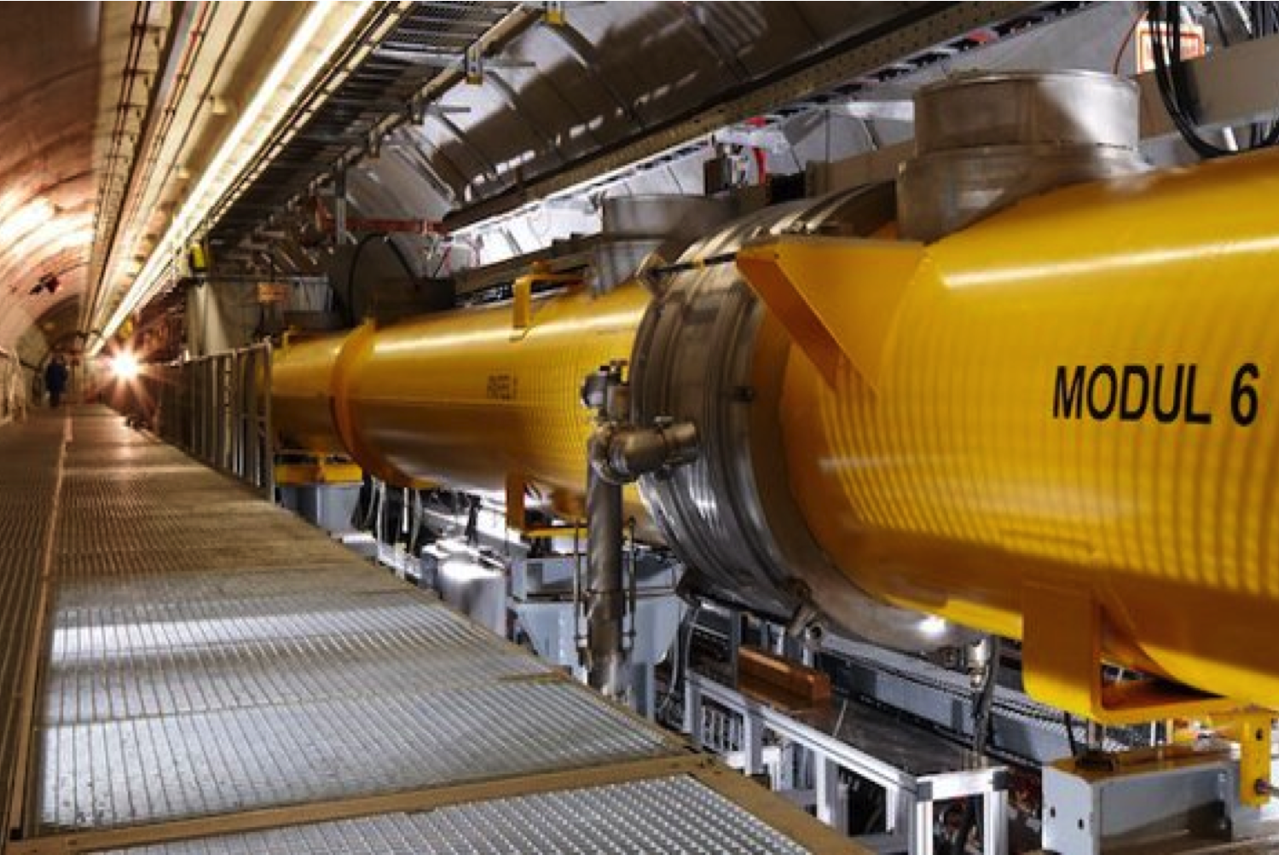
FLASH Accelerator
RF CAVITIES:
Seven 1.3 GHz modules
8 cavities per module
9 cells per cavity
RF pulsed at 10 Hz
1-800 bunches per pulse
Up to 1.25 GeV

Slide 11
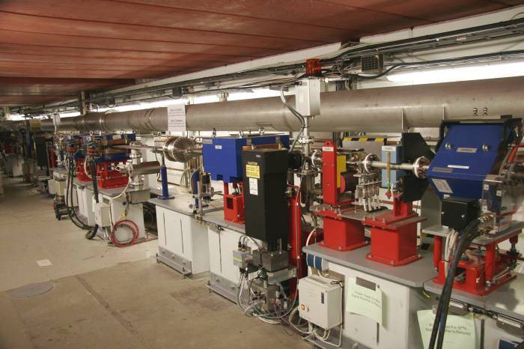
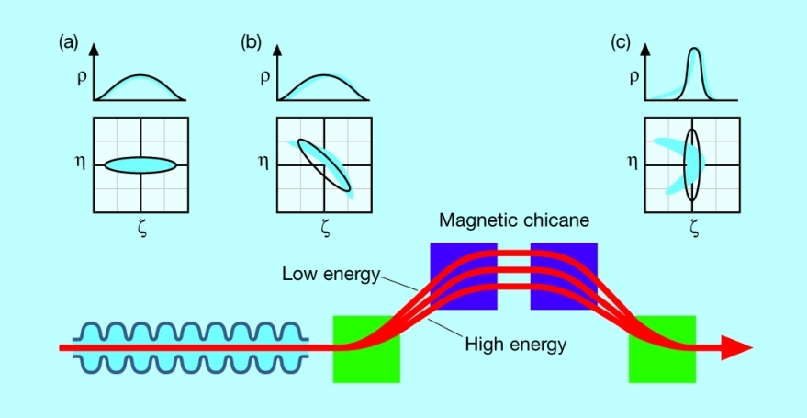
FLASH Accelerator
BUNCH COMPRESSORS
Reduce the bunch length
Increase the peak current

Slide 12
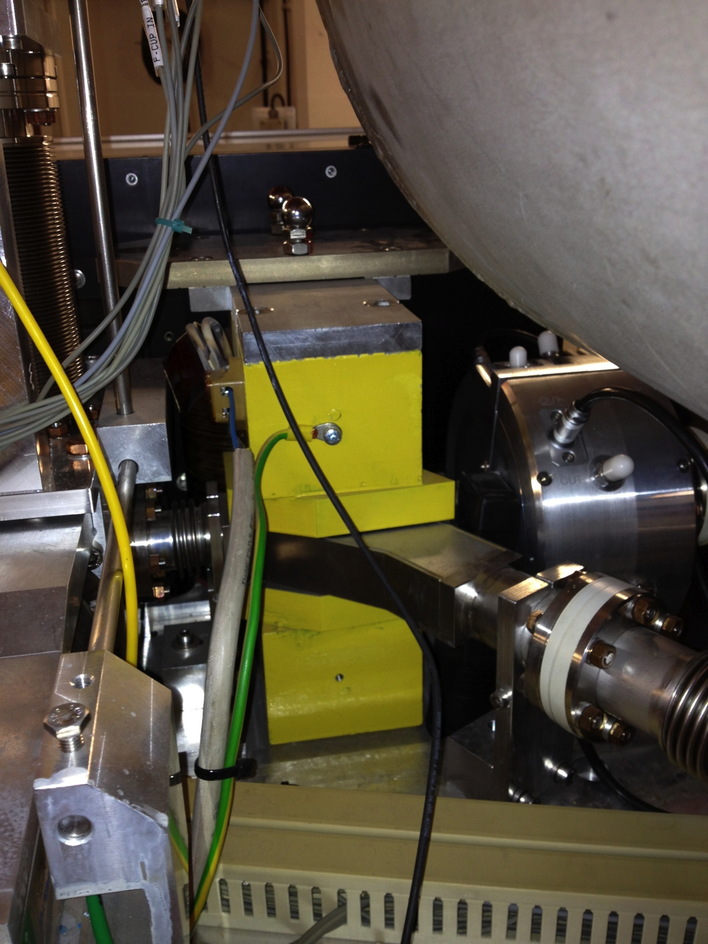
FLASH Complex

Slide 13
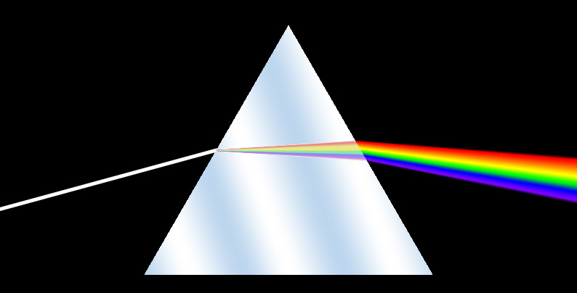
The spectrometer
Longitudinal phase space is scanned by means of a spectrometer to determine:
Mean Momentum
Momentum Spread

Slide 14
The spectrometer
Multiple particle
Same initial position but different momenta
Different position depending on the momentum
SCREEN

Slide 15
The spectrometer
Distribution is the convolution of
Beam transverse size
Momentum dispersion

Slide 16
The spectrometer
Collimators can be used to reduce as much as possible the contribution of the beam width
SCREEN

Slide 17
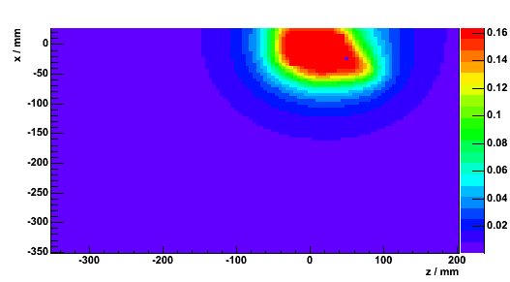
Dipole
A good knowledge of the moments requires a good knowledge of the dipole filed:
Non flat field
Edge Effects

Slide 18
Dipole: Hysteresis Cycle
Important to move ALWAYS on the falling cycle edges.
Small area but significant momentum difference
Need to know the B field for each current

Slide 19
Dipole: Hysteresis Cycle
Difference between measure and fitted value. NO interpolation

Slide 20
Dipole: Hysteresis Cycle
Small field differences translate into great momentum differences
Typically exponential with three parameters is used
Exponential with 4 parameter provides best fitting

Slide 21
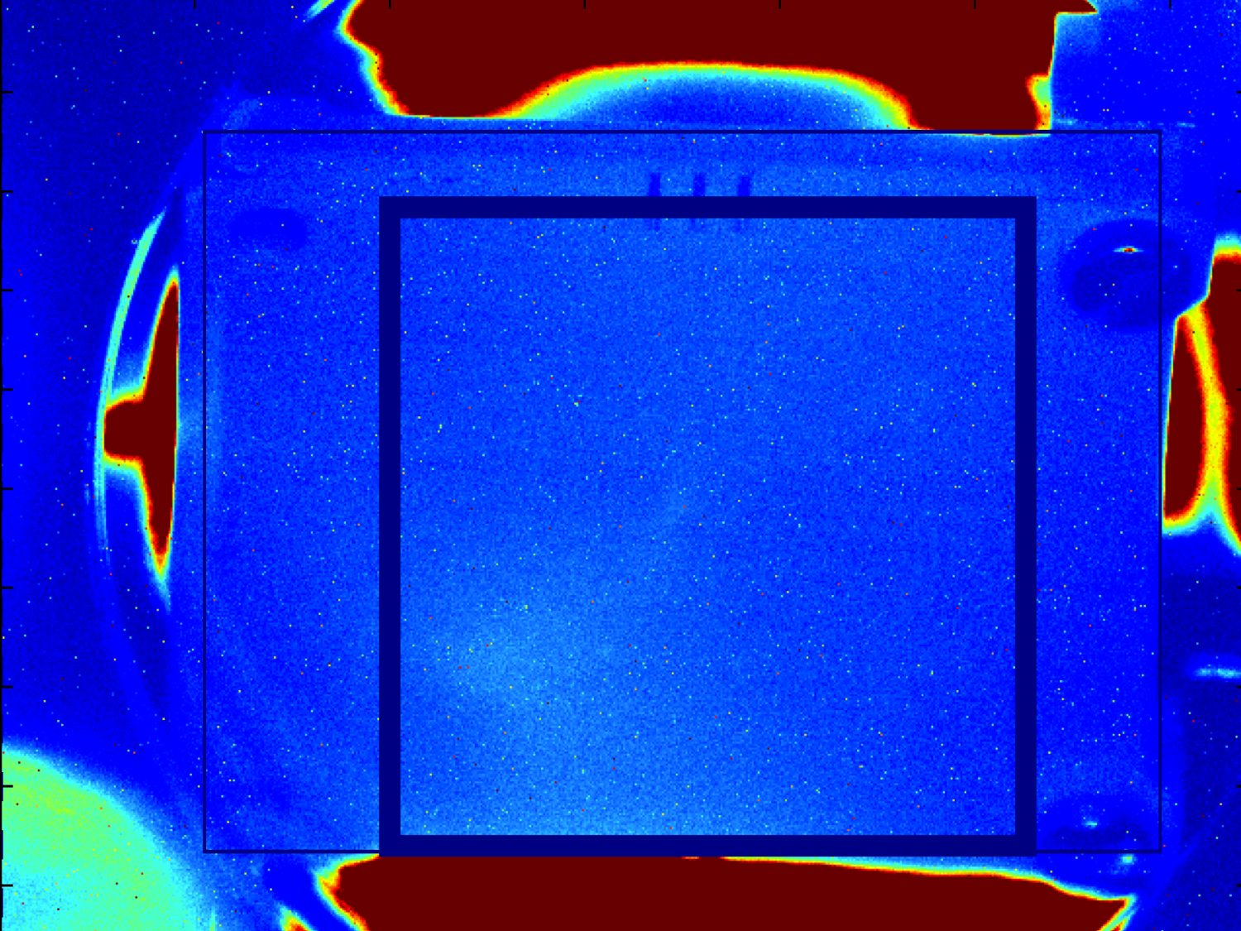
MAMA Software
Insert the screen
Turn on the light
Acquire screen image

Slide 22
MAMA Software
Calibration:
Extablish relation position-pixel

Slide 23
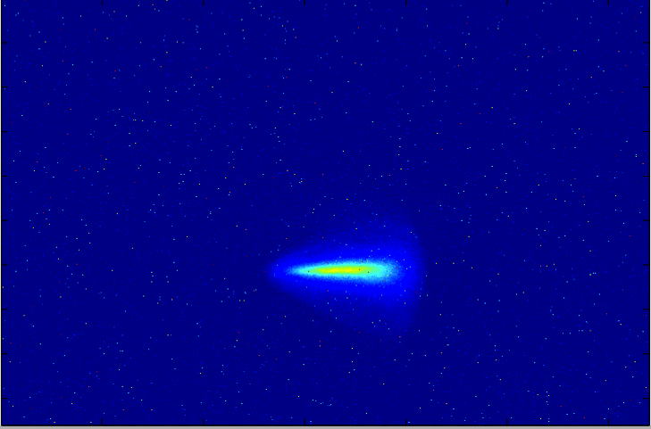
The spectrometer
Beam Acquisition
Image of the beam on the screen

Slide 24
The spectrometer
Beam Acquisition
The Dispersion takes places only in one direction

Slide 25
The spectrometer
Beam Acquisition
Transverse spread is only due to beam size
It has to be as small as possible

Slide 26
The spectrometer
Beam Acquisition
Sum over trasverse direction

Slide 27
The spectrometer

Slide 28
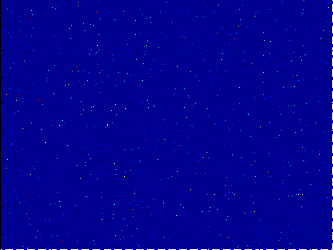

MAMA Software
Possibility to define background reduction
With BKG
Without BKG

Slide 29
MAMA Software
Development of an analysis code:
Inspired by MAMA code for PITZ (by Lipka)
Matlab Based
Project is meant to be expanded and improved….it’s not a complete project:
The code must be simple and easy to be modified
Separate features and functions on separate files

Slide 30
MAMA Software
Four files with separate functions:
MAMA_GUI.fig: Graphic information
MAMA_GUI.m: Callback definition
MAMA_main.m: Test file
Data.m: Class with:
  Parameters
  Acquired data
  Analysis functions

Slide 31
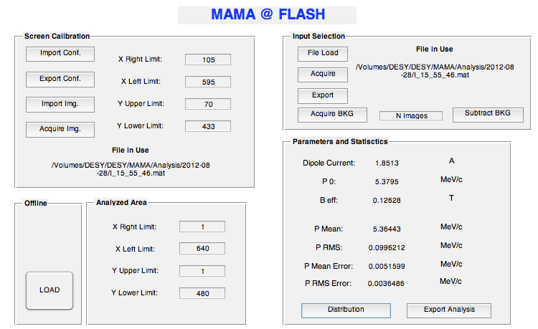
MAMA Software

Slide 32
MAMA Software
Further Improvements:
Embedded control on the machine:
  Control of the screen
  Control on the dipole current and hysteresis cycle
  Control on the beam status
Embedded logbook printout
Current Scan function for non-fitting beams
  Multiple pictures for a single analysis
  To generate momentum distribution as a function of the dipole current

Slide 33
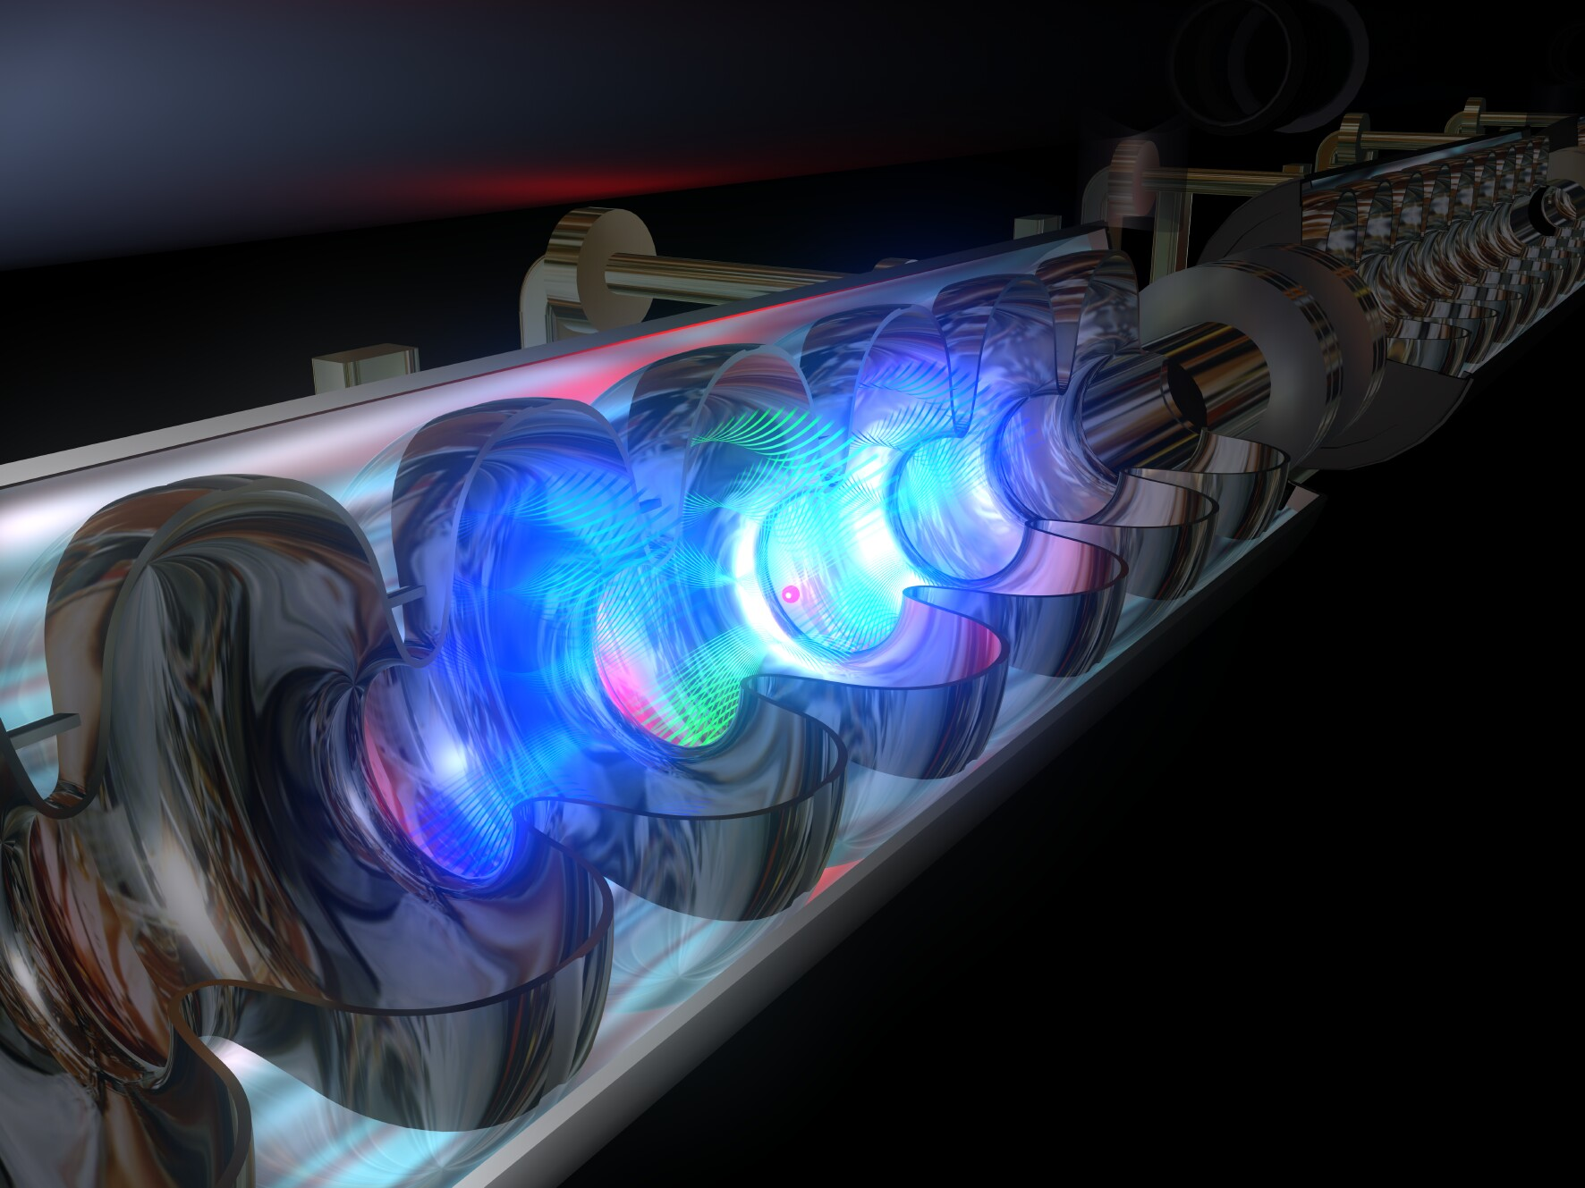
Thank you!!!
Thanks to DESY and to MPY group

Slide 34
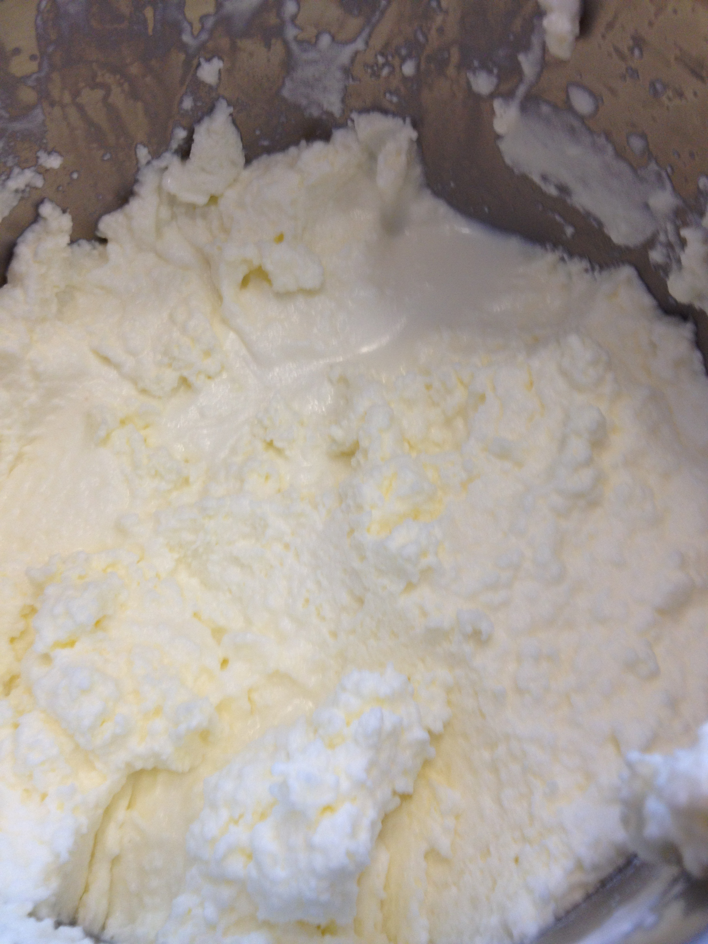
Thanks to ALL the summer students….

Slide 35
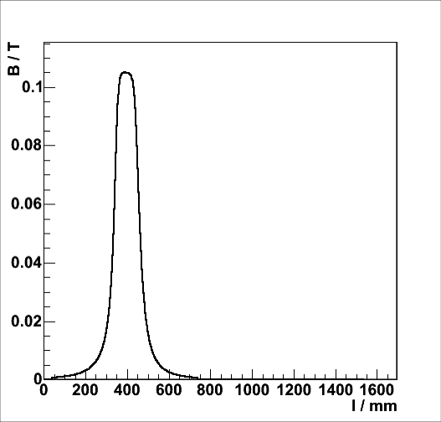
The spectrometer
The central particle is called reference particle
Every other measure is expressed referring to the reference particle frame
Momentum of the reference particle:

Slide 36
Dipole: Hysteresis Cycle
Search of the best fitting function:

Slide 37
Dipole: Hysteresis Cycle
Only exponential with four parameters
Propagation of errors
Errors take into account measurement errors and fitting parameter uncertainties
ALMOST
COMPATIBLE WITH ZERO

Slide 38
The spectrometer
The main statistical functions we can compute are:
Mean Momentum:
Momentum Spread:

Slide 39
The spectrometer
It is also possible to compute associate errors:

Slide 40
MAMA Software
Graphic Interface

Slide 41
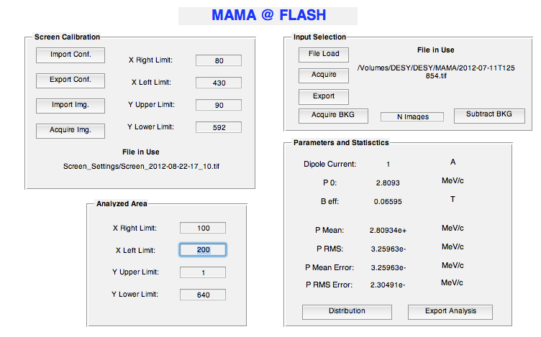
MAMA Software
1 Step: Screen Acquisition and calibration
Go to GUN mode
Move in the screen
Turn on the light
Acquire a Screen image
Turn off the light
Or
Import a old screen image

Slide 42
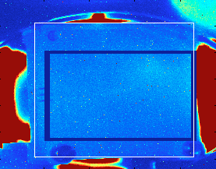
MAMA Software
1 Step: Screen Acquisition and calibration
Calibration:
Find a relation between screen size and pixels
Set the screen border pixels

Slide 43
MAMA Software
1 Step: Screen Acquisition and calibration
Export configuration:
  Screen Image
  Calibration Parameters
Import configuration
  Screen Image
  Calibration Parameters
File Path
  Screen image in use
  “ONLINE”: acquired non save image

Slide 44
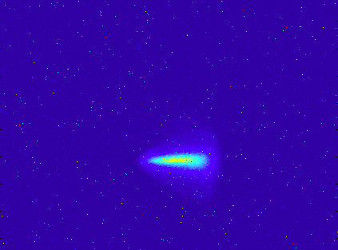
MAMA Software
2 Step: Image Acquisition
Set dipole current
Acquire an image from the screen
Load an image from file
Export the acquired image
Read the image in use:
  File path
  “ONLINE”: acquired non saved image

Slide 45
MAMA Software
3 Step: Background Reduction
Set number of samples
Acquire background
Turn ON and OFF the BKG reduction
Pictures and results are refreshed at every change
With BKG
Without BKG

Slide 46
MAMA Software
Step 4: Analysed area
Resize the analysed area to reduce noise
Pictures and results are refreshed every time a change is made

Slide 47
MAMA Software
Step 5: Results and Storing
Read the results
  Momentum and momentum spread
  Associated errors
  Dipole parameters
Zoomed distribution view
Export entire class properties:
  Pictures (matrixes and paths)
  Dipole parameters
  Screen and parameters
  Statists results

Slide 48
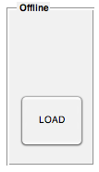
MAMA Software
Offline analysis
Possibility to reload saved data and perform new analysis

