Slide 1
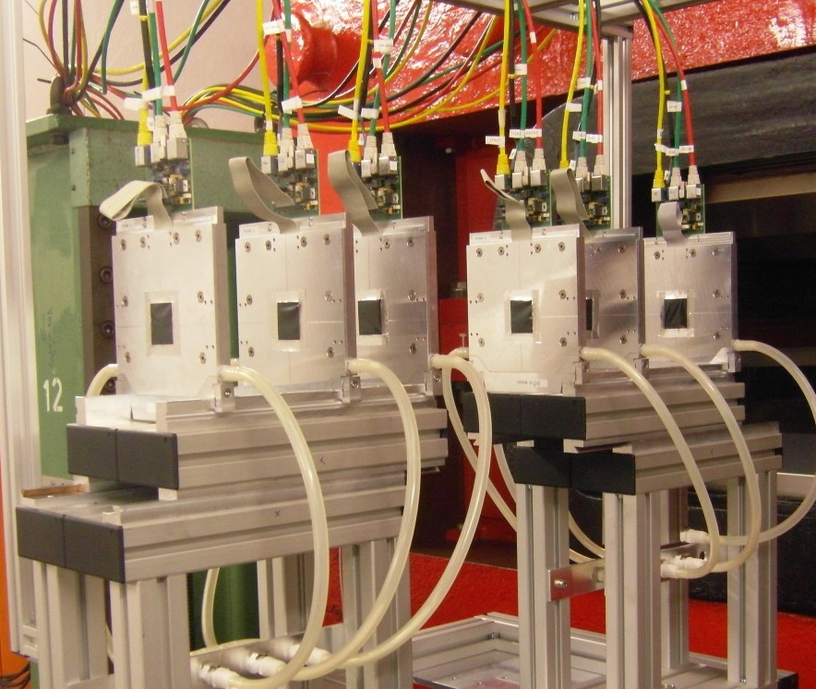
Pixel Beam Telescope - Online Monitor
Timing, Tests and Optimisation
Michał Wysokiński
AGH University of Science and Technology, Krakow, Poland
Supervisor: Igor Rubinsky

Slide 2
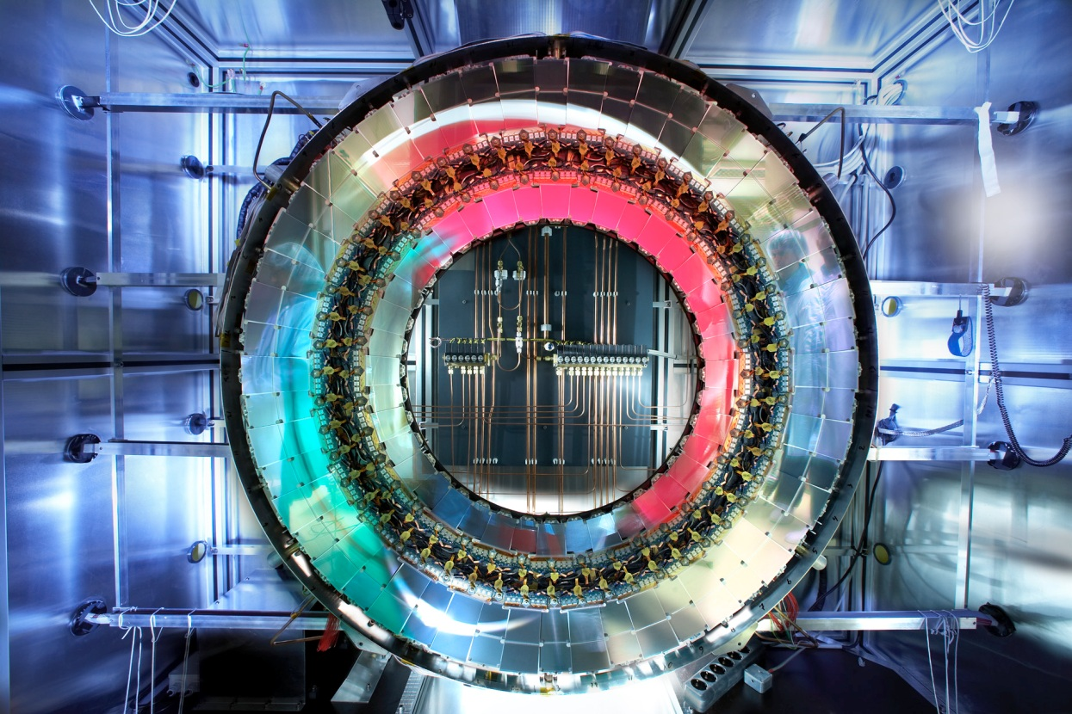
0. General Introduction
ATLAS Experiment
one of the four great experiments at the LHC

Slide 3
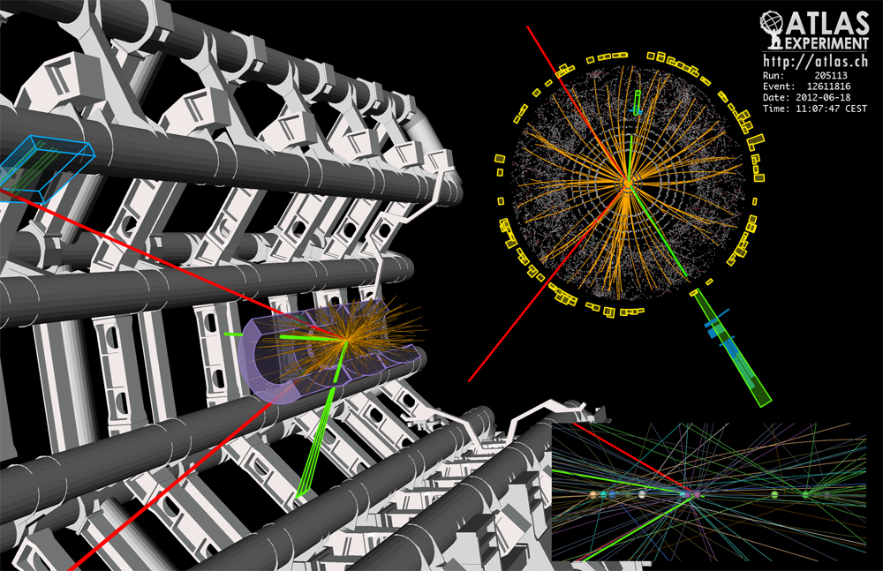
0. General Introduction
ATLAS Experiment
Most famous for the new boson discovery:

Slide 4
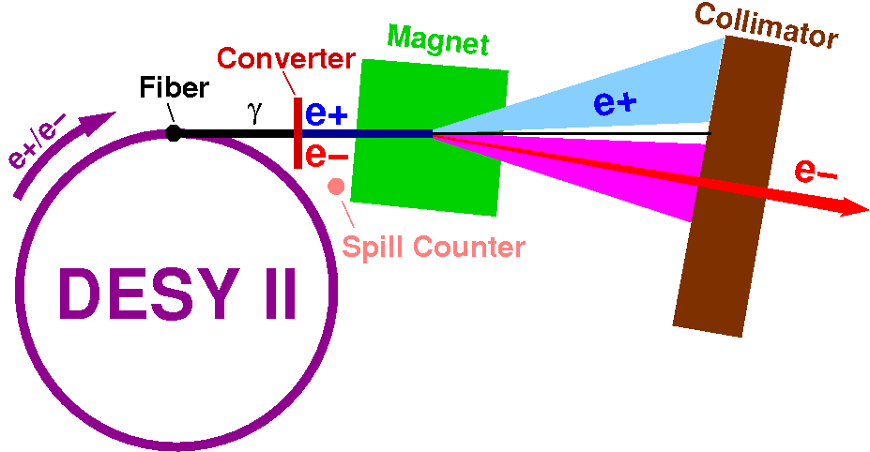
1. Test beams
DESY test beam
Test beams are used for determinig properties of new cutting edge detector systems
They use devices called telescopes

Slide 5
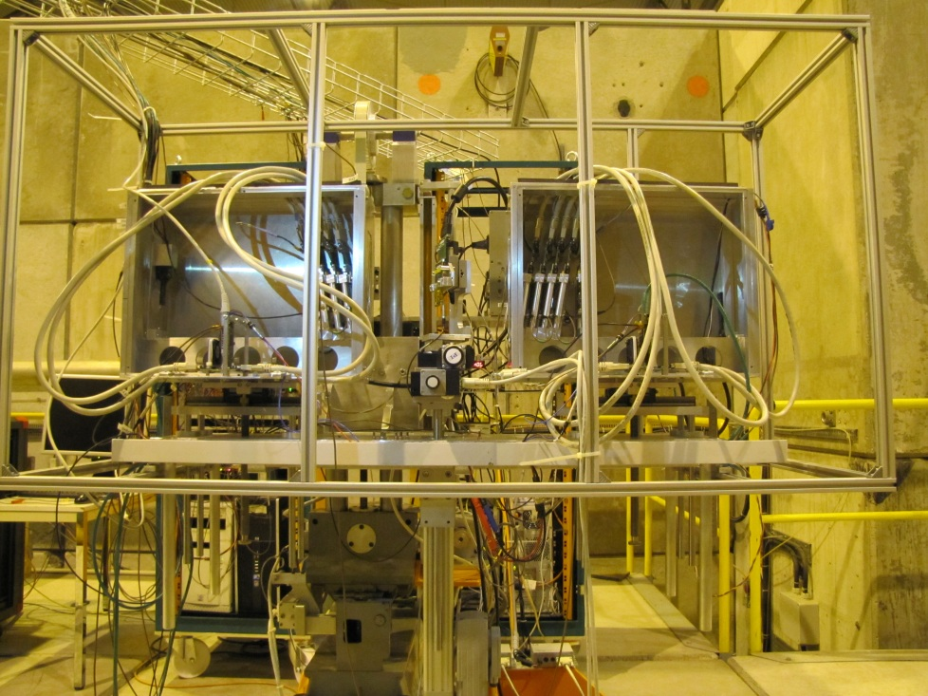
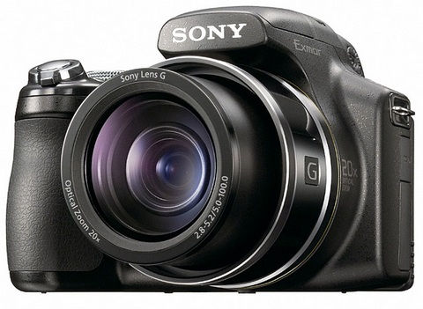
2. Pixel Telescopes for test beams
Pixel telescopes
Telescopes work like a normal camera

Slide 6
2. Pixel Telescopes for test beams
What do we want to measure with the telescope?
Check whether a device works or not and measure its properties:
- resolution
- etc...
beam

Slide 7
2. Pixel Telescopes for test beams
Pixel telescopes
Telescope arm
DUT
Telescope arm
DUT – Device Under Test

Slide 8
2. Pixel Telescopes for test beams
„Datura” telescope
6 telescope planes
MIMOSA 26 sensors:
1152x576 pixels = 0.7 Mpix
„pictures” are taken every 115.2 µs
binary readout
Sensors are usually cooled to 15°C (to stabilize their performance in time)

Slide 9
Architecture
2. Pixel Telescopes for test beams

Slide 10
Architecture
2. Pixel Telescopes for test beams

Slide 11
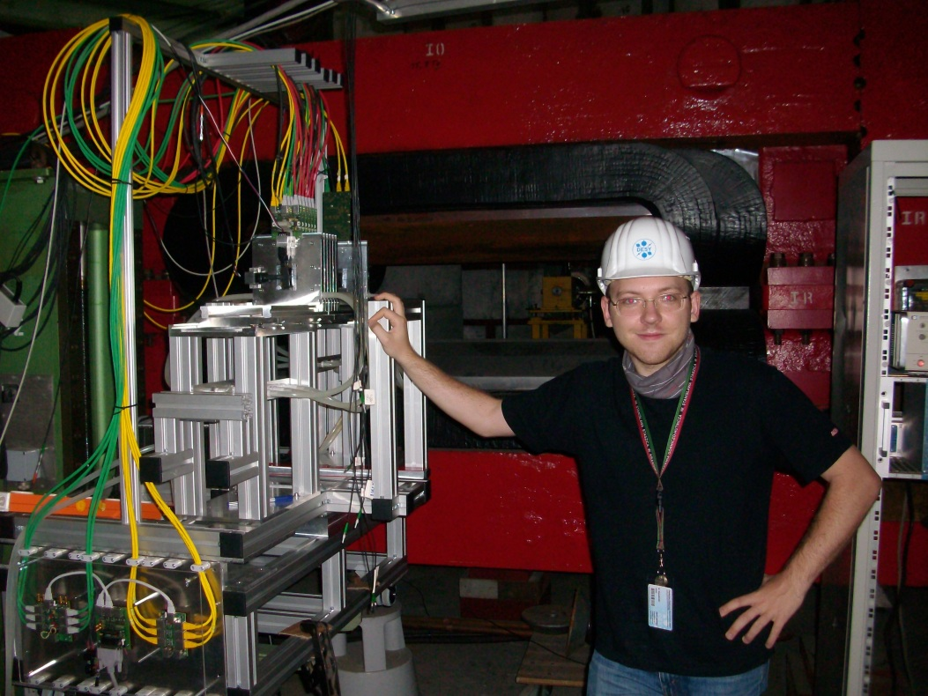
3. Goals
Goals
Make the Online Monitor as robust and fast as possible (make it a real-time tool).
Add new features for users’ convenience.
Test it with the real data.

Slide 12
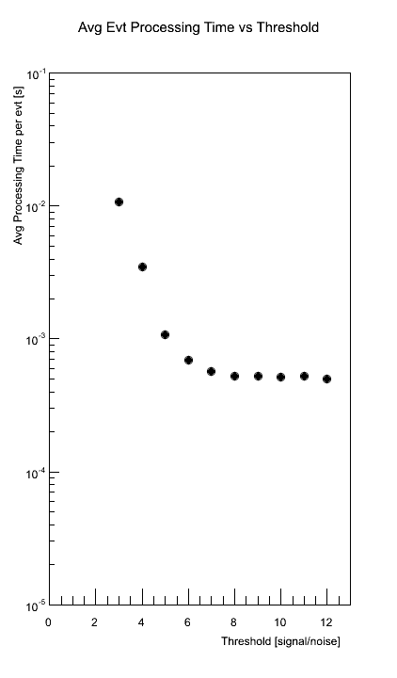
Preliminary analysis
4. Starting Point
We are here

Slide 13
Preliminary analysis
4. Starting Point
We are here
We want to be here

Slide 14
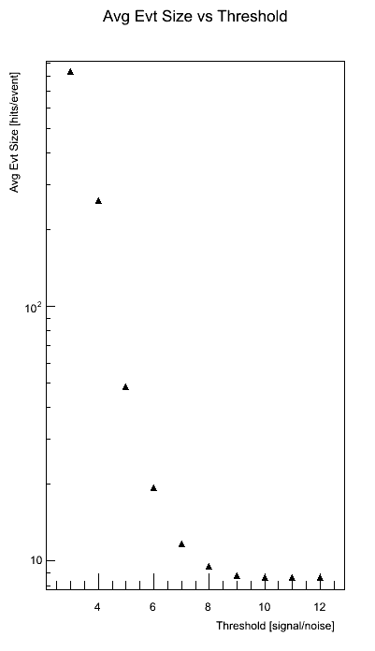
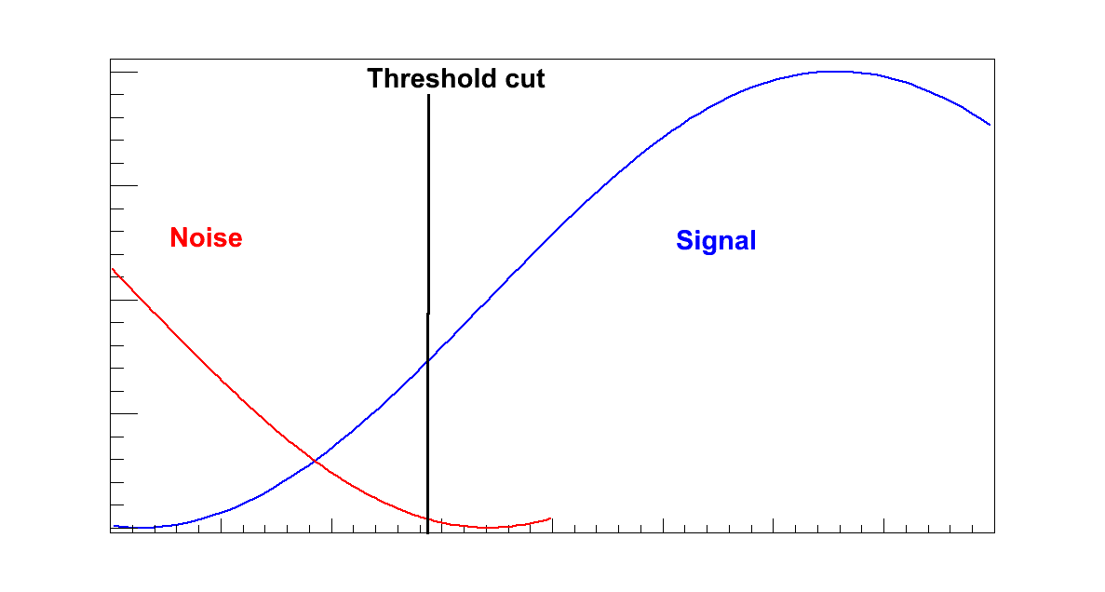
Preliminary analysis
4. Starting Point
Threshold impacts the event size [hits/event]
significantly.

Slide 15
Profiling
4. Starting Point
I started with profiling...
Profiling – analysis of how much time is spent in different functions and how many times they are being called
...and I was about to find out that my start would not be very simple...

Slide 17
Questions I asked myself after seeing a few callgraphs
3. Starting Point
Which functions are the most crucial for the performance?
Will structural optimisations be enough? Or new algorithms will have to be developed?

Slide 18
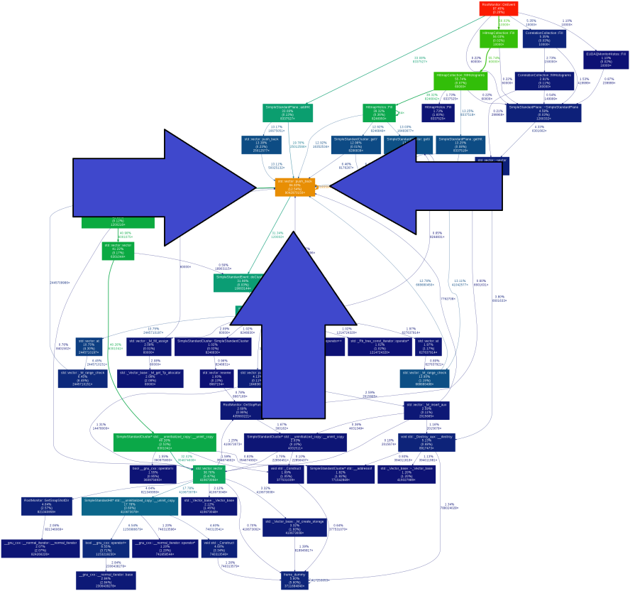
1) Which functions are the most crucial for the performance?
3. Starting Point
Clusterisation
Correlation
?

Slide 19
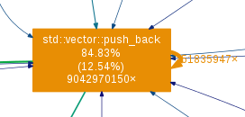
1) Which functions are the most crucial for the performance?
3. Starting Point
What is the root of all evil in the Online Monitor?
Answer: C++ STL dynamic vectors

Slide 20
1) Which functions are the most crucial for the performance?
3. Starting Point
What is the root of all evil in the Online Monitor?
Answer: C++ STL dynamic vectors
Solution: Accept it, because changing it is impossible without rewriting the entire application

Slide 21
Will structural optimisations be enough? Or new algorithms will have to be developed?
4. Starting Point
This version of the Online Monitor was originally developed within the ATLAS pixel test beam group
It is very good but there is always something to improve, so I decided to investigate the algorithms

Slide 22
Previous clusterisation algorithm
5. Clusterisation
How does the previous clusterization algorithm work?
It compares every single hit with the rest from the same plane - O(n²)

Slide 23
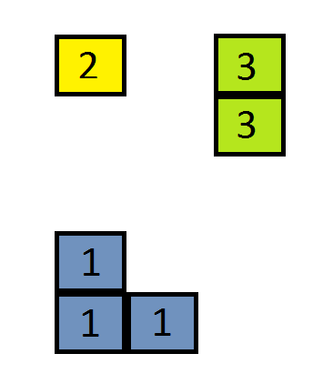
How does the previous clusterisation algorithm work?
5. Clusterisation
Telescope Plane 1
Telescope Plane 1
Is there a way to optimise this?

Slide 24
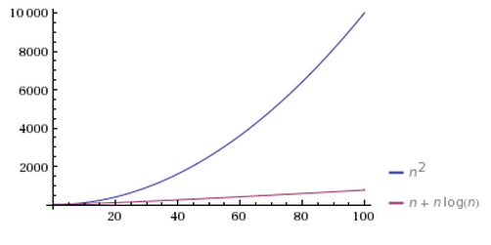
New clusterisation algorithm
5. Clusterisation
Let’s sort all hits
Now we can look only for the nearest neighbours
O(n*log(n) + n)

Slide 25
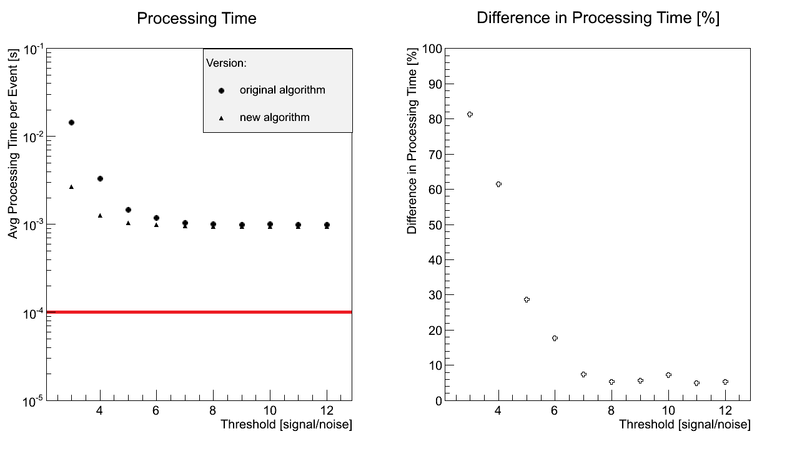
Performance
4. Clusterisation
Did it help?
We want to be somewhere here

Slide 26
Previous correlation algorithm
5. Correlation
How does the previous correlation algorithm work?
It correlates all clusters between every two planes - O(n²)

Slide 27
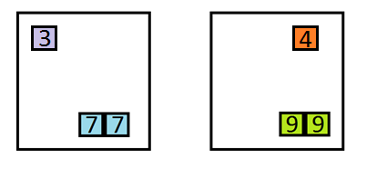
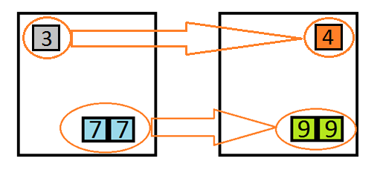
How does the previous correlation algorithm work ?
5. Correlation
Telescope Plane 1 Telescope Plane 2
Telescope Plane 1 Telescope Plane 2
Is there a way to optimise this?

Slide 28
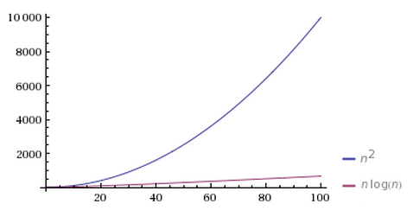
New correlation algorithm
5. Correlation
Let’s try to reconstruct all tracks first
Then we could use reconstructed tracks to get information about correlations
... and in addition to that we now know how many tracks (roughly) we have in a single event
O(n*log(n))

Slide 29
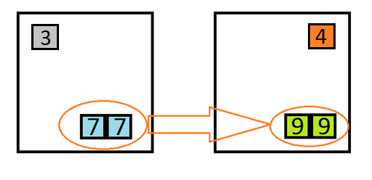
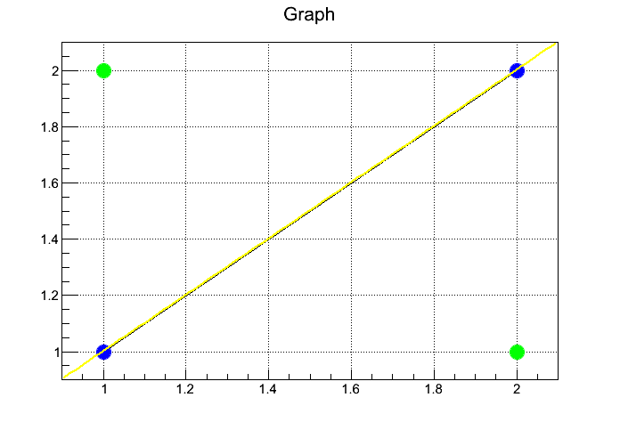
How the new correlation algorithm works ?
5. Correlation
Telescope Plane 1 Telescope Plane 2
Telescope Plane 1 Telescope Plane 2
Telescope Plane 1 Telescope Plane 2

Slide 30
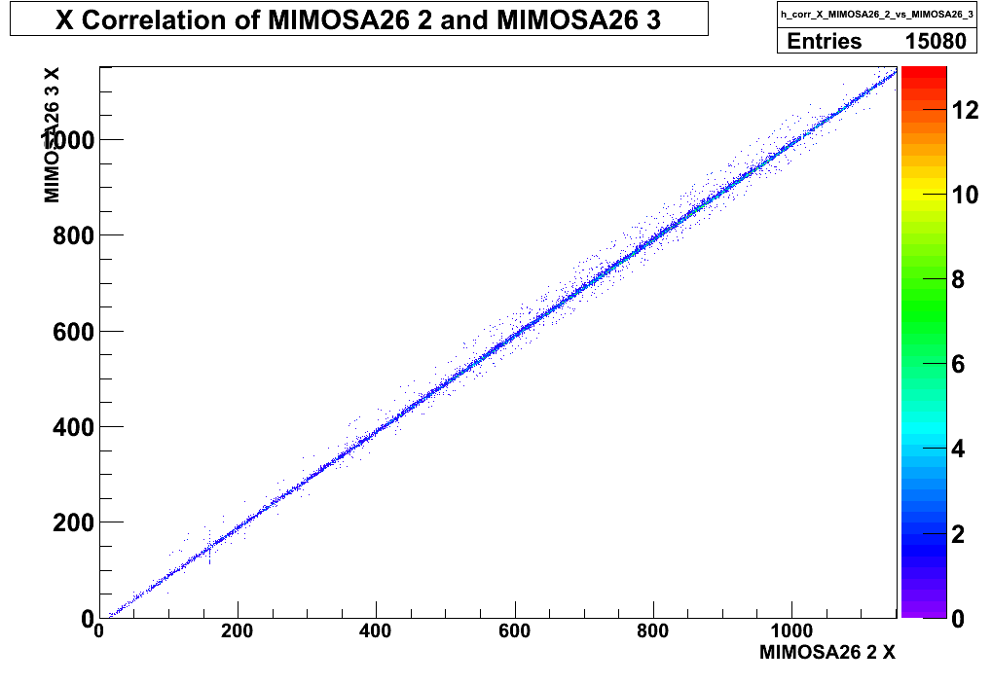
Changes in Plots
5. Correlation
Old Correlation Plot
New Correlation Plot
All clusters are being correlated.
Only clusters with associated tracks are being correlated.

Slide 31
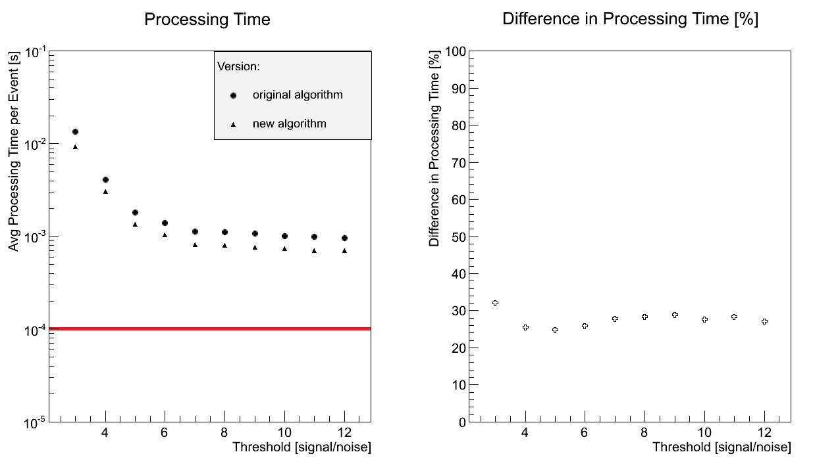
Performance
5. Correlation
Did it help? 2GeV beam (2 kHz)
Adding new functonalities usually makes application slower but in this case we have a speed up!
We want to be somewhere here

Slide 32
The only solution left was to skip the incoming events.
6. New features

Slide 33
Performance with skipping 90 % of events
6. New features

Slide 34
Summary
7. Summary
The Online Monitor:
became a real-time tool
has new data quality monitoring functionalities
conducts self-analysis about its performance
We took data necessary for the performance study of the telescope.

Slide 36
BACKUPS

Slide 37
Tracks per Event plot in the Online Monitor
5. Correlation

