Slide 1
Sample preparation, characterization and delivery for Free Electron Laser protein serial crystallography experiments
Kirill Baranov
supervised by
Henry Chapman
Francesco Stellato

Slide 2
Summary
FEL crystallography
Sample preparation
Sample characterization
Sample delivery

Slide 3
I. FEL crystallography
PROTEIN STRUCTURE PROTEIN FUNCTION
Number of structures
in PDB databank
X-ray crystallography gives
the majority of biological structures
BUT
It needs crystals of sufficient size
Notes:
Number of structures in PDB databank

Slide 4
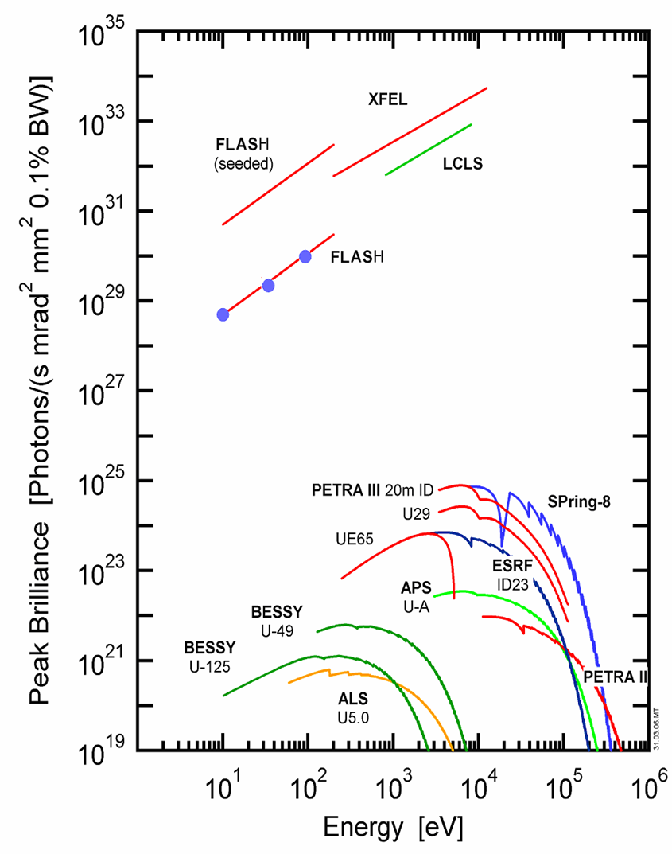
I. FEL crystallography
-High brilliance 10¹² photons/pulse in ~1 μm² Small objects Weak scattering objects -Short pulses: <10 fs pulses (up to 120 Hz) Diffraction before destruction Pump-probe measurements -Short wavelength: LCLS goes up to 10 keV High resolution measurements

Slide 5
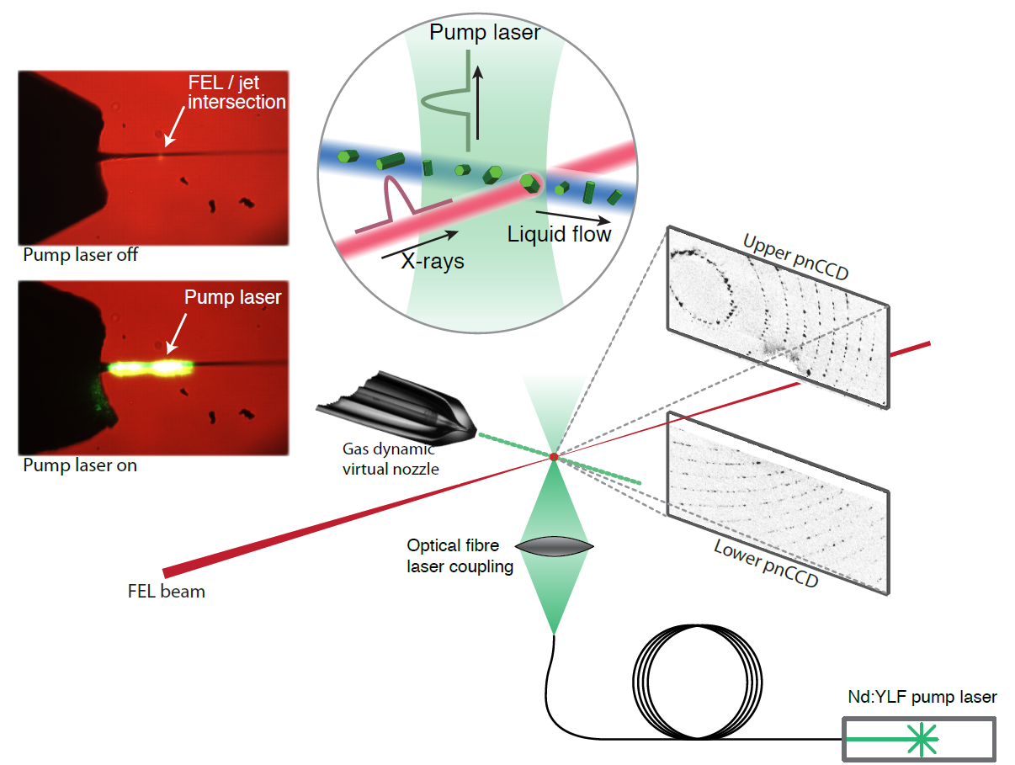
I. FEL crystallography
In diffract-before-destroy experiments fresh sample must be continuously injected

Slide 6
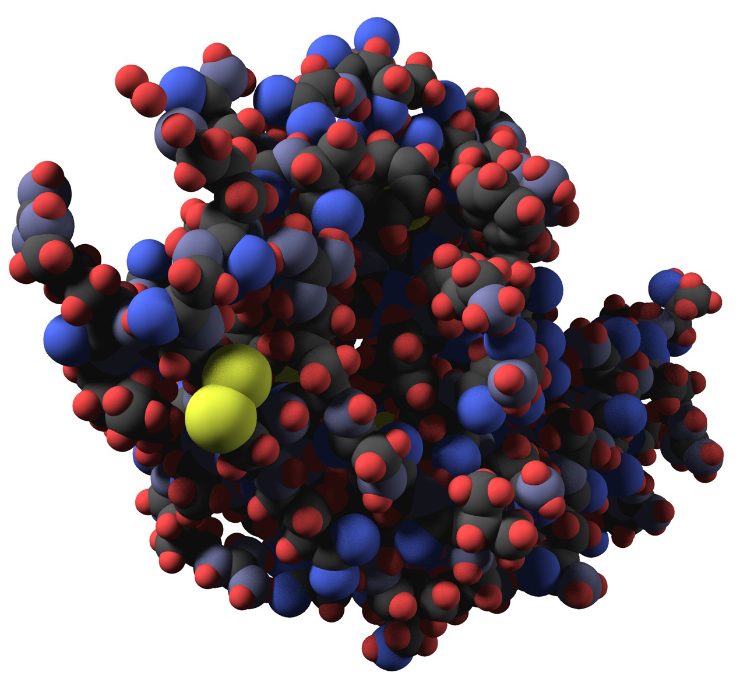
II. Sample preparation
Small crystals are necessary for FEL experiments: protocols to grow micron-sized crystals or to crush big ones are developed
Lysozyme microcrystals
are grown in different
conditions
(pH, salt concentration,
temperature, buffers)

Slide 7
II. 1. Lysozyme batch crystallization
BUFFER_1: 2 M NaCl, 0.1 M ammonium acetate
Sample | LYSOZYME_A | LYSOZYME_B | LYSOZYME_C | LYSOZYME_D | LYSOZYME_E
Protocol | 2 M NaCl 0.1 M amm. ac. | 2 M NaCl 0.1 M amm. ac. 0.09 M ac. acid | 2 M NaCl 0.1 M amm. ac. 0.17 M ac. acid | 2 M NaCl 0.1 M amm. ac. 0.34 M ac. acid | 2 M NaCl 0.1 M amm. ac. 0.67 M ac. acid
pH | 7 | 6 | 5.5 | 5.5 | 5
BUFFER_2: 0.9 M NaCl
Sample | LYSOZYME_F | LYSOZYME_G | LYSOZYME_H | LYSOZYME_I
Protocol | 0.9 M NaCl 0.34 M ac. acid | 0.9 M NaCl | 0.45 M NaCl 0.08 M NaOH | 0.9 M NaCl 0.15 M NaOH
pH | 4 | 8 | 12 | 13

Slide 8
III. Sample characterization
Optical microscopy
Crystal concentration
Size distribution
X-ray diffraction

Slide 9
III. 1. Optical microscopy
LYSOZYME_H_F_4
0.43 M NaCl
0.08 M NaOH
50 g/l HEWL;
0.5 µm pre-filtered;
pH 12
temperature 4°C

Slide 10
III. 1. Counting crystal
put a uniform droplet of known volume;
measure the surface of the droplet.;
count the number of crystals in different parts of the droplet;
calculate the total number of crystals.
LYSOZYME_H_F_4
V_{droplet} = 2 µl
S_{droplet surface} = 6 mm²
#/10 000 µm² = 160
(6 mm²/0.01 mm²) * 160 #/2 µl = 50 000 #/µl = 5*10⁷ #/ml

Slide 11
III. 1. Crystal shape and size distribution
Crystals of different sizes and shapes are observed:
Needles - length: from less than microns to a few hundreds microns, width: from microns to 30 microns;
Tetrahedrons - up to about 20 microns;
Aggregates (maybe containing small crystals) – up to 100 microns.

Slide 12
III. 1. Crystal shape and size distribution
LYSOZYME_M_F_4:
0.09 M NaCl
0.01 M NaOH
50 g/l HEWL;
2 µm prefiltered;
pH 11
temperature 4°C
Crystal density is high, about 10⁶ #/µl here.
Most part of crystals are needles.

Slide 13
III. 1. Crystal shape and size distribution
LYSOZYME_G_F:
0.9 M NaCl
50 g/l HEWL;
0.5 µm prefiltered;
pH 8
temperature 20°C

Slide 14
III. 1. Crystal shape and size distribution
LYSOZYME_G_F:
0.9 M NaCl
50 g/l HEWL;
0.5 µm prefiltered;
pH 8
temperature 20°C

Slide 15
III. 1. Crystal shape and size distribution
LYSOZYME_H_F_4:
0.43 M NaCl
0.08 M NaOH
50 g/l HEWL;
0.5 µm prefiltered;
pH 12
temperature 4°C

Slide 16
III. 1. Crystal shape and size distribution
LYSOZYME_D:
1.84 M NaCl
0.1 M amm. ac.
0.34 M ac. acid
50 g/l HEWL;
pH 5.5
temperature 20°C

Slide 17
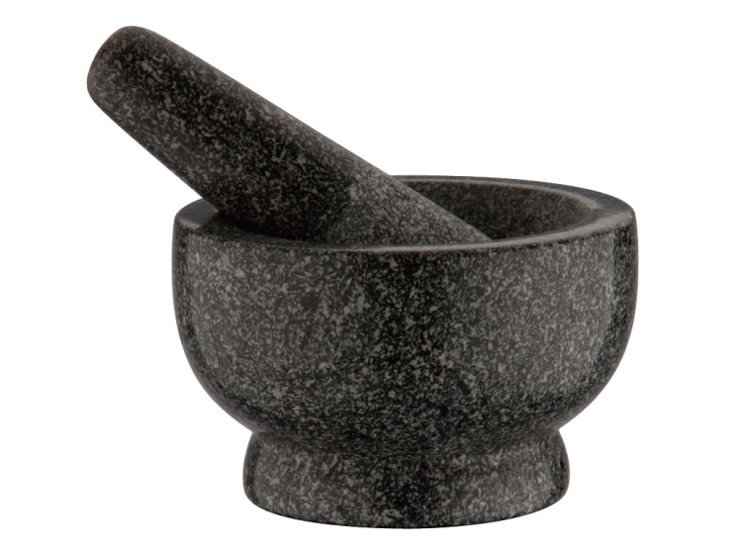
III. 1. How to get small crystals
When crystals are too big for serial crystallography experiments, protocols to crush them can be applied.
Manual grinding
Vortexing with glass beads

Slide 18
III. 1. Crystal shape and size distribution
LYSOZYME_G:
0.9 M NaCl
50 g/l HEWL;
pH 8
temperature 20°C
This sample was vortexed with beads for 10 minutes – all big crystals are gone.

Slide 19
III. 2. Electron microscopy
It allows to get high-resolution pictures of small objects.
Problems because of specimen charging and salt crystals formation.
LYSOZYME_P_F_4
(20/8/2012):
0,85 М NaCl
0,0005 М NaOH
50 g HEWL;
2 µm prefiltered;
pH 11
temperature 4°C

Slide 20
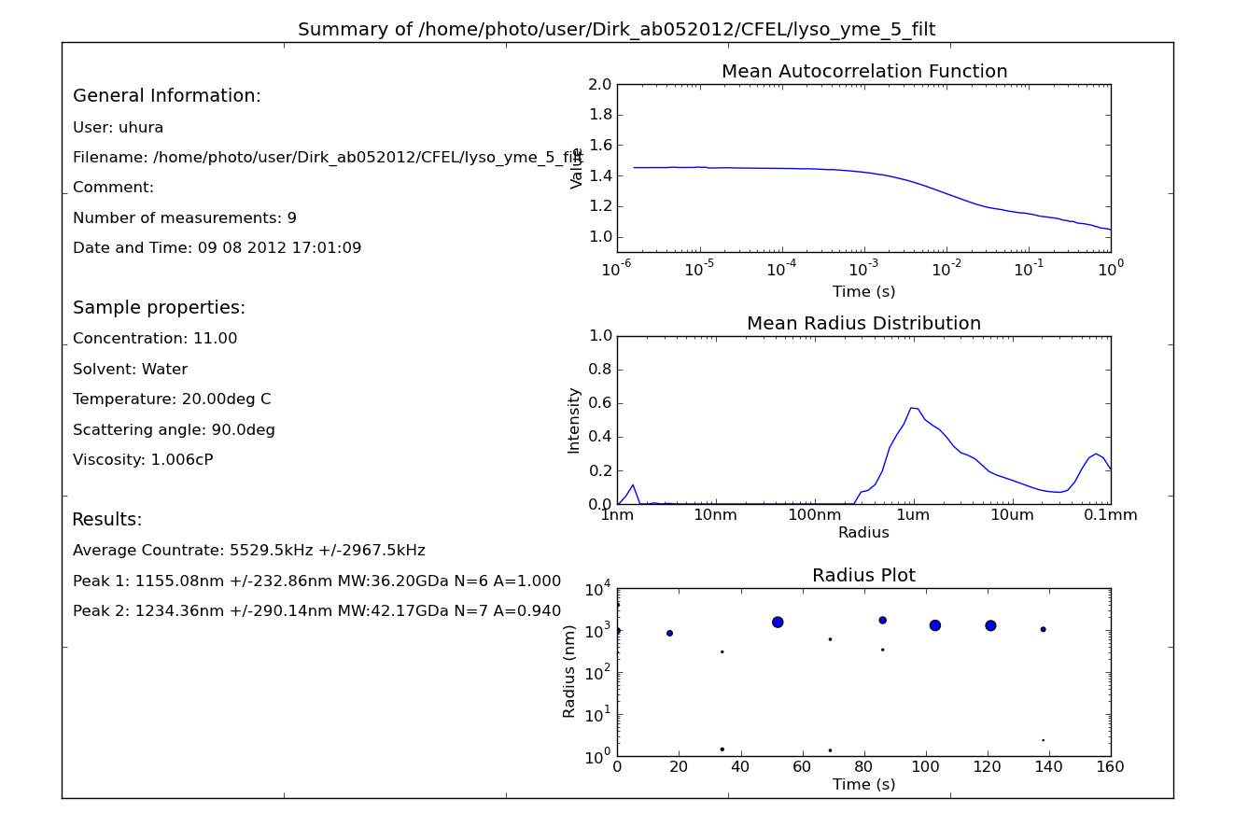
III. 4. Dynamic Light Scattering
Gives information on size of particles in suspension
LYSOZYME_E:
1.81 M NaCl 0.1 M amm. ac. 0.67 M ac. acid
50 g/l HEWL;
pH 5
temperature 20°C

Slide 21
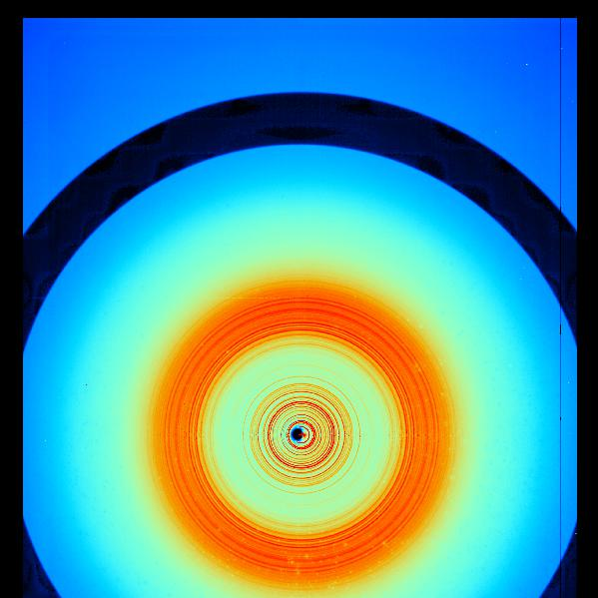
III. 2. X-ray diffraction
X 11 beamline at DORIS
Room temperature measurements
MAR detector
15 keV beam
Detector distance: 330 mm
Resolution at the corner: 1.15 Å
Diffraction up to high resolution
LYSOZYME_H_F_4 :
0.43 M NaCl
0.08 M NaOH
50 g/l HEWL;
0.5 µm prefiltered;
pH 12
temperature 4°C
3 Å
Notes:
X 11 beamline at DORIS

Slide 22
III. 2. X-ray diffraction
X 11 beamline at DORIS
Room temperature measurements
MAR detector
15 keV beam
Detector distance: 330 mm
Resolution at the corner: 1.15 Å
Diffraction up to high resolution
3 Å
LYSOZYME_H_F_4 :
The sample was grinded for 10
minutes and filtered using a 2 µm filter.
4 Å

Slide 23
IV. Sample delivery
To deliver protein crystals into FEL (or synchrotron) x-ray beam gas focused virtual nozzles are used.
Nozzle making
Nozzle testing with and without crystals

Slide 24
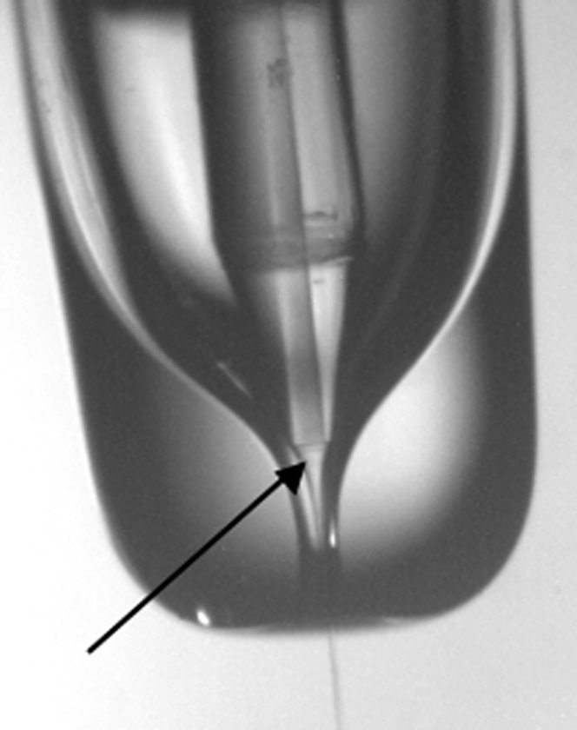
IV. 1. Nozzle making
Inner capillary
To produce jetting nozzle one needs to follow this protocol:
1. A glass capillary is shrunk by fire to match the inner capillary shape;
2. Cleaning and sharpening of inner glass capillary;
3. Inner capillary should fit the exit hole of the tube very well. The end of the capillary should be close enough to the end of the tube to obtain a stable and small jet.
Virtual nozzle
Outer tube
Notes:
2. -> passive

Slide 25
IV. 1. Nozzle making
Inner fiber too far from the end of the glass tube
Inner fiber very close to the tip
Inner fiber too far out from the end of the glass tube

Slide 26
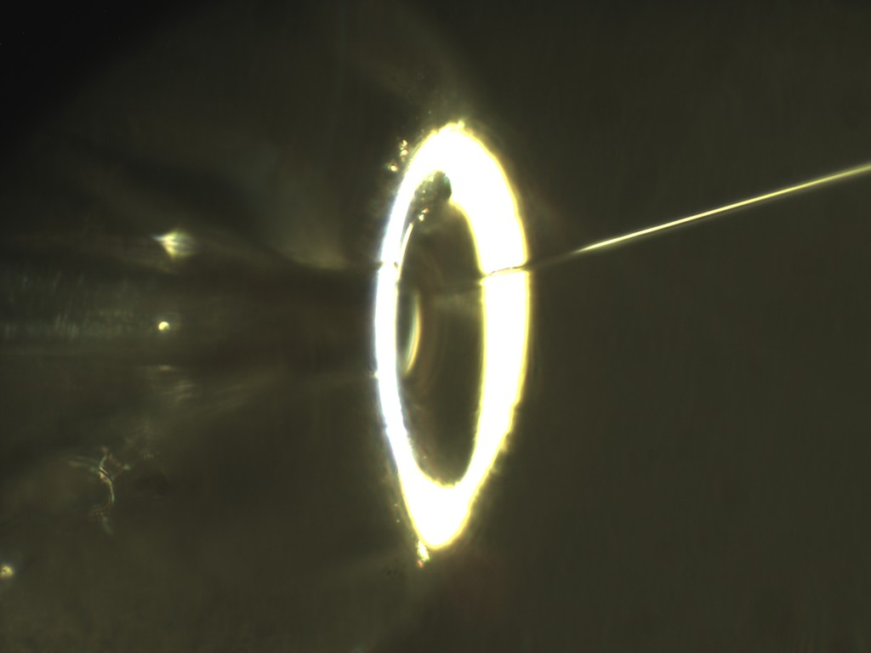
IV. 2. Nozzle testing without crystals
Gas pressure
297 psi
50 µm
Water pressure
62 psi
NOZZLE_3
Configuration 1 Outer tube tips out
Jetting with water
Gas pressure
297 psi

Slide 27
IV. 2. Nozzle testing with crystals
NOZZLE_3:
Jetting with LYSOZYME_A:
2 M NaCl 0.1 M amm. ac.
50 g/l HEWL;
pH 7
temperature 20°C;
2 µm filtered
NaCl crystal growth on the nozzle observed
after 20 minutes jetting

Slide 28
Conclusions
Lysozyme is successfully crystallized; pH, temperature and salt concentration, effects are studied;
The best sample for FEL protein serial crystallography has high pH, low salt concentration, hold in low temperature and shall be prefiltered after mixing and vortexed before using.
Sample | LYSOZYME_H
Protocol | 0.45 M NaCl 0.08 M NaOH
pH | 12
T | 4°C

Slide 29
Conclusions
X-ray diffraction measurements showed that the crystals diffract to high resolution;
Nozzles to inject micro crystals are produced and tested.

