Slide 1
FLASH Reaching the Transition Metals
DESY Summer Student Program
Valeri Vardanyan
Supervisor: Bart Faatz

Slide 2
FLASH Layout
RF-Gun
FLASH Accelerator
FLASH1
Fixed Gap Undulators
5 MeV
150 MeV
450 MeV
1250 MeV
Beam parameters
Beam Energy | 0.38 – 1.25 GeV
Normalized emittance (proj.) | 1.4 – 3 mm mrad
Energy spread | 0.2 MeV
Peak Current | 2.5 kA
Bunches per second | <8000
Bunch Charge | 0.07 – 0.7 nC
Undulator parameters
Period | 27.3 mm
Segments length | 4.5 m
Number of segments | 6
Focusing Structure | F0D0
Radiation | SASE
Wavelength | 4.2 – 44 nm
Pulse duration (FWHM) | 10 – 500 fs
Peak power | 1 – 5 GeV
Bandwidth | 0.5 – 2 %
Number of pulses | < 8000
Peak Brilliance | 10²⁸ – 10³¹
Pulse Energy | 1 – 500 uJ

Slide 3
FLASH Upgrade: FLASH II
RF-Gun
FLASH Accelerator
FLASH1
Fixed Gap Undulators
5 MeV
150 MeV
450 MeV
1250 MeV
FLASH2
Variable Gap Undulators
Beam parameters
Beam Energy | 0.5 – 1.25 GeV
Normalized emittance (proj.) | 1.4 – 3 mm mrad
Energy spread | 0.5 MeV
Peak Current | 2.5 kA
Bunches per second | <8000
Bunch Charge | 0.02 – 0.7 nC
Undulator parameters
Period | 31.4 mm
Segments length | 2.5 m
Number of segments | 12
Focusing Structure | F0D0
New tunnel for undulator
New Hall for experiments

Slide 4
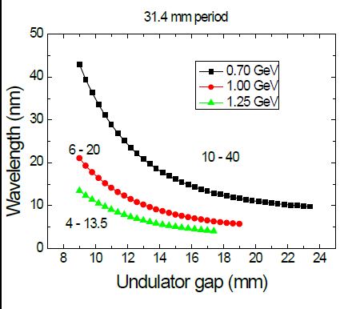
FLASH Upgrade: FLASH II
Radiation | SASE
Wavelength | 4 – 60 nm
Pulse duration (FWHM) | 10 – 500 fs
Peak power | 1 – 5 GeV
Bandwidth | 0.5 – 2 %
Number of pulses | < 8000
Peak Brilliance | 10²⁸ – 10³¹
Pulse Energy | 1 – 500 uJ
Tunability > factor 3
Expected beam parameters

Slide 5
FLASH Layout: Proposed
RF-Gun
FLASH Accelerator
FLASH1
Fixed Gap Undulators
5 MeV
150 MeV
450 MeV
1250 MeV
FLASH2
Variable Gap Undulators
Main Goal: Reach Transition metals with circular polarization at FLASH
Cu: 1.33 nm
Ni: 1.45 nm
Co: 1.59 nm
Needed: energy upgrade to 1.6 GeV or higher and new undulator
Possible intermediate step:
Energy upgrade to 1.4 GeV (easy to achieve) and a new undulator
Energy upgrade to 1.467 GeV (at the limit) with the existing one.
→Reach same wavelengths at reduced pulse energy at the 2nd harmonic (to be explained later)
Questions:
Do we get enough pulse energy and short enough pulses for the experiments with this intermediate step
2nd harmonic afterburner
Main Undulator
3.0 nm 1.5 nm
2.6 nm 1.3 nm

Slide 6
Harmonic Generation
Main Undulator
Afterburner
800 W
10 GW
Power at beginning (normal synchrotron radiation): smooth at kW level.
Power at end (SASE Radiation with GW spikes).
Power growth along the main undulator.

Slide 7
Harmonic Generation
Main Undulator
Afterburner
Power growth along the main undulator.
Bunching along the main undulator at fundamental harmonic.
Bunching along the main undulator at 2nd harmonic.
Afterburner

Slide 8
Harmonic Generation
Main Undulator
Afterburner
800 W
10 GW
80 MW
Power growth along the main undulator.

Slide 9
The Simulation Code

Slide 10
The Simulation Code
Genesis 1.3
Simulates Interaction of electrons and radiation field.
Assumes small bandwidth with radiation in the forward direction
Solves ODEs by 4th order Runge-Kutta method for particle dynamics and PDEs by method of finite differences for radiation.
Time dependent simulations!

Slide 11
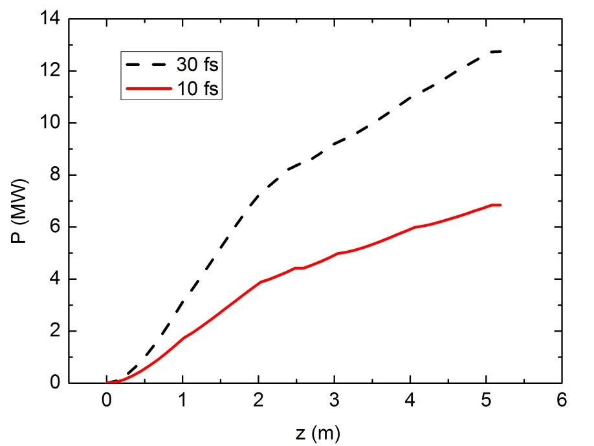
Results for 1.4 GeV, 1.5 nm
Undulator period main | 30 mm
K main | 0,7
Undulator period afterburner | 18,8 mm
K afterburner | 0.4417
Pulse energy, 10 fs | 0.4 (uJ) | 0.7 (uJ)
Pulse length, 10 fs | 34 (fs) | 35.7 (fs)
Pulse energy, 30 fs | 1.9 (uJ) | 2.8 (uJ)
Pulse length, 30 fs | 99.3 (fs) | 93.8 (fs)
30 fs
30 fs
After 2.5 m Afterburner Undulator After 5 m Afterburner Undulator

Slide 12
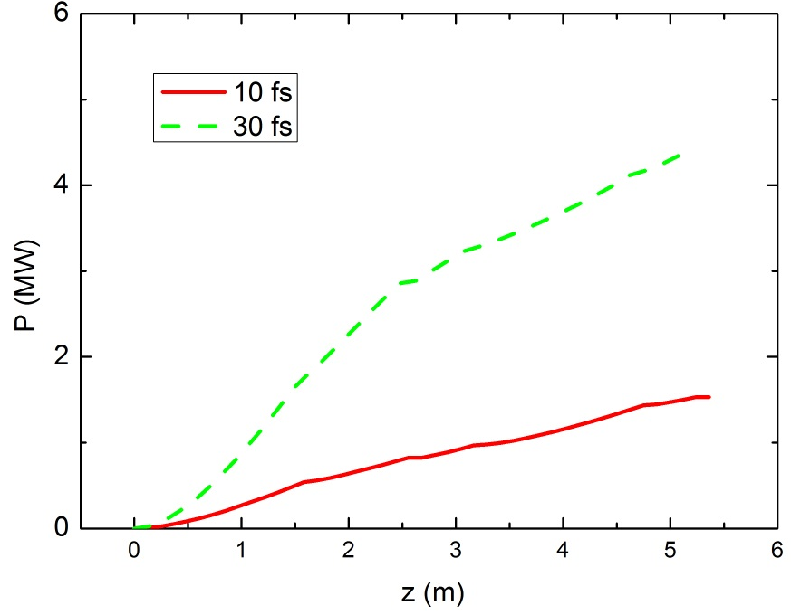
Results for 1.4 GeV, 1.3 nm
Undulator period main | 26 mm
K main | 0,7
Undulator period afterburner | 17,4 mm
K afterburner | 0.3464
Pulse energy, 10 fs | 0.1 (uJ) | 0.18 (uJ)
Pulse length, 10 fs | 36.5 (fs) | 31.1 (fs)
Pulse energy, 30 fs | 0.68 (uJ) | 1.04 (uJ)
Pulse length, 30 fs | 90.27 (fs) | 89 (fs)
30 fs
30 fs
After 2.5 m Afterburner Undulator After 5 m Afterburner Undulator

Slide 13
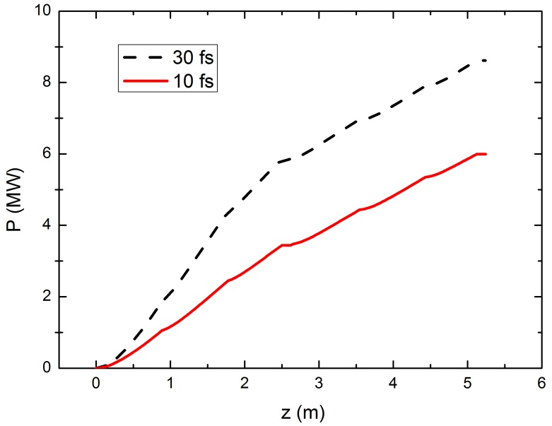
Results for 1.467 GeV, 1.5 nm
Undulator period main | 27,3 mm
K main | 0,9
Undulator period afterburner | 19,7 mm
K afterburner | 0.505
Pulse energy, 10 fs | 0.29 (uJ) | 0.56 (uJ)
Pulse length, 10 fs | 42.4 (fs) | 42.8 (fs)
Pulse energy, 30 fs | 1.25 (uJ) | 1.84 (uJ)
Pulse length, 30 fs | 113.8 (fs) | 119.7 (fs)
30 fs
30 fs
After 2.5 m Afterburner Undulator After 5 m Afterburner Undulator

Slide 14
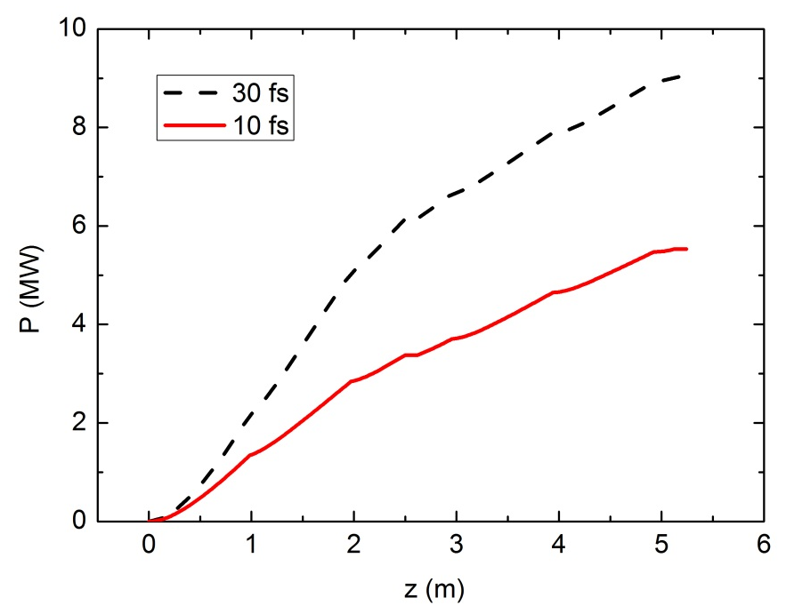
Results for 1.575 GeV, 1.3 nm
Undulator period main | 27,3 mm
K main | 0,9
Undulator period afterburner | 19,7 mm
K afterburner | 0.505
Pulse energy, 10 fs | 0.29 (uJ) | 0.5 (uJ)
Pulse length, 10 fs | 42.6 (fs) | 42.6 (fs)
Pulse energy, 30 fs | 1.3 (uJ) | 1.9 (uJ)
Pulse length, 30 fs | 105.5 (fs) | 114.1 (fs)
30 fs
30 fs
After 2.5 m Afterburner Undulator After 5 m Afterburner Undulator

Slide 15
Conclusion
We can make radiation at the wavelengths for transition metals.
Level of 0.1 to 2 uJ.
Pulse duration of 30 to 120 fs.

Slide 16
Danke Schöne

