Slide 1
Ptychographical measurements of biological specimen
Supervisor: Alke Meents
Karolina Stachnik
Hamburg, 6 September 2012

Slide 2
Outline
Coherent Diffractive Imaging
Ptychography – lensless imaging
Experimental setup
Ptychographical Iterative Engine
Applications
Conclusions

Slide 3
Fresnel Coherent Diffractive Imaging
A tool for structure analysis on the nanoscale
CDI experiment:
Zone plate – creation of divergent beam incident on the sample
OSA – removal of other diffracting orders from the zone plate
a coherent plane wave illuminating sample
C. A. Larabell, K. A. Nugent, Imaging cellular architecture with X-rays
Notes:
Current Opinion in Structural Biology, Volume 20, Issue 5, October 2010, Pages 623-631

Slide 4
Coherent Diffractive Imaging
Result of measurements:
Diffraction pattern the the Fraunhofer far field
Lensless imaging – resolution ultimately limited only by the wavelength of the radiation
Direct reconstruction of the original optical transmission function of the specimen
$$T\left(x,y\right)=\exp\left[\frac{2πi}{λ}∫δ\left(r\right)+iβ\left(r\right)dz\right]$$
Phase problem: measured real-valued intensity – amplitude information only, phase lost
Iterative phase retrieval methods
Alternations between real and Fourier space with certain boudary constraints

Slide 5
Ptychographical Coherent Diffractive Imaging (pCDI)
Ptychography (from the Greek ”πτνξ” meaning ”fold”)
First proposed by Hoppe and Hegerl in 1970s
Diffraction patterns recorded from a series of overlapping beam positions
M. Dierolf et al., Ptychography and lensless X-ray imaging

Slide 6
Ptychography
Prerequsite for pCDI: localized and mainly coherent illumination
Parameters:
Data: real-valued intensity
Positions of illumination function
Sample illuminated at e.g. 15x15 overlapping positions spaced by certain stepsize
Overlap of about 70% causing high increase of image resolution in reconstruction process
M. Dierolf et al., Ptychography and lensless X-ray imaging

Slide 7
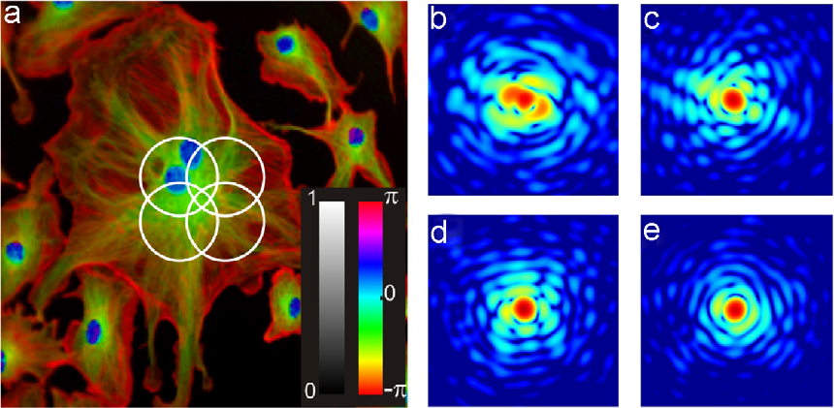
Sample image and some diffraction patterns
Oliver Bunk et al., Influence of the overlap parameter on the convergence of the
ptychographical iterative engine

Slide 8
Reconstructions for different relative overlaps
Relative overlap (5x5 object positions)
10%
60%
100% (conventional iterative phase retrieval)
Oliver Bunk et al., Influence of the overlap parameter on the convergence of the
ptychographical iterative engine

Slide 9
Experimental setup
OSA
sample
FZP
PILATUS 6M
detector
polarization
direction
FZP – Fresnel Zone Plate
OSA – Order Sorting Aperture

Slide 10
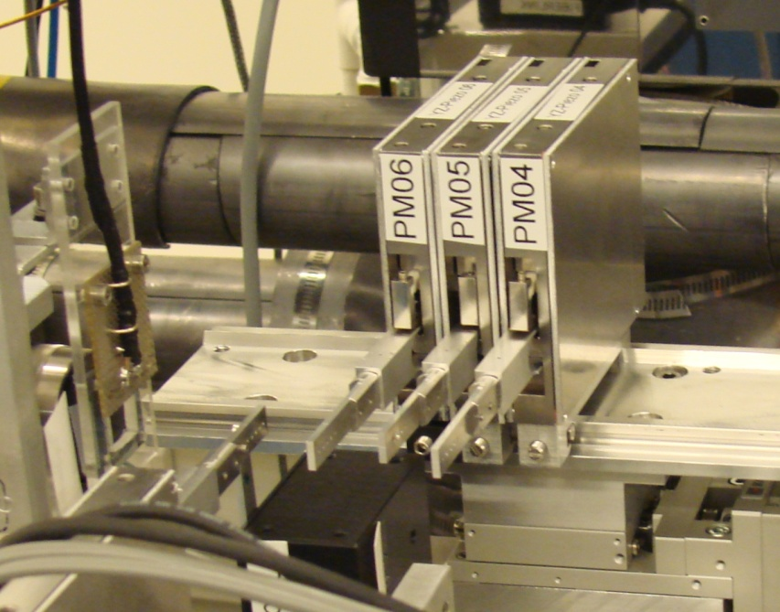
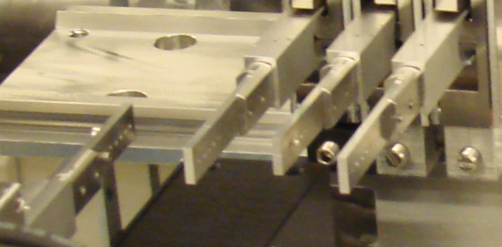
Experiment design – crucial parameters
Beam defining pinhole | 150 μm
Zone plate diameter | 150 μm
Order sorting aperture | 10 μm
Focal length of the zone plate: $f=D∙\frac{Δr}{λ}≅2.34cm$
Sample-to-detector distance: 636 cm
OSA
FZP
CS
BDP

Slide 11
P11: Ptychography
Flight
tube

Slide 12
Ptychographical Iterative Engine
Phase retrieval algorithms
The probe: complex-valued probe function $P(r)$
The object: complex-valued object function $O(r)$
The resulting exit wave – complex-valued diffraction pattern
$$Ψ\left(r\right)=P(r)O(r)$$
Recorded real-valued far field intensities
$$I(q)∝{\left|ℱ[Ψ\left(r\right)]\right|}^{2}$$
First iteration of the phase retrieval: random guesses of the probe $P_{0}(r)$ and the specimen $O_{0}(r)$

Slide 13
Algorithm of reconstruction
The superresolution algorithm:
Specimen and probe reconstructions
Significant improve of their resolution (extrapolation of the recorded deffraction patterns beyond the aperture of the detector)
A. M. Maiden, M. J. Humphry, F, Zhang J. M. Rodenburg, Superresolution imaging via ptychography

Slide 14
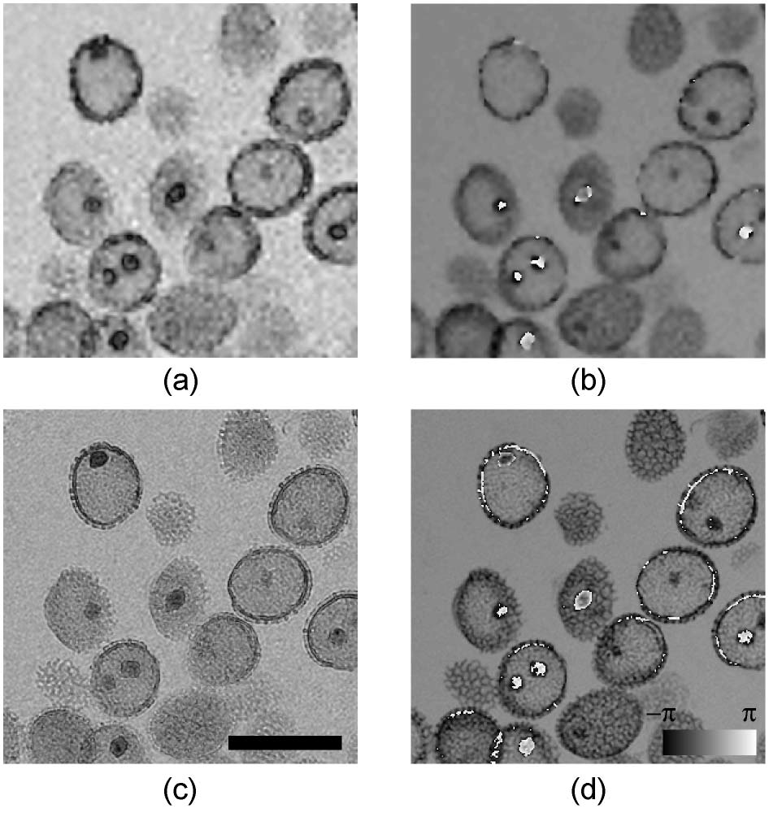
Applications
Modulus
Phase
The lily pollen images reconstruced using two versions of ptychographical iterative engine (PIE):
(a), (b) – extended PIE
(c), (d) – superresolution PIE
A. M. Maiden, M. J. Humphry, F. Zhang, J. M. Rodenburg, Superresolution imaging via ptychography

Slide 15
Applications
The image of the bee’s leg (the amplitude)
(a) PIE
(b) parallel PIE
A. M. Maiden, J. M. Rodenburg, An improved ptychographical phase retrieval algorithm for diffractive imaging

Slide 16
Conclusions
Ptychography as a lensless imaging
Quite simple experimental setup
Optimal overlap – high increase in resolution in comarison to other methods
Ptychographical algorithms for solving phase problem and reconstruction process
Promising method for nanoscale bio-imaging

Slide 17
Acknowledgments

Slide 18
Thank you for your kind attention!

