Slide 1



Applications of Linear Collider Supporting Instrumentation Technology
M. C. Ross
SLAC National Accelerator Laboratory
30 October, 2012 16:30
Notes:
(16:30) LC6-1, invited, Applications of Linear Collider Supporting Instrumentation Technology (Industry Perspective)
M. Ross
SLAC National Accelerator Laboratory, Menlo Park, CA, USA
The recently - published Department of Energy Report ' Accelerators for America's Future' (http://www.acceleratorsamerica.org/report/index.html), lists Reliability, Beam Power/RF and Beam Transport and Control as the top R & D needs for various accelerator applications. While it is unlikely the Grand Challenges formulated in response to the report will target these needs specifically, we can expect follow-on work to focus on these top R & D needs as high-priority by-products. Instrumentation of different kinds is used to support the operation of modern accelerators through beam measurements, component monitoring and control and RF feedback and will therefore have a strong role in this work. The example of RF feedback, to be presented in this talk, uses leading-edge technology digital signal processing to achieve the required stabilization. Other examples to be discussed include radiation effects on electronics (LHC and ILC), low latency feedback (ILC / CLIC), ultra-low noise receivers (ILC) and mechanical stabilization systems (CLIC).
Instrumentation
Synthesize new technologies: lasers and signal processing

Slide 2
Instrumentation
Linear Colliders will extend basic science reach through high technology coupled with precision and control
  Example: Strategy adopted for telescopes -
  See ALMA (1 picosecond / 10’s microns) km-sized radio telescope array; not practical without precision
Design Paradigm and Goal:
  Synthesize new instrumentation technologies and use improved performance to reduce cost and extend reach
Generally transferable strategy for a variety of technologies

Slide 3
Atacama Large mm/sub-mm Array–
Precisely linking radio telescopes together
Image copied from ALMA website

Slide 4
Capturing and adopting LC Instrumentation Technology: Outline
Keywords:
Precision:
  Moving into the nano-world – but retaining macro-world sensitivity
Reliability:
  Moving from technology demonstrations to ‘factories’
Speed:
  Feedback Control
Simplicity
Scaling
Cost and
Mass Production Strategies

Slide 5
 | Keyword | Application | Example
1 | Precision | Extended Dynamic Range | Beam Loss Monitors
2 | Reliability | Full operations simulation model | ‘Availsim’ – Operations Monte Carlo
3 | Reliability | Radiation effects | LHC r2e
4 | Precision | Digital Receivers | Beam Position Monitors
5 | Precision | Alignment | Wire alignment
6 | Precision | Stabilization | CLIC linac magnet
7 | Speed | Feedback | FONT
8 | Precision | Synchronization | Fiber timing links

Slide 6
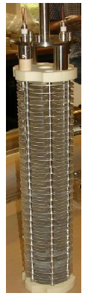
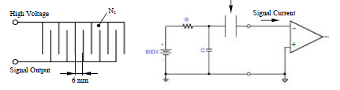
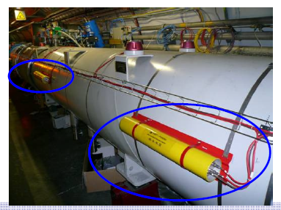
Dynamic Range: 1e6
Example 1: LHC Beam Loss Monitors
Problem: (the greatest operational challenge of LHC / ILC) →
Reliable operation of very high power beams through active monitoring and reliable protection
LHC stored beam: 360 MJ (σ_{x} σ_{y} ~ 1 mm²)
ILC single pulse: 5MJ (σ_{x} σ_{y} ~ 10⁻⁵ mm²)
  Roughly 1000 times the energy density of LHC.
B. Dehning et al

Slide 7
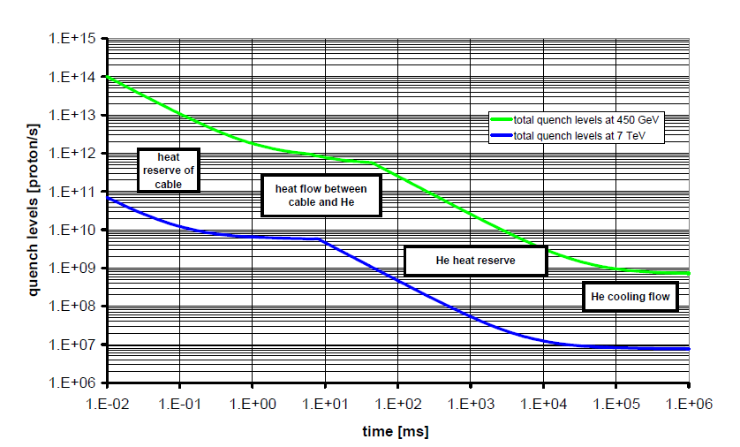
LHC Beam Loss Monitors
LC: Large dynamic range 10⁶ to cover destructive and operational losses
Annual dose ≤ 50 kGy at detector location
Ionization chambers as baseline choice : ~ 3500 (1 BLM/quadrupole)
Based on LHC ionization chamber and readout electronics with dynamic range 10⁶ and sensitivity 7e10⁻⁹ Gy
Quench Threshold Proton Flux vs integration (exposure) time

Slide 8
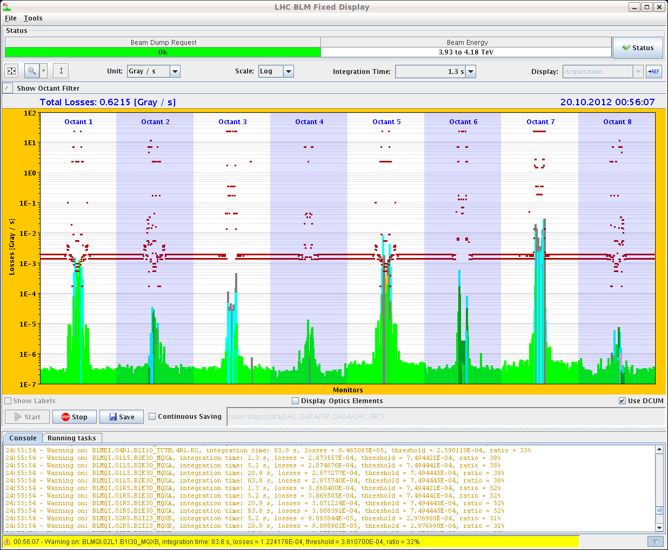
LHC BLM On-line display:
Losses and thresholds around the ring (E. B. Holzer)

Slide 9
Operating very large scale systems
Example 2: Availsim’ – Operations Monte Carlo
Bringing high-tech components together: Redundancy and Maintenance strategies
Monte-Carlo Simulation:
  List Components, Failure rate, Failure impact, Repair times and repair requirements (i.e. # people etc)
  Formulate maintenance, deferred repair, access and recovery schemes
  Run ‘fast-forward’, adjust input parameters and compare integrated performance
‘Availsim’ (T. Himel et al) Excel / Matlab
Unique aspect of Availsim: Beam tuning and Operations / Maintenance Management

Slide 10


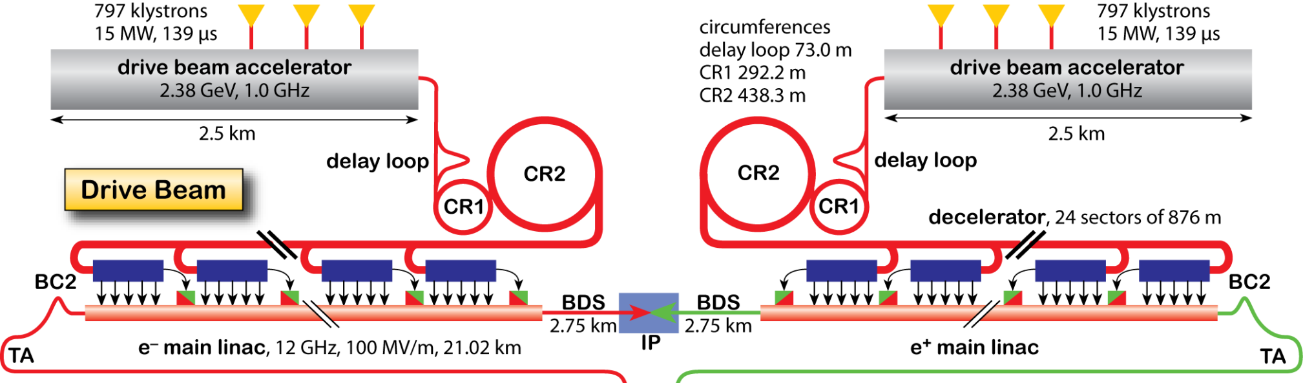
CLIC Drive Beam
DB Instruments | Surface | Tunnel | Total
Intensity | 38 | 240 | 278
Position | 1834 | 44220 | 46054
Beam Size | 32 | 768 | 800
Energy | 18 | 192 | 210
Energy Spread | 18 | 192 | 210
Bunch Length | 24 | 288 | 312
Beam Loss | 1730 | 44220 | 45950
    CLIC RF power source based on Drive Beams
    High intensity (100A) high frequency (12GHz) beams
    Accounts for another 100kms of beam lines and
    ~ 10⁵ beam instruments (>95% in tunnel)
    Large number but more relaxed requirements
Main Beam
Complex

Slide 11
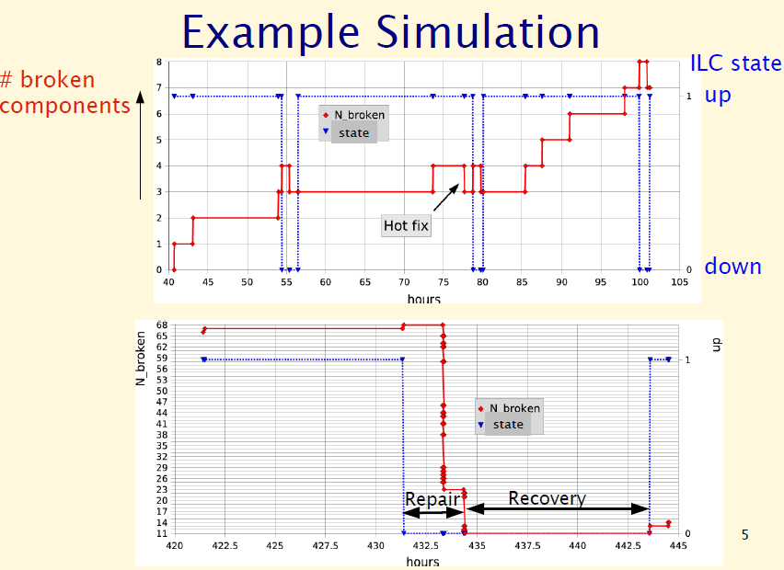
Reliability and Availability
Notes:
++++++++++++++++++++++++++++
LC Accelerator Technologies for Industrial Applications (ILC & CLIC) – Session 6, 31 October, 2012 Anaheim, CA IEEE NSS.
Marc Ross, SLAC National Accelerator Laboratory
++++++++++++++++++++++++++++
• 16:30 – 16:55 - Applications of Linear Collider supporting instrumentation technology
Abstract:
The recently - published Department of Energy Report ' Accelerators for America's Future' (http://www.acceleratorsamerica.org/report/index.html ), lists Reliability, Beam Power/RF and Beam Transport and Control as the top R & D needs for various accelerator applications. While it is unlikely the Grand Challenges formulated in response to the report will target these needs specifically, we can expect follow-on work to focus on these top R & D needs as high-priority byproducts. Instrumentation of different kinds is used to support the operation of modern accelerators through beam measurements, component monitoring and control and RF feedback and will therefore have a strong role in this work. The example of RF feedback, to be presented in this talk, uses leading-edge technology digital signal processing to achieve the required stabilization. Other examples to be discussed include radiation effects on electronics (LHC and ILC), low latency feedback (ILC / CLIC), ultra-low noise receivers (ILC) and mechanical stabilization systems (CLIC).

Slide 12
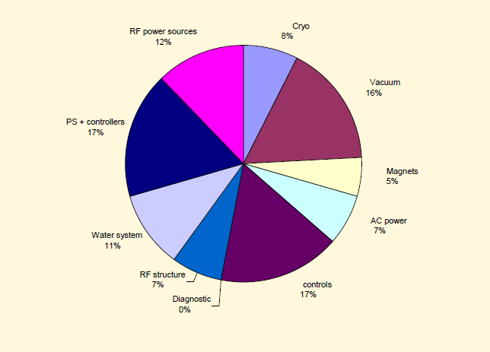
ILC Downtime by System: Sample run of ‘Availsim’

Slide 13
Radiation Effects
Example 3: LHC ‘radiation to electronics ‘r2e’
M. Brugger et al
Strategy: Reduce expensive cable infrastructure using local electronics
Problem: impact of radiation on electronics (Controls, Power converters and Instrumentation)
  (commercial equipment deployed)
  (radiation environment different from space application)
Mitigate effects to within a given ‘mean-time-to-failure’ budget
Single-Event-Effects and Total Ionizing Dose

Slide 14

R2E Mitigation Strategy
1st Safety Critical
Immediate Relocation
2nd Shielding
“Fast” & Global Improvement
Highest Impact on Operation:
Relocation
Shielding
3rd Most Sensitive
Relocation
Shielding
New Design
4th Remaining

Slide 15
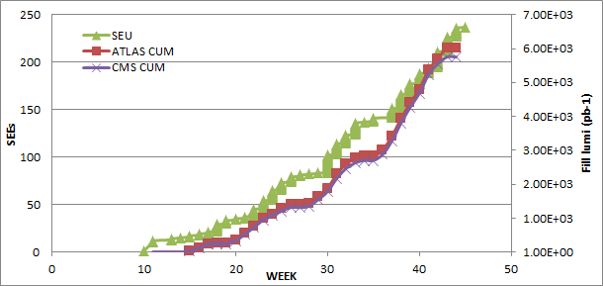
LHC Integrated Luminosity and ‘SEU’ vs time
15

Slide 16
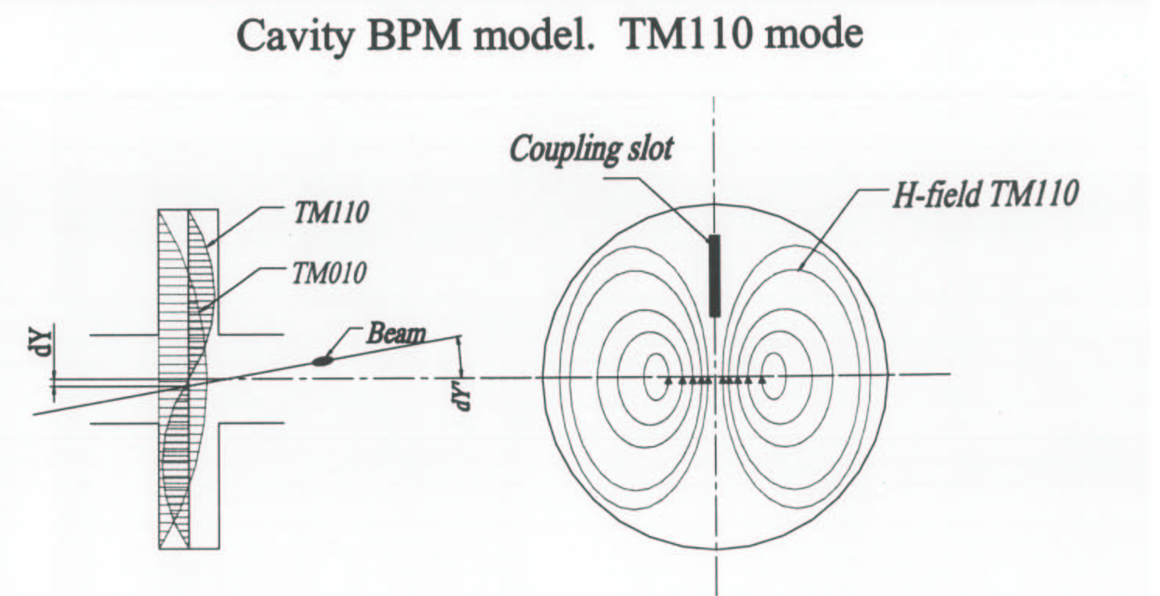
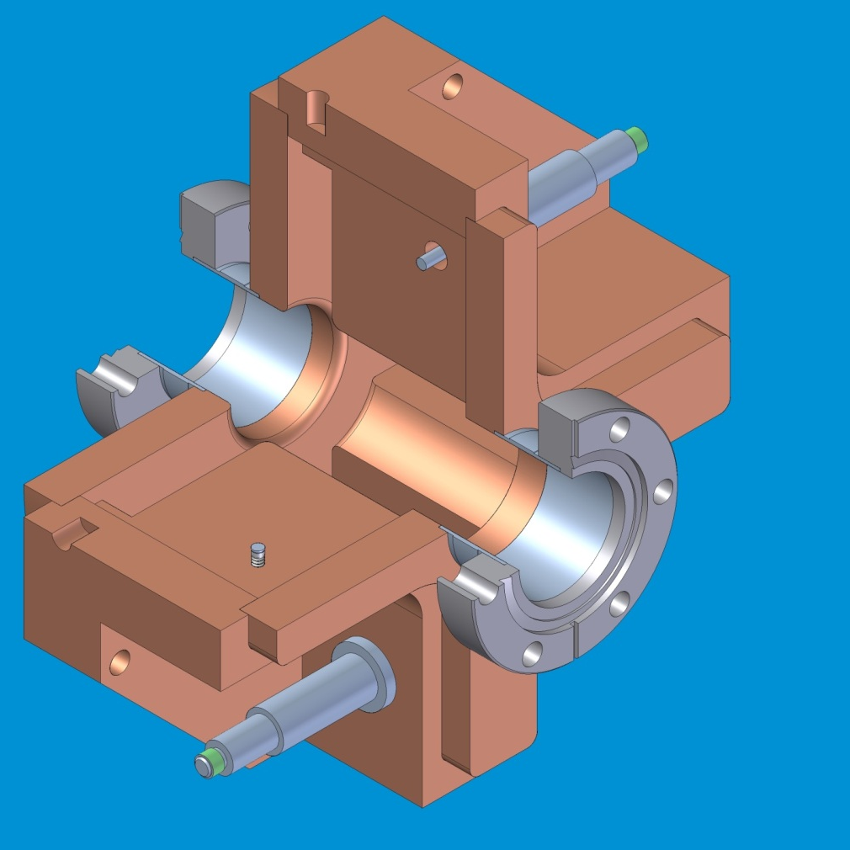
Precision Beam Position Monitoring
Example 4: Cavity Beam Position Monitors
Slot mode cavity BPM
Z. Li
Notes:
Phys. Rev. ST Accel. Beams 15, 042801 (2012)

Slide 17
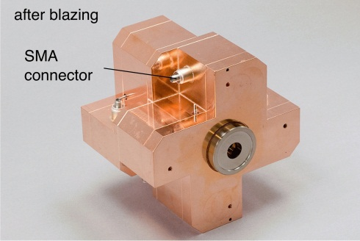
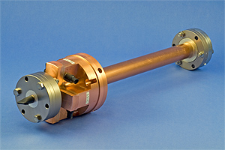
High Resolution Beam Position Monitors
Nanometer BPM’s using RF Cavities have been developed since the last 15 years (ATF2)
Output RF signal proportional to the beam offset
High precision mechanical machining of RF disks – brazing technique
IP BPM system
(BPM + Ref) Cavity : 1 unit
Target : 2 nm
Aperture: 6 mm
C-band BPM system
BPM cavity: 340 units
Reference cavity: 4 units
Target resolution: 100 nm
Aperture: 20 mm
  Resolution 8.72 nm
@ 0.7×10¹⁰ electrons/bunch, @ 5μm dynamic range
Resolution 15.6 nm
@dymamic range ±20μm
Excellent resolution using low bandwidth cavity design !
Collaboration KNU / PAL / KEK / RHUL / SLAC

Slide 18
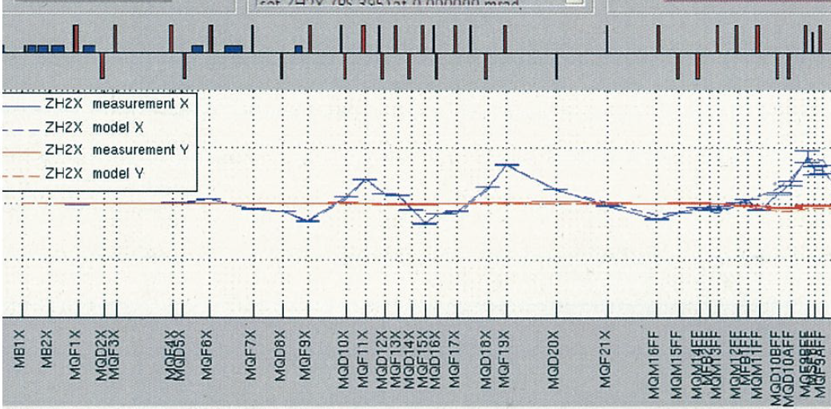
ATF2 – cavity BPM
Fitted dipole kick using cavity BPM’s
  (+/- 800 um 10 microradian)
  Model fits ~ 1%; few microns
Excellent linearity, resolution and offset control

Slide 19
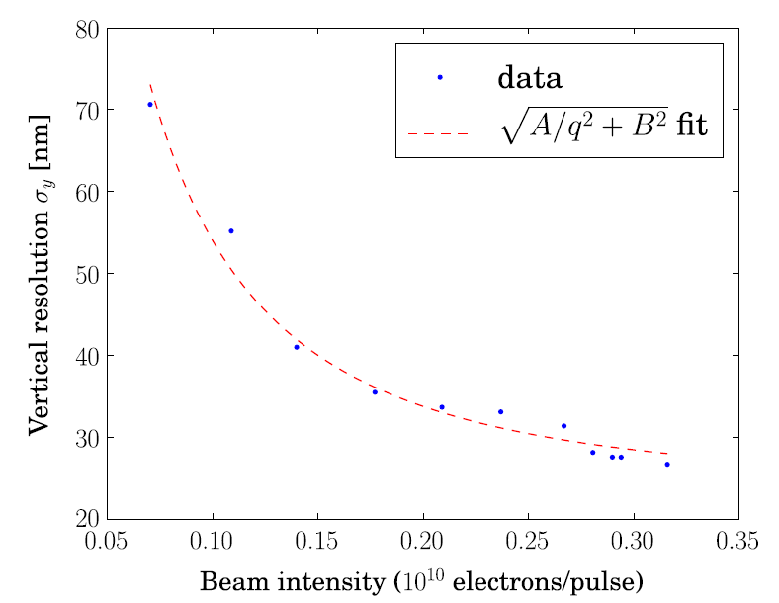
Cavity BPM resolution vs intensity

Slide 20
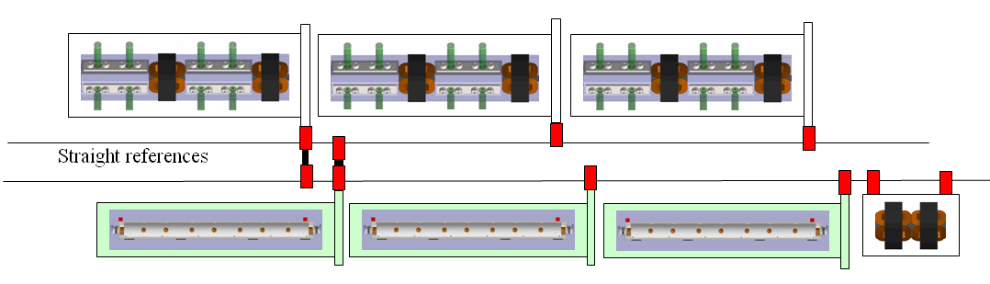
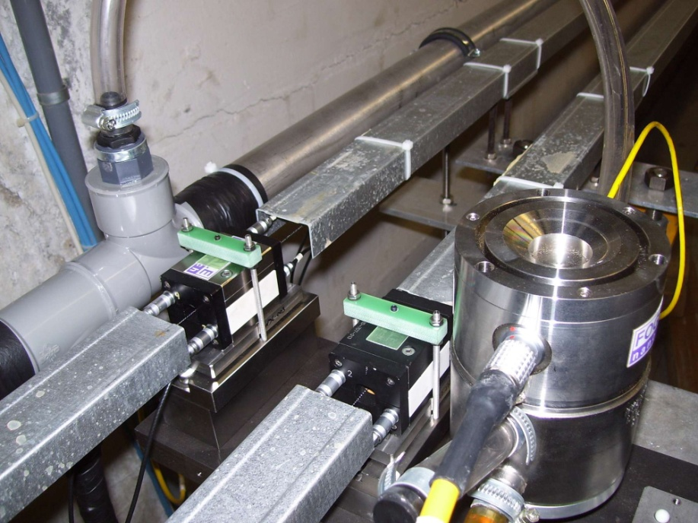
Main Linac Alignment Tolerances
Example 5: CLIC Wire alignment
Stabilise quadrupole
O(1nm) @ 1Hz
Pre-align BPMs+quads
accuracy O(10μm) over about 200m
3) Use wake-field monitors accuracy O(3.5μm)
2) Beam-based alignment
H. Mainaud-Durand, CERN
Test of prototype shows
  vertical RMS error of 11μm
  i.e. accuracy is approx. 13.5μm

Slide 21
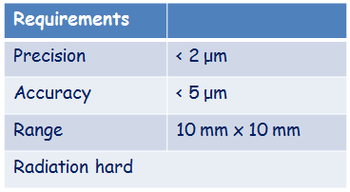
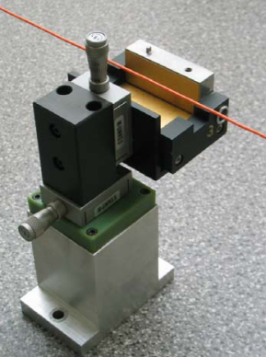
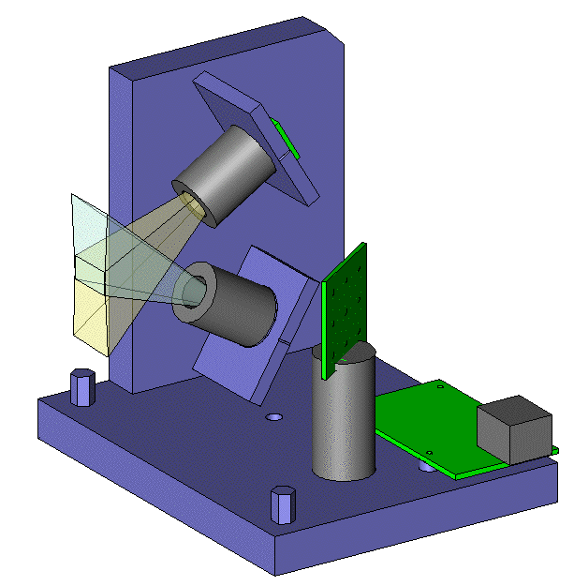
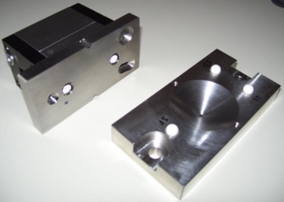
Short range alignment system
WPS (Wire Positioning Sensor)
Issue: WPS sensor fulfilling the requirements
    « absolute measurements » (known zero w.r.t mechanical interface)
    no drift
    sub micrometric measurements
Upgrade of an existing WPS
Development of a new WPS
Capacitive based WPS (cWPS)
Optical based WPS (oWPS)
Tested FFTB and ATF

Slide 22
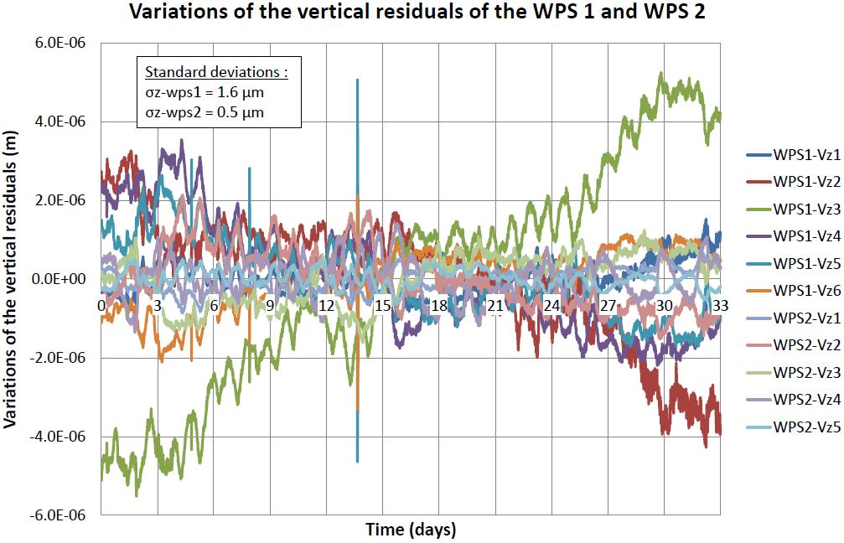
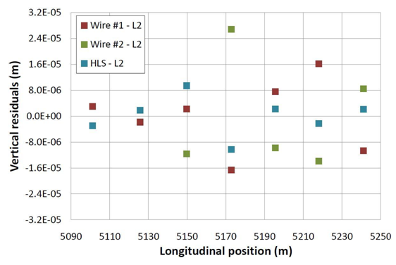
Long range alignment system
Results in TT1
    Precision on a 140 m wire: better than 2 microns over 33 days
    Accuracy: 11 microns in vertical, 17 microns in radial. Can be improved!
  Vertical residuals of the 2 longest wires:
    σ (wire 1) = 1.6 µm
    σ (wire 2) = 0.5 µm
  Accuracy of the TT1 network adjusted by the least squares method in vertical:
    σ = 11 µm r.m.s (27 µm max. value)

Slide 23
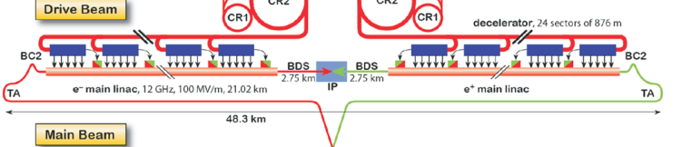
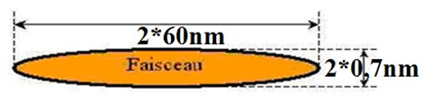
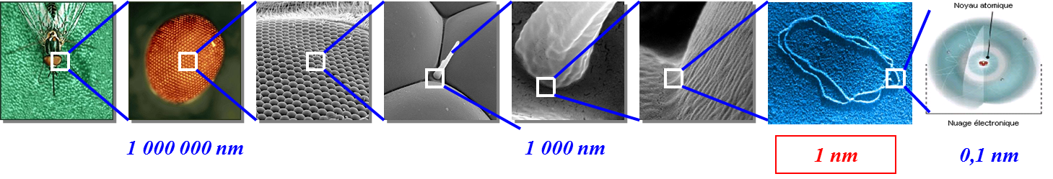
Why do we need stabilization?
A. Jeremie, LAPP
Beam
DNA
But Vibration Sources can amount to 100s of nm:
Ground motion, Traffic, Lifts, cooling water, ventilation, pumps, machinery, acoustic pressure
Transmitted:
from the ground through the magnet support,
directly to the magnet via beam pipe, cooling pipes, cables...
We cannot rely only on the quietness of the site
Stabilization techniques have to be developed
 | Last magnet | Main Beam Quad
Vert. | 0.2 nm > 4Hz | 1.5 nm > 1 Hz
Active Stabilization techniques have been chosen

Slide 24
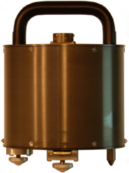
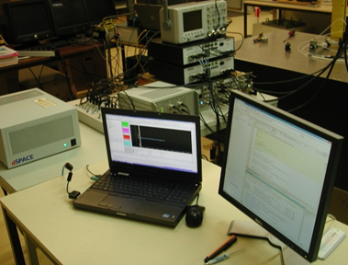
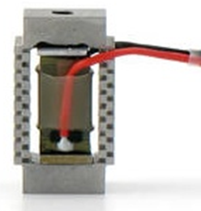
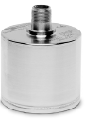
Active Stabilization:
Example 6: Vibration supression / Mechanical stabilization
Active Stabilisation means :
measure => decide action => act
sensor feedback/-forward actuator
-measure sub-nanometre
-low frequency
-Large band width (0.5-100Hz)
-Low noise
-Smalest delay for real-time
-Small and light
=> Seismic sensors
-real-time feedback
-Mutli-channel
-simulation possibilities
-Fast electronics
-Large dynamics( >16bits)
-Nanometre displacement
-Displace heavy weight
-Compact
-Real-time response
=> Piezoelectric actuator
Accelerator environment
=> Magnetic field resistant and radiation hard

Slide 25



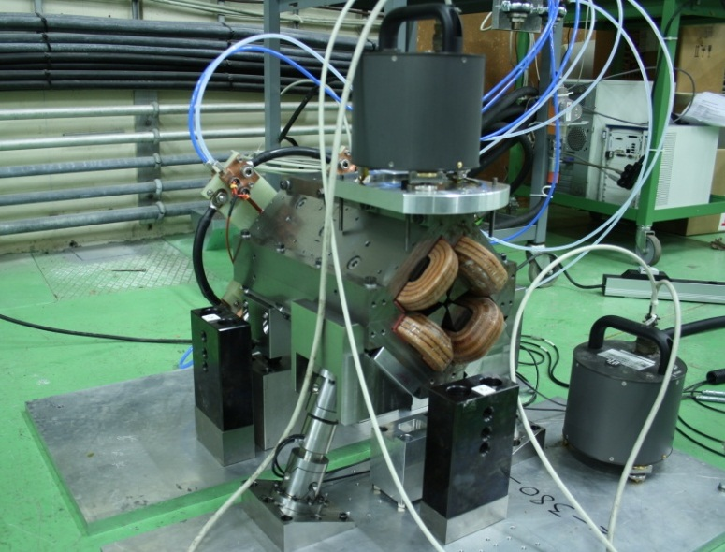

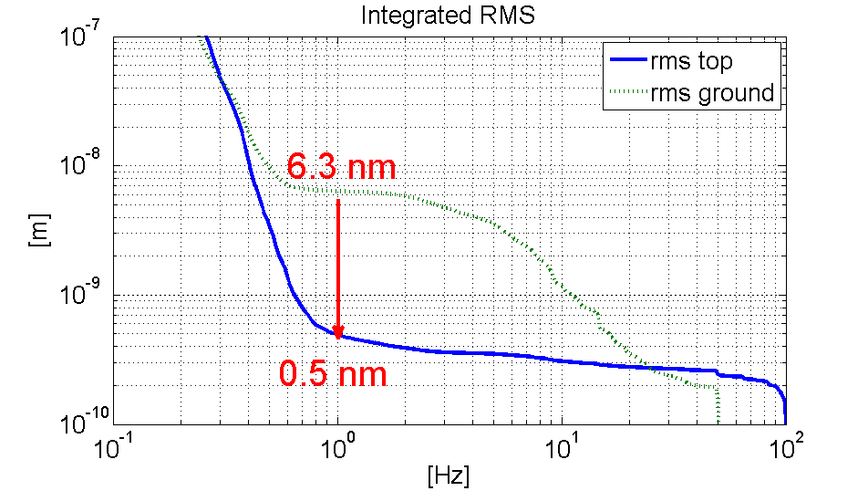
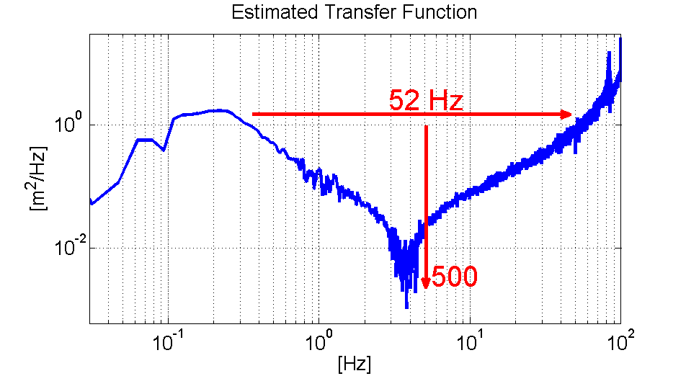

Stabilization on Type 1 MBQ
    Water cooling 4 l/min
    With magnetic field on
    With hybrid circuit
sensor
actuator
Figure | Value
R.m.s @ 1Hz magnet | 0.5 nm
R.m.s @ 1Hz ground | 6.3 nm
R.m.s. attenuation ratio | ~13
R.m.s @ 1Hz objective | 1.5 nm

Slide 26
Stabilization and Alignment (CLIC)
Example 6: Vibration supression / Mechanical stabilization
(ILC requirements less challenging ~ similar)
CLIC Linac Stabilization and Alignment
  20000 structures (W. Wuensch)
  4000 focusing magnets
Mass production (and associated cost reductions) of precision sensors and controls
ILC: internal cryo-component alignment

Slide 27
LC intra-train feedback system - concept
Example 7: Low latency feedback
P. Burrows, JAI/Oxford
Last line of defence against relative beam misalignment
Measure vertical position of outgoing beam and hence beam-beam kick angle
Use fast amplifier and kicker to correct vertical position of beam incoming to IR
FONT – Feedback On Nanosecond Timescales

Slide 28
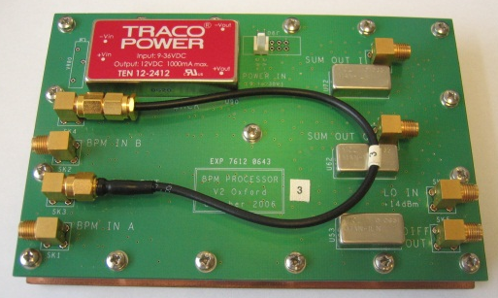
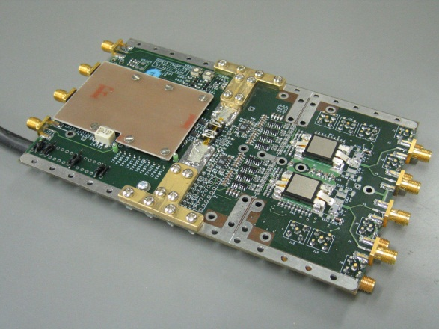
CLIC prototype: FONT testing at KEK/ATF
Kicker
BPM
1
BPM
2
BPM
3
e-
Analogue BPM
processor
BPM resolution ~ 1um
Latency ~ 23ns
Drive power > +-50nm @ CLIC

Slide 29
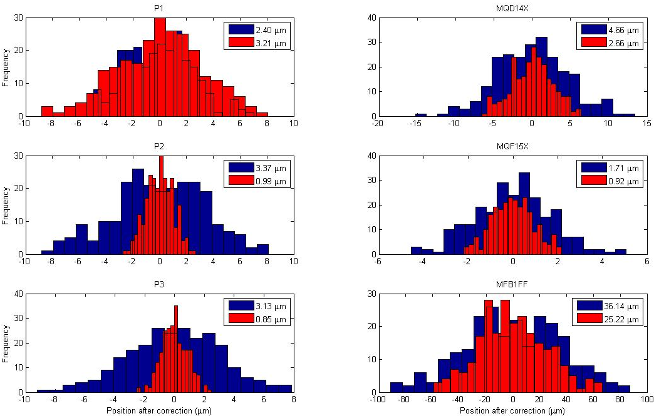
Using first bunch to correct trajectory of the next

Slide 30
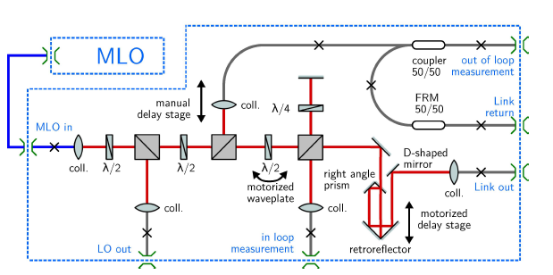
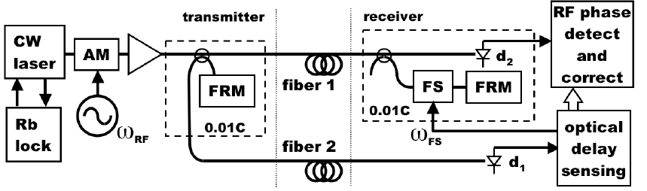
Synchronization Systems - reflectometry
Example 8: Timing and Synchronization Systems
Critical technical challenge for FEL (and LC)
Goal: few femtoseconds
  1 micron
transmitter:
System:

Slide 31
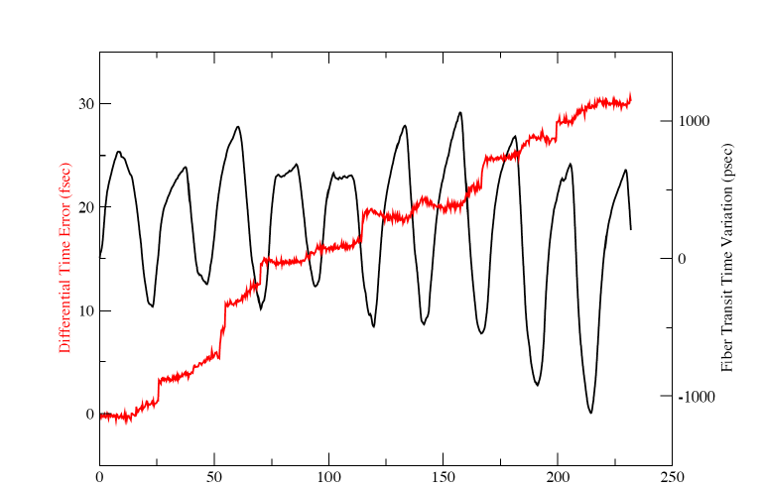
Stabilizing long fiber optics (1)
Example 1: LBNL/SLAC
Hours →
2 km fiber showing daily oscillations (+/- 1 ns) and feedback attempt (30 fs drift residual)

Slide 32
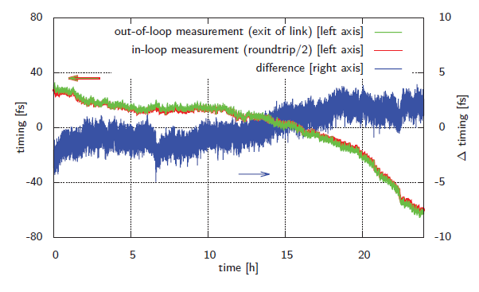
Stabilizing long fiber optics (2)
~200 m system showing feedback performance
Error rms < fs

Slide 33
Applications – Summary
← Support for the project
← Exchange with others
← Needs effort
LC Applications open the ‘nano-world’ on an industrial scale
Industrial approach is required simply to build it economically and effectively
FEL ←→ LC technology exchange
  LCLS uses cavity BPM’s and ultra-precise timing distribution
  (FELs provide a ‘test facility’ for LC)
Integration into industrial / medical accelerator systems

