Slide 1
The Status of
Advanced Accelerator Association Promoting Science & Technology
2012 IEEE Nuclear Science Symposium and Medical Imaging Conference
“ Linear Collider Event”
Oct. 30, 2012
Masanori Matsuoka
Secretary General, Advance accelerator association
promoting science & technology

Slide 2

Contents
Outline of AAA
Our Activities
Collaboration with Industry & Academia
Accelerator industry in Japan
Conclusion
1

Slide 3
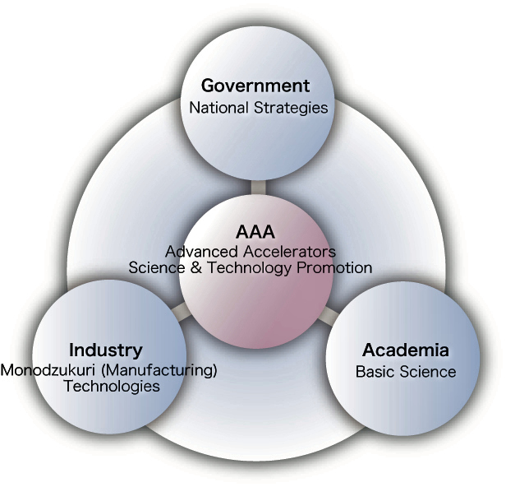
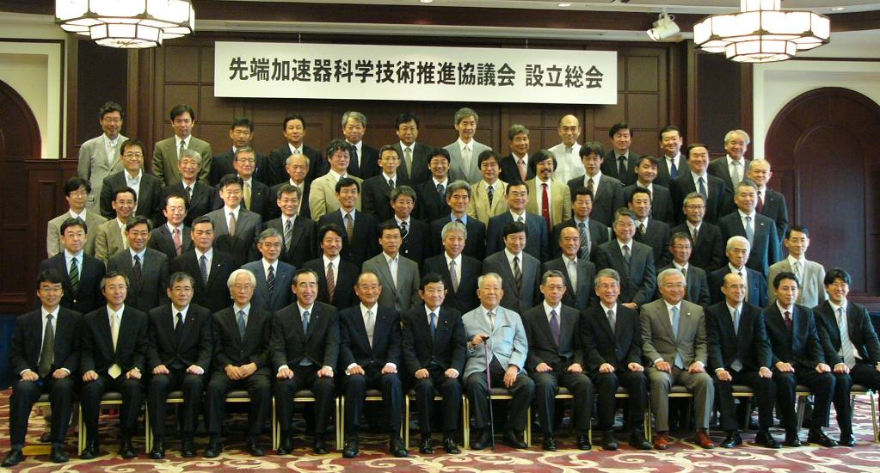
The Advanced Accelerator Association Promoting Science & Technology
(AAA) was established in June 2008 with 76 member companies / institutes,
Outline of AAA
to study how to reach a consensus to realize ILC (International Linear Collider) in Japan, and
to promote and seek various industrial applications of advanced accelerators and technologies derived from R&D on such accelerators
with facilitating Industry-Government-Academia collaboration
2

Slide 4

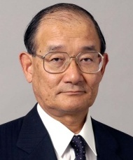
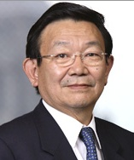
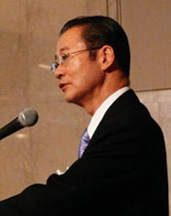
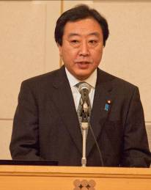
History of AAA
Jun, 2008 AAA was established
July, 2008 Nonpartisan Federation of Diet members
for ILC was established
Dec.,2008 Symposium was held by AAA & Federation
Chief cabinet secretary Takeo Kawamura insisted,
“Promoting of basic science can make people more happy.
ILC is attractive project because it gives big dream
to young people”
April, 2010 2nd term of activity started
Dec., 2011 Symposium was held by AAA & Federation
Prime minister Yoshihiko Noda expressed,
“Accelerator is very important technology
because it is used for not only basic science
but also other various field.
And broad public understanding will be mandatory
to realize ILC hosted by JAPAN.”
April, 2012 3rd term of activity started
M. Koshiba
T. Nishioka
K. Yosano
T. Kawamura
Y.Noda
3

Slide 5
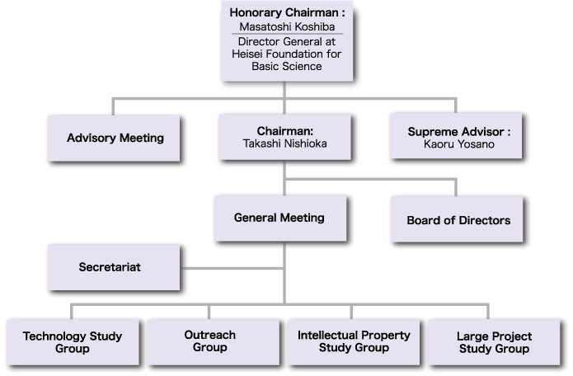
AAA Organization
2002 Nobel laureate
4

Slide 6
Board Members
Chairman
Takashi Nishioka :Former President, Mitsubishi Heavy Industries, Ltd.
Director
Atsuto Suzuki :Director General,
High energy accelerator Research Organization(KEK)
Yasuharu Igarashi :Executive Officer, Toshiba Corporation
Akira Maru :Senior Corporate officer, Hitachi, Ltd.
Yoshiaki Nakatani :Executive Officer, Mitsubishi electric corporation
Keijiro Minami :Senior Executive Officer, Kyocera Corporation
Akira Noda :Professor, Kyoto University
Auditor
Sachio Komamiya :Professor, University of Tokyo
5

Slide 7
AAA Members as of Oct. 30, 2012
Industry
AKITA FINE BLANKING, ATOX, azbil, Canon, Central Japan Railway Company (JR Central), DIA CONSULTANTS, Electric Power Development Co., Ltd(J-POWER), Fujikura , FUJITSU, Fukken, Fukuyama Ｃonsultants, FURUKAWA C&B, Hazama, Hitachi Cable, Hitachi High-Technologies, Hitachi Technologies and Services, HITACHI ZOSEN, HITACHI, IBM Japan, Innoshima, JFE Steel, Kajima, Kawasaki Geological Engineering, KDC Engineering, KUMAGAI GUMI, Kuroki Kogyosho, KYOCERA, KYOWA ELECTRONIC INSTRUMENTS, KYUSHU ELECTRIC POWER, LAPIS SEMICONDUCTOR, MAEDA, MAYEKAWA MYCOM, MEIDENSHA, MIRAPRO, Mitsubishi Electric, Mitsubishi Electric System & Service, Mitsubishi Electric Tokki Systems, Mitsubishi Heavy Industries Compressor, Mitsubishi Heavy Industries, MITSUI ENGINEERING & SHIPBUILDING, NEC, NEC Tokin, Net One Systems, NIHON KOSHUHA, Nihonchikatansa, Nikken Sekkei, Nikkyo Technos, Nippon Advanced Technology, NIPPON CIVIC CONSULTING ENGINEERS, Nippon Steel, Nishimatsu Construction, NOMURA PLATING, OBAYASHI, OKUMURA, ORIENTAL CONSULTANTS, OYO, PENTA-OCEAN CONSTRUCTION, SALTASS, SAN-AI PLANT, Seibu Polymer, SEIKO EG&G, SGI Japan, SHIMADZU, SHIMZ, SNK, Sumitomo Heavy Industries, SUMITOMO MITSUI CONSTRUCTION, TAISEI, TAIYO NIPPON SANSO, TAIYO, NAKAJIMA & KATO, TAKASAGO Thermal Engineering, Takenaka Civil Engineering & Construction, TAKANAKA, TEKKEN, TOBISHIMA, Toda, Tohoku Electric Power, Tokyo Denkai, Tokyo Electric Power Services, Tokyu Construction, Tosei Electrobeam, TOSHIBA, TOSHIBA ELECTRON TUBES & DEVICES, TOYAMA, TOYOTA TSUSHO, TSUKISHIMA TECHNO MACHINERY, UBER, Ultra Finish Technology, ULVAC, Urban Planning and Design Institute, YASKAWA Electric
Academia
ILC-GDE, Osaka University, Okayama Institute for Quantum Physics, Okayama University, Ochanomizu University, Kyushu University, Kyoto University, High Energy Accelerator Research Organization(KEK), Kogakuin University, Japan Synchrotron Radiation Research Institute (JASRI), Kobe University, PSG, Saga University, National Institute of Advanced Industrial Science and Technology (AIST), UVSOR Facility, Institute for Molecular Science, National Institutes of Natural Sciences, Natural Sciences, High Energy Physics Laboratory, Shinshu University, Seikei University, A Study Group for Science and the Next Generation Accelerator, Research Facility Center for Science and Technology, University of Tsukuba, Tokyo Kasei University, Tokyo Institute of Technology, The University of Tokyo, Tohoku Accelerator Fundamental Science Committee, Tohoku University, Nagoya University, High Energy Physics Laboratory, Nara Women's University (NWU-HEP), Niigata University, Japan Atomic Energy Agency (JAEA), Nihon University, Hiroshima University, National Institute of Radiological Sciences (NIRS), Hokkaido University, The Institute for Future Technology (IFTECH), Meiji Gakuin University, Yokohama National University, RIKEN, Waseda University
6

Slide 8
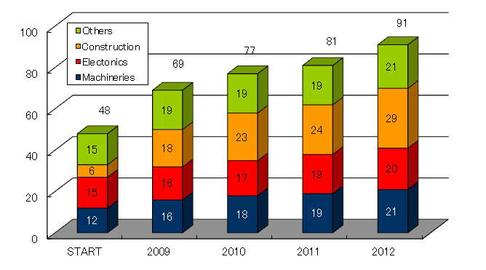
Increasing of AAA Members
76 members
128 members
・Members continue to increase,
especially construction industry
・Many Japanese companies
expect to realize ILC in Japan
7

Slide 9
Contents
Outline of AAA
Our Activities
Collaboration with Industry & Academia
Accelerator industry in Japan
Conclusion
8

Slide 10
Mission of AAA
【Technical Study Group 】
Seek directionalities on advanced accelerator with ILC
Integrate “manufacturing technologies” from a variety of industrial fields to create innovative scientific technologies
【Outreach Group】
Inform the public of possibilities and significance of advanced accelerator and ILC, through a variety events and media exposures.
【Large project Study Group】
Study how to reach a consensus with understanding the site issue in order to realize ILC in Japan.
Study proper organization for promoting ILC
【Intellectual Property Study Group 】
Study intellectual property with “ ILC Project ” as an underlying model
9

Slide 11
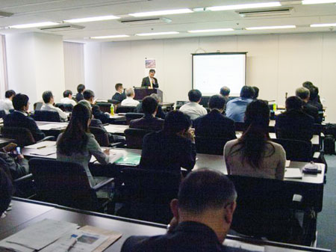
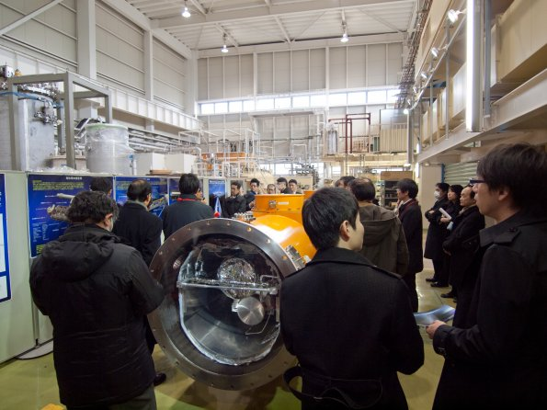
Activities of Technical Study Group
28 Seminars
  Superconducting and Accelerator
  Muon Applications
  Neutron and Synchrotron Radiation
  Vacuum technology
  Materials for accelerator
  Accelerator for medical
  Etc.
8 working group (WG) meeting
  Superconducting Accelerator WG
  Civil engineering WG
Visit to Accelerator Lab.(KEK STF)
10

Slide 12
Seminars by Technical Study Group
No. | Theme
1 | Starting the technical study group
2 | The status and challenges of SC accelerators
3 | Accelerator and Civil Engineering
4 | Superconducting RF Cavity Technologies
5 | High power RF Technology
6 | Advanced accelerators and Synchrotron Radiation Science
7 | Advanced accelerators and Cryogenics
8 | Advanced accelerators and Neutron Science
9 | Advanced accelerators and Control Technologies
10 | Industrial technologies, supporting advanced accelerators
11 | Summary talks of technical study group and outreach group
12 | Advanced accelerators and Medical applications
13 | Advanced accelerators and Laser technologies
14 | Summary of the first term activities
15 | Report on IPAC and GDE meeting
No. | Theme
16 | Refrigeration technologies
17 | New applications of accelerators
18 | Current and future of Medical accelerators
19 | Status of ILC, Regulation of High Pressure Gases
20 | Advanced accelerators and Muon Science
21 | Measuring instruments and Simulation
22 | Cutting-edge materials used in the accelerators
23 | Superconducting technologies for the environment
24 | Status and future of ILC
25 | State-of-the-art accelerators for Synchrotron Radiation
26 | The latest digital technologies for accelerators
27 | Technologies and products of advanced accelerator components
28 | Technologies of Ion accelerators
11

Slide 13
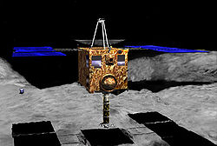
Activities of Outreach Group
13 symposiums in 4.5 years
  Japanese Contribution to understanding the Universe using
  Asteroid explorer “HAYABUSA”,
  “SUBARU” telescope and
  such Accelerators “TRISTAN”, “KEKB”, “J-PARC”, …
  Birth of the Universe and Life
  Understanding the Universe by using the advanced
  accelerator from KEKB to ILC
  The advanced accelerators saving life and creating the universe
  International Linear Collider and applications of advanced accelerators
  etc.
AAA Home page (http://www-sentan.org)
  Introductory of AAA
  About ILC
  Applications of accelerators
  Event Information
  etc.
12

Slide 14
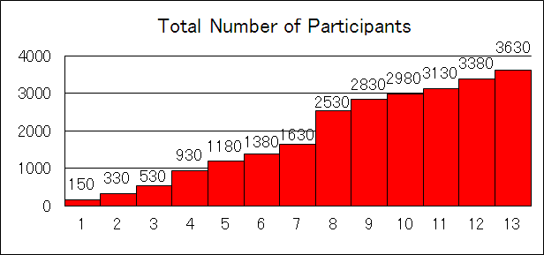
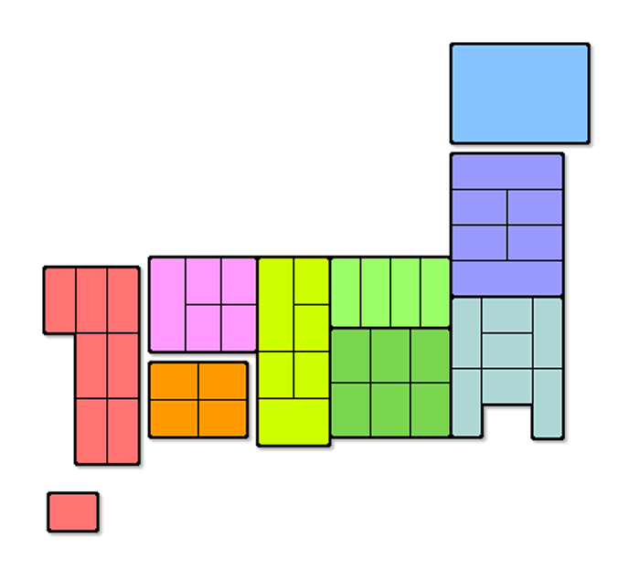
Symposiums at the various cities in Japan
u
No.11 Sapporo
No.4 Fukuoka
No.9 Fukuoka
No.8 Oushu
No.6 Kyoto
No.13 Fukuoka
No.2 Sendai
No.3 Hiroshima
Participants
100-199
200-299
300-399
400-499
No.7 NAGOYA
No.1 Tokyo
No.5 Tokyo
No.10 Tokyo
500-
No.12 Tokyo
13

Slide 15
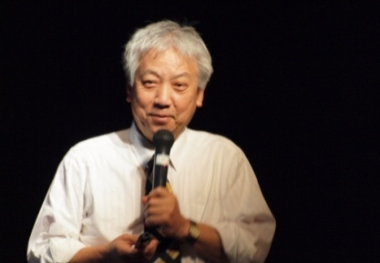
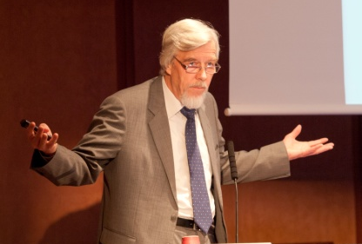
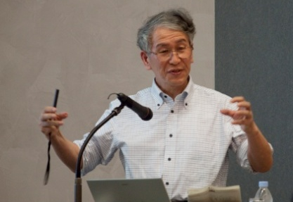
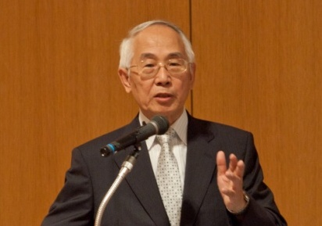
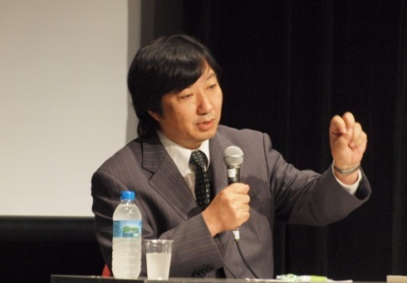
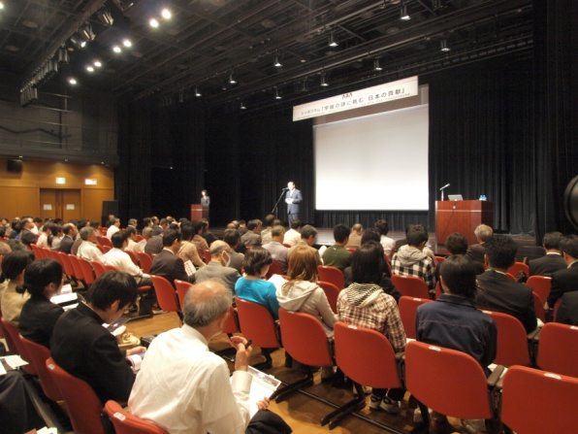
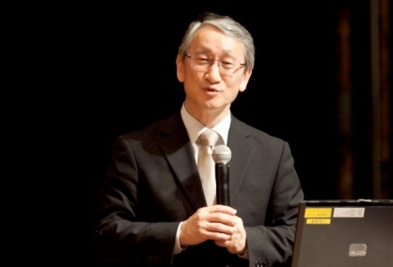
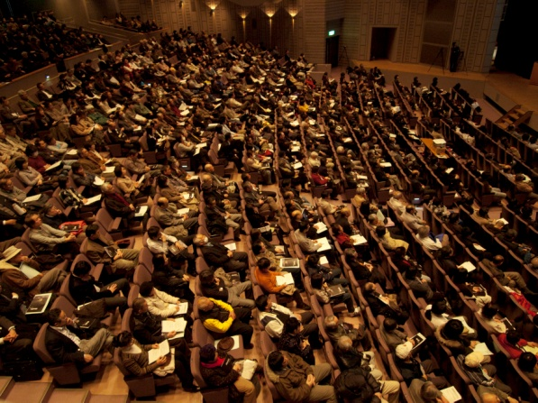
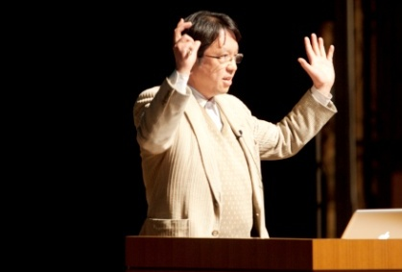
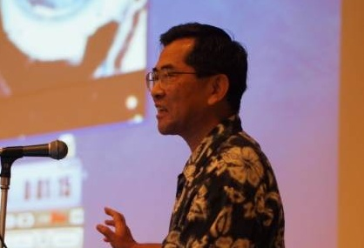
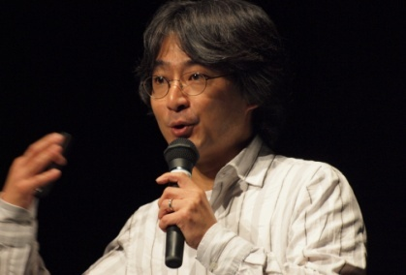
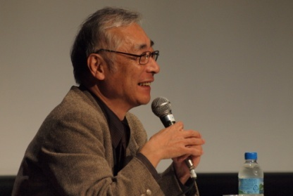
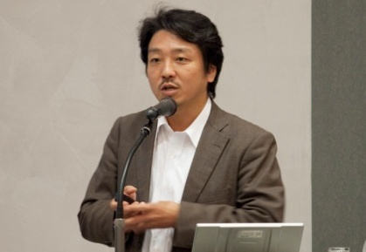
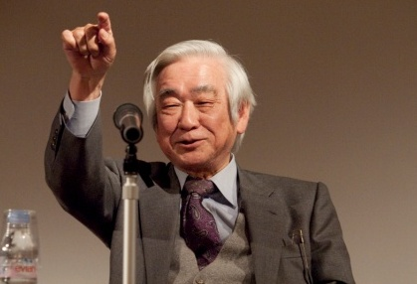
Symposiums on Advanced Accelerator
M. Yoshioka
R. D. Heuer
A. Suzuki
M. Tsujii
#4 Symposium in Fukuoka
S. Komamiya
J. Kawaguchi
#8 Symposium in Ohshu
H. Yamamoto
M. Ie
H. Murayama
Y. Takayanagi
S. Yamashita
T. Masukawa
14

Slide 16
Activities of Large Project Study Group
(International organization)
Investigate international organizations of large scale facilities for study of ILC
(Site issue)
Study how to reach a consensus of site issue
Investigate challenges for ILC construction in Japan
Support two candidate local governments to research how to build a global city with ILC
(Proposal to Government)
Propose the policy for promoting advanced accelerator to government
15

Slide 17
Large project study Group
No. | Theme
1 | Starting Large project study group
2 | The history and current status of ITER
3 | Construction of J-PARC / International Collaboration at DESY
4 | The history and current status of LHC / The experience of Spring-8
5 | Intellectual Issue for Large project / The experience of KEKB
6 | Intellectual property Issues in conducting R&D with International collaboration
7 | The experience of High performance computing infrastructure development / International large project of Astronomy
8 | Management of Big science project / The experience of the super express export to Taiwan
9 | International political aspect of International science project ,for example International Space Station
10 | Innovative outreach; How do we publicize the future possibility?
11 | Marketing research for the accelerators
12 | Experience of HIMAC and the future of heavy particle therapy
No. | Theme
13 | Policy of Atomic energy based on the energy and environmental issues
14 | Radiation Restriction of the accelerators
15 | The status of ILC / WG on Study for challenges of ILC construction
16 | Intermediate report on Study for challenges of ILC construction (WG)
17 | Intellectual property issues of ITER
18 | Report on Study for challenges of ILC construction (WG)
19 | How to promote the accelerator industry / Intermediate report of Study for challenges of ILC construction (WG)
20 | Activities at the candidate sites, Tohoku and Kyushu / WG on Promoting collaboration with industry, government and academia
21 | WG on Promoting collaboration with industry, government and academia WG on Study for ILC construction
22 | Spring-8 & SACLA contributing Drug Development / WG on Promoting collaboration with industry, government and academia
16

Slide 18
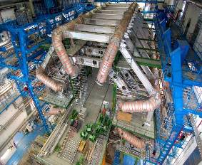
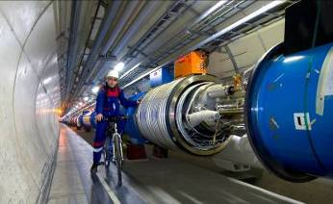
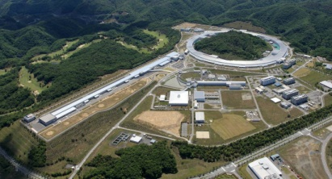
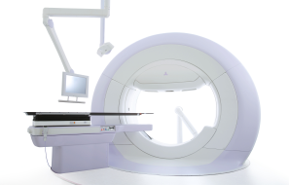
Accelerator- Pyramid
LHC（CERN）
Number in the world
1～5
High end Accelerator for particle Physics
RIKEN SACLA
10 ～20
Large project for science & technology
More than 100
Advanced accelerator for New usage development
Radio Therapy
Innovative technologies, New applications, ･･･
Elemental technologies, Cost reduction,
Standardization, ･･･
More than 10,000
(USD 3.5Billion*)
General purpose machine
(Medical, Industry,･･･
(USD 500Billion*)
Products derived from
accelerator technologies
*) ”Accelerators for America’s Future” , 2010, Department of Energy, USA
17

Slide 19
Contents
Outline of AAA
Our Activities
Collaboration with Industry & Academia
Accelerator industry in Japan
Conclusion
18

Slide 20
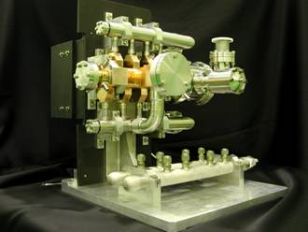
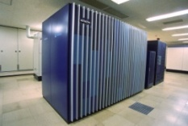
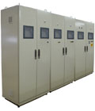

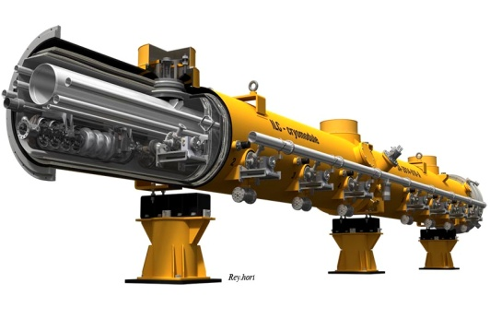
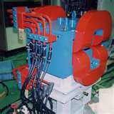
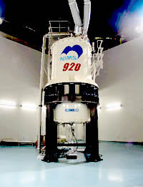
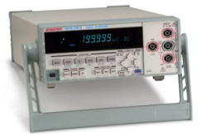
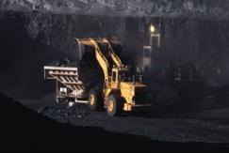
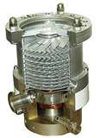
Accelerators Supported by Various Industries
New technology derived from accelerator will bring big impact in many field.
Machinery system
IT system
Control system
Supercomputer
Information Tech.
Accelerator system
Cryogenics
Beam control
Electronics
RF system
Electro magnet
Power source
RF power source
Micro wave parts
Machinery parts
Instruments
Material
Civil engineering
Vacuum pump
Beam monitor
Radiation monitor
Radiation shield
High purity material
Ceramics
19

Slide 21
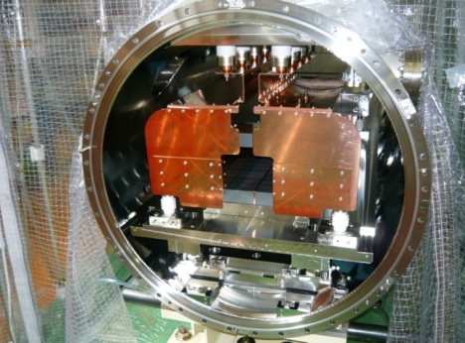
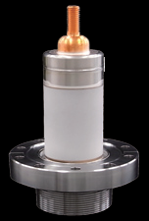
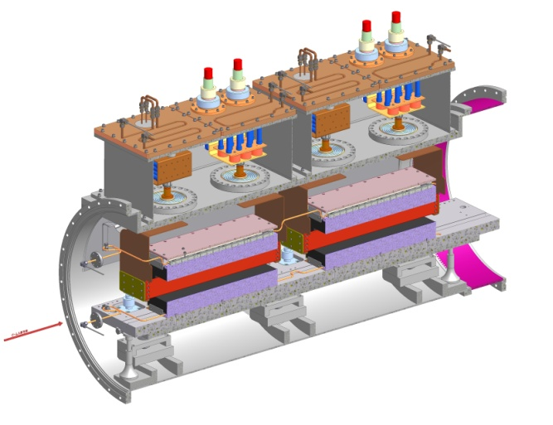
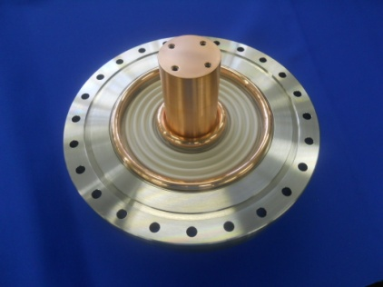
Collaboration with industry & Academia (1)
Kyocera succeeded in development of new type ceramics for high voltage isolation in collaboration with KEK.
This technology contributed to miniaturizing of the kicker magnet chamber.
Feed through for Kicker magnet used in J-PARC (50kV)
<Advantages>
1.Volume reduction : 40%
2.No Corrugation
New type
Conventional type
Disk type feed through for Kicker magnet used in J-PARC
<Advantages>
Reducing of discharge by the use of ceramics containing conductive material
Courtesy of KEK & Kyocera
20

Slide 22
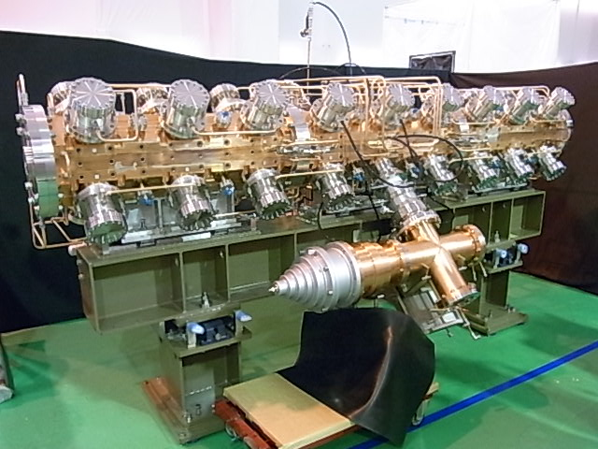
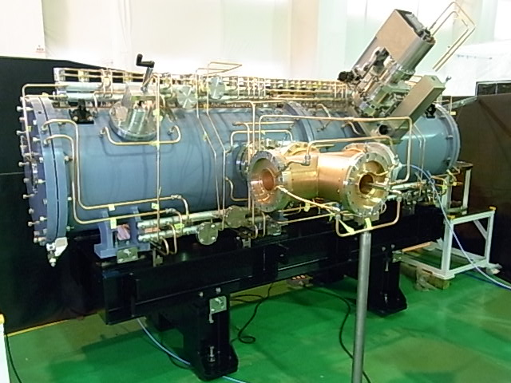
Collaboration with industry & Academia (2)
MHI is developing a high duty proton accelerator for Boron Neutron Capture Therapy or BNCT in collaborating with Tsukuba University, KEK, Hokkaido University, JAEA, several companies, and Ibaraki-prefecture.
Specification of accelerator
Beam energy : 8 MeV
Beam current : 10 mA (Average)
RFQ (Radio Frequency Quadrupole)
DTL (Drift Tube Linac)
21

Slide 23
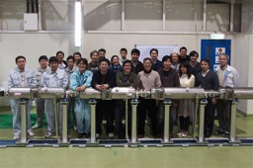
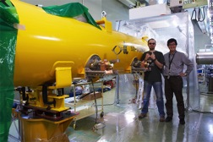
R&D on Superconducting cavity
MHI and Hitachi are reaching 35 MV/m of accelerating field by vertical test.
Hitachi reached 41 MV/m with HOM coupler.
Toshiba reached 35 MV/m without HOM coupler.
MHI cavities were installed in the cryomodule in order to conduct the horizontal test called S1-Global.
year | # 9-cell cavities qualified | # of Labs reaching 35 MV/m processing | # of Industrial manufacturers reaching 35 MV/m fabrication
2006 | 10 | 1 DESY | 2 ACCEL, ZANON
2011 | 41 | 4 DESY, JLAB, FNAL, KEK | 4 RI, ZANON, AES, MHI,
2012 | (45) | 5 DEY, JLAB, FNAL, KEK, Cornell | 5 RI, ZANON, AES, MHI, Hitachi
Courtesy of Prof. A. Yamamoto of KEK
22

Slide 24
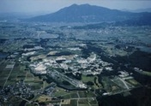
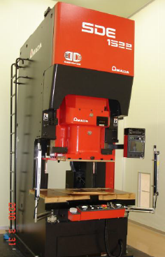





Cavity Fabrication Facility at KEK
KEK prepared the facility for cavity production R&D in collaborating with industries
Courtesy of Prof. A. Yamamoto of KEK
23

Slide 25
Contents
Outline of AAA
Our Activities
Collaboration with Industry & Academia
Accelerator industry in Japan
Conclusion
24

Slide 26
Japanese companies contribute to the advanced accelerator projects in the world
Companies which have contributed to LHC
Company | Products
Toshiba corporation | Superconducting magnet, TDC chip
Furukawa, Ltd. | Superconducting cable
IHI corporation | 1.8K refrigeration units
Nippon steel, Ltd. | Non-magnetic steel plate
JFE steel corporation | Non-magnetic steel plate
Kaneka corporation | Insulation film for SC wire
Hitachi Cable, Ltd. | Superconducting cable
Kawasaki Heavy Industries, Ltd. | Cryostat for Liquid-Ar, CMS end york
Sumitomo Chemical | Aluminum for SC Cable
Kyocera corporation | Ceramics duct
Fujikura, Ltd. | Rad-hard optical fibers
Hamamatsu photonics K. K. | Photo-tube, Silicon sensor, SCT module
Rinei Seiki, Co., Ltd. | TGC(Thin Gap Chamber) trigger chamber
Nippon Mektron, Ltd. | Cu/Polyimide flexible circuits
Arisawa Manufacturing Co., Ltd. | Polyimide film
25

Slide 27


Japanese companies contribute to the advanced accelerator projects in the world
Companies which have contributed to Euro-XFEL
Company | Products
Tokyo Denkai Co., Ltd. | Pure Niobium Sheet
Toshiba Electrical Tubes and Devices Co., Ltd. | L-band Klystron
Kyocera corporation | Feed through flange
Companies which have contributed to other projects
Company | Products
Mitsubishi Heavy Industries | S-band accelerator Superconducting accelerator
Mitsubishi Electric | Superconducting accelerator Superconducting magnet
Toshiba corporation | Normal conducting cavity
Toyama | Beam line instruments
26

Slide 28

Conclusion
AAA have promoted the science and technology of the accelerators and ILC project.
New ideas and products have been created through the activities of AAA.
AAA conducted symposiums to publicize the ILC and the advantage of promoting accelerator industry.
In Japan, local governments are endeavoring for citizens to understand the benefit of hosting ILC.
We will continue to strive for realizing ILC in Japan
27

