Slide 1
Overview of Industrial, Medical, Energy and Security-Related Accelerator Use
Stuart Henderson
Associate Laboratory Director for Accelerators
Fermilab
2012 IEEE Nuclear Science Symposium and Medical Imaging Conference

Slide 2
Accelerators for America’s Future
In the last half-decade there has been a growing recognition of the importance that accelerators have in advancing, not only Discovery Science, but
Medicine and Health,
Industry,
National Security,
and potentially, Energy and the Environment
These advances benefit society by contributing to our quality of life and by generating jobs and wealth
2009 DOE/OHEP Symposium and Workshop on Accelerators for America’s Future

Slide 3
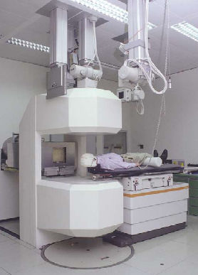
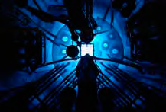
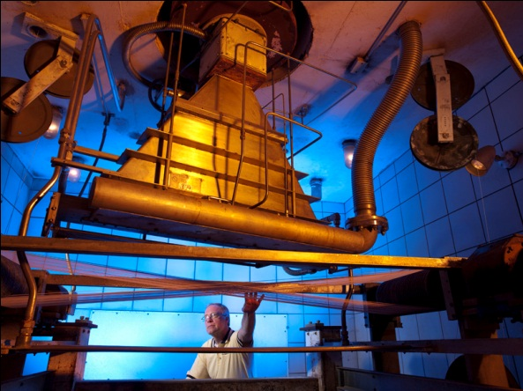
Discovery Science
Discovery Science
Medicine and Biology
Energy and Environment
Accelerators and Beams
National Security
Industry

Slide 4
Accelerators By the Numbers
Numbers of accelerators:
Particle accelerators built to-date throughout the world: ~30,000
Industrial accelerators: ~21,000
Medical accelerators: ~9,000
Economic Impact
Annual Market for Ion Beam Implantation systems: $1.5 B
Annual Market for medical accelerators: $4 B
Annual value of all products that make use of accelerator technology: $500B
US government-funded capital investment in accelerator facilities: > $2.5 B in the last 10 years
Health Impact
Tens of millions of patients receive accelerator-based diagnoses and treatments each year
Patients who have received proton/ion therapy: ~70,000
50 medical isotopes routinely produced with accelerators

Slide 5
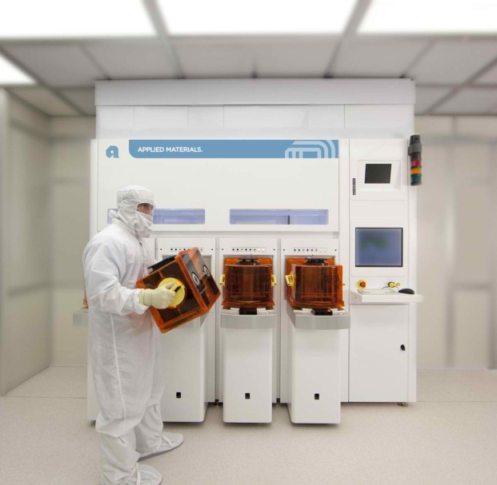
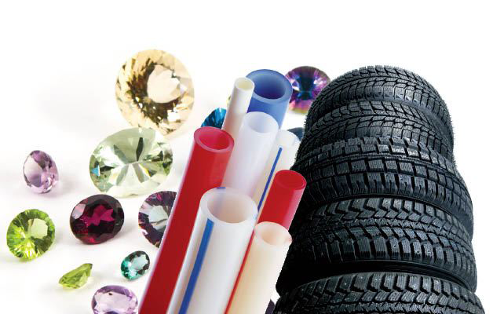
Accelerators are Essential Tools in Industry
A wide-range of industrial applications makes use of low-energy beams of electrons, protons and ions (~20,000 have been built)
Protons, ions (keV to MeV) –electrostatic, RFQs, cyclotrons,
Semiconductor fabrication (ion implantation)
Hardening of surfaces
E-beams (0.1-10 MeV up to MW power) from electrostatic, linacs, betatrons
Cross-linking and polymerization for tires, rubber, plastics
Sterilization of medical products
Food irradiation for disinfection, extension of shelf-life or sterilization
Welding/hardening, cutting and drilling
Applied Materials, Inc.

Slide 6
Industrial Accelerator Business
Application | Systems (thru 2008) | Yearly unit sales | Yearly sales ($M) | System price ($M)
Ion Implantation | 10,000 | 500 | 1,500 | 1.5-5.0
Electron beam modification | 7,000 | 100 | 150 | 0.5-2.5
Electron and X-ray irradiators | 2,000 | 75 | 130 | 0.2-8
Ion beam analysis and AMS | 200 | 25 | 30 | 0.4-1.5
Radioisotope production | 600 | 50 | 70 | 1-30
High energy x-ray inspection | 750 | 100 | 70 | 0.3-2.0
Neutron generators | 2000 | 50 | 30 | 0.1-3.0
Total | 22,550 | 900 | 1,900
From “Industrial Accelerators & Their Applications”, edited by R. W. Hamm & M. E. Hamm, World Scientific Publishing, 2012.
All the products that are processed, treated or inspected by particle beams have an annual value exceeding US$500B.

Slide 7
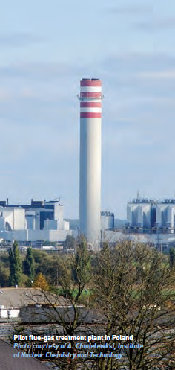
Trends in Industrial Accelerators: Environmental Applications
Decades of research demonstrated effectiveness of electron accelerators for purifying drinking water, treating waste water, disinfecting sewage sludge, and high-efficiency removal of NO_{X} and SO_{X} from flue gases.
Radiation processing of flue gases from coal-fired power plants has been proven in pilot plants in Poland, Bulgaria, China
Requires 0.8 MeV, ~1 MW e-beam power per 50 MW plant
Radiation processing of waste water has been demonstrated to be effective for biological and chemical control
Water treatment industrial scale system operates in Korea
Requires < 5 MeV, 0.4-10 MW for small to large scale plant
7
S. Henderson, IEEE NSS, Oct. 30, 2012

Slide 8
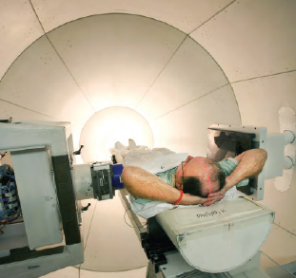
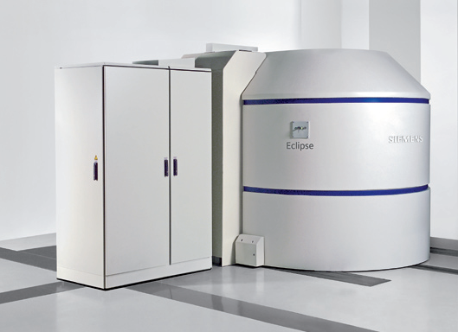
Accelerators are Essential Tools for Medical Treatment and Diagnosis
Tens of millions of patients receive accelerator-based diagnoses and treatments each year
50 medical isotopes, used for diagnosis and treatment, are routinely produced with accelerators
Siemens Eclipse Cyclotron (11 MeV) marketed for PET isotope production
There are ~9000 medical accelerators in operation in the world
Annual market for medical accelerator systems: $4 B

Slide 9
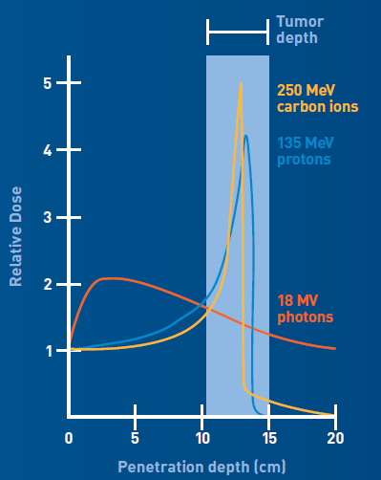
Trends in Accelerators for Medical Applications
Radioisotope production
New high power accelerators based on superconducting radio-frequency technology can be used to solve specific problems:
Tenuous supply chain for clinically relevant fission-produced radioisotopes such as ⁹⁹Mo/^{99m}Tc (most commonly used radioisotope)
Need to move away from production of isotopes via HEU
Production of new clinically relevant isotopes
Beam therapy
Light ion therapy (e.g. Carbon)
Higher biological effectiveness
Superior dose distribution
The U.S. does not have a carbon therapy facility
Technologies directed at more compact designs are pursued at national labs

Slide 10
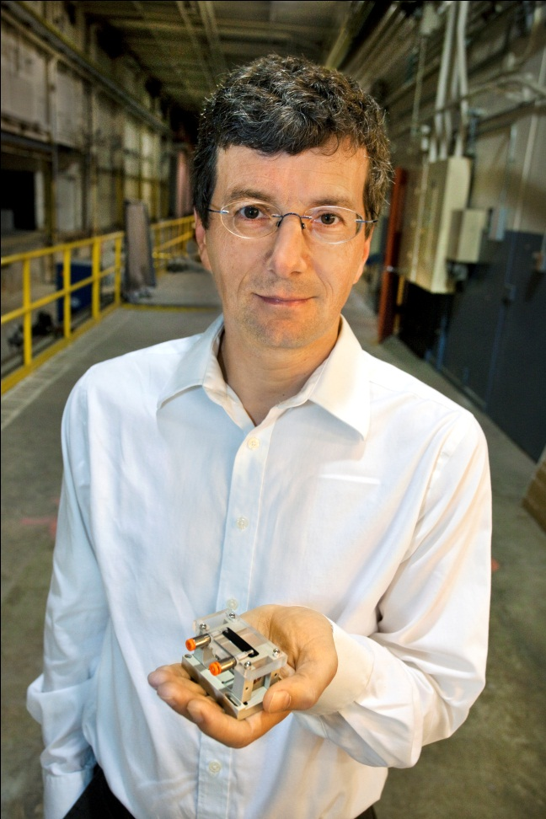
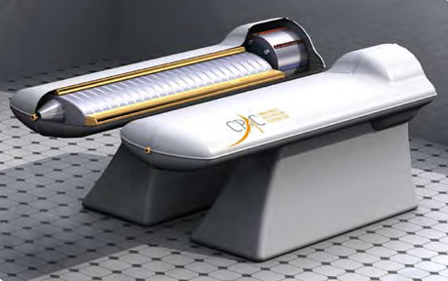
Trends in Accelerators for Medical Applications
Considerable efforts to develop new, compact types of particle accelerators which have the potential for very compact (and less expensive) sources of x-rays, electrons and protons for cancer therapy and other applications
W. Leemans, LBNL
1 GeV accelerator (1.3 inches long)
Concept for compact proton therapy accelerator (Compact Particle Acceleration Corporation)

Slide 11
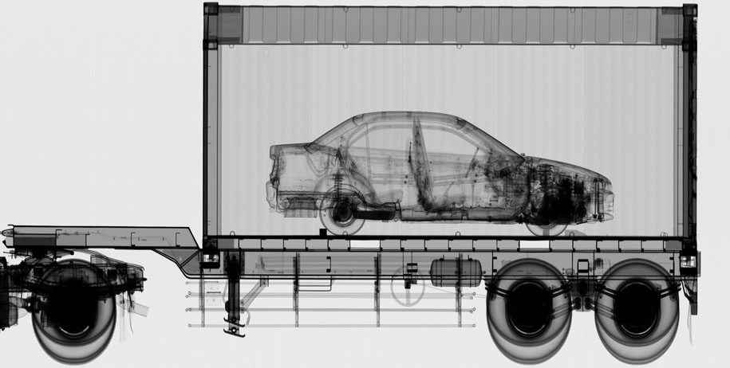
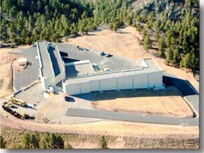
Accelerators for Security
Accelerators are used for cargo scanning and “active interrogation” to detect special materials
…and in Nuclear Defense: stockpile stewardship, materials characterization, radiography, and support of non-proliferation
Dual Axis Radiographic Hydrodynamic Test Facility, Los Alamos Nat. Lab

Slide 12
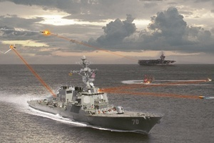
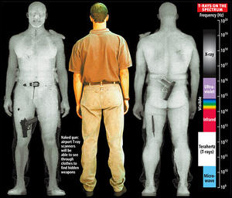
Trends in Accelerators for Security and Defense
Accelerators based on superconducting radio-frequency technology are being developed to produce high power laser beams for defense
New accelerators are under development to produce “Terahertz” radiation sources for scanning
Inspection and Scanning: Emphasis on
Developing compact, “fieldable” systems
Active interrogation at appropriate stand-off distances
Development of a suite of probes (n, x-ray, gamma, THz, p, …)

Slide 13
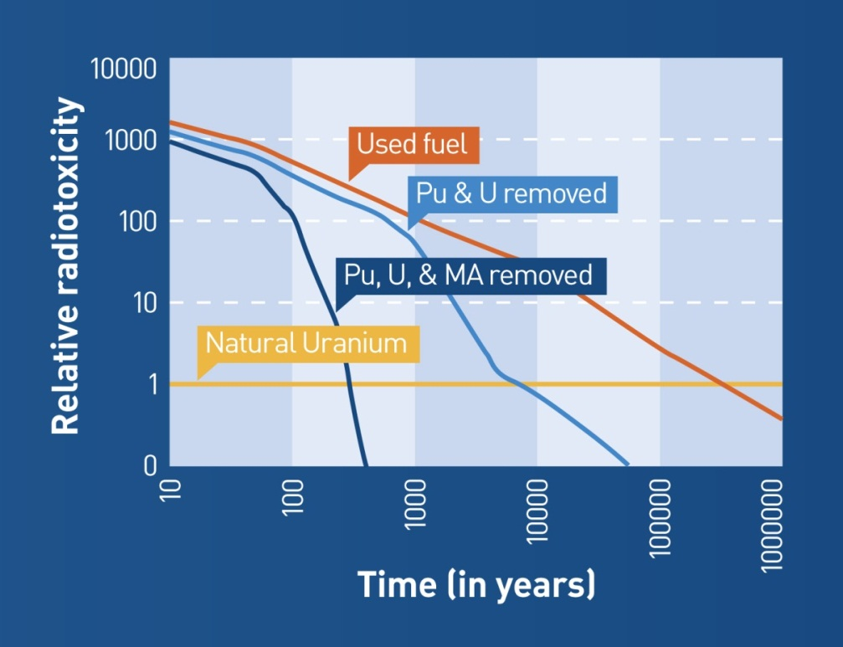
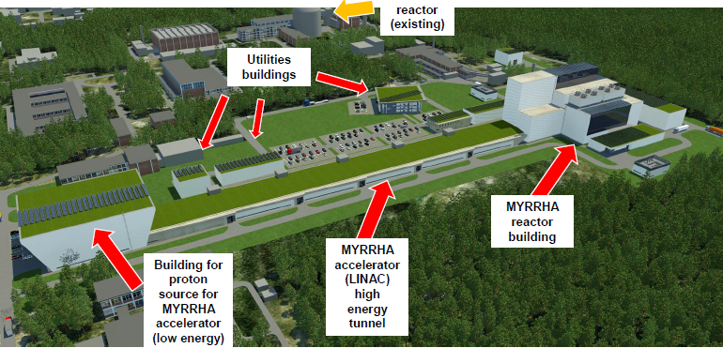
Accelerators in the Energy Sector
Accelerators have tremendous potential – largely untapped thus far – in the Energy Sector:
Accelerator Driven Subcritical Reactors (based on superconducting particle accelerators) can transmute nuclear waste so it is much safer and simpler to store, while at the same time generating electrical power
Requires very high beam power (>10 MW) and very high reliability
This technology is actively pursued in Europe, China, India
MYRRHA Accelerator Driven Reactor Project, Mol, Belgium

Slide 14
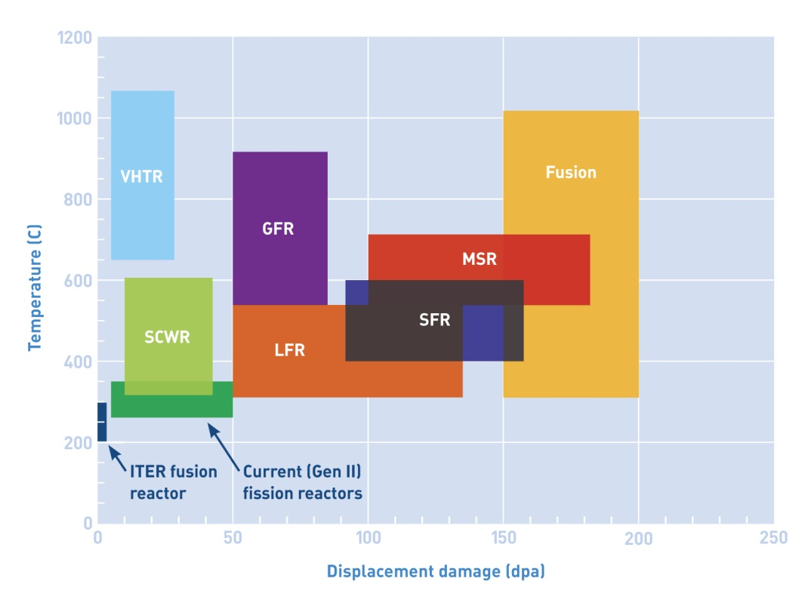
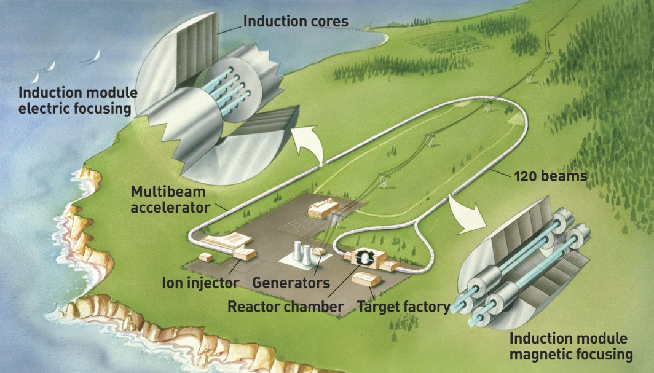
Accelerators in the Energy Sector
Zinkle and Busby, Materials Today 12 (2009) 12.
Materials for next generation fission reactors or fusion devices need x10 greater radiation resistance than those used today; damage regime can be reached by accelerator-driven sources based on high-power hadron beams (p, d)
Inertial Confinement Fusion by ignition from heavy-ion beams. Requires very high-intensity ion beams
~5MJ/10 nsec (500 TW!); 1-10 GeV; 5 pulses/second

Slide 15
How Can DOE Sponsored R&D Advance Applications with Societal Benefit?

Slide 16
Senate Energy and Water Subcommittee Mark-up
“The Committee understands that powerful new accelerator technologies created for basic science and developed by industry will produce particle accelerators with the potential to address key economic and societal issues confronting our Nation. However, the Committee is concerned with the divide that exists in translating breakthroughs in accelerator science and technology into applications that benefit the marketplace and American competitiveness.”
“The Committee directs the Department to submit a 10-year strategic plan by June 1, 2012 for accelerator technology research and development to advance accelerator applications in energy and the environment, medicine, industry, national security, and discovery science. The strategic plan should be based on the results of the Department’s 2010 workshop study, Accelerators for America’s Future, that identified the opportunities and research challenges for next-generation accelerators and how to improve coordination between basic and applied accelerator research. The strategic plan should also identify the potential need for demonstration and development facilities to help bridge the gap between development and deployment.”
16
Notes:
Why are we here? Senate Markup requested 10 year plan to be delivered.
Follows the Accelerators for America’s Future Workshop
Requests a 10 year strategic plan
Focuses on the thrust areas from the workshop: Energy, Environment, Medicine, Industry, National Security and Discovery Science
This can be interpreted as a directive away from Discovery science only. It certainly stresses the fact Tech Transfer and “creating Jobs” as contributing to the economy is on the radar-screen.

Slide 17
Accelerator Stewardship Task Force
Sandra Biedron Colorado State Univ.
Lester Boeh Varian Medical Systems
James Clayton Varian Medical Systems
Stephen Gourlay LBNL
Robert Hamm R&M Tech. Ent., Inc.
Stuart Henderson FNAL
Georg Hoffstaetter Cornell
Norbert Holtkamp SLAC
Lia Merminga TRIUMF
Stephen Milton Colorado State Univ.
Satoshi Ozaki BNL
Fulvia Pilat JLab
Marion White ANL
George Zdasiuk Varian Medical Systems
Michael Zisman DOE-HEP
Community
Industry
DOE-OS
BES-NP-FES-ASCR
NSF, NIH, NCI, Defense, ONR
OHEP
Steward for long lead R&D
…with tremendous support from Leah Hesla, Fermilab Communications
Notes:
Take away: A little background; this really started before the congressional request/
In order to be quick we had to assemble a small group across the office of science with no real time to make sure that every lab, every agency, every University doing accelerator research or every industry was represented. It would have become unmanageable.
It started certainly with the Accelerators for Americas Future Workshop and the follow up that everybody, including congress, was waiting for.
Next came an expensive dinner between Steve, Stuart and myself (April 2010) – followed by the congressional request and soon after a discussion between Jim, OHEP staff and us.

Slide 18
How Accelerator Physicists Think About R&D: The Grand Challenges
Higher Energy: Extend the energy reach of collider technology to probe fundamental phenomena at the multi-TeV scale
Higher Power: Extend the beam power and intensity reach of hadron accelerator technology to enable next-generation capabilities in fundamental physical sciences and applications in energy
Higher Gradient: Extend the capability and understanding of performance limits of RF accelerating structures and technology
New Acceleration Methods: Break the “RF Barrier” by developing scalable next-generation acceleration methods in the 10 GeV/meter range
Beam Emittance: Develop tools and technologies for the manipulation of particle beam phase-space and the exploration of limitations to beam emittance
Brightness and Coherence: Develop concepts and technologies to extend the brightness, brilliance and coherence of photon sources to meet the challenges of 21st century materials science
Compact Accelerators: Develop accelerator systems to serve as compact sources of photons, neutrons, protons and ions

Slide 19
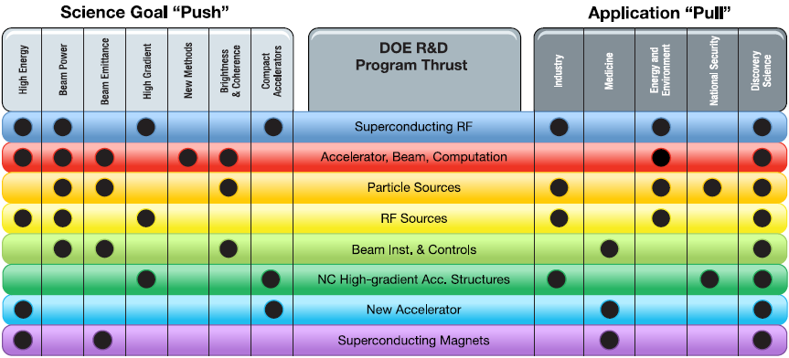
Connecting the Dots: From Science to Application
Feedback

Slide 20
Accelerator Stewardship Task Force Suggestions
Encourage Stakeholder (DOE, NSF, DOD, DHS, NIH, NCI, EPA, …) engagement with a seat at the Stewardship table
Engage partners by communicating capabilities and streamlining access to national lab resources
Streamline processes to encourage partnerships with Industry
Leverage the SBIR/STTR Programs
Focus efforts by forming interdisciplinary teams to solve problems: Collaborative Accelerator Research Teams
Establish a Program in Applied Accelerator Technology
Ensure the accelerator workforce of tomorrow by expanding educational programs
Specific proposals to engage with the medical community on a dedicated hadron beam therapy facility, and to establish a home for laser R&D (for accelerators) within DOE-SC

Slide 21
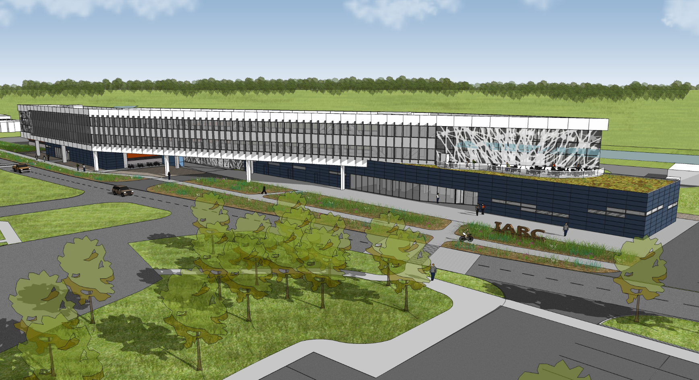
One Example of Trying to Make the Connection: the Illinois Accelerator Research Center (IARC)
IARC is a new facility, expected to come online in FY15, depending on funding
IARC is a partnership between the DOE and State of Illinois with a mission to bring together Industry, Universities and Fermilab to develop, demonstrate and transfer accelerator technology to solve problems of national importance in medicine, industry, energy, environment, security and discovery science

Slide 22
Summary
Accelerator Technology developed in our laboratories and universities will have a tremendous impact on Discovery Science
But those same breakthroughs will have a reach that goes far beyond, benefitting society in direct and tangible ways
We are in a new era of use-inspired R&D, with a goal of taking a more deliberate approach (as opposed to relying on serendipity) to partner with industry to meet challenges in medicine, energy, environment, industry and security

Slide 24
RI Prod
Courtesy R. Hamm

Slide 25
Commercial Accelerator Business
Updated total >24 000 and estimate is that
> 18 000 installed base.
Total sales increasing almost 10% per year.
More than 70 vendors worldwide in this business.
Vendors primarily in US, Europe and Japan, but growing in China, Russia and India
All the products that are processed, treated or inspected by
particle beams have an annual value exceeding US$500B.
Courtesy R. Hamm

Slide 26
Accelerator vendors worldwide
Courtesy R. Hamm

Slide 27
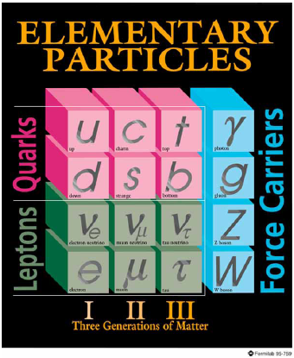
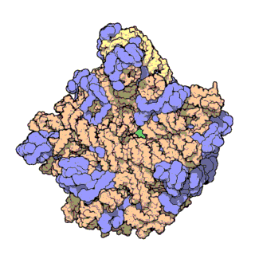
Accelerators for Discovery Science
Accelerators have powered much of our understanding of the subatomic world enabled through a rich history of discovery
Increasingly, accelerators are powering fundamental discoveries in chemistry, biology and medicine
Indeed,
39 of 142 Nobel Prizes in Physics since 1939 have utilized accelerators, or were influenced by them.
Accelerator-related research yields a Nobel Prize every 2.9 years (Haussecker and Chao, ICFA BDN no. 53)
5 of last 15 Nobel Prizes in Chemistry utilized synchrotron radiation facilities

Slide 28
Accelerators for Medicine: Recent Trends
Now ~35 proton/ion facilities worldwide
Use of light ions is now actively studied, with major investments
Narrower penumbra
High linear-energy-transfer causes greater local cell damage to tumor tissue
Example clinical results for tumor control:
95% (15 yrs) malignant melanoma of the eye
95% (15 yrs) Chondrasarcoma of the skull base
Modern particle-beam facilities incorporate very sophisticated delivery systems to carefully tailor the beam distribution by scanning, depth modulation, and gantry systems.
This field will benefit from R&D into compact accelerator systems
Heidelberg Ion Therapy Facility

Slide 29
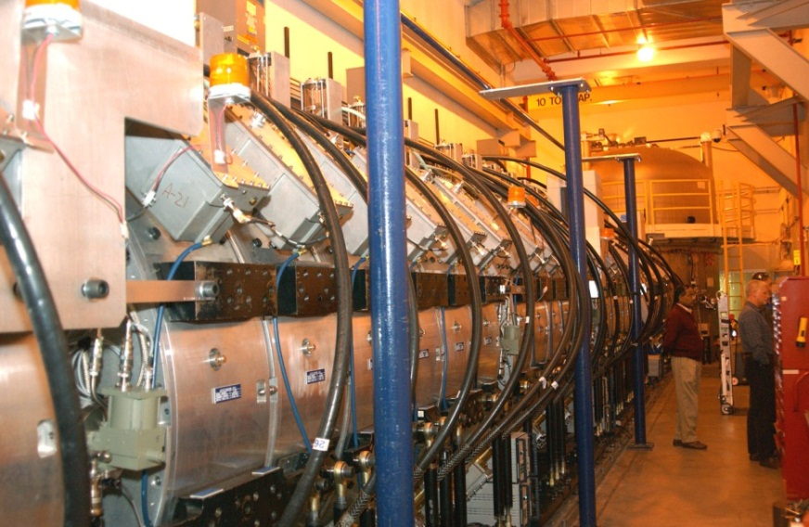
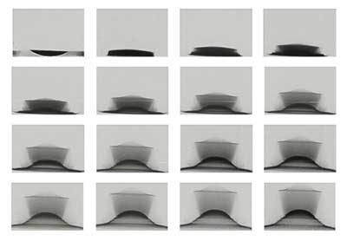
Applications of Accelerators in National Security: Radiography
Accelerator technology was deployed in the War Effort for isotope separation and nuclear measurements
Today, accelerators are in use for, or are being developed for
Nuclear defense: stockpile stewardship, materials characterization, radiography, and support of non-proliferation
Interrogation and inspection of cargo
Airborne or ship-mounted weapons
Radiography: Imaging materials in motion using x-ray and particle beams
Dual-Axis Radiographic Hydrodynamic Test Facility (DARHT) at Los Alamos completed
pRad movie of high-speed shock test of Sn disk at usec intervals

