Slide 1
Applications of Normal-conducting RF linear accelerators
(industry perspective)

Slide 2
Objective
In this presentation I will consider the relationships between nc (normal conducting) linear collider projects and industry. I approach it from two distinct perspectives:
Consider how the technology developed for nc linear colliders may be applied to existing and future industrial and industrial-use linacs.
Consider how nc linear collider studies have stimulated industrial development which may then be used for other applications.
Linear collider study
Industrial linacs
Industry
Other applications

Slide 3
Outline
More specifically I will:
Consider how the technology developed for nc linear colliders may be applied to existing and future industrial and industrial-use linacs.
  What are the important dependencies which influence high-gradient linac design?
  Which industrial linacs might benefit from higher gradients, frequency and precision? I discuss an example, a medical accelerator – TULIP
Consider how nc linear collider studies have stimulated industrial development which can be used in other applications.
  I will address this with a “case study” - the of development of micron-precision machining with and within VDL.

Slide 4
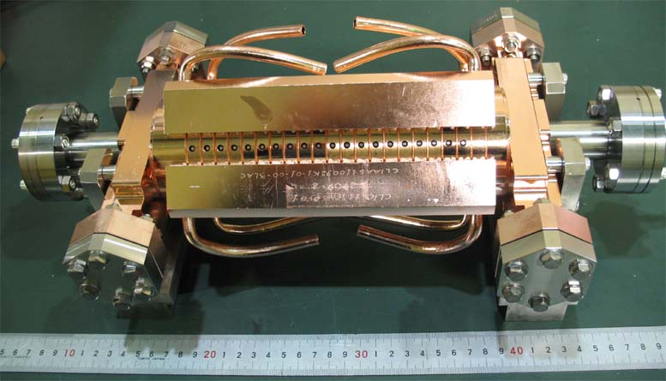
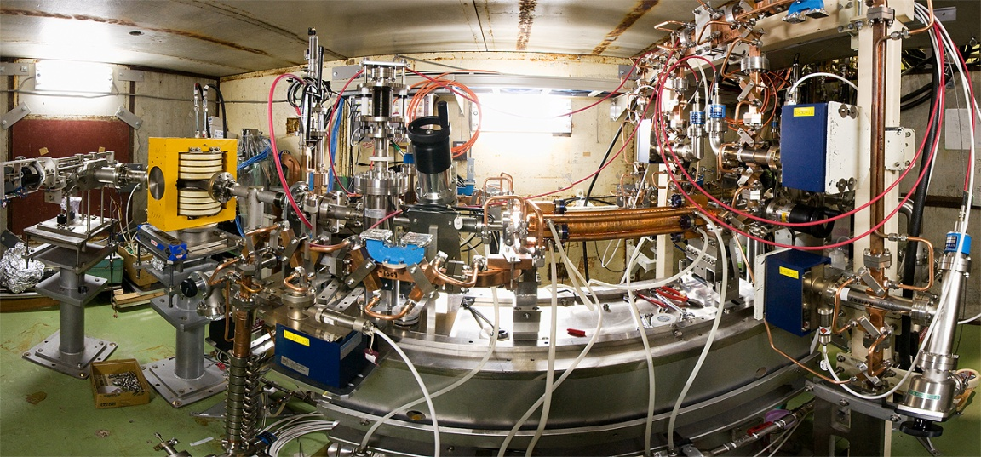
A reminder of our linear collider application –
100 MV/m accelerating structures
CLIC accelerating structure prototype
NEXTEF test area at KEK

Slide 5
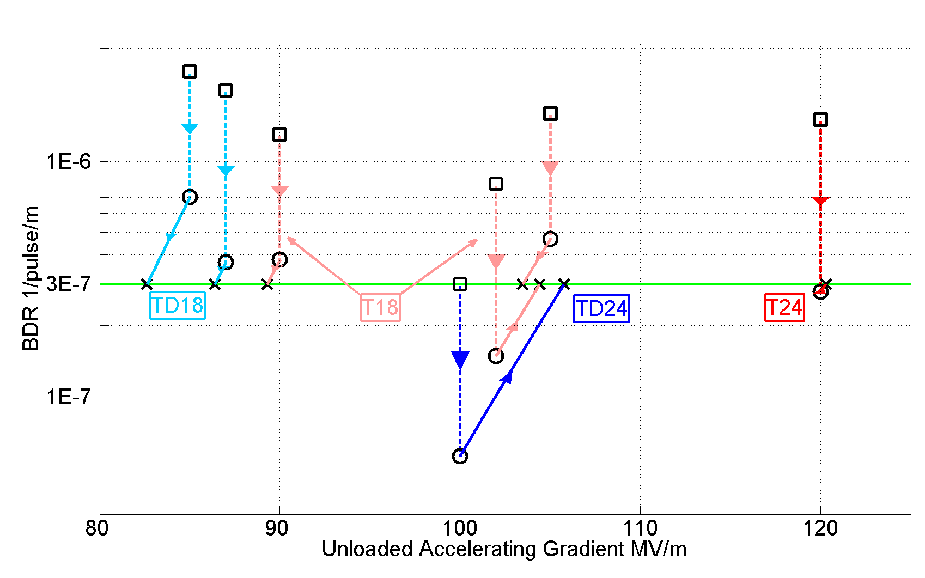
Accelerating gradient test status: 4-9-2012

Slide 6
The importance of power sources
There are two key issues which drive normal conducting rf linac parameters:
Accelerating structures
rf power sources
Progress on achieving high-gradients for nc linear colliders has been as much a story of developing high peak power sources (be they klystrons or two-beam) as of accelerating structures.
Consequently the cross-flow of advances between NC linear collider projects and industry has been, and has to be, for both rf power production and for acceleration.
I will primarily cover the technology related to the accelerating structures.
But please bear in mind that power sources are an equally important issue, so please pay close attention to the next speaker!

Slide 7
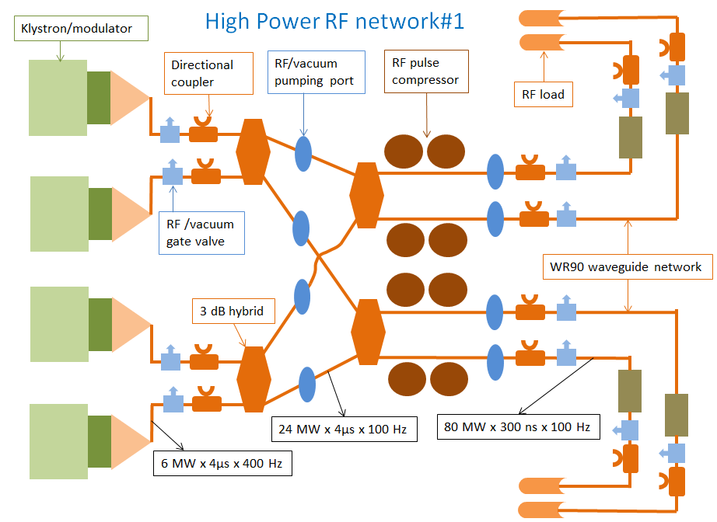
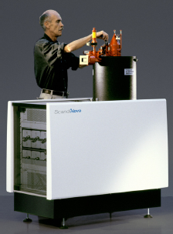
rf power sources
We are particularly excited by the progress in the industrial development of:
5 to 30 MW C-band (5.7 GHz) klystrons
5 to 50 MW X-band klystrons
combined with compact pulse compressors.
The low end of the power range is proving crucial to significantly bringing down the “cost of entry” to high-gradient nc systems. Modulator voltages are lower etc.

Slide 8
Higher Gradient and what comes with it
The high-energy physics community has supported R&D on increasing the gradient in normal conducting linacs.
With the higher gradient comes naturally higher frequency.
So with higher gradient also comes the need for higher precision.
I’ll present the basic scaling laws which drive these trends.
Then I will try to put these trends into the context of some industrial and industrial-use accelerator applications.

Slide 9
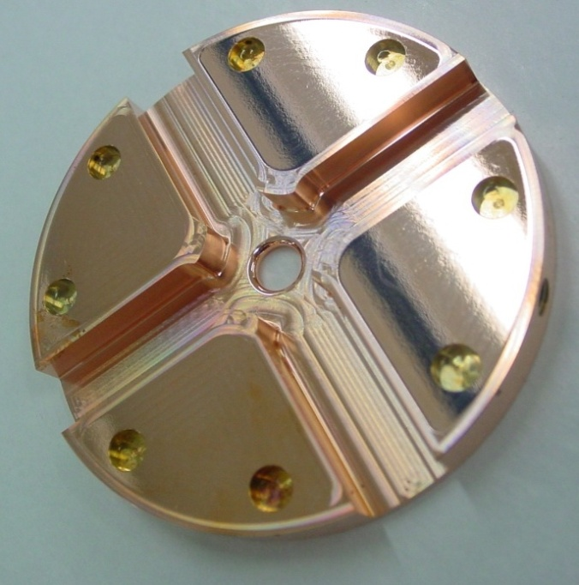
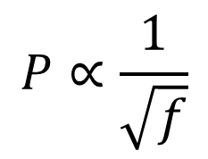

Some high-gradient theory
$$P∝\frac{1}{\sqrt{f}}$$
$$P∝G^{2}$$
for a given geometry and a fixed energy gain.
for a fixed geometry
Beam transmission gets harder as aperture gets smaller. Can be compensated with higher precision alignment.
Achievable gradient goes up as a/λ goes down.

Slide 10
Possible applications
We can identify other applications which would benefit from high-gradient technology:
Linacs for proton and carbon ion cancer therapy.
High repetition rate FELs (Free Electron Lasers) for the ‘photon-science’ community. Users of these machines encompass biology, chemistry, material science and many other fields.
Compton-scattering gamma ray sources providing MeV-range photons for laser-based nuclear physics (nuclear-photonics) and fundamental processes (QED studies for example). There are also potential applications such as nuclear resonance fluorescence for isotope detection in shipping containers and mining.
Classical industrial linacs.

Slide 11
Now a look at a high-gradient for a medical application.

Slide 12
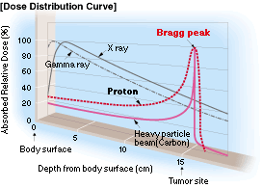
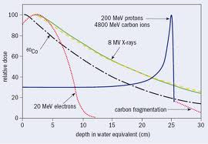
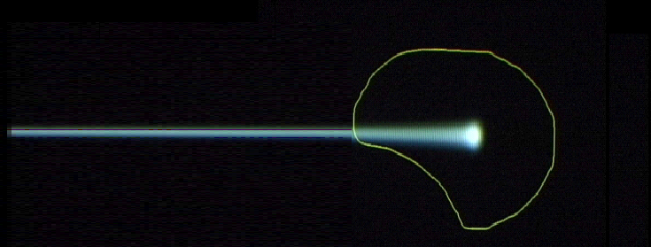
Basics on Hadrontherapy:
Characteristics of a therapeutical beam
tail
httt://global.mitsubishielectric.com/bu/particlebeam/index_b.html
27 cm
Depth-dose
distribution
200 MeV - 1 nA
protons
4800 MeV – 0.1 nA
carbon ions
(radioresistant tumours)
Charged hadron beam that loses energy in matter
Tumour
target
Courtesy of PSI
Notes:
First, we should understand which are the characteristics of a therapeutical beam.
Hadrontherapy is the radiotherapy technique that exploits the advantegeous depth-dose profile of hadrons while traversing the matter. Proton beams of 200 MeV and carbon ions beams of about 400 MeV/u are needed for killing tumoural cells at 27 cm depth. Intensity: a couple of nA.
Proton and carbon ion beams present advantegeous depth-dose distributions (Bragg peak) with respect to X rays. Carbon ions beams produce clustered damages to the DNA of the traversed cells which allows the control of tumours which are “radioresistant” to both X-rays and protons.
The depth at which the maximum dose delivery occurs can be modified by changing the beam energy.
The accelerators should provide small currents of proton and carbon ions (less than a couple of nanoamperes) of energies larger than 200 MeV and 400 MeV/u, respectively if one wants to reach tumoural cells located at 27 centimeters depth.

Slide 13
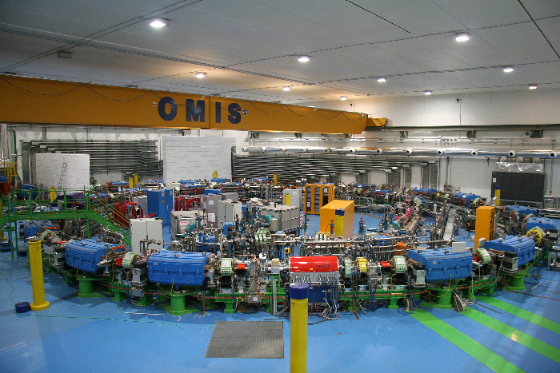
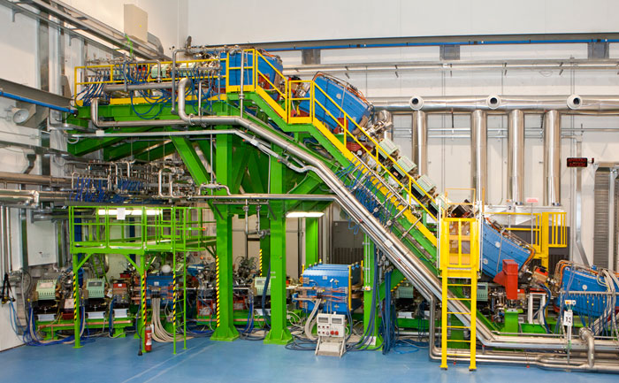
Synchrotron-based proton therapy at CNAO in Pavia

Slide 14
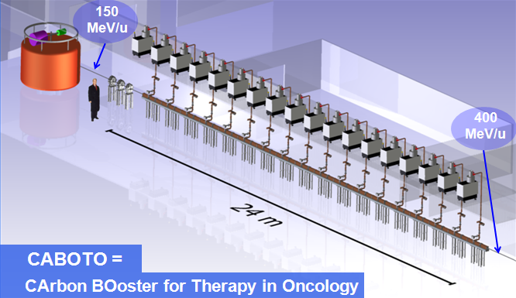
Accelerators for Hadrontherapy
The cyclinac: cyclotron + high frequency linac
Cell Coupled Linac
RF frequency: 5.7 GHz
18 accelerating modules - Length of each module ~ 1.3 m
High gradient : 40 MV/m (TERA+CLIC collaboration)
CELL COUPLED LINAC
Cell Coupled Linac
Standing-wave structure
RF frequency: 5.7 GHz
2.5 μs-long pulse at 300 Hz
CABOTO
(CArbon BOoster for Therapy in Oncology)
Notes:
For these hadrontherapy applications the Italian research foundation TERA proposes a new type of accelerator, the cyclinac, made of a high-frequency linac which boosts the energy of the hadrons accelerated by a cyclotron. CABOTO is the newest proposal of TERA and will accelerate
[TErapia con Radiazioni Adroniche: Application of physics and computing to medicine and biology]
[CABOTO (Carbon BOoster for Therapy in Oncology ) works at a higher frequency of 5,7 GHz, to reduce the overall length. The CCL (Cell Coupled Linac) is made of eighteen 1,3 m long units (gradient = 40 MV/m, Kilpatrick = 2.9).]

Slide 15
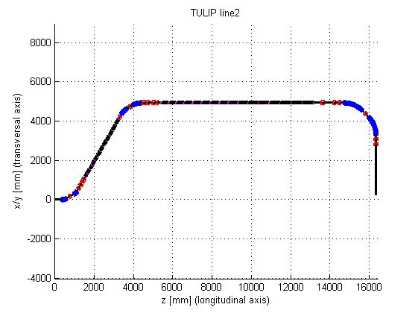
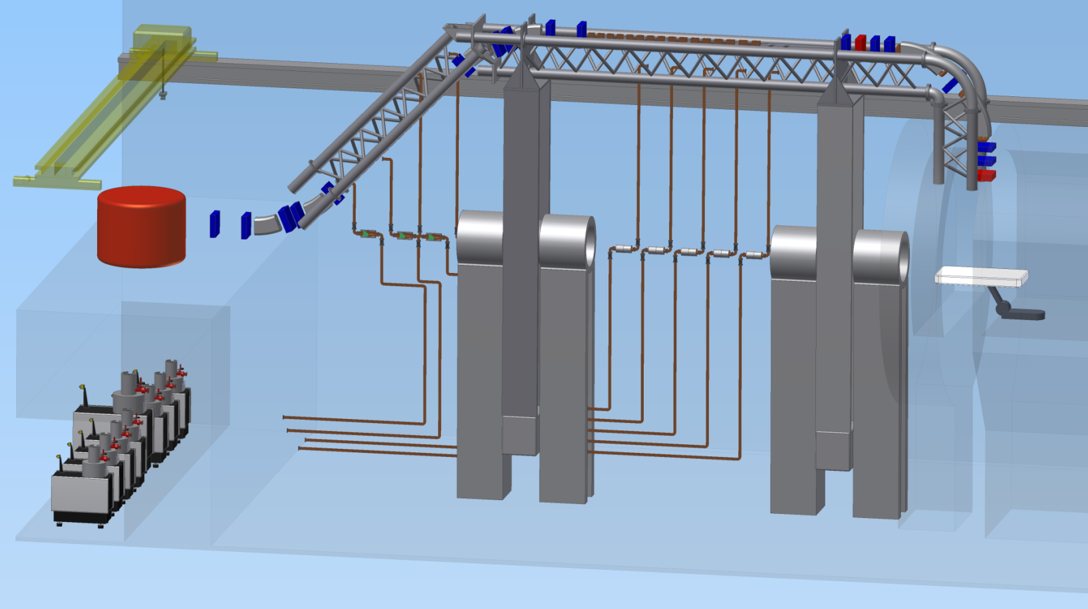
Target project - TULIP
70 MeV
230 MeV
proton therapy single room facility
compact machine (accelerator and gantry together)
cyclinac concept with fast actively energy modulated beam
24 MeV

Slide 16
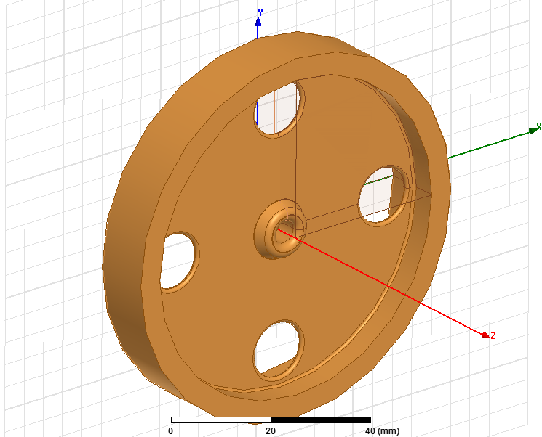
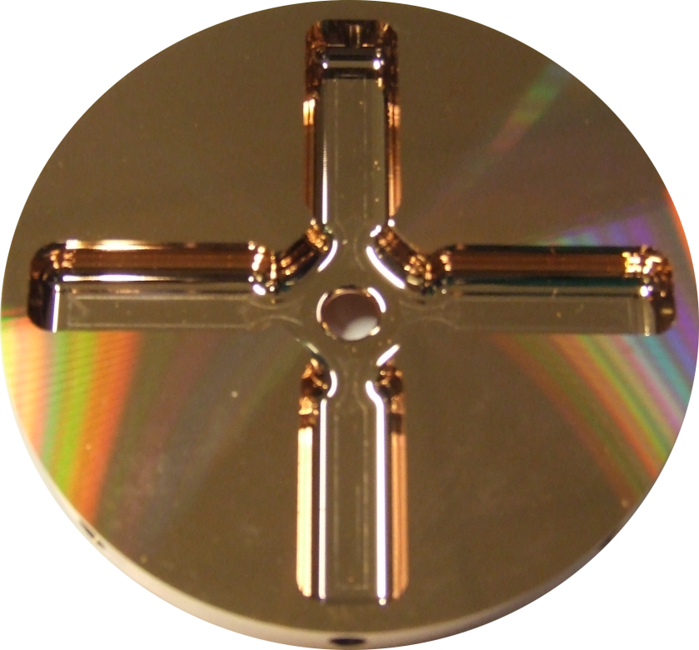
We plan to improve it with a novel high-gradient backward wave structure an our standard high-gradient technology:
The current design of the basic cell geometry for low velocity acceleration
(still under optimization)
And a micron-precision CLIC cell

Slide 17
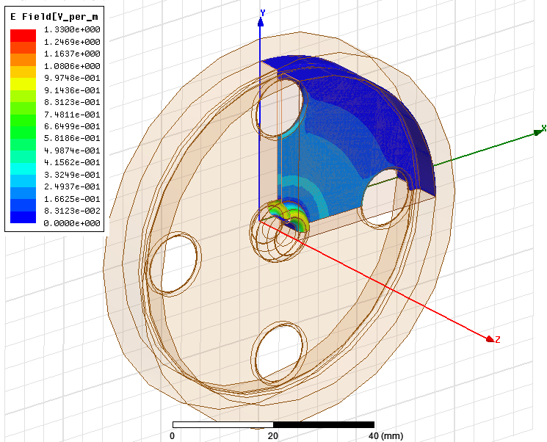
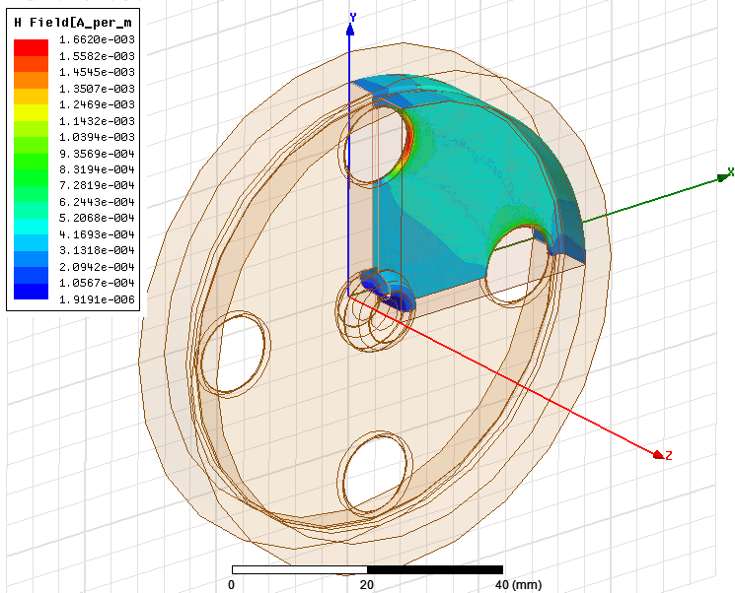
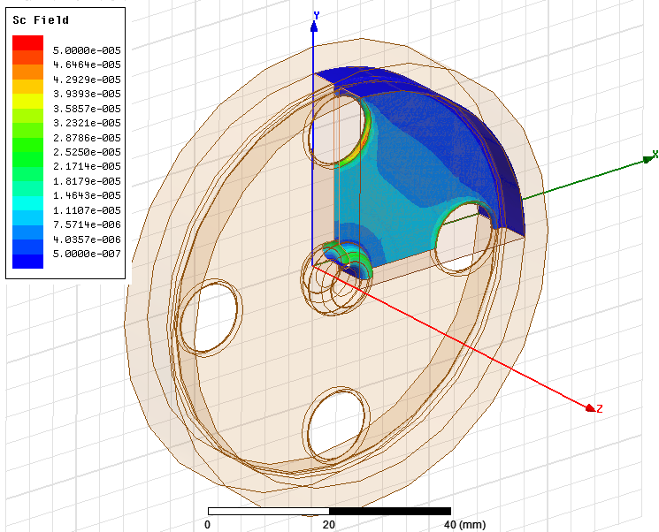
For rf enthusiasts – here you can see how we design for high gradient
Surface electric field
Surface magnetic field
Modified Poynting vector
Our current understanding of high-gradient limits

Slide 18
Some other examples of high-gradient and high-frequency normal conducting linac applications

Slide 19
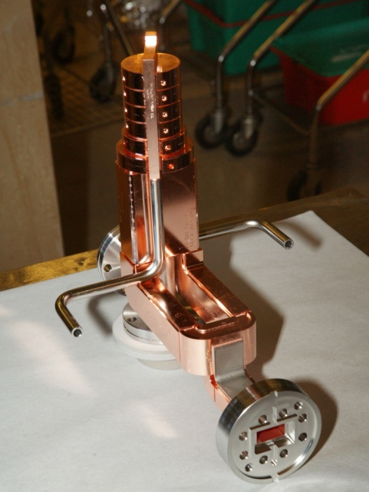
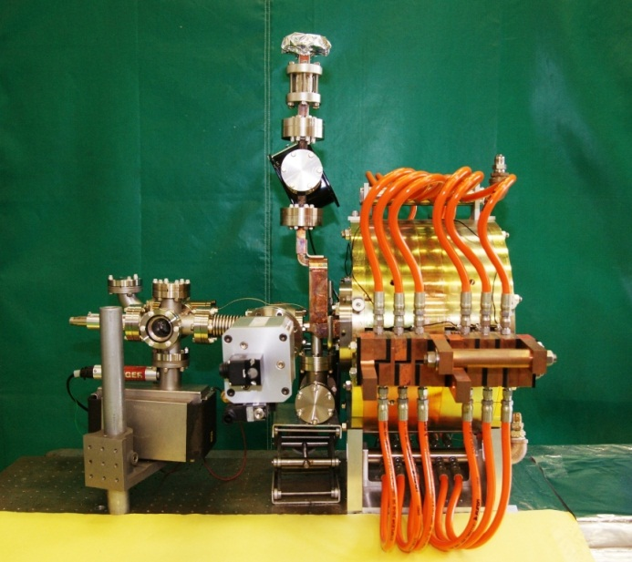
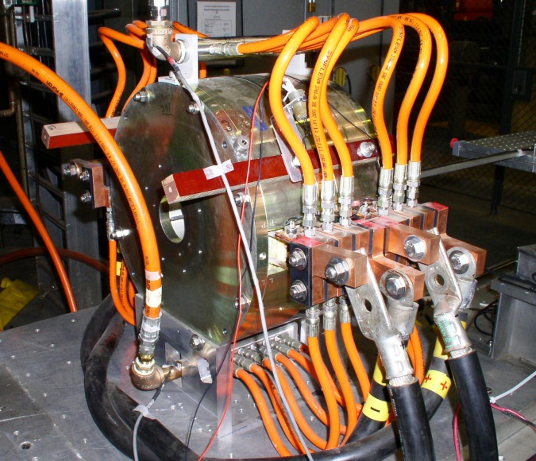
Mark-0 X-band photo-injector
5.5 cell RF Gun
Photo-injector assembly
SLAC
Cathode
Coupler Cell
Water Cooling
Splitter/Input Waveguide
6 kG Solenoid Magnet
F = 11.424 GHz, 5.5 cells, π-mode
Earlier version tested at 200 MV/m with 250 ns RF pulse.
Coupling factor β ≈ 1.7
Improved version under construction → MARK-1
5.59 cells
> 25 MHz mode separations
elliptical irises
racetrack coupler
Courtesy of
A. Vlieks

Slide 20
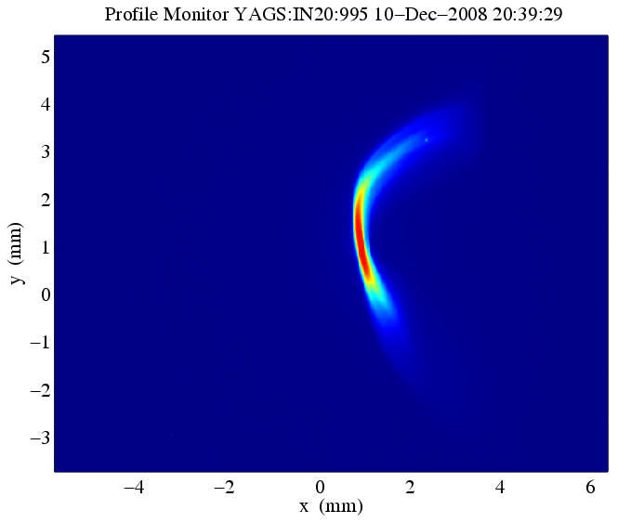
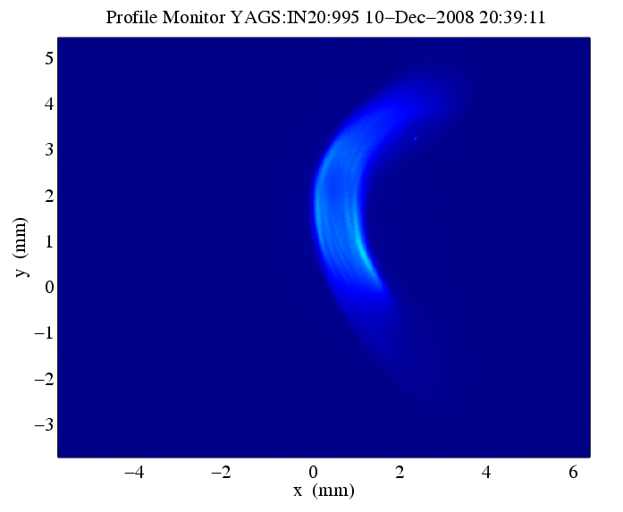
Transverse Cavity Diagnostics
Principle of operation
RF
‘streak’
The Transverse Cavity (TCAV) technique is now a well established diagnostic tool at the X-ray FELs to measure sub-ps temporal bunch profiles.
V(t)
σ_{y}
e⁻
σ_{z}
SLAC
β_{d}
Δψ ≈ 90°
β_{s}
gun
LCLS injector layout
The diagnostics is further enhanced if the deflected beam is observed on an energy spectrometer screen, where the energy dispersion is in the plane perpendicular to the RF deflection. The dispersion properties of the dipole allow for the complete characterization of the energy distribution of each bunch slice reconstructing the longitudinal phase space.
L0
TCAV0
L1X
Laser
heater
L1S
3 wires
3 OTR
DL1
135 MeV
BC1
250 MeV
YAGS2
YAGS2
RF deflector ON
energy
time
Energy profile and slice energy spread measurements with TCAV at LCLS
Laser OFF
Laser: 40 µJ
σ_{E}/E < 12 keV
σ_{E}/E ≈ 45 keV
Courtesy of
P. Krejcik, P. Emma, H. Loos

Slide 21
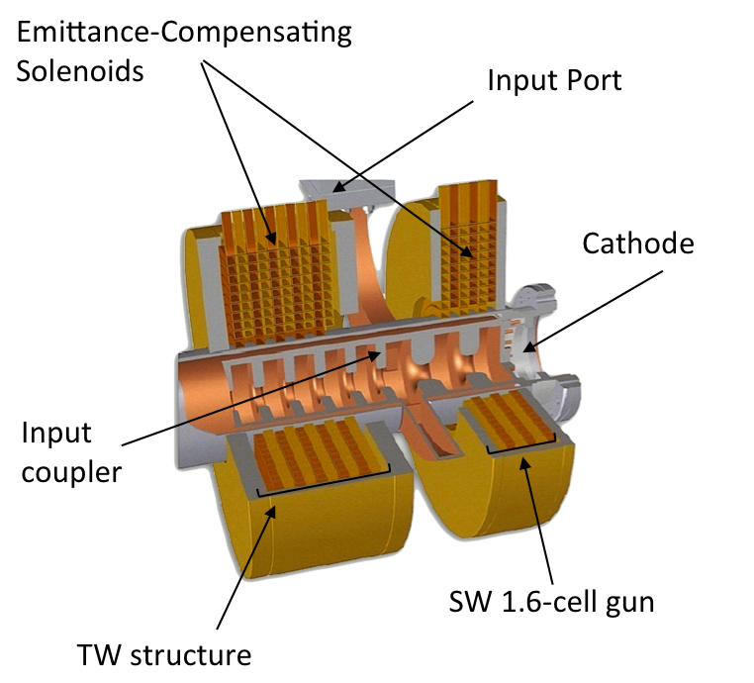
UCLA Hybrid Photoinjector
SW high gradient RF gun section
+
TW low gradient section
both fed on-axis
with a common coupling cell
More compact than a split system
Nearly RF matched – no isolator
Avoids post-gun bunch lengthening
Strongly longitudinally focused with the TW section performing as velocity bunching (90° phase shift between SW cell and input coupler)
SW 2.6-cell gun
High accelerating field on axis, 200 MV/m peak → very high brightness beams.
X-band scaled from an existing S-band unit, preserving acceleration and transverse dynamics.
Tens of fs beams at 3.5 MeV with sub-0.1 mm-mrad emittance at 7 pC
Applications: PWFA, coherent Cerenkov rad., electron diffraction
Courtesy of
A. Valloni, J. Rosenzweig

Slide 22
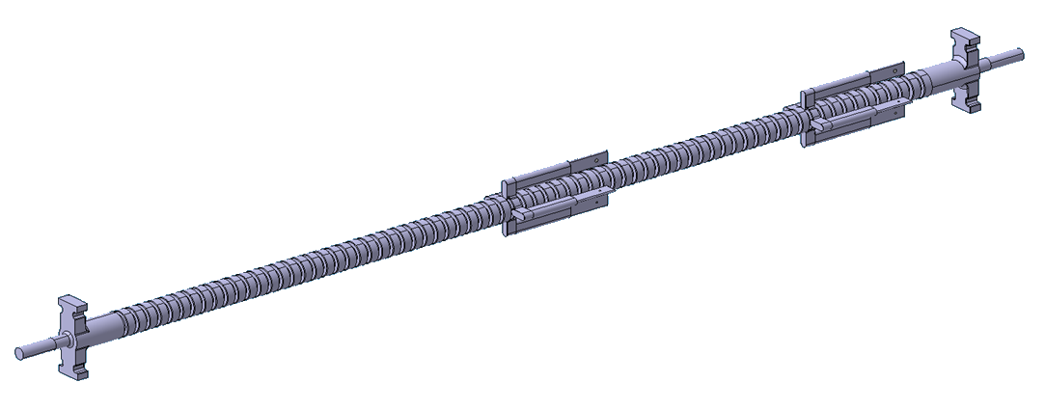
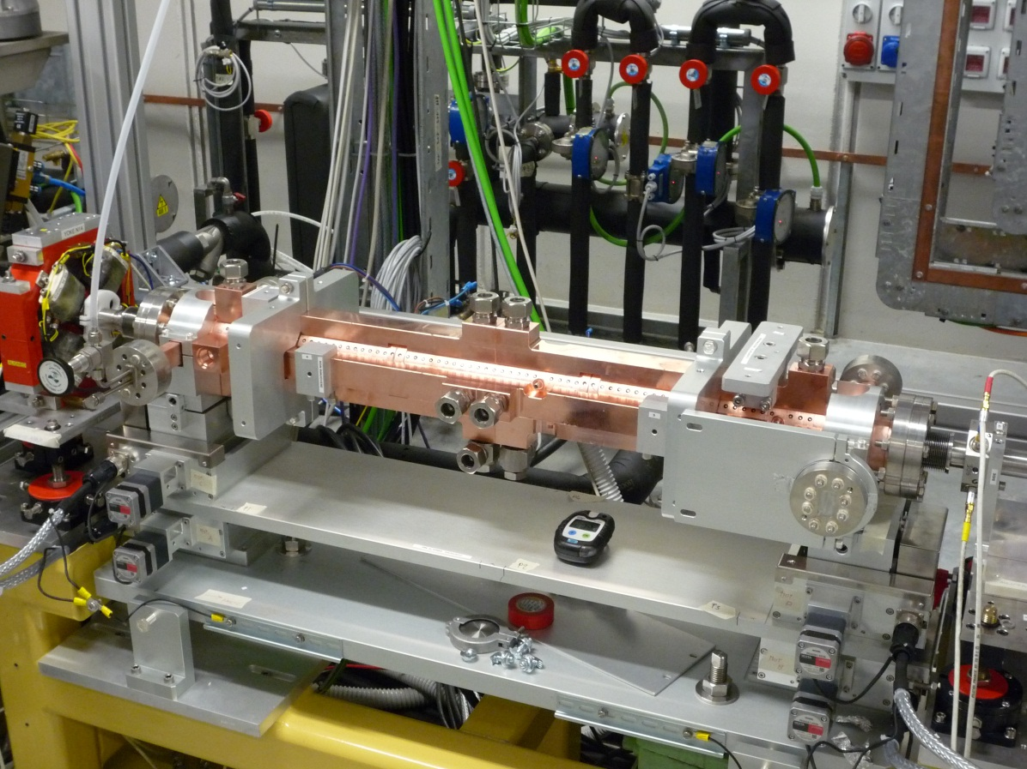
Accelerating Structure
2 Coupl.
72 Cells
2 Regions for monitoring wakefields

Slide 23
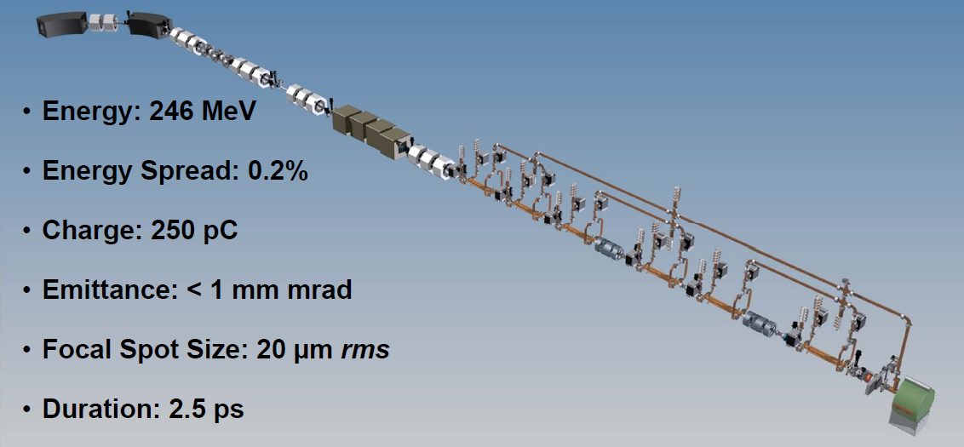
LLNL Gamma-ray source
Two XL4 Klystrons + RF pulse compressor
Six SLAC T53 accel. str. (@70 MV/m)
Mark-1 Photo-injector
γ-rays 0.5 - 2.5 MeV
(10²⁰ ph/sec/mm²/mrad²/0.1%bw)
for
Nuclear Resonance Fluorescence (NRF)
Courtesy of
C. Barty

Slide 24



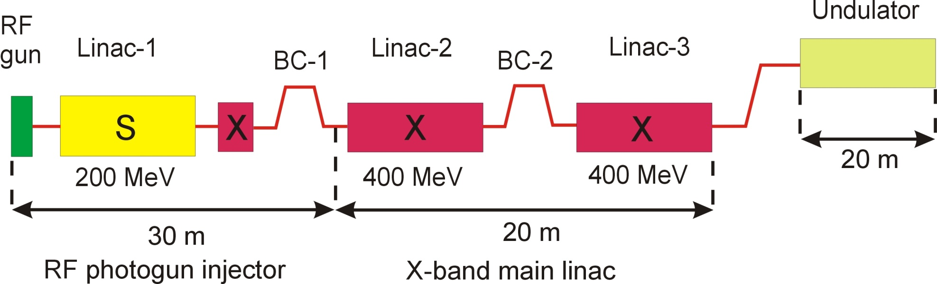
X-band linac concept
3 of 4 standaard 3 m lange S-band versnelstructuren die een 5 ps electronbunch versnellen tot ≈ 240 MeV
X-band linearizer remt bundel af met ≈ 40 MeV
bunchcompressie tot 1 ps in magnetische chicane BC1
2 X-band main linac secties, elk bestaande uit 8 0.5 m lange versnelstructuren met versnelgradient van 100 MV/m
bunchcompressie tot 50 fs in magnetische chicane BC2
magnetische dogleg naar undulator

Slide 25
An incomplete, but on-going attempt at a summary of industrial rf linacs
 |  |  |  |  | Typical parameters | Examples | Source
Medical
 | Cancer therapy
 |  | Electron |  |  | 6 MeV, X-band, electrons | Cyberknife, Accuthera Inc. | X-band 6, http://www.accuray.com/
 |  | Proton
 |  |  | Fixed linac |  | 30-230 MeV protons, S-band | LIGHT, ADAM SA | http://adam-geneva.com/
 |  |  | Rotating linac |  | 30-230 MeV protons, S-band | TULIP, TERA Foundation | https://indico.cern.ch/conferenceDisplay.py?confId=178002
 |  | Carbon ion |  |  | 300-430 MeV/u carbon ions | CABOTO, TERA Foundation | Reviews of Accelerator Science and Technology, Chao and Chou eds.
 | Diagnostics and imaging
 | Radio-pharmacutics
 |  | Isotope production
 |  | PET tracers (with linac?)
 | Sterilization
 |  | Medical equipment |  |  | 5 to 10 MeV, 25 to 700 kW beam power |  | Hamm
 |  | Blood irradiation |  |  | 2 MeV, X-band, electrons | Radiabeam | X-band 5
Non-Destructive Testing (NDT)
 | On-site X-ray |  |  |  | 1-9 MeV, X-band electrons | Accuthera, Mitusbishi Chemical, Hitachi Engineering | X-band 6
 | Neutron
Inspection
 | Cargo X-ray |  |  |  | 1-9 MeV | American Science and Engineering, L-3 Communications, Rapiscan Systems, Science Application International Corporation, Smiths Detection, Varian, Nuctech | http://www.nuctech.com
Food irradiation |  |  |  |  | 5 to 10 MeV, 25 to 700 kW beam power |  | Hamm
Waste treatment |  |  |  |  | 5 to 10 MeV, 25 to 700 kW beam power |  | Hamm
Material processing
 | Cross-linking and polymerization |  |  |  | 5 to 10 MeV, 25 to 700 kW beam power |  | Hamm
Comments and help requested to expand this list! This is just the beginning in a long program of work.

Slide 26
How CLIC has worked with industry:
Case study of VDL

Slide 27
Micron Precision, 3-D Geometries and Industry
As we have seen, high-gradients drive us toward linacs which have higher rf frequency and consequently tighter mechanical tolerances.
Linear colliders main linacs also need to preserve the quality of the low emittance beams also driving us to micron precision.
In addition the acceleration of multi-bunch trains in linear colliders to gain rf-to-beam efficiency has required incorporating 3-D features in our parts.
This is challenging!
I will now consider a case study of a long-standing industrial collaboration CLIC has had with VDL in the production of micron-precision copper parts for our high-gradient prototypes.
The following slides have been prepared in collaboration with VDL and representatives from the firm are in the audience.

Slide 28
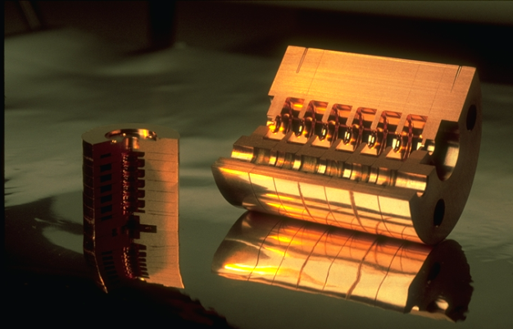
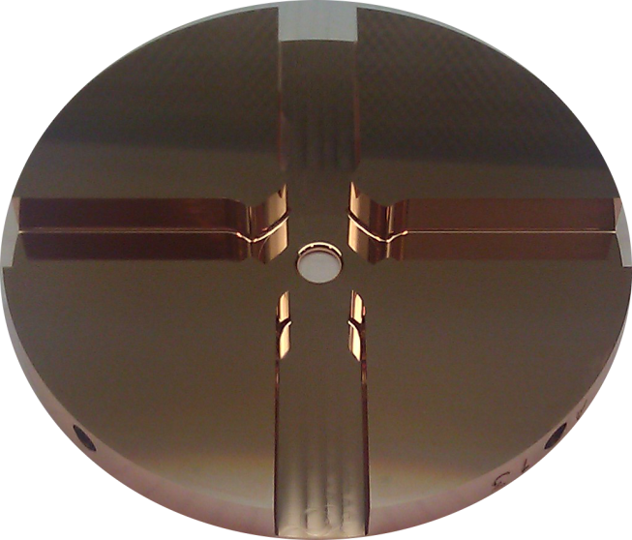
Case study with VDL
VDL is the longest standing and highest quantity supplier of CLIC accelerating prototype structure parts.
We have worked with them since 1989 (although called “Phillips Machinefabriken J” in those days) so we have evolved a way to reconcile our respective long and short term interests.
I think it is valuable to try to understand clearly how and why this has worked for insight into how R&D studies and industry can cooperate over the long term.
circa 1994
2012

Slide 29
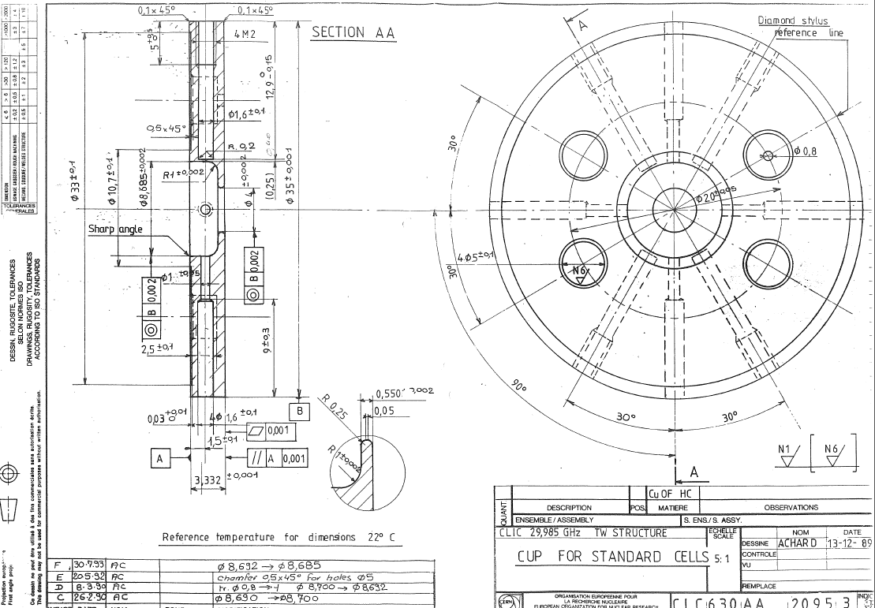
Case Study with VDL - history
1989 – 30 GHz micron-precision accelerating structures

Slide 30
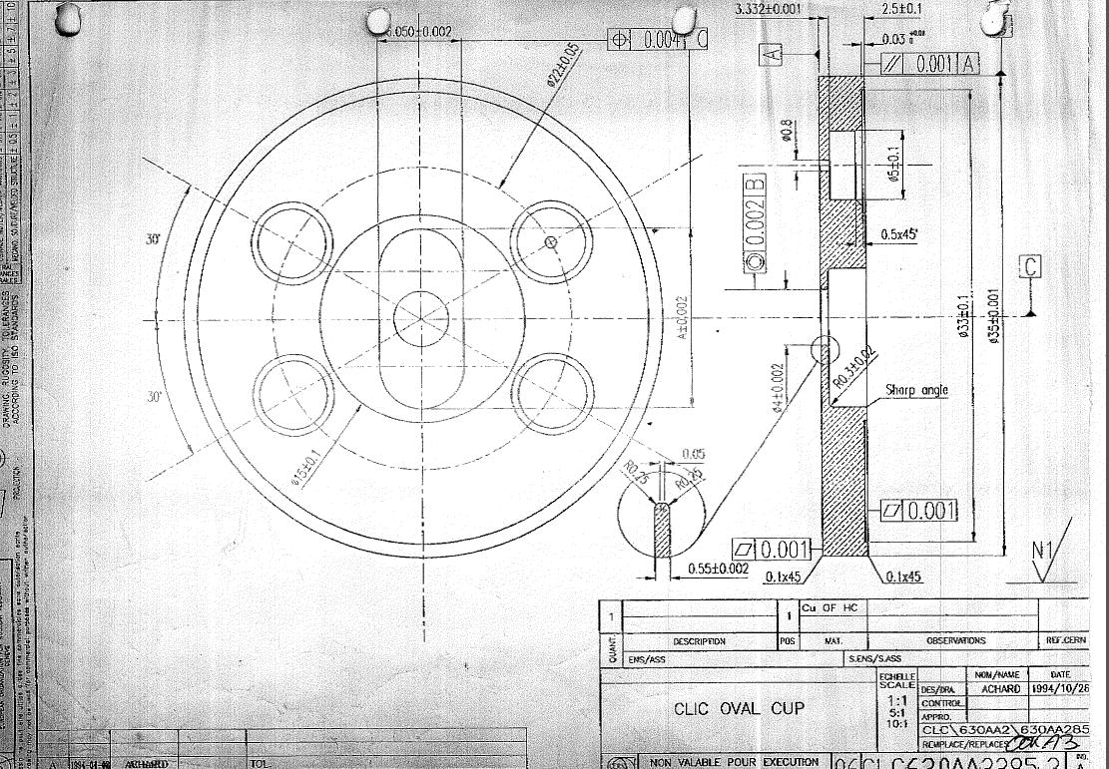
Case Study with VDL - history
1994 – Radio frequency quadrupoles, the introduction of micron-precision 3-D geometries.

Slide 31
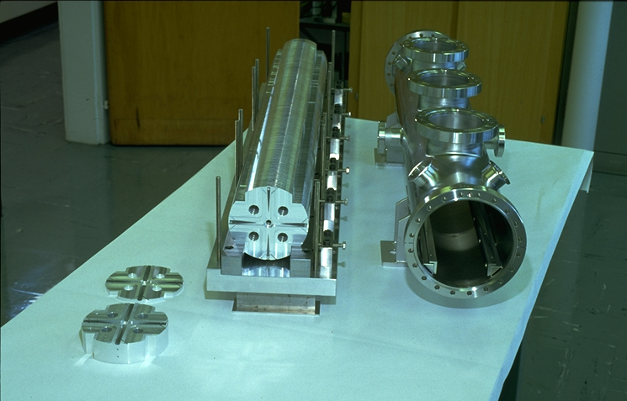
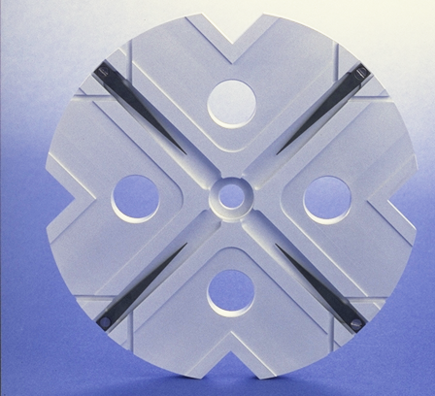
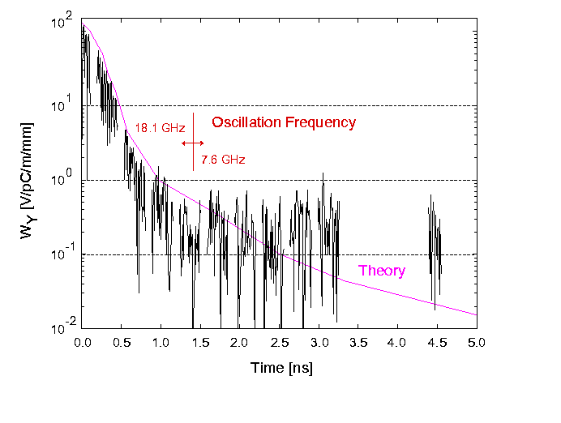
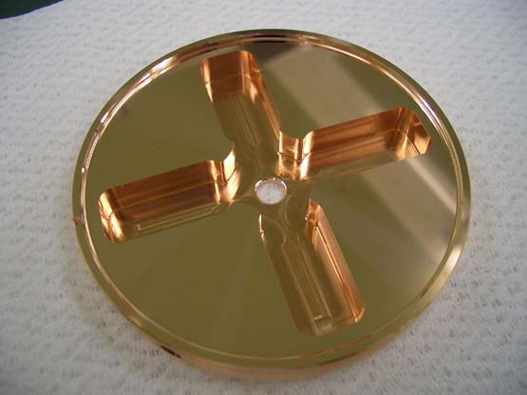
150 cells/structure, 15 GHz
Higher-order mode damping demonstration in ASSET 1999
Then
Now
Double band circuit model
24 cells/structure, 12 GHz
(loads not implemented yet)
An Asset Test of the CLIC Accelerating Structure, PAC2000

Slide 32
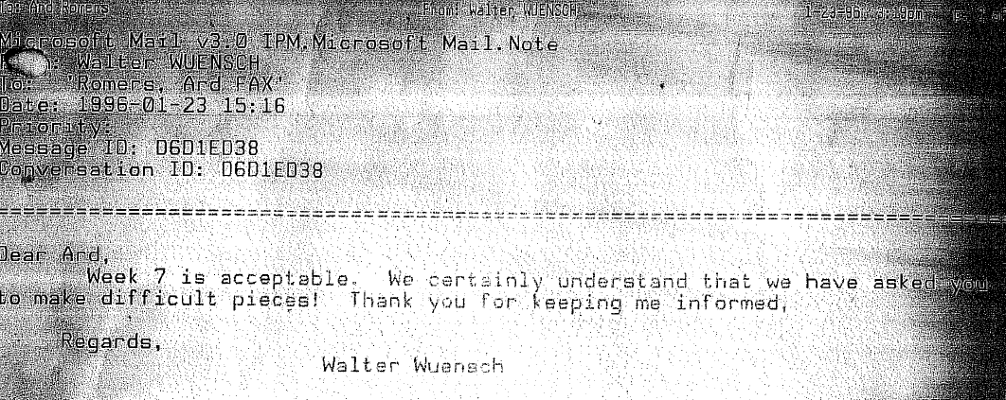
It’s not always been easy…

Slide 33
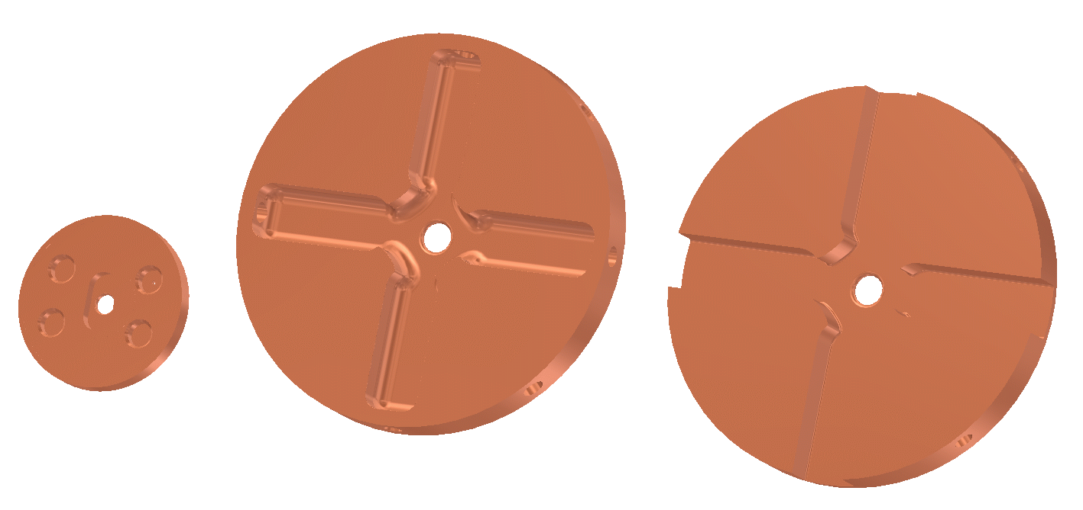
Evolution of requirements
30 mm disks
circular iris
no waveguides
80 mm disks
elliptical iris
closed waveguides
Due to shift from brazing to bonding higher demands on surface finish and flatness
  Open waveguides
1990’s
2000’s
2010’s

Slide 34
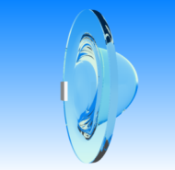
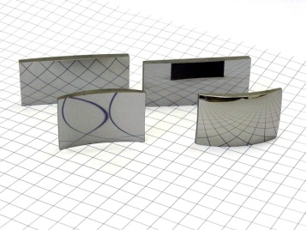
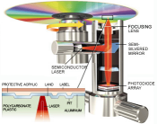
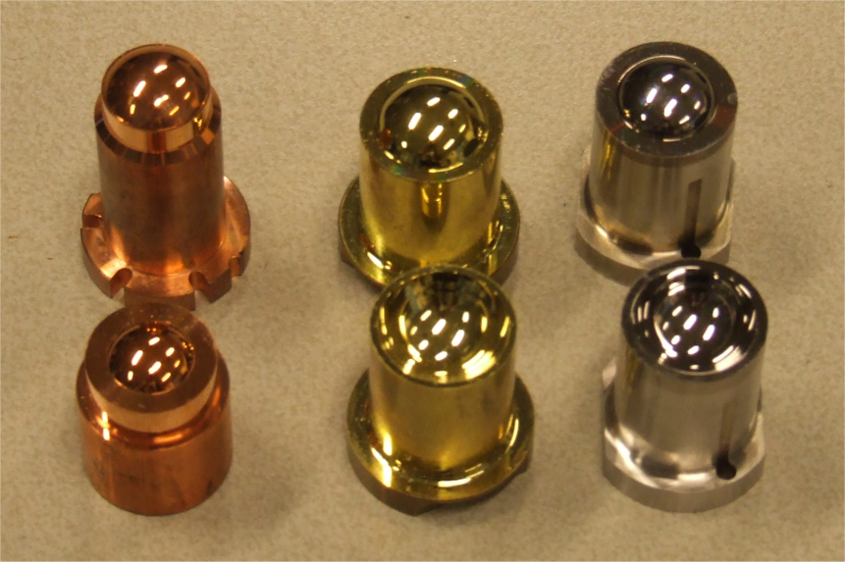
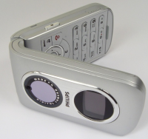
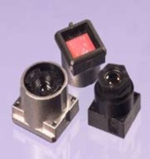
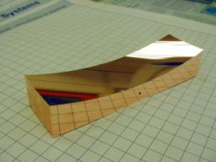
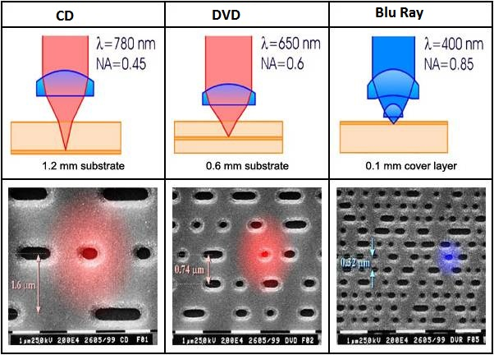
Evolution of the micron-precision market
The market for micron precision parts has evolved over the last decades.
Linear colliders are not alone.
Mirror optics
Optical recording
Injection molding of contact lenses
Imaging Optics
Freeform optics
1970’s
1980’s
1990’s
2000’s
2010’s
Optical recording was the driving force to achieve higher accuracies
  Form accuracy: 150 nm  50 nm
  Roughness Ra : 5 nm  2 nm

Slide 35
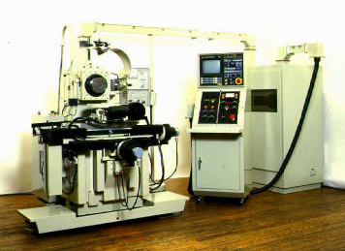
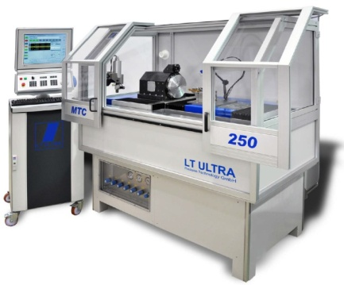






Evolution of machining capability
Single point diamond turning
Up to the 1980’s
1980’s - 1990’s
2000’s - 2010’s
Future ?
First machines at research institutes and universities
Start of industrialization
Optical recording
contact lenses
Larger machines
Multiple axis ( X/Y/Z and C)
Intelligent machines ?
  Robotisation ?
Ultra precision diamond milling (lagging more than a decade behind on turning)
Up to the 1990’s
1990’s - 2000’s
2010’s
Future ?
Limited to fly cutting
mirror optics
Laser scanner mirrors
Milling as add-on on lathes
Lens arrays
Intra ocular lenses
First proto type machines
Micro fluidics
Accelerator parts
Pallet machining?
  Robotisation ?

Slide 36


Current challenges for the basic technology
Bigger structures, same tolerances
  Started at ø35mm – now at ø80mm – in future up to ø200mm ?
Tight accuracy specifications for series manufacturing
  Moulds for DVD optics :
    50 nm form accuracy on ø 2 mm
    equals ratio of 1 / 40000
  CLIC disk -> series part
  2 µm accuracy on ø 80 mm
  equals ratio of 1 / 40000

Slide 37

Broadening the involvement with industry
TIME TO MARKET
    Co-development with industry to enable swift innovations
INDUSTRALISATION
    Early industry involvement for cost control & risk reduction
    Co / Redesign for manufacturability
  Straight mode converter
  VDL redesign from 16 to 2 parts

Slide 38

Broadening the involvement with industry
We are moving industrialization up the system scale – from machined components, to complete rf structures perhaps all the way up to complete modules for example.
Increased complexity requires higher level outsourcing
      Using experience of industry to securing shortest cycle time to end-product
  Complex modules to be manufactured in series

Slide 39
How working on CLIC can be in VDL’s interest
Linear colliders are very long term projects with many scientific and technical uncertainties and for which finding funding will be challenging. How can this match with the world of quarterly profit reports?
VDL’s drivers to invest in a long term relation is a combination of three crucial factors
All three must be in place to secure the long term cooperation with institutes like CERN
precision technology, and (re)design for manufacturability are key competences of VDL
which must evolve continuously to serve its mainstream customers and maintain industry
leadership. CERN is regarded as a crucial driver being ahead of VDLs mainstream industry
VDL recognizes the long term business potential of high gradient accelerator projects and
applications
Cultural and Value fit. VDL is a large privately owned company, 100% equity funded, where
profit maximization is not the only goal in life. Open culture of VDL fits well with research institutions and universities.

Slide 40
Summary
Linear collider study
Industrial linacs
Industry
Other applications
I hope that I have given you some insight how normal conducting accelerating structure development for linear colliders has interacted with industry and how this may evolve – thank you!
Acknowledgments - I would like to personally thank Hans Priem and Mathieu Breukers from VDL and Gerardo D’Aurio from Sincrotrone Trieste for help in preparing slides for this presentation.

