Slide 1

State-of-the-art in Hadronic Calorimetry for the Lepton Collider
José Repond
Argonne National Laboratory
2012 Nuclear Science Symposium
Anaheim, CA
October 28 – November 3, 2012

Slide 2
What to measure at a future Lepton Collider
● Single charged particles → YES → use the tracker
● Single photons → YES → use the ECAL
● Single neutral hadrons → ???
● Hadronic jets → YES → how?
Dijet masses
K_{L}
HCAL
ECAL
γ
π⁺
YES
Not necessarily with a calorimeter with the best
possible single particle energy resolution
But with a detector providing the best possible
jet energy and dijet mass resolution
Detector optimized for PFAs

Slide 3
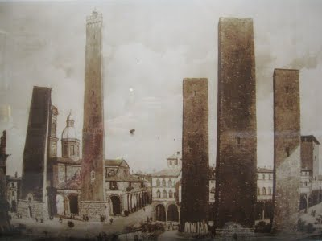
Particle Flow Algorithms
Attempt to measure each particle in a event/jet individually
Implications for calorimetry
● Need a calorimeter optimized for photons: separation into ECAL + HCAL
● Need to place the calorimeters inside the coil (to preserve resolution)
● Need to minimize the lateral size of showers
● Need the highest possible segmentation of the readout
● The role of the HCAL reduced to measure the part of showers from neutral hadrons
leaking from the ECAL
● Need to minimize thickness of the active layer or the depth of the HCAL
Two performance measures of a hadronic calorimeter optimized for PFAs
Χ
Energy resolution for Identification of energy deposits
single neutral hadrons (minimize confusion)

Slide 4
The absorber
Steel
Discussion has boiled down to three choices Tungsten
Crystals
Element | ρ [gcm⁻³] | X₀ [cm] | λ_{I} [cm] | λ_{I} /X₀
Fe | 7.87 | 1.758 | 16.8 | 9.6
W | 19.30 | 0.350 | 9.94 | 28.4
e.g. BGO | 7.13 | 1.118 | 22.3 | 20.0
Sampling
Given space restrictions, best choice not obvious
~2 cm Fe-absorber corresponding to 1.2 X₀ or 0.13 λ_{I} sampling
~1 cm W-absorber corresponding to 2.9 X₀ or 0.10 λ_{I} sampling
Have been tested
Impact on measurement of electromagnetic sub-showers

Slide 5

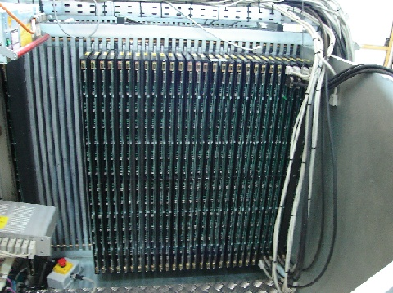
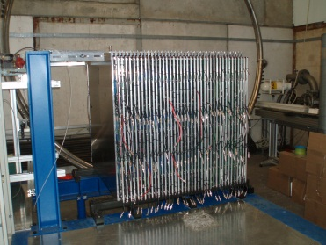
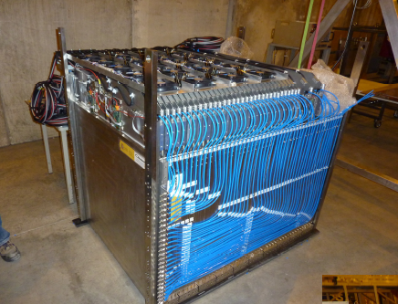
R&D for PFA Hadronic Calorimeters
16-bit
1-bit
2-bit
Scintillator tiles
RPC
GEM
RPC
μMegas
Fe
W
Fe
W
Fe
Fe

Slide 6
The large prototypes
Needed to contain hadronic showers

Slide 7
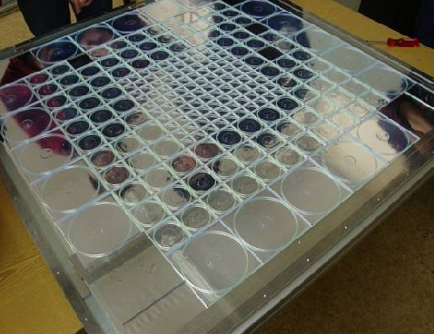

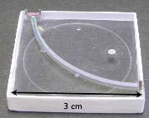
Large Prototype I
Scintillator – AHCAL
Description
38 active layers
Scintillator pads of 3 x 3 → 12 x 12 cm²
→ ~8,000 readout channels
Complemented by a Scintillator strip tail-catcher (TCMT)
Electronic readout
Silicon Photomultipliers (SiPMs)
Digitization with VME-based system (off detector)
Tests at DESY/CERN/FNAL
with Iron absorber in 2006 - 2009
Tests at CERN
with Tungsten absorber 2010-2011
1st use in large system

Slide 8
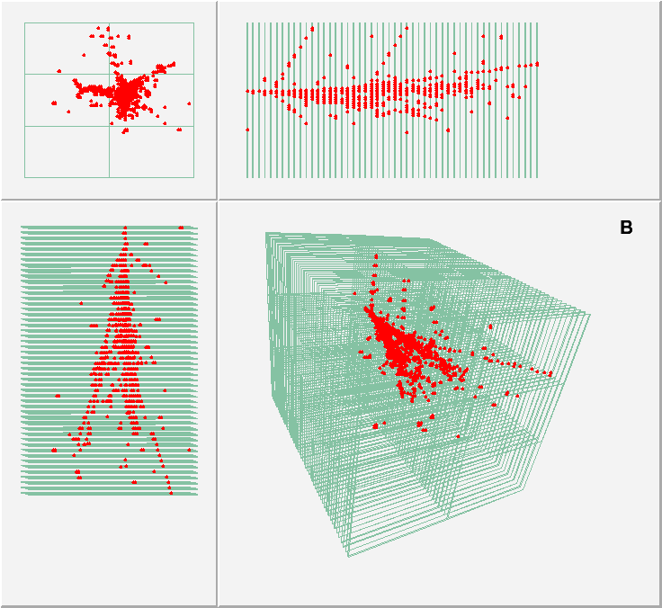

Large Prototype II
RPC – HCAL (DHCAL)
Description
54 active layers
Resistive Plate Chambers with 1 x 1 cm² pads
→ ~500,000 readout channels
Main stack and tail catcher (TCMT)
Electronic readout
1 – bit (digital)
Digitization embedded into calorimeter
Tests at FNAL
with Iron absorber in 2010 - 2011
Tests at CERN
with Tungsten absorber 2012
1st time in calorimetry

Slide 9
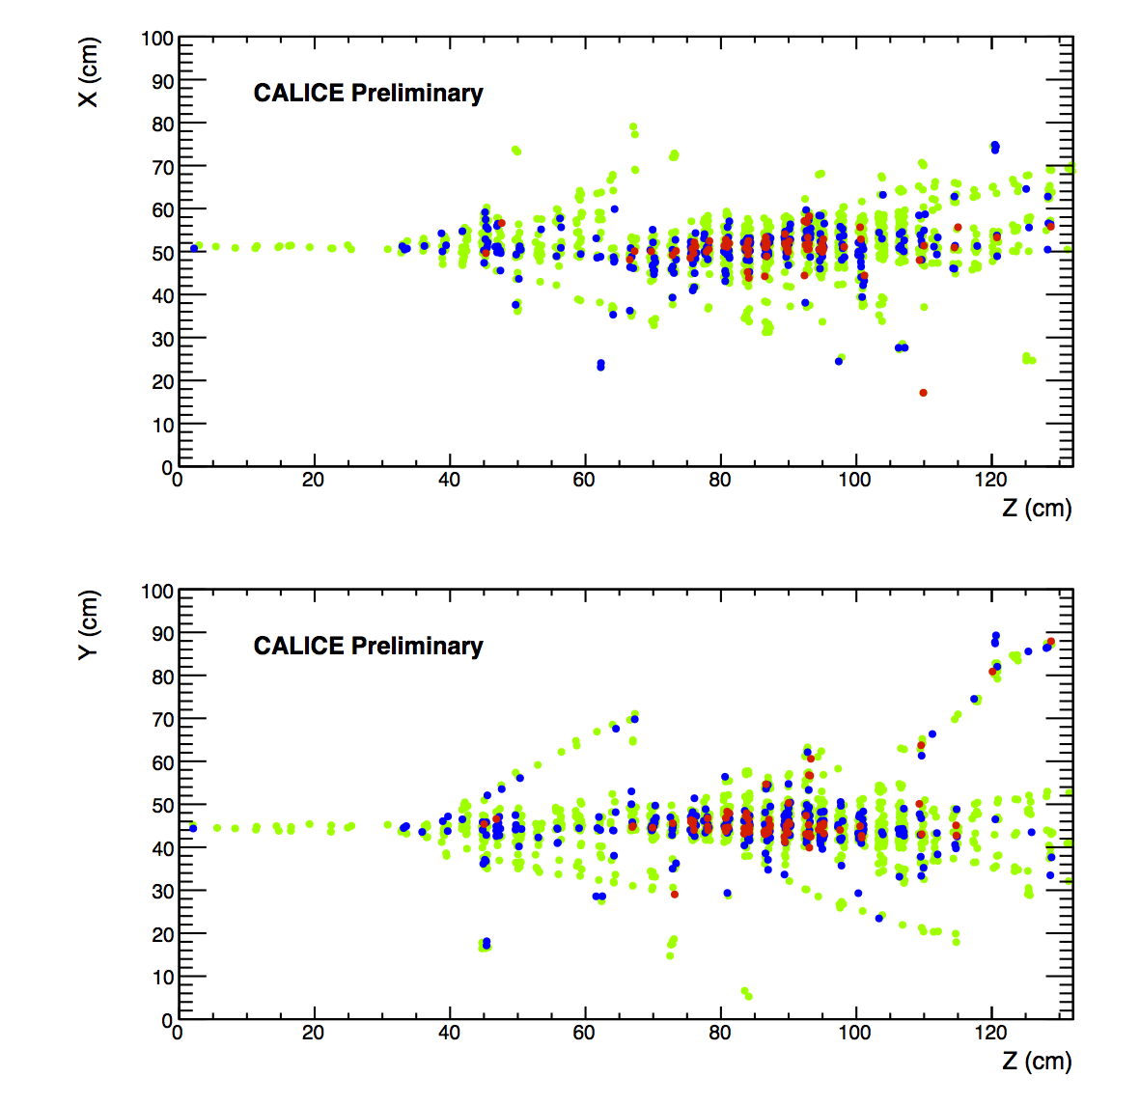
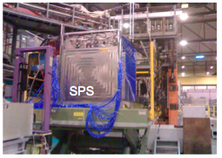
Large Prototype III
RPC – HCAL (SDHCAL)
Description
48 active layers
Resistive Plate Chambers with 1 x 1 cm² pads
→ ~430,000 readout channels
Electronic readout
2 – bit (semi-digital) → 3 thresholds
Digitization embedded into calorimeter
Power pulsing
Tests at CERN
with Steel absorbers 2012
1st use in large system

Slide 10
Some of the many results…

Slide 11
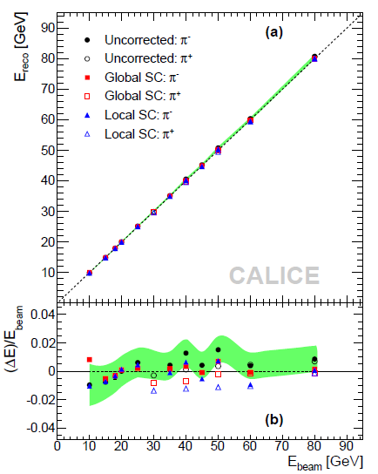
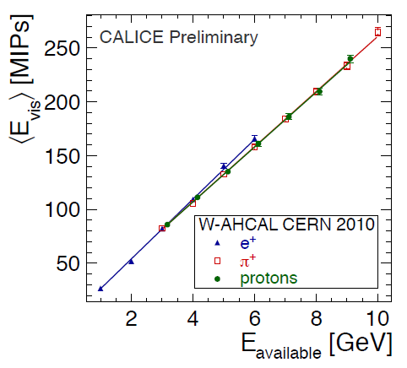
Response – Scintillator - AHCAL
Should be linear: but is it necessary?
Steel -Absorber
Tungsten -Absorber
Linear response up to 10 GeV
(higher energies still being analyzed)
5mm scintillator + 10 mm W
→ Compensation : e/h ~1
-- Electrons
Linear response to hadrons at the <1% level
Under-compensating: e/h ~ 1.2

Slide 12
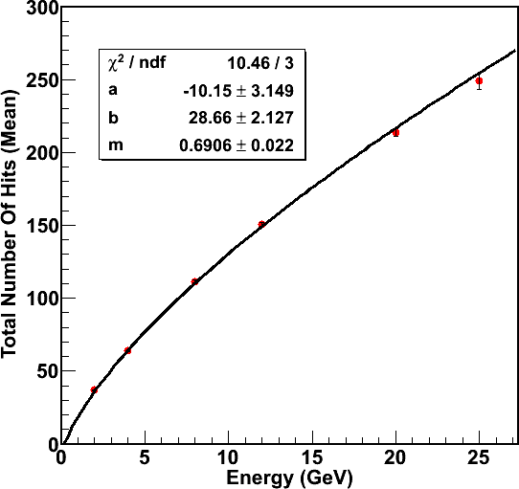
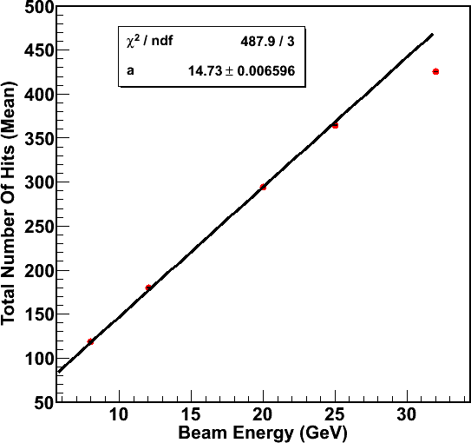
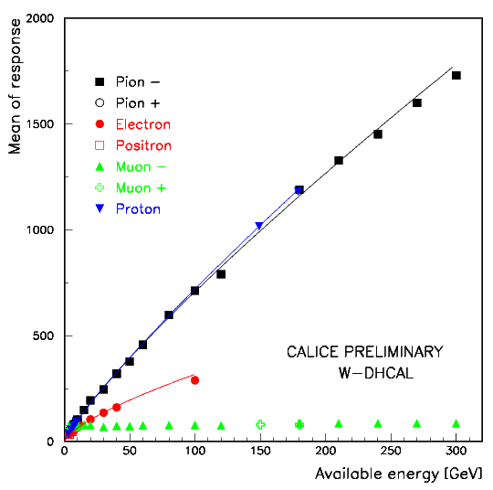
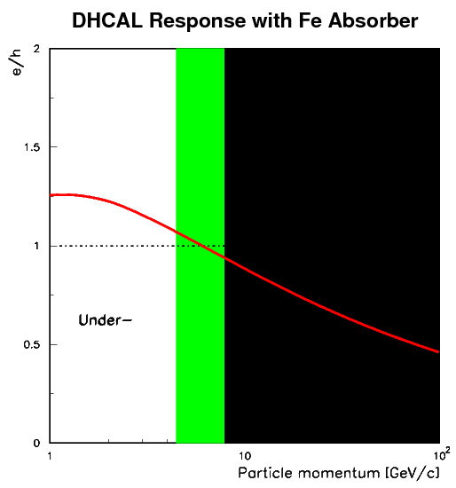
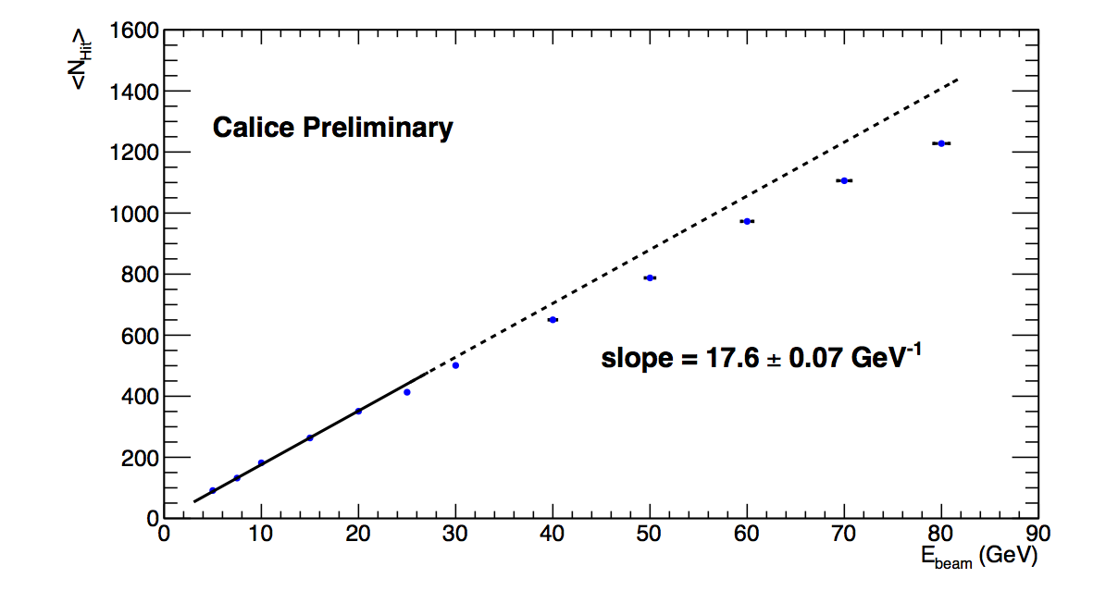
Response – (Semi) - Digital HCALs
Steel – DHCAL
Should be linear: but is this necessary?
Tungsten – DHCAL
30% fewer hits compared to steel
Non-linear response
to both e± and hadrons
Both well described by
power law αE^{β}
Badly over-compensating
e/h ~ 0.9 – 0.5
→ need smaller readout pads
uncalibrated
e⁺ - uncalibrated
π⁺ - uncalibrated
e⁺ – well described by power law αE^{β}
π⁺ - appear to be linear up to 25 GeV
Steel – SDHCAL (1-bit mode)
Deviations from
linear response
due to finite
readout pad
size
Over-
Compensation
uncalibrated
Functional form a priori not known, but needed for energy reconstruction

Slide 13
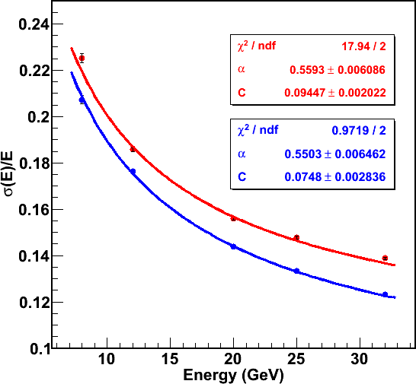
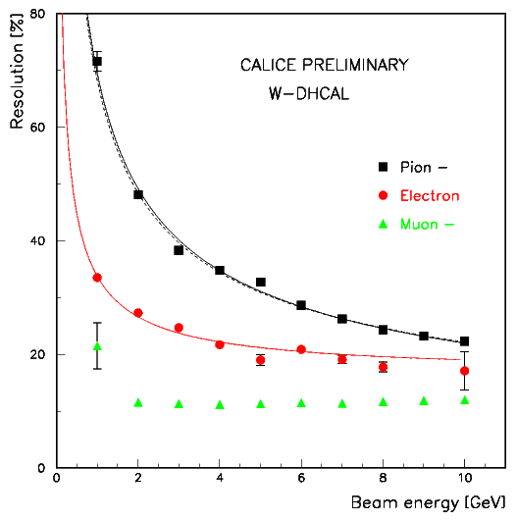
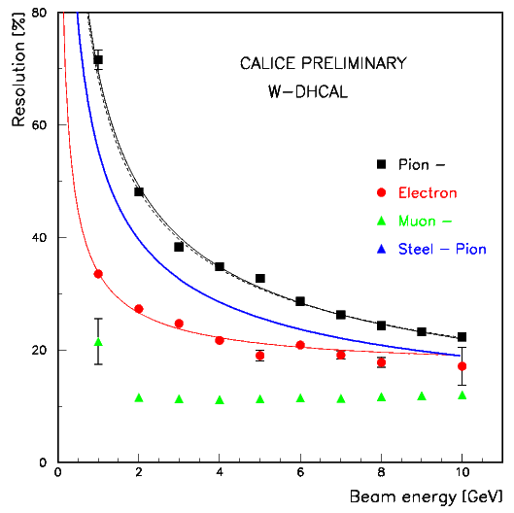
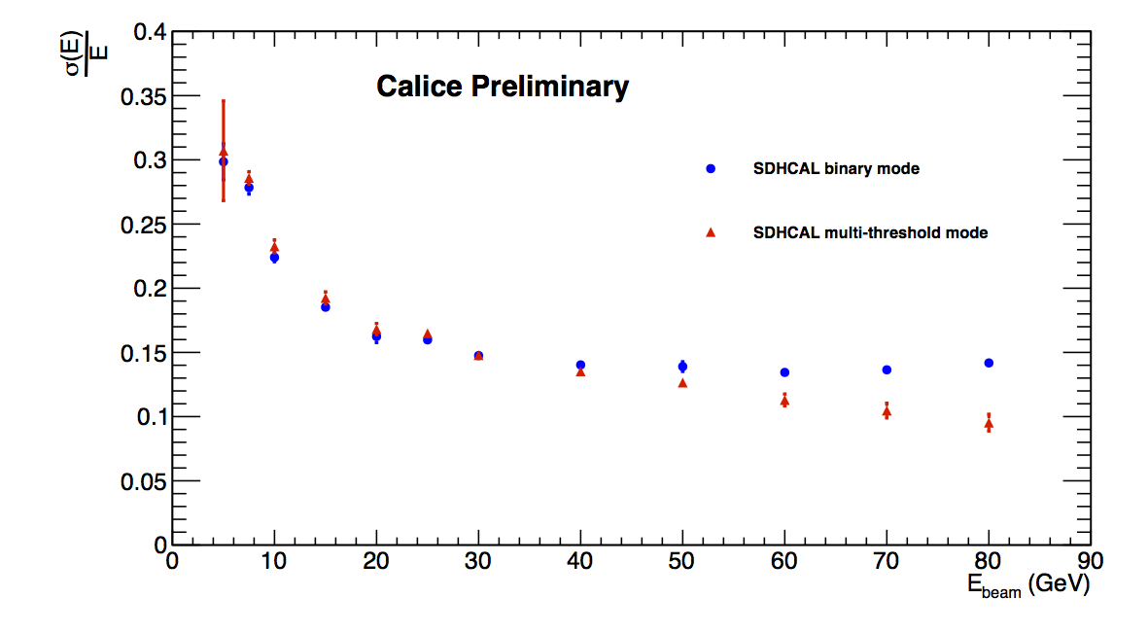
Resolutions
For PFAs this is only part of the story…
Steel – DHCAL
Tungsten – DHCAL
Without containment cut
With containment cut
Not corrected for
non-linearity
(expected to be a +(3±2)% correction)
Resolution
~ 25% worse
than with steel
Corrected for
non-linearity
Steel – SDHCAL
Correction for non-linearity applied
Measurements using either 1 or 3 thresholds
Improvement at higher energies with 3 thresholds

Slide 14
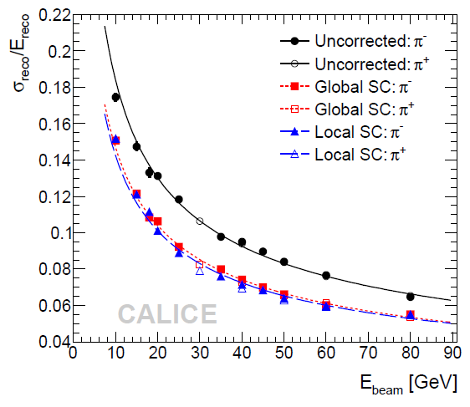
Software compensation – Scintillator AHCAL
Apply different weights to ‘hadronic’ or ‘electromagnetic’ sub-showers
based on energy density
Large improvement (~20%)
Stochastic term 58%/√E → 45%/√E
Similar stochastic terms of
Steel – DHCAL and ‘raw’ AHCAL
→ Resolution dominated by sampling
Software compensation should also work
for the DHCAL: how well?
The power of imaging calorimeters

Slide 15
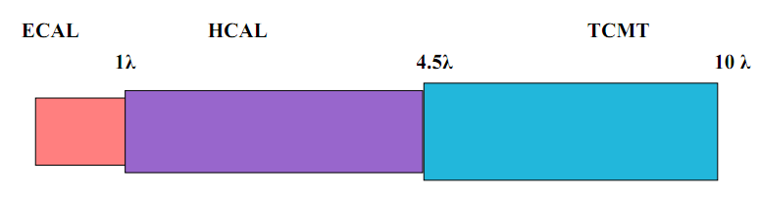
Leakage correction
Select showers (80 GeV π) starting in first part of AHCAL
Apply corrections depending on
Interaction layer (shower start)
Fraction of energy in last 4 layers
Mean value restored
RMS reduced by ~24%
The power of imaging calorimeters

Slide 16
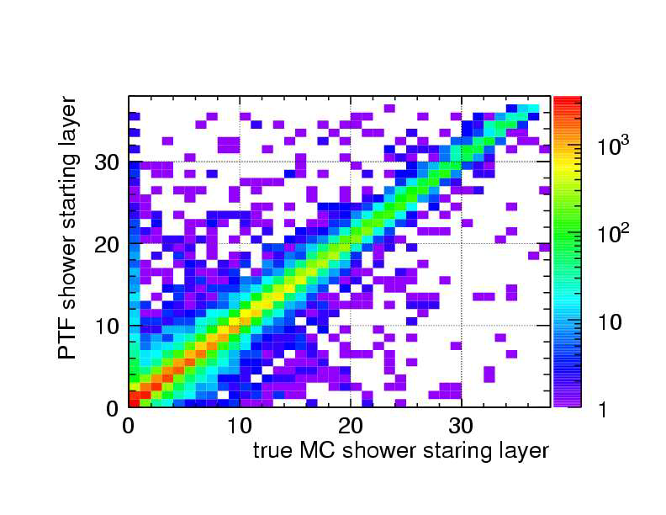
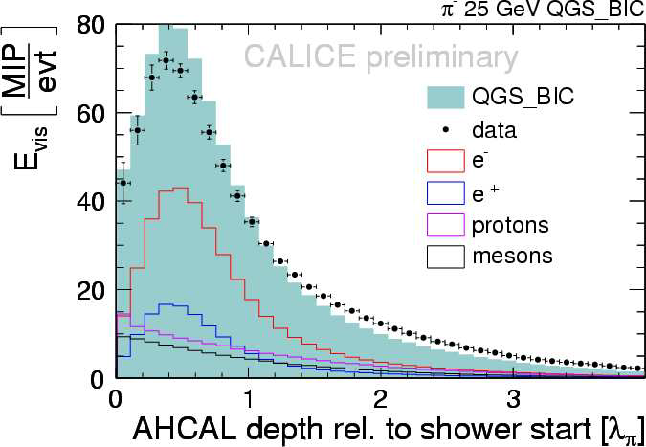
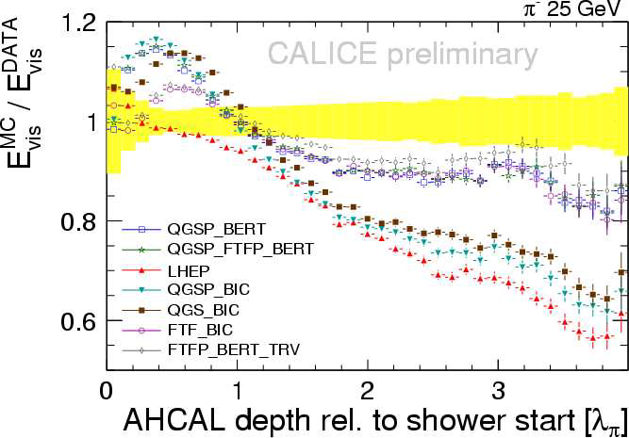
Shower shapes
Identification of
layer with shower start
Comparison with various hadron shower models
The power of imaging calorimeters

Slide 17

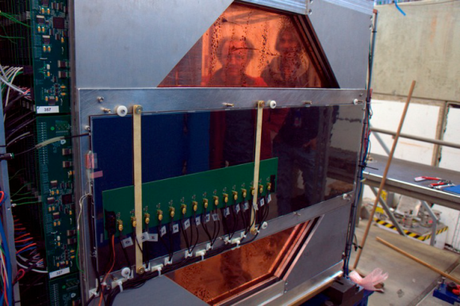
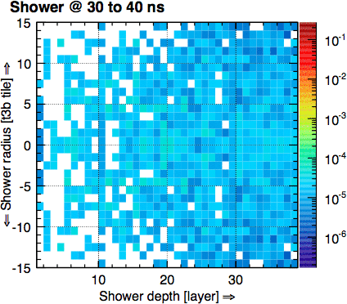
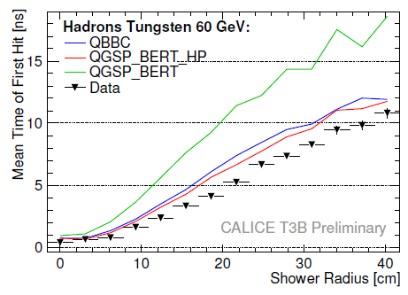
Timing measurements
Measurement of shower timings using
Scintillator pads or
RPC with pads
Positioned downstream of
Steel stack or
Tungsten stack
Comparison with hadron shower models
Average 60 GeV shower in 4D
Use reconstructed interaction
point in Tungsten - AHCAL
The power of imaging calorimeters

Slide 18
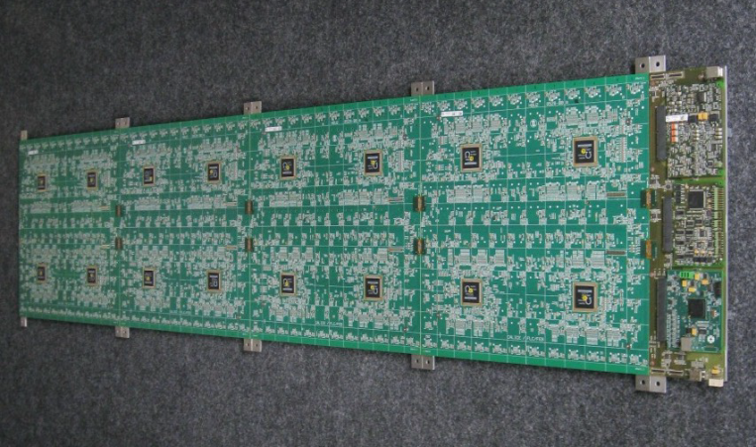
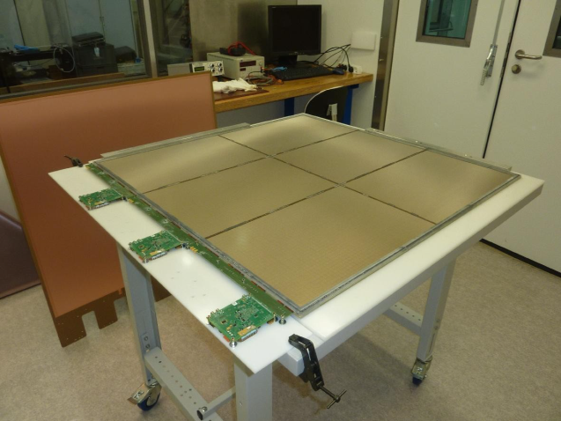
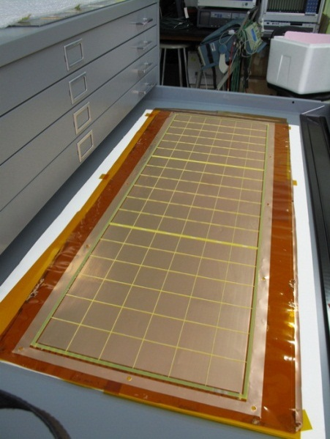
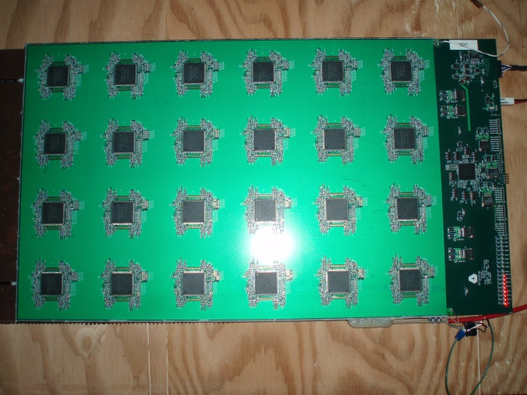
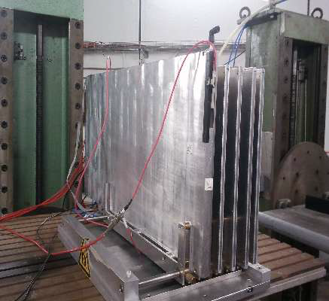
R&D beyond current prototypes
Embedded readout for AHCAL
1 m² μMegas as alternative to RPCs
32 x 96 cm² GEMs as alternative to RPCs
Ultra-thin 1-glass RPCs
High-rate RPCs

Slide 19
And now to something completely different

Slide 20
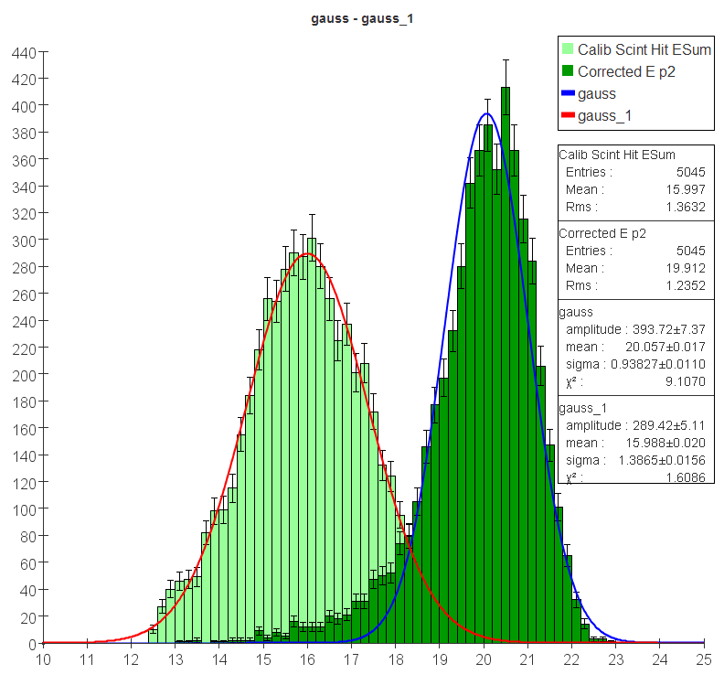
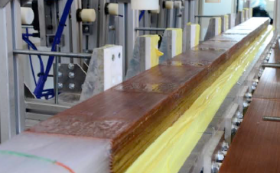
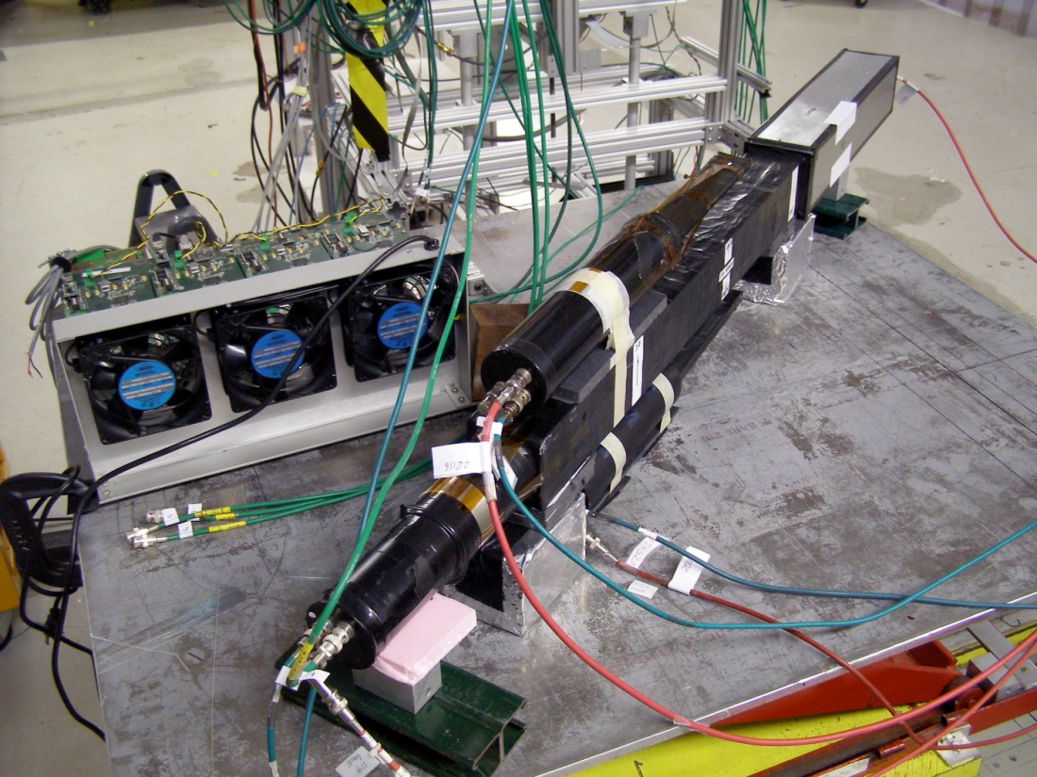
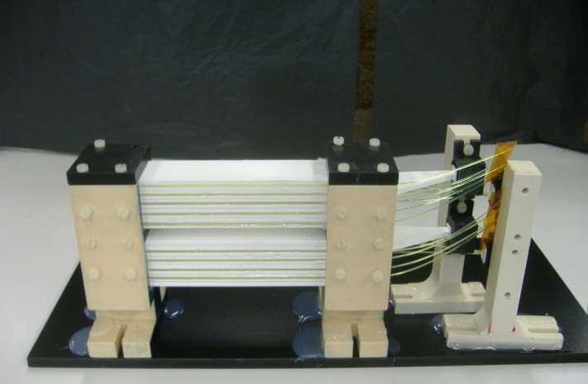
Dual Readout
20 GeV π
simulation
The idea
Typically, compensating calorimeters feature poor em resolution
Dual readout measures both
Scintillation light (ionization by any charge particle)
Cerenkov light (predominantly produced by electrons and positrons)
And so reconstructs f_{em} (the electromagnetic fraction of a hadronic shower)
and corrects for the different electromagnetic and hadronic response
on an event-by-event basis
Several different approaches
Correction
40 → 22%/√E
Experimental proof still needed
DREAM
Fiber readout
CALTECH/FNAL
Crystals/glass
ADRIANO
Fiber readout with
scintillating glass/plastic

Slide 21
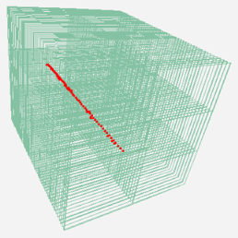
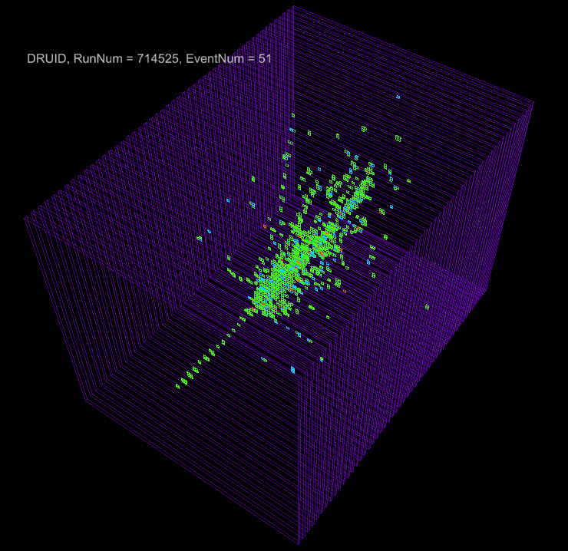
Summary
Scintillator Analog HCAL First use SiPMs in large prototype
Demonstration of software compensation
Demonstration of leakage corrections
Detailed measurements of shower shapes
RPC-Digital HCAL First large prototype with embedded electronics
First digital pictures of hadronic showers
Record channel number in calorimetry
Demonstrated viability of concept of digital calorimetry
RPC-Semi-Digital HCAL First use of power pulsing
Demonstrated benefit from 3 thresholds (semi-digital)
Further R&D Many different activities

Slide 22
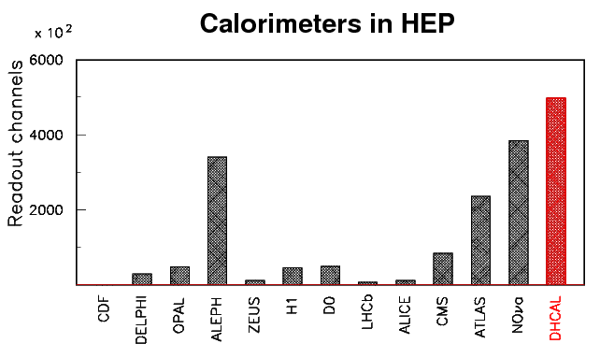
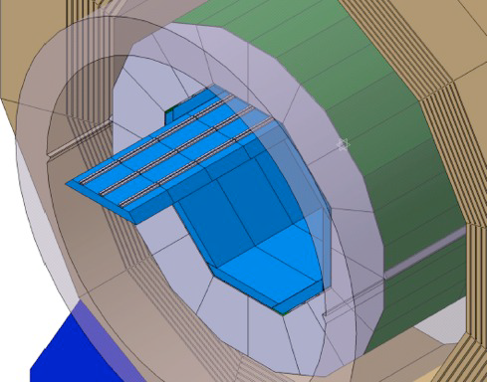
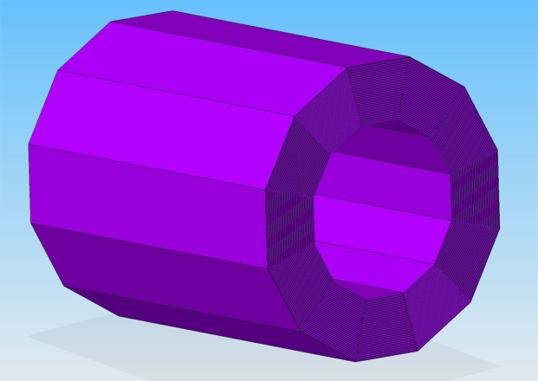
Summary
of the summary
These are only prototypes
For real detector x50
Technical feasibility of imaging hadron calorimetry proven
new endeavor
Measurement of hadronic showers with unprecedented spatial resolution ongoing
Detailed comparison with GEANT4 based MCs → valuable information for further tuning
Further work needed to design/build modules for a colliding beam detector
ILD
SiD

Slide 23
Backup slides

Slide 24
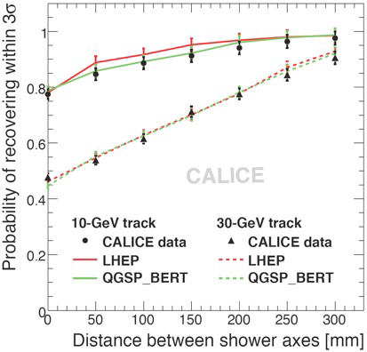
Validation of PFA performance
Shower separation
Showers reconstructed with
PandoraPFA
Excellent agreement with
simulation
GEANT4 can be trusted to
optimize detector design for
PFA performance

