Slide 1
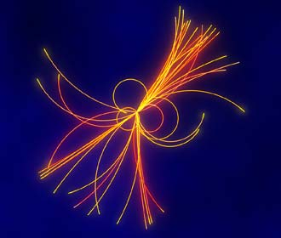
State of art of the ECAL
for LC experiment
Jean-Claude BRIENT
Laboratoire Leprince-Ringuet
Ecole polytechnique- CNRS/IN2P3

Slide 2
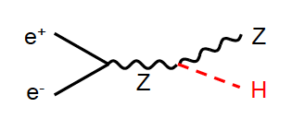
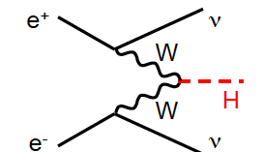
The CERN Boson X(125GeV) is coupled to the Z boson (Signal in ZZ)
2 jets+X(125) @ 65%
X(125)
Would it be possible to separate it
from 2 jets+Z or from 2 jets+W ?
Not yet a clear
signal in WW
YES, if the jets measurement is sufficiently good
to disentangle Z,W and X(125) by the recoil to the
di-jets mass
X(125)
PFA reconstruction ,
Partially demonstrated by ALEPH
Proposed and studied for TESLA project (1998-2003)
Used by CMS
Use to design ILC detector (SID, ILD)
What is PFA ??
See talk by H.Yamamoto san

Slide 3
Goal for the ECAL
Stop, Identify and Measure photon (s) , electron(s)
If possible, follow all the other particles
For HEP community members
Particle Flow Algorithm
Make a photography
of the particles created
by beams collisions
Separate the photon(s) from neutral and charged hadrons
Identify the electron
Follow the hadronic showers development (need good connection with HCAL)
Estimate as precisely as possible the photon(s) direction, position and energy
Create a camera with
Radiator between 2 layers
of pixels to make interaction
for electron(s) , photon(s)
A large number of pixels
No hole
Uniform response to have
good picture
Following e.m. showers development and optimising
separation between close showers leads to readout
of large segmentation, small pixel readout size,
compactness (small Molière radius), minimal distance
between ECAL-HCAL (pattern ECAL-HCAL), ….
Granularity , compactness, homogeneity

Slide 4
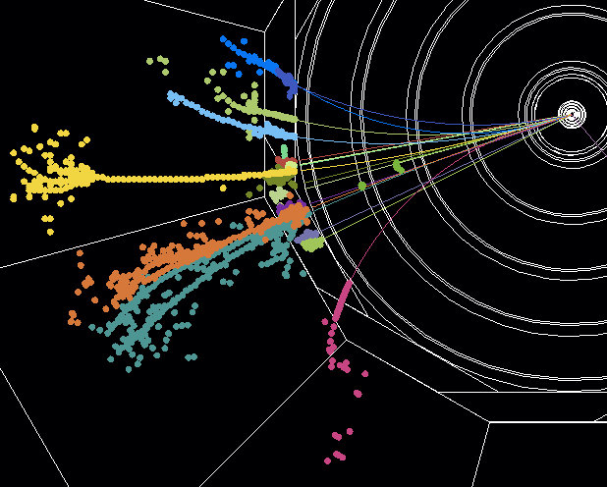
LHC-CMS
Illustration
WANT an
IMAGING DEVICE
Detector for LHC at CERN
HCAL
From this
This talk
to that
PHOTO with
ECAL
100M pixels every 300 ns
LC Proposed detector

Slide 5
Granularity , compactness, homogeneity
--------------------------------------------------------------------
large number of pixel layers, small pixel size, compactness
with
External constraints from
The large B-Field (protection against machine background),
The accelerator time structure,
and of course the COST
leads to
The camera ….. (we call that sampling calorimeter)
Radiator in Tungsten for compactness, small width for em showers
and for the active layers
Pixels in silicon PIN diode (R&D on MAPS with digital readout)
Possible small size scintillator strips , read by SiPM (R&D on going)
Micromegas (possible but not demonstrated)

Slide 6
It is opening the following questions
Calibration of 100 millions channels and signal stability (we want same response for same collision)
Capability to make zero suppress “on site” (we don’t want to read empty pixel)
Keep S/N ≥ 10 at MIP level and coherent noise under control (noise , radio/TV , telephone call )
Multiplexing for the quantity of signal line out (we don’t want to have 100M cables)
Power management due to large number of channels (we don’t want to burn our electronics readout)
KEEP the COST UNDER CONTROL (we want an affordable cost)
A set of answers
Choose stable device (silicon) or control & monitor the signal stability (Scint. or Micromegas)
ADC& digital memory in readout chip, close to active layer. Read memories at each end of bunch train
i.e. Silicon PIN diodes …. AC/DC coupling , ground loop , etc… a lot of R&D (EMC study)
Large number of Channels/VFE ASIC… (KPIX, SKIROC), but only few readout line
Power pulsing (thanks to machine structure) → reduced the power to dissipate… no cooling inside
Reduce the overall surface or use lower cost active device (Micromegas, scintillator) BUT warning versus point a) and c) . Contact with producers and try to define R&D to reduce cost

Slide 7
The answers open new set of questions
For scintillator … signal stability vs temp., dark rate, linearity , uniformity inside strip, COST
VFE inside ….. Power dissipation, e.m. shower effect on VFE, very high level of integration
Very thin PCB …. Crosstalk, EMC, Industrial Yield , COST !!
Power pulsing …. Gain amplifier stability, Eddy current, power distribution, induced NOISE
Trade off between cost vs performances … Define the cost drivers, the right level of realism
for simulation and disentangle detector from PFA program effects
define R&D on cost …….
1 - Convince the producers to give us the information on the cost drivers
2 - Establish a FAIR comparison on the cost (contingency, construction model, manpower,..)

Slide 8
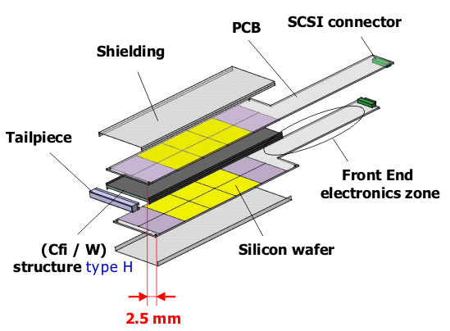
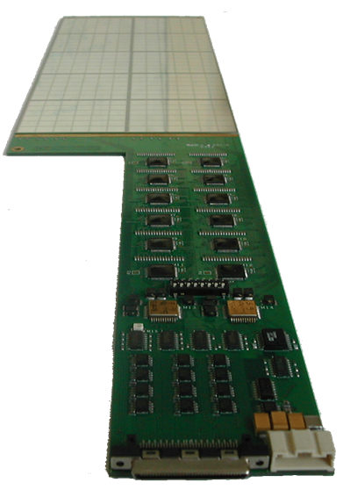
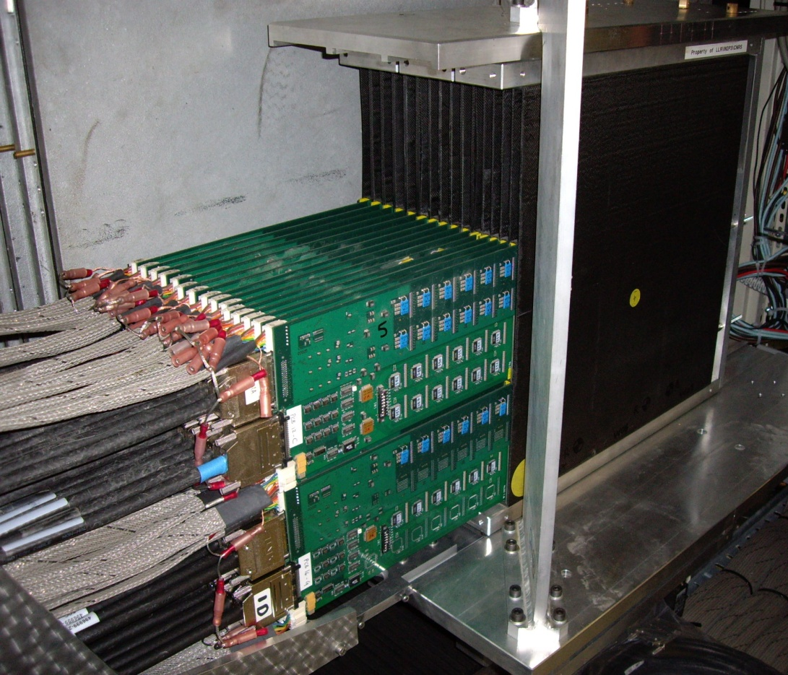
First prototype (2006) : validation of physics perf. for high density channels device
FIRST ATTEMPT
First generation prototype
tested on beam 2006-2010
30 layers - ~10000 channels
Mechanical structure: carbon fibre
composite, incorporating tungsten layers
Standard printed circuit slabs hold
silicon sensors & electronics
(outside detection area)

Slide 9
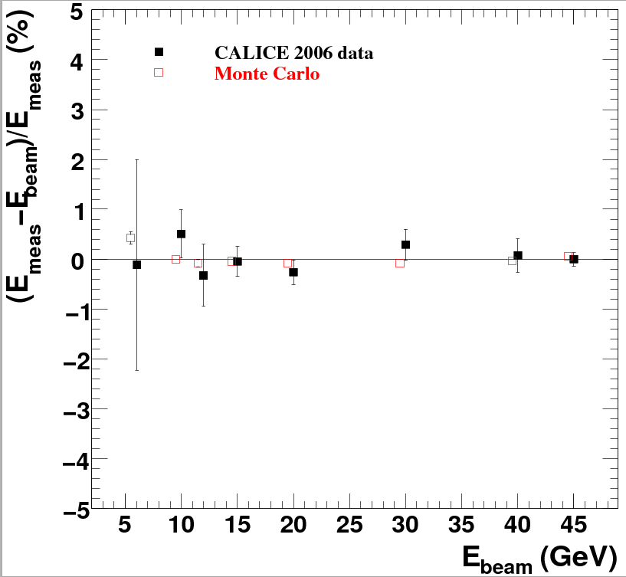
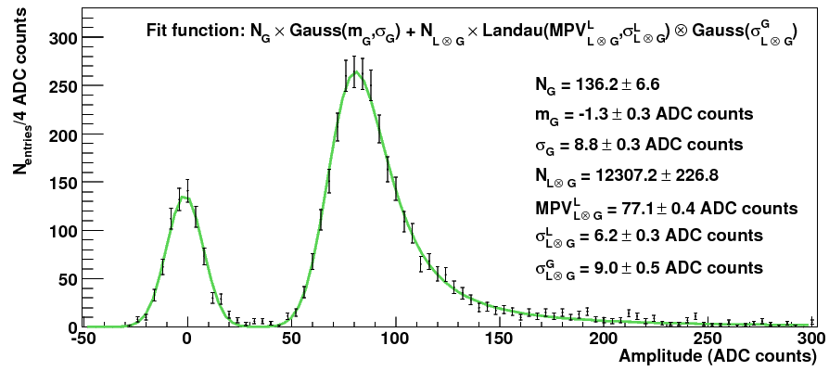
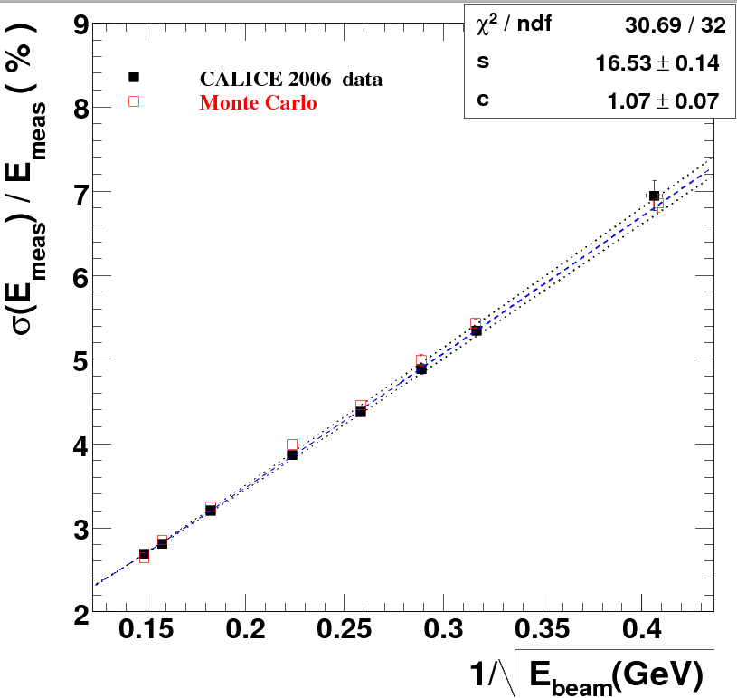
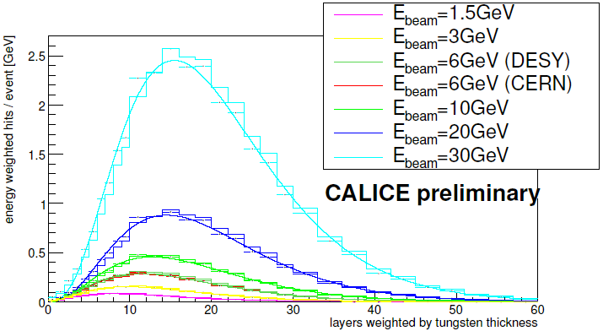
SILICON - TUNGSTEN
FIRST ATTEMPT
S/N ~ 7.5
non-linearity<1%
Pedestal MIP
ECAL calibrated with cosmics and muon beams
Shows very stable behaviour
Longitudinal
shower profiles
Energy resolution =
16.5/sqrt(E)+1.1%
9

Slide 10
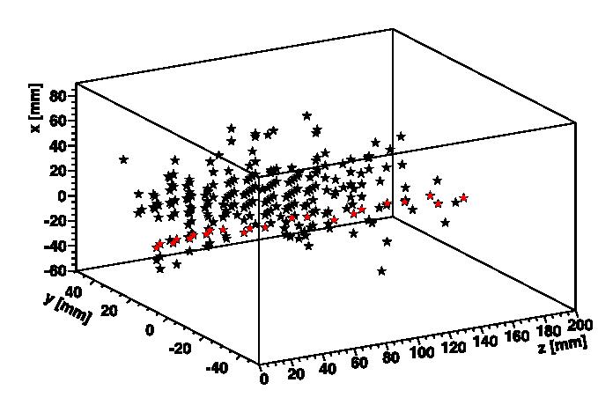
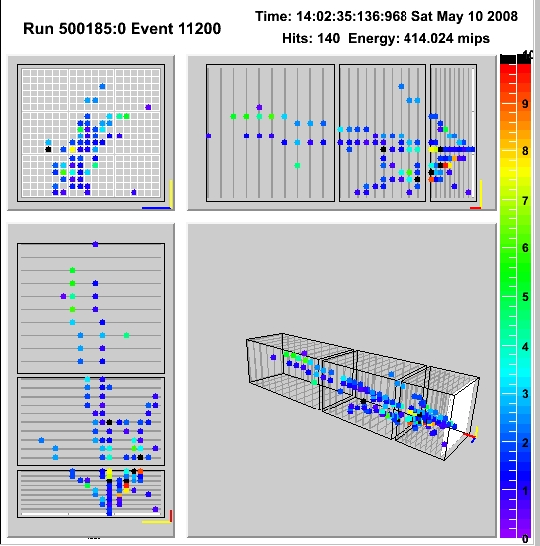
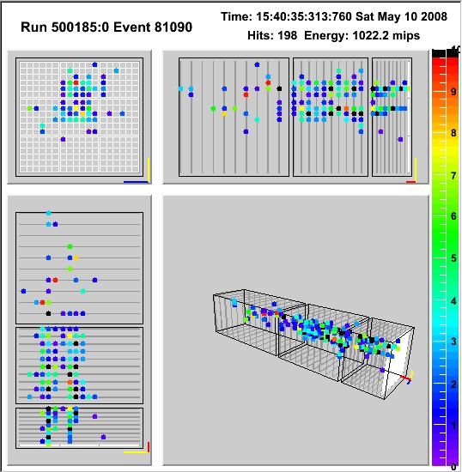
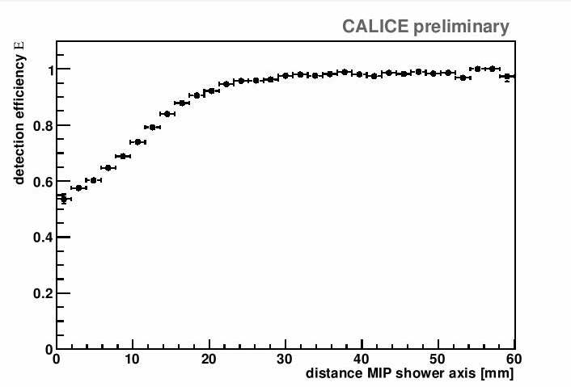
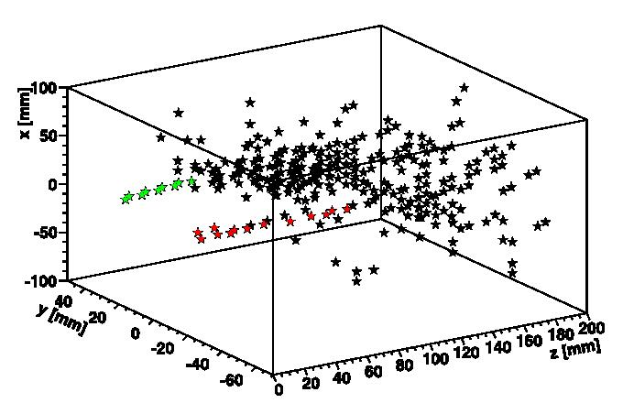
And now the tests of the camera
Electron - muon
pion
pion - pion
pion - pion
Efficiency finding electron
close to muon
Quantitative test has been published by CALICE (test of PANDORA PFA with TB data)

Slide 11
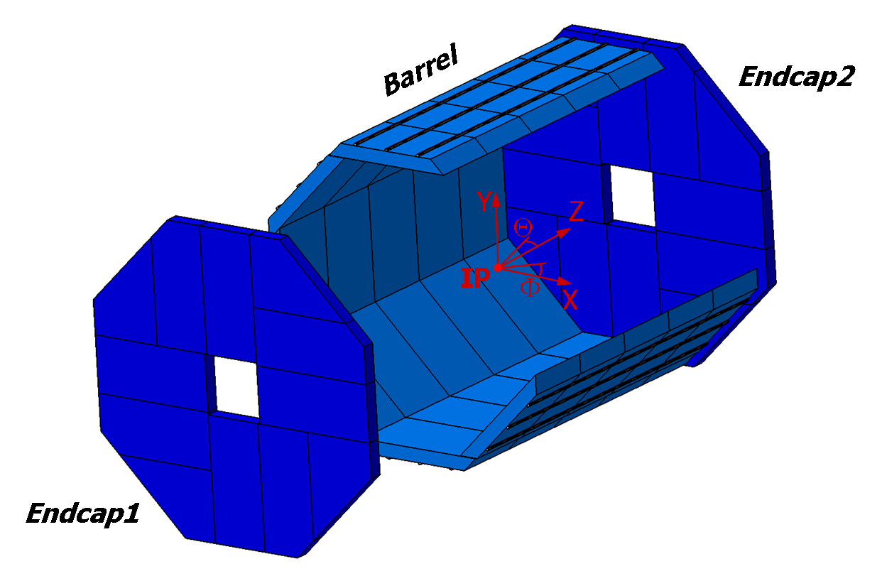
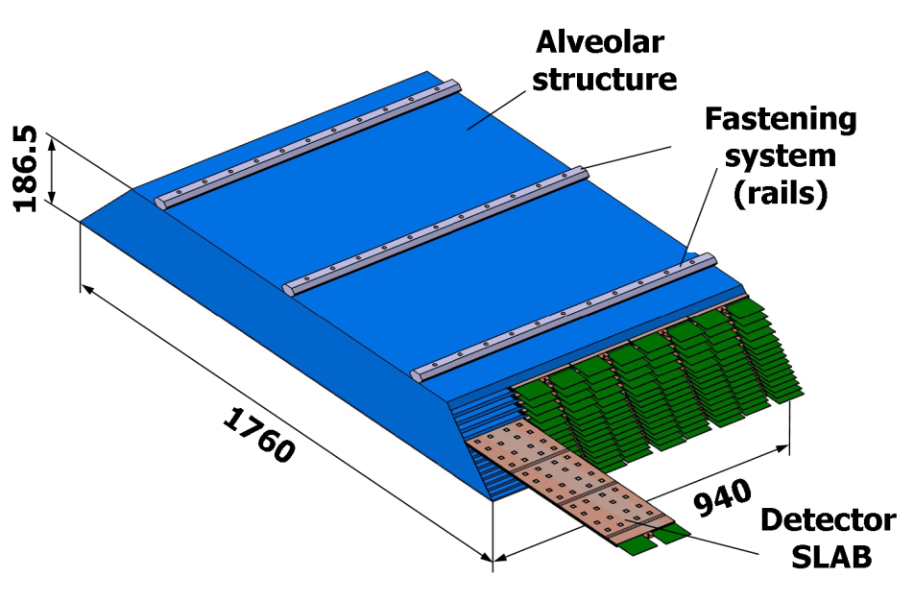
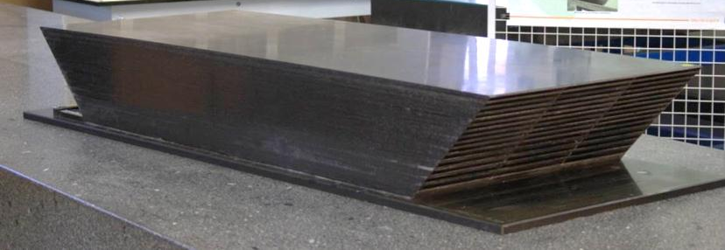
NOW develop a scalable version.
Here the example of ILD ECAL
GEOMETRY
No DEAD ZONE !!!
Carbon fiber –Tungsten structure with Alveola
to slide in the active layers.

Slide 12
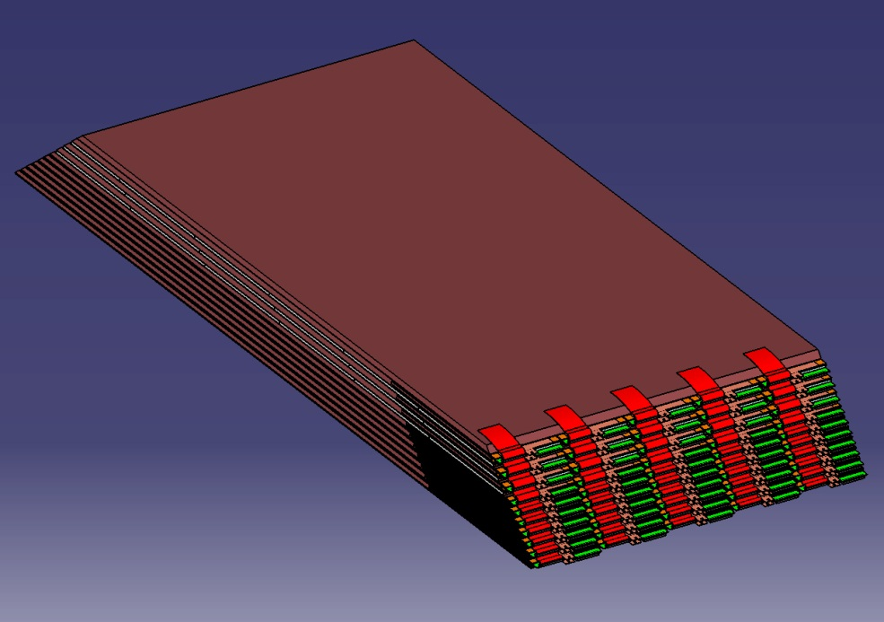
GEOMETRY
Slide off
the detector slab

Slide 13
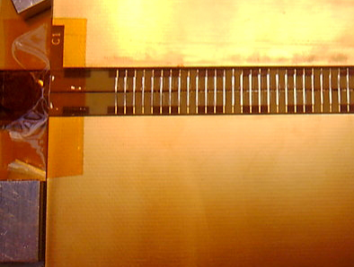
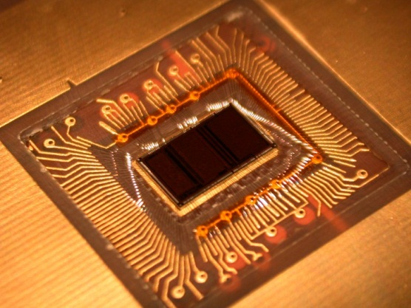
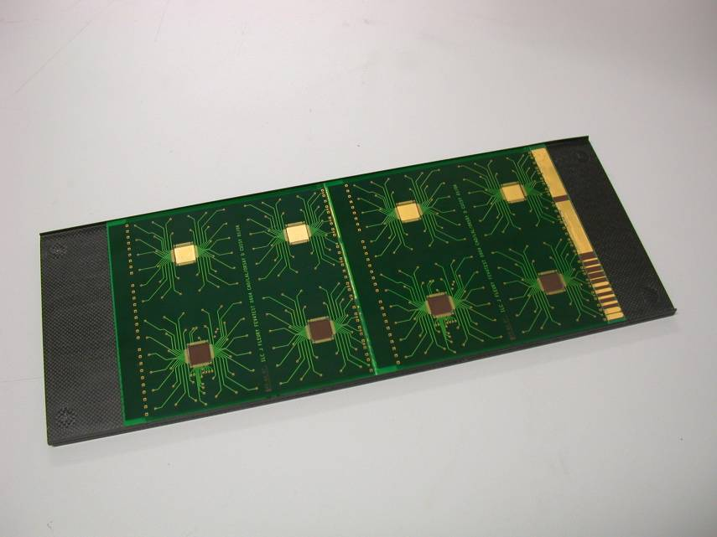
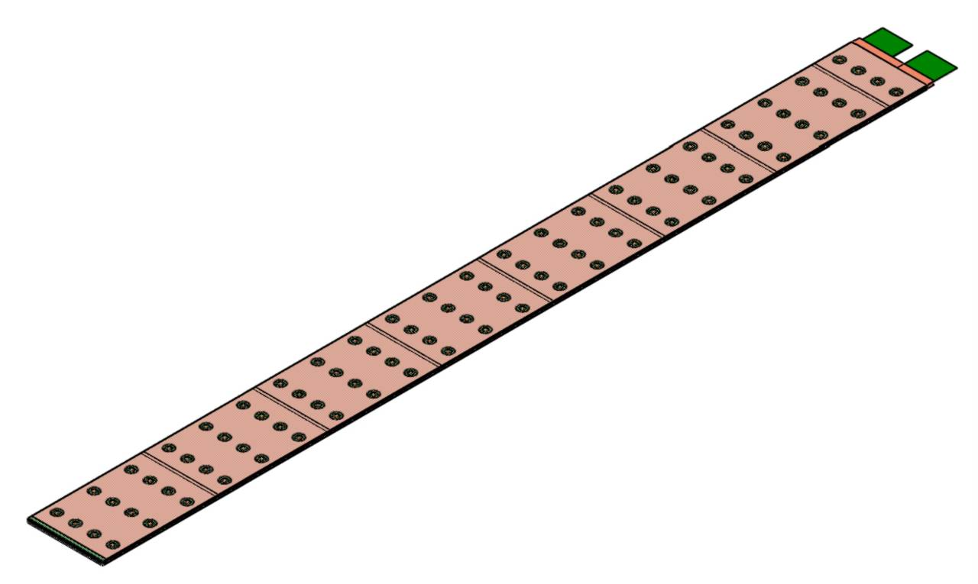
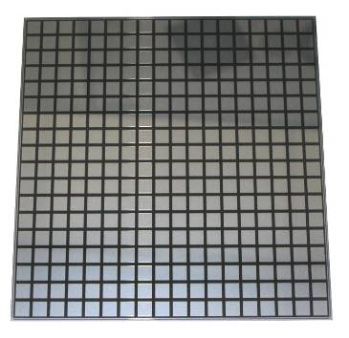
ACTIVE LAYERs
PCB is critical :
1 mm tick, 8 layers,
1% flatness ,
chips bounded into
Connection between 2 PCB
Interface card
Chip « inside »
and below
Short sample
7 “unit” PCB = A.S.U.
90
16×16 pixels (5×5 mm)

Slide 14
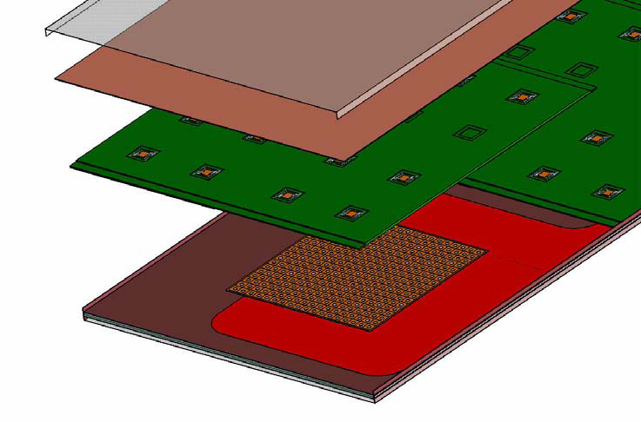
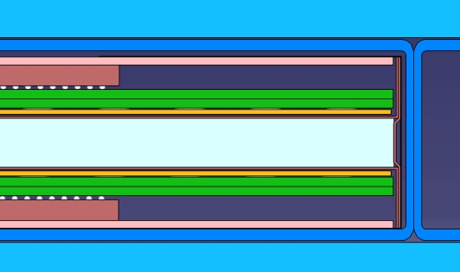
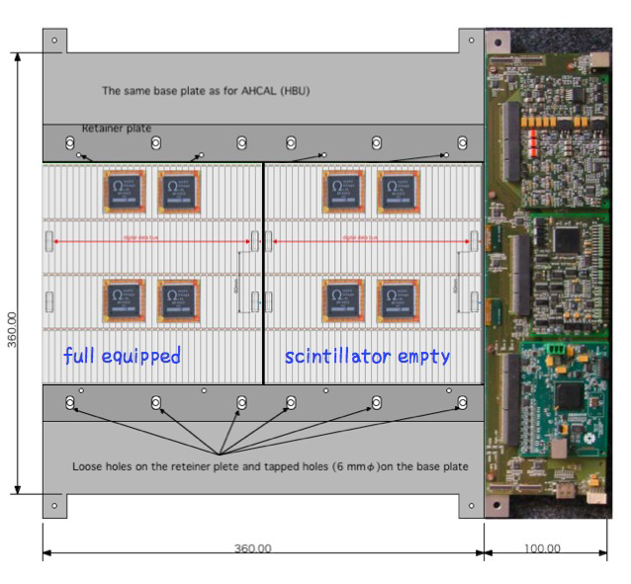
Level of Integration !!!!!
ACTIVE LAYERs
PCB with Silicon diodes on one side
VFE and cooling plate on the other side
Heat shield
PCB
Silicon wafer
VFE ASIC
glue
PCB
Kapton film
Silicon
TUNGSTEN
Carbon
fiber
Equivalent with scintillator strips
TOTAL/ Active Layer : 3.8 mm
⇨ Gaps (slab integration) : 500 µm
⇨ Heat Shield: 500 µm
⇨ Thickness of BGA : 1700 µm
⇨ PCB : ~1200 µm
⇨ Thickness of Glue : 100 µm
⇨ Thickness of SiWafer : 325 µm
⇨ Kapton® film HV : 100 µm
⇨ Thickness of W : 2100/4200 µm (± 80 µm)

Slide 15
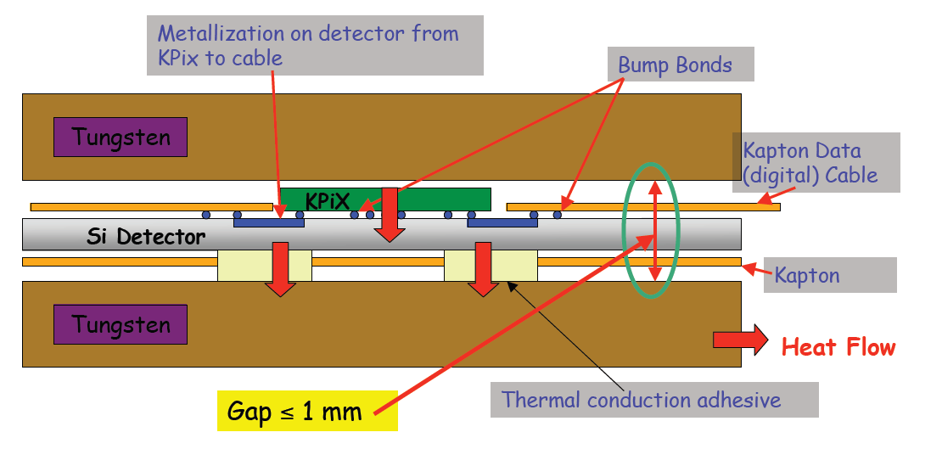
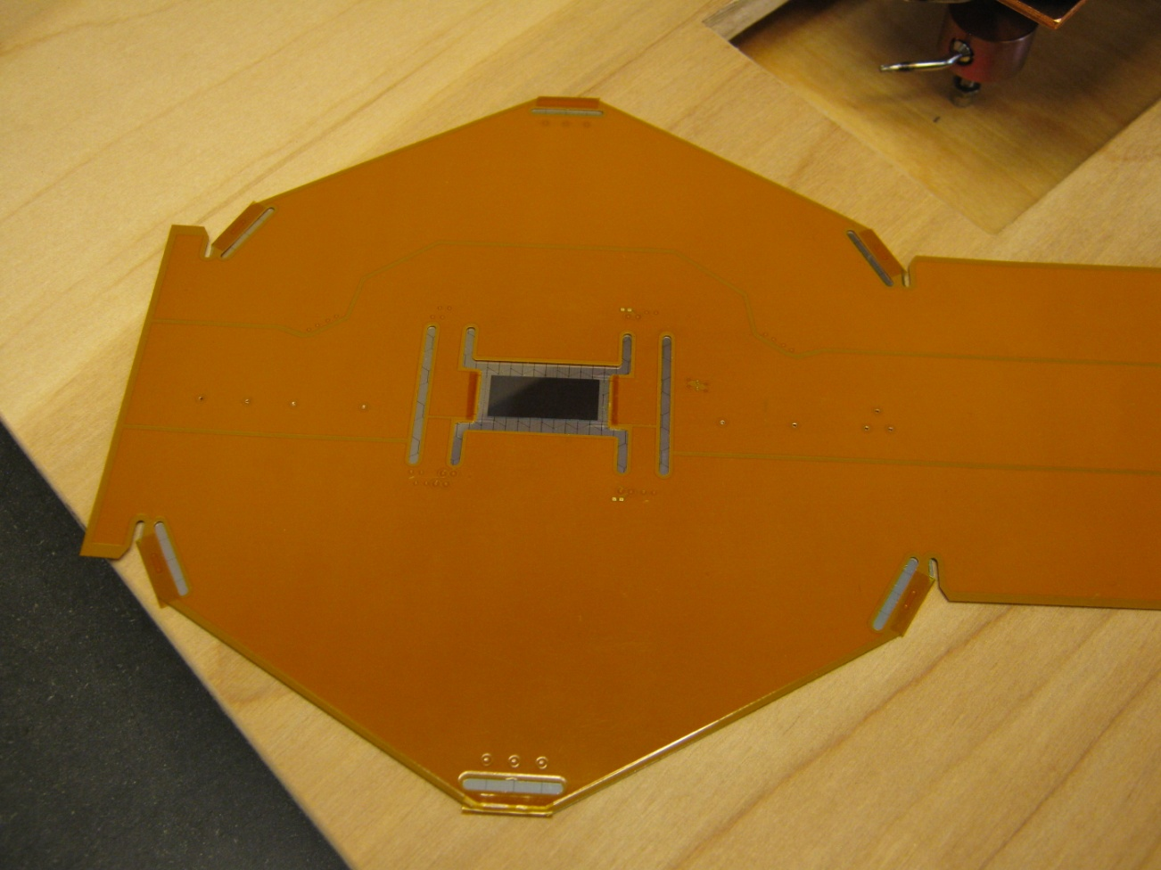
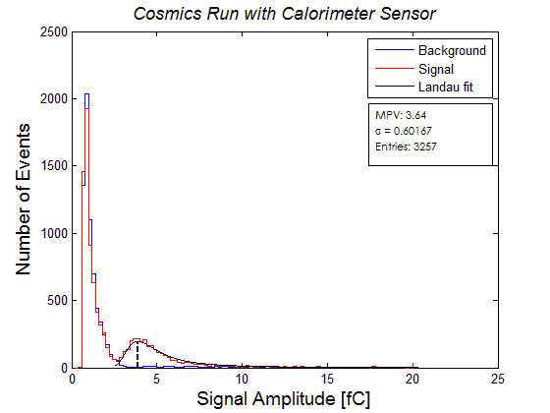
ACTIVE LAYERs
At the extreme of integration :
Readout chip directly bonded on Silicon Wafers
KPIX
Gap ≤ 1 mm

Slide 16
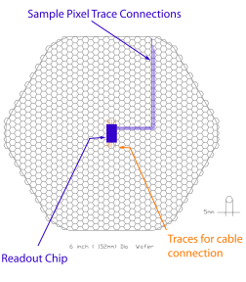
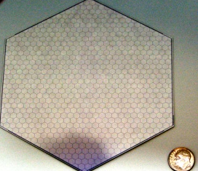
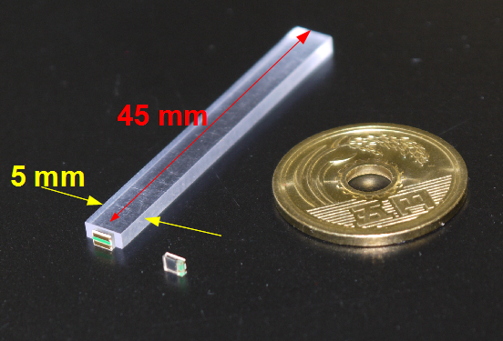
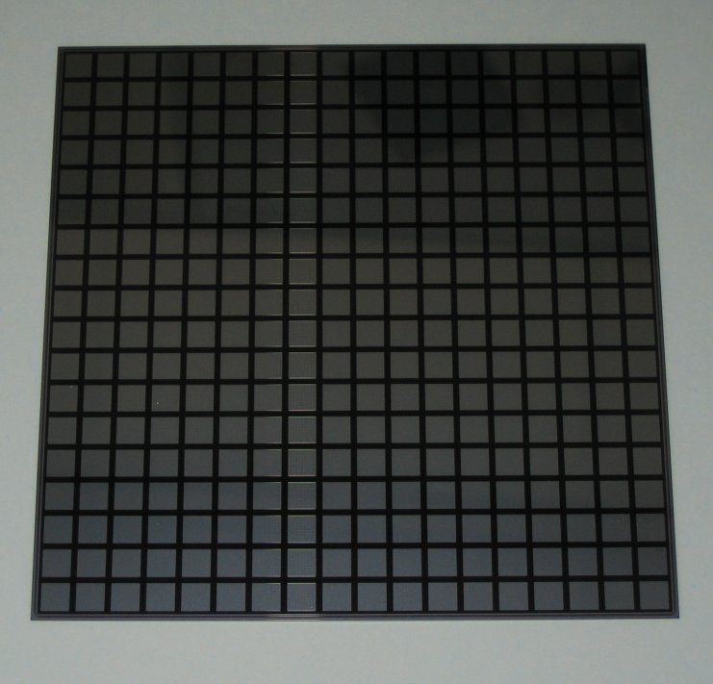
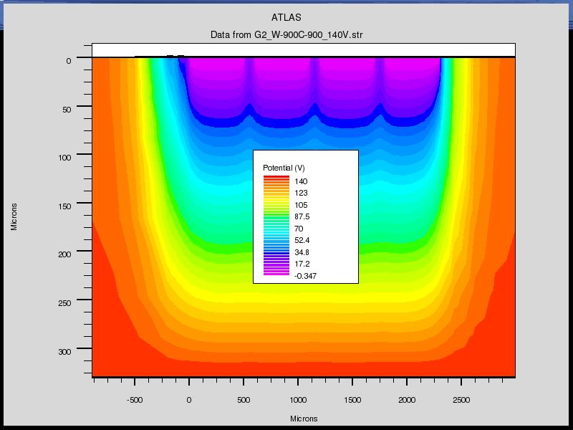
ACTIVE MEDIUM
Simple Silicon Matrices
Hexagonal silicon wafers
A simple design to control the cost
Few thousands of m² needed for ILD
Glued on PCB : Floating Guard Rings
Drawbacks :
Large dead zone at the edges (~1 mm)
Crosstalk with GR
R&D in (if possible in collaboration with producers)
Split GR and/or complete removal of GR
Laser dicing : gain a factor 2 on dead zone
Smaller size abutted matrices may improve yield
Maximize the use of silicon wafers
Strips on surface to connect to readout
chip bump bonded on Si wafer itself
Alternative - 1
SCINTILLATOR 45x5 mm² , read by SiPM
Seems promising
Need to be “validated”
by detailed comparison
data/MC (TB soon)
R&D on
Engineering model
overall cost estimation
256 pixels of 5x5 mm²
Alternative - 2
A mix up of Scintillator-silicon (Hybrid) . Interesting on paper (simulation)
CMOS – MAPS with digital readout (at a very preliminary stage, some first TB )
Resistive Glass - Micromegas (seems very promising but at the level of first simulation..)

Slide 17
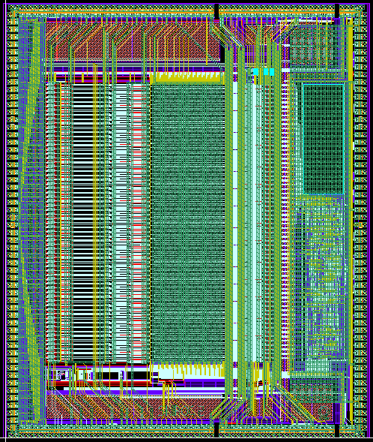
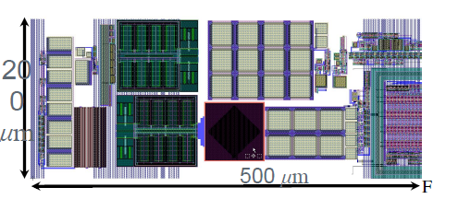
Readout for the ECAL with silicon diodes
READOUT CHIP
SKIROC-2
Silicon Kalorimeter Integrated Read Out Chip
Technology SiGe 0.35µm AMS. (7229 µm x 8650 µm)
Production batch received Q3’10
64 channels, variable gain charge amp, 12-bit ADC, digital logic
Power-pulsed → 25 μW/channel
Power pulsing
Variable current consumption according to state
1 slab : 0 to 10 Amps pulses
of 1 ms at 5 Hz
KPIX
1024 channels intended to bump bond to Si detectors, optimized for the ILC (1 ms trains, 5 Hz rate):
Low noise dual range charge amplifier w 17 bit dynamic range.
Power modulation w average power <20 μW/channel (ILC mode).
Up to 4 measurements during ILC train; each measurement is amplitude and bunch number.
Digitization and readout during the inter-train period.
Internal calibration system
Noise Floor: 0.15 fC (1000 e⁻ )
Peak signal (Auto-ranging) 10 pC
Trigger Threshold Selectable (0.1 – 10 fC)

Slide 18
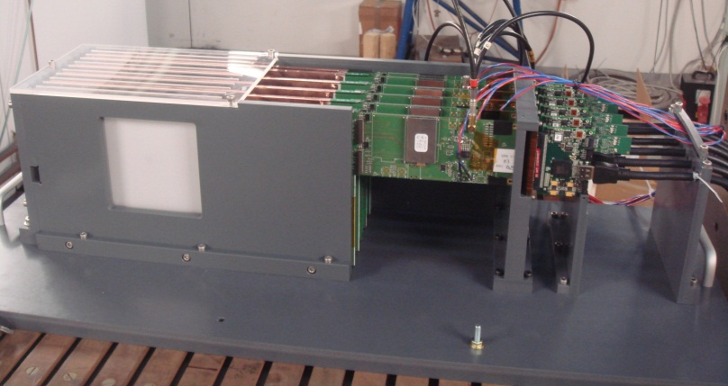
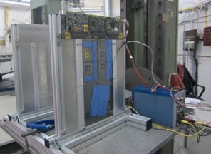
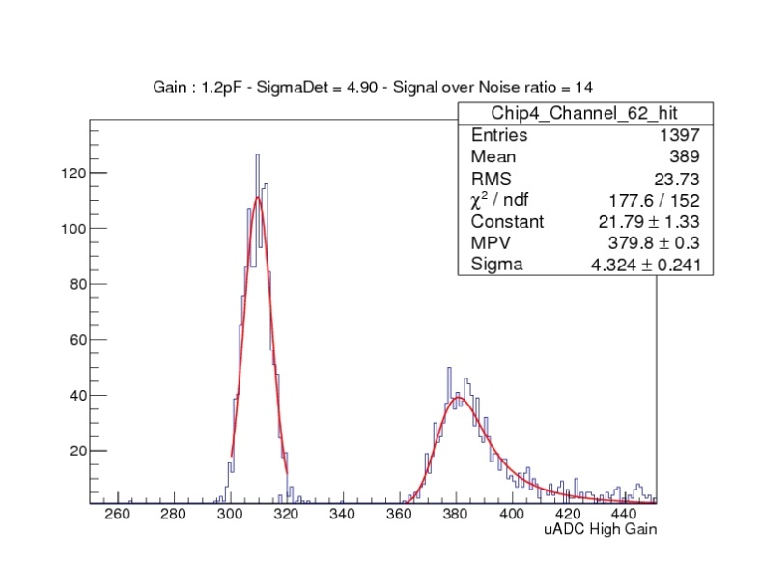
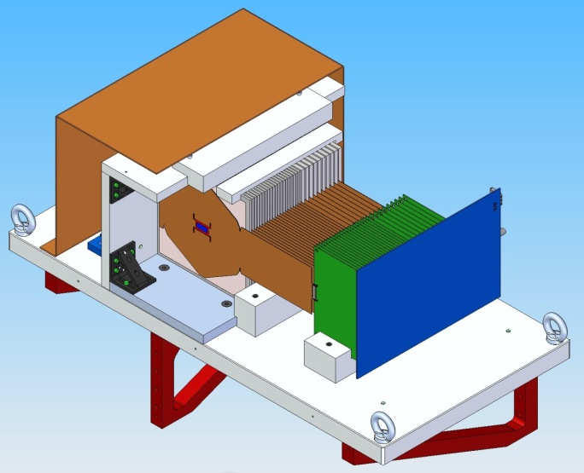
ILD-CALICE,
Univ. Shinshu, SKKU
ILD within CALICE
LLR, LAL, LPNHE, LPC, LPSC, OMEGA,
Kyushu University, Tokyo University, Nippon Dental University, SKKU
The scintillator strips version
TB at DESY (Oct. 2012)
Silicon ECAL – EHI (Extremely High Integration)
from US colleagues will start TB soon at SLAC
S/N ~ 14
SiD coll.
SLAC, UO,
UCSD,BNL
Test beam@DESY
Summer 2012

Slide 19
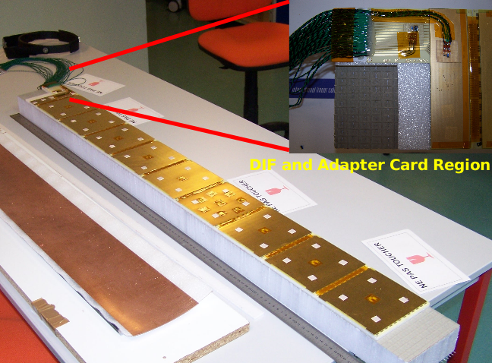
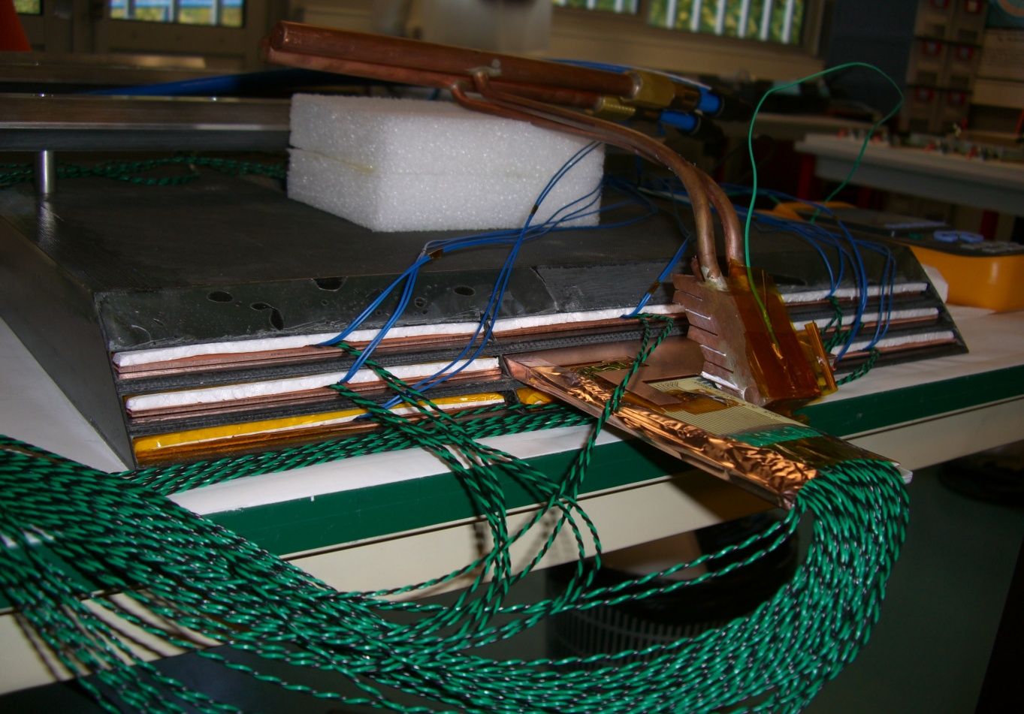
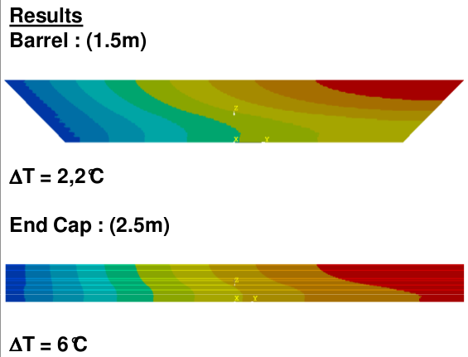
Developing a leakless water
cooling system
POWER DISSIPATION
Total ECAL power dissipation O(10 kW) even at 25 µW/ch
Need active cooling system (cold water pipe + radiator), but OUTSIDE
Limit : temperature differences within ECAL
heat transfer to neighboring detectors
Measurements in
the Tungsten-Cfi structure
Validation of the limit conditions for simulation
Thermal simulations of the full size module of the detector

Slide 20
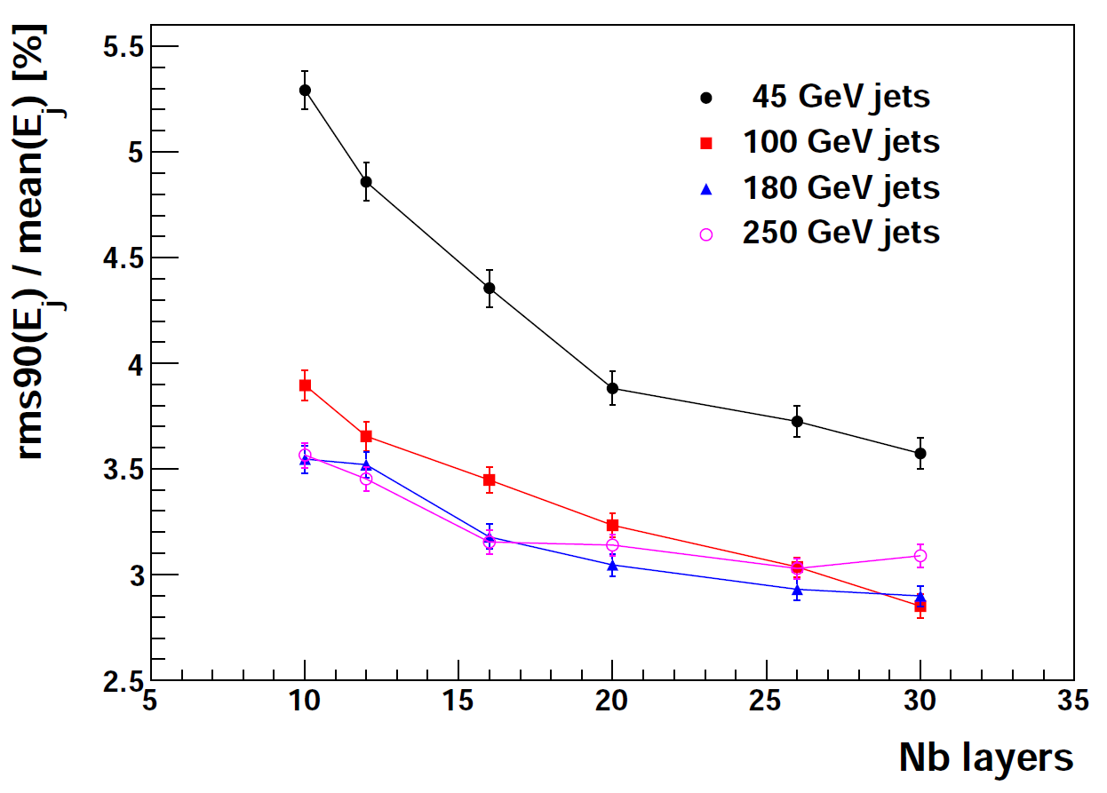
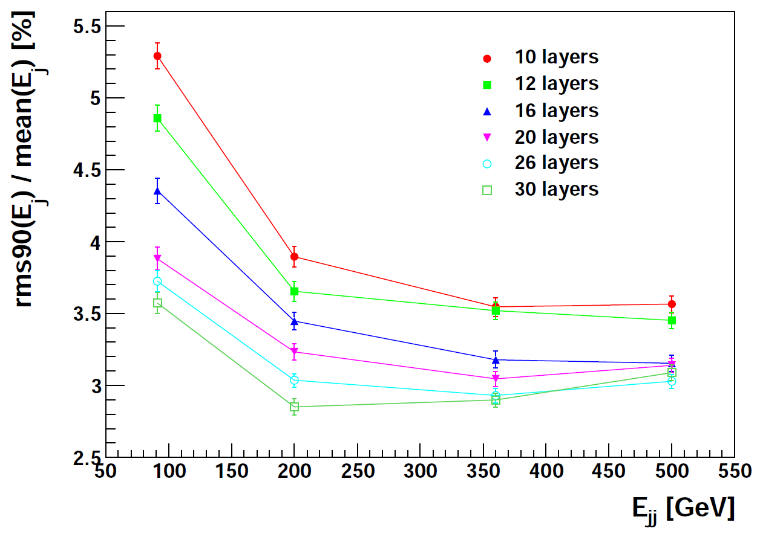
Trong Hieu Tran (LLR)
Project stages
 Concept
 Prototype test performances
Prototype scalable
 Engineering model
Optimization (cost vs perf.)
Project organisation (& funds)
Productions & Quality tests
construction & in-situ Integration
Trong Hieu Tran (LLR)

Slide 21
SUMMARY -1
For the LC physics program, we need an ultra granular
electromagnetic calorimeter. (a Camera or FAST electronic bubble chamber)
R&D for 10 years leads to a version with High Level of Integration
Tungsten is the baseline for the radiator
Silicon diodes , scintillator strips for active medium (on 20-30 layers)
VFE ASIC inside detector with large number of channels/ASIC
The PERFORMANCE tests goes through RECONSTRUCTION program !!!
Single particle is important, but it is not the right test !!!!
Don’t use a camera to measure temperature !!

Slide 22
SUMMARY -2
Not yet to the point where we can write
“we area ready to construct the ECAL”
a lot of VERY interesting R&D !!! JOIN US

Slide 23
SUMMARY -2
Not yet to the point where we can write
“we area ready to construct the ECAL”
a lot of VERY interesting R&D !!! JOIN US
BUT at the point where we can write
“we are approaching to be ready,
at least for a baseline version”

Slide 24
SUMMARY -2
Not yet to the point where we can write
“we area ready to construct the ECAL”
a lot of VERY interesting R&D !!! JOIN US
BUT at the point where we can write
“we are approaching to be ready,
at least for a baseline version”
We even start the next step :
“ optimise …
cost, performance, industrial close contacts”

Slide 25
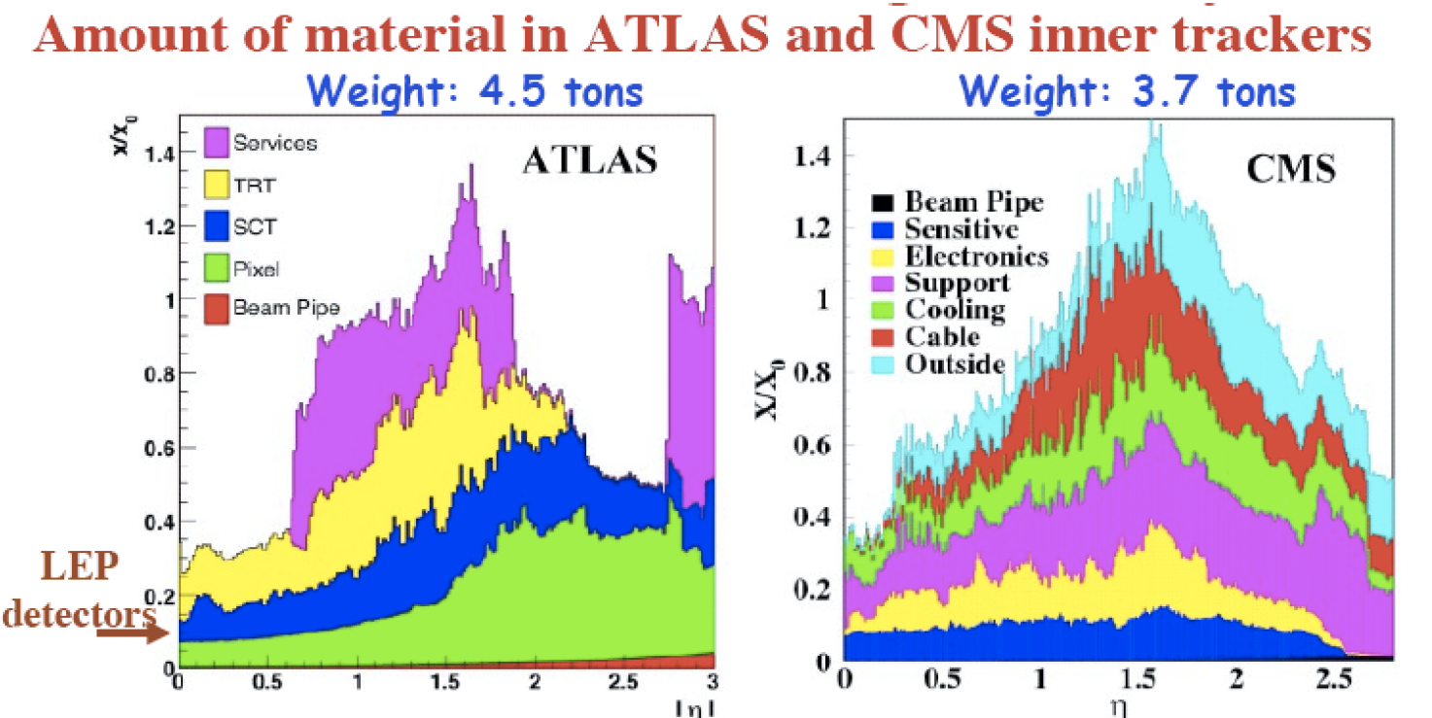
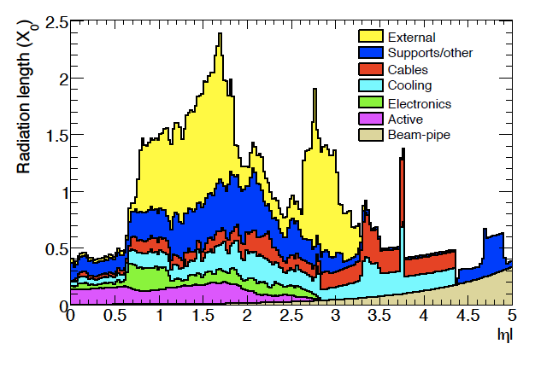
Le danger qui guette le chasseur
The danger which wait for the hunter

Slide 26
BACK UP

Slide 27
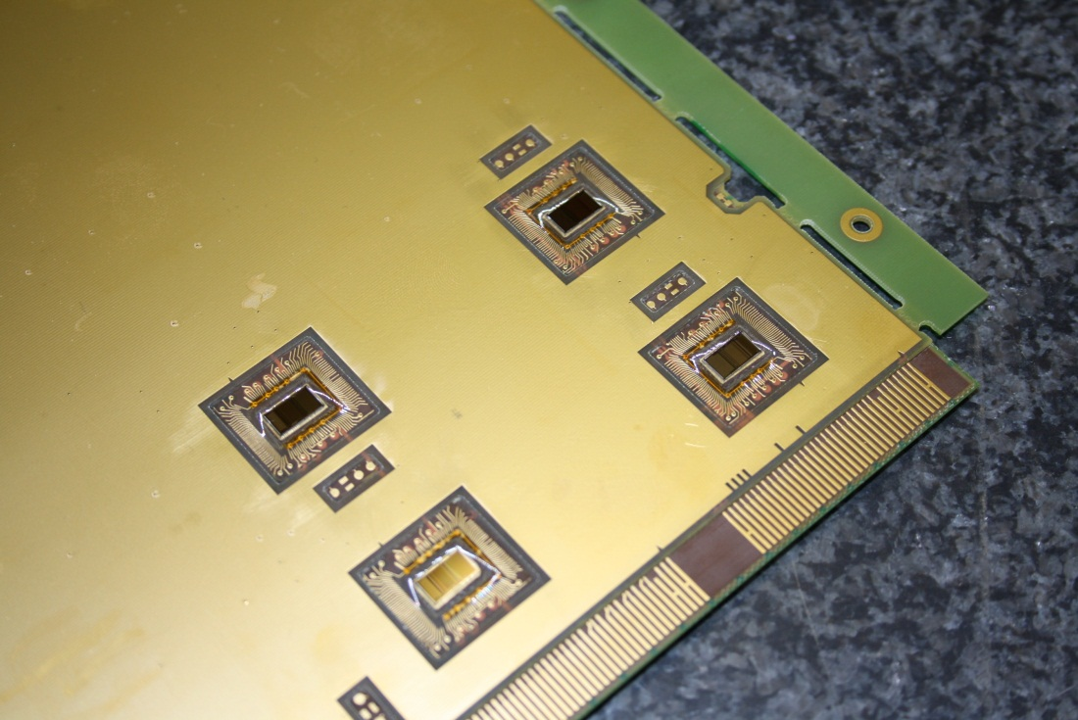

Slide 28
R&D for silicon wafers
Square pattern in wafer response
dB
0
Segmented guardring
-30
Xtalk with continous guardring <-> Pixel
Attenuation of Xtalk

Slide 29
Calibration – Uniformity of Response
Calibration with with wide spread µ-beam
18 Mio. Events
Uniform response of all cells
only 1.4‰ dead cells
Differences in Response can
attributed to different
- Manufacturers
- Production series
Experience to deal with different
manufacturers and production series
Essential for final detector
~3000m² of Silicon needed

Slide 30
Stability of Calibration?
Important Criterium during evaluation process by IDAG
Affects both: precision and operability of detector: ~10⁸ calo cells in ILC Detector
Calibration Constants on testbench and in beam test campaign
High Correlation between calibration constants
For “final” detector:
Detector modules can be calibrated in beam test prior to installation

Slide 31
Example for SKIROC characterisation – Trigger efficiency

Slide 32
PFA : « Particle Flow » Algorithm
In our detectors, the charged tracks are better measured than photon(s)
which are themselves better measured than neutral hadron(s)
Resolution on the charged track(s) ∆p/p ~ few 10⁻⁵
Resolution on the photon(s) ∆E/E ~ 12%
Resolution on the h° ∆E/E ~ 45%
E_{jet fraction} = E_{charged tracks} + E_{γ} + E_{h}0
65% 26% 9%
With a perfect detector, no confusion between species and individual reconstruction
σ² jet = σ²ch. + σ² γ + σ² h⁰ gives about σ² jet = (0.14)² E_{jet}
σ²threshold
→ Energy threshold to be rec. (depends on species)
Real life and
real detector
σ²efficiency
→ loss of particles (not reconstructed)
σ²confusion
→ Mixing between particles in the calorimeter

Slide 33
Is it possible ?
e⁺e– → W⁺W– at √s = 800 GeV
Display from the true MC informations
With K⁰

Slide 34
e⁺e– → W⁺W– at √s = 800 GeV
e⁺e⁻ → W⁺W– at √s = 800 GeV
Charged pads
Reconstruction
photons
Display from the true MC informations
Display of the reconstructed event
With K⁰
Neutral hadron ECAL
Reconstruction

