Slide 1



Linear Collider Module Control and
Stabilization
A.Jeremie
LAPP: S.Vilalte, J.Tassan, J.M.Nappa, J.Allibe, G.Balik, L.Brunetti, G.Deleglise, J.P.Baud,
CERN: L.Soby, M.Vanden Eynden, M.Draper, K.Artoos, M.Esposito, P.Fernando Carmona, M.Guichard, C.Hauviller, A.Kuzmin, R.Leuxe, R.Moron Ballester
UdS: B.Caron, A.Badel, R.LeBreton,
ULB: C.Collette,
Nikhef: S.Jansens,

Slide 2
Outline
Introduction
Module control
Stabilization
Conclusion
  CLIC case study although applicable to other systems
  Slides from (and others)
    K.Artoos, M.Draper, A.Samoshkin (CERN)
    S.Vilalte, G.Balik (LAPP)
    S.Jansens (Nikhef)
    CDR

Slide 3
Introduction

Slide 4
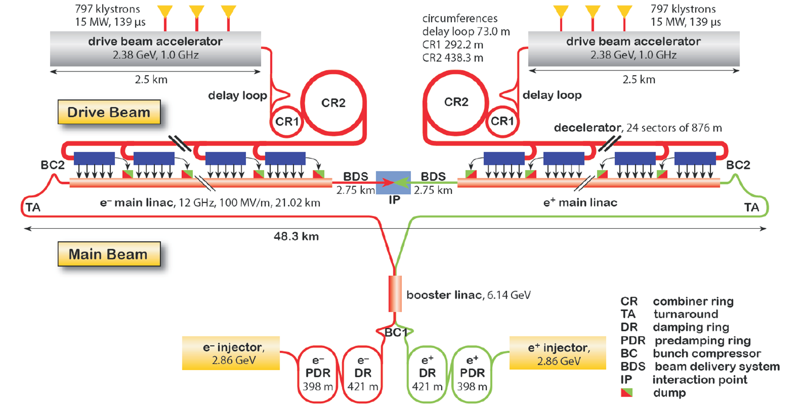
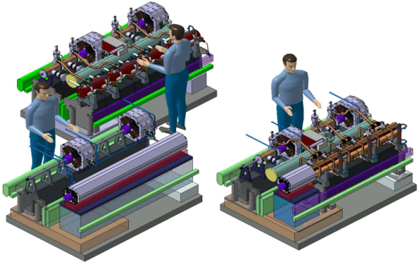
CLIC and CLIC modules
Type 0: No Main Beam Quad
20.920 “Modules” of which there are 4010 with CLIC Main Beam Quadrupoles
Type 4: 2m, 400 kg
Type 1: 0.5 m, 100 kg

Slide 5
Module control

Slide 6
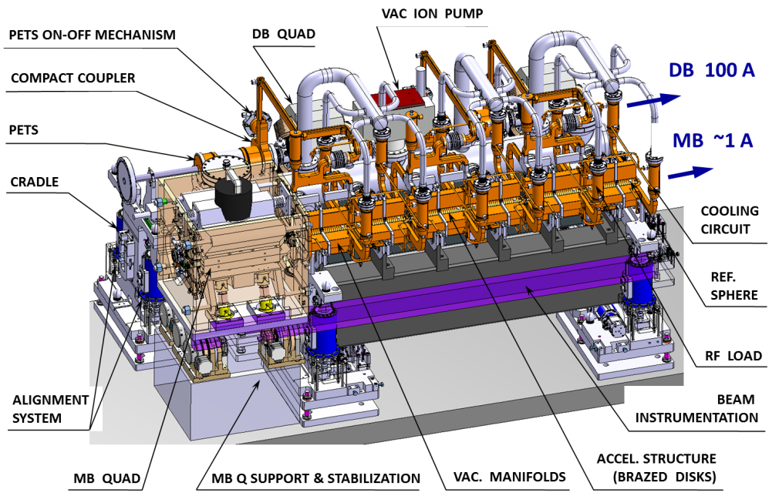
What is being controlled?
There are a lot of components on each CLIC Module!

Slide 7
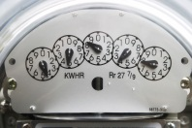
Channels
Module acquisition signals
~200
Module control signals
~175

Slide 8
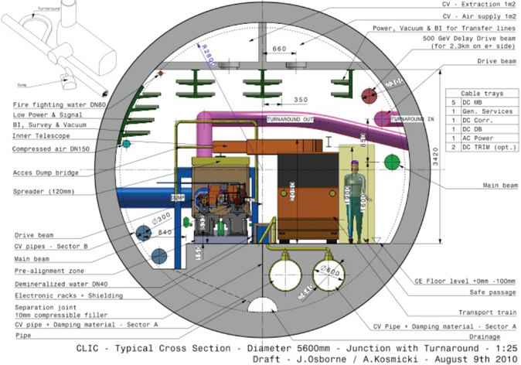
Key requirements
Tunnel space
  Access only every 900m, Front-End electronics close to Hardware (cabling issues)
Limited power dissipation
  Total power dissipation to air = 150 W/meter
  Power budget for all Front-End electronics MAX 30 to 50 W/meter
Radiation Hardness
  Electronics lifetime 10–15 years
  withstand 15 kGy or be shielded
  neutron flux => single-event
  upsets or single-event latch-ups

Slide 9
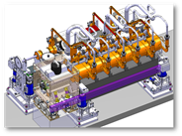
CLIC Control software architecture
Still under development!
In buildings above ground
Underground
In accelerator tunnel
ACM
ACM
ACM

Slide 10

Acquisition and Control Module
ACM
Here « Module » is the electronic card!
Module (itallic) is still the CLIC module…
Characteristics
  Synchronized with Machine Timing System; CLIC will be pulsed @ 50 Hz
  Bi-directional and synchronous data transfer via optical links (ACM ⬄ CLIC control); Configuration and diagnostic commands; White Rabbit network
  Time stamping of acquisitions
  Need for Real-Time feedback loops (Beam trajectory, …)
Hardware choices
  Long distance (~878 m) between the underground alcoves => one local ACM per CLIC module (every 2.01 m) as close as possible to each module.
  Modular architecture with similar hardware modules for each CLIC sub-system. Acquisition crate with standard form factor, one crate per module.
  Hardware module /standardized connectivity & backplane protocol
    common hardware part (carrier concept) dealing with powering (standard set of voltage sources), data communication and diagnostics
    specific part (one or multiple mezzanines) implementing the sub-system-specific acquisition and controls actions (DACs, ADCs, etc)

Slide 11
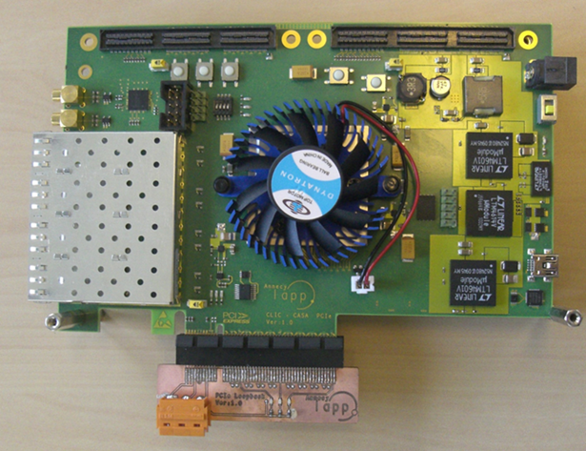
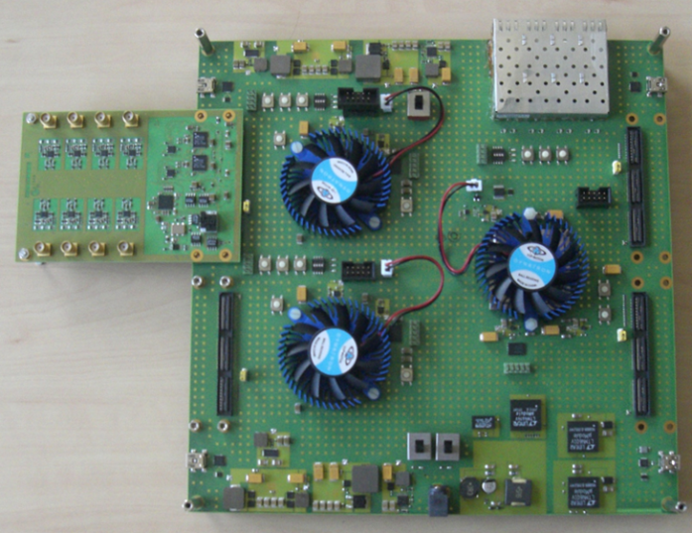
ACM Development for a BPM
(for the Instrumentation part see T.Lefevre’s talk)
Parts that are needed to fit in a standard electronics crate:
    Service Board (currently a PCI board only for network): autonomous 12VDC power supplies from 230VAC line, network access and distribution on back-plane.
    Instrument Boards:
      Standard Mother Board (based on FPGA)
      Sub-system specific Board (Mezzanine)

Slide 12

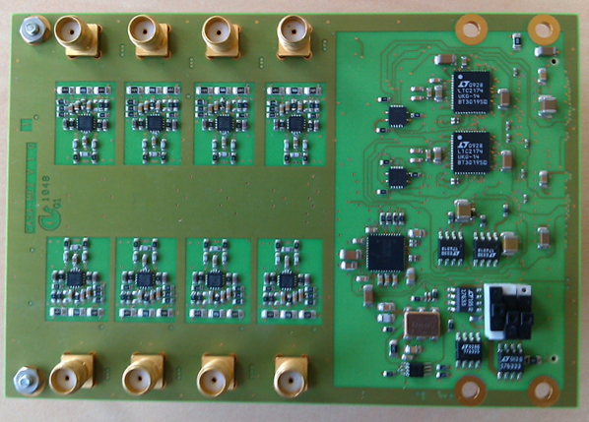
Test with an evaluation board
Possible architecture: standard motherboards with mezzanines dedicated to the subsystems.
In 2011, development of an evaluation board allowing the module emulation and generic acquisition mezzanine.
→ 8 channels, Fs=96Msps (CTF3 clock).
→ tests of the LTC2175 ADC: 11,7bits.
→ tests of the LTC6406 OPA (ADC driver).
Allows to test input shaping for BPM and will allow acquisition with beam.
=> test lots of different configurations for future CLIC developments

Slide 13
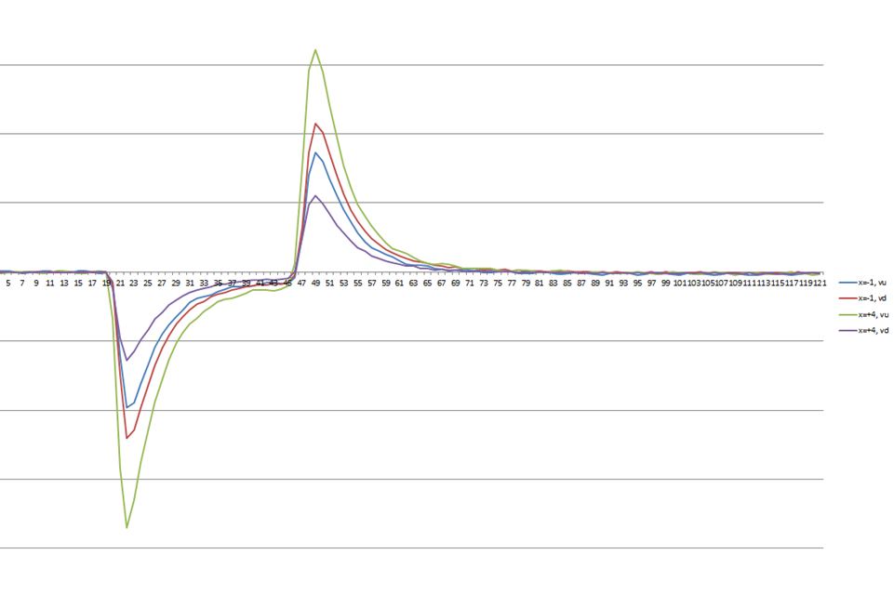
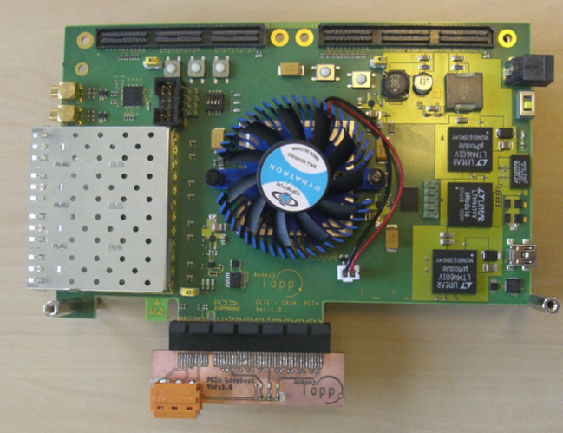
BPM shaping and acquisition
First tests performed with a PCIe board instead of mother board.
Developed for the module crate network, can host a mezzanine in a stand alone configuration.
Filter characterization with network analyzer & characterization of the full chain: OK.
And first Instrument readout tests
Good shape, expected levels

Slide 14
Conclusion for Module Control
Lots of channels (~375) for acquisition and control
Need for a distributed and standardized system
Evaluation boards very helpful
First results of instrument readout
Next step:
  test in accelerator environment
  Start by shielding components
  Power consumption will be evaluated also

Slide 15
Stabilization
Another sub-system with channels to be read-out and controlled

Slide 16

Let’s go back to CLIC Module
Main Linac Module with Type 1 quadrupole

Slide 17
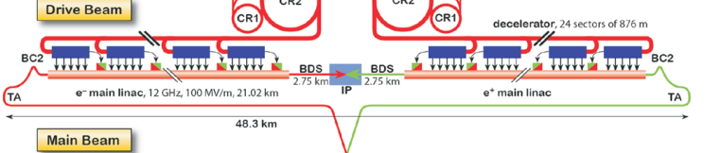
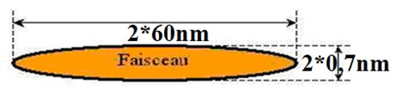
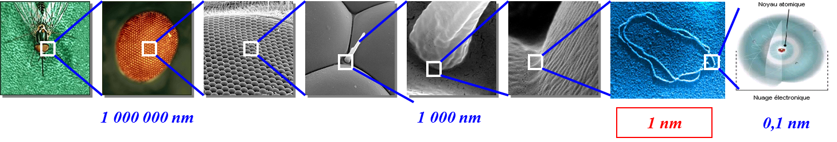
Why do we need stabilization?
Beam
DNA
But Vibration Sources can amount to 100s of nm:
Ground motion, Traffic, Lifts, cooling water, ventilation, pumps, machinery, acoustic pressure
Transmitted:
from the ground through the magnet support,
directly to the magnet via beam pipe, cooling pipes, cables...
We cannot rely only on the quietness of the site
Stabilization techniques have to be developed
 | Last magnet | Main Beam Quad
Vert. | 0.2 nm > 4Hz | 1.5 nm > 1 Hz
Active Stabilization techniques have been chosen

Slide 18
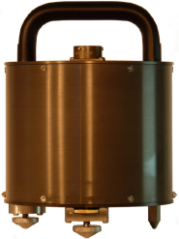
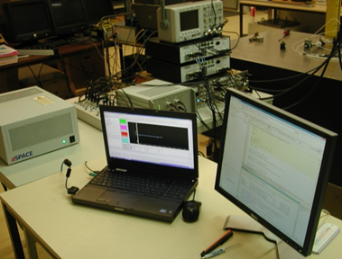
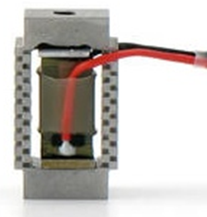
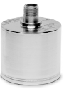
What is needed?
Active Stabilisation means :
measure => decide action => act
sensor feedback/-forward actuator
-measure sub-nanometre
-low frequency
-Large band width (0.5-100Hz)
-Low noise
-Smalest delay for real-time
-Small and light
=> Seismic sensors
-real-time feedback
-Mutli-channel
-simulation possibilities
-Fast electronics
-Large dynamics( >16bits)
-Nanometre displacement
-Displace heavy weight
-Compact
-Real-time response
=> Piezoelectric actuator
Accelerator environment
=> Magnetic field resistant and radiation hard

Slide 19



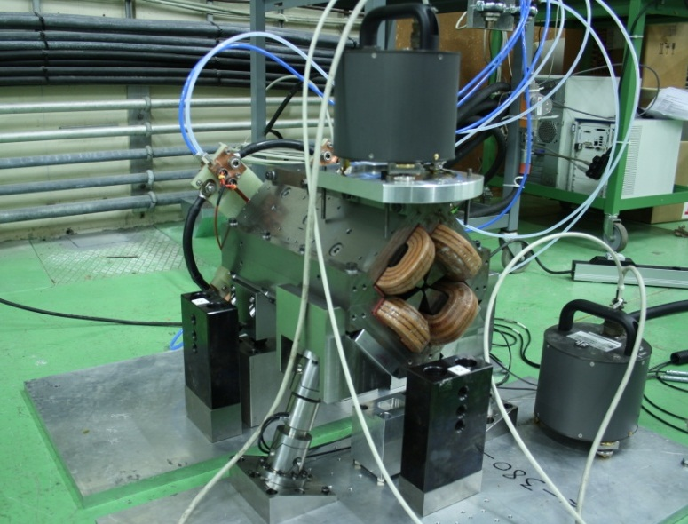

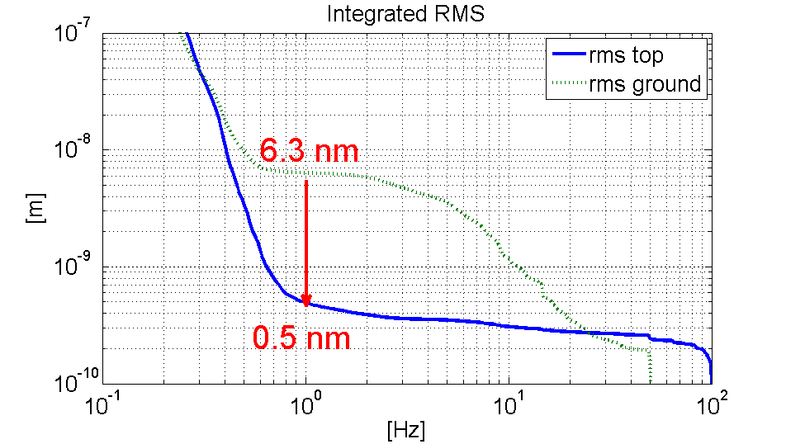
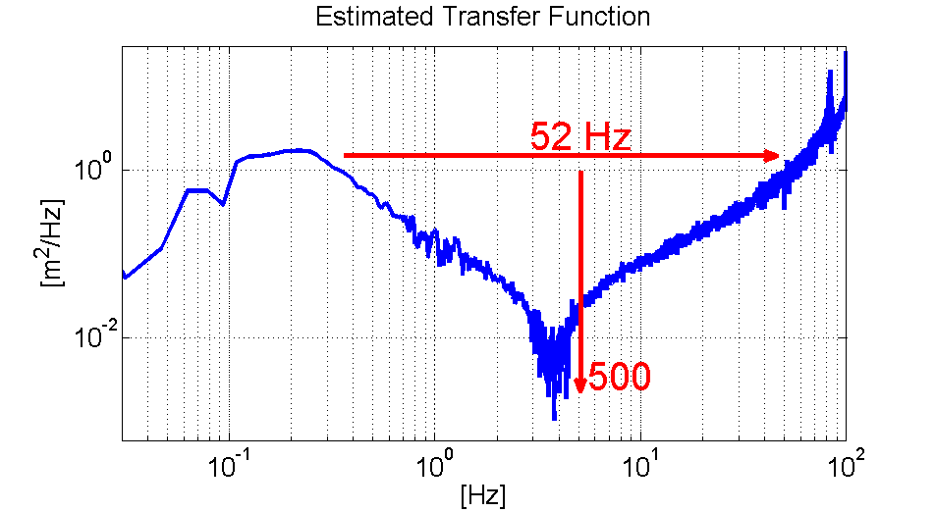

Stabilization on Type 1 MBQ
    Water cooling 4 l/min
    With magnetic field on
    With hybrid circuit
sensor
actuator
Figure | Value
R.m.s @ 1Hz magnet | 0.5 nm
R.m.s @ 1Hz ground | 6.3 nm
R.m.s. attenuation ratio | ~13
R.m.s @ 1Hz objective | 1.5 nm

Slide 20


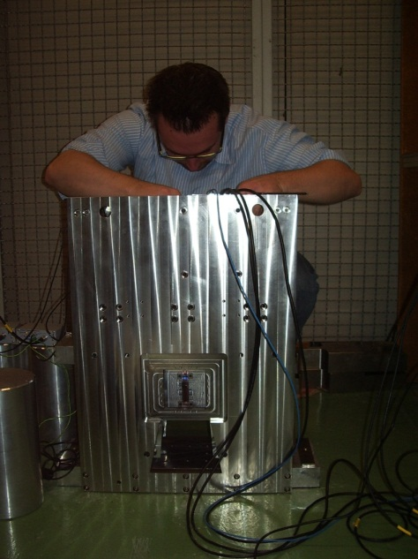
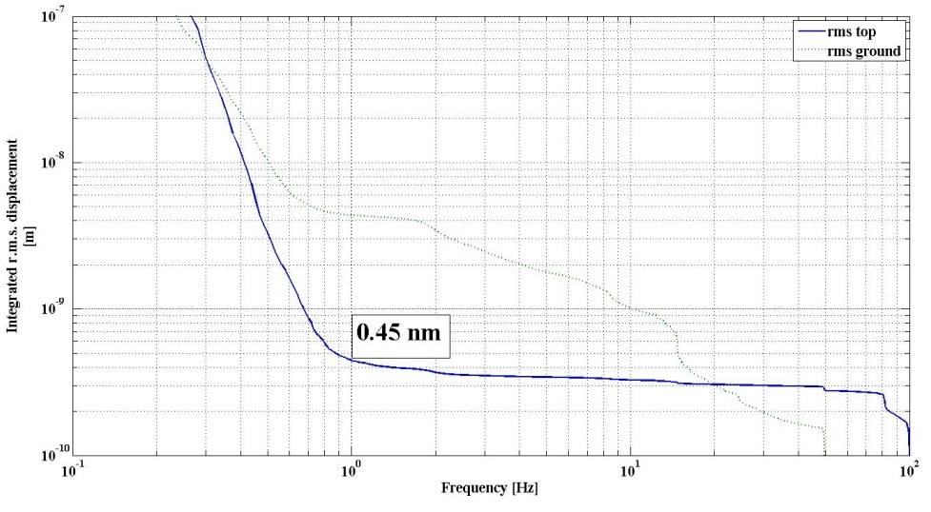
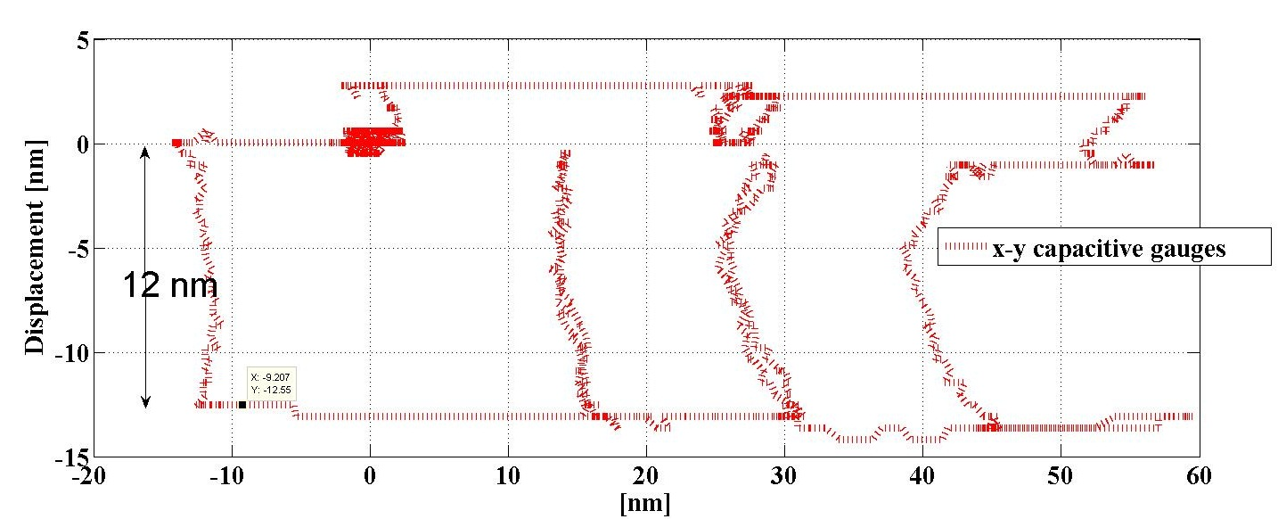
2012: Positioning + Stab. test bench
X-y guide prototype operational
Improves the mechanics: no resonance before 100Hz
1&2
Notes:
Prototype of the x-y guide that improves the mechanics. Block of 52 kg on two actuators. With capacitive gauges, strain gauges, interferometer (CEA/IRFU collaboration) and optical ruler.
Measurements and kinematics greatly improved. Stabilisation same as on type 1 (but without hard points ). This intermediate step confirms our solution for final design for MBQ type 1 and type 4.

Slide 21
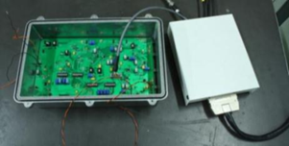
Control and module
Component | Delay
ADC | 8 µs
Electro-optic transducer | 100 ns
Optic fiber transmission | 5 µs/Km
Opto-electric transducer | 120 ns
DAC | 3 µs
Actuator (20nm single step) | 1 µs
Typical catalog delay values for the components
The farther away the control hardware, the less effective the
stabilisation system
=> Need for a local controller
Control loop delay | Stabilization performance
43μs | 100%
80 μs | 90%
90 μs | 80%
100 μs | 60%
130 μs | 30%
Digital and analog hybrid controller
Local controller

Slide 22

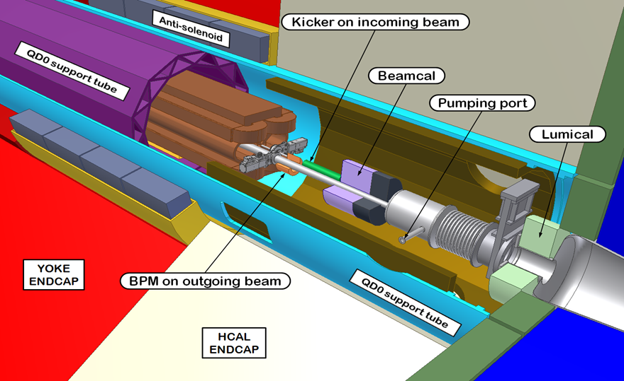
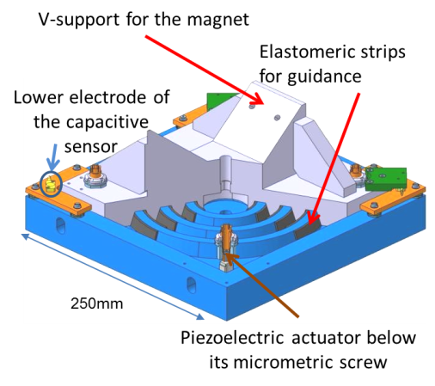
Special case for the last magnet inside detector : Final Focus magnet
H.Gerwig + N.Siegrist

Slide 23
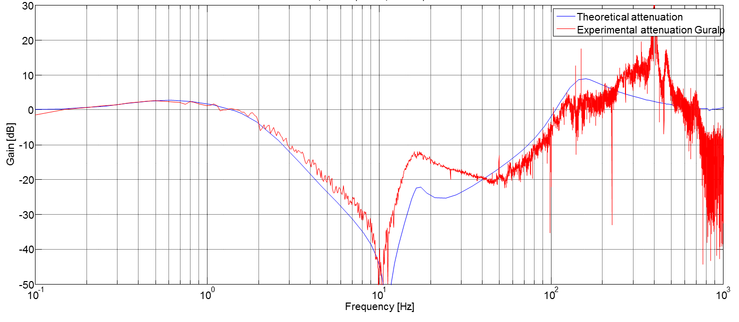
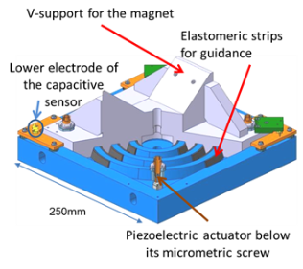
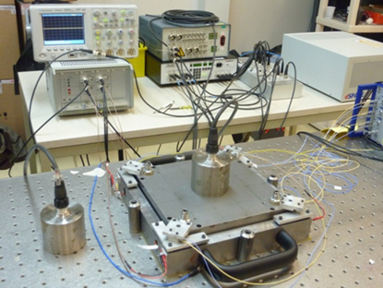
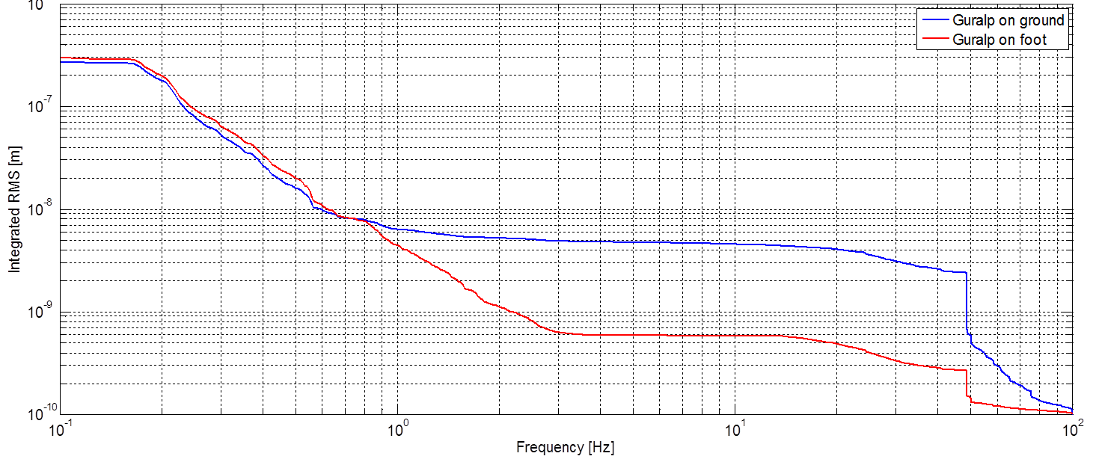
FF stabilisation results
Attenuation up to 50dB between 1,5-100Hz
1,5Hz-100Hz
5 nm
RMS ground at 4 Hz: 5 nm
RMS on foot at 4Hz: 0,6nm
RMS ratio: 8,3
0,6 nm

Slide 24
Conclusion for Stabilization
Different domains needed:
  Mechanics (supports, guides, mechanical resonators, …)
  Instrumentation (sensors, compatibility with active control, …)
  Electronics (acquisition & control, band-width, resolution,…)
  Controls engineering (control, real time simulation …)
  Accelerator physics (beam simulations, luminosity at Interaction Point…).
Sub-nanometre stabilisation peformed validating CLIC stabilisation feasibility: limiting factor are the « noisy » sensors and electronics
Next step: tests in accelerator environment

Slide 25
Conclusion and impact for Industry
Linear Colliders: very creative, yet complex projects
  Many development needs on different topics
Large scale strategies needed
  Increasing number of components to check
CLIC divided into semi-standartized modules
  Industrialization eased
Hundreds of signals to readout and control => standard components, with modularity
  Electronics development
Unprecedented stabilization needs bringing together state-of-the art sensors, actuators and precision automatics
  Sensors development needed to enhance performance

