Slide 1



Opportunities for Applications of LC Technology
M. C. Ross
SLAC National Accelerator Laboratory
30 October, 2012 14:00
Notes:
(14:00) LC5-1, invited, Opportunities for Applications of LC Technology (Institutional Perspective)
M. C. Ross
SLAC National Accelerator Laboratory, Palo Alto, CA, USA
Particle accelerators are widely perceived as tools for mankind in the service of science. The next generation will see applications of accelerators broadly expanded and adapted for use in service to society. This transition has been enabled by an era of work to extend the frontiers of technology in terms of performance, reliability and cost. The surprising richness of the micro-universe has motivated accelerator builders over the last few decades to push their art to the limits and we now begin to doubt if these limits have been reached and if machines much larger than LHC, ILC or CLIC are realistic. The term ‘high-technology’ characterizes work on linear colliders and related accelerators, and generally indicates a high level of investment and return on investment (ROI), in other words: high risk. Following the unique decision in 2004 by the world high energy physics community to develop the International Linear Collider an unprecedented degree of global focus and participation allowed this investment in, for example, superconducting RF technology and precision beam control. As we now move forward to realize the linear collider, it is time to consider the ROI, especially toward industrial applications. In this talk we will review this remarkable era and consider the next steps to be taken toward applying what has been learned

Slide 2
Outline: Applications of LC Technology
Introduction: Challenges
Study by Funding Agency Group ‘FALC’: (ILC, 2007)
Key Comments and Findings: Return on Investment
  Spread of innovative technology - new Components and Tools
  Direct adaptation of Linac Technology
Technology Transfer: ILC Project Development
  Global R & D Program
Future Prospects: Next Steps

Slide 3
Opportunities ≡ Challenges
e⁺
e⁻
~15-20 km
Collision Energy (E_cm)
Beam Intensity (P_beam)
Ultra small beams (ε)
  interacting beams (δ_{BS})
Cost: construction and operation (€, ¥, $)
IEEE LC (M. Ross, SLAC)
Notes:
Purpose vs benefit - to say.
Review - Tech transfer for issues ; successes
Outlook
Marketing and tech xfer summary
TDP story.
App talks
Issues
Work commissioned - falc - approach to spin-offs or transfer

Slide 4
LC Design Issues
Energy:
  Fill factor
  Gradient
  Length
Power:
  Efficiency
  Utilities
Ultra precision
  Instrumentation
  Stabilization
  Alignment
  Control
  Simulation
Efficiency 7.5%
Transformer ‘turns’ ratio: 500K
CW SCRF (CEBAF)
100% efficient RF to beam
  14% overall efficiency

Slide 5
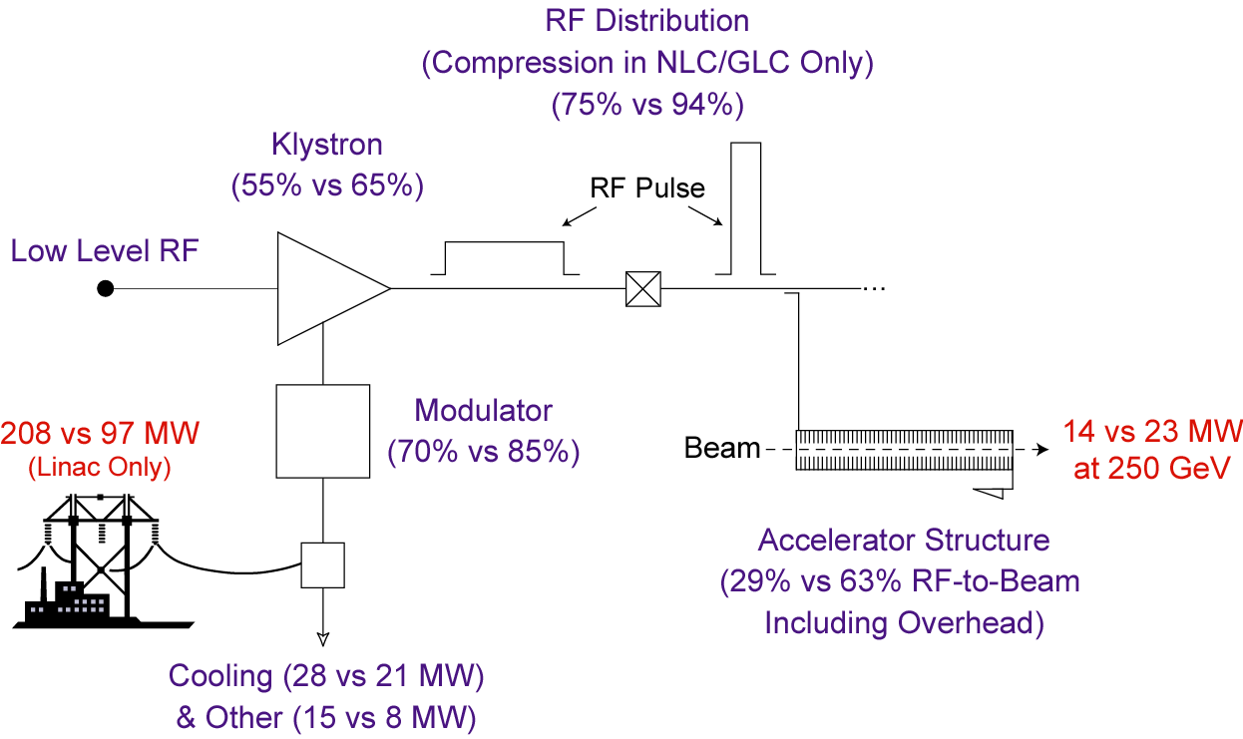
Normal Conducting / Super Conducting
Linac efficiency
Normal Conducting
Chris Adolphsen, SLAC
Super Conducting

Slide 6
Funding Agency interest in Applications:
Funding Agencies for Large Colliders (FALC) study commissioned 2007
  http://ilcdoc.linearcollider.org/record/17864/files/ILC_TechnologyBenefits-FALC.pdf
  FALC Members: Canada (NRC and NSERC), CERN (DG and Chair of Council), China (MOST), France (CNRS), Germany (BMBF), Italy (INFN), India (Tata Institute), Japan (MEXT), Korea (MOST), Spain (ENCYT), UK (STFC), and US (DOE)
‘Technology Benefits Deriving from the International Linear Collider’
  P. Grannis, K. Wurr, M. Yamauchi (SUNY, DESY, KEK)
Major Impacts:
  Accelerators, Computer Science and High-Technology
Technology Sectors:
  Superconducting RF, RF sources, ‘Damped’ beams, Beam instrumentation, Electron and Positron sources, Accelerator simulations, Particle detectors, Computing applications and Remote operations

Slide 7
Technology Benefits to Industry:
This talk
See 16:30 talk
See Sessions 3 and 4
Superconducting RF cavities → Cost Driver
Superconductor material → Technology Driver
RF sources → Core technology
Particle beam simulation → Core expertise
Short electron bunches → Emerging Science
Beam position monitoring and control →
Ground motion monitoring and mitigation →
Particle detectors
Imager resolution, speed and scale
Electronics for massive parallel signal processing
Distributed computing ‘Grid’ architecture

Slide 8
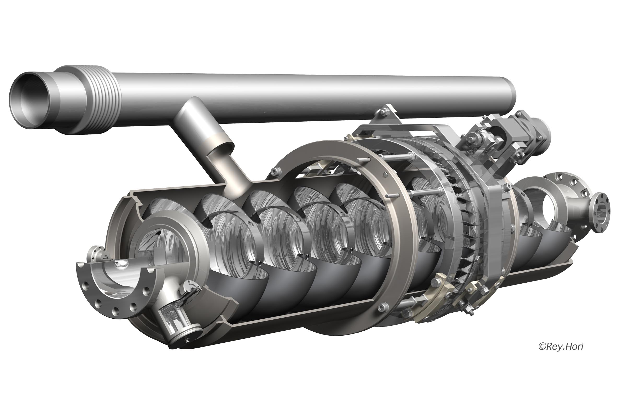
ILC SCRF Cavity
9 cell 1300 MHz SW cavity
Formed, welded niobium sheet
2.4 mm thick
1 m long; 30 kg
Cryogen fill pipe
Field Probe
Power Coupler Port
Higher Order Mode extraction
Tuner
Graphics by Rey. Hori
Notes:
Mamoru Horiuchi

Slide 9
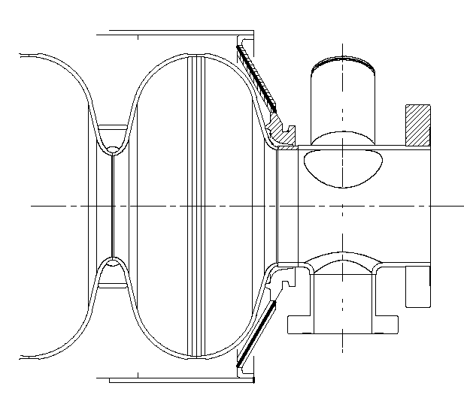
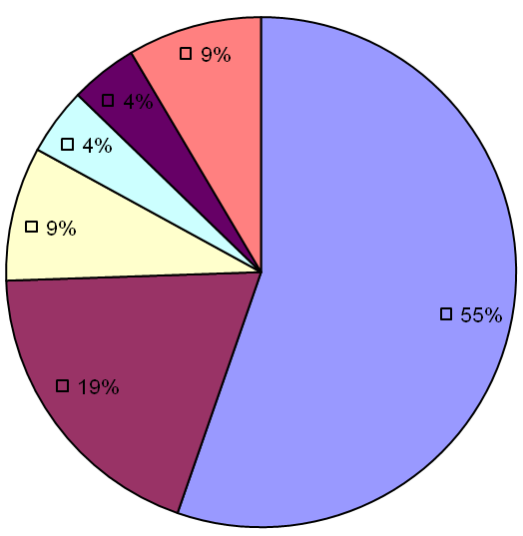
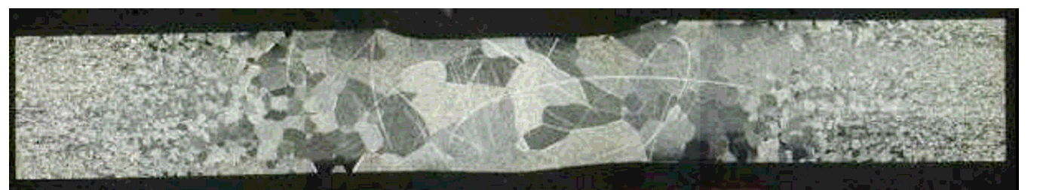
ILC SCRF Cavity
‘End Group’ of the 9 cell sheet metal cavity
R
Gradient Limits in Vertical test:
Quench (55%)
Field Emission (19%)
Q-slope (4%)
(Other)
Electron Beam Welds
Rongli Geng, Jefferson Lab
Kenji Saito, KEK

Slide 10
Vertical Cavity Test Results: 1995-2006
2007-2012
ACID ETCH
→
ElectroPolish
103 cavities / 434 tests
4.2 tests/cavity average
DESY: Establishing the basic recipe

Slide 11
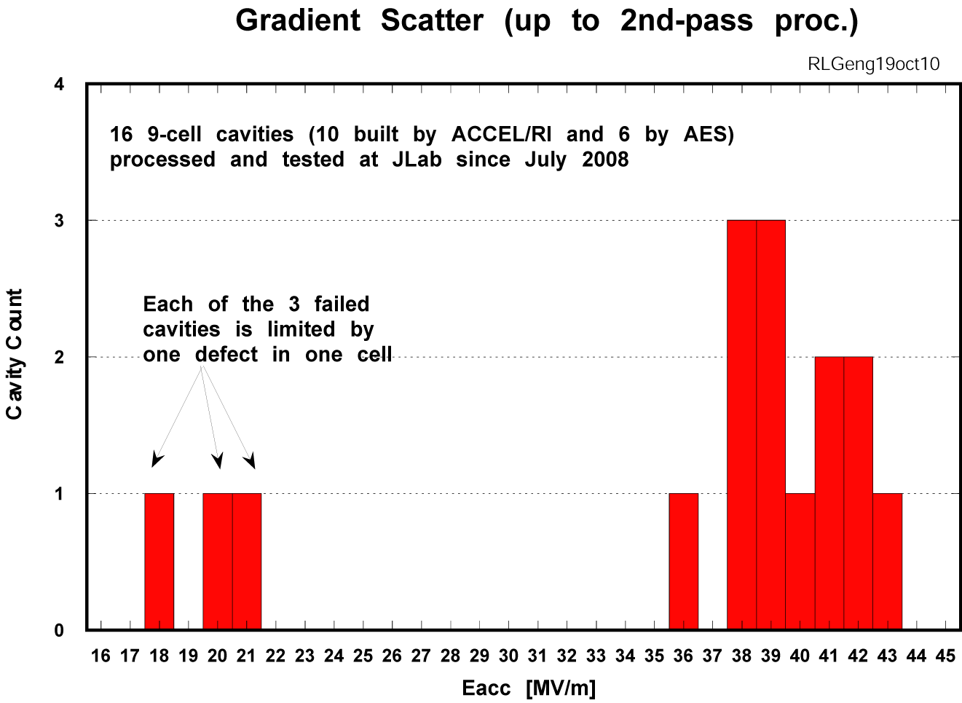




Gradient Limit Understanding and Control
Gradient yield of 100% achieved at an average gradient of 39 MV/m when allowing post-cycle repair
(2008-2010)
+ mechanical polishing at Cornell & FNAL (2010-2011)
Geometrical defects cause quench and
limit gradient < 20 MV/m (more on next slide)
ILC R&D Goal
Mechanical abrasive polishing removes geometrical defects and raises gradients

Slide 12
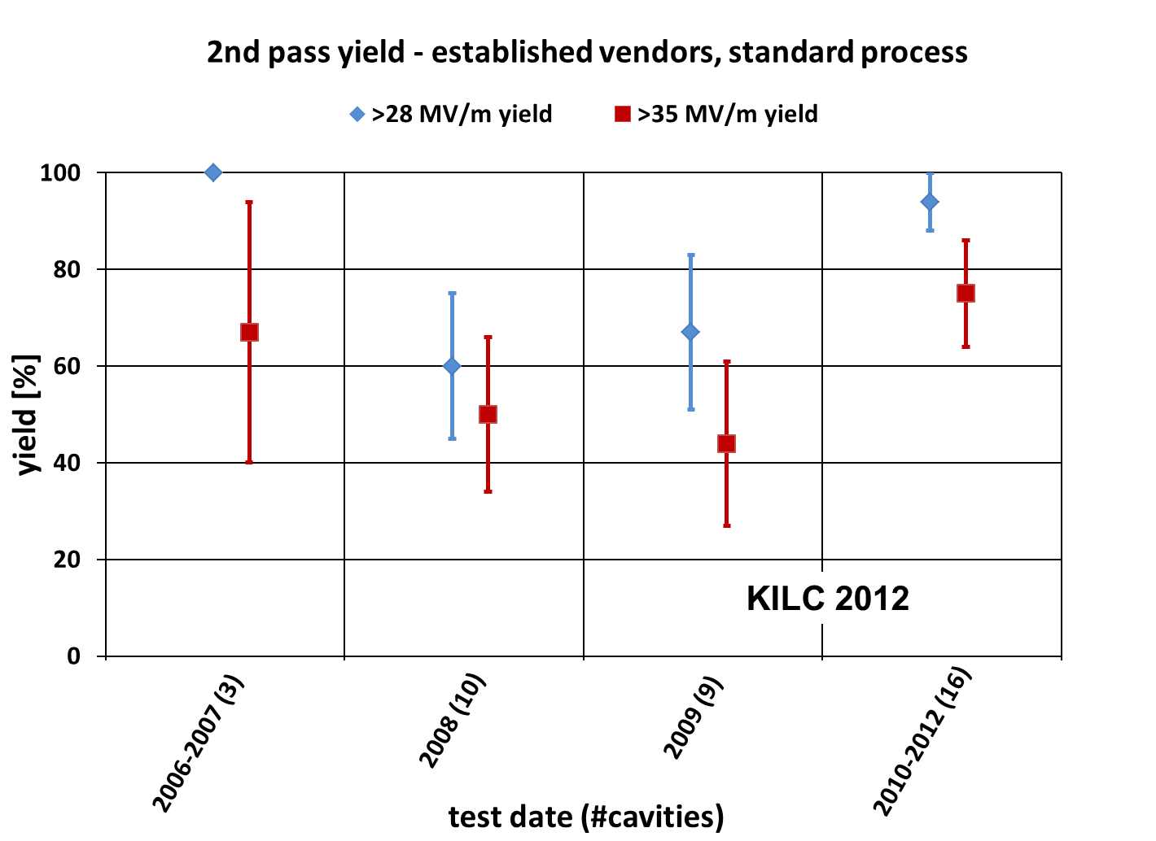
Global Progress in Cavity Gradient Yield
(94+/-6)% acceptable for ILC mass production

Slide 14
Final Stage of Tech. Transfer: Sustainable enterprise
Linking customers with enabling technology

Slide 15
Superconductor material: Technology Driver
Niobium:
Has high melting point – 2500 degC
Has strong acid resistance → ‘refractory’
Is difficult to machine
is ductile and very difficult to grind
Has affinity for oxygen ← technical limitation to performance
Is a daughter metal to Tantalum
R & D topics:
Ta content?
Crystalline structure
Metal working
RRR – Residual Resistance Ratio (R_300K/R_sc)
Typical pure Nb RRR=300

Slide 16
Nb (high purity, RRR 300)
No shortage of raw Nb
  (40000 tons annual production)
  ILC needs around 500 tons
limited high purity e-beam refining facilities
  4 qualified companies,
  only one is capable of full ILC yield
Marginal savings in mass production
  Size of melting furnace is limited
  But some saving can be realized by
    Disc rather than rectangular sheet (scrap can be recovered)
    Other material produced ready for fabrication, e.g. flange material
Latest developments in large/single crystal cavities promise cost reductions, needs more experience / studies

Slide 17
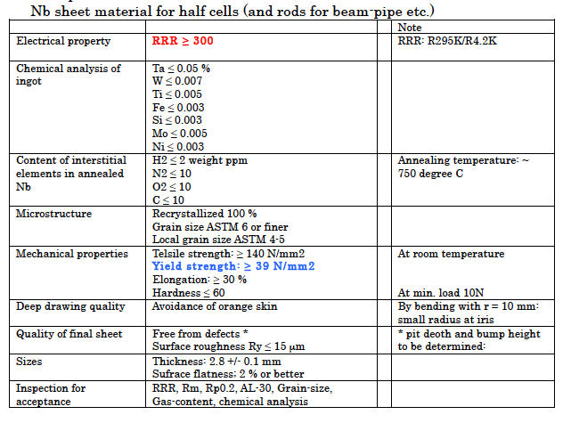
IEEE LC (M. Ross, SLAC)

Slide 19
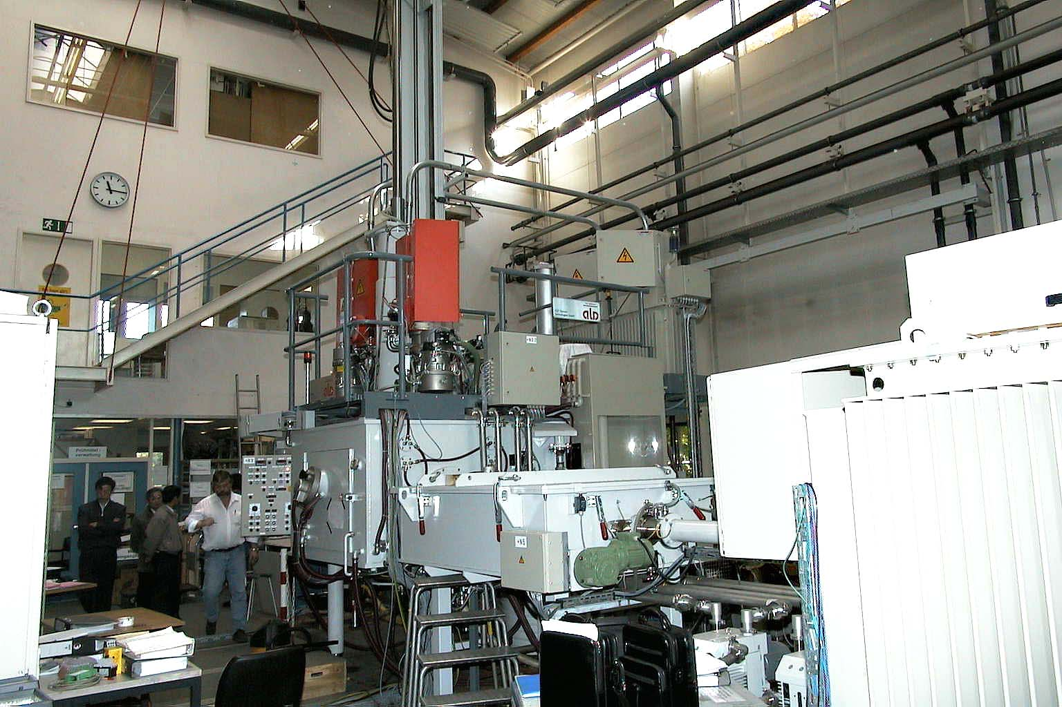

500KW electron beam cold hearth furnace

Slide 20
<50% yield

Slide 21
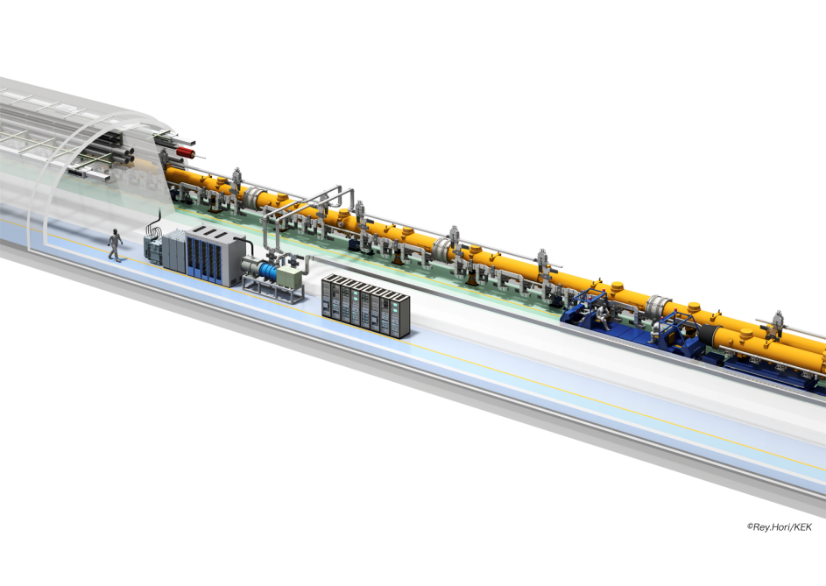
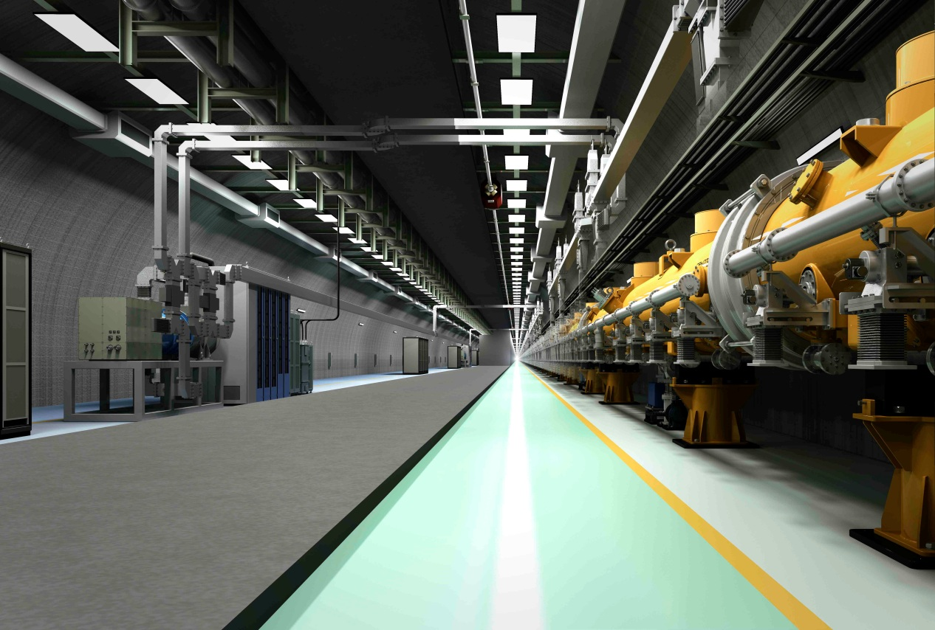
RF sources Core technology
Solid State ‘Marx’ Modulator
Fast rise → high efficiency
Modern construction
No transformer
Important cost saving for ILC and CLIC
Graphics by Rey. Hori

Slide 22
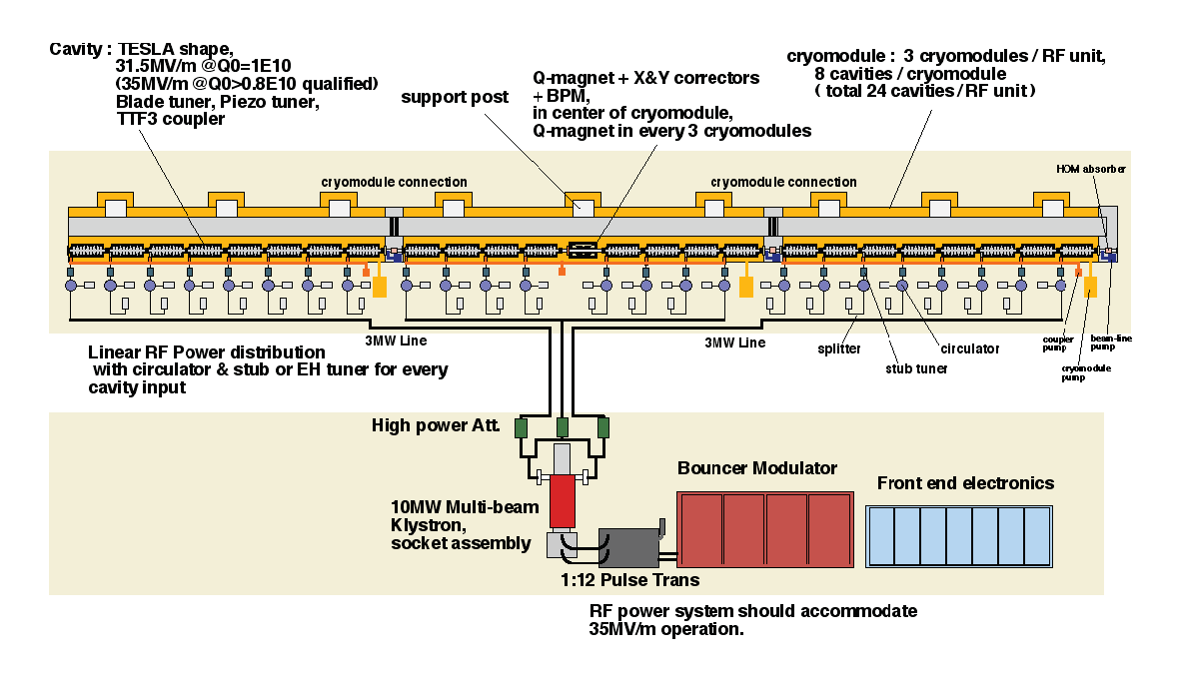
10 MW (pulsed) RF Power Unit
26 Cavities powered by one klystron
To be replaced with Marx Modulator:

Slide 23
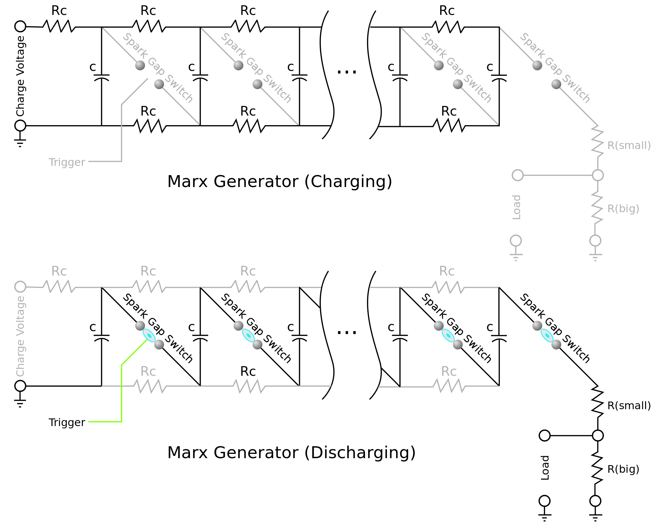
Single Stage
Marx Generator Operation

Slide 24
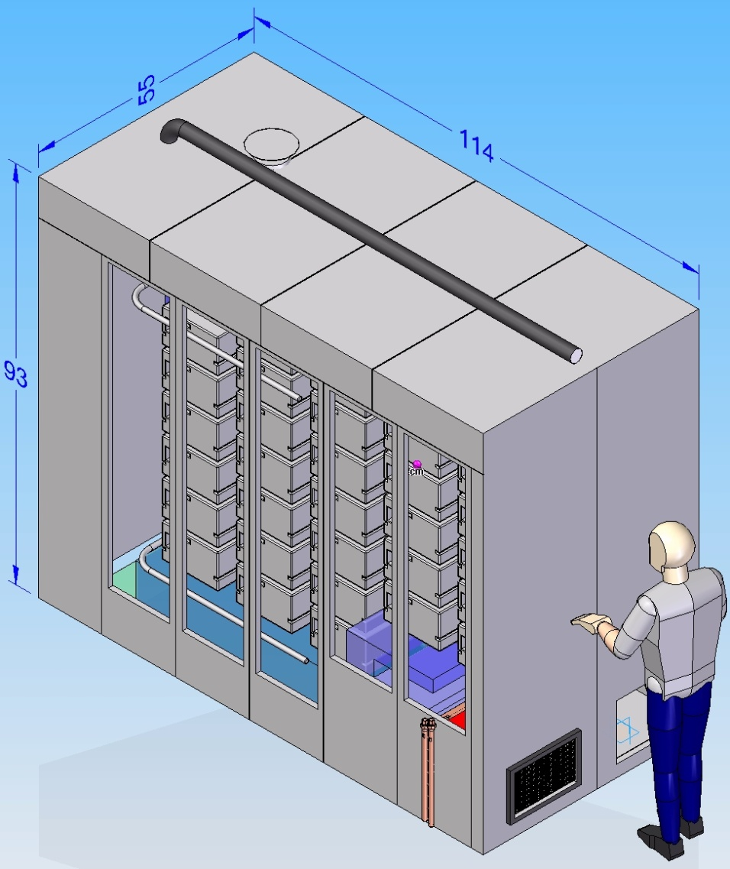
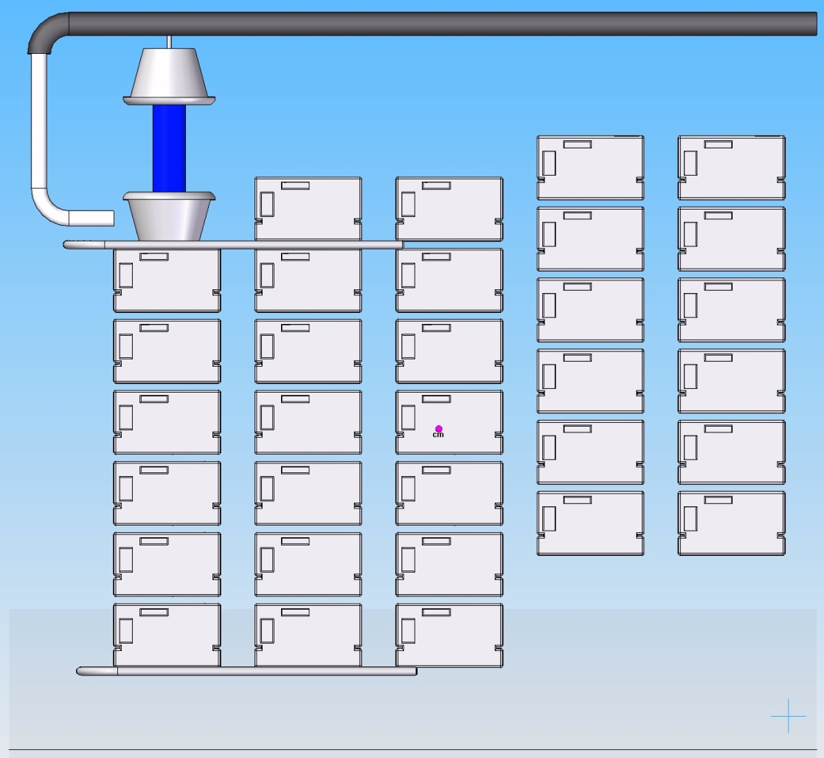
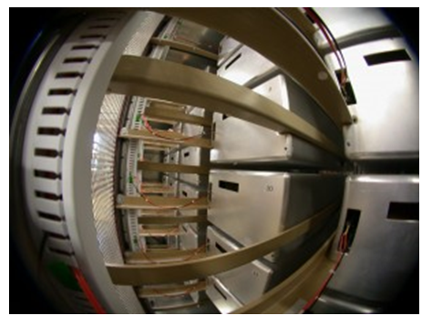
Marx Modulator: adopted by ILC (and CLIC?)

Slide 25
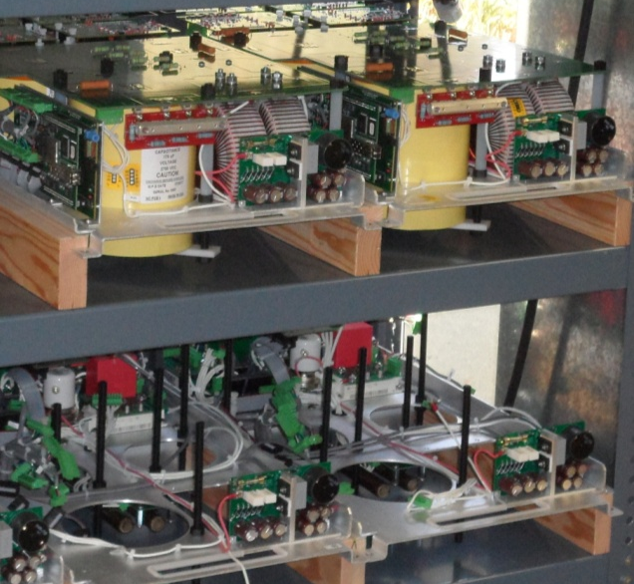
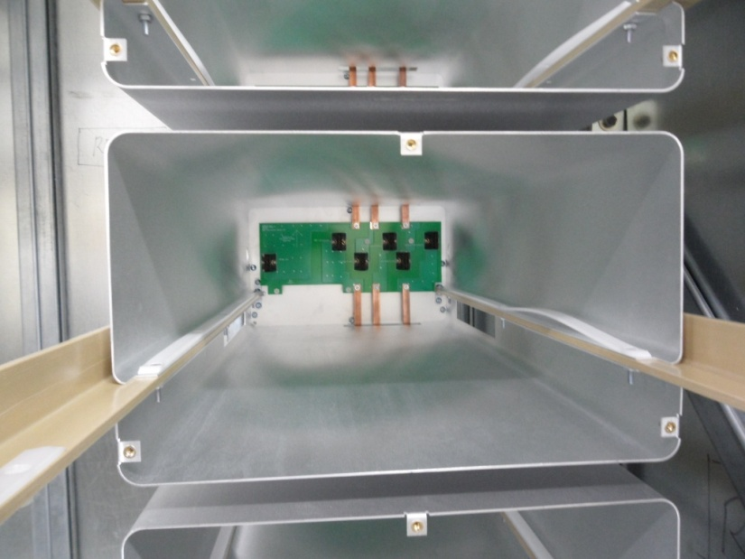
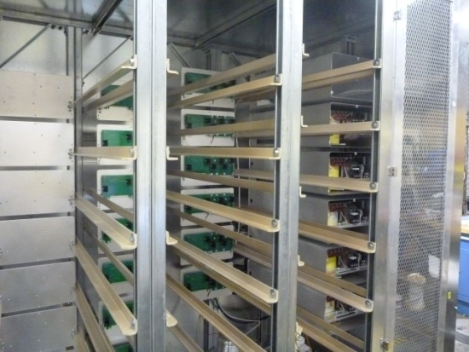
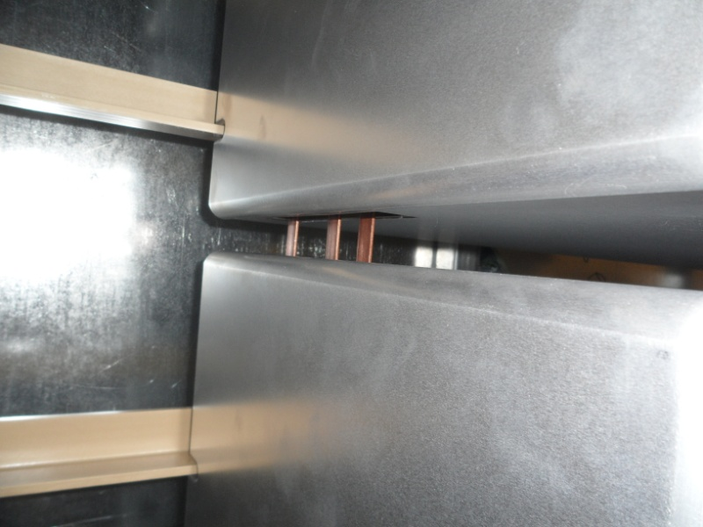
Marx Cell Assembly

Slide 26
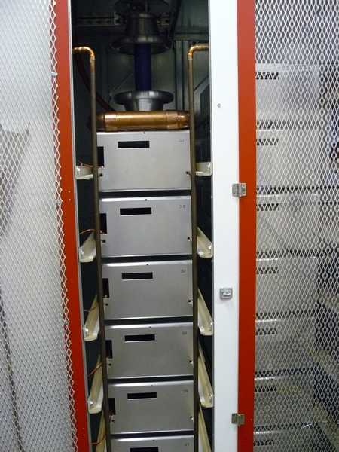
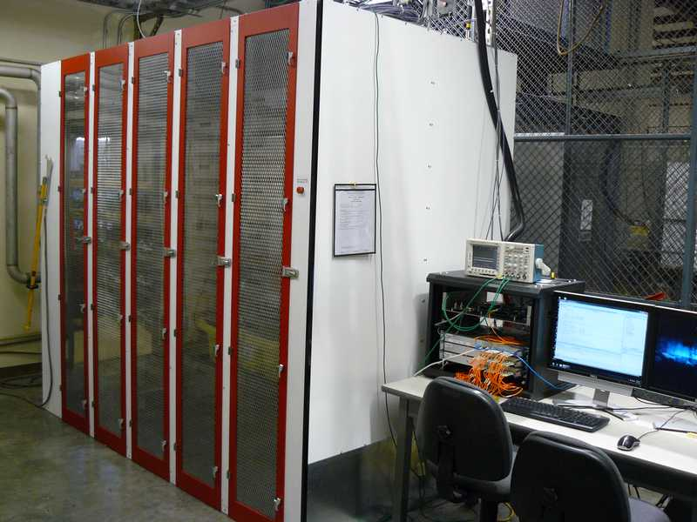
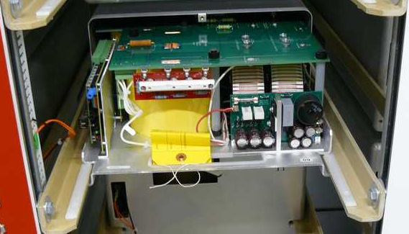
Nearly Assembled Marx Modulator

Slide 27
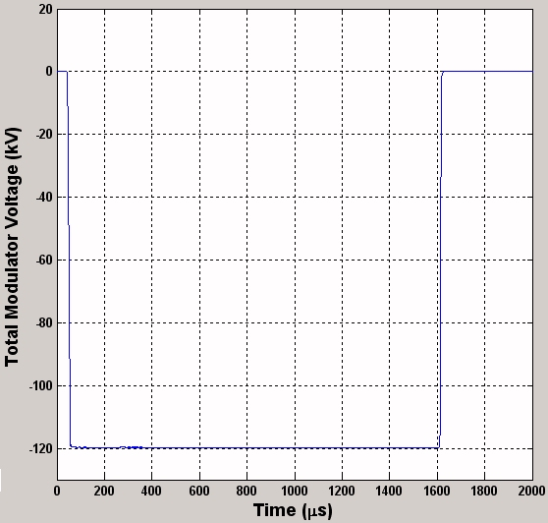
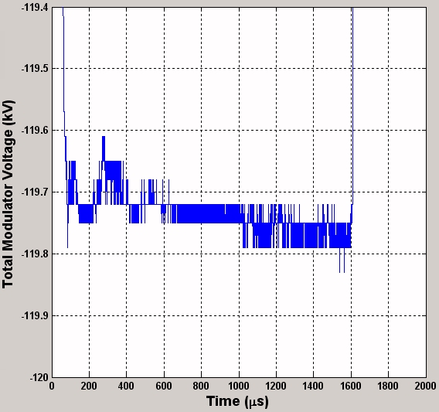
Marx Modulator Pulse
-120 KV
0.1% p/p ‘flatness’
1.6 ms
CLIC: 10ppm reproducibility

Slide 28
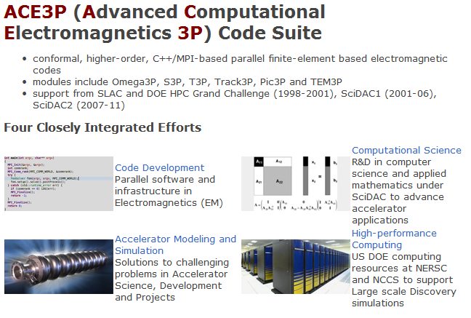
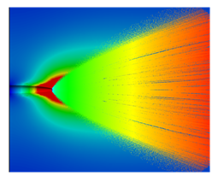
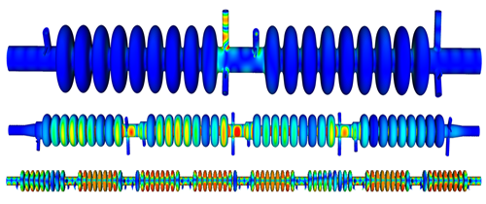
Particle beam simulation Core expertise
ACE3P from SLAC

Slide 29
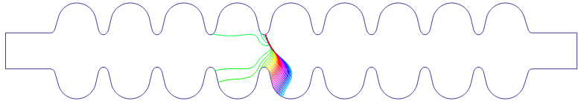
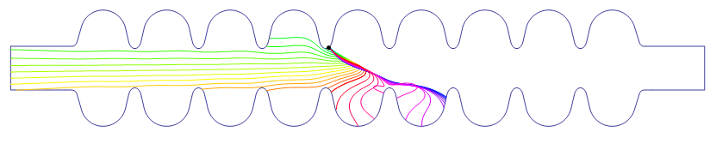
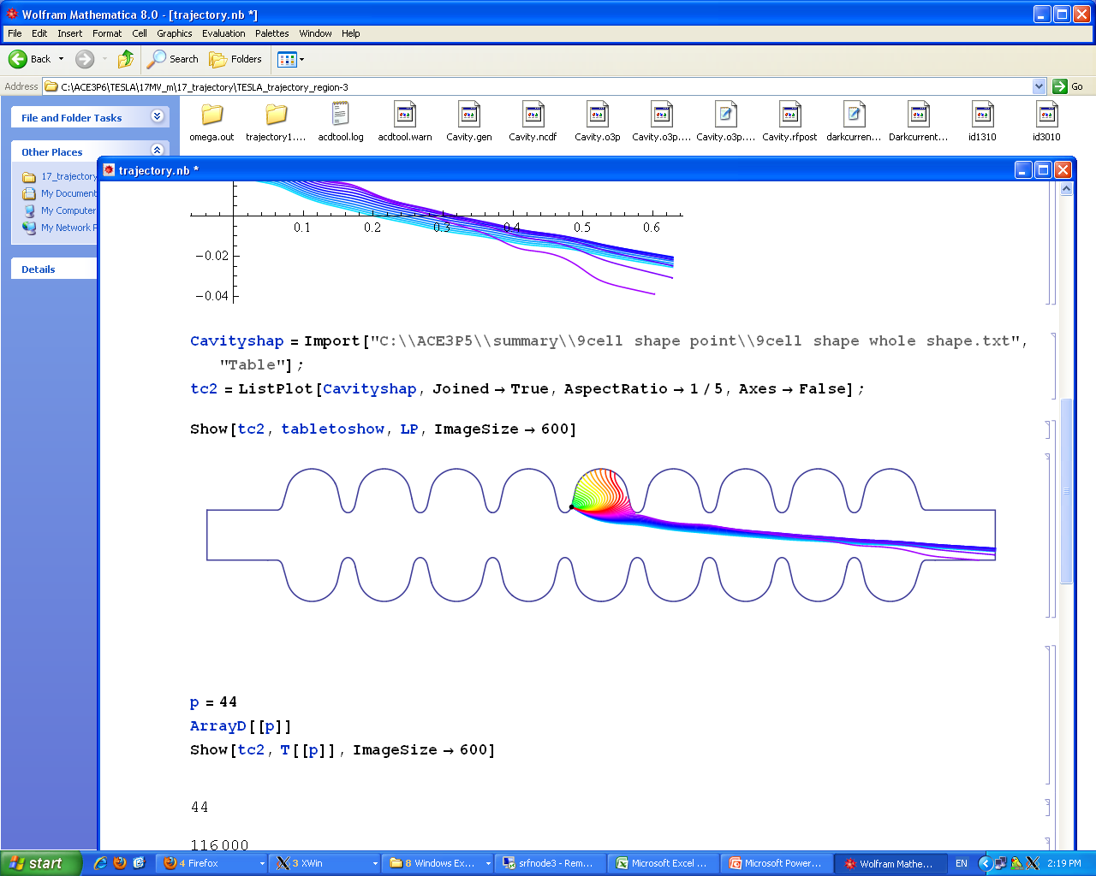
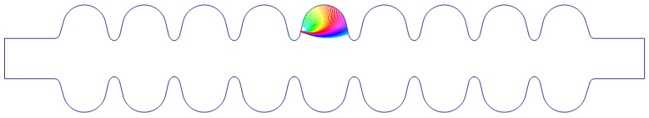
Example: Trajectories of different Emitters
Understanding field emission:
Rongli Geng,
JLab

Slide 30
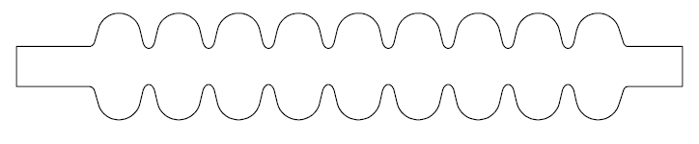
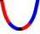
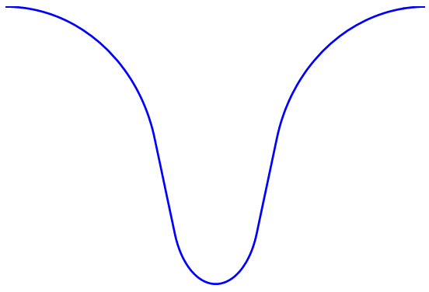
9-cell Model and Definition of Coordinate
iris4
iris5
R
iris2
iris3
iris6
iris7
iris8
iris9
iris1
iris10
(0,0)
Z
Left flange
Right flange
(Iris-5 left)
R/m
(Iris5- right)
I5 region, 15MV/m
β=150, Φ=4.4eV
I5-L
I5-R
-S
S
Z/m

Slide 31
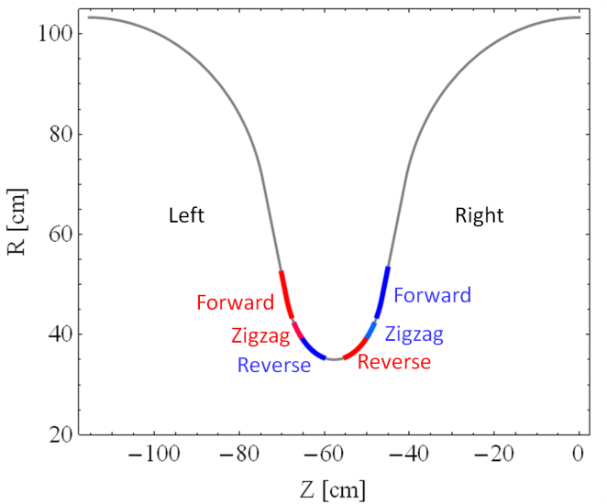
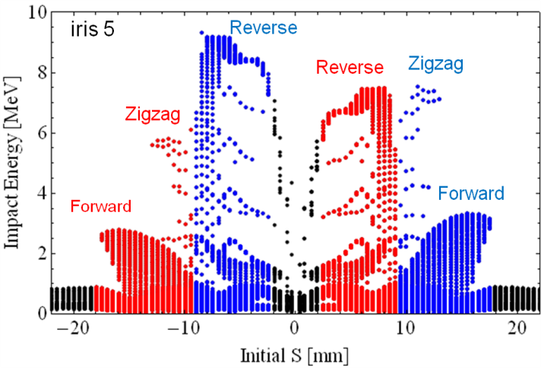
3 Types of “Long Range” Trajectories
Emission in region
>>> “Reverse type”
Emission in region >>> “Zigzag type”
Emission in region >>> “Forward type”
IR5
Impact position VS impact energy distribution

Slide 32
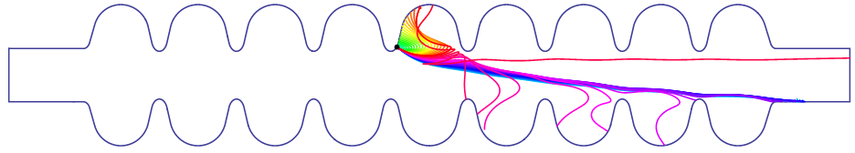
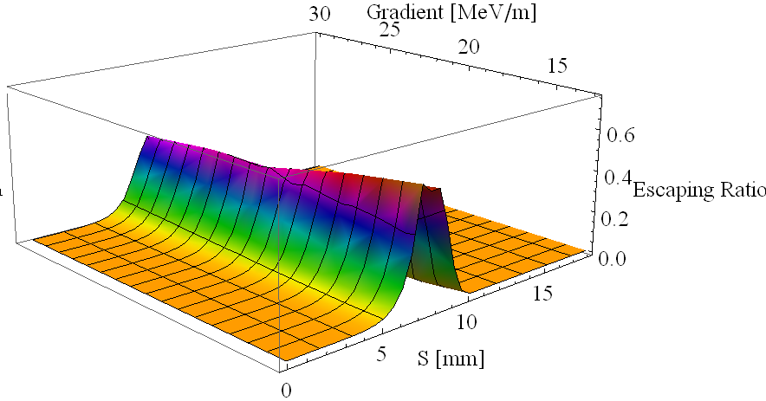
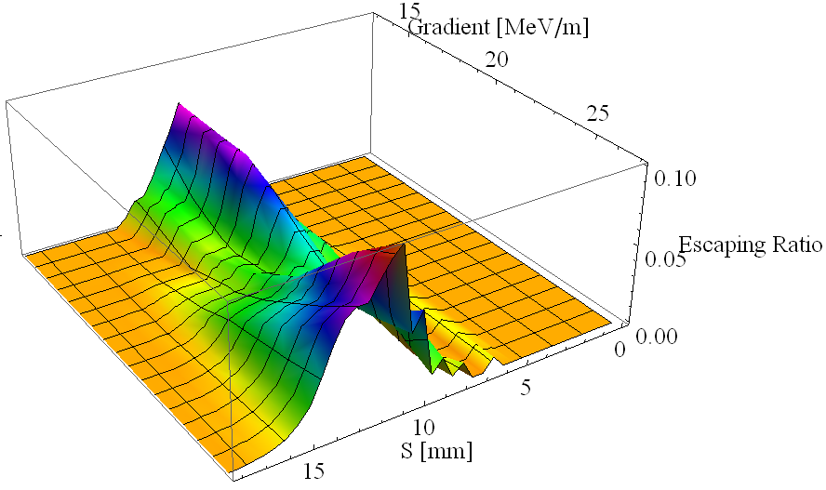
Escaping Ratio
Escaping from Left Flange
“Reverse type” trajectory
Escaping from Right Flange
“Zigzag type” & “forward type” trajectory

Slide 33
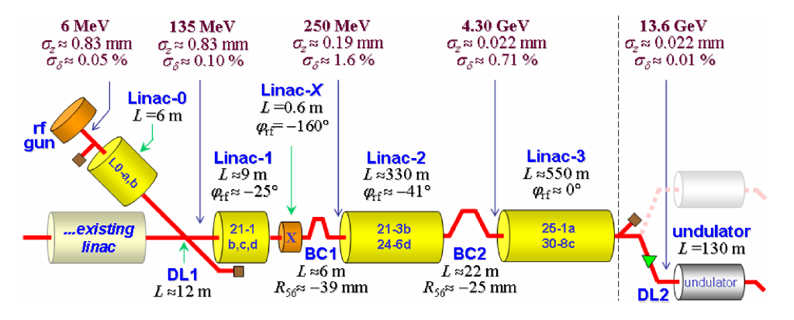
Short electron bunches:
Emerging Science - Free Electron Lasers (FEL)
‘femtosecond molecular dynamics’ with atomic site specificity
~40x longitudinal compression at LCLS (SLAC)

Slide 34
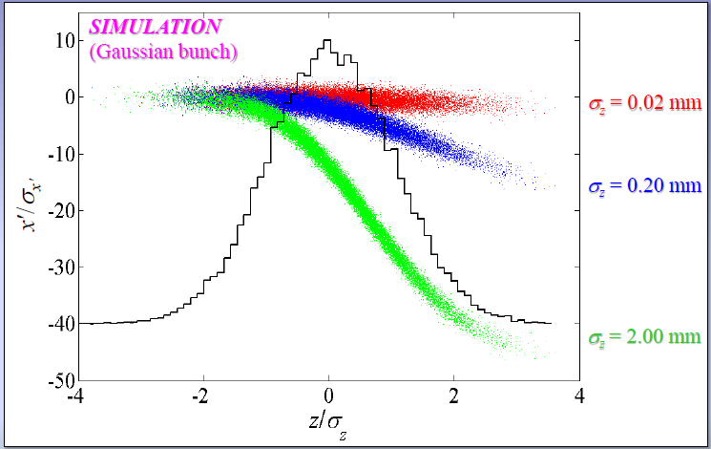
FEL Linac Beam Dynamics:
Short bunches have a weaker wake

Slide 35
ILC Technology Applications - Summary:
Superconducting RF cavities:
  Performance and Cost improvements; Technology transfer
Superconductor material:
  Quality feedstock production process development
RF sources
  Modulator Performance and Cost improvement
Particle beam simulation
  Beam / Electro-dynamic simulation with unprecedented accuracy
Short electron bunches:
  Free Electron Lasers: understanding the dynamics of chemistry / molecular biology

Slide 36
Technology Transfer –
Global SRF R & D for ILC
Timeline:
Goal: Tech Transfer between labs and to industry DURING R & D PHASE
2006: One Lab with proven cavity production performance; 2 companies
2012: 5 labs / 5 companies (four more coming)
2010, 2011: Convene Workshops to exchange information
  Project : Institutions : Industry
2009 – 2012: One-on-One visits to each interested vendor
Piece-part investment
(… - 2013) Commissioned mass-production studies

Slide 37
The 3rd Cycle Communication with Companies in 2011-2012
 | Year | Company | Place | Technical subject
1 | 2011~2012 | Hitachi (KEK) | Tokyo (JP) | Cavity/Cryomodule (CM)
2 | 2011~2012 | Toshiba (KEK) | Yokohama (JP) | Cavity/CM, SC Quadrupole
3 | 2011~2012 | MHI (KEK) | Kobe (JP) | Cavity / CM
4 | 2011~2012 | Tokyo Denkai | Tokyo (JP) | SC Material
5 | 2011 | OTIC | NingXia (CN) | SC Material
6 | 2011 | Zanon | Schio (IT) | Cavity/CM
7 | 2011~2012 | RI (DESY) | Koeln (DE) | Cavity, Coupler
8 | 2011~2012 | AES (Fermilab) | Medford, NY (US) | Cavity
9 | 2011 | Niowave | Lansing, MI (US) | Cavity/CM
10 | 2011 | PAVAC | Richmond, BC (CA) | Cavity
11 | 2011 | ATI Wah-Chang | Albany, OR (US) | SC Material
12 | 2011 | Plansee | Ruette (AS) | SC Material
13 | 2011 | SDMS | Sr. Romans (FR) | Cavity
14 | 2011~2012 | Heraeus | Hanau (DE) | SC Material
15 | 2011~2012 | Babcock-Noell (CERN) | Wurzburg (DE) | CM assembly
16 | 2011 | SST | Maisach (DE) | EBW
17 | 2012 | Toshiba Electron-Tube | Nasu (JP) | HLRF (Klystron, Coupler)
18 | 2012 | Thales | Velizy - Villacoublay (FR) | HLRF (Klystron)

Slide 38
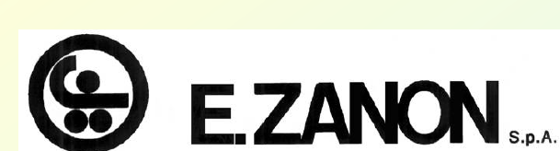




Global Industrial Cavity Fabrication Partners – qualified*
2 Europe
3 Americas
4 Asia

Slide 39
Progress in Industrial Participation to
ILC Cavity Production
year | # 9-cell cavities qualified | # of Labs reaching 35 MV/m processing | # of Industrial manufacturers reaching 35 MV/m fabrication
2006 | 10 | 1 DESY | 2 ACCEL, ZANON
2011 | 41 | 4 DESY, JLAB, FNAL, KEK | 4 RI, ZANON, AES, MHI,
2012 | (45) | 5 DESY, JLAB, FNAL, KEK, Cornell | 5 RI, ZANON, AES, MHI, Hitach
Recent Progress in Industry/Lab
  Niowave-Roark/Fermilab (TB9NR004): reached 30 MV/m (Nov. 2011)
  Hitachi/KEK (HIT02): reached 41 MV/m with HOM (April, 2012)
  Toshiba/KEK (TOS-02): reached 35 MV/m w/o HOM (March 2011)
  Accel (RI)/Cornell (A9) : reached 40 MV/m w/ HOM, vertical EP (April, 2012)
  DESY (LG- ) : reached > 45 MV/m w/ large-grain (2011~12)
  IHEP-KEK: 1st cavity (LL, large-grain, no-end) reached 20 MV/m,
  PKU-JLab: Cavity (Tesla, fine-grain) reached 28 MV/m,
Progress in EXFEL (updated by W. Singer : the 2nd EP at DESY, as of Sept. ‘12)
  RI: 4 reference cavities with Eacc > 28 MV/m, (~ 39 MV/m max.)
  Zanon: 4 reference cavities with Eacc > 30 MV/m ( ~ 36 MV/m max.)

Slide 40
ILC-SCRF Industrialization Model
ILC Host-Lab
Technical Coordination
(for Lab- Consortium)
Regional Hub-Lab:
A
Regional Hub-Lab:
E, & …
World-wide
Industry responsible for
‘Build-to-Print’ manufacturing
by
Cavity/Cryomodule Fabricators
Sub-component Suppliers
Material Venders
Regional Hub-Lab:
B
Regional Hub-Lab:
D
Regional Hub-Lab:
C: responsible for
Hosting System Test and
Gradient Performance
Note 1:
-Regional hub-laboratories are responsible for any regional procurement and must be open for world-wide industry participation
- Industry may deliver to any region’s laboratory through procurements above
: Coordination link
: Procurement link
Notes:
Comparison with Iter - using the rd phase for tech xfer. Models to be used for construction.

Slide 41
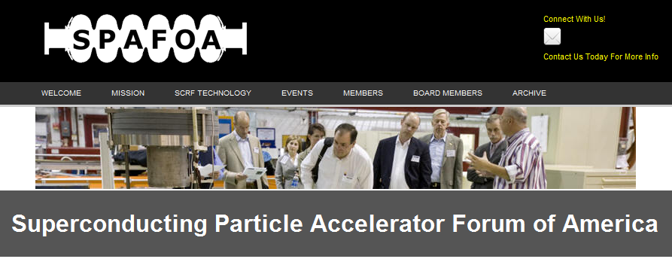
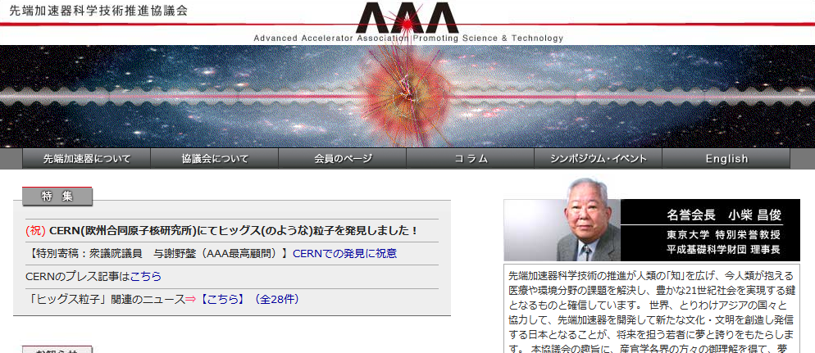
Industry Groups
http://spafoa.org/
http://aaa-sentan.org
http://www.eifast.eu

Slide 42
Concluding questions:
Developing links between projects, institutions, universities and industry requires an ongoing, multi-faceted approach
  Can effective science be done through ‘staged’ application of new technology?
  Are there new ways to partner with industry in a strong and fair manner
Panel Discussion: Session LC7, 30 October, 2012 17:30-18:30
  How to promote technology transfer?
(See upcoming talks: Accelerator technology ‘Stewardship’ has been mandated by DoE)

Slide 43
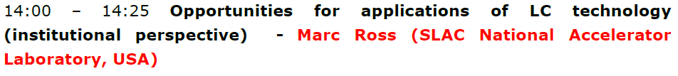
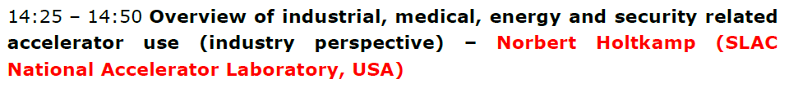
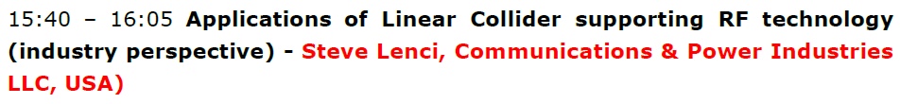
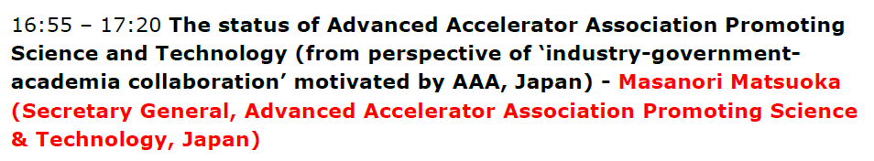
Stuart Henderson (Fermilab)
Anthony Favale

