Slide 1
Alignment challenges for a future linear collider

Slide 2
OUTLINE
Introduction: alignment tolerances achieved for the LHC
Specifications for alignment of CLIC and ILC, and alignment challenges
Solutions being studied
Long range alignment system
Short range alignment system
Fiducialisation
Case of the Machine Detector Interface area
Conclusion

Slide 3
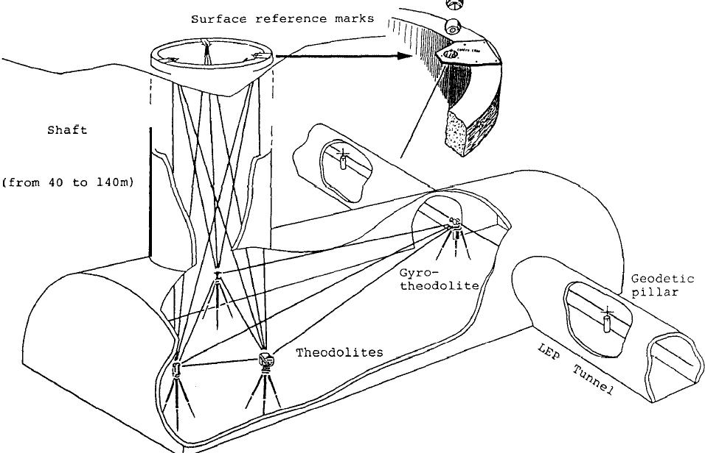
Introduction : state of the art
Steps of alignment of an accelerator
Surface
Installation and determination of the Survey network
Fiducialisation
Transfer of reference into tunnel
Installation and determination of the tunnel network
Absolute alignment
Relative alignment of the elements: smoothing
Injection of pilot beam
Implementation of beam based alignment and beam based feedbacks
Control and maintenance of the alignment
Monitoring and remote adjustment in remote areas
Underground

Slide 4
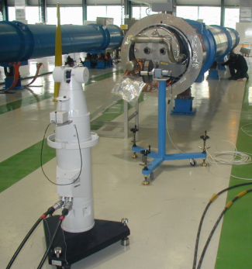
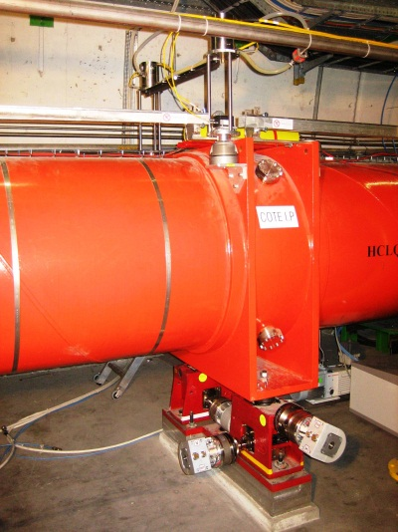
Introduction: state of the art (case of the LHC)
Fiducialisation
Operation during which the position of the fiducials is measured w.r.t. a reference axis (magnetic, mechanic)
➔ Uncertainty of measurement < 0.1 mm (1σ)
Absolute alignment
Initial alignment of each component w.r.t underground geodetic network ➔ uncertainty of measurement < 0.3 mm (1σ)
Relative alignment of the elements
Smoothing : relative position of components w.r.t to the trend curve ➔ uncertainty of measurement < 0.1 mm (1σ) over 150 m
Control and maintenance of the alignment
Monitoring and remote adjustment in specific areas
Monitoring of the relative displacements w.r.t a given reference time or position σ = a few microns using alignment systems and remote adjustment using motorized jacks

Slide 5
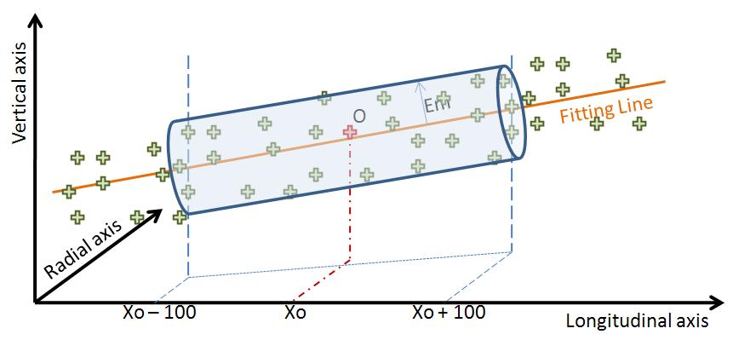
Specification for ILC & CLIC
Above state of the art for ILC:
Area | Nb of beam | Error of misalignment on the fiducials (1σ)
Main linac | 1 | 0.2 mm rms over 600 m
BDS | 1 | 0.02 mm over 200 m
Fiducialisation: : 0.05 mm rms
Above state of the art for CLIC:
Special case of main linac and BDS
The zero of each component will be included in a cylinder with a radius of a few microns:
14 μm over 200 m (RF structures)
17 μm over 200 m (MB quadrupoles)
10μm over 500m (BDS and final focus components)
Adjustment required: step size below 1 µm

Slide 6
Alignment challenges for a future linear collider
Up to a few microns
Fiducialisation
Smoothing
Active pre-alignment for CLIC
Active determination of the position for ILC
replaced by
Long range alignment system
Short range alignment system
Fiducialisation at a micron level
Stable alignment reference, known at the micron level
Submicrometric sensors providing « absolute » measurements
Measure objects within a few microns
Submicrometric displacements along 3/5 DOF

Slide 7
Special case of MDI area
Requirements (CLIC):
Determination of left reference line w.r.t right reference line : within ± 0.1 mm rms
Monitoring of left reference line w.r.t right reference line : within a few microns
Monitoring of the position of left QD0 / right QD0 within ± 5 μm rms
Taking into account:
Push pull detectors
Last component (QD0) inside the
detector (L*=3.5m)

Slide 8
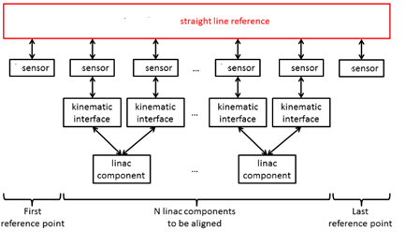
Long range alignment system
As it is not possible to implement a straight alignment reference over kilometers: ➔ use of overlapping references

Slide 9
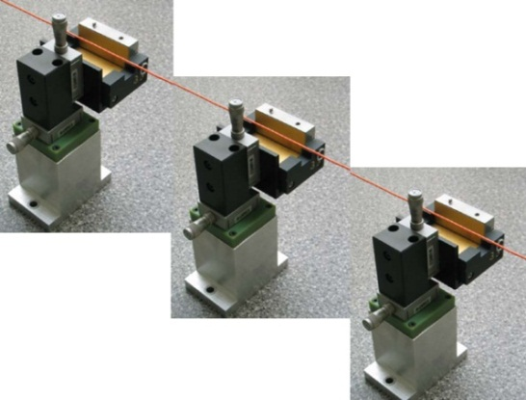
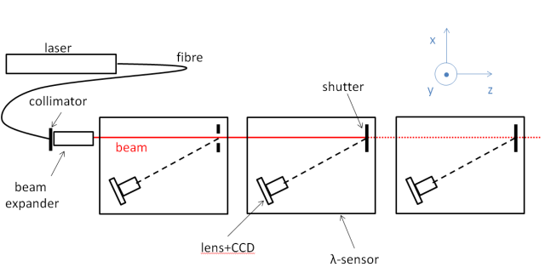
Long range alignment system
Reference over hundreds of meters
(n - points)
(3 - points)
Stretched wire
Laser beam under vacuum
Λ-system
Raschain
Wire Positioning Sensors (WPS)
Solution consisting of overlapping stretched wires and WPS sensors chosen for CDR of CLIC and RDR of ILC

Slide 10
Long range alignment system
Stretched wire
Main issue: long term stability of a wire
(effects of temperature, humidity, creeping effects, air currents)
Modelization of the wire using Hydrostatic Levelling Systems (HLS)
but only in the vertical direction
but HLS system follows the equipotential of gravity which needs then to be known
➔ studies undertaken concerning the determination of the equipotential of gravity
Subject of a PhD thesis:
« Determination of a precise gravity field for the CLIC feasibility studies »
Notes:
Se

Slide 11
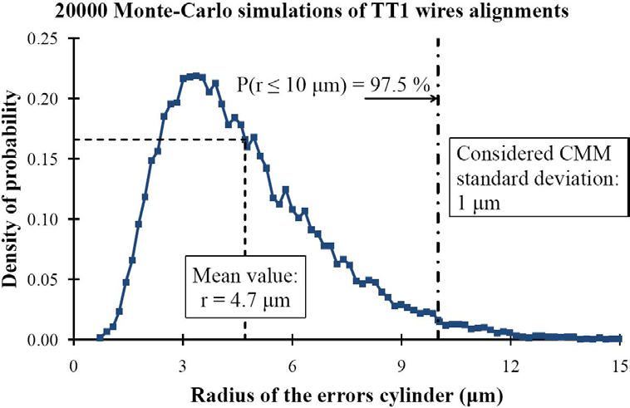
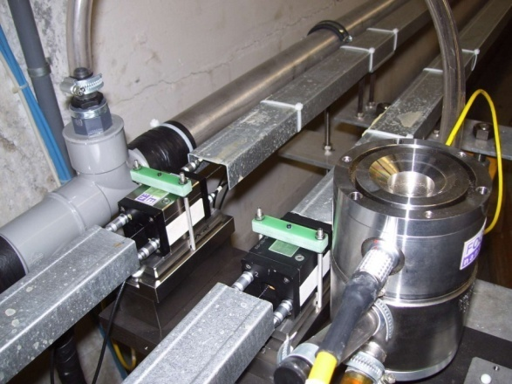
Long range alignment system
TT1 facility
Simulations
Position & orientation of the metrological plates in the coordinate system of the tunnel
Monte Carlo method using theoretical readings of sensors
➔ in 97.5% of the cases, all the pre-alignment errors fit in a cylinder with a radius of 10 µm.
One of the objectives ➔ to determine the precision and accuracy of a reference network consisting of overlapping stretched wires.

Slide 12
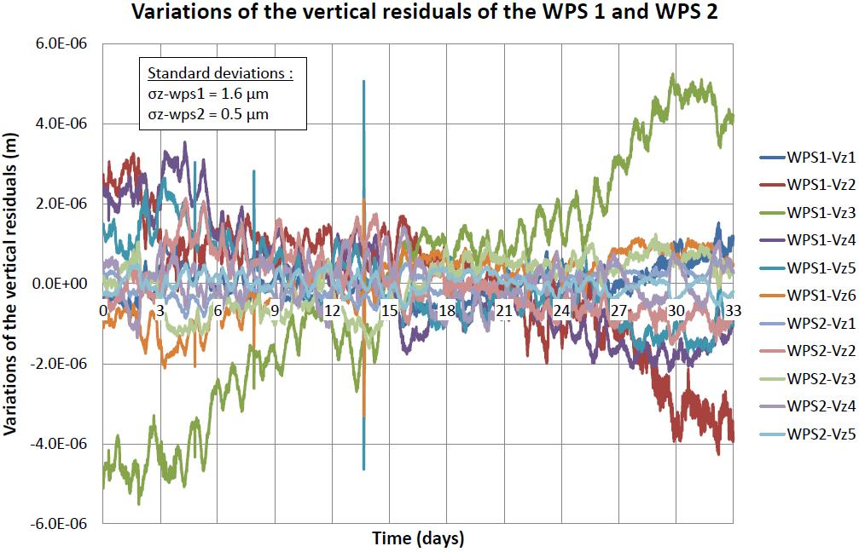
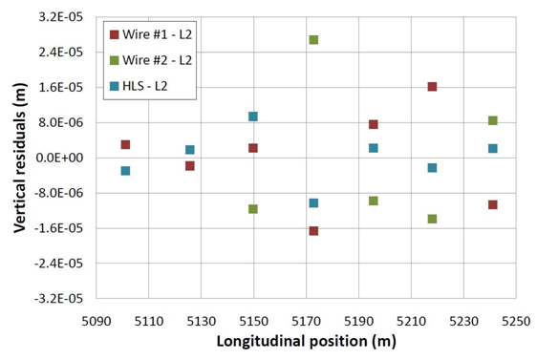
Long range alignment system
Results in TT1
Precision on a 140 m wire: better than 2 microns over 33 days
Accuracy: 11 microns in vertical, 17 microns in radial. Can be improved!
Vertical residuals of the 2 longest wires:
σ (wire 1) = 1.6 µm
σ (wire 2) = 0.5 µm
Accuracy of the TT1 network adjusted by the least squares method in vertical:
σ = 11 µm r.m.s (27 µm max. value)

Slide 13
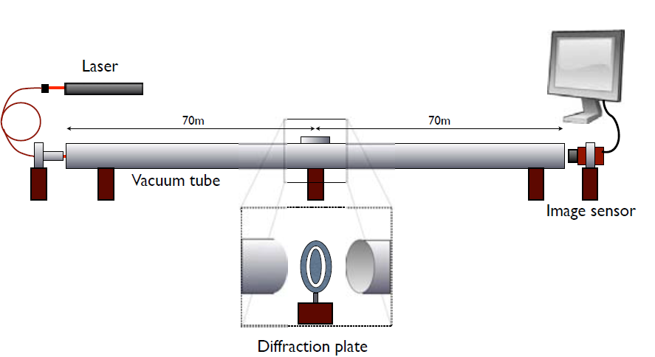
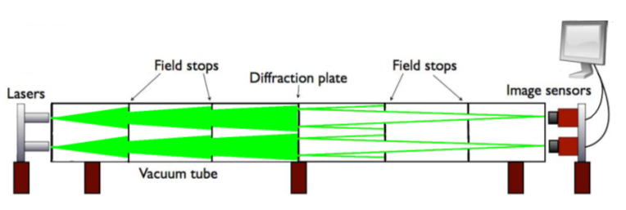
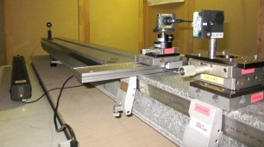
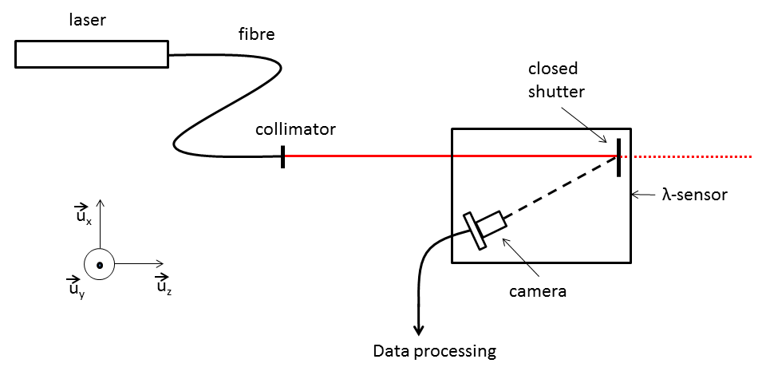
Long range alignment system
Development of laser based alternatives
Latest achievements on RasDif:
First configuration installed successfully in 2009
Resolution below 0.1µm
Appears to behave as a very precise seismometer
Double configuration showed non coherent results
➔ inter-comparison needed with WPS
Latest achievements on λ- system:
Basic laboratory experiments with low cost elements and simple methods done at short distance (about 2 m)
Measurement repeatability within an interval of
[−4 μm,4 μm] around the mean values
Standard deviation less than 5 μm
First simulations performed: angular orientation & repeatability of shutter should be better than 0.2 mrad and 12 μm in order to detect a micrometric displacement

Slide 14
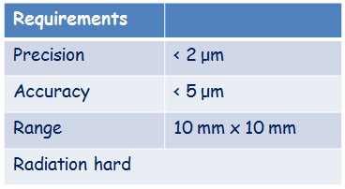
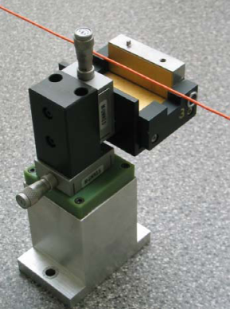
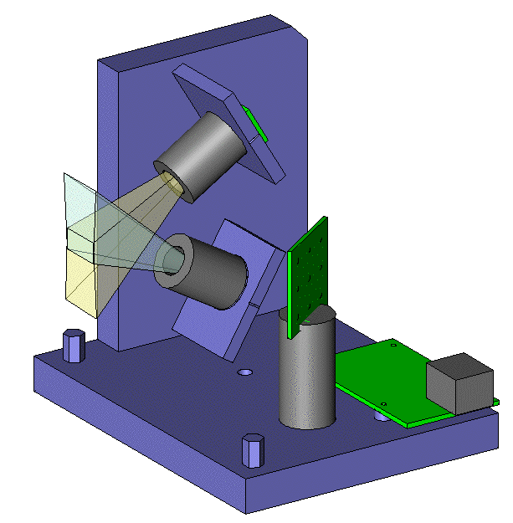
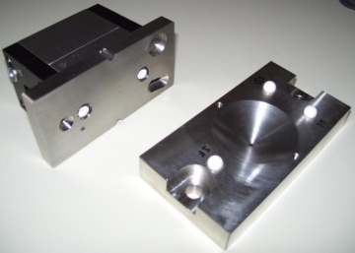
Short range alignment system
WPS (Wire Positioning Sensor)
Issue: WPS sensor fulfilling the requirements
« absolute measurements » (known zero w.r.t mechanical interface)
no drift
sub micrometric measurements
Upgrade of an existing WPS
Development of a new WPS
Capacitive based WPS (cWPS)
Optical based WPS (oWPS)

Slide 15
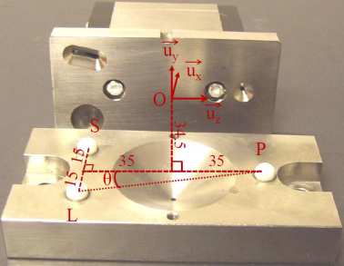
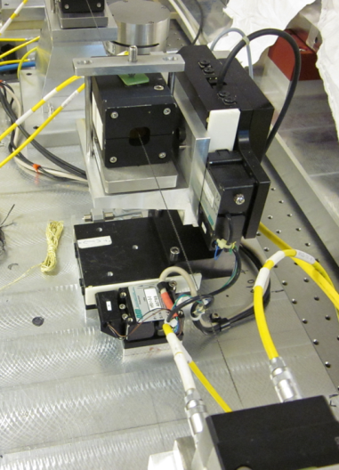
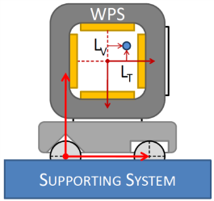
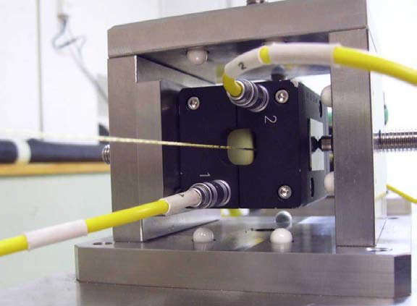
Short range alignment sensors
Sensors : cWPS
60 sensors installed in the LHC on the low beta triplets
Rad Hard (sensors up to 300 kGy, Remote electronics up to 50 kGy)
Resolution: 0.2 µm
But relative measurements only!
Latest achievements:
An isostatic mechanical interface allowing a repositioning within 1µm and an absolute calibration has been developed
A very accurate linearity bench
An « absolute » bench
Dedicated lab with a temperature stable within ± 1ºC
Status / current issues:
Linearity depends of the generation of carbon peek wire used: < 5 μm over the whole range (better in middle range)
Repeatability & interchangeability < 1μm
Accuracy (“absolute calibration”) of cWPS < 20 μm (bench recalibrated last week in the metrology lab).

Slide 16
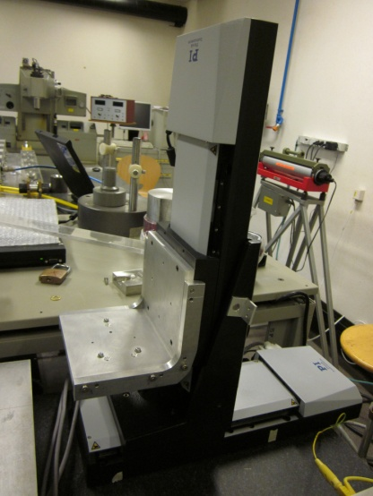
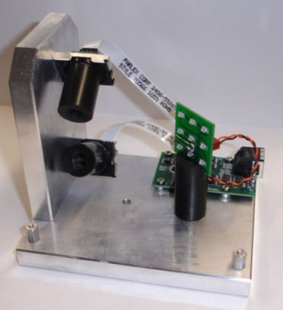
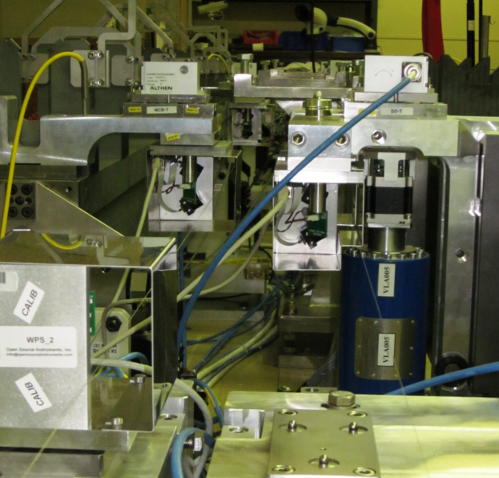
Short range alignment sensors
Sensors : oWPS
Main characteristics (from the manufacturer)
Resolution: < 0.1 μm
Range : +/- 5 mm (along two axes)
Repeatability: 2μm
Accuracy : < 5μm
Wire: Vectran
Latest achievements:
A very accurate linearity bench
A vectran wire (manufactured fiber spun from a liquid crystal polymer) visible to infra-red light and not antistatic ➔ silver plasma coated wire.
Status
Resolution < 1 µm, interchangeability < 5 µm
Noise problem to be solved
Impact of temperature: ~ 6µm/°C to be corrected
Absolute calibration to be controlled.

Slide 17
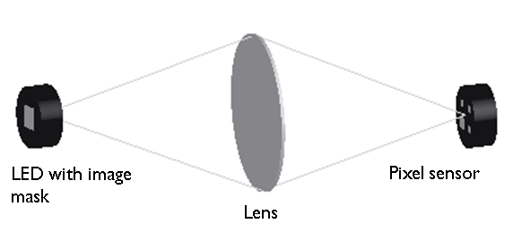
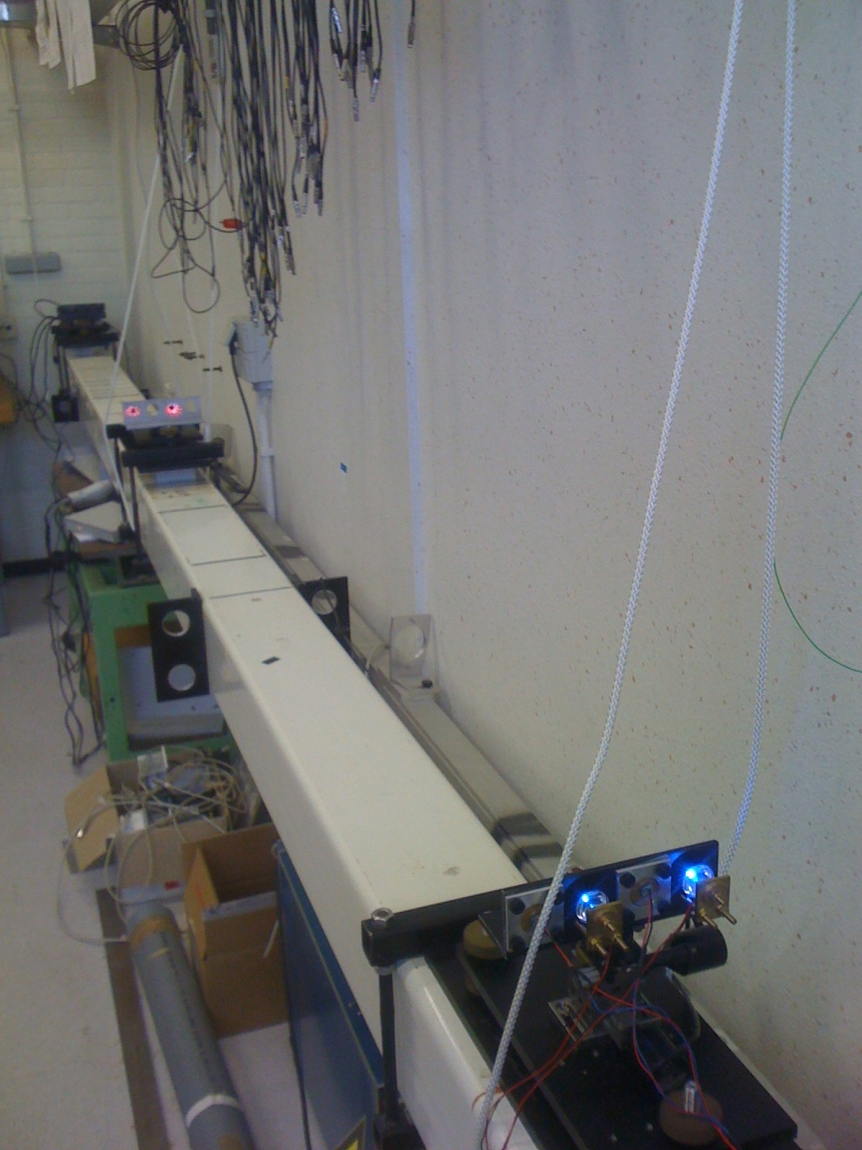
Short range alignment sensors
Sensors : RasChain
2 possibilities: RasNik versus RasDif
RasNik
RasDif
Status:
Test setup to validate RasNik & Rasdif on 4 m
First results: jitter and refractive bending of light ➔ thermal shielding needed
Preparation of sensors for two beam modules and inter-comparison tests with other sensors

Slide 18
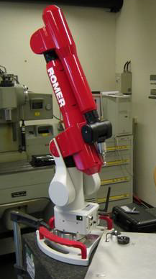
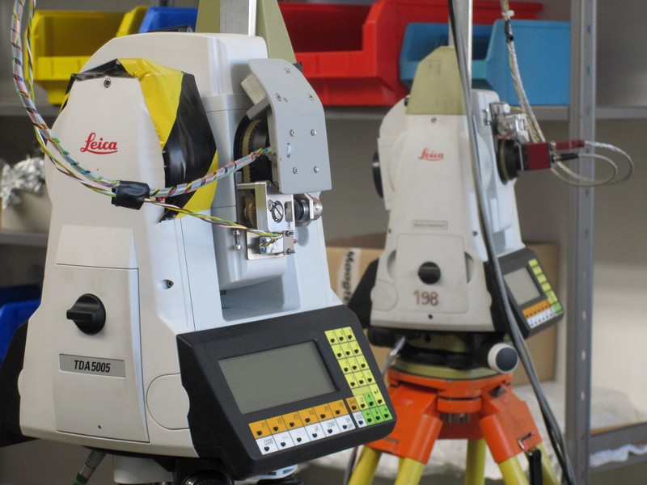
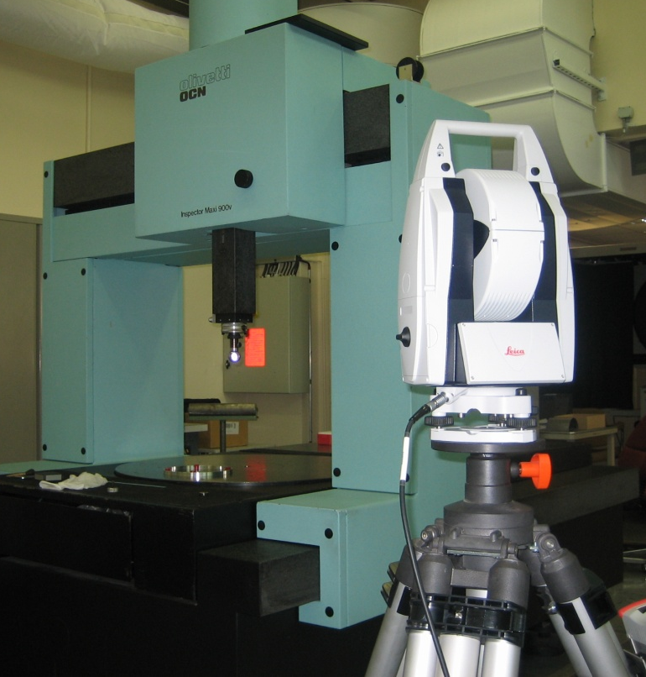
Fiducialisation
First solution: CMM measurements (dimensional control, pre-alignment of components on their supports, fiducialisation), but STATIC
Most accurate but for very short components
➔ Development of portable means
Romer arm
MPE = 0.3 µm + L/1000 (L in mm)
Micro triangulation
Latest achievements:
Fiducials developed
Several means developed and validated:
AT401 ~ 5µm @ 2m
Micro triangulation ~ 5µm @ 2m
Romer arm ~ 10 µm @ 2m
Test of fiducialisation strategy:
Very precise for short objects on CMM
Accuracy ~ 20 µm on 2m long objects
Laser tracker: AT 401

Slide 19
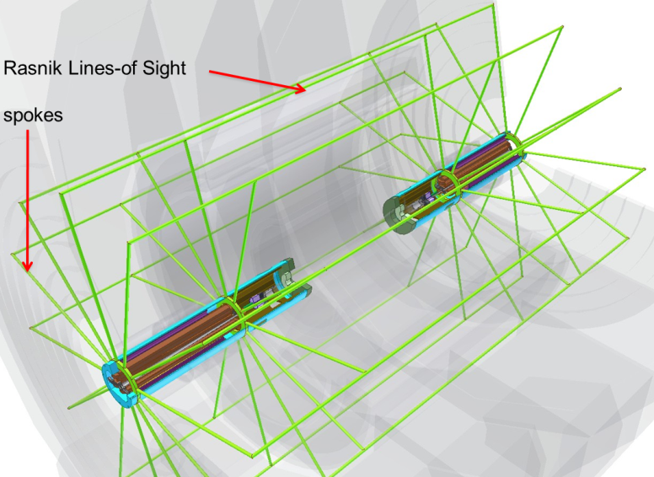
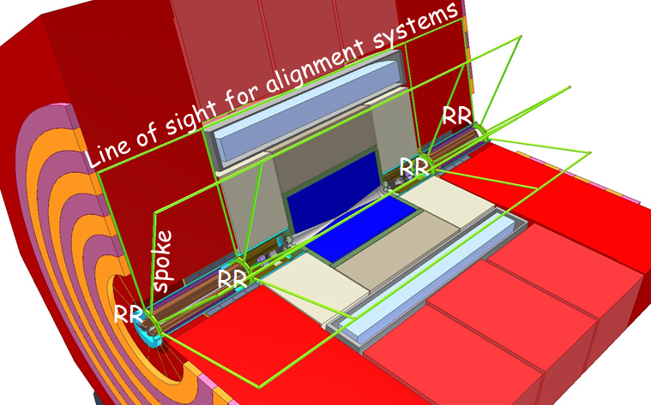
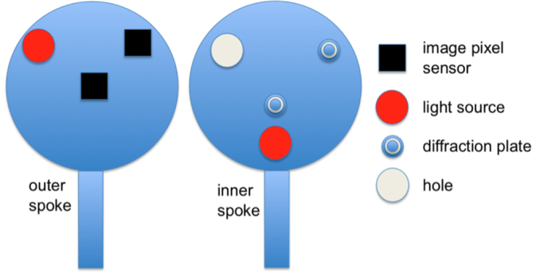
Special case of MDI area
Monitoring on both sides of the detector:
No direct line of sight at the level of the beam
External line of sight at 3m in “dead space”
Spokes equipped at both ends by alignment sensors linking the components and line of sights
Status and next steps :
A mock-up real size will be built @CERN to validate the whole concept
Design ready

Slide 20
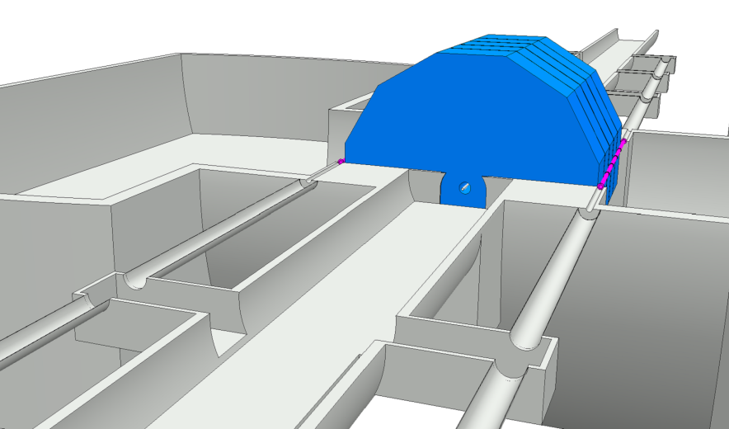
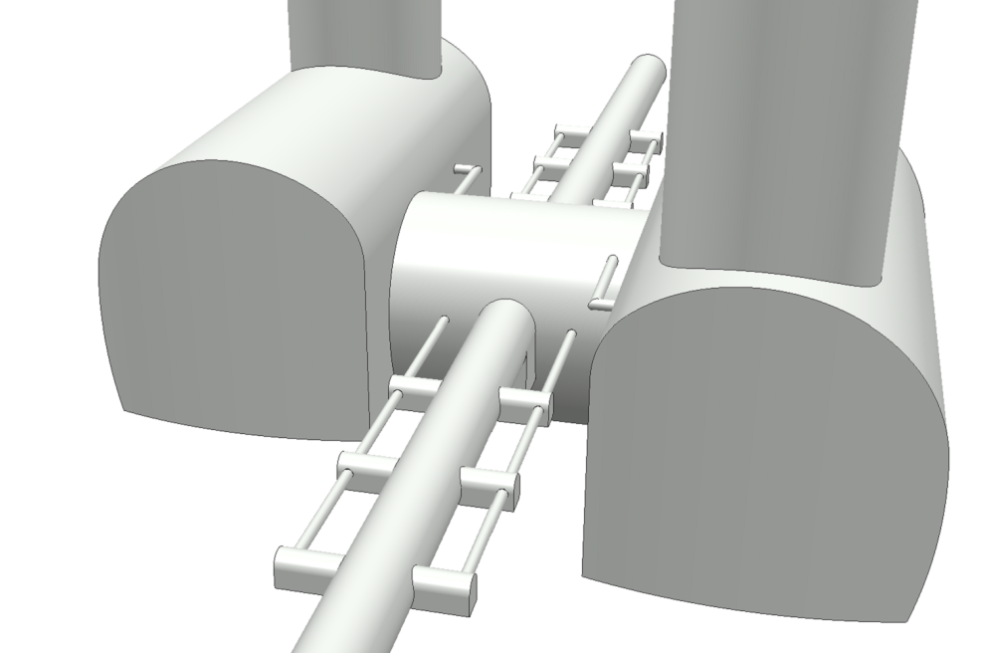
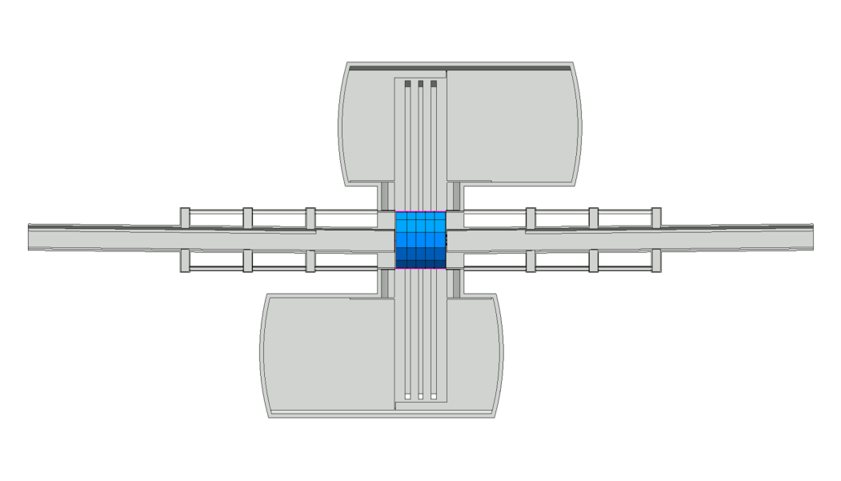
MDI area
Link between left and right sides:
Parallel survey galleries
Laser system shielding coupled to the push-pulled detector
Next steps:
Distance reference to reference : means to be developed
N-point laser based alignment system over ~ 100 m to be developed

Slide 21
Conclusion
CONCLUSION
In comparison with alignment requirements of the LHC, the alignment of linear colliders is a real challenge, with precision and accuracy of a few microns over several hundreds of meters, including the fiducialisation process.
Solutions are under development concerning long range alignment system:
A stretched wire solution has been proposed for the RDR of ILC and CDR of CLIC.
Results from test setup have shown that an uncertainty in the determination of the position of a sensor over 140m is of the order of 11 μm.
Alternatives, based on laser beam under vacuum, are under development, first to validate the stretched wire solution, and why not to replace it.
Short range sensors are under development as well, and the latest results show that an accuracy below 5 μm and a repeatability below 1μm are reachable.
Fiducialisation at a micron level is a challenge too, with a level of difficulty depending of the size of the component. For very short components (length <1m), CMM are a must, but will need to be replaced by portable means that are under development and validation.

