Slide 1
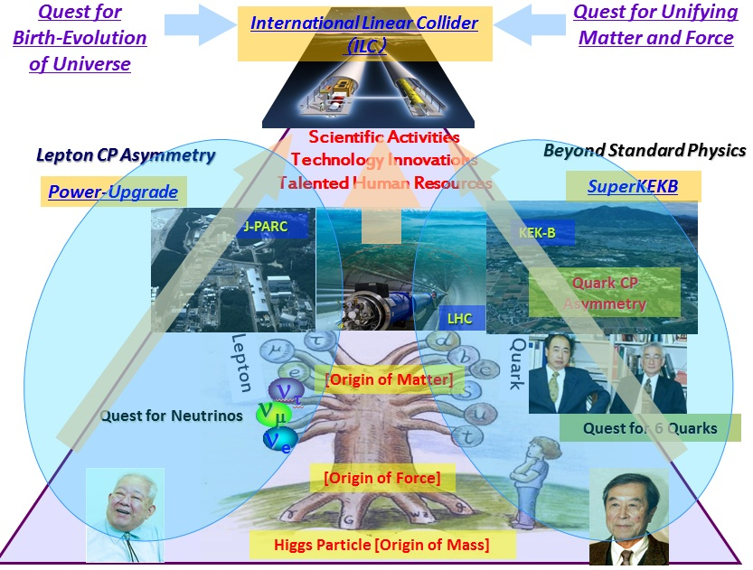
ILC Proposal from Japan
1. Why ILC in Japan ? : 1
In 2008

Slide 2
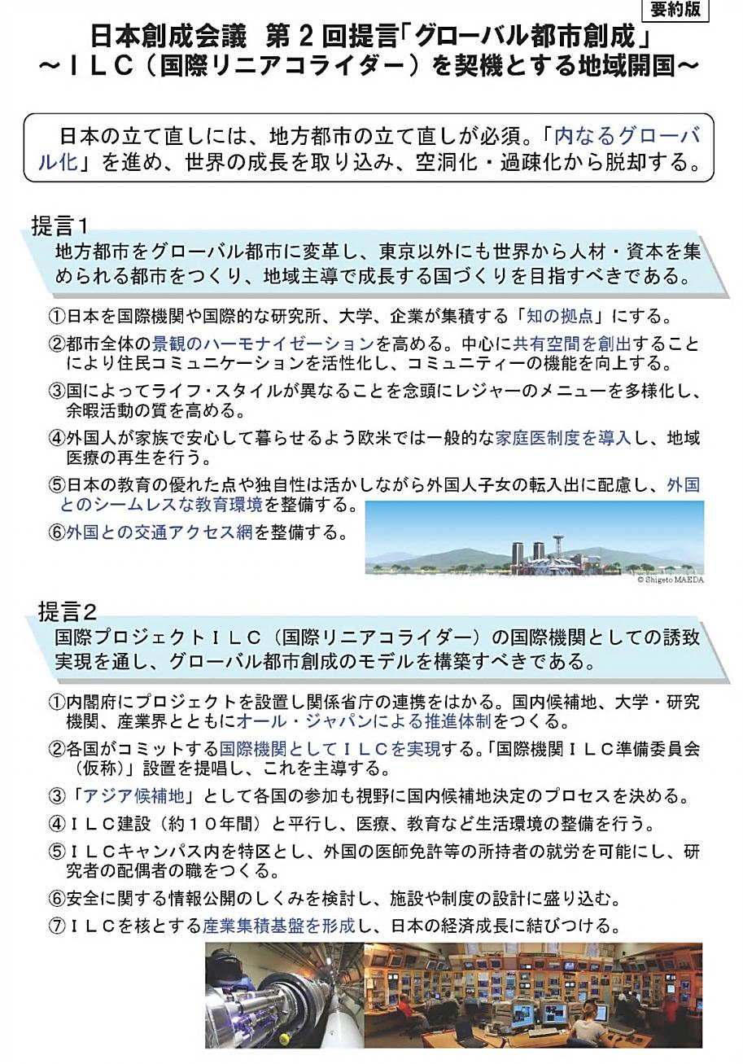
Why ILC in Japan ? : 2
July 12, 2012
Japan Policy Council
Second Recommendations:
Regional Development through Creation of Global Country inside Japan
Realizing a global city that can attract human and financial resources from around the world: Regional development triggered by the International Linear Collider (ILC)
Realizing an international organization for the International Linear Collider (ILC), to push towards reforming regional cities as a role model for the creation of a global country.

Slide 3
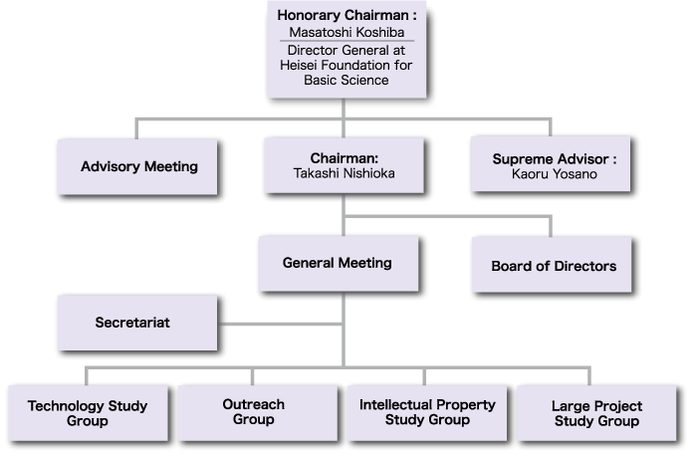
A bid-to host activity in Japan
~90 industries & ~30 universities

Slide 4
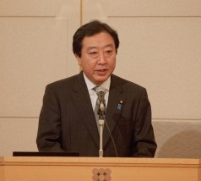
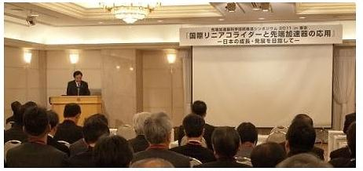
Prime Minister Noda
15/Dec./2011
positive reference to the ILC

Slide 5
What next in Japan ?
# of members : ~20 → > 100
Japan Policy Council
Second Recommendations:
Regional Development Through Creation of Global Cities
Assessment/Recommendation
for hosting the ILC
to the government
until next fall
Designing
the new country
concept starts.
Formal government statement
for hosting the ILC
within a few years

Slide 6
Budget support from the government
In principal (researcher’s proposal)
50% of the total ⬅ host country
the other ⬅ non-host countries
Extra support
Given the special aims in Japan (Creation of Global Country inside Japan), the extra support from the government is feasible.
Multi-body promotion :
MEXT (Ministry of Education, Culture, Sports, Science &
Technology )
+ METI (Ministry of Economy, Trade and Industry)
+ MLIT (Ministry of Land, Infrastructure, Transport and Tourism)
+ ………..

Slide 7
Why ILC in Japan ? : 3

Slide 8
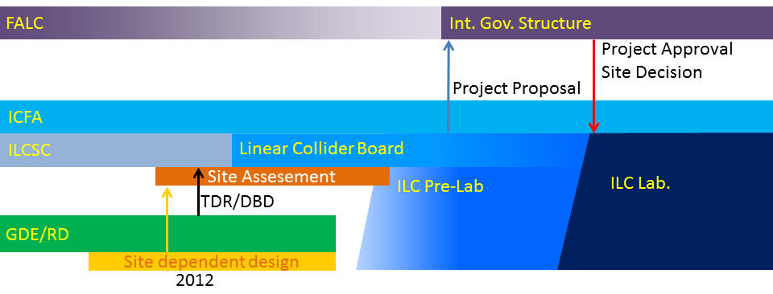
2. ILC Possible Timeline
CY
2010
2011
2012
2013
2014
2015
2016
2017
2018
Baseline established
Technical Design Report complete
Decision to proceed
TDR reviews
ILC
Technical design & R&D program
Site EOI’s
Site/host established
Cost Estimating
SRF system tests
Project Implementation Plan complete
XFEL operation
Physics Run 1
Interconnect repair
Physics Run 2
LHC
Existence of low-lying SUSY known
Higgs energy scale known
Transition Period
Facility Period

Slide 9
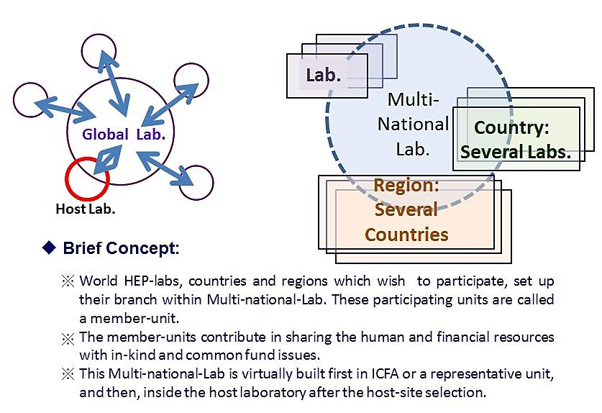
3. Preferable Organization Model for the ILC
ILC : Global Project
Transition Period & Facility Period

Slide 10
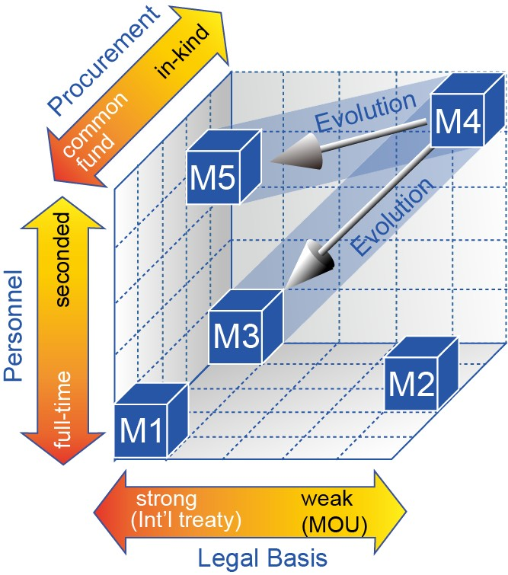
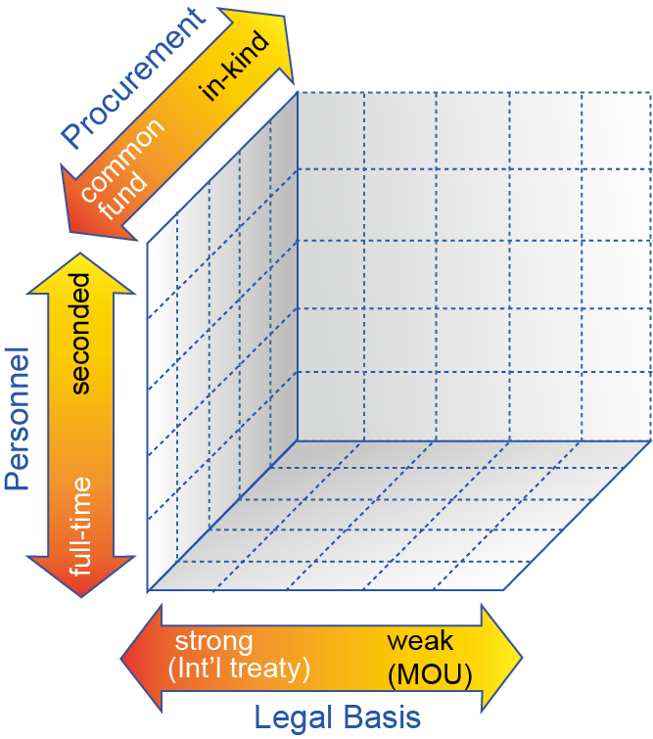
Organization Framework
from Legal and Procurement Perspectives
Procurement of Material Resources
In-kind contributions
Common-fund
Legal Basis of Organization
Treaty-based organization (like CERN)
Limited liability company (like XFEL)
Institution-level agreements
Procurement of Human Resources
Seconded personnel
from participating institutes
Direct employment
Multi-National Lab. : Essential
foster regional activities both for current
and future programs.
foster younger generation in regional
activities

