Slide 1

‘Little Bang at Big Collider’
Heavy Ion Physics at the LHC
Introduction to Heavy Ion Physics
Results from the LHC Ion Runs
in the context of previous low energy results
RHIC(Brookhaven/US); SPS(CERN)

Slide 2
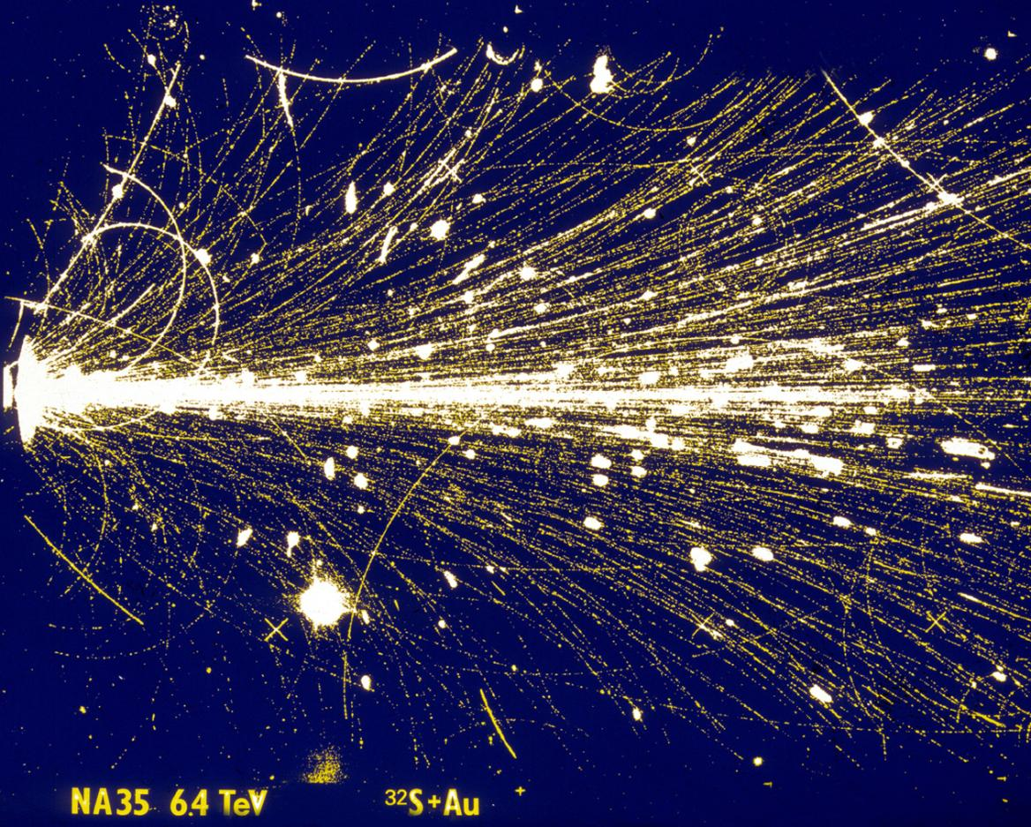
Heavy Ion Collision (ca 1990)
¹⁹⁷Au
³²S
CERN SPS
√s = 20 GeV/Nucleon
NA35 streamer chamber picture, ca 1990

Slide 3
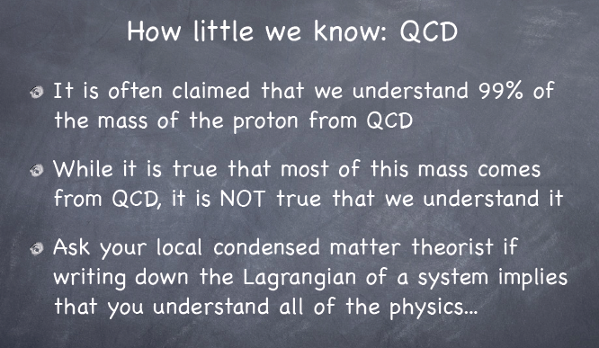
What for ? Exploring the SM (QCD)
J. Lykken, FNAL, Overview talk HCP2012

Slide 4
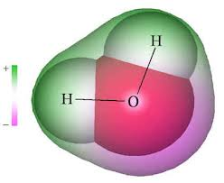

What for ? Exploring the SM (QCD)
We perfectly know the QCD Lagrangian, but in practice
  pQCD: remarkable accuracy at high Q², of little help for > 90-99% of the 'stuff' which happens
  other 'first principle' formulations of QCD which can be explored with nuclear collisions:
    lattice QCD: equilibrium calculations (static properties) at finite temperature => QGP
    CGC: classical limit of QCD for high occupation numbers (low-x): pp (HERA), pA, (AA)
The Lagrangian is not everything…
  Matter: large (mfp λ >> system size) & long-lived (life-time >> relaxation time) systems
    governed by emergent properties
    which are shaped by, but usually can not be derived from, its basic constituents and their interactions
    - H₂O + QED: constituents and forces of 'water':
    - looking at a single (or a few) H₂0 molecules, we don't learn anything
    about the properties of 'water', its different phases (ice, water, steam), …
  - we need a 'bucket' full and experiment with it
  (change temperature, make 'waves', measure transparency, observe a fish…)
If you like smashing things to see what happens, it doesn't get better than PbPb@LHC
  explore the strong interaction where it is strong
    curiosity driven 'discovery' physics, full of surprises..

Slide 5
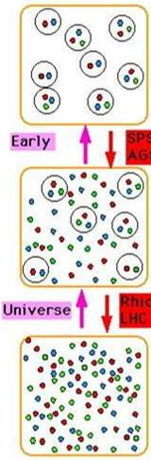
Heavy Ion Physics
Hadronic Matter
ε(nucleus) ≈ 0.15 GeV/fm³
ε(proton) ≈ 0.3 GeV/fm³
q’s confined
q’s large effective mass
m_{u},m_{d} ≈ 1/3 m_{p} ≈ 300 MeV
m_{s} ≈ 500 MeV
Matter under extreme conditions
QCD prediction:
increase energy density (T, P)
→
new phase of matter
QGP:
The ‘primordial’ state of matter
in the early Universe
(at high Temperature & energy density)
AGS,
SPS
Phase Transition
composite hadrons ‘melt’
RHIC,
LHC
Quark Gluon Plasma
ε_{c} > 1 - 2 GeV/fm³
ρ_{c} ≈ 5 - 10 ρ(nucleus)
q’s are deconfined
chiral symmetry restored
m_{u} ≈ m_{d} ≈ few MeV
m_{s} ≈ 150 MeV
Aim:
Study phase diagram of 'matter' to learn about the strong interaction
Universe underwent several phase transitions (Inflation, electro-weak, QCD). The last (QCD) transition is
the only one we can study in the laboratory

Slide 6
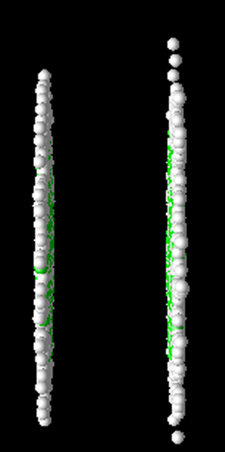
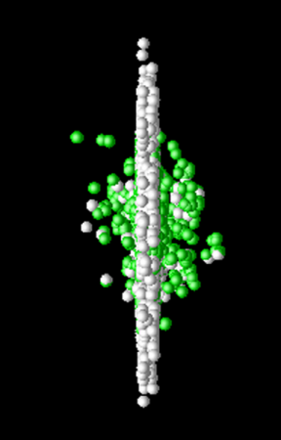
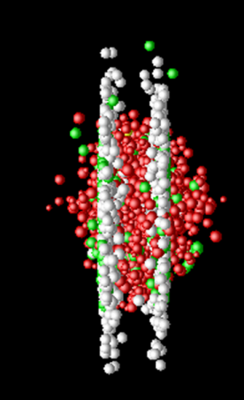
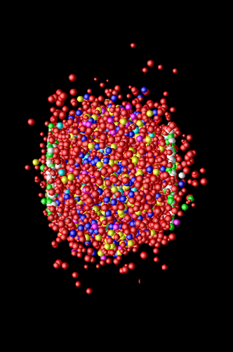
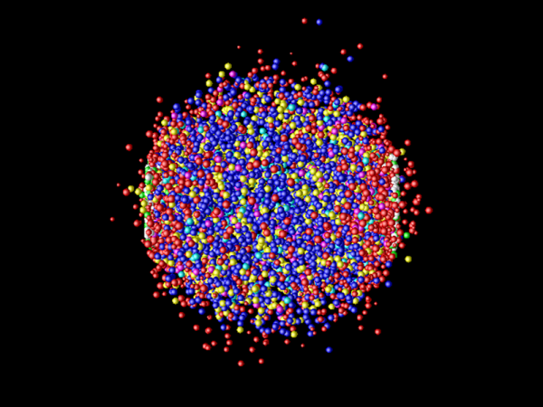
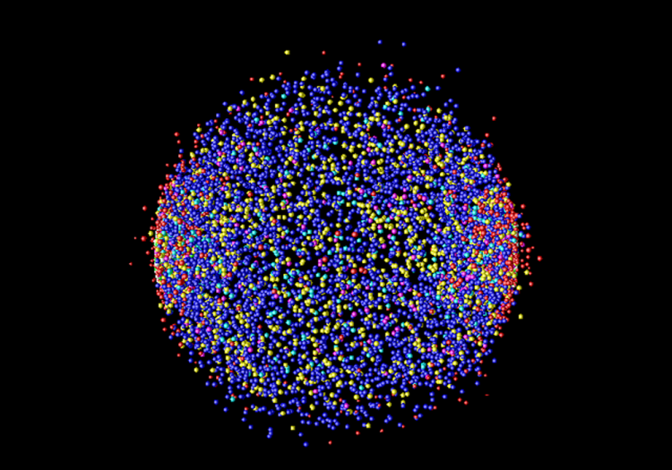
Heating matter in Heavy Ion Collision
t = - 3 fm/c
t = 0
t = 1 fm/c
t = 5 fm/c
hard collisions
pre-equilibrium
QGP (matter)
t = 10 fm/c
t > 10 fm/c
hadron gas (matter)
freeze-out (free individual particles)

Slide 7
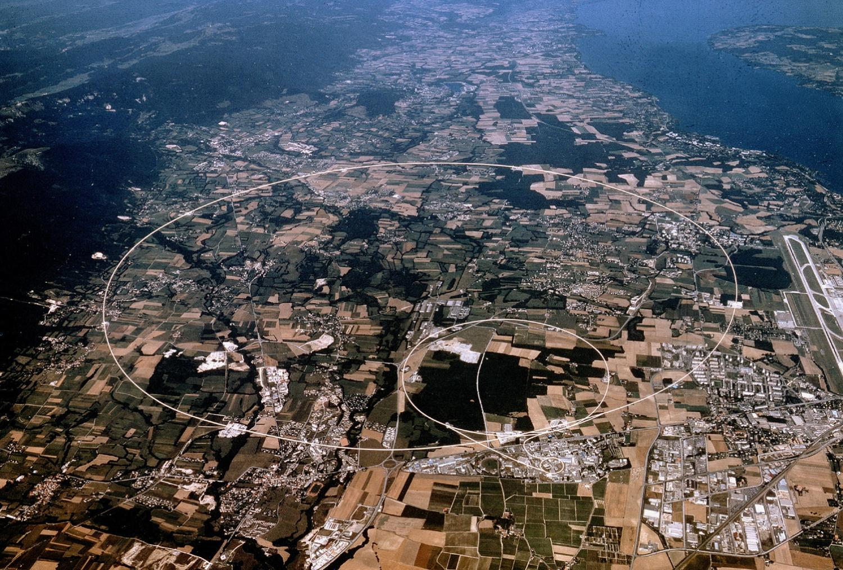
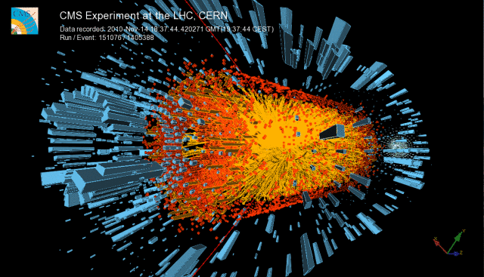
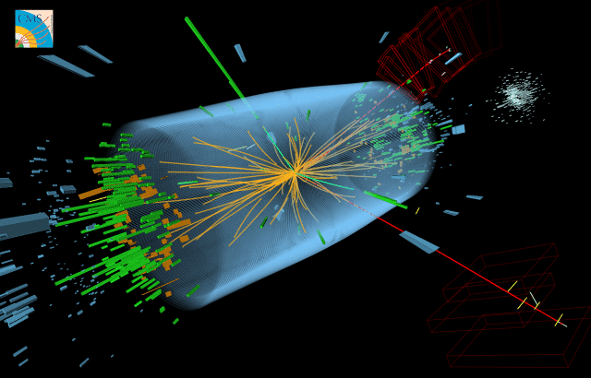
Large 'Hadron Collider'
Collider of 'Large Hadrons'
27 km circumference
≈ 100 m underground
Design Energy:
14 TeV (pp)
1150 TeV (PbPb)
Lake Geneva
CMS
p + p
Pb + Pb
LHCb
ALICE
ATLAS
4 Large Experiments

Slide 8

Atlas

Slide 9
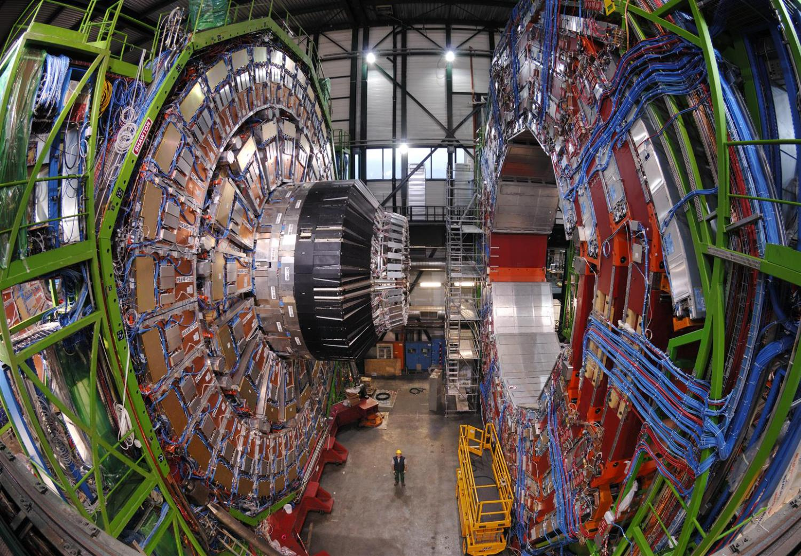
CMS

Slide 10
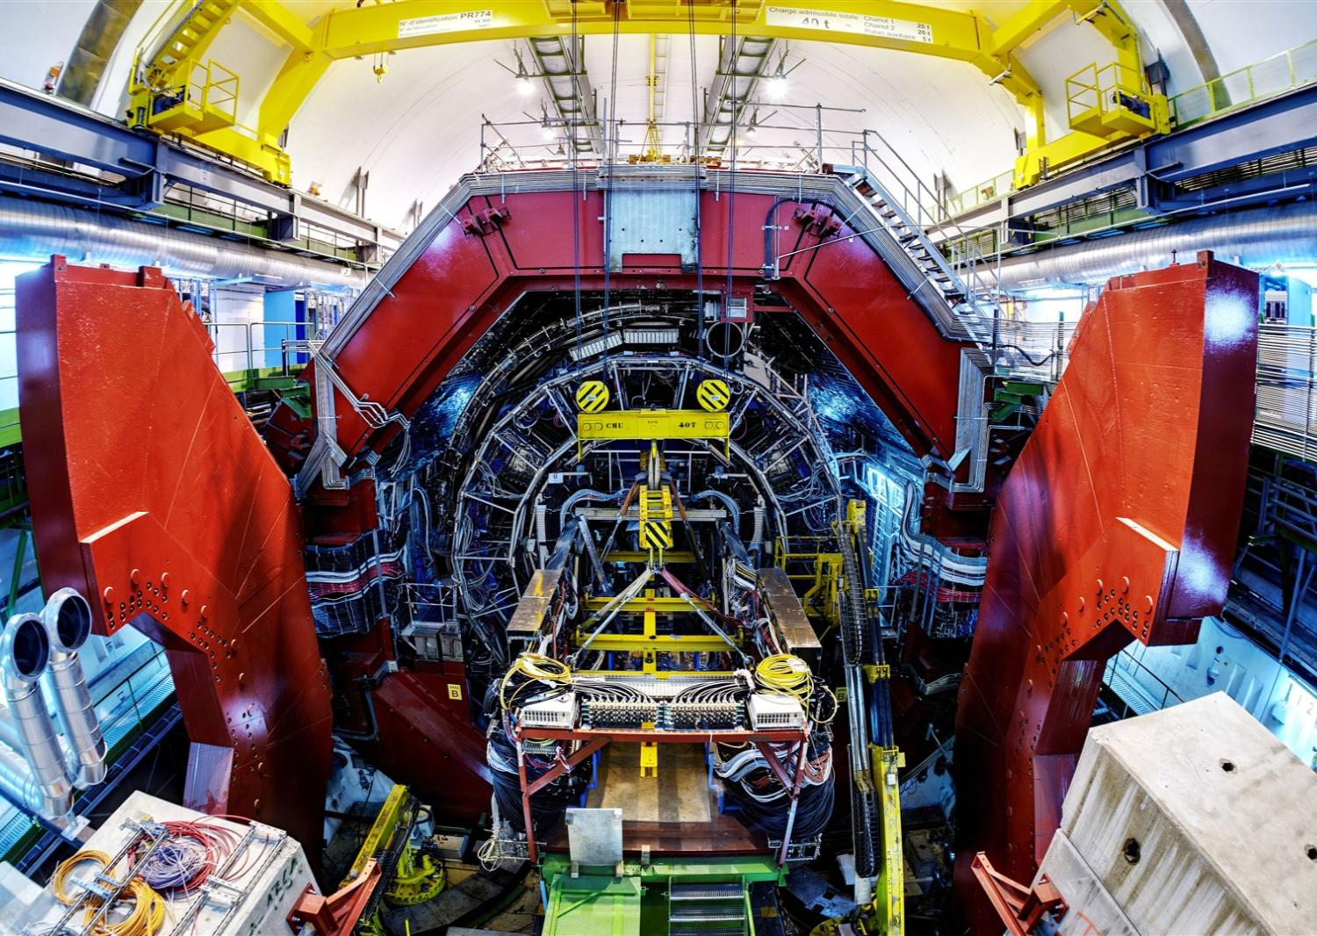
Alice

Slide 11

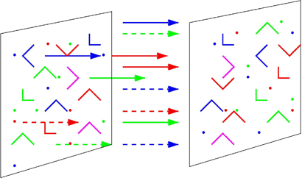
Theory Tools
Lattice QCD
  ideal for thermodynamics(static), EoS, T_{c}
Pert. QCD
  cross sections, dynamical coefficients
Phenomenology
  hydrodynamics, thermal models
  event generators (Phytia, Hijing, ..)
Duality: AdS/CFT
  4D gauge theory equivalent to SuSY YM in 5D
  strong coupling => reduced to class. gravity
  remarkable results: η/s = 1/4π; ε(λ∞)/ε(λ₀)=3/4; ..
Color Glass Condensate
  initial state: classsical FT in high density limit
  related to gluon shadowing, saturation, small x physics
T_{c} ~ 180 MeV
ε_{c} ~ 6 T_{c}⁴
(ε-3P) ≠ 0
T_{c} ~ 176 MeV
μ_{c} =41 MeV

Slide 12
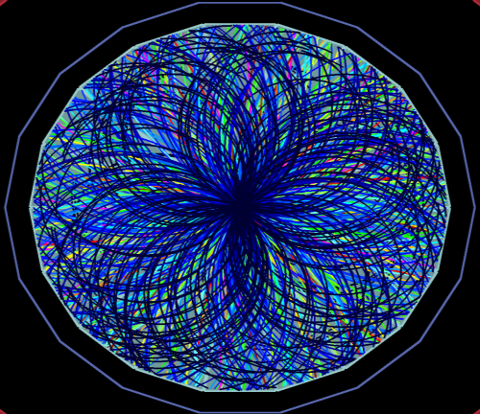
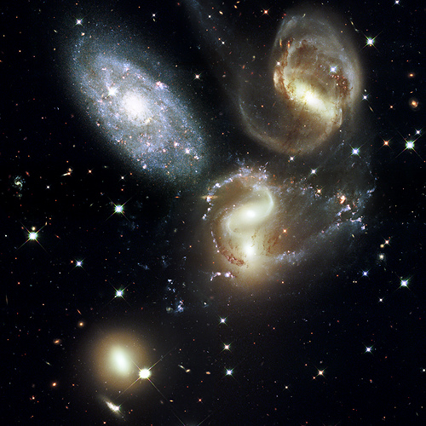
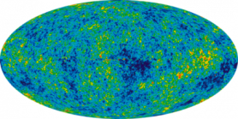
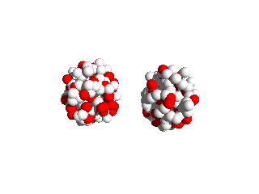


Big Bang
Little Bang
Present t₀+13.7×10⁹ years
Present t₀+3×10⁻²³ seconds
CMB
Hadron gas
time
≈ 1 μs
QGP
QGP
t₀
Notes:
This analogy with the Big Bang is appropriate not only because we investigate a tiny piece of the early universe but also becase many of the tools and methods we are using are quite similar

Slide 13
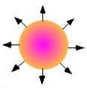

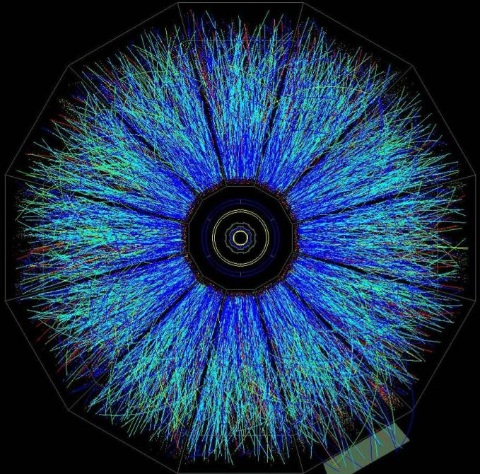

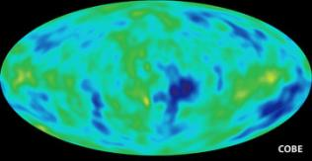
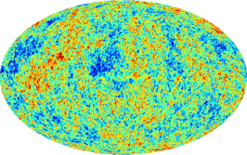
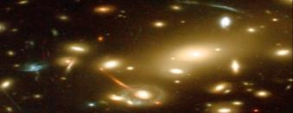
Big Bang
Little Bang
Global Characteristcs
Mass density Ω, Age
Global Characteristics
Energy Density, Size, Lifetime
Expansion (Hadrons)
Particle Flow
Expansion (Galaxies)
Hubble Flow
Nucleosynthesis (H, He, Li)
Thermodynamics at τ ~100 s
Hadron-Synthesis (π, K, p, ..)
Thermodynamics at τ ~3x10⁻²³ s
Microwave BG
T at decoupling
Thermal Radiation (γ, l⁺l⁻)
Temp. evolution ∫T dt
Temperature Fluctuations
Initial State Density Fluctuations
Flow Fluctuations
Initial State Density & Fluctuations
Gravitational Lensing
(Dark) Matter Density
Jet Quenching
Quarkonia suppression
QGP density

Slide 14
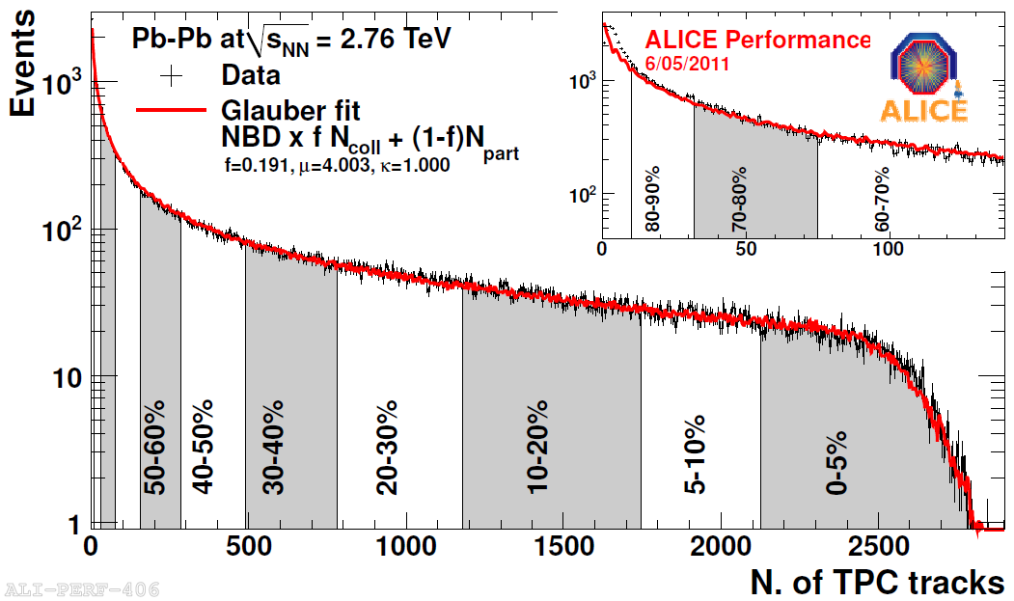
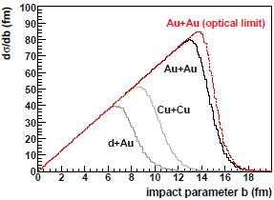
Nuclei are extended objects..
Central
'Centrality' & impact parameter b
  Measured Quantity: Centrality
    slice any observable monotonic in b (eg N_{ch}, E_{T}, ..)
      0-5%: 5% most 'central' collisions
      90-100%: 10% most 'peripheral' collisions
  Derived Quantities (syst error typically ~ 1%-10%)
    b = Impact Parameter
    N_{part} = Number of nucleons in overlap volume (participants)
    N_{coll} = Number of nucleon-nucleon collisions
      (N_{part} ~ 400, N_{coll} ~ 2000 for central Pb-Pb @ LHC)
b
Peripheral
b
Probability Distribution of b
2 x Nuclear Radius
90-100%
0-5% most central

Slide 15
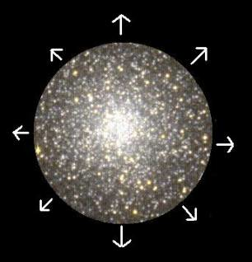
Big Bang
Little Bang
Global characteristics
  mass density Ω, age
Global characteristics
  Energy density, size, lifetime
Notes:
If you want to study the universe you want first to measure its mass density, you want to know its age likewise

Slide 16

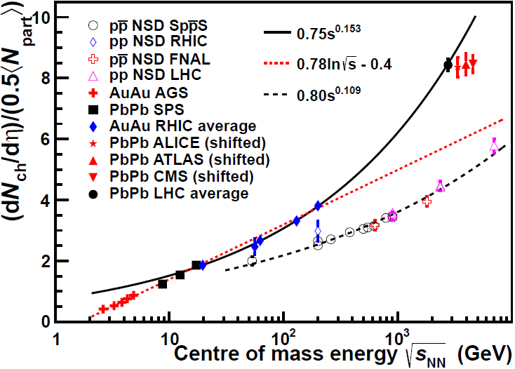
Characterizing the Little Bang (1)
Particle Production and Energy density ε:
  Produced Particles:dN_{ch}/dη ~ 1600 ± 76 (syst)
    ~ 30,000 particles in total, ~ 400 times pp !
    somewhat on high side of (recent) expectations
  power law (√s)^{α}, α(AA) ~ 0.15 > α(pp) ~ 0.11 (√s dependent 'nuclear amplification')
    power law and α as predicted by Saturation Physics (CGC)
    excellent agreement between expts
  Energy density ε ≈ 2.5 x RHIC (fixed τ₀=1fm/c)
  Temperature ≈ + 30%
    lower limit, likely τ₀(LHC) < τ₀(RHIC)
Particle production
at RHIC (BNL)
Data
N_{ch}/N_{part}: particles per participant N_{part} versus √s
Matter under extreme conditions:
ε > 15 GeV/fm³
> 10 times ε_{c}(QCD)
~ 50 times core of a neutron star
(40 billion tons/cm³)
50 protons packed into the volume of one p !
Temperature > 4 x 10¹² ⁰K
> 200,000 times center of Sun !

Slide 17
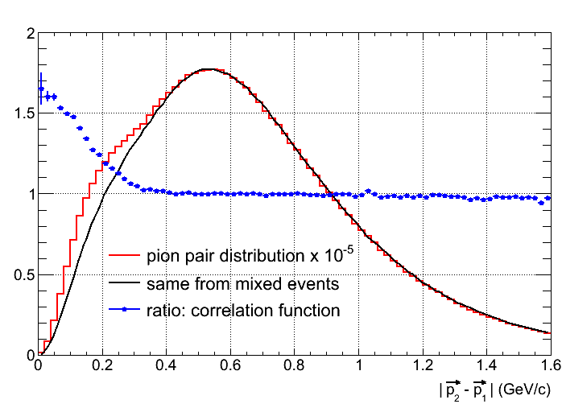
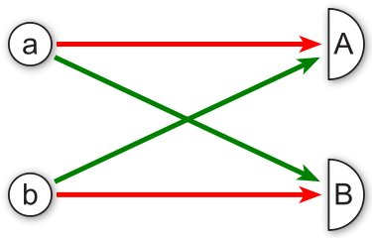
Measuring Volume & Lifetime
Identical particle interferometry (Bose Einstein Correlations, HBT)
  Quantum mechanical interference => Bose-Einstein / Fermi-Dirac statistics
  enhanced(bosons)/suppressed(fermions) occupation of quantum states
    used to measure star diameter (γγ) Hanbury-Brown & Twiss (ca 1953)
    used in high energy physics (ππ) Goldhaber (ca 1959)
measure extend of dynamical (evolving) source
Particle correlations in momentum & energy
⇓
Fourier Transform
⇓
Source distribution space & time
Distribution of ππ momentum difference Δp=|p₁-p₂|
Ratio
radius ~ 1/width
γ (π)
Δr, t
Δp, E
Data
γ (π)
independent ππ (phase space)
Notes:
Volume of Pb nucleus about 4/3*pi*r^3 = 1800 fm^3

Slide 18
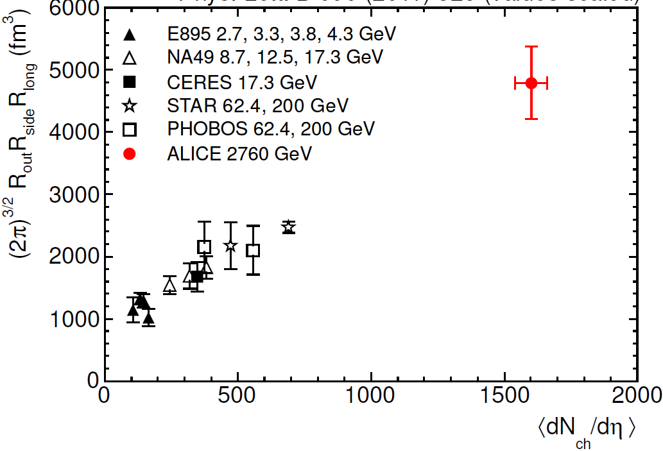
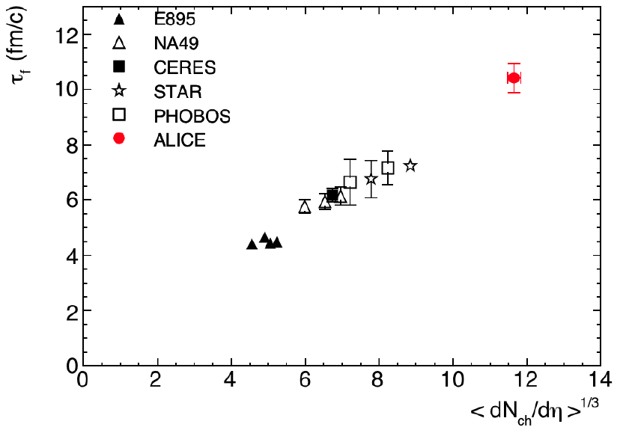
Characterizing the Little Bang (2)
Volume and Lifetime:
  Volume ≈ 2 x RHIC (≈ (2π)^{3/2}xR³ ≈ 5000 fm³)
    ≈ few x Nuclear Volume
  Lifetime ≈ + 40% (> 10 fm/c ~ 3x10⁻²³ s)
Lifetime: from collision to
‘freeze-out’ (hadron decoupling)
Volume at decoupling
RHIC
+ 40%
RHIC
x 2
'Macroscopic' system:
Size R >> Interaction length λ
Lifetime τ >> Relaxation times τ_{R}
‘Little Bang’ lives some 10⁴⁰ less than
current age of Universe..
800 fm³ ≈ Volume of ²⁰⁸Pb
Multiplicity
Multiplicity^{1/3}
Notes:
Volume of Pb nucleus about 4/3*pi*r^3 = 1800 fm^3

Slide 19
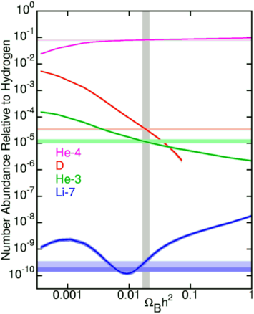

Big Bang
Little Bang
Global Characteristics
  mass density Ω, age
Primordial nucleosynthesis (H, He, Li)
  Thermodynamics at τ ∼ 100 s
Global Characteristics
  Energy density, size, lifetime
Hadrochemistry (π, K, p ratios)
  Thermodynamics at τ ∼ 10⁻²³ s
Calculated
Observed
http://astro.berkeley.edu/~mwhite/darkmatter/bbn.html
http://arxiv.org/format/nucl-th/0511071v3
Notes:
Nucleo synthesis is one of the pillar of the BB model, by looking at the ration of light elements you can learn about the thermodynamical properties at the time these particles were created a few minutes after the BB. We do something similar by looking at particle ratiosto learn about temperature, pressure and thermodynamical evolution at the time these particles were created

Slide 20
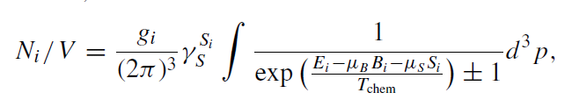
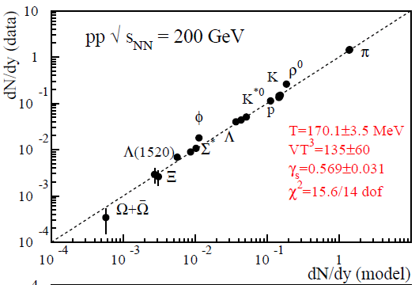
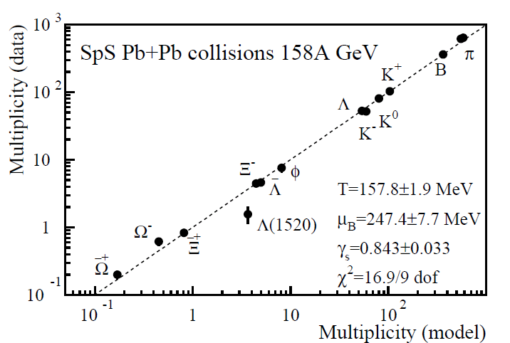
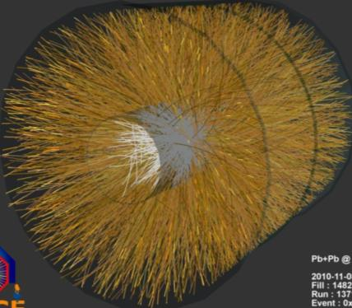
Particle Production
Dozens of different particle types: π(ud),p(uud), K(us), Λ(uds),Ξ(uss),Ω(sss),.
  production ratios can not be calculated with QCD (non-pertubative)
    phenomenological models ('event generators') use many adjustable parameters
Statistical ('thermal') models:
  particle with mass m produced in 'heat bath T' according to phase space
  P(m) ~ e^{-(m/T)}
  T_{ch} Temperature (ch='chemical')
  μ_{b} Baryo-chemical potential (baryon conservation)
  γ_{s} Strangeness suppression
accurate to ~10% (but no 'a priori' justification in pp)
T_{ch}: 160-170 MeV γ_{s} : 0.9-1 (AA), 0.5-0.6 (pp)
strangeness enhancement = QGP signal ?
particles created per collision
RHIC pp
SPS Pb-Pb
Data
Model

Slide 21
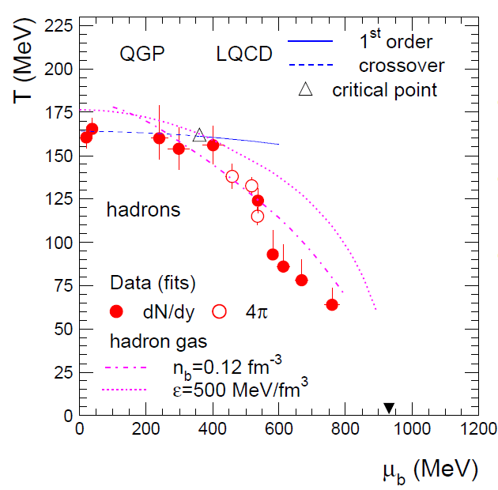
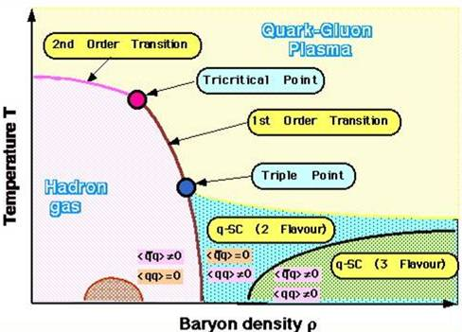
Mapping the Phase Boundary
smooth cross-over
QGP boundary
measured
'particle freeze-out'
boundary (ε ≈ 0.5 GeV/fm³)

Slide 22
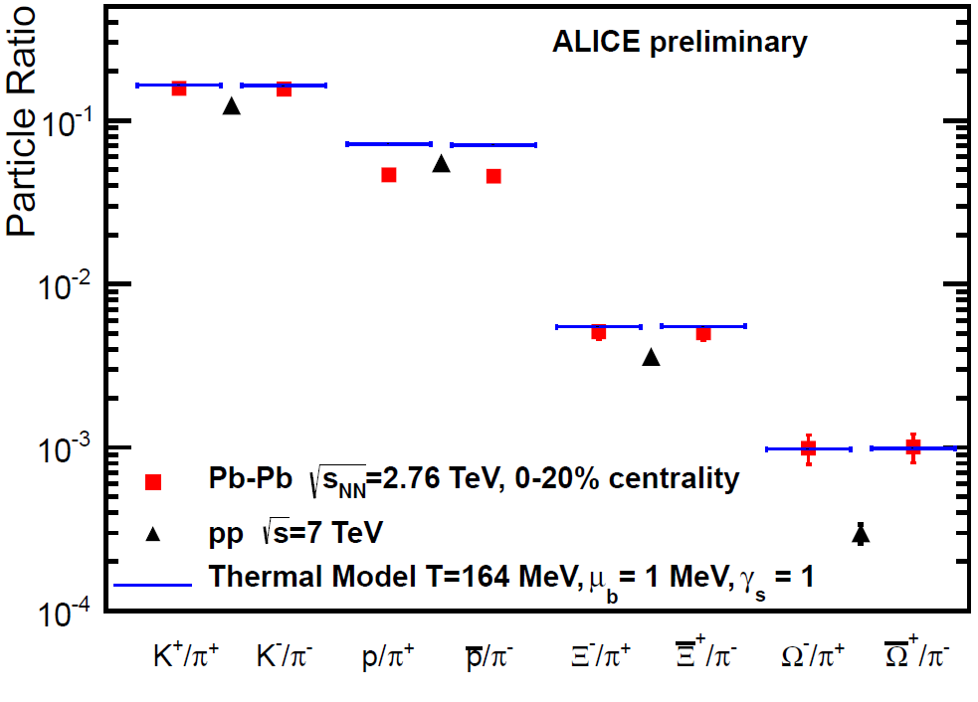

Particle Ratios Pb-Pb
Strangeness is enhanced
+30% (K), > factor 3 (Ω)
γ_{s} = 1, like thermal model
p/π off by factor > 1.5
from predictions !
suppressed,
not enhanced,
compared to pp
very puzzling, indeed (safest prediction for LHC !)
- non-equilibrium freeze-out at LHC ??
- final state interactions -> sequential freeze-out ??
K(s)
Ξ(ss)
?
Ω(sss)
(Prediction, no fit)

Slide 23
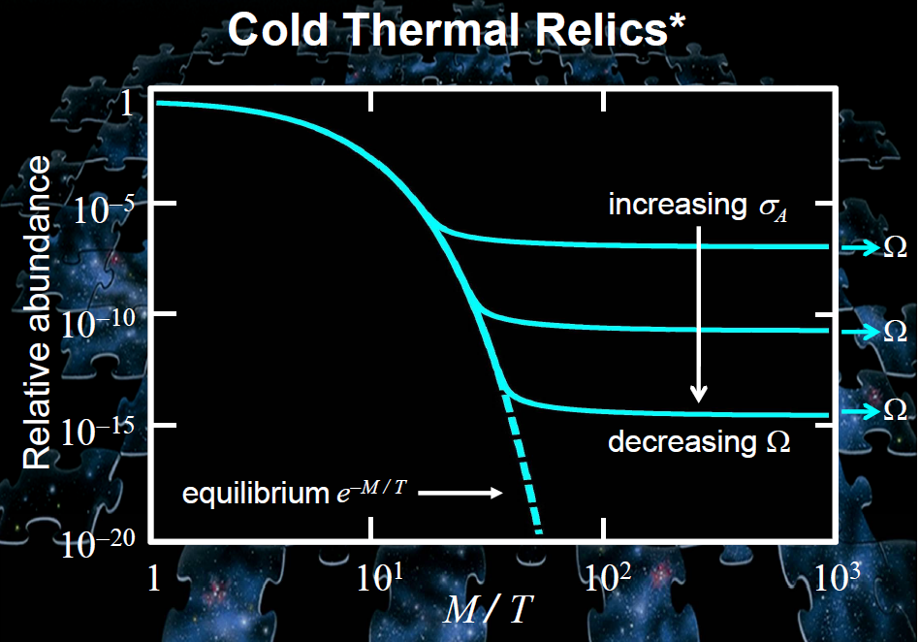
Abundance 'at freeze-out' is determined by the cross section
large σ => freeze-out at low T => smaller abundance

Slide 24
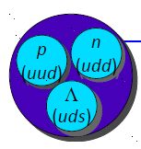
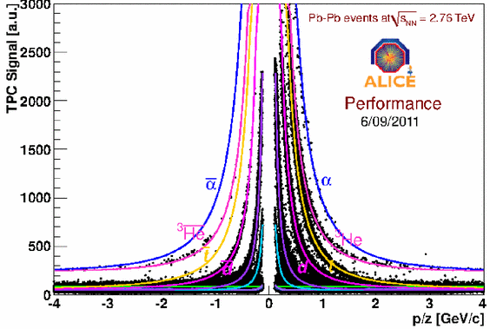
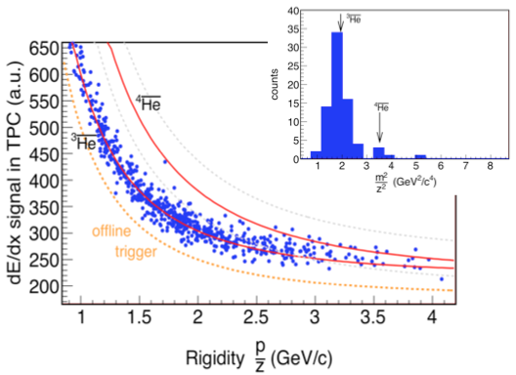
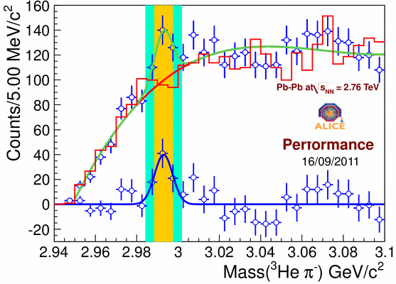
Nucleo-synthesis at LHC
Light Nuclei & anti-Nuclei
  anti-⁴He is the heaviest anti-nucleus ever observed
  Hypertriton: one proton replaced by Λ particle
³_{Λ}H → ³He + π⁻
5 ⁴He candidates
4 with TOF
3 with correct mass
Energy Loss in Gas Detector
Background
Momentum/Charge
In general, also nuclear abundances fit a common freeze-out
(T ~ 170 MeV) with π/K/p, .. tbc at LHC

Slide 25
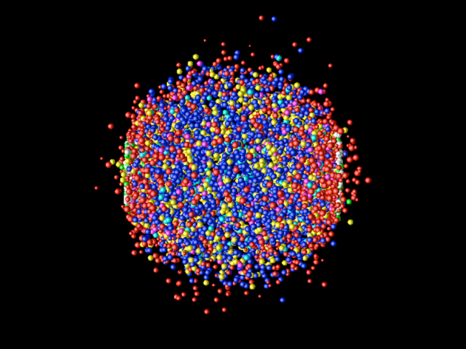
Big Bang
Little Bang
Primordial nucleosynthesis (H, He, Li)
  Thermodynamics at τ ∼ 100 s
Expansion (galaxies)
  Hubble flow
Hadrochemistry (π, K, p ratios)
  Thermodynamics at τ ∼ 10⁻²³ s
Expansion (hadrons)
  Particles flow
Notes:
We know that the Universe expands, we can measure that by the Hubble flow of galaxies and also the little bang expands at the speed of light and we can measure its expansion by the flow of particles

Slide 26
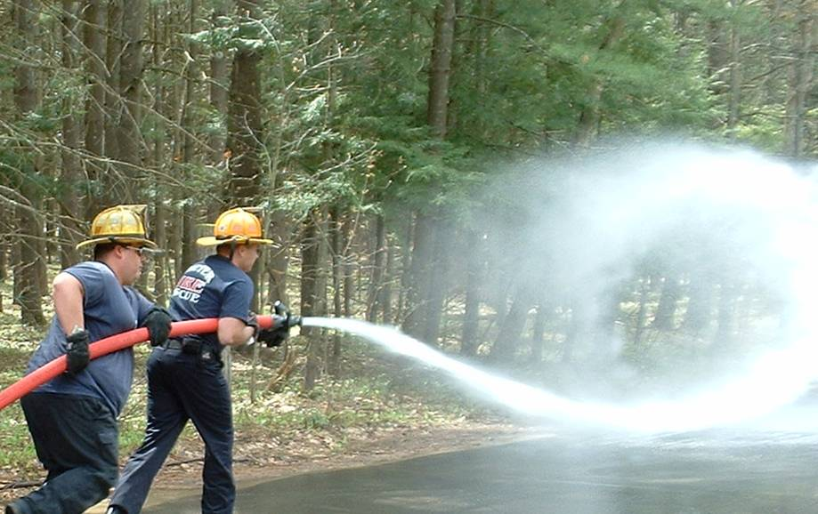
Hydrodynamic Flow
Flow: Correlation between coordinate and momentum space
  close particles move at similar velocity and direction
  flow builds up in an interacting medium with pressure gradients
  Hydrodynamics: flow depends on
    Initial Conditions: geometrical boundary conditions, pressure gradients
    Fluid properties: Equation of State EoS f(P,E,T), viscosity η (internal friction),..

Slide 27
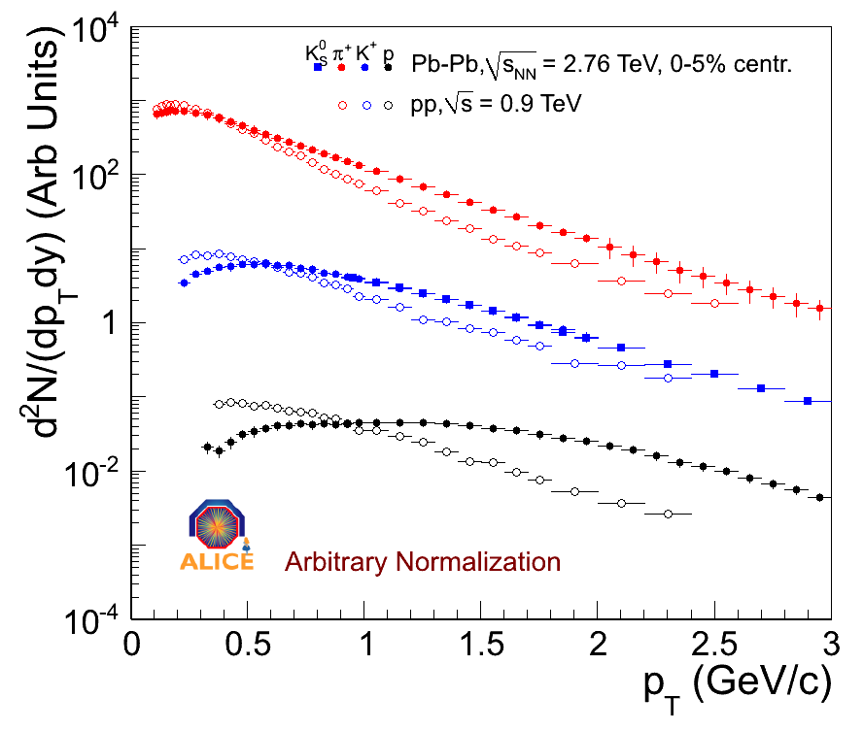
Flow in Heavy Ion Collisions
Radial Flow
  pressure P in center drives expansion
  flow velocity β=v₀/c depends on f(P, τ, EoS, ..) (most important is the absolute pressure P)
  momentum p = γ m v₀ => particles of different mass have
  characteristic & different momentum spectra
Momentum Distribution
π
isotropic radial flow
v₀
K
P = 0
p
v₀
P >> 0
PbPb
v₀
pp

Slide 28
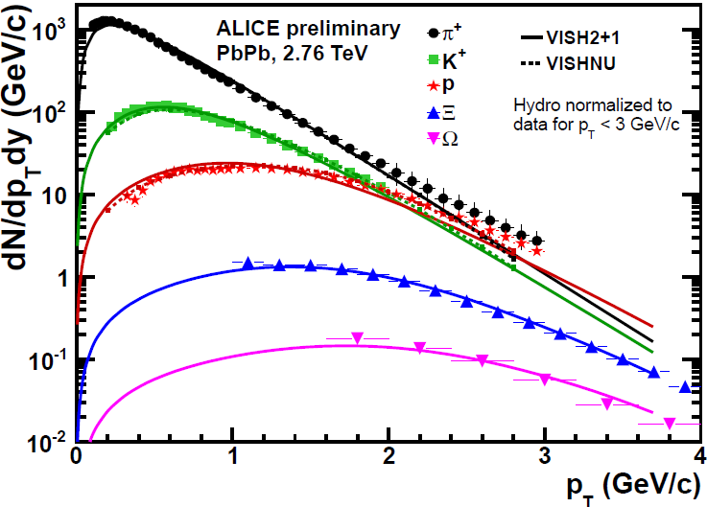
Identified Particle spectra
Hydrodynamic Model Calculation
w & w/o URQMD 'afterburner'
Shape and mass dependence well described by Hydro flow models
up to ~ 1.5 GeV for π, up to ~ 4 GeV for Ξ, Ω
Very strong radial flow, <β> ≈ 0.66 2/3 speed of light, shock front reaches β ≈ 1 !
(flow is significantly larger than at RHIC !)

Slide 29


Flow in Heavy Ion Collisions
Elliptic Flow
  non-central collisions
    deformed, 'elliptic' reaction zone
    anisotropic particle density around reaction plane
  flow modulation v₂ depends on f(ε,η, EoS,..)
    eccentricity ε = (y²-x²)/(y²+x²)
    (shear) viscosity η
    large η dissipates pressure
    gradients => reduces v₂
Fourier analysis: dN/dφ = 1 + 2 v₂ cos(2φ) + …
dN_{ch}/dφ
x
y
y
x
Anisotropic particle density
φ
Pressure Δp_{x} > Δp_{y}
Z
P_{y}
P_{z}
Azimuthal (φ)
pressure gradients
Reaction plane
P_{x}
Y
X
Spatial deformation
Anisotropic flow

Slide 30

Discovery at RHIC
Very large elliptic flow (v₂) (2005)
  Coincides with Hydro calculations for ideal fluid (η=0)
    at top energy, for very central collisions
RHIC
SPS
BNL Press release, April 18, 2005:
Data = ideal Hydro
"Perfect" Liquid
New state of matter more remarkable than predicted –
raising many new questions
(scaled) Flow
AGS
Multiplicity

Slide 31




QGP: The 'perfect Liquid'
Perfect liquid → Viscosity η ≈ 0
  large interaction cross section σ in the liquid
    usually use Viscosity/Entropy (η/s dimensionless)
  QGP almost ideal fluid, η/s < 0.2 - 0.4
unexpected result
  QGP though to behave like a gas
  (weakly interacting)
  closest Theory prediction η/s > 1/4π ≈ 0.08
    AdS/CFT: ('QCD analogue')
    (Conformal Field Theory in Anti-de Sitter Space)
    SUSY string theory in 5 dimensions !
    conjecture: η/s = 1/4π
    is lower quantum limit for viscosity
    mfp λ ~ 1/σ = Compton wavelength of particles
Viscosity/Entropy η/s
QGP
10¹² ⁰C
Temperature

Slide 32
Predictions for LHC
LHC prediction: modest rise 0-30%
  (Depending on EoS, viscosity, dN_{ch}/dη, ..)
Hydro seems to work very well for first time at RHIC
  experimental trend & scaling predicts larger increase of flow
    (‘RHIC = Hydro is just a chance coincidence’)
LHC ?
RHIC
SPS
(scaled) Flow
AGS
one of the most anticipated results from LHC
Multiplicity

Slide 33


First Elliptic Flow Measurement at LHC
v₂ versus p_{T}
  essentially no change from RHIC
v₂ integrated over p_{T}
  30% increase from RHIC
  at the upper edge (but within)
  hydro-predictions
particle mass dependence
  as predicted by hydro
STAR at RHIC
ALICE
Hydro Interpretation past the test !
CERN Press release, November 26, 2010:
‘confirms that the much hotter plasma
produced at the LHC behaves as a
very low viscosity liquid (a perfect fluid)..’
QGP@LHC :
still a (almost) perfect liquid
+30%
Flow coefficient
How perfect is it ?
Is η/s at the quantum limit 1/4π ?
RHIC
ALICE

Slide 34


Big Bang
Little Bang
Expansion (galaxies)
  Hubble flow
Temperatures fluctuations
  Initial Density Fluctuations
Expansion (Hadrons)
  Particle flow
Flow fluctuations
  Initial Density & Fluctuations
WMAP (Wilkinson Microwave Anisotropy Probe)
ATLAS-CONF-2011-074
Significant progress & new insights from LHC
Notes:
By looking at fluctuations in the temperature we can get signals from the early parts which are beyond this horizon when the universe was opaque likewise we do have signals which are created at the very early moment of the collision like jet quenching .. A few examples

Slide 35


Initial Conditions
Current limit: η/s < (2-5) x 1/4π
  initial conditions (pressure/energy distribution) not known precisely enough
  1) energy distribution (→ eccentricity ε) in overlap volume is model dependent
    different combinations of ε and η/s describe data equally well
  2) event-by-event fluctuations → change ε at fixed b & higher order deformation
    suggested in 2010 but controversial, higher v_{n} where not directly 'seen' in the data
Fourier series: dN/dφ = 1 + 2 v₁ cos(φ) + 2 v₂ cos(2φ) + 2 v₃ cos(3φ) +…
Elliptic, v₂
Triangular, v₃

Slide 36










Fluctuations & Higher Moments
Associated
v₁+v₂₊v₃₊v₄₊v₅
v₃
v₂
Δφ
v₄
eccentricity large
Trigger Direction
geometrical eccentricity ≈ 0
Trigger
2 particle correlation function
Average collisions: Dipole elliptic flow dominant: cos(2φ)
Central collisions: different, very broad structures develop ('Mach Cone' & 'Near Side Ridge')
Very central collisions (1% most central, b < 1.5 fm): triple peak very visible
Nicely described by Fourier series: v₂ ≈ v₃ ≈ v₄ > v₁ ≈ v₅ > v_{>5} ≈ 0
average deformation ≈0 (b≈0) => flow structures from initial state density fluctuations

Slide 37


Are the structures really from Flow ?
v₃ for π/K/p
v₂ & v₃ versus p_{T}
v₂
η/s = 0
η/s = 1/4π
η/s = 0
π
η/s = 1/4π
K
p
v₃
v₅
Hydro calculation for v₃
v₃ shows mass splitting expected from hydro flow !
Has the magnitude (and p_{T} dependence) expected from geometry fluctuations
(and has larger sensitivity to η/s than v₂ ! => reduces model dependence)

Slide 38




A most amazing Discovery
The 'face' of the collision zone,
including 'warts and wrinkles'
  progress in precision measurements of η/s
    higher harmonics large sensitivity to viscosity
    discriminate & constrain models
Hydro Calculation

Slide 39



Power Spectrum
2nd maximum ?
=> measure speed of sound in QGP !
2
Flow coefficient v_{n}
5
1
9
Fourier order n
Little Bang: Fourier analysis of dNch/dφ shape fluctuations
=> initial energy density fluctuations & viscous damping
Big Bang: Fourier analysis of ΔT fluctuations => baryon-photon acoustic peaks
=> primordial density fluctuations & diffusion damping

Slide 40




2 Particle Correlations: Ridges everywhere ?
ALICE PbPb 10-20%
CMS pp 7 TeV
the first discovery at LHC !
Di-Jet
Flow
'Near Side Ridge
CMS pPb 5 TeV
ALICE pPb 5 TeV
Stronger NSR
Flow-like ?

Slide 41


Big Bang
Little Bang
Temperatures fluctuations
  Initial Density Fluctuations
Gravitational Lensing
  (Dark) Matter density
Flow fluctuations
  Initial Density & Fluctuations
  Jet quenching, color screening
  QGP Density
http://www.scitechexplained.com/tag/gravitational-lensing/
beams of
hard probes:
jets, J/ψ ….
QGP
Notes:
By looking at fluctuations in the temperature we can get signals from the early parts which are beyond this horizon when the universe was opaque likewise we do have signals which are created at the very early moment of the collision like jet quenching .. A few examples

Slide 42
Jets & 'Jet-quenching'
Scattered high energy partons (q,g) fragment into hadrons
  partons loose energy when traversing a medium
    Jet(E) → jet (E’ = E-ΔE) + soft particles(ΔE)
  QCD energy loss ΔE expected to depend on:
    q : 'opacity ' = property of medium ('radiation length of QGP')
    L: size of medium (~ L (elastic) ~ L²(radiative), L³(AdS/CFT))
    c_{q}: parton type (gluon > quark)
    f(m) : quark mass (light q > heavy Q)
    f(E) : jet energy (ΔE = constant or ~ ln(E))
Jet
^
q
q
q
q
jet quenching measures
‘stopping power' of QGP
ΔE ~ f(m) x c_{q} x q x L^{n} x f(E)
highest energy ('leading')
fragment
^
1) How much energy is lost ?
measure jet imbalance E - E'
2) Where (and how) is it lost ?
measure radiated energy ΔE
3) Shows expected scaling ?
vary L, m, E, ...
beams of
hard probes:
jets, J/ψ ….
QGP

Slide 43



Observation of Jet Quenching
Observed at RHIC in 2001
  via suppression of 'leading fragments' (not enough energy to see jets)
    qualitative clear effect, quantitative interpretation difficult & model dependent
Very striking at LHC
  many unbalanced (E₁ ≠ E₂) jets and 'monojets'
Alice
102 GeV
Energy flow in η−φ plane
47 GeV
CMS
Δφ
Δη
Atlas

Slide 44


1) How much Energy is lost ?
Di-Jet energy balance A_{j} A_{j} = (P_{T1}-P_{T2})/(P_{T1}+P_{T2})
P_{T1} ≈ P_{T2}
CMS
P_{T1}
P_{T1}
P_{T1} » P_{T2}
Simulation
<ΔE> ≈ 20 GeV (wide distribution)
Medium is VERY strongly
interacting ('opaque')
(but within expectations)
Data
arXiv:1107.0631v1 [hep-ph] 4 Jul 2011
In general, BOTH
jets loose energy !
Quenching Model
jet quenching
ΔE ~ .....

Slide 45

2) Where (& how) is it lost ?
Di-jet angular correlation Δφ₁₂
Δφ₁₂
back-to-back
Δφ₁₂=180⁰
pp
E → E’ + ΔE
Simulation
combinatorial
background
?
3) Energy dependence
as expected, ΔE ~ E
(CMS PLB 712 (2012) 176)
Unexpected Result :
- jets remain back-to-back like in pp
(little additional broadening from radiated Energy)
- radiated energy appears in low energy hadrons, far away from the jet (CMS PRC 84 (2011) 024906)
jet quenching
ΔE ~ f(m) x c_{q} x q x L^{n} x f(E)
^

Slide 46


4) Mass & Color Charge Dependence
Measure Heavy Quarks (c,b) versus π (gluon fragmentation dominates π at LHC)
jet quenching
ΔE ~ f(m) x c_{q} x q x L^{n} x f(E)
^
Expectation:
ΔE(B) < ΔE(D) < ΔE(π)
- heavy↔ light
- quark ↔ gluon
Charm Mesons
(π⁺ + π⁻) R_{AA}
B Meson
R_{AA} = measured/expected ~ AA/pp
- R_{AA} prompt charm ≥ R_{AA} pions
expected difference ≈ factor 2 @ < 8 GeV
- R_{AA} beauty ≥ R_{AA} charm
R_{AA} = 1 for (very) hard QCD
(=no modifications)
Energy Loss => R_{AA} < 1
Needs better statistics & quantitative comparison with models

Slide 47



Quarkonia Suppression
Quarkonia Suppression (Deconfinement)
R_{AA}: J/Ψ measured / expected
beams of
hard probes:
jets, J/ψ ….
QGP
SPS ≈ RHIC
Quarkonia: cc / bb bound state
created in hard scattering
should 'melt' in QGP
J/Ψ suppression similar at RHIC and SPS !
  should depend on Energy (temperature)
    1) J/ Ψ melts only at T > 1.5 – 2 T_{c} at SPS & RHIC?
      only weakly bound cc resonances (Ψ’ & χ) melt. => LHC ?
    2) more J/ Ψ melt at RHIC than at SPS
    ‘magic’ cancellation between suppression and regeneration (cc recombination) ?
    => LHC less J/ Ψ suppression , strong Y' & Y'' suppression

Slide 48



J/Ψ: Consistent with Melting + Regeneration !
J/Ψ R_{AA}: centrality dependence
J/Ψ R_{AA}:p_{T} dependence
LHC > RHIC
melting
regeneration
Regeneration more important at
- central: ~ N_{c}²
- low p_{T} : phase space
Recombination/Coalesence:
Purist: Dirt effect, obscures deconfinement
Pragmatist: Deconfimenet signal !
Deconfinement ⬄ colour conductivity
'partons roam freely over large distance'
That's what primordial charm quarks do to recombine
melting
regeneration

Slide 49




Y suppression
Y(1S), ~ 50% direct
  higher state suppression ?
Y(2S) (~ J/Ψ)
  up to 5 x stronger suppression than Y(1S)
Y(3S) ~ gone
  Y(3S)/Y(1S) < 0.1 (95%CL)
directly produced
ϒ(1S)
ϒ(2S)
+ϒ(3S)
χ_{b1}(2P)
+χ_{b2}(2P)
χ_{b1}(1P)+χ_{b2}(1P)
Sequential suppression
as expected from deconfinement !! Caveats:
- Feed-downs from the many bb states to be sorted out..

Slide 50




Other LHC Results
Chiral Magnetic Effect ('strong CP violation')
Non-statistical
Fluctuations
Quark Coalescence
............
<p_{T}> fluctuations
charge separated correlations
'Beyond the Heavy Ion Standard Model'
Quark Scaling
Baryon anomaly Λ/Κ₀

Slide 51
Summary
Matter under extreme conditions:
  'Macroscopic' piece of matter with amazing properties
    'very strongly interacting, almost perfect liquid' : sQGP
    starts with energy density far above the expected threshold for QGP
    dynamically evolves, expands and cools
    transforms into a hadron resonance gas which stays at or close to equilibrium
  we can experimentally measure and follow its evolution in quite some detail !
What we know
  good evidence for deconfinement
  decent measurements of some QGP parameters: viscosity (η/s) & opacity (q)
    better precision is ongoing (expt + theory)
  the relevant dof (particles, excitations, ..) are NOT free quarks & gluons
    the interaction is much too strong !
What we don't know (very well yet)
  what ARE the relevant dof in the QGP ?
    pseudoparticles, collective excitations (plasmons, ..), 'glueballs', ..
  evidence for chiral symmetry restoration very indirect (strangeness, low mass leptons)
  other QGP properties (EoS, velocity of sound, ..)
^

Slide 52


The End ..
LHC is a fantastic ‘Little Bang’ machine
Looking forward to
continue the journey further
into the ‘terra incognita’
of HI at LHC
There is plenty of exciting physics (and fun)
at the LHC with Heavy Ion Collisions,
exploring QCD in a new domain,
where the strong interaction is really strong !
Hic sunt Leones !
52
PLC 20J. Schukraft

Slide 53
Backup

Slide 54
Summary
Bulk features (size, lifetime, energy density, radial flow, ..)
  LHC brings the hoped for (expected) quantitative improvements
    very precise & detailed measurement of bulk features ongoing
Particle ratios (p/π)
  shocking !
Flow Tomography (v_{n})
  huge step forward:
    experimental handle on 'initial conditions'
    precision measurements of matter properties (η/s, c_{s}, EoS)
Jet Quenching
  extremely promising start (including many surprises)
    long program of measuring parameters and scaling properties ahead
Quarkonia suppression
  can LHC solve the Quarkonia puzzle ? (indications are good ! 2011 = 15 x 2010)
Plethora of unconventional/speculative ideas
  to be explored

Slide 55




Even QED becomes strong at LHC
very large em cross sections
relativistic Lorentz boost amplifies electromagnetic field of nuclei
  QED e⁺e⁻ pair production: hundreds of kbarn (>10⁵ nuclear σ)
    Hadronic Resonance (ρ, J/Ψ, ...,Higgs)
  em dissociation ~ 200 barn (via Giant Dipole Resonances)
    one or several neutrons at zero degree
    ^{208-x}Pb 'beams' limits LHC intensity (magnet quench)
  photonuclear reactions: tens of barns (kinematics very similar to pA)
    Gamma energy several 100 GeV
Pb + ²⁰⁸Pb → Pb + ^{208-x}Pb + x n
LHC is a very versatile collider:
pp, AA, pA (2013?)
γγ, γA, γ-Pomeron
1n
2n
3n

Slide 56
Kinematics, Centrality
→
Relativistic Kinematic Variables: P(p_{T}, η, φ)
  Transverse Momentum p_{T}:
  Polar angle θ => (pseudo)rapidity η = - ln tan(θ/2)
  (θ = 90⁰ => η = 0)
  Azimuthal Angle φ
'Centrality' & impact parameter b
  Participants N_{part} = Nucleons in overlap volume
  Centrality ordered in impact parameter e.g.
  0-5%: 5% most 'central' collisions
  90-100%: 10% most 'peripheral' collisions
→
p
p_{T}
φ
θ
Peripheral
Central
b
b

Slide 57

Particle Production
Energy dependence: log -> power law
  CGC prediction: λ/2 ≈ 0.13 - 0.15 (fit to Hera data)
dN_{ch}/dη as function of centrality N_{ch} ~ αN_{part} + (1-α)N_{coll}; α ≈ 0.2
  soft process dN_{ch}/d_{η} ~ N_{part} number of scattered nucleons/participants
    N_{ch}/N_{part} is centrality independent
  (very) hard processes dN_{ch}/d_{η} ~ N_{coll} number of nucleon-nucleon collisions
    more important with √s & with centrality (α should grow with √s)
  DPMJET MC (soft+hard)
    N_{part} dependence too strong
  HIJING MC (soft+hard)
    strong centr. dependent
    gluon shadowing
  Saturation Model (CGC)
    predicts weak vs dependence
LHC ~ 2.1 x RHIC
(for N_{part} > 100)
DPMJET
HIJING
Saturation
Important constraint for models
sensitive to details of saturation

Slide 58

Blastwave Fit

Slide 59


'Jet' Quenching at RHIC
absorption of jets from interior
fractional energy loss
from T. Renk
Jyvaskyula
RHIC dynamical range
Difficult to measure
energy loss at RHIC

Slide 60


'Jet' Quenching at RHIC
pQCD
AdS/CFT
Hydro
from T. Renk
Jyvaskyula
different jet-bulk combinations compatible
L^{n}: n>1
q: weak constraints on opacity
(R_{AA} ~ const => surface/volume ratio)
Energy Loss Model (jet)
Hydro Model (bulk)

Slide 61


Slide 62


Slide 63

Mapping the Phase Boundary
QGP boundary
measured
'particle freeze-out'
boundary (ε ≈ 0.5 GeV/fm³)
Temperature
Baryon Density

Slide 64


Hard Probes : Jet Quenching
beams of
hard probes:
jets, J/ψ ….
QGP
R_{AA:} Ratio AA/pp of inclusive p_{T} spectra
Two high p_{T} particle azimuthal correlation
(‘disappearance of away-side jet’)
Photons show no (little) suppression
peripheral
Leading hadrons show strong suppression
central
R_{AA} ~ constant for pT > 6 GeV
=> Difficult to quantify energy loss at RHIC

Slide 65

'Jet' Quenching at LHC
PLB 696 (2011) 30-39
Different Energy loss models
(all tuned to describe RHIC R_{AA})
Much extended p_{T} range:
R_{AA} is rising at LHC !
=> significant model constraints
Quantitative extraction of energy loss and L dependence becomes possible

Slide 66



Latest Data
Photons
Z₀
R_{AA} ≈ 1
R_{AA:} Ratio of inclusive p_{T} spectra
^
- Extraction of q & L^{n} under way
needs sign. modeling effort (TH) and data on path-length dependence (eg via event plane correlations in non-central coll.)
Hadrons
jet quenching
ΔE ~ f(m) x c_{q} x q x L^{n} x f(E)
^

Slide 67




M. Gyulassy:
- pQCD calculations can describe R_{AA}(π,D), A_{j}, v₂@high pt
- jet-medium coupling (q^) slightly reduced at LHC
dynamical mechanism, ΔE/E = constant ??

Slide 68
Jet Quenching with Jets
Very striking at LHC
  many unbalanced (E₁ ≠ E₂) jets and 'monojets'
Alice
102 GeV
Energy flow in η−φ plane
47 GeV
CMS
Δφ
Δη
Atlas

Slide 69
2) Where (& how) is it lost ?
Di-jet angular correlation Δφ₁₂
Δφ₁₂
back-to-back
Δφ₁₂=180⁰
pp
E → E’ + ΔE
Simulation
combinatorial
background
?
3) mass & 4) energy dependence
first results seem different than predicted
Medium energy loss strong (jet quenching)
Dynamics is surprising,
different from model predictions !
Unexpected Unexpected Result :
- jets remain back-to-back like in pp
(little additional broadening from radiated Energy)
- radiated energy appears in low energy hadrons, far away from the jet (CMS Arxiv 1102.1957)

Slide 70

3) Energy dependence (2011 DATA)
Ratio of energies between jets: <p_{T2}/p_{T2}> versus p_{T1} ("1" = leading jet)
jet quenching
ΔE ~ f(m) x c_{q} x q x L^{n} x f(E)
^
pp
Simulation
~ 10%
PbPb
~ 10%
?
Difference in <p_{T2}/p_{T1}> between data and MC of O(10%)
~ independent of leading jet p_{T}
=> ΔE ~ E ?? (expected: ΔE ~ constant)

Slide 71


4) Mass & Color Charge Dependence
Measure Heavy Quarks (c,b) versus π (gluon fragmentation dominates π at LHC)
?
R_{AA:} Ratio AA/pp of p_{T} spectra
D-Meson suppression / π suppression
Charm Mesons R_{AA}
Color Charge + Mass
(π⁺ + π⁻) R_{AA}
Color Charge
- R_{AA} prompt charm ≈ R_{AA} pions for p_{T} > 5-6 GeV
expected difference factor 2 @ 8 GeV
- R_{AA} charm > R_{AA} π for p_{T} < 5 GeV ?
- Heavy Flavour leptons (e,μ) give compatible results
N Armesto et al., PRD 71 (2005) 054027
jet quenching
ΔE ~ f(m) x c_{q} x q x L^{n} x f(E)
^
Needs better statistics & quantitative comparison with other models

Slide 72


J/Ψ suppression: Compared to..
R_{CP}
R_{AA}
Phenix μμ y ≈ 1.7
Alice μμ y ≈ 3.3
ATLAS
p_{T}>6.5 GeV
CMS
p_{T}>6.5 GeV
RHIC
p_{T}>5 GeV
Surprisingly: less suppression than RHIC (∫p_{t}) !
suppression depends on p_{T} and/or rapidity !
more suppression than RHIC at high p_{T}
Nuclear effects can (must) be measures in
p-Nucleus
p-Pb run planned for 2012
Potentially big nuclear effects:
- nuclear structure functions ?: (anti)shadowing is f(√s, y)
- cold nuclear matter suppression ? (absorption in nuclei)

Slide 73

Particle Ratios at LHC
pp: Less well described than at lower energies ?
  fits 2 ratios with 2 parameters (T, μ_{B})
  maybe 'hard QCD processes' (dynamics) become visible ?
    low energy: 'phase space' fragmentation

Slide 74
Quarkonia Suppression
Quarkonia Suppression (Deconfinement)
J/Ψ measured / expected
beams of
hard probes:
jets, J/ψ ….
QGP
SPS ≈ RHIC
J/Ψ: cc bound state
created in hard scattering
should 'melt' in QGP
J/Ψ suppression similar at RHIC and SPS !
  less suppression at RHIC than predicted
    1) only Ψ’ & χ melt at SPS & RHIC, J/ Ψ melts only at T > 1.5 – 2 T_{c} ?
    LHC: Ψ', χ,Y'’, (possibly Y’ & J/Ψ, but no Y) suppression
    2) ‘magic’ cancellation between suppression and regeneration (cc recombination) ?
      LHC: less J/Ψ suppresion (enhancement ?) + Y’, Y’’ (maybe Y) suppression
 | Ψ’ | χ | J/Ψ | Y’'(3S) | Y'(2S) | Y
T_{d}/T_{c} | 1-1.2 | 1-1.2 | 1.5-2.5 | 1.1-1.3 | 1.2-2 | 3-5
Lattice QCD based predictions
of 'melting' temperature T_{d}
(a bit dated..)

Slide 75
Accelerators
Particle Physics: energy doubling time ~ 4 years
Heavy Ion Physics: doubling time ~ 2 years
  energy increase by factor 10⁴ in ~ 30 years
  starting 70’- to early 80’s at Bevalac/Berkely
    field started by a few dozen physicists from a handful of countries
    > 2000 physicists active worldwide today
Total center-of-mass energy versus time
Field went from the periphery
into a central activity of
contemporary Nuclear Physics
(and now gets even some HEP guys excited !)
LHC Pb
LHC
x 15
RHIC
RHIC
x 12
TeV
SPS
SppS
LHC
SPS S/Pb
AGS
x5.5
ISR
AGS Si/Au
AGS/PS
Bevalac
LHC: At the Energy Frontier of both
Nuclear and High Energy Physics
FNAL

Slide 76




Large 'Hadron Collider'
'Large Hadron' Collider
27 km circumference
≈ 100 m underground
Design Energy 14 TeV (pp)
Lake Geneva
Alice
Temperature (QGP)
CMS
LHCb
Precision Physics (CP violation)
Atlas/CMS
Energy Frontier (Higgs, Susy, ..)
4 Experiments
3 Physics Programs
LHCb
ALICE
ATLAS

Slide 77

Other Centrality Measures
cc
A few minutes after the first Pb collisions at LHC:
Copy from ALICE logbook (predicted calibration: 9 hits = 1 dN_{ch}/dη )
Data Quality Monitoring
considered event size fatal !
TPC event size (in Mbyte); calibration was unknown..

Slide 78
Matter under Extreme Conditions
‘state of matter’ at high temperature & energy density: ‘The QGP’
  ground state of QCD & primordial matter of the Universe
    partons are deconfined (not bound into composite particles)
    chiral symmetry is restored (partons are ≈ massless)
Mission of URHI
  search for the QGP phase
  measure its properties
  discover new aspects of QCD
  where the strong interaction is strong !
After > 10 years at RHIC:
  Search for the ‘QGP’ is essentially over
  Discovery of QGP properties is well under way
  Measuring QGP parameters has just begun => LHC (still discoveries to be made !)
rapid cross-over

