Slide 1
WP-73
TDR ART Review Report:
Hard X-Ray Monochromator
On behalf of the development team:
Eng.: X.Dong; Design: M.De Felice, (J.Anton$, S.Kearney$);
PIs: D. Shu$, H.Sinn
$ APS/ Argonne National Lab.
Notes:
How to edit the title slide
Upper area: Title of your talk, max. 2 rows of the defined size (55 pt)
Lower area (subtitle): Conference/meeting/workshop, location, date,
your name and affiliation,
max. 4 rows of the defined size (32 pt)
Change the partner logos or add others in the last row.

Slide 2
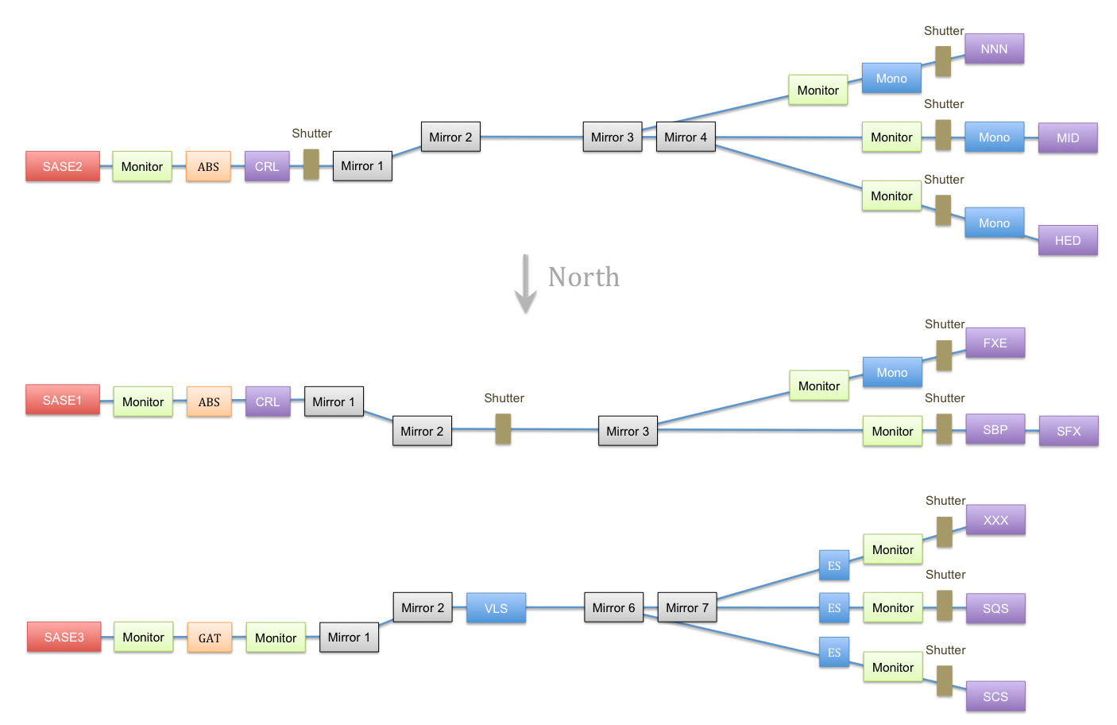
Hard X-Ray beamlines layout
Monochromators position
~900 m
H.Sinn. TDR: X-Ray optics and transport, 2012

Slide 3
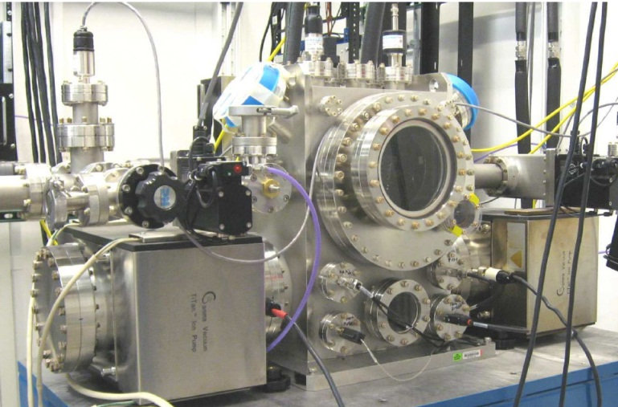
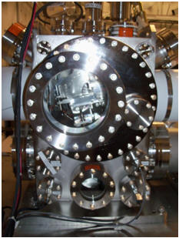
Artificial Channel-Cut Monochromator
Photo from APS/Argonne
Photo from LCLS/SLAC
Artificial (or pseudo) channel-cut type, non-monolithic
→Cryogenic cooling -- Pulse tube cooler

Slide 4
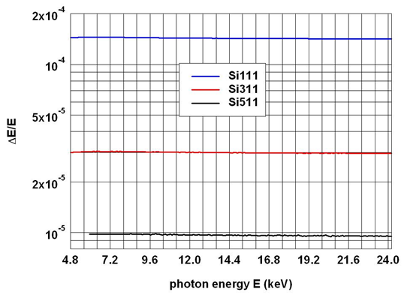
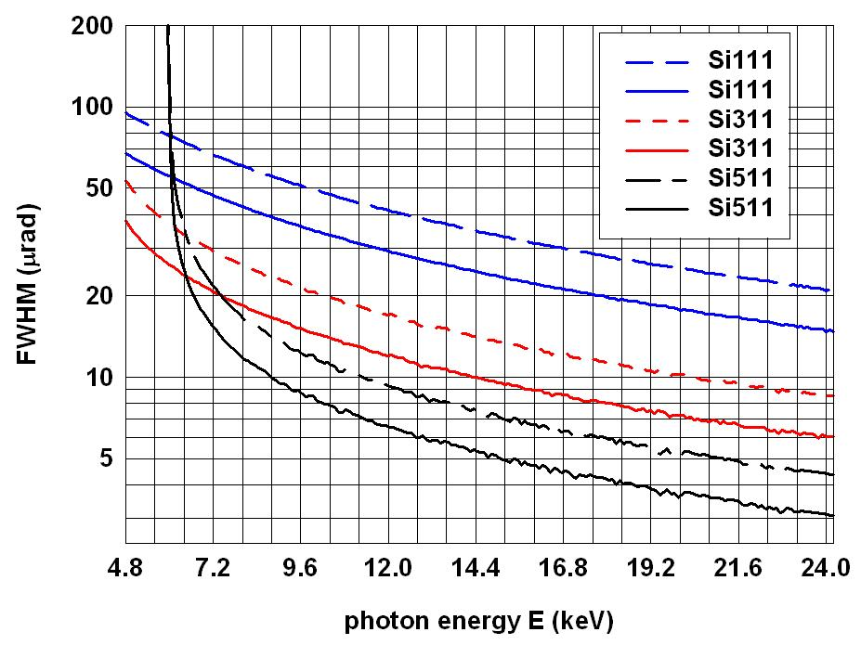

Si-Crystal reflections performances(1)
Diffraction curve = Darwin curve (one crystal rocking curve);
Rocking curve = two-crystal rocking curve but only one rocking
Rocking curve
Intrinsic energy resolution
Si111, Si311, Si511/Si333 are proposed to be used regarding different experimental requirement
Diffraction curve

Slide 5
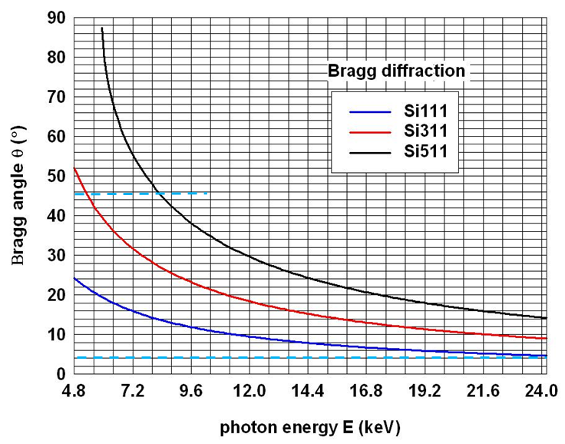
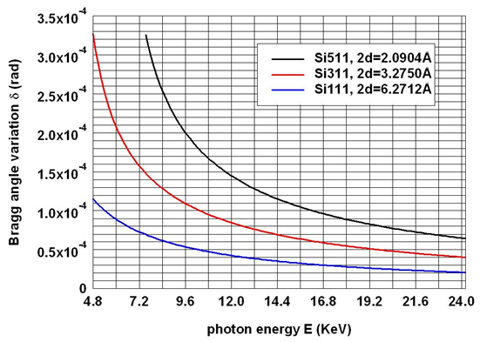
Si-Crystal reflections performances(2)
Temperature difference effect on Bragg angle variation
e.g.1st @100K; 2nd @300K
4.5 – 45 deg. Bragg angle to cover required energy range

Slide 6
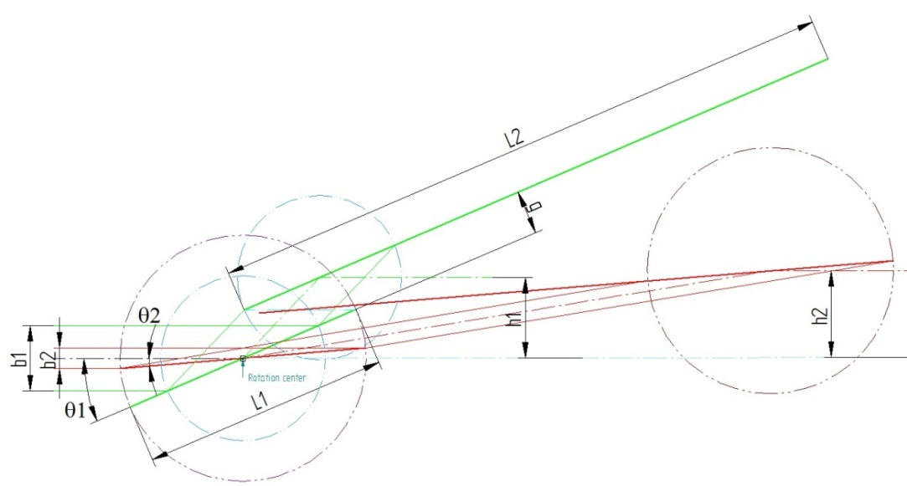
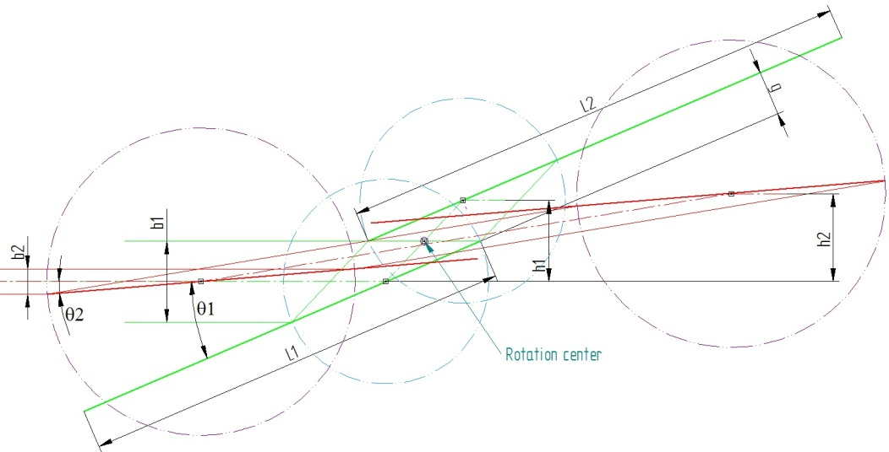
Center of rotation (COR)
Option A
Almost identical length of both crystals;
Smaller minimum gap
Option B
Minimum 1st crystal length, but very long 2nd one;
Increase minimum gap

Slide 7
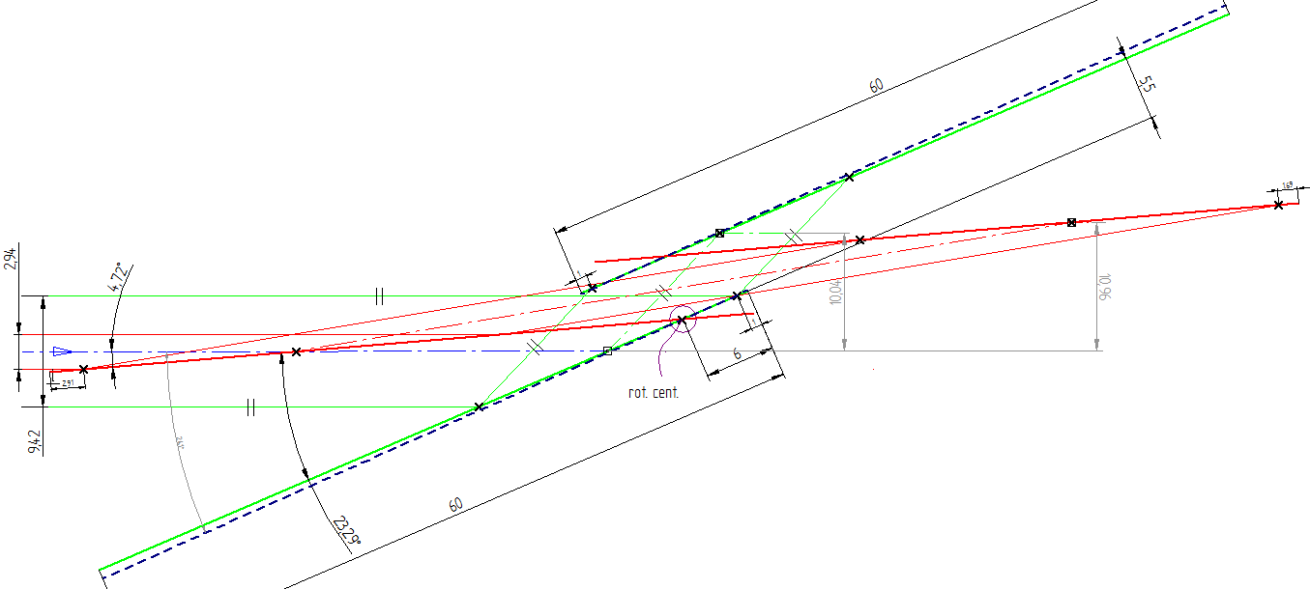
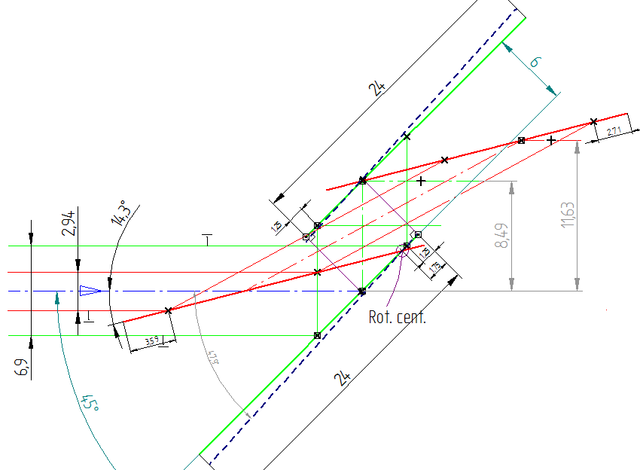
Geometry proposal
Si(111)
L1=L2=60mm, g=5.5 mm
COR
COR
extra length as safety factor and extending energy range including Ti-edge
Si(511)
L1=L2=24mm, g=6 mm
COR@ downstream end edge

Slide 8
Motion & initial alignment
X-tal_2
X-tal_1
Pitch
Roll
Combined Pitch

Slide 9
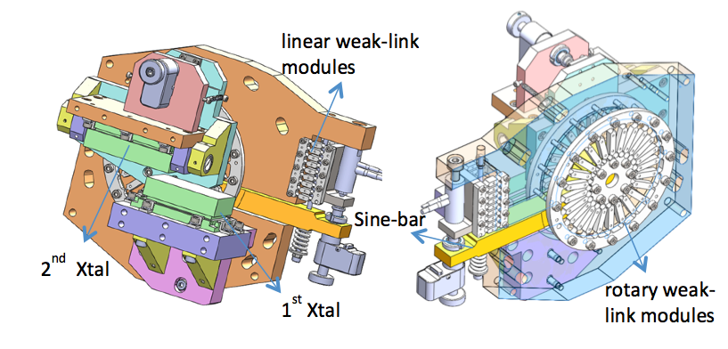
ACCM-artificial channel-cut mechanisms
Over constrained weak-link structure
(US patent, D.Shu,etc)

Slide 10
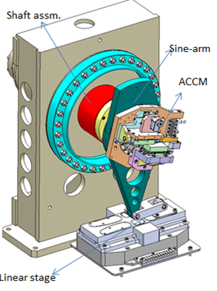
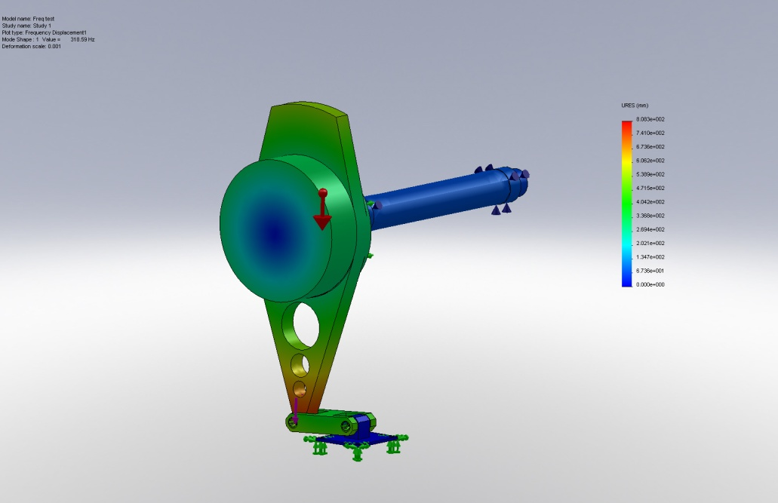
Sine-bar mechanism for combined pitch
f =318.6 Hz
J.Anton, APS

Slide 11
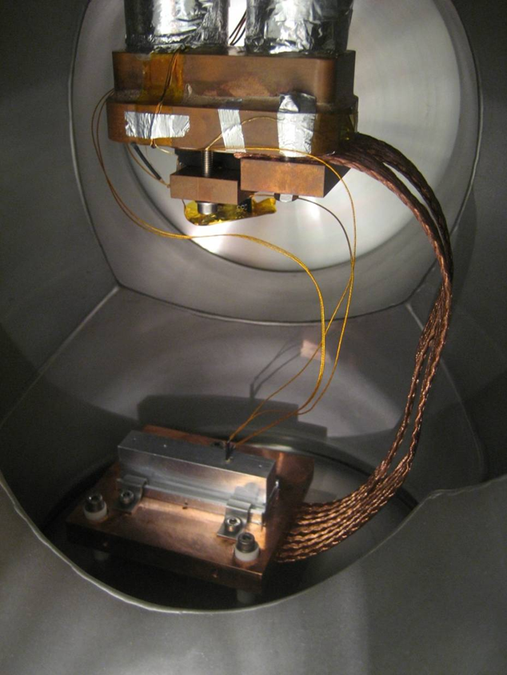
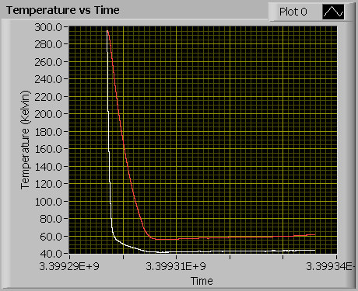
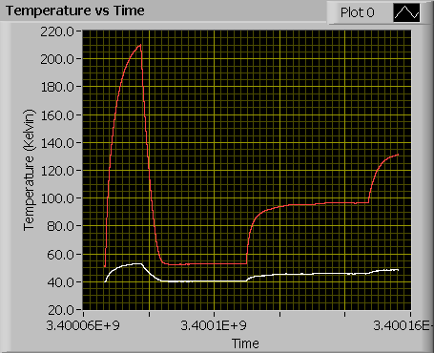

Steady thermal behavior (Cryo-cooler test)
PTS8030
Heat from 50Ω resistor
3 W
measurement done by G.Galasso, etc

Slide 12
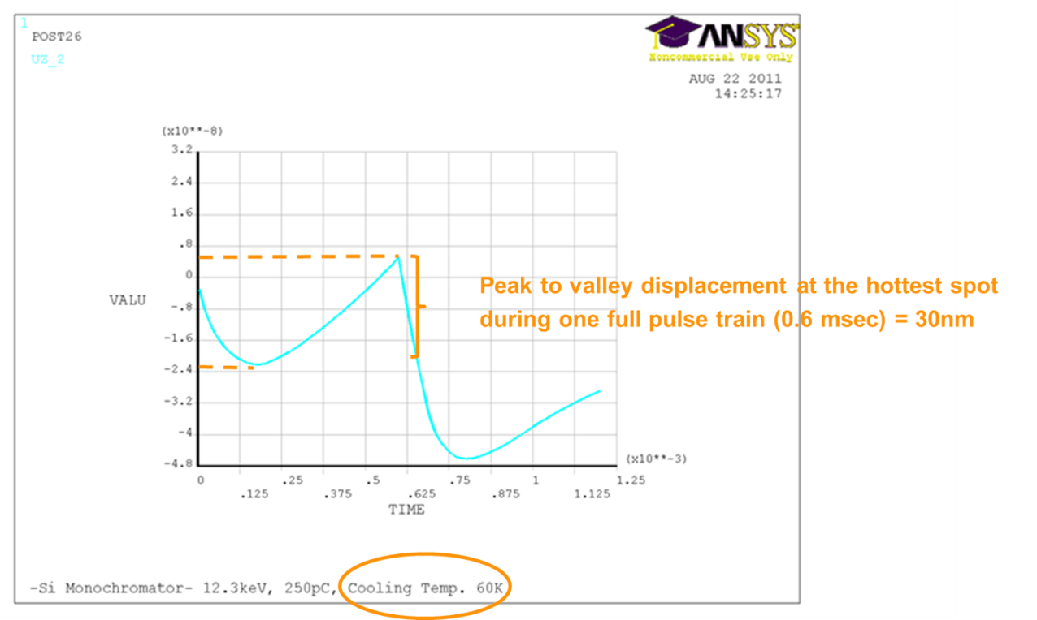
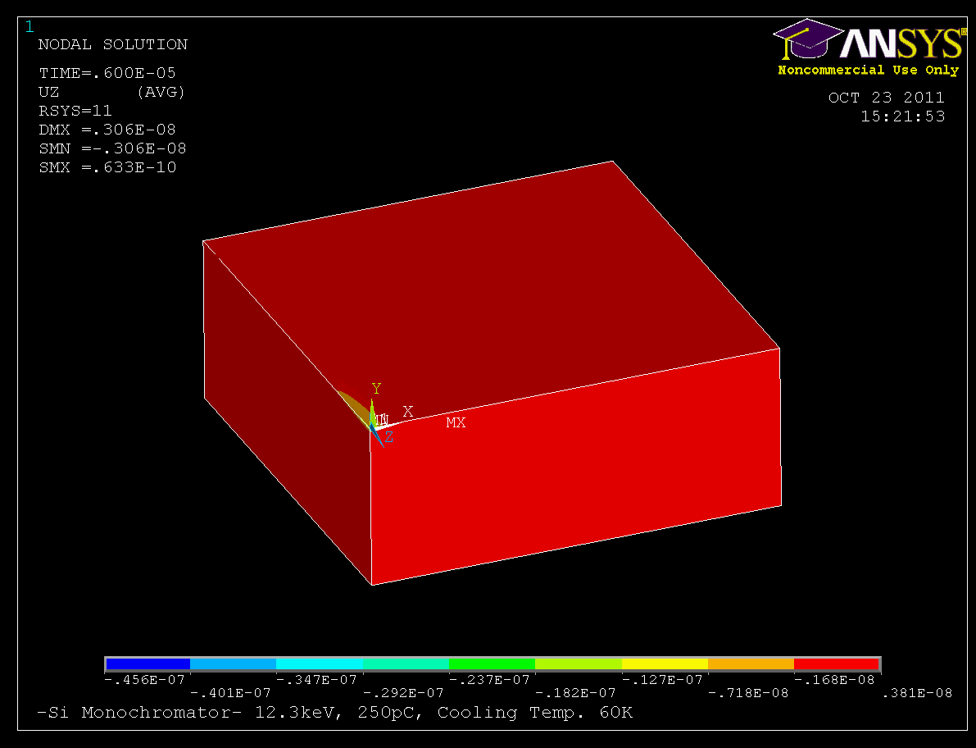
Dynamic thermal behavior (FEA SImulation)
Calculation done by G.Galasso, etc

Slide 13
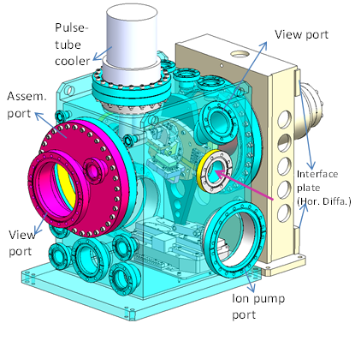
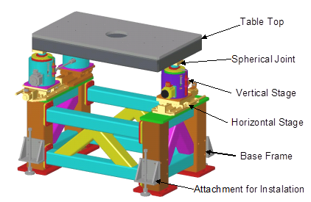
Preliminary design overview
Cone-V-Flat concept
5-DOF alignment to the beam axis
(x, z, pitch, roll, raw)
Z
Y
X
V
flat
cone
Picture from APS

Slide 14
Prototype project plan
Detailed design after TDR ~2012.10
Standard components (mainly motor/actuator, encoder, controller, etc.) finalizing, ~2012.12
Special parts through APS and test, ~2013.01 Manufacturing drawings, ~2013.01
Tender for production ~2013.03
Delivery, commissioning ~2013.09 +
Purchase, delivery of small series 2014
Questions and comments ? Thank you very much!

Slide 15
Geometry comparison
COR on center of the 1st x-tal
COR in between x-tals
 |  |  |  | footprint
E (keV) | 4σ (mm) | 6σ (mm) | θ (°) | l₀(4σ) (mm) | l₀(6σ) (mm)
3 | 9.72 | 14.6 | 41.2 | 14.8 | 22.1
5 | 6.28 | 9.42 | 23.3 | 15.9 | 23.9
24 | 1.96 | 2.94 | 4.72 | 23.8 | 35.7
Xtal gap |  |  |  | 2nd Xtal length (appr.)
g_{min}(4σ) (mm) |  | g_{min}(6σ) (mm) |  | L_{min}(4σ) (mm) |  | L_{min}(6σ) (mm)
8.44 | - | 15.41 | - | 112 | - | 198 | -
 | 4.28 |  | 6.41 |  | 62 |  | 92.5
Xtal gap |  |  |  | Xtal length (appr.)
g_{min}(4σ) (mm) |  | g_{min}(6σ) (mm) |  | L_{min}(4σ) (mm) |  | L_{min}(6σ) (mm)
6.46 | - | 9.69 | - | 59 | - | 89 | -
 | 3.42 |  | 5.12 |  | 41 |  | 62
Si111
 |  |  |  | footprint
E (keV) | 4σ (mm) | 6σ (mm) | θ (°) | l₀(4σ) (mm) | l₀(6σ) (mm)
5 | 6.28 | 9.42 | 49.2 | 8.3 | 12.4
24 | 1.96 | 2.94 | 9.1 | 12.4 | 18.6
Xtal gap |  | 2nd Xtal length(appr.)
g_{min}(4σ) (mm) | g_{min}(6σ) (mm) | L_{min}(4σ) (mm) | L_{min}(6σ) (mm)
6.00 | 9.01 | 42.6 | 64
Xtal gap |  | Xtal length (appr.)
g_{min}(4σ) (mm) | g_{min}(6σ) (mm) | L_{min}(4σ) (mm) | L_{min}(6σ) (mm)
4.81 | 7.21 | 23.3 | 34.9
Si311
 |  |  |  | footprint
E (keV) | 4σ (mm) | 6σ (mm) | θ (°) | l₀(4σ) (mm) | l₀(6σ) (mm)
8 | 4.63 | 6.95 | 47.9 | 6.24 | 9.36
24 | 1.96 | 2.94 | 14.3 | 7.94 | 11.9
Xtal gap |  | 2nd Xtal length (appr.)
g_{min}(4σ) (mm) | g_{min}(6σ) (mm) | L_{min}(4σ) (mm) | L_{min}(6σ) (mm)
3.92 | 5.88 | 18.9 | 28.4
Xtal gap |  | Xtal length (appr.)
g_{min}(4σ) (mm) | g_{min}(6σ) (mm) | L_{min}(4σ) (mm) | L_{min}(6σ) (mm)
3.45 | 5.18 | 13.1 | 19.6
Si511

Slide 16
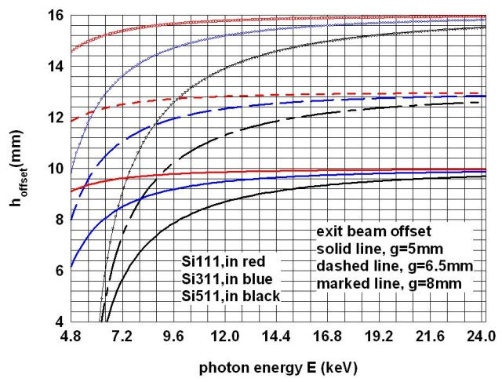
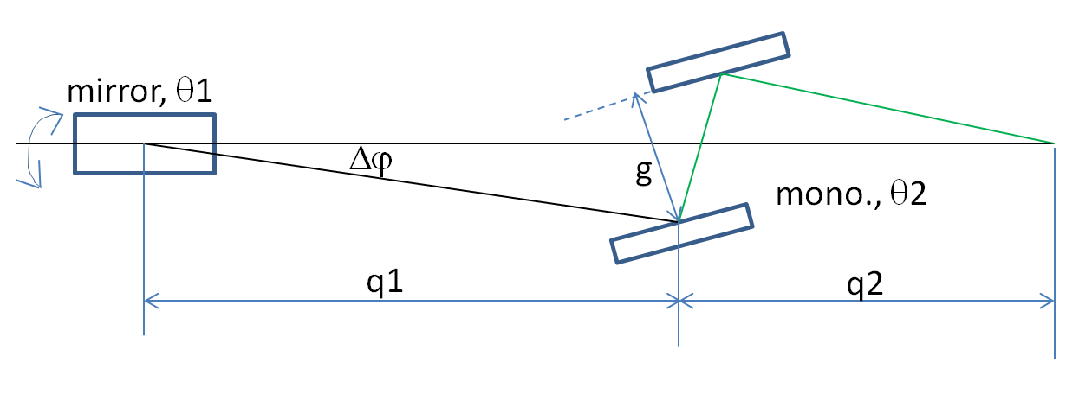
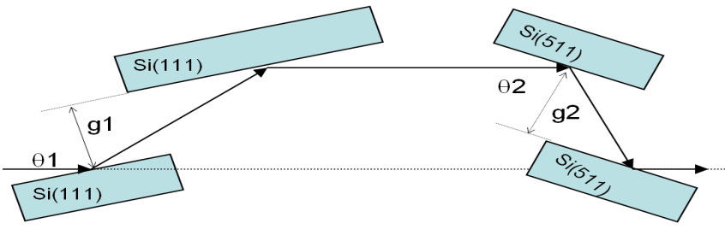
Exit beam offset & series mono.

Slide 17
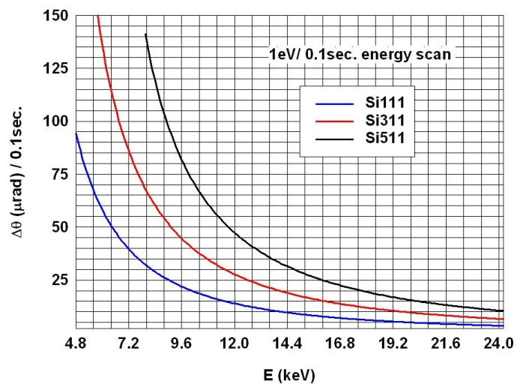
Motion (energy scanning)

Slide 18
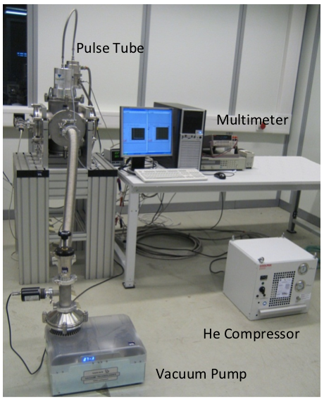
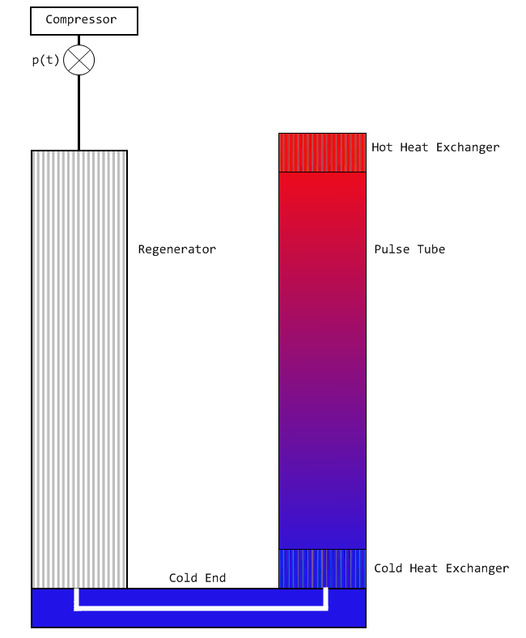
Cooling test set up

Slide 19
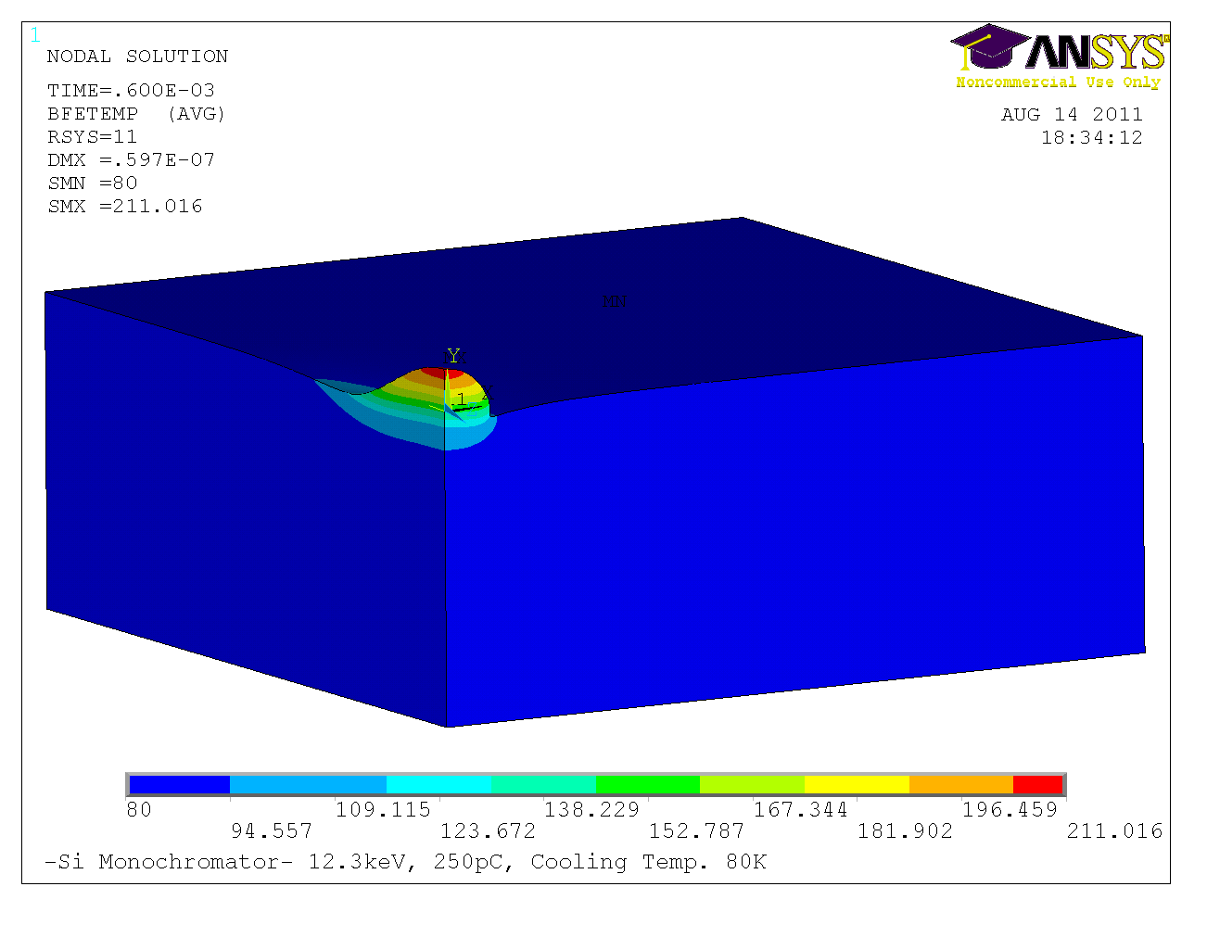
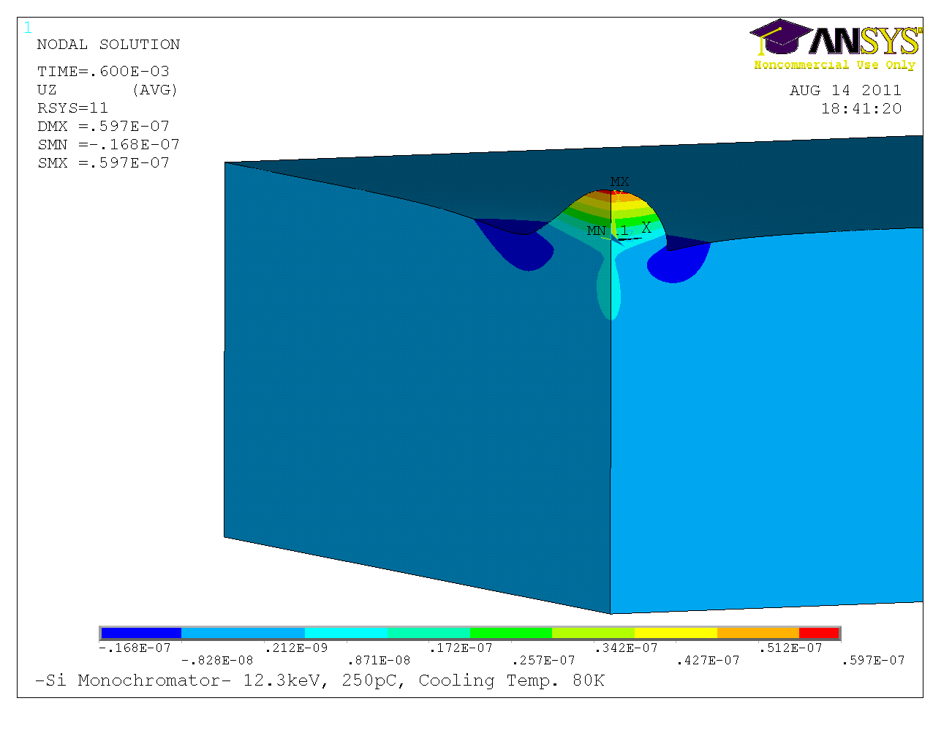
Static thermal effects (FEA simulations)

