Slide 1




Top Quark Physics from the Tevatron to the LHC
Introduction to Terascale Physics 2013
Hamburg, Mar. 27, 2013
Georg Steinbrück
Hamburg University

Slide 2
Outline
Introduction
Top Quark Production
History of Top Quark Search, Discovery
Tools for Top Physics at a Hadron Collider
Measurements of Top Production: Cross Sections, differential CS, Asymmetries, BSM in M(tT)
Top Properties: Mass
Top Production: Single Top →Top width and lifetime
Top decay: W helicity, spin correlations (production and decay)
Steinbrück
2
Steinbrück

Slide 3
Outline
Introduction
Top Quark Production
History of Top Quark Search, Discovery
Tools for Top Physics at a Hadron Collider
Measurements of Top Production: Cross Sections, differential CS, Asymmetries, BSM in M(tT)
Top Properties: Mass
Top Production: Single Top →Top width and lifetime
Top decay: W helicity, spin correlations (production and decay)
Steinbrück
3
Steinbrück

Slide 4
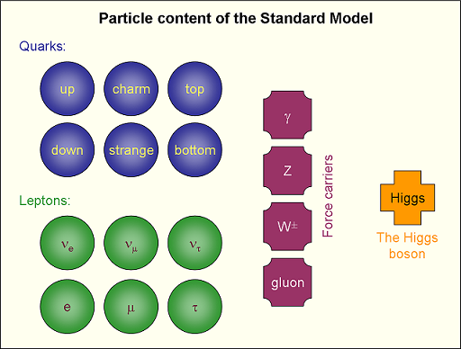
Introduction: The standard model
Steinbrück
Notes:
4

Slide 5
Quark Properties
Strong mass hierarchy.
Top quark heaviest known particle.Almost as heavy as a gold atom!
Steinbrück
Notes:
5

Slide 6
Why is the Top Quark so special?
1) Connection to mass:
Standard model described by SU(3)_{Color}xSU(2)_{L}xU(1)_{Y} symmetry.
Initially leads to massless particles, in clear contradiction to observation.
Solution: Electroweak symmetry breaking aka Higgs-Mechanism
Introduces new scalar Higgs field with non-zero vacuum expectation value v=246GeV that breaks the SU(2)xU(1) electroweak symmetry.
Electroweak gauge interaction → Weak gauge bosons (W,Z) obtain their masses
Yukawa coupling Y → Lepton and quark masses proportional to Higgs VUV and Y_{q,l}
Strong mass hierarchy → Y ranges from 10⁻⁶(electron)…10⁻² (b-quark) up to ~1 for the top quark
→”Top strongly couples to dynamics of electroweak symmetry breaking”
Note also: Higgs Boson coupling to Fermions: g∼m_{f}
→Good laboratory to test mechanism of EWSB. →Now that we have the Higgs “in the bag” test consistency
Also: Quantum loop corrections from BSM larger for top quark observables than for lighter particles
New physics can affect tT production in two ways:
1) Production of tT via intermediate particles
2) Decay of top into new particles (for example t→H⁺ b in models with multiple Higgs doublets)
→Production (1) and decay(2) variables both sensitive to new physics. Look at the complete picture.
Steinbrück
Notes:
6

Slide 7
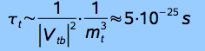
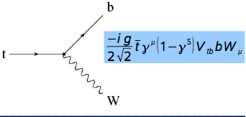
Why is the Top Quark so special?
2) Short lifetime (in the end again connected with mass…)
Lifetime τ_{top}∼5x10⁻²⁵s (compare with τ_{b}∼1.5x10⁻¹²s)
τ_{top}<< hadronisation timescale (τ_{had}∼10⁻²³s)
→Top decays before it hadronizes:
→Spin information preserved in decay products!
→study bare quarks. For example: Quark mass, not meson mass
M(top)>>m(W)
→Real W in top-quark-decays
Distinctive signatures (later…)
Steinbrück
Notes:
7

Slide 8
Top Quark Physics: Overview
Top decay:
Vtb, branching ratios, rare decays, W helicity
Top properties:
Mass, width, charge, spin,…
Top production:
tT cross section, productions dynamics, spin polarization
Steinbrück
Notes:
8

Slide 9
Outline
Introduction
Top Quark Production
History of Top Quark Search, Discovery
Tools for Top Physics at a Hadron Collider
Measurements of Top Production: Cross Sections, differential CS, Asymmetries, BSM in M(tT)
Top Properties: Mass
Top Production: Single Top →Top width and lifetime
Top decay: W helicity, spin correlations (production and decay)
Steinbrück
9
Steinbrück

Slide 10
Top Quark Production (tT)
Tevatron: qqbar: 85% gg: 15%
LHC: qqbar: 15% gg: 85%
Number of events:
Run I Run II LHC
20 800 8x10⁶
(Tt sample >=1 btag)
LHC Tevatron
Steinbrück
10
Steinbrück
Notes:
10

Slide 11
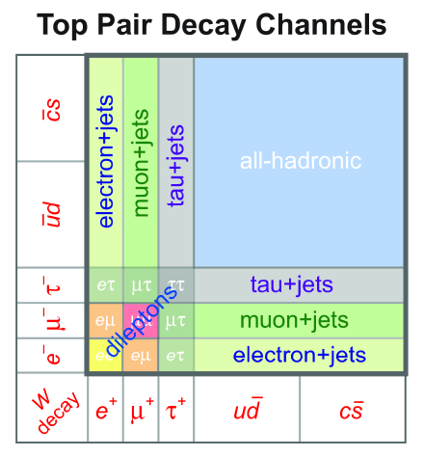
Tt Decay Channels
Top quark pairs:
● Top decay ~100% →Wb → tT → bb + W⁺W⁻
● decay channels: (3 leptons, 2 quark families, 3 colour, 2 branches)
- dileptonic: 3x3 = 9 → 11 %
- semileptonic:3x2x3x2 = 36 → 44 %
- all-hadronic :2x2x3x3 = 36 → 44 %
Σ = 81
-
Steinbrück
11
Steinbrück
Notes:
11

Slide 12
Tt Decay Channels: Experimental Signatures
Top decay ~100% →Wb
Classification of the events and experimental search strategy according to decay of W-bosons
Dilepton channel (without tau)
  5%: 2 charged leptons, 2 jets, 2 ν
lepton+jets channel (without tau)
  30%: 1 charged leptons, 4 jets, 1 ν
all-jets channel
  44%: 6 jets
Note: At least 2 jets are b jets
Steinbrück
12
Steinbrück
Notes:
12

Slide 13
Outline
Introduction
Top Quark Production
History of Top Quark Search, Discovery
Tools for Top Physics at a Hadron Collider
Measurements of Top Production: Cross Sections, differential CS, Asymmetries, BSM in M(tT)
Top Properties: Mass
Top Production: Single Top →Top width and lifetime
Top decay: W helicity, spin correlations (production and decay)
Steinbrück
13
Steinbrück

Slide 14
History of Particle Discoveries
3 generation quark model postulated as early as 1973 by Kobayashi and Maskawa:
Mechanism for CP-violation only possible with 3 generations.
Multi-generation quark model confirmed experimentally soon thereafter: Charm 1974
Third generation tau-lepton (1976) implied third quark generation.
Steinbrück
14
Steinbrück
Notes:
14

Slide 15
History of Top Quark Search
Reminder (famous plot from your favorite textbook):
Higher Energy → More hadronic channels open up.
But: Top not found this way…
Steinbrück
15
Steinbrück
Notes:
15

Slide 16
Let’s Turn to other Means: Quantum Fluctuations
Z and W mass are altered by higher order loop corrections,
i.e. virtual Tt pairs, etc.
Steinbrück
16
Steinbrück
Notes:
16

Slide 17
Can we get some indirect hints?
Precision EW measurements (like the one of the Z boson mass) can therefore be used to constrain/ predict the mass of the top quark!
Success: Measured value after direct discovery at FNAL right on!
Steinbrück
17
Steinbrück
Notes:
17

Slide 18
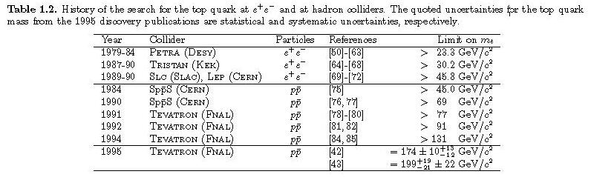
Finally: Top Discovery in 1995!
Steinbrück
18
Steinbrück
Notes:
18

Slide 19
Finally: Top Discovery in 1995!
Simultaneously discovered at CDF and D0.
Steinbrück
19
Steinbrück
Notes:
19

Slide 20

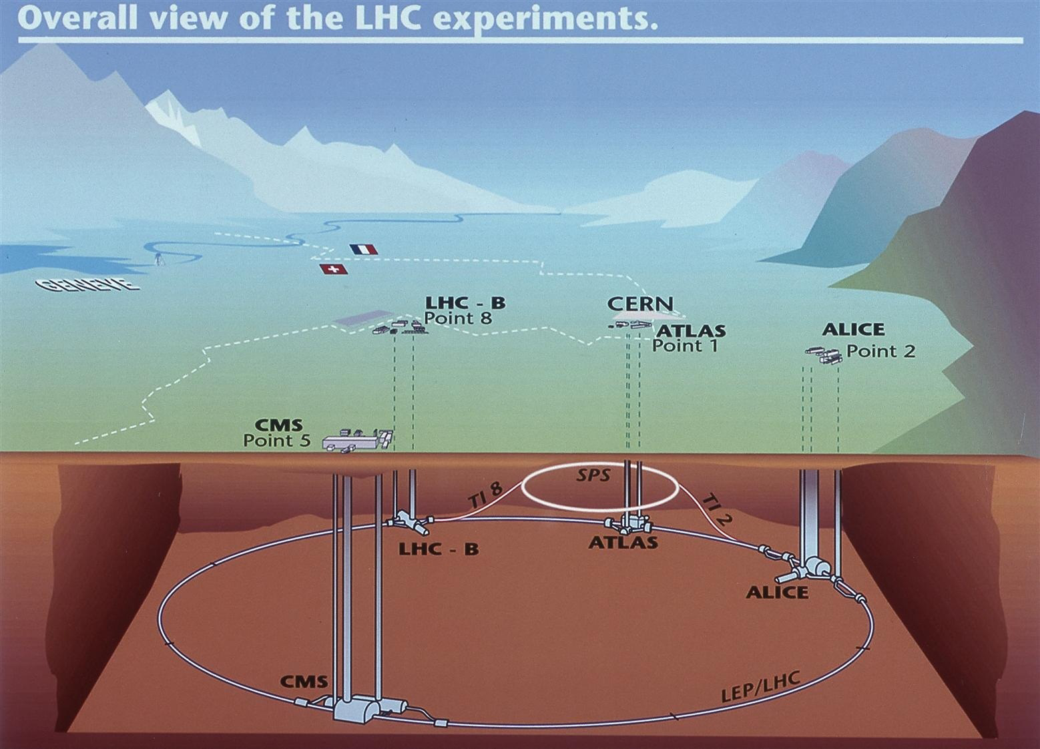
Top Factories: Tevatron →LHC
location : Fermilab, USA CERN, Geneve, Switzerland
start-end : 1987-2011 2008 (restart 2010)
collider type : proton – anti-proton proton – proton
experiments (top) : CDF, D0 ATLAS, CMS, ALICE, LHC-B
√s : 1.8 GeV→ 1.96 GeV 14 TeV (7 TeV for 2010/11, 8 TeV 2012)
L (instantaneous) : 10³⁰ → 3x10³² cm⁻²s⁻¹ 10³⁴ cm⁻²s⁻¹
L (integrated) : ≈ 10,000 pb⁻¹ ≈ 300 fb⁻¹
σ(tt) expected : ≈ 7 pb ≈ 850 pb (7 TeV: 160 pb)
tT events / 50 pb⁻¹ : ≈ 350 ≈ 42,500 (8,000)
Steinbrück
20
Steinbrück
Notes:
20

Slide 21
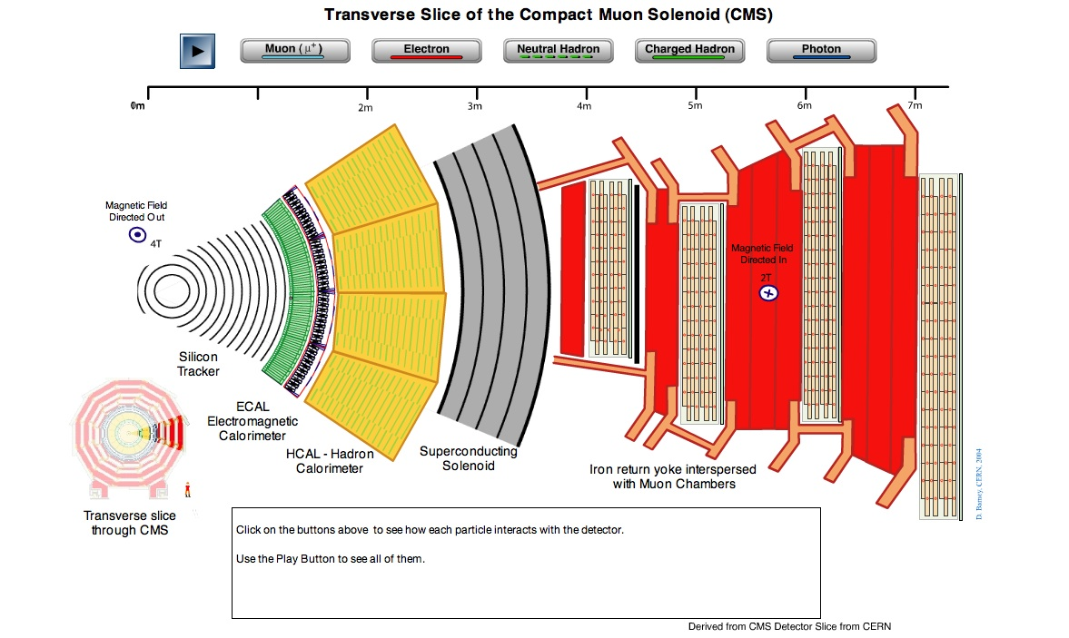
The Experiments: Example CMS
https://cms-docdb.cern.ch/cgi-bin/PublicEPPOGDocDB/RetrieveFile?docid=97&version=1&filename=CMS_Slice_elab.swf
Steinbrück
21
Steinbrück
Notes:
21

Slide 22
Outline
Introduction
Top Quark Production
History of Top Quark Search, Discovery
Tools for Top Physics at a Hadron Collider
Measurements of Top Production: Cross Sections, differential CS, Asymmetries, BSM in M(tT)
Top Properties: Mass
Top Production: Single Top →Top width and lifetime
Top decay: W helicity, spin correlations (production and decay)
Steinbrück
22
Steinbrück

Slide 23
Top Event Reconstruction: The Ingredients
A Tt event contains:
2 b-quark jets (but: not always detectable)
And:
either 2 charged leptons and large missing ET (neutrinos!)
or 1 charged lepton, large missing ET and 2 more jets
or 4 more jets
Complex signatures
All detector components used to identify electrons, muons, taus, jets, b-jets, MET
In turn: Top events can be used in understanding the detector. Especially interesting @LHC: Large Tt-data samples, high purity samples possible
Steinbrück
23
Steinbrück
Notes:
23

Slide 24
Tools: b tagging
B tagging algorithms attempt to identify (tag) jets produced by b-quarks
Identifying b-quarks is crucial for analyses of top quarks, Higgs, SUSY,…
Separate b-jets from light (u,d,s,g) jets using specific b-hadron properties:
large lifetime ~1.5 ps (→cτ~450µm) →large decay length: 20 GeV b-hadron decays after ~2 mm
→search for tracks or vertices displaced w.r.t. primary vertex
- large mass ~5 GeV
→search for leptons, from semileptonic B decays, with large transverse momentum w.r.t. jet axis
large impact
parameter

Slide 25
b tagging: Impact Parameter
Large B hadron lifetime → large impact parameter,d₀, of B decay products
Impact parameter: Distance of track and primary vertex (PV) at closest approach
→Search for tracks displaced w.r.t. primary vertex
Can use either 2D (transverse plane to beam line)
or 3D impact parameter
Use “sign” of the impact parameter
-positive if track intersection with jet
axis is downstream the PV along jet direction.
-negative: Used to measure IP-resolution
Impact parameter significance,
d₀/σd₀, used as discriminant between
signal (true b-jets)
and background (fake b-jets)
d₀

Slide 26
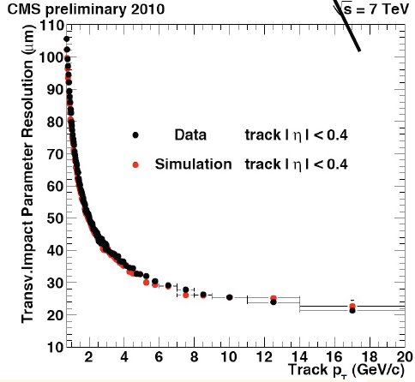
Btagging: Impact Parameter
3D-Impact parameter IP-resolution (here: 2D)
Several methods to exploit tracks with large impact parameters
Track counting: Count tracks with IP(significance) above some threshold
Track Probability: Calculate probability that track comes from primary vertex. Combine for all tracks in a jet to get overall probability: Use as discriminant

Slide 27
Secondary Vertex btagging
Large B hadron lifetime → decay vertex (secondary
vertex) significantly displaced w.r.t. primary vertex
Determine 2D or 3D decay distance
Secondary vertex tagging:
Search for secondary vertex using all tracks in jet
Use decay distance significance d/σ_{d} as discriminant
Also: vertex mass, impact parameter, often combined
vertex distance
vertex mass

Slide 28
Soft Lepton Tagging
Exploit large semileptonic branching fraction of B decays ( Br(b → lepton) ≈ 10% )
along with the large b-hadron mass (~5 GeV)
- Leptons from b decays are characterized by:
  large impact parameter w.r.t. PV
  large transverse momentum w.r.t. jet axis (P_{T}^{REL})
  large angular distance w.r.t. jet axis
P_{T}^{REL}(µ)
Often variables from the different methods described here are combined using multi variate techniques

Slide 29
Tools: Kinematic Fits
Idea:
Exploit the full event to fully reconstruct tT kinematics
→Improve resolution of momenta of reconstructed particles
Difficulties:
-jet-parton matching.
For example l+jets: 4!/2=12 jet-parton assignments considered in a 4 jet event.
Reduces to 6 if 1 jet is b-tagged, 2 if both jets are btagged: Another strong reason for
btagging!
Wrong combinations: Combinatorial background.
Using highest chisq typically yields right combination in 65-85%, depending on details
of the selection and the channel. Most difficult: all-jets channel
-Unknown longitudinal momentum of neutrino, inability to distinguish two neutrinos
Example (lepton+jets channel@Tevatron):
leptons, jets unclustered Energy W mass top mass

Slide 30
Outline
Introduction
Top Quark Production
History of Top Quark Search, Discovery
Tools for Top Physics at a Hadron Collider
Measurements of Top Production: Cross Sections, differential CS, Asymmetries, BSM in M(tT)
Top Properties: Mass
Top Production: Single Top →Top width and lifetime
Top decay: W helicity, spin correlations (production and decay)
Steinbrück
30
Steinbrück

Slide 31
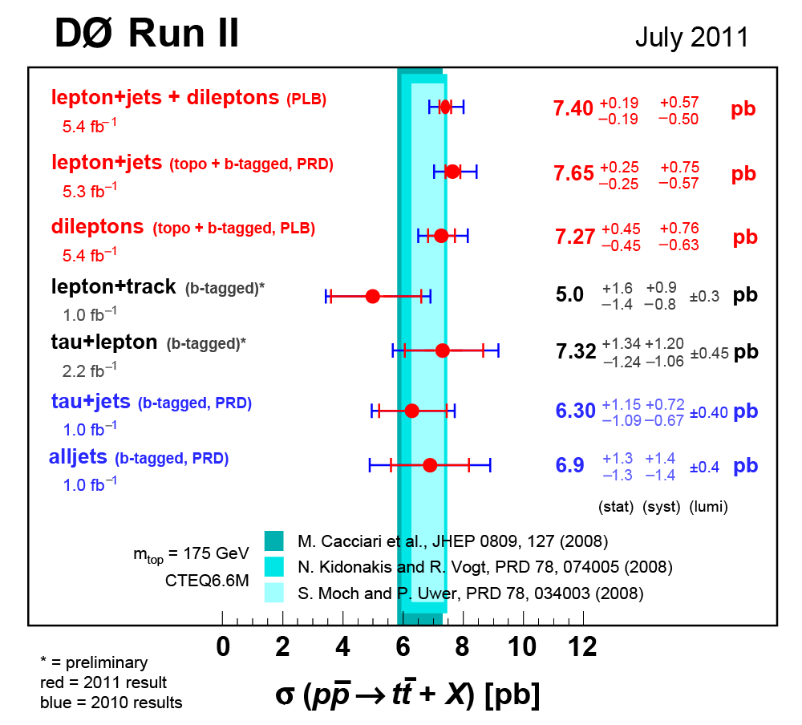
Top Cross Section
Cross section measurements are conceptually simple*:
Data driven methods or from Monte Carlo
Monte Carlo
Data/Monte Carlo
* The devil is in the details!
Many channels. Different methods
Steinbrück
31
Steinbrück
Notes:
31

Slide 32
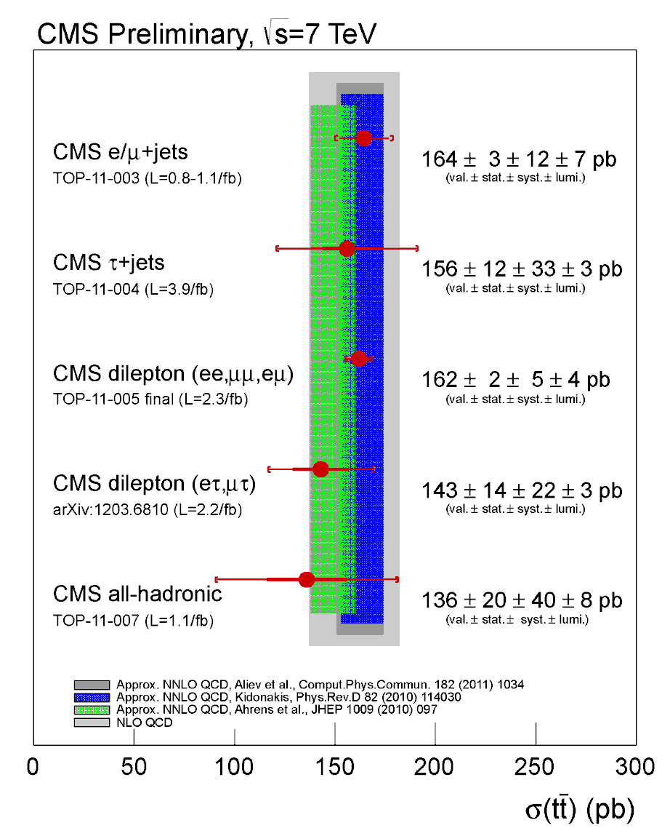
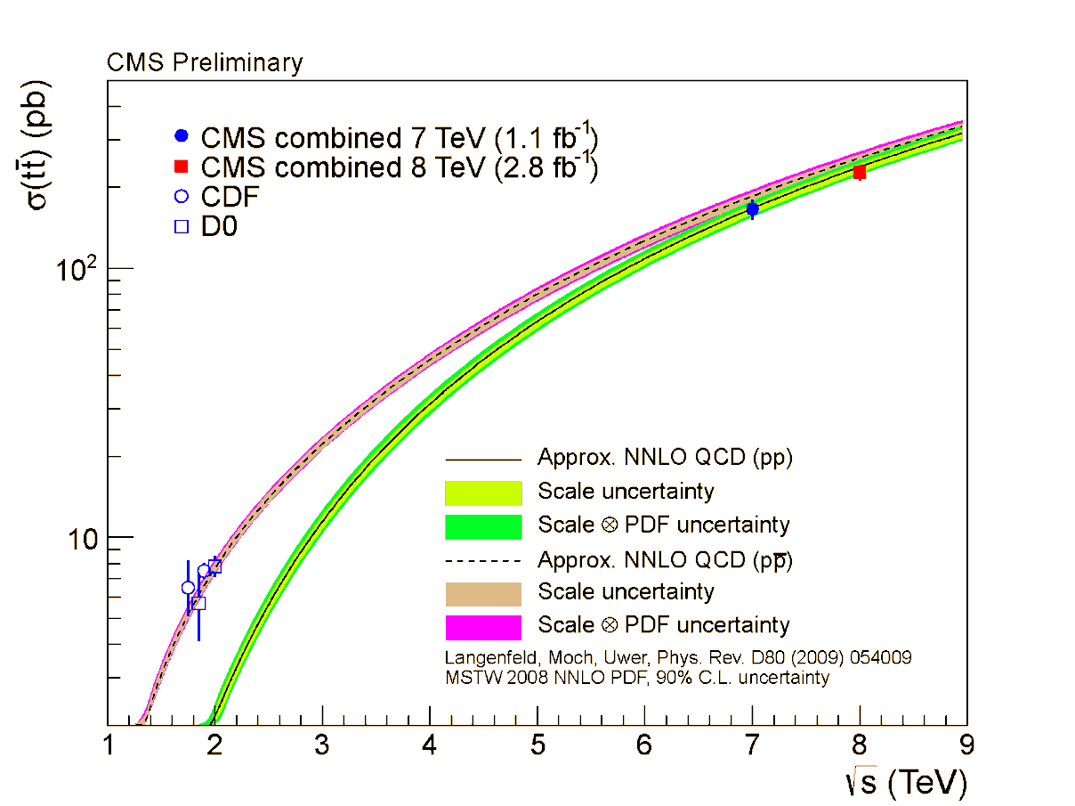
Top Cross Section Tevatron→LHC
Results consistent with standard model!
Results on 2011 data:
Note the difference between pp and ppbar…
Steinbrück
32
Steinbrück
Notes:
32

Slide 33
Tt→ µ+jets event
µ⁺
Notes:
33

Slide 34
Candidate µ+jets event (CMS)
Notes:
34

Slide 35
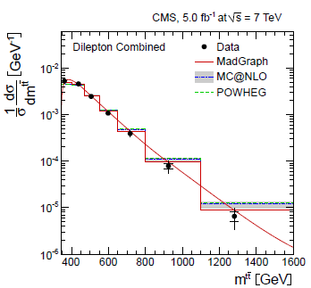
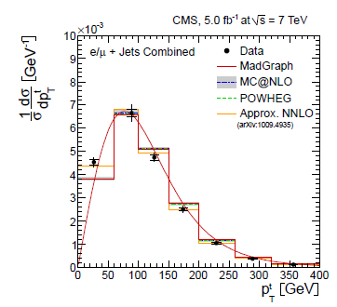
Differential Cross Sections
Differential tT cross sections in top quark pT and tT mass: Test of SM top production, sensitive to physics beyond SM.
Consistent with standard model.
No sign for heavy particle decaying into tT.
Steinbrück
35
Steinbrück
Notes:
35

Slide 36
Top and BSM in M(tT)
Search for heavy resonances decaying into tT pairs.
Predicted by many SM-extensions
Resonances with small natural width would yield enormous peaks in tT mass distribution
CDF
Steinbrück
36
Steinbrück

Slide 37
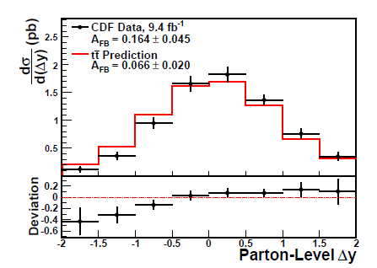
Forward-backward Asymmetry
The forward-backward asymmetry in tT events is defined as
Sensitive to new physics
Use semileptonic decay channel: Charge of the lepton used to separate top from anti-top
SM prediction 0 at LO QCD , but at NLO: 0.066 ± 0.016 (in the tT rest frame)
CDF measurement (2012, 9.4 fb⁻¹): 0.164 ± 0.045 (stat + syst) →Data 2 σ above SM!
Steinbrück
37
Steinbrück
Notes:
37

Slide 38
Outline
Introduction
Top Quark Production
History of Top Quark Search, Discovery
Tools for Top Physics at a Hadron Collider
Measurements of Top Production: Cross Sections, differential CS, Asymmetries, BSM in M(tT)
Top Properties: Mass
Top Production: Single Top →Top width and lifetime
Top decay: W helicity, spin correlations (production and decay)
Steinbrück
38
Steinbrück

Slide 39
Methods to Extract the Top Mass
Select top-like events
Further reduce backgrounds to obtain clean sample
Reconstruct final state
Use sophisticated technique to extract top mass
Simplest method: Template fit
Reconstruct m_{T} for each event
Build templates in reconstructed m_{T} using Monte Carlo generated with different m_{T}
Extract m_{T} using a maximum likelihood fit to the data
CDF lepton plus jets channel
Steinbrück
39
Steinbrück
Notes:
39

Slide 40
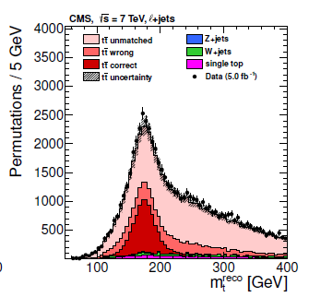
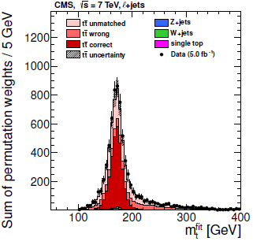
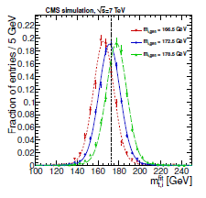

Methods to extract the top mass:
The ideogram method (µ+jets)
1. Use kinematic fit to improve top mass resolution.
2. Generate probability density distributions: for different generated top masses.
L+jets
3. Build event-by-event Likelihood-distributions „Ideograms“:
4. Maximum Likelihood to extract top quark mass:
Result (CMS):
40
Steinbrück
Notes:
40

Slide 41
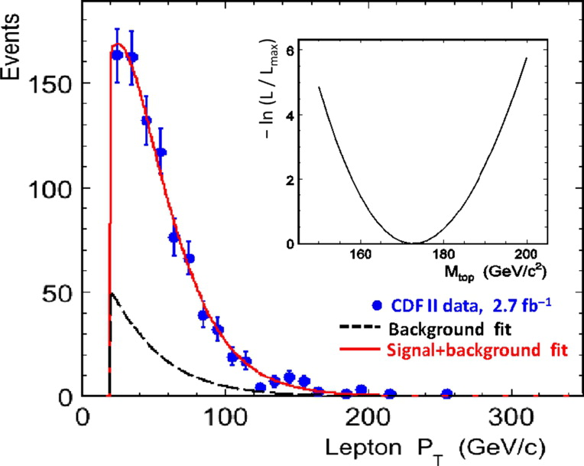
Other methods to extract m(top): Backup
Any variable that‘s correlated with the top mass can in principle be used.
New measurement: Using lepton pT in the l+jets and dilepton channels (CDF).
L+jets
Statistics dominated
Systematics independent of Jet Energy scale!
41
Steinbrück
Steinbrück
Notes:
41

Slide 42
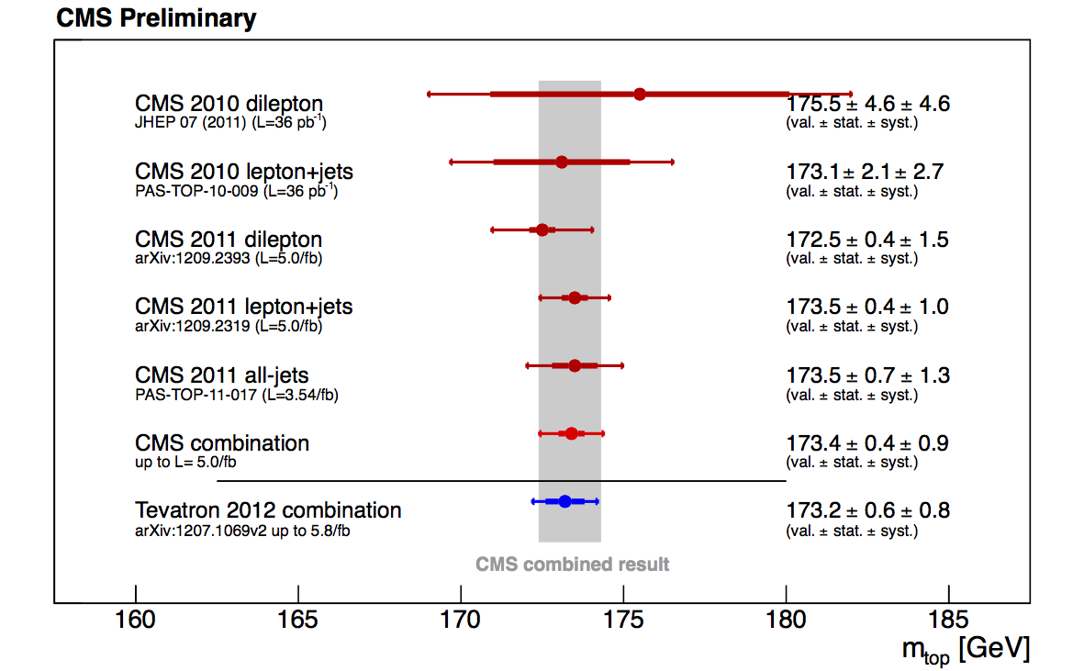
Top Mass Measurements: Combination
Combining all channels and different methods gives final precision.
Advantages of combination:
Full use of sample statistics
Cross checks
Different systematic uncertainties
Mass of top quark has best relative precision of all quark masses!
Steinbrück
42
Steinbrück
Notes:
42

Slide 43
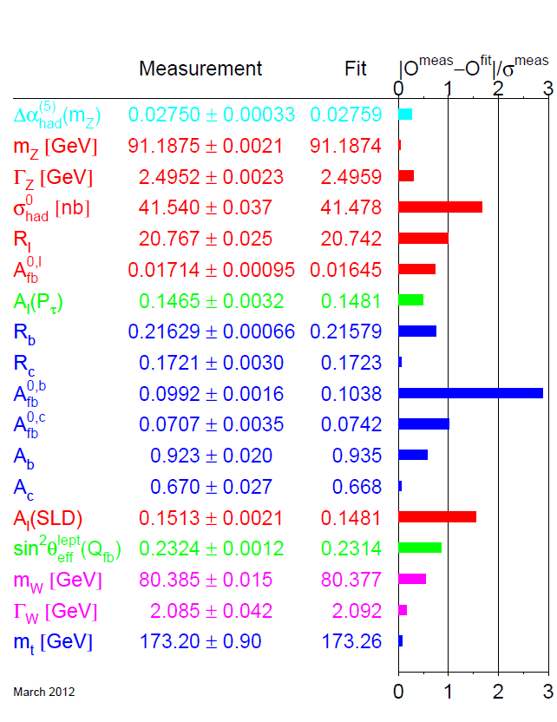
The Complete Picture…
Famous Pull plot of electroweak precision measurements.
It all fits together beautifully!
No measurement inconsistent with global electroweak fit
Steinbrück
43
Steinbrück
Notes:
43

Slide 44
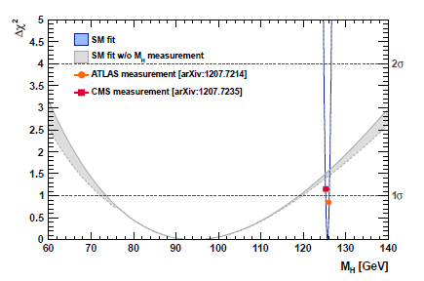
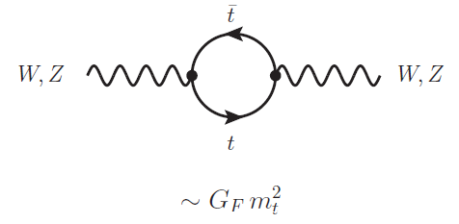
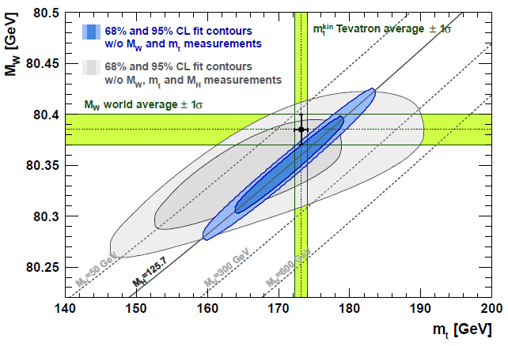
What does the Top mass Measurement tell us?
Precision EW data prefers light Higgs boson.
Loop corrections to W/Z propagators.
Depend on logarithmic on m_{H} and quadratic on m_{t}.
Steinbrück
44
Steinbrück
Notes:
44

Slide 45
Outline
Introduction
Top Quark Production
History of Top Quark Search, Discovery
Tools for Top Physics at a Hadron Collider
Measurements of Top Production: Cross Sections, differential CS, Asymmetries, BSM in M(tT)
Top Properties: Mass
Top Production: Single Top →Top width and lifetime
Top decay: W helicity, spin correlations (production and decay)
Steinbrück
45
Steinbrück

Slide 46
Electroweak Single Top Production
s-channel (tb)
tW-production
σ~0.25pb(Tevatron)
~95pb(LHC)
σ~1pb(Tevatron)
~11pb(LHC)
t-channel (tbq)
σ~2pb(Tevatron)
~235pb(LHC)
Steinbrück
46
Steinbrück

Slide 47
Single Top: Motivation
Direct measurement of V_{tb}: σ~|V_{tb}|²
SM process!
Sensitivity to new physics:
  s-channel: Resonances like W‘, charged Higgs boson, Kaluza-Klein excited W_{KK} …
  t-channel: flavor changing neutral currents (t - Z/γ/g - c/u couplings), fourth generation quarks
Measurement of top properties
  Top partial decay width and lifetime
  CP violation: Compare t and T rates
Signature similar to WH associated production
Steinbrück
47
Steinbrück
Notes:
47

Slide 48
Single Top@Tevatron
Cross section not that much smaller than for tT, but much more difficult to distinguish from background.
Very sophisticated analysis, i.e. boosted decision trees
Can be used to measure|V_{tb}|
Steinbrück
48
Steinbrück
Notes:
48

Slide 49
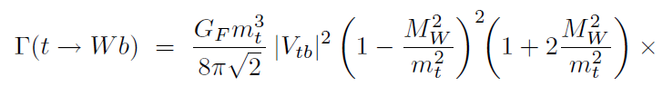
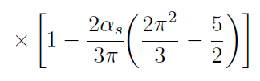
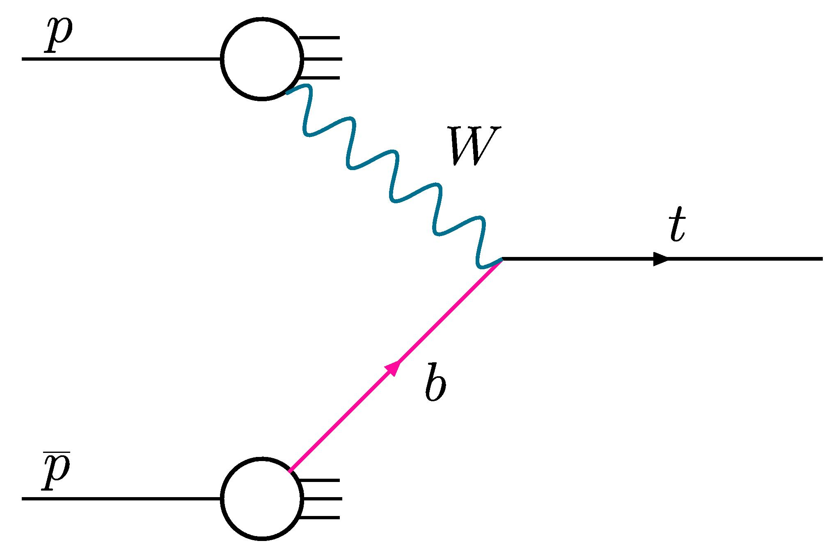
Top Width
SM: Total top quark width dominated by partial width
Leading to BSM: additional channels, i.e. 4th generation b‘→tW
would enhance the total width.
The width of an unstable particle can be measured by analyzing its mass/transverse mass spectrum (example: direct W width measurement)
However: Experimental precision for transverse top mass spectrum not good enough, only leads to upper limit
Indirect measurement via cross section of t-channel single top production
Using the measurement B(t→bW) one can determine the total width:
Steinbrück
49
Steinbrück
Notes:
49

Slide 50
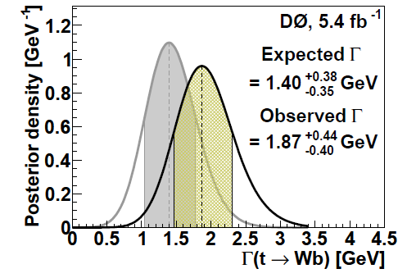

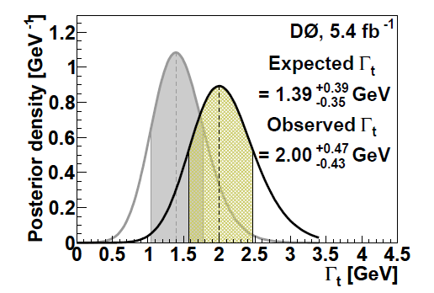




Top width
Most probable value:
Can either be used to set a lower limit on the total width or, using the previous measurement of
to determine the total width to which can also be expressed as
Steinbrück
50
Steinbrück
Notes:
50

Slide 51
Outline
Introduction
Top Quark Production
History of Top Quark Search, Discovery
Tools for Top Physics at a Hadron Collider
Measurements of Top Production: Cross Sections, differential CS, Asymmetries, BSM in M(tT)
Top Properties: Mass
Top Production: Single Top →Top width and lifetime
Top decay: W helicity, spin correlations (production and decay)…Extra topics…
Steinbrück
51
Steinbrück

Slide 52
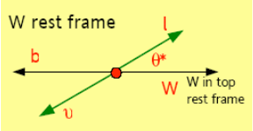
W helicity
Measurement of the fraction of longitudinally polarized (f0) and right-handed polarized (f+) W bosons from top quark decay
SM prediction: 70% longitudinal W‘s at tWb vertex
BSM can alter this
Measurement via angular distributions (lepton angle in W rest frame):
Steinbrück
52
Steinbrück
Notes:
52

Slide 53
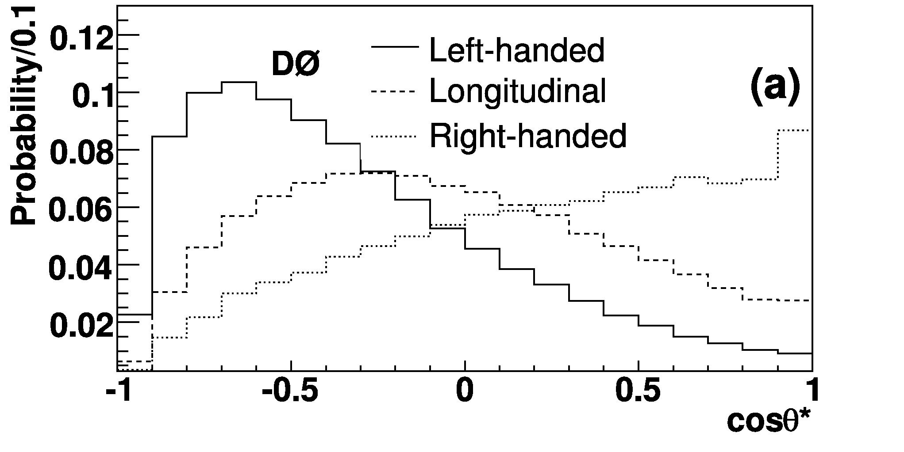
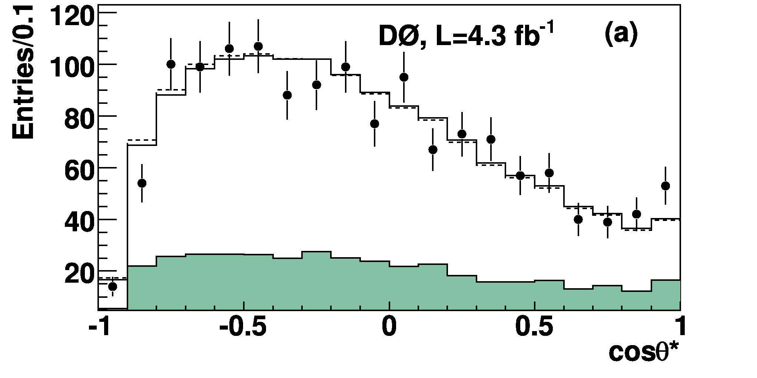
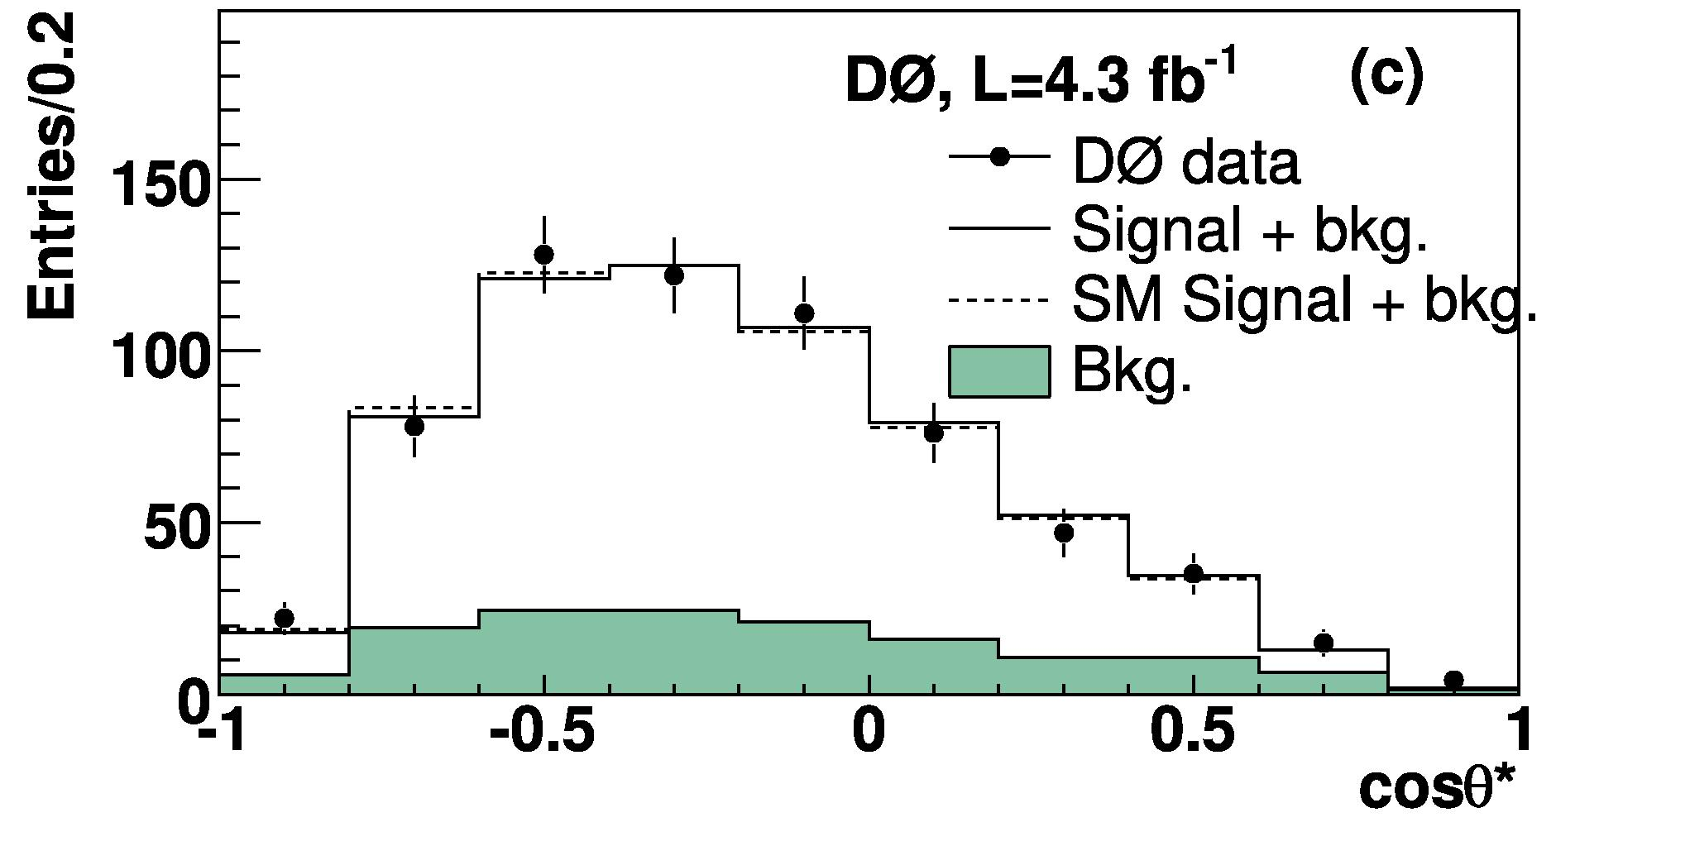
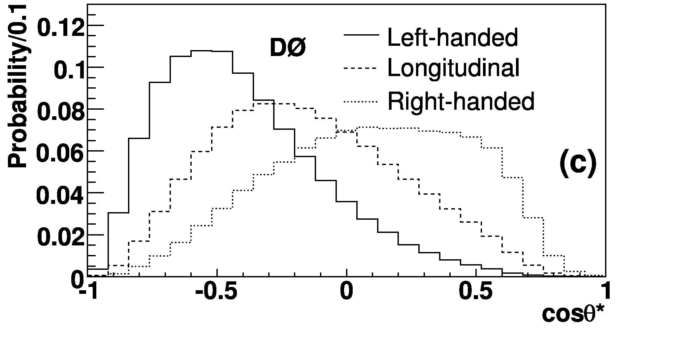
W helicity
lepton in l+jets
dilepton events
Combined result for 5.4 fb-1: f0 = 0.669 ±0.078 (stat) ±0.065 (syst)
f+ = 0.023 ±0.041 (stat) ±0.034 (syst)
Steinbrück
53
Steinbrück
Notes:
53

Slide 54
Spin correlations
The spins of the t and T at production are correlated.
τ_{top} < hadronization time scale and spin flip timescale →correlation preserved and affect the angular decay products
The angular correlations are strongest for the charged leptons from the W decay or the down type quarks, the two dimensional distribution in the respective angles are:
C is the spin-correlation coefficient, depending on:
quantization axis used (i.e. beam axis or helicity basis)
fraction of tT pairs produced at threshold
m_{tT}
fraction produced by gg-fusion
→Different spin correlation coefficient at LHC compared to Tevatron
Finding spin correlation would confirm top as spin ½ particle and the decay before hadronisation. Spin correlation can be altered by certain BSM models
Steinbrück
54
Steinbrück
Notes:
54

Slide 55
Spin correlations
qqbar: Opposite helicity production (b) dominates
gg: Equal helicity production (c) dominates
Steinbrück
55
Steinbrück
Notes:
55

Slide 56
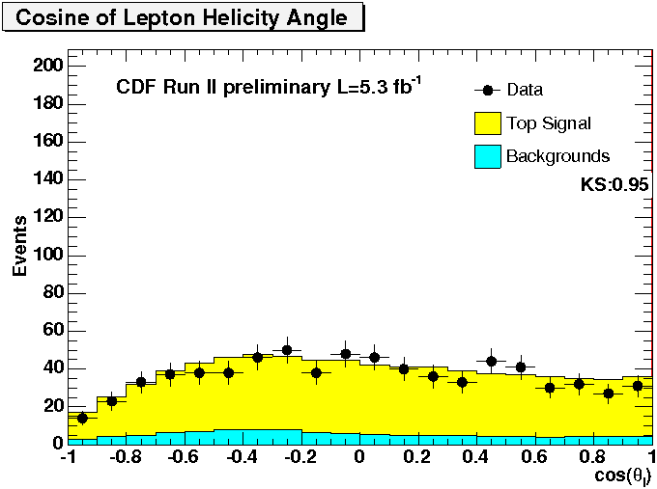
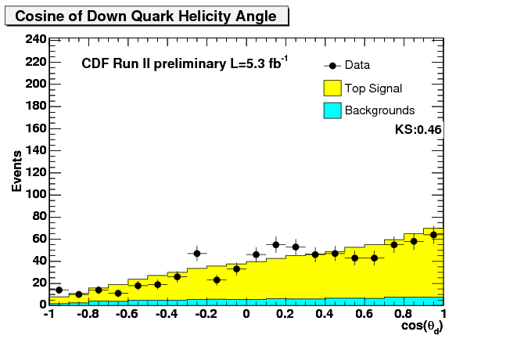
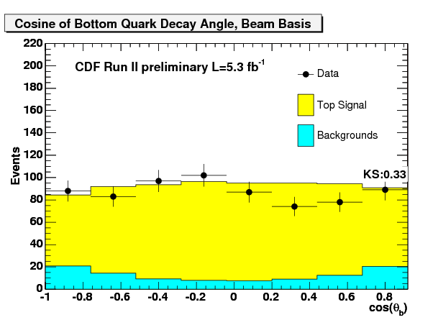
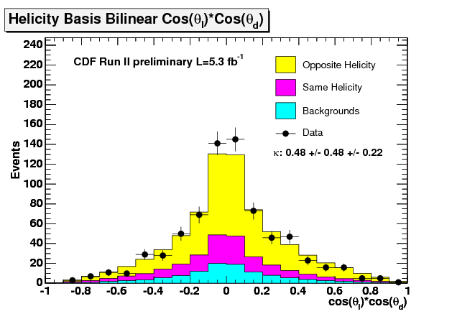

Spin correlations: Analysis
helicity angles
C = 0.48 ± 0.48 stat ± 0.22 syst (SM: C=0.4)
Opposite helicity fraction:
f_{ohel} = 0.74 ± 0.24 (stat) ± 0.11 (syst)
New analysis measures ratio of events with SM spin correlation to all tT events to be:
3 sigma evidence of spin correlation!
Steinbrück
56
Steinbrück
Notes:
56

Slide 57
Conclusions
The top quark is special:
  Short lifetime→decay before hadronisation→study bare quarks
  Large mass→ Introcate link to electroweak symmetry breaking
  → After Higgs discovery: Test consistency!
  → link to physics beyond the standard model
Predicted for a long time, discovered late @the Fermilab Tevatron
Since the discovery, based on a few events, top quark physics has evolved into precision physics with a large number of measurements
  Production: Tt cross section, differential CS, Tt asymmetries, single top,...
  Decay: W helicity, spin corellations, ...
  Properties: Mass, widths, lifetime, charge,...
The LHC is producing loads of tT pairs
→We have entered the ara of precision top physics!

Slide 58
Backup

Slide 59
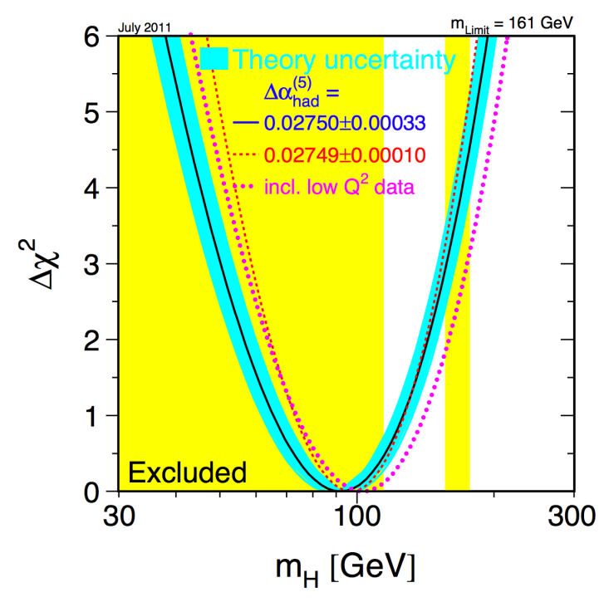
What does the Top mass Measurement tell us?
Loop corrections to W/Z propagators.
Depend on logarithmic on m_{H} and quadratic on m_{t}.
Precision EW data prefers light Higgs boson.
Steinbrück
59
Steinbrück
Notes:
59

