Slide 1
Upgrade Simulation ATLAS
Sergey Burdin (University of Liverpool)
@ Fast Detector Simulation Workshop
17/01/2013

Slide 2
Introduction
The presentation shows the upgrade plans, simulation tools and results for the ATLAS Phase-II upgrade
Descriptions of the full and fast simulation tools are available in the presentations of Andi Salzburger and Andrea Giammanco at this workshop
Disclaimer : most of the shown results are obtained in simplified assumptions and should be considered as estimates only
The presentation is heavily tracker-biased!
It is based on the presentations of many of my ATLAS colleagues
Andi Salzburger, Markus Elsing, Allan Clark, Ian Watson, Teddy Todorov, Nick Styles, Peter Vankov, Monica D’Onofrio, Jana Schaarschmidt, Phil Allport, Maurice Garcia-Sciveres, Neal Hartman, Pippa Wells, Nigel Hessey

Slide 3
ATLAS
Length = 44 m
Diameter = 22 m
Notes:
Or photons can be identified through conversions, which is affected by amount of material in the detector. The more material, the more conversions and electron brem we have, hence increasing backgrounds and reducing efficiency of prompt photon ID
fraction of conversions that happen in ID volume

Slide 4
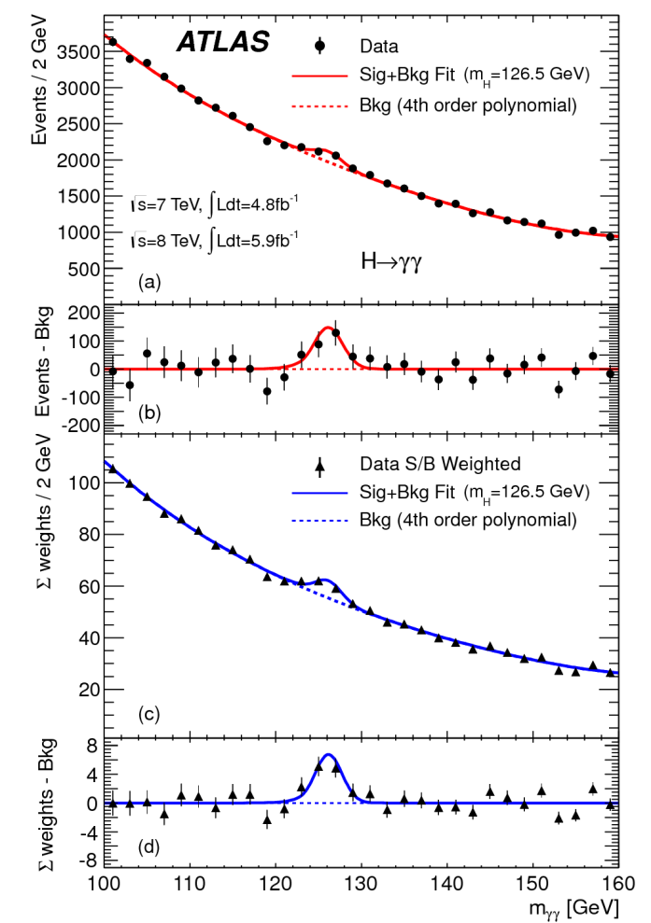
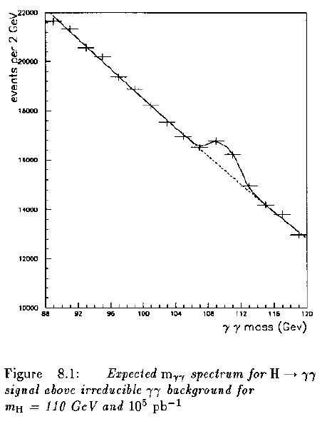
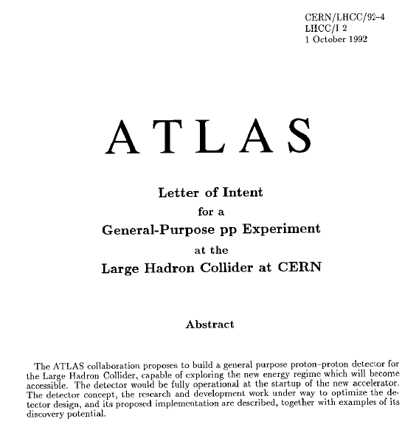
Historical Perspectives
The Higgs(-like) boson was discovered with ½ of the nominal energy, more severe pileup than expected and 1/3 of the integrated luminosity than considered to be necessary.
Utilising major innovations in analysis, technology and computing techniques.
Hope for similar surprises in the future!

Slide 5
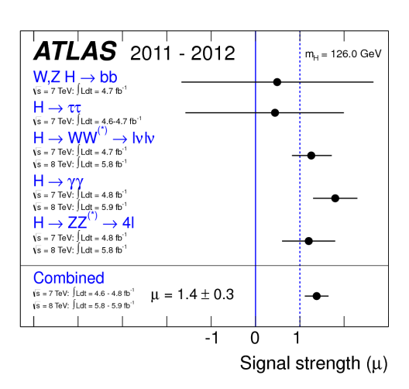
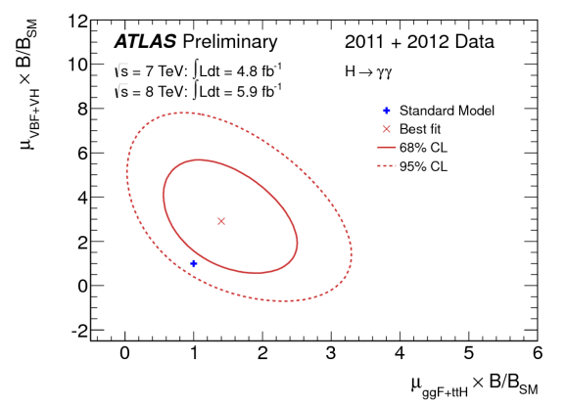
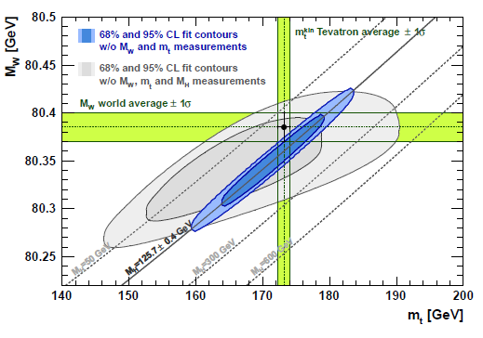
Motivation for the Upgrade
Most likely the Higgs boson is found. What is the next?
Is this the Standard Model Higgs?
Is there anything else?
Due to its nature the Higgs boson couples to all the (massive) particles and therefore we have the tool to search physics Beyond the Standard Model.
“In the absence of any direct evidence of new physics, the Higgs will be (one of?) the best source of information about possible new physics...”
p-value 0.07
arXiv:1209.2716

Slide 6
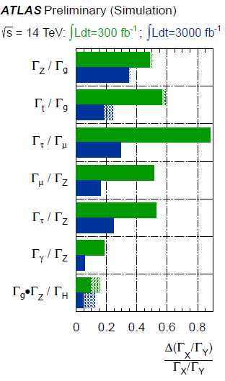
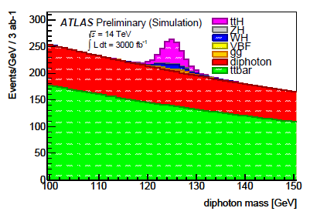
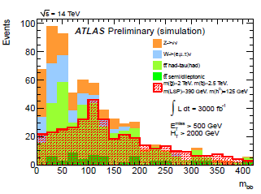
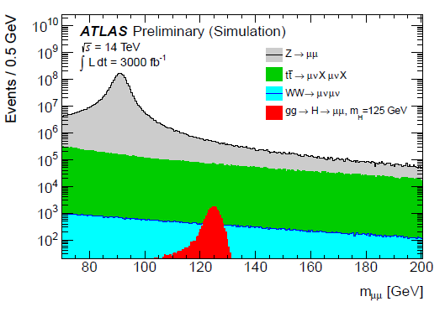
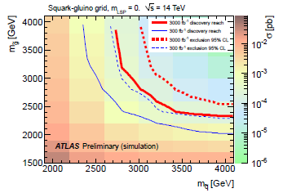
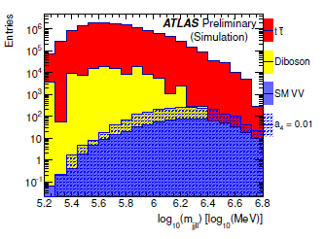
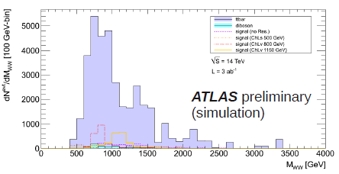
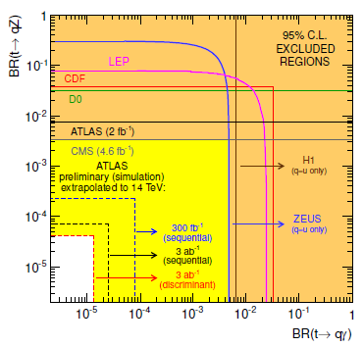
Future Physics @ ATLAS
Higgs self-coupling
~3σ in channel

Slide 7
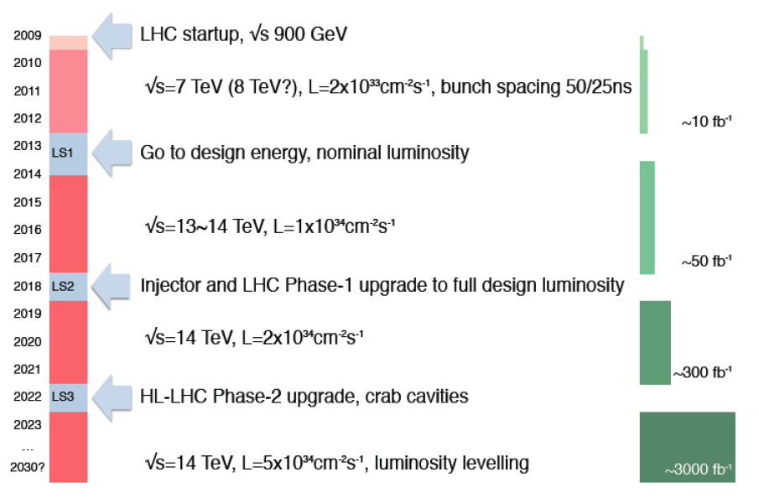
LHC Upgrade Schedule as shown in Chamonix 2012
LHC startup, √ s = 900 GeV
√ s=7~8 TeV, L=6x10³³ cm⁻² s⁻¹, bunch spacing 50 ns
4x
, bunch spacing 50 ns
~20-25 fb⁻¹
Go to design energy, nominal luminosity (Phase-0)
~20 months
√s=13~14 TeV, L~1x10³⁴ cm⁻² s⁻¹, bunch spacing 25 ns
~75-100 fb⁻¹
Injector and LHC Phase-1 upgrade to full design luminosity
~14 months
√ s=14 TeV, L~2x10³⁴ cm⁻² s⁻¹, bunch spacing 25 ns
~350 fb⁻¹
HL-LHC Phase-2 upgrade, IR, crab cavities?
?, IR
Need ~2 years
√ s=14 TeV, L=5x10³⁴ cm⁻² s⁻¹, luminosity leveling

Slide 8
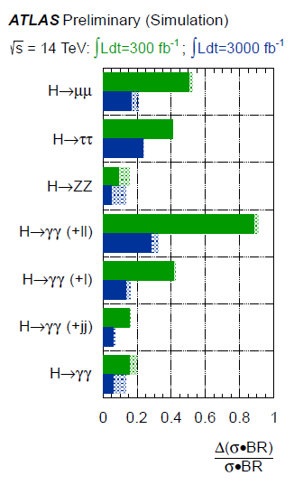
Phase-2
LOI presented in December 2012
Approval by the ATLAS CB in January 2013
Looking for endorsement by LHCC in March 2013
Upgrade projects:
New Inner Detector (strips and pixels) − very substantial progress in many R&D areas
New LAr front-end and back-end electronics
New Tiles front-end and back-end electronics
TDAQ upgrade
TAS and shielding upgrade
Various infrastructure upgrades
Common activities (installation, safety, …)
New FCAL (if conditions require it)?
LAr HEC cold electronics consolidation (radiation hardness)?
L1 track trigger (latency budget and physics case)?
Muon Barrel and Large Wheel system electronics upgrade?
Forward detectors upgrade?

Slide 9
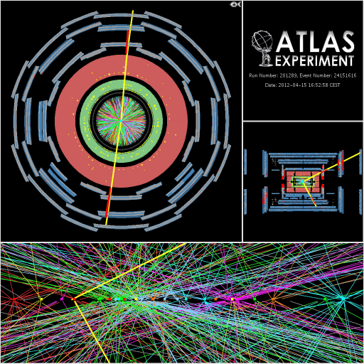
Challenges of pile-up.
Under High-Lumi conditions, and average of 140 pile-up collisions per event is expected
Consider 200 pile-up as “extreme” scenario
Excellent tracker performance required to be able to resolve tracks and vertices in such a high-multiplicity environment
Completely new tracker is required
25 reconstructed vertices
Nick Styles

Slide 10
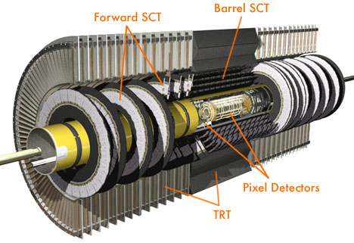
Inner Tracker Upgrade.
Current ATLAS Inner Detector comprised of 3 subsytems
Pixel Detector (planar Si pixel sensors)
Semiconductor Tracker, SCT (Si Microstrips)
Transition Radiation Tracker, TRT (straw tubes)
Inner Detector will have suffered significant radiation damage by ~2022
Performance degradation would mean replacement required, even in case of no upgrade
TRT occupancy under High-Lumi conditions will be above operational limits
Necessitates move to all-silicon tracker (pixel and microstrips)
Significant improvements required in order to deal with increased pile-up
Aim to maintain current levels of global performance, despite challenging environment
Nick Styles

Slide 11
ATLAS Simulation Framework.
ATLAS GeoModel framework used to build description of complex detector geometry
Interfaces to Geant4 to simulate particle interactions within the detector
Also used for building simplified detector description used in reconstruction
Designed to deal with ATLAS geometry
Numerous changes required to allow extension to different tracker layouts
Modifications throughout core ATLAS software extending channel addressing, to accommodate increased number of readout channels
GeoModel
Simulation
Uses Geant4 to model energy losses/energy deposition in sensors/generation of secondaries, etc
Digitisation
Models detector readout electronics, turning Geant4 energy deposits into ATLAS raw data format
Pile-up collisions added at this point
Reconstruction
Uses hits in sensors to build tracks and vertices
Nick Styles

Slide 12
ATLAS Simulation Framework.
ATLAS GeoModel framework used to build description of complex detector geometry
Interfaces to Geant4 to simulate particle interactions within the detector
Also used for building simplified detector description used in reconstruction
Designed to deal with ATLAS geometry
Numerous changes required to allow extension to different tracker layouts
Modifications throughout core ATLAS software extending channel addressing, to accommodate increased number of readout channels
GeoModel
Simulation
Uses Geant4 to model energy losses/energy deposition in sensors/generation of secondaries, etc
Not Suitable for the Initial Detector Design
Digitisation
Models detector readout electronics, turning Geant4 energy deposits into ATLAS raw data format
Pile-up collisions added at this point
Reconstruction
Uses hits in sensors to build tracks and vertices

Slide 13
Editing GeoModel
Section Pixel
// PixelEnvelope table
Table PixelEnvelope
Z RMIN RMAX
3470 34 349.9
TableEnd
// PixelCommon table
PixelCommon:HALFLENGTH 3470.0
Editing the text file which could work as an input to the GeoModel is not too difficult given the GeoModel has all the required shapes
The standard ones are disks and cylinders
Precise numbers of modules, staves and there locations should be known
But full cycle requires ~1day
Building the tracking material
Collecting enough statistics
//PixelLayer#0:RLAYER 37.0
PixelLayer#0:RLAYER 39.0
PixelLayer#0:NSECTORS 16
// Tilt angle in phi (degrees)
PixelLayer#0:STAVETILT -14.0

Slide 14
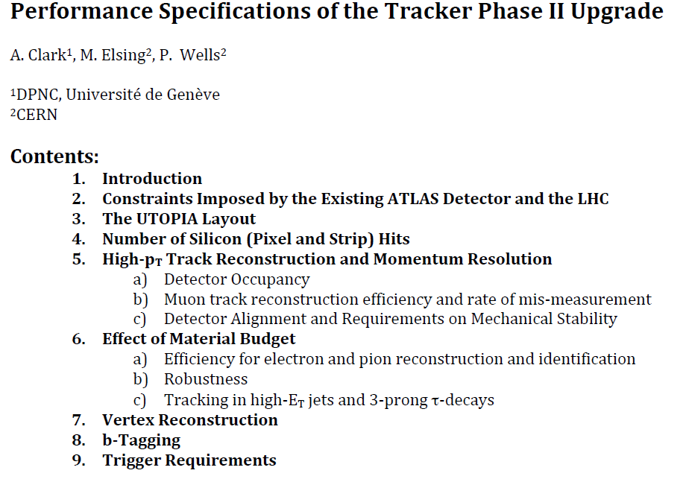
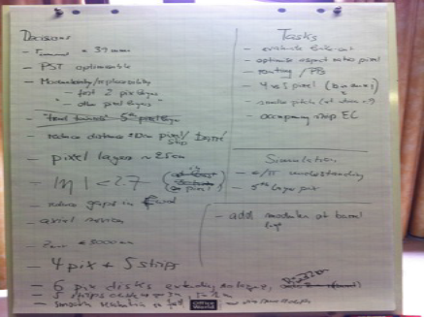

Slide 15
Impact Parameter Resolution

Slide 16
Need a program which
Allows (very) easy layout description
Visualizes the layout
Counts number of hits
Calculates material budget
Calculates momentum and impact parameter resolutions
Calculates the area of surfaces
Is very fast
The IDRES program written by Nigel Hessey (Nikhef)
calculates the error matrix for the five helix track parameters, for a given range of (perfect solenoidal) magnetic fields, eta angles, and track Pts.
The tracker is specified as any number of cylinders, discs and cones with individually-settable radiation lengths and resolutions (precision direction and second-coordinate).
Description is available at http://www.nikhef.nl/~r29/upgrade/idres.html

Slide 17
Layout Description in IDRES
[B <b-field | files <Brfilename> <Bzfilename> >... end | bIntegral <nStepsR> <rMin> <rMax> <nStepstheta> <thetaMin> <thetaMax>
eta <eta>... end
pt <Pt>... end
cylinder (<radius> <zstart> <zend> <%X0> <sigma-rphi> <sigma-z>)... end
disc (<inner-radius> <outer-radius> <z> <%X0> <sigma-rphi> <sigma-r>)... end
cone (<inner-radius> <z@outer-r> <z@inner-r> <Cone half angle> <%X0> <sigma-rphi> <sigma-2nd-coord-along-cone>)... end
! <comment> ]...
B 2.0 end
eta 0.0 0.5 1.0 1.5 2.0 2.5 end
pt 1 2 5 10 end
cylinder
0.100 -0.800 0.800 2.5 20e-6 100e-6
0.200 -0.800 0.800 2.5 20e-6 100e-6
0.300 -0.800 0.800 2.5 20e-6 100e-6
end
disc
0.100 0.400 1.0 2.0 20e-6 500e-6
0.100 0.400 1.2 2.0 20e-6 500e-6
0.100 0.400 1.5 2.0 20e-6 500e-6
end

Slide 18
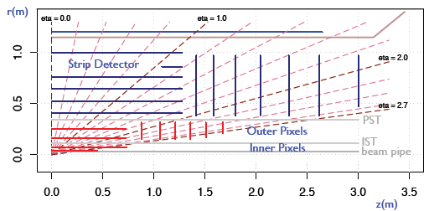
Visualization of IDRES geometry
Using R-language
Z spread

Slide 19
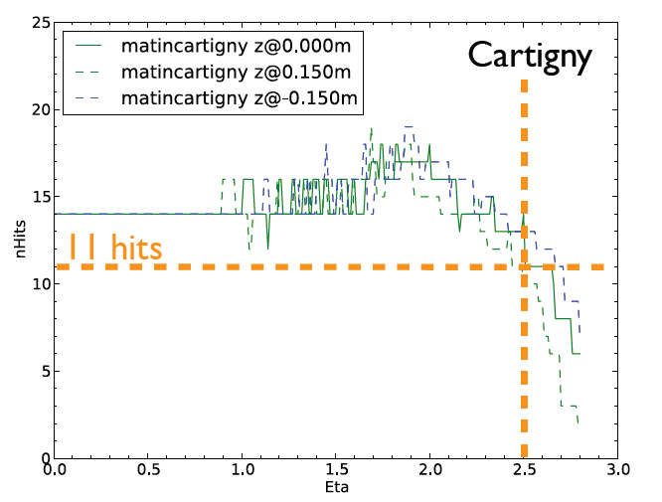
Hit Counting
Hits are counted separately for pixel and strip detectors

Slide 20
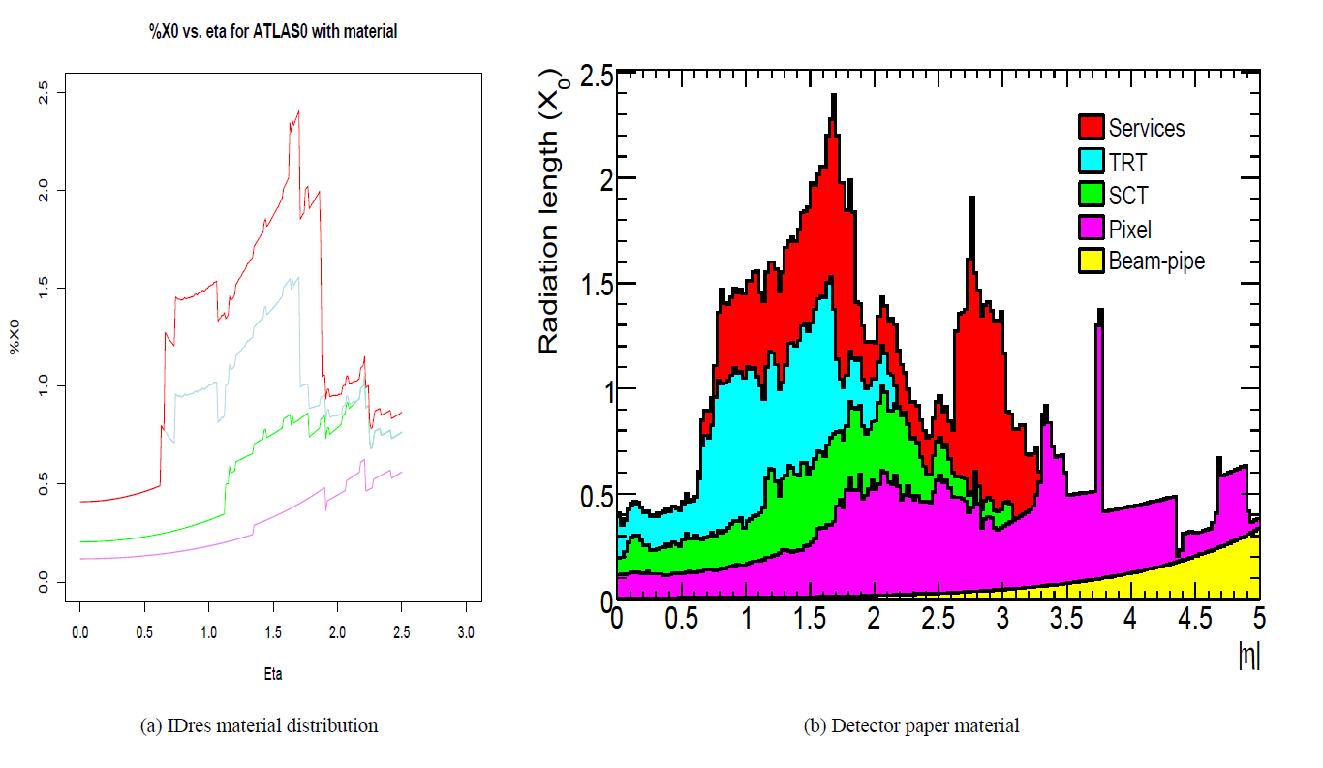
Material Budget
~10% accuracy
Nigel Hessey

Slide 21
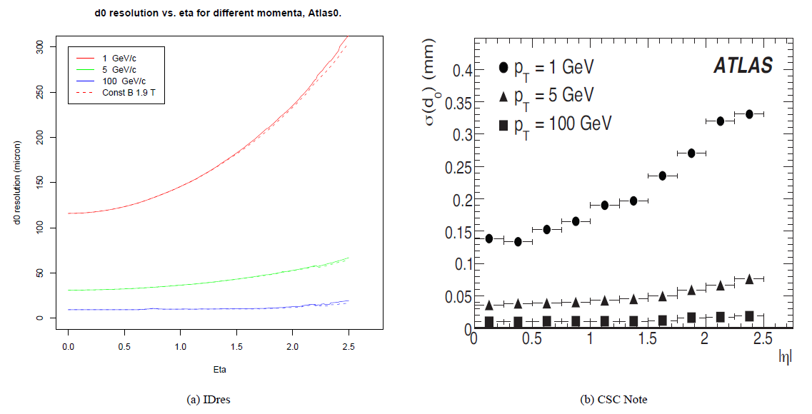
d0 resolution
Nigel Hessey

Slide 22
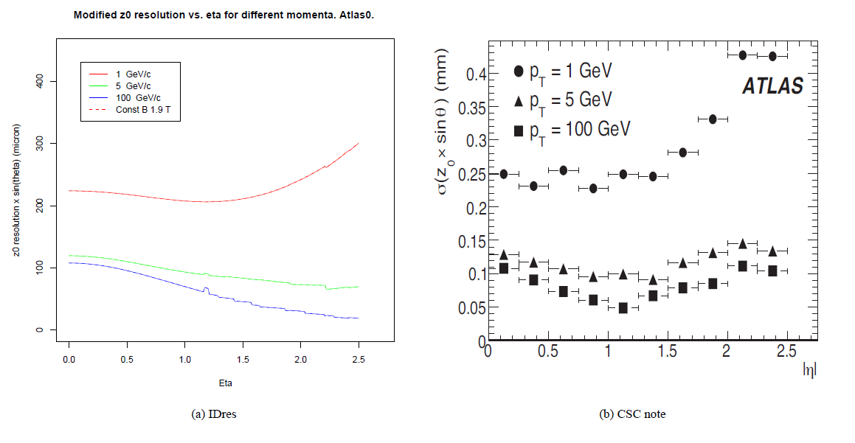
Z resolution
Nigel Hessey

Slide 23
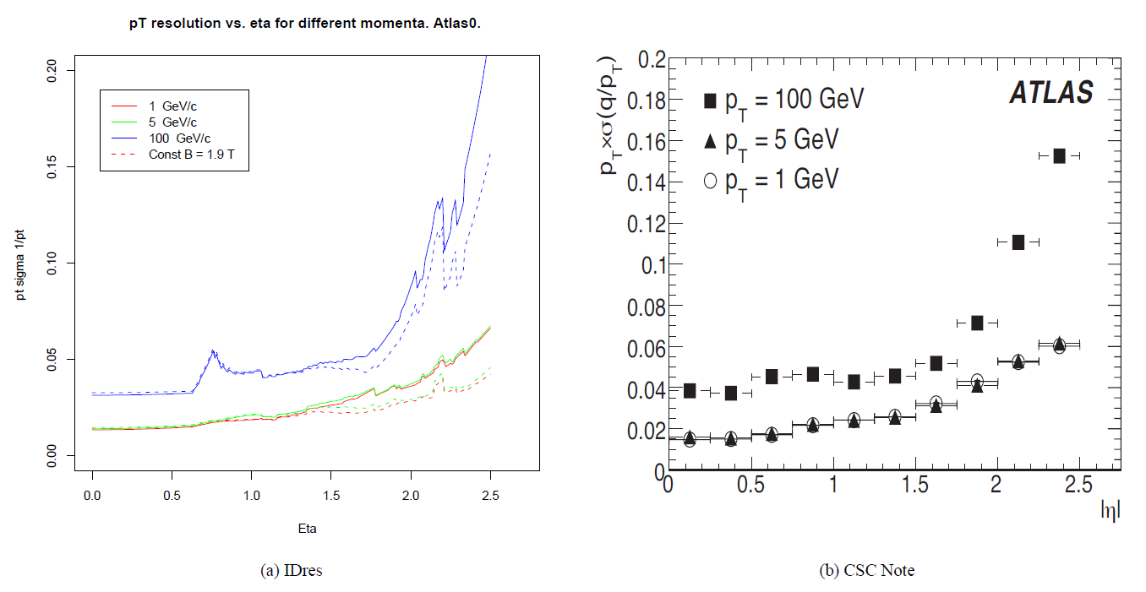
Pt resolution
Nigel Hessey

Slide 24
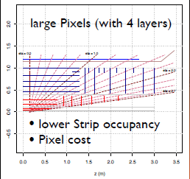
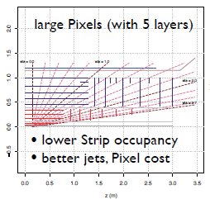
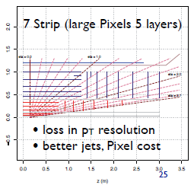
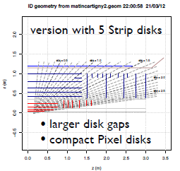
Choosing the Layout
The current baseline layout has been chosen after consideration of cost, performance, complexity, etc.

Slide 25
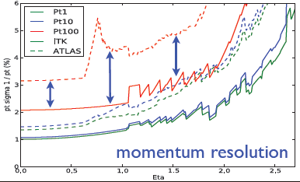
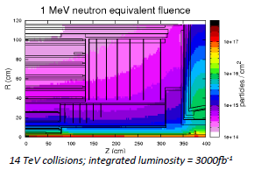
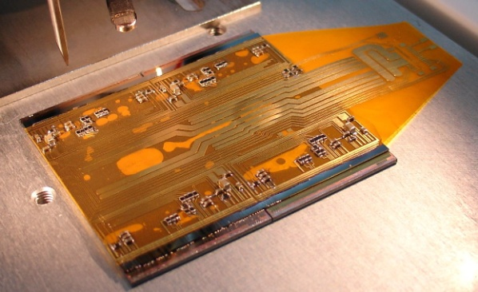
Parameters of the Baseline Layout
LOI Layout
IDRES
4 Pixel and 5 double sided Strip layers + 6 pixel and 7 strip disks
14 hit system up to η=2.5
80 -> 400 million pixels (~7m²), 6 -> 45 million strips (~200m²)
full coverage for |η| < 2.5, Pixels cover |η| < 2.7 (forward muon identification)
minimize hit gaps: Strip disk z_{max} = 3m, small layer in barrel-endcap gap
increase radius of last Pixel layer to 25-30cm (better double track resolution)
Pixel Quad Module Prototype
Microstrip Module Prototypes

Slide 26
ATLAS Simulation Framework.
ATLAS GeoModel framework used to build description of complex detector geometry
Interfaces to Geant4 to simulate particle interactions within the detector
Also used for building simplified detector description used in reconstruction
Designed to deal with ATLAS geometry
Numerous changes required to allow extension to different tracker layouts
Modifications throughout core ATLAS software extending channel addressing, to accommodate increased number of readout channels
GeoModel
Simulation
Uses Geant4 to model energy losses/energy deposition in sensors/generation of secondaries, etc
Digitisation
Models detector readout electronics, turning Geant4 energy deposits into ATLAS raw data format
Pile-up collisions added at this point
Reconstruction
Uses hits in sensors to build tracks and vertices
Nick Styles

Slide 27
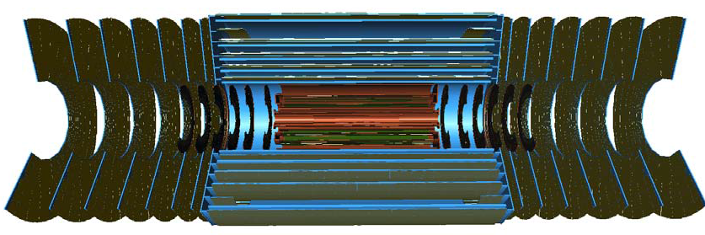
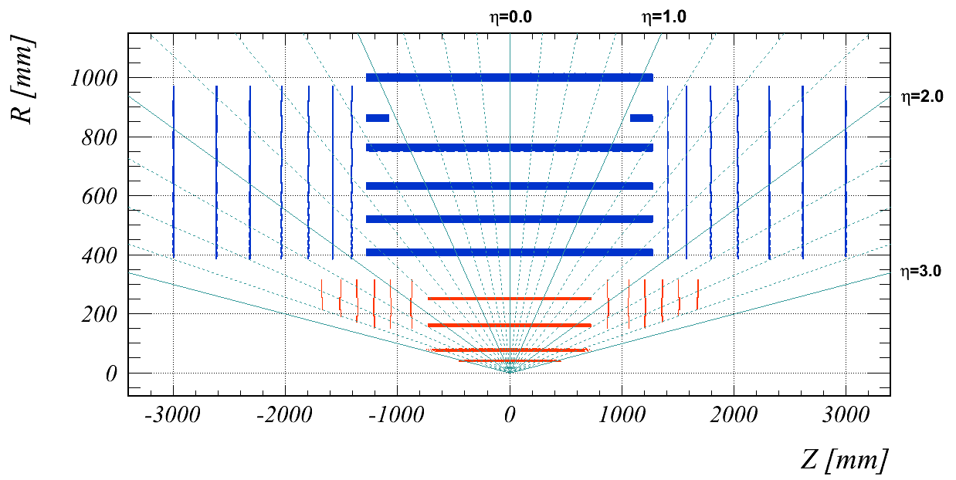
Geant4 Model
The chosen layout has been implemented in the GeoModel
Hit visualization confirms positions of the sensitive and service materials

Slide 28
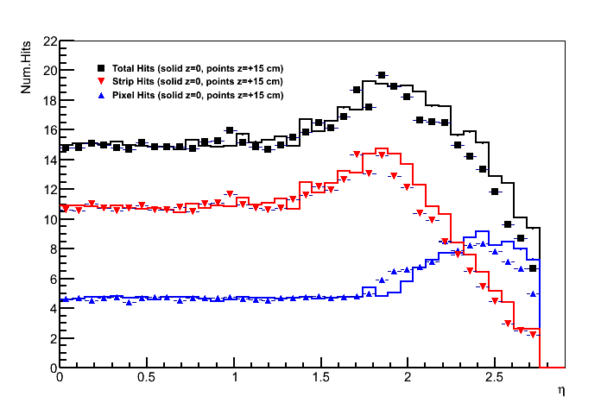
Full list of parameters for the Baseline layout
Full coverage up to pseudorapidity |η|<2.5
14 hits-per-track allows robust track selection with contingency against module failures
Limited coverage up to |η|<2.7
Pixel System
4 cylindrical barrel layers @ radii from 39 to 250 mm
6 endcap disks @ |z| from 877 to 1675 mm
Pixels 25x150 μm (φ x z) in innermost barrel layers, 50x250 elsewhere
> Strip System
5 full-size barrel layers, plus “stub” cylinders (providing extra hit coverage in barrel-endcap transition) @ radii from 405 to 1000 mm
7 endcap disks @ |z| from 1415 to 3000 mm
Barrel strips 24/48 mm (inner/outer layers) in z, 74.5 μm in φ
Endcap strips from 8 to 58 mm in r, 256 to 77 mrad in φ
All strip layers double sided, with 40 mrad “stereo angle” rotation between the sides

Slide 29
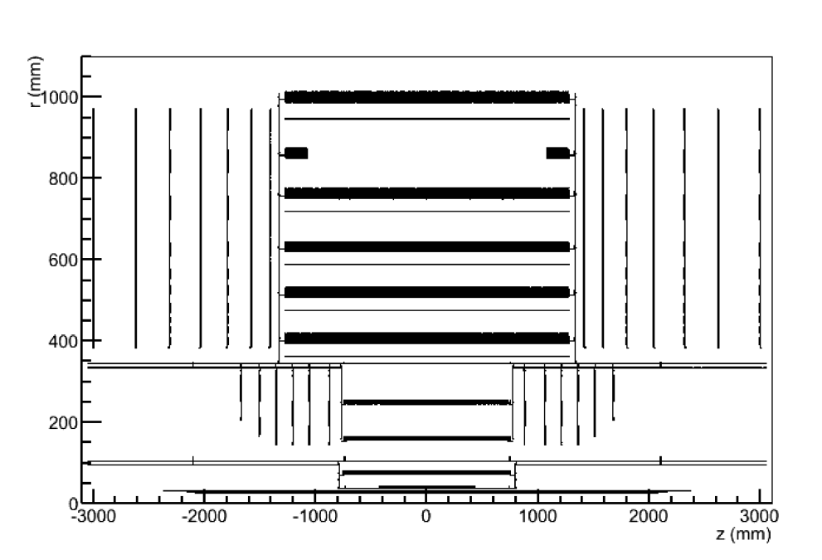
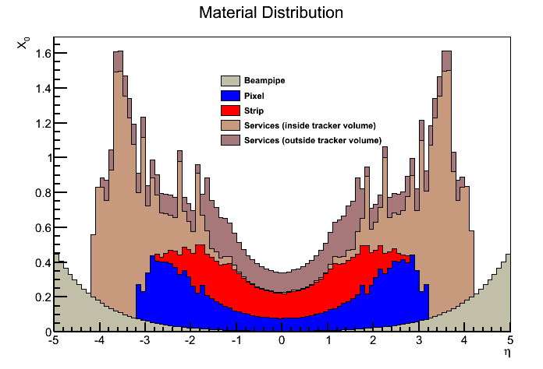
Material Distribution.
Service Materials (data fibres, HV & LV cables, cooling pipes, etc.) make up a large fraction of total tracker material
Pixel barrel services simulated along two “support tubes”
Route service out of acceptance as early as possible
Detailed survey of service material undertaken in order to estimate amount of material used in simulation
Bulk of service material outside |η|<2.7...
... or beyond last tracking point, and so doesn't directly affect tracking performance
Pixel/Strip material here contains support structures in addition to sensors
Nick Styles

Slide 30
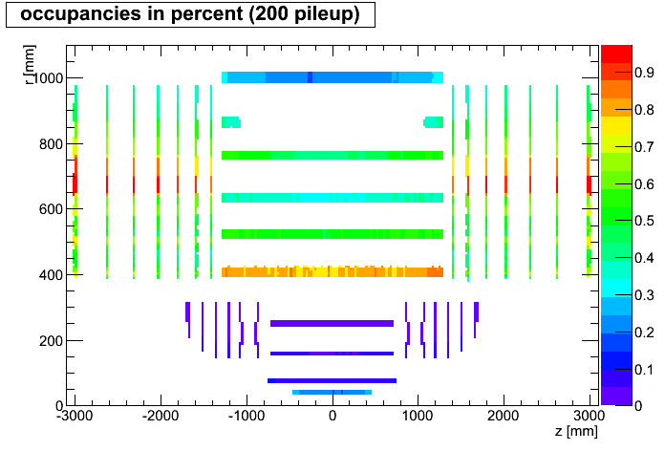
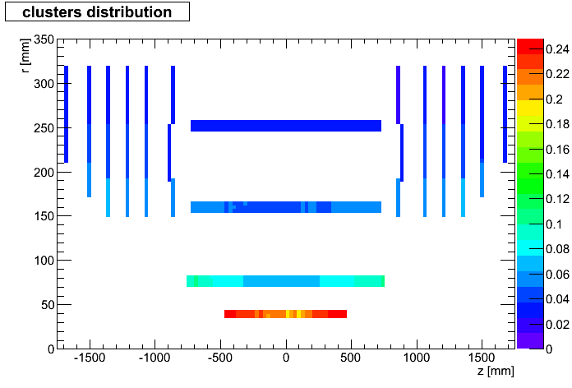
Occupancies.
Important result from the simulation studies is the occupancy in different areas of the detector
Average number of above-threshold hits per channel, per event; important consideration for detector readout electronics
Too-high occupancies increase dead time
Results at this point suggest that occupancy will be comfortably within acceptable limits, <0.4% for pixels and <2.5% for strips
Nick Styles

Slide 31
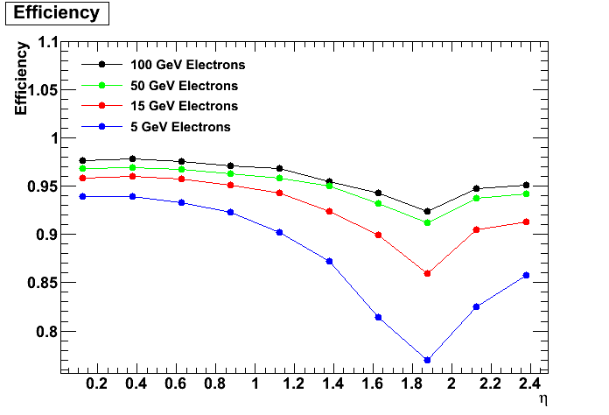
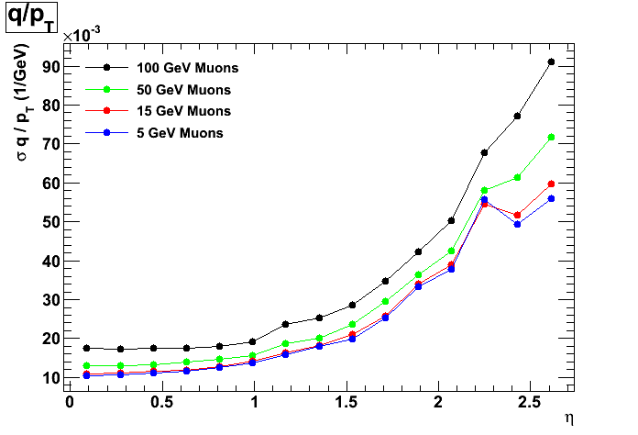
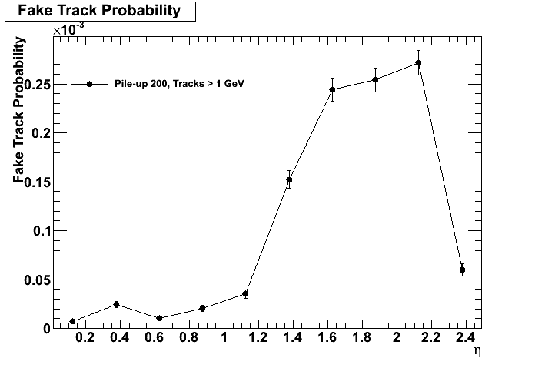
Tracking Performance.
Tracking performance assessed using various figures of merit
Depend on details of reconstruction and track selection as well as the layout itself
Must find best balance of efficiency/purity with this layout for different use cases
“Default” selection to give acceptable efficiencies, fake rates and resolutions; for instance, meet requirement of >85% efficiencies for electrons in barrel region
Nick Styles

Slide 32
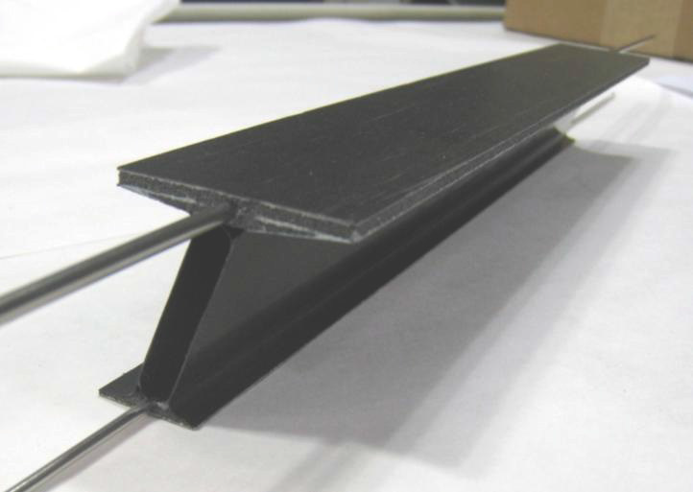
LOI presented in December 2012
Approval by the ATLAS CB in January 2013
Looking for endorsement by LHCC in March 2013
Working on the Layout for TDR
Tweaking some parameters of the Baseline LOI layout
Service routing
I-beam staves for the inner pixel layers
Alternative layouts
5-layer pixel layout
Conical layouts (bent staves for the outer pixel layers)
Alpine layout
Very Forward Pixel disks
LBL

Slide 33
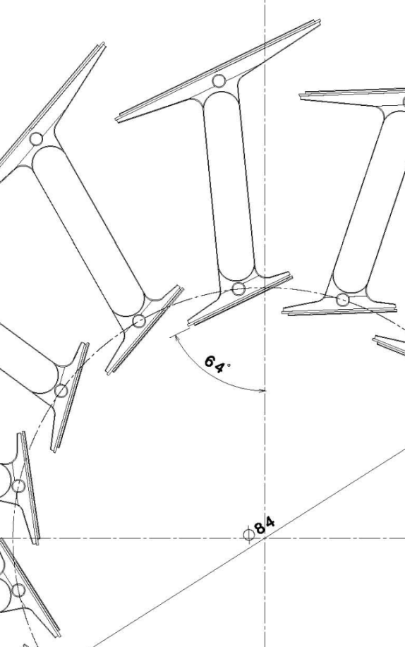
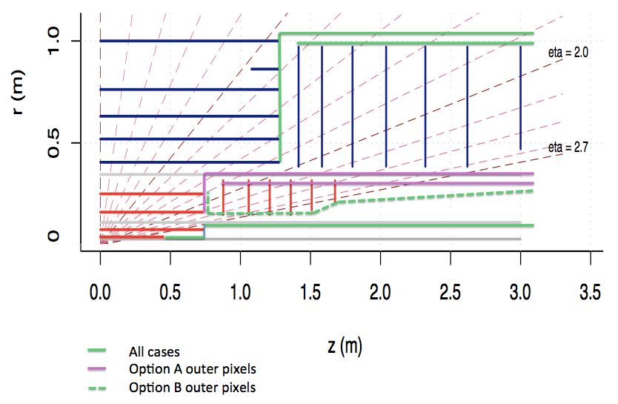
Tuning the Baseline Layout
Initial studies of the service routings could be done with the IDRES program.
The I-beam staves should be implemented in the GeoModel to understand how they affect the performance.
Conceptually not too simple as two layers got connected

Slide 34
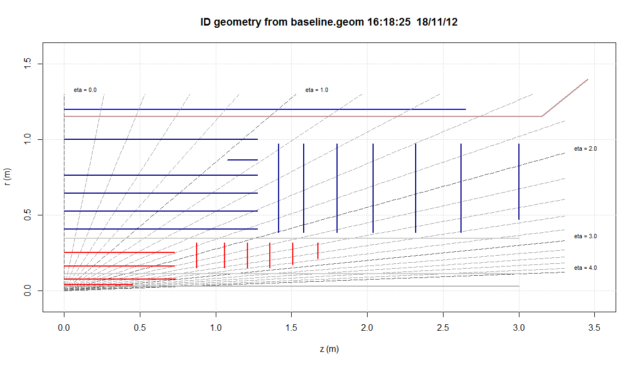
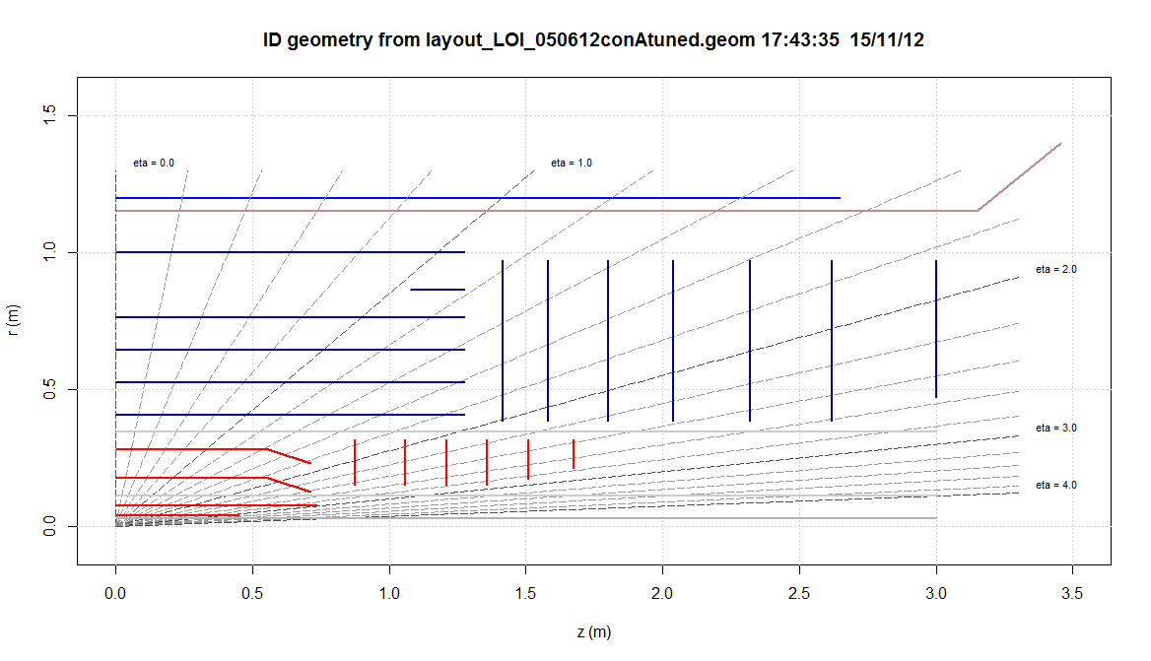
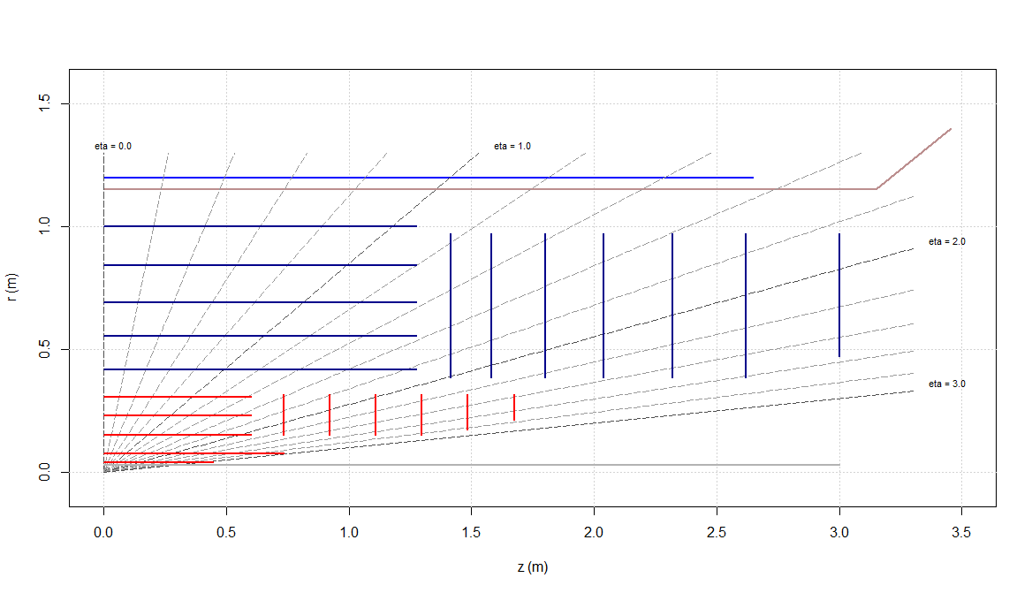
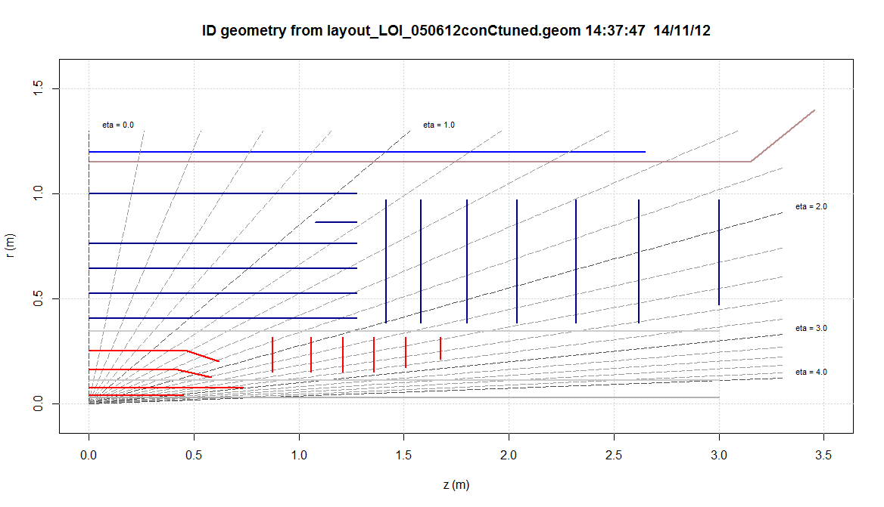
Alternative Layouts
LOI
Conical A
157mm
127mm
150mm
162mm
Conical C
5-layer
110mm
157mm
256mm

Slide 35
IDRES comparisons
nPixelHits
S-P distance
Pt
Sensitive material
σ(Z0)
σ(d0)
Expecting no differences in resolutions up to very high Pt
There could be effects in the pattern recognition and two-track resolution
➔ GeoModel

Slide 36
Implementation in GeoModel
Conical A
Conical A
Conical A
5-layer layout
Straightforward
Bent staves
Need to construct special shapes
Full simulation could be still tricky
Go for the FATRAS option
Tracking geometry
5 layers
Conical A

Slide 37
Hit Maps
LOI
Conical A
5-layer
Conical C

Slide 38
nPixelHits comparisons
Number of Hits in Athena takes into account module overlaps
Special tracking which is more pixel oriented for the 5-layer pixel layout?
IDRES
Athena
IDRES
Tune transition
region

Slide 39
Efficiencies
Low Pt electrons
High Pt electrons
No difference in the single particle efficiencies
But still need to include the pileup, study the neighbouring tracks (2-, 3-prong τ-decays)

Slide 40
Alpine Staves
Ideally: constant track density (pixel occupancy) in all sensors
The track density is constant in eta at LHC
Achieved on a cylindrical surface -> barrel-only layout?
Alpine stave
Stave placement with phi overlaps
Hermetic layer of Alpine staves seen from the interaction point
Teddy Todorov

Slide 41
Alpine Layout VS LOI Layout
Alpine pixel layout
4.6 m² pixel area
Letter of Intent baseline pixel layout
8.2 m² pixel area
Teddy Todorov

Slide 42
Alpine Material Comparison
In the Alpine layout all material is on the stave
In the LoI layout the services material is playing a big role
LoI
Current ATLAS
Alpine
LoI: EOS cards only, no cables, no pipes
Teddy Todorov

Slide 43
Service Material in Alpine Layout
All services out of tracking acceptance
(lines correspond to eta=2.5 from z=-15cm)
η=2.5
Teddy Todorov

Slide 44
Very Forward Pixel Extension
Simulation
14TeV
VBF
IDRES framework
Alpine framework
Very Forward Pixel Extension with tracking capabilities up to η=4 could be useful for VBF processes in particular
Very preliminary studies show that 1-2mm Z-resolution could be achieved at η=4
The precise magnetic field map could change the result

Slide 45
Very Preliminary Results for Very Forward Extension
IDRES and Alpine frameworks give similar results for the very forward tracking
Pixel Layers
mm
Alpine framework
250u pixel eta pitch
50u pixel
eta pitch
IDRES framework

Slide 46
Summary.
We just finished the exercise of designing and implementing the new tracking layout in the ATLAS simulation framework for the LOI.
Gained a lot of experience and have tools in hands for further layout studies and implementing more challenging layouts in the ATLAS simulation framework.
The ultimate goal is to be able to study the performance with arbitrary sensor placements
Abilities to simulate the detector should not impose limitations on the detector design
Studies of alternative layouts are under way

