Slide 1


_______________________
Upgrade Simulations for CMS
_______________________
Silvia Tentindo
Florida State University
FastSim2013
DESY, 15-17 Jan 2013

Slide 2
Overview
Physics motivation (H, H’, DM etc)
Upgrade (LHC,CMS)
Simulators
Studies
Summary

Slide 3
Overview
Physics motivation
Upgrade (LHC,CMS)
Simulators
Studies
Summary

Slide 4
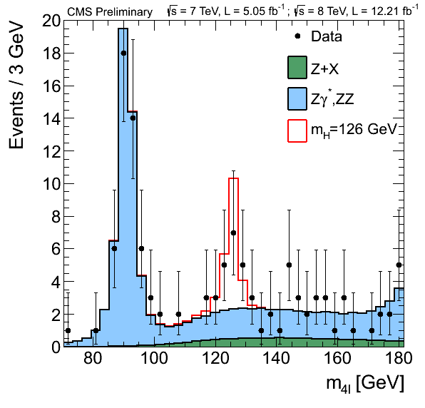
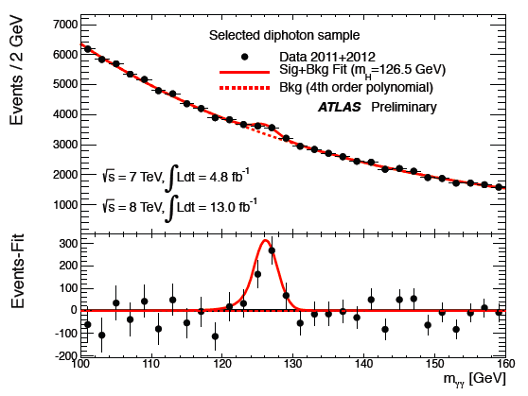
Physics Motivation
A new gauge boson observed at ~ 126GeV
What is the nature of this particle?
~ 18 fb-1,
out of 27 fl-1
All the 5 channels ….

Slide 5
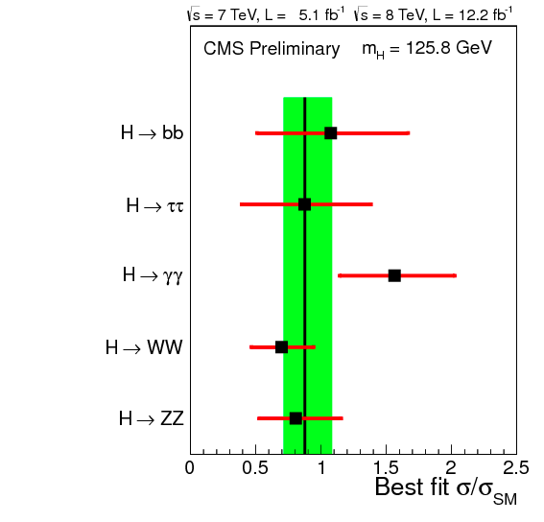
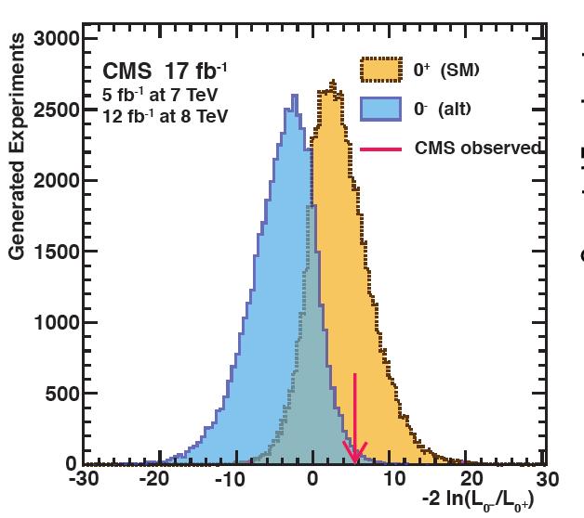
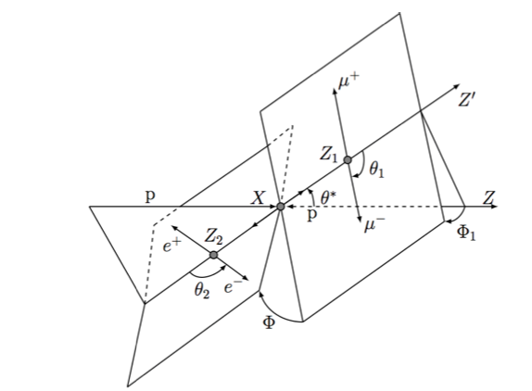
Physics Motivation: Where Do We Stand?
All five
Higgs channels
17.2 fb-1, out of 27fb-1
Higgs decay channels –
best fit:
sigma / sigma_SM = 0.88 +-0.20
Higgs Properties : J. CP
Expected 0+/ 0-separation 2.0 σ
Observed 2.4 σ
The p-value for 0⁻ is 0.072% (excluded at 95% CL)
The p-value for 0⁺ is 0.7
H->ZZ->4l
MELA kinematic variables

Slide 6
Physics Motivation: Goals
Is it the SM Higgs ?
To answer this, we need more data, so our goal is to continue the measurements :
  Branching ratios and related couplings
  Coupling to the top quark
  Quantum numbers ( J, CP)
  Mass even more precisely
  Self-coupling

Slide 7
Physics Motivation: Goals
Is there a BSM Higgs?
So far, we have not found it ! So our goal is to continue the search :
Indirect search for new physics through loop-induced effects
  Precision electroweak measurements
  Precision mass measurements (W, Z, top, …)
Direct search for new physics
  New particles
  Identify mass scale (i.e. search in the higher mass range)

Slide 8
Physics Motivation: Needs
SM Higgs studies :
  VBF, needs -> Improved acceptance for forward jets (|eta| > 3.1 (5.)): needs -> better pile up rejection (better tracking , better calorimeter granularity and segmentation)
  Higgs mass and width measurements
  Rare Higgs decays (H -> mu mu)

Slide 9
Physics Motivation: Needs
SM Higgs studies (cont) :
  d. Higgs properties – (spin, parity): -> needs better kinematic variables (forward leptons for H -> Z Z ->4l )
  e. Higgs couplings (*): do need better object identification
  f. All a,b,c,d, and e do need higher Luminosity
  (*) All the 5 Higgs decay channels ( H ->gg, H ->ZZ->4l, H->W W , H ->tau tau, V H -> ll b bbar ).

Slide 10
Physics Motivation: Needs
BSM Higgs(es) studies DM
  Hermeticity (full angular acceptance → needs high eta instrumentation), for missing Et measurements
  Sensitivity to high masses
  Better signal/background rejection → needs better object identification (e,mu,b,tau, leptons isolaion,Missing Et,PF,jets,etc)
  Higgs couplings: needs better object identification ( especially H->tau tau, V H -> ll b bbar)
  → all a,b,c,d ,and e, need higher luminosity

Slide 11
Overview
Physics motivation
Upgrade ( LHC, CMS )
Simulators
Studies
Summary

Slide 12
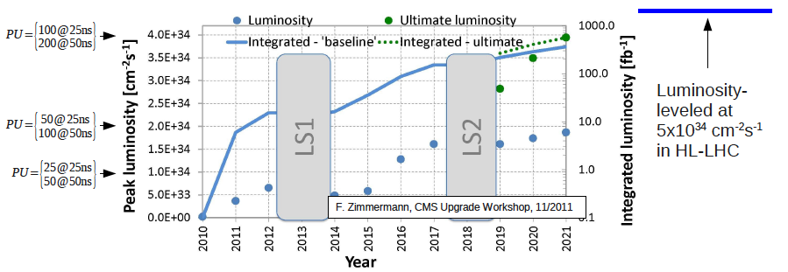
LHC Upgrade
LHC
Energy increase
8 TeV to 13/14 TeV
Injection
upgrade
HL-LHC
50 ns
25 ns
25 ns
LS- Long Shutdown
Interaction
region
upgrade
8x10³³ Hz/cm²
30 fb⁻¹
2x10³⁴ Hz/cm²
300 fb⁻¹
10³⁵ Hz/cm²
3000 fb⁻¹
LS1
LS2
Phase 1 Upgrade
CMS Upgrade plan
Phase 2 Upgrade

Slide 13
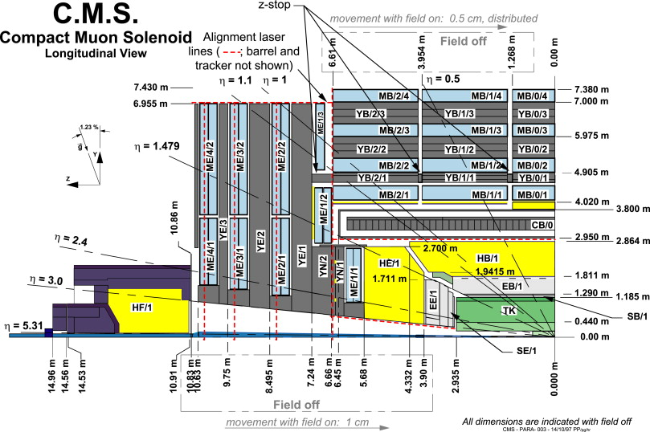
CMS Upgrade
LS1 and Phase 1
ME 4/2
HO
HF
ME 1/1
HB
Pixel
HE

Slide 14
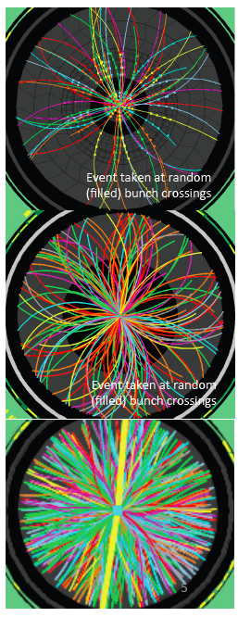
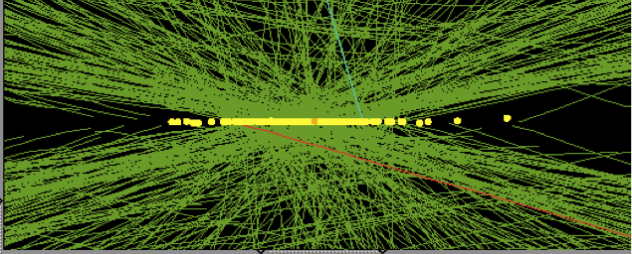
LHC Upgrade challenges:
Pile Up
ATLAS
2010
L=2.1 x 10³² cm⁻² s-1
O(2) pile-up events
150 ns bc
Maintain the LHC performance goals at the higher luminosities
  Trigger challenge
  Computing challenge: reconstruction of more complex events
  Analysis challenge: maintain high and stable id efficiency for e, mu, tau, jets, met, b-jets …
HL-LHC: pile-up @ 5x10³⁴ cm⁻² s⁻¹ leveled O(140) with 25 ns
2011
L=3.65 x 10³³ cm⁻² s-1
O(10) pile-up events
50 ns bc
2012
L=7.7 x 10³³ cm⁻² s-1
O(20) pile-up events
50 ns bc

Slide 15
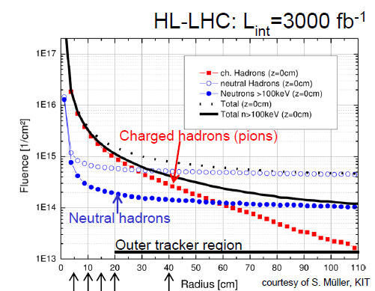
LHC Upgrade challenges :
Radiation Damage

Slide 16
Overview
Physics motivation
Upgrade ( LHC,CMS)
Simulators
Studies
Summary

Slide 17
SIMULATORS for the Upgrade
FCAL ( uses FullSim (*), StandaloneSim and FastSim) --- Kevin Pedro talk
Tracker (uses FullSim, FastSim) ---Andrea Giammarco talk
Muon (uses FullSim) -- Andrea Giammarco and Federica Primavera talks
Trigger (uses FullSim and Emulators) -- Federica Primavera talk
(*) FullSIm === Geant4

Slide 18
SIMULATORS for the Upgrade
Litrani ( simulations for light collection , in wave light guides and sensors -> study radiation damage, as a light attenuation process ) – used by FCAL Upgrade
Mars, Fluka ( calculates Fluences → Radiation Damage studies ) – used by all detectors, plus LHC machine
+ Delphes - see Pavel Demin talk

Slide 19
FCAL [Hcal (and Ecal)] CMS Upgrade
LS1 and Phase 1 (and Phase 2)
ME 4/2
HO
HF
ME 1/1
HB
Pixel
HE

Slide 20
!. F Example of UPGRADE SIMULATORS:
FASTSIM for the FCAL Upgrade – Workflow
M. Gouzevitch. The simulation effort in forward calorimetry.
Experimental measurements:
Light collection, e/h,
Density etc…
STANDALONE SIMULATION
Geant 4 based.
Precise but small piece of CMS Calo.
CALORIMETRY
UPGDARE PROJECT
WORK FLOW
Check
the compatibility of models
Qualify the project.
Suggest improvements
Energy resolution,
Shower shapes
CMS FAST SIMULATION
Showers analytical param.
Provide physical observables.
CMSSW embedded.
M.Goutsevitch, FCAL task force

Slide 21
CMS Fast Simulator for FCAL Upgrade
See Kevin Pedro’s talk ☺
EM showers parameterization (longitudinal and tansverse parameterization, study pile up and radiation hardness isseus
EM showers parameterization vs Energy dependence, and Z atomic number of material --- coefficients are given by fittings from Full Sim ( Geant4 )
ECAL sampling with non homogeneous materials ( ex PbLSO), so far only homogeneous Ecal, PbWO4: new EE, bigger radiation hardness studies
cfr S. Ledovskoy, FCAL task force

Slide 22
CMS Fast Simulator for FCAL Upgrade
See Kevin Pedro’s talk ☺
Validation FastSim with FullSim (Geant4) and Standalone FullSim(*); comparison with data
Improvements in resolution and response with pile-up corrections
Improvements in resolution and response with radiation damage corrections
Simulation of light collection vs Ecal segmentations, different sensors LYSO or ceramics), and different light guides (capillaries etc), etcNB–
HCal response smearing
cfr S. Ledovskoy, FCAL task force
(*) Standalone FullSim : made by FCAL group in order to create a simples (piece of) geometry for validating FastSim by FullSim(Geant4) (*)

Slide 23
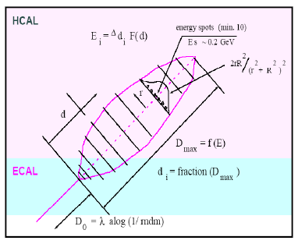

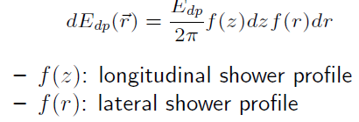
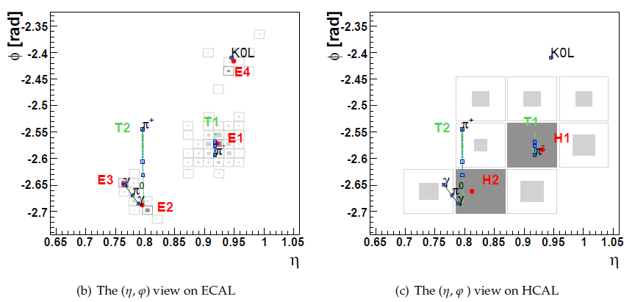
FAST SIMULATOR for FCAL Upgrade
EM showers parametrization
“GFlash H1@ HERA style approach”: analytical parameterizations
1) Estimate Edp
2) Calculate profile: EM and HAD showers
4) Cluster spots into calo cells
3) Distribute Edp into local spots
M.Goutsevitch, FCAL task force
M. Gouzevitch. The simulation effort in forward calorimetry.

Slide 24
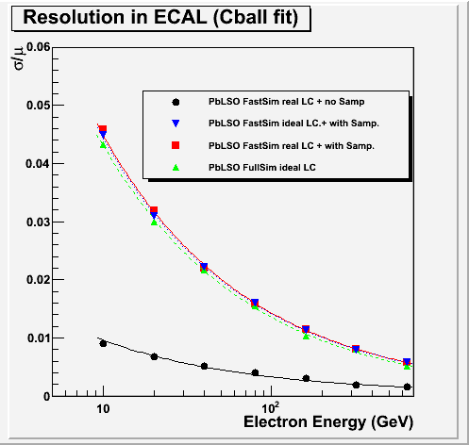
FAST SIMULATOR for FCAL Upgrade : performance comparison with
FULL SIMULATOR and FAST SIMULATOR
Simulation of the sampling calorimeters
The sampling resolution is provided by the user. We fit it from standalone GEANT simulation by assuming ideal
light collection.
Blue – FastSim
Red – FastSim
Blk – FastSim
Blue -- FullSim
M. Gouzevitch. The simulation effort in forward calorimetry.

Slide 25

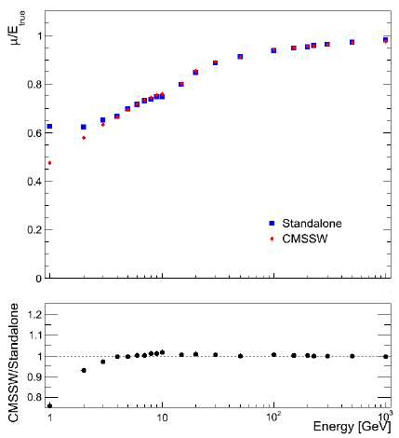
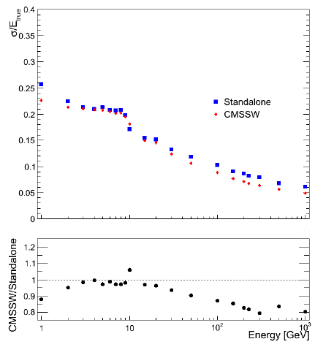

STANDALONE SIMULATOR for FCAL Upgrade : performance comparison with FULL SIMULATOR and with DATA
Testing standalone simulation
Comparison of Standalone model (Geant 4), FullSim
and CMS data works well.
Sensitive to details of simulation such as: Birk's Law (scintillators saturation), dead material (cabling) etc...
Blue – standalone
Red – CMSSW
Ratio blue / DATA
M. Gouzevitch. The simulation effort in forward calorimetry.

Slide 26
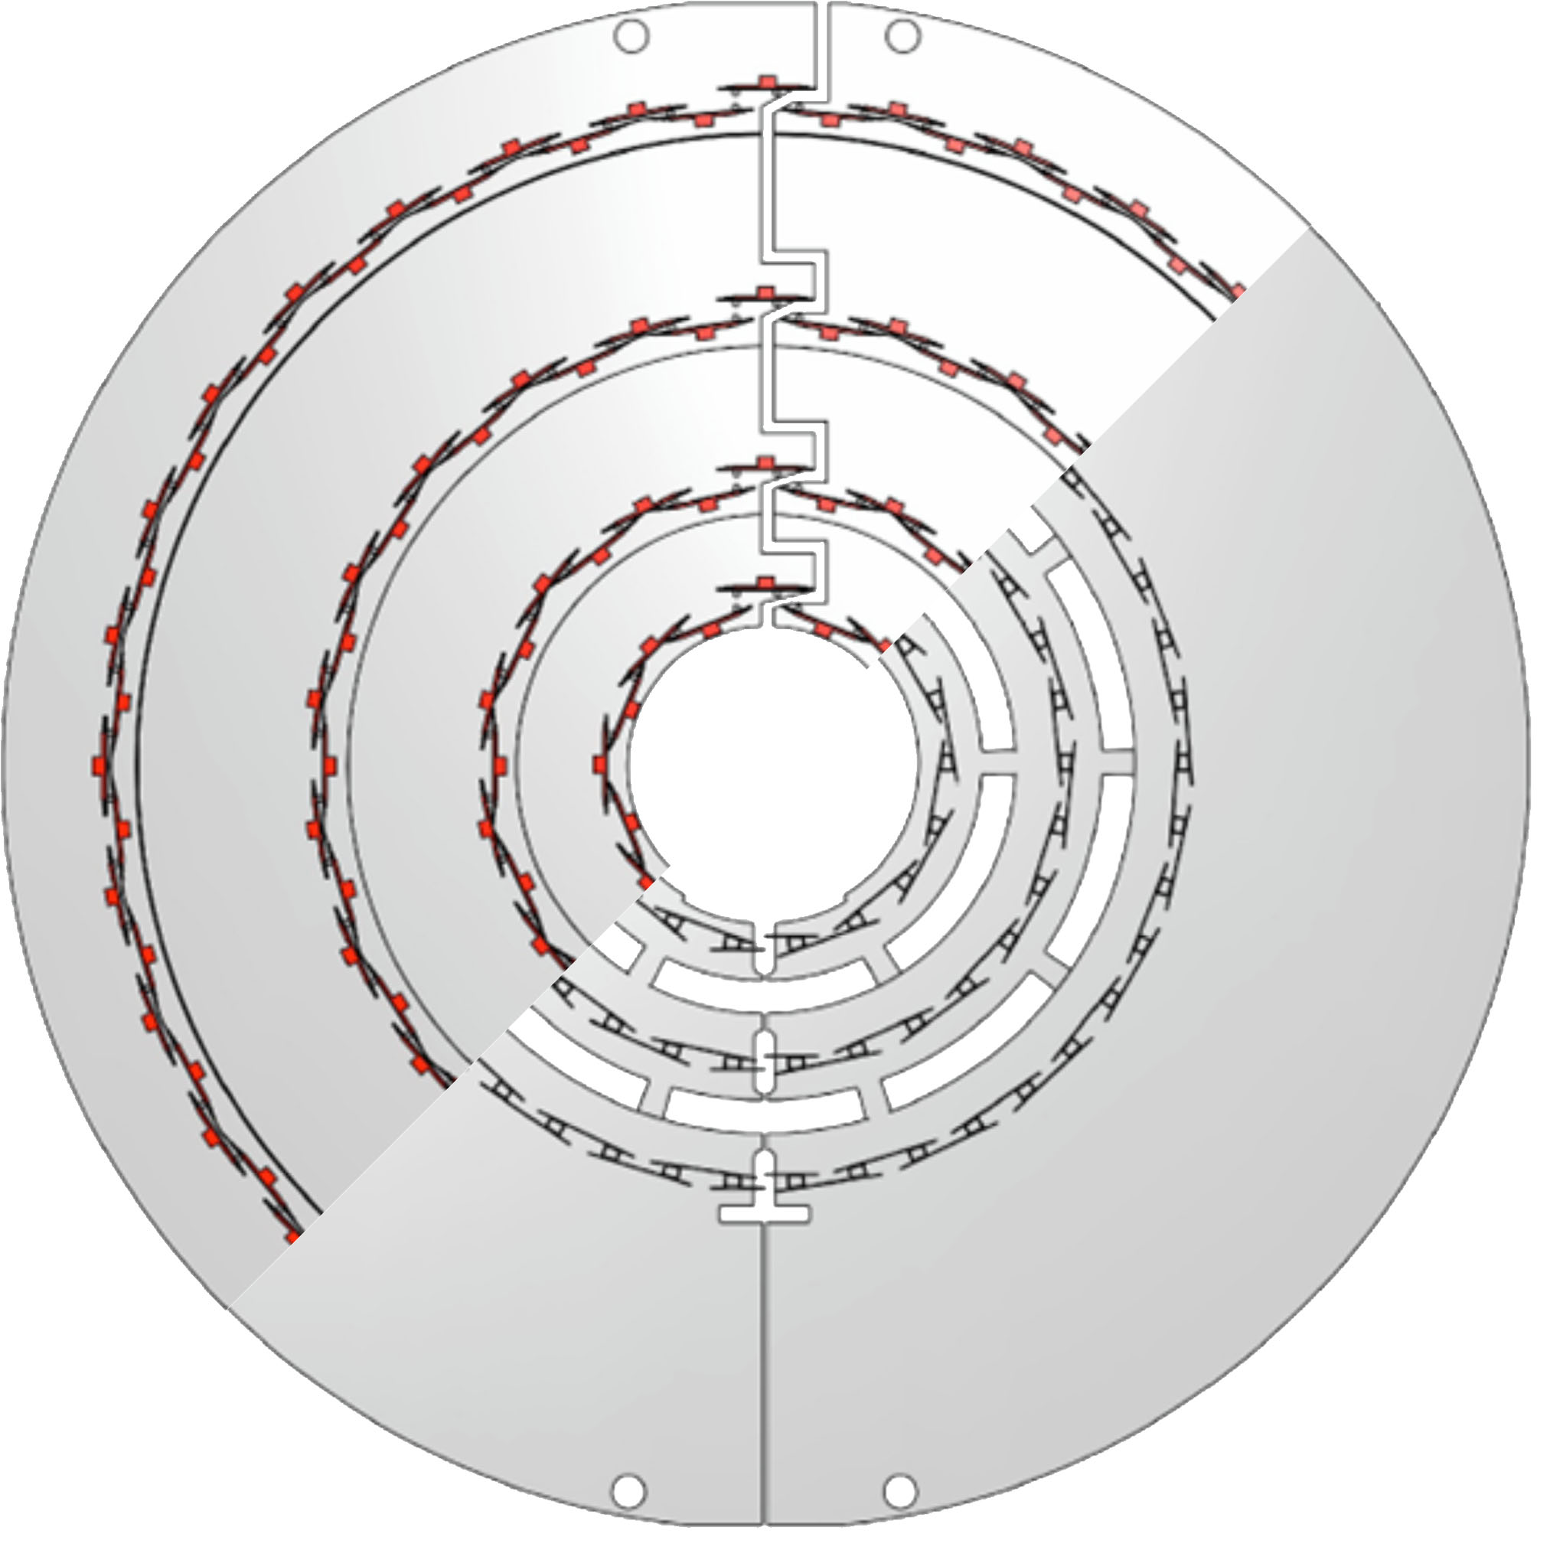
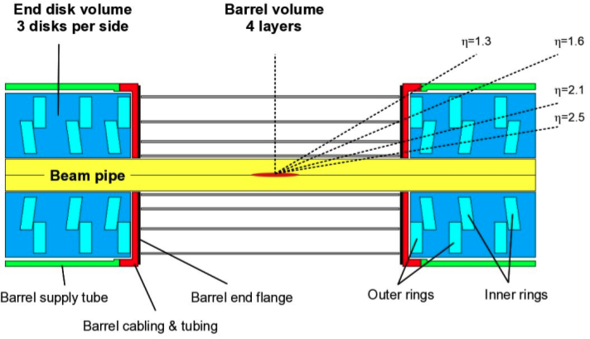
Tracker Upgrade:
Pixel Phase 1 Geometry
See Andres Giammarco’s talk
Phase 1 pixel detector replacement
  4 barrel layers, outermost layer closer to TIB
  3 FPIX disks per side, split into inner and outer disks
  New ROC chip, readout, power, cooling, etc.: Total material less than in current pixel detector
Phase 1 BPIX geometry
Current BPIX geometry

Slide 27
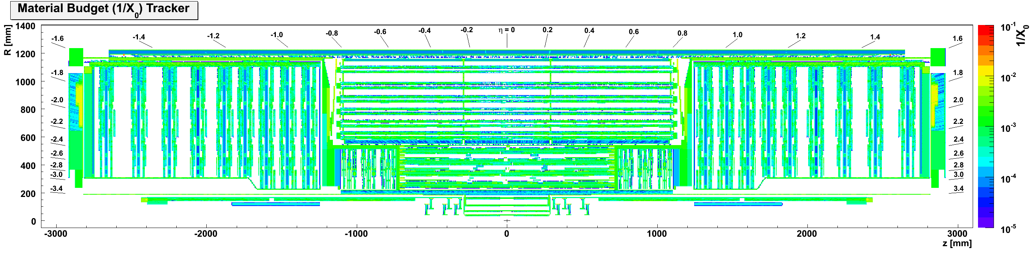
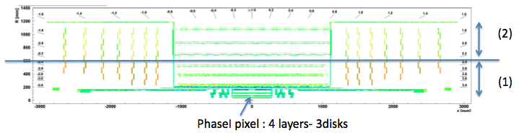
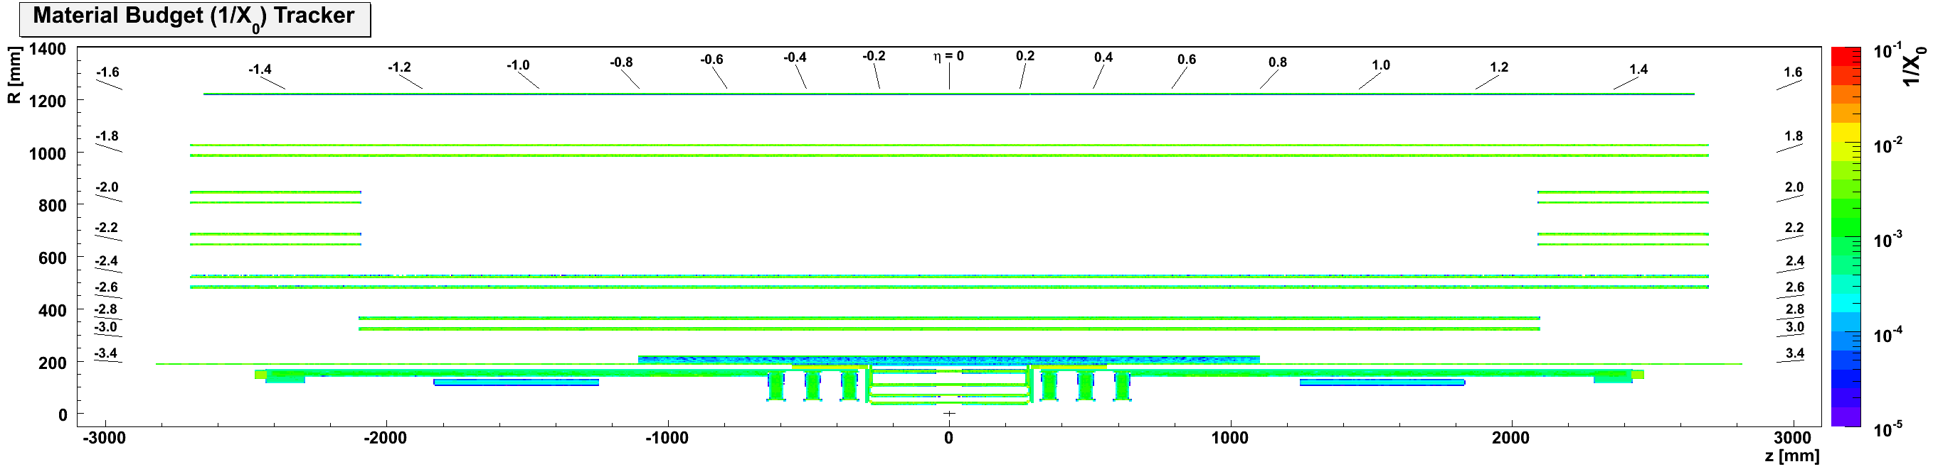
Phase 2 Tracker Geometries
Phase 1
Barrel & Endcap
Long
Barrel

Slide 28
Tracker Upgrade Simulators
See Andrea Giammarco’s talk
FastSim can be used to estimate the resolutions and efficiencies for several physics objects, typically the effects of upgraded tracker to missing Et, isolation, jet reconstruction (by particle flow method), and allows the optimization of geometry, occupancies, and to study new configurations and instrumentation.
Validation is made by comparing tracker objects (vertices, tracks, isolation) obtained from FastSim and FullSim (Geant4), or from FastSim and data
Designed to get a % - level accuracy with O(1s) CPU time in dense tracks environment.

Slide 29
Tracker Upgrade : B-Tagging Performance
Pixel replacement ( Phase 1) : 4 barrel layers + new electronics, less material
CombinedSecondaryVertex b-tagging algorithm
Compare Fastsim and FullSim, ttbar, <PU>=50
  Modified Fastsim b-tagging performance similar for a wide operating range of b-jet b-tagging efficiencies (despite fake rate difference)
Phase 1 geometry
Current Geometry

Slide 30
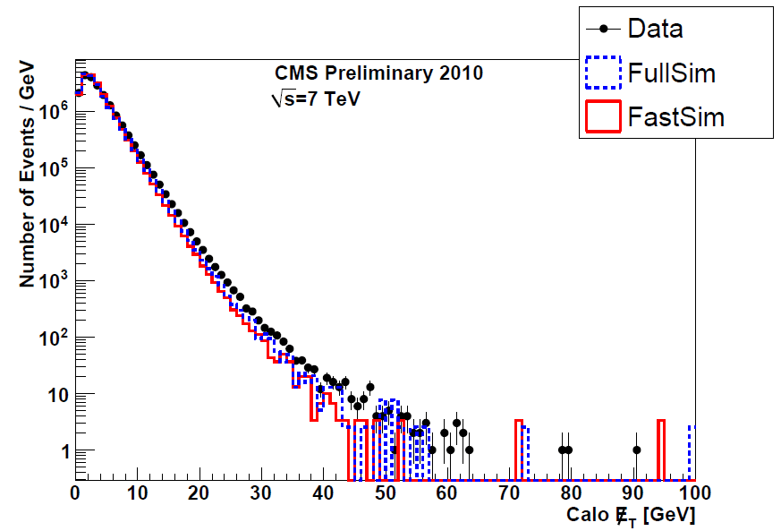
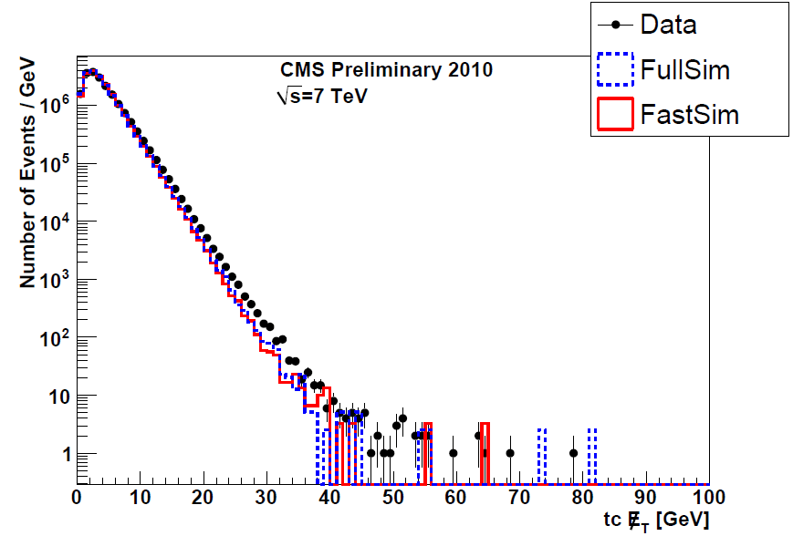
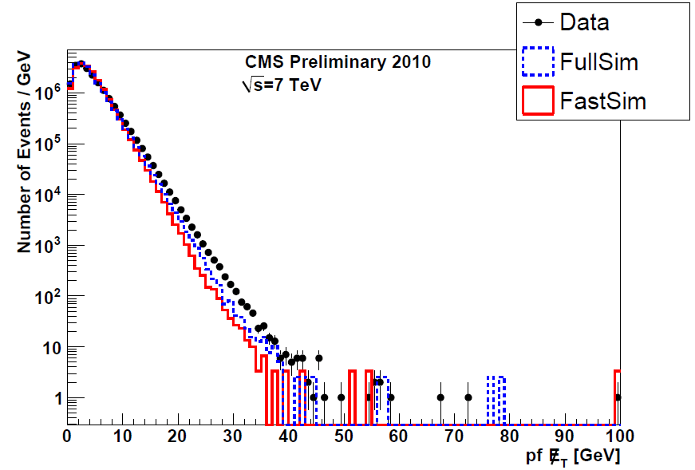
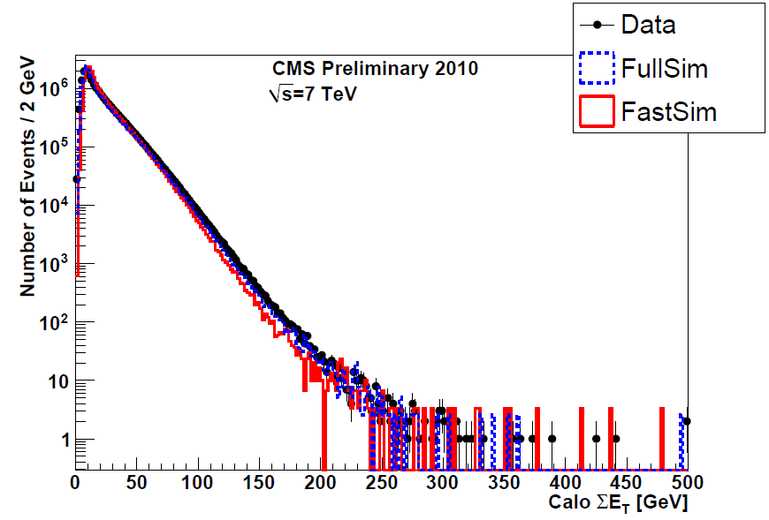
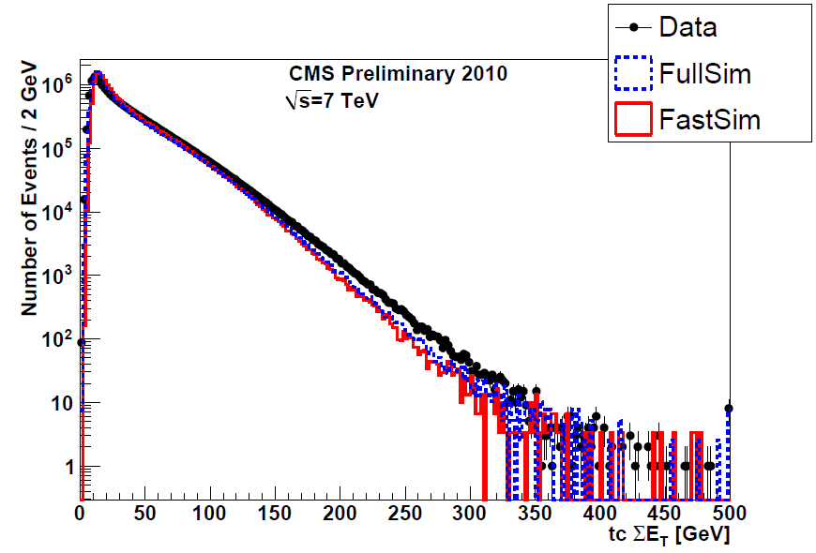
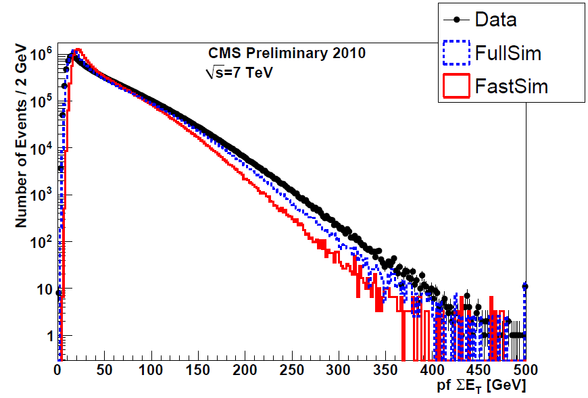
FCAL + Tracker Upgrade:
MET: FastSim vs FullSim vs Data
MET
Sum ET
Calo
TC
PFlow
Cal only
Cal+Trk,track corrected

Slide 31
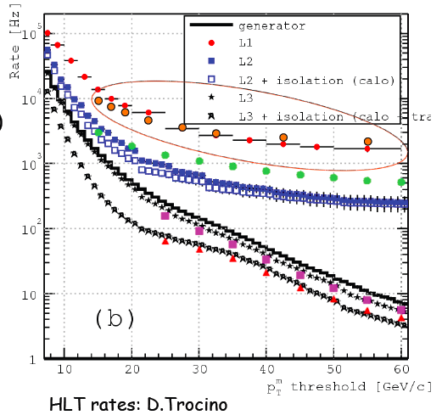
Trigger Upgrade Challenges Simulators/Emulators
See Federica Primavera’s talk
See Andrea Giammarco’s
FPGA
“stub”
y
z
x
Example:
Evolution of L1 Trigger
requires precise muon Pt resolution
Solution: powerful parallel FPGA
processors.
Optimization of Trigger is achieved using
special emulators, developed in VHDL
language or similar

Slide 32
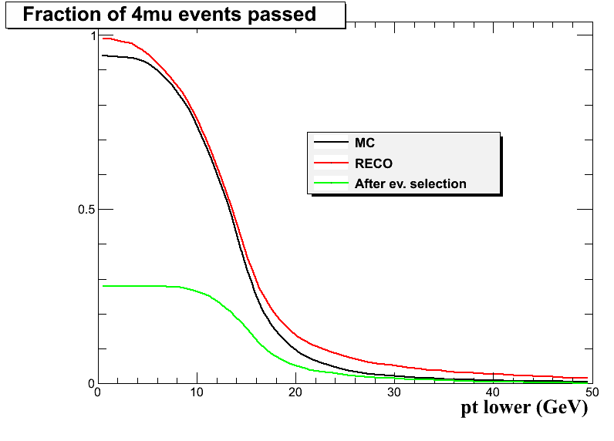
Efficiency as a function of the running threshold:
pT,2 > pT-lower; pT,1 > 12/3.5 pT-lower
Double Mu L1 seed
ε
H→ZZ→4μ
Note: offline selection
requires pT,2>10 GeV, pT,1>20 GeV
Up to pT-lower ~8 GeV no eff. loss
pT,2

Slide 33
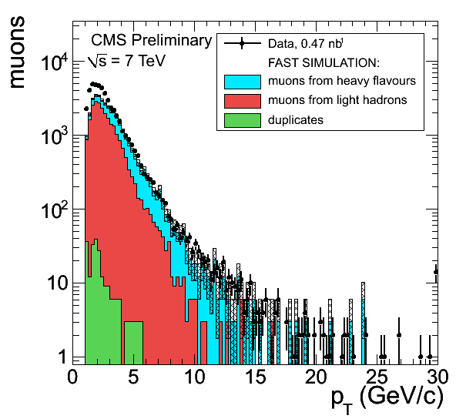
Muon Tracker Upgrade:
P_{T} distribution of Global Muons
See Federica Primavera’s talk
FastSim (histo) vs Data (points).
Different colors in the simulation distributions correspond to the different origin of the reconstructed muon:
- Prompt muons
- Decays in flight
- Fakes (ghosts)
There are fewer GlobalMuon’s in FastSim with respect to both Data and FullSim
The difference is concentrated in the low p_{T} part of the spectrum
The reason: in FastSim the decays in flight of hadrons are only allowed within the tracker volume, not outside it; moreover, in FastSim the punch-through from hadron showers is not simulated

Slide 34
Overview
Physics motivation
Upgrade (CMS, LHC)
Simulators
Simulator Studies
Summary

Slide 35
CMS Upgrade Simulators – Studies
Higgs → Z Z → 4 leptons: increased signal yield with the upgraded LHC and detector
Z Higgs → 2 leptons b bbar: increased resolution in the coupling measurement
Higgs → tau tau (plus VBF channel ): increased resolution in the coupling measurement
Higgs → mu mu: rare decay, 3-sigma mass measurement at 300 fb⁻¹; 5 sigma at 3000 fb⁻¹
Higgs couplings combination improvement
Higgs K_{f} vs K_{v}

Slide 36
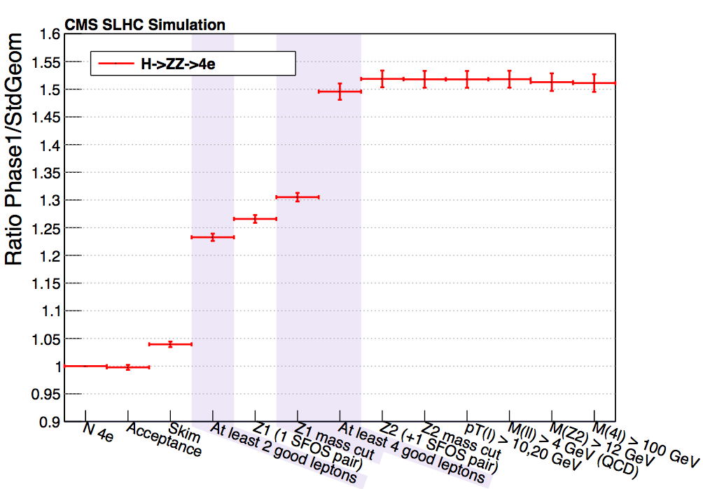
H → ZZ → 4l
is sensitive to lepton tracking, identification and isolation efficiency
Improved signal yield (relative to current detector):
mH=125 GeV
√s=14 TeV
PU=50
Significant gain in signal reconstruction efficiency:
H→ 4μ +41%
H→ 2μ2e +48%
H→ 4e +51%
+50%
    Pixel: PAS HIG-12-029
    HCAL: PAS HIG-12-030, AN-12-288

Slide 37
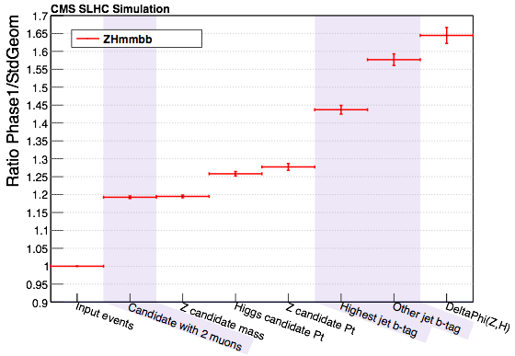
ZH → l⁺l⁻ bb
Improved signal yield (relative to current detector):
This requires:
High muon ID efficiency
High electron ID efficiency
High b-tagging efficiency
Good dijet mass resolution
Z → μ⁺μ⁻
mH=125 GeV
√s=14 TeV
PU=50
+65%
    Pixel: PAS HIG-12-029
    HCAL: PAS HIG-12-030, AN-12-288
Both lepton channels (μμ, ee) show a gain of 65% in signal efficiency with the upgraded pixel detector.

Slide 38
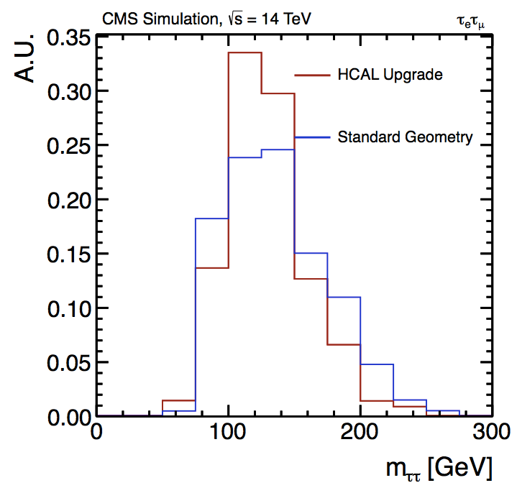
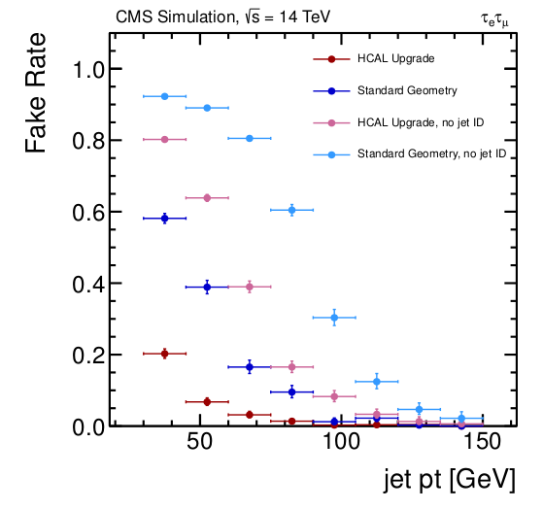
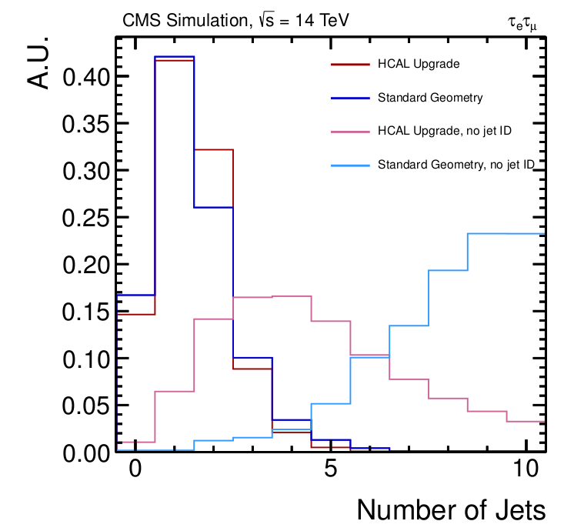
H → τ τ (including VBF)
This requires:
good ɆT (MET) resolution
forward jet tagging capability
efficient lepton identification
Improved jet and MET resolution allows 25% improvement in m_{ττ} resolution
H → ττ
Total efficiency improvement: factor of 2.5 (4.5% → 11%)
Efficiency of identifying true tag
jets is improved
Significant reduction in jet fake rate

Slide 39
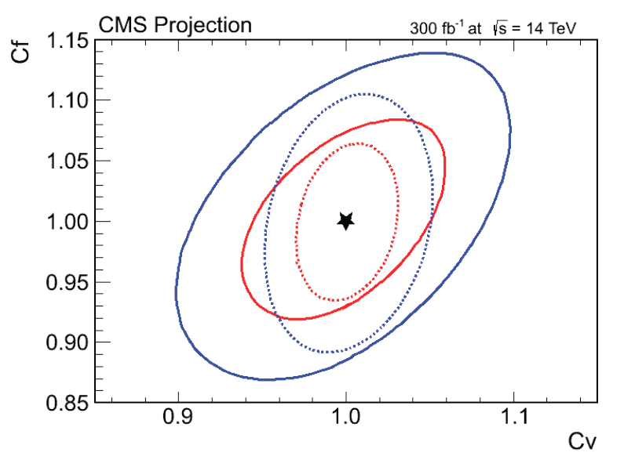
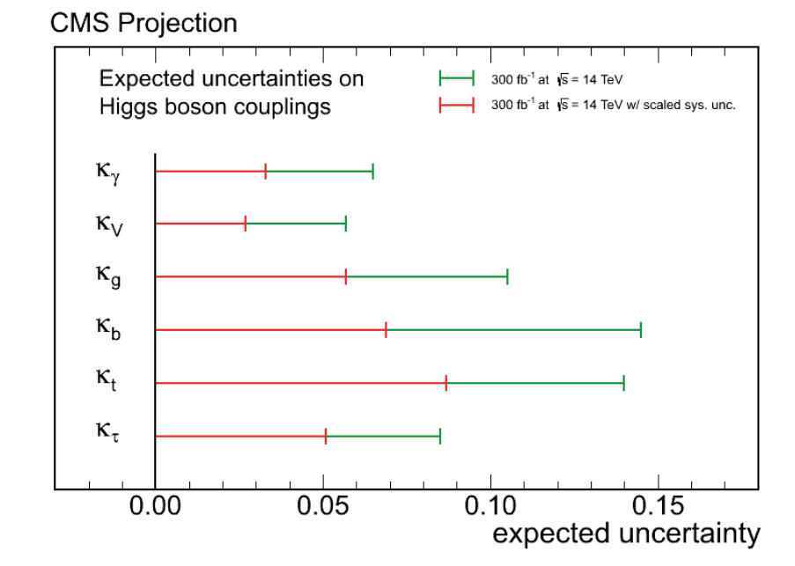
Higgs couplings @300 fb⁻¹
Three scenarios:
  Scenario 1: same systematics as in 2012
  Scenario 2: theory systematics scaled by a factor ½, other systematics scaled by 1/√L
  Scenario 3: same exp. syst. as in 2012, w/o theory uncertainty
2σ
1σ
Full line: Scenario 1
Dotted line: Scenario 3
With 300 fb⁻¹ the uncertainties on the Higgs couplings are expected in the range σ (κ_{V} ) ~ 3-6%
    σ (κ_{f} ) ~ 5-15%
300 fb⁻¹ 14 TeV, Scenario 1
300 fb⁻¹ 14 TeV, Scenario 2

Slide 40
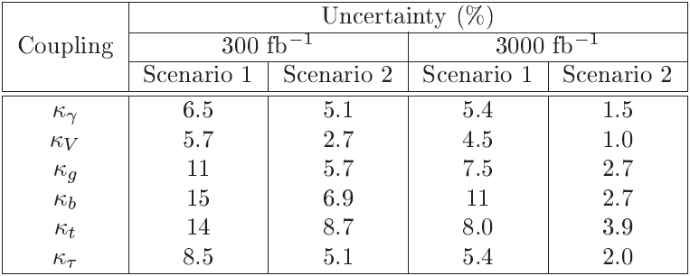
Higgs couplings @ 300 & 3000 fb⁻¹

Slide 41
Summary
Simulators are the glue between the physics we want to do and the detectors, instrumentation, and accelerators that we need in order to do the physics.
The size and complexity of present HEP detectors and accelerators, and the challenge of detecting new physics, make the role of accurate simulators more important than ever.
We need to produce them powerful, precise, resilient, convenient, fast … and, ideally, user-friendly products
CMS has already produced impressively accurate simulators that are now being used in the challenging upgrade of the CMS detector.

Slide 42
Thanks
Thanks to many CMS colleagues from all Detectors and Software groups I had to contact in order to put together this talk.
To the members of the FCAL Tasks Force
To the members of the TRACK Simulator group, including Trigger and Muon Groups.
To the five Higgs Analysis groups …. Especially
H ->ZZ -> 4 leptons and Higgs -> g g

Slide 43
BACK UPS

Slide 44
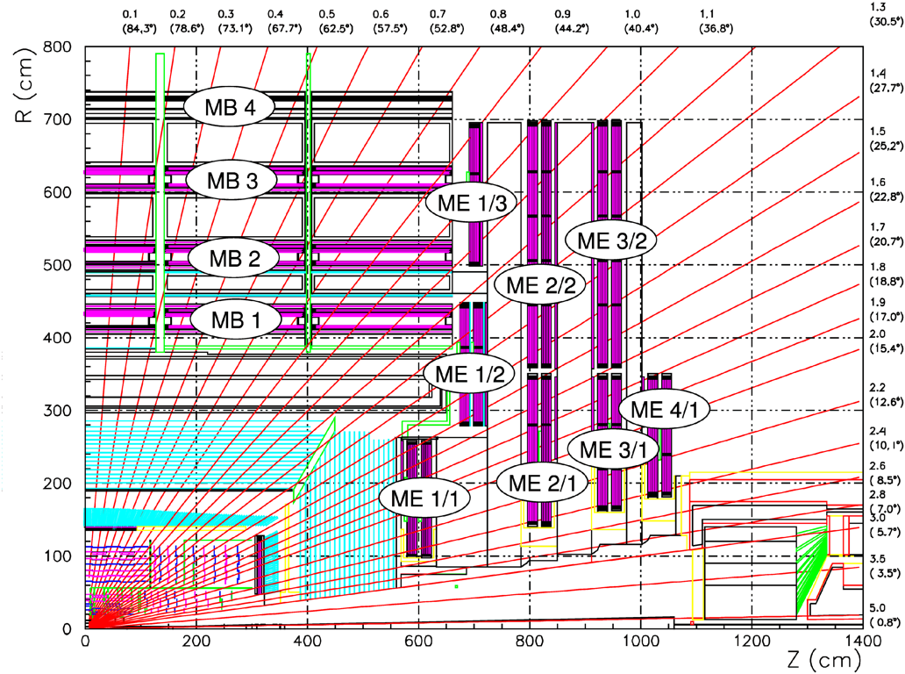
Current detector η coverage
η

Slide 45
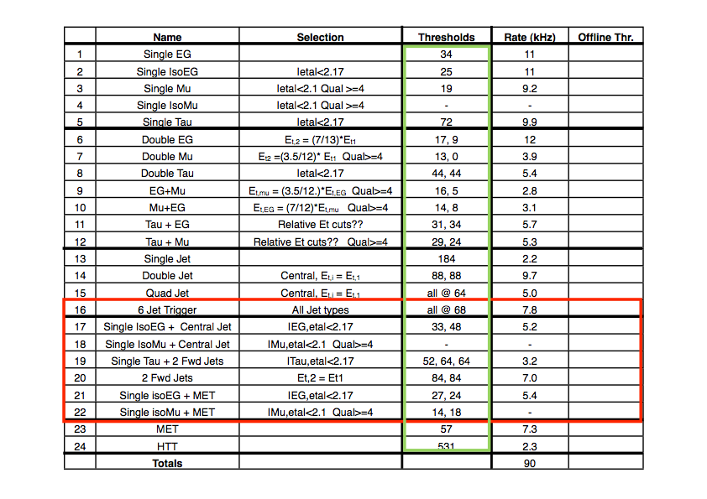
L1 trigger upgrade seeds

Slide 46
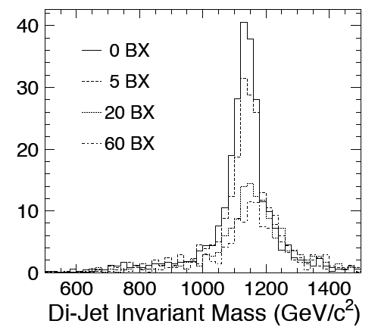
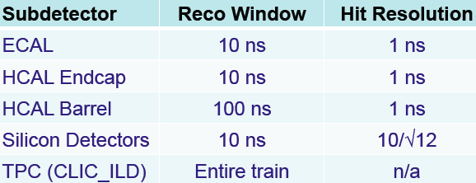
LHC Upgrade Bunch-Crossing
Calorimeter backgrounds per bunch-crossing are manageable, ~ 60 GeV
Want to integrate over as few as possible BXs
Tight timing requirements !
Tension between maximising calorimeter integration time and minimizing number of BXs of γγ → hadrons background

Slide 47
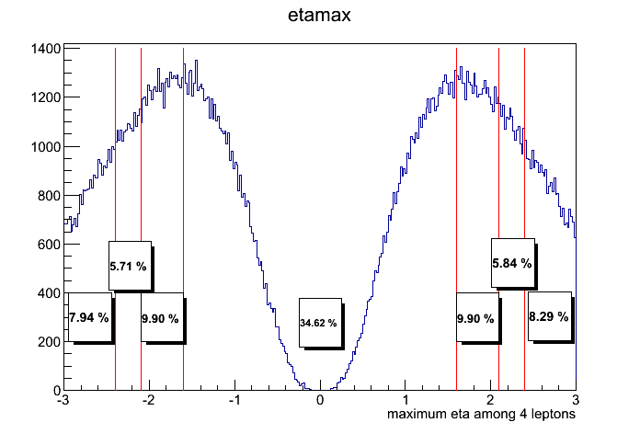
H → ZZ → 4μ
Example of Phase 2 upgrade study
Increasing tracking and muon η coverage
η of highest η muon
% of events for given η range
η

