Slide 1
XTL Tunnel Racks Specifications
Notes:
How to edit the title slide
Upper area: Title of your talk, max. 2 rows of the defined size (55 pt)
Lower area (subtitle): Conference/meeting/workshop, location, date, your name and affiliation, max. 4 rows of the defined size (32 pt)
Change the partner logos or add others in the last row.

Slide 2
Totally in the XTL tunnel 162 cabinets:
124 Cabinets are Triple racks
25 cabinets for WP01 RF, contact person R. Wagner
54 cabinets for WP02 LLRF (25 Masters + 25 Slaves + 4 Spare), contact person W. Wierba
25 cabinets for PS (WP34, J. Eckold) and Diagnostics (WP17, D. Nölle)
12 cabinets for Cryo (WP13, O. Korth) and Vacuum (WP08,WP19, D. Hoppe)
5 cabinets IBFB (WP16, B. Keil, W. Decking)
2 cabinets Vacuum (WP08,WP19, D. Hoppe) and Diagnostics (WP17, D. Nölle)
1 cabinet Kickers
Stakeholders XTL:
WP01
WP02
WP05
WP07
WP08 & WP19
WP13
WP17
WP18
WP34
WP38
WP39
1. einige formale Dinge:
* Inhaltsverzeichnis
* Änderungshistorie
o Version
o Datum
o Ersteller
o Änderungsgrund
o Änderung
* Status
o Ersteller / Datum
o Prüfer / Datum
o Genehmiger / Datum
„Für die fertig bestückten Racks müsste eine Transportsicherung vorhanden sein für die Löscheinrichtung (Gasflasche) und die Türen“ - Gehört nicht zu Spezifikationen und ist in Aufgabenliste verschoben
„Die Abschaltungseinrichtung für das Notaussystem sollte in den Racks einheitlich integriert sein ebenso wie eine Anschlußbox für die Netzzuleitungen“ – die ganze NOT Aus Konzept wurde noch nicht endgültig ausarbeitet. Vor allem es ist noch nicht klar wer die Abschaltungseinrichtung designet und installiert. Daran wird noch gearbeitet. Die Abschaltungseinrichtung wird nicht in Schrankspezifikation aufgenommen (siehe Aufgabenliste). Die Netzzuleitungen und Steckdosen sind in Spezifikationen schon definiert.
„Da wir auch wassergekühlte Komponenten in den Racks haben, sollte auch ein Feuchtesensor vorgesehen werden bzw. auch ein Auslauf im Bodenbereich im Falle einer größeren Leckage“ – sollte intern für 25 RF Racks gemacht werden (siehe Aufgabenliste)
Notes:
Before you start editing the slides of your talk change to the Master Slide view: Menu button “View”, Master, Slide Master:
Edit the following 2 items in the 1st slide: 1) 1st row in the violet header: Delete the existent text and write the title of your talk into this text field 2) The 2 rows in the footer area: Delete the text and write the information regarding your talk (same as on the Title Slide) into this text field.
If you want to use more partner logos position them left beside the DESY logo in the footer area Close Master View

Slide 3
Eine Anregung zwei Temperaturstabilitätsklassen anzufragen, ist scheinbar untergegangen.
gemäss Dokument (…) haben wir für Undulator- & IBFB Analog-/Digitalelektronikracks 0.1°C/h und 1°C/Woche (Peak-Peak) spezifiziert, bei den übrigen BPM-Typen 1°C/h und 10°C/Woche.
Vielleicht sollet ihr daher noch den von den Racks zu erreichenden max. Temperaturgradienten mit in die Rack Spezifikation schreiben, und die Bedingung unter der er gemessen werden soll (Vollast der Kühlung, lineare Variation der Wärmelast der Racks von 50-100% und 100-50% innerhalb 60 Minuten oder sowas ...).
Wenn wir 0.1°C bzw. 0.2 °C Stabilität anfordern dann müssen die Herstellern diese auch garantieren. Das führt dazu, dass entweder Preise werden zu hoch oder Herstellern treten zurück. Aus DESY-Erfahrung wissen wir dass 0.2°C Stabilität bei üblichen Schroff und Rittal Schränke erreichbar ist. Es wurde entschieden dass in Spezifikationen lassen wir wie gehabt:
“Die Temperatur in den Schränken soll auf besser als +/-1 Grad geregelt sein. Die Temperaturstabilität bezieht sich auf eine Messstelle an einen Ort im Schrank. Unterschiedliche Positionen in den Schränken dürfen größere Temperaturunterschiede aufweisen. Es darf aber keine Zweipunktregelung verwendet werden, die Temperatur soll sich bei konstanter Last auf einen Wert stabilisieren“
Dazu schreiben wir aber dass Messgenauigkeit von Temperatur soll mindestens 0.1°C sein
Notes:
Before you start editing the slides of your talk change to the Master Slide view: Menu button “View”, Master, Slide Master:
Edit the following 2 items in the 1st slide: 1) 1st row in the violet header: Delete the existent text and write the title of your talk into this text field 2) The 2 rows in the footer area: Delete the text and write the information regarding your talk (same as on the Title Slide) into this text field.
If you want to use more partner logos position them left beside the DESY logo in the footer area Close Master View

Slide 4
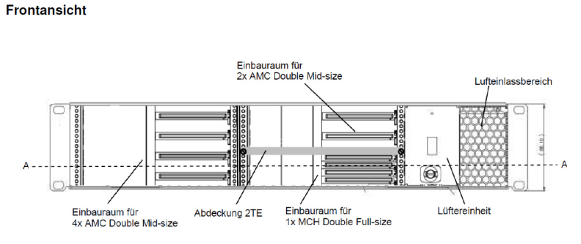
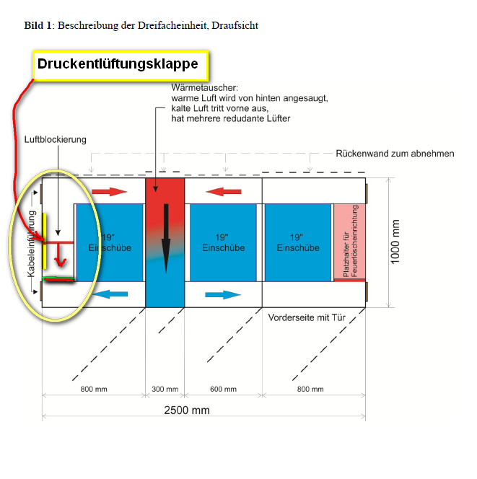
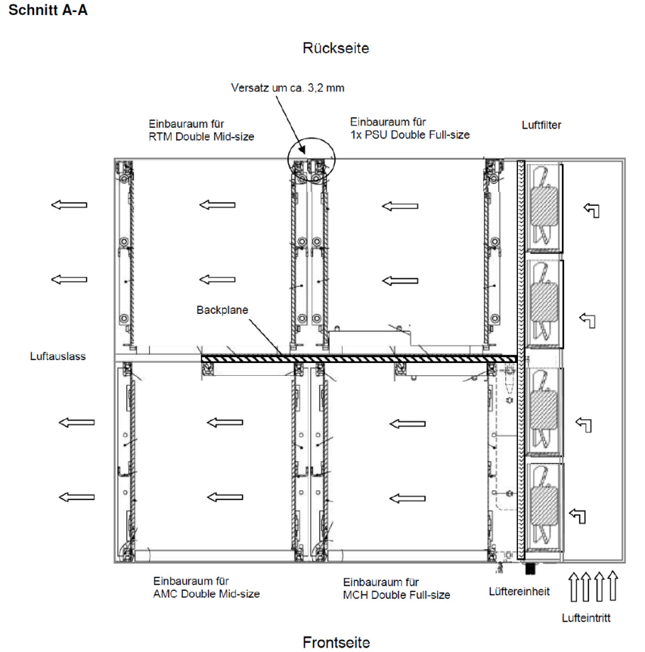
2U MTCA Crate
Die Änderung wird in Spezifikationen übernommen
See alsoo slide 5, Mechanics, (1)
…it is hard to tell how many of these crates we'll use at the end. Today Hans asked for possibilities to upgrade in case of new ideas.
This 2HE crate would be perfect to fit in the few holes we left free so far.
We just need about 5cm on the left side of the racks between crate and wall…
Notes:
Before you start editing the slides of your talk change to the Master Slide view: Menu button “View”, Master, Slide Master:
Edit the following 2 items in the 1st slide: 1) 1st row in the violet header: Delete the existent text and write the title of your talk into this text field 2) The 2 rows in the footer area: Delete the text and write the information regarding your talk (same as on the Title Slide) into this text field.
If you want to use more partner logos position them left beside the DESY logo in the footer area Close Master View

Slide 5
To avoid discrepancies and exclude translation mismatching, there will be only one official version of specification in German available.
Even for the international tendering we are not obliged to translate it.
See next slide. In case, in some regions, we need to add additional shielding doors, there is still enough space for that
Notes:
Before you start editing the slides of your talk change to the Master Slide view: Menu button “View”, Master, Slide Master:
Edit the following 2 items in the 1st slide: 1) 1st row in the violet header: Delete the existent text and write the title of your talk into this text field 2) The 2 rows in the footer area: Delete the text and write the information regarding your talk (same as on the Title Slide) into this text field.
If you want to use more partner logos position them left beside the DESY logo in the footer area Close Master View

Slide 6
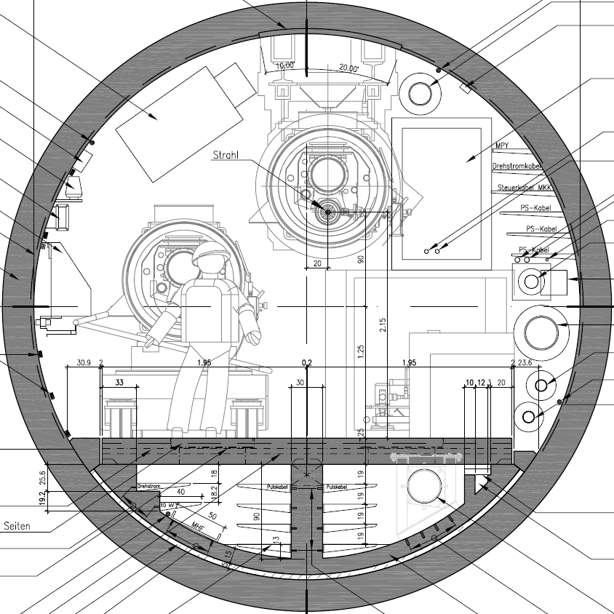
reserviert für Hohlleiter
100 cm
~90 cm
Fluchtweg
1,7 m x 0,5 m

Slide 7
There are a lot of remarks (slides 7-11) coming from WP02 LLRF which are probably not relevant for other users. At the moment LLRF group performs additional examinations of prototype for EMI, vibrations and thermal stability. We expect to get the final results within the next two weeks and discuss them on the next Racks Coordination Meeting (to be announced).
In worst case, if respective modifications of specifications lead to significant raise of the cabinet prize, LLRF Racks (totally 54 Cabinets) must be specified separately.
Notes:
Before you start editing the slides of your talk change to the Master Slide view: Menu button “View”, Master, Slide Master:
Edit the following 2 items in the 1st slide: 1) 1st row in the violet header: Delete the existent text and write the title of your talk into this text field 2) The 2 rows in the footer area: Delete the text and write the information regarding your talk (same as on the Title Slide) into this text field.
If you want to use more partner logos position them left beside the DESY logo in the footer area Close Master View

Slide 8
Notes:
Before you start editing the slides of your talk change to the Master Slide view: Menu button “View”, Master, Slide Master:
Edit the following 2 items in the 1st slide: 1) 1st row in the violet header: Delete the existent text and write the title of your talk into this text field 2) The 2 rows in the footer area: Delete the text and write the information regarding your talk (same as on the Title Slide) into this text field.
If you want to use more partner logos position them left beside the DESY logo in the footer area Close Master View

Slide 9
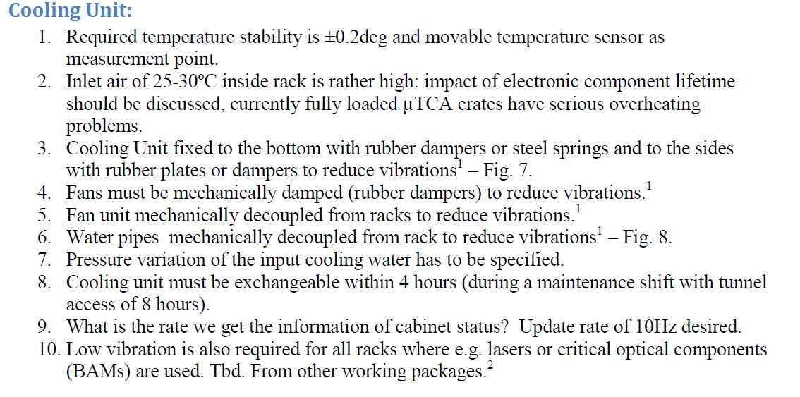
Rack specially critical for final performance
EMI shielding & very good grounding required (risk!)
Vibration control/ vibration suppression (risk!)
Better temperature stability (+-0.2 deg sufficient) (unsolved issues)
25-30 deg inlet air ⇒ rather high temp. for electronics (life-time!)
Notes:
Before you start editing the slides of your talk change to the Master Slide view: Menu button “View”, Master, Slide Master:
Edit the following 2 items in the 1st slide: 1) 1st row in the violet header: Delete the existent text and write the title of your talk into this text field 2) The 2 rows in the footer area: Delete the text and write the information regarding your talk (same as on the Title Slide) into this text field.
If you want to use more partner logos position them left beside the DESY logo in the footer area Close Master View

Slide 10
Notes:
Before you start editing the slides of your talk change to the Master Slide view: Menu button “View”, Master, Slide Master:
Edit the following 2 items in the 1st slide: 1) 1st row in the violet header: Delete the existent text and write the title of your talk into this text field 2) The 2 rows in the footer area: Delete the text and write the information regarding your talk (same as on the Title Slide) into this text field.
If you want to use more partner logos position them left beside the DESY logo in the footer area Close Master View

Slide 11
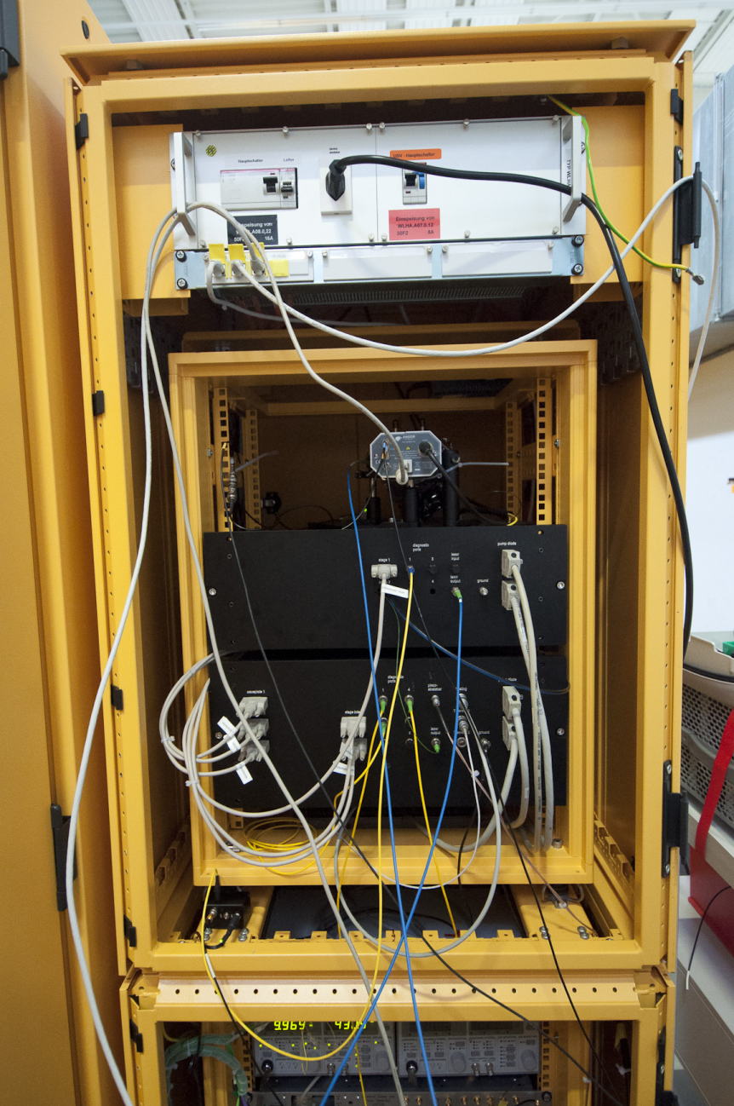
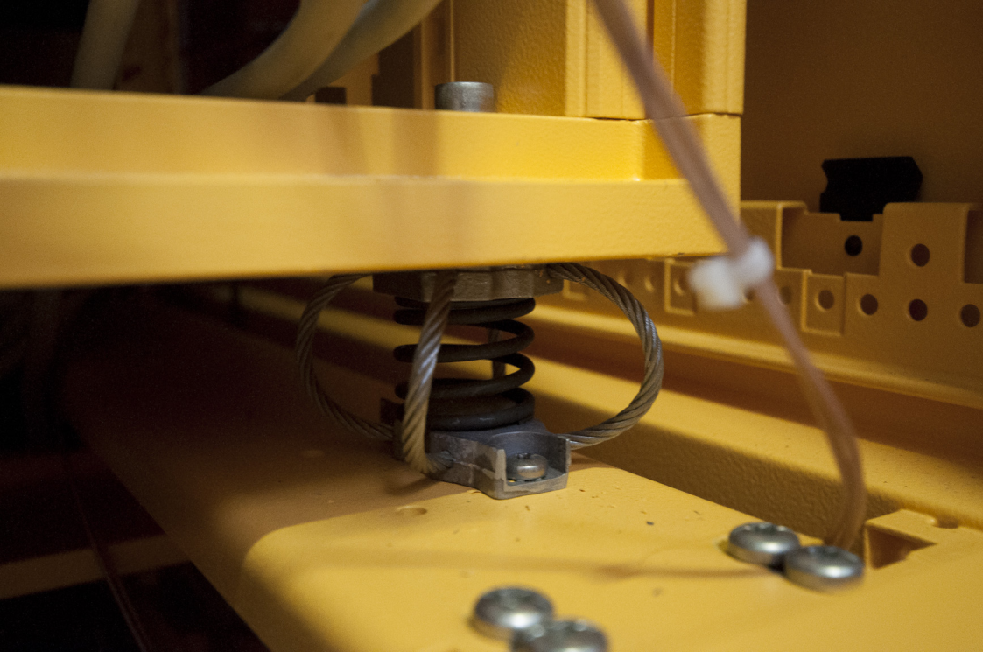
The LLRF (WP02) rack specifications sent round by Wojtek apply also to WP18.
… in WP18 we have 2 rack stations in B1 and B2 special requirements on the vibration damping and temperature stability…
However, as this applies only to 4 racks in XTL, in my opinion it may not be necessary to put these requirements into a general rack specification;
these 4 rack stations could be custom made and not part of a larger order?
When the 'standard' racks (or prototype) have been ordered, one could test if these racks are sufficient in terms of temp stability and vibration damping for the crucial WP18 applications.
I assume there will be a PRR before the racks will be ordered?

Slide 12
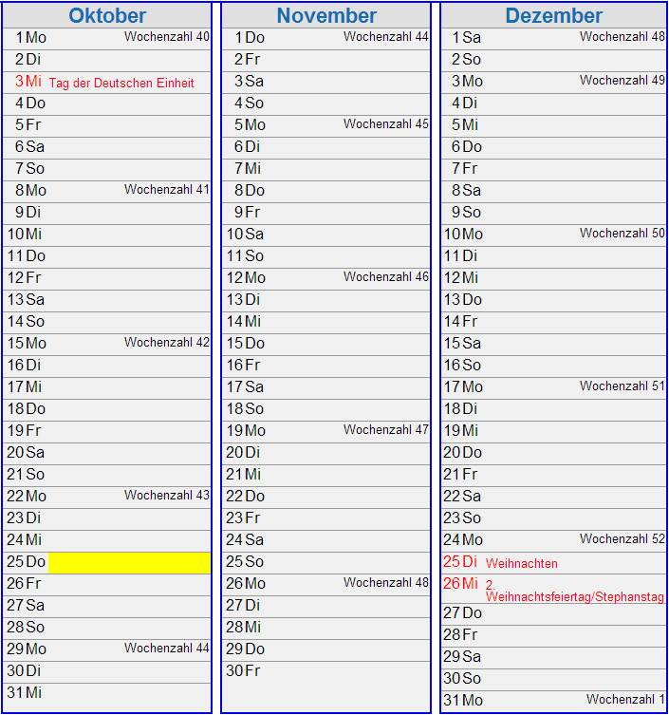
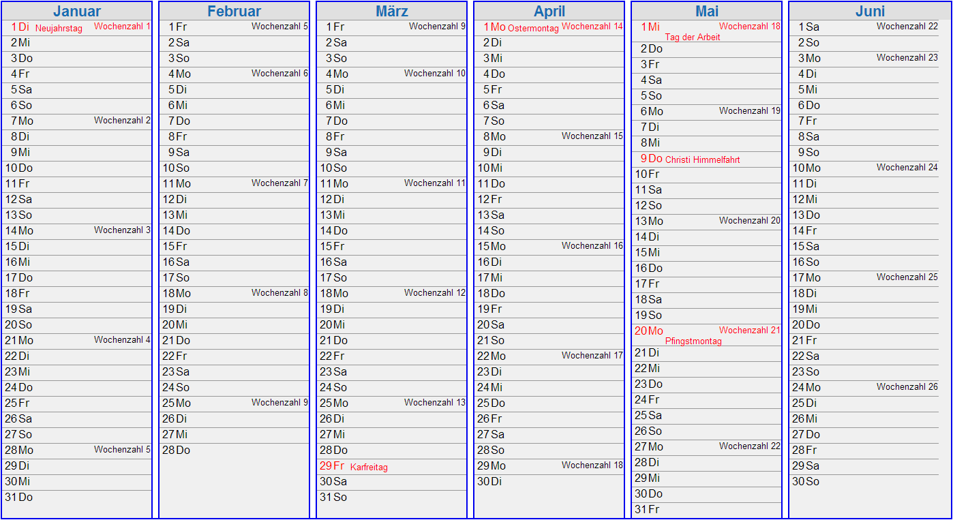
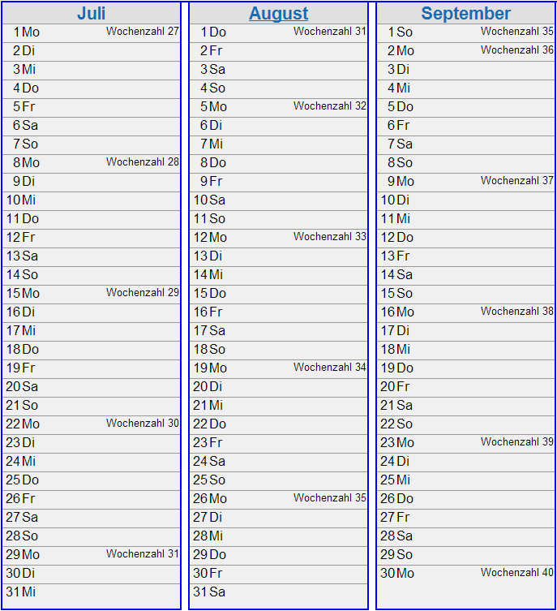
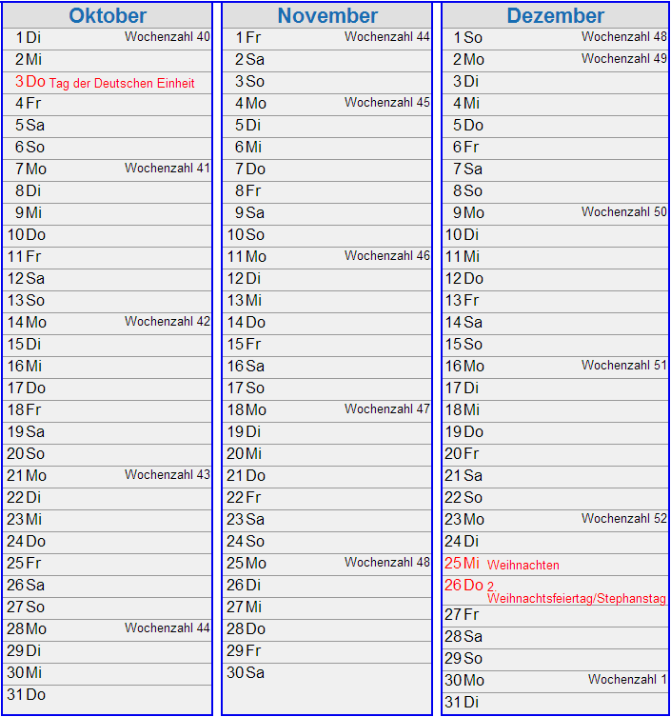
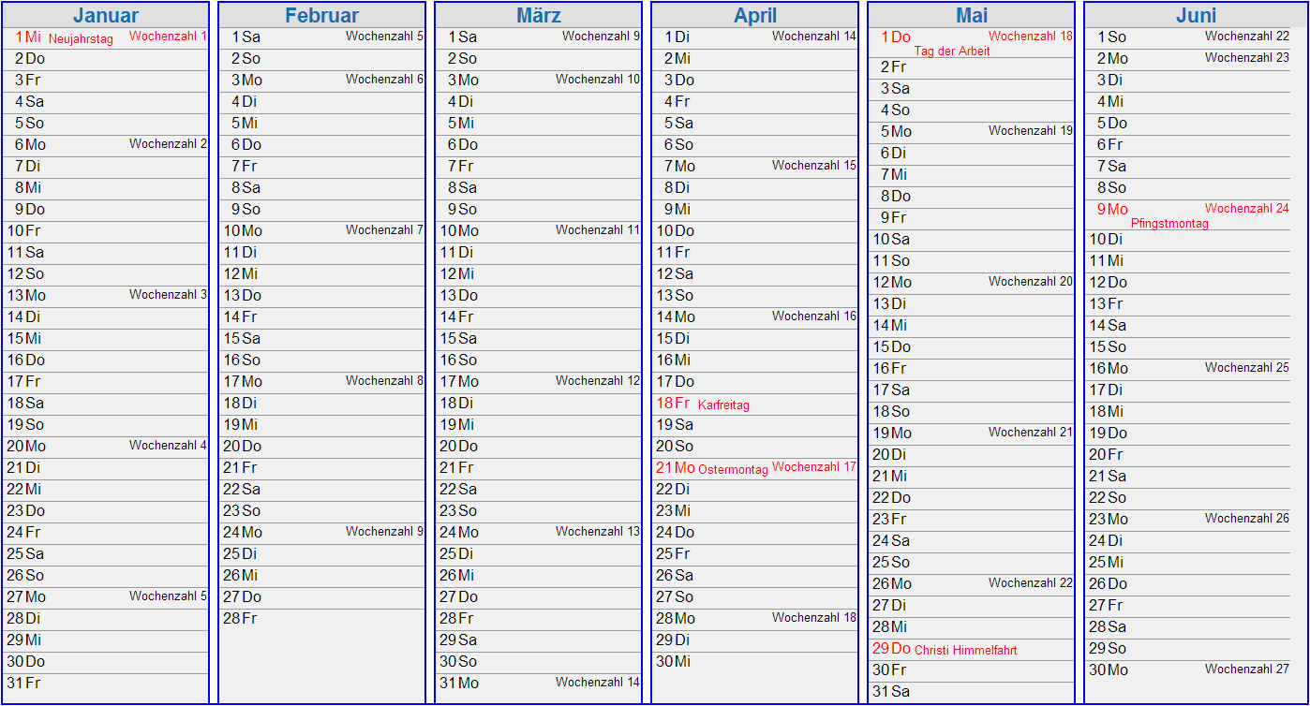
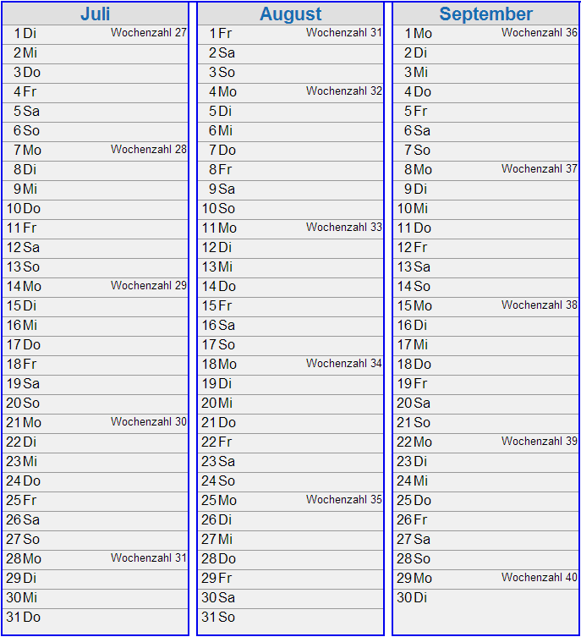
Calendar
2012
2013
2013
2014
Racks
Racks
Racks
Up to 700 m
Racks

Slide 13
