Slide 1
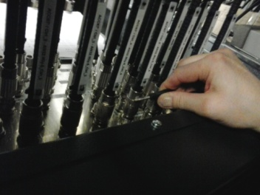
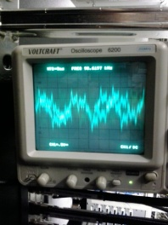
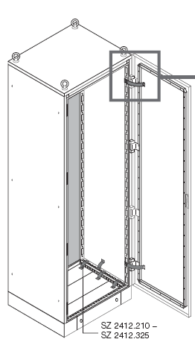
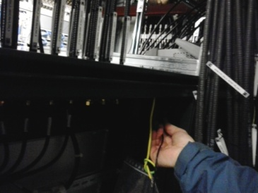
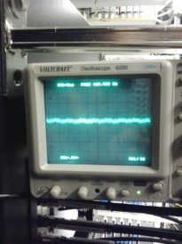
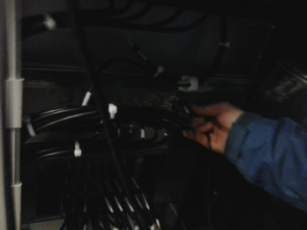
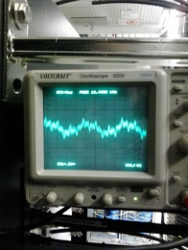
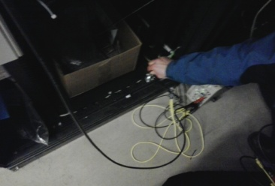
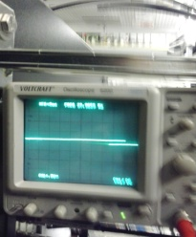
EMI – Rack (Top – Bottom chassis) resistance determination for an efficient distortion bypassing (FL, BS /MSK) :
expected <10mOhm -> 4 point measurement technique
Couldn’t induce enough current efficiently into the top rack GND ports
-> passive comparison of voltage drop along the crate chassis parts
ACC67 (Schroff Rack): Diff. DC-Amp. A-B (Standford), 1MHz BW, x1E3
Rack not in operation.
Top metal plate
>1mV !!!
Inner rack frame <0.1mV
Rear MTCA crate >1mV !!!
Inner rack frame <0.1mV
Inner rack frame <0.1mV
-> Top rack planel is isolated
-> Rear MTCA panels are polluted
-> no distortion bypass function

Slide 2
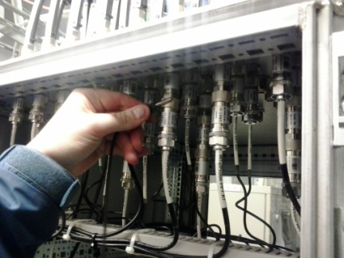
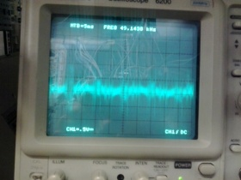
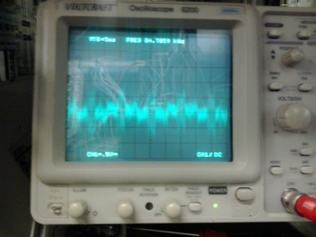
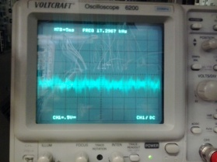
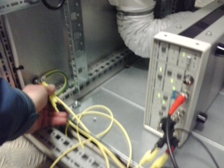
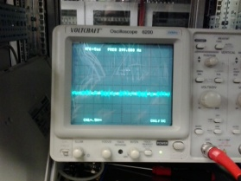
ACC1 (EMI-Rittal): Diff. DC-Amp. A-B (Standford), 1MHz BW, x1E3
Rack in operation !!!
Top metal plate
<1mV !!!
Inner rack frame <1mV
Rear MTCA crate <
<1mV !!!
Inner rack frame <1mV
Inner rack frame <1mV
-> Top rack planel has bypass funtion
-> Rear MTCA panels are not poluted
-> Top-bottom rack impedance currents in the range of 1A should be imprinted.
-> Vibration tests continue /monday next week.
-> EMI tests using clamb-on ampere meter / monday next week.

