Slide 1
Rack Impedance: Calculations, Measurements, Conclusions
H. Kapitza (FLA)
LLRF Rack Meeting
16. Nov. 2012
Notes:
How to edit the title slide
Upper area: Title of your talk, max. 2 rows of the defined size (55 pt)
Lower area (subtitle): Conference/meeting/workshop, location, date, your name and affiliation, max. 4 rows of the defined size (32 pt)
Change the partner logos or add others in the last row.

Slide 2
Outline
What is a rack?
Metal sheet impedance
Sheet resistance calculation
Measurements
Conclusions

Slide 3
What Is A Rack?
A rack is essentially an assembly of multiply bent metal sheets, held together by screws and/or welds.
Besides storing crates mechanically, a rack also serves electrical purposes:
The metal cabinet is a shield against external electromagnetic fields. Rack manufacturers provide diagrams of the frequency-dependent shielding effectiveness (Schirmdämpfung) of their products.
The rack metal is part of the hierarchical grounding system in a large facility like XFEL. As such it is part of a low impedance bypass for common mode noise currents.

Slide 4
Metal Sheet Impedance
Impedance:
$$Z=R+jωL$$
$R$ and $L$ of metal sheets are orders of magnitude lower than for metal wires, because currents in a sheet always have the freedom to flow along the path of least impedance. A simple DC resistance measurement will already characterize the metal sheet quality.

Slide 5
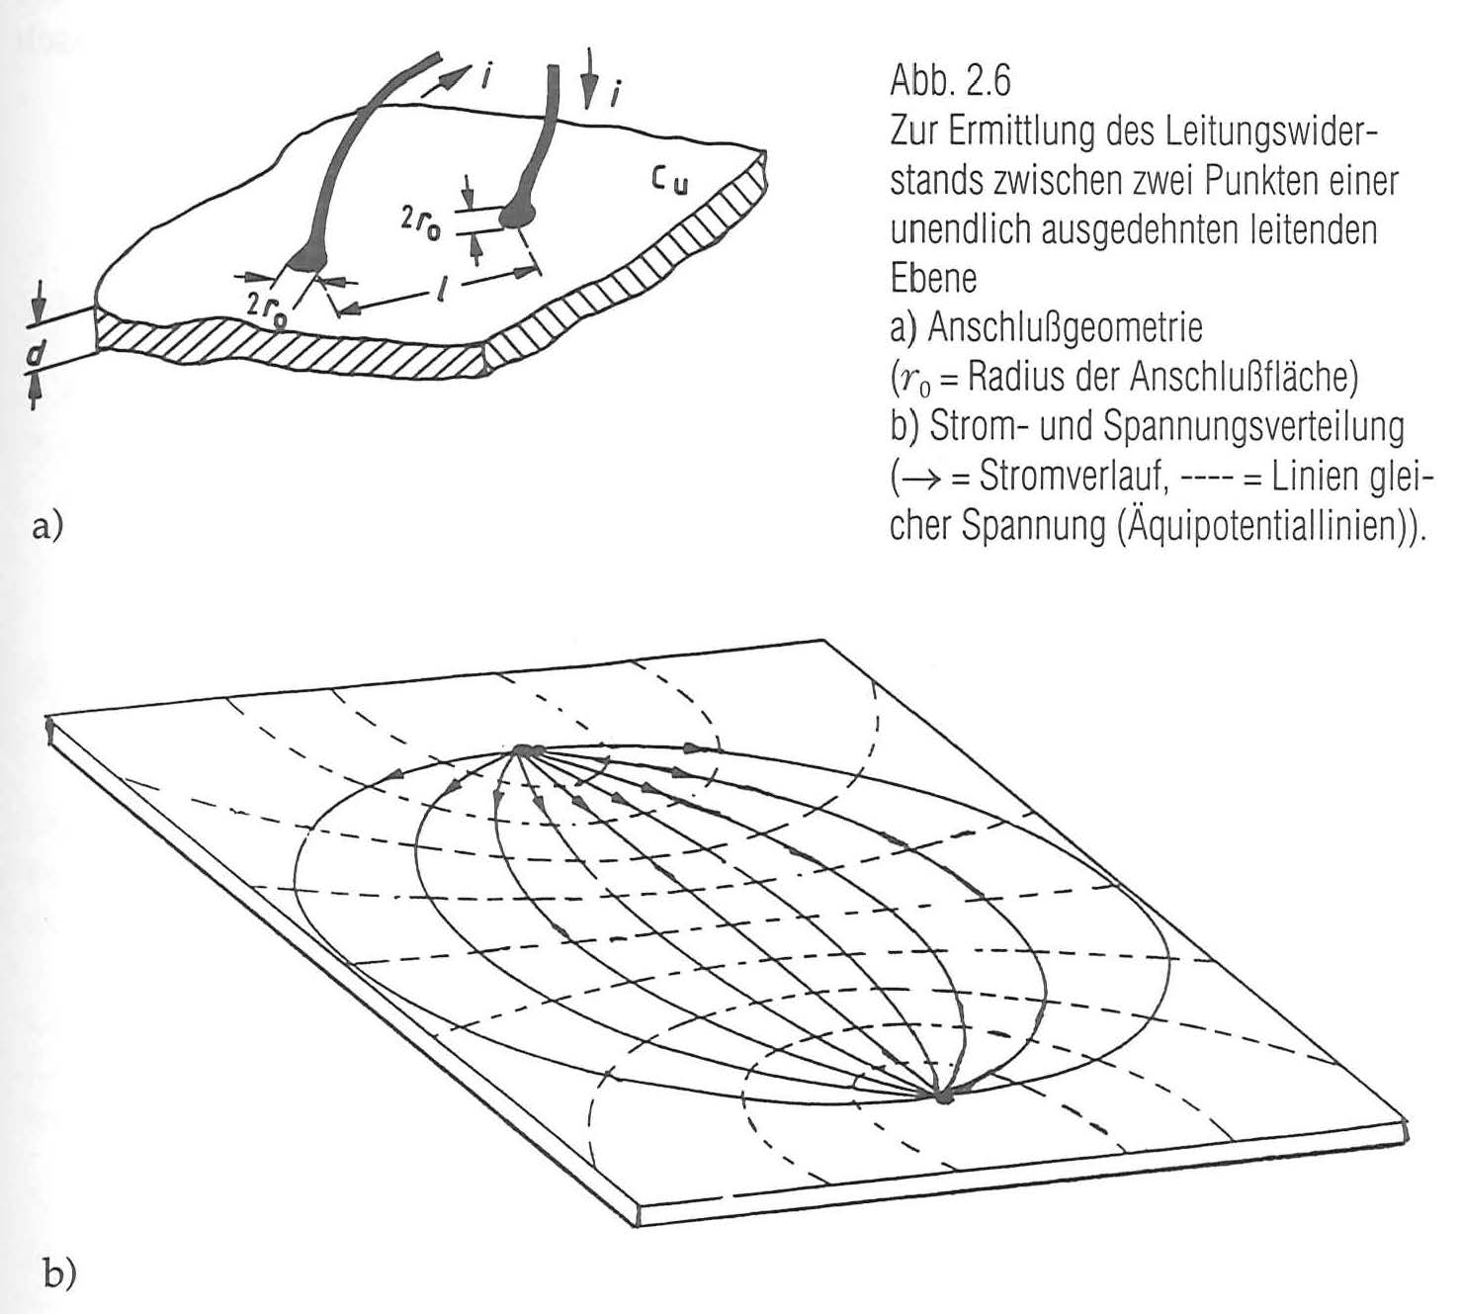
Sheet Resistance Calculation
For the parameters
$ρ:$ resistivity
$d:$ sheet thickness
$l:$ measuring distance
$r_{0}:$ contact radius
the resistance is
$$R=\frac{ρ}{πd}\ln{\frac{l}{r_{0}}}$$
$ρ$(steel) = $10∙ρ$(Cu) = 170 nΩm
$d$ = 1 mm, $l$ = 2 m, $r_{0}$ = 5 mm yields $R$ = 0.324 mΩ.
Due to the logarithm the dependence on $r_{0}$ is quite weak.

Slide 6
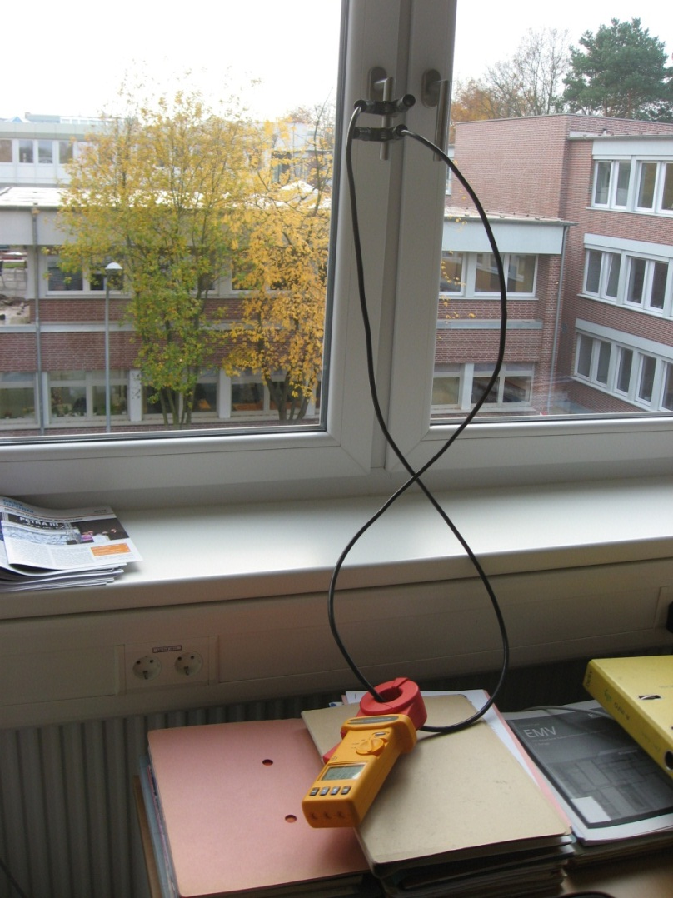
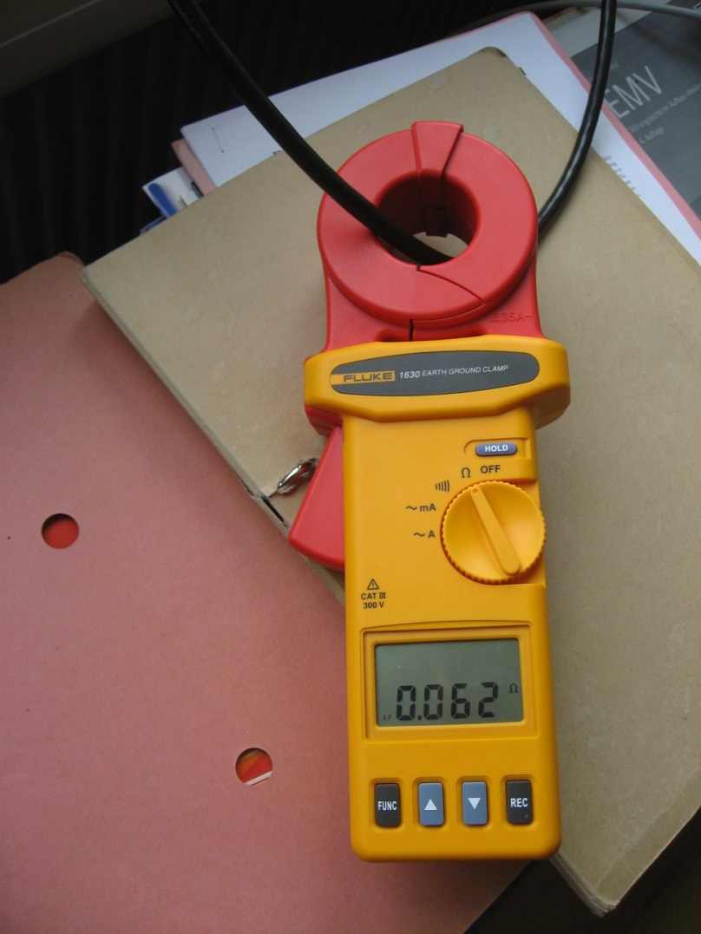
Loop Impedance Measurement
Using a booster cable, make the rack part of a closed current loop. Measure Z(loop) and subtract Z(cable) to obtain Z(rack).

Slide 7
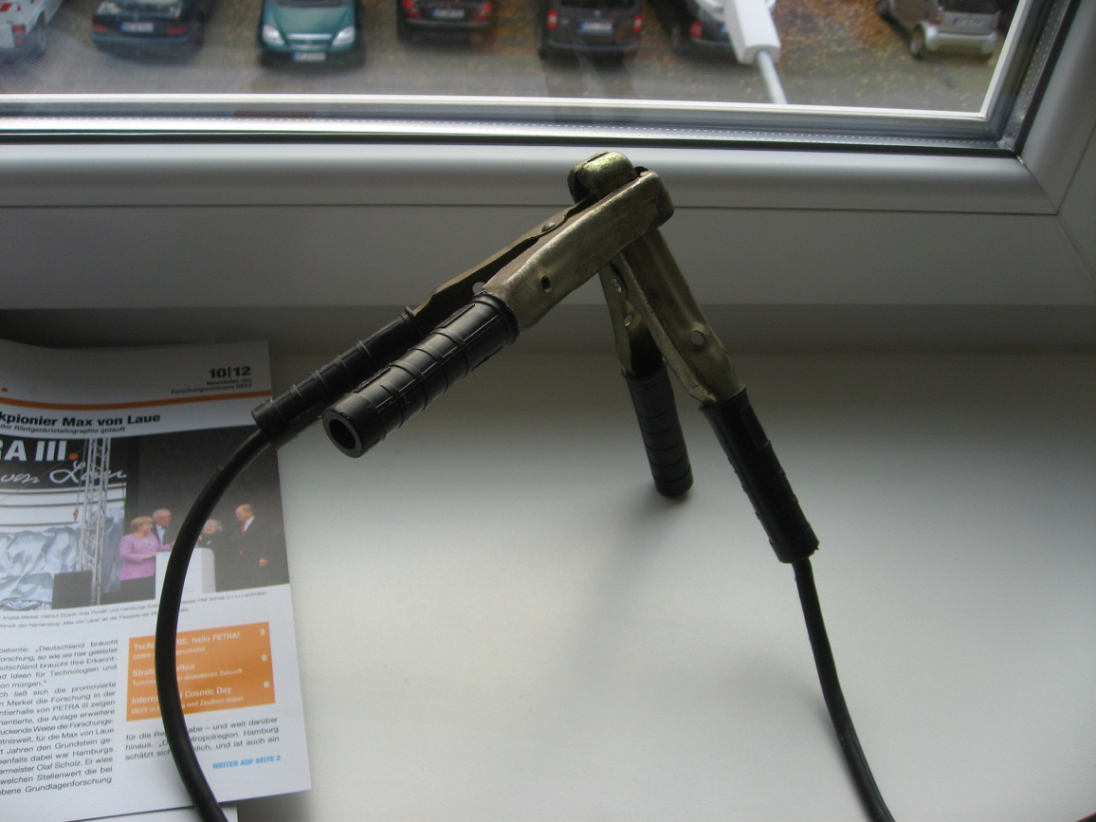
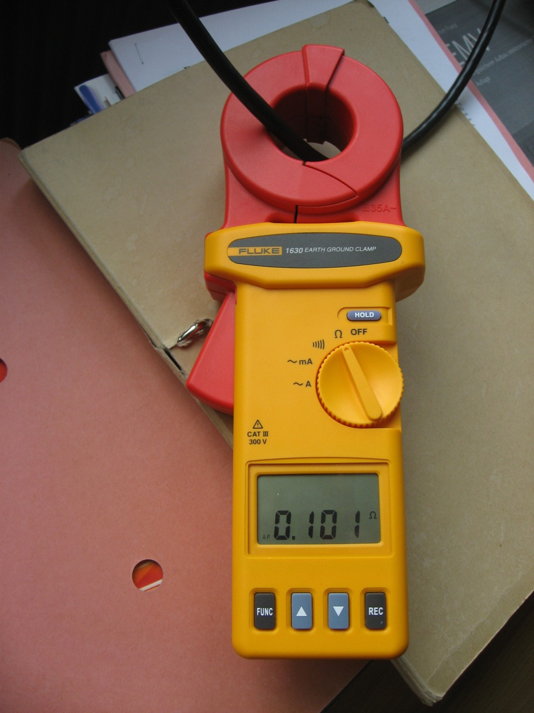
Loop Impedance Measurement
A lot of contact resistance in the cable clamps. Bad reproducibility of contacts. Lowest measurement range 25 – 250 mΩ. ►►► Forget about this method.

Slide 8
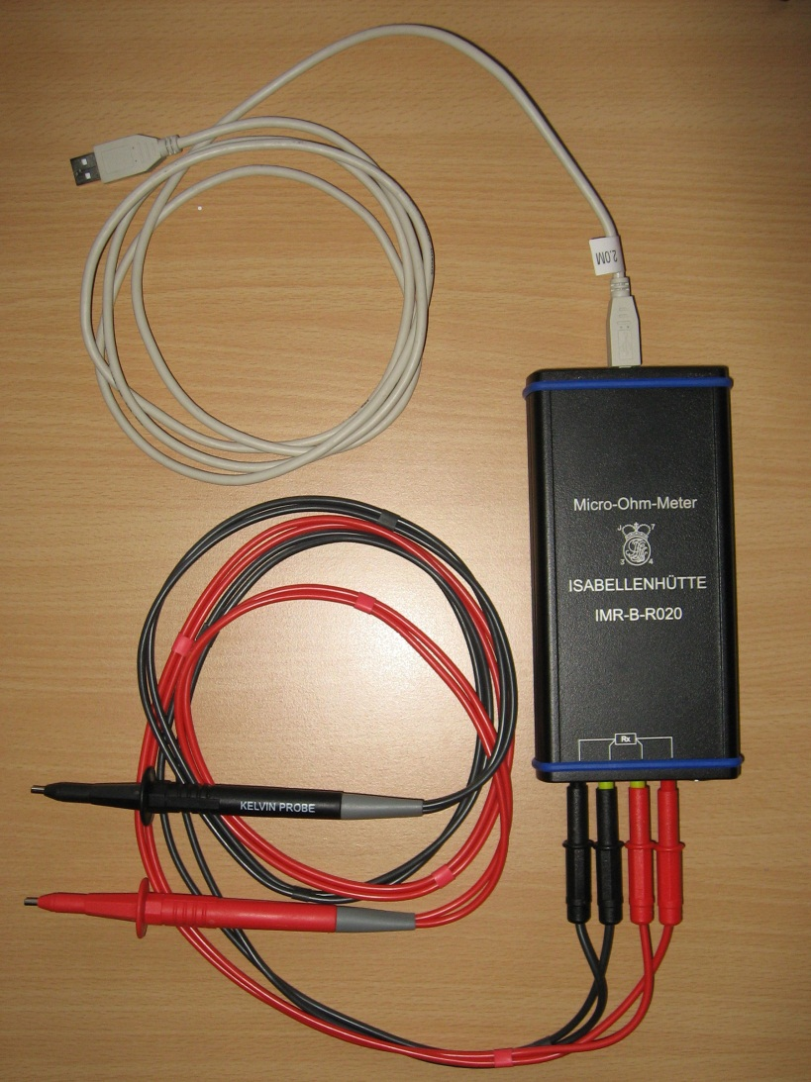
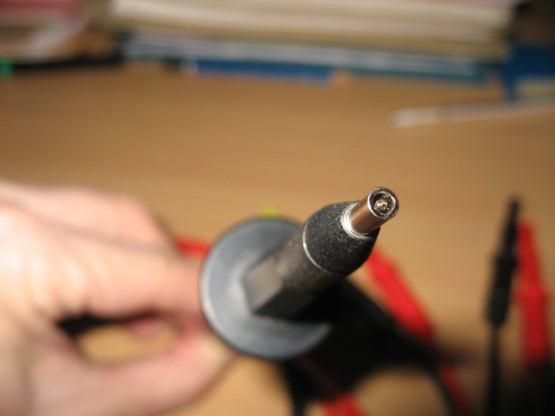
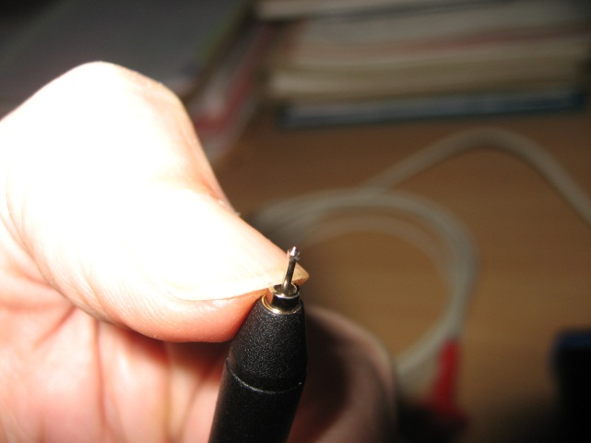
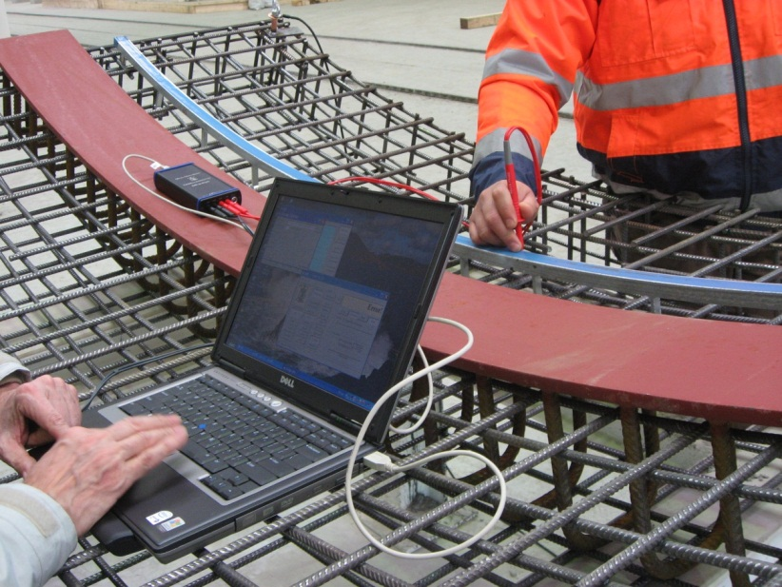
Rack Resistance Measurement
Isabellenhütte IMR-B-R020 USB-Mikro-Ohm-Meter with Kelvin probes for true 4-point resistance measurements:
Kelvin probe
$$I$$
$$U$$
USB
Device at work in tübbing factory

Slide 9
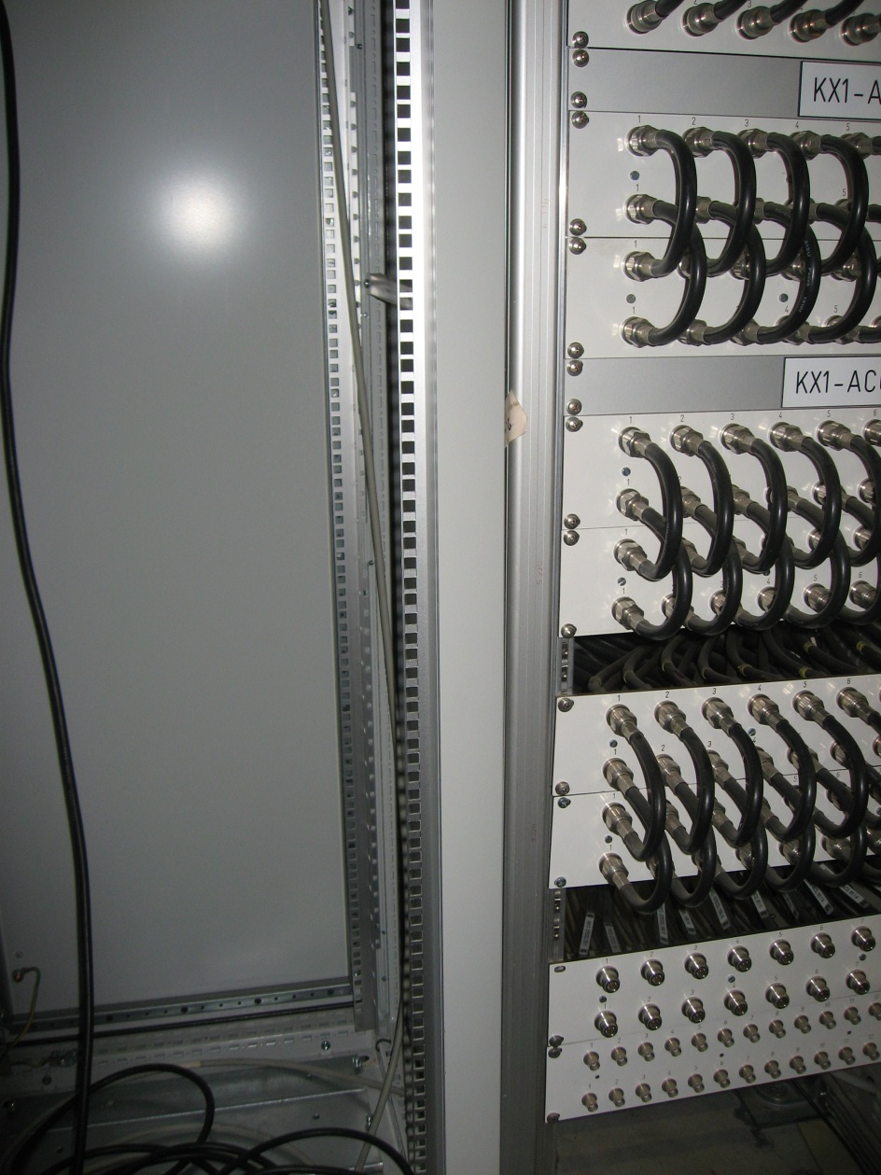
Rack Resistance Measurements
Measurements on an old rack:
R = 0.092 mΩ for a distance of about 50 cm is in good agreement with the calculation of R = 0.324 mΩ for a distance of 2 m.
Each screw adds a contact resistance of 2.8 mΩ.
Next I measured on two of the new Schroff racks.
4.8 mΩ
0.092 mΩ

Slide 10
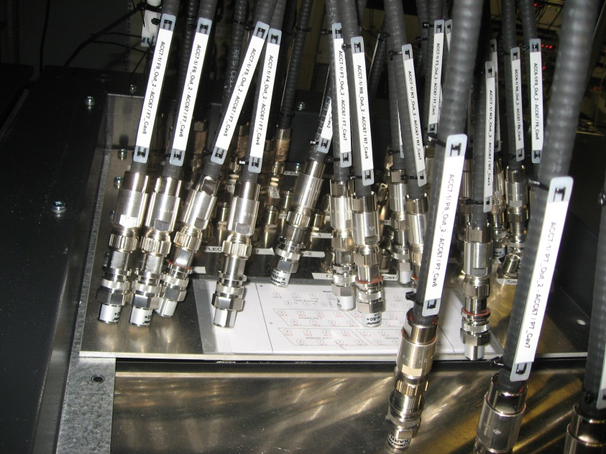
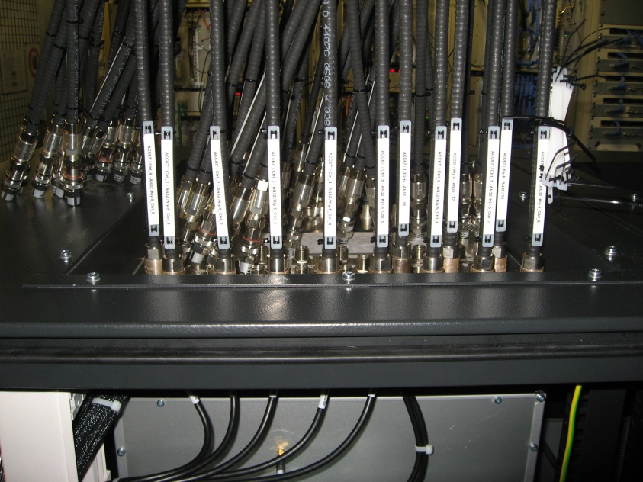
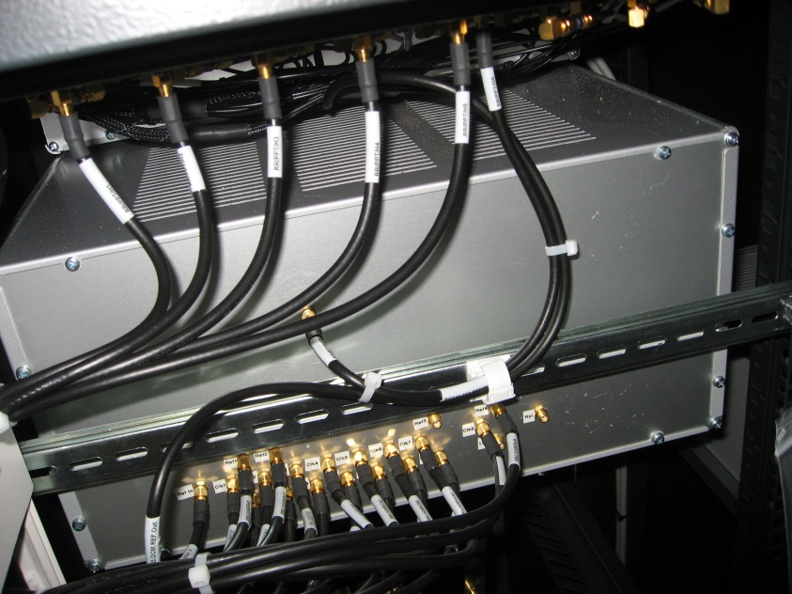
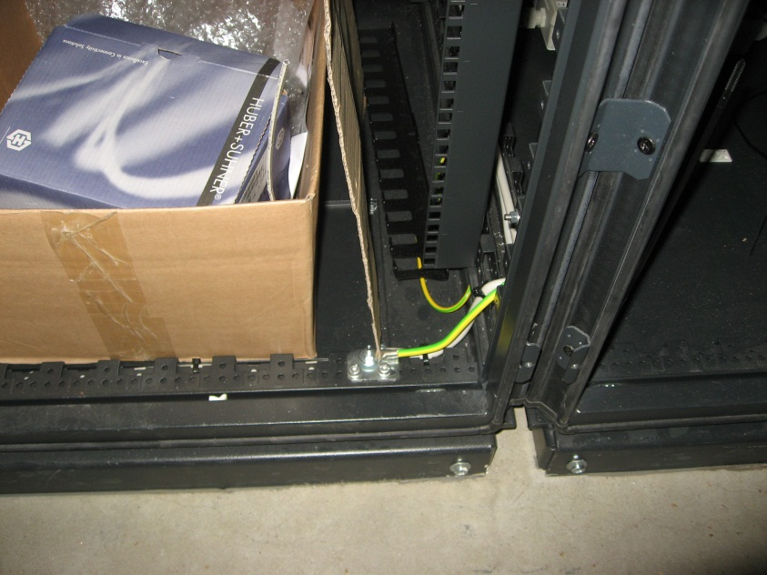
Rack Resistance Measurements
leftmost rack (seen from the back)
0.042 mΩ
0.048 mΩ
top plug
SMD conn.
7 mΩ
3 mΩ

Slide 11
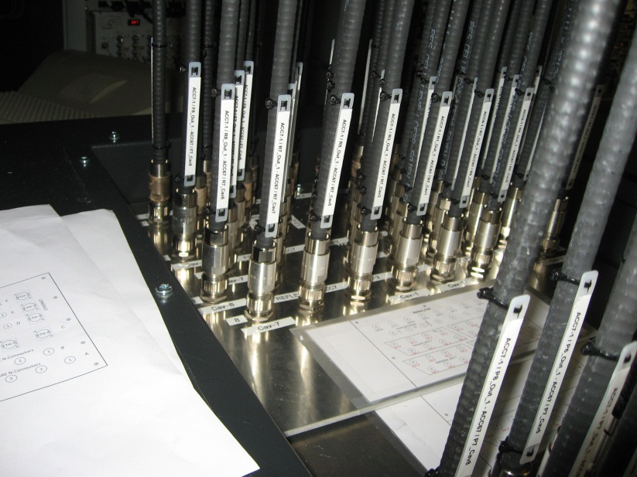
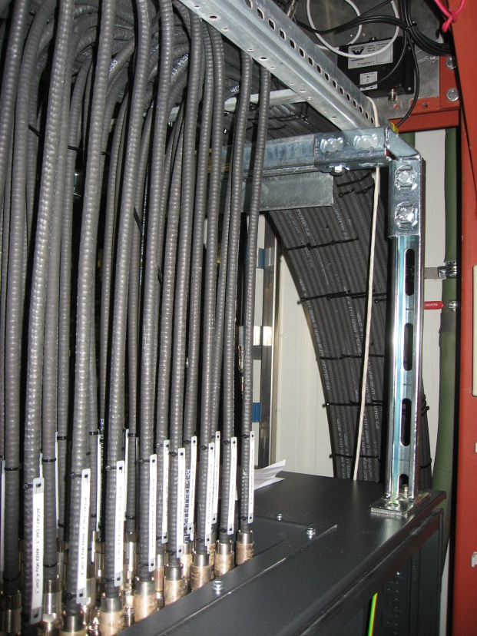
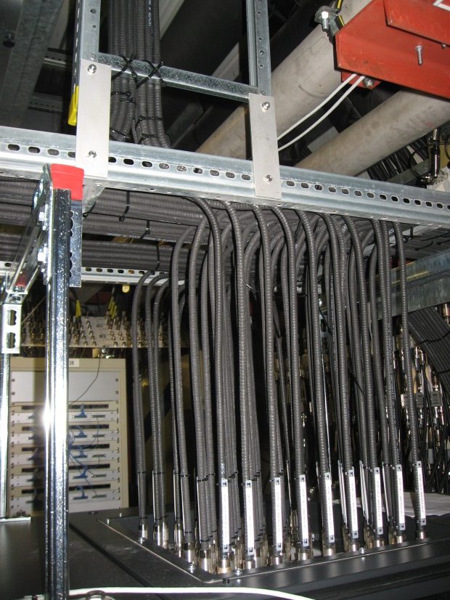
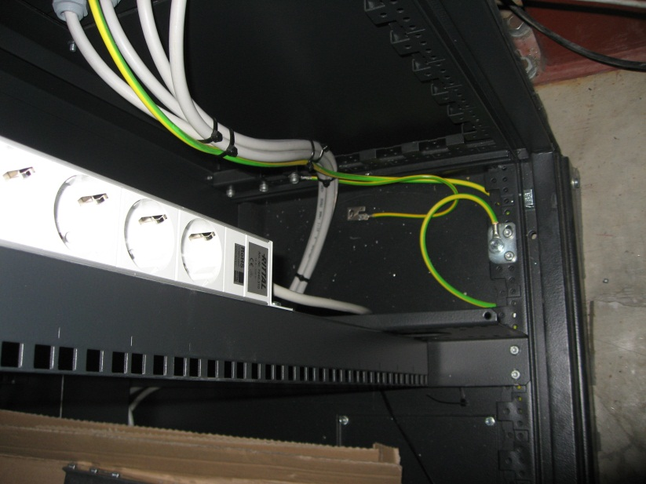
Rack Resistance Measurements
1.6 mΩ
0.046 mΩ
3.6 mΩ
2.0 mΩ
plug plate
rightmost rack (seen from the back)

Slide 12
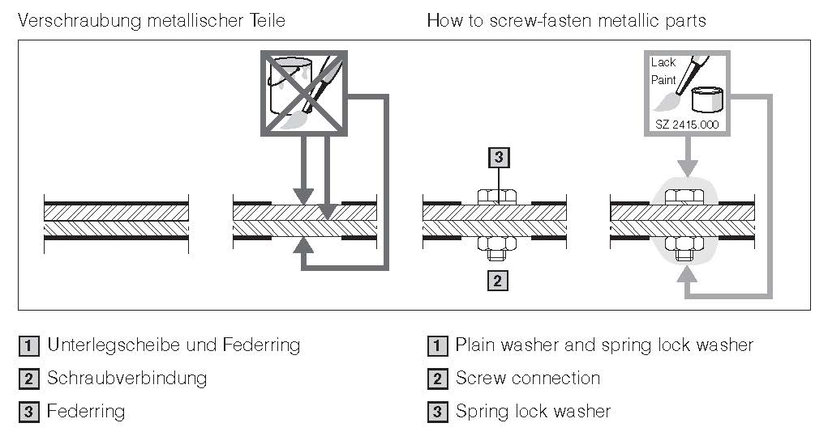
Conclusions
A perfect rack (without screws) made of 1 mm thick steel sheet would have a resistance R ≈ 0.5 mΩ from top to bottom.
Screw joints add largely varying contact resistances of a few mΩ. This makes it difficult to specify a target value defining rack quality.
Assume good contact at the screw joint only, not between screws. Hence set screws well and often. A grid is as good as a plane if the mesh size is much smaller than the wavelength: $d<λ/{50}.$ This means f < 30 MHz for d = 20 cm. There must be no paint or other insulators in contact areas, absolutely not at the screws!
Further improvement comes from rack placement on a ground plane, but that’s not important here.

