Slide 1
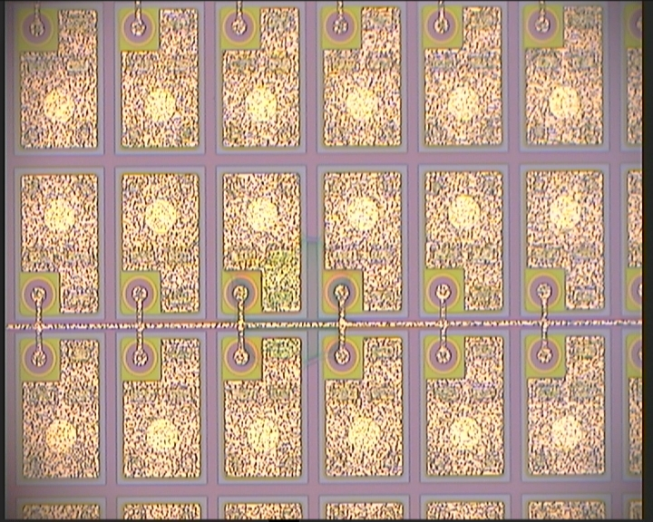
Thinner passivation may lead to unwanted UBM growth
WAFER 4, SENSOR 3, N-SIDE
Max. 4 pixels
No pad affected
May work anyway
If it‘s the only defect on the wafer I wouldn‘t complain

Slide 2
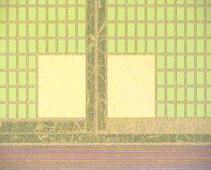
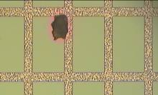
P-side defects look more serious but are not necessarily problematic
WAFER 4, SENSOR 1, P-SIDE
P-side not affected by PacTech process and involved in further processing
Stress induced?
Maybe not problematic.
Looks bad

Slide 3
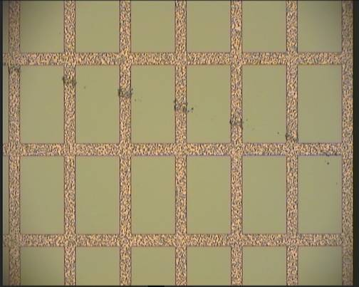
P-side defects look more serious but are not necessarily problematic
WAFER 4, SENSOR 2, P-SIDE
Not serious?
CiS handling ? because metal affected, which is later under passivation layer

Slide 4
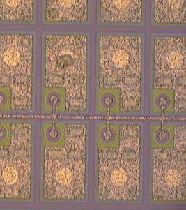
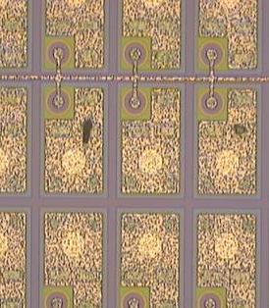
P-side defects look more serious but are not necessarily problematic
WAFER 5, SENSOR 1 + 3, N-SIDE
Sensor 3
Could end as a defective pad after UBM process
Sensor 1
Not good but is it problematic?
Probably not for Pac Tech
One or two Pixel affected only

Slide 5
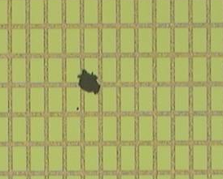
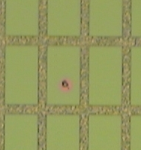
P-side defects look more serious but are not necessarily problematic
WAFER 5, SENSOR 1 + 3, P-SIDE
Sensor 1
Looks removable through Pac Tech rinsing process
Sensor 3
CiS related failure but maybe unproblematic for P-side
Just one pixel in sensor

Slide 6
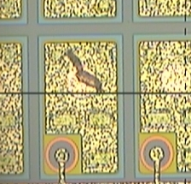
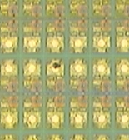
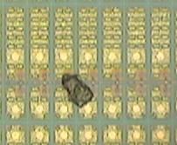
Wafer 6 has few lost pixels due to debris
WAFER 6, ALL SENSORS , N-SIDE
Most probably pixel lost
Chipped silicon?
Problematic?
Pixel lost

Slide 7
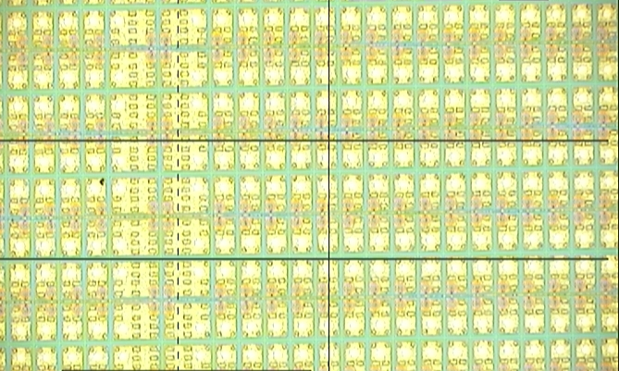
Wafer 6 presents interesting defect. First real problem?
WAFER 6, ALL SENSORS , N-SIDE
Probably not aliasing
Pairs of pixels present (colored) defects along punch through line:
Pads seem not affected
UBM problematic?

Slide 8
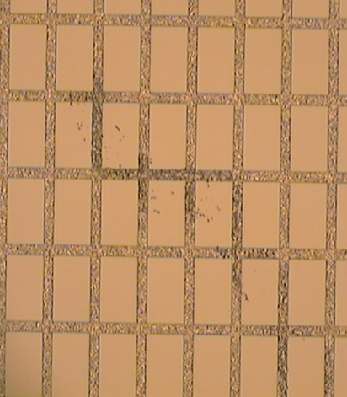
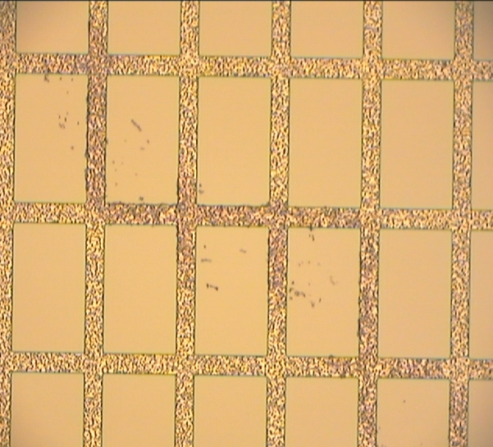
Wafer 6 has scratch on P-side. CiS handling?
WAFER 6, SENSOR 1, P-SIDE
Probably not aliasing
Seems to be below passivation

Slide 9
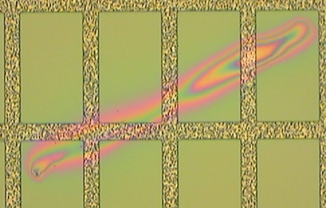
Wafer 6 P-side has area of thickness variation in passivation layer
WAFER 6, SENSOR 2 , P-SIDE
Dust was within the deposition process
Not a problem for functionality?

Slide 10
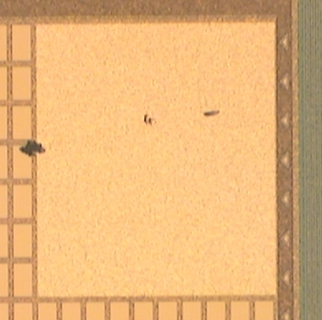
Wafer 6 P-side not very much affected
WAFER 6, SENSOR 2 , P-SIDE
Probe mark?
removable

Slide 11
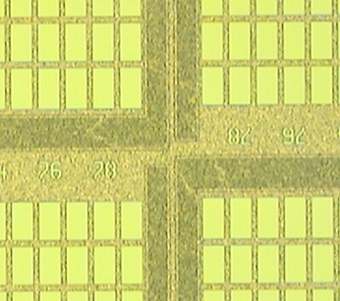
Wafer 6 P-side again presents non-uniform metal
WAFER 6, SENSOR 3 , P-SIDE
I think, there is no problem

Slide 12
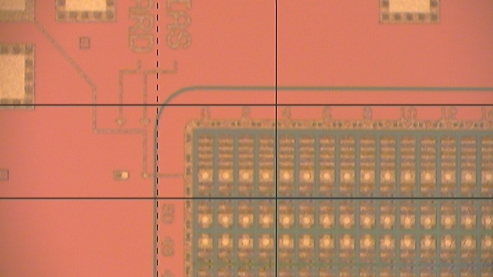
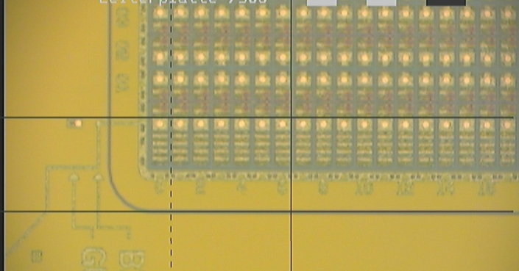
Color change, i.e. thickness variation, is not a good sign
WAFER 7, SENSOR 1 , N-SIDE
May not be a problem but it is a sign for non uniform processing
→ Not good, should be avoided

Slide 13
Dirty wafer. Handling problem
WAFER 7, ALL SENSORS, P-SIDE
A lot of debris
Scratchlike dirt depositions
CiS or Uni-HH handling?
Perhaps Pac Tech rinsing cleans away most of it, but it should be avoided
P-Side doesn‘t matter as much as N-side

Slide 14
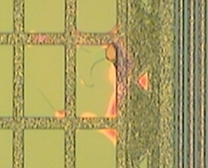
Wafer 8 is dirty with minor fabrication issues
WAFER 8, ALL SENSORS
N-side
Nothing serious
Usual kind and number of defects
P-side
Nothing serious
Very dirty
Few pixels have defective passivation
Sensor 3

Slide 15
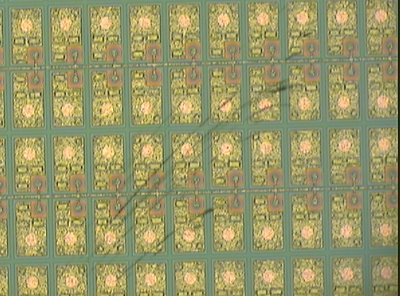
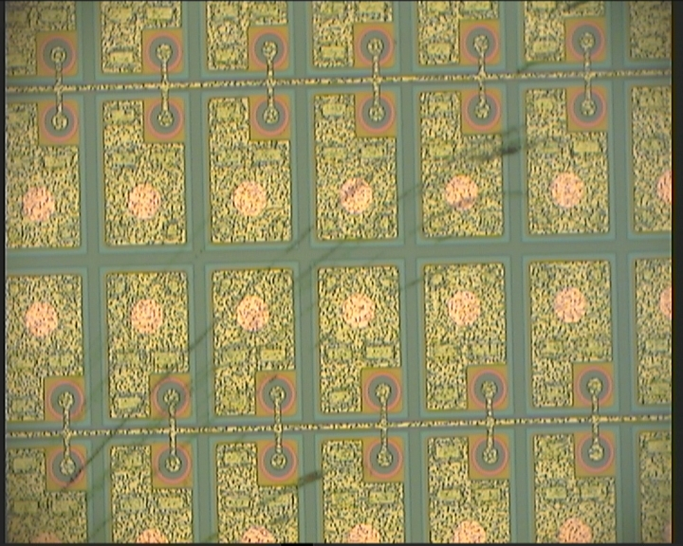
Interesting scratchy structure can perhaps cleaned away by Pac Tech
WAFER 9, SENSOR 2, N-SIDE
P-side
Nothing serious
Very dirty
Few pixels have defective passivation
Is it deposit or passivation layer related?

Slide 16
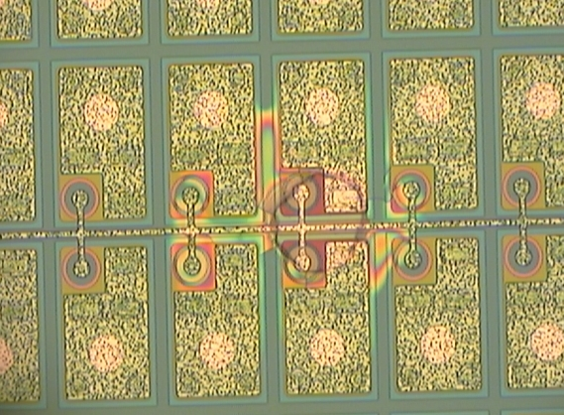
Interesting scratchy structure can perhaps cleaned away by Pac Tech
WAFER 9, SENSOR 2, N-SIDE
If this occurs every 6 wafers (18 sensors) there is no big problem
Two to six pixel affected
No pad directly affected

