Slide 1
Helmholtz Virtual Institute for Plasma Wakefield Acceleration
B. Foster Uni-HH/DESY/JAI-Oxford
What is a Helmholtz Virtual Institute?
Why centered at DESY?
Why now?
The proposal – added value, partners, expertise, proposed investments
Summary
Notes:
Not my title!

Slide 2
What is a VI?
“A Helmholtz Virtual Institute brings together
the key competencies of one or more
Helmholtz Centres with those of one or more
universities to create a centre of excellence of
international standing. This serves to create a
new quality of cooperation strengthening
scientific excellence and increasing
international competitiveness. Other national
or international partners may be involved as
associated partners.”

Slide 3
What is a VI?
Over a three to five year period,
Virtual Institutes receive up to a maximum
of 600,000 euros per year. Matching funds
and other schemes can increase this.
New institutions can join as associate
members. Although they do not get a direct
travel allocation from the VI, we have other
sources to ensure that associate members
can take part in VI programmes.

Slide 4
Why activities based @ DESY?
DESY has enormous expertise and
infrastructure in accelerators but in particular
has several unique facilities that are extremely
relevant for many of the key questions in PWA.
In particular, electrons driving FEL, FLASH, based on superconducting technology have
exquisite timing and reproducibility. FLASH programme at the core of the VI proposal,
enabling the investigations.

Slide 5
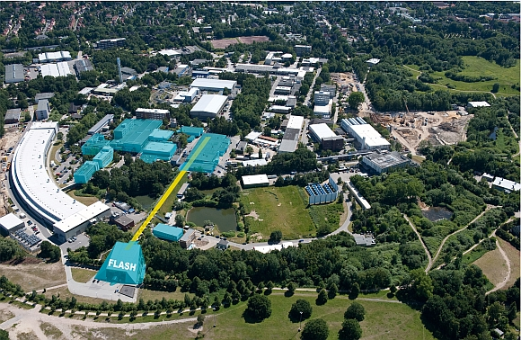
Why activities based @ DESY?

Slide 6
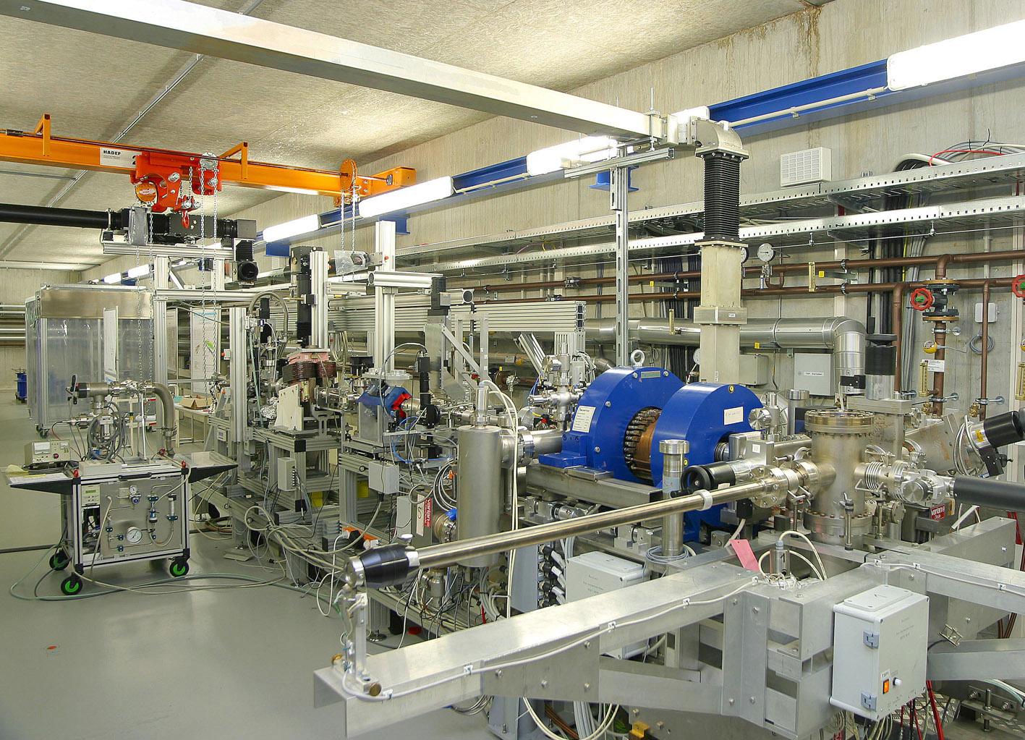
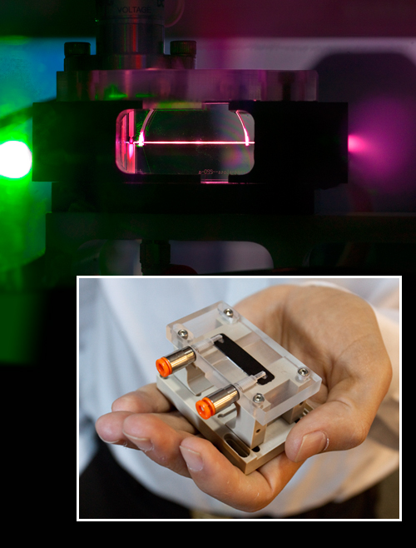
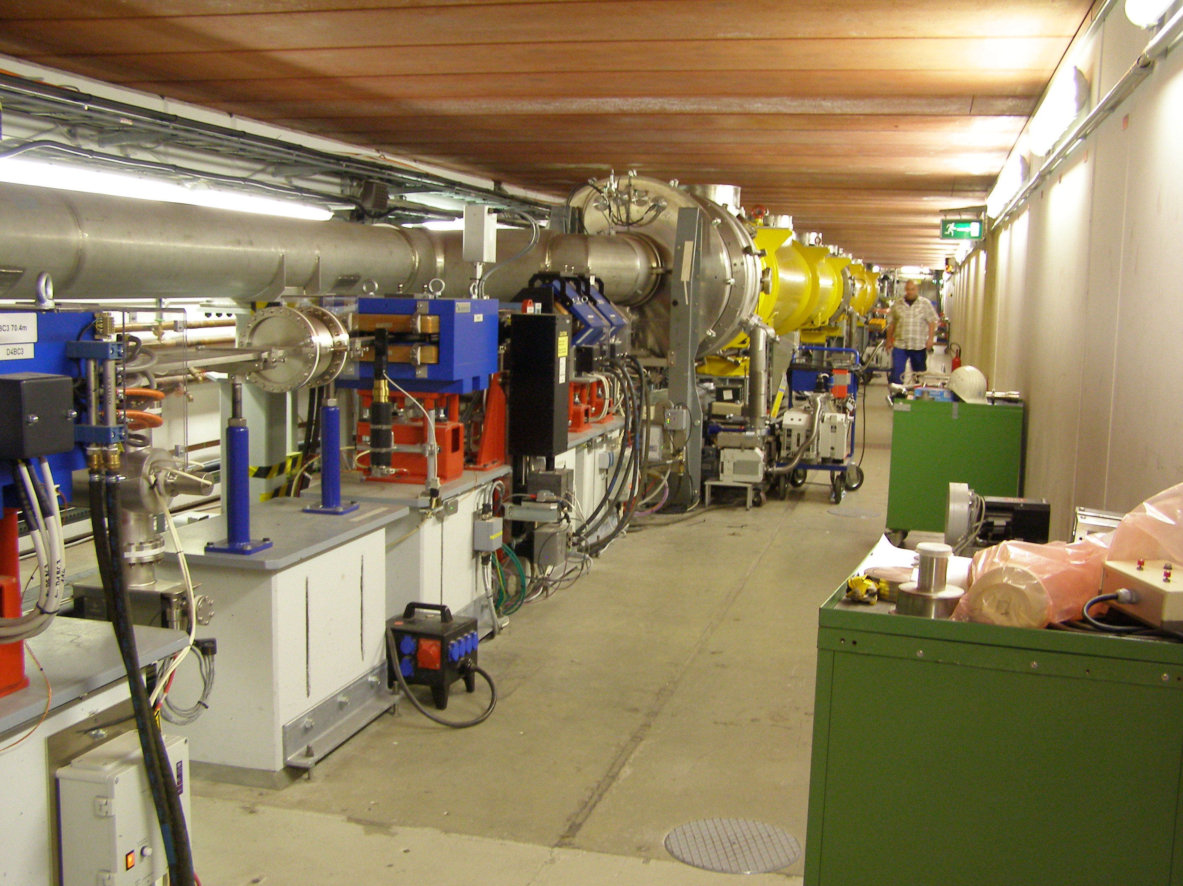
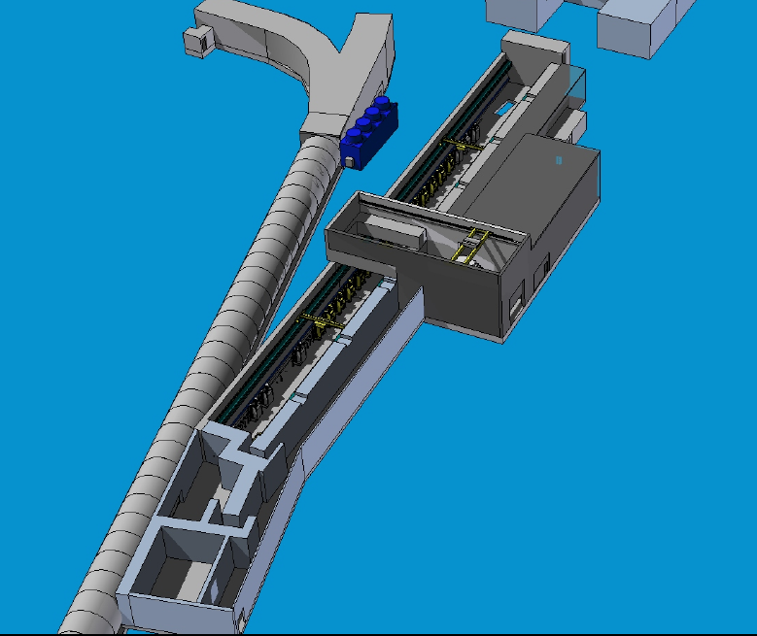
PWA Facility @ DESY
REGAE, PITZ, FLASH II…...
Notes:
The photo is PITZ not Regge . Electron bunch length must be small fraction of the plasma wavelength – otherwise energy spread too large; and jitter small fraction of inverse plasma frequency.
Some facilities under development at DESY have the right properties – PITZ – and FLASH II could be an ideal research instrument.

Slide 7
Why a VI now?
DESY one of leading accelerator-based labs in
world – over the last decades saturated by
developing superconducting accelerators,
-> XFEL. New things must now develop.
Four major developments recently
Helmholtz Accelerator R&D programme
(ARD) – DESY major player – PWA strand
2) J. Osterhoff leads Young Investigator Group
on cell development & simulation
3) BF Humboldt Professorship – devoting
substantial fraction of award to PWA
4) F. Grüner ➔ Chair in Hamburg –
R. Assmann (CERN) ➔ DESY;
B. Hidding ➔ Assistant Prof. in Hamburg
Notes:
Say YIG is Helmholtz.

Slide 8
Added value
VI gives excellent framework for collaboration
with world-leading institutions including
John Adams Institute (JAI) (Oxford, RHUL,
Imperial London), Stanford, Berkeley, together
with CERN and MPI Munich.
E.g., FACET leading facility for PWA
investigations – after closure FLASH II facilities
should be available – obvious synergy brokered
by VI – collaborate first on FACET then
FLASH II.

Slide 9
Added value
Only the synergetic coming together of UniHH,
ARD, Humboldt funding - used for purchase of
200 TW laser and hiring postdocs & students -
and DESY infrastructure allows us to carry out
the proposed programme. VI essential to fund
instrumentation and specialised beam-line
elements necessary to perform PWA expts.
VI gives collaborative framework in which
international partners can travel to and work
at DESY and influence development of PWA
facilities.
JAI has small capital allocation from VI to apply
plasma cell expertise to build prototype for
shipment to DESY and use in FLASH II.

Slide 10
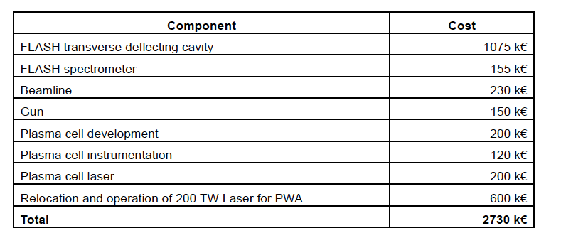
Summary of Funding Request
Builds strongly on infrastructure of DESY.
Total budget 4.4M€ - of which 1.9M€ is own
resources, both national & international.

Slide 11
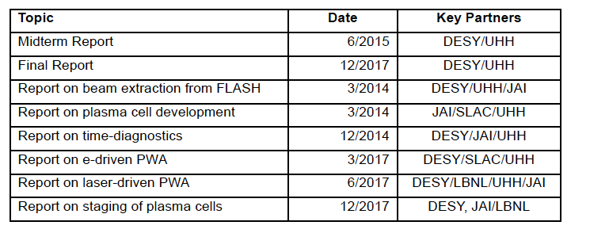
Summary of Milestones
Already looks very optimistic
DESY resources saturated by XFEL
construction.

Slide 12
Summary
Conjunction of many different elements make
this the ideal time for DESY to kick-start a
world-leading PWA programme.
This VI is an ideal instrument to bind in the
best of the world’s experts to mutually
beneficial structure.
DESY has unique facilities and extensive
infrastructure that guarantee a long-term
sustainable facility for PWA experiments.
The resources requested in the VI complement
those available nationally & internationally.
Hope to discuss exciting research programmes
at today’s – and subsequent - meetings.

