Slide 1
JAI and the Helmholtz VI
Simon Hooker
John Adams Institute for Accelerator Science

Slide 2
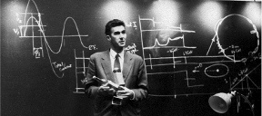
What is JAI ?
The John Adams Institute for Accelerator Science is a centre of excellence in the UK for advanced and novel accelerator technology, created in 2004 to foster accelerator R&D in the universities
JAI is based on 3 universities: University of Oxford; Royal Holloway College, London; and Imperial College
JAI scale: ~25 academic professorial staff, ~15 research staff, ~10 affiliates, ~30 post-grad students, produce ~6PhD/year in Acc. science
Sir John Adams (24 May 1920 - 3 March 1984) was the 'father' of the giant particle accelerators which have made CERN the leader in the field of high energy physics. John Adams worked at the UK Atomic Energy Research establishment on design & construction of a 180 MeV synchro-cyclotron. He then came to CERN in 1953 & was appointed director of the PS division in 1954. In 1961-66 Adams worked as director of the UK Culham Fusion Lab. In 1971 he returned to CERN and served until 1975 as Director-General of then called Laboratory II, responsible for the design & construction of the SPS. From 1976-80 he was executive DG of CERN and instrumental in approval of LEP.
http://www.adams-institute.ac.uk

Slide 3
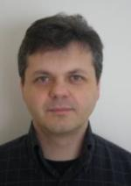
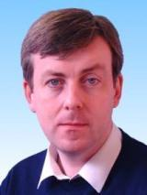
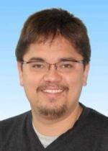
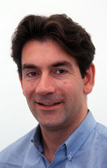
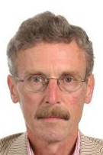
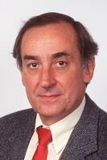
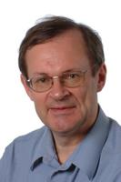
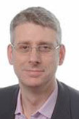

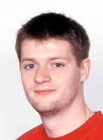
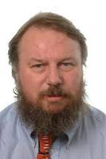
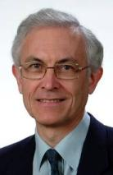
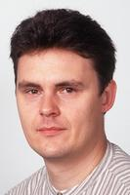
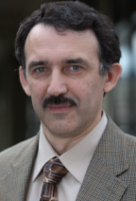
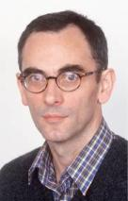

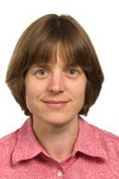
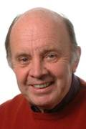
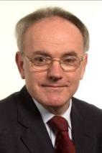

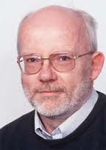
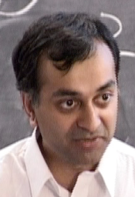
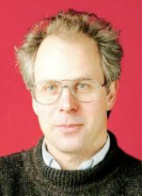
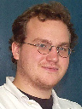
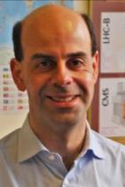

JAI Faculty
Riccardo Bartolini
Grahame Blair
Stewart Boogert
Phil Burrows
John Cobb
George Doucas
Brian Foster
Simon Hooker
Pavel Karataev
Research Facilitator
CERN
Glenn Christian
Ken Peach
Chris Prior
Armin Reichold
Andrei Seryi
Roman Walczak
Vice-Molloy
Michele Warren
Ted Wilson
Particle Therapy Cancer Research institute
Bleddyn Jones
Stuart Mangles
Steve Rose
Zulfikar Najmudin
Ken Long
Ivan Konoplev
Emmanuel Tsesmelis
Also : JAI Academic and Industrial Affiliates (not shown)

Slide 4
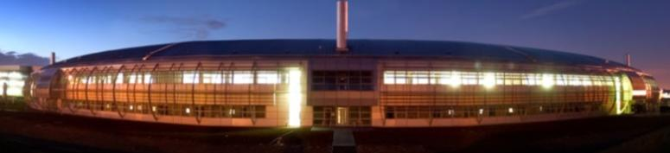
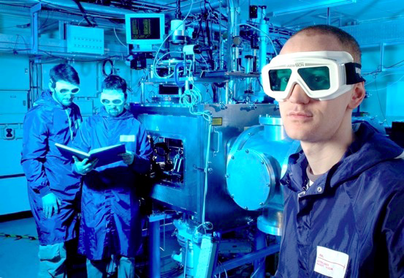
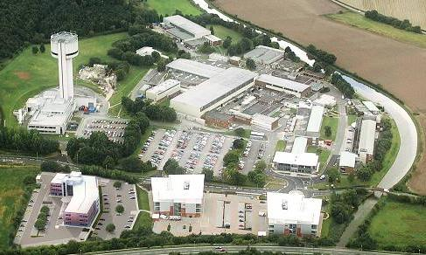

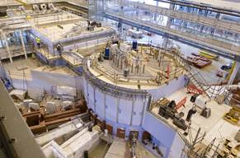
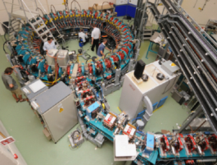
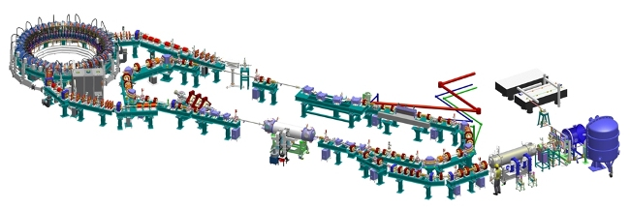
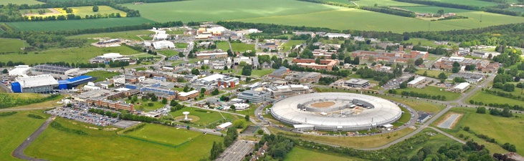
within the UK SciTech ecosystem
Diamond Light Source
Central Laser Facility
Daresbury Science & Innovation Campus
ISIS neutron source
Rutherford Lab & Harwell-Oxford Innovation campus
Accelerator Science &Technology Centre

Slide 5
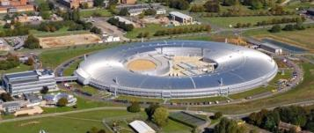

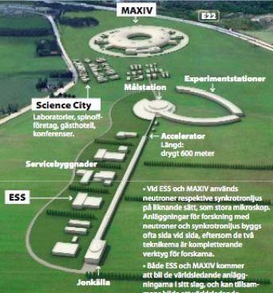
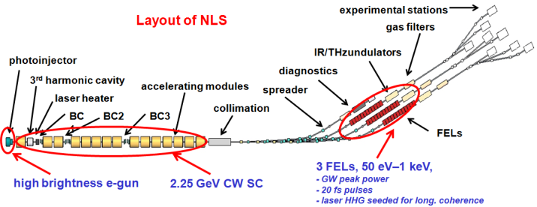
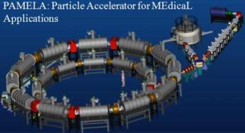
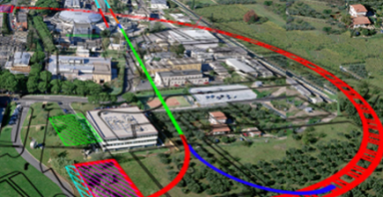
JAI research interests
3rd Gen Light Sources
Future 4th Gen Light Source design
ISIS & ESS neutron sources
Neutrino Factory / m-cooling
Accelerators for cancer therapy
Ion sources
LHC upgrade
Linear Colliders

Slide 6
JAI research interests
Plasma channel development
Advanced beam instrumentation
Compact radiation sources

Slide 7
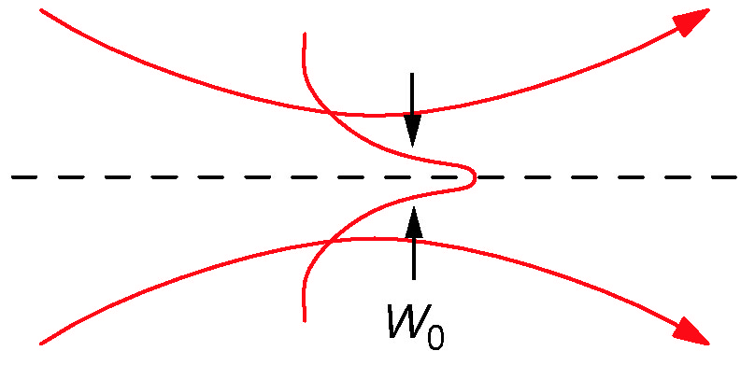
Development of plasma channels
Capillary discharge waveguide developed at Oxford
To date:
  Channels up to 50mm long
  Typical on-axis density 10¹⁸ cm⁻³
Beams up to 1 GeV generated
  Leemans et al 2006

Slide 8
Development of plasma channels
Development of longer plasma channels
Separate control of breakdown & main current pulse
Capacitively-coupled RF discharge
  10 mbar He
  13.56 MHz
  30 W RF power
  Cap diam 600 um
  Cap length 50mm
To date work done by Anthony Dyson in “spare time”
New grad student (Christopher Thornton) started last week

Slide 9
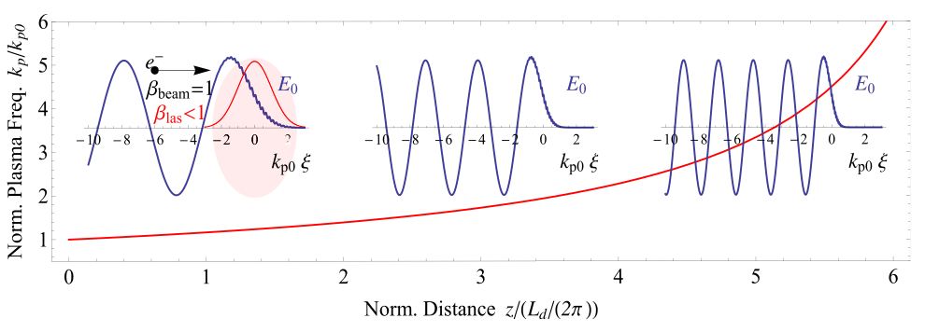
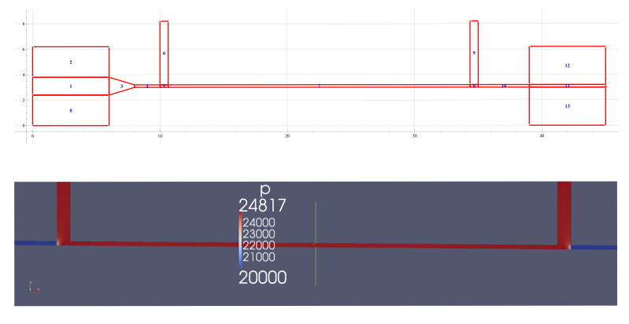
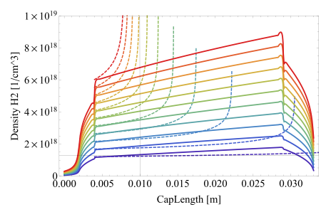
Development of plasma channels
Tapered channels can overcome dephasing limit
  Katsouleas1986, Sprangle 2001, Rittershofer 2010
Starting to develop tapered capillary discharge waveguides

Slide 10
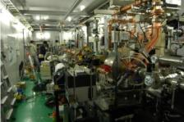
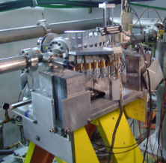
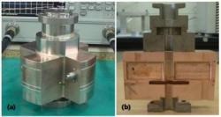
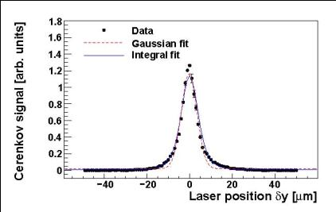
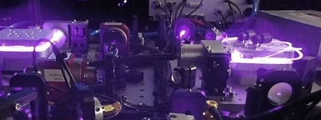
Advanced Beam Instrumentation
Far-Infrared Coherent Radiation
  CSR, CDR for beam diagnostics
  Soft-X ray and microwave source based on Thomson scattering of CDR
Nano-resolution BPM
  C, S-band (~100nm resol.)
  Special ~nm resolution
Coherent Smith-Purcell radiation
  Longitudinal diagnostics –extending to fs range
Laser – wire
Ultra-fast nanosecond feedback
LUXC, jointly with KEK
Laser wire
Smith-Purcell diagnostics instrumentation

Slide 11
Diagnostics development
Measurements of bunch duration of ~10fs pulses from radiation spectrum
  Smith-Purcell radiation
  Coherent OTR spectrum
Development of phase-retrieval algorithms for longitudinal profile reconstruction
  Kramers-Kronig analysis
  Bubblewrap algorithm (Shrinkwrap +)

Slide 12
Diagnostics development
Measured
OTR
Fitted
OTR
Deduced
profile
YAG
profile
Lineouts
Measurement of transverse bunch profile from near-field image of COTR

Slide 13
Radiation generation
SVEA
AURORA
Analytic
Bajlekov, Fawley, Schroeder, Bartolini & Hooker PRSTAB 14 060711 (2011)
Scaling analysis and GENESIS simulations of FELs driven by laser-accelerated bunches
Considered limitation of SVEA in modelling FELS driven by fs bunches and seeded with HHG radiation
S. Bajlekov, D. Phil thesis (2011)

Slide 14
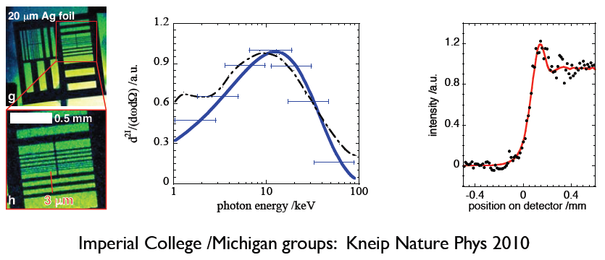
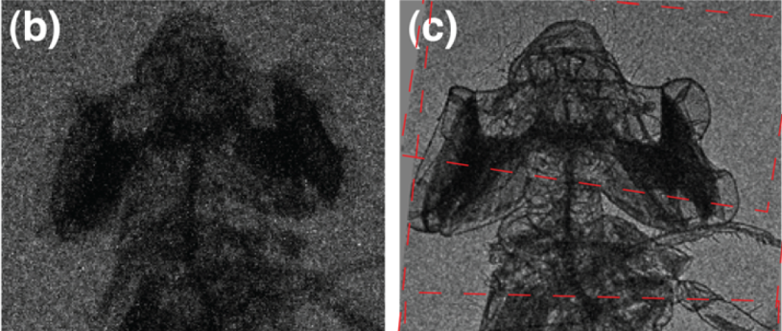
Betatron radiation sources
Strong radial electric field within plasma wave cause transverse oscillation of electron bunch
Generates very bright betatron radiation in 1- 100 keV range
S. Kneip et al., Appl. Phys. Lett. 99, 093701 (2011)

Slide 15

Novel Compton Source
JAI & ASTeC plan to develop new compact X-ray source
  Based on a patent filed by JAI
  Will use SC RF, sophisticated cryostat, sophisticated cavities
  ASTeC experience match perfectly the needs of the project
  Now forming working teams to develop the design further
JAI
RAL
ASTeC & CI
Daresbury

Slide 16
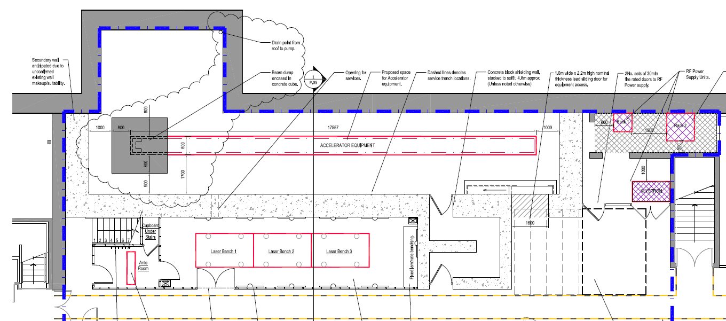
Accelerator Science Lab
Development of stable laser-driven accelerators
Undulator / FEL radiation sources
Compton sources etc

Slide 17
Summary
JAI has a broad programme of research in conventional and plasma accelerators
Training programme for next generation of accelerator scientists
Research activities on
  plasma accelerators
  radiation generation
  novel diagnostics

