Slide 1

Studies for Particle Driven Plasma Acceleration at PITZ
Experiments planned utilizing PITZ (Photo Injector Test facility at DESY, Zeuthen site)
Matthias Gross
Helmholtz Virtual Institute on Plasma Acceleration Meeting
SLAC, 8. October 2012

Slide 2
Contents
Introduction
Unique positioning of Photo Injector Test Facility (PITZ)
State of development of plasma cell experiment
Outlook: high transformer ratio

Slide 3
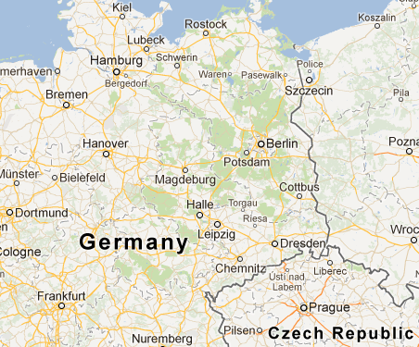
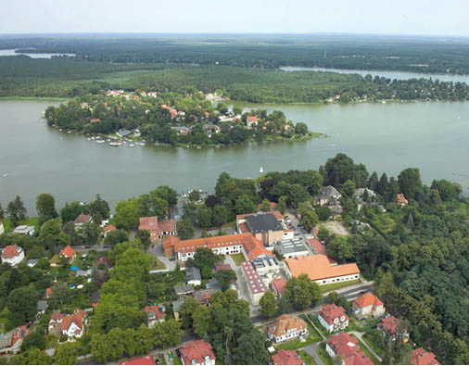
DESY, Location Zeuthen
Former Institute for High Energy Physics in Zeuthen (Academy of Sciences of the GDR). Was merged with DESY on 1st January 1992
200 employees of which 50 are scientists

Slide 4
Photo Injector Test facility at Zeuthen – PITZ
Goals & research activities
  Study, development, characterization and conditioning of electron beam sources for FLASH and the European XFEL
  Testing new developments e.g. laser system, accelerating structures (e.g. PWA), deflecting structure, cathodes, and beam diagnostics
History – some highlights
  1999: DESY directorate decision to build PITZ in Zeuthen
  2002: 1st photoelectrons produced
  2005: 10 MW Multi Beam Klystron (MBK)
  2006: Three emittance measurement systems (EMSY)
  2008: New Yb:YAG photocathode laser system
  2009: New Cut Disk Structure (CDS) booster – Maximum beam energy: 25 MeV
  2010: 10 MW In-vacuum directional coupler and a new LLRF system
  2012: Deflection cavity and 3rd dispersive arm HEDA2

Slide 5
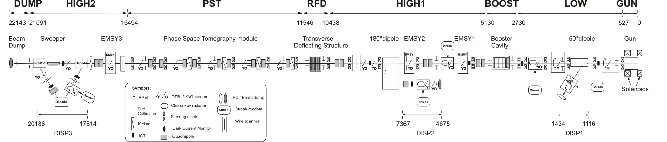
current
PITZ 2.0 setup

Slide 6
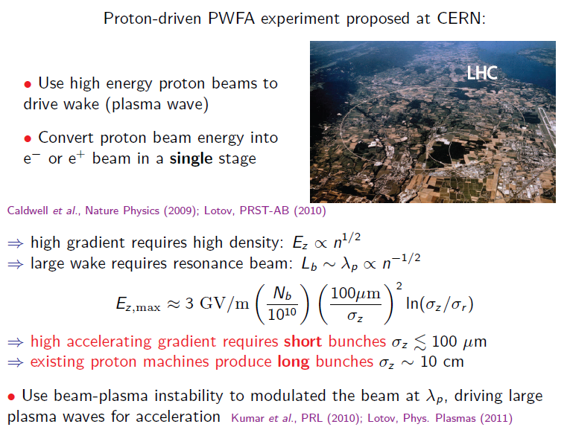
Background
Background:
Courtesy of Carl Schröder, LBNL
Does this work ?
→Dephasing ?
→Hose instability ?

Slide 7
Why Experiments at PITZ?
Favorable circumstances
  Pure R&D facility (no users)
  Unique laser system (pulse shaper)
  Well developed diagnostics (high resolution electron spectrometer, etc.); soon: transverse deflecting cavity + dispersive section for longitudinal phase space measurements
Possible contribution from PITZ:
  Self modulation of electron beam
  Later: High transformer ratio (needs bunch compressor)

Slide 8
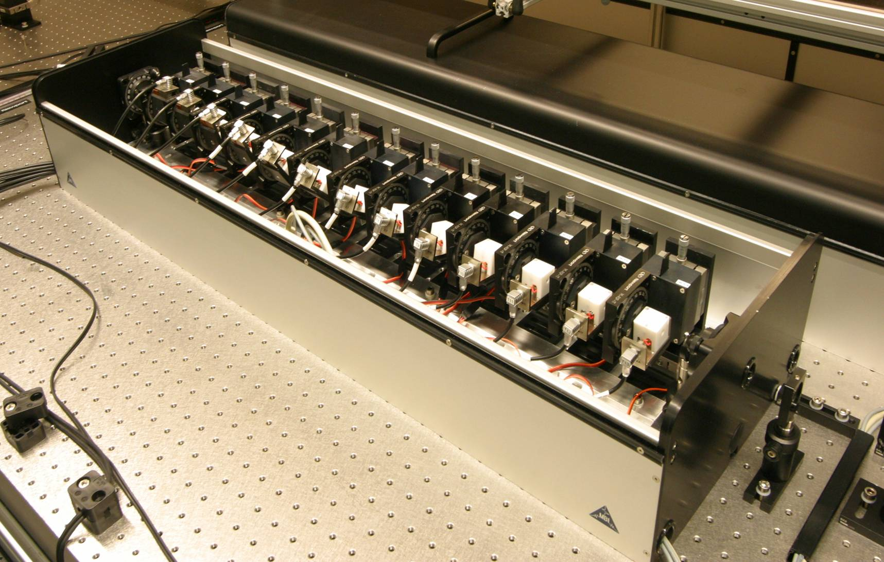
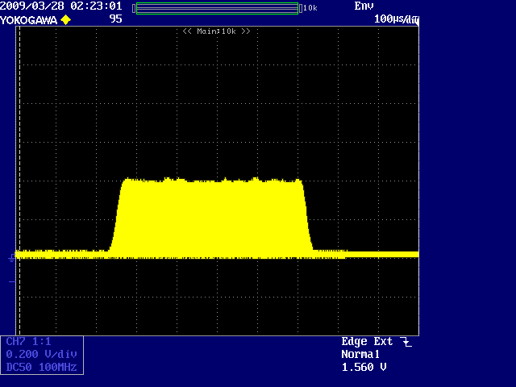
Flexible Laser Pulse Formation at PITZ
Photoinjector laser
Developed and built by Max-Born Institute Berlin
Key element: the pulse shaper
  Contains 13 birefringent crystals. Pulses are split according to polarization. Delay is given by crystal thickness; relative amplitude can be varied freely by adjusting relative angle between crystals
motorized rotation stage
Shaped ouput pulses
temperature controlled birefringent
crystal
FWHM
= 25 ps
OSS signal (UV)
edge₁₀₋₉₀
~ 2 ps
birefringent shaper, 13 crystals
edge₁₀₋₉₀
~ 2.2 ps
Gaussian
input pulses
birefringent shaper, 13 crystals
Will, Klemz, Optics Express
16 (2008) , 4922-14935

Slide 9
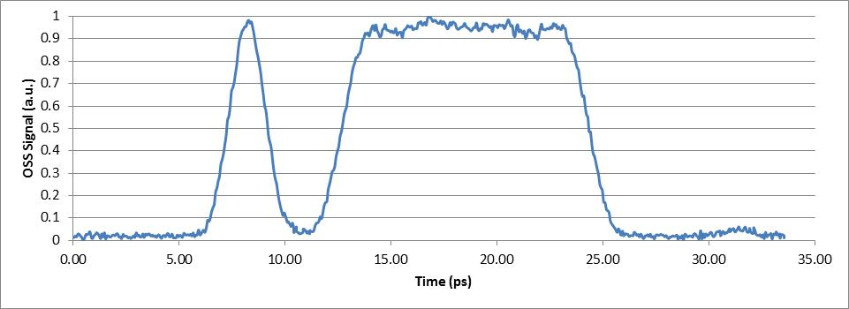
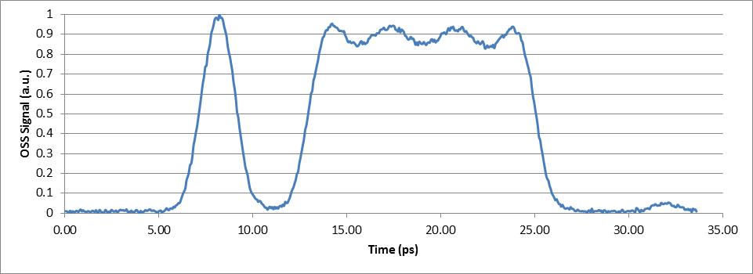
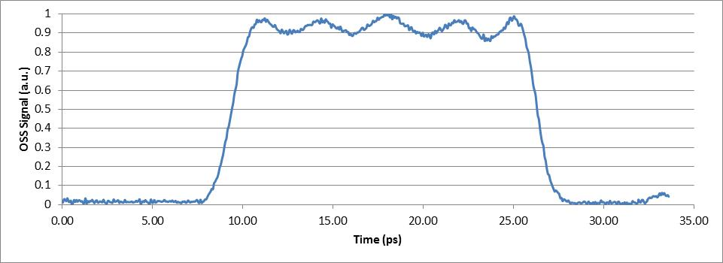
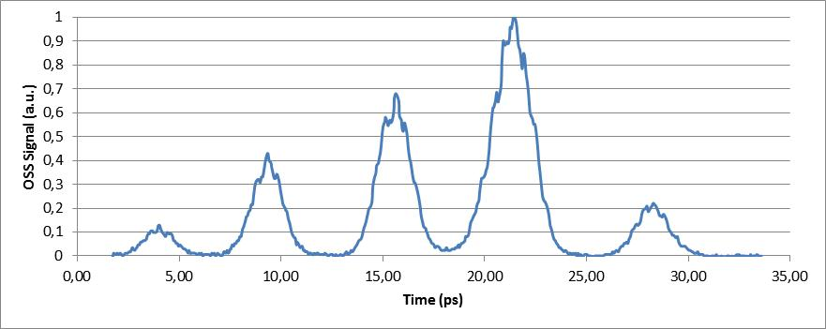
Experimentally Demonstrated Pulse Shapes
Driver + witness bunch
Modulated driver + witness bunch
Modulated driver
Multi bunches

Slide 10
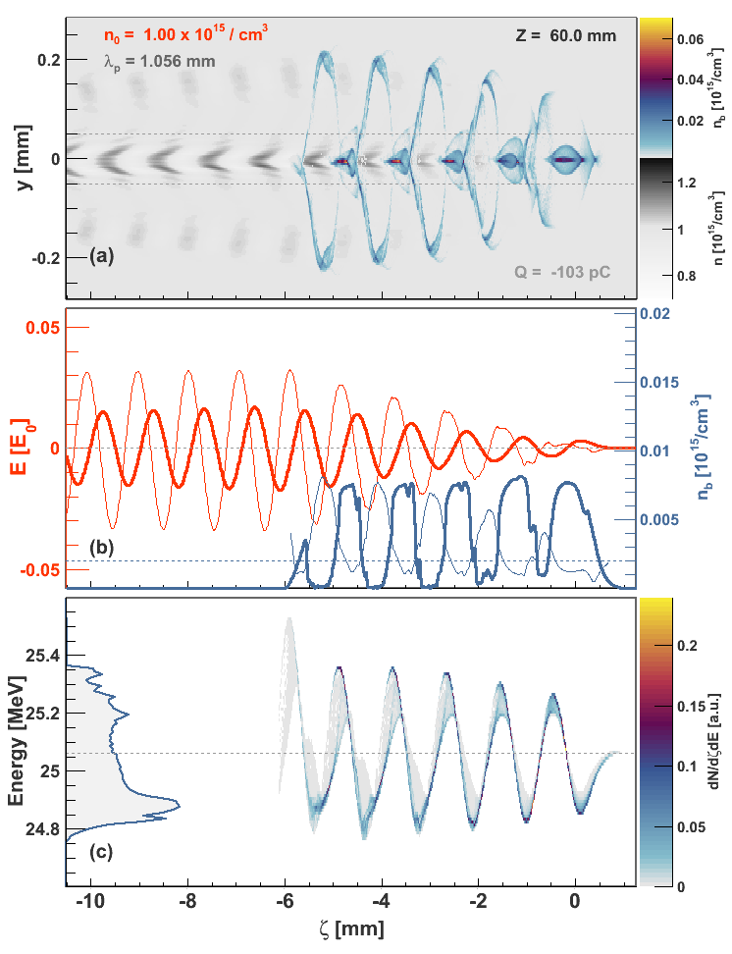
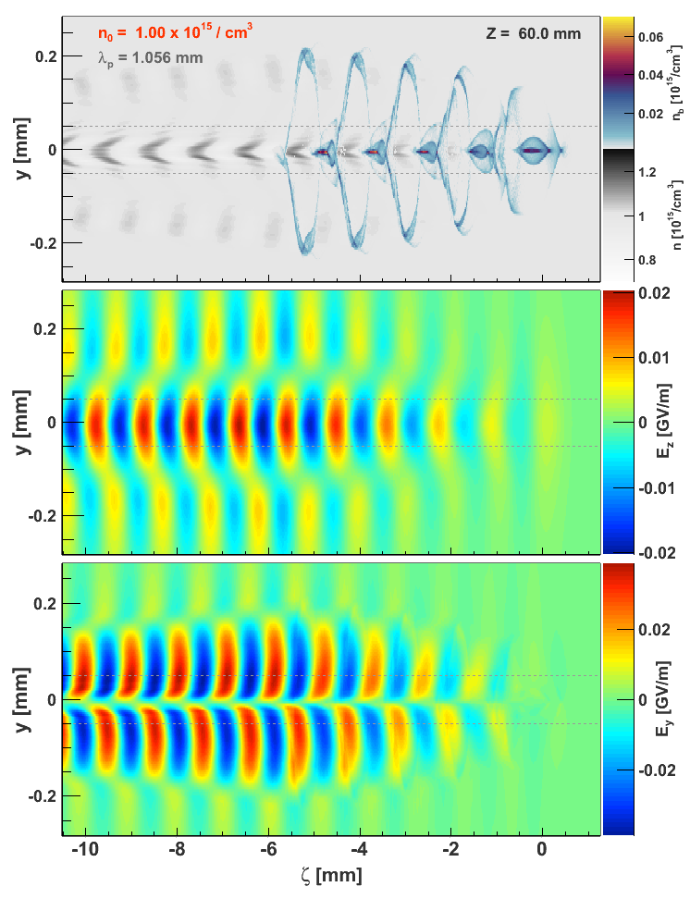

PIC (Particle in Cell) Simulation of PITZ Experiment
Expected energy modulation ≈600 keV. PITZ beam energy spread as low as ≈60keV. Resolution of TDS/HEDA2: 10keV and 100μm (Malyutin et al. “Simulation of the Longitudinal Phase Space Measurements With the Transverse Deflecting Structure at PITZ”, Proc. of IPAC 2012, MOPPP034 → Measurable
Beam parameters | Setup 1
Total charge, pC | 100
Longitudinal beam position, m | 6.35
Horizontal rms beam size, um | 49.8
Vertical rms beam size, mm | 51.2
Bunch length in FWHM, mm | 5.92
Average kinetic energy, MeV | 24.55
Rms energy spread, keV | 27.5
Peak slice current, A | 5.2
Horizontal rms emittance, mm mrad | 0.37
Horizontal beam divergence, mrad | 0.008
Vertical rms emittance, mm mrad | 0.38
Vertical beam divergence, mrad | 0.002
Longitudinal rms emittance, keV mm | 42.4
Peak beam density, 10^12 e / cm^3 | 9.1
PITZ resolution window
Simulations:
Alberto Martinez de la Ossa

Slide 11
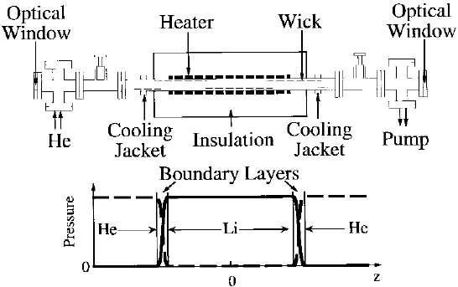
Lithium Plasma Cell
Principle:
  Evaporate Lithium in central pipe (700°C)
  Define beginning and end of Lithium zone with steep temperature gradient and Helium buffer gas
  Once pressure regions have stabilized:
    Ionize Lithium gas with laser (Photoionization with ArF or field ionization with Ti:Sa)
    Inject particle beam for PWA experiment
Figure from: P. Muggli et al. “Photo-Ionized Lithium Source for Plasma Accelerator Applications”, IEEE Trans. Plasma Science 27 (1999), pp. 791-799

Slide 12
Optics for Laser Plasma Generation
Axicon for homogeneous ionization profile
  Adjustable aperture to define length of plasma channel
Simple focusing mirror
  Length of plasma channel defined by Li gas volume
Li gas
e⁻ beam
Plasma channel
Aperture
Li gas
e⁻ beam

Slide 13
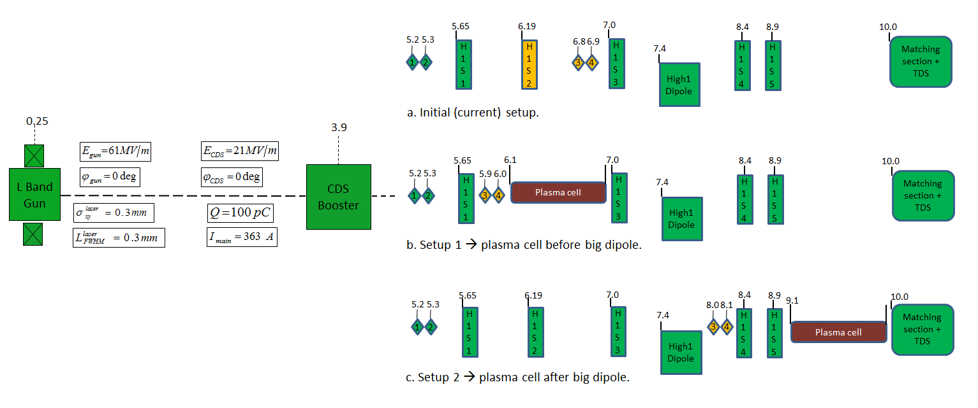
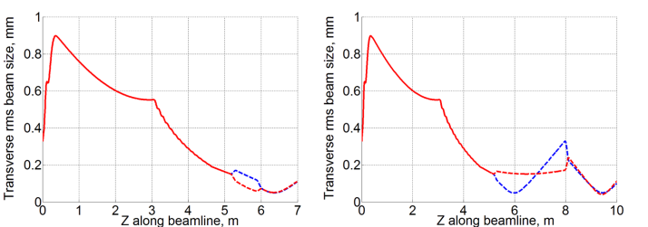
Simulation: Scenarios for Plasma Cell Insertion
Schematic views
Electron beam rms size
  More complex beam focusing for setup 2
Setup 1
Setup 2
Simulations:
Martin Khojoyan

Slide 14
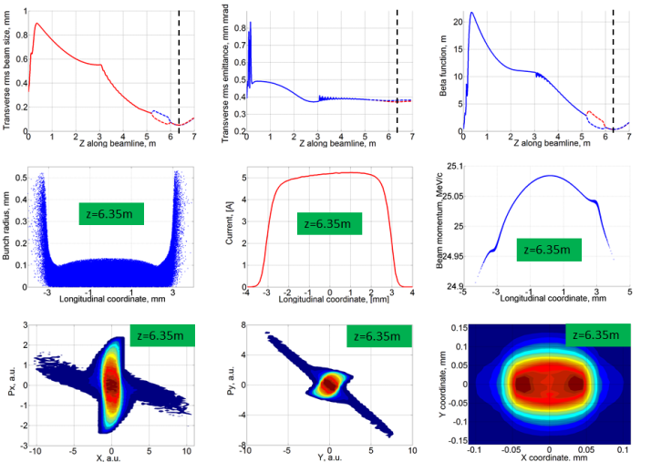
Simulation: Beam Properties
Beam properties for Setup 1 (I_{main} = 363A) Comparison of setups
Setup 1: beam properties acceptable. Smaller beam size, less divergence, higher peak density – overall preferable
Beam parameters | Before dipole | After dipole
Total charge, pC | 100 | 100
Longitudinal beam position, m | 6.35 | 9.45
Horizontal rms beam size, um | 49.8 | 59.4
Vertical rms beam size, mm | 51.2 | 59.4
Rms bunch length, mm | 1.71 | 1.71
Bunch length in FWHM, mm | 5.92 | 5.92
Average kinetic energy, MeV | 24.55 | 24.55
Rms energy spread, keV | 27.5 | 27.8
Peak slice current, A | 5.2 | 5.2
Horizontal rms emittance, mm mrad | 0.37 | 0.38
Horizontal beam divergence, mrad | 0.008 | 0.09
Vertical rms emittance, mm mrad | 0.38 | 0.36
Vertical beam divergence, mrad | 0.002 | 0.13
Longitudinal rms emittance, keV mm | 42.4 | 42.4
Peak beam density, 10^12 e / cm^3 | 9.1 | 6.6
Simulations:
Martin Khojoyan

Slide 15
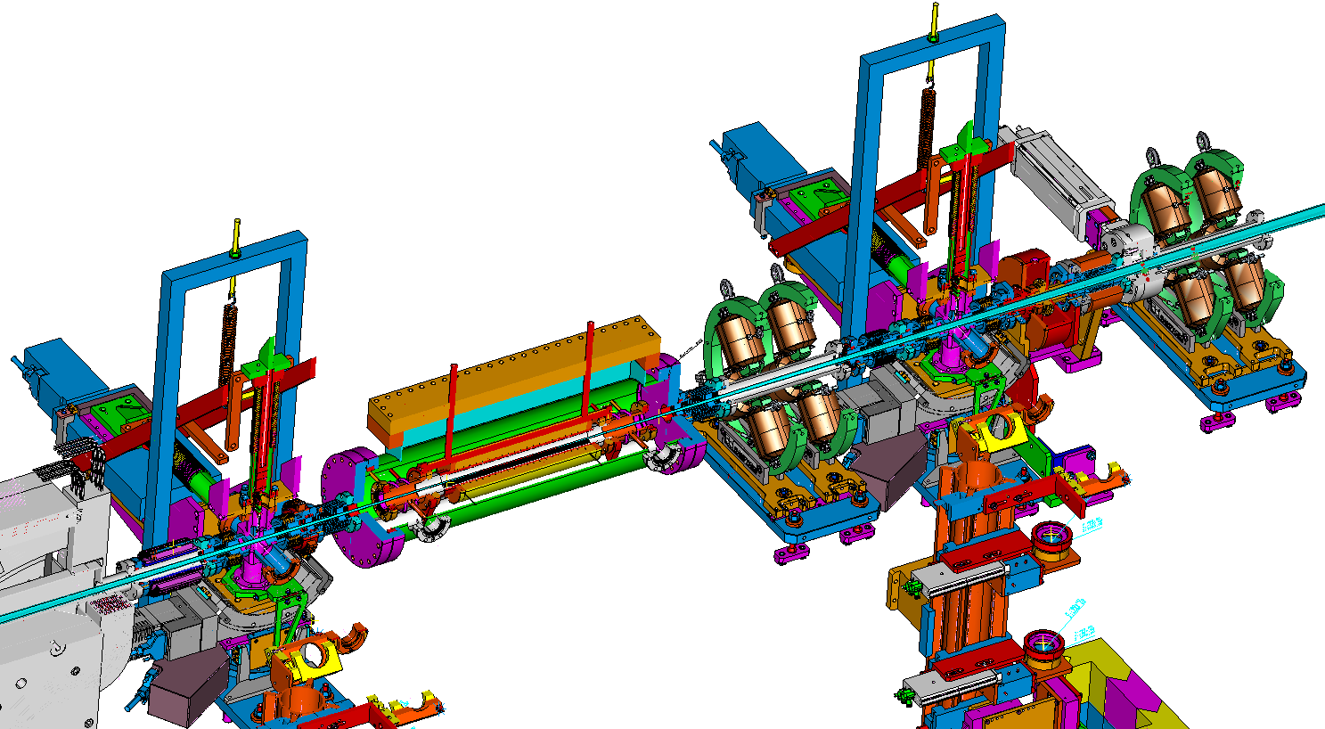
Plasma Cell Assembly: Sketch
Design:
Gerald Koss
Electron
Beam /
Laser
Screen stations
Quadru-
poles
Preliminary Version
Plasma cell

Slide 16
Multi Bunches: High Transformer Ratio
Plasma Acceleration: e.g. 5 bunchlets within bunch → transformer ratio >2
Setup: - use PITZ2 beamline with gun, booster, and matching quads up to z=7m
  - install a short bunch compressor (dogleg)
ASTRA simulations through gun and booster up to z=5m
use Elegant for matching
and the dogleg design (ongoing)
Parameters:
Q = 170 pC in 5 pulses
100 000 particles
Gun phase: 10 deg
Booster phase: 40 deg
BC layout:
compression factor C = 4
R₅₆ = 0.15
Total length l = 1m
dipoles: r = 0.6m, α = 60 deg
S2
Longitudinal phase space at z=5m
D2
Longitudinal laser profile at the cathode
S1
Q3
Q2
Q1
D1
l=1m
10pC 30pC 50pC 70pC 10pC
Design with 2 doglegs (↑↓) on the way
Simulation by Anne Oppelt

Slide 17
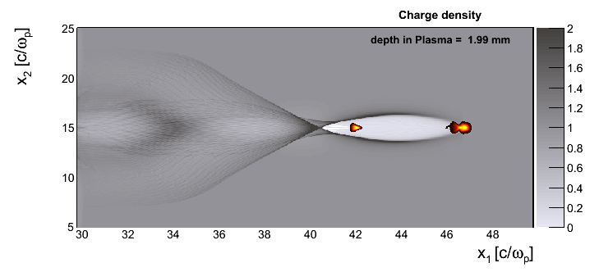
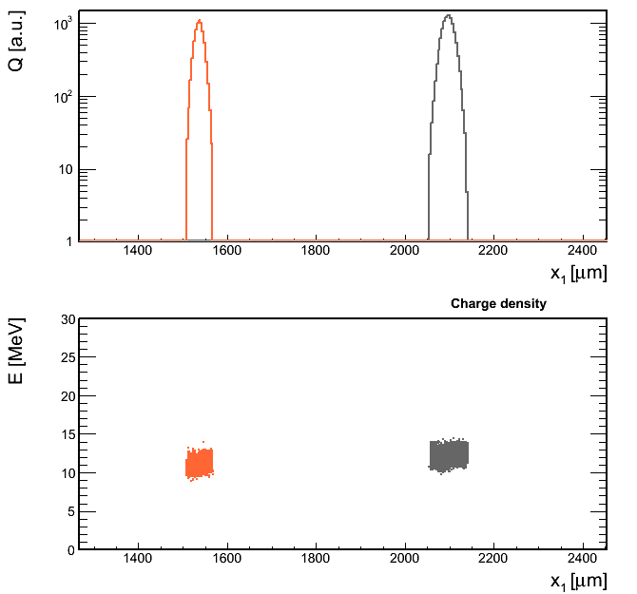
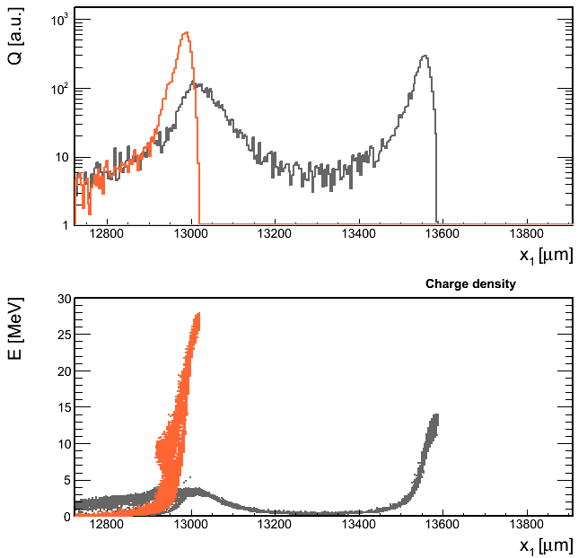
Very Preliminary Results: Needs Optimization
/n0
The witness bunch falls in the region where
the wakefield is maximum.
Witness bunch
Driver bunch
In approx. 1 cm of propagation in the
plasma, a fraction of the electrons in
the witness bunch double their energy.
~λp
Bunches at the beginning:
Bunches after 1 cm in plasma:
Witness bunch
Driver bunch
Energy gain!
Simulation by Alberto Martinez de la Ossa

Slide 18
Outlook
2013: First experiments with plasma cell
2014: Characterization of energy modulation of electron beam in plasma
Then: Insertion of bunch compressor – experiments with high transformer ratio etc.
Cooperation with SLAC, CERN etc.

Slide 19
Summary
PWA Experiments are planned at PITZ
  Now: Characterization of electron beam self modulation
  Later: High transformer ratio
Utilization of good diagnostics and unique laser system
Simulations show promising results
  Electron sub bunching and energy modulation with current setup
  Energy gain with bunch compressor
Current main work
  Detailed plasma cell design
  Insertion of plasma cell into PITZ beam line

Slide 20
Backup

Slide 21
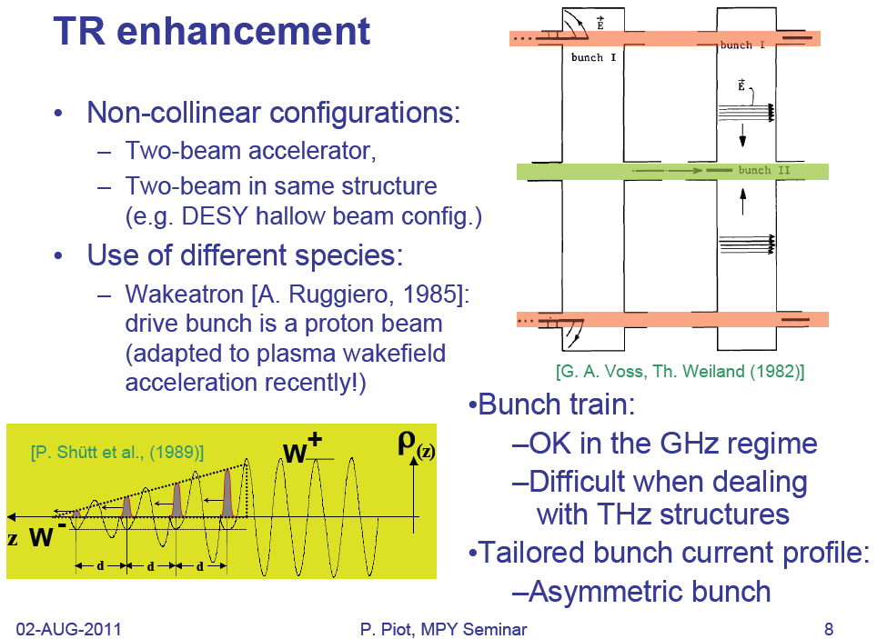
How to Increase the Transformer Ratio

