Slide 1
“Financial Sustainability” 2nd CoPoRi meeting 13 February 2013, Brussels
the case of SKA
Patricia Vogel (NWO)

Slide 2
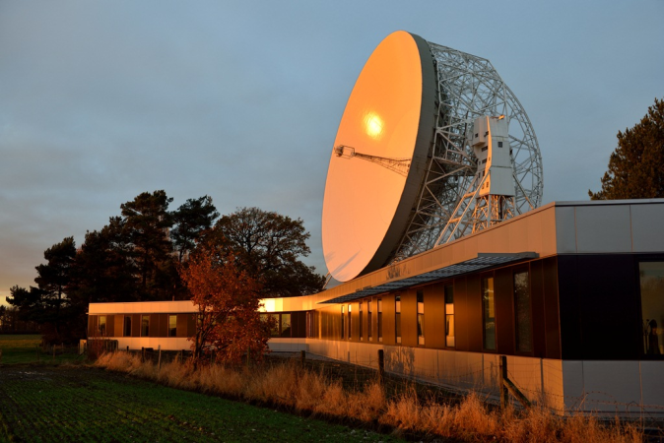
Square Kilometre Array
SKA entering ‘Pre-construction Phase’ developing detailed design
New project HQ building completed at Jodrell Bank Observatory (November 2012)
SKA Organisation now has ten Full Members plus India as Associate Member
In May 2012, SKA Organisation Members selected dual-site implementation for project:
New SKA building: JBO, Manchester
Southern Africa
Australia
SKA phase 1: ~350 dishes
SKA phase 2: ~3000 dishes
‘Low-frequency’ aperture array and smaller dish array

Slide 3
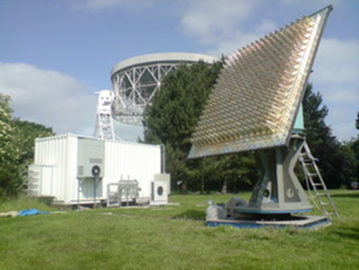
SKA – Science and Impact
The Science Goals
Understanding how the first objects (stars and galaxies) formed in the Universe
Understanding what the Universe is made of (Dark Matter and Dark Energy)
Testing Einstein’s theories of gravitation
Astrobiology and SETI
VLA (now)
SKA (modelled))
HEI’s, Industry and Technology
SKA driving e-infrastructure hardware and software development (SKA dishes will produce 20 times current global internet traffic)
Novel networking and antenna systems
Institutes and industry working together in the pre-construction phase, readiness for construction phase

Slide 4
Top level schedule and Phasing
Technical
2008-12 telescope system design and costing (FP7 PrepSKA)
2013-16 detailed design & pre-construction phase (PEP/Business Plan)
~2017-20 Phase 1 construction
~2020-24 Phase 2 construction
2020→ full science operations with Phase 1
2024→ full science operations with Phase 2
Programmatic
April 2011 LoI to establish legal entity signed by 9 FA’s/Ministries
Nov 2011 Established SKA organisation legal entity by 7 Members
(PEP budget ~ 90 M€: 1/3 cash and 2/3 in-kind by PO’s in WPC
Site selection
2013 10 Full Members, 1 Associate Member of SKA Organisation
2014 construction funding approved for Phase 1 (~350 M€, 2007)
2017 construction funding approved for Phase 2 (~1.5 B€, 2007)
Operations: 160 M€/year

Slide 5
Evolution of the project (2010-2011)
Technical evolution:
PrepSKA-supported technical activity led to:
Development of ‘Project Execution Plan’ – detailed workpackage plan for all ‘pre-construction’ activities
Governance evolution:
Informal Agencies group signed Letter of Intent (aim of seeking commitment to project, and appropriate funding)
Creation of Founding Board to prepare policy questions leading to:
Establishment of SKA Organisation limited company to govern project in pre-construction phase
Funding evolution:
Development of Business Plan
Commitment of funding to establish Organisation
Commitment of resources (cash and in-kind) to deliver technical aims of pre-construction phase

Slide 6
SKA pre-construction phase organisation model
SKA Organisation formed in 2011:
To deliver a construction-ready SKA project
A UK Company structure
With paying Full Members (minimum €1M 2012-2016)
Associate Members
Cash
(Common Fund)
Local resourcing
(In country)

Slide 7
How to achieve financial sustainability and move towards implementation?
SKA entered the pre-construction phase by end 2011, stepping stones:
LoI signed by 9 FA’s and Ministries (small fixed contribution for preparing the legal entity) in April 2011
Members Agreement signed by 7 funding agencies/ministries to establish the SKA Organisation (UK company ) to govern SKA project in preconstruction phase in November 2011
Success factors (besides strong project case and project progress, results)
starting with limited commitments for an agreed pre-construction period
a minimum required number of founding members (5) was agreed
a fixed cash minimum members’ contribution for 4 years
and estimated additional (national) in-kind contributions to WPC’s
a sense of urgency (deadline): expiration of preparatory governance (SSEC) & funds by end 2011, site selection process was nearing final decision making (spring 2012)

Slide 8
What criteria did you use to define your project as “financially sustainable”?
The Business Plan set the financial level that people could sign up to. The differentiating between cash and in-kind contribution ensured that
a) there’s enough cash to run a central project office for coordination
b) enough in-kind contribution to be confident that there’s confidence that the technical requirements as set by the Project Execution Plan (PEP) could be delivered.

Slide 9
What is the level of sustainability needed to start implementation (focus on infrastructures with modular implementation strategies)?
Phased approach of the SKA project: PrepSKA – Pre-construction Phase - SKA1 - SKA2
Need a certain level of commitments to be able to construct (for SKA1)
To deliver, will need an agreed business case for all partners to use in their national approval systems, and a construction phase governance to be developed.
Process for developing a Funding model for SKA1 has started, few principles yet agreed by SKA Board, some working assumptions and a process in place for further work by a Funding Task Force, work is ongoing.
Expected to become more clear by end 2013 (in the mid of the pre-construction period).

Slide 10
How does your financial model look like?
SKA pre-construction phase funding model:
~33% Cash contributions (fixed minimum level for 4 years cash contribution plus additional cash contributions by hosts (HQ & selected sites)
~66% in-kind contributions by Participating Organisations by self organising Work Package Consortia to execute the Project Execution Plan
Current budget for the pre-construction phase
23,4 M€ cash for the SKA Office
87,8 M€ in-kind to run the national work programs

Slide 11
Concluding remarks
like SKA entering the next phase (construction of SKA1) around 2016? Interesting to be aware of what is (or has been) driving the process of resourcing
use the ‘momentum’ in the project
have a realistic sense of what can be reached with at least a substantial part of potential members
within an agreed project timeline (go/no go decisions, define the threshold)
accept a certain level of uncertainty in the overall resourcing (how to define sustainability?)
and be attractive/open for new partners to join along the road (inclusiveness)
importance of EC-funding for SKA (FP7 PrepSKA) was crucial for the develop a business plan for the next phase
FP7 GO-SKA provides policy support to new SKA Organisation
Horizon2020 may offer funding opportunities to support global projects

