Slide 1
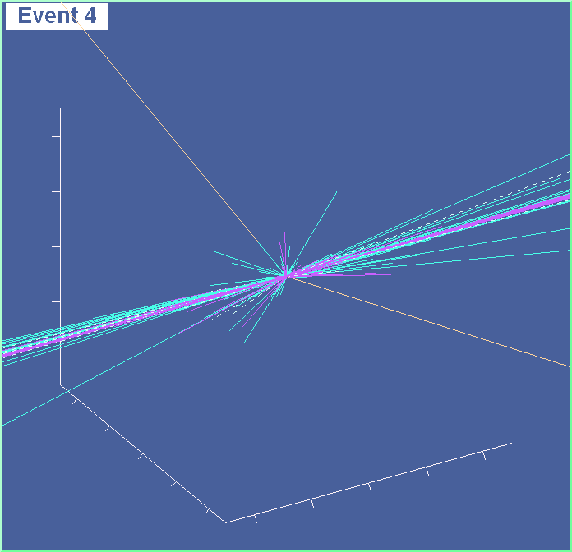
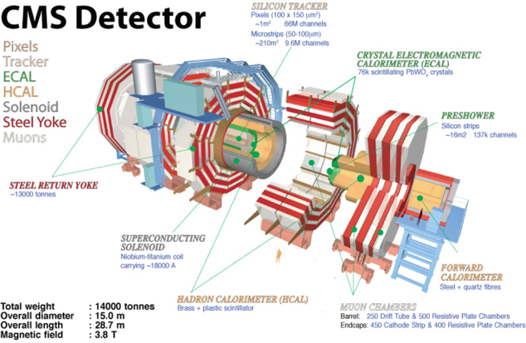
Di-boson Measurements, aTGC and Quartic Gauge Boson Couplings with CMS
Dimitri Bourilkov
University of Florida
On behalf of the CMS Collaboration
QCD@LHC, 2-6 September 2013, DESY, Hamburg, Germany

Slide 2
Multi-boson Production @ LHC
The LHC is a Heavy Gauge Boson (GB) Factory
Measure cross sections (σ), differential distributions and couplings, test SM
Primary background in many searches: Higgs, new physics…
Leptonic decays to e or μ: W  lν_{l}, Z  l⁺l⁻ provide clean signals

Slide 3
CMS Multi-boson Studies
Channel | Decay | Energy [TeV] | Lumi [fb⁻¹] | Coupling Limits | Reference
WW, ZZ | l’νl’’ν, 2l2l’ | 8 | 3.5, 5.3 | - | PL B721 (2013) 190
WZ | l⁺l⁻lν | 7 & 8 | 4.9, 19.6 | - | CMS PAS SMP-12-006
WW+WZ | lν+di-jet | 7 | 5.0 | WWγ, WWZ | EPJ C13 (2013) 2283
ZZ | lll’l’ | 8 | 19.6 | ZZγ, ZZZ | CMS PAS SMP-13-005
γγ → WW | μ⁺e⁻, μ⁻e⁺ | 7 | 5.05 | WWγγ | JHEP 1307 (2013) 116
WWγ+WZγ | lν+di-jet+γ | 8 | 19.3 | WWγγ, WWZγ | CMS PAS SMP-13-009
New this summer l = e, μ l’(l’’) = e, μ, τ

Slide 4
WW Selection & Results
WW
2 isolated leptons l’l’’ l’(l’’)=e,μ,τ
Observed: ee, eμ, μμ
Large missing E_{T}
Good agreement data/MC
WW
WW inclusive cross section
(measured slightly above NLO predictions)
Energy | σ_{MEAS} [pb] | σ_{MCFM@NLO} [pb]
7 TeV | 52.5 ± 2.0(st) ± 4.5(sys) ± 1.2(lum) | 47.0 ± 2.0
8 TeV | 69.9 ± 2.8(st) ± 5.6(sys) ± 3.1(lum) | 57.3 ± 2.0

Slide 5
WZ Selection
z
W
1 isolated
lepton l=e,μ
P_{T} > 20 GeV
E_{T} > 30 GeV
W
z
2 isolated
leptons ll
ll=ee,μμ
P_{T} > 20,10 GeV
|m_{ll}-m_{Z}|< 20 GeV
Backgrounds:
ZZ
Fakes
6% syst. err

Slide 6
WZ Results
WZ inclusive cross section
(measured slightly above NLO predictions)
Energy | σ_{MEAS} [pb] | σ_{MCFM@NLO} [pb]
7 TeV | 20.8 ± 1.3(st) ± 1.1(sys) ± 0.5(lum) | 17.8 ± 0.6
8 TeV | 24.7 ± 0.8(st) ± 1.1(sys) ± 1.1(lum) | 22.0 ± 1.0

Slide 7
WW/WZ/ZZ Production & aTGC
Self-interactions of electro-weak GB - fundamental prediction of the non-Abelian SU(2)xU(1) gauge theory
TGC/QGC (triple & quartic GB couplings): fully fixed in the SM
Anomalous aTGC & aQGC ⇒ modify σ and kinematics
WWZ/WZγ LEP parametrization: 5 parameters equal to zero in the SM
Δg^{Z}₁ = g^{Z}₁ – 1, Δκ_{γ} = κ_{γ} - 1, Δκ_{Z} = κ_{Z} - 1, λ_{γ}, λ_{Z}
3 independent parameters ⇐ SU(2)xU(1) gauge invariance
Δκ_{Z} = Δg^{Z}₁ - Δκ_{γ}tan²θ_{W} λ_{γ} = λ_{Z}
Zγγ/ZZγ /ZZZ couplings - all anomalous neutral TGCs are zero at tree level in the SM. Place limits on the anomalous parameters h₃, h₄, f₄ and f_{5.}

Slide 8
WW+WZ → W+dijet → lν+jj @ 7 TeV
First LHC WW+WZ measurement using the semi-leptonic final state (e or μ + jj)
Branching 6 times higher
Large backgrounds
W+jets, top (tt,tW)
DY+jets, Multi-jets (QCD)
Can’t resolve W or Z due to jet resolution

Slide 9
WW+WZ → W+dijet
Exactly 1 isolated lepton: P_{T} > 25/35 GeV (μ/e)
Large E_{T} > 25/30 GeV (μ/e) M_{T}(l, E_{T}) > 30/50 GeV (μ/e)
Exactly 2 jets with P_{T} > 35 GeV & b-veto
Background from unbinned likelihood fit to the jj mass spectrum
75 < M_{jj} < 95 GeV for aTGC

Slide 10
WW+WZ → W+dijet aTGC
σ(pp → WW+WZ) =
68.9 ± 8.7 (stat) ± 9.7 (syst) ± 1.5 (lumi) pb
SM@NLO: 65.6 ± 2.2 pb (includes gg → WW)
Di-jet P_{T} distribution sensitive to aTGC

Slide 11
Charged aTGC Results
Δg^{Z}₁ = g^{Z}₁ – 1, Δκ_{γ} = κ_{γ} - 1, Δκ_{Z} = κ_{Z} - 1, λ_{γ}, λ_{Z}
Δκ_{Z} = Δg^{Z}₁ - Δκ_{γ}tan²θ_{W} λ_{γ} = λ_{Z}
New improved limits on Δκ_{γ} and λ from WW+WZ → W+dijet (WV V = W or Z)
WWγ
WWZ

Slide 12
ZZ → lll’l’ @ 8 TeV
4 isolated leptons: lll’l’ (2l2l and 2l2τ) l = e,μ l’ = e,μ,τ
|m_{ll}-90|< 30 GeV P_{T} > 20(10) GeV
20(eμ)/30(other) < m_{ττ}^{vis} < 90 GeV
τ → e,μ (P_{T} > 10 GeV) or hadrons (P_{T} > 20 GeV) π⁰/charged had

Slide 13
ZZ → lll’l’ aTGC
σ(pp→ZZ)=7.7 ±0.5(stat) ±0.5(syst) ±0.4(th) ±0.3(lumi) pb
σ(MCFM@NLO) = 7.7 ± 0.6 pb

Slide 14
Neutral aTGC Results
In the SM all anomalous neutral TGCs are zero at tree level.
New improved limits from ZZγ and ZZZ on the anomalous parameters f₄^{Z}, f₅^{Z} , f₄^{γ} and f₅^{γ}.
Zγγ, ZZγ
ZZγ, ZZZ

Slide 15
γγ → WW & First LHC Limits on aQGC
First measurement @ LHC of
exclusive pp → W⁺W⁻ or
quasi-exclusive p*p* → W⁺W⁻production by γγ interactions
Untagged analysis: protons stay intact or dissociate
W⁺W⁻ →μ±e±
0 extra tracks @ μe vertex (reduce pileup)
P_{T}(μe) > 30 GeV SM signal region
P_{T}(μe) > 100 GeV aQGC search region
(a)QGC
t channel
u channel

Slide 16
γγ → WW @ 7 TeV
CMS @ 7 TeV
5.05 fb⁻¹
Data - two events with P_{T}(μe) > 30 GeV, 2.2 ± 0.4 SM signal events expected with 0.84 ± 0.15 background

Slide 17
γγ → WW
⇐ μμ control samples. Selections:
Elastic-enriched: 0 extra tracks
Proton-dissociation enriched

Slide 18
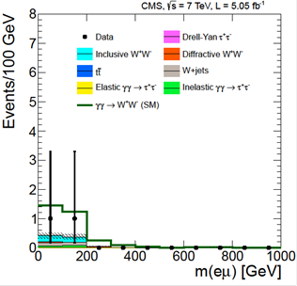
γγ → WW aQGC
0 extra tracks
P_{T} > 30 GeV
P_{T} > 30 GeV
P_{T} > 100 GeV

Slide 19
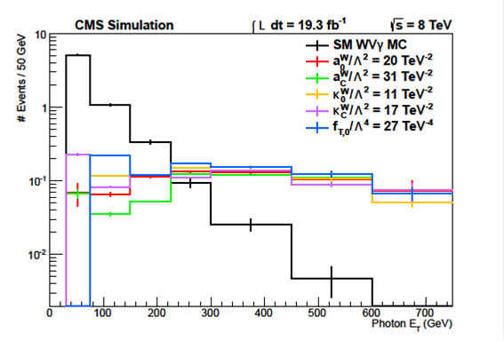
WWγ & WZγ @ 8 TeV
(a)QGC
(a)QGC
V = W or Z
First limits on some aQGC (dimension 8 f_{T,0}; CP cons. κ₀^{W} κ_{C}^{W})
lν+di-jet+γ (W V γ)
Exactly 1 lepton:
P_{T} > 25/30 GeV (μ/e)
Large E_{T} > 35 GeV
M_{T}(l, E_{T}) > 30 GeV
|Δϕ(E_{T}, leading jet)| > 0.4
2 jets with P_{T} > 30 GeV & b-veto 70 < M_{jj} < 100 GeV |Δη_{jj}| < 1.4
Isolated γ, E_{T} > 30 GeV, |η| < 1.44

Slide 20
WWγ & WZγ
Background from binned likelihood fit to the jj mass spectrum
Expected events: 194 (μ), 148 (e) Observed: 183 (μ), 139 (e)
WVγ expected: 6 (μ), 5(e) σ < 241 fb @ 95% CL (3.4 > SM aMC@NLO)
Photon P_{T} spectra sensitive to aQGC (dimension 6 or 8 effective operators: dimension 8 parameters f_{M,i} are related to dimension 6 parameters a₀^{W}, a_{C}^{W} via a simple linear transformation)

Slide 21
WWγγ & WWZγ aQGC
dim 6
dim 8
The effective field theory terms directly violate unitarity at parameter values close to the measured limits and the unitarity condition cannot be generally satisfied by the addition of any dipole form-factors with scale ΛFF.

Slide 22
Summary
CMS has studied a variety of multi-boson channels (2 or 3 final state bosons) with the 7 and 8 TeV LHC data
Both leptonic (e, μ, τ) and di-jet decay modes used
Cross sections for WW, ZZ, WZ, WW+WZ, WVγ (limits) and γγ→WW: all results agree with the Standard Model predictions
Improved limits for anomalous triple gauge boson couplings
First limits for anomalous quartic gauge boson couplings from exclusive two-photon production and WVγ

Slide 23
Backup Slides

Slide 24
CMS @ LHC @ 7 & 8 TeV
2011-12 data @ 7 & 8 TeV

