Slide 1
Neutrinos oscillations:
the basic formalism
A. Y. Smirnov
International Centre for Theoretical Physics, Trieste, Italy
Exploring the neutrino sky and
fundamental particle physics
on the Megaton scale
Bad Honnef, January 21, 2013

Slide 2
Content:
1. Mixing
2. Oscillations: basics
3. Oscillations effects in matter
Resonance enhancements
Parametric enhancement of oscillations
4. CP-violation

Slide 3
1. Mixing

Slide 4
Mixing
ν_{e}
ν_{μ}
ν_{τ}
|U_{μ3}|²
|U_{τ3}|²
Mixing matrix:
ν₃
ν_{e}
ν_{μ}
ν_{τ}
ν₁
ν₂
ν₃
|U_{e3}|²
= U_{PMNS}
mass
Δm²₃₁
|U_{e2}|²
ν₂
U_{PMNS} = U₂₃I_{δ} U₁₃I_{−δ} U₁₂
ν₁
Δm²₂₁
|U_{e1}|²
Mixing angles:
flavor
tan²θ₁₂ = |U_{e2}|² / |U_{e1}|²
Normal mass hierarchy
sin²θ₁₃ = |U_{e3}|²
Δm²₃₁ = m²₃ - m²₁
tan²θ₂₃ = |U_{μ3}|² / |U_{τ3}|²
Δm²₂₁ = m²₂ - m²₁
Mixing determines the flavor composition of mass states

Slide 5
Mixing
ν_{e}
Dual
role
ν_{μ}
ν_{τ}
|U_{μ3}|²
|U_{τ3}|²
ν₃
|U_{e3}|²
mass
|U_{e2}|²
ν₂
ν₁
|U_{e1}|²
ν_{e}
ν_{μ}
ν_{τ}
Flavor content of mass states
Mass content of flavor states
ν_{f} = U_{PMNS} ν_{mass}
ν_{mass} = U_{PMNS} ⁺ ν_{f}
l γ ^{μ} (1 - γ₅) U_{PMNS}ν_{mass}

Slide 6
Who mixes neutrinos?
Q
Mixing in CC → mixing in produced states
Non-trivial
interplay
of
Kinematics
of specific
reactions
Difference
of the charged
lepton masses
Charged current
weak interactions
ν_{e}
β− decays,
energy conservation
ν_{μ}
π− decays,
chirality suppression
ν_{τ}
Beam dump,
D - decay
How about neutral currents?

Slide 7
P
2. Oscillations
Periodic (or quasiperiodic) process of transformation of one neutrino species into another in the process of propagation

Slide 8
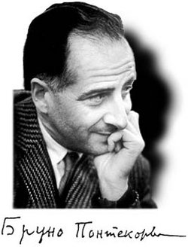
100 anniversary
Pisa, 1913
B. Pontecorvo
``Mesonium and antimesonium’’
Zh. Eksp.Teor. Fiz. 33, 549 (1957)
[Sov. Phys. JETP 6, 429 (1957)] translation
mentioned a possibility of neutrino
mixing and oscillations
Oscillations imply non-zero masses
(mass squared differences) and mixing
Proposal of neutrino oscillations was motivated
by rumor that Davis sees effect in Cl-Ar detector from atomic reactor

Slide 9
56 year later:
Oscillation effects have been observed in many experiments
Results are well described by
the standard oscillation formula
Naïve derivation (in most of textbooks) in few lines
Still hot debates on validity of the formula and correctness of its derivation
New experimental setups
- LBL long tunnels
- Long lived parents
Naive derivation
Questions & Paradoxes

Slide 10
Based on
[1] Neutrino production coherence and oscillation experiments.
E. Akhmedov, D. Hernandez, A. Smirnov, JHEP 1204 (2012) 052,
arXiv:1201.4128 [hep-ph]
[2] Neutrino oscillations: Entanglement, energy-momentum conservation and QFT.
E.Kh. Akhmedov, A.Yu. Smirnov, Found. Phys. 41 (2011) 1279-1306
arXiv:1008.2077 [hep-ph]
[3] Paradoxes of neutrino oscillations.
E. Kh. Akhmedov, A. Yu. Smirnov Phys. Atom. Nucl. 72 (2009) 1363-1381
arXiv:0905.1903 [hep-ph]
[4] Active to sterile neutrino oscillations: Coherence and MINOS results.
D. Hernandez, A.Yu. Smirnov, Phys.Lett. B706 (2012) 360-366 arXiv:1105.5946 [hep-ph]
[5] Neutrino oscillations: Quantum mechanics vs. quantum field theory.
E. Kh. Akhmedov, J. Kopp, JHEP 1004 (2010) 008
arXiv:1001.4815 [hep-ph]

Slide 11
In principle:
Lagrangian
g
2 2
l γ ^{μ} (1 - γ₅)ν_{l} W⁺_{μ}
Amplitudes, probabilities
of processes
- ½ m_{L} ν_{L}^{T}Cν_{L}
- l_{L} m_{l} l_{R} + h.c.
QFT
Starting from
the first principles
QM
Observables,
number of events, etc..
Actually not very simple
Quantum mechanics at macroscopic distances

Slide 12
What is the problem?
Set-up
Approximations
Approximations, if one does
not want to consider whole
history of the Universe to
compute e.g. signal in
Daya Bay
Formalism should be adjusted
to specific physics situation
Initial conditions
Truncating the process
Recall, the usual set-up
(scattering)
asymptotic states
described by plane waves
enormous
simplification
single interaction
region

Slide 13
Oscillation set-up
External
particles
E. Akhmedov, A.S.
ν_{i}
S
D
baseline L
production
region
detection
region
not a detector
Finite space and time phenomenon
Two interaction regions in contrast
to usual scattering problem
QFT formalism
should be
adjusted to
these condition
Neutrinos: propagator

Slide 14
Localization
Where to truncate,
how external particles
should be described?
External
particles
ν_{i}
S
D
baseline L
production
region
detection
region
Detection and production areas
are determined by localization
of particles involved in neutrino
production and detection
Wave packets for
external particles
or
Finite space-time
integration limits
not source/detector volume
(still to integrate over incoherently)
Describe by plane waves
but introduce finite integration

Slide 15
How to treat neutrinos?
ν_{i}
S
D
baseline L
production
region
detection
region
Unique process,
neutrinos with definite masses are described by propagators,
Oscillation pattern – result of interference of
amplitudes due to exchange of different mass eigenstates
Very quickly converge to mass shell
Real particles – described by wave packets

Slide 16
In terms of mass eigenstates
Without flavor states
g
2 2
U_{li} l γ ^{μ} (1 - γ₅) ν_{i} W⁺_{μ} + h.c.
ν_{i}
l
Scattering
W
interaction constant
Eigenstates of
the Hamiltonian
in vacuum
N
ν_{i}
π
Lagrangian
of interactions
wave functions
of accompanying
particles
π ◊ μ ν_{i}
μ
compute the wave function
of neutrino mass eigenstates
Wave packet

Slide 17
Factorization
ν_{i}
S
D
baseline L
production
region
detection
region
If oscillation effect in
production/detection
regions can be neglected
factorization
Production propagation and
Detection can be considered
as three independent processes
r_{D} , r_{S} << l_{ν}

Slide 18
Wave packets and oscillations
Suppose ν_{α} is produced in the source centered at x = 0, t = 0
After formation of the wave packet (outside the production region)
|ν_{α} (x,t)> = Σ_{k} U_{αk}* Ψ_{k}(x, t)|ν_{k}>
Ψ_{k} ~ dp f_{k}(p – p_{k}) e
ipx – iE_{k}(p)t
In general
E_{k}(p)= p² + m_{k}²
- dispersion relation
f_{k}(p – p_{k}) - the momentum distribution function peaked at
p_{k} - the mean momentum
describes spread of the wave packets
Expanding around mean momentum
E_{k}(p) = E_{k}(p_{k}) + (dE_{k}/dp) (p - p_{k}) + (dE_{k}²/dp²) (p - p_{k})² + …
p_{k}
p_{k}
v_{k}= (dE_{k}/dp) = (p/E_{k})
- group velocity of ν_{k}
p_{k}
p_{k}

Slide 19
Shape factor and phase factor
E_{k}(p) = E_{k}(p_{k}) + v_{k}(p - p_{k})
(neglecting spread of
the wave packets)
Inserting into
Ψ_{k} ~ dp f_{k}(p – p_{k}) e
ipx – iE_{k}(p)t
ip_{k}x – iE_{k}(p_{k})t
Ψ_{k} ~ e g_{k}(x – v_{k}t)
Phase factor
Shape factor
iφ_{k}
ip(x – v_{k}t)
e
g_{k}(x – v_{k}t) = dp f_{k}(p) e
φ_{k} = p_{k} x – E_{k} t
Depends on x and t only in combination (x – v_{k}t) and therefore
describes propagation of the wave packet with group velocity v_{k} without change of the shape
Depends on mean characteristics p_{k} and corresponding energy:
E_{k}(p_{k}) = p_{k}² + m_{k}²

Slide 20
Wave packet picture
ν_{e}
ν_{e} = cosθ ν₁ + sinθ ν₂
cosθ
ν_{μ} = - sinθ ν₁ + cosθ ν₂
opposite phase
σ_{x}
ν₁ = cosθ ν_{e} − sinθ ν_{μ}
ν₁
ν₂ = cosθ ν_{μ} + sinθ ν_{ε}
Interference of
the same flavor parts
sinθ
ν₂
φ = 0
Main, effective frequency
x
iφ₁
iφ₂
|ν (x,t)> = cosθ g₁(x – v₁ t)e |ν₁> + sinθ g₂(x – v₂t)e |ν₂ >
φ = φ₂ - φ₁
Oscillation phase

Slide 21
Oscillations
φ = φ₂ - φ₁
iφ(x,t)
|ν (x,t) > = cosθ g₁(x – v₁ t) |ν₁> + e sinθ g₂(x – v₂t) |ν₂ >
Two components - correspond
to two mass eigenstates
They interfere
Interference depends on relative phase
The phase depends on (x, t) →
interference depends on (x, t) → oscillations

Slide 22
Oscillation phase
φ = φ₂ - φ₁
φ_{i} = - E_{i} t + p_{i} x
p_{i} = E_{i}² – m_{i}²
Dispersion relation
enters here
φ = ΔEt - Δpx
Δp = (dp/dE) ΔE + (dp/dm²) Δm² = 1/v_{g} ΔE + (1/2p) Δm²
group velocity
Δm²
2E
φ = ΔE/v_{g} (v_{g}t - x) + x
standard
oscillation
phase
ΔE ~ Δm²/2E
< σ_{x}
σ_{x}Δm²/2E
Effect of averaging over
size of the wave packet
usually- small

Slide 23
Oscillations
ν_{e}
+
ν_{μ}
ν_{e} = cosθ ν₁ + sinθ ν₂
cosθ
ν_{μ} = - sinθ ν₁ + cosθ ν₂
opposite phase
σ_{x}
ν₁
Interference pattern depends on
relative (oscillation) phase
sinθ
ν₂
Main, effective frequency
φ = π
x
iφ
|ν (x,t)> = cosθ g₁(x – v₁ t)|ν₁> + sinθ g₂(x – v₂t)e |ν₂ >
φ = φ₂ - φ₁
Oscillation phase

Slide 24
Oscillations
ν_{e}
cosθ
σ_{x}
ν₁
- Destructive interference
of the muon parts
- Constructive interference
of electron parts
sinθ
ν₂
φ = 0
x

Slide 25
Oscillations
ν_{e}
+
ν_{μ}
cosθ
σ_{x}
ν₁
- Destructive interference
of the electron parts
- Constructive interference
of muon parts
sinθ
ν₂
φ = π
x

Slide 26
Detection:
As important as production
Should be considered symmetrically with production
Detection effect can be included in the generalized shape factors
g_{k}(x – v_{k}t) → G_{k}(L – v_{k}t)
x → L - distance between central points of the production and detection regions

Slide 27
Oscillation probability
Amplitude of (survival) probability
iφ
A(ν_{e}) = <ν_{e}|ν (x,t)> = cos²θ g₁(x – v₁ t) + sin²θ g₂(x – v₂t) e
Probability in the moment of time t
interference
P(ν_{e}) = dx |<ν_{e}|ν (x,t)>|² =
= cos⁴θ + sin⁴θ + 2sin²θ cos²θ cos φ dx g₁(x – v₁ t) g₂(x – v₂t)
if dx |g |² = 1
If g₁ = g₂
P(ν_{e}) = 1 - 2 sin²θ cos²θ (1 - cos φ)
= 1 - sin² 2θ sin² ½φ
Δm² x
2E
2 π x
l_{ν}
depth of
oscillations
φ = =
l_{ν} =
4 π E
Δm²
Oscillation length

Slide 28
Physics summary
Apperance probability
πx
l _{ν}
P(ν_{μ})
= sin²2θ sin²
Robust
All complications – absorbed in normalization
or reduced to partial averaging of oscillations
or lead to negligible corrections of order m/E << 1
Oscillations - effect of the phase difference
increase between mass eigenstates
Admixtures of the mass eigenstates ν_{i} in a given
neutrino state do not change during propagation
Flavors (flavor composition) of the eigenstates
are fixed by the vacuum mixing angle

Slide 29
3. Matter effects:
Oscillations & flavor conversion

Slide 30
Matter potential
L. Wolfenstein, 1978
for ν_{e} ν_{μ}
at low energies Re A >> Im A
inelelastic interactions can be neglected
ν_{e}
e
Elastic forward
scattering
V_{e}, V_{μ}
W
e
ν_{e}
potentials
Refraction index:
difference of potentials
n - 1 = V / p
V = V_{e} - V_{μ} = 2 G_{F} n_{e}
for E = 10 MeV
V ~ 10⁻¹³ eV inside the Earth
n – 1 =
~ 10⁻²⁰ inside the Earth
< 10⁻¹⁸ inside the Sun
Refraction length:
2π
V
l₀ =

Slide 31
Mixing in matter
in vacuum:
in matter:
Effective
Hamiltonian
H₀
H = H₀ + V
Eigenstates
ν₁, ν₂
ν_{1m}, ν_{2m}
depend on n_{e}, E
m₁²/2E, m₂²/2E
H_{1m}, H_{2m}
instantaneous
Eigenvalues
Finding eigenstates
is equivalent to
finding mixing matrix
ν_{mass}
θ
ν_{e}
ν₁
ν_{f}
ν_{2m}
θ_{m}
ν_{H}
ν_{1m}
θ
ν₂
Mixing angle determines flavors
(flavor composition) of eigenstates
of propagation
θ_{m}
ν_{μ}

Slide 32
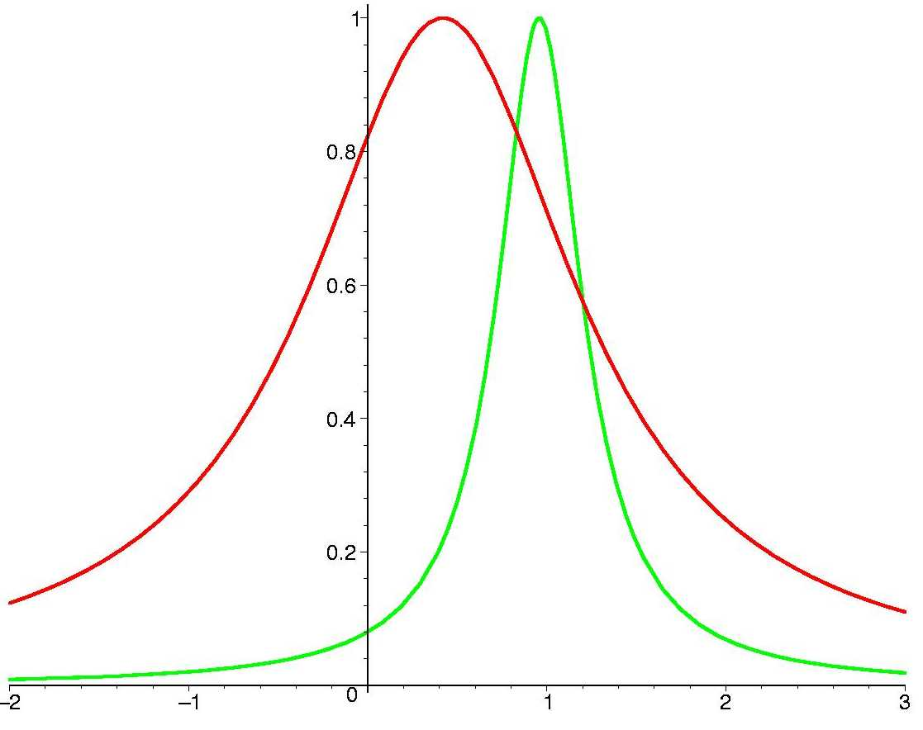
Resonance
sin² 2θ_{m}
In resonance:
ν
ν
sin² 2θ_{m} = 1
sin²2θ₁₂ = 0.825
sin²2θ₁₃ = 0.08
Flavor mixing is maximal
l_{ν} = l₀ cos 2θ
Vacuum
oscillation
length
~
~
Refraction
length
l_{ν} / l₀
~ n E
Resonance width: Δn_{R} = 2n_{R} tan2θ
Resonance layer: n = n_{R} +/- Δn_{R}

Slide 33
Oscillation length in matter
Oscillation
length in vacuum
4π Ε
Δm²
l_{ν} =
Refraction
length
l₀ =
2π
2 G_{F}n_{e}
- determines the phase produced
by interaction with matter
l_{m}
l_{ν} /sin2θ
(maximum at
l_{ν} = l ₀ /cos2θ)
shifts with respect
resonance energy:
2π
H_{2m} - H_{1m}
l_{m} =
l_{ν} (E_{R}) = l ₀ cos2θ
l₀
converges to the refraction length
~ l_{ν}
E_{R}
E

Slide 34
Oscillations in matter
H₀ → H = H₀ + V
ν_{k} → ν_{mk}
ν_{1m}
eigenstates
of H₀
eigenstates
of H
θ → θ_{m} (n)
ν_{2m}
x
Resonance - maximal mixing in matter –
oscillations with maximal depth
θ_{m} = π/4
Constant density medium:
the same dynamics
Resonance condition:
Δm²
2E
Mixing changed
V = cos2θ
phase difference changed

Slide 35
Varying density
for comparison
Adiabatic conversion
Main in effect for neutrinos propagating in the Sun and supernovae

Slide 36
Adiabatic conversion
ν_{2m}
ν_{1m}
resonance
x
if density
changes
slowly
- the amplitudes of the wave packets do not change
- flavors of the eigenstates follow the density change
Flavor composition of the eigenstates changes according to mixing angle change

Slide 37
Master equation
If loss of coherence
and other complications
related to WP picture are irrelevant –
`` point-like’’ picture
ψ_{e}
= ψ_{μ}
ψ_{τ}
d Ψ
d t
i = H Ψ
M M⁺
2E
with mater effects
H = + V(t)
m²
2E
generalization
E ~ p +
M is the mass matrix
V = diag (V_{e} , 0, 0) – effective potential
Mixing matrix
in vacuum
M M⁺ = U M_{diag}² U⁺
M_{diag}² = diag (m₁², m₂², m₃²)

Slide 38
Neutrino polarization vectors
ν_{e}
ν_{τ},
Polarization vector:
Re ν_{e}⁺ ν_{τ},
P = Im ν_{e}⁺ ν_{τ},
ν_{e}⁺ ν_{e} - 1/2
ψ =
P = ψ⁺ σ/2 ψ
Evolution equation:
d Ψ
d t
d Ψ
d t
i = H Ψ
i = (B σ ) Ψ
2π
l_{m}
B = (sin 2θ_{m}, 0, cos2θ_{m})
Differentiating P and using equation of motion
d P
dt
= ( B x P )
Coincides with equation for the electron
spin precession in the magnetic field

Slide 39
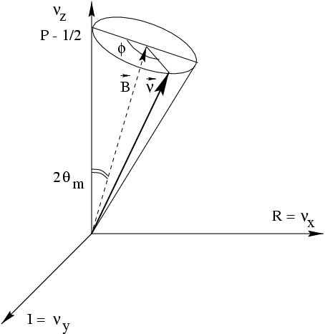
Graphical representation
Equation of motion
(= spin in magnetic field)
z
d P
dt
= (B x P)
ν_{e}
B
P
where ``magnetic field’’ vector:
2π
l_{m}
B = (sin 2θ_{m}, 0, cos2θ_{m})
ν_{τ},
P = (Re ν_{e}⁺ ν_{τ}, Im ν_{e}⁺ ν_{τ}, ν_{e}⁺ ν_{e} - 1/2)
x
Phase of oscillations
φ = 2πt/ l_{m}
y
P_{ee} = ν_{e}⁺ν_{e} = P_{Z} + 1/2 = cos²θ_{Z}/2
Probability to find ν_{e}

Slide 40
Resonance enhancement
of oscillations
Constant density

Slide 41
Resonance enhancement
Constant density
ν
ν_{e}
ν_{e}
Source
Detector
layer of length L
F₀(E)
F(E)
Depth of oscillations determined by sin²2θ_{m}
as well as the oscillation length, l_{m}
depend on neutrino energy
For neutrinos propagating in the mantle of the Earth

Slide 42
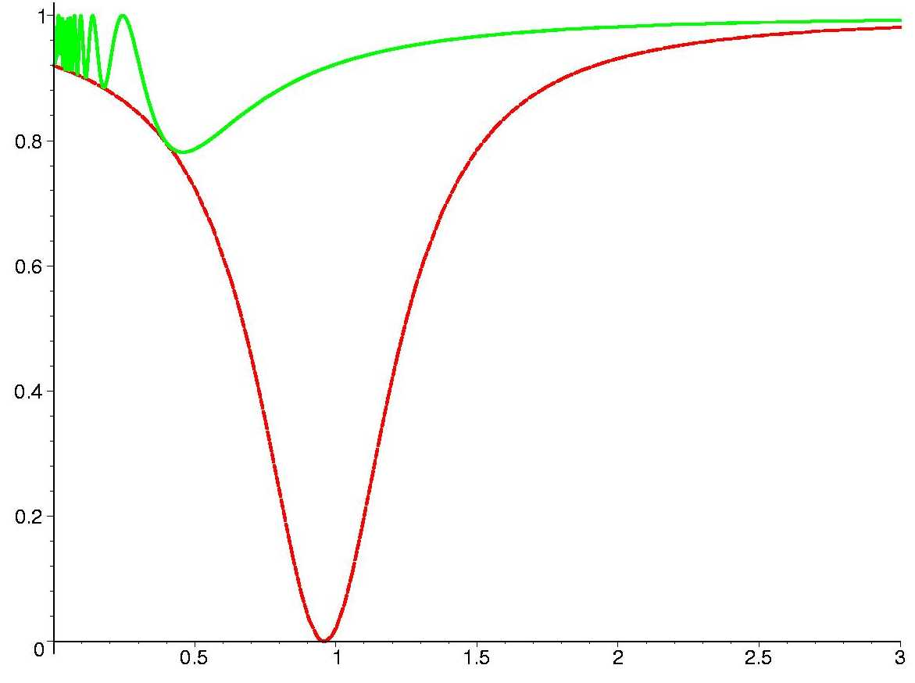
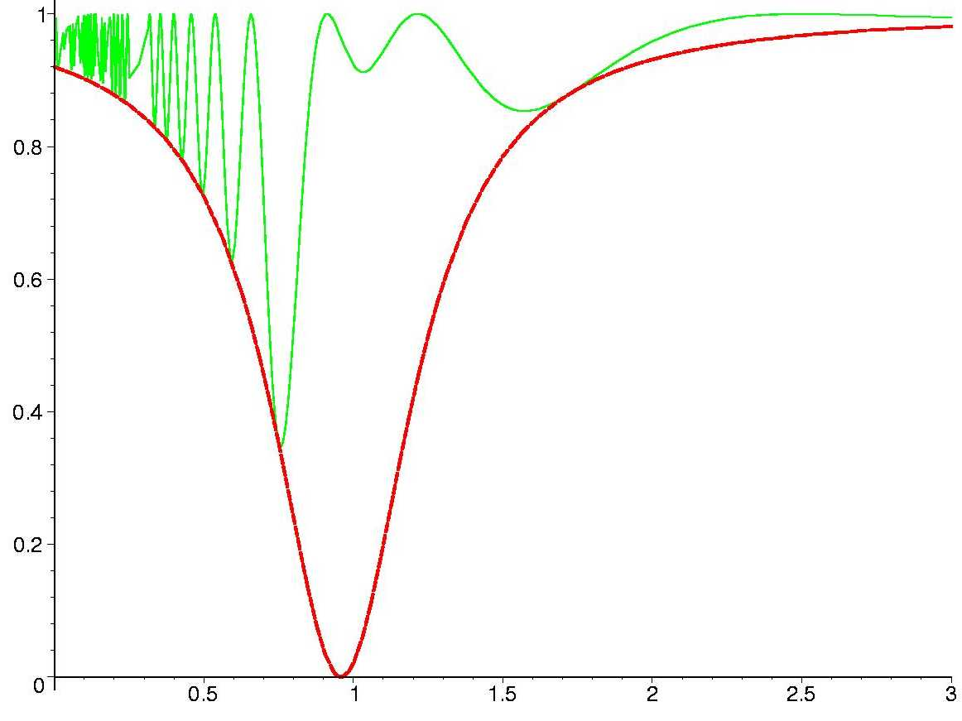
Small mixing sin²2θ = 0.08
thin layer
k = 1
thick layer
k = 10
F (E)
F₀(E)
sin² 2θ_{m}
E/E_{R}
E/E_{R}

Slide 43
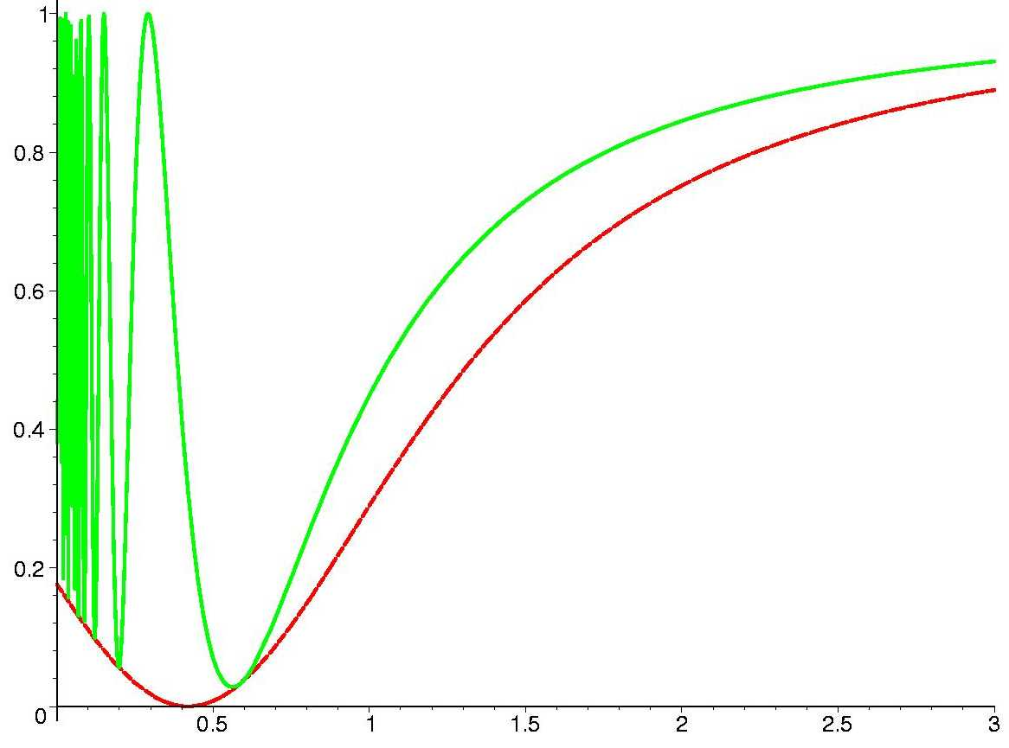
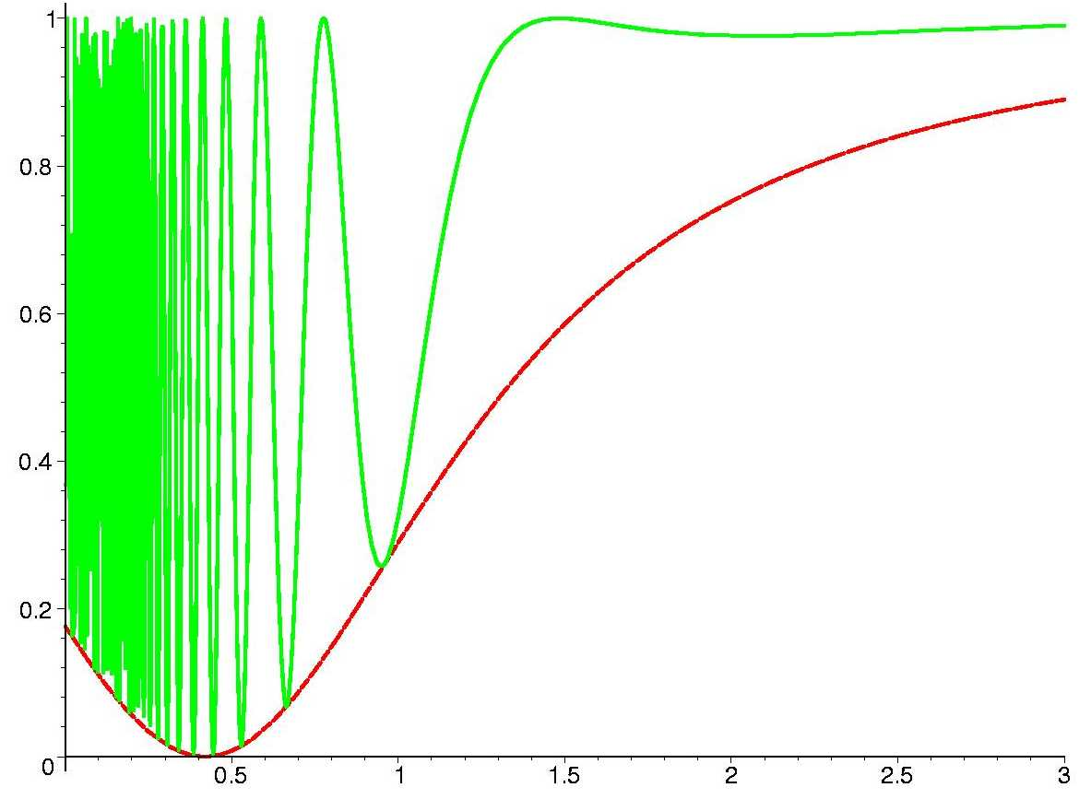
Large mixing sin²2θ = 0.824
Layer of length L
k = πL / l₀
thin layer
k = 1
thick layer
k = 10
F (E)
F₀(E)
sin² 2θ_{m}
E/E_{R}
E/E_{R}

Slide 44
Resonance enhancement
In maximum
1
B
1
2
2

Slide 45
Parametric enhancement
of oscillations
Oscillations in multilayer medium

Slide 46
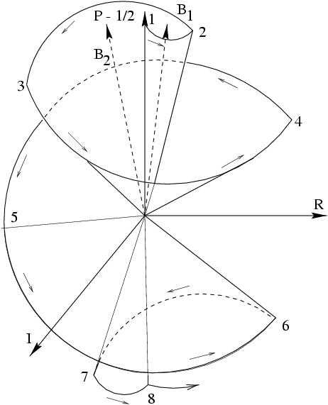
Parametric enhancement
of oscillations
Enhancement associated to certain
conditions for the phase of oscillations
Φ₁ = Φ₂ = π
Another way of getting strong transition
No large vacuum mixing and no matter
enhancement of mixing or resonance
conversion
2θ₂^{m}
2θ₁^{m}
V. Ermilova V. Tsarev, V. Chechin
E. Akhmedov
P. Krastev, A.S., Q. Y. Liu,
S.T. Petcov, M. Chizhov
V
Φ₁
Φ₂
θ₁^{m}
θ₂^{m}
1 2 3 4 5 6 7
``Castle wall profile’’
18

Slide 47
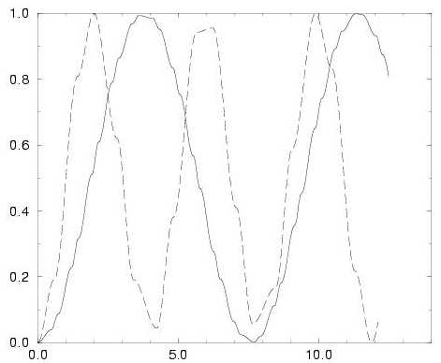
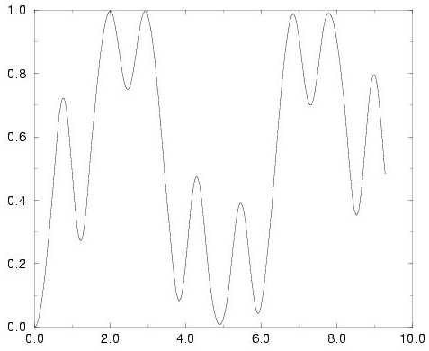
Parametric resonance
s_{i} = sinφ _{i},
c_{i} = cosφ_{i}, (i = 1,2)
half-phases
s₁c₂cos2θ₁^{m} + s₂c₁cos2θ₂^{m} = 0
E. Kh. Akhmedov,
transition probability
distance
distance
c₁ = c₂ = 0
(φ₁ = φ₂ = π/2)
General case: certain correlation
between the phases and mixing angles

Slide 48
Parametric enhancement
1
mantle
2 3
1
4
core
2
mantle core mantle
3
mantle
4
22

Slide 49
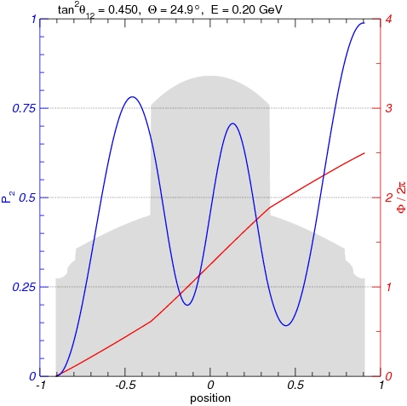
Parametric enhancement of 1-2 mode
mantle
1
core
3
4
2
2
mantle
4
3
1
23

Slide 50
Summary
Oscillations in vascuum or matter are effect of the phase difference increase
between the eigenstates of the Hamiltonian in vacuum (mass states) or in matter
Resonance enhancement of oscillations occurs
in certain energy range in matter with constant density
nearly constant
Parametric enhancement of oscillations occurs in multilayer medium
when parameters of medium correlate in certain way with
oscillation lengthes and mixing angles in matter

Slide 51
Backup slides

Slide 52
4. CP violation
Grid of magic lines
and CP domains

Slide 53
CP-violation
CP- transformations:
ν → ν^{c}
ν^{c} = i γ₀ γ₂ ν ⁺
applying to the chiral components
Under CP-transformations:
U_{PMNS} → U_{PMNS} *
δ → - δ
V → - V
usual medium is C-asymmetric
which leads to CP asymmetry
of interactions
Degeneracy of effects:
Matter can imitate CP-violation

Slide 54
Evolution
For E > 0.1 GeV
CP-violation and 2-3 mixing
are excluded from dynamics
of propagation
Propagation
basis
~
ν_{f} = U₂₃I_{δ} ν
I_{δ} = diag (1, 1, e^{iδ} )
ν_{e}
ν_{e}
ν_{e}
ν_{e}
A_{e2}
ν_{μ}
~
~
ν_{μ}
ν₂
ν₂
A_{e3}
~
~
ν_{τ}
ν_{τ}
ν₃
ν₃
projection
propagation
projection
CP appears in
projection only
A₂₂
A₃₃
A₂₃
For instance:
A(ν_{e} → ν_{μ}) = cosθ₂₃ A_{e2}e^{iδ} + sinθ₂₃A_{e3}

Slide 55
Interference
P(ν _{e} → ν_{μ}) = |cos θ₂₃ A_{S}e ^{iδ} + sin θ₂₃A_{A}|²
``solar’’ amplitude
``atmospheric’’ amplitude
dependence on
δ and θ₂₃ is explicit
A_{S} depends mainly on Δm₁₂², θ₁₂
``Factorization’’
approximation:
A_{A} depends mainly on Δm₁₃², θ₁₃
corrections of the order Δm₁₂² /Δm₁₃ ² , s₁₃²
π L
l₁₂^{m}
For constant density:
A_{S} ~ i sin2θ₁₂^{m} sin
up to phase
factors
A_{A} ~ i sin2θ₁₃^{m} sin
π L
l₁₃^{m}

Slide 56
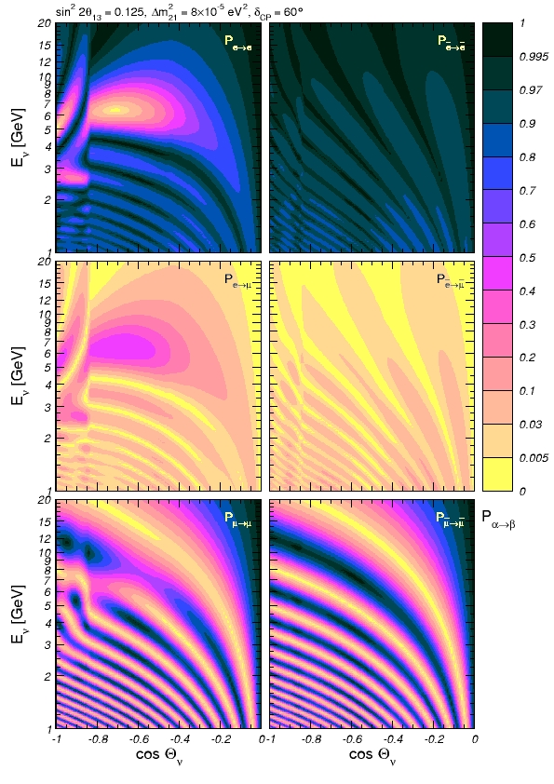
CP-violation
δ = 60º
Standard
parameterization

Slide 57
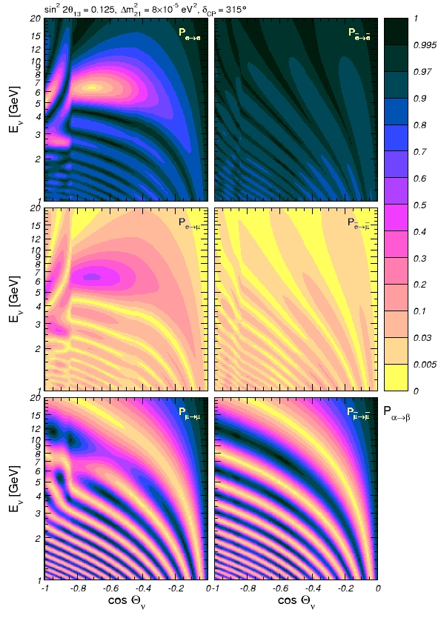
δ = 315º

Slide 58
δ = 130º

Slide 59
CP-violation
domains
Solar magic lines
Three grids
of lines:
Atmospheric magic lines
Interference phase lines

Slide 60
``Magic lines"
V. Barger, D. Marfatia,
K Whisnant
P. Huber, W. Winter,
A.S.
Explicitly
P(ν_{e} → ν_{μ}) = c₂₃²|A_{e2}|² + s₂₃²|A_{e3}|² + 2s₂₃c₂₃|A_{e2}||A_{e3}|cos(φ + δ)
φ = arg (A_{e2} A_{e3}*)
P_{int} = 2s₂₃c₂₃|A_{e2}||A_{e3}|cos(φ + δ)
Dependence on δ disappears, interference term is zero if
A_{e2} = 0
- solar magic lines
P_{int} = 0
A_{e3} = 0
- atmospheric magic lines
(φ + δ ) = π/2 + 2π k
- interference phase condition
φ (E, L) = - δ + π/2 + π k
depends on δ

Slide 61
``Magic lines''
For ν_{μ}→ ν_{μ} channel
P_{int} ~ 2s₂₃c₂₃|A_{S}||A_{A}|cosφ cosδ
- The survival probabilities is CP-even functions of δ
no CP-violation
dependences on phases factorize
Dependence on δ disappears
A_{S} = 0
P_{int} = 0
A_{A} = 0
φ = π/2 + π k
interference phase
does not depends on δ
Form the phase line grid
32

Slide 62
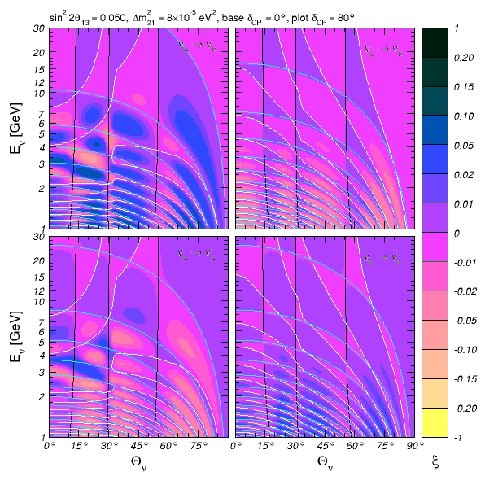
Δ P = P(δ) - P(δ_{f}) = const
Int. phase
line (blue)
moves with
δ-change
Magic grid
Grids do not
change with δ
ΔP
Black: solar
White: atmospheric

Slide 63
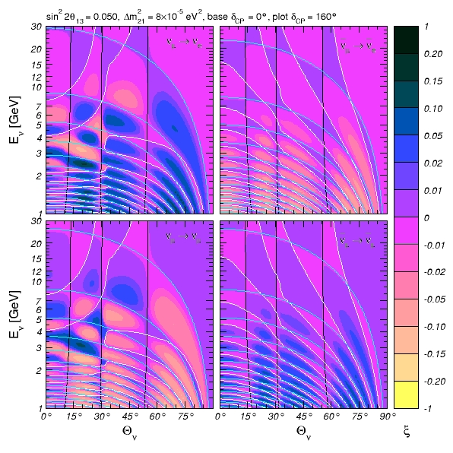
ΔP

Slide 64
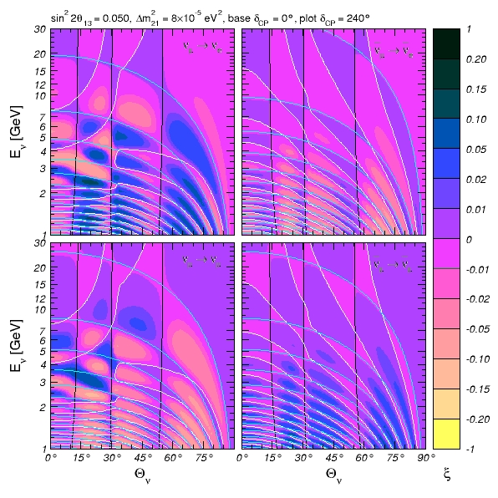
ΔP

Slide 65
Shape factors
**
Pion decay:
E. Akhmedov, D. Hernandez, A.S.
iφ_{i}
g_{i}(x,t) e = dp dx_{S} dt_{S} M ψ_{π} (x_{S}, t_{S}) ψ_{μ} (x_{S}, t_{S}) exp[ip ( x - x_{S}) – iE_{i} (t – t_{S})]
integration over
production region
part of matrix
element
plane wave
of neutrino
Pion wave function:
ψ _{π} (x_{S}, t_{S}) = exp[ –½Γt_{S}] g_{π}(x_{S}, t_{S}) exp[ -iφ_{π}(x_{S}, t_{S})]
usually:
g_{π}(x_{S}, t_{S}) ~ δ (x_{S} - v_{π}t_{S})
Muon wave function:
ψ _{μ} (x_{S}, t_{S}) = g_{μ}(x’ - x_{S}, t’ - t_{S}) exp[ iφ_{μ} (x’ - x_{S} , t’ - t_{S})]
determined by detection of muon
If muon is not detected: plane wave → phase factor →
disappears from probability

Slide 66
Neutrino wave packets
**
p
π
ν
l_{p}
L
target
decay tunnel
absorber
detector
D. Hernandez, AS
E. Kh Akhmedov,
D. Hernandez, AS
arXiv:1110.5453
ν wave packet
x
The length of the ν wave packet
emitted in the forward direction
v – v_{π}
v_{π}
σ = l_{p}
box function
Shape factor
Γ
2(v - v_{π})
g = g₀ exp (x - σ) Π(x, [0, σ])
Doppler effect

Slide 67
Decoherence at production
**
oscillations within
WP formation region
π
L
ν
l_{p}
D. Hernandez, AS
sin²2θ
2(1 + ξ²)
1
1 – e
ξ = Δm²/2EΓ
P = P + [cos φ_{L} + K]
-Γl_{p}
decoherence parameter
-Γl_{p}
MINOS: ξ ~ 1
β−beam ?
K = ξ sin φ_{L} - e [cos(φ_{L} - φ_{p}) - ξsin (φ_{L} - φ_{p})]
φ_{L} = Δm² L/2E
φ_{p} = Δm² l_{p}/2E
Coherent ν-emission
- long WP
Incoherent ν-emission
- short WP
Equivalence
x
x

Slide 68
Space-time diagrams
**
x
X_{D}
detector
detector
ν
l_{p}
μ
π
pion
Coherent emission
of neutrino by pion
along its trajectory
X_{T}
target
t

Slide 69
Coherent and incoherent
**
x
X_{D}
detector
detector
ν
l_{p}
μ
π
integration
pion
If pion is ``point-like’’ – result
coincides with usual incoherent
computations; otherwise –
integration – corrections ~ σ_{π}
X_{T}
target
t

Slide 70
Coherence in propagation
**
In the configuration space: separation of the wave packets due to
difference of group velocities
Δv_{gr} = Δm² /2E²
separation:
Δv_{gr} L = Δm² L/2E²
σ_{x}
no overlap:
Δv_{gr} L > σ_{x}
ν₁
ν₂
coherence length:
x
L_{coh} = σ_{x} E²/Δm²
In the energy space: period of oscillations
ΔE = 4πE²/(Δm² L)
Averaging (loss of coherence) if
energy resolution σ_{E} is bad:
ΔE < σ_{E}
Coherence is determined by conditions of detection
If ΔE > σ_{E} - restoration of coherence even if the wave packets separated

Slide 71
**
Q
x
detector
detector
X_{D}
detector
ν₂
ν₁
l_{p}
μ
π
π
pion
X_{T}
target
t

Slide 72
Mixing and mass matrices
Origin of mixing:
off-diagonal mass matrices
M_{l} = M_{ν}
l⁰ γ ^{μ} (1 - γ₅) ν ⁰
l⁰ = U_{lL} l
Mixing matrix
Diagonalization:
Mass spectrum
for Majorana
neutrinos
M_{l} = U_{lL}m_{l}^{diag} U_{lR}⁺
M_{ν} = U_{νL}m_{ν}^{diag} U_{νL}^{T}
m_{l} ^{diag} = (m_{e}, m_{μ}, m_{τ})
m_{ν}^{diag} = (m₁, m₂, m₃)
CC in terms of mass eigenstates:
l γ ^{μ} (1 - γ₅) U_{PMNS}ν_{mass}
U _{PMNS} = U_{lL}⁺ U_{νL}
Flavor basis:
M_{l} = m_{l}^{diag}
U _{PMNS} = U_{νL}

Slide 73
Formation of the wave packet
μ
In most of the cases precise
form of the shape factor and therefore details of its formation are not important
S
p
π
ν_{i}
x_{S}, t_{S}
It is important in the cases of
production
region
of partial
separation of
wave packets
production region
is comparable with oscillation length
Solving the wave problem: pion moves and emits neutrino waves
r_{S} ~ l_{ν}
Integration of the neutrino waves emitted from space-time points where pion lives

Slide 74
Parameterization
U_{PMNS} = U₂₃ I_{δ} U₁₃ I_{−δ} U₁₂
I_{δ} = diag (1, 1, e^{iδ})
c₁₂c₁₃ s₁₂c₁₃ s₁₃e^{-iδ}
s₁₂c₂₃ + c₁₂s₂₃s₁₃e^{iδ} c₁₂c₂₃ - s₁₂s₂₃s₁₃e^{iδ} - s₂₃c₁₃
s₁₂s₂₃ - c₁₂c₂₃s₁₃e^{iδ} c₁₂s₂₃ + s₁₂c₂₃s₁₃e^{iδ} c₂₃c₁₃
U_{PMNS} =
c₁₂ = cos θ₁₂ , etc.
δ is the Dirac CP violating phase
θ₁₂ is the ``solar’’ mixing angle
θ₂₃ is the ``atmospheric’’ mixing angle
θ₁₃ is the mixing angle determined by T2K, Daya Bay, CHOOZ, DC…

Slide 75
Flavors and mixing
Flavor neutrino states:
Mass eigenstates
ν_{e}
ν_{μ}
ν_{τ}
ν₁
ν₂
ν₃
m₁
m₂
m₃
e
μ
τ
- correspond to certain
charged leptons
Mixing
- interact in pairs
flavor is characteristic
of interactions
Flavor
states
Mass
eigenstates
=
n → p + e⁻ + ν_{e}
π → μ + ν_{μ}
ν_{f} = U_{PMNS} ν_{mass}

Slide 76
Mixing & mixed states
One needs to compute the state which is produced
i.e. compute
the shape factors
- Fundamental interactions
Kinematics
characteristics of parent and accompanying particles
g_{k}(x – v_{k}t)
mean momenta p_{k}
Process dependent
If heavy neutrinos are present but can not be produced for kinematical reasons, flavor states in Lagrangian differ from the produced states, etc..

Slide 77
p
Phase and oscillations
For maximal mixing
ν_{μ} = 2^{-1/2} (- ν₂ + ν₃ )
Differ by the phase
difference
ν_{τ} = 2^{-1/2} ( ν₂ + ν₃ )
Interaction of a given state depends on the phase difference:
- if the phase 0, the state interacts as ν_{τ}
- if the phase π , the state interacts as ν_{μ}
If phase changes by π , ν_{μ} transforms to ν_{τ}
and vice versa

Slide 78
Propagation of wave packets
What happens?
Phase difference
Due to different masses (dispersion relations) → phase velocities
Oscillations
change
Separation of
Loss of
Due to different group velocities
wave packets
coherence
Spread of individual
Due to presence of waves with different momenta and energy
in a packet
…homework
wave packets

Slide 79
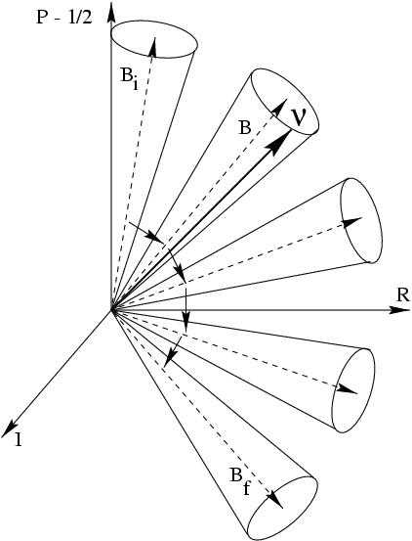
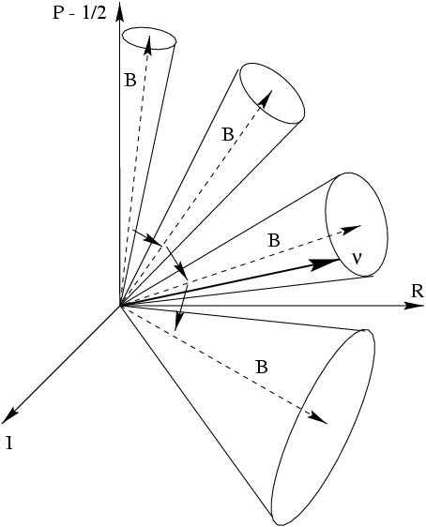
Adiabatic conversion
Pure adiabatic conversion
Partialy adiabatic conversion
ν _{e}
ν_{μ}
17

Slide 80
Parametric oscillations
``Castle wall profile’’
E. Kh. Akhmedov
hep-ph/9805272
φ₁
φ₂
θ_{i}^{m}
- mixing angles
V
φ_{i}
oscillation
half-phases
θ₁^{m}
θ₂^{m}
S. Petcov
M. Chizhov
hep-ph/9903399
PR D63 073003
d
Evolution matrix over one period (two layers)
S = Y – i σ X
X = (X₁ , X₂, X₃)
σ -Pauli matrices
X, Y = X, Y (θ_{i}, φ_{i})
Probability after n periods: multiplying the evolution matrices for each layer
P = (1 – X₃ / |X| ) sin ² Φ_{n}
Maximal depth of oscillations
X₃ = 0
parametric resonance condition

Slide 81
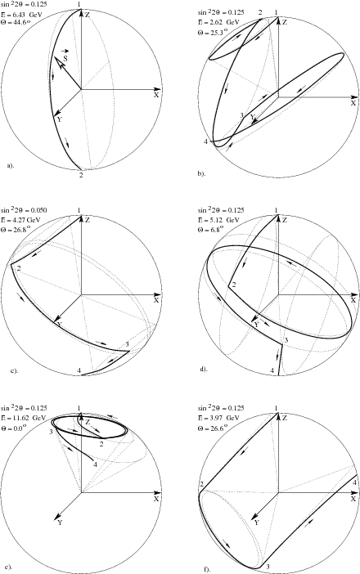
Graphical
representation
a).
b).
a). Resonance in the mantle
b). Resonance in the core
c). Parametric ridge A
c).
d).
d). Parametric ridge B
e). Parametric ridge C
f). Saddle point
e).
f).

Slide 82
Mixing angle
Diagonalization of the Hamiltonian:
sin²2θ
sin²2θ_{m} =
( cos2θ − 2EV/Δm²)² + sin ²2θ
V = 2 G_{F} n_{e}
Mixing is maximal if
Δm²
2E
Resonance
condition
H_{e} = H_{μ}
V = cos 2θ
sin²2θ_{m} = 1
Difference of the eigenvalues
Δm²
2E
H_{2m} - H_{1m} =
( cos2θ − 2EV/Δm²)² + sin²2θ

Slide 83
Oscillations in matter
Oscillation
probability
constant density
πL
l_{m}
P(ν_{e} −> ν_{a}) = sin²2θ_{m} sin²
half-phase φ
Amplitude of
oscillations
oscillatory factor
θ_{m}(E, n )
- mixing angle in matter
l_{m}(E, n )
θ_{m} → θ
– oscillation length in matter
In vacuum:
l_{m} → l_{ν}
l_{m} = 2 π/(H_{2m} – H_{1m})
sin ²2θ_{m} = 1
MSW resonance condition
Maximal effect:
φ = π/2 + πk

