Slide 1
Borexino: summary of results and plans for the future
A. Ianni
I.N.F.N. at LNGS
Wilhelm and Else Heraeus Seminar
Exploring the neutrino sky and fundamental particle physics on the Megaton scale
Bad Honnef, Jan 22nd, 2013

Slide 2
Outline
Borexino:
a look at the detector
Liquid scintillator filling and purification strategy
Data reduction
Solar neutrinos in Borexino
7Be
8B
pep and CNO
Future plans

Slide 3
Borexino Collaboration
Genova
Milano
Princeton University
Perugia
APC Paris
Virginia Tech. University
Munich
(Germany)
Dubna JINR
(Russia)
Kurchatov
Institute
(Russia)
Jagiellonian U.
Cracow
(Poland)
Heidelberg
(Germany)

Slide 4
Outer Detector
Inner Detector
Buffer region
Inner Vessel

Slide 5
Borexino Scientific Goals
MAIN: solar neutrino detection below 1 MeV
Antineutrino detection (geoneutrinos + reactor antineutrinos on 1000 km baseline) – see L. Ludhova this meeting
Neutrinos from galactic SN’s – not in detail in this talk
Rare/non-standard processes (e⁻ decay, violation of Pauli exclusion principle, axions, neutrino decay etc) – not in detail in this talk

Slide 6
Solar Neutrinos
4p → ⁴He+2e⁺+2ν_{e}+(24.69+2·1.022)MeV
<E_{ν}> ~ 0.53 MeV, 2% of total energy produced
Solar neutrinos are a unique tool to probe the physics
at the core of the Sun and neutrino propagation in dense
matter (100 g/cm³)

Slide 7
Solar Neutrinos Sources: pp chain
~0.4%
~85%
~15%
S₃₃
S₃₄
~0.02%

Slide 8
Solar Neutrinos Sources: CNO chain
S_{1,14}
~10⁻²

Slide 9
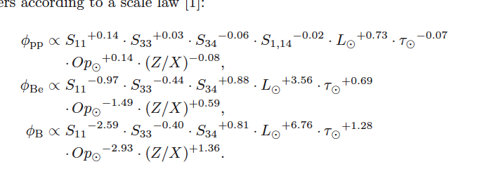
Solar Standard Model
The SSM is the framework from which we make predictions on
the production of solar neutrinos
Within the SSM solar neutrino fluxes are written as:

Slide 10
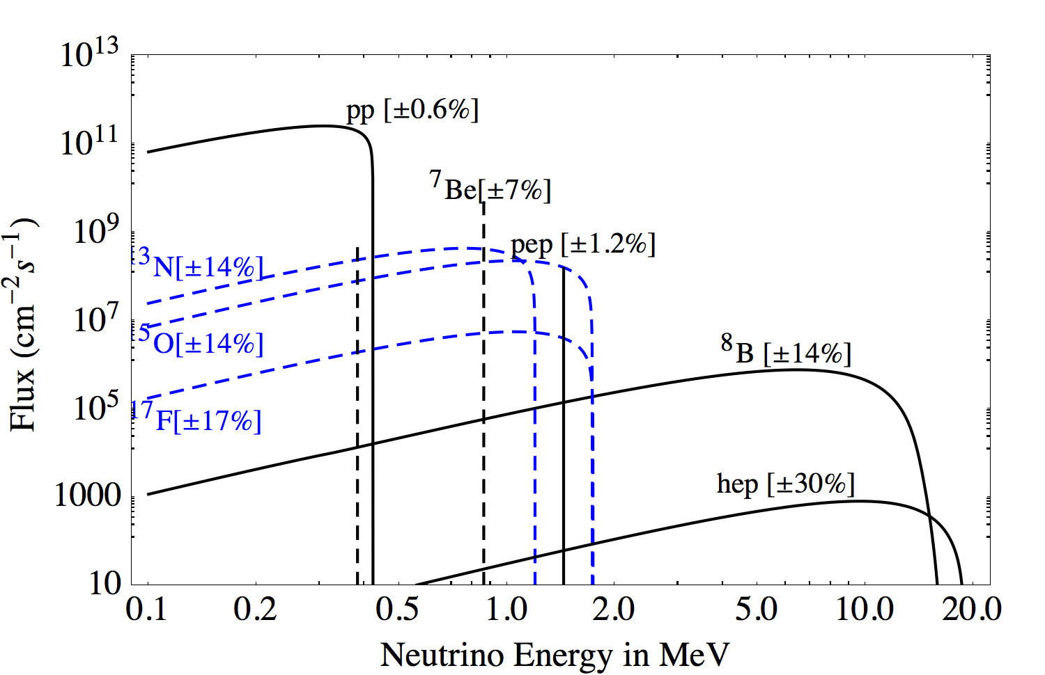
Solar Neutrino Spectrum at Earth
A. Serenelli at al., Astrophys. J 7432, 2011

Slide 11
Recent developments of the SSM
Since 2004 a number of improvements in the SSM have taken
place which are worth reporting:
New determination of ¹⁴N(p,γ)¹⁵O cross section reduces by
a factor ~2 CNO fluxes
A factor of 2 better accuracy for ³He(⁴He,γ)⁷Be cross section
New opacities calculations
New surface abundance calculations based on improved 3D
model

Slide 12
Luminosity Constraint

Slide 13
Solar Standard Model: neutrino flux predictions
Source | Flux [cm⁻²s⁻¹] SSM-GS98 | Flux [cm⁻²s⁻¹] SSM-AGSS09 | Flux [cm⁻²s⁻¹] SSM-GS98-2004
pp | 5.98(1±0.006)×10¹⁰ | 6.03(1±0.006)×10¹⁰ | 5.94(1±0.01)×10¹⁰
pep | 1.44(1±0.012)×10⁸ | 1.47(1±0.012)×10⁸ | 1.40(1±0.02)×10⁸
⁷Be | 5.00(1±0.07)×10⁹ | 4.56(1±0.07)×10⁹ | 4.86(1±0.12)×10⁹
⁸B | 5.58(1±0.13)×10⁶ | 4.59(1±0.13)×10⁶ | 5.79(1±0.23)×10⁶
¹³N | 2.96(1±0.15)×10⁸ | 2.17(1±0.15)×10⁸ | 5.71(1±0.36)×10⁸
¹⁵O | 2.23(1±0.16)×10⁸ | 1.56(1±0.16)×10⁸ | 5.03(1±0.41)×10⁸
¹⁷F | 5.52(1±0.18)×10⁶ | 3.40(1±0.16)×10⁶ | 5.91(1±0.44)×10⁶
Total CNO: 5.24×10⁸
3.76×10⁸
10.8×10⁸

Slide 14
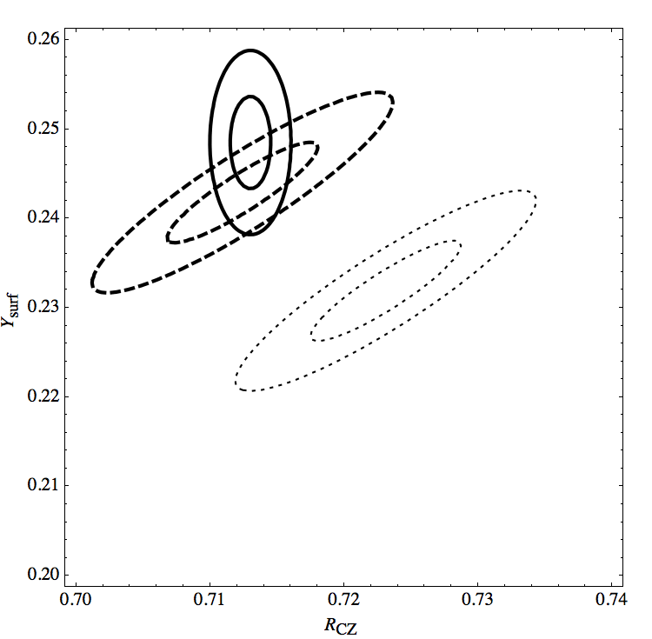
The metallicity problem
Given a number of input parameters …
The SSM determines:
the depth of the convective zone, the helium surface
abundance at the present time and ...
Helioseismology provides data for these output quantities
Y_{surf} vs R_{CZ}
data
GS98
AGS05

Slide 15
Solar Neutrinos Observations

Slide 16
Detecting Solar Neutrinos
Electron capture: ν_{e}+(A,Z-1)→(A,Z)+e⁻ (σ~10⁻⁴²cm²)
Elastic Scattering: ν_{x} + e⁻ → ν_{x} + e⁻ (σ~10⁻⁴⁴cm²)
ν_{e} + d → e⁻ + p + p (E_{ν} ≥ 1.44 MeV) (σ~10⁻⁴²cm²)
ν_{x} + d → ν_{x} + p + n (E_{ν} ≥ 2.74 MeV)
pure NC interaction
SNO

Slide 17
Solar Neutrino Experiments
Detector | Target mass | Threshold [MeV] | Data taking
Homestake | 615 tons C₂Cl₄ | 0.814 | 1970-1994
Kamiokande | 3ktons H₂O | 7.5 | 1983-1990
SAGE | 50tons molted metal Ga | 0.233 | 1989-present
GALLEX | 30.3tons GaCl₃-HCl | 0.233 | 1991-1997
GNO | 30.3tons GaCl₃-HCl | 0.233 | 1998-2003
Super-Kamiokande | 22.5ktons | 4.5 6.5 4.5 4 | 1996-2001 2003-2005 2006-2008 2008-present
SNO | 1kton D₂O | 5[3.5] | 1999-2006
Borexino | 300ton C₉H₁₂ | 0.2 MeV | 2007-present

Slide 18
Solar Neutrino Measurements
Experiment | Sources contributing to data | Data
Homestake | ⁷Be(13.1%)+pep(2.7%)+ CNO(2.4%)+⁸B(81.8%) | 2.56±0.16±0.16 SNU
GALLEX/GNO/SAGE | pp(55%)+⁷Be(28.3%)+ pep(2.3%)+ CNO(3.4%)+⁸B(11%) | 66.1±3.1 SNU
Super-Kamiokande (I, II, II) | ⁸B | Φ_{νe} = (2.38±0.08)×10⁶ cm⁻²s⁻¹ Φ_{νe} = (2.41±0.16)×10⁶ cm⁻²s⁻¹ Φ_{νe} = (2.39±0.07)×10⁶ cm⁻²s⁻¹[~3%]
SNO | ⁸B | φ_{B} = 5.25±0.16^{+0.11}_{-0.13} [~4%] CC/NC=0.301±0.033
BOREXINO | ⁷Be(0.862MeV) pep ⁸B(>3MeV) | 46±1.5±1.6 cpd/100tons [~5%] 3.1±0.6±0.3 cpd/100tons 0.22±0.04±0.01 cpd/100tons

Slide 19
Observations vs Predictions
SNO-NC
BX
Ga
SK
Cl

Slide 20
⁷Be Solar Neutrino Signal
⁷Be flux ≈ 5×10⁹ cm⁻² s⁻¹
Energy = 0.862 MeV (90% BR)
Detection channel: neutrino-electron elastic scattering
Signature: Compton-like edge
T_{max} = 2 E_{ν} ² / (2 E_{ν} + m_{e}c²) = 0.665 MeV
≈ 33 cpd/100tons in [0.25,0.8] MeV
No event-by-event tagging

Slide 21
Breakdown of most important background sources in Borexino
²³⁸U and ²³² Th
⁴⁰K
²¹⁰Pb -> ²¹⁰Po and ²¹⁰Bi
²²²Rn
⁸⁵Kr and ³⁹Ar
¹⁴C
Cosmogenic background produced by muons interacting with ¹²C
Cosmic muon induced neutrons

Slide 22
Borexino: a matter of background
With ²³⁸U and ²³²Th at 10⁻¹⁶g/g,
B_{[0.25,0.8]} = 24 cpd/FV
S/B≈1 with a purity of ~10⁻⁴ μBq/kg
⁸⁵Kr (Q_{β}=0.687MeV), ³⁹Ar(Q_{β}=0.565MeV), ²¹⁰Bi(Q_{β}=1.162MeV) at 1cpd/100tons will give 1.5 cpd/100tons in [0.25,0.8] MeV

Slide 23
Backgrounds Measurements in Borexino
From fast coincidences (β−α fast decay chain)
Early results (before 2011)
²³⁸U : (1.6 ± 0.1) × 10⁻¹⁷ g/g ≈ 0.2 nBq/kg
²³²Th : (6.8 ± 1.5) × 10⁻¹⁸ g/g ≈ 0.03 nBq/kg
⁸⁵Kr : 30 ± 5 cpd/100tons
Most recent (after Water Extraction)
²³⁸U : ~ 2 × 10⁻¹⁹ g/g
²³²Th : < 2 × 10⁻¹⁸ g/g (95% CL)
⁸⁵Kr : < 6 cpd/100tons (95% CL)

Slide 24
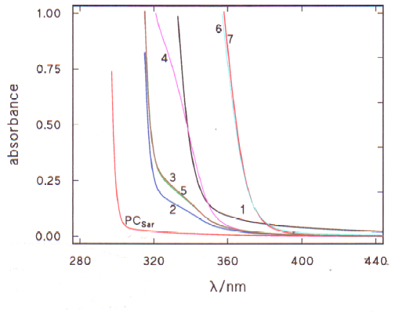
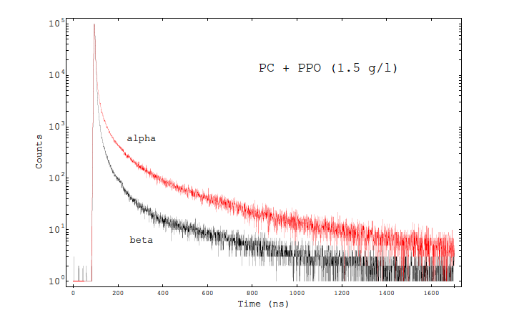
Borexino Liquid Scintillator
PC [C₉H₁₂] + 1.5g/l of PPO
Decay time ~ 3ns
Absorbance
Emission spectrum ~10⁴ ph/MeV
distilled
Pulse shape

Slide 25
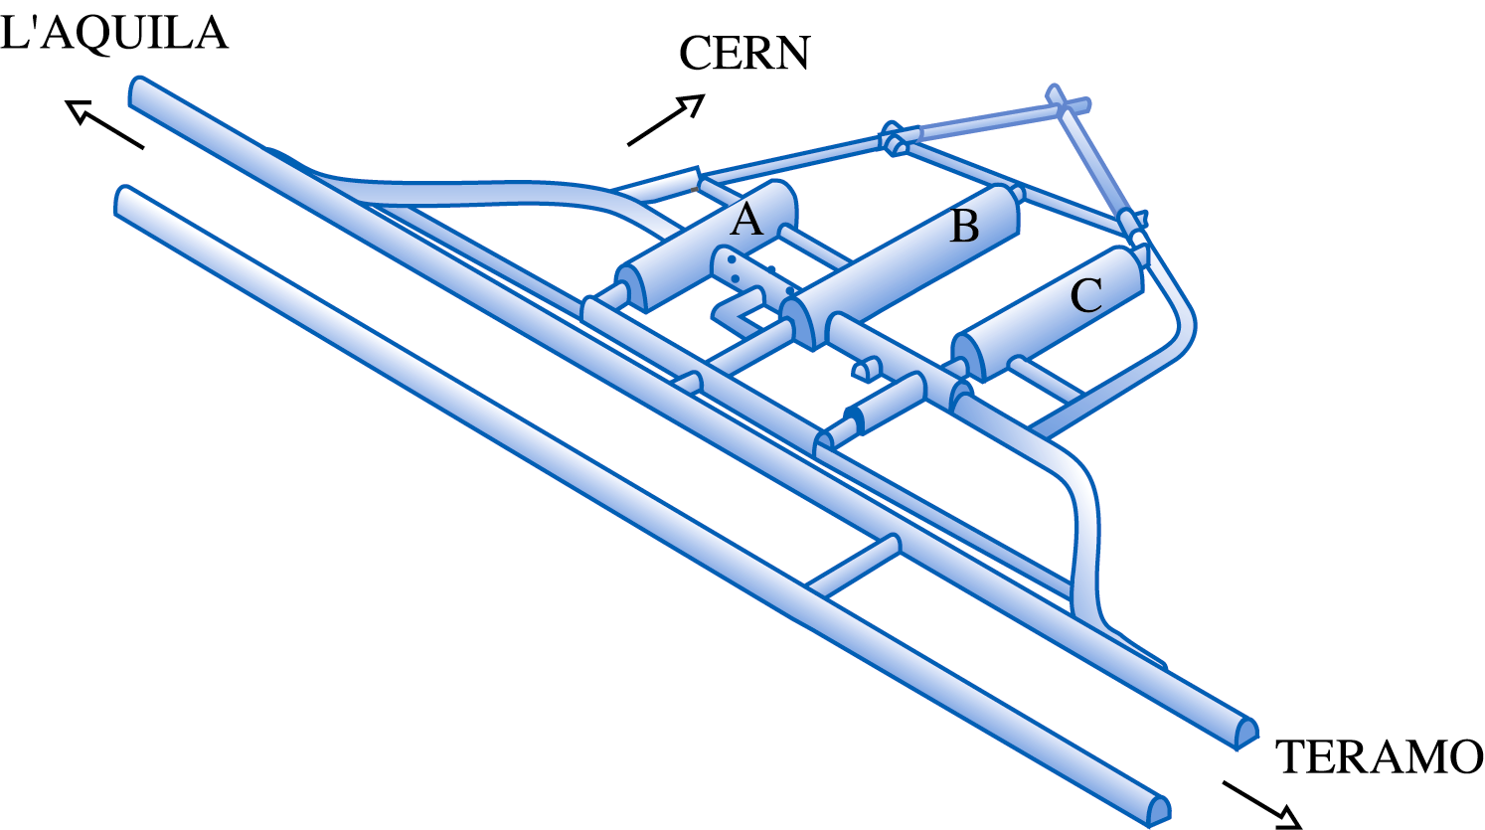
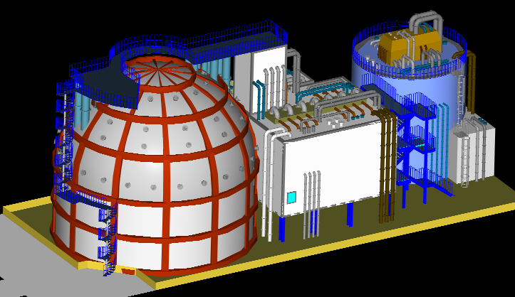
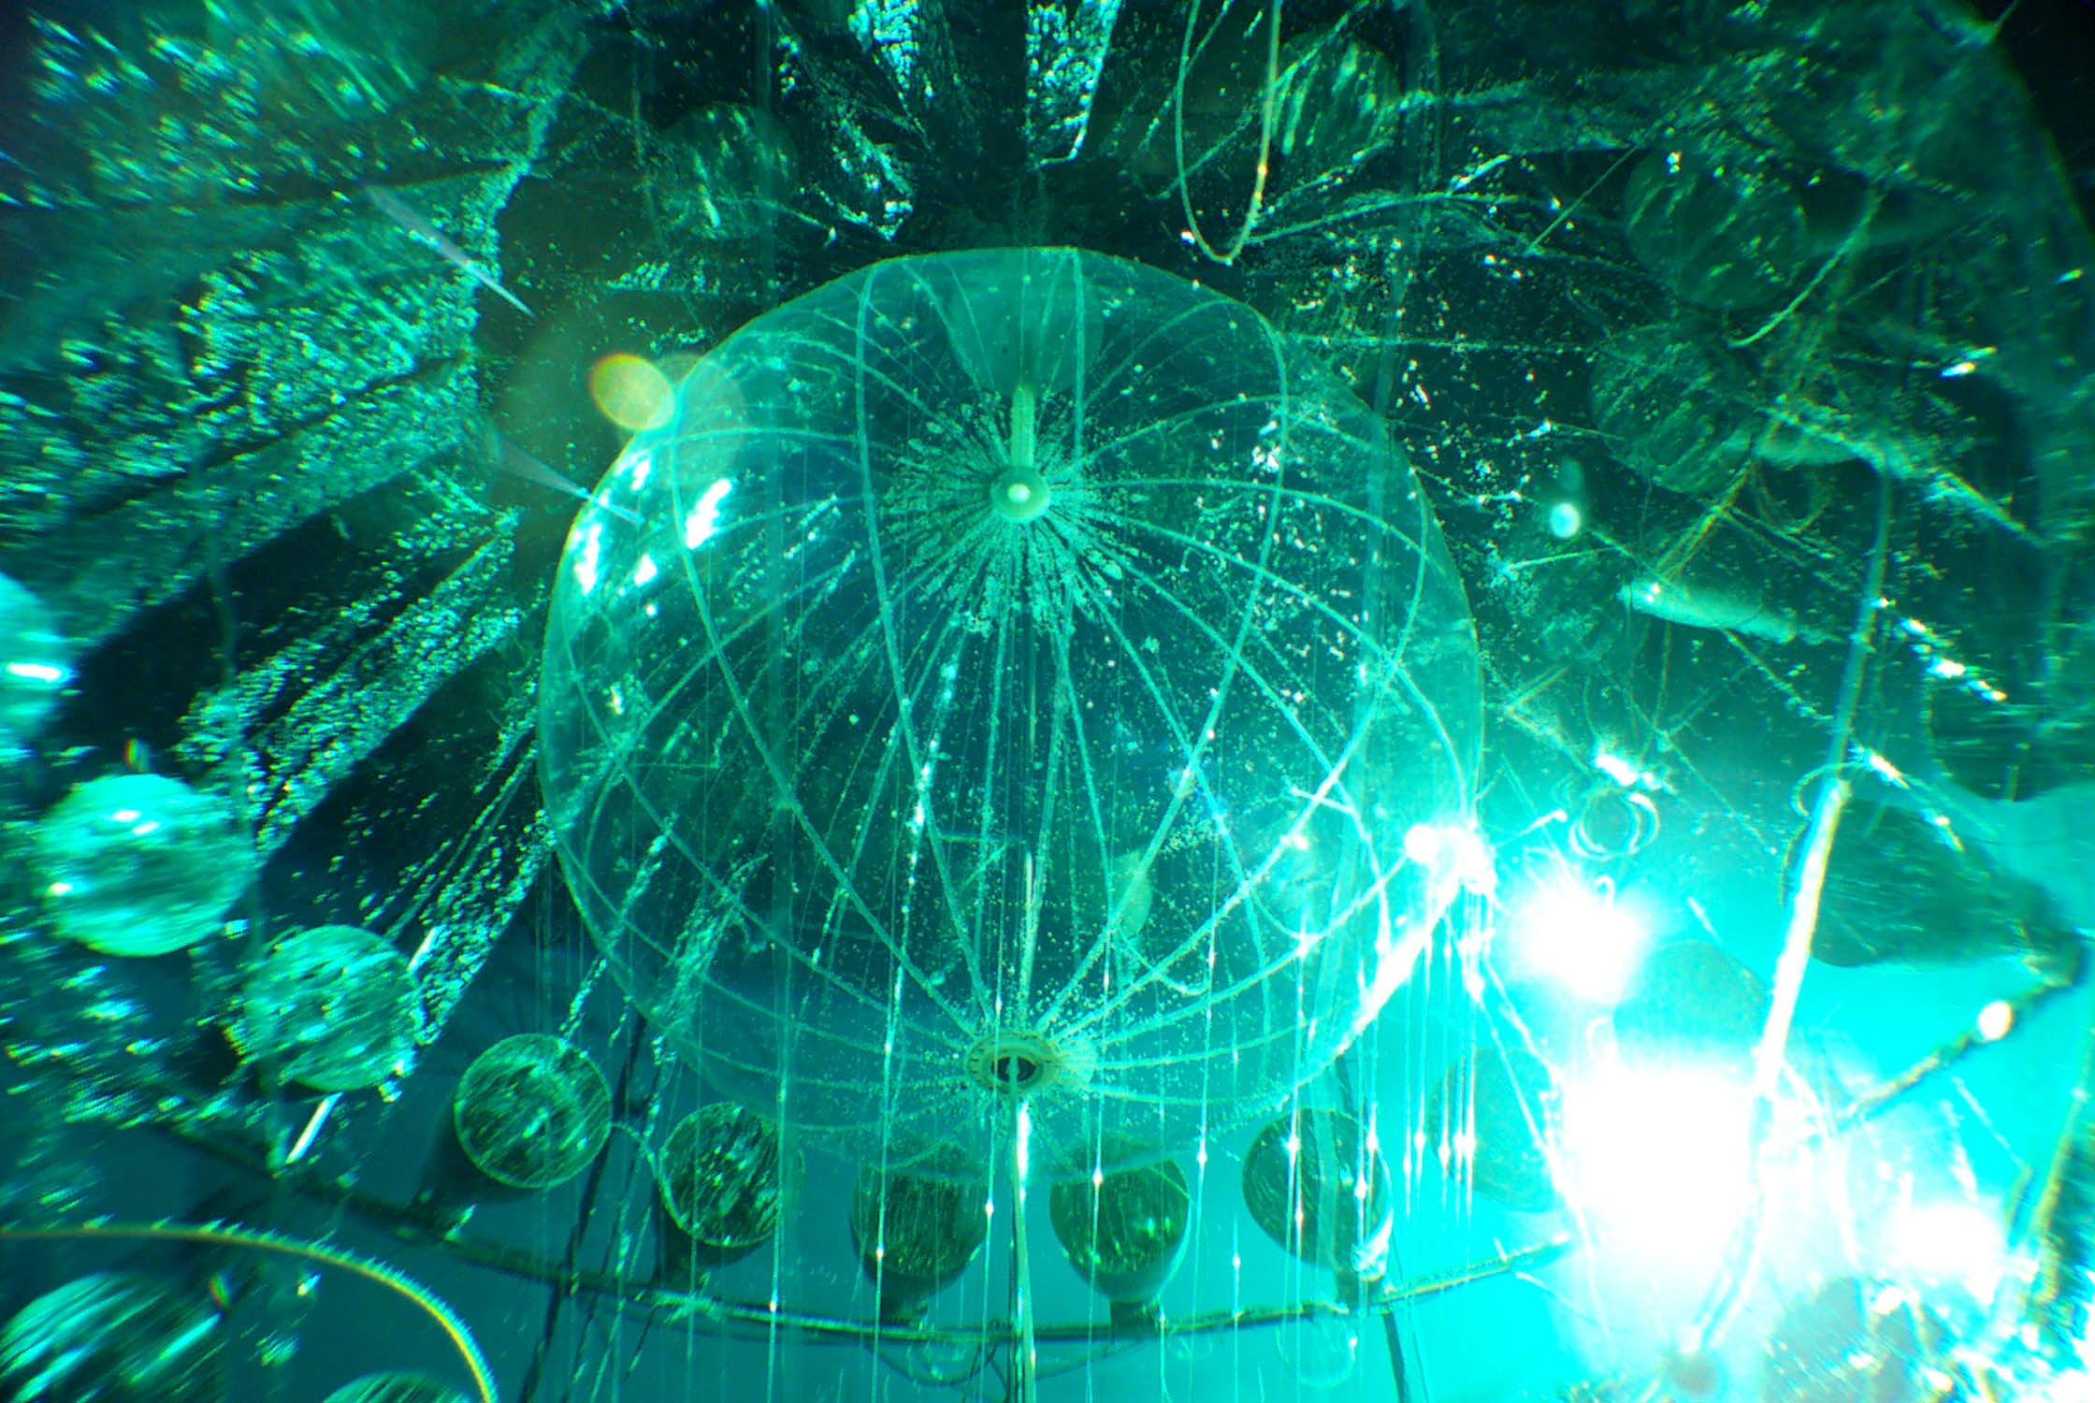
Borexino location and plants
Borexino
Gran Sasso Lab
Counting Test Facility

Slide 26
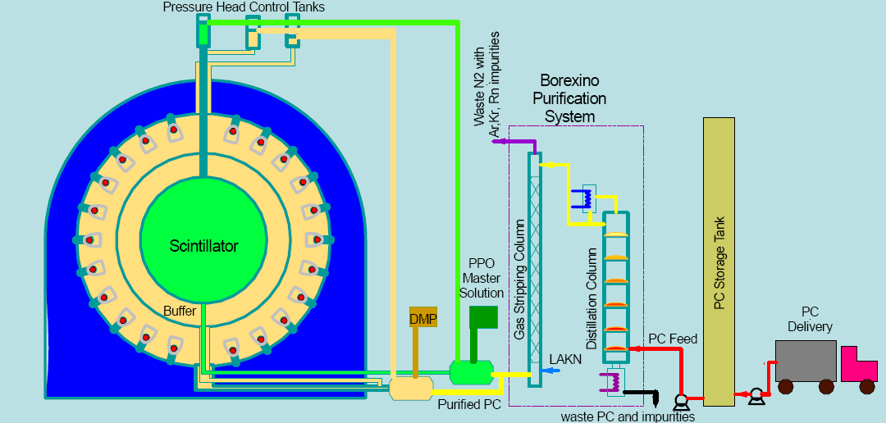
Borexino filling
CTF detector coupled with Borexino filling system for
monitioring radiopurity of LS and unexpected contaminations/leaks

Slide 27
PC Purification
GOAL: remove impurities in solvent
1168 tons of PC distilled:
6m 6-stage column
80 mbar abs
92 ºC
850 l/h
1168 tons PC stripped:
8m column
300 mbar abs
9 kg/h N₂
850 l/h PC

Slide 28
Master Solution and PPO purification
GOAL: remove impurities in fluor
Water Extraction:
Pre-purification (remove ⁴⁰K) in Master Solution (120 g/l PPO)
Distillation:
30 mbar abs, 200 ºC
20 l/h
Stripping:
2 kg/h N₂
20 l/h

Slide 29
Water Extraction
Scintillator circulates through “packed” column C200 @ 900 l/hr.
Water in evaporator is distilled, condenses into V202, then flows through C200 counter-current to scintillator @ 200 l/hr.
Make-up water enters @ 20 l/hr.

Slide 30
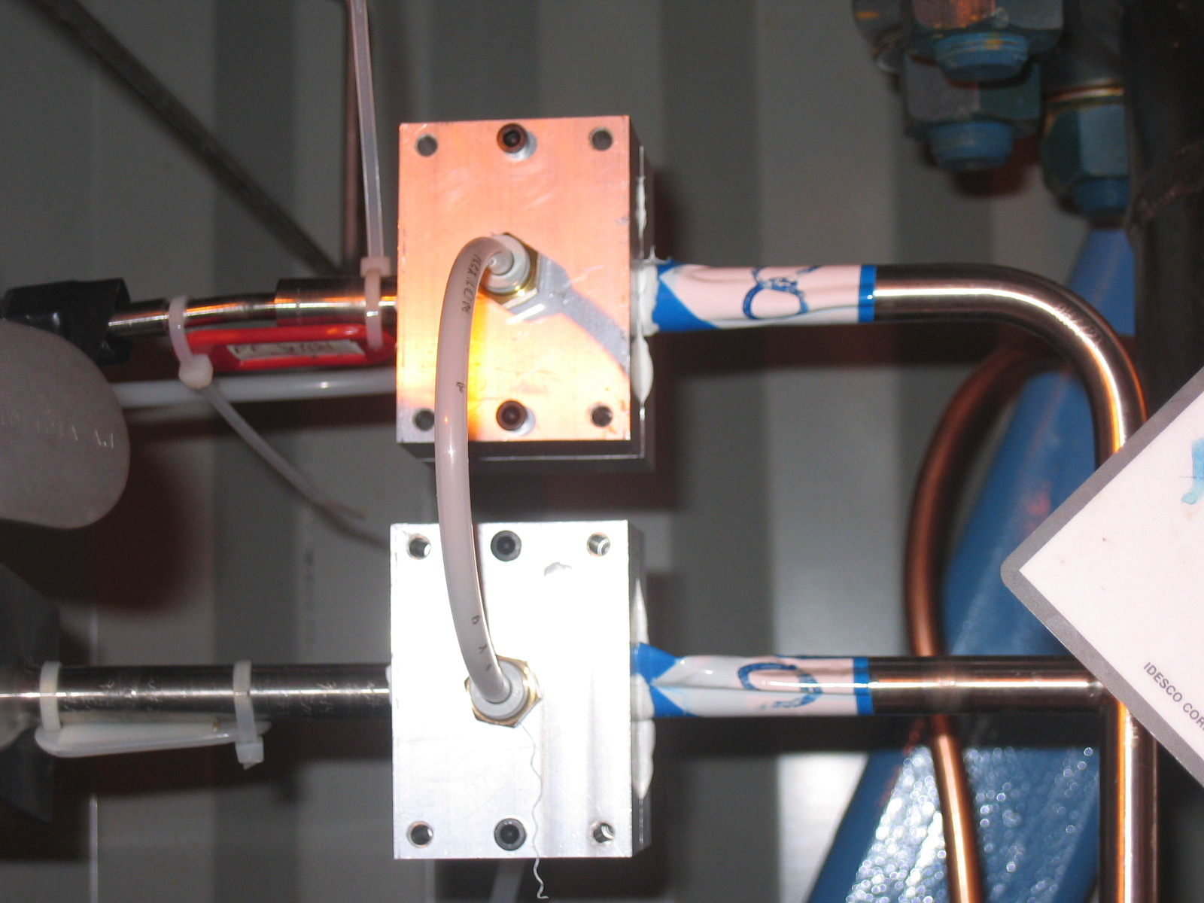
Leak tightness
GOAL: 10⁻⁸ std cc/s driven by
⁸⁵Kr in air 1 Bq/m³
filling rate 1 m³/h
about 300 VCR fittings
To prevent leaks during filling:
Double sealings with nitrogen purging
Purging around all joints and pumps in the filling line
On line monitoring (Bi-Po)

Slide 31
Purification operations performed in Borexino
Distillation of PC and PPO (before mixing) and Kr free nitrogen stripping during filling
Kr-free nitrogen stripping after filling
Distillation of PC in the buffer to reduce the DMP from 5 g/l to 3 g/l
Water Extraction:
Six cycles from July 2010 to August 2011

Slide 32
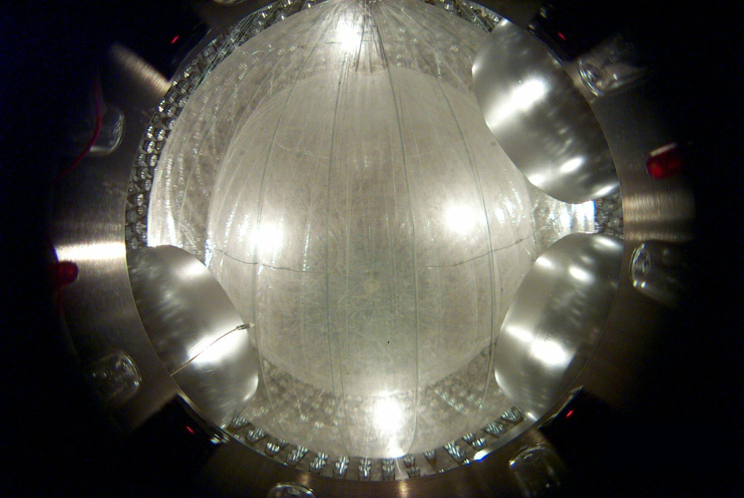
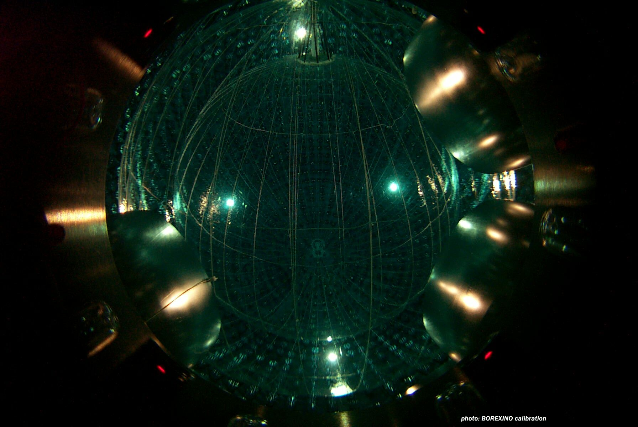
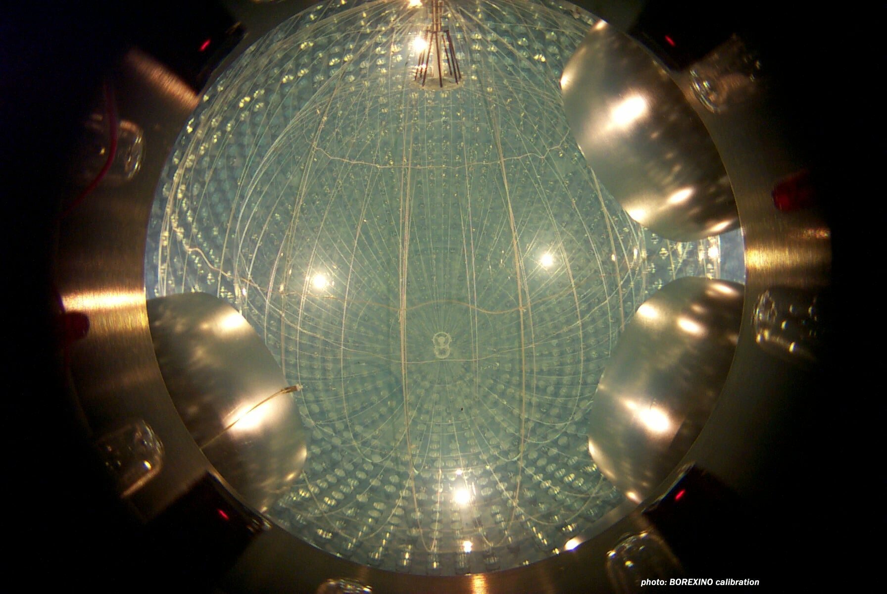
Filling Borexino: three main steps
2nd high purity H₂O
Aug-Nov 2006
1st Kr/Ar free N₂
3rd distilled and stripped LS
4 months

Slide 33
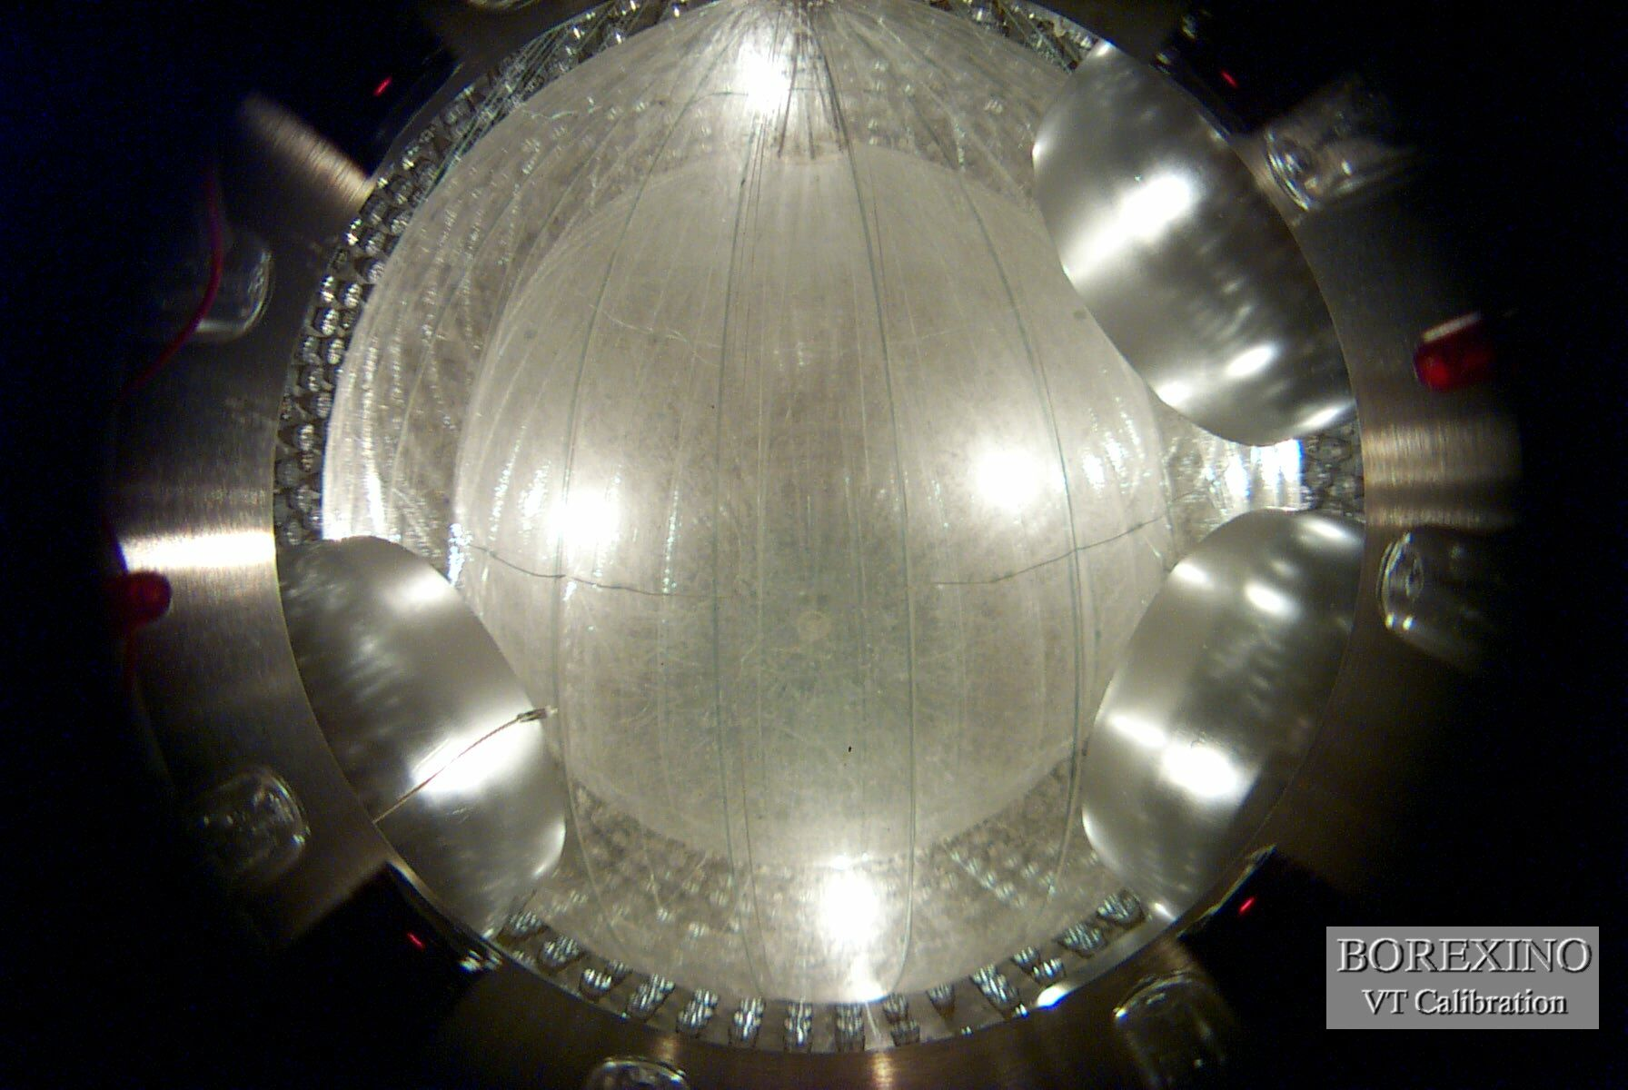

Slide 35
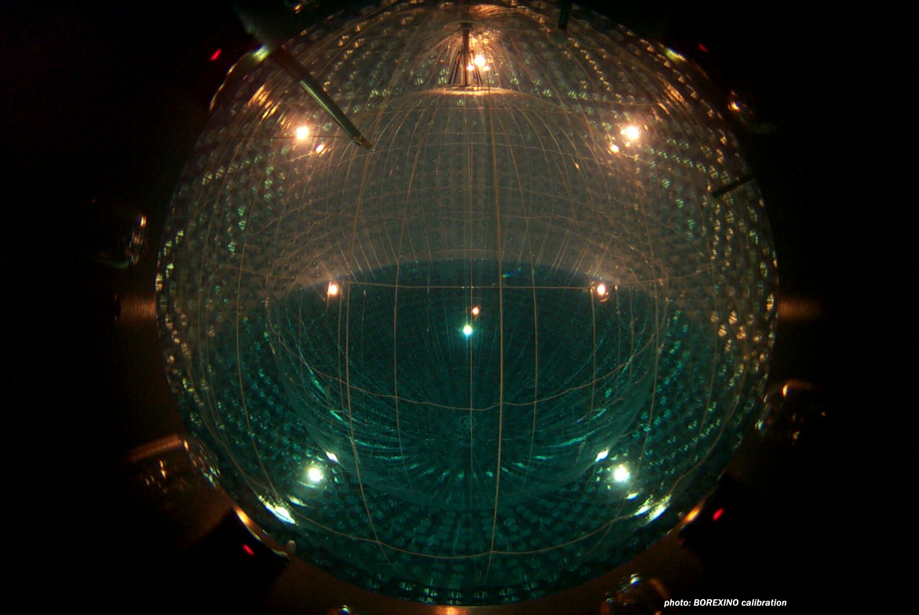

Slide 36
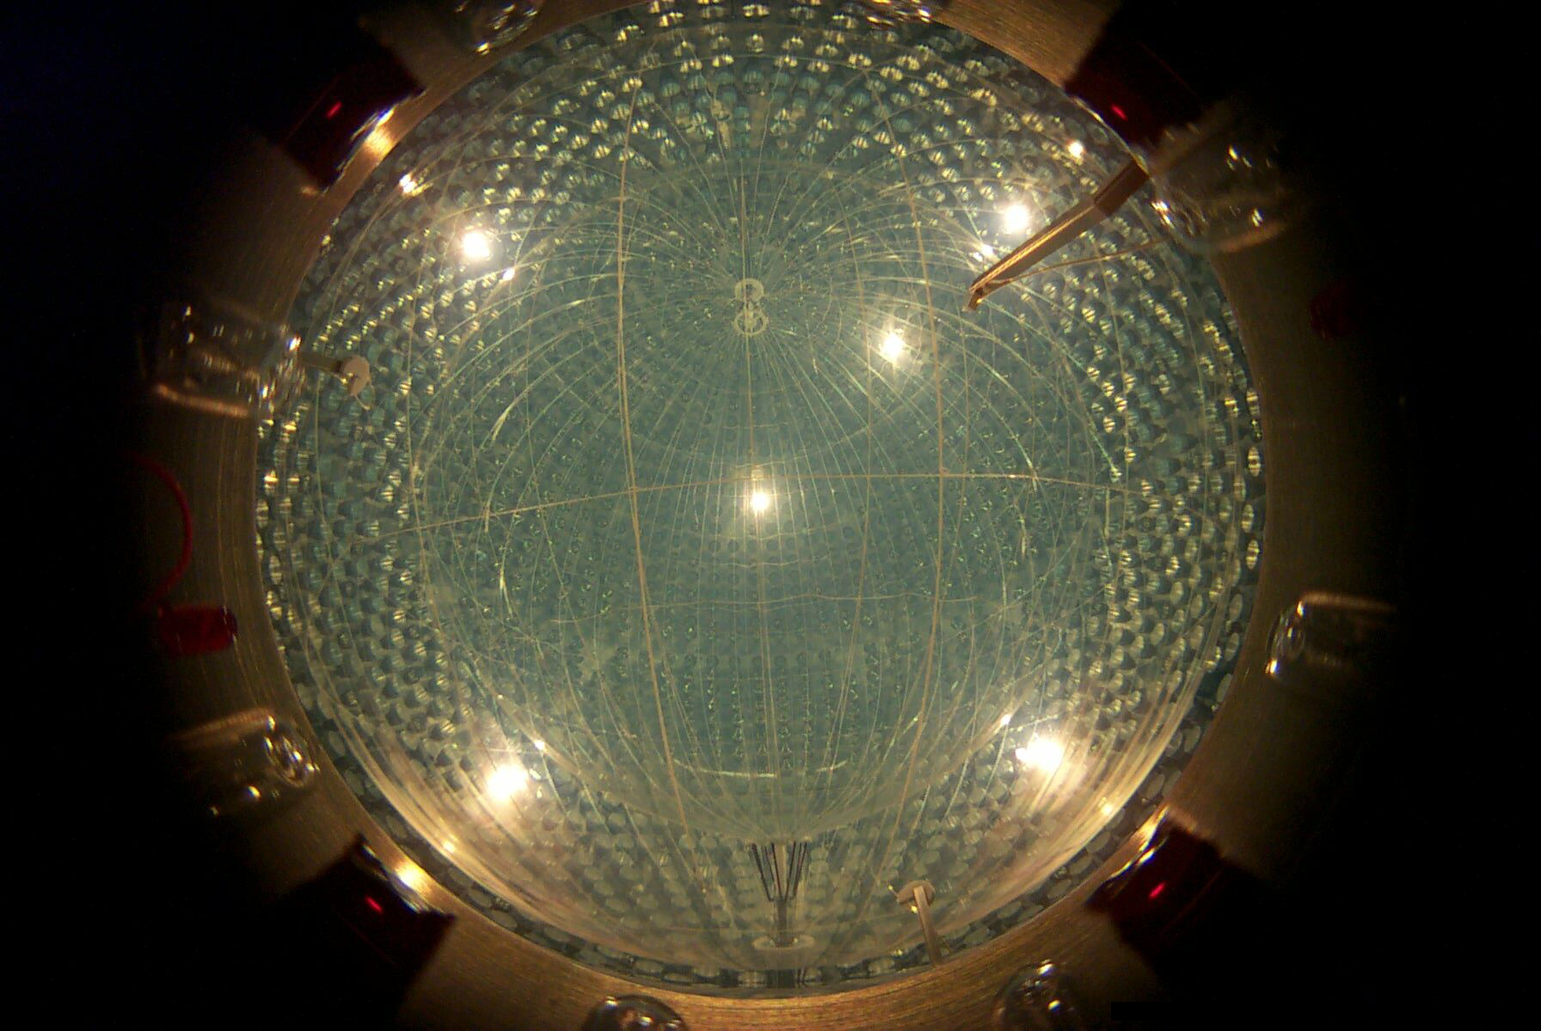
May 13 2007: start DAQ with filled detector

Slide 37
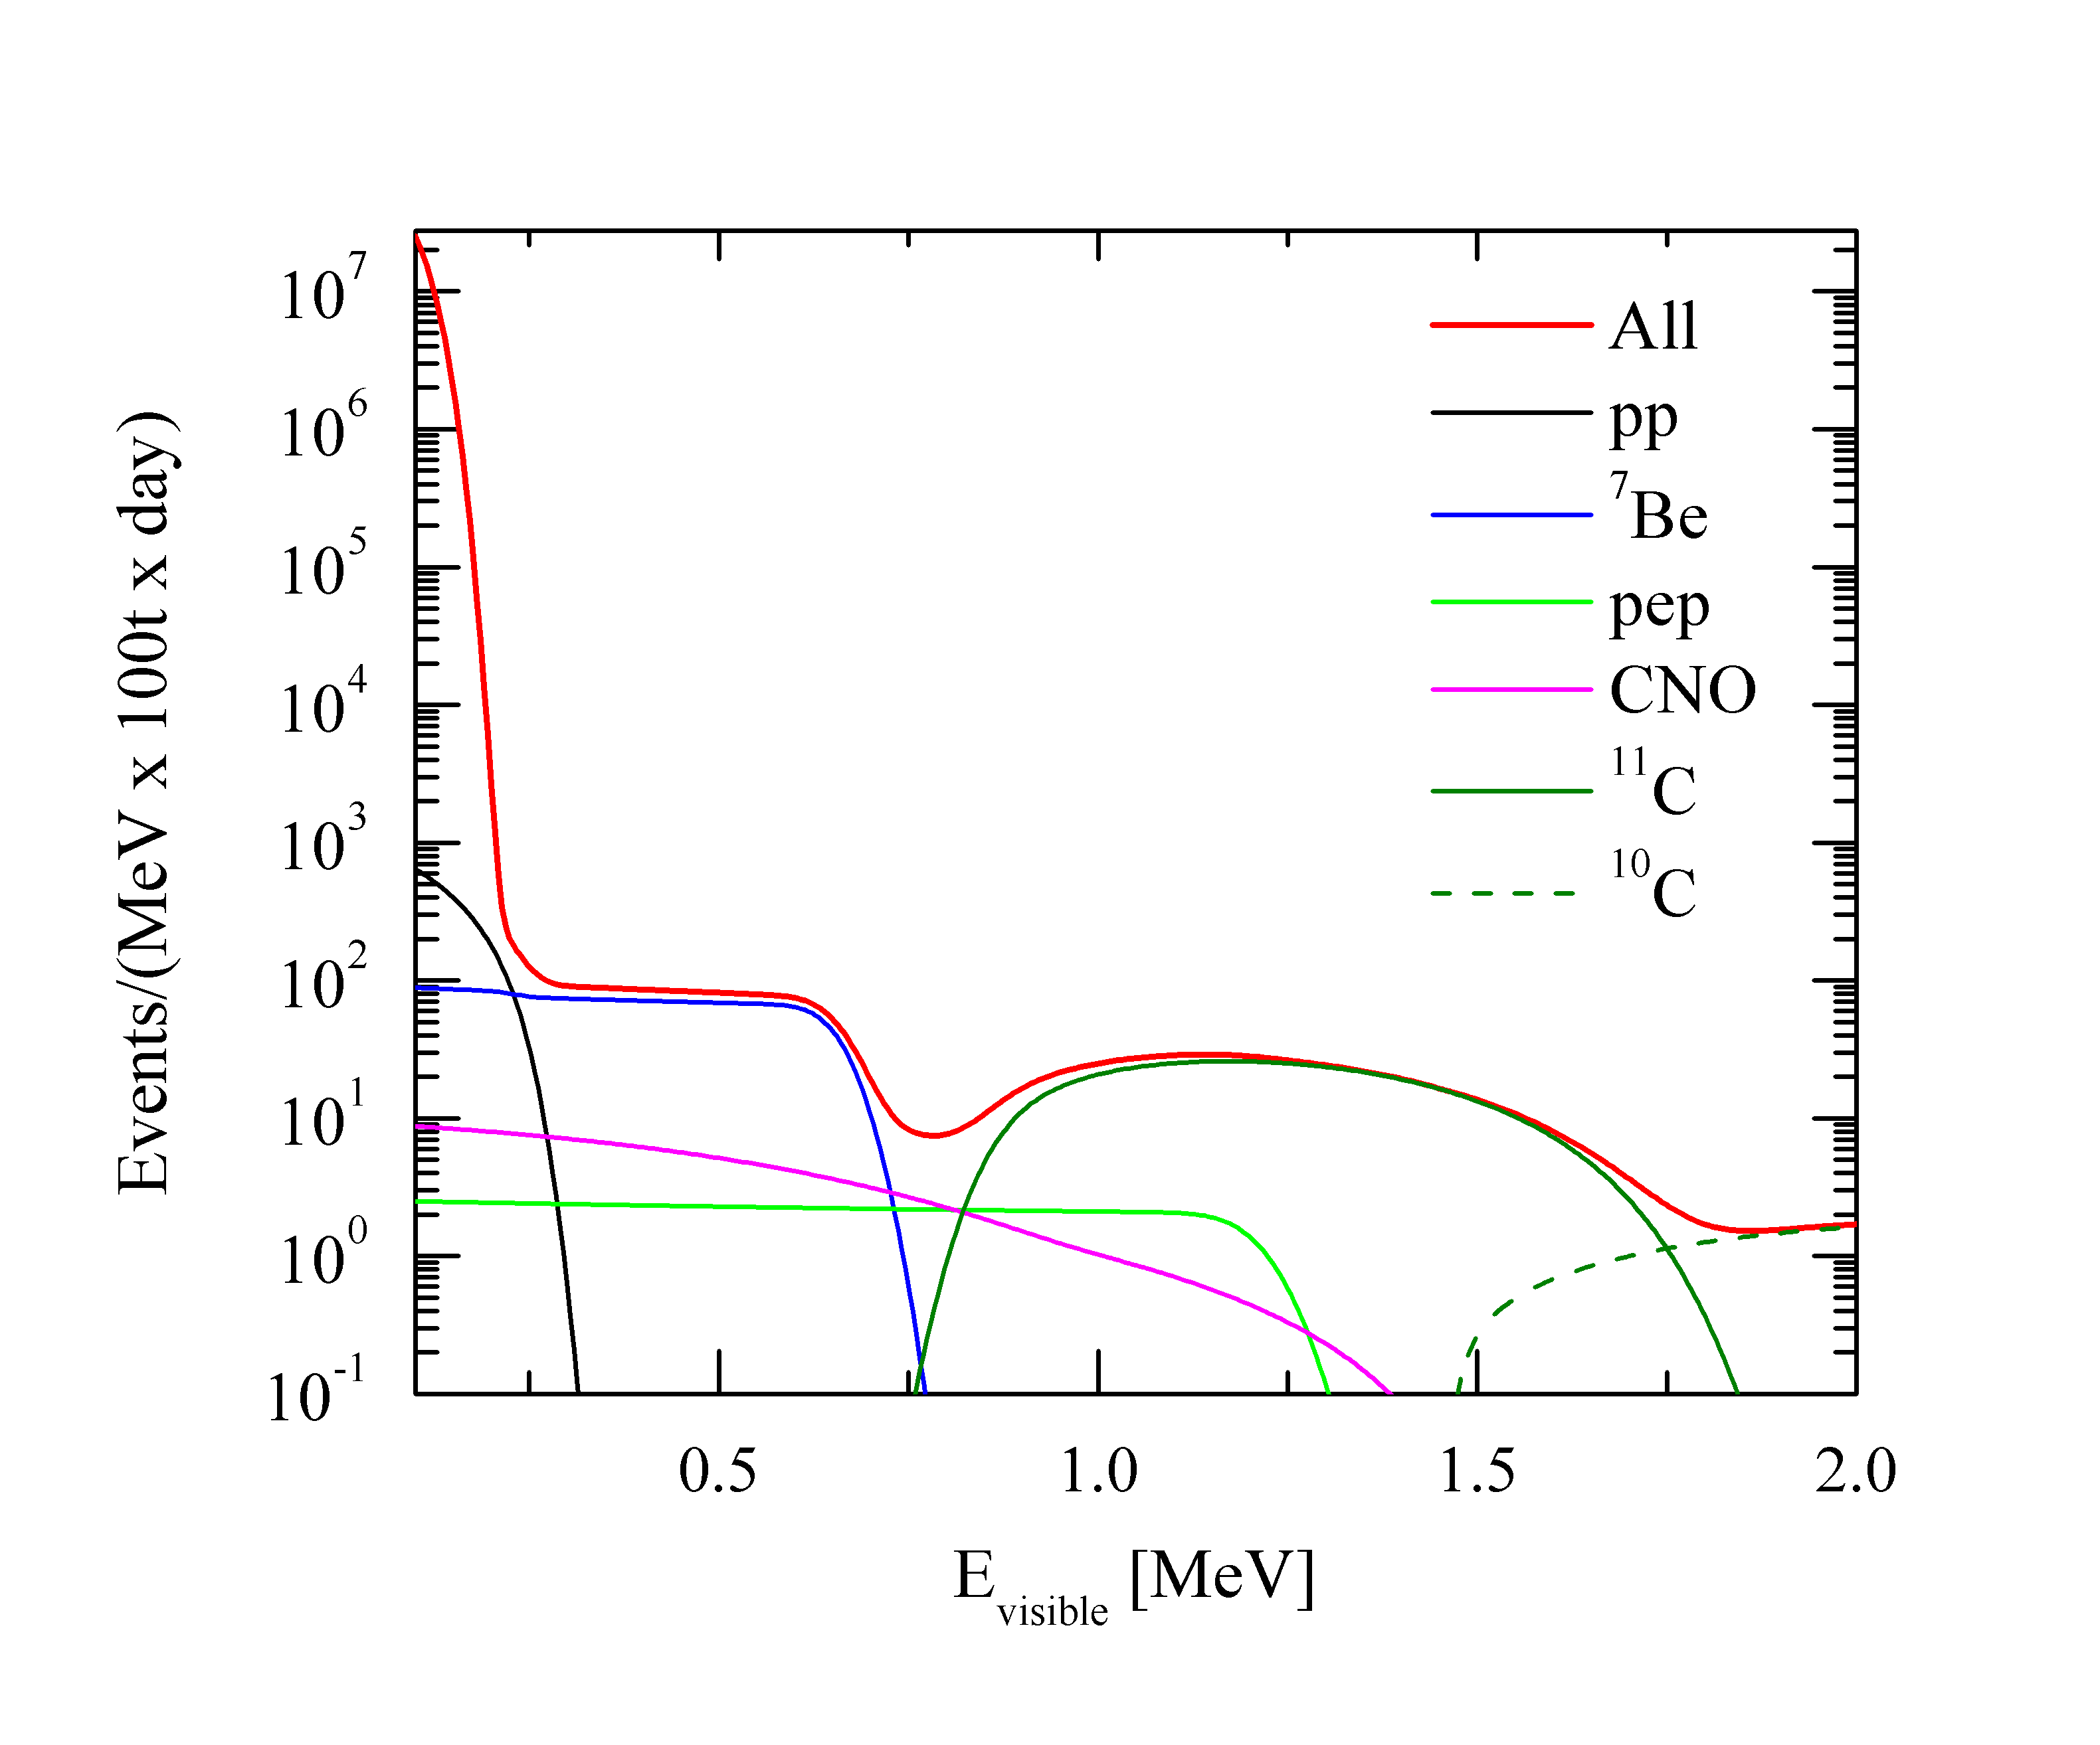
Borexino Expected Solar ν Spectrum
Spectrum with irreducible backgrounds

Slide 38
What do we measure?
Energy of ionizing particles in the liquid scintillator by charge collected in the PMTs
Vertex of events from the pattern of the hits distribution on PMTs and time of flight of photons
Muons by the Cherenkov veto
Internal backgrounds from fast coincidences
β−α
α−α
n−γ
μ−γ

Slide 39
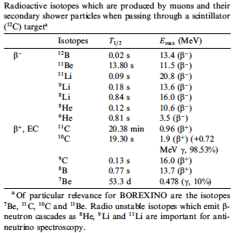
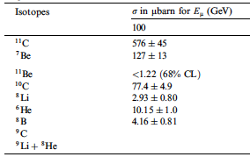
Irreducible Background Sources
¹⁴C (Q_{β}=0.156 MeV) : ≈7 Hz [0.1,0.2]MeV
Cosmogenic [see T. Hagner et al. Astrop. Phys. 14 (2000) 33]

Slide 40
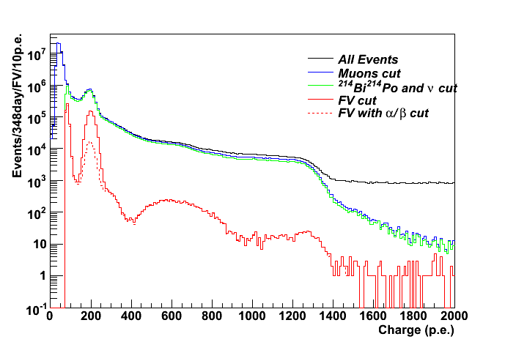
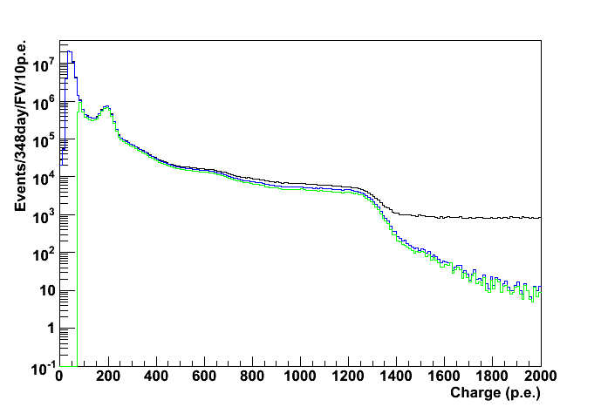
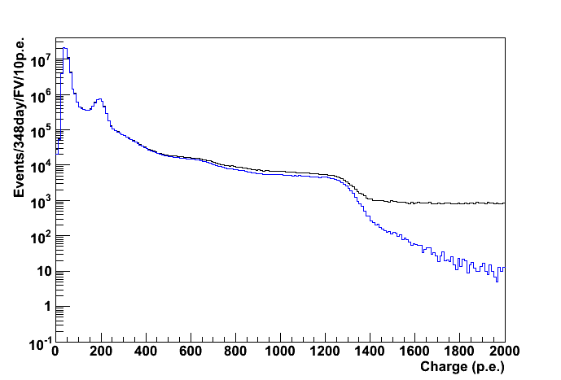
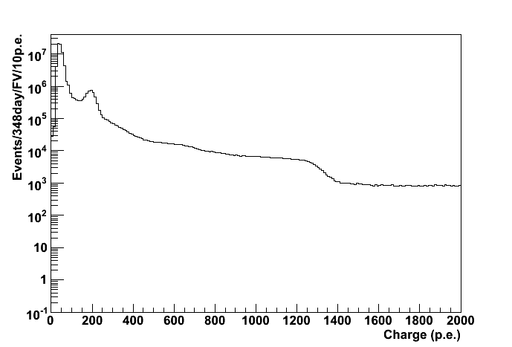
Data reduction

Slide 41
Data reduction
¹⁴C
²¹⁰Po
¹¹C
1 MeV

Slide 42
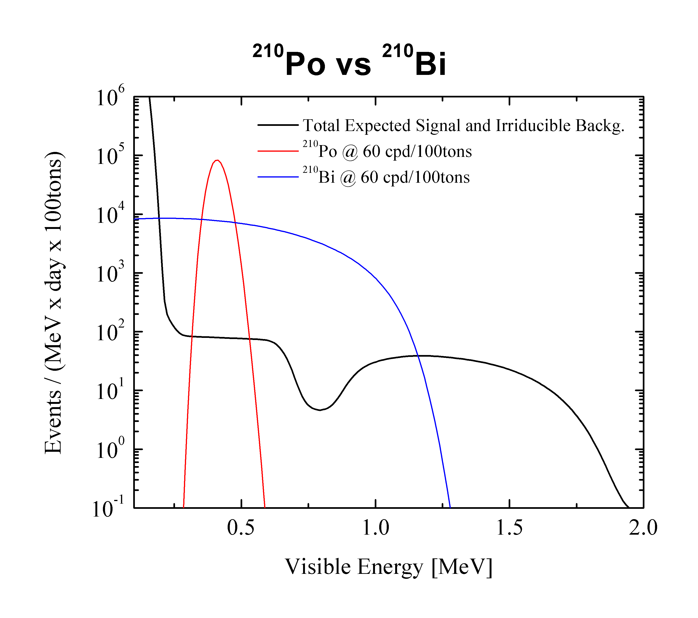
²¹⁰Po in Borexino
Chain: ²¹⁰Pb(β;τ=32yr) ->²¹⁰Po(α;τ=199.6days)->²¹⁰Bi
²¹⁰Po not in equilibrium
Not a surprise: seen in the CTF (prototype)
not clear origin (PPO, particulate etc)
τ=202 ± 5 days

Slide 43
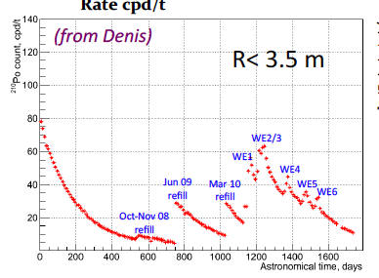
²¹⁰Po history
Units for rate are
cpd/ton

Slide 44
Pulse Shape Discrimination
α
β
0.5 MeV
⁷Be edge

Slide 45
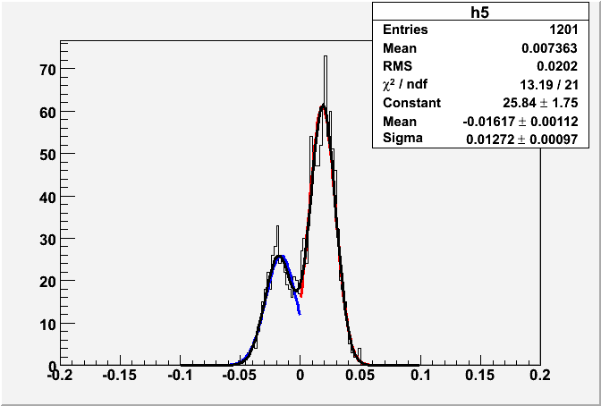
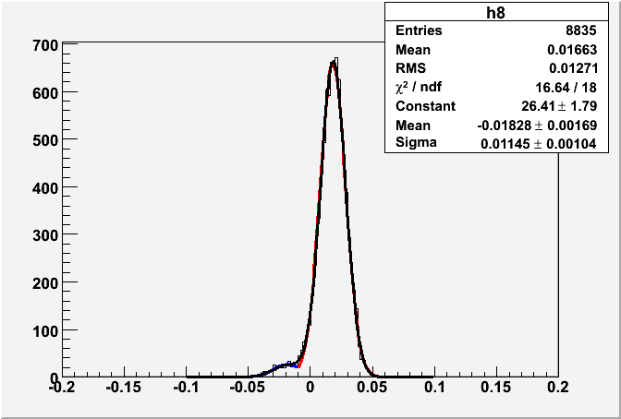
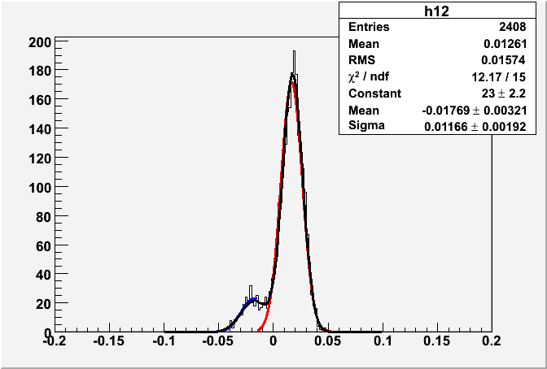
Some examples of fit for α/β sub.
α
β

Slide 46
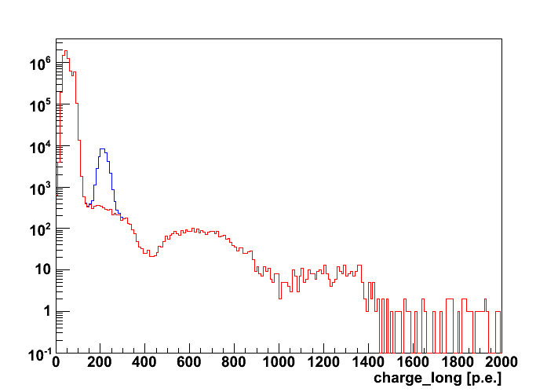
Alpha subtracted spectrum
1 MeV

Slide 47
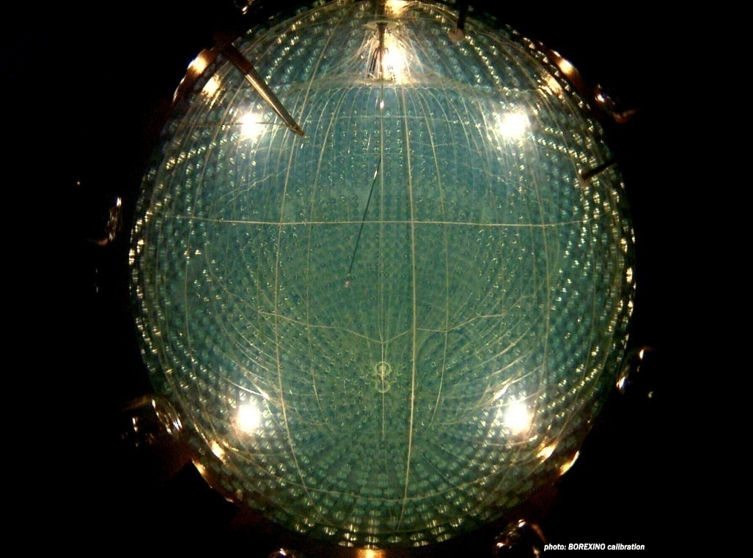
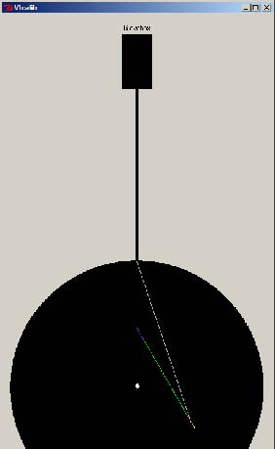
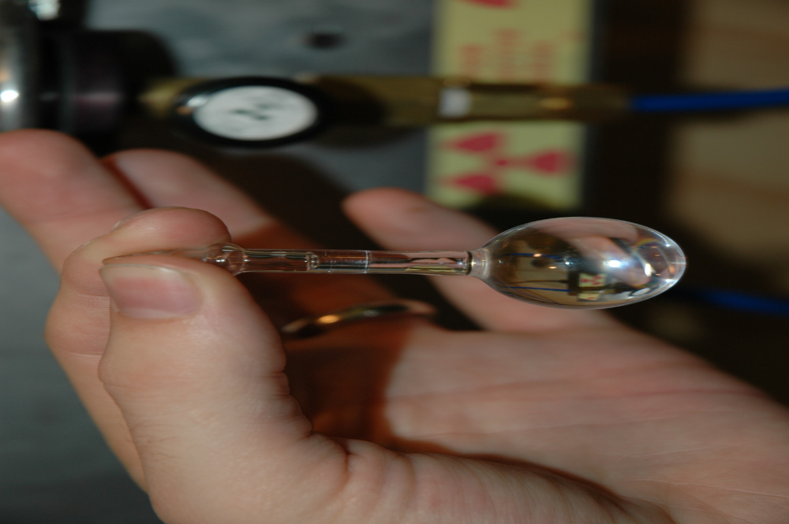
Energy and Position calibration
Calibration campaigns performed without introducing contamination
Goal: reduce systematic error on FV and on energy scale below 5% on ⁷Be

Slide 48
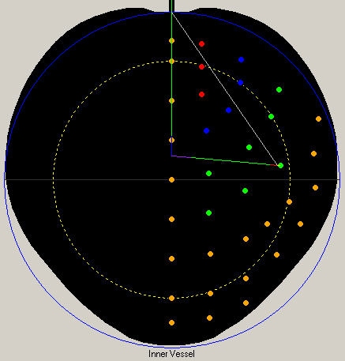
Vertex position calibration
¹⁴C , ²²²Rn, γ and AmBe
sources deployed inside
the LS volume
reached 2% error on FV
definition

Slide 49
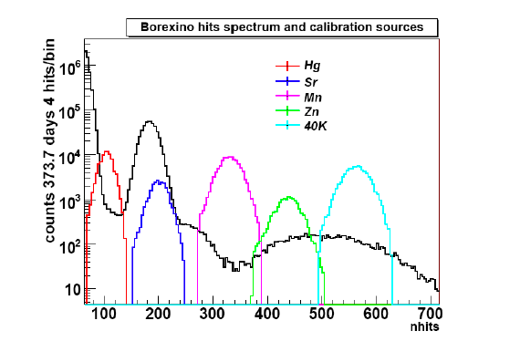
Calibration of the energy scale

Slide 52
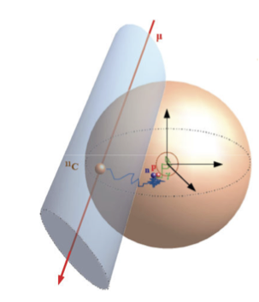
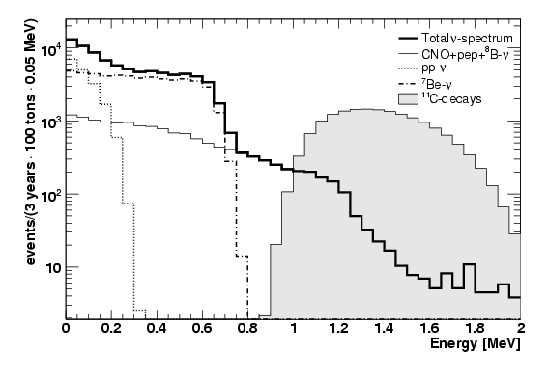
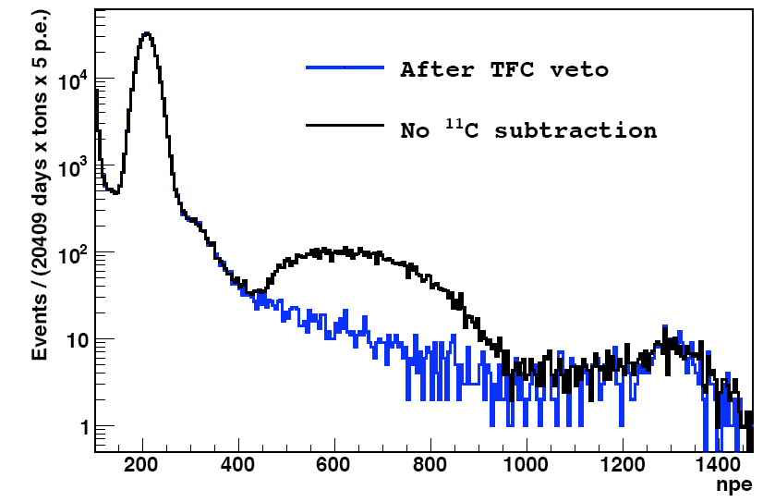
First observation of pep neutrinos
μ + ¹²C → μ + ¹¹C + n
τ ~ 260 μs
+ p → d + γ
¹¹C τ ~ 30 min
→¹¹B + e⁺ + ν_{e}
Three Fold Coincidence (TFC):
space-time veto removes 90% of ¹¹C paid with 50% loss of exposure

Slide 54
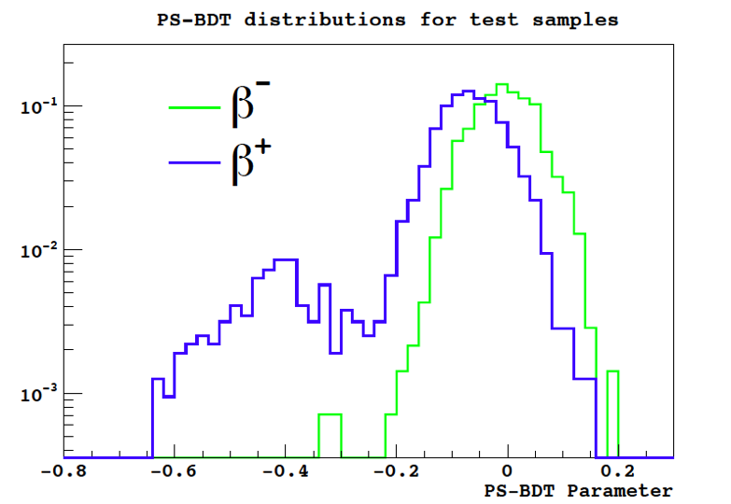
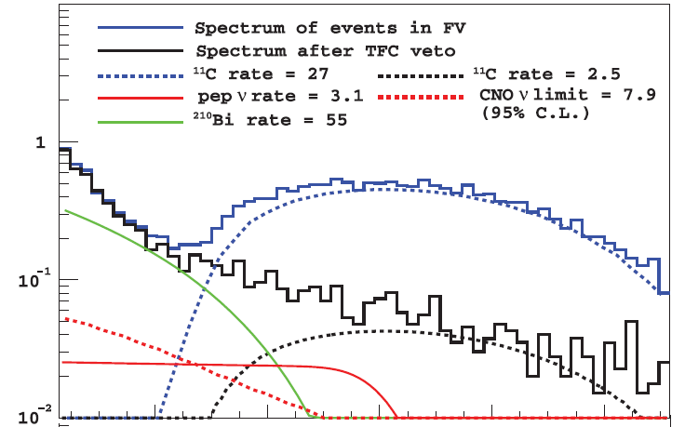
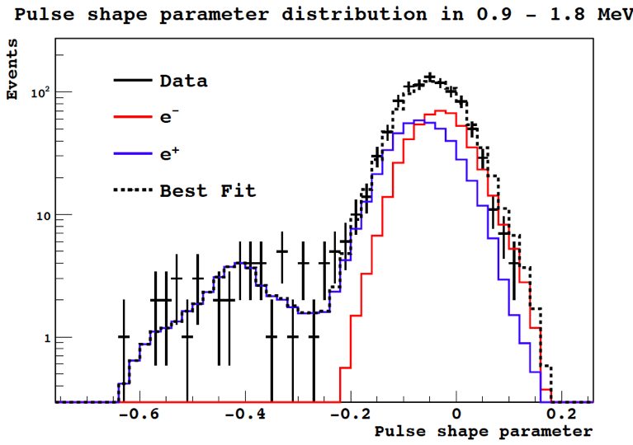
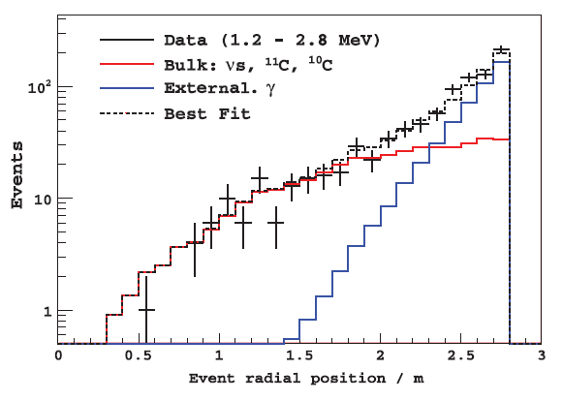
Multivariate maximum likelihood fit
Pulse shape test
Energy spectral fit
Pulse shape fit
Radial fit

Slide 55
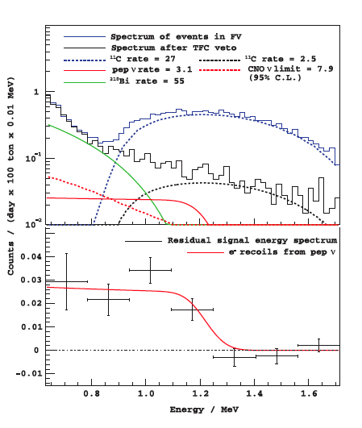
pep Solar Neutrino Measurement in Borexino
MAIN sources of systematic uncertainties | %
Fiducial Volume | ^{+0.6}_{-1.1}
Energy response | 4.1
Fit methods | 5.7
PSD | 5
²¹⁰Bi shape | ⁺¹₋₅
Rate pep: 3.1±0.6(stat)±0.3(sys) cpd/100tons

Slide 56
pep vs CNO rates in Borexino

Slide 57
⁸B neutrinos in Borexino
Measure ⁸B neutrino spectrum on ES interactions in 100 tons FM above 3 MeV
> 3 MeV
1 MeV

Slide 58
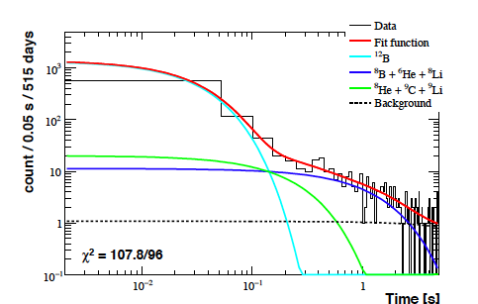
Cosmogenic Backgrounds
A number of cosmogenic backgrounds above 3 MeV must be removed by a muon correlated 6.5s time cut
(29% dead time)

Slide 60
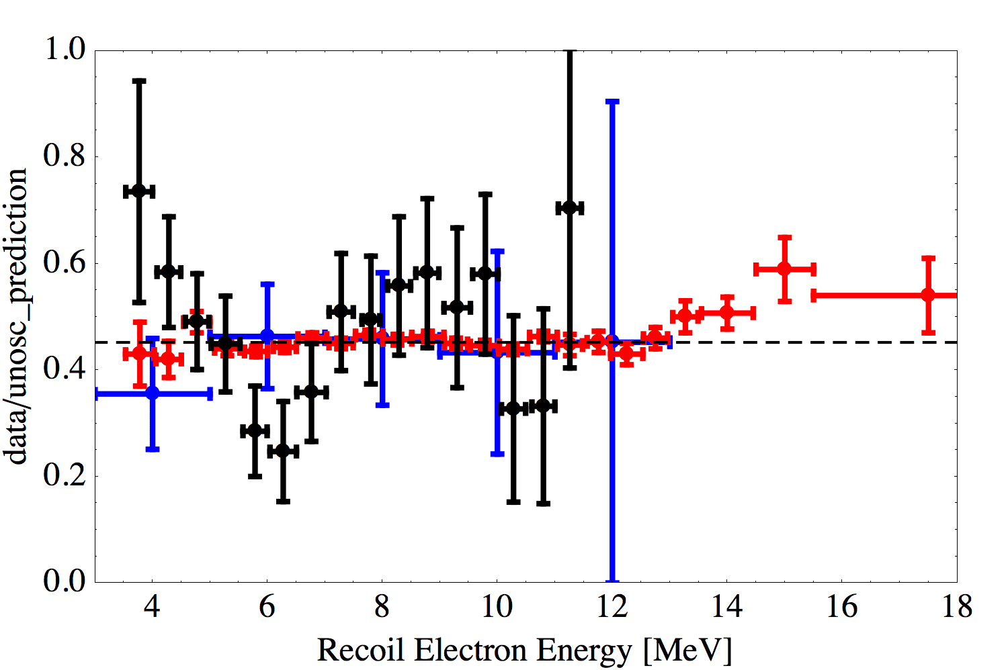
⁸B Solar Neutrino Spectrum
Detection by neutrino-electron ES
Super-K
SNO
Borexino
Flat spectrum
gives p-value~11%

Slide 61
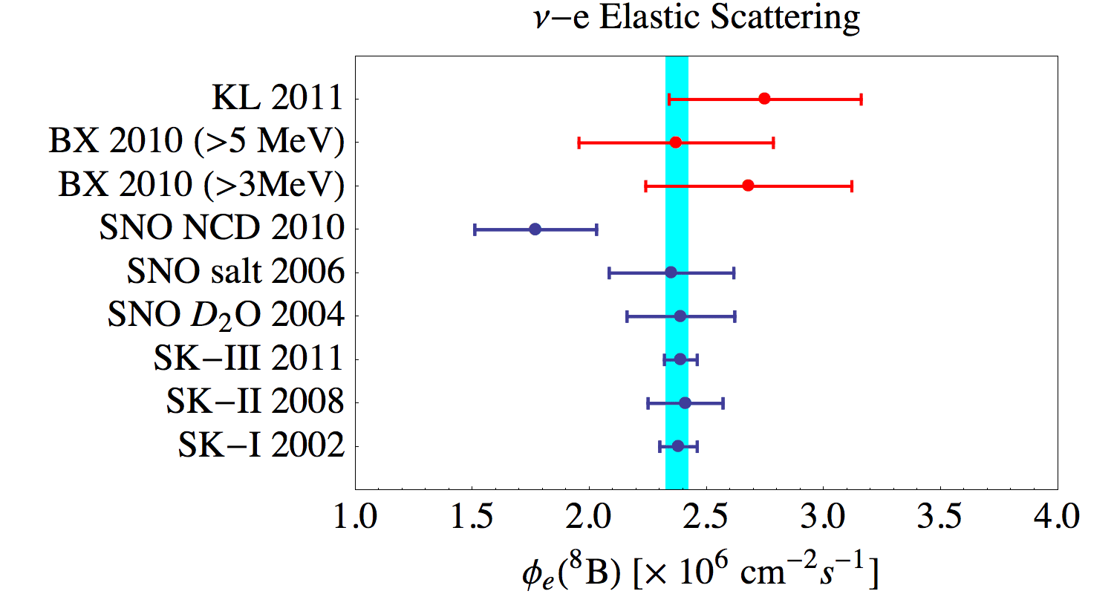
ν_{e}-equivalent flux for ⁸B neutrinos

Slide 62
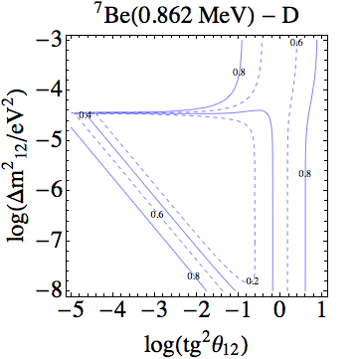
Day-Night regeneration
LMA

Slide 63
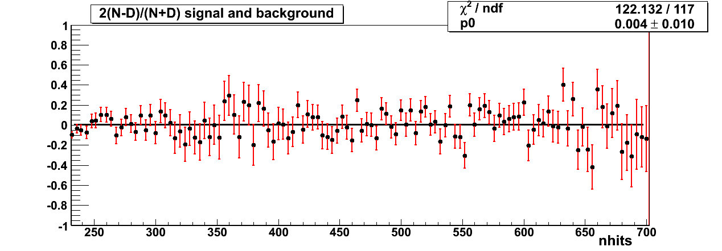
Day-Night asymmetry for ⁷Be rate
Be7 signal region
Be7 Day spectrum 387.46 days
Be7 Night spectrum 401.57 days
Statistical error 2.3 c/d100t
The ⁷Be flux is obtained from the separate full fit of the day and night spectra

Slide 64
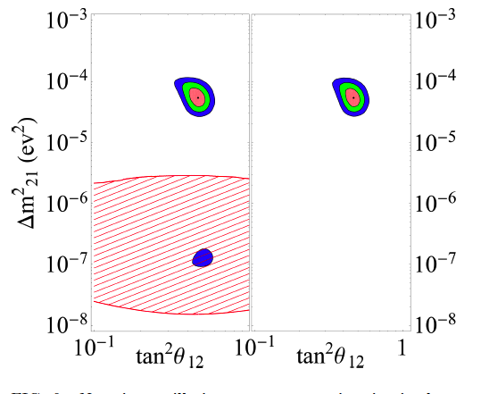
Global Analysis of Solar Neutrino Data including Borexino
In the framework of neutrino oscillations one defines:
Daya Bay and RENO included

Slide 65
Solar Neutrinos Survival Probability
Vacuum regime
Matter regime
upturn

Slide 67
Solar Neutrino fluxes: observations vs predictions
Source | Flux [cm⁻²s⁻¹] SSM-GS98 | Flux [cm⁻²s⁻¹] SSM-AGSS09 | Flux [cm⁻²s⁻¹] Data
pp | 5.98(1±0.006)×10¹⁰ | 6.03(1±0.006)×10¹⁰ | 6.06(1^{+0.003}_{-0.01})×10¹⁰
pep | 1.44(1±0.012)×10⁸ | 1.47(1±0.012)×10⁸ | 1.60(1±0.19)×10⁸
⁷Be | 5.00(1±0.07)×10⁹ | 4.56(1±0.07)×10⁹ | 4.84(1±0.05)×10⁹
⁸B | 5.58(1±0.13)×10⁶ | 4.59(1±0.13)×10⁶ | 5.40(1±0.031)×10⁶
¹³N | 2.96(1±0.15)×10⁸ | 3.76(1±0.15)×10⁸ | <6.7×10⁸
¹⁵O | 2.23(1±0.16)×10⁸ | 1.56(1±0.16)×10⁸ | <3.2×10⁸
¹⁷F | 5.52(1±0.18)×10⁶ | 3.40(1±0.16)×10⁶ | <59×10⁶
CNO | 5.24×10⁸ | 3.76×10⁸ | <7.7×10⁸ (2σ)
Without the luminosity constraint:
φ_{pp} determined with 15% uncertainty
upper limit smaller
than 2004 prediction!

Slide 68
Borexino future plans (<2016)
Real time measurement of pp neutrinos
work in progress with data before and after Water Extraction
issue: ¹⁴C pile-up to be properly understood by MonteCarlo
Improve 7Be accuracy with low Kr data (>2011)
Annual modulation of 7Be rate
it will be published soon
Improve CNO sensitivity with data after Water Extraction
use higher radiopurity for Kr and Bi
use lower ²¹⁰Po to constrain ²¹⁰Bi by means of ²¹⁰Po measured activity
Improve further radiopurity by better quality water (no Pb)

Slide 69
HZ vs LZ SSM
Δ(7Be) ~ 9%
Δ(8B) ~ 20%
Δ(CNO) ~ 35%
Use CNO to determine metallicity in the core of the Sun
Borexino phase II (>2011) standard analysis: ~50% prob. to measure pep at 3σ and exclude HZ at 2σ with ²¹⁰Bi at the level of 5 cpd/100tons

Slide 70
Toward a CNO observation: Borexino at present
Borexino radiopurity at present:
²¹⁰Po ~ 4 cpd/ton
²¹⁰Bi ~ 20 cpd/100tons
¹¹C ~ 28 cpd/100tons
¹⁴C/¹²C ~ 2.5×10⁻¹⁸
pp
¹⁴C pileup
²¹⁰Bi
CNO

Slide 71
Toward CNO observation: ¹¹C subtracted + no ²¹⁰Po + new purification
Goal Borexino radiopurity:
²¹⁰Po ~ 0 cpd/ton
²¹⁰Bi ~ 5 cpd/100tons
¹¹C ~ 3 cpd/100tons
¹⁴C/¹²C ~ 2.5×10⁻¹⁸

Slide 72
²¹⁰Bi – ²¹⁰Po

Slide 73
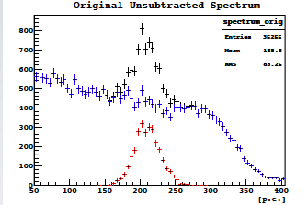
CNO neutrino measurement
Determine ²¹⁰Po
Only spectral info.
B
A
w/ prior on Bi-Po decay
Determine ²¹⁰Bi
²¹⁰Po
²¹⁰Bi
C
D
Villante et al. , Phys. Lett. B 701, 2011

Slide 74
Borexino results and goals on solar neutrinos
Measurement of ⁷Be solar neutrino flux at 5%
Observation of pep neutrinos (~20%)
⁸B solar neutrino flux measured above 3 MeV (~17%)
Strongest bound on CNO neutrinos: <7.7×10⁸ (2σ)
NEXT (work in progess)
Annual modulation of 7Be rate
Improve 7Be rate measurement to 3-4%
pp neutrinos direct observation
Improve pep and CNO with data >2011

Slide 75
References
Technical papers
Borexino collaboration, G. Alimonti et al., The Borexino detector at the Laboratori nazionali del Gran Sasso, NIM A 600, 568-593, 2009.
J. Benziger at al., A scintillator purification system for the Borexino solar neutrino detector, NIM A 587, 277-291, 2008.
Borexino collaboration , The liquid handling systems for the Borexino solar neutrino detector, NIM A 609, 58-78, 2009.
Physics results
⁷Be evidence: PL B658 101-108 (2008)
⁷Be at 10% + f_{pp}/f_{CNO}: PRL 101, 091302 (2008)
Borexino collaboration, Measurment of the solar 8B neutrino rate with a liquid scintillator target and 3MeV energy threshold in the Borexino detector, PRD 82 (2010) 033006
Borexino collaboration, “Precision measurement of the 7Be solar neutrino interaction rate in Borexino”, Phys. Rev. Lett. 107, 141302, 2012
Borexino collaboration, “Absence of day-night asymmetry of 862 keB 7Be solar neutrinos in Borexino and MSW oscillation parameters”, Phys. Lett. B 707, 22-26, 2012
Borexino collaboration, “Precision measurement of the 7Be solar neutrino interaction rate in Borexino”, Phys. Rev. Lett. 107, 141302, 2012
G. Bellini et al., “First evidence of pep solar neutrinos by direct detection in Borexino”, Phys. Rev. Lett. 108, 051302, 2012

Slide 76
Radioactive Sources in Borexino (>2015)
Source | decay | τ [days] | Energy [ MeV] | Kg/MCi | W/kCi
⁵¹Cr | e-capture (E_{γ}=0.32 MeV 10%) | 40 | 0.746 81% | 0.011 | 0.19
⁹⁰Sr-⁹⁰Y | Fission product β⁻ | 15160 | <2.28 MeV 100% | 7.25 | 6.7
¹⁴⁴Ce-¹⁴⁴Pr | Fission product β⁻ | 411 | <2.9975 MeV 97.9% | 0.314 | 7.6

Slide 77
Source Experiment: Physics Case
Probing Short Baseline Flavor Oscillations in disappearance
Search for Neutrino Magnetic moment
Probe neutrino-electron scattering at 1 MeV scale
Weinberg’s angle
g_{V} and g_{A} coupling

Slide 78
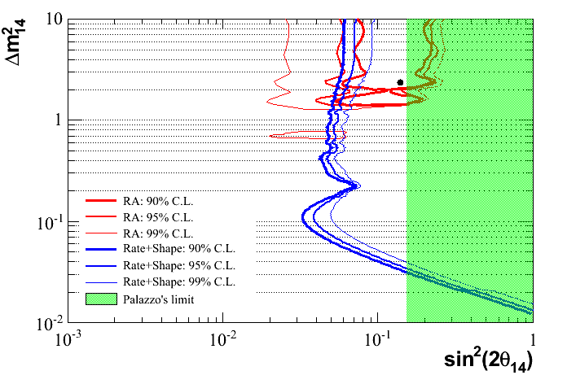
Sensitivity of a ⁵¹Cr source in Borexino

Slide 79
Borexino as a SN neutrino detector ν-p ES from SN: predicted spectrum
Need sub-MeV detection threshold
_
ν_{e}
ν_{x}
ν_{e}

Slide 80
References on the search of rare processes
Anti-neutrinos from unknown sources – PLB 696 (2011) 191-196
Limits on Pauli forbidden transitions on ¹²C – PRC 81 (2010) 034317
Search for solar axions from p(d,³He)a – PRD 85 (2012) 092003
Cosmic muon flux and annual modulation in Borexino – JINST 1205 (2012) 015
Heavy sterile neutrino mixing in ⁸B decay
ν_{H} -> ν_{L} + γ(e⁺e⁻)
Internal review

Slide 81
Spares

Slide 82
Status of the Source Project
Short distance Oscillations with BoreXino (SOX) funded ERC Advanced Grant: 3.5 M€
Got Interest in the Collaboration and outside (J. Link from VT working on submitting a proposal to DOE and NSF)
⁵¹Cr program
Move enriched Cr (38% in Cr-50) from Saclay to Italy – in progress
Reactors for irradiation:
Petten + URENCO (Cr enrichment to >80%)
Oak Ridge through VT collaborators
Ludmilla (Russia) meeting held in Nov 2012
¹⁴⁴Ce
Discussions on methodology and feasibility at scheduled meeting in November

Slide 83
U chain and correlated ²¹⁴Bi-²¹⁴Po events

Slide 84
R_{7Be}(Δm₁₂²,θ₁₂)/R_{7Be}^{SSM}
Only solar ν
Solar+KamLAND

Slide 85
Muons and induced neutrons
Muons rate
Events with many induced neutrons detected
≈ 0.05 Hz
Work in progress …

Slide 86
⁷Be driven pp neutrino flux
p+p➔d+e⁺+ν_{e} main reaction in pp-chain
Cross section from β decay theory with some modification
At 1 MeV σ~10⁻⁴⁷ cm² not possible to measure
With luminosity constraint
No luminosity constr.

Slide 87
2400 ETL 8” PMTs
64 at a time tested in a dedicated
dark room with a 6-coil system
to compensate the earth’s MF
Jitter ~ 1.5 ns
Peak-to-valley ratio ~ 1.5
Afterpulses <5% above 0.2 p.e.
QE ~ 30% @ 380 nm

