Slide 1
The LENA Project
Heraeus Seminar „Exploring the neutrino sky ...“ Physikzentrum Bad Honnef 22 Jan 2013
Michael Wurm Universität Hamburg

Slide 2
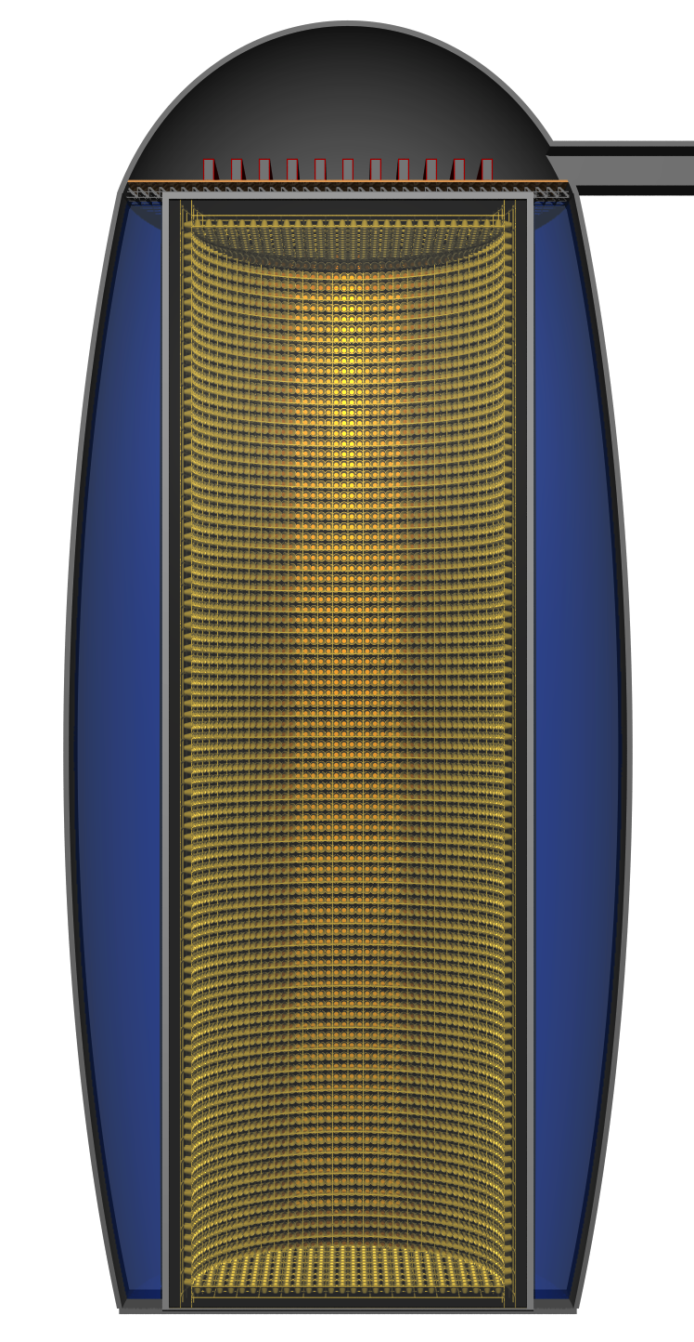
Outline
The low-energy neutrino sky – Neutrino sources – Current detectors
LENA experiment – Detector site – Detector design
LENA physics program – Natural neutrino sources – Artificial neutrino sources – Nucleon decay
Michael Wurm (UHH) Exploring the neutrino sky: LENA 2

Slide 3
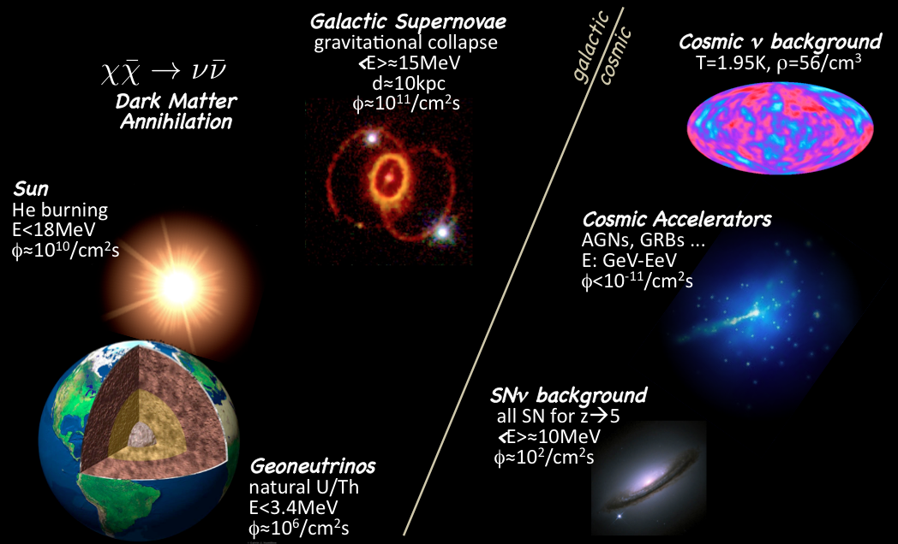
The Neutrino Sky
→ Cherenkov neutrino telescopes
Michael Wurm (UHH) Exploring the neutrino sky: LENA 3

Slide 4
The Neutrino Sky
→ All others (potentially) produce neutrinos in the MeV energy range!
Michael Wurm (UHH) Exploring the neutrino sky: LENA 4

Slide 5
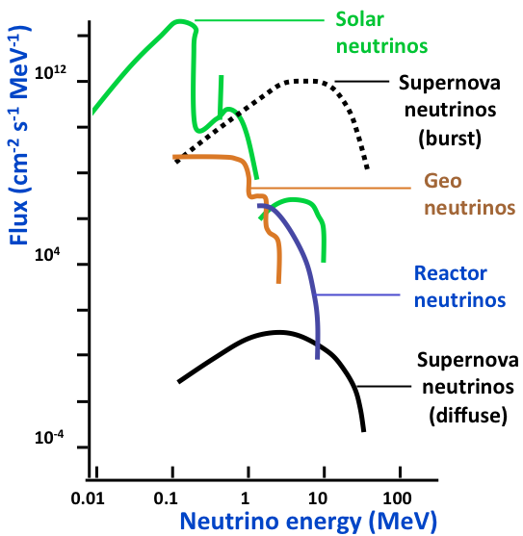
The low-energy neutrino spectrum ...
Michael Wurm (UHH) Exploring the neutrino sky: LENA 5

Slide 6
... and the main players in the field
Water-Cherenkov Detectors
Super-Kamiokande: – mass: 50 kt – energy threshold: 5 MeV
Neutrino program: – Solar ⁸B neutrinos – Supernova neutrinos – Diffuse SN ν background
Advantages: – Large mass – Directional resolution
Disadvantages: – high energy threshold – moderate energy resolution – limited channel and background discrimination
WCD
Michael Wurm (UHH) Exploring the neutrino sky: LENA 6

Slide 7
... and the main players in the field
Liquid-Scintillator Detectors
e.g. Borexino: – mass: 300 t – energy threshold: ~200 keV
Neutrino program: – Sub-MeV solar neutrinos – Geoneutrinos – Supernova neutrinos
Advantages: – low energy threshold – high energy resolution – excellent channel and background discrimination
Disadvantages: – Small mass – No directional resolution
LSD
WCD
Michael Wurm (UHH) Exploring the neutrino sky: LENA 7

Slide 8
How to get the best out of two worlds?
Large-volume liquid-scintillator detector
– large target mass: 50 kt. – low threshold: ~200 keV
→ LENA
Water-Cherenkov Detectors
Super-Kamiokande: – mass: 50 kt – energy threshold: 5 MeV
Neutrino program: – Solar ⁸B neutrinos – Supernova neutrinos – Diffuse SN ν background
Advantages: – Large mass – Directional resolution
Disadvantages: – high energy threshold – moderate energy resolution – limited channel and background discrimination
Liquid-Scintillator Detectors
e.g. Borexino: – mass: 300 t – energy threshold: ~200 keV
Neutrino program: – Sub-MeV solar neutrinos – Geoneutrinos – Supernova neutrinos
Advantages: – low energy threshold – high energy resolution – excellent channel and background discrimination
Disadvantages: – Small mass – No directional resolution
Michael Wurm (UHH) Exploring the neutrino sky: LENA 8

Slide 9
LENA detector layout
Liquid Scintillator ca. 69kt LAB
Concrete Tank r = 16m, h = 100m
PMT support structure radius: 14m
32,000 12‘‘-PMTs Winston cones optical coverage: 30%
Optical shield
Active volume ca. 50kt of LAB
Electronics Hall dome of 15m height
Top Muon Veto gas/solid scint. panels vertical muon tracking
Water Cherenkov Veto 2000 PMTs, Δr > 2m fast neutron shield inclined muons
Egg-Shaped Cavern about 10⁵ m³
Rock Overburden at least 4000 mwe
Michael Wurm (UHH) 9

Slide 10
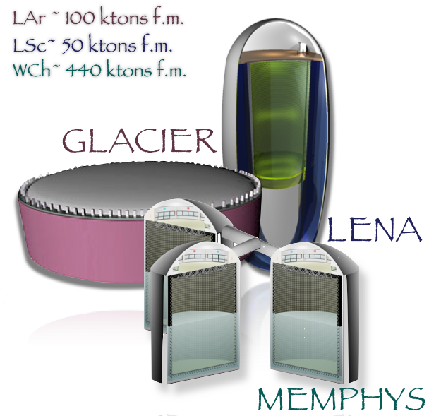
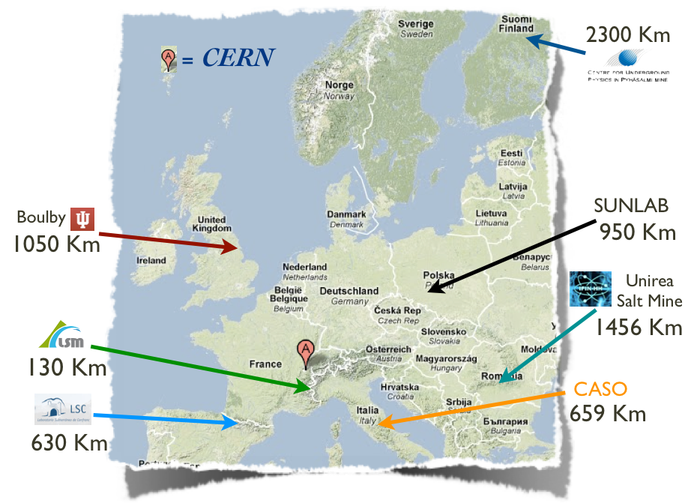
LAGUNA → LAGUNA-LBNO
Consortium of European science institutions and industry partners
Design studies funded by the European Community (FP7)
LAGUNA: detector site, cavern, and oscillation baselines (2008-11)
LAGUNA-LBNO: detector tank, instrumentation, and beam source (2011-14)
Seven sites, three detector technologies
Michael Wurm (UHH) Exploring the neutrino sky: LENA 10

Slide 11
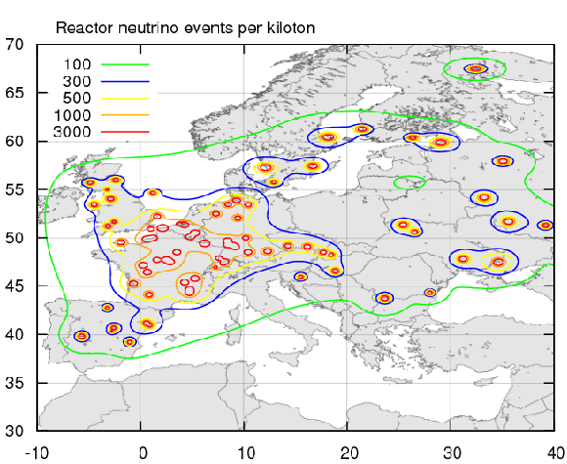
LAGUNA site study
Selection criteria for LENA
feasibility of cavern construction
reactor ν_{e} background
depth/cosmic ray shielding
→ In Europe: Pyhäsalmi or Fréjus
_
Michael Wurm (UHH) Exploring the neutrino sky: LENA 11

Slide 12
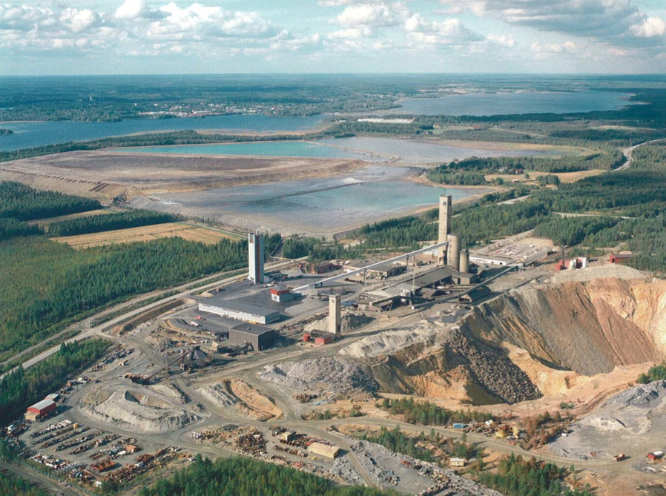
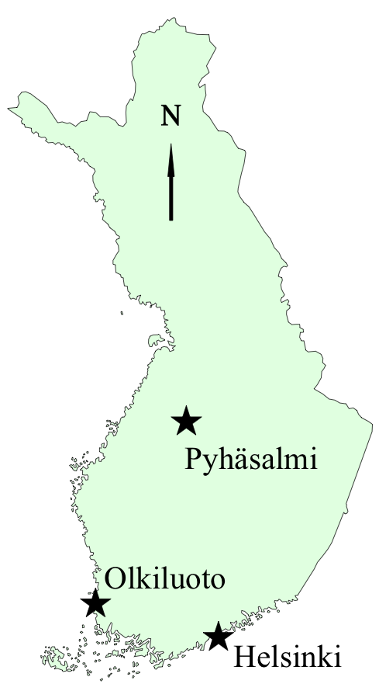
Pyhäsalmi mine
Michael Wurm (UHH) Exploring the neutrino sky: LENA 12

Slide 13
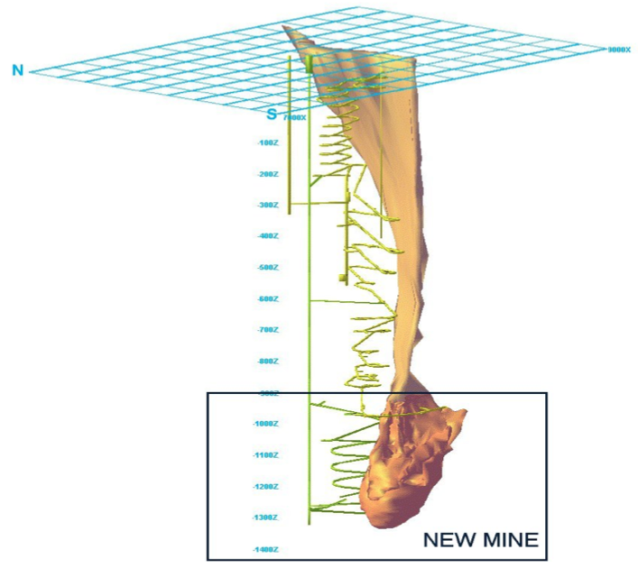
Pyhäsalmi underground
Pyhäsalmi Mine Oy
active copper/zinc-mine in central Finland
deepest level: -1450m (4000mwe) → muon flux about 1/3 of LNGS
old bedrock: 3x10⁹ years → very hard, dry, 23°C
access: elevator shaft road decline railway connection
sauna
Michael Wurm (UHH) Exploring the neutrino sky: LENA 13

Slide 14
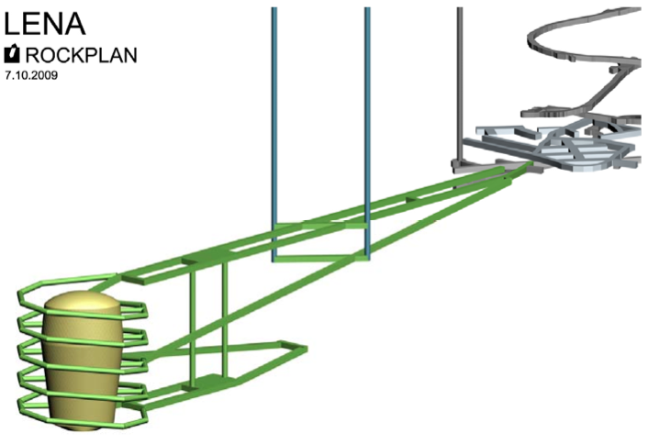
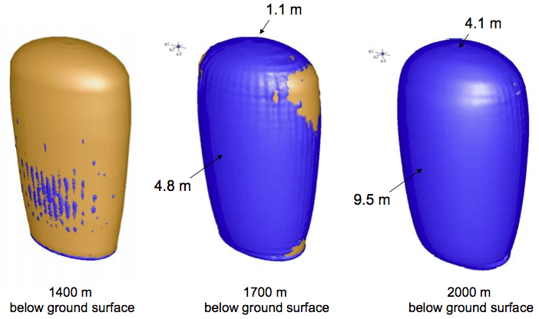
Detector cavern
connected to the deepest mine level by a twin tunnel
oval shape to withstand vertical stresses ...
... deeper than 1400m is difficult.
Michael Wurm (UHH) Exploring the neutrino sky: LENA 14

Slide 15
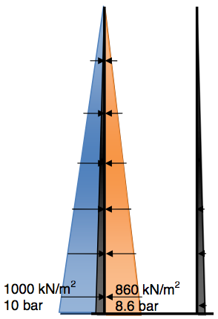
Detector tank
scintillator is lighter than water → vertical tank avoids bouyancy forces
outside water has larger density than inside scintillator
H₂O
ρ=1
C_{x}H_{y}
ρ<0.9
net inward pressure at tank bottom
concrete tank superior to steel
Sandwich structure with liners inside: stainl. steel outside: plastic
Michael Wurm (UHH) Exploring the neutrino sky: LENA 15

Slide 16
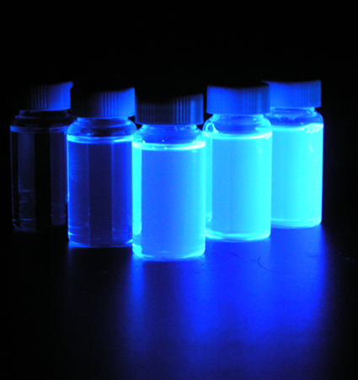
Major challenge: The liquid scintillator
LENA is much larger than any of the present liquid scintillator detectors!
Required properties
Transparency → light transport over >15m
High light yield → energy resolution
Fast fluorescence times → time resolution → vertex/track reconstruction
Good pulse shaping → particle identification
Radiopurity → low background/threshold
Michael Wurm (UHH) Exploring the neutrino sky: LENA 16

Slide 17
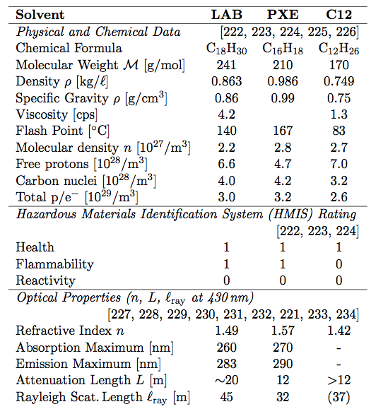
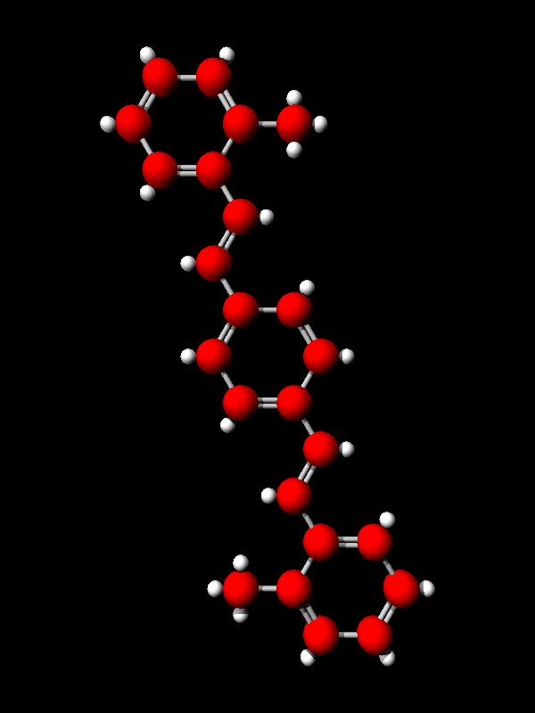
LENA‘s scintillator mixture
Candidate scintillator solvents Preferred compound
Linear alkylbenzene (LAB) as solvent
+
non-radiative → 280nm
3 g/L PPO
+
non-radiative → 390nm
20 mg/L bis-MSB
light emission → 430nm, t = 5.2ns
Michael Wurm (UHH) Exploring the neutrino sky: LENA 17

Slide 18
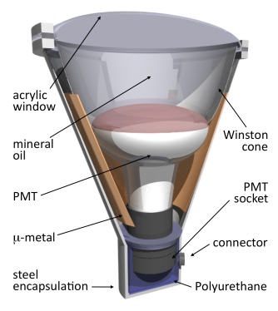
Optical modules (OMs)
Light collection efficiency Quantum efficiency 20% Optical coverage x 30% Collection efficiency 6%
Baseline design of the OMs
12‘‘ PMTs: – peak quantum efficiency >20% – transit time spread (1σ) <1.5ns
reflective Winston cones: effective collection area x1.5
required number of PMTs: 30,000
metal+acrylic encapsulation vs. pressure at detector bottom (10bar)
Michael Wurm (UHH) Exploring the neutrino sky: LENA 18

Slide 19
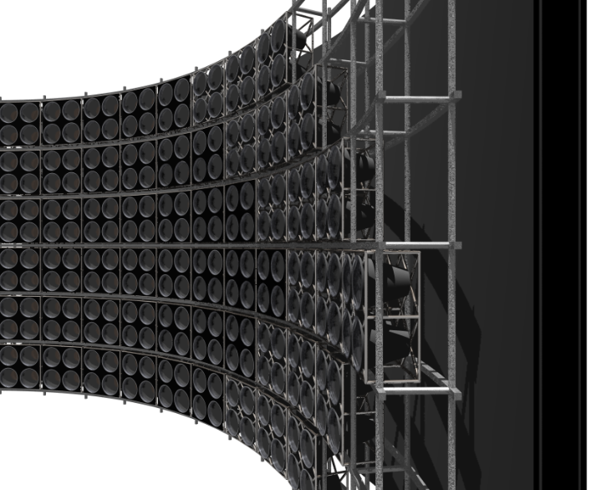
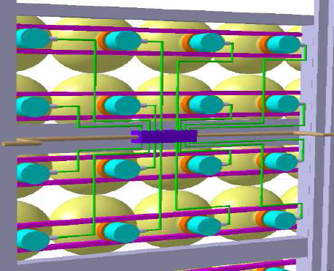
Support structure for optical modules
4x4 arrays of OMs
2,000 in total
each individual array: HV generation and digitization unit inside the tank
→ reduces cabling
Optical shield
supresses light from external γ-rays
mitigates convection
Michael Wurm (UHH) Exploring the neutrino sky: LENA 19

Slide 20
Neutrino interactions in liquid scintillator
Target | Reaction | Flavors | Threshold
electron | elastic scattering (NC/CC) | all flavors, mostly ν_{e} | ~200 keV
free proton | inverse beta decay (CC) elastic scattering (NC) | only ν_{e} all flavors | 1.8 MeV ~20 MeV
carbon-12 | inverse beta decays (CC) inelastic scattering (NC) | ν_{e} and ν_{e} all flavors | ~15 MeV 15.5 MeV
carbon-13 | inverse beta decay (CC) inelastic scattering (NC) | only ν_{e} all flavors | 2.2 MeV 3.7 MeV
CC channels feature coincidence signatures,
e.g. ν_{e} + p → e⁺ + n and n + p → d + γ [2.2MeV] after 250μs
→ used for background and channel discrimination → neutrino flavors can be resolved
_
Michael Wurm (UHH) Exploring the neutrino sky: LENA 20

Slide 21
Event reconstruction in LENA: Energy
Isotropic emission of scintilllation light: ~10⁴ photons per MeV
Absorption/scattering, 40% survive: 4x10³
~6% of photons collected by PMTs: 250 photoelectrons/MeV
Energy reconstruction by counting pe:
Michael Wurm (UHH) Exploring the neutrino sky: LENA 21

Slide 22
Event reconstruction in LENA: Position
Fit to time-of-flight differences of all detected photons
Accuracy depends on number of collected photons (energy)
Position resolution in LENA: ~20 cm at 1 MeV
Isotropic light emission → no directional resolution
Michael Wurm (UHH) Exploring the neutrino sky: LENA 22

Slide 23
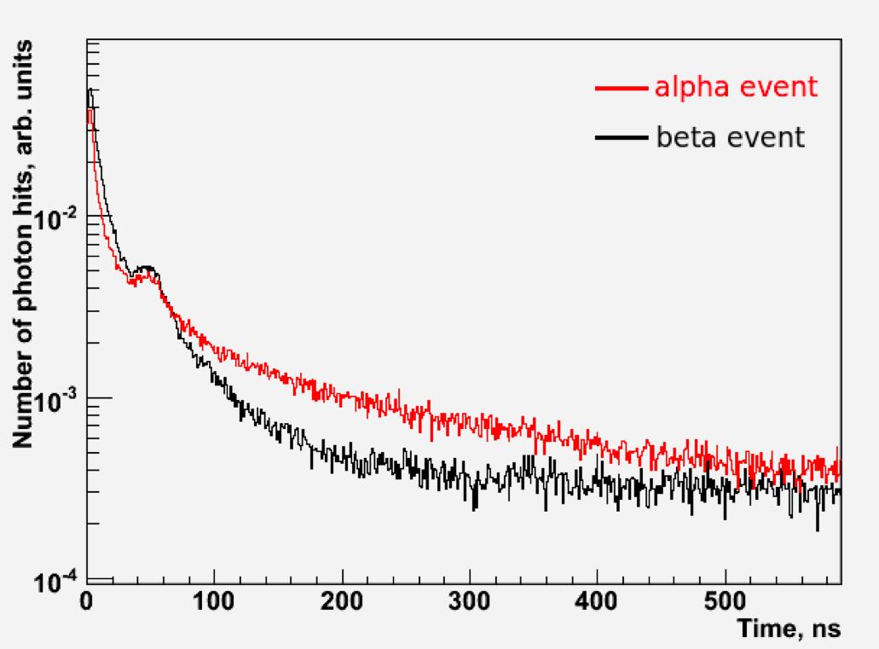
Event reconstruction in LENA: Particle ID
Light yield and emission profile depend on particle type
Initial emission profile can be reconstructed by combining all PMT hits (tof-corrected)
Michael Wurm (UHH) Exploring the neutrino sky: LENA 23

Slide 24
Observation of astrophysical sources
Supernova ν‘s: 10⁴ in 10 sec observe core-collape phases
propagation of shock-wave
observe dim/failed SNe
DM annihilation ν‘s sensitive for m_{χ} ≈ 10-100 MeV
Solar ν‘s: 10⁴ per day core metallicity
CNO fusion rate
helioseismic g-modes
DSNB: 5–10 per year average spectral temperature
fraction of dim SNe
Geo-ν‘s: 10³ yr ⁻¹ radiogenic heat flow U/Th ratio

Slide 25
Neutrino physics with natural sources
Supernova ν‘s: 10⁴ in 10 sec observe core-collape phases
propagation of shock-wave
observe dim/failed SNe
neutrino mass hierarchy neutrino mass
SN/Earth matter effects ν→ν conversion
DM annihilation ν‘s sensitive for m_{χ} ≈ 10-100 MeV
_
Solar ν‘s: 10⁴ per day core metallicity
CNO fusion rate
helioseismic g-modes
MSW transition region
Earth matter effects → non-standard effects ν→ν conversion
_
DSNB: 5–10 per year average spectral temperature
fraction of dim SNe
Geo-ν‘s: 10³ yr ⁻¹ radiogenic heat flow U/Th ratio

Slide 26
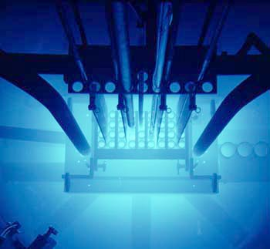
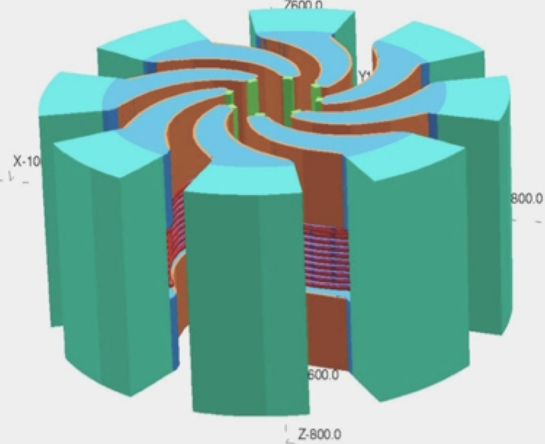
Neutrino physics with artificial sources
π⁺ decay-at-rest beam
from high-power cyclotrons ν_{e}, ν_{μ}, ν_{μ} with E<50MeV
→ sterile ν‘s, CP phase
_
Nuclear reactors
ν_{e}, E<8MeV
→ solar mixing: θ₁₂, Δm²₁₂ (mass hierarchy)
_
Radioactive Sources
ν_{e} or ν_{e}, E~1MeV
→ sterile neutrinos
_
Long baseline neutrino beam
e.g. CN2PY: 2288 km, E~4 GeV
→ mass hierarchy, CP phase

Slide 27
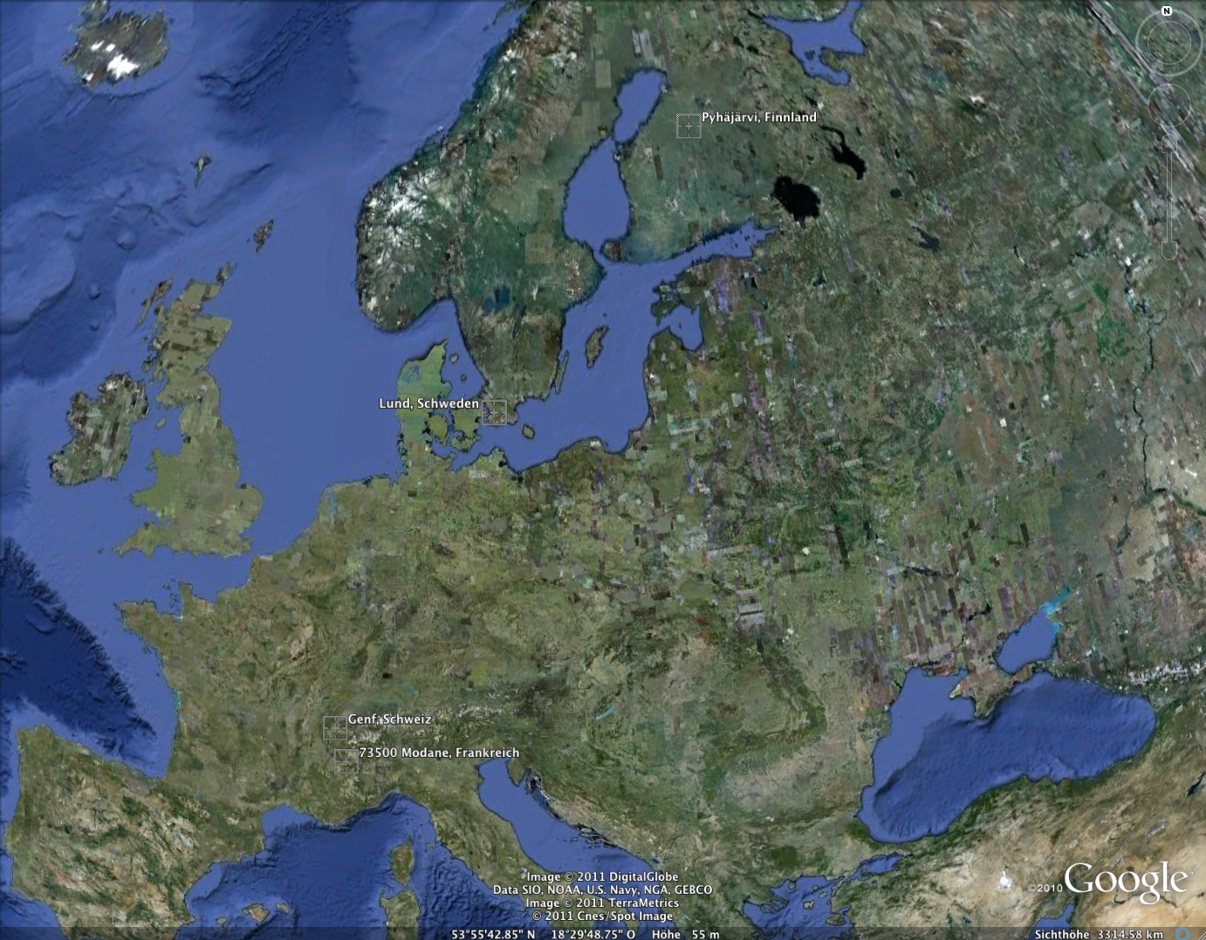
Long-baseline oscillation experiments
Pyhäsalmi
1120 km
2288 km
Protvino
CERN
CN2PY: SB 500kW 4.5 GeV
CN2FR: βB 0.4 GeV P2PY: SB 450kW 2.2 GeV
130 km
Fréjus

Slide 28
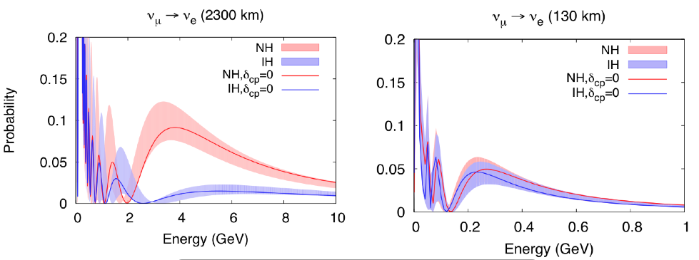
Baselines vs. sensitivities
CERN → Pyhäsalmi CERN → Fréjus
Conventional neutrino beam: ν_{μ} → ν_{e} appearance
CN2PY: Large distance → Large matter effect
→ Strong signature for neutrino mass hierarchy
Michael Wurm (UHH) Exploring the neutrino sky: LENA 28

Slide 29
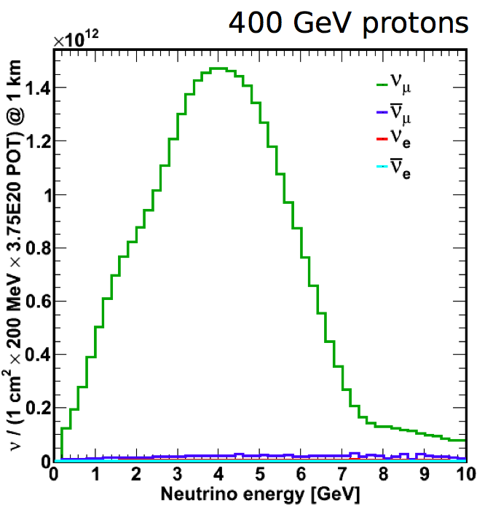
CN2PY with LENA
Initial beam spectrum
Basic beam parameters
Beam power: 700 kW
Proton energy: 400 GeV
Protons on target: 1.25 x 10²⁰ (per year)
Peak ν energy: 4.2 GeV
Baseline: 2288 km
Michael Wurm (UHH) Exploring the neutrino sky: LENA 29

Slide 30
Main requirements for the far detector
Large target mass → 50 kt
Energy reconstruction → in water: recoiling nucleon invisble lepton energy + scattering angle ΔE/E ~ 17% @ 360 MeV in scintillator: nucleon quenched but visible calorimetric measurement ΔE/E ~ 8%
Event identification → in water: e.g. CC ν_{e}→e vs. NC ν→π⁰ one vs. two Cherenkov rings in scintillator: vs. pulse shape analysis
e,μ
ν
p,n
Michael Wurm (UHH) Exploring the neutrino sky: LENA 30

Slide 31
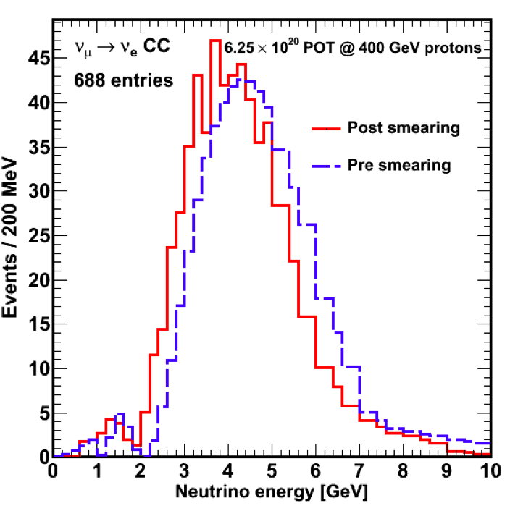
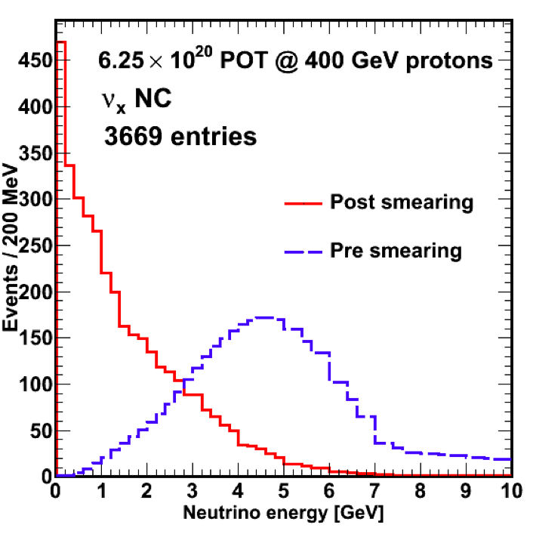
Effect of detector response
Signal: CC ν_{e} appearance Background: NC scattering
→ Background is shifted to lower visible energies!
→ Great for MH measurement, but not necessarily for δ_{CP}.
Michael Wurm (UHH) Exploring the neutrino sky: LENA 31

Slide 32
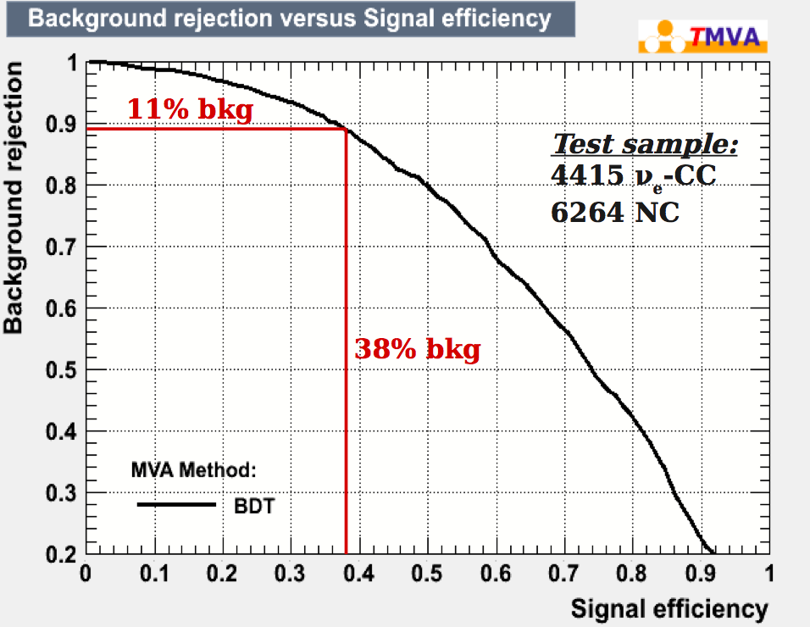
Multivariate analysis for pulse shape
MVA is based on classic pulse shape parameters (rise time, mean time ...), but also PMT activitation patterns; no particle track information used
MC study for CN2PY
energy range: 3-5 GeV
includes all sub-kinds of CC-appearance and NC-background events
→ Event identification possible w/o vertex reconstruction!
Michael Wurm (UHH) Exploring the neutrino sky: LENA 32

Slide 33
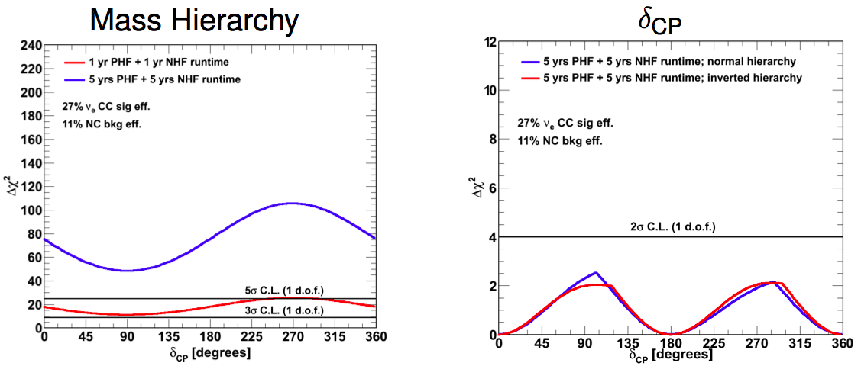
Expected sensitivity in LENA
5σ determination of mass hierarchy in ~5 yrs!
δ_{CP} much more demanding, needs better detector performance.
Michael Wurm (UHH) Exploring the neutrino sky: LENA 33

Slide 34
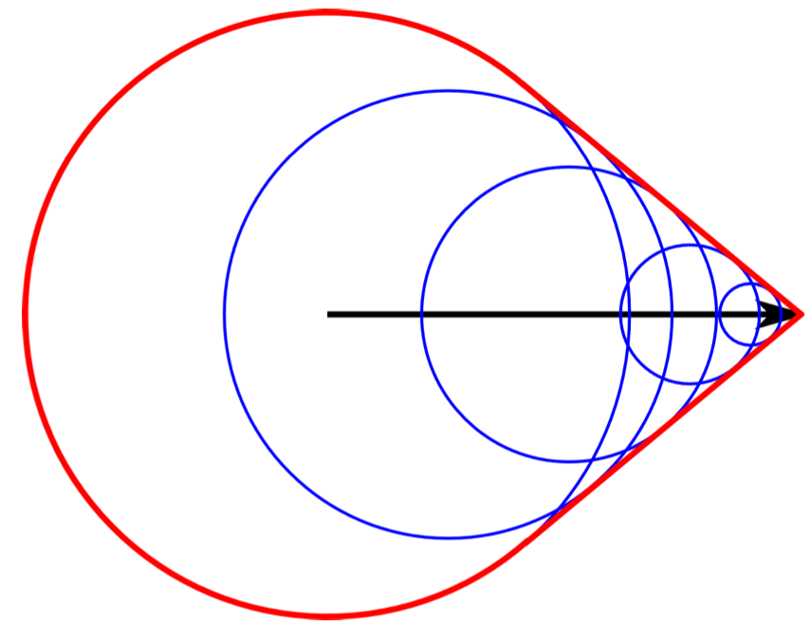
GeV particles in liquid scintillator
Possibility for improval: Include information on particle tracks!
HE particles create spherical light fronts along their track that lead in superposition to a Cherenkov-like light cone.
But: about 50x more light!
Michael Wurm (UHH) Exploring the neutrino sky: LENA 34

Slide 35
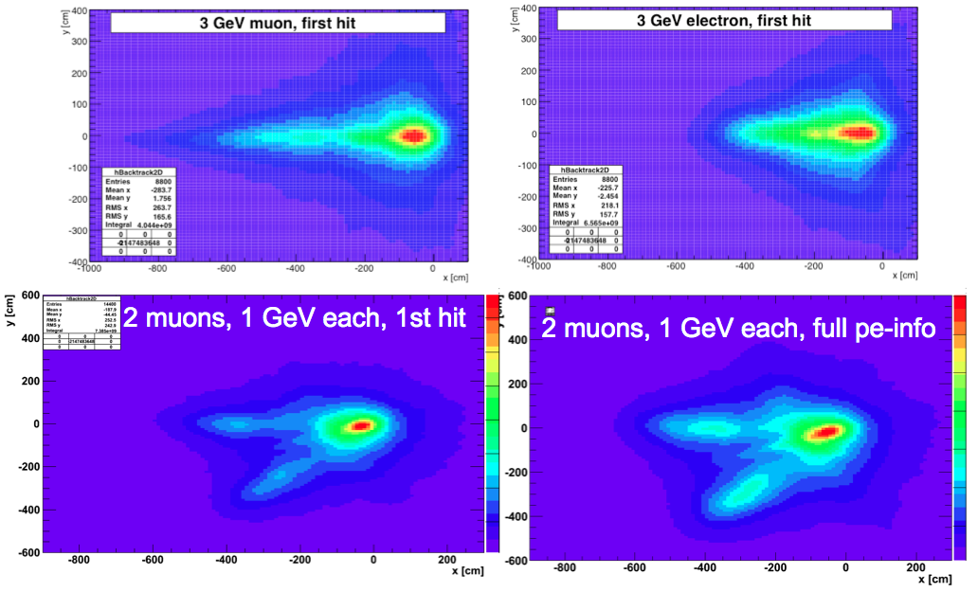
Vertex reconstruction in liquid scintillator
Michael Wurm (UHH) Exploring the neutrino sky: LENA 35

Slide 36
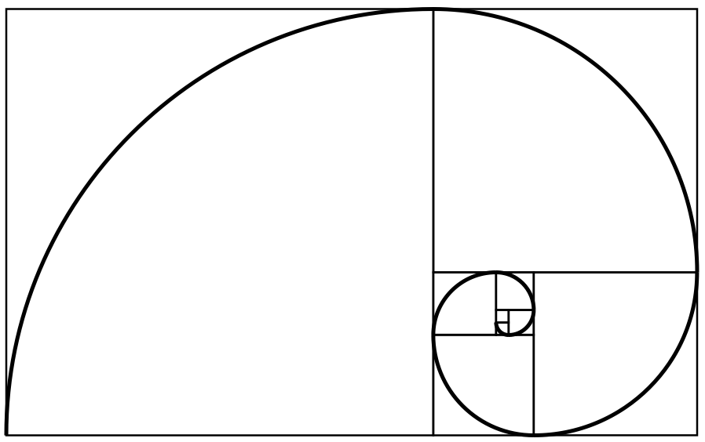
Alternative: π⁺ decay-at-rest source for δ_{CP}
DAEδALUS
@LENA
Michael Wurm (UHH) Exploring the neutrino sky: LENA 36

Slide 37
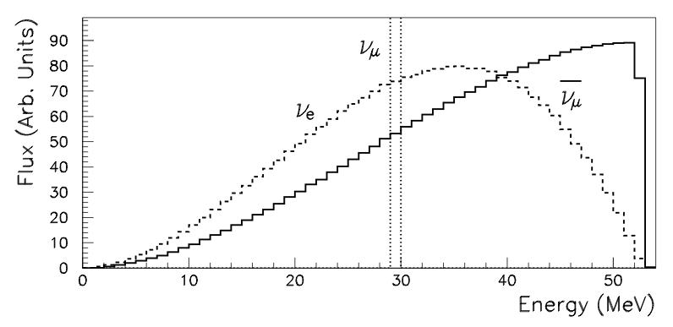
Pion Decay-at-Rest (piDAR) source
Resonant production of pions by low-energy (~1GeV), high-power (~MW) proton beam
π⁺ are stopped and decay via (π⁻ absorbed in target, ν_{e}<0.04%)
→ Low energy (10-50 MeV) ‘neutrino beam‘ of ν_{e}, ν_{μ} and ν_{μ}
_
_
spectral shape driven by nature
Michael Wurm (UHH) Exploring the neutrino sky: LENA 37

Slide 38
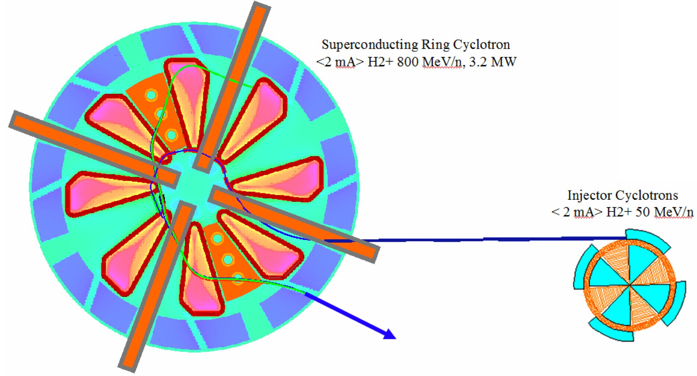
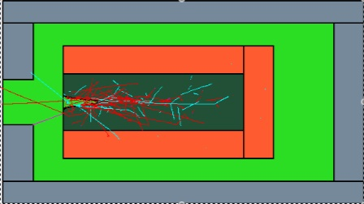
Proton source: High-power cyclotrons
Uses Multiple “Accelerator Units”
constructed of cyclotrons
to accelerate H₂⁺ to 800 MeV
Primary
Cyclotron
Injector Cyclotron
H₂⁺ Ion Source
Target/shielding
The result is a decay-at-rest-flux
That can be used for ν_{μ} → ν_{e} searches
_
_
Michael Wurm (UHH) Exploring the neutrino sky: LENA 38

Slide 39
How to measure δ_{CP} with antineutrinos only
_
_
DAEδALUS approach: Use ν_{μ} → ν_{e} appearance
and exploit the L/E dependence in absolute rates
SBNO, so no matter effects! → oscillation probability in vacuum
}
}
We want to see
if δ is nonzero
terms depending on
mixing angles
terms depending on
mass splittings
Michael Wurm (UHH) Exploring the neutrino sky: LENA 39

Slide 40
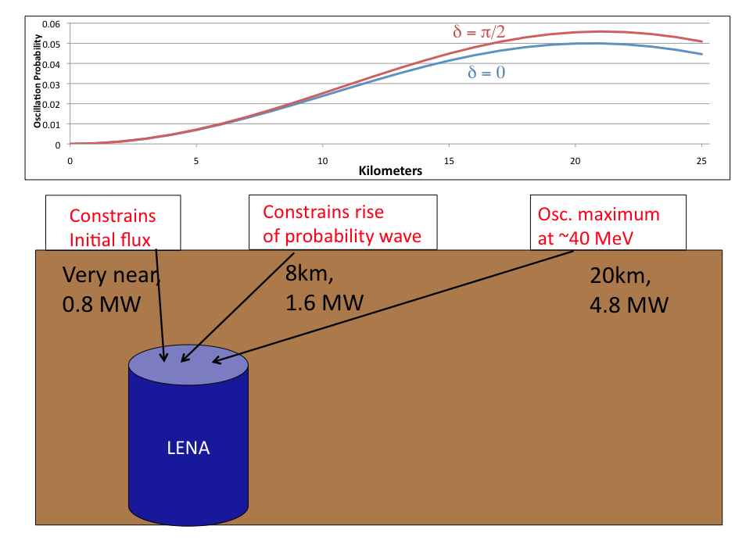
DEAδALUS‘ three-baseline design
Michael Wurm (UHH) Exploring the neutrino sky: LENA 40

Slide 41
LENA as detector for DAEδALUS
Original proposal for detector: 200 kt of Gd-doped water (LBNE)
LENA: smaller target volume (50kt), but better detection efficiency for IBD discrimination for νe-scat., ν¹²C reactions
First estimate from INT conference uses
detector mass: 42.5kt IBD detection efficiency: 63% low! atmospheric ν background: no duty cycle of cyclotrons: 75%
→ about 100 IBD events per year for each baseline
Michael Wurm (UHH) Exploring the neutrino sky: LENA 41

Slide 42
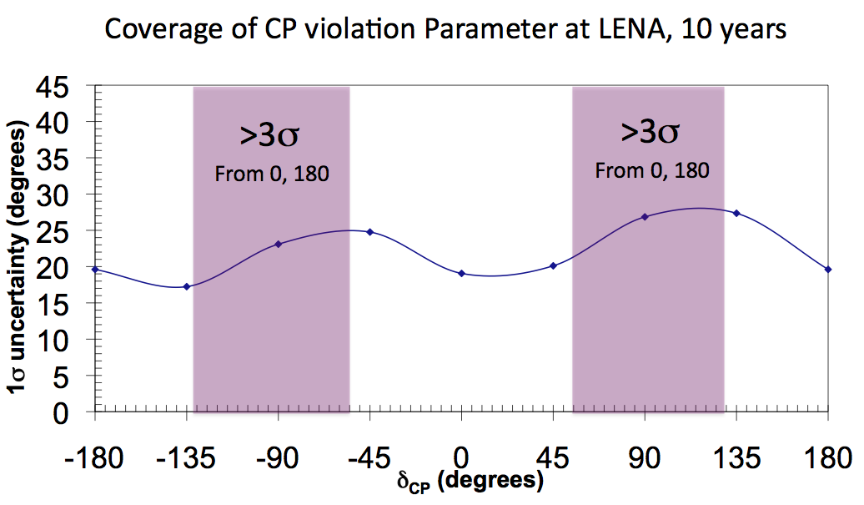
Projected sensitivity to δ_{CP}
→ Predicted coverage for δ_{CP} at 3σ: 42% after 10 years
→ Sensitivity is dominated by statistical uncertainty
Michael Wurm (UHH) Exploring the neutrino sky: LENA 42

Slide 43
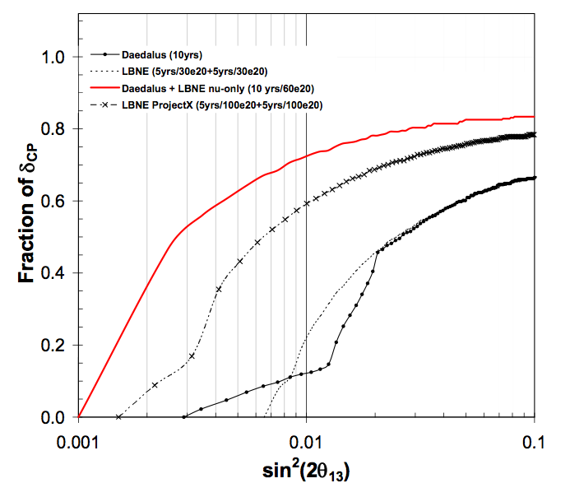
Complementarity to LBL options
outdated!!
combined
LBNE
DAEδALUS
Added value: → approaches have substantially different systematics
→ LBL mainly ν_{e}, piDAR only ν_{e}
_
Michael Wurm (UHH) Exploring the neutrino sky: LENA 43

Slide 44
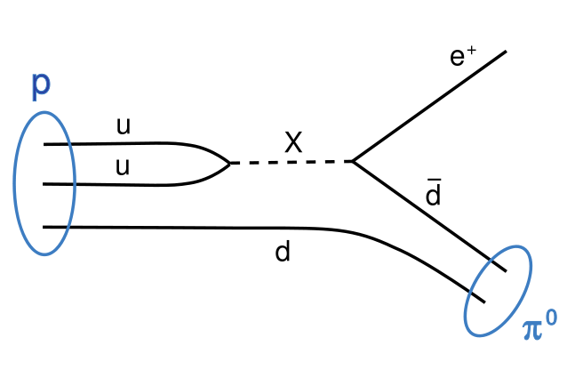
Proton decay
Michael Wurm, TUM Physics with LENA 44/24
Michael Wurm (UHH) Exploring the neutrino sky: LENA 44

Slide 45
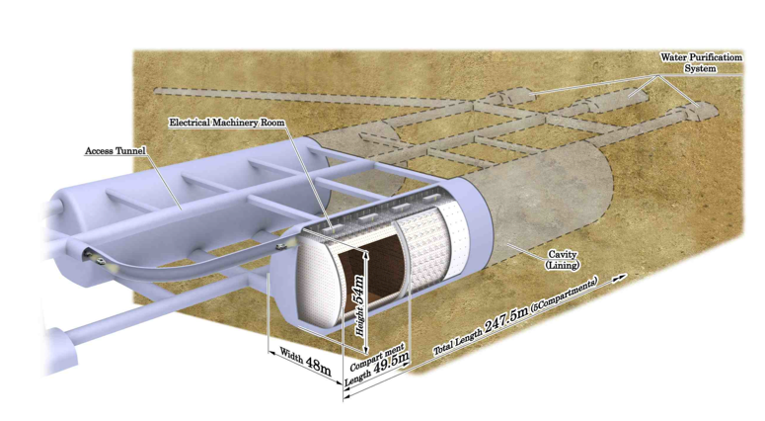
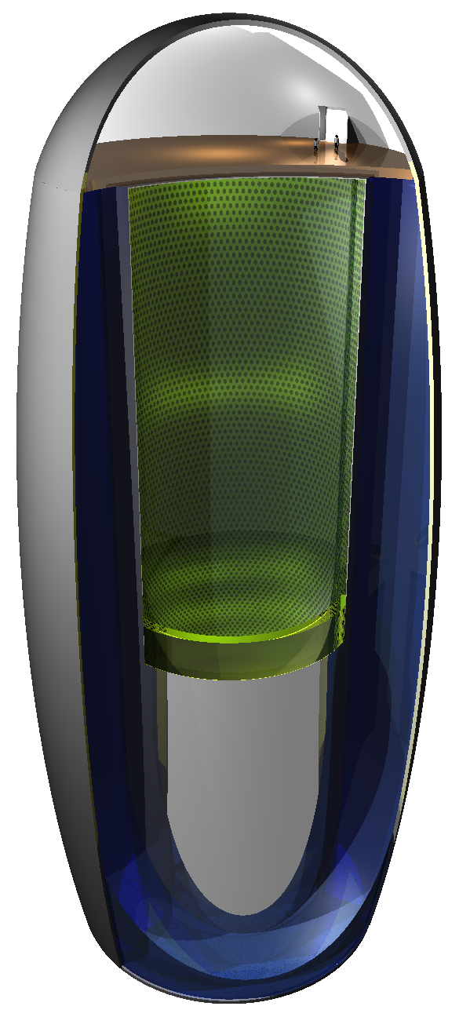
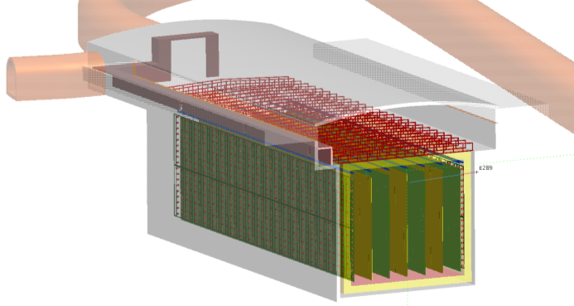
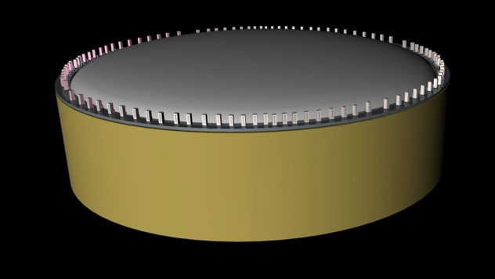
Proton decay searches in large ν detectors
_
p → π⁰ + e⁺
favored by standard GUTs
predicted proton lifetime: τ ~ 10^{31-?} yrs
current best limit from SK: τ ≥ 5.4 × 10³³ yrs
Large detection efficiency in water, and in this case, size does matter ...
p → K⁺ + ν
favored by SUSY, large BR in SUGRA
predicted proton lifetime: τ ≤ 10³⁴⁻³⁵ yrs
current best limit from SK: τ ≥ 2.3 × 10³³ yrs
Low efficiency in water as the kaon is below Cherenkov threshold. → Window for „small“ detectors
Michael Wurm, TUM Physics with LENA 45/24
Michael Wurm (UHH) Exploring the neutrino sky: LENA 45

Slide 46
Signature of the K⁺ν decay
_
Michael Wurm (UHH) Exploring the neutrino sky: LENA 46

Slide 47
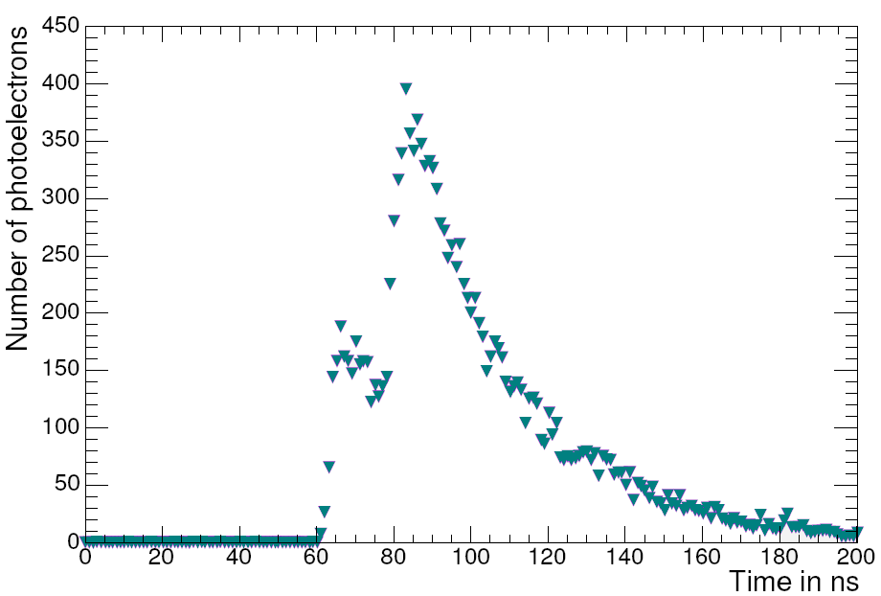
Proton decay into K⁺ν
_
SUSY-favored decay mode
Signature p → K⁺ ν  μ⁺ν_{μ} / π⁰π⁺
kaon visible in liquid scintillator!
fast coincidence signature (τ_{K} = 13 ns)
signal efficiency: ~65% (atm. ν bg)
remaining background: <0.1 ev/yr
_
μ⁺
K⁺
Michael Wurm (UHH) Exploring the neutrino sky: LENA 47

Slide 48
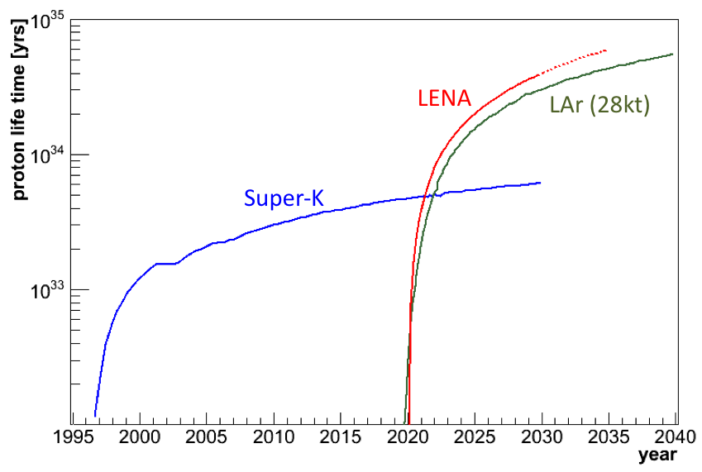
Proton decay into K⁺ν
_
SUSY-favored decay mode
Signature p → K⁺ ν  μ⁺ν_{μ} / π⁰π⁺
kaon visible in liquid scintillator!
fast coincidence signature (τ_{K} = 13 ns)
signal efficiency: ~65% (atm. ν bg)
remaining background: <0.1 ev/yr
_
μ⁺
K⁺
Limit for LENA if no event is observed in 10yrs (0.5 Mt.yrs):
τ_{p} > 4x10³⁴ yrs (90%C.L.)
Michael Wurm (UHH) Exploring the neutrino sky: LENA 48

Slide 49
Conclusions
A liquid-scintillator detector on the scale of 50 kt will be a multipurpose ν observatory:
➔ Astrophysical neutrino sources
stellar core collapse/fusion processes
Earth heat flow, elemental composition ...
➔ Neutrino physics
mixing parameters, incl. δ_{CP}
neutrino mass hierarchy
sterile flavors
non-standard interactions ...
➔ Particle physics
baryon number violation
light dark matter
Michael Wurm (UHH) Exploring the neutrino sky: LENA 49

Slide 50
How long to wait?
Michael Wurm (UHH) Exploring the neutrino sky: LENA 50

Slide 51
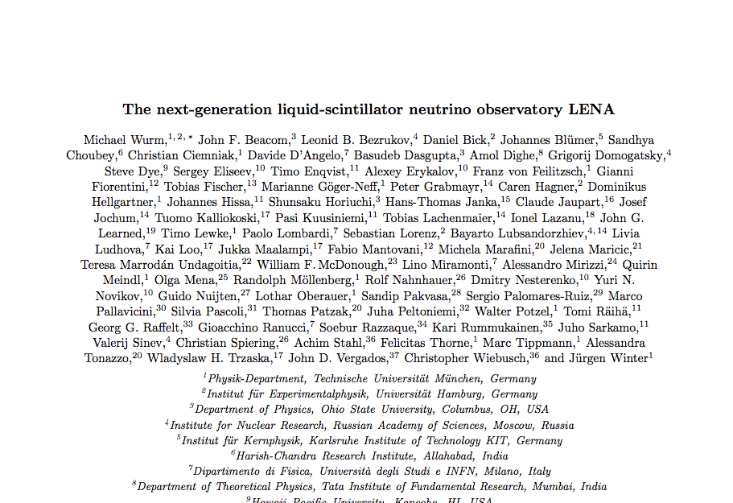
Further reading

Slide 52
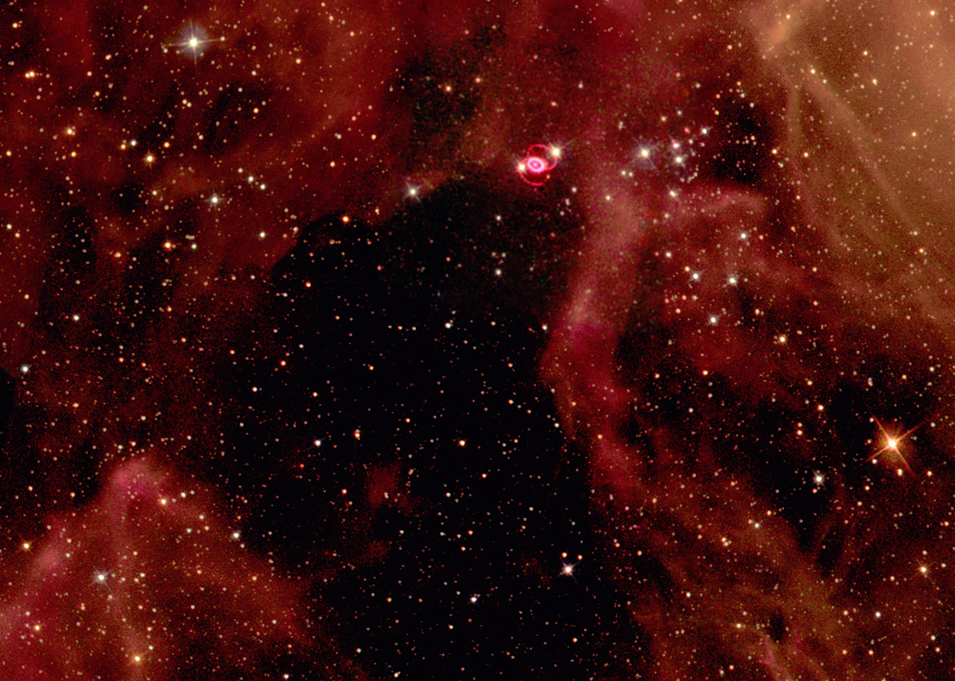
Backup Slides

Slide 53
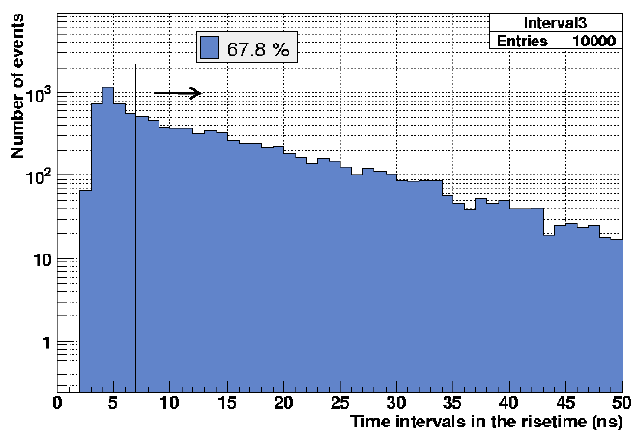
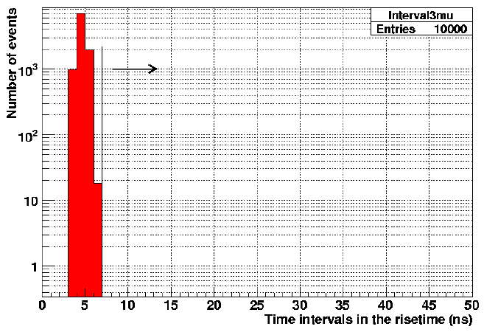
_
Proton decay into K⁺ν
_
Signature p → K⁺ ν  μ⁺ν_{μ} / π⁰π⁺
coincidence: τ_{K} = 13 ns energy: 250-450 MeV modified by Fermi motion for ¹²C Background atmospheric ν‘s rejected by rise time cut: efficiency 0.67 hadronic channels: <1.2 per 1Mt.yr (producing kaons) @ 4kmwe Current SK limit: 2.3x10³³ yrs
Limit for LENA if no event is observed in 10yrs (0.5 Mt.yrs):
τ_{p} > 4x10³⁴ yrs (90%C.L.)
Proton decays
Atmospheric neutrinos
Michael Wurm, TUM Physics with LENA 53/24

Slide 54
LENA – a mulitpurpose neutrino observatory
Neutrinos at low energies
Galactic Supernovae ν‘s
DSNB
Solar neutrinos
Dark matter annihilation
Geoneutrinos
Reactor neutrinos
Radioactive sources
Pion decay-at-rest beams
GeV energies
Long-baseline neutrino beam
Atmospheric neutrinos
Proton decay
➔ Astrophysical neutrino sources
stellar core collapse/fusion processes
Earth heat flow, elemental composition
➔ Neutrino physics
mixing parameters
neutrino mass hierarchy
sterile flavors
neutrino-antineutrino conversion
non-standard interactions
➔ Particle physics
baryon number violation
light dark matter
Michael Wurm (UHH) LENA – NOW 2012 54

Slide 55
Extraction of oscillation signature
Using the near accelerator
measure absolute flux normalization with ν-e events to ~1%,
Also, measure the ν_{e}C event rate.
At far and mid accelerator,
Compare predicted to measured ν_{e}C event rates
to get the relative flux normalizations between 3 accelerators
In all three accelerators,
given the known flux, fit for the ν_{μ} → ν_{e} signal
with free parameters: θ₁₃ and δ
_
_

Slide 56
LENA physics programme
Neutrinos at low energies
Galactic Supernovae ν‘s 10⁴/SN
DSNB 10/yr
Solar neutrinos 10⁴/d
Dark matter annihilation
Geoneutrinos 10³/yr
Reactor neutrinos 10³⁻⁴/yr
Radioactive sources 10⁴/MCi
Pion decay-at-rest beams
GeV energies
Long-baseline neutrino beam
Atmospheric neutrinos
Proton decay
Michael Wurm (UHH) LENA – NOW 2012 56

Slide 57
Pulsing of the beam source
Beam Off
Beam Off
1.5 km Accelerator
100μs
400μs
100μs
400μs
100μs
8 km Accelerators
100μs
400μs
100μs
400μs
100μs
20 km Accelerators
100μs
400μs
100μs
400μs
100μs
Constrains
Initial flux
Constrains rise
of probability
Oscillation maximum
You need to know which
One is providing the beam.
So they have to turn on/off.
The duty factor is flexible,
But beam-off time is needed.

Slide 58
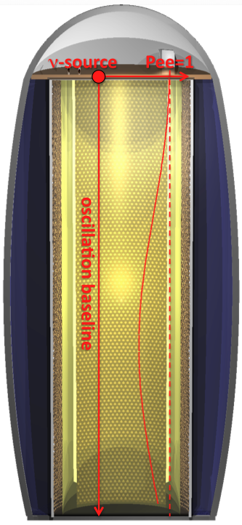
Neutrino oscillometry
Concept: Short-baseline oscillation experiments using neutrinos from radioactive sources.
Radioactive neutrino sources
ν_{e} (monoenergetic) from electron-capture sources: ⁵¹Cr, ³⁷Ar
ν_{e} (E < 3 MeV) from long-lived fission products: ⁹⁰Sr, ¹⁴⁴Ce
typical activities: 5-10 MCi for ν_{e} 100 kCi for ν_{e}
Oscillation baselines at source energies
for ν_{e}→ ν_{τ} via Δm²₃₂ (θ₁₃): 750m for ⁵¹Cr
for ν_{e}→ ν_{s} via Δm²₄₁ (θ₁₄): ~1m (~1 eV²)
→ very sensitive sterile neutrino search!
_
_
Michael Wurm (UHH) Exploring the neutrino sky: LENA 58

Slide 59
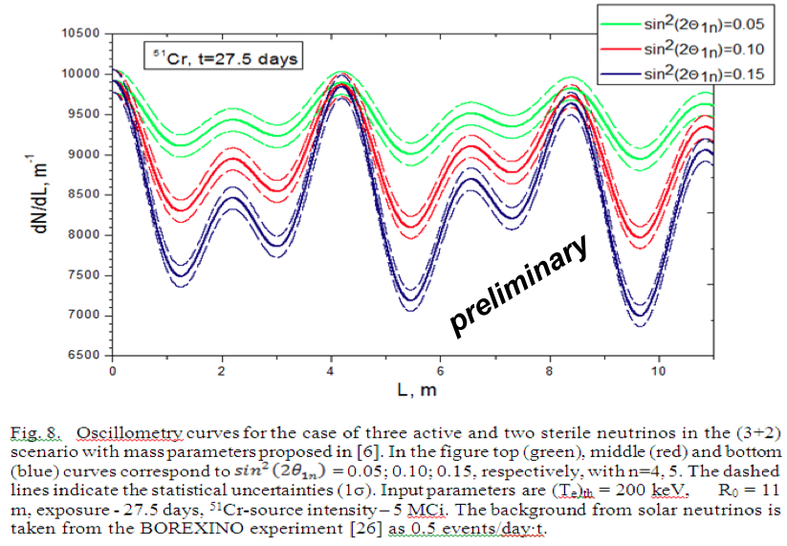
Sensitivity to sterile neutrinos
If evidence for ν_{s}‘s is found in 1st generation experiments, LENA offers the possibility to investigate scenarios (e.g. 3+1 vs. 3+2) in high-statistics measurements.
Michael Wurm (UHH) Exploring the neutrino sky: LENA 59

Slide 60
Sterile neutrinos with piDAR source @ 20m
Beam configuration
Proton beam: E = 800 MeV, P = 100 kW
Neutrinos (per year): 4x10²¹ in ν_{e},ν_{μ},ν_{μ} 1.6x10¹⁸ in ν_{e}
Distance from LENA: 20m
Sterile neutrino signal
ν_{μ}→ν_{e} appearance for 3+2: >10⁴ IBD events, S/B 10:1
ν_{e}→ν_{s} disappearance: ~2x10⁵ ν_{e}¹²C CC events
_
_
_
_
piDAR→LENA provides capability to distinguish 3+1 and 3+2 scenarios
Michael Wurm (UHH) Exploring the neutrino sky: LENA 60

Slide 61
Sensitivity with piDAR beam
_
_
ν_{μ} → ν_{e} appearance
ν_{e} → ν_{s} disappearance
Michael Wurm (UHH) Exploring the neutrino sky: LENA 61

Slide 62
Precision measurements with reactor ν‘s
Solar oscillation parameters
LENA @ Fréjus: sin²2θ₁₂ ~ 10% (3σ) Δm²₁₂ ~ 1% (3σ)
Michael Wurm (UHH) Exploring the neutrino sky: LENA 62

