Slide 1
Free-space quantum teleportation over 143 kilometers
—— Photon collection and denoising
by Daqing Wang
Institute for Quantum Optics and Quantum Information
Austrian Academy of Sciences
daqing.wang@univie.ac.at
13.12.2012

Slide 2
Outlines
Introduction
Setting-up
Entangled photon source
Complete optical setup
Factors on spot size
Single-photon detectors
Temporal filtering
Results

Slide 3
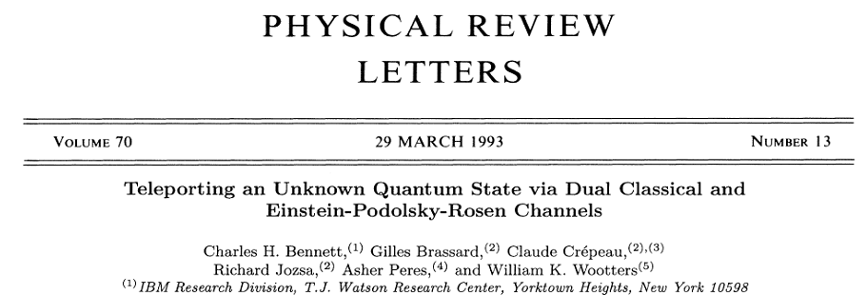
Introduction the idea of quantum teleportation
“To make a person or object disappear while an exact replica appears somewhere else.”
----Bennett et al. 1993
Beam me up, Scotty!
Quantum State Teleportation

Slide 4
Introduction the idea of quantum teleportation
Proposal in Bennett et al. 1993
Feed-forward
1 & 2,3 in a product state:
Four “Bell-states”:
$$\left({α|H〉}_{1}+β{|V〉}_{1}\right) ⨂ \frac{1}{\sqrt{2}}\left({|H〉}_{2}{|V〉}_{3}−{|V〉}_{2}{|H〉}_{3}\right)$$
$${|ψ^{±}〉}_{12}=\frac{1}{\sqrt{2}}\left({|H〉}_{1}{|V〉}_{2}±{|V〉}_{1}{|H〉}_{2}\right)$$
project 1 and 2 onto Bell-states:
$= \frac{1}{2} [{|ψ^{−}〉}_{12} ⨂ ({−α|H〉}_{3}−β{|V〉}_{3})$ $+ {|ψ^{+}〉}_{12} ⨂\left(−{α|H〉}_{3}+β{|V〉}_{3}\right)$ $+ {|φ^{−}〉}_{12} ⨂\left({α|V〉}_{3}+β{|H〉}_{3}\right)+ {|φ^{+}〉}_{12} ⨂ ({α|V〉}_{3}−β{|H〉}_{3})$
$${|φ^{±}〉}_{12}=\frac{1}{\sqrt{2}}\left({|H〉}_{1}{|H〉}_{2}±{|V〉}_{1}{|V〉}_{2}\right)$$

Slide 5
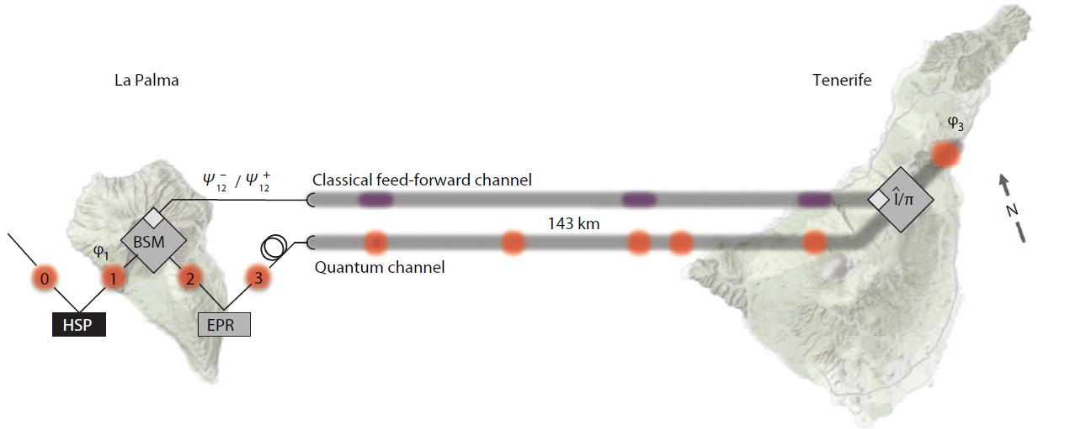
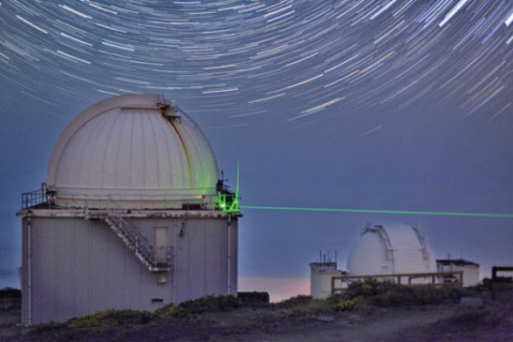
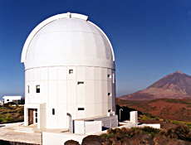
Setting-up a blueprint
Single photon source
Entangled-photon source
Bell-state measurement setup
Feed-forward channel
Tracking
Jacobus Kapteyn Telescope
Polarization measurement module
Single photon detectors
Polarization transformation (Pockels-cells)
ESA Optical Ground Station

Slide 6
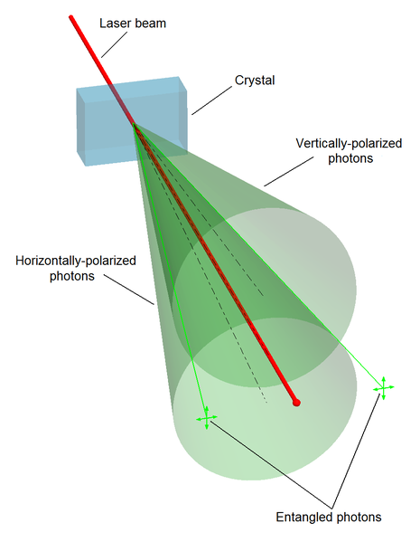
Setting-up entangle photons via SPDC
Spontaneous parametric down conversion (SPDC)
Energy and momentum conservation
${\vec{k}}_{1}+{\vec{k}}_{2}={\vec{k}}_{0}$
$ω_{1}+ω_{2}=ω_{0}$
Photon 1
Photon 2
Any of the four Bell-states can be prepared with a set of HWP+QWP
from wikipedia/SPDC
$${|ψ^{±}〉}_{12}=\frac{1}{\sqrt{2}}\left({|H〉}_{1}{|V〉}_{2}±{|V〉}_{1}{|H〉}_{2}\right)$$
$${|φ^{±}〉}_{12}=\frac{1}{\sqrt{2}}\left({|H〉}_{1}{|H〉}_{2}±{|V〉}_{1}{|V〉}_{2}\right)$$
Type II: anti-correlated in polarization
Indistinguishable from their path and frequency
→Polarization entangled
A bright (2 million pairs/second *) entangled photon source can be built up, with continuous pumping.
* J.B. Altepeter, E. Jeffey and P.G. Kwiat. Opt. Exp. 13, 8951-8959, 2005

Slide 7
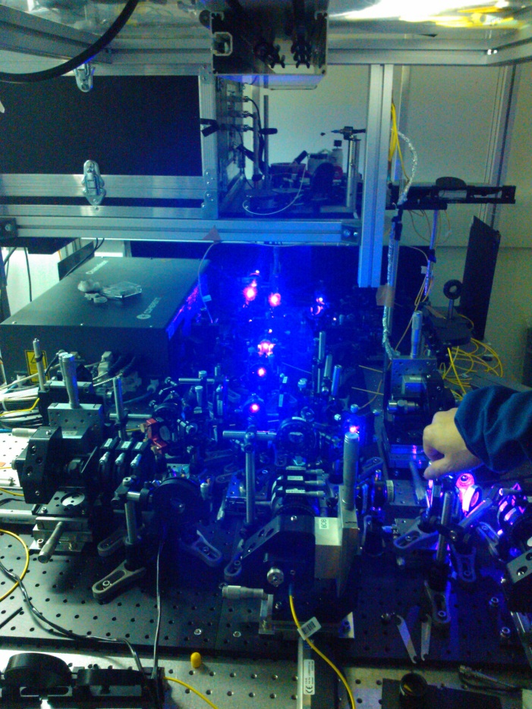
Setting-up frequency-uncorrelated SPDC source
In multi-photon experiment, interference required → timing property
Pump with ultrafast laser pulses (broad band pumping) → spectral distinguishability
Using narrow band filters (2-3 nm)
→ Strong loss of photons
H-polarized: e photon
V-polarized: o photon
H-polarized:
+
V-polarized:
+
Erase the distinguishability without strong filtering
Pair rate = 180 kHz
Entanglement visibility = 88%
*W.P. Grice and I.A. Walmsley. Phys. Rev. A 56, 1627-1634, 1997.
** H.-S. Poh, J. Lim, I. Marcikic, A. Lamas-Linares and C. Kurtsiefer. Phys. Rev. A 80, 043815, 2009.

Slide 8
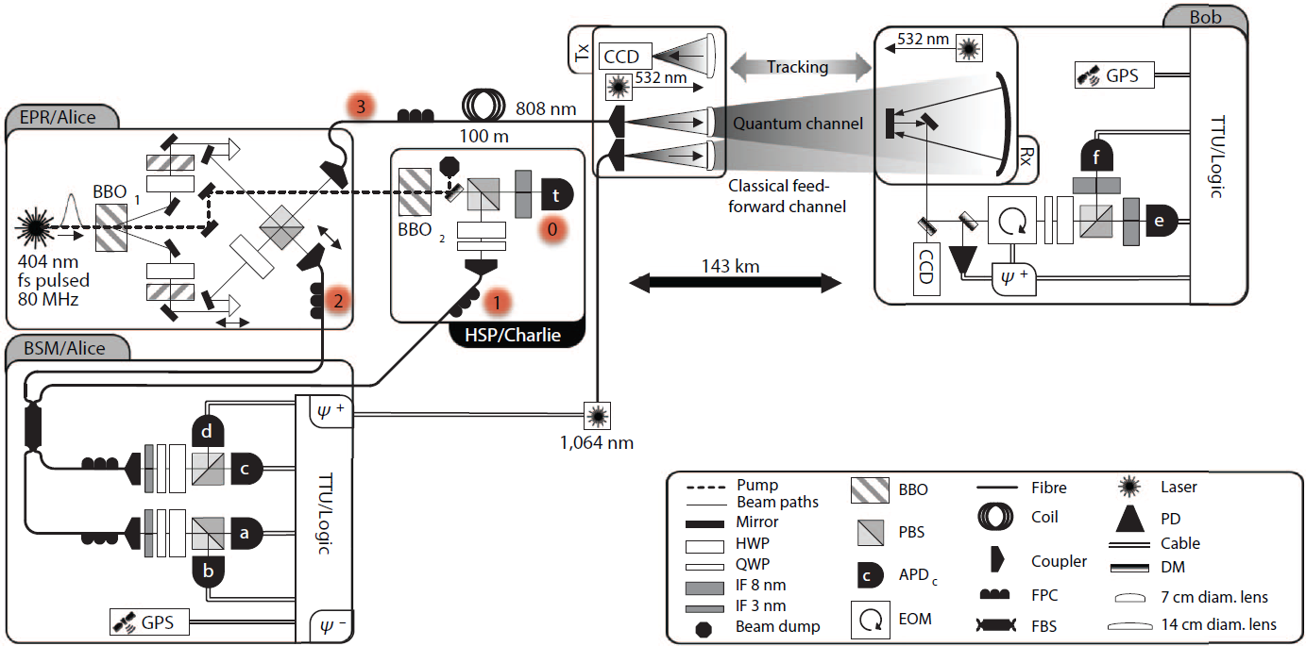
Setting-up sender
2
1
Heralded single photon
Sub-poissonian statistics only with the trigger photon
Bell-state measurement:
Hong-Ou-Mandel interference + polarization analyze
${|ψ^{−}〉}_{12}$ ($D_{a}+D_{c}$ or $D_{b}+D_{d}$)
${|ψ^{+}〉}_{12}$ ($D_{a}+D_{d}$ or $D_{b}+D_{c}$)
Teleportation event = 4-photon coincidence event
3
1
3
2
Frequency uncorrelated EPR
Heralded single photon
Bell-state measurement

Slide 9
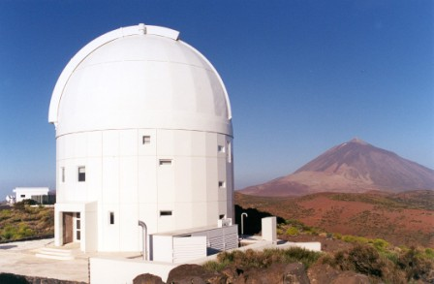
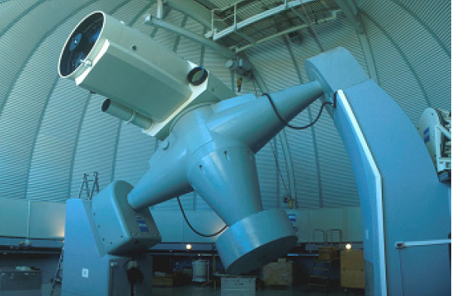
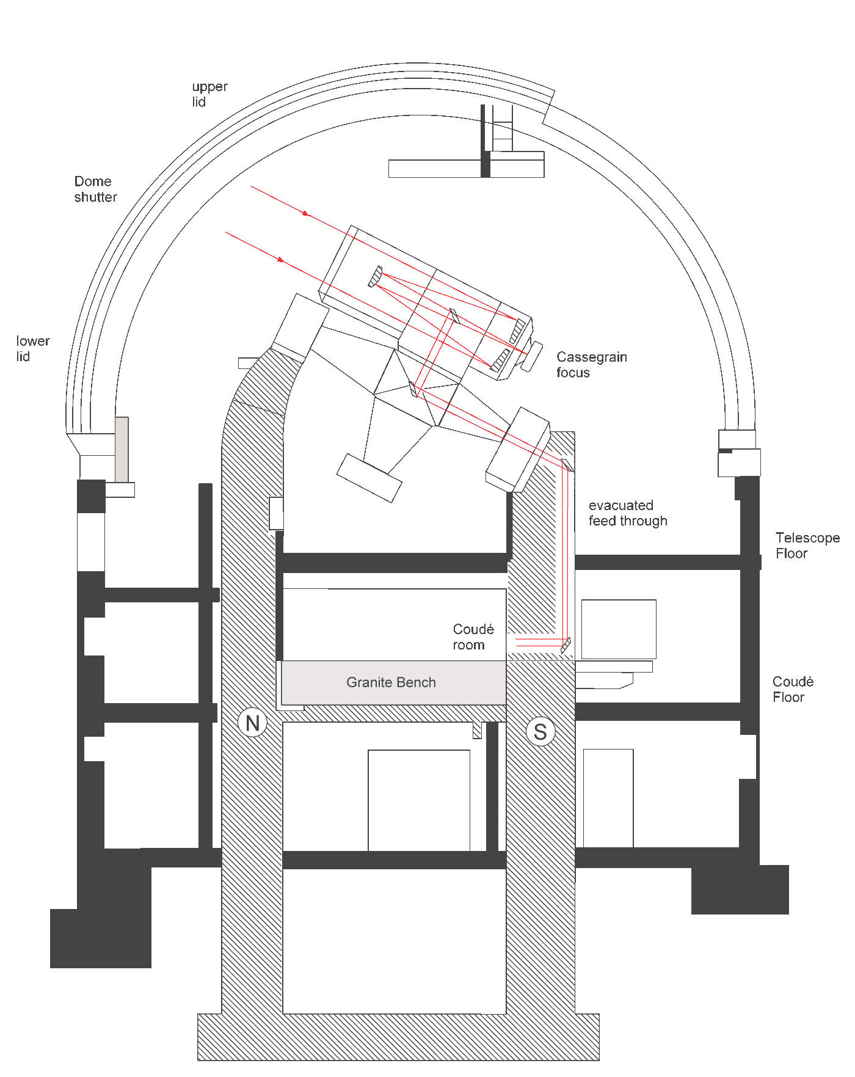
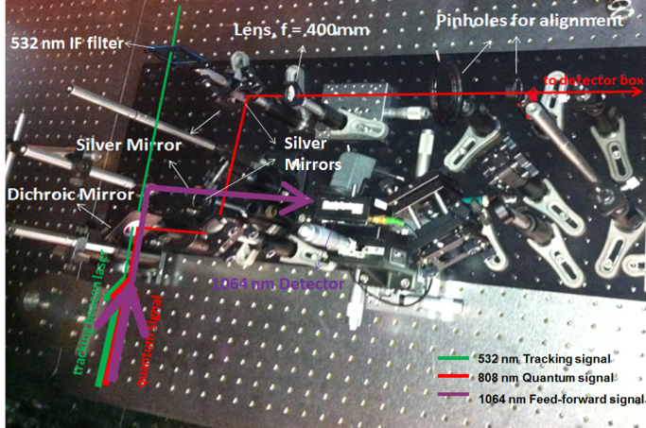
Setting-up receiving telescope
European Space Agency (ESA)
1m Ritchey-Chrétien telescope
Horizon pointing

Slide 10
Setting-up receiver
4
2
1
3
4
532nm tracking laser
808nm quantum signal
1064nm classical signal

Slide 11
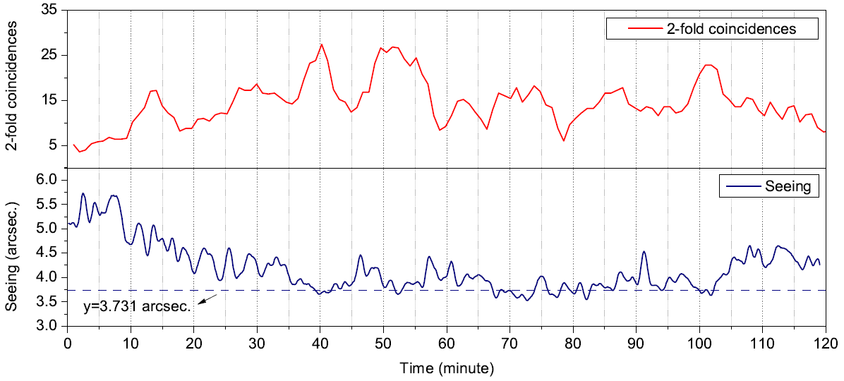
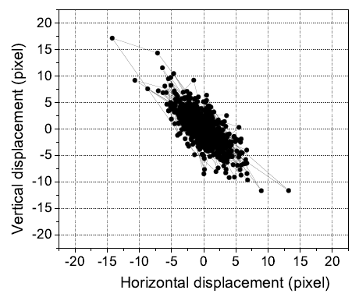
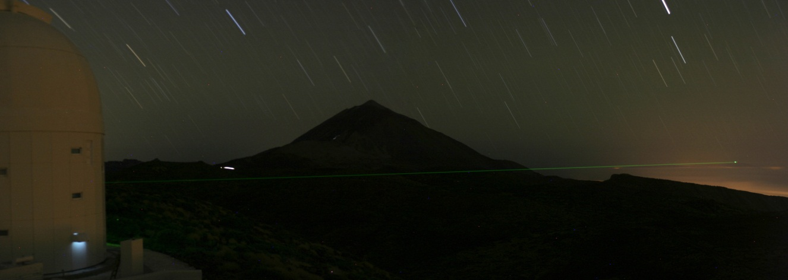
Setting-up factors on the spot size
Fast atmospherical variations → wavefront distortions
Characterized by seeing
3.731 arcsec. → 300 µm diameter spot
Adaptive optical elements (not applied in final experiment)
Slow variations mechanical instabilities → beam wandering
Bi-directional closed-loop tracking
Tracking spot at Tenerife over 2 hours (4.5um/pixel)

Slide 12
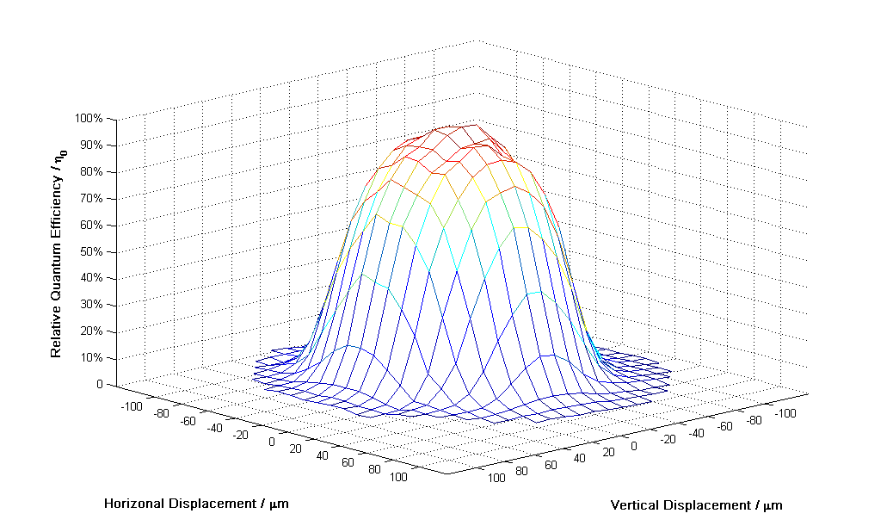
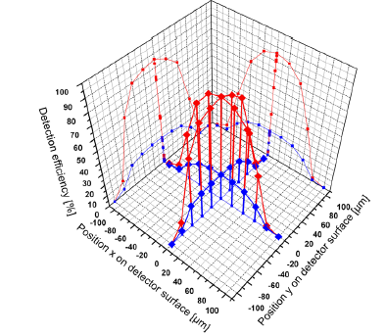
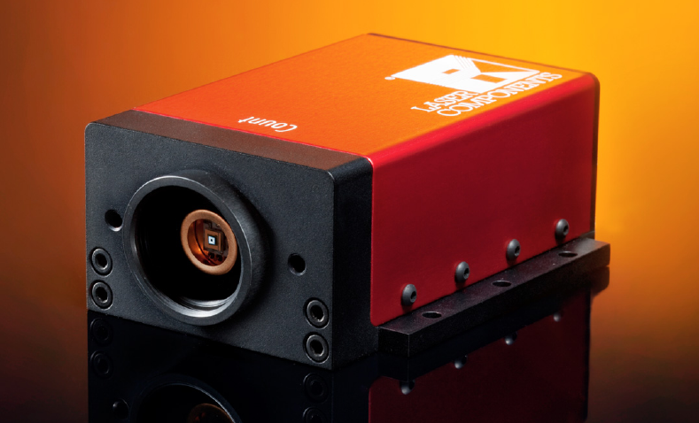
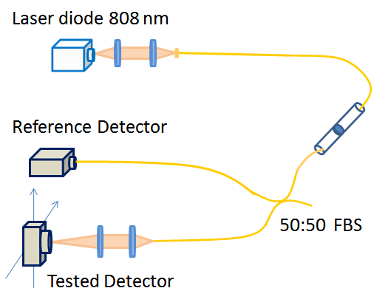
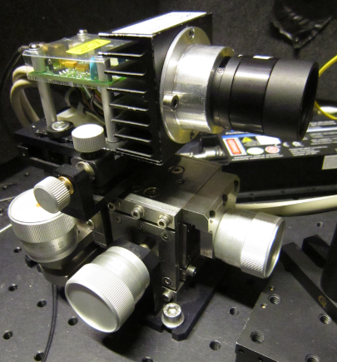
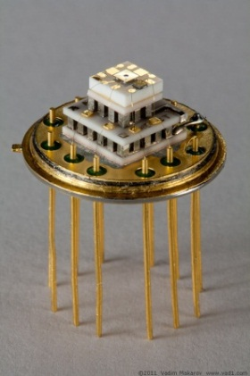
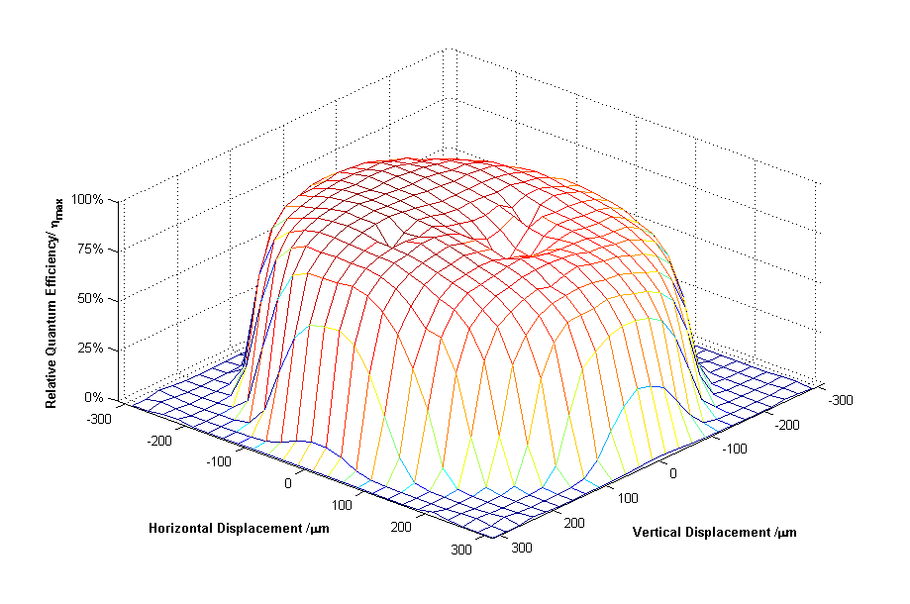
Setting-up single-photon detectors
FWHM:
130 μm
Demanding on the detectors:
Large sensitive area (>300 μm)
Low dark count rate (<1kHz)
Laser Components SPCM
FWHM:
510 μm
Laser Components SAP 500
FWHM:
510 μm
Cooled down to -70 degrees
4-stage TEC
Dark count rate < 20 Hz
QE at 808nm: 40%
Perkin Elmer C30902SH

Slide 13
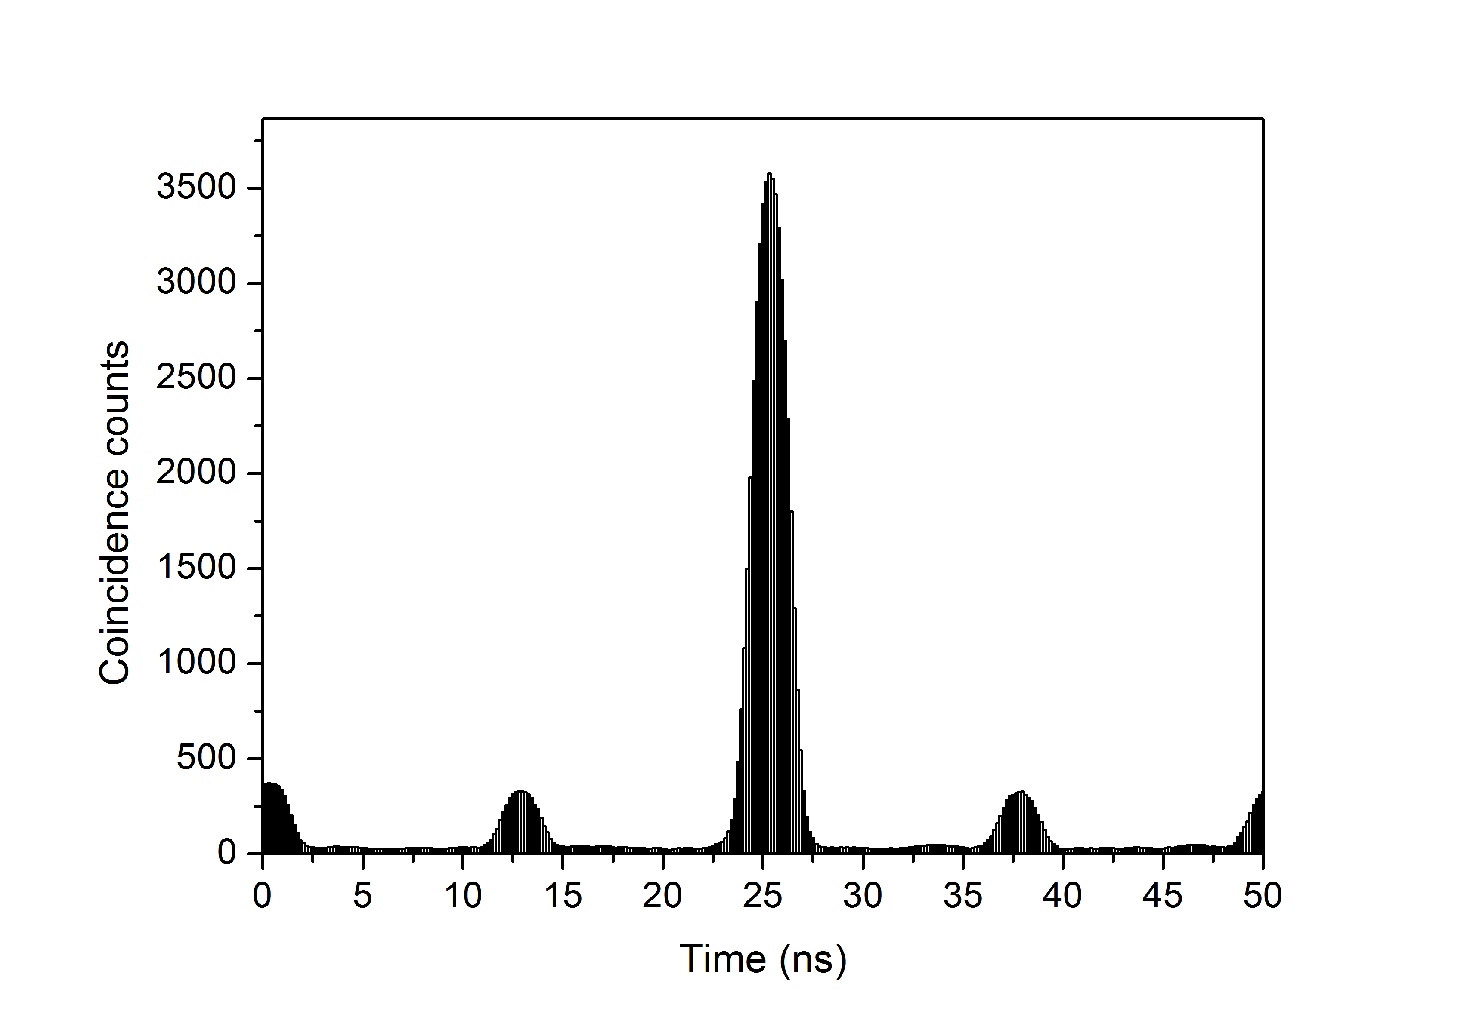
Setting-up temporal filtering
Detector dark counts: 35Hz
8nm wavelength filtering
Background counts: 1.5kHz - 2.0kHz
0.2
200
1000
Signal
Coincidence searching → temporal filtering
Coincidence window size: 2ns
Teleported
Background
t_{A0}
t_{A}
t_{B0}
t_{B}

Slide 14
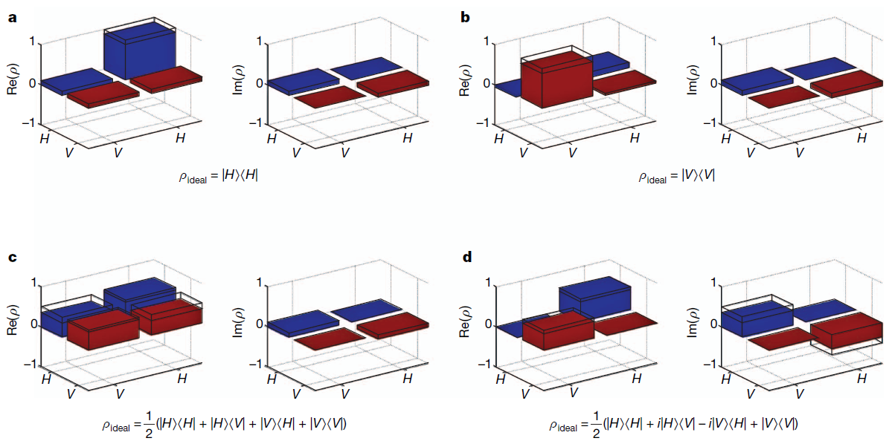
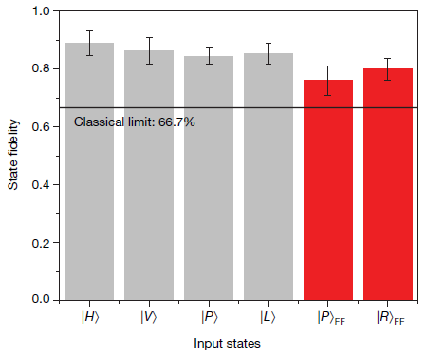
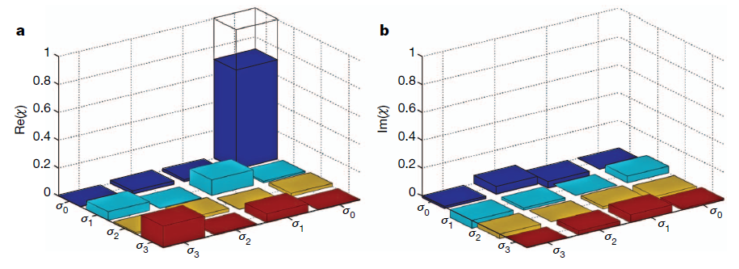
Results
State tomography:
Fidelity:
Process tomography:
H with f = 0.890(42)
V with f = 0.865(46)
P=H+V with f = 0.845(27)
L=H-iV with f = 0.852(37)
P_{f}=H+V with f = 0.760(50)
R_{f}=H+iV with f = 0.800(37)
f_{process} = 0.710(42)

Slide 15
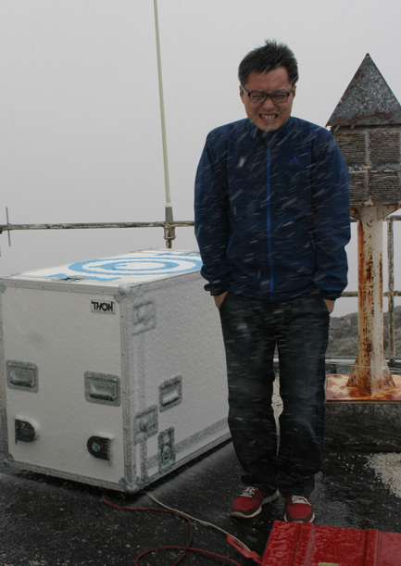
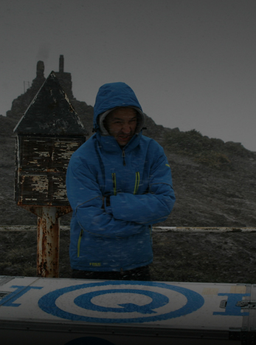
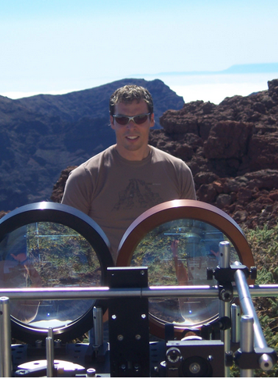
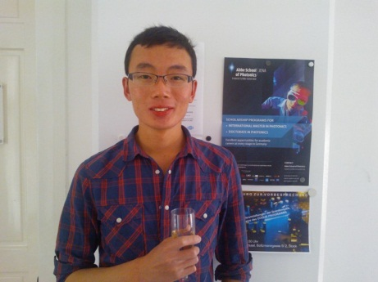
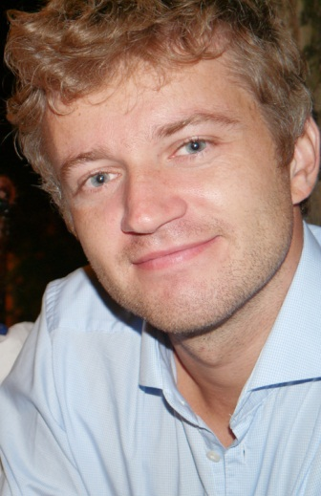
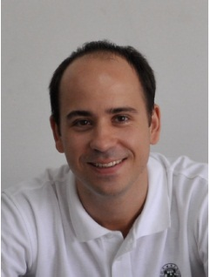
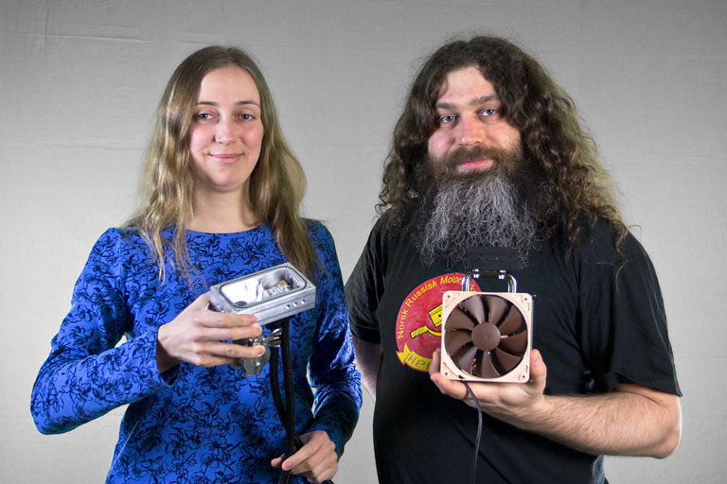
William Naylor
Bernhard Wittmann
taken from vad1.com
Thomas Jennewein
X. Ma, et al., Quantum teleportation over 143 kilometres using active feed-forward Nature 489, 269-273 SEP (2012) .

