Slide 1
Moonshot
Adam Bishop
11th March 2013

Slide 2
Use Cases

Slide 3
Use cases
Lets dive straight in and look at some use cases:
That have no current deployable federated solution, apart from Moonshot
Have a user experience that can be significantly improved by Moonshot
Have existing deployment models whose cost and effort can be reduced by Moonshot
This is just a small sample, to illustrate the range of possibilities…

Slide 4
Cancer Research UK
Cancer Research UK is the world’s leading charity dedicated to beating cancer through research.
The institutes form ad hoc relationships to collaborate for research purposes, but when the need arises to share data and documents, each institute can only authenticate within their own organisation.
“Moonshot is a valuable enabler for Cancer Research across the UK. It will make collaboration systems easy to build internally so that we can quickly share large data sets between institutes, without complicating the management of that system.”
Peter Maccallum, Head of IT & Scientific Computing, CRUK Cambridge Research Institute

Slide 5
Moonshot and… Federated Sharing of Data
Many organisations collaborate with others, wanting to share data and documents:
E.g. Provision of access to remote file systems (SAMBA / CIFS / NFS)
Today, users’ credentials must be managed by the provider
Using Moonshot, authentication happens at user’s home organisation – provider does not manage and ‘see’ the credentials

Slide 6
Moonshot and… Cloud Services
Many organisations are outsourcing services to the cloud, or delivering services in the cloud
For example: Exchange in the cloud
Today, user’s credentials must be supplied to the provider
E.g. Using directory synchronization technologies
SAML authentication an option for some, but not all, and not all clients (e.g. Microsoft Lync client)
Using Moonshot, authentication happens at user’s home organisation – provider does not manage and ‘see’ the credentials

Slide 7
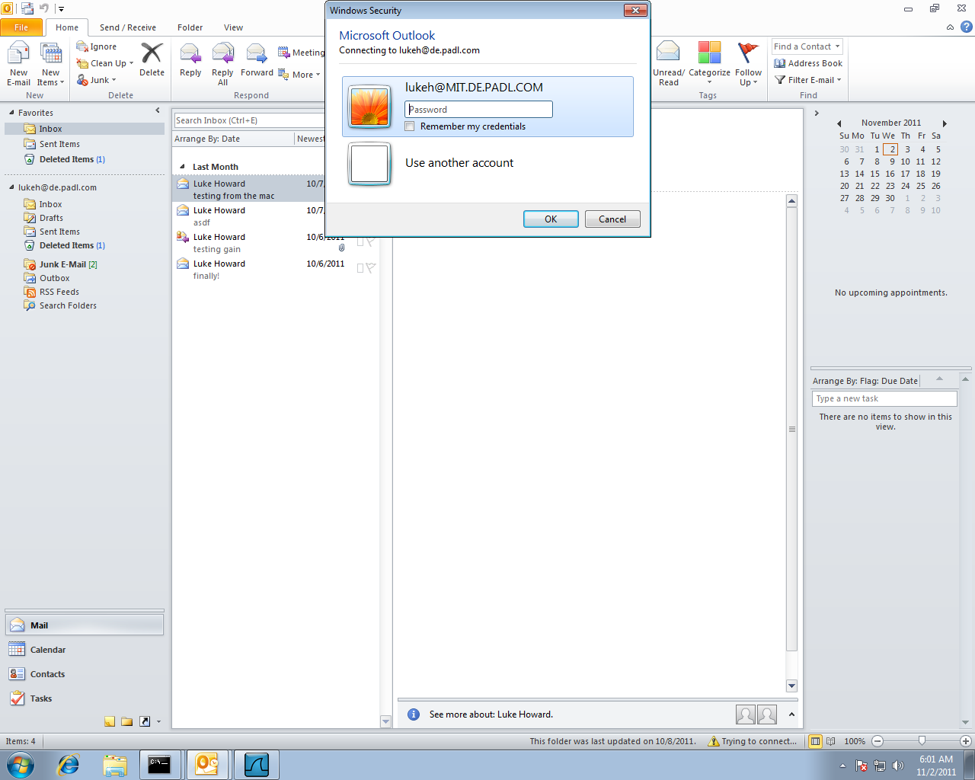
e.g. Outlook connecting to hosted Exchange

Slide 8
Diamond Light Source
The UK’s national synchrotron facility
Piloting Moonshot within the PANDATA project, which supports a community of 30,000 scientists from 100s of organisations at 20+ photon and neutron facilities
Federated access needed to physical consoles in person, or remotely using SSH
“Moonshot has thought beyond websites, and looked at what is really required in authentication – right down to the point when you open your laptop to begin work.”
Bill Pulford, Head of DASC, Diamond Light Source

Slide 9
Moonshot and… Federated SSH
Organisations with compute clusters typically:
Allow access through SSH
Have a community of users, some internal some external
Have to manage the credentials of all users
Using Moonshot for SSH access:
Authentication happens at user’s home organisation – no credentials to manage at service!
Various options possible for mapping users to accounts

Slide 10
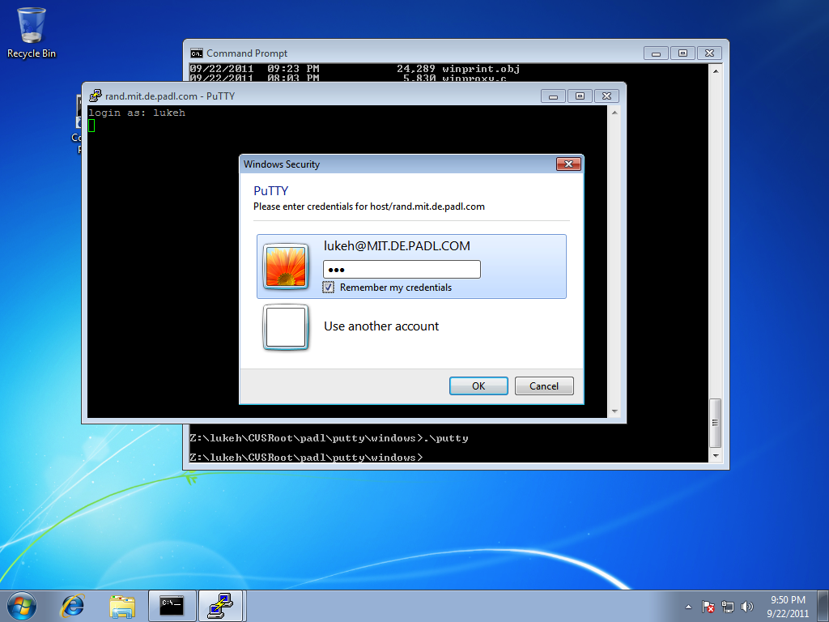
e.g. PuTTY connecting to Linux OpenSSH

Slide 11
Moonshot and… Federated Desktop Sign-in
Some organisations want to enable manageable desktop sign-in for external users
Seconded personnel, visitors, contracts, etc;
Or beyond – e.g. public sector desktops that should allow local government users, police users, fire users, health workers, social services users, etc
Highly challenging using contemporary technology
Moonshot integrates directly into Windows and Linux desktop sign-on

Slide 12
Other tested scenarios
For example… (these are tested, working examples)
OpenLDAP client → OpenLDAP server (GSS)
OpenLDAP client (GSS) → Windows Active Directory (SSPI)
Firefox → Apache (GSS)
Internet Explorer → IIS (SSPI)
MyProxy client → MyProxy server (SASL)
Adium → Jabberd (SASL)

Slide 13
Introducing Moonshot

Slide 14
Moonshot’s Goals
Lower the barriers to collaboration within the Janet community
Reduce the cost and time to create new services
Drive down operational costs for both Janet and our community

Slide 15
How?
By enabling our customers to Federate Anything & Everything, Easily
By enable communities to manage themselves
By unifying the disparate trust technologies in use today

Slide 16
Moonshot Technology
Moonshot builds on deployed, proven technology…
Strong authentication used by eduroam (EAP/RADIUS)
Strong authorisation used by UK federation (SAML)
Strong service/application integration used by many major applications (operating system security APIs)
Standardisation approaching completion within the Internet Engineering Task Force (IETF)
Moonshot is Janet’s open source implementation

Slide 17
Architecture
(1) Credentialing
(3) Authentication
(6) SSH session
(5) Attributes
(2) SSH negotiation
(4) RADIUS
SSH client
SSH server
RADIUS server
OpenSSH used as example of application; many others also apply

Slide 18
Moonshot’s Flexibility
Moonshot enables:
Federated authentication to virtually any network-connected system, application, or service
Virtually any deployment model (centralised, distributed, cloud)
The use of almost any kind of authentication credential
A unified trust & identity infrastructure, capable of satisfying virtually any security requirement

Slide 19
Benefits of Moonshot

Slide 20
Federate Anything & Everything, Easily
Moonshot integrates with OS level security APIs (GSS-API / SSP / SASL)
Proven, deployed technology already in use by many applications within your organisation
Many applications already support Moonshot with little or no modification
(Kerberos is a well-known GSS-API mechanism)

Slide 21
Easy to Deploy
Many organisations already have the necessary infrastructure
A RADIUS server (you may have already for eduroam)
A SAML server (you may have already for the UK federation)
If so
You already have the technology and skills in place

Slide 22
Easy to Manage
Communities set up and managed by the community themselves!
Saves on administrative overhead everywhere
No configuration changes required at IdP/service to support new communities
Policies can be targeted for the specific community
Easier and more intuitive for users
How?

Slide 23
Easy to Manage
Community management portal
Communities create and manage themselves in the portal
Easily managed list of organisations (and/or specific users) that are a part of that community and have agreed to its policies
Services belong to particular communities
Authorisation can happen based on community membership (amongst the other “usual” things)
Community membership can be used to enable cross-organisational authorisation (“virtual organisations”)

Slide 24
Deploying Moonshot - Requirements

Slide 25
Requirements
So what’s needed to “do” Moonshot?
There are 3 main roles in Moonshot:
Identity Provider
Relying Party (Service)
User

Slide 26
Requirements – Identity Provider & User
At the home organisation:
An existing identity store (e.g. LDAP)
RADIUS Server
SAML Server
On the user’s device:
Moonshot libraries
MSIs on Windows, RPMs/Debs on Linux, installer on Mac
A way of choosing the identity
Moonshot Identity Selector / Windows Credential Manager

Slide 27
Requirements – Relying Party
At the service:
RADIUS Server
Moonshot libraries
MSIs on Windows, RPMs/Debs on Linux, installer on Mac
Service configured to use GSS/SSP/SASL authentication

Slide 28
Janet’s Moonshot Pilot Service

Slide 29
Moonshot Pilot Service
18 month pilot
Begins April 2013
All technology ready and in place
Portal for managing communities available
Support available for participants
Main aims:
Allows Janet to pilot the service and support offerings
Allows community to pilot Moonshot with a stable backend infrastructure and with support available
Around 50 applications:
A mix of education, HPC and cloud use cases.

Slide 30
Moonshot Pilot Service
GÉANT Pilot:
Subject to approval and final details
Running at the European level, under GÉANT
Goals:
Worth with partner NRENs to promote non-web SSO within eduGAIN
Multiple peered trust routers in operation for interoperability and performance testing

Slide 31
A Quick Recap
Standardised next-gen identity & trust technology
Building on proven, deployed technologies
Cross-platform implementation
Communities manage themselves
Easy to deploy and use

Slide 32
Trust Router

Slide 33
Important R&E trust infrastructures today
Organisation
Kerberos / Windows Domains for corporate ICT services
Various Web SSO solutions using variety of hacks/technologies
National/Regional
Web SSO federations, principally using SAML metadata PKI
National/European Grid Infrastructure(s) using x.509 PKI
Other x.509 PKI initiatives (e.g., GÉANT’s eduPKI)
Global
Internet x.509 PKI (with TERENA enabling purchasing aggregation)
IGTF, principally using x.509 PKI
eduroam using RADIUS (and RadSec/x.509 PKI)
eduGAIN using SAML metadata PKI

Slide 34
Some reflections on these trust infrastructures
Our customers would prefer to deploy fewer technologies; and preferably just one
However a single trust technology must support the policy requirements of a broad range of communities distributed across our customers; there is no “one size fits all”
Today’s hierarchical organisation of R&E trust infrastructure (campus → national → regional → global) is increasing irrelevant to our customers, who need multiple trust infrastructures (not multiple technologies!) reflecting their relationships with other organisations globally

Slide 35
Collapsing to a single trust technology
Use cases spanning one or more communities
Community
Community
Community
Baseline Trust Policy

Slide 36
Community-centric Federation
Helpful to segregate communities into logical groups
‘Authentication Policy Community’ (APC)
A collection of registrations representing each customer
Common registration policy is relatively easy to define (e.g., NIST 800-64, WebTrust, etc)
‘Community of Interest’ (CoI)
A collection of these customer representations
CoIs have any kind of policy; very difficult to normalise

Slide 37
APCs and CoI
C
D
Janet Authentication Policy Community
“Janet customer” Community of Interest
“Local government” Community of Interest
“Health services” Community of Interest
B
E
A
F
A
B
E
D
D
C

Slide 38
Technology requirements
Efficient & robust
Significant scalability
Janet’s target use cases imply 100Ks of RPs
Support for numerous and diverse communities
These will be organised arbitrarily, across many organisational and national boundaries
Integration with diverse use cases & applications
One trust technology, supporting multiple trust infrastructures, for any use case

Slide 39
Janet’s Trust Router
The final major output of Project Moonshot: https://community.ja.net/groups/moonshot
A next generation trust infrastructure for ABFAB-based federated identity systems
Implements draft-mrw-abfab-trust-router
Functional Specification: https://community.ja.net/groups/moonshot/documents/draft-trust-router-specification

Slide 40
Terminology
Trust Link – asserts that one Trust Router is willing and able to forward Trust Path Requests to another TR or AAA Server
Trust Path – set of Trust Links that can be used by a specific Relying Party to reach an AAA Server in the domain of a specific Identity Provider
A(T)->B(T) – a Trust Link between two Trust Routers for realms A and B

Slide 41
Trust Router Protocol
3
2(T) ->3(T)
3(T)->C(A)
2(T)->5(T)
5(T)->6(T)
6(T)->F(A)
3(T)->C(A)
2
Realm C
AAA
1
5(T)->6(T)
6(T)->F(A)
4(T)->5(T)
5(T)->6(T)
6(T)->F(A)
5(T)->6(T)
5(T)->F(A)
4
5
6(T)->F(A)
6
Realm F
AAA

Slide 42
Further Information
Moonshot Community website:
https://community.ja.net/groups/moonshot Software:
https://community.ja.net/groups/moonshot/article/moonshot-dvd-image-and-code-update
https://community.ja.net/groups/moonshot/article/moonshot-pilot-release-1-dvd
Standards:
https://tools.ietf.org/wg/abfab

