Slide 1
Electronics Racks for XFEL
Overview of installation sites for racks
Injektor
E. Negodin
Version 6

Slide 2
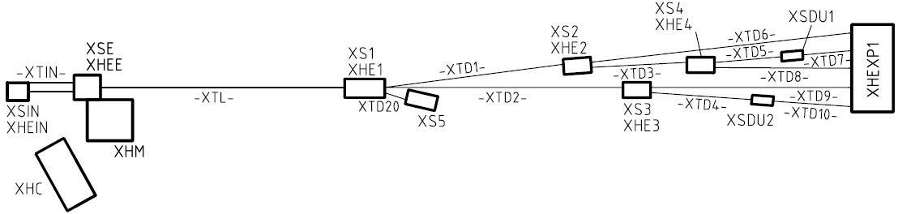
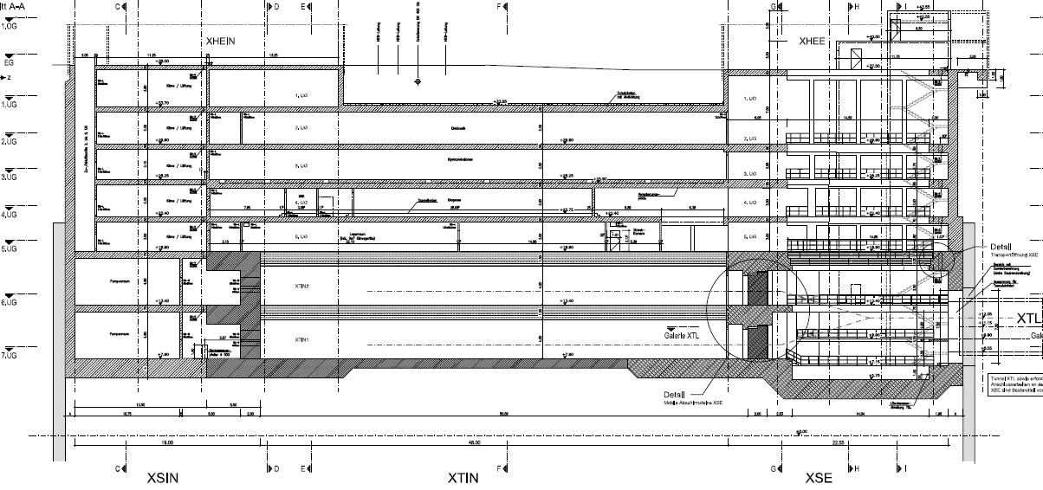
Injector Overview
S:\user\groups\xfel\public\all Transfer\Bauzeichnungen_110207\5.03_Bauwerkspläne_Los 3
2.UG
3.UG
4.UG
5.UG

Slide 3
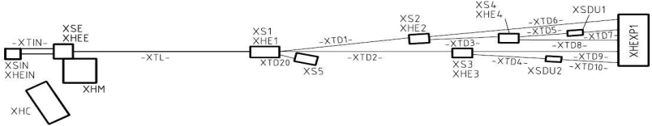
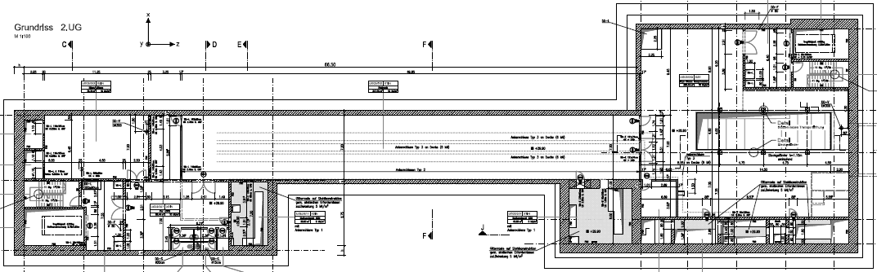
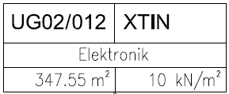
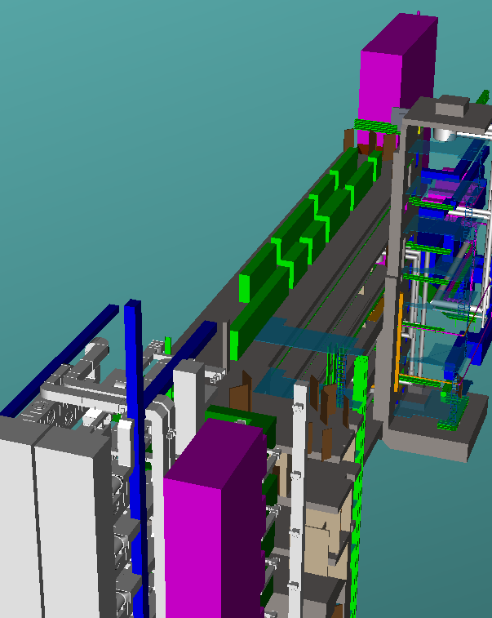
XSIN-XTIN-XSE
2UG
( Level -2 )
Elektronikschraenke Netzgeräte - 54 St (60x80x220)
Elektronikschraenke Korrekturnetzgeräte - 10 St (60x80x220)
Elektronikschraenke Reserve - 20 St (60x80x220)
Erdungsschraenke - 4
Diodengeraete - 5
Thyristorgeraet - 1
Verteilungen 400 V - 1
Verteilungen 600 V - 1
WP34 Utilities
Verantwortlicher: J. Eckold

Slide 4
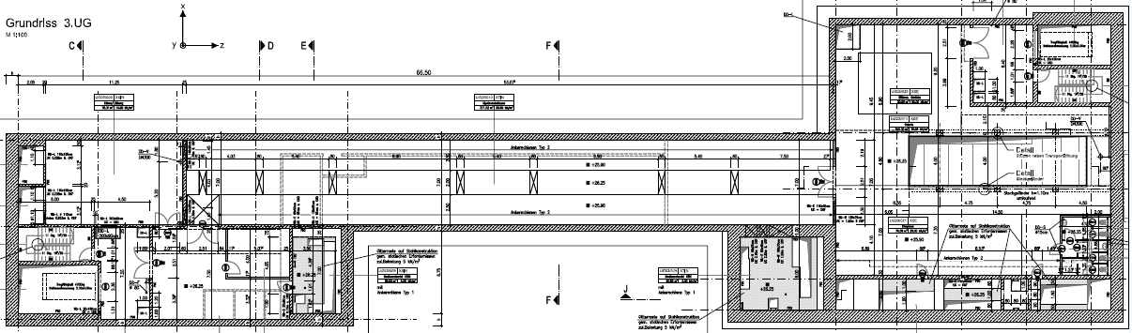
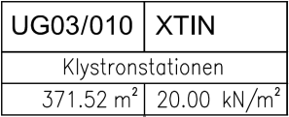
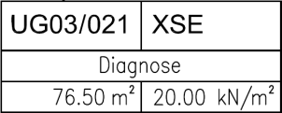
XSIN-XTIN-XSE
3UG
( Level -3 )
WP01 RF System
Responsible: R. Wagner
12 Electronic racks
2+2 HF Stations
je 3 Racks pro Station
ca. 1600mm hoch fur die Klystron Elektronik
Die Gesamtzahl der Hoeheneinheiten betraegt nach jetziger Schaetzung 61 HE. Die Racks sollten wassergekuehlt sein
WP46 3.9 GHz System
2x4 Electronic racks
Responsible: J. Rothenburg
WP38 Personnel Interlock
6 Server-Schränke mit Klima (2,5m hoch) + 2 Res.
3 Verteiler-Schränke + 1 Res.
WP17 Standard diagnostics
(Responsible: M. Steckel)
2 Electronic racks

Slide 5
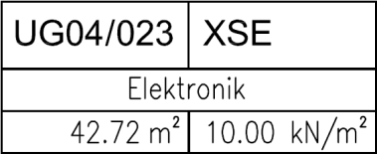
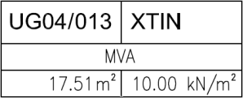
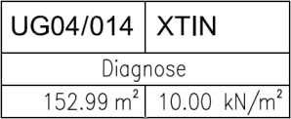
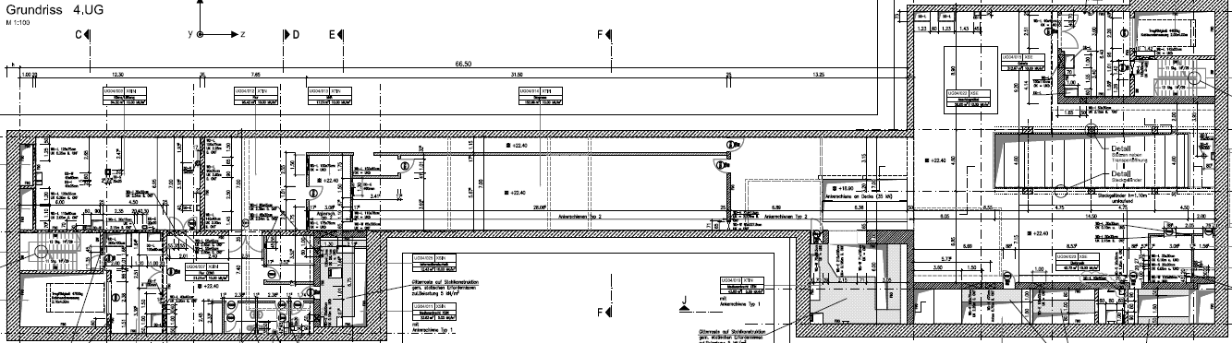
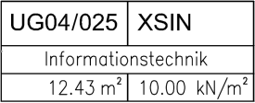
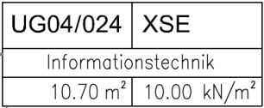
XSIN-XTIN-XSE
4 UG
( Level -4 )
WP05 Power coupler
2x2 Racks (Injektor 1 und 2). Standard 19“ IT Racks
WP17 Standard diagnostics (Responsible: M. Steckel)
8 Racks + 2 Racks mit UPS und Notstromversorgung)
WP18 Special diagnostics (Responsible: F. Obier)
2 Kicker Schränke Racks
WP28 Accelerator Control
8 Server Racks
WP08 Cold Vacuum
6 Schränke
Responsible: D. Hoppe
Zugang beidseitig
Up to now no requirements for this room !
WP34
Ansprechpartner T. Witt
IT Verteiler….............. 2 Racks
WP34
Ansprechpartner T. Witt
IT Verteiler….............. 2 Racks

Slide 6
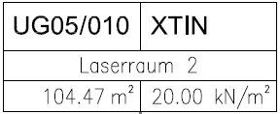
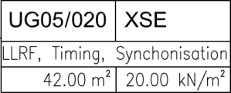

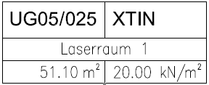
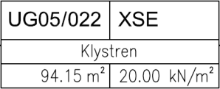
XSIN-XTIN-XSE
5 UG
( Level -5 )
WP14 Injector
Cathode laser and Misc. electronic devices
10 Racks ?
Responsible: M. Huening
WP02 LLRF
20 Racks
Responsible: W. Wierba
WP02 LLRF
Responsible: W. Wierba
Spare space
WP34
Responsible: T. Witt
IT Unterverteiler für LLRF
WP18 Special diag.
Synchronisation
5 Racks ?
Responsible: M. Bousonville
WP34
IT Hauptverteilerraum
Ansprechpartner T. Witt
Passive LWL- Verteiler ………… 5 Racks
Aktive Komponenten ……………. 4 Racks
Kommunikation …………………… 3 Racks
WP18 Special diag.
HF electronic, TDS Modulators
Responsible: C. Gerth

Slide 7
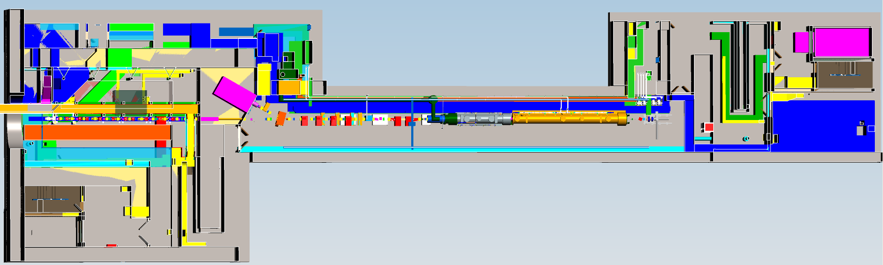
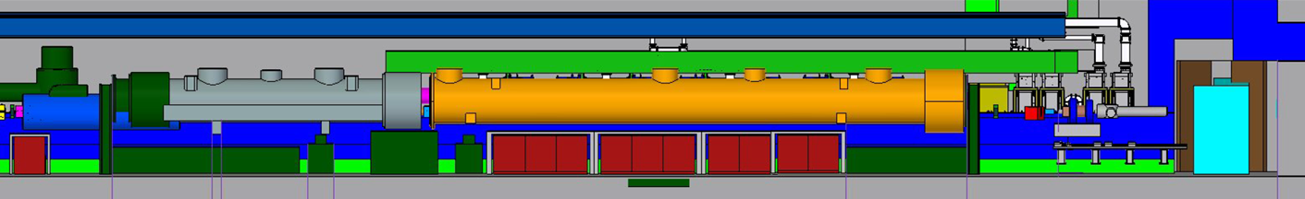
XSIN-XTIN-XSE
7 UG
( Level -7 )
Warning: Top view is 180° rotated
XTL
Gun
z

Slide 8
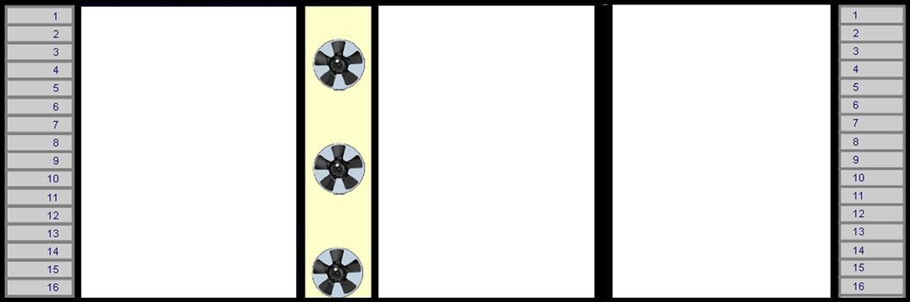










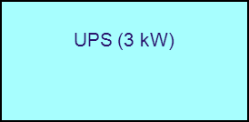
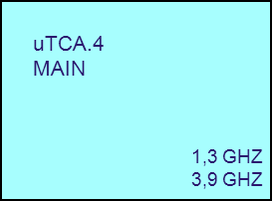
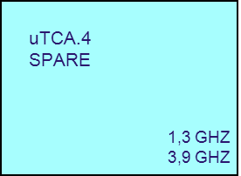

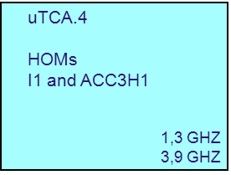




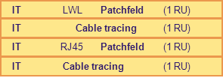

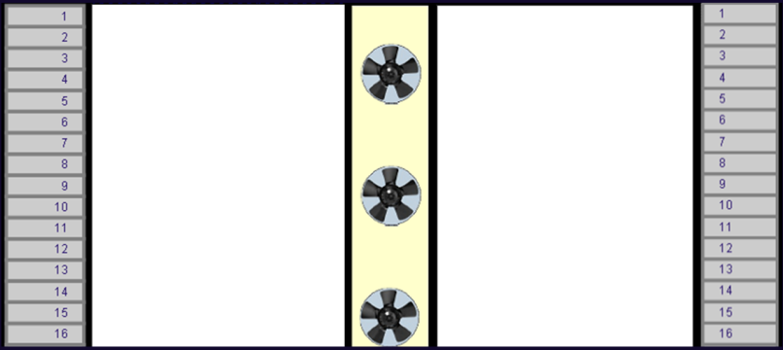

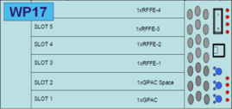


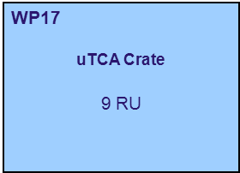
XSIN-XTIN-XSE
7 UG
( Level -7 )
Preamplifier
3,9 GHz
Phasenschieber
1,3 GHz
Phasenschieber
3,9 GHz
Tuner
1,3 GHz and 3,9 GHz
Main Coupler
1,3 GHz

Slide 9
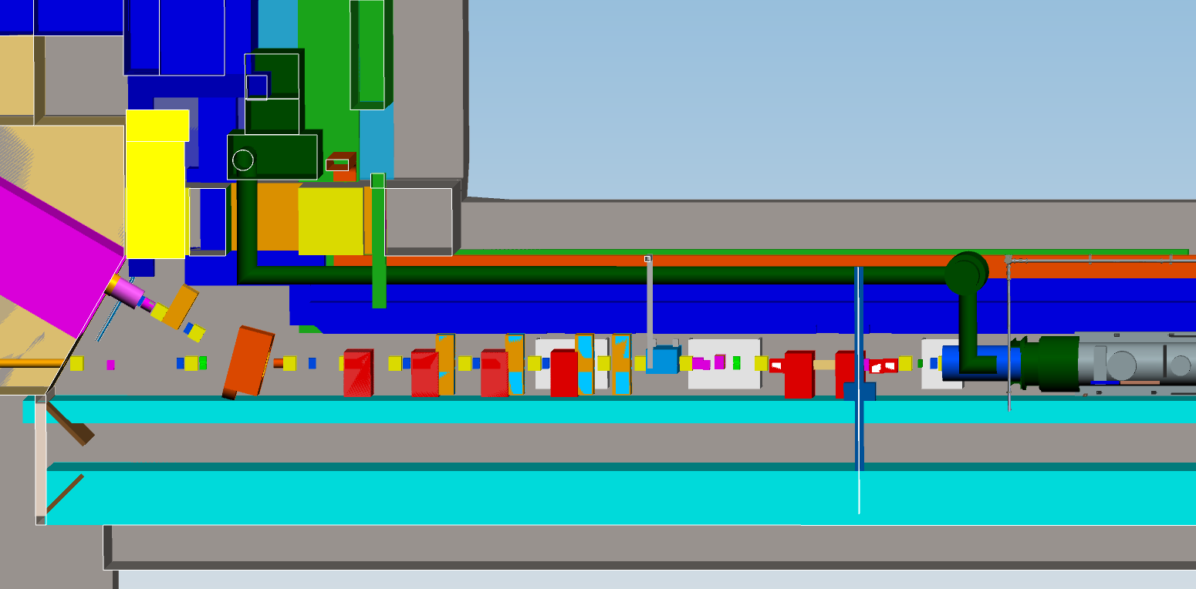
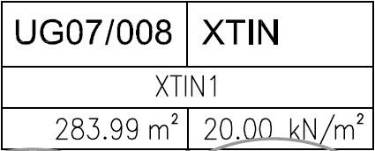
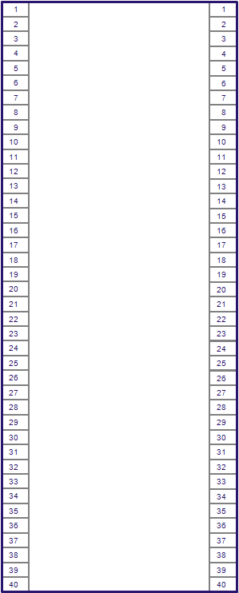

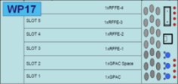


XSIN-XTIN-XSE
7 UG
( Level -7 )

Slide 10
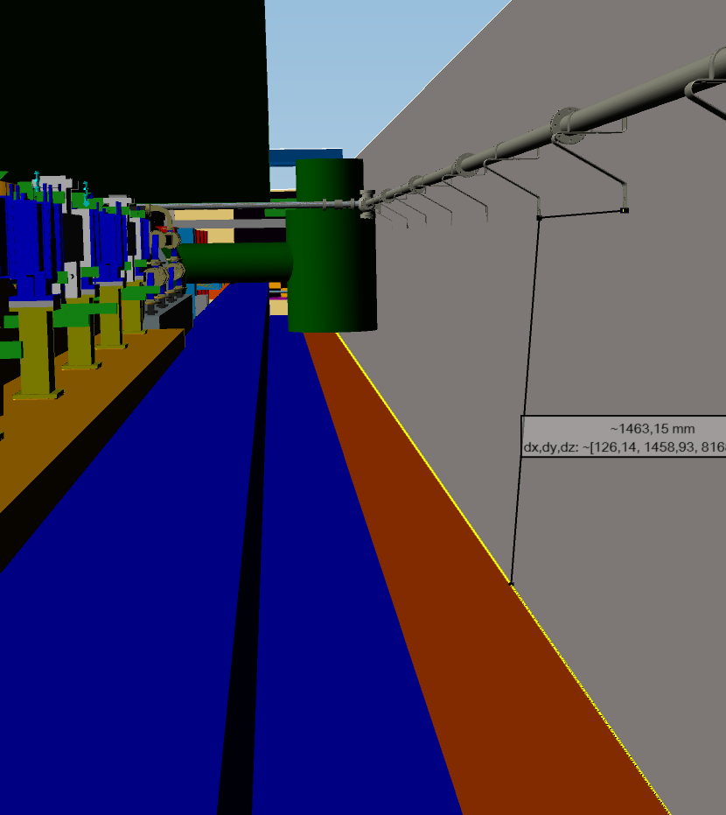
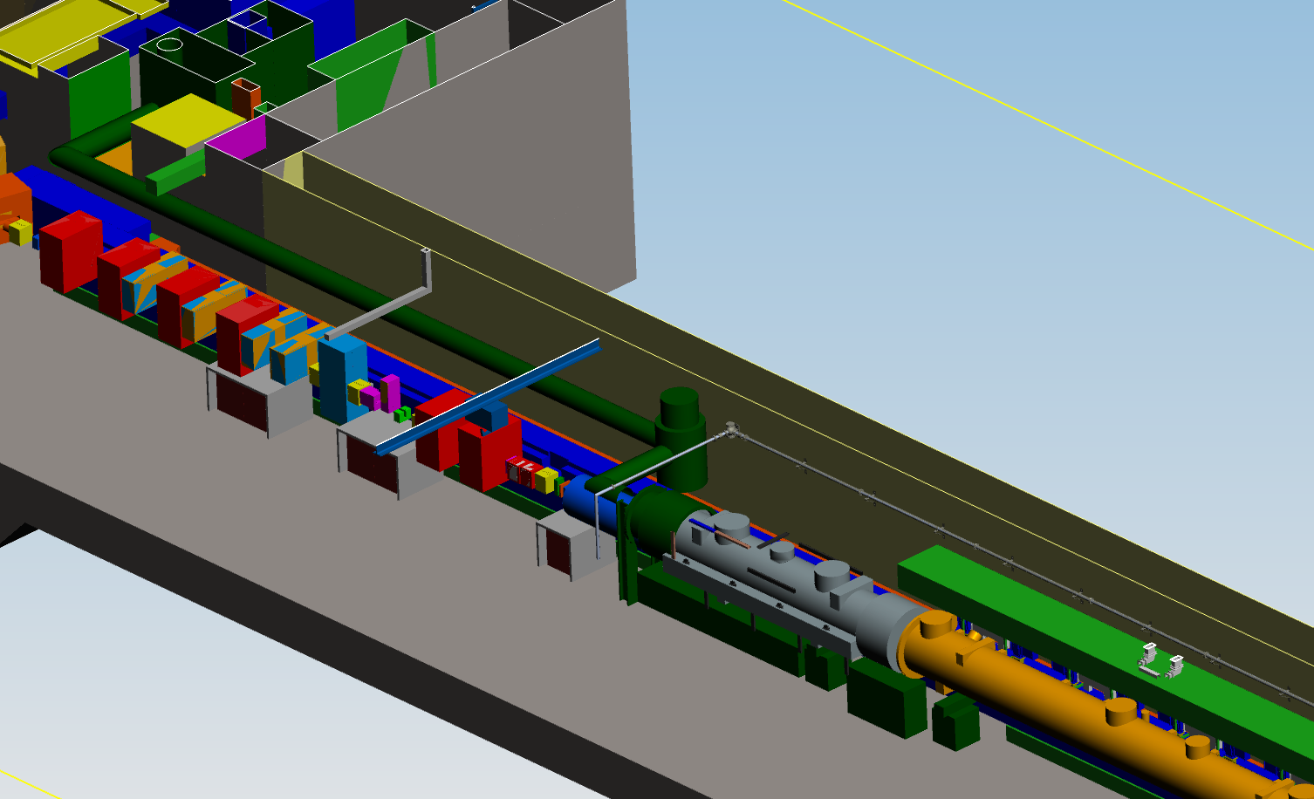
XSIN-XTIN-XSE
7 UG
( Level -7 )
WP13 Cryogenics

Slide 11

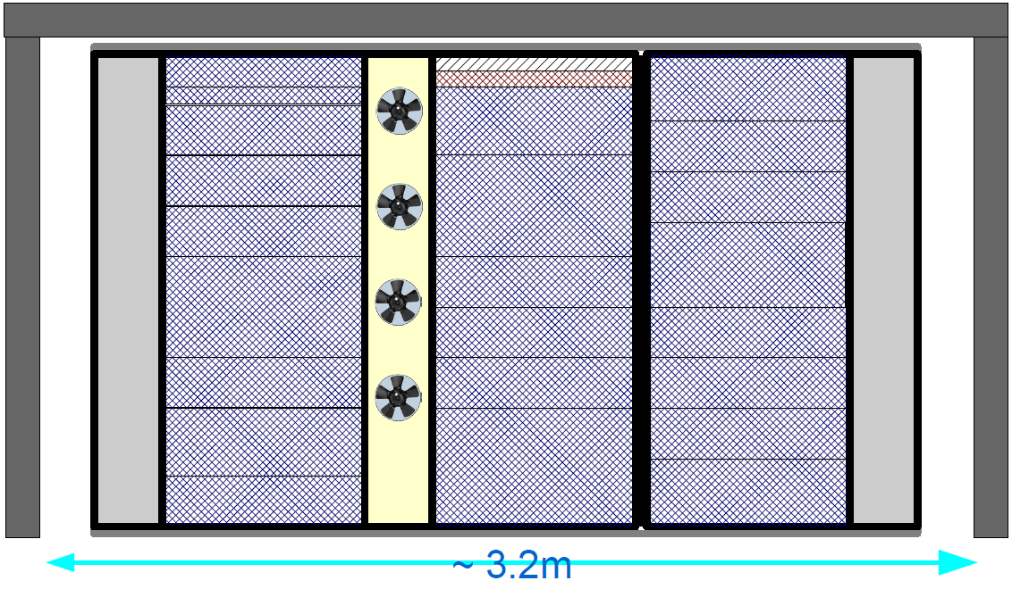
Appendix XTL: Standard rack
The height of the electronic modules is also standardized as multiples of 44.5 mm (1.75 inches) or one rack unit or "U".

Slide 12
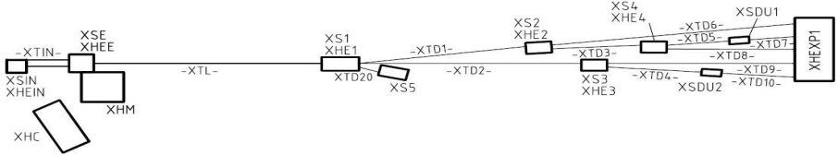
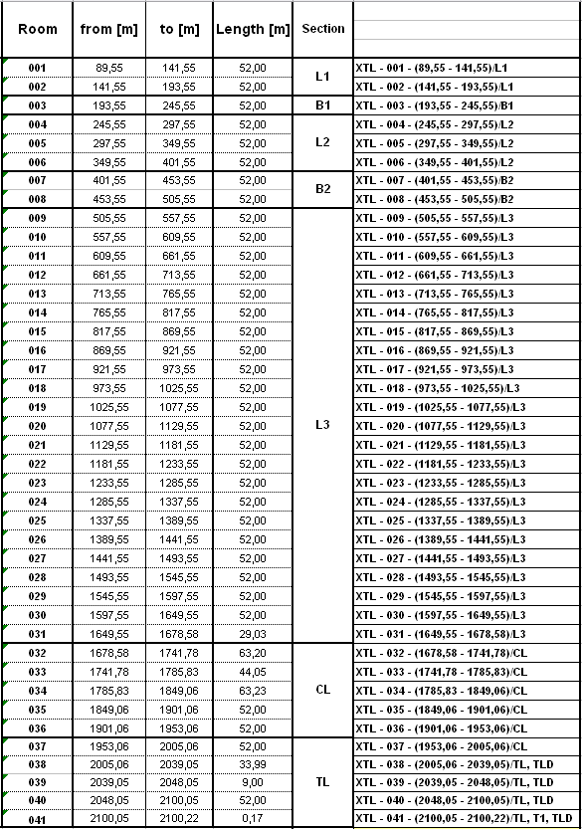
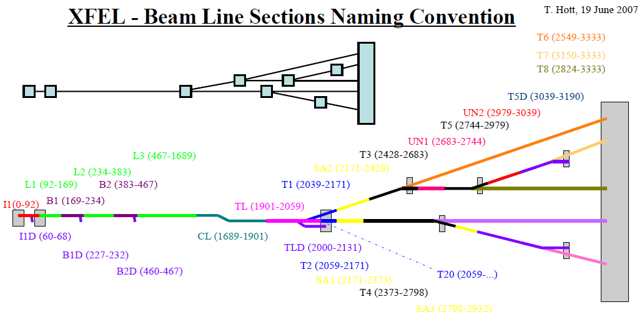
XTL tunnel common remarks
Description/Location of the rooms in XFEL could be found in GISFMS under
http://ippgisfmsweb.desy.de/GIS/gisfms.html
Tunnel rooms assignment is also represented in EDMS: D00000001681851

Slide 13
Appendix XTL: common remarks
It is suggested that the beam direction in the tunnel is from left to right
Direction of the z-axis in the tunnel is from left to right
Detailed population of the Racks is shown from the front side of the cabinet
Positions of the cabinets shown in the tunnels are lowest z-coordinates (starts) of the respective shielding
KDS-nomenclature:

Slide 14
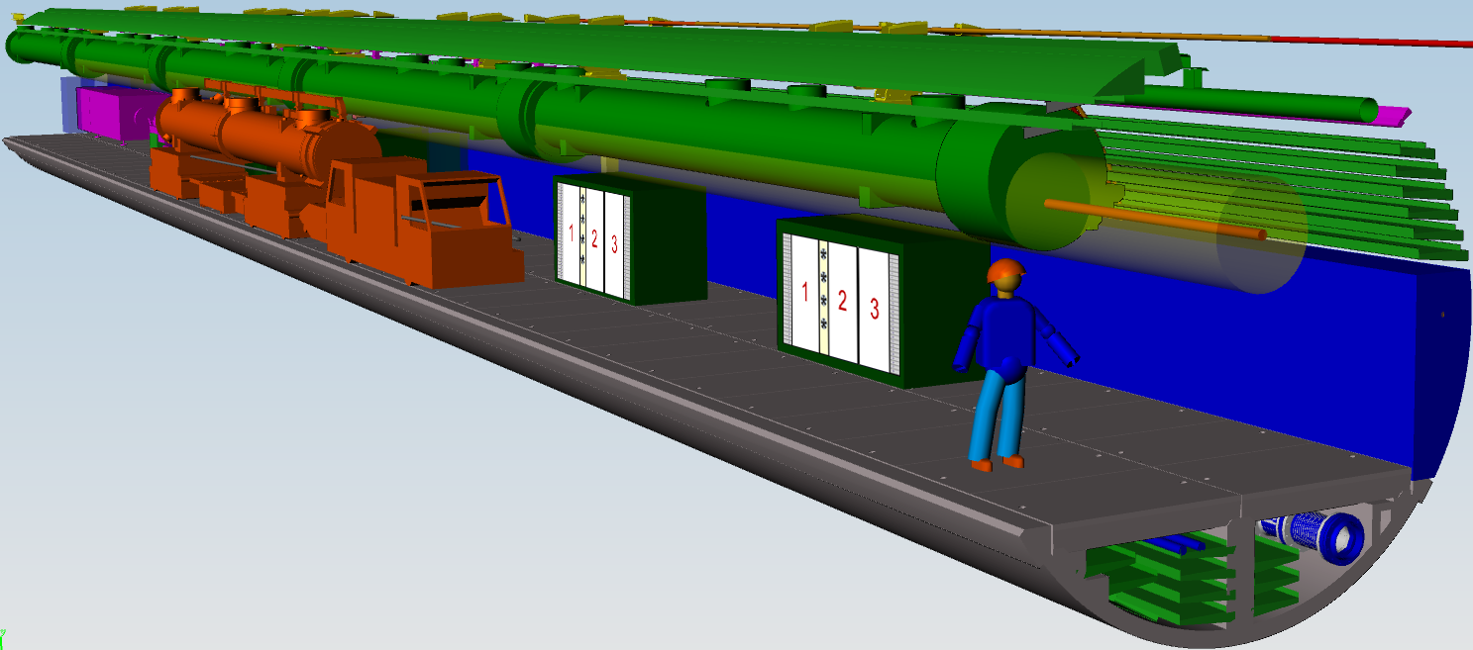
Appendix XTL: Front view
Front view
3
2
1
3
2
1
Beam direction
Position of the cabinets:
Lowest z-coordinate of the shielding
Z
Y
X

Slide 15
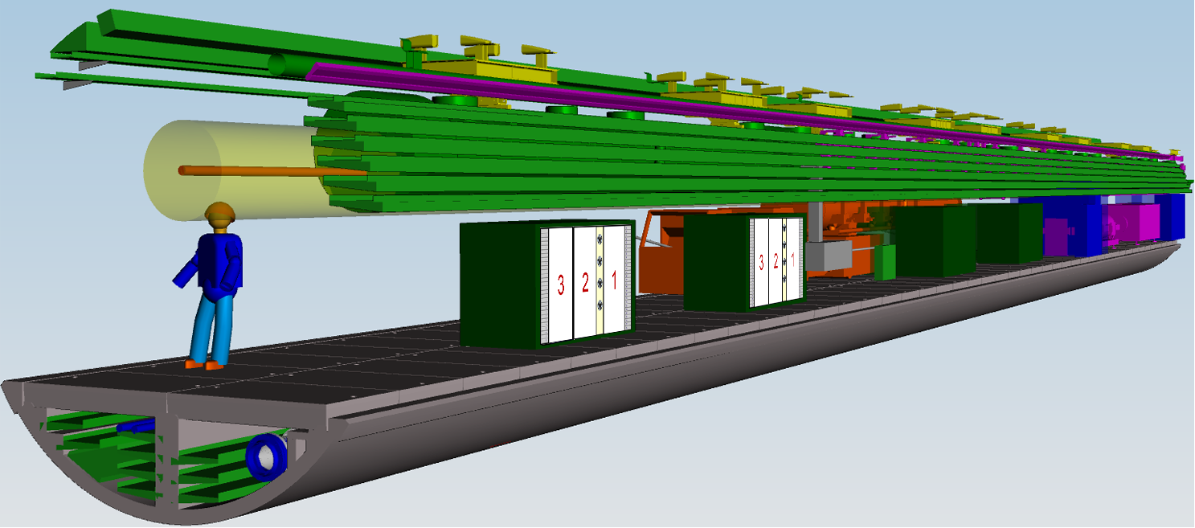
Appendix XTL: Rear view
Rear view
Beam direction
2
3
1
2
3
1
Y
Z
Position of the cabinets:
Lowest z-coordinate of the shielding
X

Slide 16
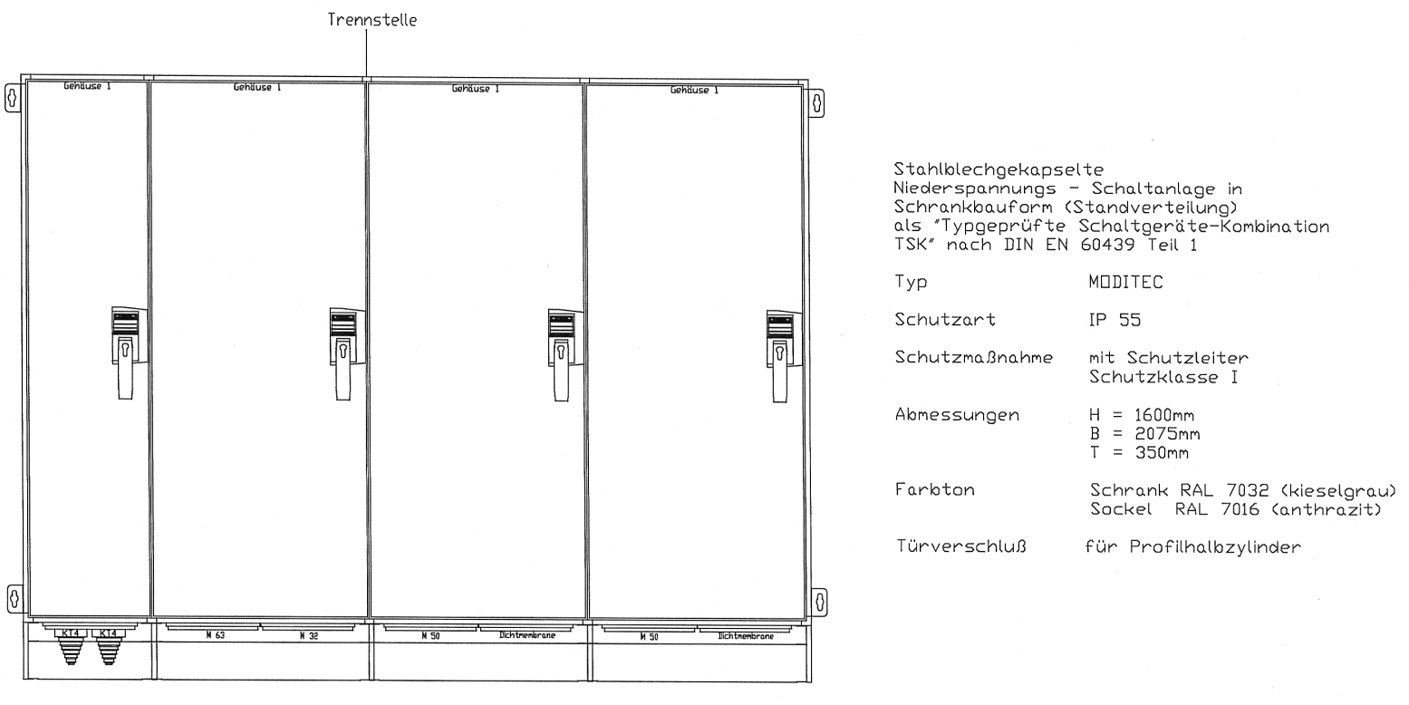
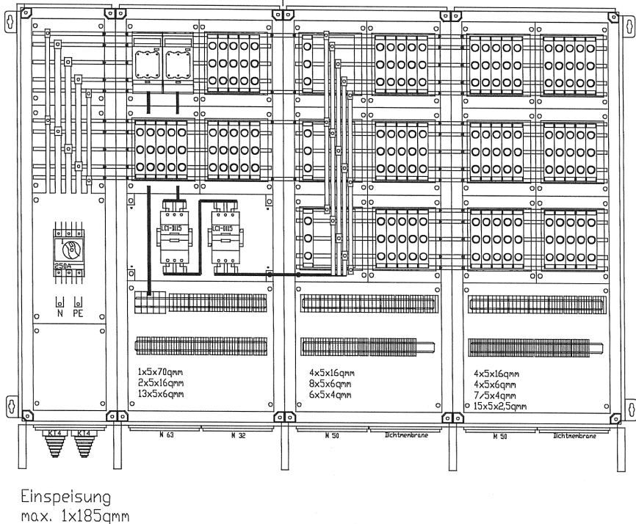
Appendix XTL: Schaltschrank

Slide 17
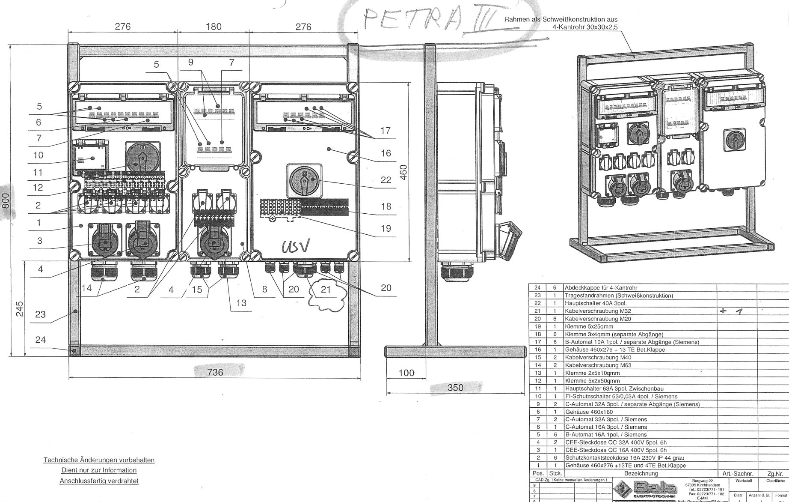
Appendix XTL: Elektrant

Slide 18
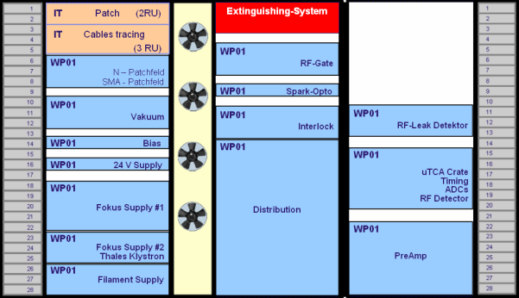
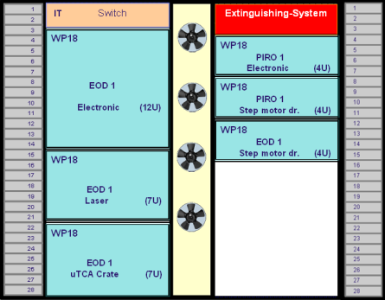
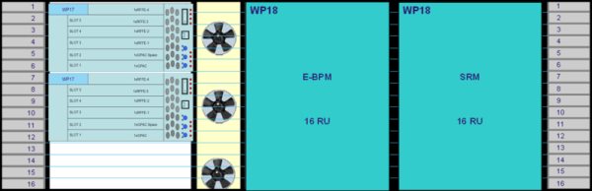
Appendix XTL: Statistics
Triple Rack Unit
(3er Schrank)
123 + 1
Double Rack Unit
(2er Schrank)
35
Low Rack Unit
(16 RU)
2
Totally 161 Cabinets

Slide 19
Appendix XTL: Statistics
Totally in the XTL tunnel 162 cabinets:
124 Cabinets are Triple racks
25 cabinets for WP01 RF, contact person R. Wagner
54 cabinets for WP02 LLRF (25 Masters + 25 Slaves + 4 Spare), contact person W. Wierba
25 cabinets for PS (WP34, J. Eckold) and Diagnostics (WP17, D. Nölle)
12 cabinets for Cryo (WP13, O. Korth) and Vacuum (WP08,WP19, D. Hoppe)
5 cabinets IBFB (WP16, B. Keil, W. Decking)
2 cabinets Vacuum (WP08,WP19, D. Hoppe) and Diagnostics (WP17, D. Nölle)
1 cabinet Kickers

Slide 20

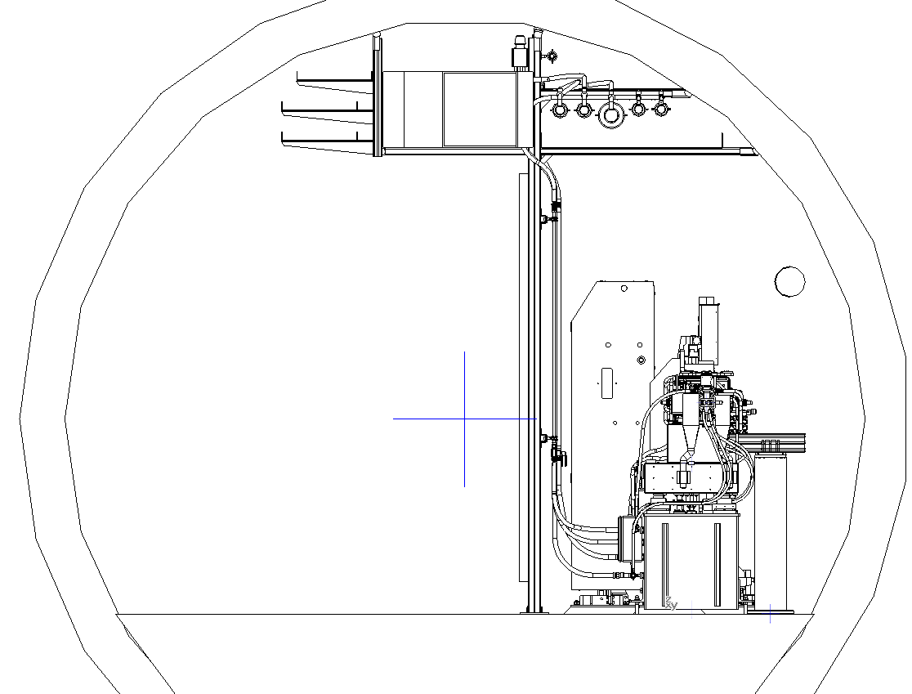

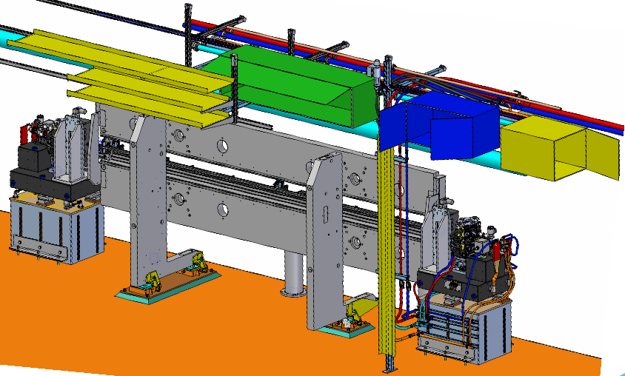

SASE Racks
„The doors is equipped with open/close sensors. One sensor is to switch on the lighting inside the rack and the other one is to disable the fire-extinguishing system when the door is open.”
„Each rack is equipped with 32A, 3 phases “Emergency Main Switch”…
The emergency switch must be secured with a lock in case it is switch off. It is necessary to avoid accidental power-on during the maintenance in the rack.”

Slide 21

SASE Racks
001
2160,79 m - 2212,75 m (T1)
The racks are no longer fixed on the ceiling (needs special fixation plates in the racks = expensive)
The racks are located on an anchor bar, which are connected to the water and energy supports
undulator rack : 2000mm x 500mm x 500mm
intersection rack : 1000mm x 500mm x 500mm
machine rack : 800mm x 600mm x 500mm

Slide 22

SASE Racks
No shielding
Requirements for the temperature stability of the tunnel air are 0.1 K
Machine rack : 800mm x 600mm x 500mm
800 mm
400 mm
5 RU
500 mm
Place required for:
Fire detection System ……… 1 RU
BPM Unit ……………………. 6 RU
Machine Control ……………..7 RU
Patch panels …………………2 RU
___________
16 RU (~ 70 cm)
10-11 RU (?)
Für den Diagnostik-Kasten im SASE-Bereich stehen ca. 1,3 l/min zur Verfügung, was bei 300 W eine Temperaturspanne von 3,3 °C ergibt. Die Solltemperatur für die Vakuumkammern entspricht der Lufttemperatur und die kann zwischen 19 ... 23 °C schwanken.
Bei 21°C Lufttemperatur im SASE-Bereich ist die Austrittstemperatur aus der Vakuumkammer 21,2°C. Das wäre dann die Eintrittstemperatur in die Diagnostik; die Austrittstemperatur des Wärmetauschers in der Diagnostik ist dann 24,5 °C.
Wobei die zu kühlende Leistung auf Grund von Wakefield Verlusten in der Vakummkammer von MVA mit 2 ... 3 Watt/m angegeben wird.

Slide 23




SASE Racks
Schroff 10230-202
800 mm
1000 mm
WP28
Accelerator Control System
Diagnose - 6 RU
Lüftern - 1 RU
Diagnose - 6 RU
Brandschutz - 1 RU
AC - 7 RU
Nicht besetzt - 2 RU
Lüftern - 1 RU

Slide 24




Slide 25


Slide 26

XSIN - XTIN - XSE
XS2
XS4
XTL
XS1
XS3
XHM

