Slide 1
ATLAS SCT End Cap Integration 2000 - 2008
Tim Jones
(University of Liverpool)
tim.jones@cern.ch

Slide 2
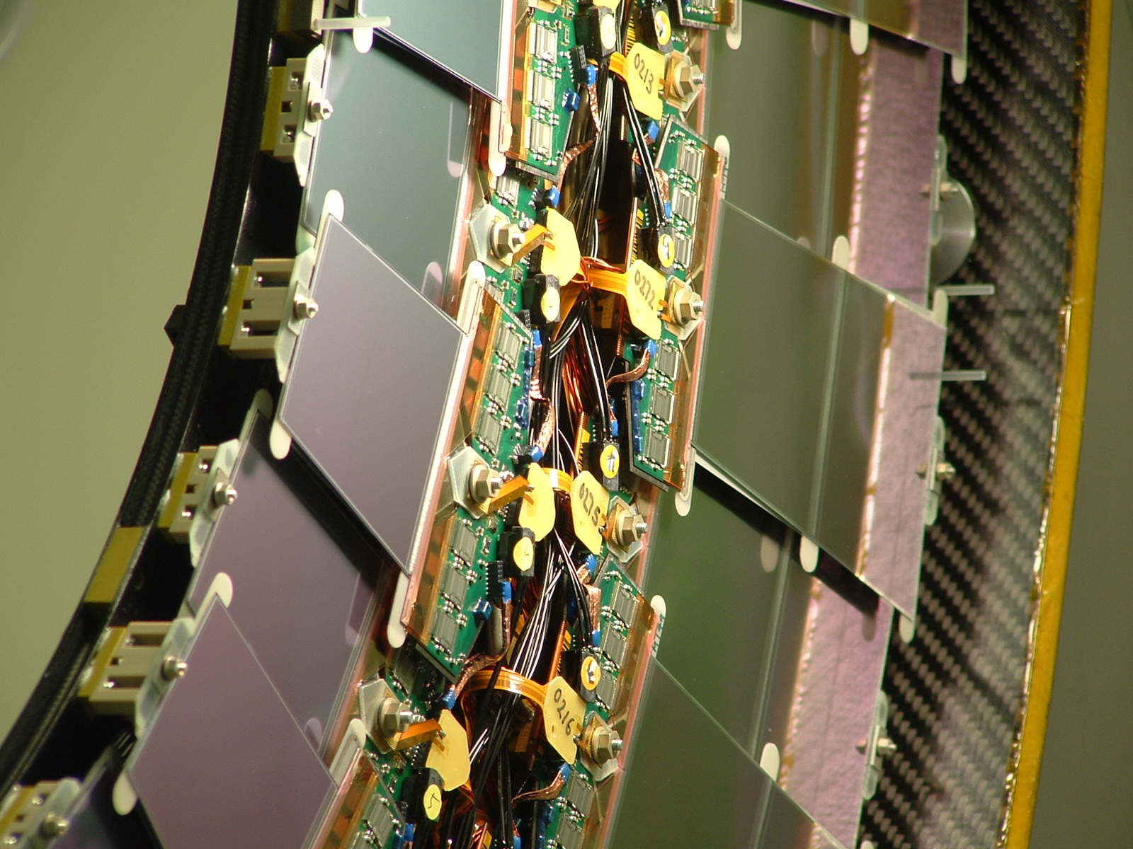
terror

Slide 3
ATLAS SCT End cap Integration 2000 - 2008
Integration
What do we mean by ‘Integration’?
The ATLAS Endcap SCT
System Design
Macro-Assembly
The Future....

Slide 4
Integration (according to Wikipedia!)
Sociology and Economy
Social Integration
Racial Integration
Mathematics
Calculus
Electronic Engineering
Systems Integration
Integrated Circuit
Economic integration, etc...

Slide 5
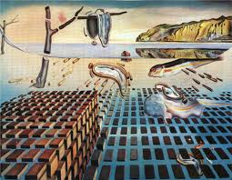
Disintegration
Disintegration of the Persistence of Memory
(1954)

Slide 6
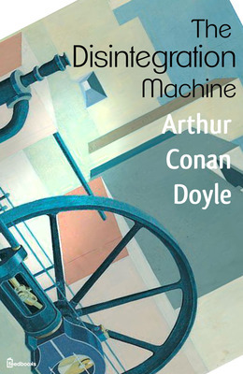
The Disintegration Machine
Arthur Conan Doyle
First published in January 1929
The story about the discovery of a machine capable of disintegrating objects and reforming them as they were.

Slide 7
Systems Integration
The engineering practices and procedures for assembling large and complicated systems from less-complicated units, especially subsystems.

Slide 8
Concurrent Engineering
Cross-functional teams
Concurrent product realization
Incremental information sharing
Integrated project management

Slide 9
The ATLAS Inner Detector
ID
Pixel
Silicon Strips
TRT
Silicon Strips
Barrel
2112 modules on 4 barrels
Endcaps
2 x 988 modules
2 x 9 disks

Slide 10
Endcap SCT System Design
Silicon modules arranged on disks in (upto) 3 rings
52 / 92 / 132 modules per disk
Radial positions defined by hermeticity requirements
Double-sided modules with silicon rotated at /- 20mrad to axis
Hybrids mounted at end of silicon
Outer modules have hybrid at narrow
end to maximise active radius
Separation of FE ASIC and Silicon
heat paths
Ensures optimal cooling of silicon to
inhibit thermal runaway
Module Interfaces
Thermal Contact
Electrical power
Redundancy
Plug-able Opto converters

Slide 11
Support Cylinder and Thermal Enclosure

Slide 12
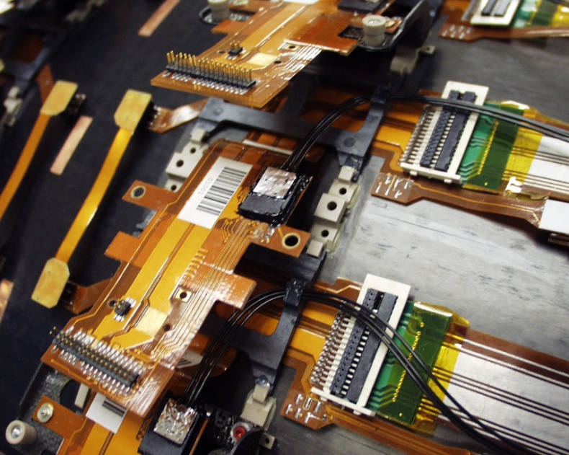
Barrel / Endcap Differences
Mid-mounted wrap-around bridged hybrid with single-connector electrical interface
Single edge cooling via baseboard
On-cylinder ‘dog-leg’ for
Power interface to low-mass cable
Redundancy
Opto conversion

Slide 13
Endcap Macro-Assembly
Carbon-fibre Structures
Services Assembly & Test
Module Mounting
Disk System Test
Endcap Assembly & Test
Services Assembly & Test
Transportation to CERN
Reception Testing
Final Endcap Assembly & Test
Integration into the TRT
Installation & Commissioning in ATLAS

Slide 14
Macro-Assembly Timeline
Feb 2006
End cap Arrives at CERN
July 2006
End cap C integrated into TRT
May 2007
End cap C installed
Sept 2004
Module Mounting Starts
July 2005
Last disk completed
July 2003
Cylinders Delivered
2000-03
Final Prototyping

Slide 15
Module Mounting Tooling

Slide 16
Module Manipulator

Slide 17
Module Interfaces: Thermal & Electrical

Slide 18
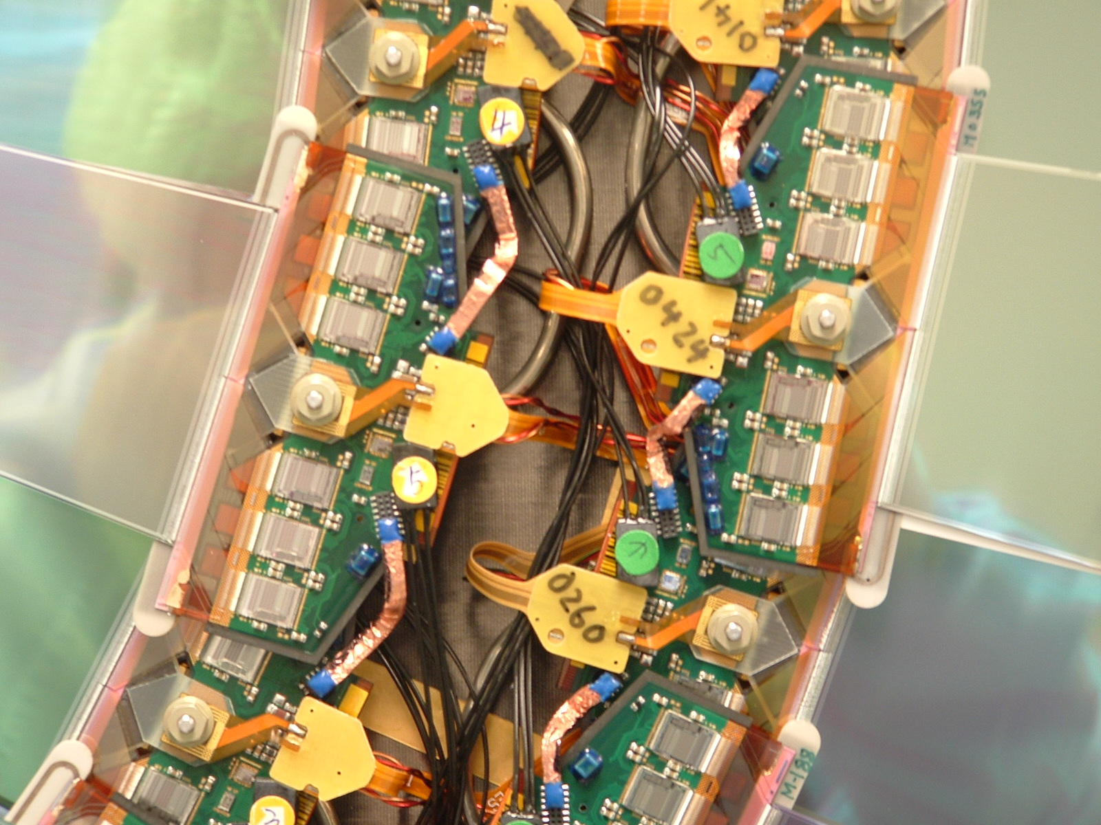

Slide 19
Module Mounting Progress
1
3
4
5
6
2
7
9
8

Slide 20
.... and somethings raise a smile!

Slide 21
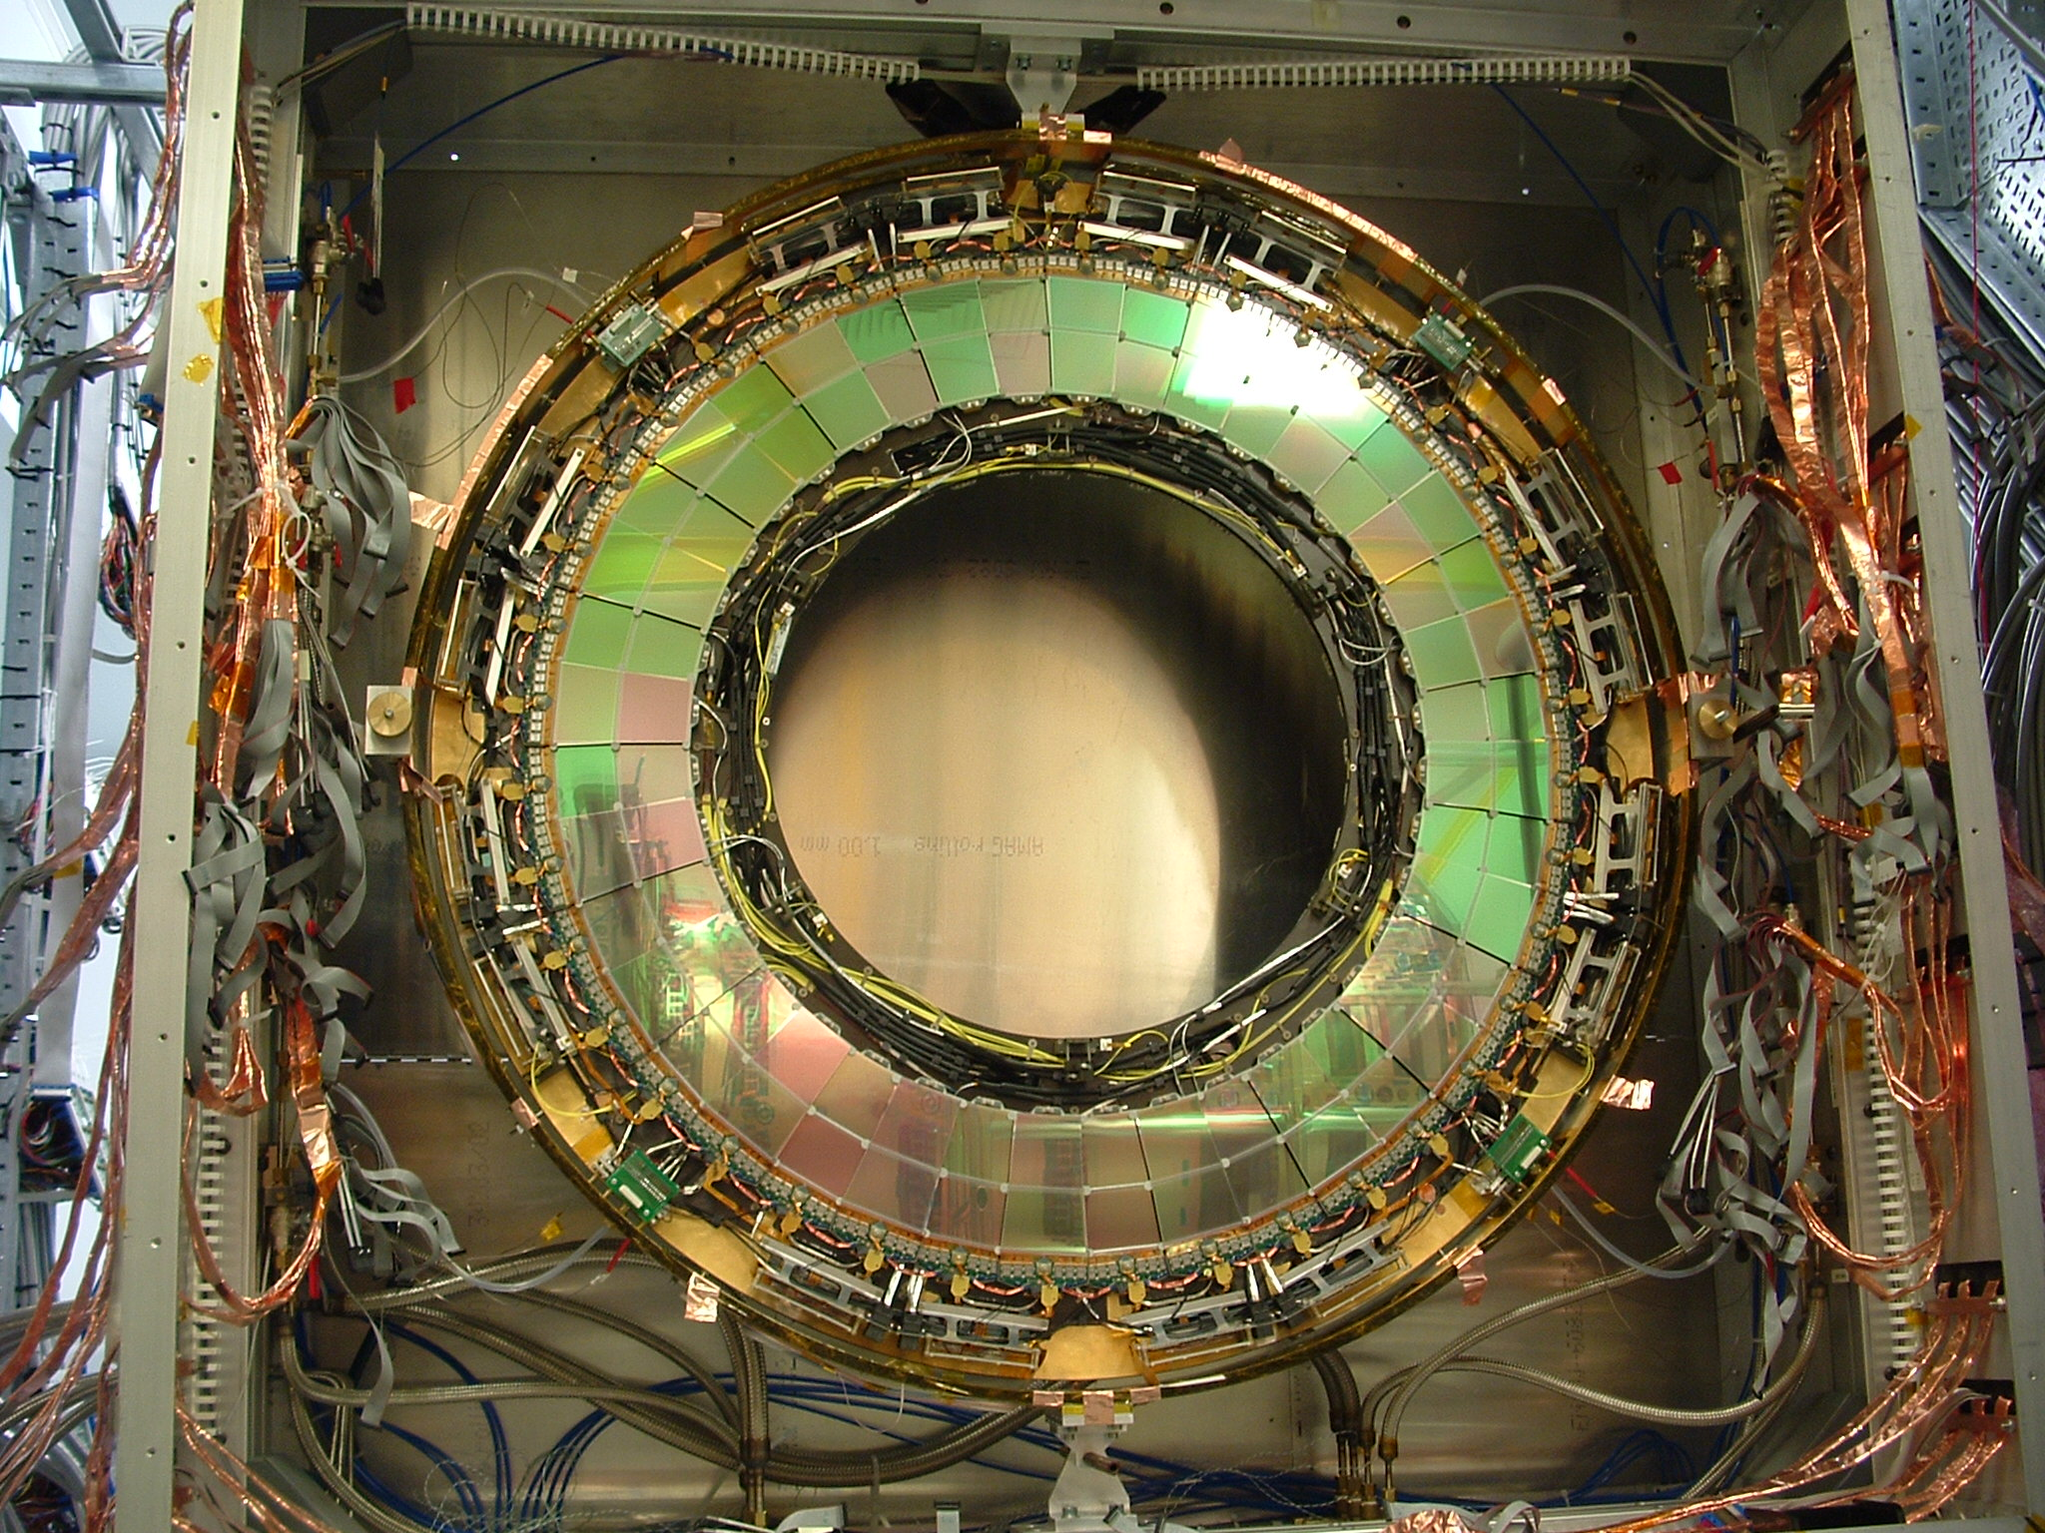

Slide 22
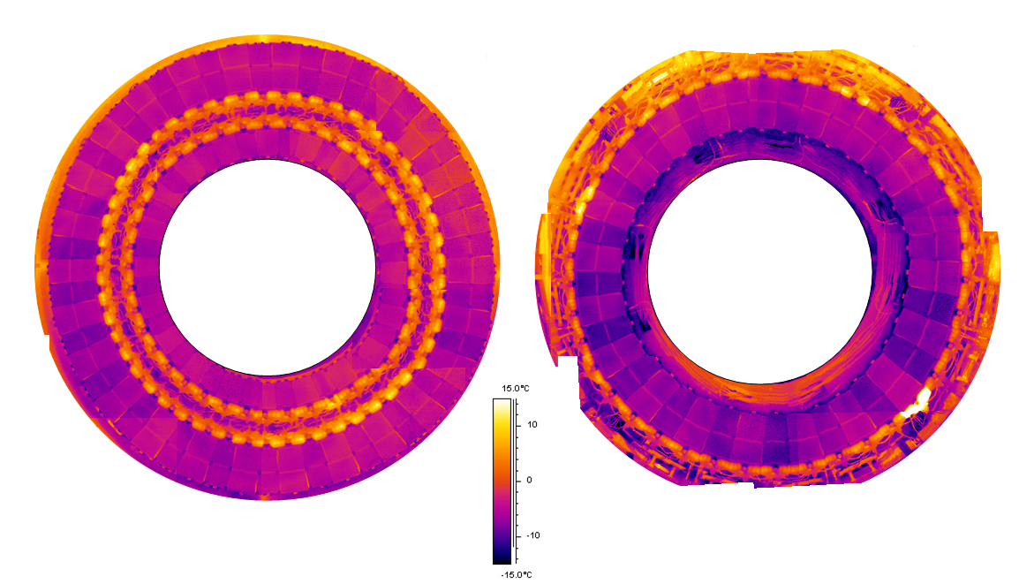
Disk Thermal Testing

Slide 23
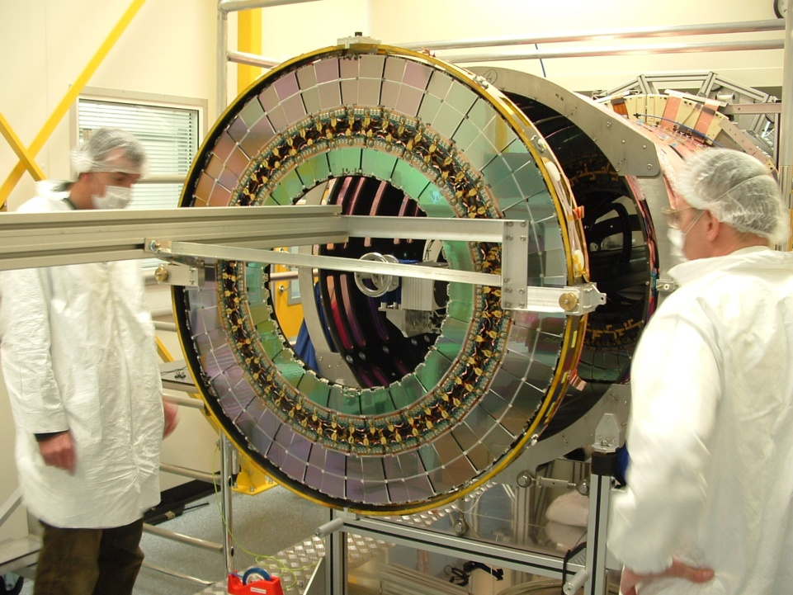
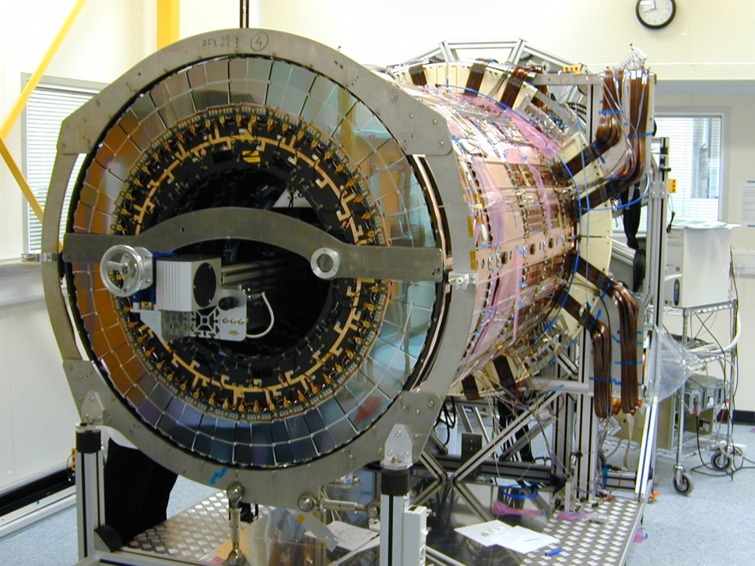
Disk Insertion

Slide 24
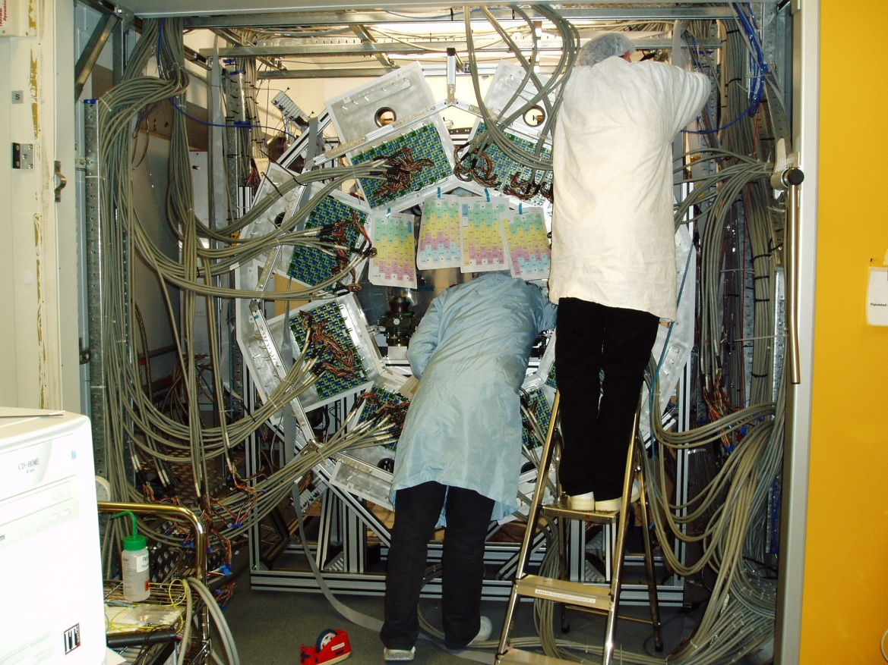
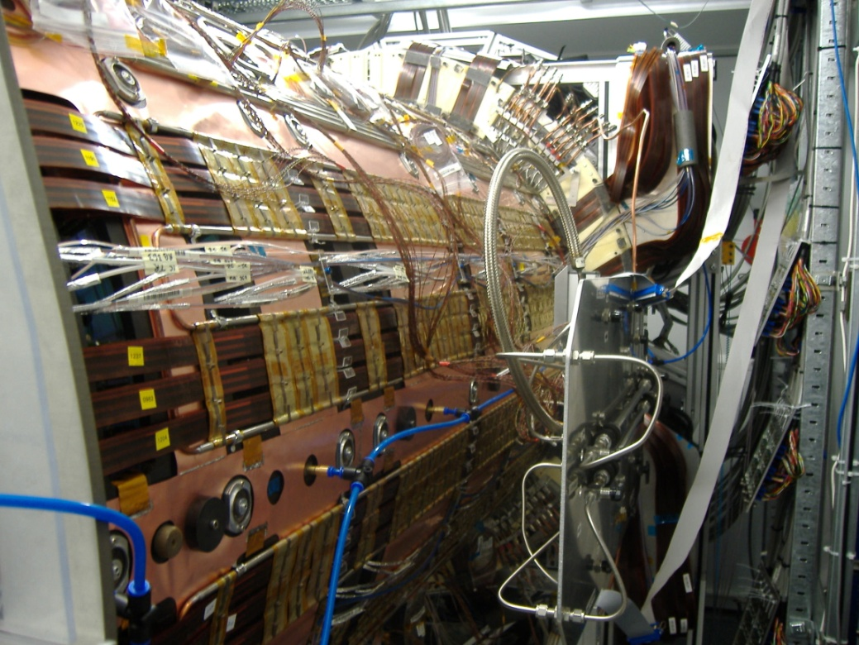
Cylinder System Tests

Slide 25
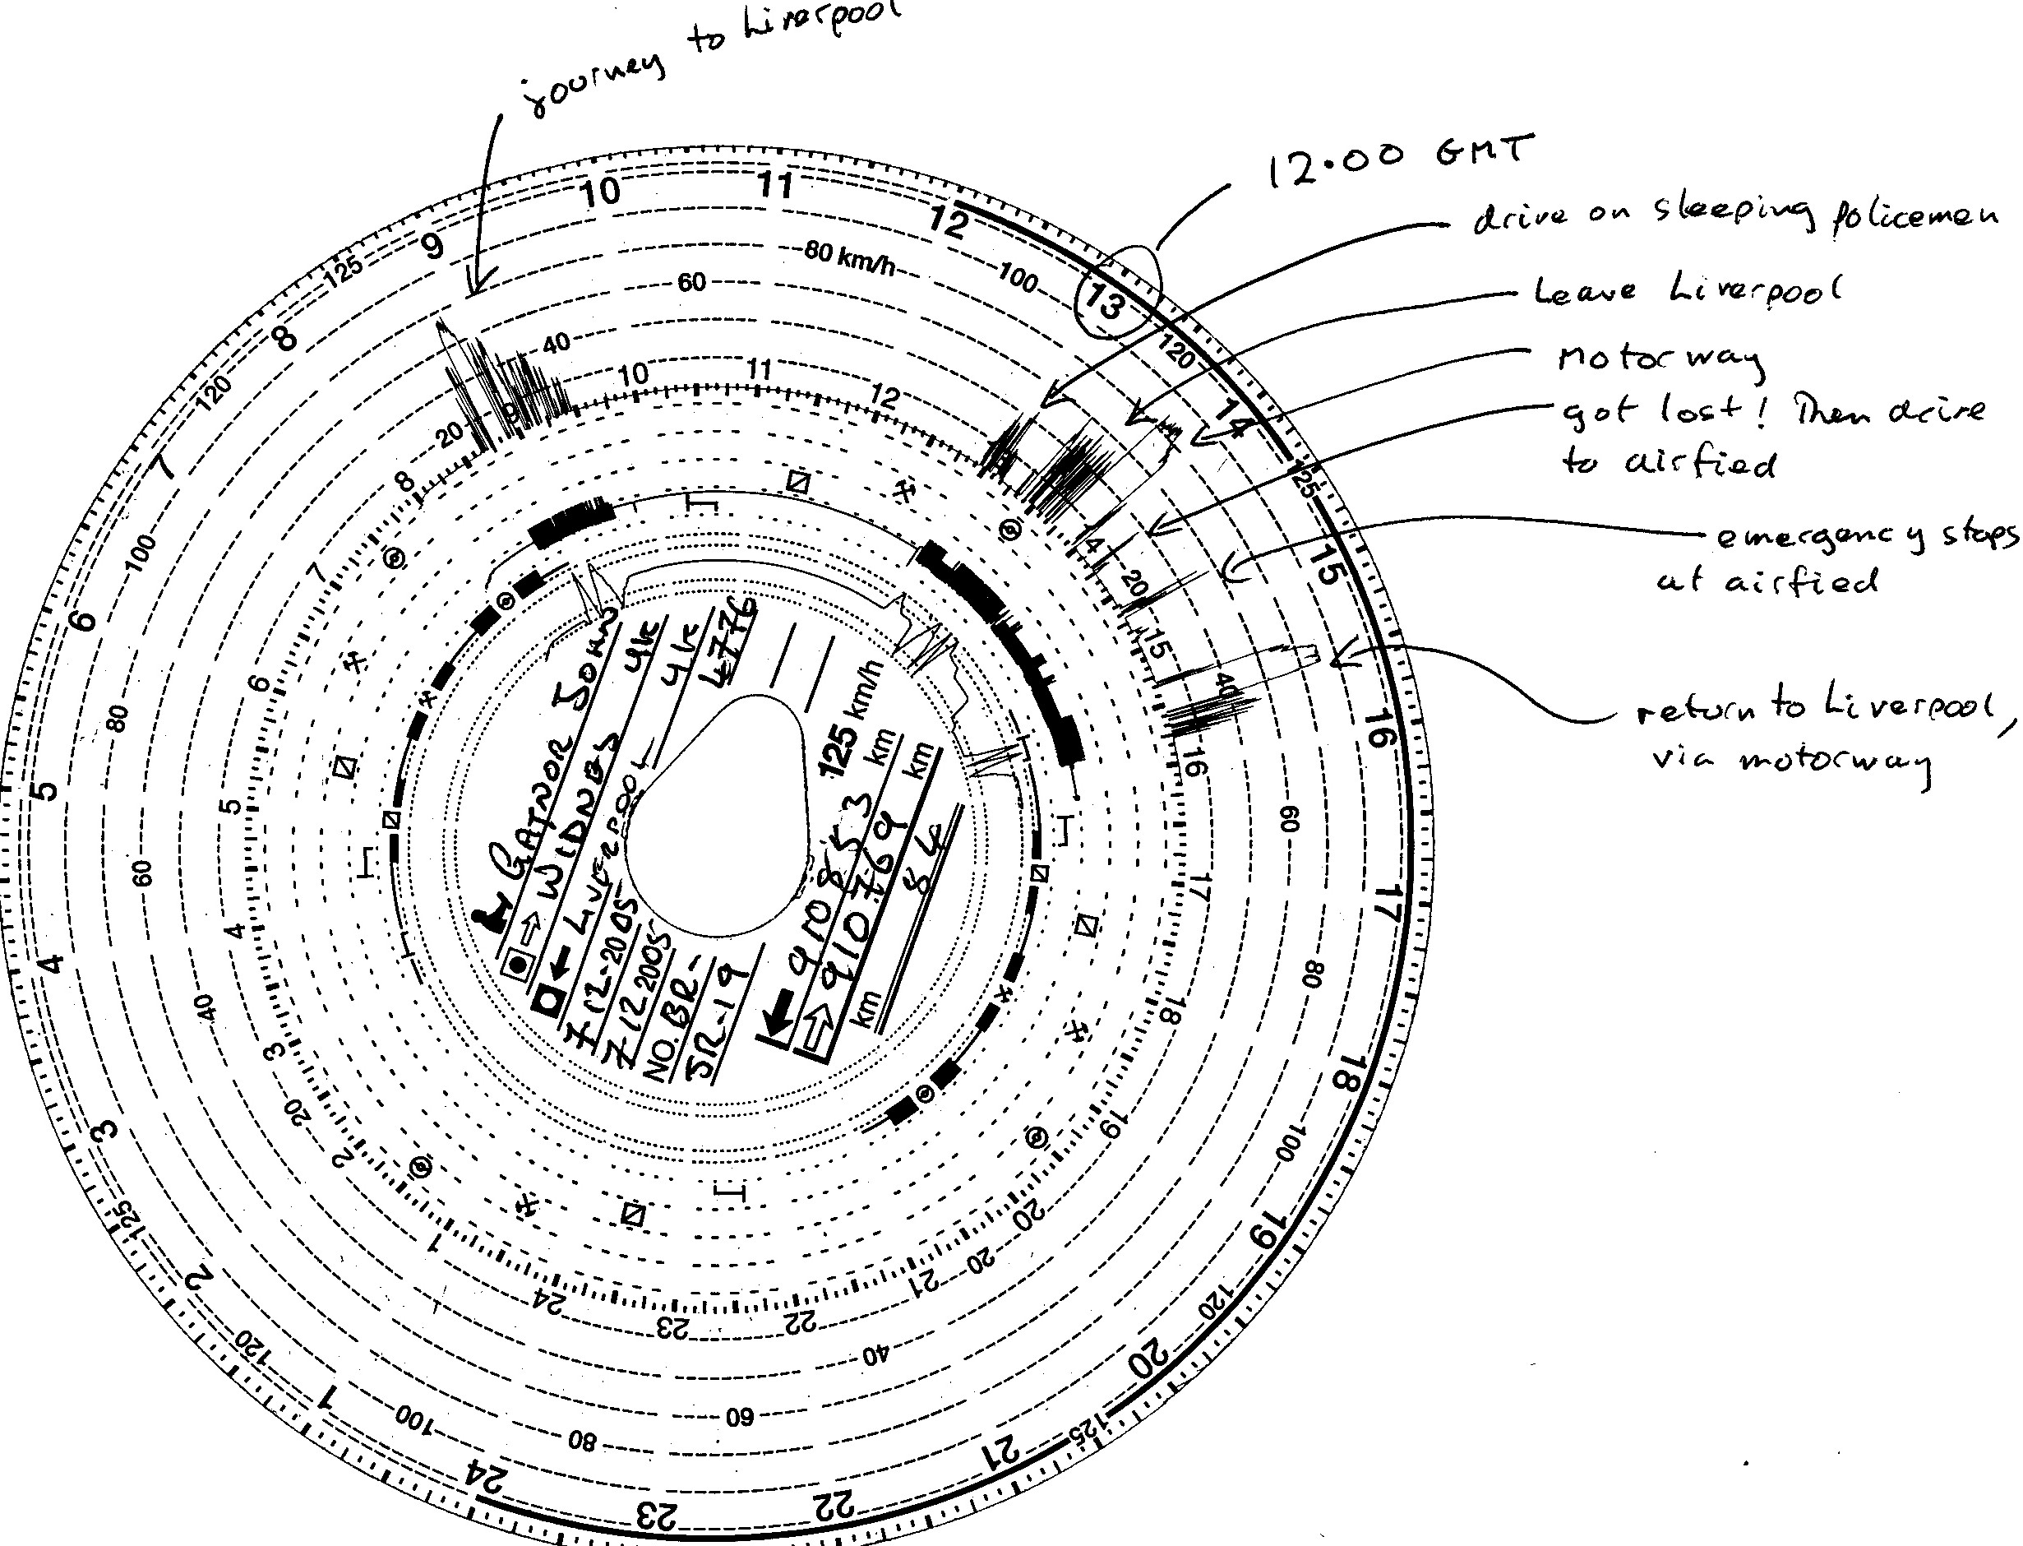
Transportation to CERN
Endcap packaged in custom shipping container
Transport via road freight
Transport test to study shocks, etc...

Slide 26
Final Assembly
Reception Test
Complete services
Add rear support wing
Add thermal enclosure
Integrate into TRT
Add front wing

Slide 28
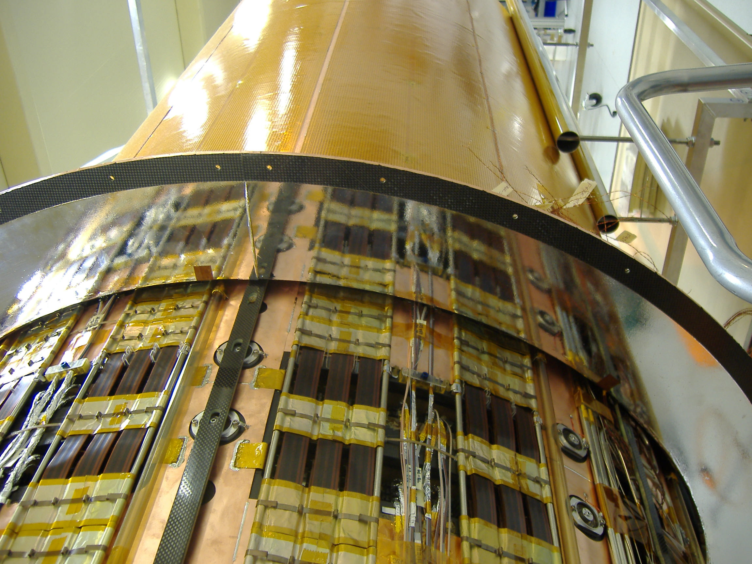

Slide 29
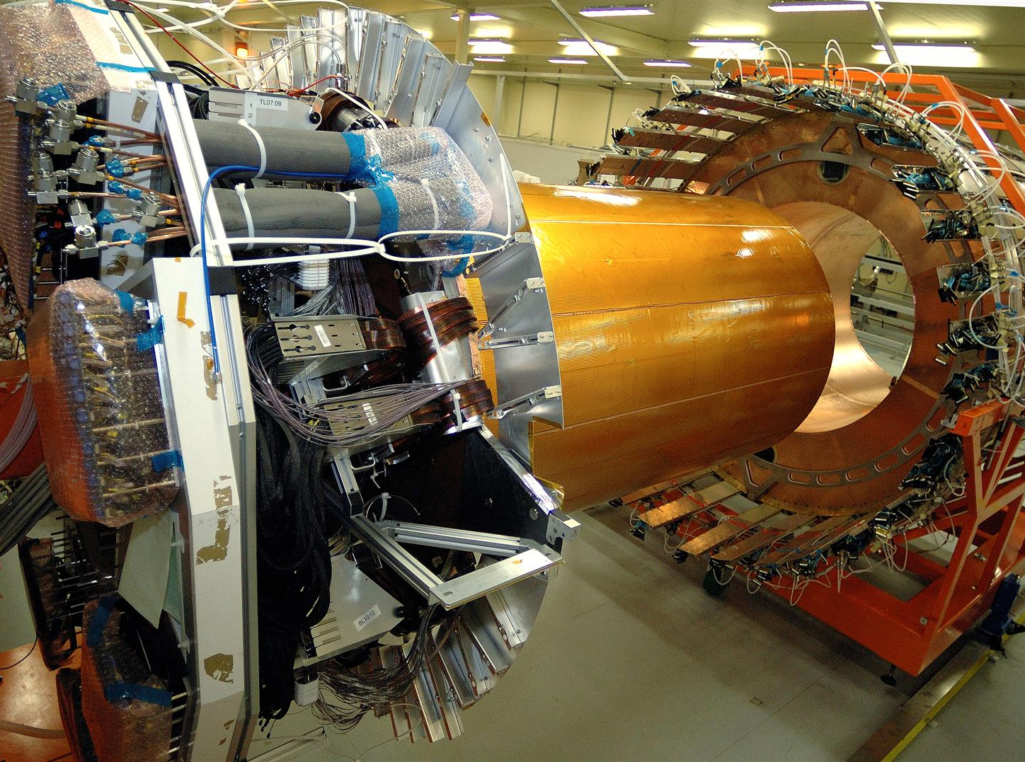

Slide 30
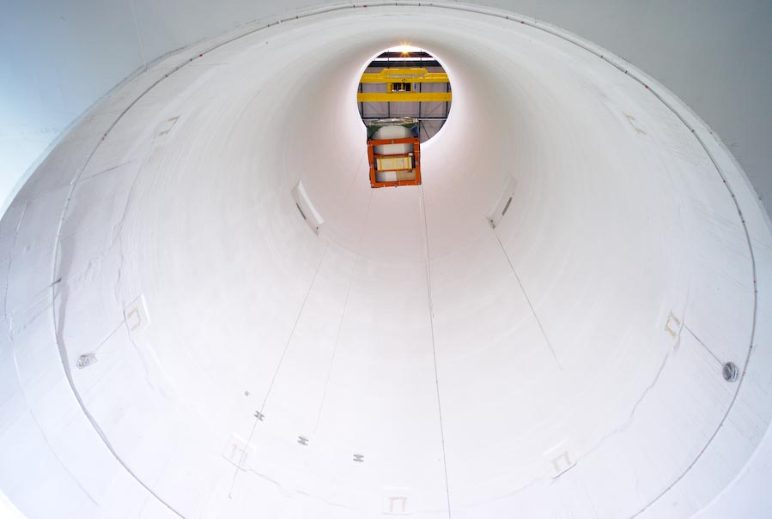
Installation into ATLAS
Package ID
Install insertion platforms
Lower ID

Slide 31
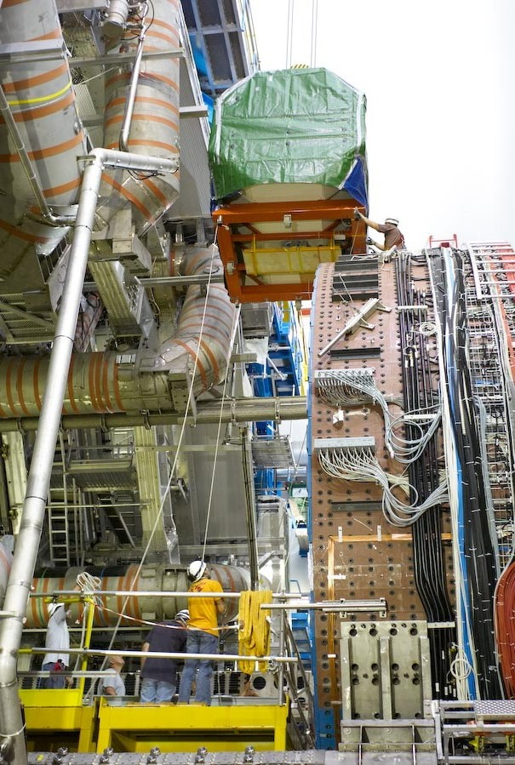
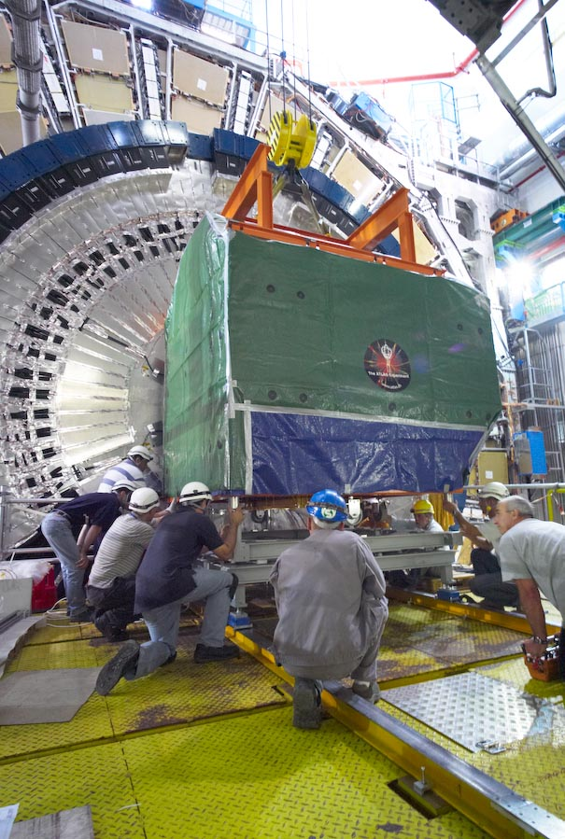

Slide 32
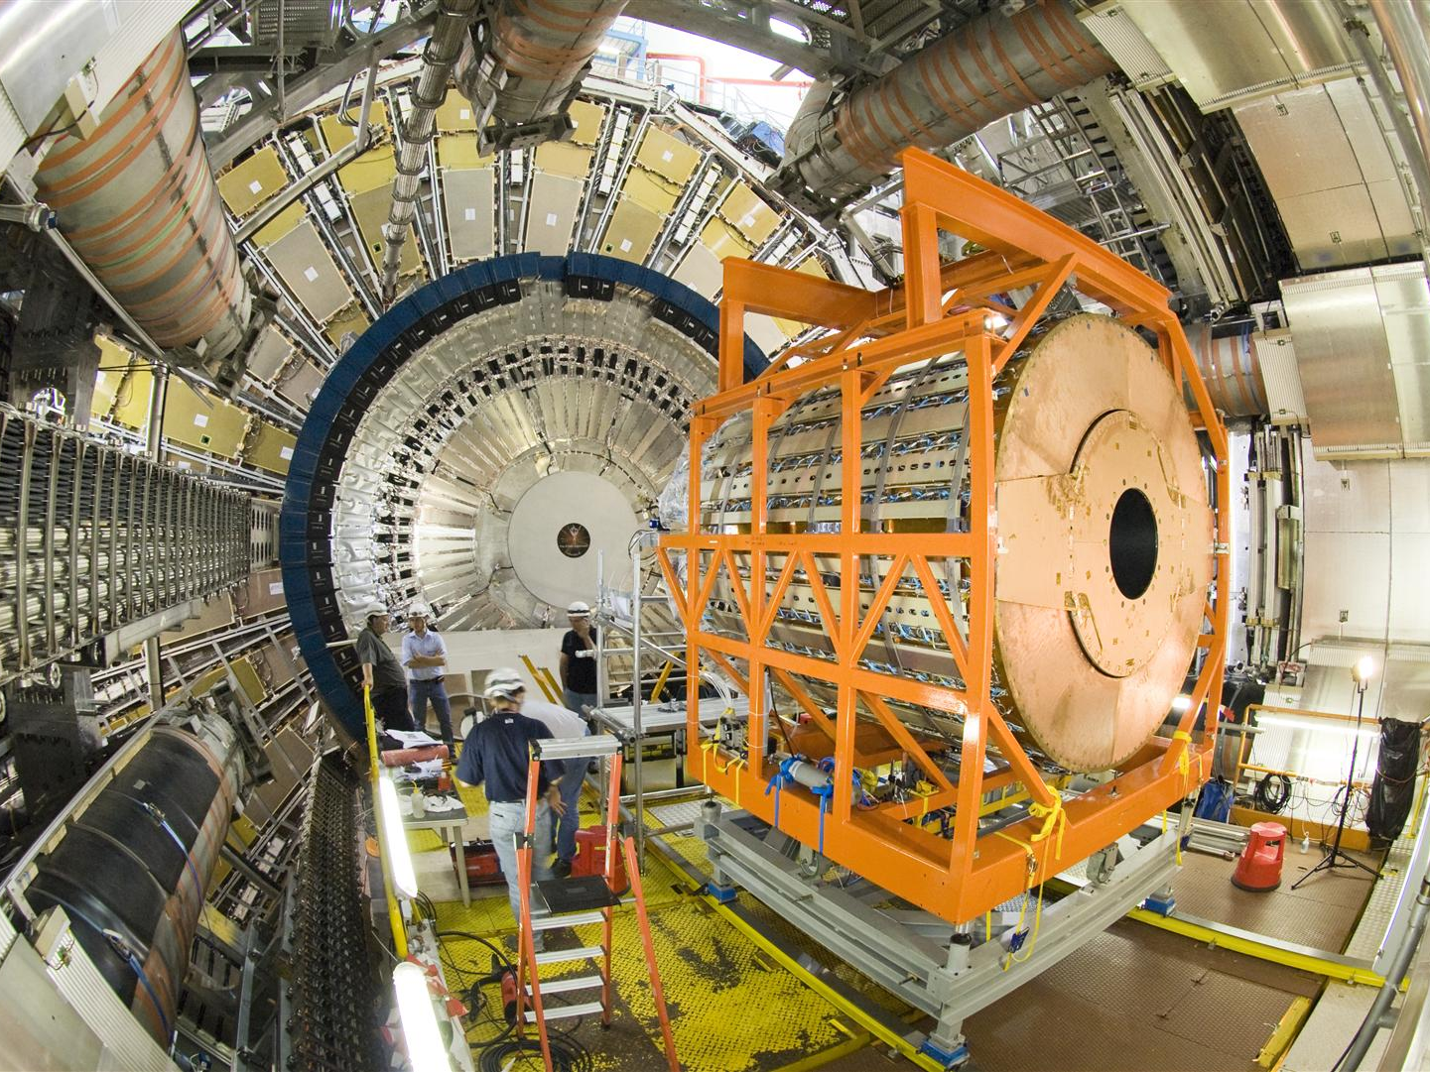

Slide 33
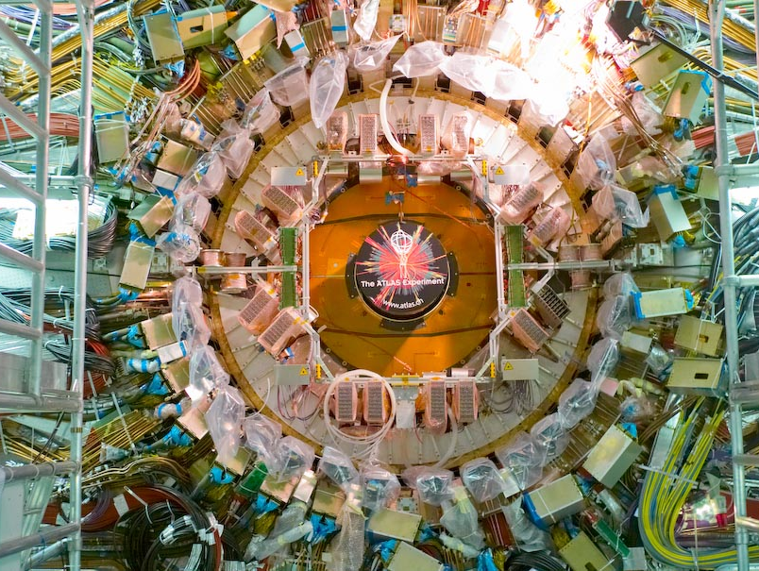

Slide 34
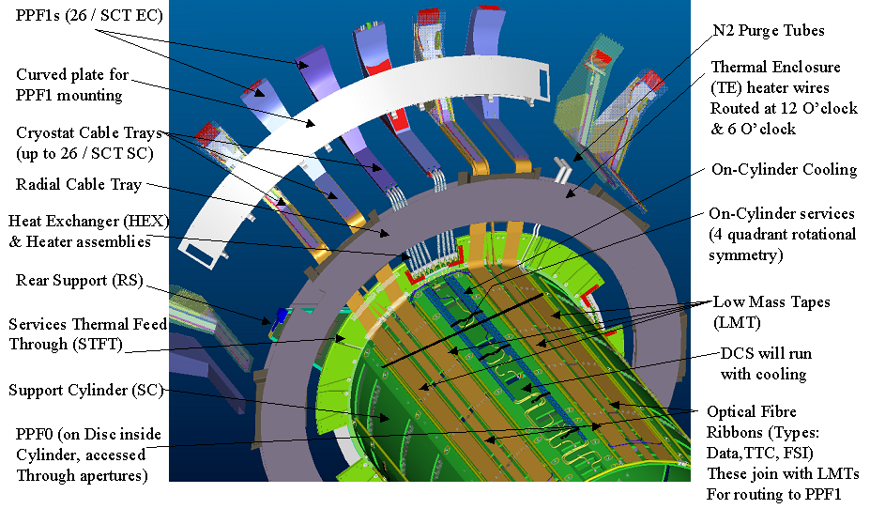
Services Feed-through

Slide 35
The Good, the Bad and the Ugly
Mounting of 2 x 988 modules with no breaks
All disks passed acceptance tests
Assembly of two end-caps completed
Several carbon-carbon cooling blocks had to be re-soldered to cooling pipe (same block, many pipes)
Services feed-through very hard to get leak-tight – almost impossible to disassemble without damage
3 Disks had to be removed to fix a cooling leak during assembly at Liverpool
One cooling loop (9C) has a leak. (discovered just after installation)

Slide 36
Back to the Future ?
2000
Modules
Installation
Mechanics
Modules
Installation
Mechanics
Modules
Installation
Mechanics
2005
2013

Slide 37
Marching in Step...
Vital that collaboration keeps together through the design phase and into production
Climbing the production curve requires focussed activity and the wider project gets forgotten
Module builders
Disk Assemblers
This leaves a gaping hole in the ‘brain-power’ devoted to final assembly & sub-system integration
100’s of Google images of ‘modules’
Try and find 1 showing the PEEK conical insulator at PPF1
(My feeling) The biggest ‘failure’ of the ATLAS ID project is that it’s nearly impossible to take it apart.

Slide 38
Integration by Assembly vs Design
Integration by Assembly
System Architecture and Design
Sub-component Assembly and Testing
Macro-Assembly
Systems Testing
Integration by Design
System Architecture and Design
Sub-component Assembly and Testing
Macro-Assembly
Systems Testing

Slide 39
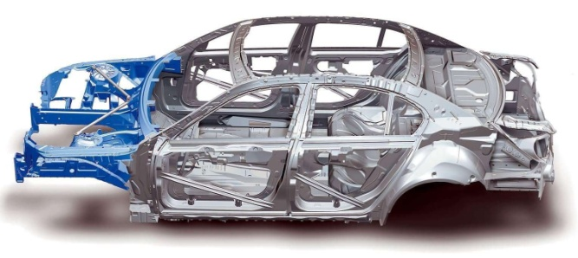
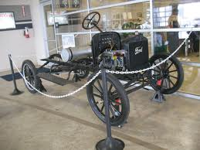
Evolution of ‘Integration’
Integration by Assembly
(1908)
Integration by design
(2008)

Slide 40
ATLAS Tracker Upgrade Staves
Co-curing Electrical services to carbon-fibre
Embedded cooling tube surrounded by Low-density thermally conducting foam

Slide 41
Summary
Successful assembly & commissioning of two 988-module End-caps
Most issues related to services and / or things that did not get enough attention at the right (ie. soon enough) time
In looking forward it’s important to go back to where ATLAS SCT was in ~ 2000
Barrel+endcaps / Modules + mechanics all in 1 room
ATLAS Tracker Upgrade moving towards ‘Integration by Design’
Makes it even more important to keep everyone together for as long as possible!

Slide 42
