Slide 1
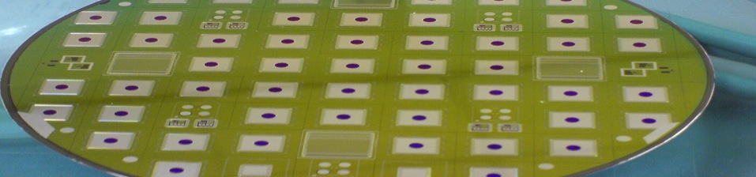



WP2
Radiation Hardness of Silicon Detectors
Alexander Dierlamm
KIT
Alexandra Junkes
Uni Hamburg
1st Project meeting
Enabling Technologies for Silicon Microstrip Tracking Detectors at the HL-LHC
Mainz, February 28th 2013
Notes:
Talk gives overwiev of influence of bulk defects on the performance of siicon particle detectors.
Main focus set on radiation induced defect clusters
Connectin of defects with ele properties

Slide 2
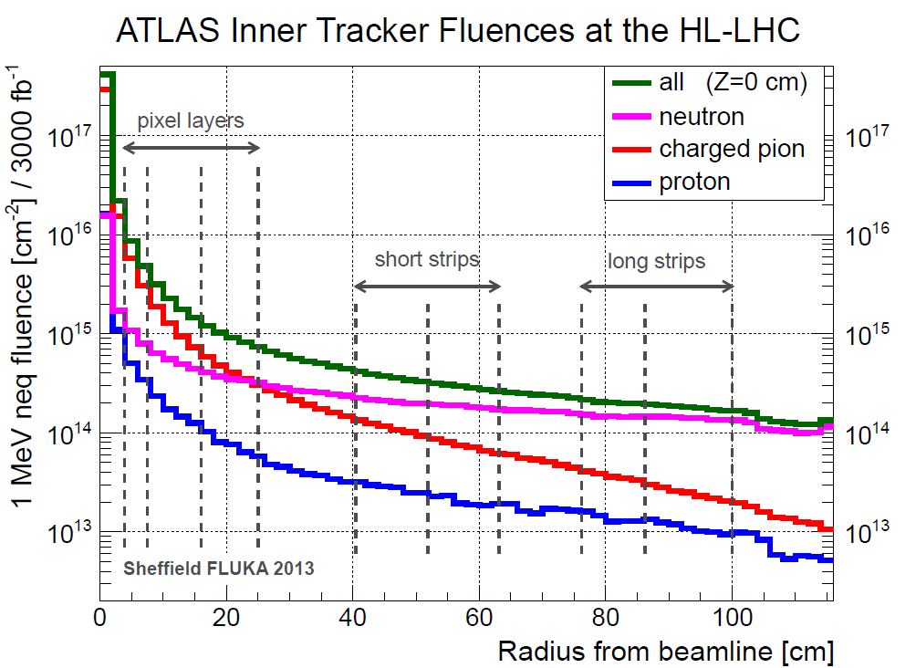
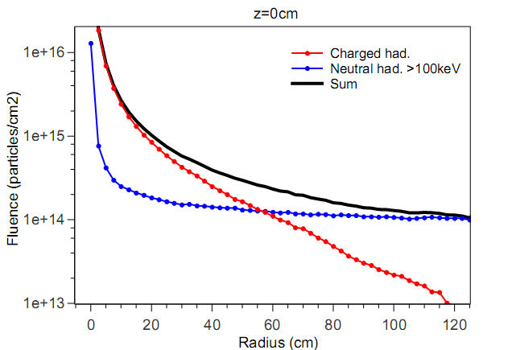

Expected Radiation depending on position in detector
ATLAS
CMS
z= 0 cm
Pion/Neutron mixture
Pixels
Strips
[I. Dawson, P. S. Miyagawa , Atlas Upgrade radiation background simulations]
L=3000 fb⁻¹
A. Mueller, KIT
Very similar requirements for ATLAS & CMS
Φ_{max}= 2x10¹⁵ cm⁻² (with security margins)
Mixed particle contribution

Slide 3
Questions from the proposal:
Are expectations and the forecast correct?
  Validate existing models describing and forecasting the damage today’s detectors.
What are the radiation effects for materials and novel design options?
  Bring together results from both experiments and perform complementary measurements.
Can we optimize the sensors and predict their behavior?
  Use input from 2. and create accurate device simulations.
Can we use/ should we avoid some effects?
  Investigate and simulate charge multiplication, surface effects…
 | Aachen | Berlin | DESY | Freiburg | UHH | KIT
WP2 |  |  | X |  | X | X

Slide 4
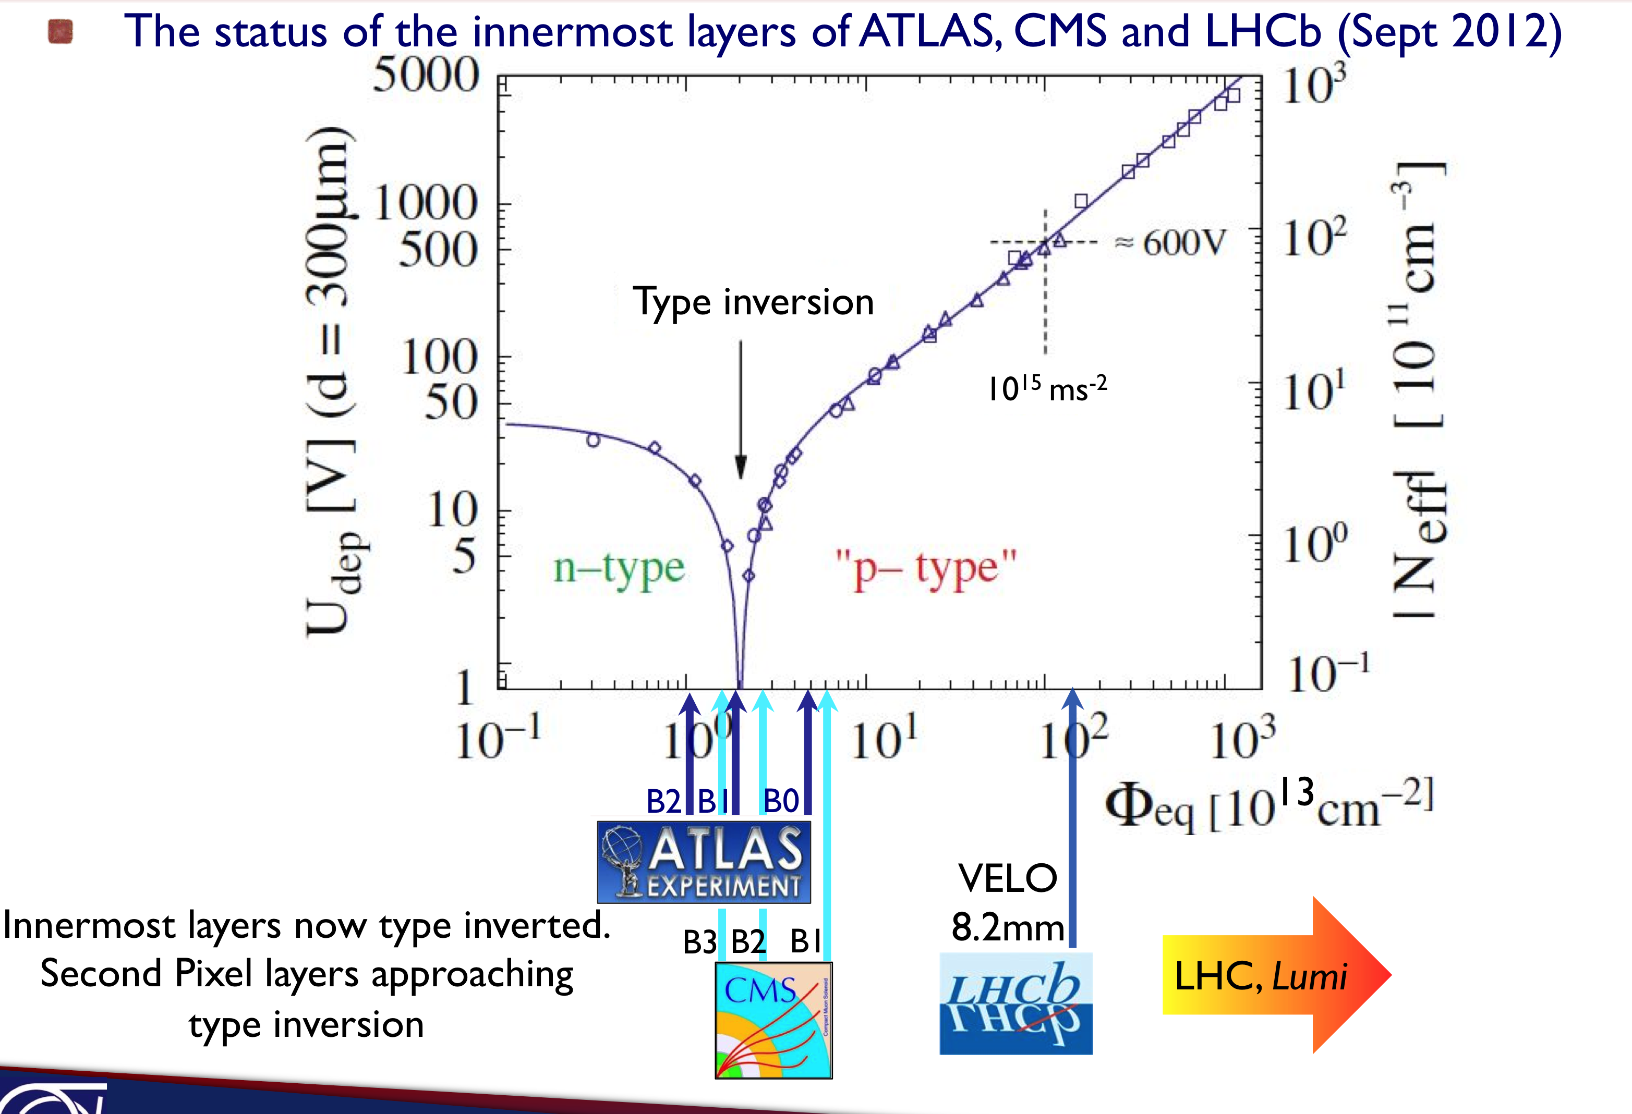
1. Validate models
Working with the Inter-Experiment Radiation Damage Working Group on understanding and forecast for:
  Leakage current, depletion voltage, trapping
  Long term annealing…
Set work parameters for design
- C. Barth (KA)
S. Gibson, 21st RD50, CERN
CMS: S.Zenz, 21st RD50, CERN
S. Gibson, 21st RD50 meeting, CERN

Slide 5
2. Radiation Effect + 3. Device Simulation
2. Radiation effects on materials and devices
Collection of results from ATLAS/CMS projects, most of them are part of RD50
Competencies:
DESY: Sensor design, macroscopic radiation effects
KA: Sensor design, macroscopic radiation effects
UHH: Microscopic radiation damage, macroscopic radiation effects, surface effects
3. Device simulation
Most important step: Take results from 2. and work on accurate device simulations
Forecast of radiation damage and impact on sensor properties (electric field, trapping (?))
Implement further designs (short strips, strip isolation, second metal layers…)
Adapt and optimize layout
T. Eichhorn (DESY), R. Eber (KA), C. Scharf (UHH)

Slide 6
4. Special Effects
Survey of possible new technologies, effects and problems:
Charge multiplication: New devices or more of a problem than a solution?
Random phantom hits: New problems for highly irradiated sensors due to surface effects?
Experience with multiple vendors.
More?
R. Eber, 21st RD50 meeting, CERN

Slide 7
Conclusion
Most important step is transition from test-measurements to accurate simulations
Pooling existing information (e.g. from RD50 results) to a complete picture (overlap with WP1)

