Slide 1
MSK Collaboration Meeting
Advanced Techniques in LLRF control for XFEL
19-21 February 2013, Otwock-Swierk
XFEL WP18 Hardware requirements and schedule
Presented by: Christopher Gerth
Notes:
How to edit the title slide
Fill in the text written in brown

Slide 2
Scope of WP-18
Scope of WP-18 Special Diagnostics:
  Distribution of fs-stable optical timing signals and measurement of
  longitudinal momentum (beam energy), bunch length and bunch arrival time.
E = 0.15 GeV
σ_{s} = 2 mm
I_{peak} = 50 A
E = 0.15 GeV
σ_{s} = 1 mm
I_{peak} = 50 A
E = 0.6 GeV
σ_{s} = 0.1 mm
I_{peak} = 1 kA
E = 2.0 GeV
σ_{s} = 0.02 mm
I_{peak} = 5 kA
E = 17.5 GeV
σ_{s} = 0.02 mm
I_{peak} = 5 kA
I0
BC0
L1
BC1
L2
BC2
L3
Energy change (x 100) after accelerating sections: I0, L1, L2, L3
Bunch length change (x 100) after bunch compressors: BC0, BC1, BC3
Bunch arrival change after dispersive sections: BC0, BC1, BC3
  => Complex systems of which only very few items will be installed!
Notes:
Before you start editing the slides of your talk change to the Master Slide view:
Menu button “View”, Master, Slide Master:
Edit the following 2 items in the 1st slide:
1) 1st row in the violet header:
Delete the existent text and write the title of the EoI for WPnumber
2) The row in the footer area: write the institute name
Close Master View

Slide 3
Overview on devices
Suite of devices required to cover full range of beam energies and bunch lengths
femtosecond optical
timing distribution
Beam energy
Bunch arrival
Bunch profile
MLO – master laser oscillator
FSD – free-space distribution
OXC/RF Link – stabilized links
Energy BPM
EBPM⁽¹⁾
Synchrotron
Radiation
Monitors
SRM
Coherent
Radiation
Diagnostics
CRD
EO
Diagnostics
EOD
Transverse
Deflecting
Structure
TDS⁽¹⁾
Beam energy
Beam Energy
Energy profile
Compression
Bunch profile
Bunch profile
Bunch profile
Slice emittance
Phase space
L2L
Laser
Synchronization
L2RF
RF
Synchronization
BAM
Bunch Arrival
Monitor
Bunch arrival
Beam energy
1)
High-Power RF system and TDS are part of contract between European XFEL GmbH and Inst. for Nuclear Research (INR).
Optical Synchronization System about half of the WP (cost, personnel)
TDS System largest diagnostic device
Notes:
Before you start editing the slides of your talk change to the Master Slide view:
Menu button “View”, Master, Slide Master:
Edit the following 2 items in the 1st slide:
1) 1st row in the violet header:
Delete the existent text and write the title of the EoI for WPnumber
2) The row in the footer area: write the institute name
Close Master View

Slide 4
General Comments and Generic Layout
4
WP18 in comparison to the LLRF system:
Only very few devices of a large variety of complex systems
Reduce development costs and achieve 20 years maintenance
=> Try to use commercial parts or hardware of ‘big brother’ LLRF
=> Try to use same hardware for all devices where possible
=> Partyline: First get series production of LLRF systems finished
but try to incorporate specs of WP18 where possible.
Control of Hardware
Vacuum
setup
Signal detection
Computation
Signal conversion to electrical signals
FB
Notes:
4
Before you start editing the slides of your talk change to the Master Slide view:
Menu button “View”, Master, Slide Master:
Edit the following 2 items in the 1st slide:
1) 1st row in the violet header:
Delete the existent text and write the title of your talk into this text field
2) The 2 rows in the footer area: Delete the text and write the information
regarding your talk (same as on the Title Slide) into this text field.
If you want to use more partner logos position them left
beside the DESY logo in the footer area
Close Master View

Slide 5
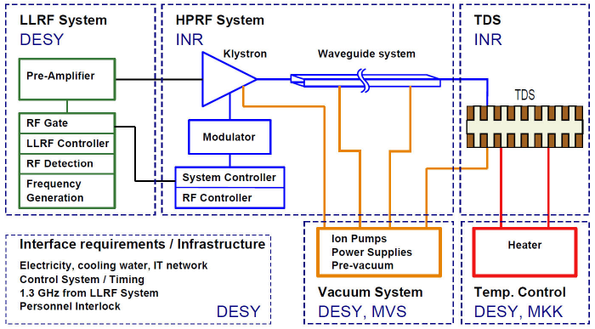
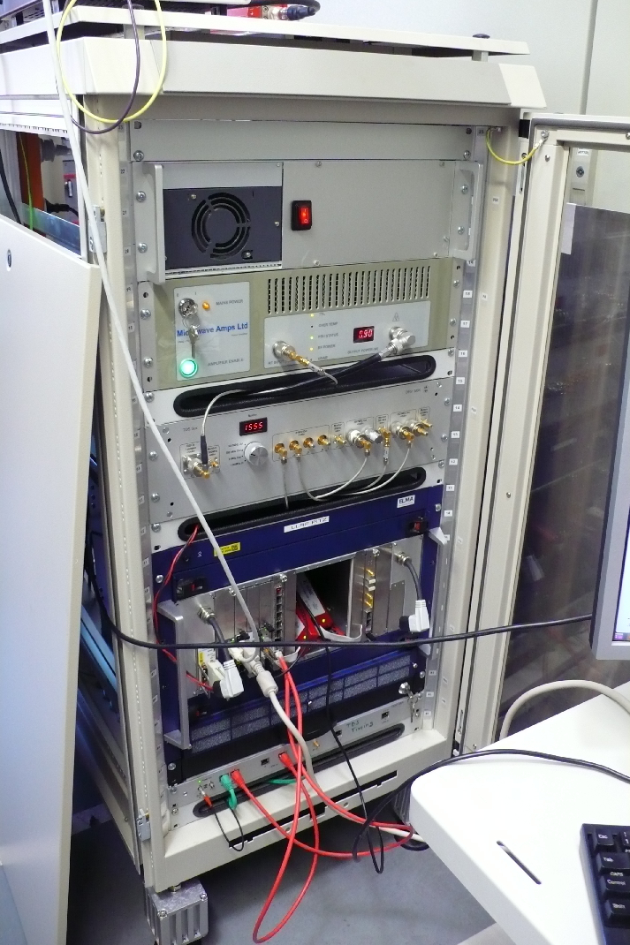
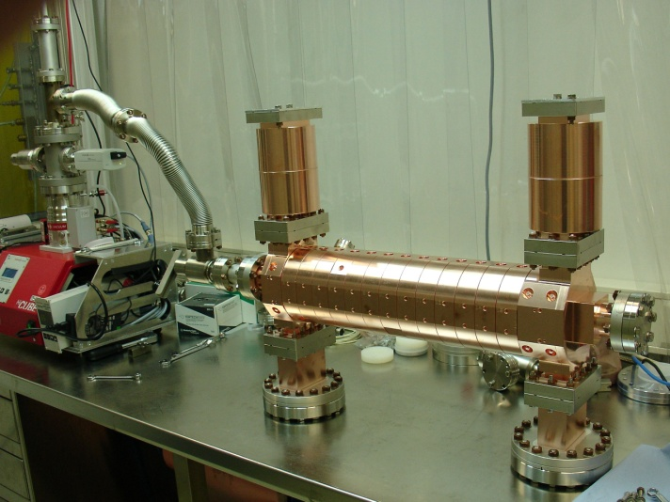
Overview TDS
5
PITZ Prototype
TDS: disk-loaded travelling wave structure
MSK is responsible for the LLRF System: LLRF system for single cavity regulation ( 1 – 4 μs, Struck SIS8300 + DWC) but at special frequency.
The High-Power RF system and Transverse Deflecting Structures are part of contract between European XFEL GmbH and Inst. for Nuclear Research (INR), Troitsk, Russia.
Prototype system to be build at PITZ at DESY Zeuthen.
Notes:
5
Before you start editing the slides of your talk change to the Master Slide view:
Menu button “View”, Master, Slide Master:
Edit the following 2 items in the 1st slide:
1) 1st row in the violet header:
Delete the existent text and write the title of your talk into this text field
2) The 2 rows in the footer area: Delete the text and write the information
regarding your talk (same as on the Title Slide) into this text field.
If you want to use more partner logos position them left
beside the DESY logo in the footer area
Close Master View

Slide 6
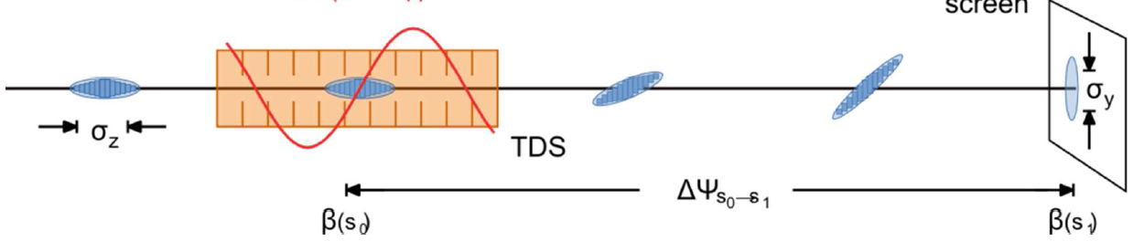

TDS Measurement Principle and choice of Frequency
View screen
“Streak Strength (Shear Parameter):
V_{y} : TDS Voltage => Powerful commercial klystron
ω : TDS Frequency => As high as possible
Wakefields => Iris > 40 mm => TDS Frequency < 4GHz
=> S-Band at around 3 GHz
Notes:
Before you start editing the slides of your talk change to the Master Slide view:
Menu button “View”, Master, Slide Master:
Edit the following 2 items in the 1st slide:
1) 1st row in the violet header:
Delete the existent text and write the title of the EoI for WPnumber
2) The row in the footer area: write the institute name
Close Master View

Slide 7
TDS Frequency
Find frequency that is a harmonic of f_{MO} = 9 MHz and can be generated from the 1.3 GHz:
LOLA : f_{TDS} = 2.856 GHz
=> ~ 100 deg phase change per bunch at 1 MHz)
TDS: f_{TDS} = 332 · f_{MO} = 332/144 · f_{1.3GHz}
f_{TDS} = 2 · f_{1.3GHz} + 1/3 · f_{1.3GHz} - 1/12 · (1/3 · f_{1.3GHz}) = 2997 MHz
f_{LO} = 2 · f_{1.3GHz} + 1/3 · f_{1.3GHz} = 3033 MHz
=> f_{IF} = 36 MHz
f_{CLK} = 81 MHz

Slide 8
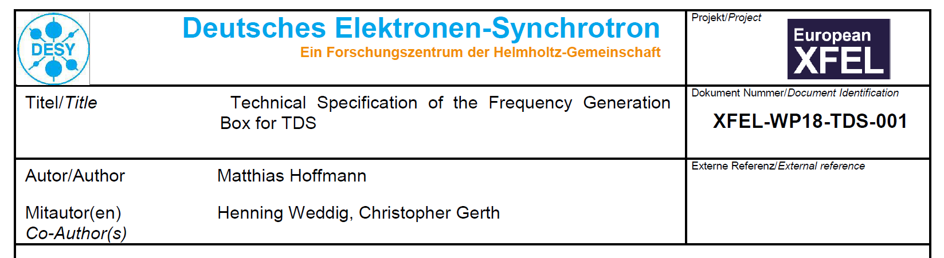
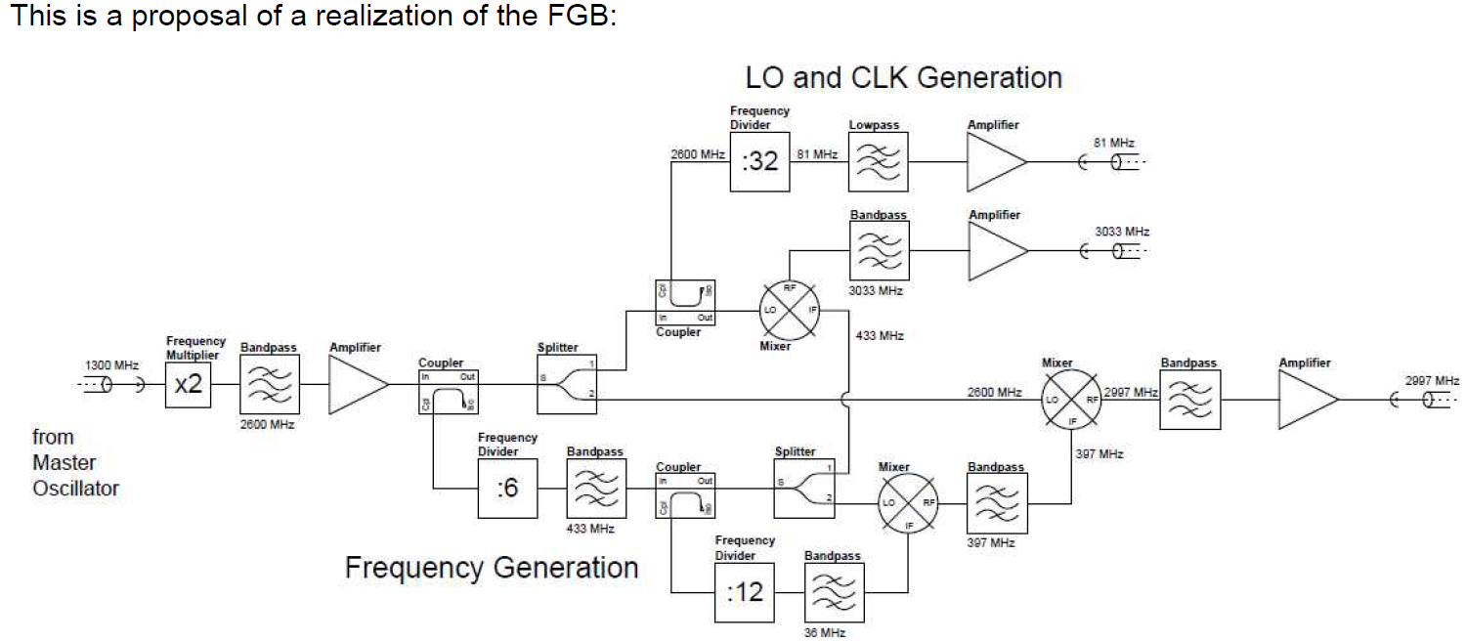
Specification FGB
Notes:
Before you start editing the slides of your talk change to the Master Slide view:
Menu button “View”, Master, Slide Master:
Edit the following 2 items in the 1st slide:
1) 1st row in the violet header:
Delete the existent text and write the title of the EoI for WPnumber
2) The row in the footer area: write the institute name
Close Master View

Slide 9
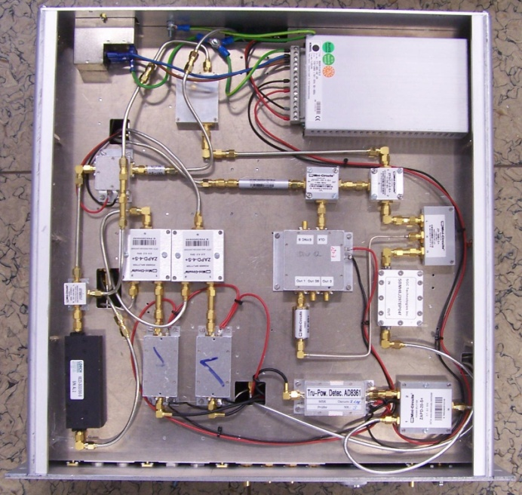
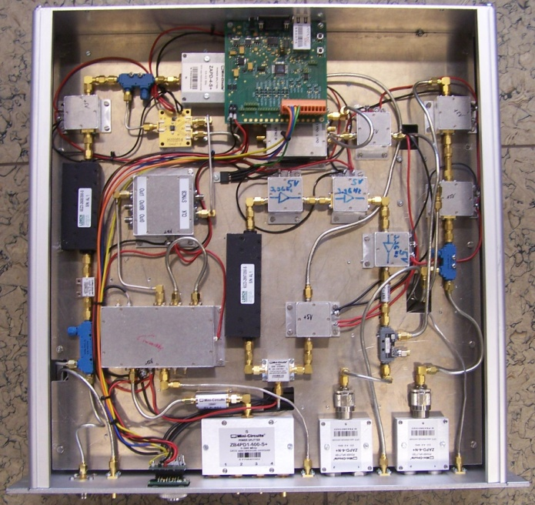
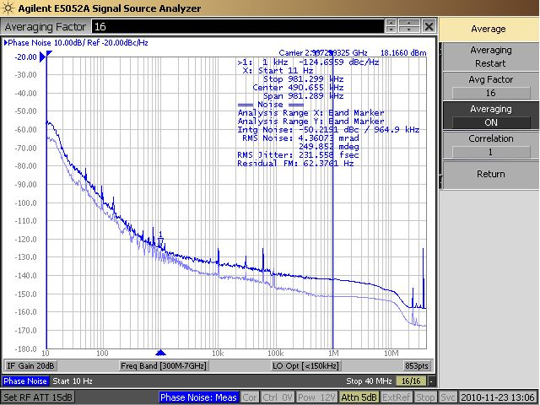
Frequency Generation Box (1): DESY Prototype
Bottom View
Top View
Specs fulfilled!
Make PCB Design => Erhard Salow (RALAB, INWAVE)
Notes:
Before you start editing the slides of your talk change to the Master Slide view:
Menu button “View”, Master, Slide Master:
Edit the following 2 items in the 1st slide:
1) 1st row in the violet header:
Delete the existent text and write the title of the EoI for WPnumber
2) The row in the footer area: write the institute name
Close Master View

Slide 10
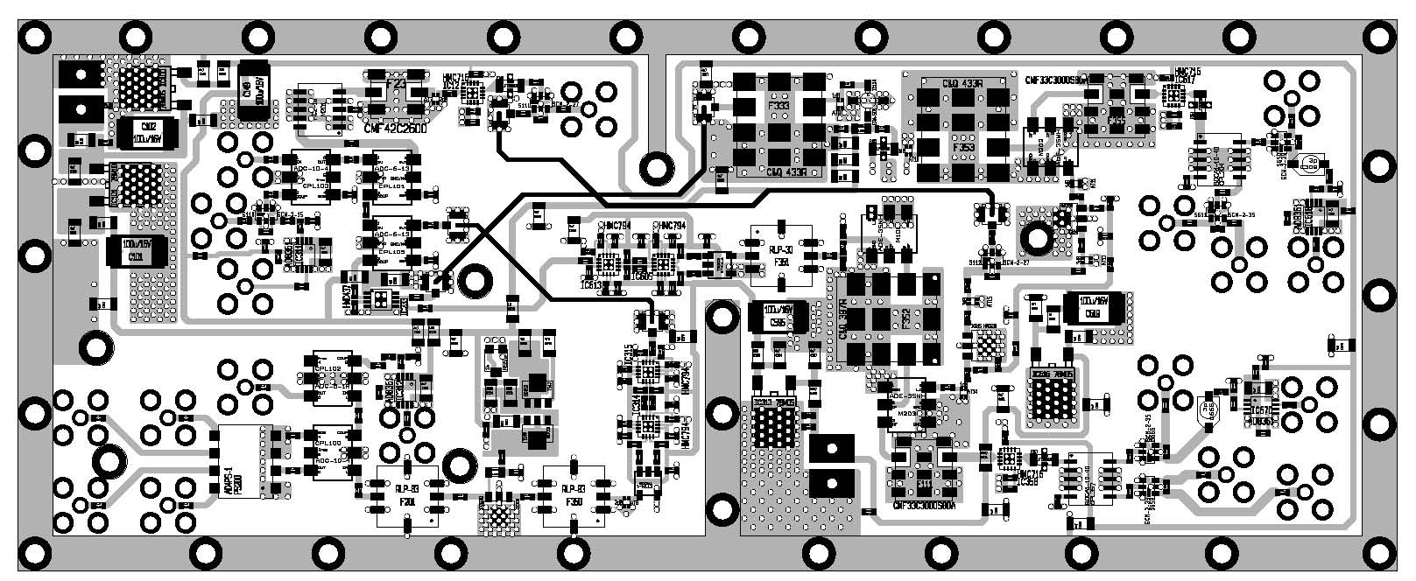
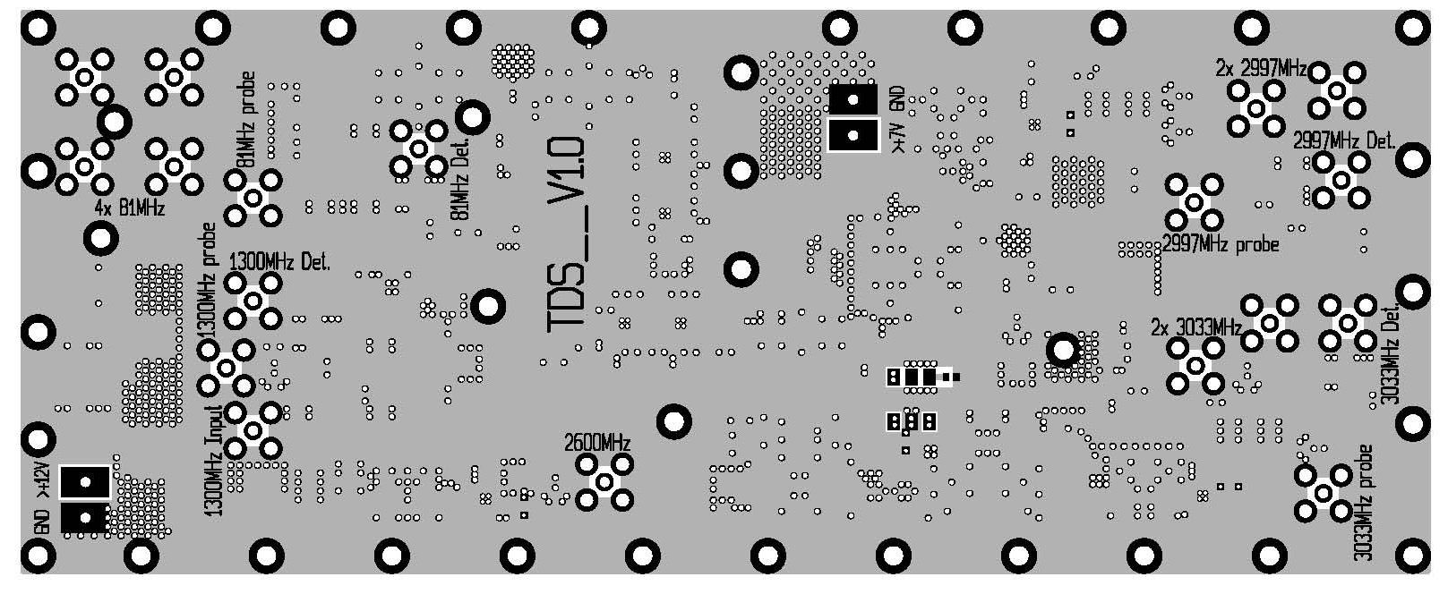
FGB (2): 1st PCB Protoype by RALAB
Few smaller changes required and 2.997MHz output level too low and board too hot!
=> Make 3 separate modules in ZG4 housings
Notes:
Before you start editing the slides of your talk change to the Master Slide view:
Menu button “View”, Master, Slide Master:
Edit the following 2 items in the 1st slide:
1) 1st row in the violet header:
Delete the existent text and write the title of the EoI for WPnumber
2) The row in the footer area: write the institute name
Close Master View

Slide 11
FGB (3a): 3 PCBs in ZG4 housings
1300 MHz
from MO
3033 MHz
TDS LO
Local Oscillator Module: LOM
3033 MHz
TV
M
2600 MHz
1300 MHz
433 MHz
433 MHz
2600 MHz
12
Clock Generator Module: CDM
1
2 x HMC794 (divider 1, 2,3 or 4)
433 MHz – 27MHz
L-to-S band
Module: LSM
4 x Clock
M
TV
2 x 2997 MHz
TDS ADC Clock: 81MHz
TDS Frequency
Notes:
Before you start editing the slides of your talk change to the Master Slide view:
Menu button “View”, Master, Slide Master:
Edit the following 2 items in the 1st slide:
1) 1st row in the violet header:
Delete the existent text and write the title of the EoI for WPnumber
2) The row in the footer area: write the institute name
Close Master View

Slide 12
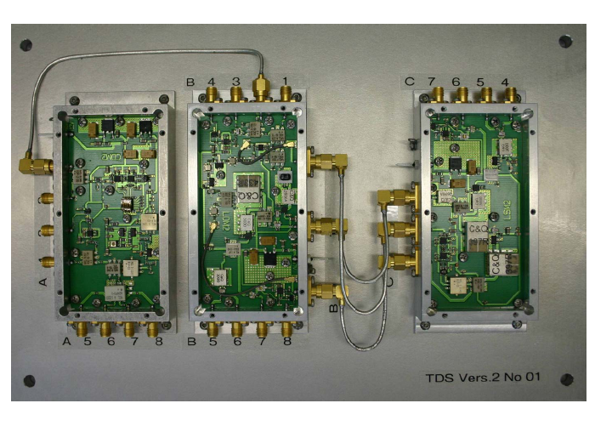
FGB (3b): 3 PCBs in ZG4 housings
=> (Revision 2) delivered last Friday
Notes:
Before you start editing the slides of your talk change to the Master Slide view:
Menu button “View”, Master, Slide Master:
Edit the following 2 items in the 1st slide:
1) 1st row in the violet header:
Delete the existent text and write the title of the EoI for WPnumber
2) The row in the footer area: write the institute name
Close Master View

Slide 13
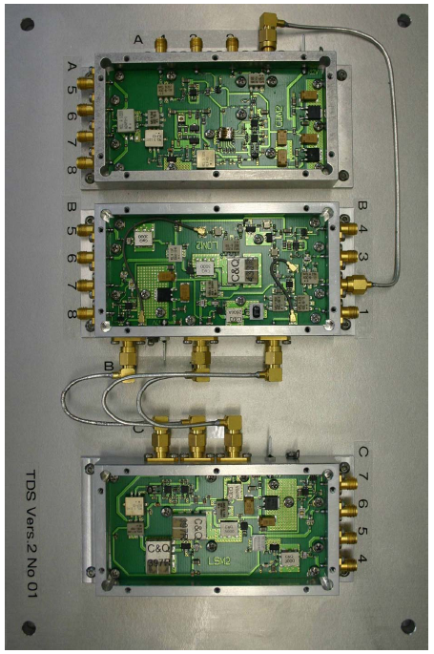
FGB (4): 19’’ Crate
Front
Rear
DPM340
+ Schalter
Ground plate
RF connectors
TMCB:
Communication
Temperatures
DC Monitors
PS Monitors
CDM1
1300 MHz in
CLK
1300 MHz
433 MHz
3033 MHz
2997 MHz
RF Monitors
LOM1
Space for filers, rf switches, etc.
Power Amp
for Peltier
Power Supply
230 VAC
15V
12V
7V
LSM1
Temperature
Isolation (foam)
Peltier cooling
from below

Slide 14
TDS Summary
TDS
TDS
TDS
First system for XFEL injector commissioning required 06/2014:
FGB, DWC, SIS8300, pulse-power Pre-amp (200 W) available
TMCB for DC monitors and temp stabilization required 08/13 for tests.
Notes:
Before you start editing the slides of your talk change to the Master Slide view:
Menu button “View”, Master, Slide Master:
Edit the following 2 items in the 1st slide:
1) 1st row in the violet header:
Delete the existent text and write the title of the EoI for WPnumber
2) The row in the footer area: write the institute name
Close Master View

Slide 15
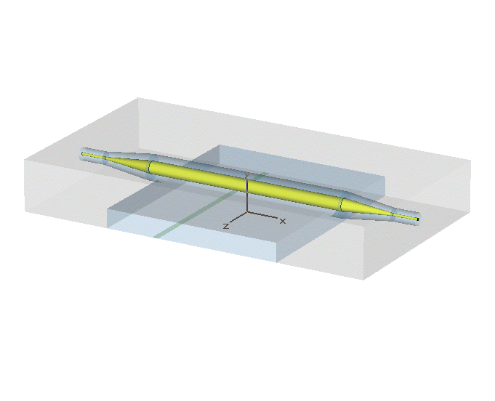
Overview EBPM
15
Pickup
EBPM
Measures the centre-of-gravity of bunch
Relative energy ⇒ dE/E ≈ dx / R₁₆
Absolute energy ⇒ cross-calibration required
Beam Path
Δφ, Δt ~ Δx
Experience with signal detection from EBPM at FLASH:
- optical front-end: high resolution but complex/expensive and very limited dynamic range
- RF front-end: also complex and included VMs => very prone to temp drifts
New RF detection scheme based on LLRF signal detection.
EBPM Firmware has been integrated in general LLRF firmware.
RF Design of pickup for XFEL vacuum chambers (400 x 40 mm² ) done by Technical University of Darmstadt
Notes:
15
Before you start editing the slides of your talk change to the Master Slide view:
Menu button “View”, Master, Slide Master:
Edit the following 2 items in the 1st slide:
1) 1st row in the violet header:
Delete the existent text and write the title of your talk into this text field
2) The 2 rows in the footer area: Delete the text and write the information
regarding your talk (same as on the Title Slide) into this text field.
If you want to use more partner logos position them left
beside the DESY logo in the footer area
Close Master View

Slide 16
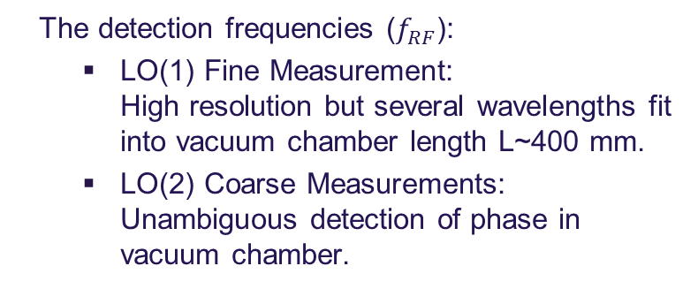
EBPM: LO Generation
3033 MHz
EBPM LO (1)
1300 MHz from MO
Local Oscillator Module: LOM
3033 MHz
TV
M
2600 MHz
1300 MHz
433 MHz
433 MHz
2600 MHz
Clock Generator Module: CDM
EBPM LO(2)
2 x HMC794 (divider 1, 2,3 or 4)
433 MHz – 27MHz
The detection frequencies ($f_{RF}$):
  LO(1) Fine Measurement:
  High resolution but several wavelengths fit into vacuum chamber length L~400 mm.
  LO(2) Coarse Measurements:
  Unambiguous detection of phase in vacuum chamber.
4 x Clock
EBPM ADC Clock 108 MHz
Notes:
Before you start editing the slides of your talk change to the Master Slide view:
Menu button “View”, Master, Slide Master:
Edit the following 2 items in the 1st slide:
1) 1st row in the violet header:
Delete the existent text and write the title of the EoI for WPnumber
2) The row in the footer area: write the institute name
Close Master View

Slide 17
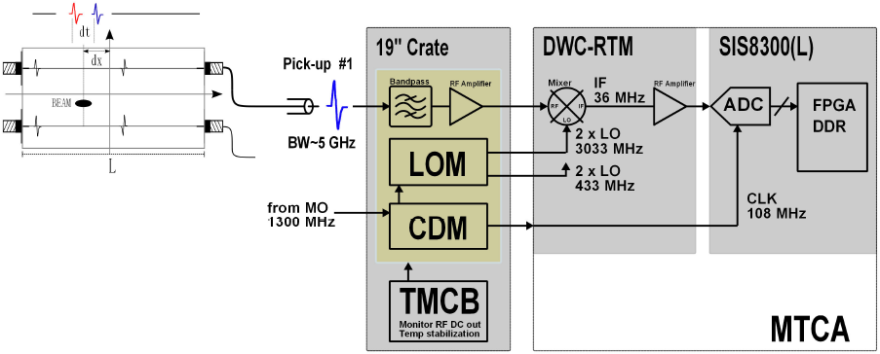
EBPM: DWC Detection Scheme
Dark Current
Fine Meas.
Coarse Meas.
4 x
Notes:
Before you start editing the slides of your talk change to the Master Slide view:
Menu button “View”, Master, Slide Master:
Edit the following 2 items in the 1st slide:
1) 1st row in the violet header:
Delete the existent text and write the title of the EoI for WPnumber
2) The row in the footer area: write the institute name
Close Master View

Slide 18
EBPM Summary
TDS
TDS
TDS
EBPM
EBPM
EBPM
First system for XFEL required 01/2016:
LO Generation, DWC, SIS8300 all available
TMCB for DC monitor channels and temp stabilization required for tests.
Open point: Study Influence of signal reflections on detection scheme.
Notes:
Before you start editing the slides of your talk change to the Master Slide view:
Menu button “View”, Master, Slide Master:
Edit the following 2 items in the 1st slide:
1) 1st row in the violet header:
Delete the existent text and write the title of the EoI for WPnumber
2) The row in the footer area: write the institute name
Close Master View

Slide 19
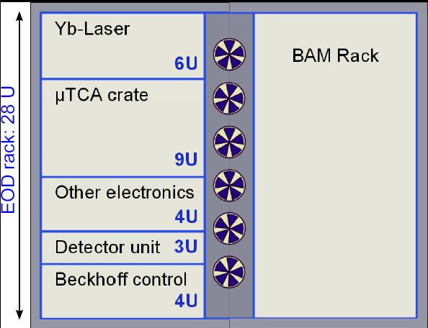
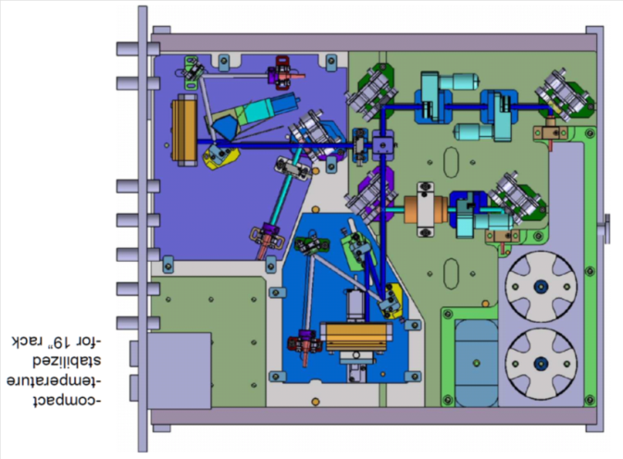
Overview EOD
19
Beamline Unit
e⁻
Coulomb field of e-beam changes optical properties of the crystal and imprints longitudinal profile on the laser pulse.
=> Measurement of longitudinal bunch profile by spectral analysis of laser: time resolution > 200fs
Goal: Complete system to fit into 28U rack in XTL
Development of fast 1D detector for multi-bunch readout
=> changes in the bunch profile within bunch train can be detected (1MHz, 256 pixels)
Notes:
19
Before you start editing the slides of your talk change to the Master Slide view:
Menu button “View”, Master, Slide Master:
Edit the following 2 items in the 1st slide:
1) 1st row in the violet header:
Delete the existent text and write the title of your talk into this text field
2) The 2 rows in the footer area: Delete the text and write the information
regarding your talk (same as on the Title Slide) into this text field.
If you want to use more partner logos position them left
beside the DESY logo in the footer area
Close Master View

Slide 20
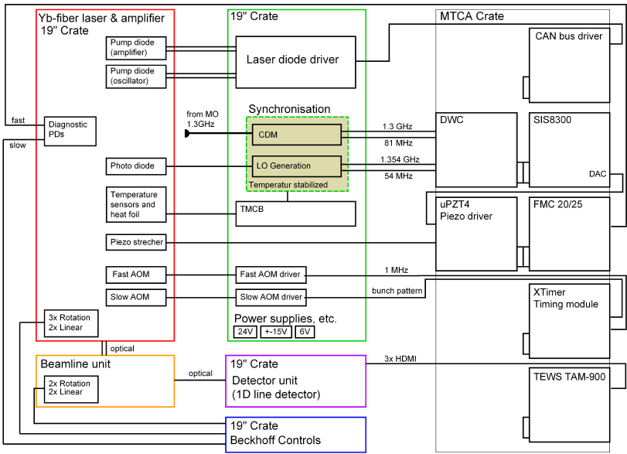
EOD electronics layout - baseline

Slide 21
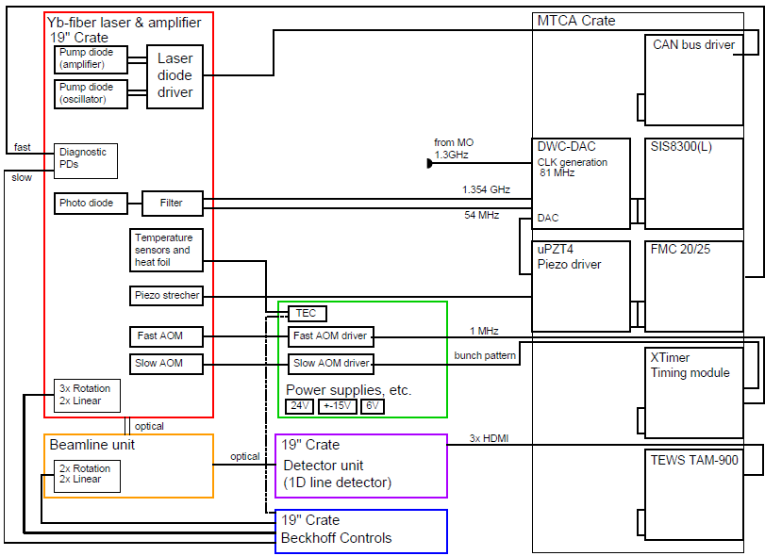
EOD electronics layout – ‘wish’

Slide 22
EOD Summary (1)
TDS
TDS
TDS
EOD
EOD
EOD
EBPM
EBPM
EBPM
First system for Lab tests required latest 09/2013.
Notes:
Before you start editing the slides of your talk change to the Master Slide view:
Menu button “View”, Master, Slide Master:
Edit the following 2 items in the 1st slide:
1) 1st row in the violet header:
Delete the existent text and write the title of the EoI for WPnumber
2) The row in the footer area: write the institute name
Close Master View

Slide 23
EOD Summary (2)
Baseline Layout :
LO Generation, DWC, SIS8300 available
LDD + CAN Bus required
TMCB for DC monitor channels and temp stabilization required
Upgrade:
LDD and filters for LO generation to be integrated in to Yb-Laser crate
Wish: DWC-DAC Board with ADC-CLK generation from 1.3GHz and 2 DACs
Wish: uPZT2 with local DC Piezo voltage generation on-board
=> reduces electronics in external crate: TMCB and CDM not required
=> to be ‘synchronized’ with other laser synchronization needs
(session by M. Felber)
Notes:
Before you start editing the slides of your talk change to the Master Slide view:
Menu button “View”, Master, Slide Master:
Edit the following 2 items in the 1st slide:
1) 1st row in the violet header:
Delete the existent text and write the title of the EoI for WPnumber
2) The row in the footer area: write the institute name
Close Master View

Slide 24
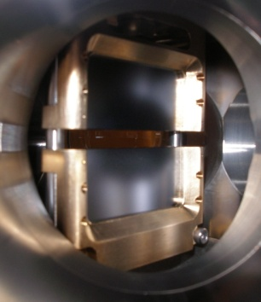
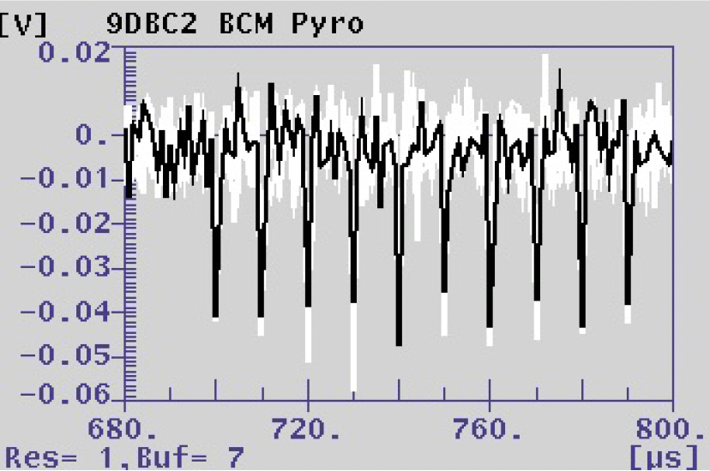
Bunch Compression Monitor: Overview
Detection of Coherent Diffraction Radiation
Coherent ratiation at wavelengths ~ bunch length
Radiated coherent intensity scales with N²
=> very sensitive to ACC phase => FB
Pyro detector:
Generation of surface charges due to change of temperature during absorption of diffraction radiation
Aim: Detect these charge signals
Postdoc will start in April 2013
Define vacuum chamber
Define detector to be used
Define detection scheme
e⁻

Slide 25
BCM/CRD: Summary
TDS
TDS
TDS
EOD
EOD
EOD
EBPM
EBPM
EBPM
CRD
BCM
BCM
BCM
BCM
First systems required for XFEL operation ≈ 06/2015 => not time critical
Notes:
Before you start editing the slides of your talk change to the Master Slide view:
Menu button “View”, Master, Slide Master:
Edit the following 2 items in the 1st slide:
1) 1st row in the violet header:
Delete the existent text and write the title of the EoI for WPnumber
2) The row in the footer area: write the institute name
Close Master View

Slide 26
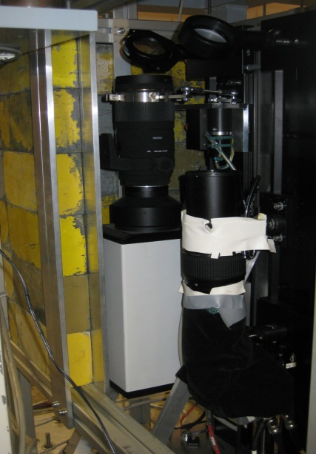
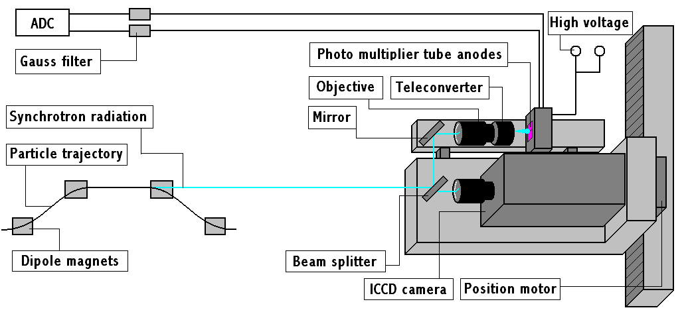
Synchrotron Radiation Monitor: Overview
26
FLASH
Measurement of beam position in the bunch compressor chicanes by imaging the visible SR emitted in the 3rd dipole
Beam energy measurement ⬄ EBPM
SR port in vacuum chamber is defined
Complicated vacuum setup to out-couple SR due to large chambers
Detection scheme to be decided (1D line detector, ICCD, PMT, Fast camera, …) to be installed outside of vacuum
Notes:
26
Before you start editing the slides of your talk change to the Master Slide view:
Menu button “View”, Master, Slide Master:
Edit the following 2 items in the 1st slide:
1) 1st row in the violet header:
Delete the existent text and write the title of your talk into this text field
2) The 2 rows in the footer area: Delete the text and write the information
regarding your talk (same as on the Title Slide) into this text field.
If you want to use more partner logos position them left
beside the DESY logo in the footer area
Close Master View

Slide 27
SRM: Summary
TDS
TDS
TDS
EOD
EOD
EOD
BAM
BAM
BAM
BAM
EBPM
EBPM
EBPM
CRD
SRM
SRM
BCM
BCM
BCM
BCM
First systems required for XFEL operation ≈ 06/2015
Notes:
Before you start editing the slides of your talk change to the Master Slide view:
Menu button “View”, Master, Slide Master:
Edit the following 2 items in the 1st slide:
1) 1st row in the violet header:
Delete the existent text and write the title of the EoI for WPnumber
2) The row in the footer area: write the institute name
Close Master View

Slide 28
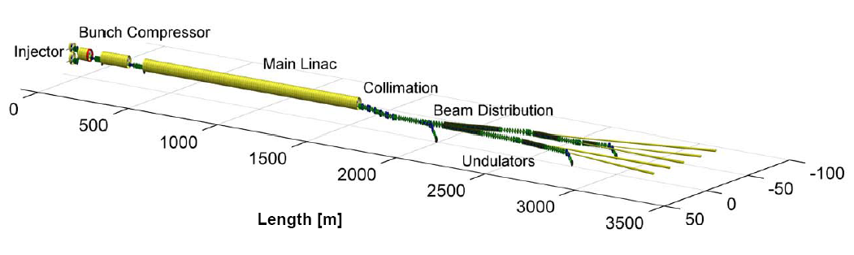
Devices
28
 | INJ | BC0 | BC1 | BC2 | COLL | UND | Sum
BAM | 1 | - | 2 | 2 | - | 3 | 8
EOD | 1 | 1 | 1 | - | - | - | 3
BCM | - | 1 | 1 | 2 | - | - | 4
CRD | - | - | - | - | 1 | - | 1
SRM | - | - | 1 | 1 | - | - | 2
TDS | 1 | - | 1 | 1 | - | - | 3
EBPM | - | 1 | 1 | 1 | - | - | 3
Sum | 3 | 3 | 7 | 7 | 1 | 2 | 23
Plus OXC-links. RF links, L2R, L2L
Notes:
28
Before you start editing the slides of your talk change to the Master Slide view:
Menu button “View”, Master, Slide Master:
Edit the following 2 items in the 1st slide:
1) 1st row in the violet header:
Delete the existent text and write the title of your talk into this text field
2) The 2 rows in the footer area: Delete the text and write the information
regarding your talk (same as on the Title Slide) into this text field.
If you want to use more partner logos position them left
beside the DESY logo in the footer area
Close Master View

Slide 29
Conclusions
TMCB needed as soon as possible
DWC-DAC Board with ADC-CLK generation from 1.3GHz and 2 DACs
uPZT2 with local DC Piezo voltage generation on-board
Thanks for your attention

Slide 30
MSK in a ‘nutshell’
Field Detection
LLRF Regulation
(XFEL WP02)
Beam Diagnostics
Beam-Based FB
(XFEL WP18)
Controller
I, Q
E, C, Δt, …
Optical
Laser
MLO
WP-18 was integrated into MSK in beginning of 2010.
(M. Felber, Ch. Gerth, H. Schlarb from MPY)

Slide 31
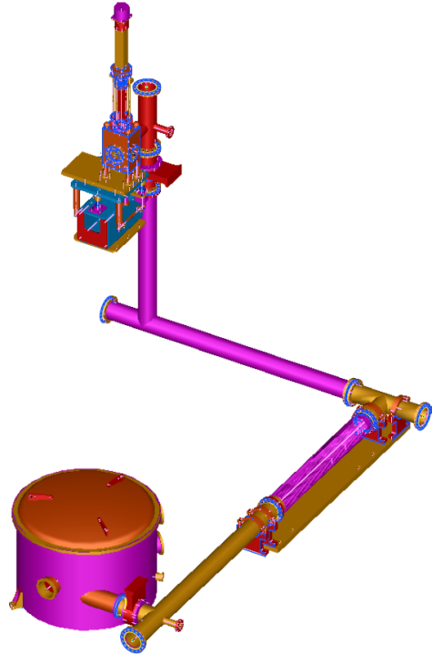
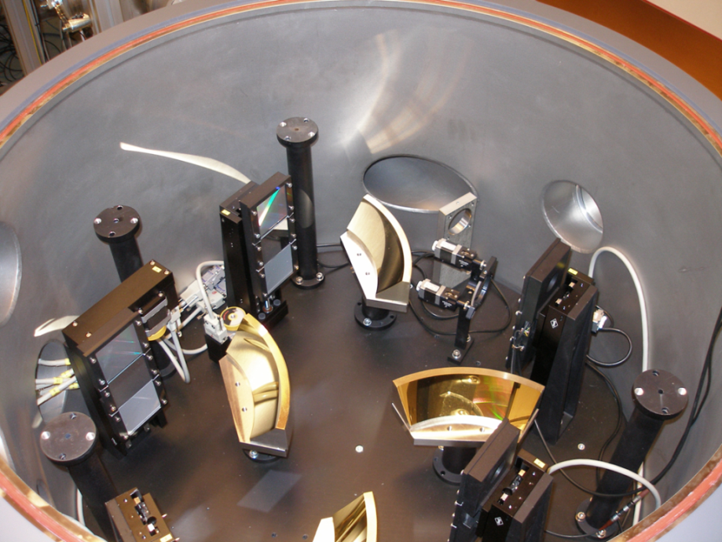
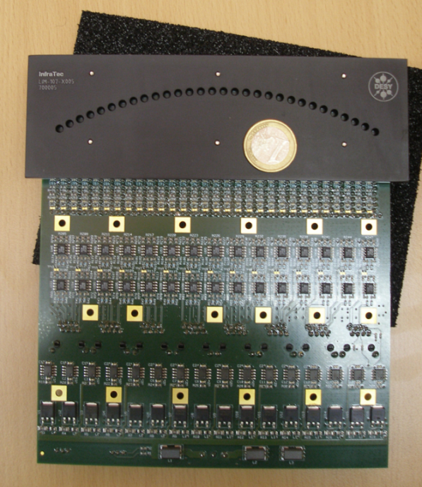
CRD: Overview
31
4-stage THz spectrometer CRISP4 developed by FLA (B. Schmidt)
Pyro line-detector was developed together with company InfraTec
Signal readout is being developed by FLA in MTCA standard
=> 120 ADC channels
Works best with compressed bunches and at high beam energies
=> installation in XFEL collimator
Notes:
31
Before you start editing the slides of your talk change to the Master Slide view:
Menu button “View”, Master, Slide Master:
Edit the following 2 items in the 1st slide:
1) 1st row in the violet header:
Delete the existent text and write the title of your talk into this text field
2) The 2 rows in the footer area: Delete the text and write the information
regarding your talk (same as on the Title Slide) into this text field.
If you want to use more partner logos position them left
beside the DESY logo in the footer area
Close Master View

Slide 32
Milestones
32
Devices in XTIN for Injector Commissioning
  09/2013 - Vacuum components delivered to vacuum group
  03/2014 – TDS LLRF system ready
  06/2014 – TDS system conditioned
  12/2013 – Optical Front-ends and electronics BAM and EOD ready
  06/2014 – Synchronization room functional
  06/2014 – All devices installed and ready for beam commissioning
Devices in XTL and XTD
  06/2014 - Vacuum components delivered to vacuum group
  06/2015 – All devices assembled
  11/2015 – TDS systems conditioned
  12/2015 – All devices ready for operation
Devices in HEXP
  12/2015 – Synchronization hutch for sub-distribution functional
Notes:
32
Before you start editing the slides of your talk change to the Master Slide view:
Menu button “View”, Master, Slide Master:
Edit the following 2 items in the 1st slide:
1) 1st row in the violet header:
Delete the existent text and write the title of your talk into this text field
2) The 2 rows in the footer area: Delete the text and write the information
regarding your talk (same as on the Title Slide) into this text field.
If you want to use more partner logos position them left
beside the DESY logo in the footer area
Close Master View

Slide 33
Time schedule
33
We are planning to have all devices installed and ready for operation when beam operation starts
  Beginning 2014 – Devices in XTIN: Laser-based synchronization system with link to photo-cathode laser and BAM, TDS system and kicker, EOD Monitor
  Mid 2015 – All devices in B1, B2, COLL installed
  End 2015 – All devices in SASE1/2 installed and synchronization hutch in HEXP in operation for sub-distribution to pump-probe lasers, all devices ready for operation
Notes:
33
Before you start editing the slides of your talk change to the Master Slide view:
Menu button “View”, Master, Slide Master:
Edit the following 2 items in the 1st slide:
1) 1st row in the violet header:
Delete the existent text and write the title of your talk into this text field
2) The 2 rows in the footer area: Delete the text and write the information
regarding your talk (same as on the Title Slide) into this text field.
If you want to use more partner logos position them left
beside the DESY logo in the footer area
Close Master View

Slide 34
Equipment manufacturing
34
Keep in mind we have only very few items per diagnostics device
Where possible, commercial systems will be used
  E.g. master laser oscillator (MLO) of laser-based synchronization system (Origami of company OneFive)
Where applicable, we are trying and will try to industrialize sub-systems
  This is the goal for all electronic developments for MTCA.4 standard (larger amount required by other WPs, e.g. WP-02 LLRF)
  Support by Post-doc (C Sydlo) funded by Helmholtz Beschleuniger-Initiative – ARD
  However, usually the amount is too small to benefit from industry
Most systems will be manufactured and assembled in-house
  1 mechanics is working full time for WP-18
  1 system-engineer for assembly of opto-mechanics
Quality insurance is typically in the hand of experts or expert knowledge
  We try to establish ‘standard routines’ where applicable
Notes:
34
Before you start editing the slides of your talk change to the Master Slide view:
Menu button “View”, Master, Slide Master:
Edit the following 2 items in the 1st slide:
1) 1st row in the violet header:
Delete the existent text and write the title of your talk into this text field
2) The 2 rows in the footer area: Delete the text and write the information
regarding your talk (same as on the Title Slide) into this text field.
If you want to use more partner logos position them left
beside the DESY logo in the footer area
Close Master View

Slide 35
Team organization
35
System Engineer
Mechanics, Technician
High-level software engineer (position open)
Coordiantion: M Bousonville
BAM: M Bock
L2RF: T Lamb
L2L: S Schulz
EOD
CRD
SRM
TDS
EBPM
Lb Sync System / BAM
B Steffen
Post-doc
Post-doc
(from 2014)
Ch Gerth
LLRF:
M Hoffmann
U Mavric
Post-doc
Notes:
35
Before you start editing the slides of your talk change to the Master Slide view:
Menu button “View”, Master, Slide Master:
Edit the following 2 items in the 1st slide:
1) 1st row in the violet header:
Delete the existent text and write the title of your talk into this text field
2) The 2 rows in the footer area: Delete the text and write the information
regarding your talk (same as on the Title Slide) into this text field.
If you want to use more partner logos position them left
beside the DESY logo in the footer area
Close Master View

Slide 36
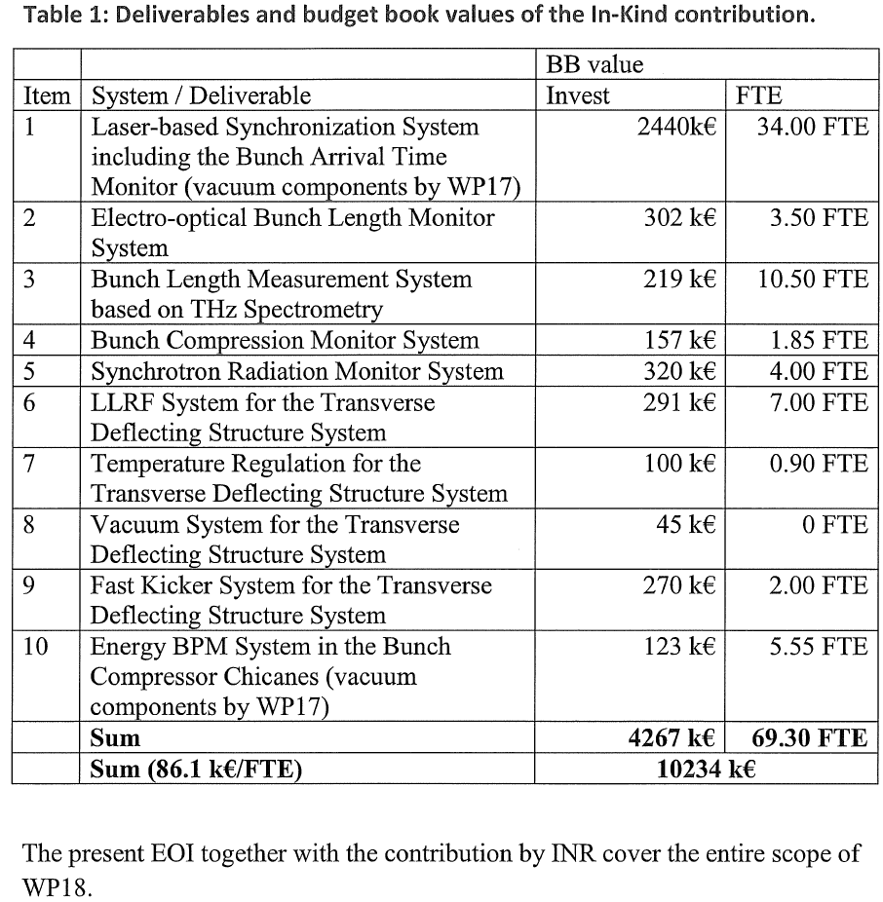
Value
36
According to the BB2005 these contributions amounted to 4308 k€ Invest and 71.3 FTE.
Notes:
36
Before you start editing the slides of your talk change to the Master Slide view:
Menu button “View”, Master, Slide Master:
Edit the following 2 items in the 1st slide:
1) 1st row in the violet header:
Delete the existent text and write the title of your talk into this text field
2) The 2 rows in the footer area: Delete the text and write the information
regarding your talk (same as on the Title Slide) into this text field.
If you want to use more partner logos position them left
beside the DESY logo in the footer area
Close Master View

Slide 37
Scope of the contribution
All devices to be designed as monitors with single bunch resolution
All devices have pros and cons: One diagnostics is no diagnostics
 | Measurement | Pros | Cons
BAM | Arrival time Beam energy | Multi bunch resolution High resolution | Laser-based synchronization system Small dynamic range
EBPM | Beam energy | Multi bunch resolution Large dynamic range | -
SRM | Beam energy profile | Energy profile | Single bunch resolution Limited resolution
View Screen (WP17) | Beam energy profile | Absolute reference | Destructive Method Single Bunch Operation
TDS | Longitudinal beam profile Longitudinal phase space slice emittance | Direct method | Single bunch resolution Destructive to measured bunch
EOD | Longitudinal beam profile | Multi bunch resolution | Limited resolution (> 200 fs)
CRD | Spectral dist. of THz radiation (Longitudinal beam Pprofile) | Multi bunch resolution High resolution | Reconstruction depends on profile Only compressed bunches (< 1ps)
BCM | Integrated THz radiation Compression | Multi bunch resolution Simple RF phase monitor | Only compressed bunches (< 1ps) No reconstruction of profile possible
Notes:
Before you start editing the slides of your talk change to the Master Slide view:
Menu button “View”, Master, Slide Master:
Edit the following 2 items in the 1st slide:
1) 1st row in the violet header:
Delete the existent text and write the title of the EoI for WPnumber
2) The row in the footer area: write the institute name
Close Master View

Slide 38
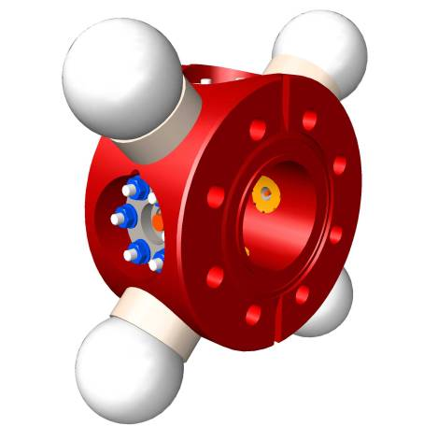
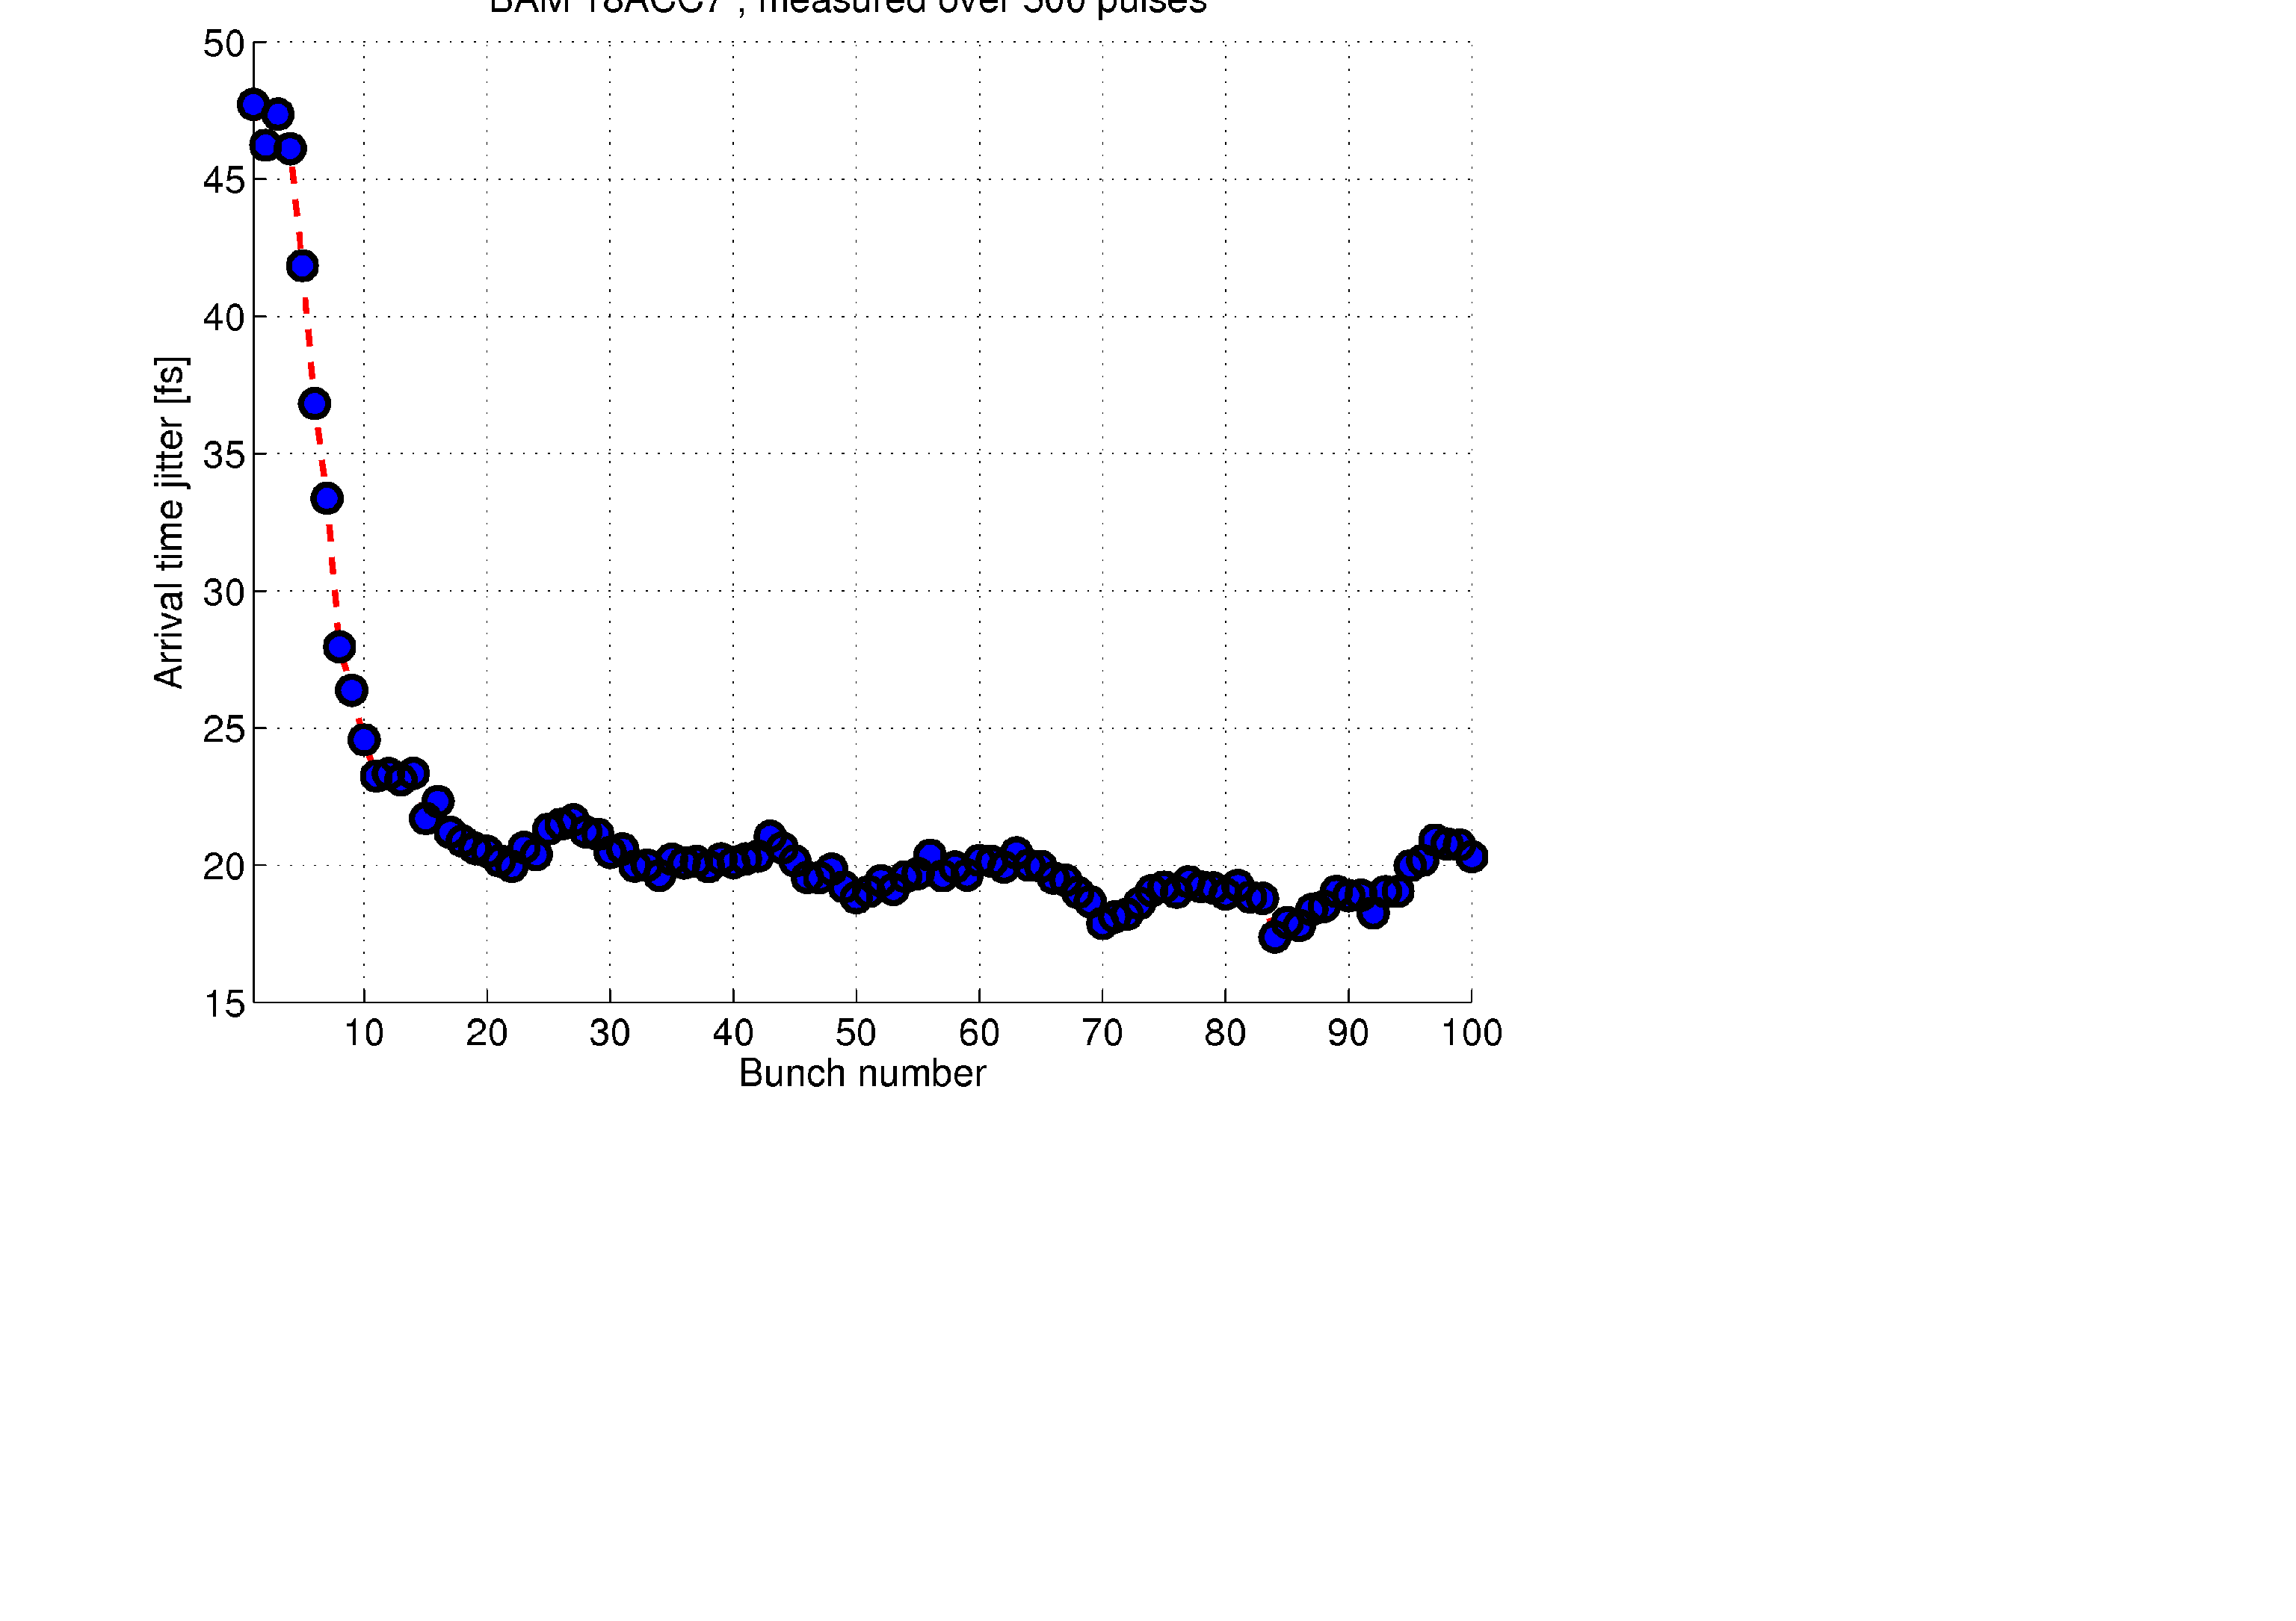
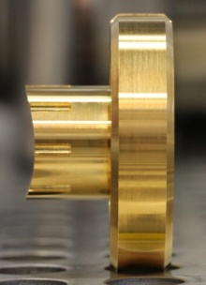
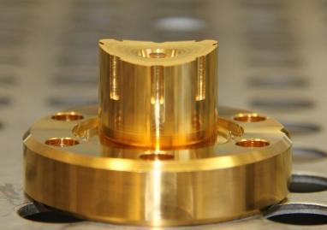
Evidence of competence: LBSync / BAM
38
Laser-based Synchronization system based on pulsed 1550 nm radiation (Er-fibre laser) in operation at FLASH
Many components have gone through 3 - 4 revisions (stability, reliability) and are close to ‘industrialization’
Interfaces to other lasers and LLRF are still under development for FLASH
Beam-based feedback at FLASH
Pick-up with CF16 flange manufactured to specifications by Orient Microwave Corp.
< 20fs rms arrival time jitter
Courtesy of WP-17
4 BAMs in operation at FLASH
Advanced 40 GHz Pick-up design (developed by industry) for higher resolution
readout electronics in MTCA.4 standard is being developed
Notes:
38
Before you start editing the slides of your talk change to the Master Slide view:
Menu button “View”, Master, Slide Master:
Edit the following 2 items in the 1st slide:
1) 1st row in the violet header:
Delete the existent text and write the title of your talk into this text field
2) The 2 rows in the footer area: Delete the text and write the information
regarding your talk (same as on the Title Slide) into this text field.
If you want to use more partner logos position them left
beside the DESY logo in the footer area
Close Master View

