Slide 1
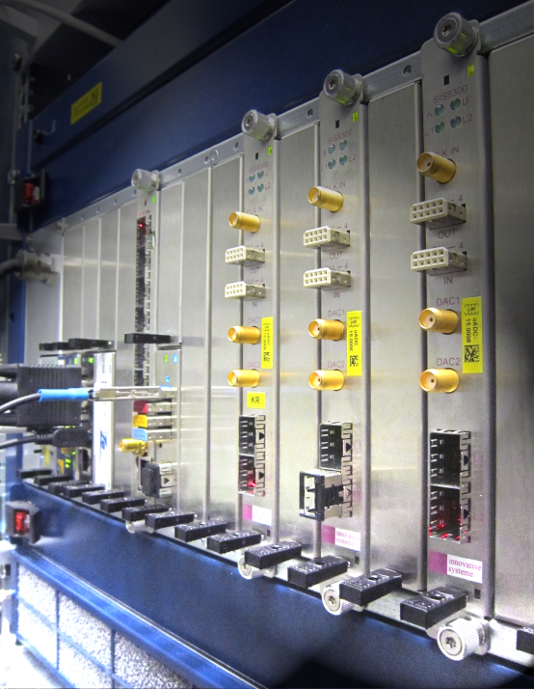
Generic concept of front-end electronics for “Laser Synchronization”
Dr. Holger Schlarb
MSK, DESY
Swierk, 20.02.2013

Slide 2
Typical laser synchronization element
First generation:
RF Frontend unit
Temperature controlled
Splitter / Monitor
Mixer to baseband
VM on frep
VM on flock
Laser oscillator
Drift free detector
All on baseband
VM puts limit on phase noise
(-155dBc => diagnostics
at large offset frequencies!)
Different configuration
of front-end chassis
Try to unify system
L2RF (1550nm/800nm)
OXC (single/multi-colour)
ADC
Digital controller
DAC
PZT driver
Second generation: Integrated to LLRF using DWC
Non-IQ sampling
=> LO generation / CLK generation unit!
Main limit for direct conversion: Drifts on photodetection process
Thus usually additional drift free detector is used
Notes:
Before you start editing the slides of your talk change to the Master Slide view: Menu button “View”, Master, Slide Master:
Edit the following 2 items in the 1st slide: 1) 1st row in the violet header: Delete the existent text and write the title of your talk into this text field 2) The 2 rows in the footer area: Delete the text and write the information regarding your talk (same as on the Title Slide) into this text field.
If you want to use more partner logos position them left beside the DESY logo in the footer area Close Master View

Slide 3
Typical laser synchronization element
New RTM:
Laser oscillator
PD in
LPF f_{ref}
RF Ampl.
AC Ports 0-4
IF0
...
IF9
CPL. 10dB
BPF f_{lock}
RF Ampl.
Down-converter
5
AC Ports 5-9
DET1
Down-converter
Drift free detector
Input stage
DC/AC configurable
+ Amplifier
RTM_CLK 0/1
RTM Management
RTM.1/.2/.4
DET2
LPF f_{ref}
RF Ampl.
User I2C
PD in
Channel configuration (2 units):
2 x DWC
1 x DS
2 x DC/AC
2 x DAC
Up to 2 LO / CLK generation
AMC:
SIS8300L
SIS8325
CPL. 10dB
BPF f_{lock}
RF Ampl.
Down-converter
LO / CLK
Generation
Mezzanine
DET1
Down-converter
Input stage
DC/AC configurable
+ Amplifier
DET2
DAC1-4
RF in
REF (RF-backplane)
RF-Distribution / PWS Detector
Typical Down-converter performance ~ 3-4 mdeg (…1MHz)
Phase adjustments via phase setpoint
Optional lock via drift free detector or DWC loop
Notes:
Before you start editing the slides of your talk change to the Master Slide view: Menu button “View”, Master, Slide Master:
Edit the following 2 items in the 1st slide: 1) 1st row in the violet header: Delete the existent text and write the title of your talk into this text field 2) The 2 rows in the footer area: Delete the text and write the information regarding your talk (same as on the Title Slide) into this text field.
If you want to use more partner logos position them left beside the DESY logo in the footer area Close Master View

Slide 4
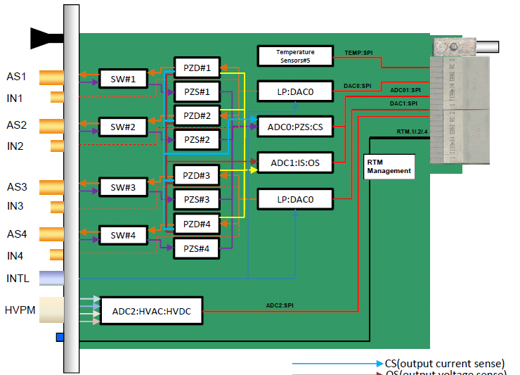
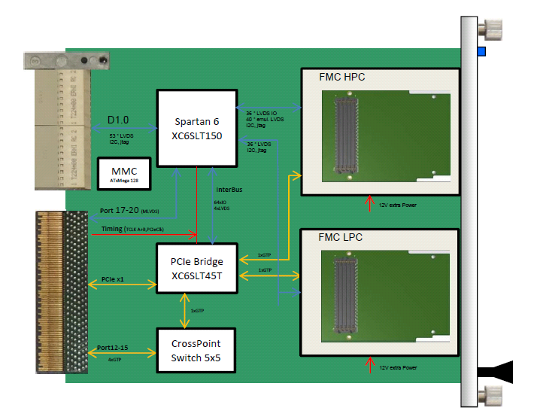
Actuator Modules
Hans Thomas Duhme, design complete now in production
Notes:
Ribosom

