Slide 1
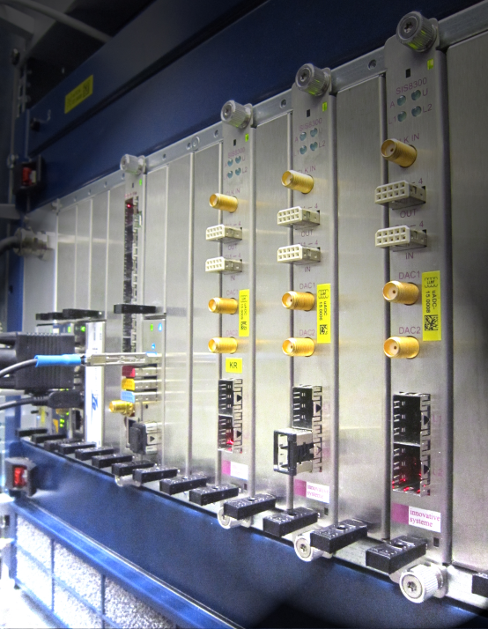
Status update on HVF-0016
“MTCA.4 for Industry”
Introduction to Validation funds (HVF)
Workpackages HVF-0016
Status / schedule for modules
Involvement in facilities
Dr. Holger Schlarb
MSK, DESY
Swierk, 19.02.2013

Slide 2

Helmholtz association (HGF) validation-fond (HVF)
What is the HGF validation fond?
Finance instrument to support the spin-off and technology transfer from scientific, technical inventions or developments from HGF centers to the industry and society
Validation: increase of value (material/immaterial) with direct application to society / industry
Ideally: generate commercial product
Boundaries:
Duration max. 2 years
Funding max. 2 M€/a (50% by HGF)
Screening of DESY (2011):
“MTCA.4 ….” good candidate
Notes:
Before you start editing the slides of your talk change to the Master Slide view:
Menu button “View”, Master, Slide Master:
Edit the following 2 items in the 1st slide:
1) 1st row in the violet header:
Delete the existent text and write the title of your talk into this text field
2) The 2 rows in the footer area: Delete the text and write the information
regarding your talk (same as on the Title Slide) into this text field.
If you want to use more partner logos position them left
beside the DESY logo in the footer area
Close Master View

Slide 3












Helmholtz validation-fond (HVF)
MTCA.4 history at DESY:
2007 decision to use “xTCA“ as standard platform for European XFEL
2009 narrowed down to MTCA.4 (“xTCA for Physics” formed)
2010 decision to migrate LLRF from ATCA to MTCA.4
… 2012 substantial investment to develop platform and various modules:
AMCs
RTMs
Industry
DAMC02
X1TIMER
X2TIMER
uTC-V5
uTC-K7
DS800
…
RTM test boards
MPS signal adapter
AD-DA-converter
Coupler interlock
Beam loss monitor
Toroid readout
Wire scanner
…
uDWC
APD stretcher
BPM
uDWC-VM
uVM
uLOG (eRTM)
Adapters uRFB
…
Crates
PS-1138/…
PM Wiener
SIS8300/8900
AM900
uLOG (RTM)
ADQxxx
MCH
TAMC900
ADIO24
…
RTM backplane (precision analog, here RF/Clk distribution)
Many of the module being design within collaboration
Notes:
Before you start editing the slides of your talk change to the Master Slide view:
Menu button “View”, Master, Slide Master:
Edit the following 2 items in the 1st slide:
1) 1st row in the violet header:
Delete the existent text and write the title of your talk into this text field
2) The 2 rows in the footer area: Delete the text and write the information
regarding your talk (same as on the Title Slide) into this text field.
If you want to use more partner logos position them left
beside the DESY logo in the footer area
Close Master View

Slide 4
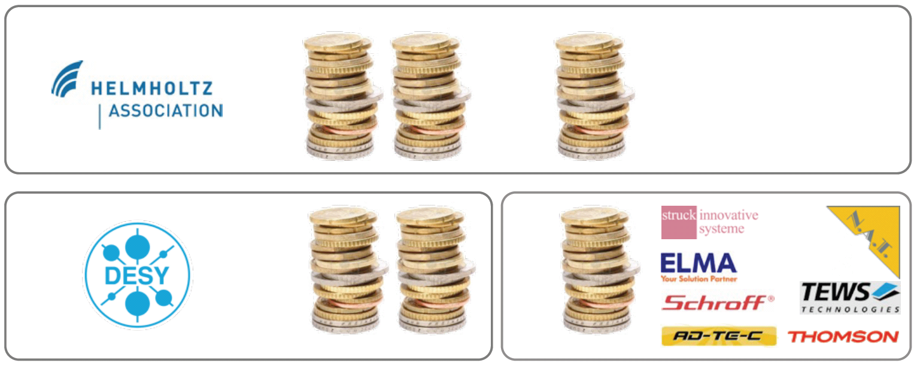
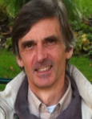
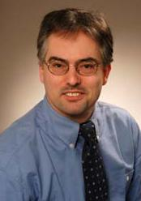

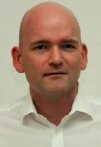
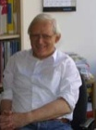


Helmholtz validation-fond (HVF)
Validation fond:
Nov. 2011 release of MTCA.4 standard by PICMG PICMG = PCI Industrial Computer Manufacturing Group (http://www.picmg.org)
Jan. 2012 summit pre-proposal (received approval for application)
Apr. 2012 summit proposal “MTCA.4 for Industry”
Jun. 2012 approval (funding 3.9M€/minor imposed condition)
July 2012 project start with industrial consortium
Steering board
50%
1.9M€
30%
1.3M€
20%
0.7M€
Notes:
Before you start editing the slides of your talk change to the Master Slide view:
Menu button “View”, Master, Slide Master:
Edit the following 2 items in the 1st slide:
1) 1st row in the violet header:
Delete the existent text and write the title of your talk into this text field
2) The 2 rows in the footer area: Delete the text and write the information
regarding your talk (same as on the Title Slide) into this text field.
If you want to use more partner logos position them left
beside the DESY logo in the footer area
Close Master View

Slide 5
Work Packages of HVF
Main objective of HVF application:
To foster industrialization of MicroTCA.4
AP1: Current design → industry (licensing)
  Cost and quality improvements
  New modules to complete portfolio
AP2: Supporting industry
  Adding critical missing modules
  Improve EMI with test environments, shielding and classification
  Gain new applications in more market segments
  Transition to MTCA.4 by a company (AMPEGON)
  Extend/accomplish/development of standard
  & implementation / inter-compatibility conflicts
AP3: Support for institutes and industry
  Consulting: help to start with MicroTCA
  User guide and web services
  Organization of workshops, tutorials, exhibitions
Notes:
Before you start editing the slides of your talk change to the Master Slide view:
Menu button “View”, Master, Slide Master:
Edit the following 2 items in the 1st slide:
1) 1st row in the violet header:
Delete the existent text and write the title of your talk into this text field
2) The 2 rows in the footer area: Delete the text and write the information
regarding your talk (same as on the Title Slide) into this text field.
If you want to use more partner logos position them left
beside the DESY logo in the footer area
Close Master View

Slide 6
Work Packages of HVF
Main benefits of HVF proposal:
Establish system:
In accelerator community / large scale facilities
Industrial branches
Scientific community
Follower of VME crate system (Market volume ~ 1 Billion $)
Direct benefit:
Reduce personnel for production by industrialization of components
Significant cost reduction due to enlargement of MTCA.4 products
Long life time and availability of components due to market request
Educate students / personnel on modern plate form
Professionalize work within MSK & Collaboration
=> Data sheets / Detailed Specification / Good Manuals / Documentation
Approximately 800 kEuro additional funding for LLRF activities!
Contact to other facilities for implementing XFEL Style LLRF system
Remark: 1) The license fee is transferred to HGF!
2) We expect approx. 5% of invest as return due to fee’s
3) Market development with “low” budget modules more important
Notes:
Before you start editing the slides of your talk change to the Master Slide view:
Menu button “View”, Master, Slide Master:
Edit the following 2 items in the 1st slide:
1) 1st row in the violet header:
Delete the existent text and write the title of your talk into this text field
2) The 2 rows in the footer area: Delete the text and write the information
regarding your talk (same as on the Title Slide) into this text field.
If you want to use more partner logos position them left
beside the DESY logo in the footer area
Close Master View

Slide 7
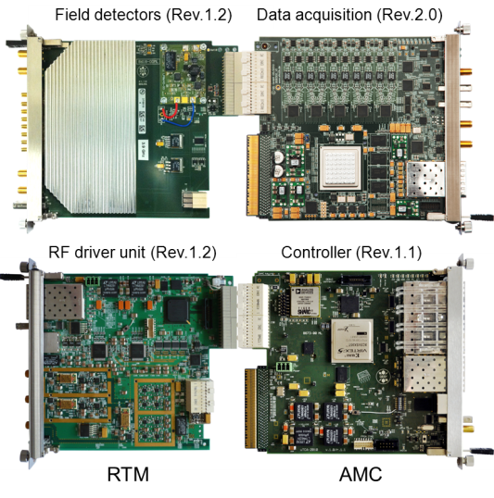
Work Packages of HVF
AP1: RF control system in MTCA.4
AP1.1 Revision of existing modules
    AP 1.1.1 Field Detection (uDWC)
    AP 1.1.2 Controller (uTC)
    AP 1.1.3 RF driver unit (uVM)
    AP 1.1.4 Local RF-Generation (uLOG)
AP1.2 Cost optimization for Single Cavities Applications
    AP 1.2.1 Field detector with RF driver (uDWC-VM)
    AP 1.2.2 High-end Digitizer (DAQ-LNC)
AP1.3 Extending Portfolio in Frequency
    AP 1.3.1 Field detector with RF driver (uVM, 0.35-6GHz)
    AP 1.3.2 Local RF-Generation (uLOG, 0.35-6GHz)
    AP 1.3.3 RTM with local clock circuit (uCLK-RTM, 10–350MHz)
    AP 1.3.4 Global clock generation (uCLK-eRTM, 10-350MHz)
AP1.4 Supplementary systems for RF control
    AP 1.4.1 Multi-channel Direct RF-sampling (uDS800)
    AP 1.4.2 AMC carrier with motor/RTM with Piezo driver (uFMC20)
AP1.5 Introduction of RTM-RF Backplane
AP 1.5.1 Development of RTM-RF Backplane concept
AP 1.5.2 Crate integrated RF source (uOSC_eRTM)
32 cavities
~mdeg precision
WP02
New!
Due to modularity
only moderate effort
to develop
RF controls for
- 1/2/4/.. Cavities
- NRF/SRF
- 10-6000 MHz
- valuable add on’s
New!
WP02
New!
WP02
New!
Notes:
Ribosom

Slide 8
Work Packages of HVF
DESY
FAIR
ESS
ITER
LCLS2
PAL
SwissFEL
Thomson
AP1: RF control system in MTCA.4
Universell
Allg. HF
AP1.1 Revision of existing modules
    AP 1.1.1 Field Detection (uDWC)
    AP 1.1.2 Controller (uTC)
    AP 1.1.3 RF driver unit (uVM)
    AP 1.1.4 Local RF-Generation (uLOG)
AP1.2 Cost optimization for Single Cavities Applications
    AP 1.2.1 Field detector with RF driver (uDWC-VM)
    AP 1.2.2 High-end Digitizer (DAQ-LNC)
AP1.3 Extending Portfolio in Frequency
    AP 1.3.1 Field detector with RF driver (uVM, 0.35-6GHz)
    AP 1.3.2 Local RF-Generation (uLOG, 0.35-6GHz)
    AP 1.3.3 RTM with local clock circuit (uCLK-RTM, 10–350MHz)
    AP 1.3.4 Global clock generation (uCLK-eRTM, 10-350MHz)
AP1.4 Supplementary systems for RF control
    AP 1.4.1 Multi-channel Direct RF-sampling (uDS800)
    AP 1.4.2 AMC carrier with motor/RTM with Piezo driver (uFMC20)
AP1.5 Introduction of RTM-RF Backplane
AP 1.5.1 Development of RTM-RF Backplane concept
AP 1.5.2 Crate integrated RF source (uOSC_eRTM)
WP02
New!
New!
WP02
New!
WP02
New!
Notes:
Ribosom

Slide 9
Work Packages of HVF
AP 2.1 Extension of MTCA.4 Portfolio
    AP 2.1.1 Optimizing of Timing Module (X2Timer) for Production
    AP 2.1.2 ADC with 2 GSPS
    AP 2.1.3 ADCs on RTM
    AP 2.1.4 Management of Low Noise Power Supply
AP 2.2 EMI Optimization und Classification of MTCA.4 components
    AP 2.2.1 EMI Test Boards
    AP 2.2.2 EMI Current and Noise Distribution within MTCA.4 Systems
    AP 2.2.3 Optimizing of MTCA.4 Crate-contacts and grounding
    AP 2.2.4 Manufacturing of AMC and RTM Shielding
    AP 2.2.5 Development of EMI Bypass-Concept
    AP 2.2.6 Minimizing der Vibration for Precision High Frequency References
    AP 2.2.7 EMI Classification of AMC/RTM Modules
    AP 2.2.8 Backplane Development for 10 Gbit/sec Transfer Speed
AP 2.3 New application of MTCA.4 in Industry
AP 2.3.1 Integrated Klystron-Interlock und LLRF System with MTCA.4
AP 2.4 MTCA.4 Market evaluation
AP 2.4.1 Market Evaluation for Industry
AP 2.4.2 Market Evaluation for Institute
AP 2.4.3 Optional Contract with Industry after Market Evaluation
AP 2.5 Integral Test of complex Systems, Availability + Faults Studies / Reporting
Notes:
Ribosom

Slide 10
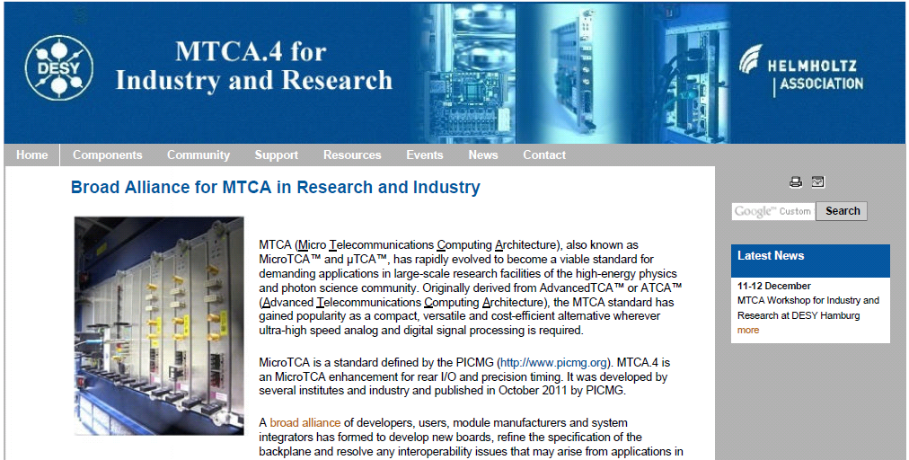
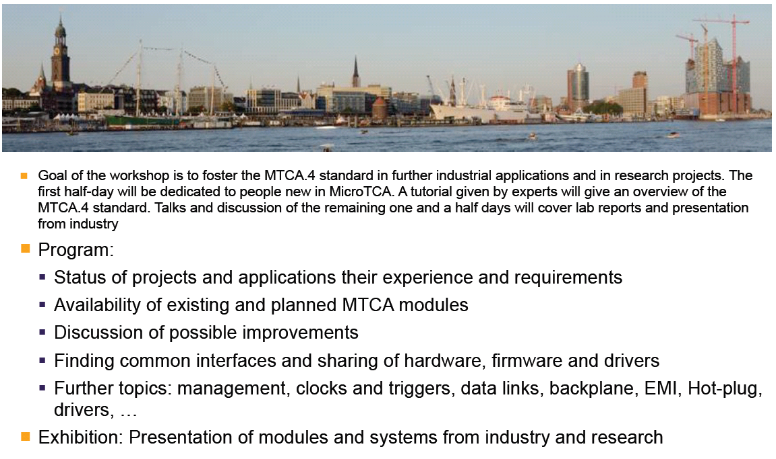
Work Packages of HVF
AP 3.1 Support and consulting
    FAQ
    Request Tracker system
    Hotline
    Available product lists / evaluations
    Templates for AMC/RTM management & MMC firmware
AP 3.2 MTCA.4 user guide
    Book will be published DESY/N.A.T.
AP 3.3 Product marketing & information
2x MTCA workshops
Support for interests groups / task force / discussion forum
Marketing of industrial exhibitions
Road show through HGF
Webpage
Supports concerning LLRF layout/implementation
Webpage URL http://mtca.desy.de/
Workshop URL http://mtcaws.desy.de/
Notes:
Ribosom

Slide 11
Status of Modules / Scheduling
HVF project demands rather high degree of reporting / management
Quarterly reports on all sub-work packages, finances, budget shifts, contracts,…
Half year report on Milestones
Finances are milestone driven (MS1 31.01.13…MS3 31.01.2014)
Contracts: proximately 30 contracts/appendices with industry to be worked out
Clear structuring:
Required Documents / processes:
Data sheet for web
Specification
Manuals
Board documentation
QA/QC procedure
Only for few modules
Can be preferable
in same cases
Specification
Module design
Prototype Production
Optimization for Industry
License
Notes:
Ribosom

Slide 12
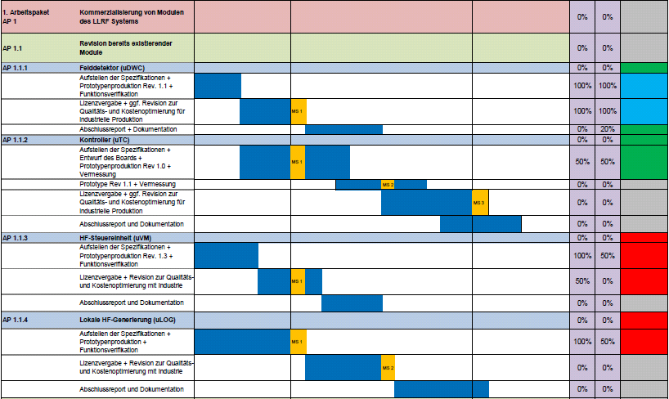
Status of Modules / Scheduling
AP1.1.*: Existing modules
- 2 month late
- 4 month late
Conversion to ALTIUM
ZONE 3 classification
MMC definition / MMC recommondation
Reliability consideration
- 3 month late
Notes:
Ribosom

Slide 13
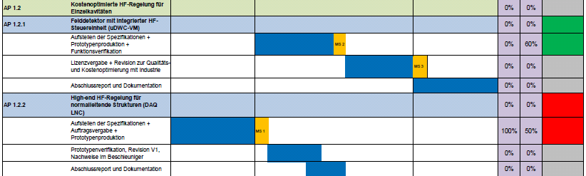
Status of Modules / Scheduling
AP1.2.* Single cavity regulation
- 3 month earlier
+ 2 month delay
+ 6 month delay
+ 4 month delay
New module produced by Struck
SIS8325 with 16bit 10 channel, 250MSPS
Notes:
Ribosom

Slide 14
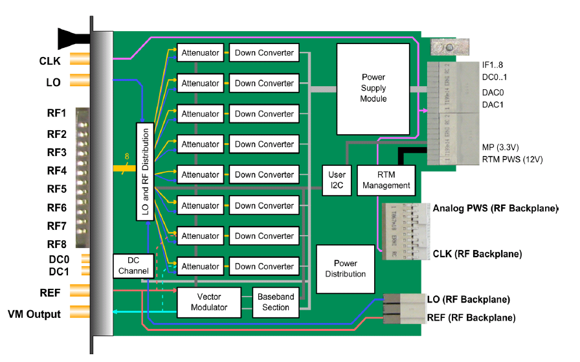
Down-converter Vector Modulator
M. Hoffmann, design complete now in production
Notes:
Ribosom

Slide 15
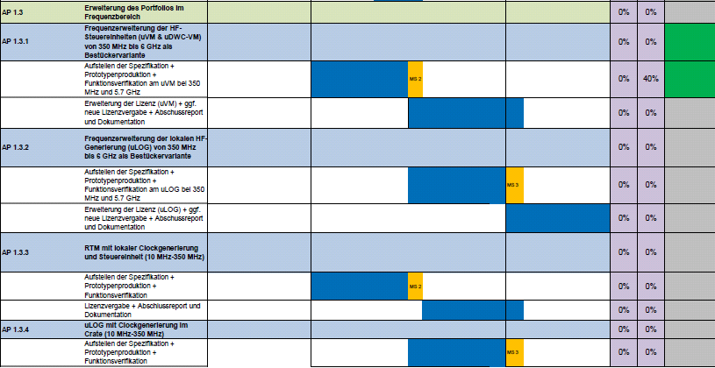
Status of Modules / Scheduling
AP1.3.*: Frequency range extension
- 3 month earlier
Now started
Notes:
Ribosom

Slide 16
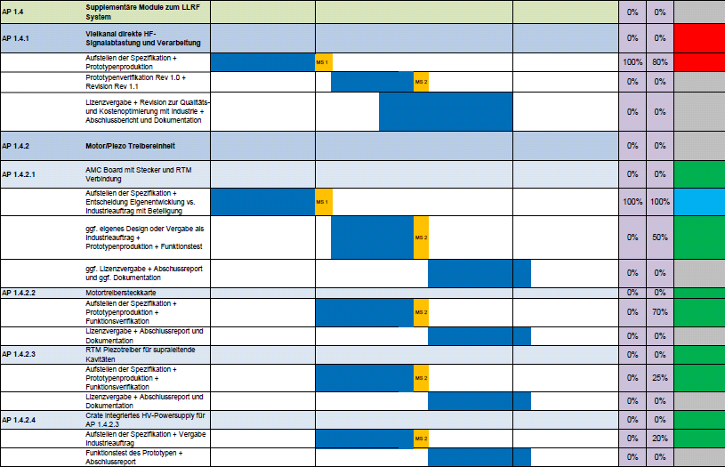
Status of Modules / Scheduling
AP1.3.*
+ 2 month delay
- 2 month earlier
- 4 month earlier
- 2 month earlier
- 2 month earlier
Notes:
Ribosom

Slide 17
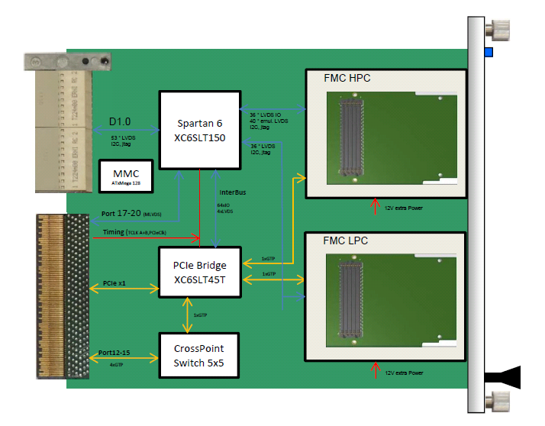
DAMC-FMC20
Hans Thomas Duhme, design complete now in production
Notes:
Ribosom

Slide 18
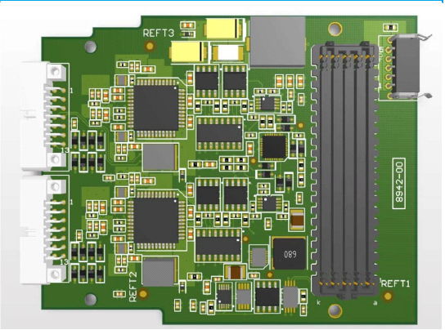
DFMC-MD22
Robert Meyer, produced and in commissioning
Notes:
Ribosom

Slide 19
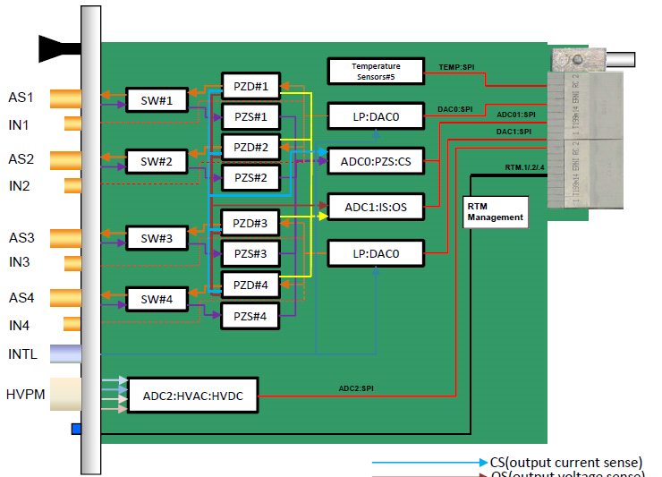
DRTM-PZ4
Konrad Pzygoda, Design stage
Notes:
Ribosom

Slide 20
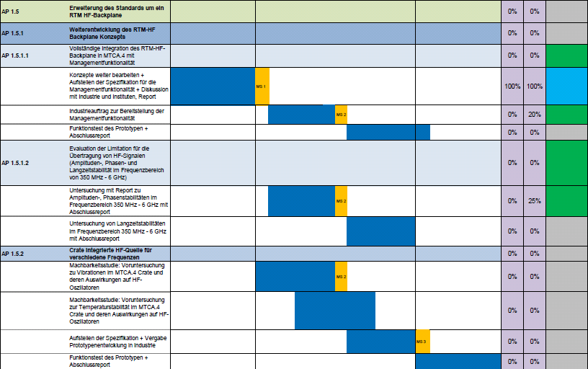
Status of Modules / Scheduling
AP1.3.*
- 4 month earlier
Notes:
Ribosom

Slide 21
Involvement in facilities
Main involvement related to single cavity regulation:
Single cavity NRF at 3 GHz with non-IQ
  REGAE (DESY) / FLUTE (KIT) / PITZ TDS (DESY)
Single cavity NRF at 1.3GHz with non-IQ
  PITZ GUN/BOOSTER / FLASH GUN / XFEL GUN
Single cavity SRF CW at 1.3 GHz with non-IQ
  ELBE (HZDR) / HOBICAT (HZB)
Single cavity using with direct sampling
  ESS 352MHz / AMPEGON 214MHz / …
Involvement in 9 facilities / 5 institutes / 1 company
Only few boards are required for starting (DWC8VM1 / DS10VM1)
System integration, system adaption and commissioning main issue
~ 3-4 PhD works should be coupled to this. Coordinator M. Hoffmann
Notes:
Ribosom

Slide 22
Involvement in facilities
Single cavity RF regulations and facilites
REGAE
FLUTE
ELBE
HOBICAT
PITZ GUN
FLASH GUN
ESS
AMPEGON
Notes:
Ribosom

Slide 23
Future work WP02 / HVF centered around
Mean time between failure
Careful test of MTBF of modules and boards
Test stand and test procedure
Pre-series and production
Analysis of failures
Vibration studies
EMI/EMC improvement in crates
Notes:
Ribosom

